Slide 1

TV Maze Api Wrapper
Baldeep Dhada | Dylan Longert | Somya Nagar

Slide 2
Description
We will be using the TVMaze API to collect 3 types of data:
Data on specific television shows
Data on specific television show seasons
Data on specific television show episodes
We will modify the URL being fed to the API based on the data we are collecting:
Television shows: (e.g. "https://api.tvmaze.com/search/shows?q=One%20Piece")
Seasons: (e.g. "https://api.tvmaze.com/shows/1505/seasons")
Episodes within Season: (e.g. “https://api.tvmaze.com/seasons/12403/episodes”)
All episodes: (e.g. https://api.tvmaze.com/shows/12403/episodes”)

Slide 3
Functionality
The program functions can roughly broken down into 3 categories:
API calls
Data formatting
Data visualization

Slide 4
API call functions
get_shows() → get_shows(“The Sopranos”)
API call with television show parameter
Returns data frame with 23 columns
get_seasons() → get_seasons(527)
API call with television show id parameter
Returns data frame with 21 columns
get_episodes_of_season() → get_episodes_of_season(2098)
API call with television show season id parameter
Returns data frame with 14 columns
get_all_episodes() → get_all_episodes(527)
API call with television with television show id parameter
Returns data frame with 14 columns

Slide 5
Format functions
format_show_name() → format_show_name(show)
format_season_name() → format_season_name(season)
format_episode_name() → format_episode_name(episodes)
format_all_episodes() → format_all_episodes(all_episodes)

Slide 6
Visualization functions
generate_ratings_plot() → generate_ratings_plot(all_episodes_df)
This function produces a visualization of a show’s average rating per season for all the seasons.
Plots a line graph for average rating over season number.
generate_season_ratings_plot() → generate_season_ratings_plot(seasons_df)
This function produces a visualization of ratings of all the episodes for a season.
Plots a line graph for rating over episode number

Slide 7
Functionality
The program is split into 3 phases: Show/Seasons/Episodes
The get function sends a request to a TVMAZE API and the format function cleans the data of Null values/spaces/empty strings and filters for the desired columns
get_shows(query) -> Returns a data frame with shows and show ids in it
format_show_name(show) -> cleans the data frame
get_seasons(show_id) -> Uses the id to return a data frame of seasons
format_season_name(season) -> cleans the seasons data frame
get_episodes_of_season(season_id) -> Uses the season id to return a data frame of episodes
format_episode_name(episode) -> cleans the episodes data frame
plot_season_ratings(episodes):
Plots the ratings of each episode of the season and calculates the average rating

Slide 8
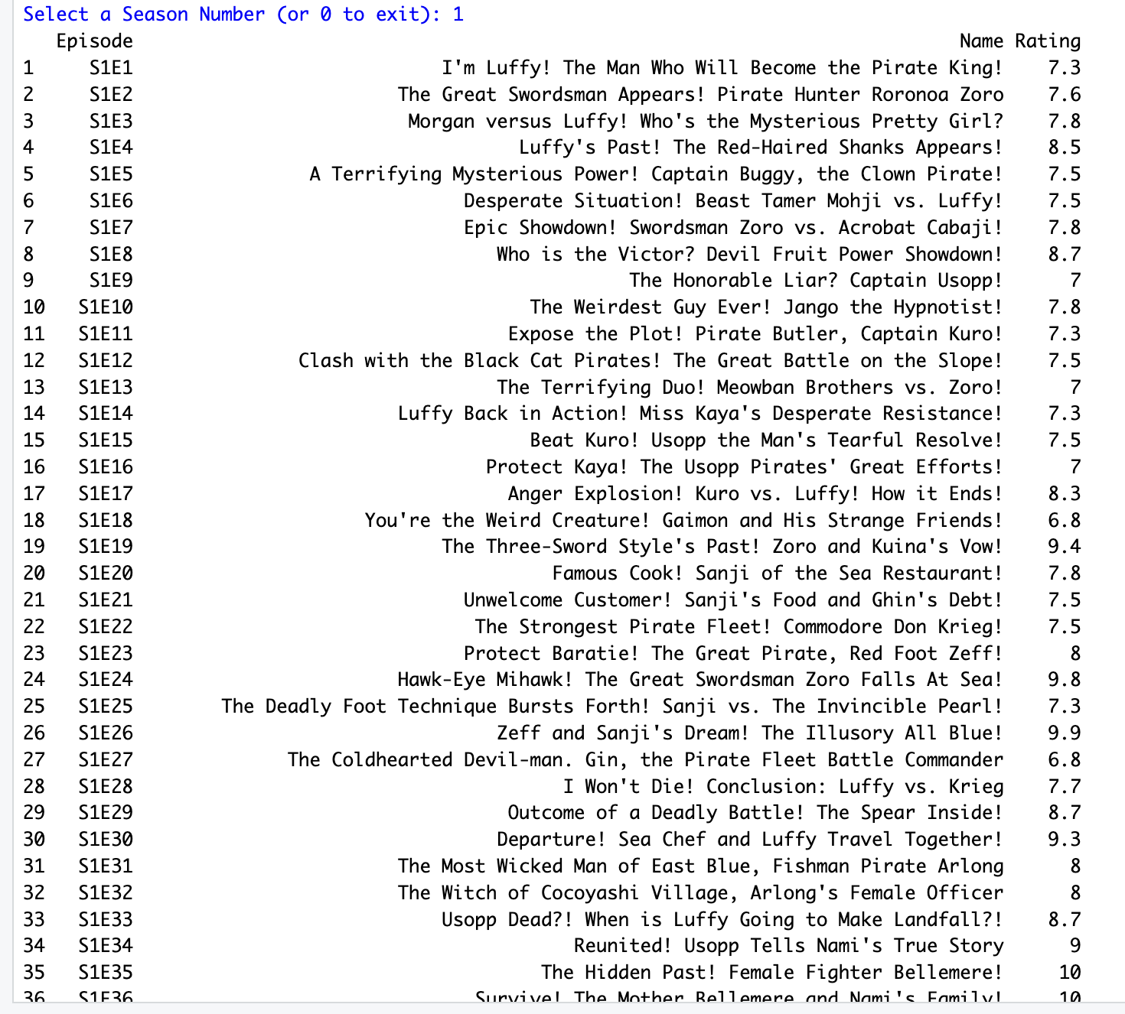
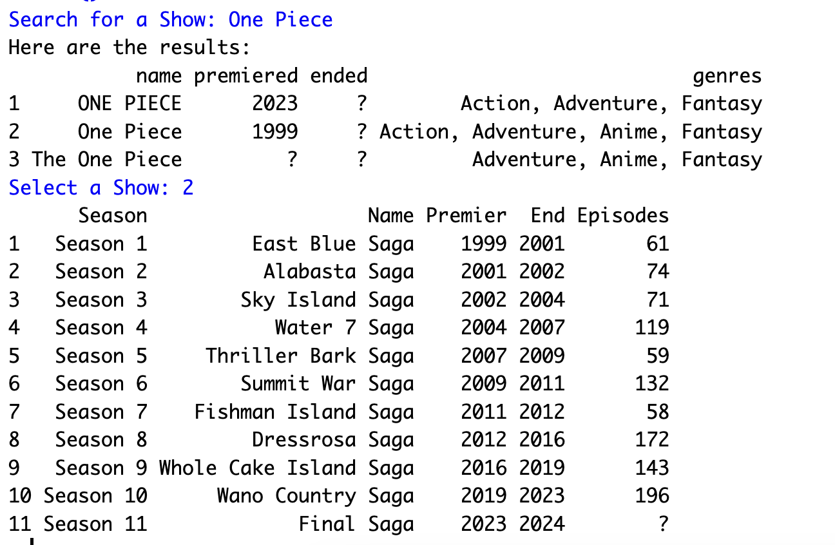
RESULTS

Slide 9
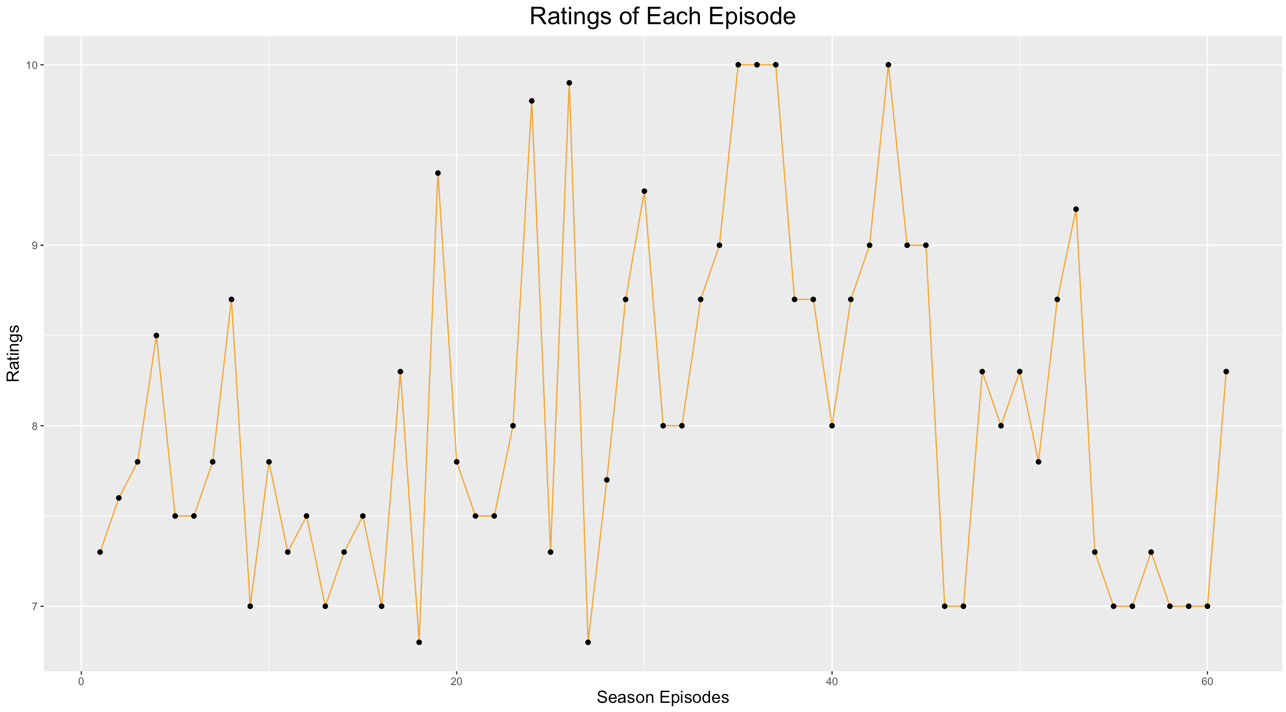
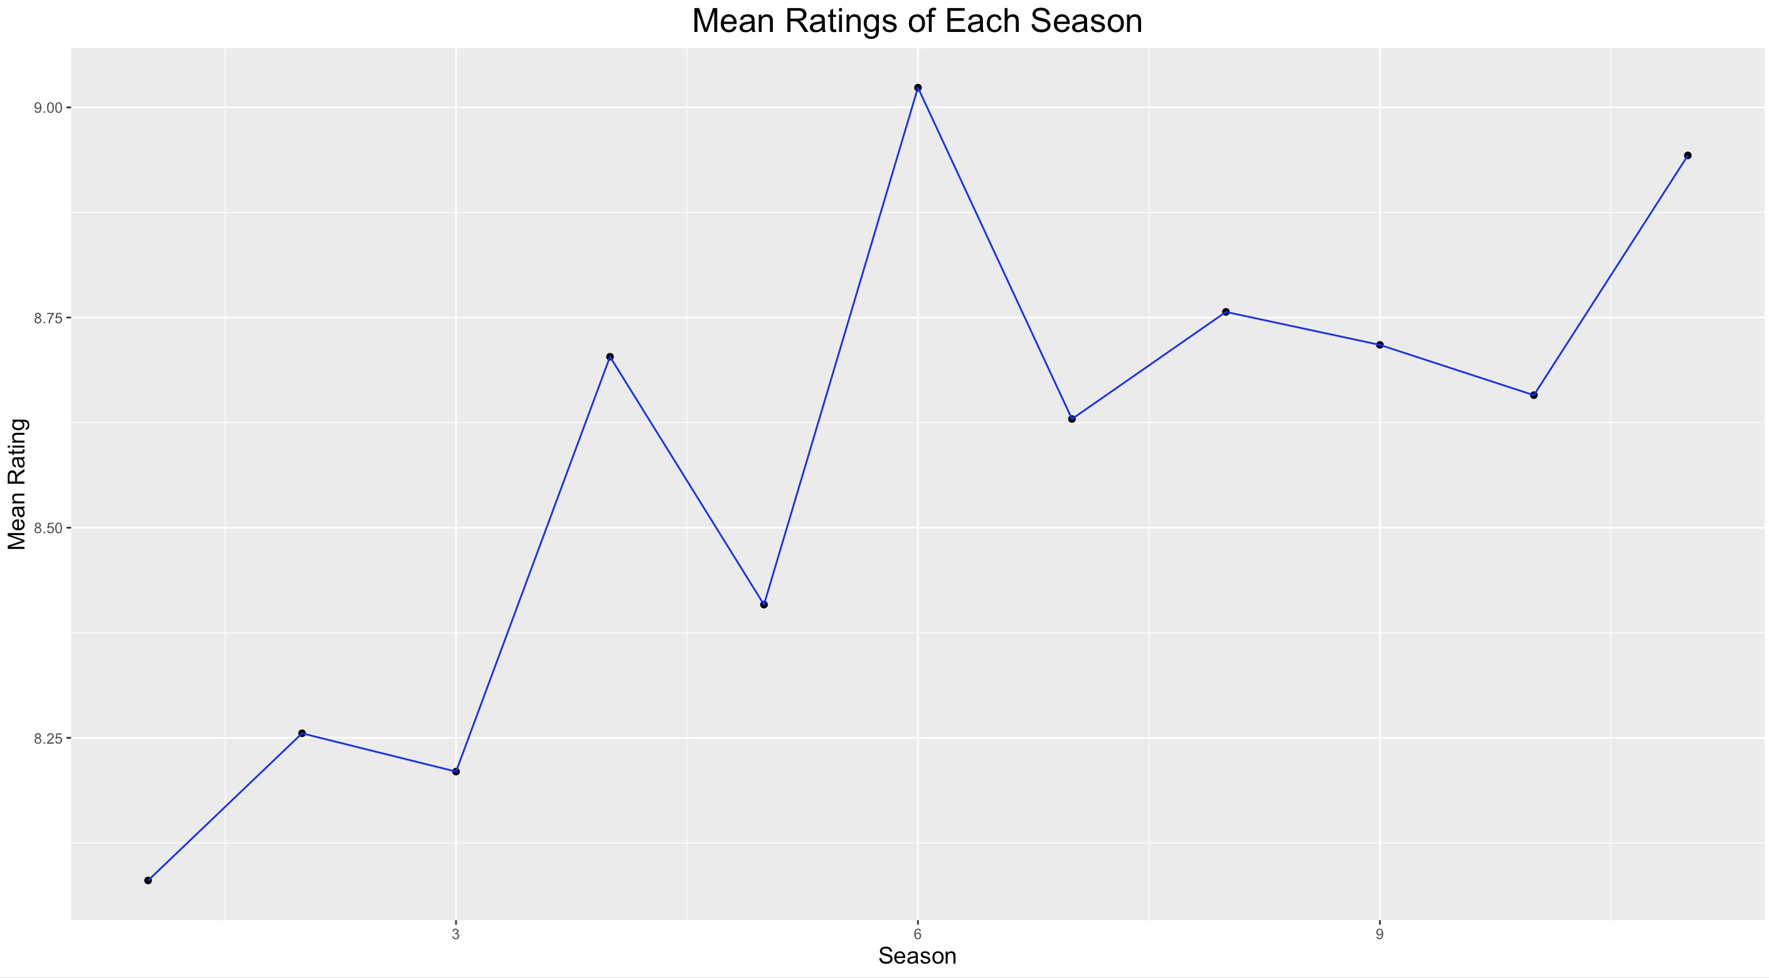
Rating of Episodes Within a Season
Mean Rating of Seasons
Within a Show

Slide 10
Demonstration

Slide 11
Thank you

