Slide 1

ShowSage
Baldeep Dhada | Dylan Longert | Somya Nagar

Slide 2
Description

Slide 3
Functionality
The program is split into 3 phases: Show/Seasons/Episodes
Each phase has its own get function and format function.
The get function sends a request to a TVMAZE API and the format function cleans the data of missing information
get_shows(query)
format_show_name(show)
get_seasons(show_id)
format_season_name(season)
get_episodes_of_season(season_id)
format_episode_name(episode)
plot_season_ratings(episodes):
Plots the ratings of each episode of the season and calculates the average rating

Slide 4
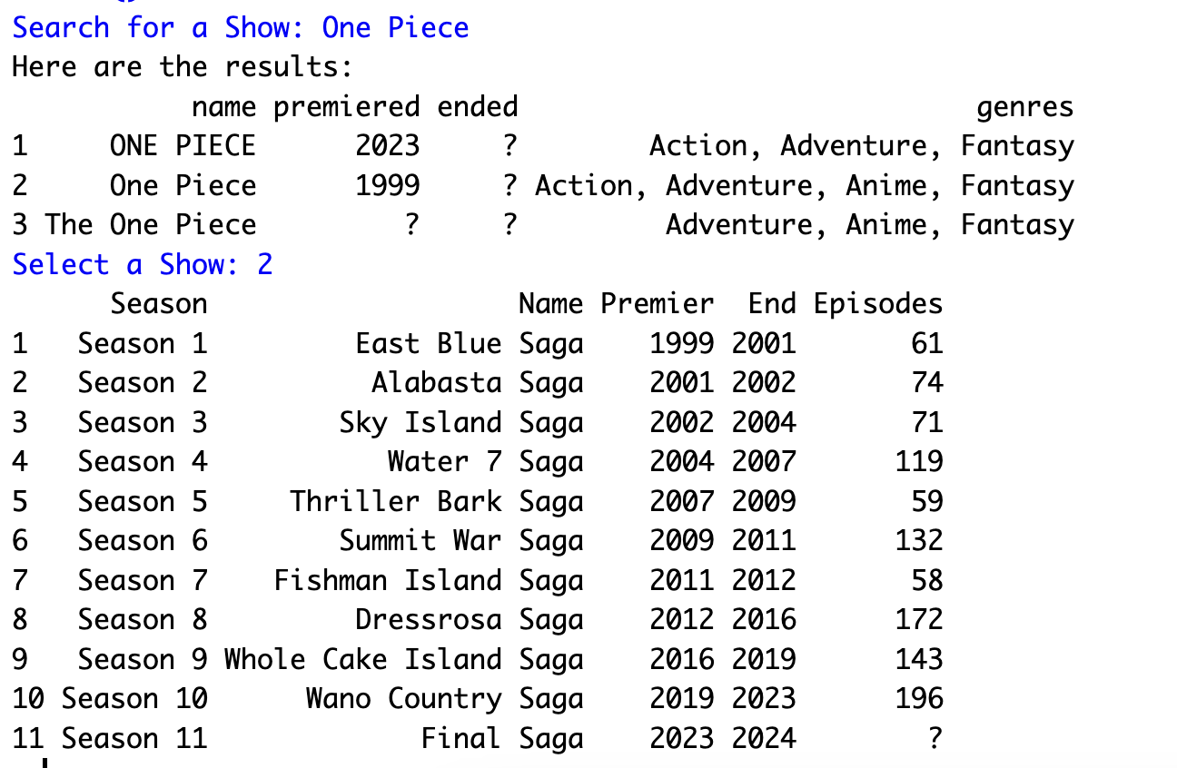
Results
Sample Output :
The wrapper package will allow the user to:
View the show/season data retrieved from the API as a DataFrame.
View a plot between ‘Ratings’ and ‘Episode Number’ for any given season.
View the average rating for all the episodes from a given season

Slide 5
Thank you

