Slide 1
Stream API

Slide 2
Синтаксис Method Reference
Используется вместо лямбда-выражений:
Static method: <Class name>::<method name>
Non-Static method: <Object reference>::<method name>
Constructor: <Class name>::new

Slide 3
Примеры:
lambda: list.sort((x,y) -> Integer.compare(x,y))
method reference: list.sort(Integer::compare)
lambda: list.forEach( x -> System.out.println(x))
method reference: list.forEach(System.out::println)

Slide 4
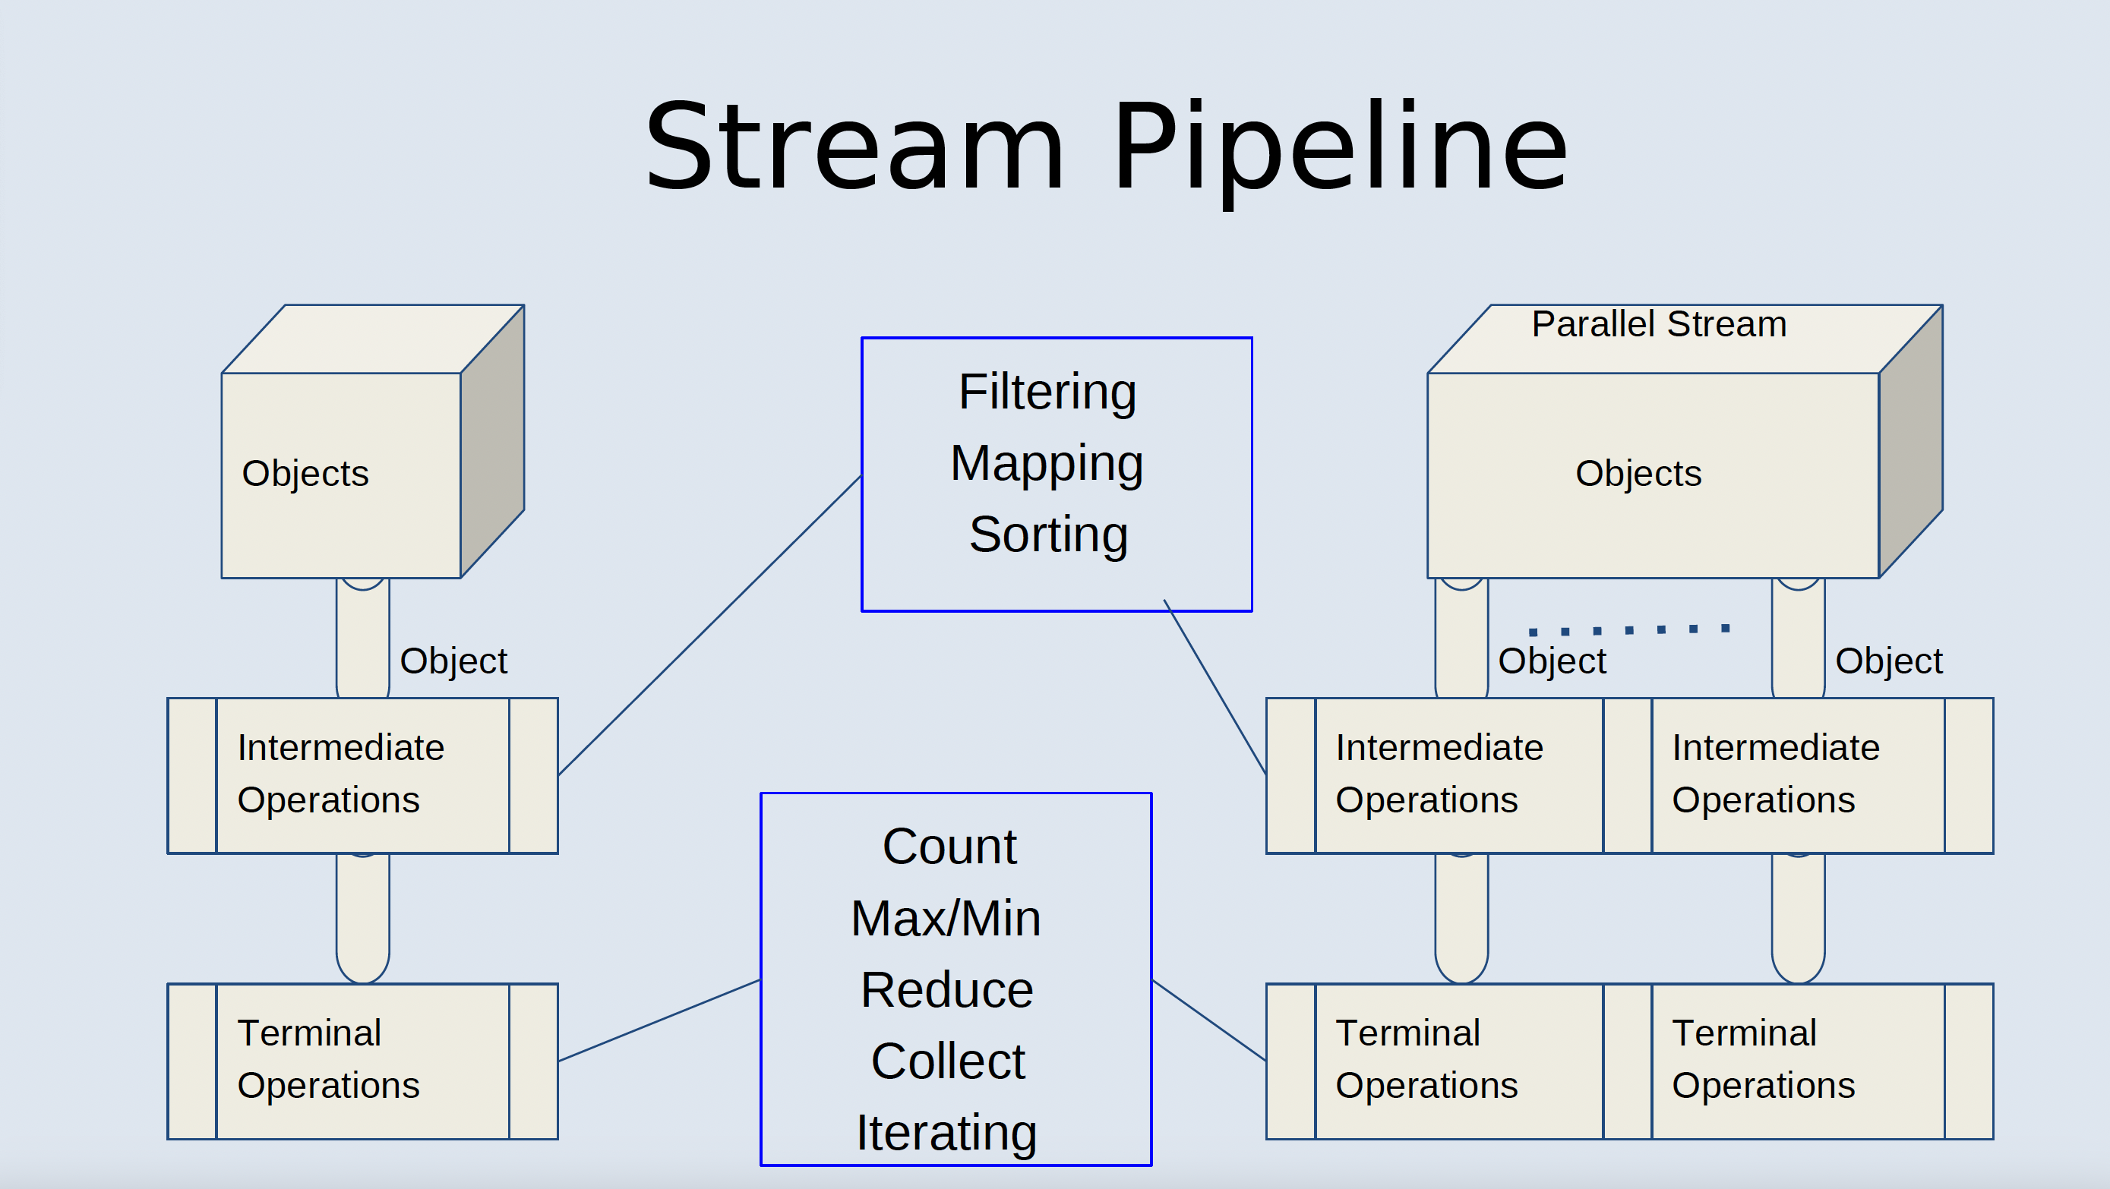

Slide 5
Как получить стрим?
From collection:
collection.stream()/collection.parallelStream()
From array:
Arrays.stream(array)/Arrays.stream(array).parallel()
From iterable:
StreamSupport.stream(numbers.spliterator(), false) - regular
StreamSupport.stream(numbers.spliterator(), true) - parallel
From Random Generator:
generator.ints()/generator.longs() (with several options in the method parameters)
From BufferedReader:
reader.lines()

Slide 6
Intermediate Operations
• Filtering
– filter(Predicate<T>)
• Sorting
– sorted()/sorted(Comparator)
• Mapping
– gets a reference to the Function interface
– map - mapping one to one
– mapToObj - mapping one primitive (int,long,double) to an object
– mapToInt/Long/Double – mapping one object to a primitive
– flatMap/flatMapToObj/Int/Long/Double - mapping one to many (распаковка)

Slide 7
Terminate Operations
Starts running whole pipeline from a getting stream
• Aggregated statistics
• Iterating - forEach
• Reducing
• Collecting

Slide 8
Aggregated statistics
For all streams:
– count/min/max
• For the primitive’s streams (IntStream, LongStream, DoubleStream):
– summaryStatistics() getting reference to Int/Long/DoubleSummaryStatistics class with methods:
getMin, getMax, getSum and getAverage

Slide 9
Reducing
• Combines all elements of a stream into a single result
– For Stream<T> :
T reduce (T initial, BiFunction<T,T> accumulator )
R reduce(R initial, BiFunction<R,T> accumulator, BiFunction<R,R>combiner)
Examples:
numbers.stream().reduce(1,(x,y)->x+y) – sum all
persons.stream().reduce(0,(sum,p2)->sum+
p2.getAge(),(sum1,sum2)->sum1+sum2)

Slide 10
Collecting
Method collect() transforms the elements of the stream into a different kind of result, e.g. a List, Set or Map
• Accepts Collector objects
• Pretty complicated but there are the standard collectors for most applied operations:
– Collectors.toList
– Collectors.toSet
– Collectors.groupingBy

Slide 11
GroupingBy
• Collectors.groupingBy()
Groups according to the method apply of the interface Function<T,R>
• Mostly two kinds:
– groupingBy(Function<T,R>)
returns Map<R,List<T>>
example: lists of the persons (List<T> - List<Person>) having the specific age (R- Integer)
– groupingBy(Function<T,R>,Collectors.counting())
Returns Map<R, Integer>
example: how many persons (Integer) have the specific age (R-Integer)

