Slide 1
Employee Data Analysis using Excel
STUDENT NAME: BALENDU C
REGISTER NO:312202986
NM.ID: 7B82AB7A21BDEC59F694E01B8A457C57
DEPARTMENT:COMMERCE (B.COM GENERAL)
COLLEGE: ASAN MEMEORIAL COLLEGE OF ARTS & SCIENCE

Slide 2
PROJECT TITLE
Employee Performance Analysis using Excel

Slide 3


AGENDA
Problem Statement
Project Overview
End Users
Our Solution and Proposition
Dataset Description
Modelling Approach
Results and Discussion
Conclusion
3/21/2024 Annual Review

Slide 4

PROBLEM STATEMENT
Employee performance evaluations will help you know if your employees are performing up to the standards and expectations. If you can conduct these evaluations regularly and properly, it will have a highly positive impact on your company.

Slide 5

PROJECT OVERVIEW
Data analysis in Excel is the process of using Excel's tools to manipulate, analyze, and visualize data. It can help you make sense of your data, identify patterns and trends, and make informed decisions.
.

Slide 6
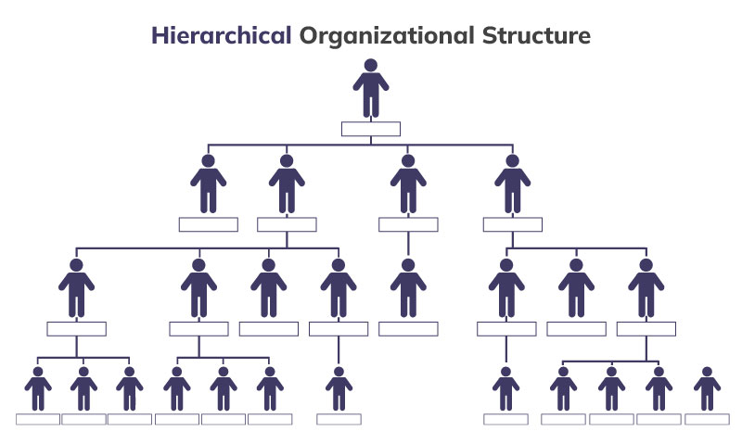

WHO ARE THE END USERS?

Slide 7

OUR SOLUTION AND ITS VALUE PROPOSITION
FILTERING
COLOURING
CONDITIONAL FORMATING
PIVOT TABLE
SLICER

Slide 8
Dataset Description
1. EMPLOYEE DATA SET COLLECT FROM IBM DASHBOARD
2. THERE ARE 26 FEATURES IN THE DATA SET
3. ONLY 8 FEATURES WE COLLECT FROM THE DATA SET
4. 1ST FEATURE WE COLLECT FROM THE DATA SET IS EMPLOYEE ID
5. 2ND FEATURE IS FIRST NAME
6. 3RD FEATURE IS LAST NAME
7. 4TH FEATURE IS TITLE
8. 5TH FEATURE IS AD EMAIL
9. 6TH FEATURE IS EMPLOYEE STATUS
10. 7TH FEATURE IS PAYZONE
11. AND THE LAST FEATURE WE COLLECT FROM THE
DATA SET IS EMPLOYEE CLASSIFICATION TYPE

Slide 9
MODELLING
DATA COLLECTION
DATA SET DOWNLOAD FROM EDUNET DASHBOARD
EMPLOYEE PERFOMANCE ANALYSIS USING EXCEL
FEATURES COLLECTING
THERE ARE 26 FEATURES IN THE DATA
EMPLOYEE ID,FIRST NAME,LASTNAME, SUPERVISOR,EXIT DATE, ETC.
IN THIS 26 FEATURES WE COLLECT ONLY 8 FEATURES
EMPLOYEE ID,FIRST NAME,LAST NAME,TITLE,AD EMAIL,EMPLOYEE STATUS
PAYZONE,EMPLOYEE CLASSIFICATION TYPE
9

Slide 10
DATA CLEANING
IF THE DATA CLEANING WE ALSO USE CONDITIONAL FORMATTING
IDENTIFYING THE MISSING VALUES
USING CONDITIONAL FORMATTING AND HIGHLIGHITING BY COLOURS
REMOVE THOSE BLANK VALUES WITH USING FILTERS
SUMMARIZING(PIVOT TABLE)
COLLECT THE DATA FROM EXCEL SHEET
SUMMARIZE THE VALUE USING PIVOT TABLE
A PARTICULAR DATA IS SET TO BE IN THE ROW
AND WE USE SLICER TO SELECT THE FIELD TO USE FOR FILTERING LIKE FIRST NAME

Slide 11
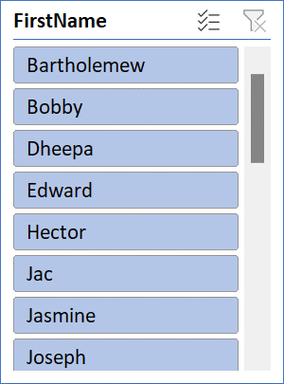
RESULTS
Row Labels
3427
Uriah
Bridges
uriah.bridges@bilearner.com
Production Technician I
Temporary
Zone C
Active
3428
Paula
Small
paula.small@bilearner.com
Production Technician I
Part-Time
Zone A
Active
3429
11

Slide 12
conclusion
IN CONCLUSION, ANALYSING EMPLOYEE DATA USING EXCEL PROVIDES ROBUST FRAME WORK
FOR GAINING VALUABLE INSIGHTS INTO WORK FORCE DINAMIC AND OPERATIONAL EFFICIENCY
EXCEL DIVERCE ARRAY OF TOOLS AND FUNCTIONS, SUCH AS PIVOT TABLE ALLOWS FOR COMPREHENSIVE
DATA MANIPULATION AND VISUVALIZATION

