Slide 1

MSc DATA SCIENCE FOR ECONOMICS · UNIVERSITÀ DEGLI STUDI DI MILANO
Aspect-Based Sentiment Analysis
of Airline Reviews
A Domain-Aware NLP Study
Antonella Convertini Student ID 45853A
Supervisor Prof. Alfio Ferrara Co-supervisor Prof. Stefano Montanelli
Academic Year 2025 / 2026
Notes:
[0:20 | running total 0:20]
Good morning, and thank you. My thesis develops a domain-aware Aspect-Based Sentiment Analysis framework for airline passenger reviews. I will briefly present the problem and the three research questions, then the methodology, and I will dedicate most of the time to the results.

Slide 2






MOTIVATION
Airline satisfaction is multidimensional
A flight is a sequence of experiences — one review mixes several opinions.
ABSA reframes the task
A typical review
“what is evaluated,
and with what sentiment?”
The crew was friendly, but we were delayed three hours. The seat was cramped, yet for the price it was fair value.
Five domain-specific aspects
Punctuality
→ positive, negative & neutral — in one text.
Cabin Comfort
Document-level sentiment gives one label and hides what mattered.
Cabin Crew Service
Food & Beverages
Value For Money
2
Notes:
[0:35 | running total 0:55]
A flight is a sequence of experiences, so one review mixes several opinions — like this one: friendly crew, a three-hour delay, a cramped seat, yet fair value for the price. Document-level sentiment collapses this into one label and hides what mattered. ABSA reframes the question: not 'is this review positive or negative', but 'what is evaluated, and with what sentiment' — around five domain aspects: Punctuality, Cabin Comfort, Cabin Crew Service, Food and Beverages, and Value For Money.

Slide 3



RESEARCH QUESTIONS
Three questions guide the thesis
RQ1
RQ2
RQ3
Models & method
Drivers & segments
Context
Does domain-aware ABSA beat a lexicon — and does DistilBERT beat TF-IDF?
Which aspects drive satisfaction, and how does it vary by carrier, cabin & traveller?
Do weather, seasonality & global events modulate aspect sentiment?
3
Notes:
[0:30 | running total 1:25]
Three research questions, at three levels. RQ1, methodological: does domain-aware ABSA beat a lexicon baseline, and does a fine-tuned DistilBERT improve over classical TF-IDF? RQ2, the structure of satisfaction: which aspects drive the overall rating, and how does this vary across carriers, cabins and traveller segments? RQ3, context: do weather, seasonality and major events change how passengers judge the same service?

Slide 4

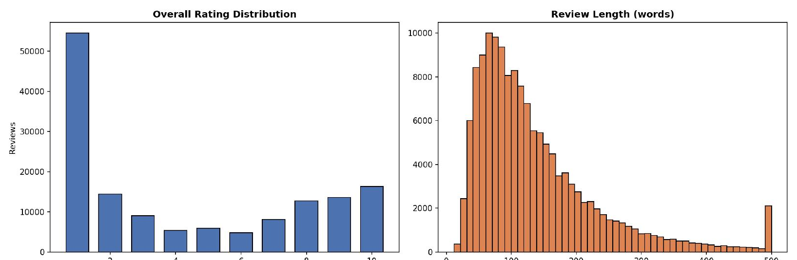
DATA
A large, real-world review corpus
144,934
578
2012–2026
4.38 / 10
passenger reviews
airlines
Apr 2012 → Mar 2026
mean overall rating
Source airlinequality.com (SkyTrax)
Rating distribution & review length
Strongly bimodal & self-selected: voluntary reviews over-represent extreme journeys, so 4.38 is the mean of memorable trips — not of all passengers.
Figure 1
4
Notes:
[0:30 | running total 1:55]
The corpus: almost 145 thousand reviews, 578 airlines, from 2012 to 2026, from SkyTrax — each linking the text to an overall rating, seven sub-ratings, and context like cabin class and traveller type. One property shapes every interpretation: the distribution is strongly bimodal. This is self-selection — people write when an experience is exceptional. So the mean of 4.38 is the average of memorable journeys, not of all passengers.

Slide 5

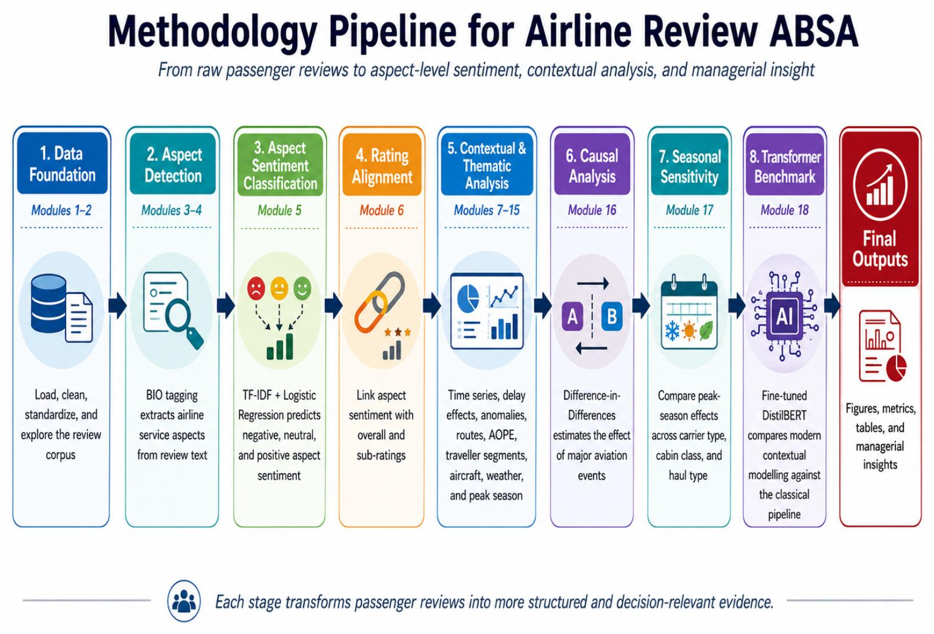
METHODOLOGY
An end-to-end, modular ABSA pipeline
18 Python modules · from raw passenger voices to managerial interpretation
Figure 4
5
Notes:
[0:30 | running total 2:25]
The methodology is an end-to-end modular pipeline of eighteen Python modules, following the passenger journey: data preparation, aspect detection with BIO tagging, the core sentiment classification with three models, rating alignment, and finally the contextual and causal modules — delay, segments, weather, seasonality, events. The modular design keeps every step transparent and reproducible, and the code is open-source.

Slide 6

METHODOLOGY
How aspects are found & labelled
1 · Aspect extraction — BIO tagging
3 · Three levels of model complexity
we
missed
connection
again
1
Lexicon baseline
dictionary near the aspect — transparent reference
O
B
I
O
Begin / Inside / Outside → span “missed connection” (Punctuality). Longest-match keeps phrases whole.
2
TF-IDF + Logistic Regression
uni/bigrams, one classifier per aspect
2 · Supervision — silver labels
3
Fine-tuned DistilBERT
aspect-aware [CLS] context [SEP] aspect [SEP]
★ 1–2
★ 3
★ 4–5
Negative
Neutral
Positive
Time-based split — train on the past, test on later reviews.
Sub-ratings → sentiment: scalable, but injects label noise.
The core test: is the bottleneck model capacity, or supervision quality?
6
Notes:
[0:40 | running total 3:05]
Two core ingredients. Extraction uses BIO tagging — each token labelled Begin, Inside or Outside an aspect phrase, so expressions like 'missed connection' stay whole. Supervision uses silver labels derived from the sub-ratings — low to negative, middle to neutral, high to positive. This enables training at scale but injects noise, and that noise becomes part of the question. I then compare three levels of complexity — a lexicon baseline, TF-IDF with Logistic Regression, and a fine-tuned aspect-aware DistilBERT — all on a time-based split: train on the past, test on later reviews. The central test: is the bottleneck the model, or the labels?

Slide 7

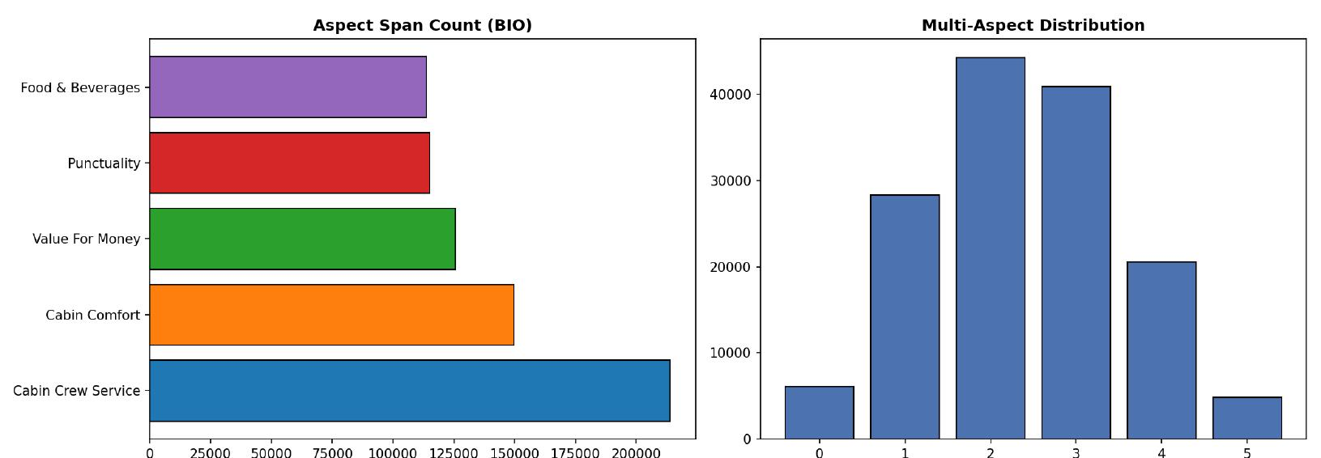
RQ1
RQ2
RQ3
RESULTS · RQ1
Aspect extraction works at scale
Cabin Crew Service is the most-discussed aspect; 76% of reviews mention ≥2 aspects — the empirical case for ABSA over a single label.
717,904
95.8%
76.2%
aspect spans
review coverage
multi-aspect reviews
Aspect span counts (BIO) & number of aspects per review
Figure 5
7
Notes:
[0:30 | running total 3:35]
Now the results, starting with RQ1. Extraction works at scale: about 718 thousand aspect spans, covering ninety-six percent of reviews. On the left, Cabin Crew Service is the most-discussed aspect — passengers describe airlines through the human interface. On the right, the key number: seventy-six percent of reviews mention two or more aspects. This is the empirical justification for ABSA — a single document label would genuinely lose information.

Slide 8

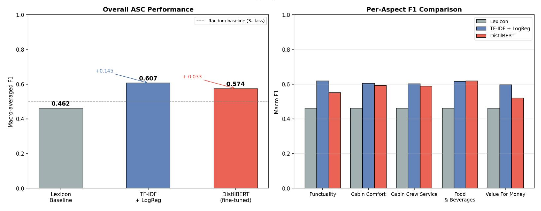
RQ1
RQ2
RQ3
RESULTS · RQ1
Domain learning wins — the transformer doesn't
Lexicon 0.462 → TF-IDF 0.608. DistilBERT (0.574) loses on 4 of 5 aspects — the bottleneck is label quality, not capacity.
Figure 8
8
Notes:
[0:40 | running total 4:15]
The headline of RQ1. On the left: the lexicon reaches 0.462 macro-F1; TF-IDF jumps to 0.608 — a clear, consistent gain, because airline dissatisfaction is expressed through events, not adjectives. The surprise is on the right: DistilBERT reaches only 0.574 and loses to TF-IDF on four of five aspects. A transformer does not dominate here — and the explanation is supervision: with noisy silver labels, the high-capacity model learns the inconsistencies, while the simpler, regularised model is more robust.

Slide 9
RQ1
RQ2
RQ3
RESULTS · RQ1
Why the transformer struggles
Lexicon vs TF-IDF disagreement by aspect
The neutral class is the bottleneck
DistilBERT classifies clear positives and negatives well, but stumbles on neutral — which in airline reviews rarely means neutral language; it means a mixed experience an indirect label can't pin down.
Value For Money is hardest
59.8% disagreement — price words aren't inherently positive or negative; meaning depends on perceived fairness. Crew (38.1%) uses direct words like “friendly”, “rude”.
Implication: under noisy labels, improving label quality matters more than a bigger model.
9
Notes:
[0:30 | running total 4:45]
Why does the transformer struggle? Two diagnostics. First, the neutral class is the bottleneck: in airline reviews, neutral rarely means neutral language — it means a mixed experience, which an indirect label cannot pin down. Second, the disagreement chart: Value For Money is the hardest aspect, with almost sixty percent disagreement, because price words are not inherently positive or negative — meaning depends on perceived fairness. The implication: under noisy labels, improving label quality matters more than a bigger model.

Slide 10
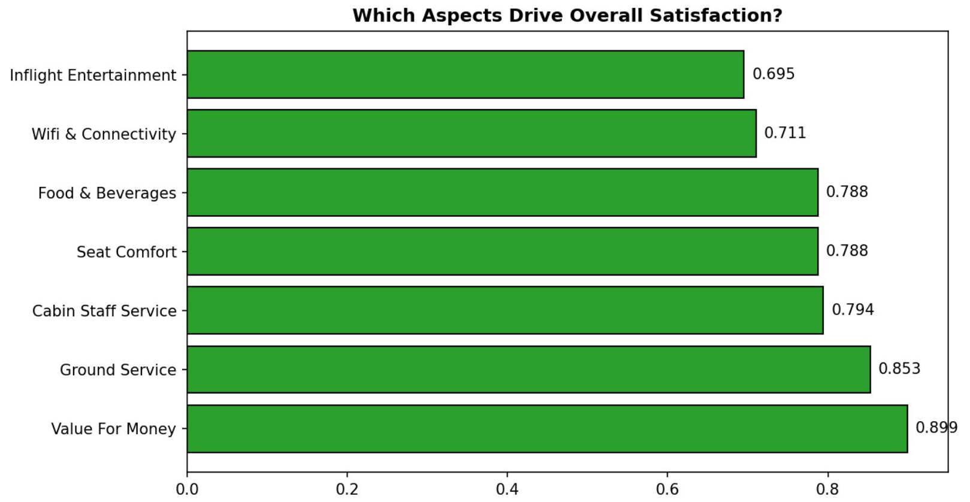
RQ1
RQ2
RQ3
RESULTS · RQ2
Value For Money is the strongest driver
Which aspects drive satisfaction? (Pearson r)
Three methods agree
Correlation r = 0.899 · dominant Ridge predictor (R² = 0.874) · near-neutral AOPE. Value For Money tops every view.
The lens, not just an aspect
Passengers judge comfort, crew and food relative to the fare paid. Value is compensable — a basic flight can still pass if the price feels fair.
Figure 10
10
Notes:
[0:35 | running total 5:20]
RQ2: what drives satisfaction. Value For Money is the strongest driver, and three independent methods agree: the highest correlation with the overall rating, 0.899; the dominant Ridge predictor, with eighty-seven percent of variance explained; and a near-neutral opinion polarity. The interpretation: Value For Money is the lens through which passengers judge everything else — comfort, crew and food are weighed against the fare. It is compensable: a basic flight can still pass if the price feels fair.

Slide 11
RQ1
RQ2
RQ3
RESULTS · RQ2
Punctuality is the non-compensable damage factor
Opinion polarity by aspect (AOPE)
Only negative aspect
AOPE −1.03. “delayed” is the single most frequent opinion word — 37,619×, ahead of “good” or “friendly”.
A satisfaction switch
Ratings collapse between the 1-hour and 2-hour delay bands, then plateau at a floor. Once a delay is severe, crew, food or comfort can’t repair it — it is non-compensable.
11
Notes:
[0:35 | running total 5:55]
Punctuality plays the opposite role. It is the only aspect with negative opinion polarity — minus 1.03 — and 'delayed' is the single most frequent opinion word in the corpus: over thirty-seven thousand occurrences, ahead of 'good' or 'friendly'. And delay behaves like a switch: ratings collapse between the one-hour and two-hour bands, then plateau at a floor. Once a delay is severe, crew, food or comfort cannot repair the judgement. Punctuality is non-compensable — which is why operational reliability remains central.

Slide 12

RQ1
RQ2
RQ3
RESULTS · RQ2
Satisfaction is read relative to expectation
Mean sub-ratings by cabin class (1–5)
Carrier type
Legacy > low-cost on service, but Value For Money is near-identical — expectations track the business model.
Traveller type
Solo Business in Business Class are most satisfied; Family Leisure in Economy least.
Wifi is the weakest dimension in every cabin — a structural gap, not an Economy problem.
And delay overrides everything: when a delay is mentioned, all traveller groups converge to a shared dissatisfaction floor.
12
Notes:
[0:30 | running total 6:25]
Satisfaction is read relative to expectation. Business outperforms Economy across the board — but Wifi is the weakest dimension in every cabin: a structural gap. Legacy carriers score higher on service, yet Value For Money is almost identical to low-cost — expectations track the business model. Solo Business travellers are the most satisfied, Family Leisure in Economy the least. But delay overrides everything: when mentioned, all groups converge to a shared dissatisfaction floor.

Slide 13

RQ1
RQ2
RQ3
RESULTS · RQ3
Weather softens blame through attribution
Mean rating by weather / delay
Rating by weather category
Delay alone crashes ratings to 2.64; weather as an external cause softens the blame — and the clearer the cause (turbulence 6.09 vs vague “generic” 3.21), the more forgiving passengers are.
13
Notes:
[0:35 | running total 7:00]
RQ3: context. First, weather — which works through attribution. On the left: delay alone crashes ratings to 2.64; reviews mentioning weather alone are the highest, at 5.71; and weather plus delay recovers to 3.77. Weather softens the blame without removing it, because the cause appears external. On the right, specificity matters: turbulence — clearly uncontrollable — scores 6.09, while vague 'generic weather' scores only 3.21. Passengers forgive what is clearly outside the airline's control.

Slide 14

RQ1
RQ2
RQ3
RESULTS · RQ3
Peak season is an expectations penalty
Northern-Hemisphere peak-season penalty by cabin class
Hemisphere-aware
Peak season is defined per hemisphere. The Northern summer carries a significant penalty of −0.47 (p<0.001).
Expectations, not just capacity
Premium Economy is hit hardest; First Class shows no significant decline. A strong enough service floor insulates against peak-season pressure.
14
Notes:
[0:30 | running total 7:30]
Second, seasonality — measured hemisphere by hemisphere, since the two peak in opposite months. The Northern summer carries a significant satisfaction penalty of minus 0.47. But it is uneven: Premium Economy is hit hardest, while First Class shows no significant decline. So this is not only a capacity effect — it is an expectations effect: a strong enough service floor insulates against peak-season pressure.

Slide 15

RQ1
RQ2
RQ3
RESULTS · RQ3
Major events need a causal design
Difference-in-Differences vs raw before/after — seven aviation events
Event
Raw change
DiD estimate
EU Aviation Strikes (2023)
+0.69
+1.33
Boeing 737 MAX Ban (2019)
-0.28
+0.80
Post-COVID Boom (2022)
+0.26
+0.73
CrowdStrike Outage (2024)
+0.22
+0.06
Boeing Door Blowout (2024)
+0.32
-0.30
Ukraine War & Airspace (2022)
-0.17
-0.35
COVID-19 Pandemic (2020)
-1.17
-0.89
Boeing Door Blowout: raw ratings rose (+0.32) yet DiD is −0.30 — once seasonality is removed, the effect flips. COVID is the strongest true negative.
15
Notes:
[0:35 | running total 8:05]
Third, major events — where a causal design is essential. The table compares the raw before-and-after change with a Difference-in-Differences estimate that controls for the seasonal baseline. The Boeing Door Blowout is the clearest case: raw ratings rose, plus 0.32 — but the DiD is minus 0.30. Once seasonality is removed, the effect flips sign. COVID is the strongest genuine negative. The lesson: raw before-and-after comparisons can point the wrong way.

Slide 16

SYNTHESIS
Satisfaction is a layered judgement
1
2
3
Compensable vs non-compensable
Match model to supervision
ABSA + context = evidence
Value For Money trades off; Punctuality sets a floor others can't lift.
With silver labels, better labels beat a bigger model.
Shows when & for whom each sentiment matters.
In one line: satisfaction is governed by fairness, reliability, expectations & attribution — not a single score.
16
Notes:
[0:30 | running total 8:35]
Pulling the three questions together, three takeaways. First, compensable versus non-compensable dimensions: Value For Money is judged through trade-offs, Punctuality sets a floor other aspects cannot lift. Second, a methodological lesson: model complexity should match supervision quality — with noisy labels, fixing the labels beats scaling the model. Third, ABSA becomes managerially useful when combined with context: it shows when, and for whom, each sentiment matters. In one line: satisfaction is governed by fairness, reliability, expectations and attribution — not by a single score.

Slide 17


CONCLUSIONS
Contributions, limitations & next steps
Contribution
Limitations & future work
Methodological
a modular, domain-aware ABSA pipeline at scale
Managerial
reviews → structured evidence on what failed & for whom
No gold-standard annotation
silver-label noise — the likely DistilBERT gap
Next
manual eval set · better neutral class · richer context
Grazie per l'attenzione
Antonella Convertini · Questions welcome
17
Notes:
[0:25 | running total 9:00]
To conclude: the contribution is twofold — methodologically, a modular, domain-aware ABSA pipeline working at scale; managerially, a way to turn reviews into structured evidence about what failed, for whom, and under which conditions. The main limitation is the absence of gold-standard annotation: silver-label noise is the most likely reason the transformer underperformed. Future work: a manually annotated evaluation set, better neutral-class handling, richer contextual signals. Thank you very much — I am happy to take your questions.

