Slide 1
CuringBox
Light source and Bioreactor holder

Slide 2
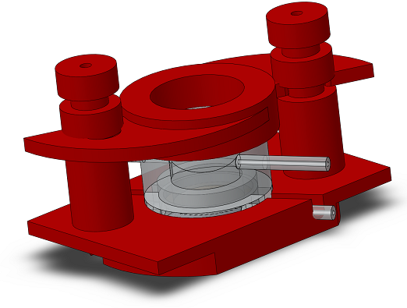
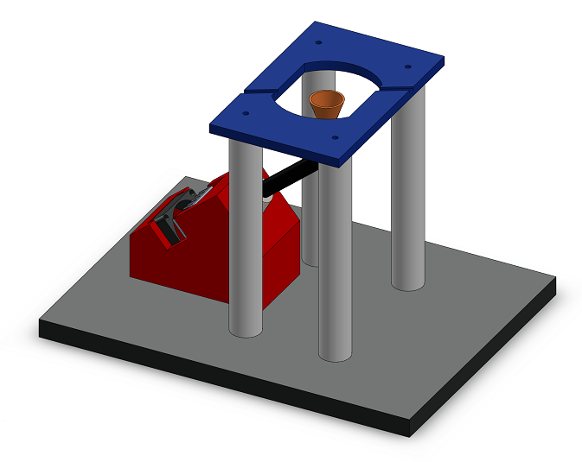

Slide 3
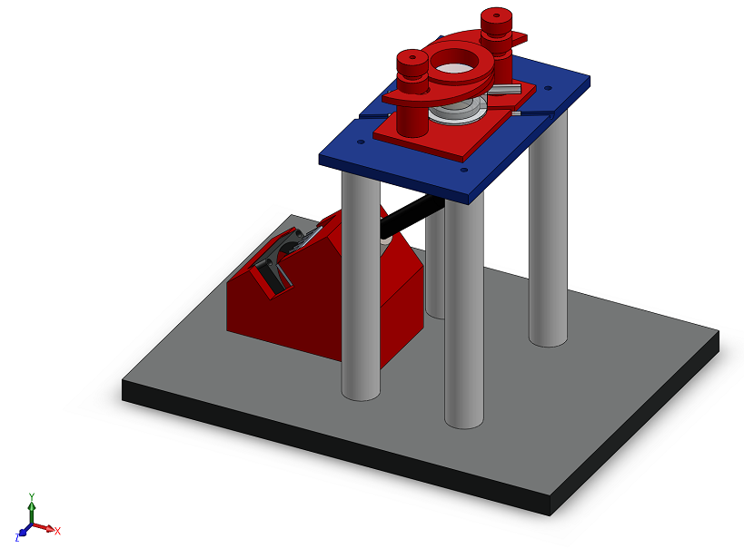

Slide 4
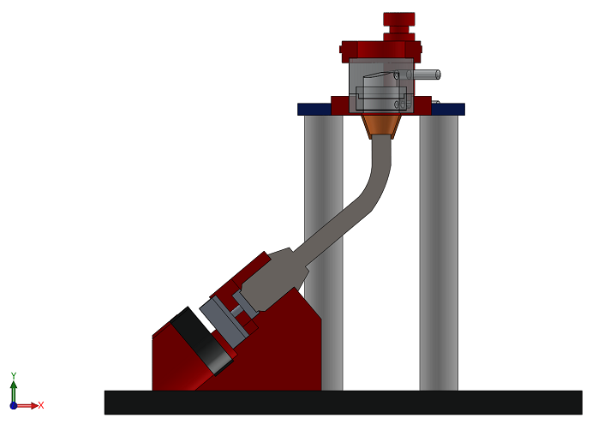
Light guide
Blue LED + heatsink
Dissipation fan

