Slide 1
Disease Prediction using Machine Learning
J-Component – Review -3
CSE3506 - Essentials of Data Analytics
G2
Team Members:
19MIS1018 – B DEVI PRASAD
19MIS1085 – VIGNESH KUMAR REDDY
19MIS1121 – M SAI BENARJY

Slide 2
ABSTRACT
Our Disease Prediction system predicts the disease of the user on the based on the symptoms provided by the user , the symptoms are given as an input to the system. The system analyzes the given symptoms and lets user know the disease he / she may have. Our model uses 4 classifier algorithms and takes the mode of the 5 algorithms to provides us the optimal solution.

Slide 3
INTRODUCTION
It is difficult to identify heart disease because of several contributory risk factors such as diabetes, high blood pressure, high cholesterol, abnormal pulse rate and many other factors. Various techniques in data mining and neural networks have been employed to find out the severity of heart disease among humans.
The severity of the disease is classified based on various methods like Support vector classifier, Gaussian Naive Bayes Classifier , Random Forest Classifier, K-Nearest Neighbours , Decision tree and Logistic Regression.
The nature of heart disease is complex and hence, the disease must be handled carefully. Not doing so may affect the heart or cause premature death. The perspective of medical science and data mining are used for discovering various sorts of metabolic syndromes.

Slide 4
DATASET
The hospital data will be in the form of textual format or in the structural format. The dataset used in this project is real-life data. The structural data contains symptoms of patients while unstructured data consist of textual format.
The dataset used is contains real-life hospital data, and data stored in data centre. The data provided by the hospital contains symptoms of the patients. Complete Dataset consists of 2 CSV files. One of them is training and other is for testing your model. Each CSV file has 133 columns. 132 of these columns are symptoms that a person experiences and last column is the prognosis. These symptoms are mapped to 42 diseases you can classify these set of symptoms to. The dataset used is contains real-life hospital data, and data stored in data Centre. The data provided by the hospital contains symptoms of the patients.

Slide 5
Data set Link’s
https://www.kaggle.com/datasets/kaushil268/disease-prediction-using-machine-learning
https://www.geeksforgeeks.org/disease-prediction-using-machine-learning/

Slide 6
LITERATURE SURVEY
Paper. No | Paper Title | Authors | Problem | Solution for the problem
1. | Multiple disease prediction using Machine learning algorithms | K. Arumugam , Mohd Naved, Priyanka P. Shinde , Orlando Leiva-Chauca,Antonio Huaman-Osorio, Tatiana Gonzales-Yanacd | For prediction of diseases, different machine learning algorithms are used to ensure quick and accurate predictions. | We find-tuned the decision tree model for optimum performance in forecasting the chance of heart disease in diabetic patients since it consistently outperformed the naive Bayes and support vector machine models.
2. | Disease Prediction Using Machine Learning Over Big Data | Vinitha S, Sweetlin S, Vinusha H and Sajini S | Due to big data progress in biomedical and healthcare communities, accurate study of medical data benefits early disease recognition, patient care and community services. | In this paper, it bid a Machine learning Decision tree map algorithm by using structured and unstructured data from hospital. It also uses Map Reduce algorithm for partitioning the data. the scheming accuracy of our proposed algorithm reaches 94.8% with an regular speed

Slide 7
Paper. No | Paper Title | Authors | Problem | Solution for the problem
4. | Disease Prediction by Machine Learning Over Big Data From Healthcare Communities | MIN CHEN (Senior Member, IEEE), YIXUE HAO, KAI HWANG (Life Fellow, IEEE),LU WANG, AND LIN WANG | The big data growth in biomedical and healthcare communities, accurate analysis of medical data benefits early disease detection, patient care, and community services. | In this paper, they proposed a new convolutional neural network based multimodal disease risk prediction (CNN-MDRP) algorithm using structured and unstructured data from hospital, Compared to several typical prediction algorithms, the prediction accuracy of our proposed algorithm reaches 94.8% with a convergence speed which is faster than that of the CNN-based unimodal disease risk prediction(CNN-UDRP) algorithm.
5. | Development of Big Data Predictive Analytics Model for Disease Prediction using Machine learning Technique | R. Venkatesh & C. Balasubramanian & M. Kaliappan | Now days, health prediction in modern life becomes very much essential. Big data analysis plays a crucial role to predict future status of health and offers preeminent health outcome to people. | They designed a map reduce algorithm for Naive Bayes technique that integrated with Apache Spark framework for performing big data predictive analytics that helps to reduce the computation complexity because of its parallelism. The proposed BPA-NB scheme classify and predict the future status from the heart disease data set effectively that discussed in result and discussion section

Slide 8
Paper. No | Paper Title | Authors | Problem | Solution for the problem
5. | Diabetes Disease Prediction using Machine Learning on Big Data of Healthcare | Ayman Mir, Sudhir N. Dhage 978-1-5386-5257-2/18/$31.00 c 2018 IEEE | These research hopes to recommend the best algorithm based on efficient performance result for the prediction of diabetes disease. Experimental results of each algorithm used on the dataset will be evaluated. | The four classifiers have been compared based on training time, testing time and accuracy value. The overall performance of Support Vector machine to predict the diabetes disease is better than Naive Bayes, Random Forest and Simple Cart
6. | Latest trends on heart disease prediction using machine learning and image fusion | Manoj Diwakar a, Amrendra Tripathi, Kapil Joshi c, Minakshi Memoria c, Prabhishek Singh d, Neeraj kumar e | A review of the classification methods for machine learning and image fusion that have been demonstrated to help healthcare professionals identify heart disease. | An appropriate algorithm must be used to develop a predictive model that delivers accurate results. We observe that ANN has good effects for predicting heart disease in most models. Finally, the use of machine learning and image fusion to detect heart disease is an essential activity, and it can be of assistance to both healthcare authorities and patients.

Slide 9
PROPOSED WORK
With the Dataset we initially work on the analysis part of the dataset and then starts with testing and training dataset’s.
preprocessing of the dataset
then we discuss briefly with the proposed methodology,
identifying the main features or variables which is suitable or the project.
followed by model comparison and selection of best model
finally they summarize the main finding and
We find out the highest accuracy among the algorithms and we select the algorithm and then started separating the data and label and then
And then we find the accuracy on test data then finally we will build a predictive system.

Slide 10
ALGORITHMS USED
Support vector classifier
Gaussian Naive Bayes Classifier
Random Forest Classifier
K-Nearest Neighbours
Decision tree
Logistic Regression.

Slide 11
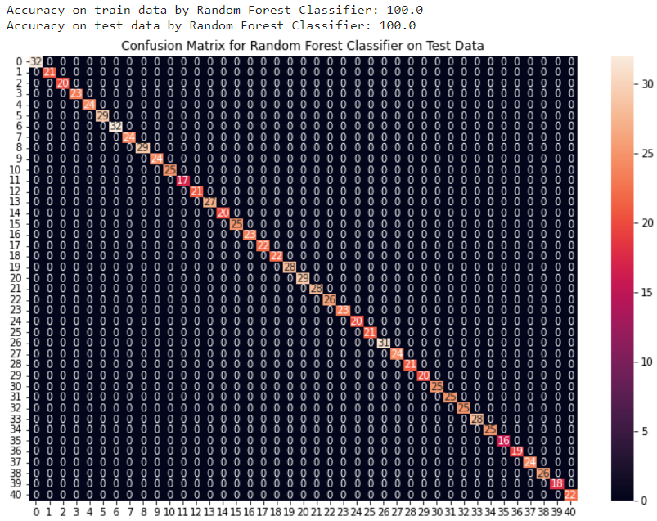
PERFORMANCE RESULTS: RANDOM FOREST CLASSIFIER

Slide 12

SVM

Slide 13
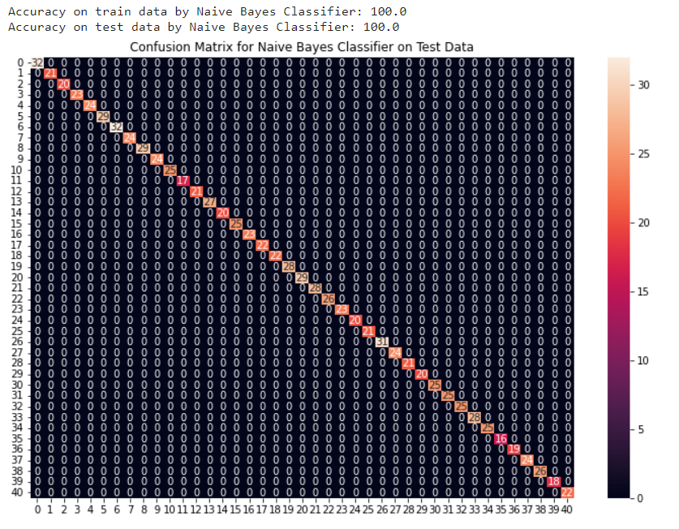
NAVES BAYES

Slide 14
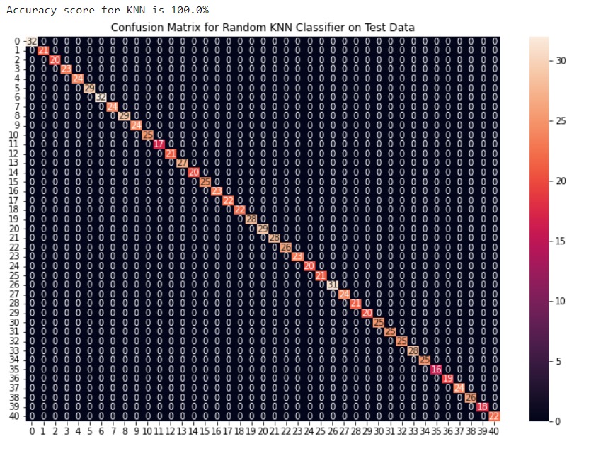
KNN

Slide 15
EXPERIMENTAL RESULTS
Random Forest
Accuracy on train data by Random Forest Classifier: 100.0
Accuracy on test data by Random Forest Classifier: 100.0
Decision Tree
Accuracy on train data and test data by Decision tree Accuracy: 0.902439024390244
Support Vector Machine
Accuracy on train data by SVM Classifier: 100.0
Accuracy on test data by SVM Classifier: 100.0
Naïve Bayes
Accuracy on train data by Naive Bayes Classifier: 100.0
Accuracy on test data by Naive Bayes Classifier: 100.0
K-Nearest Neighbors
Accuracy on train data by K-Nearest Neighbors: 100.0
Accuracy on test data by K-Nearest Neighbors : 100.0

Slide 16
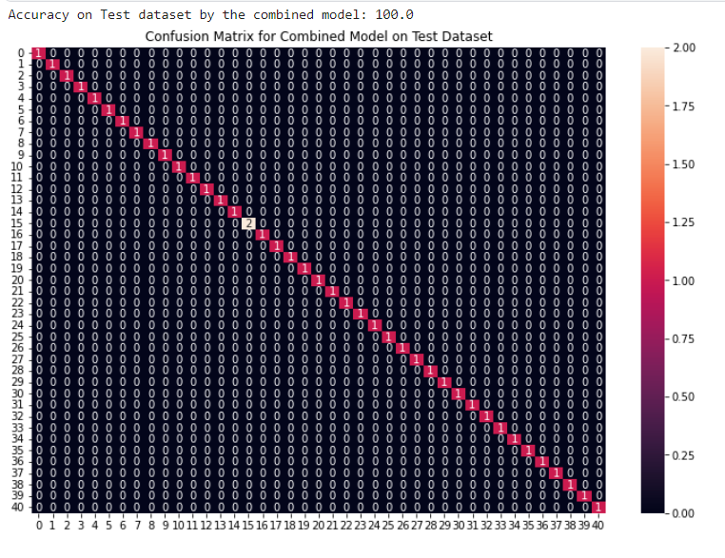
FINAL MODEL

Slide 17
COMPARITIVE STUDY
ML process starts from a pre-processing data phase followed by feature selection based on Probability in each algorithm , classification of modeling performance evaluation, and the results with improved accuracy. The feature selection and modeling keep on repeating for various combinations of attributes.

Slide 18
CONCLUSION
This project aims to predict the disease on the basis of the symptoms. The project is designed in such a way that the system takes symptoms from the user as input and produces output i.e., predict disease. In conclusion, for disease risk modelling, the accuracy of risk prediction depends on the diversity feature of the hospital data

Slide 19
Roles
TEAM MEMBERS | ROLES
M SAI BENARJY | Pre-processing of dataset, data splitting and visualization.
B DEVI PRASAD | Support vector classifier, Gaussian Naive Bayes Classifier , Random Forest Classifier.
VIGNESH KUMAR REDDY | K-Nearest Neighbours , Decision tree , Logistic Regression.

Slide 20


