Slide 1
GTFS data modeling with Neo4j

Slide 2
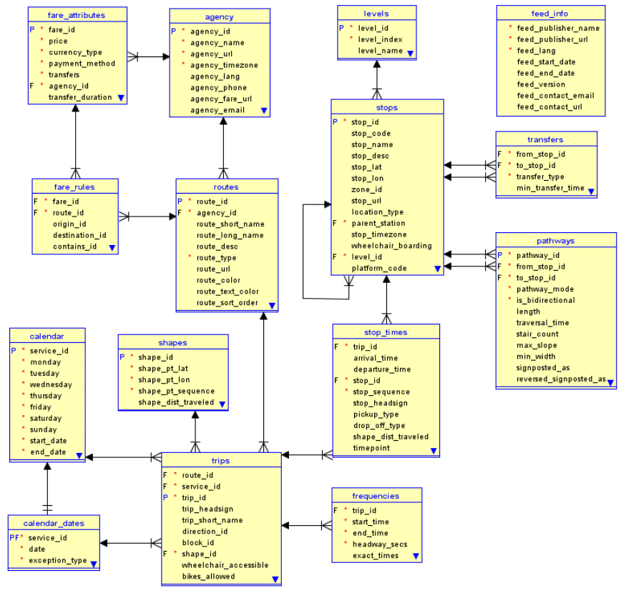
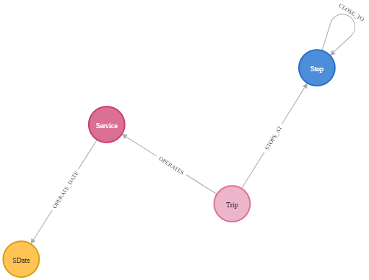
GTFS format
Odd timings
https://doi.org/10.33039/ami.2021.07.001

Slide 3
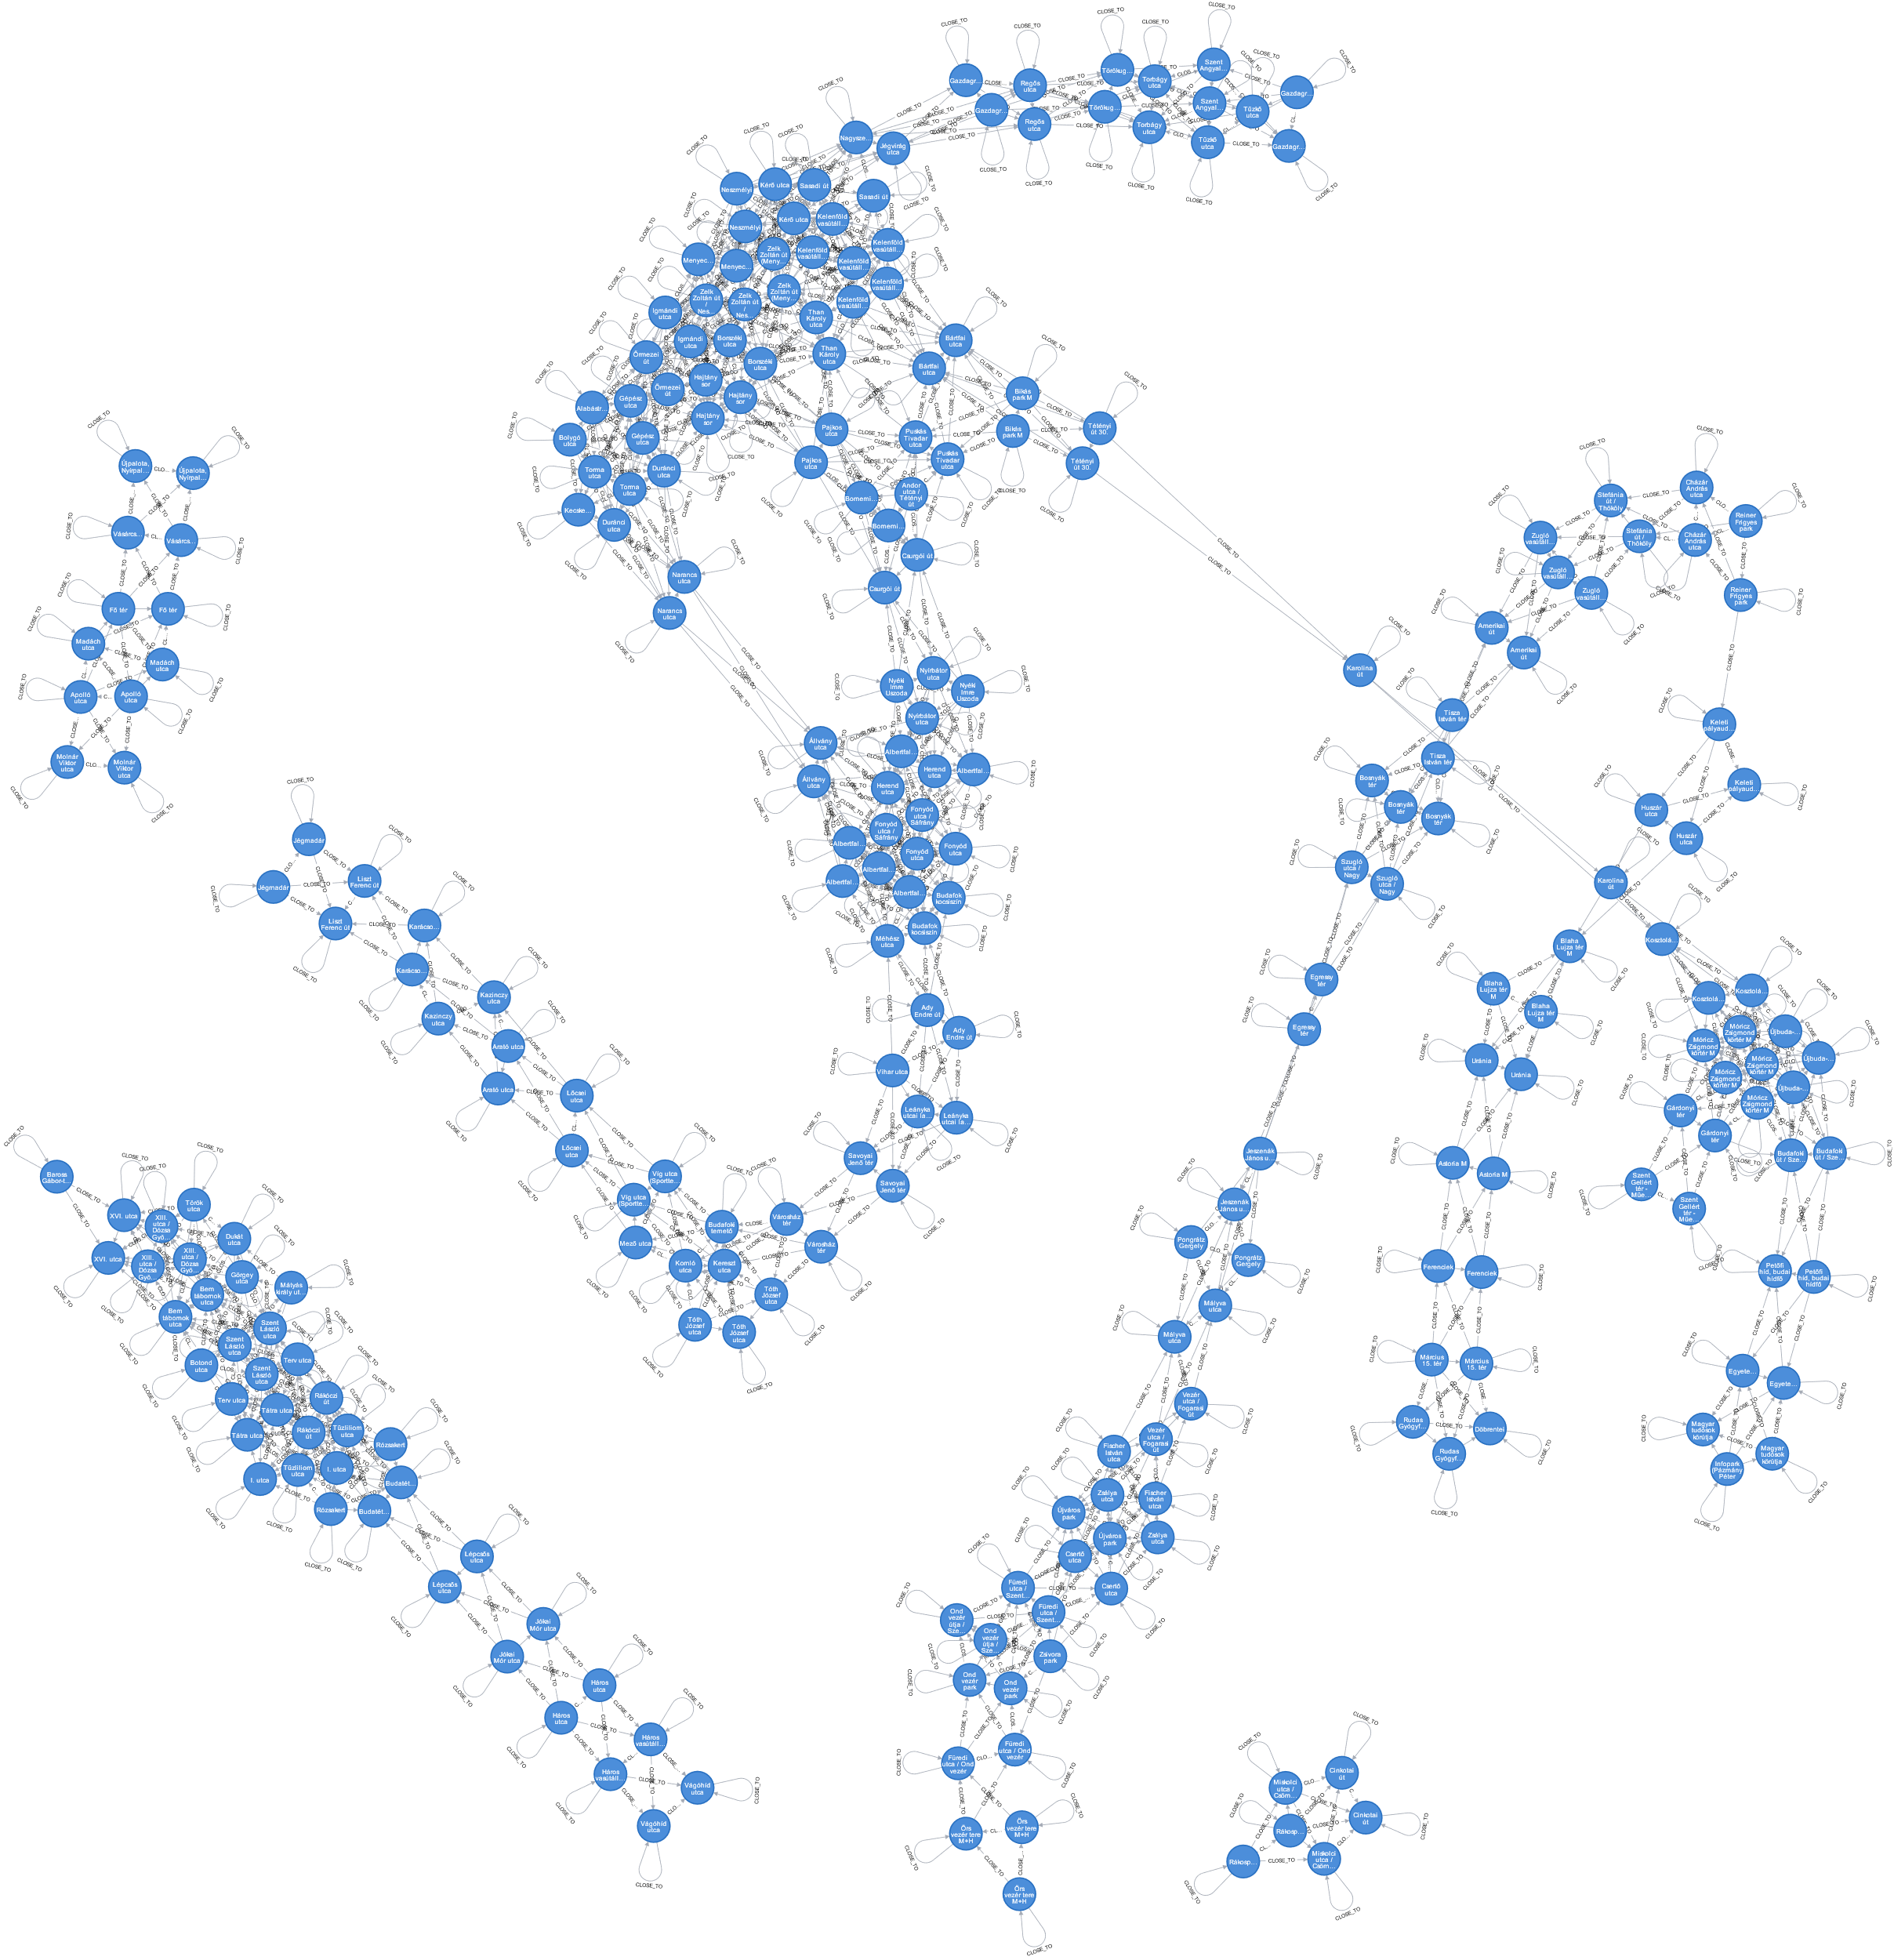

1: Reachable stops

Slide 4
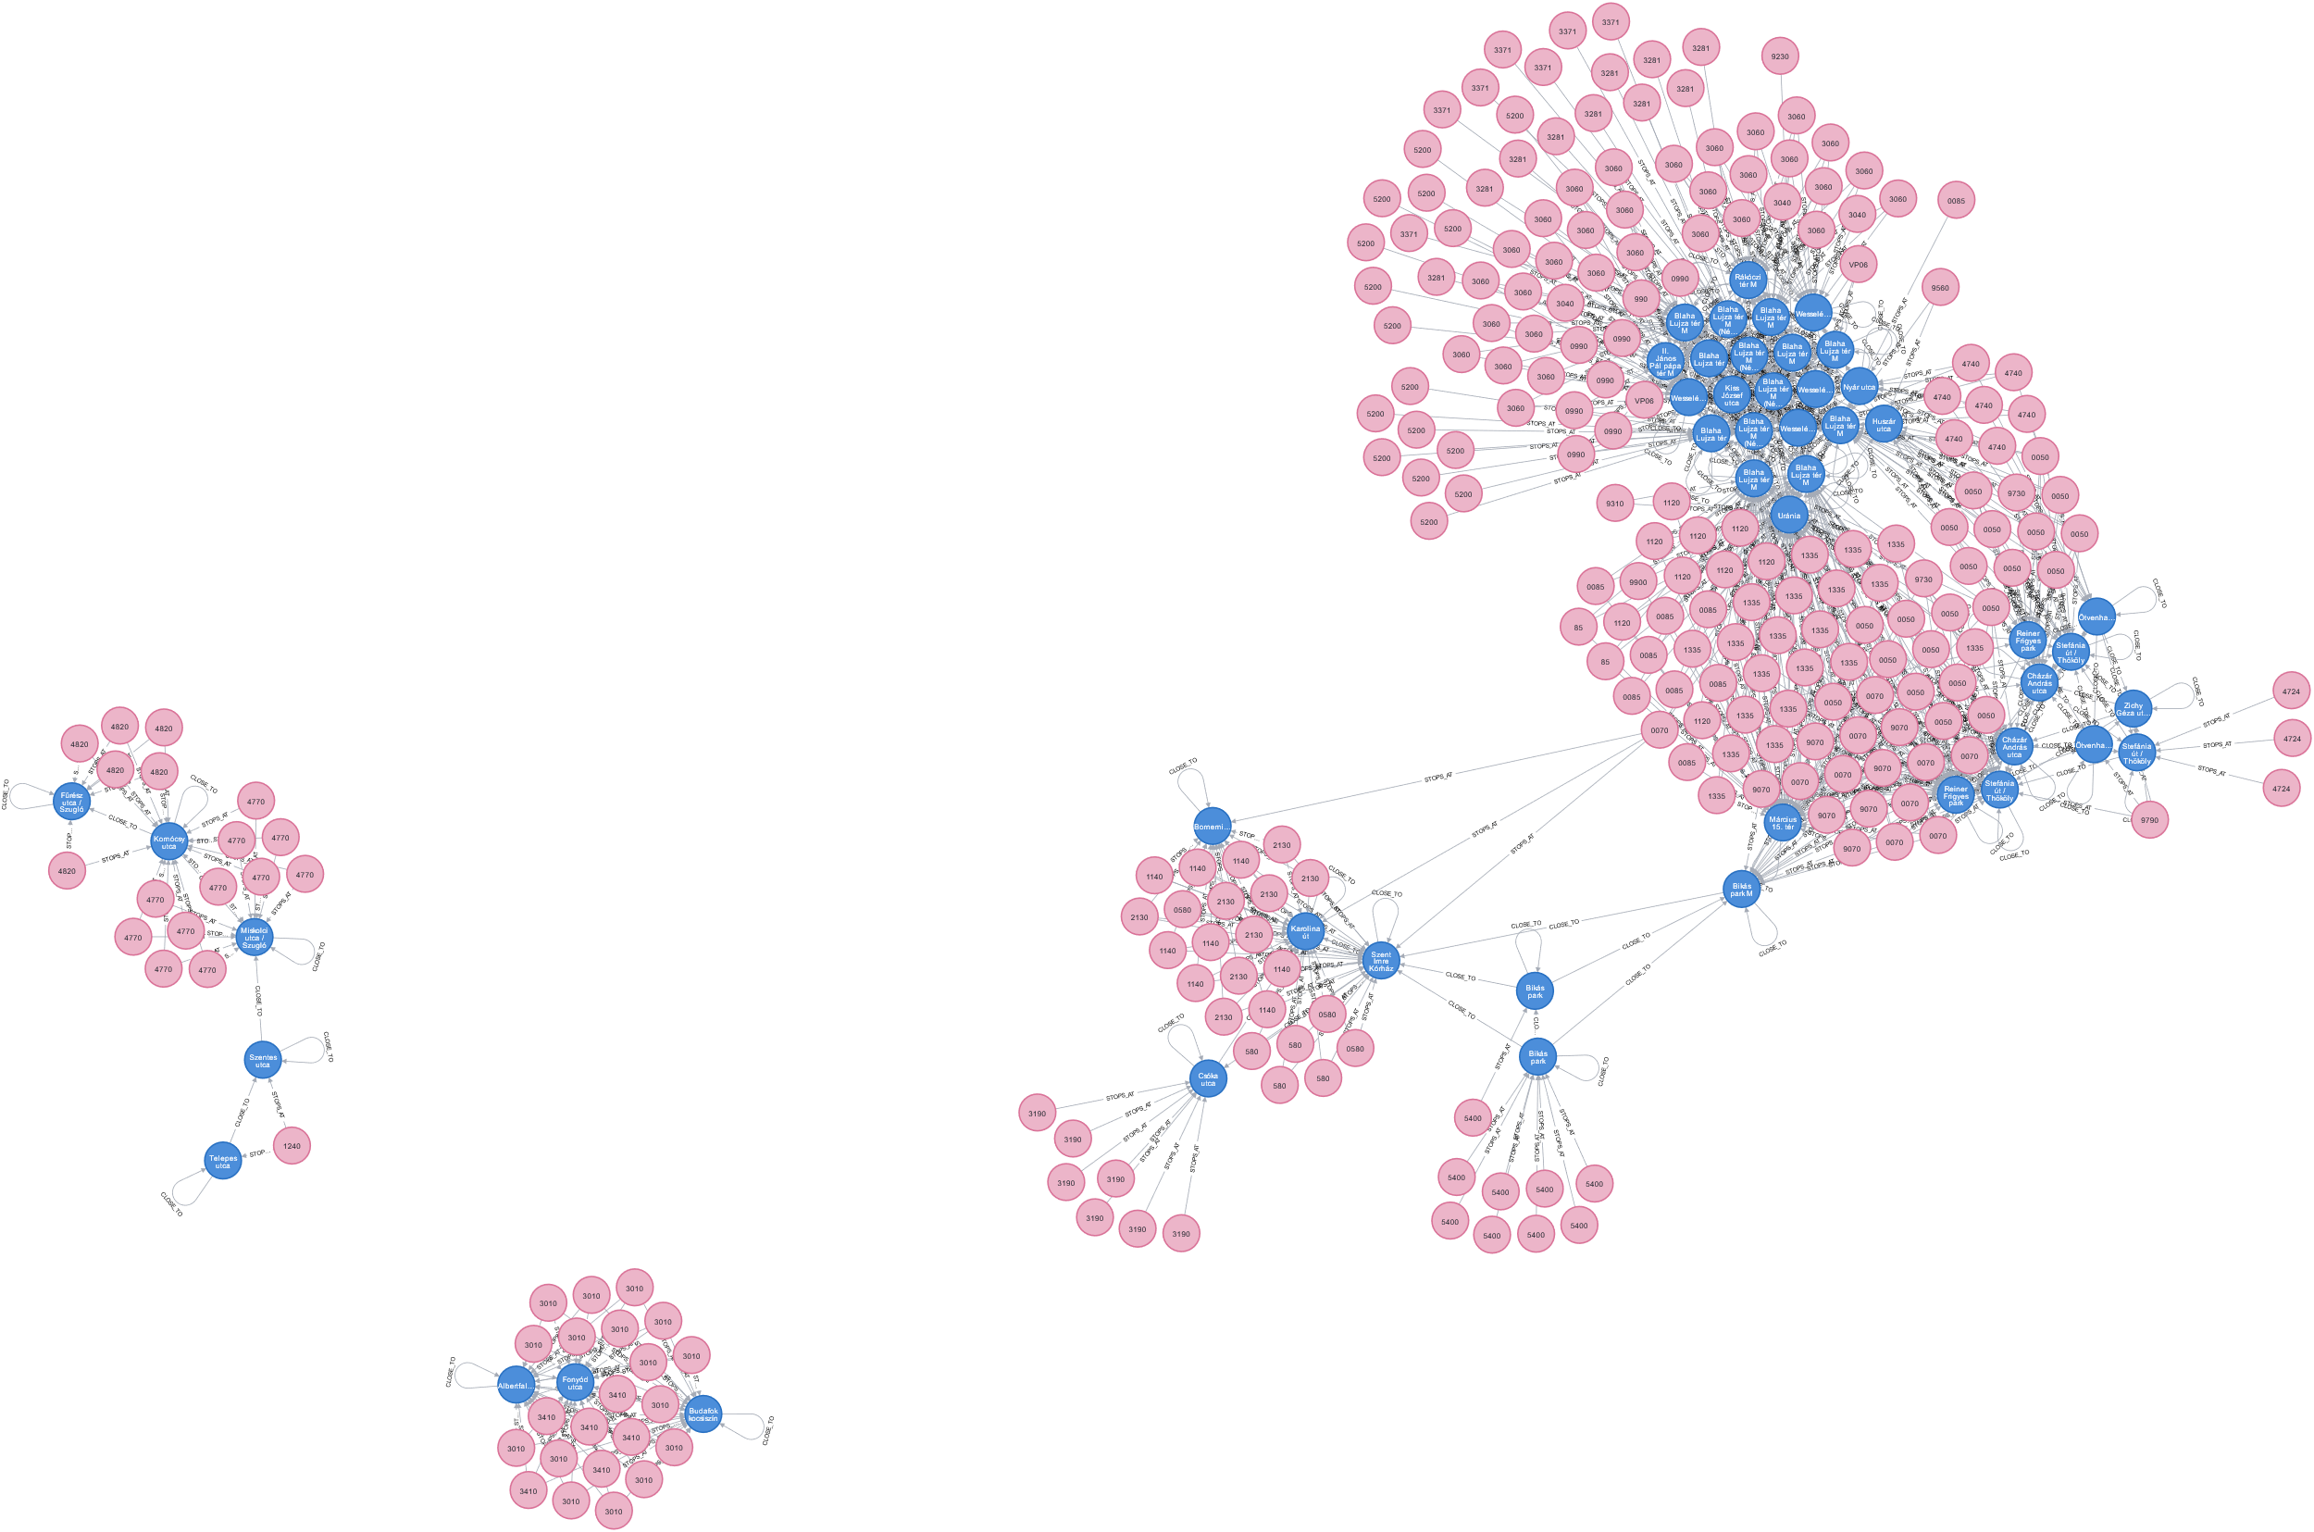

2: Switching rides
Precalculate distances

Slide 5
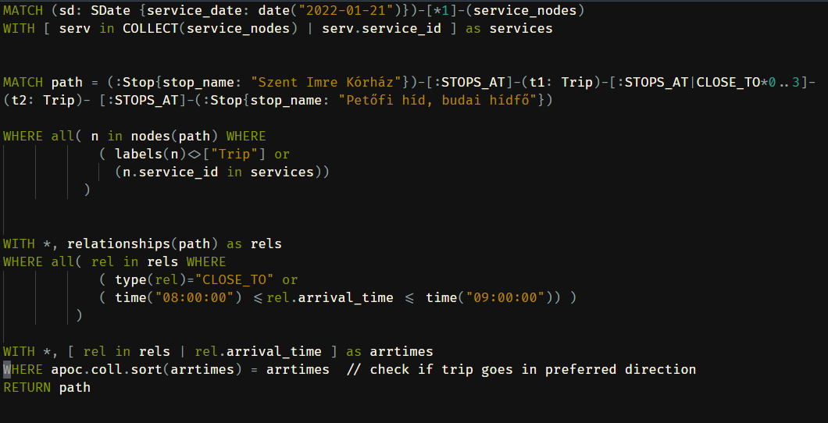
3: Path finding
Runs in finite time for 1-2 trips

Slide 6
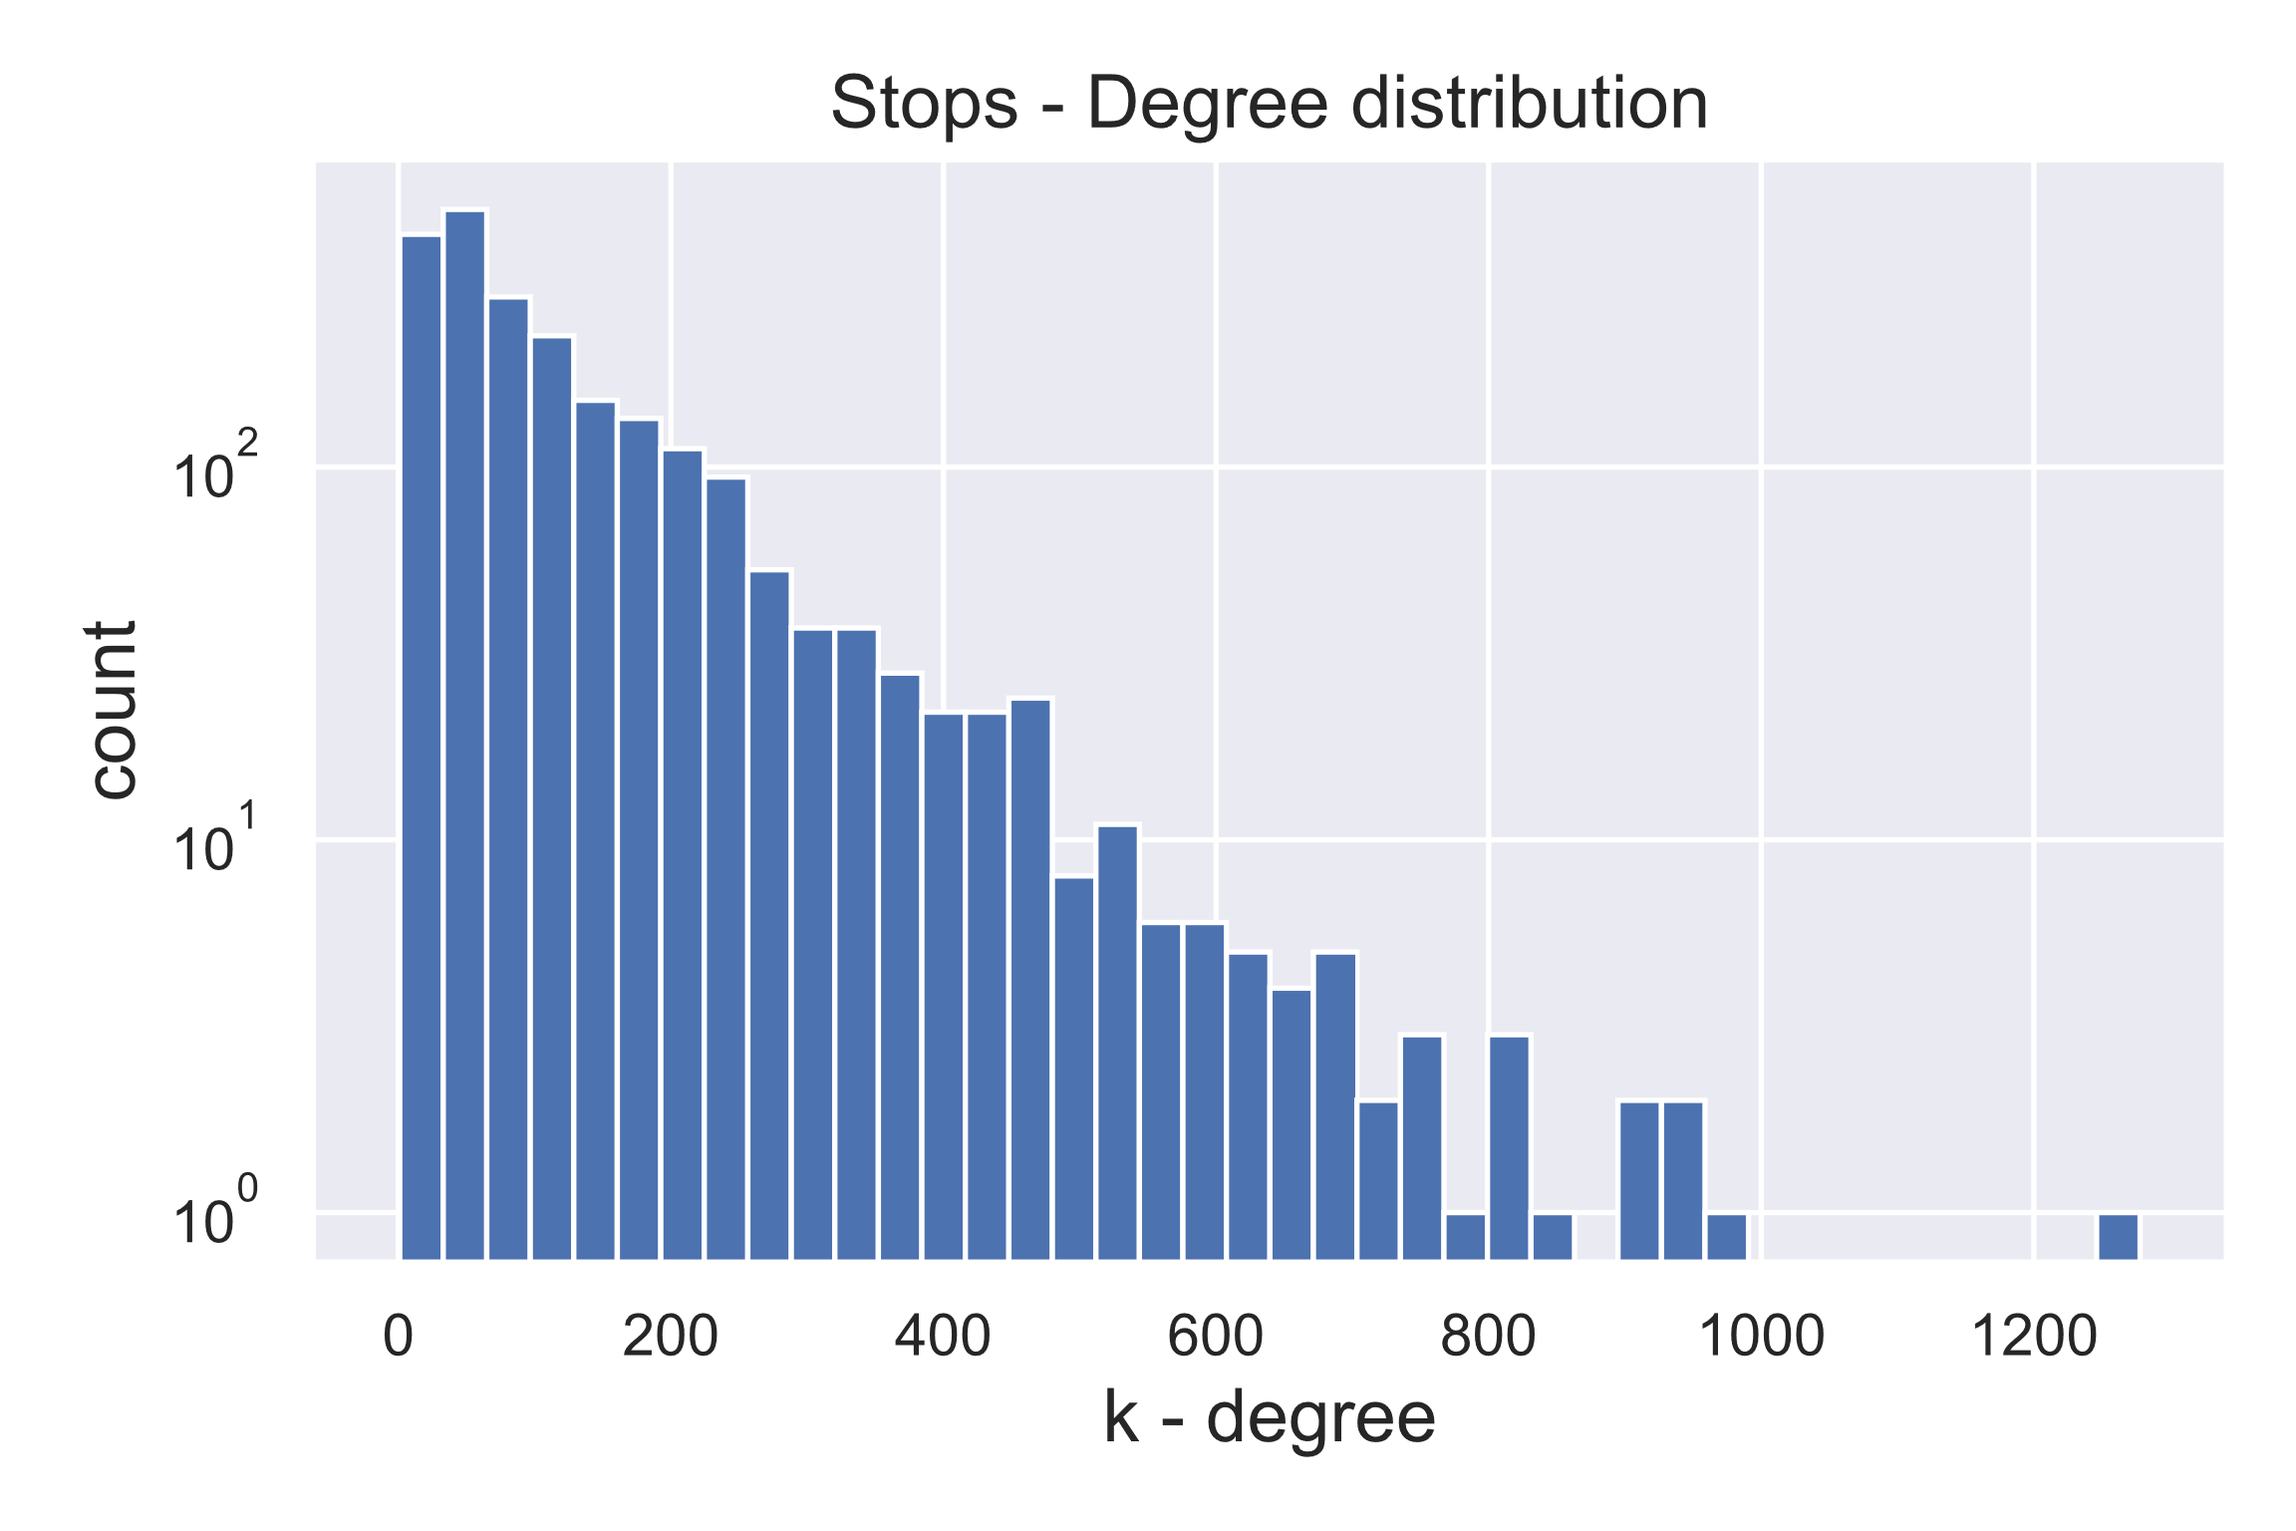
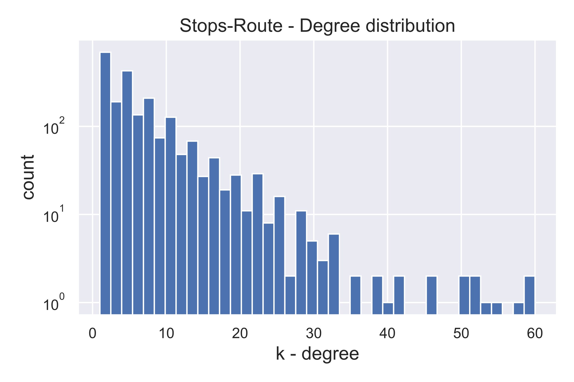
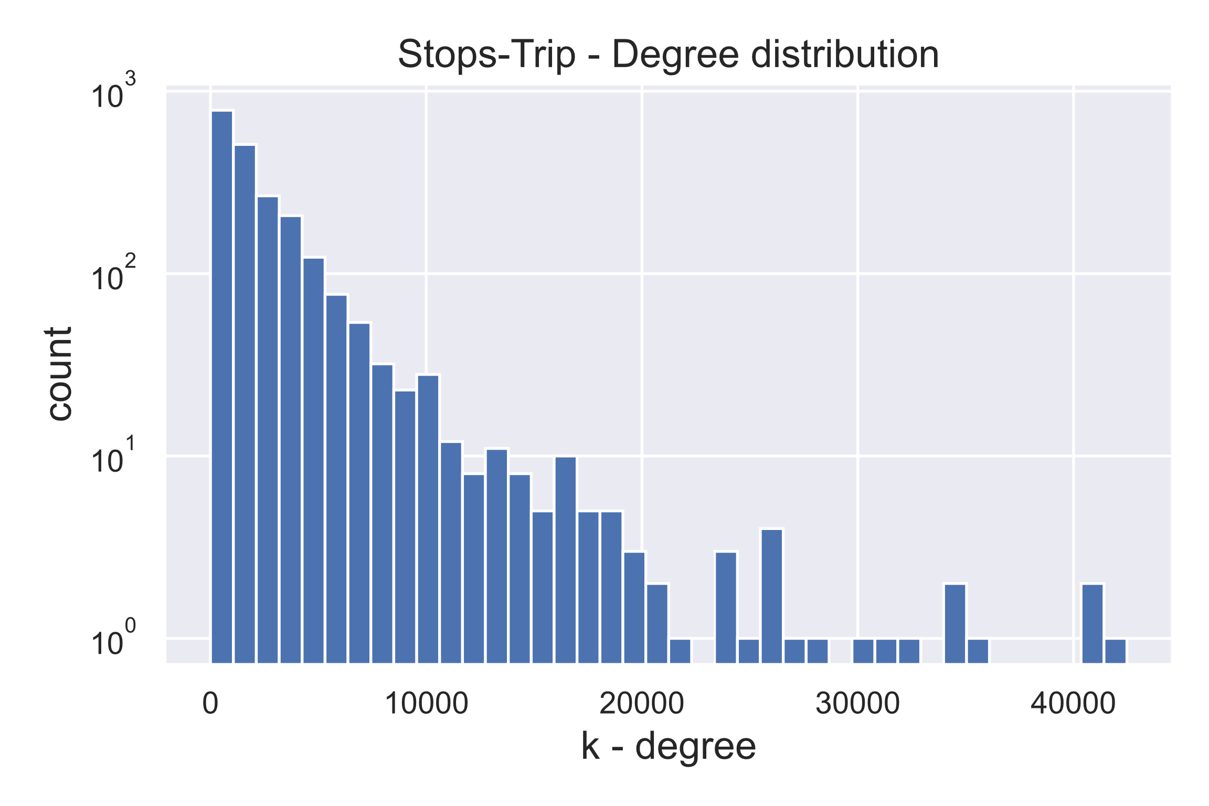

5: Centrality measures
Would be much needed for centrality calc and community detection

