Slide 1
GTFS data modeling with Neo4j
Bálint Hantos
Scientific databases and data modeling

Slide 2
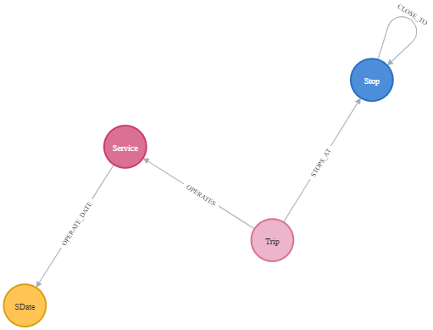
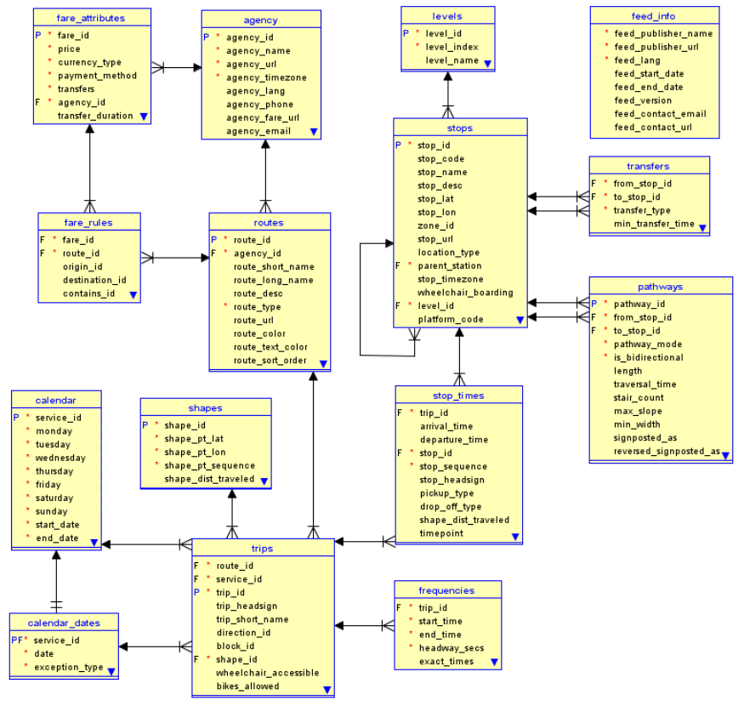

Introduction
TOOLS
Neo4j Desktop – for DBMS
Cypher
+ APOC
(+ GDS)
Odd timings: 24h+
https://doi.org/10.33039/ami.2021.07.001

Slide 3
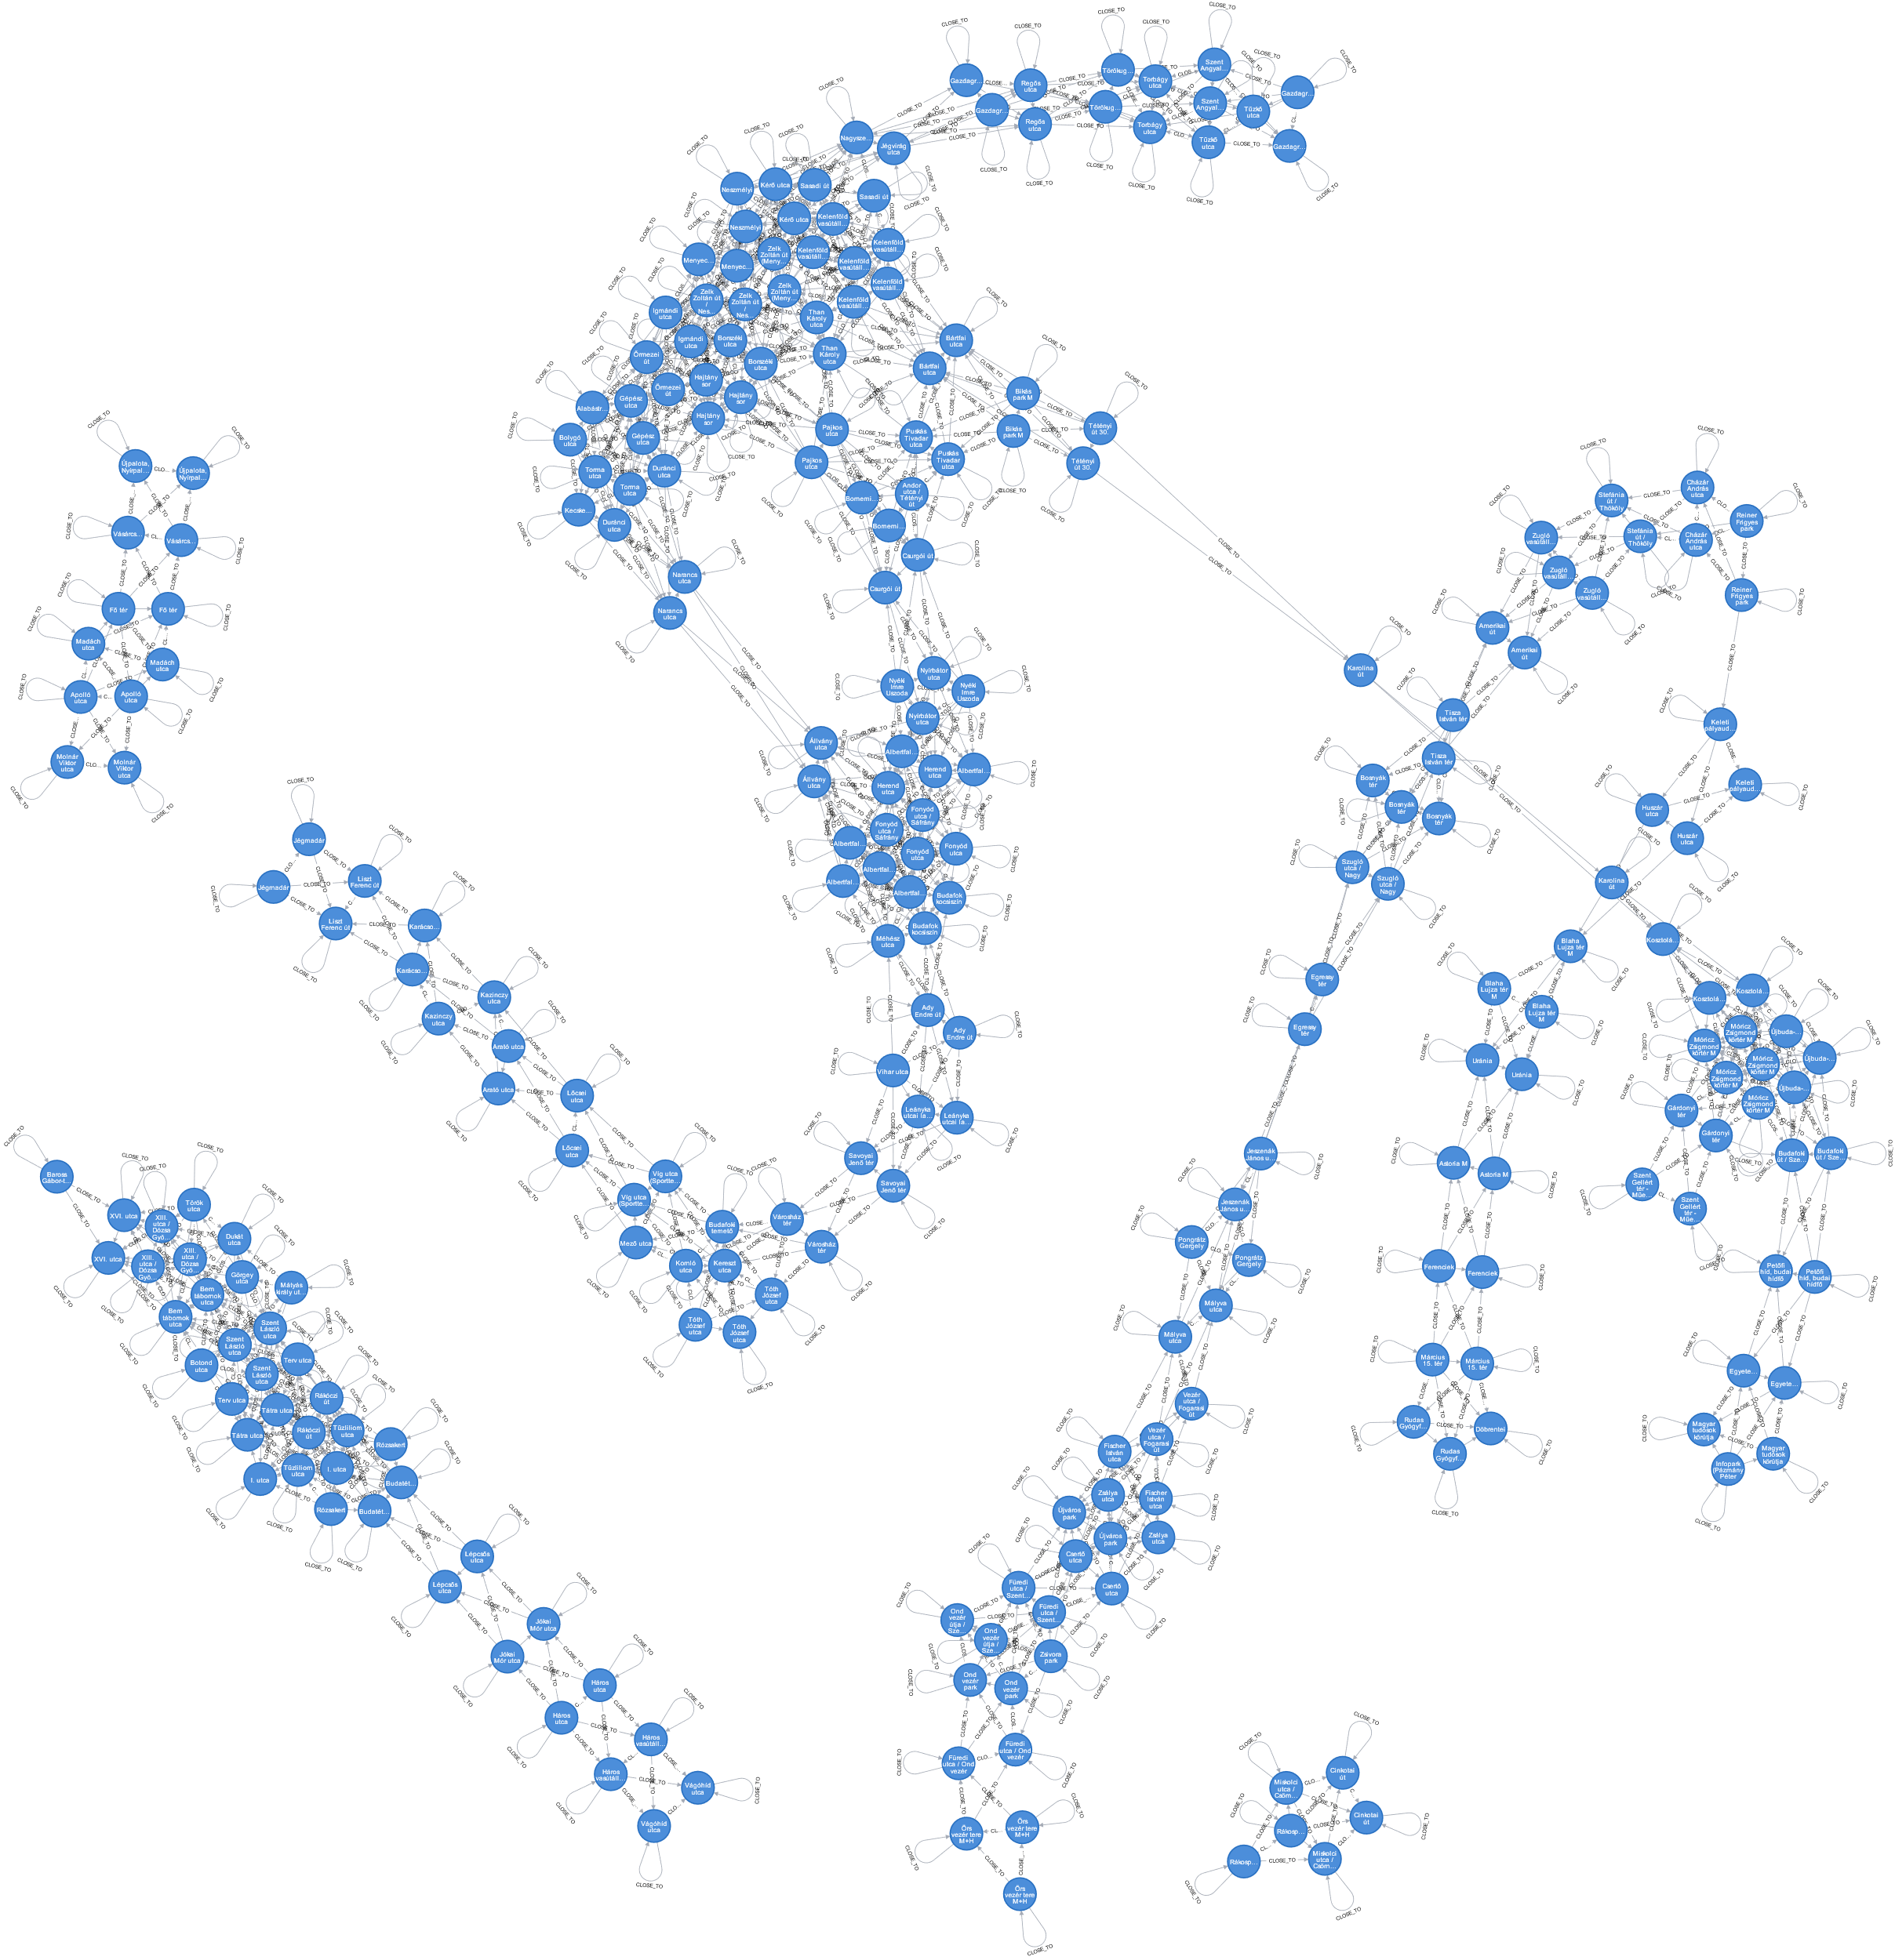
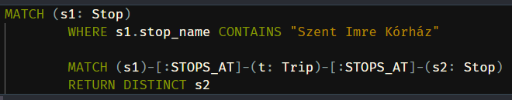
1: Reachable stops

Slide 4
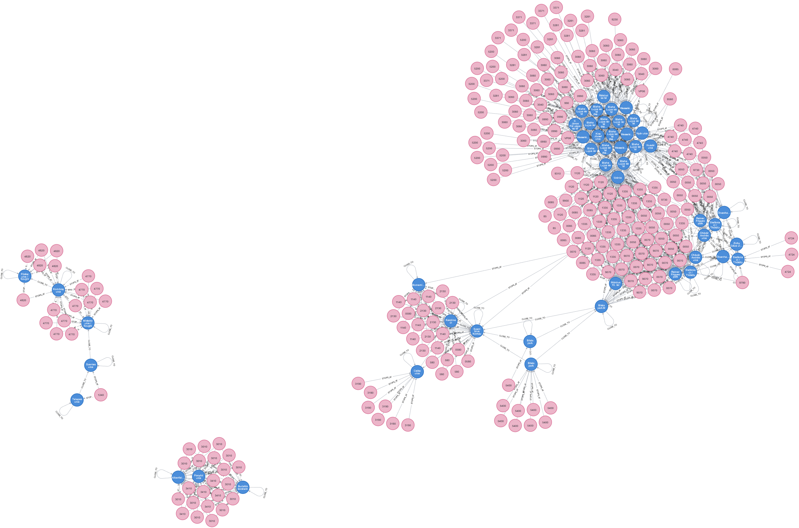
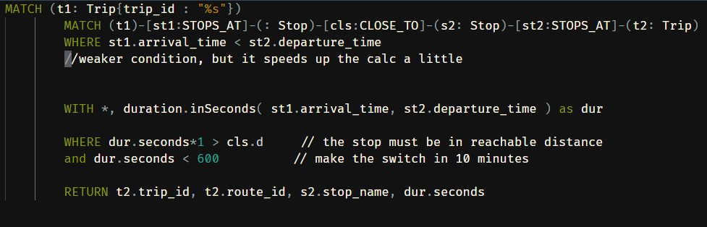
2: Switching rides
Precalculate distances

Slide 5
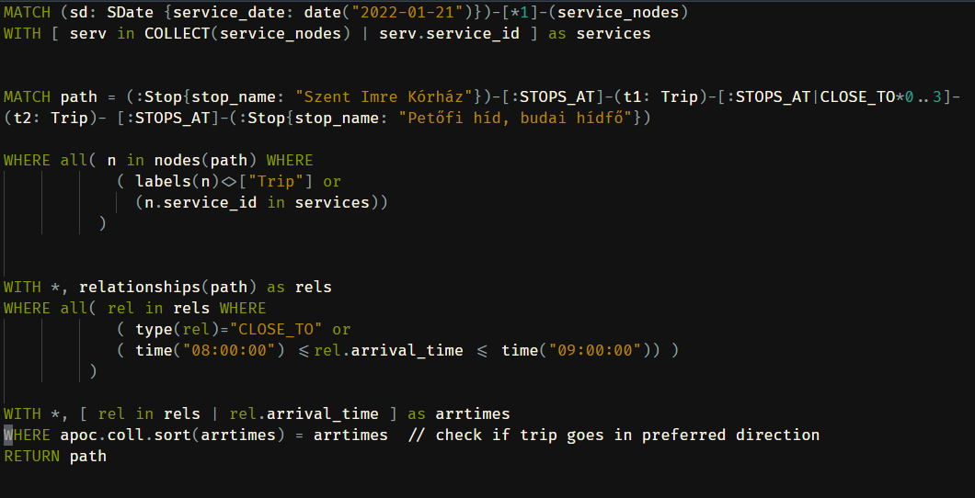
3: Path finding
Minimum sum time: min( st2.arrive_time - st1.depart_time )
Least amount of switches – shortestPath

Slide 6
3: Path finding
Minimal waiting time:
Travel time
Walking time
Waiting time
Sum of time

Slide 7
3: Path finding
Runs in finite time for 1-2 trip changes
Challenges:
Long runtimes No results for >2 trips
Quasi pythonic syntax
Error messages refer to Java code

Slide 8
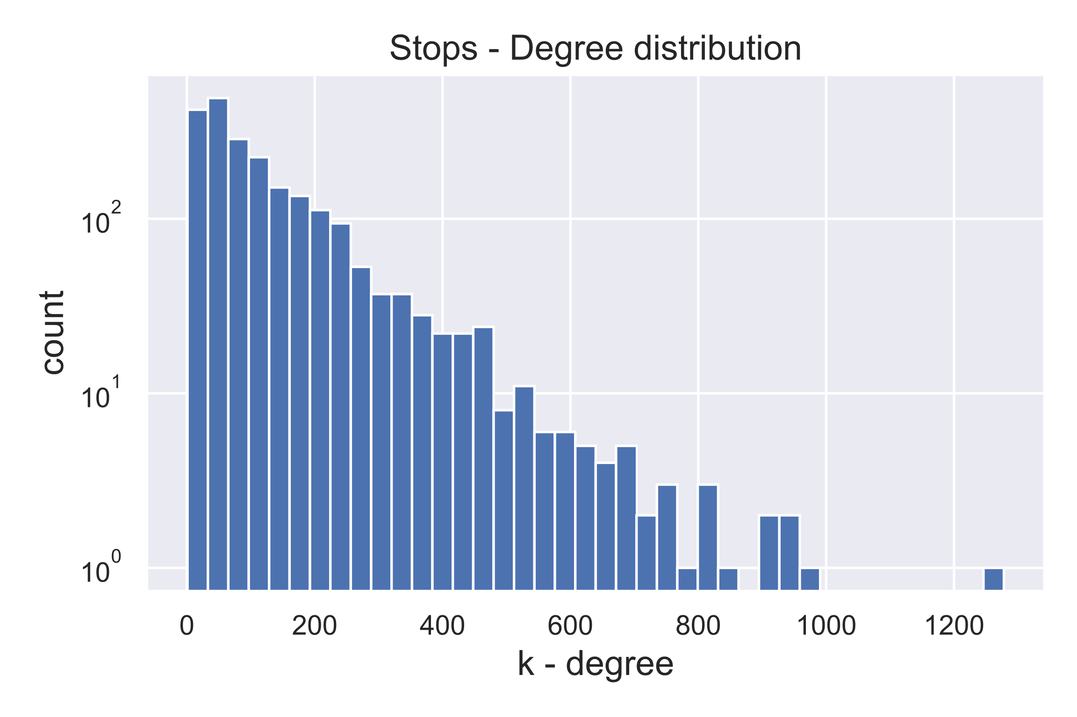
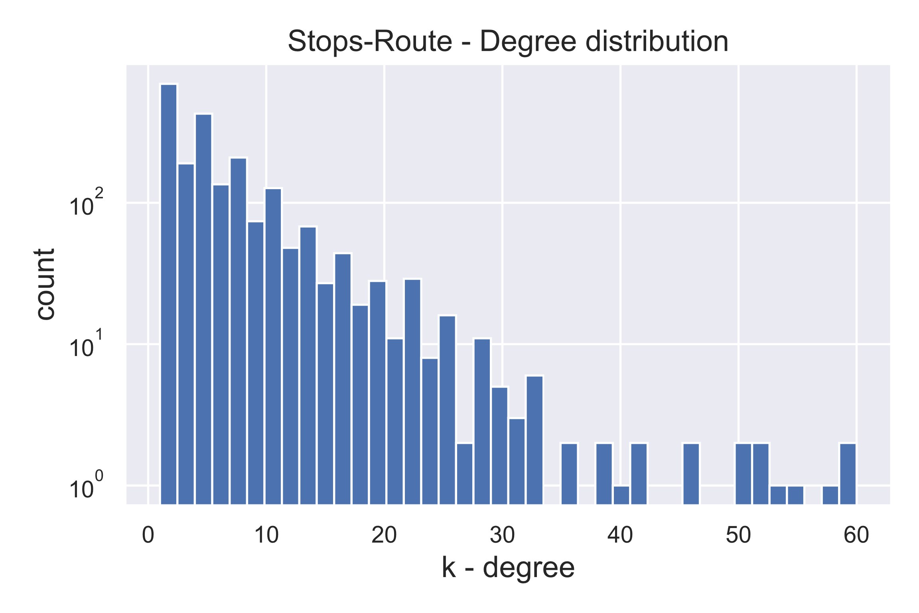
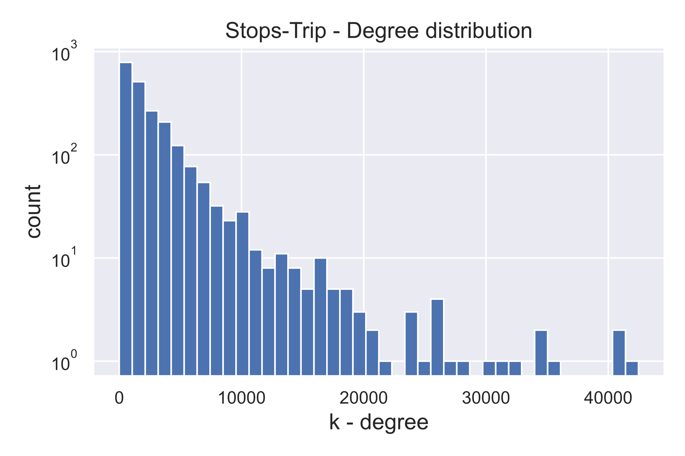
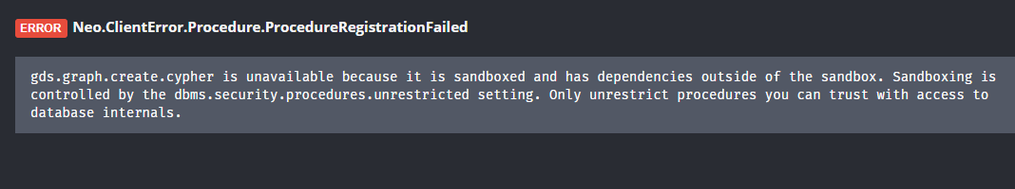
5: Centrality measures
Would be much needed for centrality calc and community detection

