Slide 1

Kovta Nyrt.
Created by SysTeam (Bánkuti Bálint, Szőke Kristóf)
Notes:
Good day, everyone! I would like to welcome you all. My name is Bálint Bánkuti, and together with my colleague Kristóf Szőke, we will be presenting the network infrastructure of Kovta Nyrt. – a system we designed and implemented through out this academic year.

Slide 2

Company history
Kovta Nyrt. is a newly launched bank. The entire bank network was designed for the company to start at the beginning and not expand, meaning everything is located in one building. The network is secure, transparent, and includes all basic protocols that are needed.
Notes:
Kovta Nyrt. is a newly launched bank. Our design was based on the assumption that the company is still in its early stages and is not yet expanding – This meaning all departments are located within a single building. We built the entire network to be secure, transparent, and to include all the fundamental protocols required for proper operation.

Slide 3
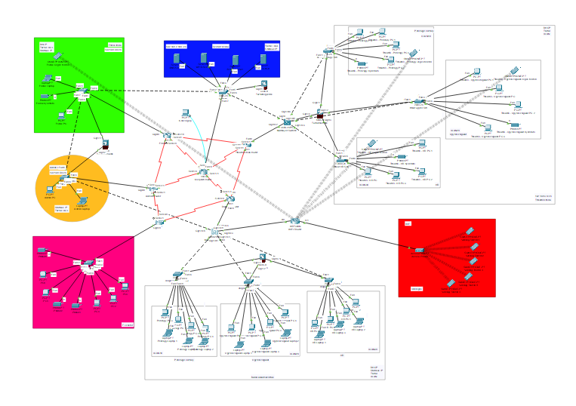
Offices
Offices:
Secretaries (Top Right)
Manager (Green)
System Administrator (Orange)
Bank Employees (Bottom)
Server Room (Blue)
IT sector (Pink)
Common Area (Red)
Notes:
Within the building, we defined seven separate network segments. Each segment is independently managed and has its own IP address range.
In the top right, you can see the secretaries – they are split across three VLANs. Green marks the manager office, orange marks the system administrator area.
At the bottom of the building are the bank employees, also using a VLAN structure.
Blue marks the server room – the heart of the network. Pink marks the IT sector, where we use IPv6 addressing. Red marks the common area, which has Wi-Fi access.
Each segment has its own router or sub-interface, and traffic between segments is controlled by firewalls and ACL rules.

Slide 4
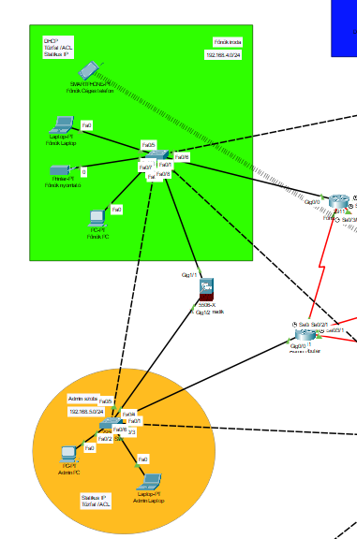
Manager Office & Admin Office
Firewall protects the most secure offices in the network
There is static address translation at the admin office, and dynamic at the boss's office.
Admin laptop and PC receive static IP addresses
Manager PC has static IP assignment
DHCP:
Manager phone via WiFi on a different network than common area phones
Manager laptop
Manager printer
Notes:
The manager’s office and the admin office are the most secure points in the network – both are protected by a firewall. We applied static NAT at the admin office and dynamic NAT at the manager’s office. The admin laptop and PC receive static IP addresses. The manager’s PC also uses a static IP, while the laptop and printer obtain their addresses via DHCP. The manager’s phone connects over WiFi and – importantly – is on a different subnet than the common area phones.

Slide 5
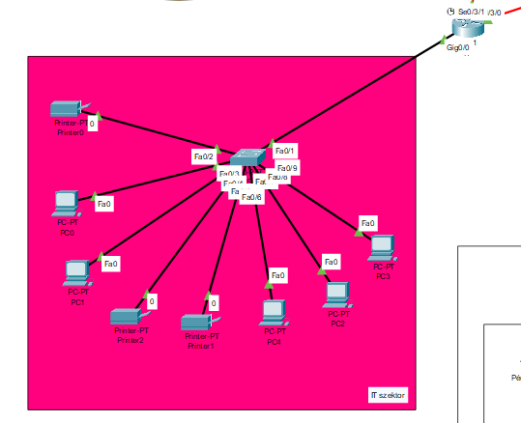
IT Sector
In this sector, we used IPv6 addressing.
Every machine receives IP addresses statically.
The router named "IT" is responsible for this sector.
Sector components include:
3 printers
5 computers
1 switch
Notes:
The IT sector is different from the rest of the network: here we use IPv6 addressing, while everywhere else we use IPv4.
We chose IPv6 because it is a more modern, future-proof protocol. The world has already run out of IPv4 addresses – there are only around 4.3 billion possible ones. IPv6 supports a practically unlimited number.
Every device in this sector has a static IP – there is no DHCP here. This makes sense because IT equipment needs to be reachable at a consistent, known address at all times.
The router named IT handles all traffic in this area. The sector consists of 5 computers, 3 printers, and 1 switch.

Slide 6
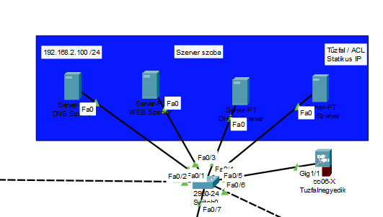
Server room
This is the network's server room.
4 servers are located here:
WEB: hosts our team's website
DHCP: server dynamically distributes IP addresses to devices
FTP: network device configurations are backed up on this server
DNS: translates domain names to IP addresses and vice versa
Notes:
This is the heart of the network: the server room hosts 4 servers. The WEB server hosts our team’s website. The DHCP server dynamically distributes IP addresses to all network devices. Network device configurations are backed up on the FTP server, ensuring they can be restored at any time. The DNS server translates domain names to IP addresses and vice versa – without it, network communication would be significantly more cumbersome.

Slide 7
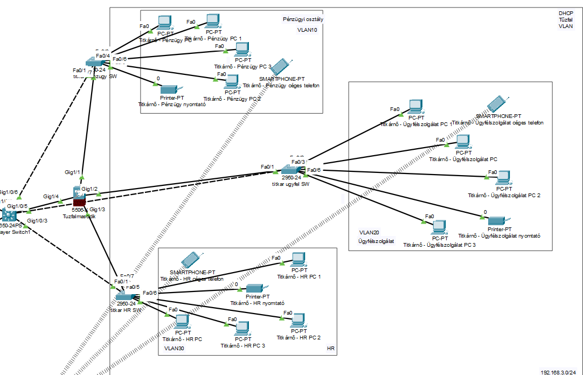
Secretaries Office
The secretaries section is divided into 3 VLANs
A firewall also operates in this network segment
Finance - VLAN 10
Customer Service - VLAN 20
HR - VLAN 30
Devices in different VLANs receive IP addresses through sub-interfaces
The multilayer switch performs basic switching tasks in the network
Notes:
In the secretaries section, we divided the network into 3 VLANs. A VLAN – Virtual Local Area Network – is a logical segment: devices can share the same physical switch, but their traffic is completely separated.
VLAN 10 serves the Finance department, VLAN 20 serves Customer Service, and VLAN 30 serves HR.
There is also a firewall operating in this segment – important because financial data and HR records are particularly sensitive.
IP addresses are distributed using sub-interfaces: a single physical router connection is divided into logical sub-interfaces, one per VLAN, each acting as the DHCP source for its own segment.
The multilayer switch ensures traffic flows quickly within each VLAN while keeping the VLANs separated from each other.

Slide 8
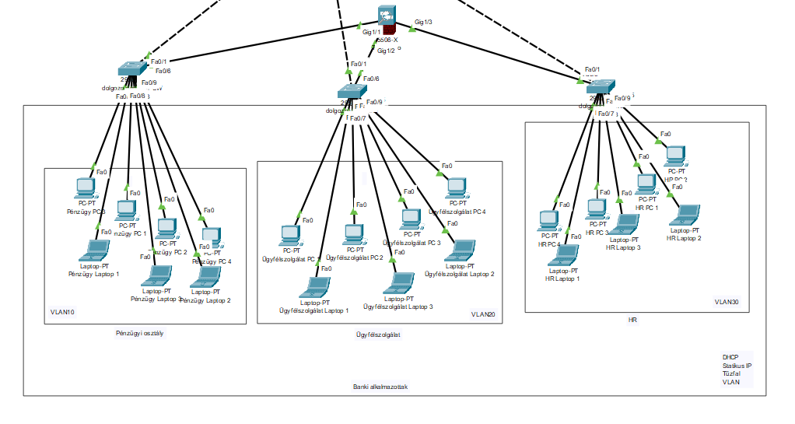
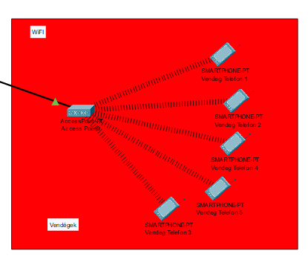
Employees Office & Common Area
Similar structure to the secretaries office
3 VLANs (HR, Finance, Customer Service)
DHCP through sub-interfaces
ACL: VLAN 20 can see others but this is not reciprocal
Common Area:
WIFI router, Access point and phones
Notes:
The bank employees’ office and the common area use a structure similar to the secretaries’ section: 3 VLANs – HR, Finance, and Customer Service – with DHCP operating through sub-interfaces. We also configured an ACL rule for security: VLAN 20 (Customer Service) can see traffic from the other VLANs, but this is not reciprocal. In the common area, a WiFi router and an access point provide convenient wireless connectivity for employees.

Slide 9
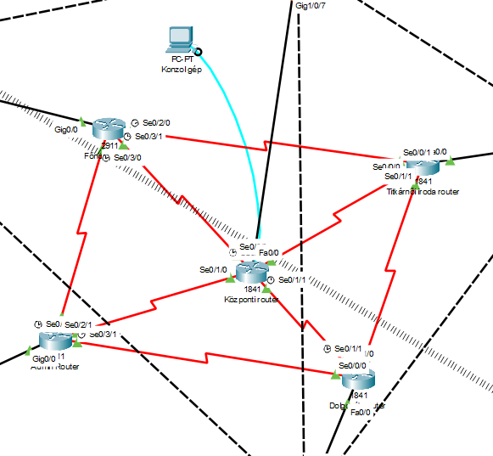
Redundancy
A router "ring" is located in the center of the network
All routers are interconnected with each other, this is redundancy
This technology is a backup system
If one router fails, information will reach from point A to point B via the fastest possible route
Notes:
In the center of the network, we created a router ring: all routers are interconnected with each other. This is the essence of redundancy – if any device fails, data packets will reach their destination via the fastest available alternative route. This setup also acts as a failover mechanism, ensuring the network remains operational even if a single point fails.

Slide 10
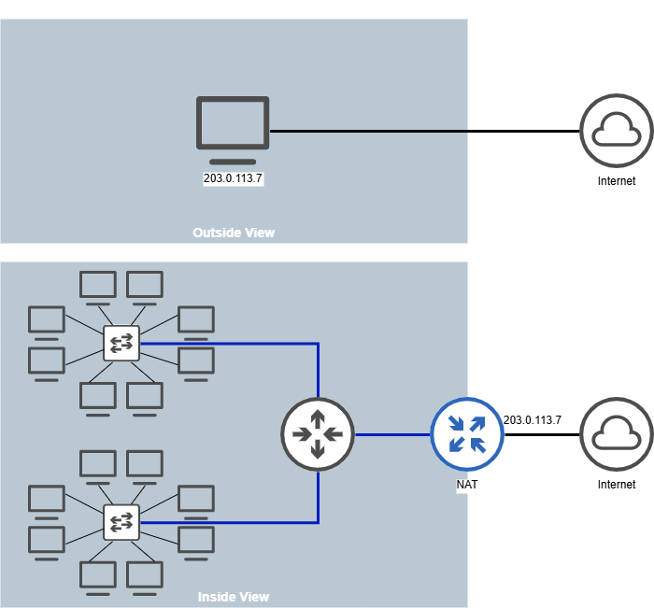
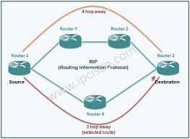
NAT-PAT and RIP Protocol
NAT translates private IP addresses to public IP addresses.
It runs on a router at the boundary between internal and external networks.
PAT (Port Address Translation) enables multiple devices to communicate through a single IP.
RIP (Routing Information Protocol) is a distance-vector routing protocol that shares network information only with neighbors.
Notes:
NAT – Network Address Translation – translates the private IP addresses of internal devices into a public IP. This translation happens at the router, at the border between the internal and external network.
PAT – Port Address Translation – goes one step further: it allows multiple devices to communicate simultaneously through a single public IP, using port numbers to tell apart the different connections.
RIP – Routing Information Protocol – is a distance-vector routing protocol. Its job is to help routers discover each other and learn the best path to reach different parts of the network.
Each RIP router shares its routing table with its neighbours every 30 seconds and always chooses the route with the fewest hops.
For the size of this network, RIP is a perfectly appropriate solution – simple to configure and reliable in operation.

Slide 11
Virtual servers
We used Virtual box
Windows 2019:
Active Directory
DNS server
DHCP server
HTTP/HTTPS
File and printer sharing
Automated software deployment to client computers
Linux Debian 2013
Automated backup
Notes:
For the server side of the project, we used VirtualBox as our virtualisation platform – the servers run as virtual machines rather than on physical hardware. On the Windows Server 2019 virtual machine, we configured Active Directory, DNS, DHCP, HTTP and HTTPS web services, file and printer sharing, and automated software deployment to client computers. On the Linux Debian virtual machine, we set up an automated backup system that regularly saves all network device configurations to the FTP server.

Slide 12
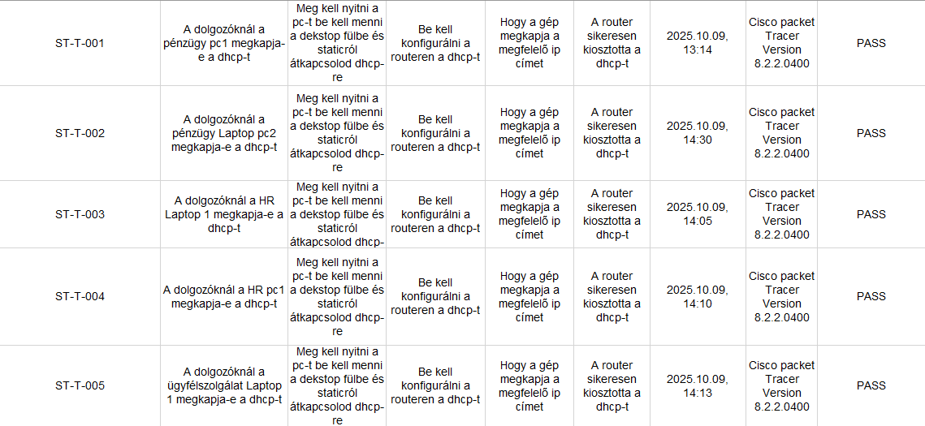
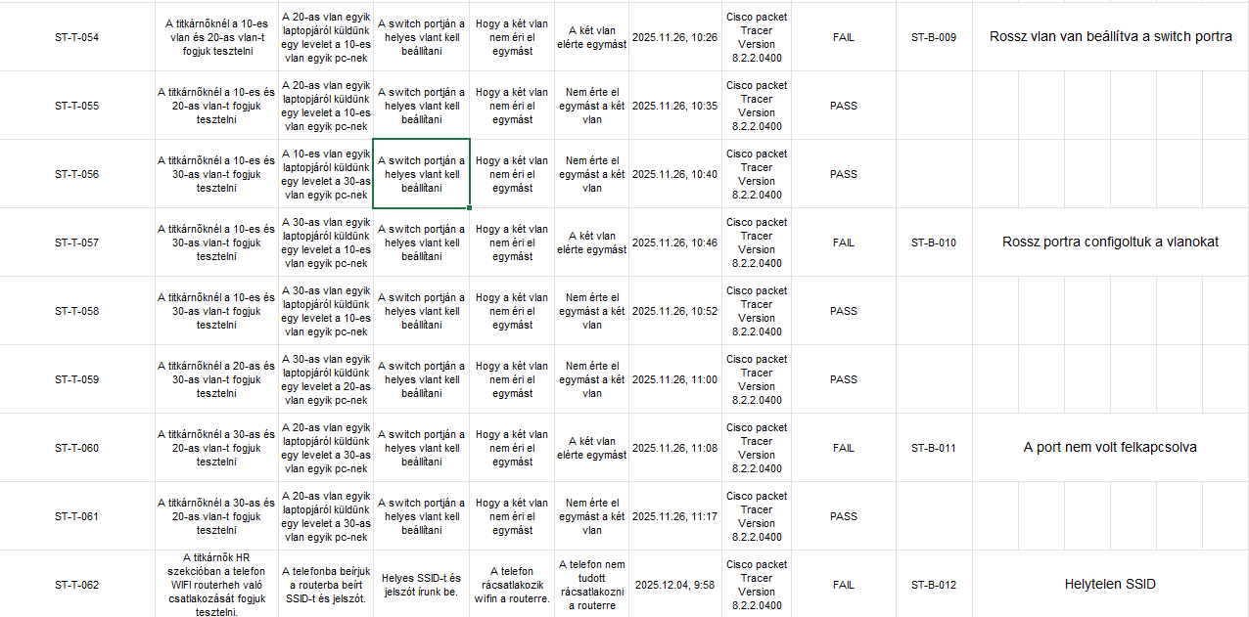
Testing
Notes:
After completing the network, we ran a thorough testing phase. It is not enough for a network to look correct on paper – it needs to be verified in operation.
We tested connectivity between all the different segments and VLANs, and confirmed that VLAN separation was working correctly.
We tested redundancy by deliberately disconnecting a router and confirming that traffic automatically re-routed through an alternative path.
We verified all firewall rules and checked that all four servers were reachable: WEB, DHCP, FTP, and DNS.
The screenshots you can see here document the results of these successful tests.

Slide 13
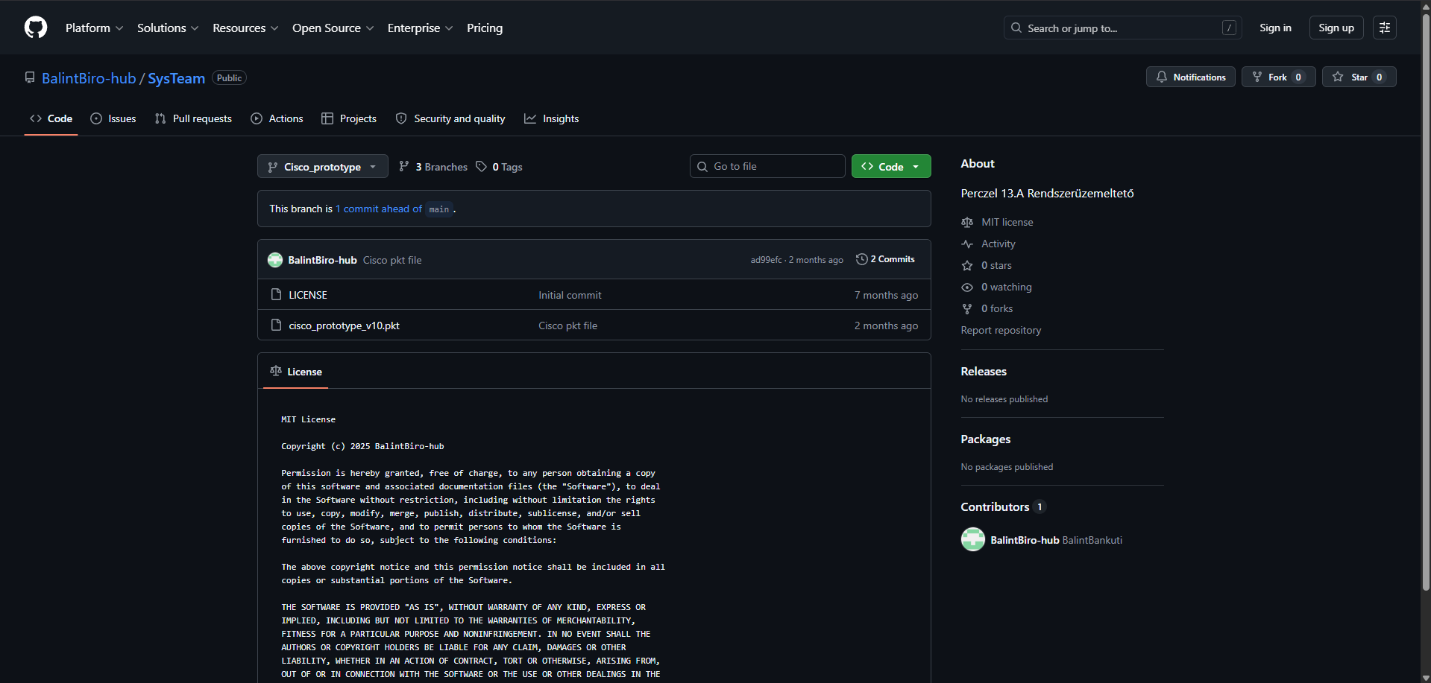
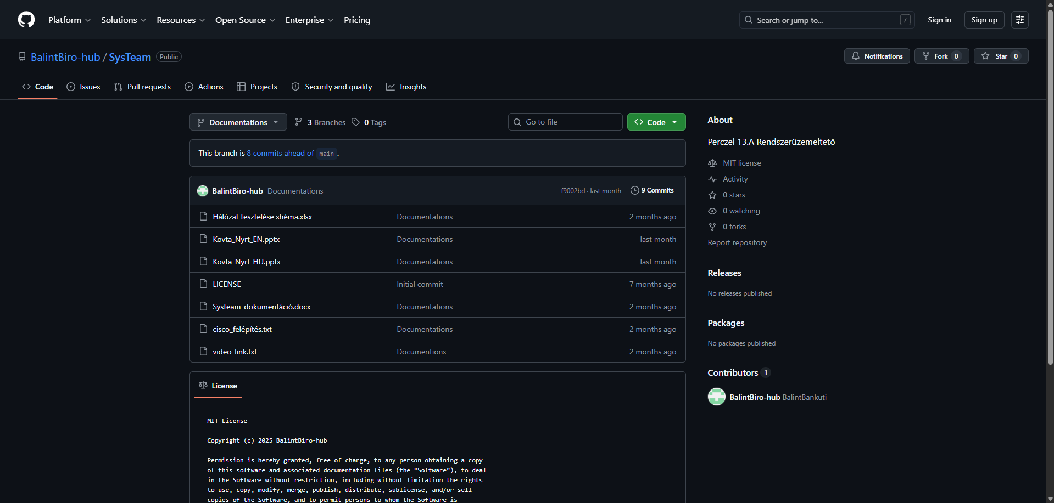
GIT
Git is a version control system that can be used for efficient management and tracking of code changes. It enables developers to manage different file versions and modifications, allowing restoration to previous states.
Notes:
Throughout the project, we used Git for version control. This allowed us to track every change, roll back to previous states when needed, and work on different tasks in parallel. We committed at every significant milestone, so the entire development process is documented and fully traceable.

Slide 14
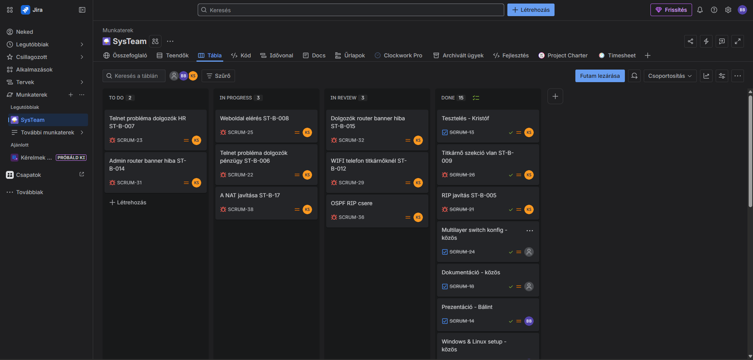
Jira
We log work hours in Jira. This platform is used to verify at the end whether actual work was done during the year or if the project was just hastily assembled.
Notes:
For time tracking and task management, we used Jira.
Every completed task and the time spent on it was recorded precisely. This makes our work transparent and accountable, and demonstrates that we worked consistently throughout the year – not just in the final week.
The Jira logs are searchable and show exactly who did what and when.

Slide 15
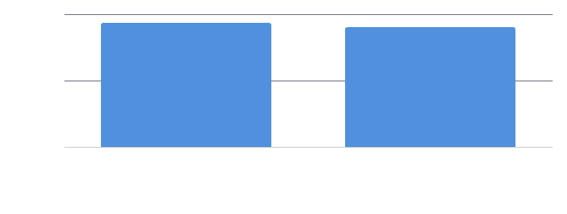
Team Time Distribution
Notes:
This chart shows the distribution of work between the two team members. We aimed for a balanced division of responsibilities – network design, configuration, testing, and documentation were all carried out with active participation from both of us.

Slide 16
Future Development Plans
Layer 2 Redundancy
Security Development
Expansion (more offices, protocolls)
Notes:
The current network is stable and functional, but we have identified several directions for future development.
The first future plan would be to build layer 2 redundancy: adding switches at critical points with Spanning Tree Protocol to avoid loops while enabling automatic failover paths.
The second plan is security development: more firewall, acl and more vlans.
And the last one is expansion this means that in the future we will create more offices inside the bank and expand to more cities.

Slide 17
Thank you
Notes:
This concludes our presentation. Thank you for your attention! If you have any questions about the network architecture, the protocols used, or the details of our implementation, we would be happy to answer them.

