Slide 1
Wireframing and prototyping

Slide 2
plan
1) definition
-wireframing
-prototyping
2) difference entre wireframing et prototyping
3) outils

Slide 3
Wireframing definition
Wireframing is a process where designers draw overviews of interactive products to establish the structure and flow of possible design solutions. These outlines reflect user and business needs. Paper or software-rendered wireframes help teams and stakeholders ideate toward optimal, user-focused prototypes and products

Slide 4
Prototyping definition
A prototype is an early sample, model, or release of a product built to test a concept or process.It is a term used in a variety of contexts, including semantics, design, electronics, and programming. A prototype is generally used to evaluate a new design to enhance precision by system analysts and users. Prototyping serves to provide specifications for a real, working system rather than a theoretical one.In some design workflow models, creating a prototype (a process sometimes called materialization) is the step between the formalization and the evaluation of an idea.

Slide 5
Defference
To break it down, websites wireframes are low-fidelity, basic layout and structural guidelines of your web product’s layout and prototypes are an advanced wireframe with more visual detail and interaction.

Slide 6
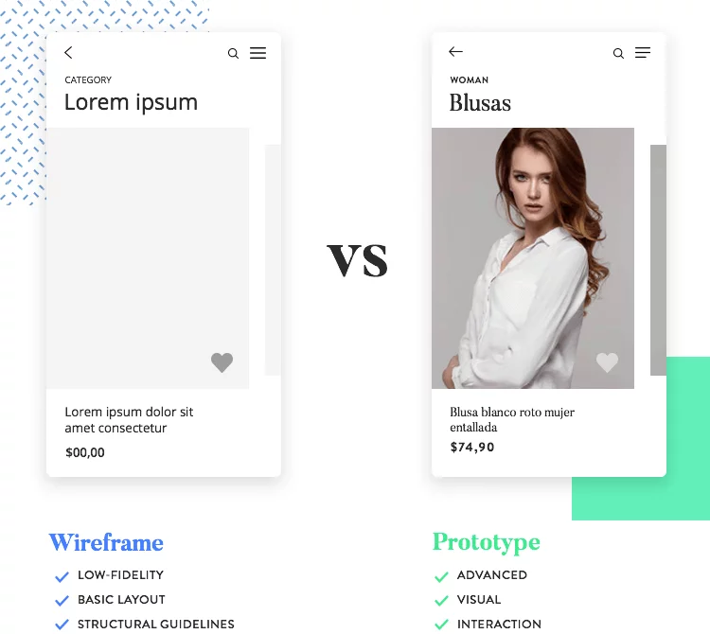

Slide 7
tools

Slide 8
Adobe XD
Adobe XD really stands out as an easy-to-use option for wireframing and interface design projects. Everything from wireframing to basic prototyping can happen within XD. And compared to other feature-rich Adobe tools, XD's minimal interface is a breath of fresh air.

Slide 9
figma
Figma stands out as a powerful cloud-based alternative to tools like Sketch and XD. And the best part: it doesn't hold back for free users, offering a suite of features that work well whether you're a standalone designer or part of a bigger team.

