Slide 1
Target Positions
OpenSwarm
Control Algorithm
Tracks, logs, and returns robot positions to control algorithm
Determines directions to send to each robot given current and target positions
Sends directional commands until robots converge on targets
Receives, logs, and returns sensor data read by each robot
Processes system state data from OpenSwarm
Updates robot target positions with objective function
Returns new target positions to OpenSwarm
Current Positions
Past Positions
Current Sensor Data
Past Sensor Data

Slide 2
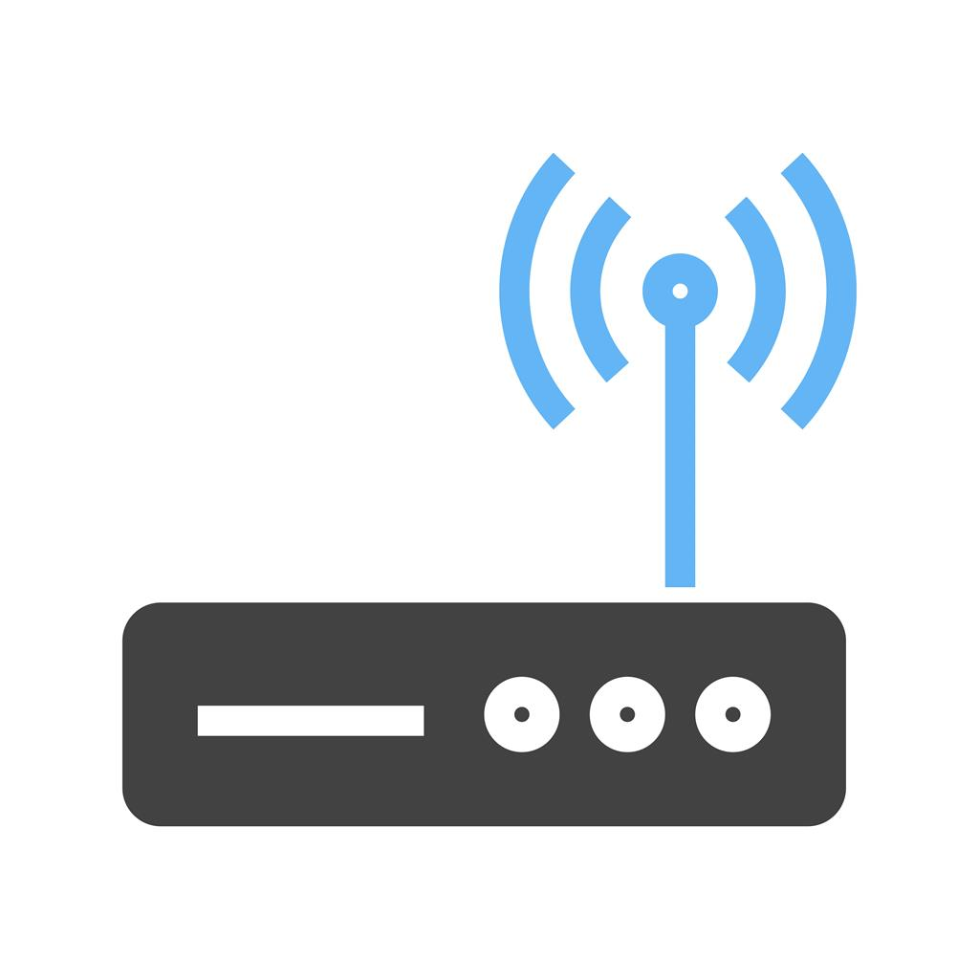

5’-10’
5’-10’

Slide 3
Nose
Robot L
Robot R
Tail

