Slide 1

Rent.It
The Database
Kirandeep Rai - 2038383

Slide 2
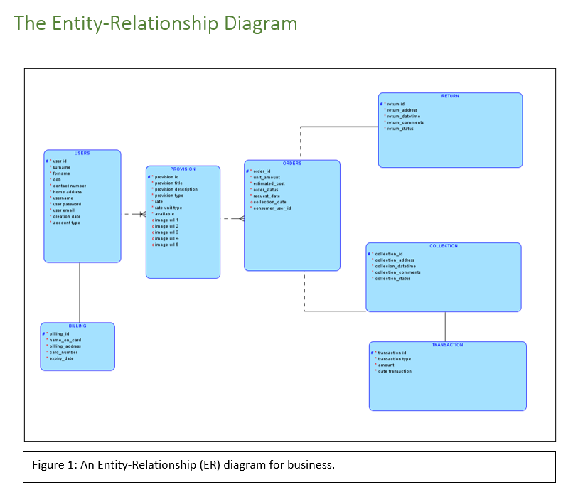

Slide 3
