Slide 1

EcoPilot
AI-Powered Campus Sustainability Assistant
1M1B AI for Sustainability Virtual Internship
IBM SkillsBuild & AICTE
Primary SDG 12
Responsible Consumption and Production
Secondary SDG 11
Sustainable Cities and Communities
NAME : R Balaganesh
AICTE STUDENT ID : STU6585af04dfa0c1703259908
Achariya College of Engineering Technology

Slide 2



From Sustainability Awareness to Action
Students encounter sustainability challenges every day
General awareness does not always translate into daily action
Students have different lifestyles and constraints
Practical, personalized guidance is limited
GAP
Awareness
Action
“Awareness → Action Gap”
Every student’s constraints — budget, hostel vs. day-scholar, transport — are different.
Problem Statement
"How might we use AI to provide students with personalized and practical sustainability guidance so that everyday campus lifestyles can become more responsible and sustainable?"

Slide 3

SDG ALIGNMENT
PRIMARY
SECONDARY
12
11
SDG 11
SDG 12
Sustainable Cities and Communities
Responsible Consumption and Production
Supports sustainable campus communities by encouraging environmentally responsible behavior in everyday campus life.
Energy usage in daily campus life
Single-use plastic usage
Transportation choices
Resource conservation & sustainable actions
Note
EcoPilot encourages more sustainable everyday behavior. It does not directly measure SDG progress.

Slide 4






WHO WE DESIGN FOR
Primary Users: College Students
Hostel Students
Day Scholars
Varied Transport
Sustainability-Minded
Secondary stakeholders: campus sustainability teams, college administrators, student communities.
Design Thinking Process
→
→
→
→
Empathize
Define
Ideate
Prototype
Test & Refine

Slide 5
DESIGN THINKING APPLIED TO ECOPILOT
1
2
3
4
5
Empathize
Define
Ideate
Prototype
Test & Refine
College students facing daily sustainability choices
Energy, plastic, transport, resource wastage
Awareness rarely turns into personalized action
→
HMW give students personalized, practical sustainability guidance?
Users: hostel students, day scholars, varied transport
Gap: no personalized, easy-to-follow guidance
→
Eco Chat + AI Eco Action Planner (AI-based)
Rule-based Calculator & Checklist for tracking
Kept feasible: lightweight stack, no database
→
Flow: Frontend → Express → /api/chat, /api/analyze → Groq LLM
Prompt construction with profile allowlist sanitization
Sample output: area, priority, 3 recommendations, action for today
→
Iterated with IBM Bob on debugging & UI refinement
Improved checklist persistence & calculator sync
Strengthened Responsible AI: fairness, ethics, privacy

Slide 6





INTRODUCING ECOPILOT
Dashboard
Eco Chat
Calculator
Daily Checklist
AI Action Planner
Sustainability Profile
Awareness → Self-Assessment → Personalized Guidance → Daily Action

Slide 7







ECOPILOT SYSTEM ARCHITECTURE
→
→
→
→
→
Student
Frontend
HTML / CSS / JS
Express.js
Backend
/api/chat
/api/analyze
Prompt
Engineering
Groq API
openai/gpt-oss-20b
↓
Structured Response → EcoPilot UI
Browser localStorage
No Database Used
Checklist
Custom Actions
Sustainability Profile
Server-side database is not part of the current architecture. All persistent user data stays in the browser.

Slide 8

AI-POWERED SUSTAINABILITY PLANNING
Student describes concern
Action Plan Output
↓
Optional sustainability profile
↓
Sustainability Area
Frontend validation
↓
Priority
Profile allowlist sanitization
↓
Situation Summary
Prompt construction
↓
3 Recommendations
Groq LLM
↓
Action for Today
Structured JSON response
↓
Every plan includes an AI limitation / disclaimer note — guidance may not reflect every local campus policy, cost, or resource.
Action Plan

Slide 9
CORE FEATURES
Eco Chat
Calculator
Daily Checklist
Sustainability Q&A
Rule-based habit score
Track sustainable actions
AI
RULE
LOCAL
Custom Actions
AI Planner
Profile
Add personal eco actions
Personalized sustainability plan
Optional sustainability context
LOCAL
AI
LOCAL
AI features: Eco Chat + AI Planner | Rule-based: Calculator | Local tracking: Checklist + Profile

Slide 10
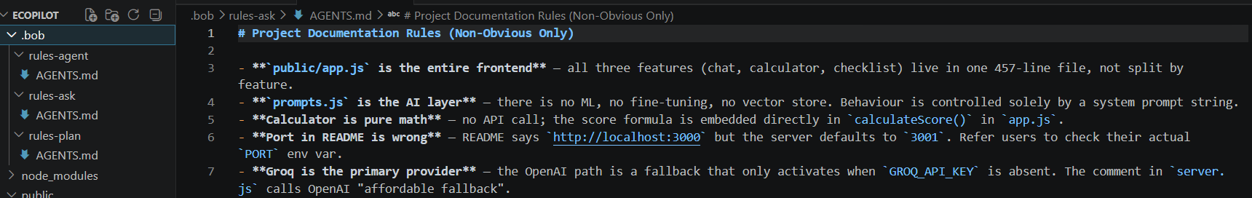
DEVELOPMENT WITH IBM BOB
Architecture Planning: Assisted in analyzing the existing application structure and planning the frontend, backend, API, and AI workflow.
Feature Development: Supported implementation and refinement of the Eco Chat, AI Eco Action Planner, Sustainability Calculator, Daily Checklist, Profile, and Dashboard components.
AI Workflow Design: Assisted in designing prompt structures, structured AI responses, profile-context handling, and sustainability recommendation workflows.
Debugging & Validation: Helped identify and resolve implementation issues, runtime errors, UI state problems, and integration issues during development.

Slide 11
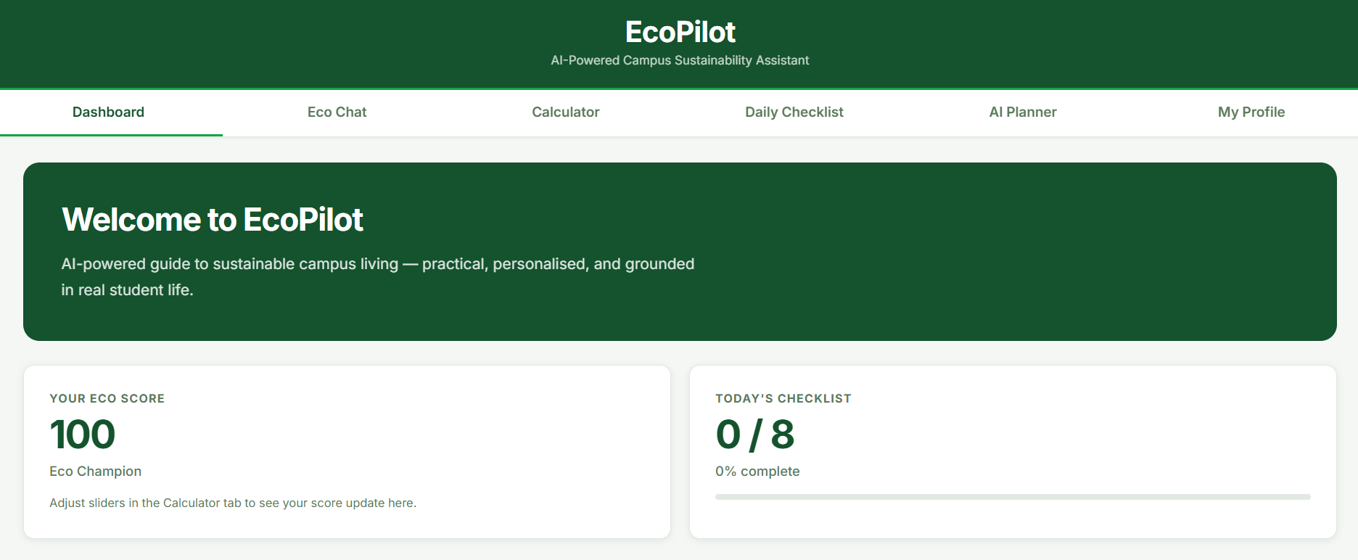
WORKING PROTOTYPE
DASHBOARD

Slide 12
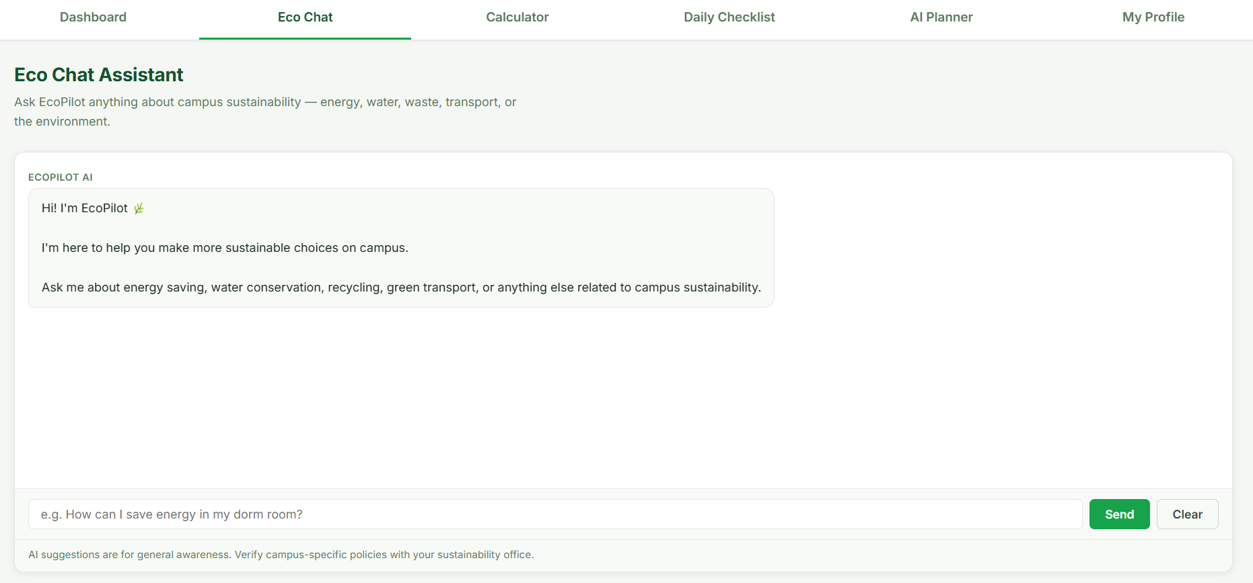
ECO-CHAT

Slide 13
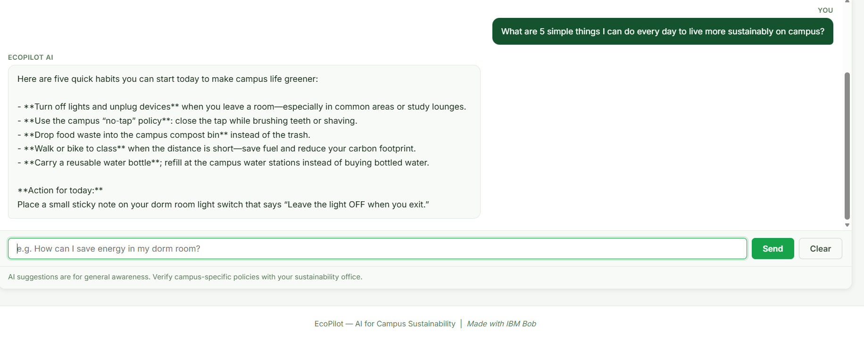
ECO-CHAT

Slide 14
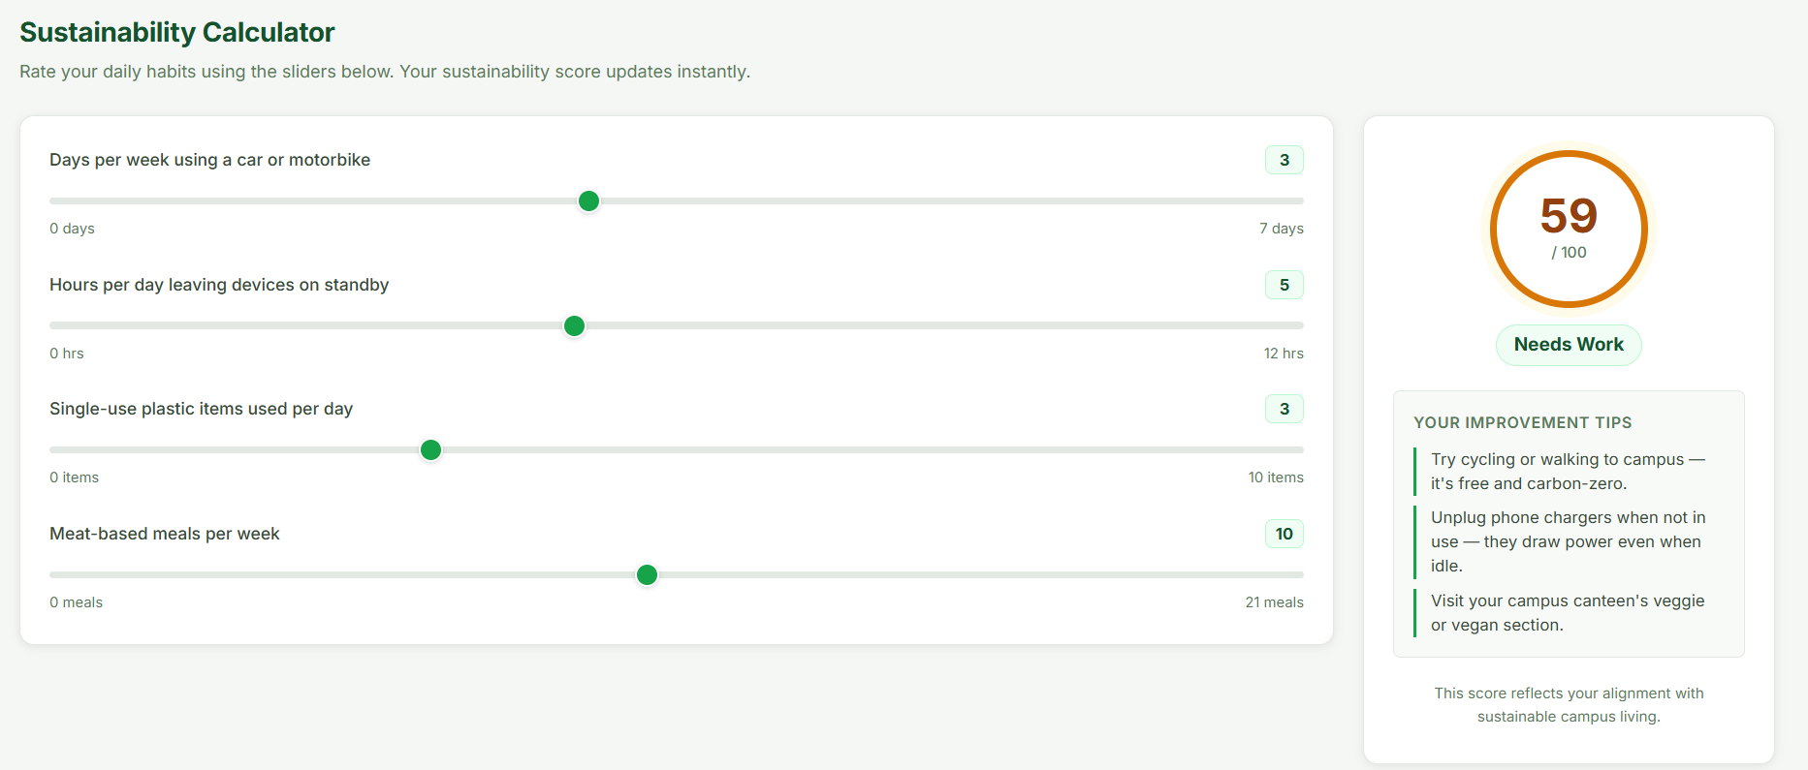
SUSTAINABILITY CALCULATOR

Slide 15
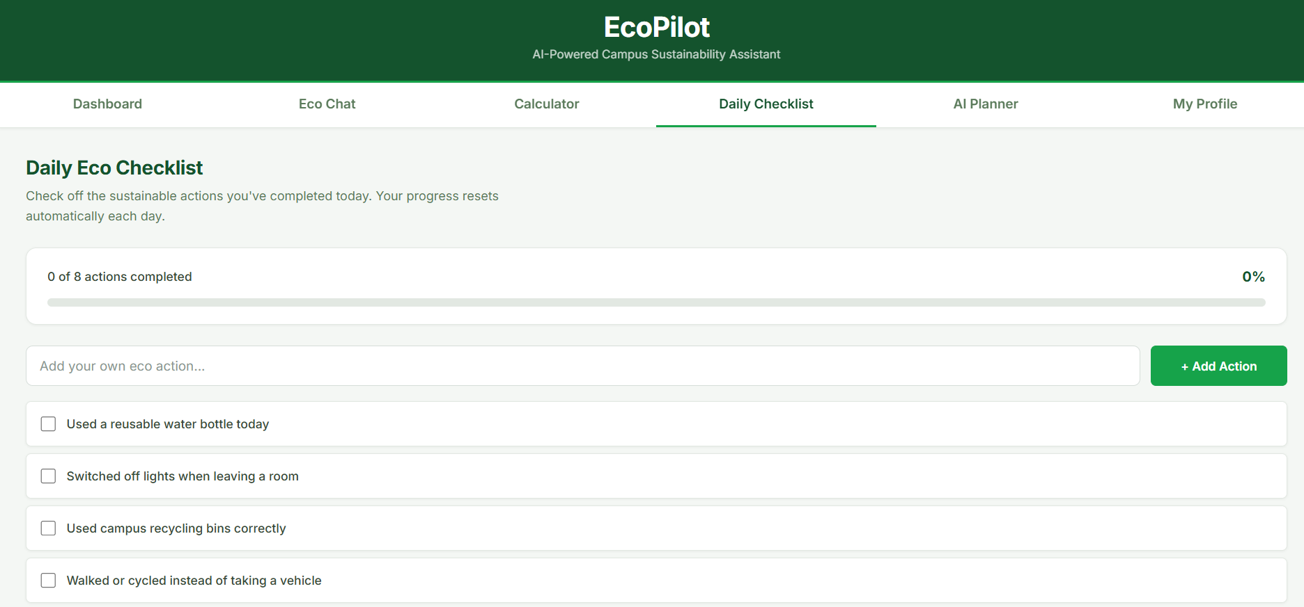
DAILY CHECKLIST

Slide 16
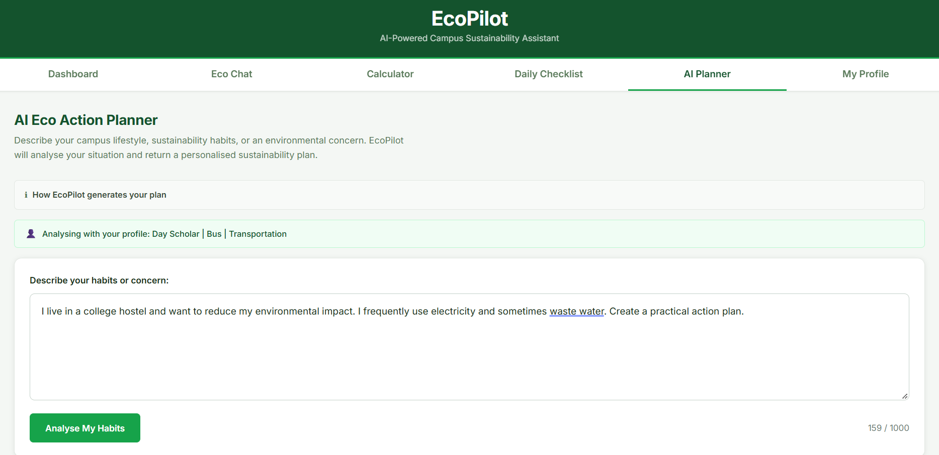
ECO – ACTION PLANNER

Slide 17
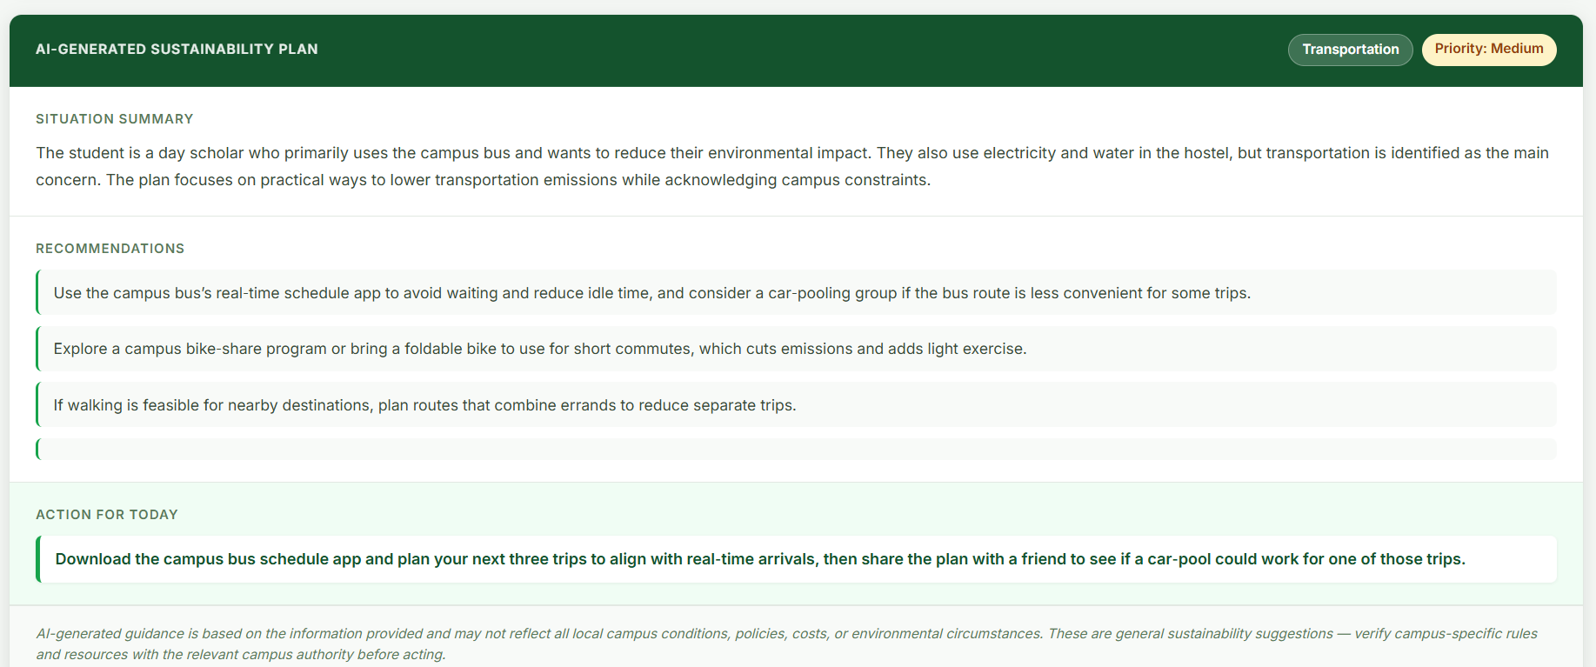

Slide 18
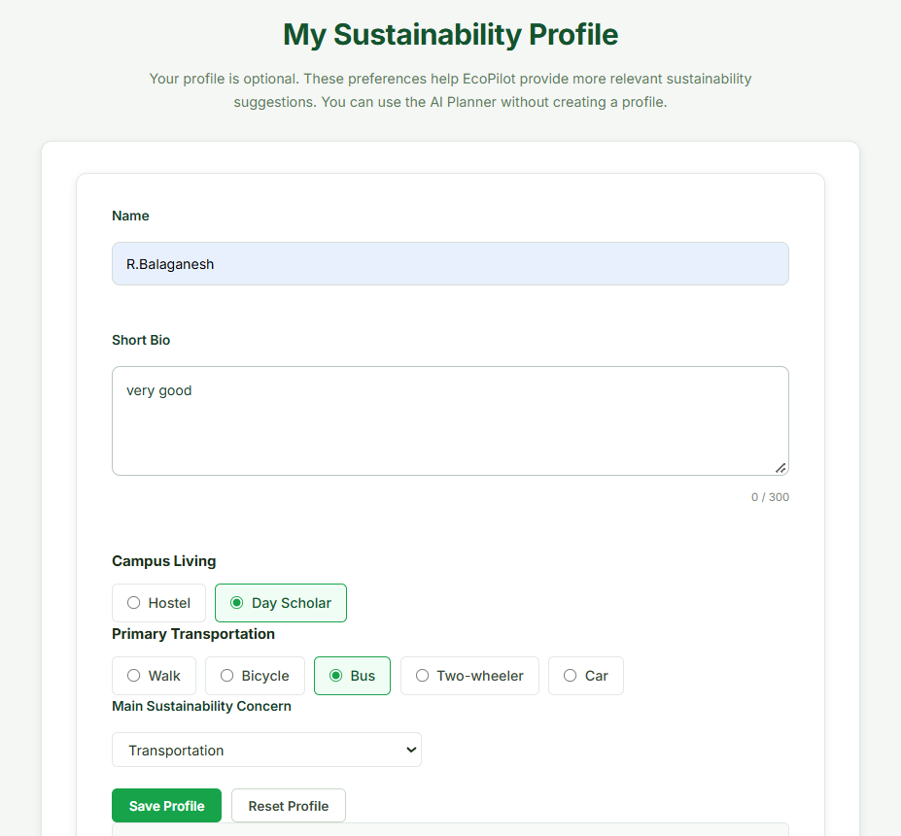
ECO – ACTION PLANNER

Slide 19


RESPONSIBLE AI BY DESIGN
Fairness
Transparency
Non-judgmental recommendations; considers affordability, accessibility, safety, and distance.
AI-generated content is labeled; "How EcoPilot generates your plan" is explained to users.
Ethics
Privacy
Guardrails discourage harmful, discriminatory, manipulative, or unsupported recommendations.
Minimal data collected; local storage; server-side allowlisting; "Clear My Local Data" option.
AI provides guidance — not guaranteed or campus-specific facts.

Slide 20

IMPACT AND NEXT STEPS
Expected Impact
Current Limitations
Future Scope
Social: sustainability awareness
Environmental: reduced wastage potential
Economic: awareness of avoidable use
Campus: stronger sustainable culture
External AI dependency
Simplified Eco Score
No live campus data
No measured large-scale impact
Campus-specific RAG
Smart campus data
Multimodal waste recognition
Analytics & gamification
Impact measurement
All impact points are expected / potential outcomes — not measured results.

Slide 21
From Awareness to Action
"EcoPilot demonstrates how responsible AI can help college students understand sustainability-related habits, receive contextual guidance and take practical everyday actions."
NAME : R Balaganesh
AICTE STUDENT ID : STU6585af04dfa0c1703259908
E-MAIL : rbalaganesh2307@gmail.com
COLLEGE : Achariya College of Engineering Technology
Thank You

