Slide 1
Interactive digital portfolio
CAPSTONE PROJECT
Presented By:
1. R.Balaganesh 2. Achariya College of Engineering Technology 3. Computer Science and Engineering

Slide 2
OUTLINE
Problem Statement (Should not include solution)
System Development Approach (Technology Used)
Algorithm & Deployment (Step by Step Procedure)
Result
Conclusion
Future Scope(Optional)
References

Slide 3
Problem Statement
Developers often struggle to showcase their skills and projects in a way that grabs the attention of recruiters.
Traditional resumes are static and lack the interactivity needed to highlight technical abilities effectively.
There is a need for a dynamic and personalized digital portfolio that reflects both skills and creativity.
Smooth navigation, modern design, and engaging animations are essential to create a lasting impression on visitors.

Slide 4
System Approach
Frontend Technologies:
HTML5 – Used to build the structure and layout of the portfolio webpage.
CSS3 – Applied for styling, smooth transitions, and creating a responsive design.
JavaScript – Implemented for dynamic interactivity, including the typing animation effect and active navigation highlighting on scroll.
Design Approach:
Clean and modern interface with simple sections like “About,” “Skills,” and “Projects.
Mobile-responsive design ensuring the website works seamlessly on different screen sizes.
Modular structure with separate HTML, CSS, and JavaScript files for better organization and maintainability.

Slide 5
Algorithm & Deployment
Content Planning & Structuring
The portfolio is structured into clear sections: Home (About), Skills, Projects, and Contact.
Each section presents personal introduction, technical skills, and project descriptions.
Frontend Design
The webpage structure is created using semantic HTML5, ensuring clean, accessible, and maintainable code.
Styling is done with CSS3, including custom variables, responsive grids to deliver a minimal design.
Interactive Features
A typing animation on the hero section enhances engagement and visual appeal.
Active navigation highlighting on scroll indicates the current section to the user.
Smooth scrolling and subtle hover effects improve the overall user experience and give the site a professional feel.
Testing
The website is tested for cross-browser compatibility across Chrome, Firefox, Edge, and Safari.
Mobile responsiveness is verified across various screen sizes to ensure consistent usability.
Deployment
The portfolio is deployed on GitHub Pages, providing free, reliable, and publicly accessible hosting.

Slide 6
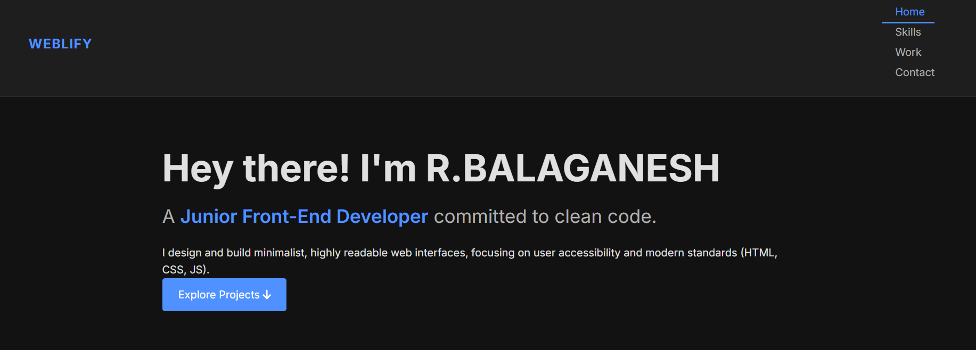
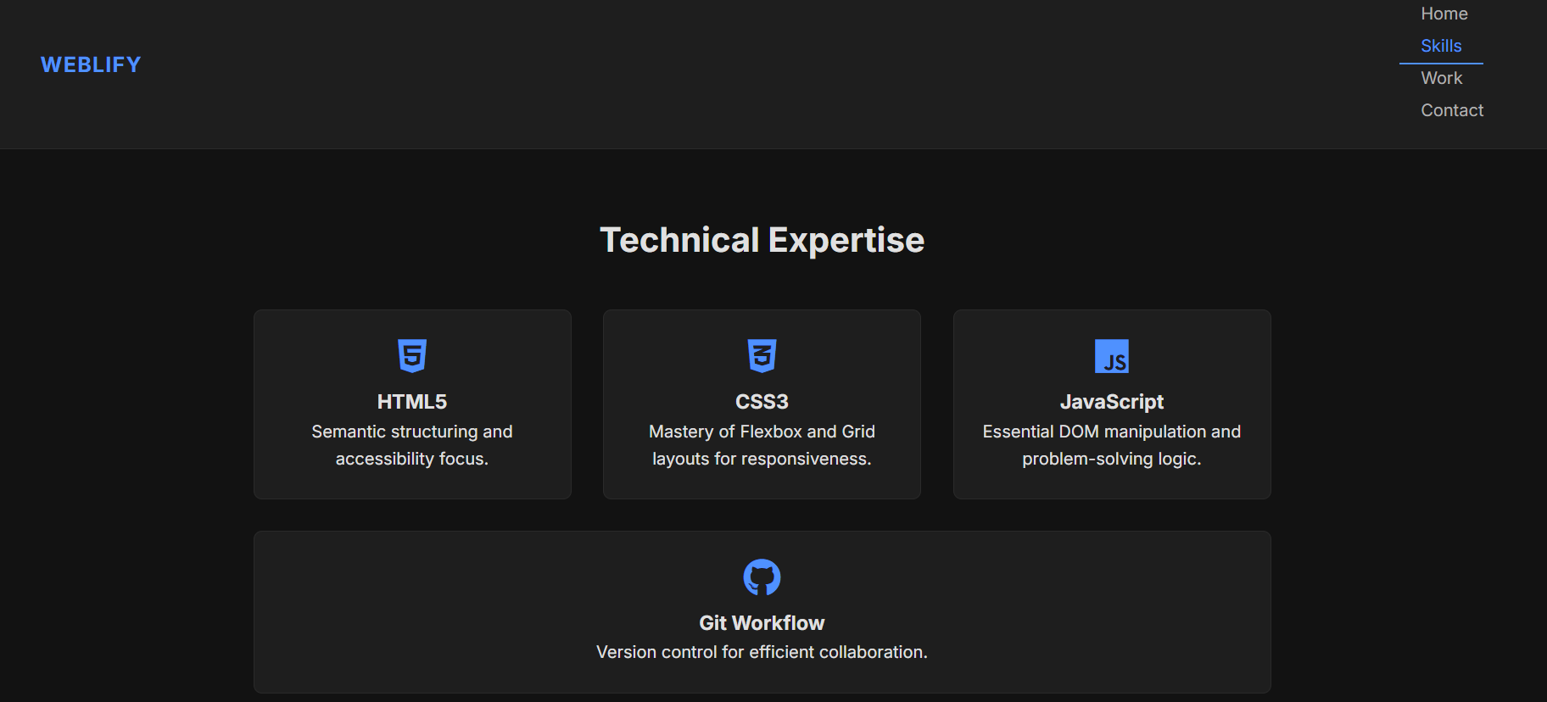
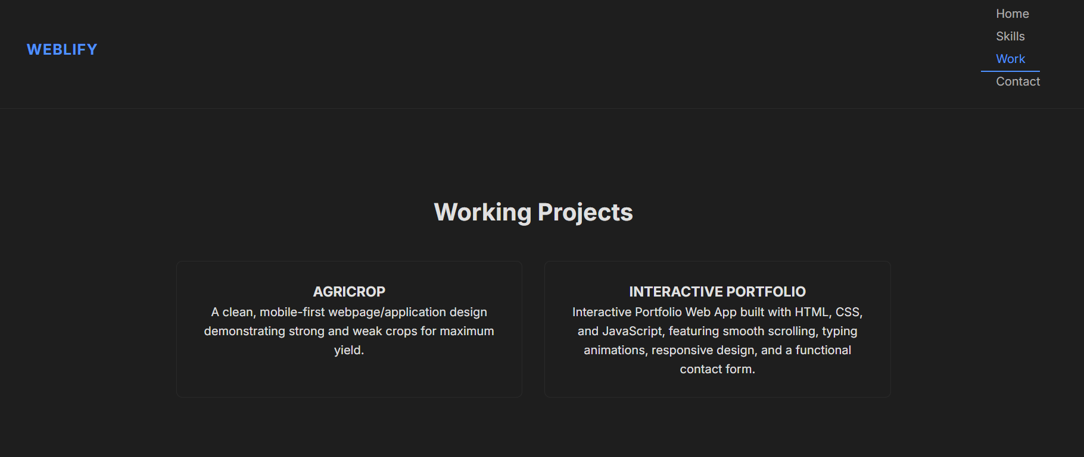
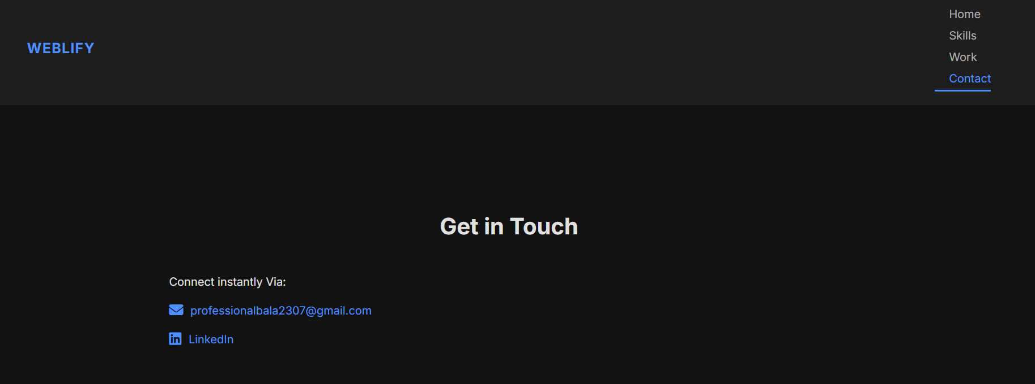
Result

Slide 7
GITHUB AND DEPLOYMNET LINK
Attach your Github Link : https://github.com/Balki07/FWD-G1-Interactive_Digital_Portfolio
Deployment link: https://balki07.github.io/FWD-G1-Interactive_Digital_Portfolio/

Slide 8
Conclusion
Successfully created a fully responsive, modern, and professional portfolio website that offers a dynamic and engaging online presence.
Highlights technical abilities and completed work in an interactive, easy-to-navigate format.
Acts as a digital resume, improving professional visibility for recruiters and clients.

Slide 9
Future scope(Optional)
Add sections like Experience, Testimonials, Blog, or Certifications for a more complete portfolio.
Connect the contact form to a backend for direct visitor messages.
Add more animations and interactive features for a visually engaging experience.
Optimize for mobile devices, performance, and SEO to increase accessibility.
Integrate analytics to track visitor engagement and improve content.

Slide 10
References
MDN-web Docs used for HTML5 structure,CSS3 Styling and JS Functionality.
Google Fonts – Typography for headings, body text, and overall design.
NanthiniMoha/TNSDC-FWD-DIGITAL_PORTFOLIO
Get started with Bootstrap · Bootstrap v5.3

Slide 11
THANK YOU

