Slide 1
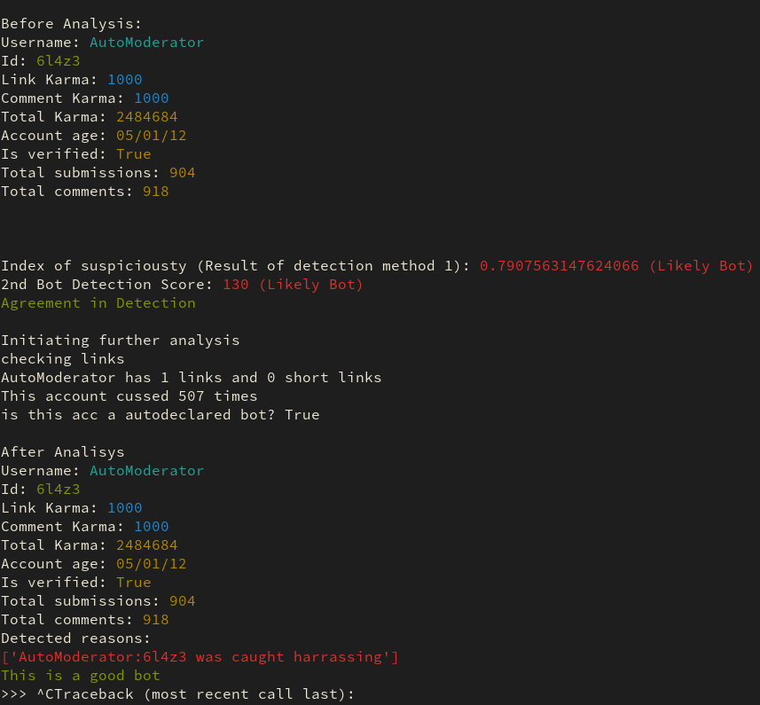
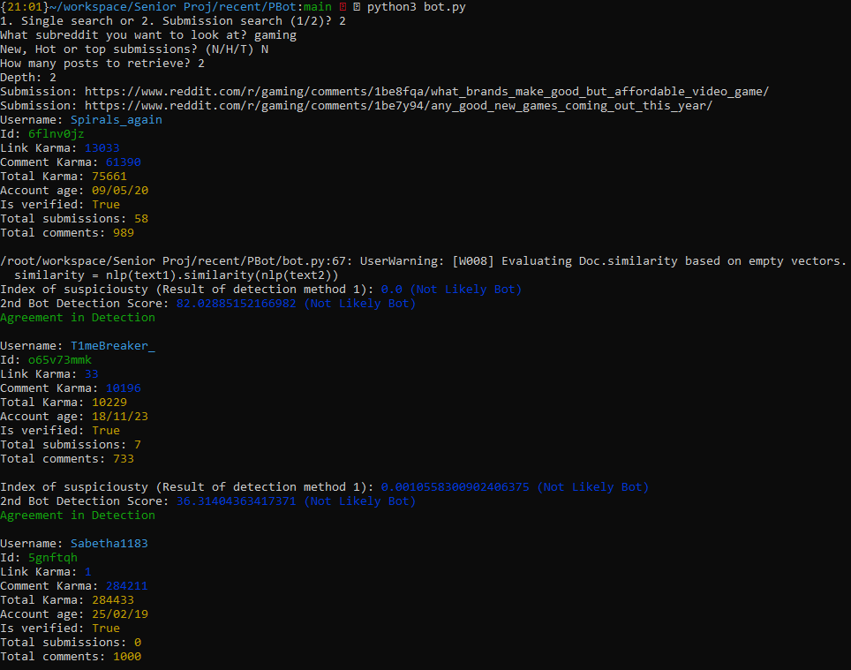
Enhancing Social Media Governance with Policing Bots
Cody Manning, J. Gabriel Silva, Liam Dumbell, Nickolas Falco
Faculty Advisor: Khaled Slhoub, College of Engineering and Science - Electrical Engineering and Computer Science, Florida Institute of Technology
Project Description
Social media has transformed how we connect, from meeting new people to showcasing ourselves to potential employers. However, it's also plagued by bots—automated software designed for various purposes, including malicious activities. These bots mimic human behavior, posing risks like data theft or annoyance to users. AI tools like ChatGPT have exacerbated this issue even further. Our framework has been developed to detect and differentiate between beneficial and malicious bots on Reddit. Expansion to other social media platforms is feasible.
Features
The framework enables users to deploy a Police Bot on Reddit within a chosen subreddit and select a specific user by their Reddit username. It scans through top, newest, or popular posts in a subreddit and asks users to specify the number of posts and depth of evaluation. After scanning, it provides a list of users with scores indicating the likelihood of being a bot or human, using multiple detection methods. Results are presented in a clear, color-coded format. If the results are unanimous a message saying so will be displayed; otherwise, the framework will indicate there was a disagreement. Additionally, the framework offers insights on whether identified bots are "good" or "bad" based on their purpose.
Key Features:
Deployable on Reddit within a chosen subreddit.
User selection by Reddit username.
Scan options: top, newest, or popular posts.
Specify number of posts and depth of evaluation.
Multiple bot detection methods.
Clear, color-coded result presentation.
Confirmation of detection results.
Bot classification: "good" or "bad."
Submission Search (Subreddit)
Evaluation
Accuracy was paramount in designing our framework. We aimed for 80% accuracy in detecting bots, using a master list from various sources. While our desired timing was under 10 seconds per account lookup, achieving speed and accuracy was challenging. Ultimately, prioritizing accuracy over speed was our team's decision.
Single Search (Username)
Challenges We faced challenges in detecting and categorizing bots, necessitating multiple detection algorithms. Determining bot nature was also challenging, we flagged bots redirecting outside Reddit as suspicious as one of our methods. The project lacks a perfect solution, highlighting the need for further research and algorithm development in the future.
Project Expansion
Our bot detection framework is versatile, easily transferable to other social media platforms like Twitter, Instagram, and Facebook. By adjusting API requests, account data parameters, and other specifics, it can seamlessly adapt to the unique features and requirements of each platform, ensuring effective bot detection across various social media channels.

