Slide 1
Grito Labs — Multi-Channel Marketing Analytics
Attribution, customer journey analysis and budget optimization | Synthetic demonstration dataset

Slide 2
1. Problem Definition
Marketing teams operate across email, paid advertising, social media and other acquisition channels.
Measure channel effectiveness, understand customer journeys and assign conversion credit consistently.
Turn campaign data into quantitative optimization decisions.

Slide 3
2. Analytical Architecture
Marketing activity → data validation → channel/campaign KPIs → customer journeys → attribution → optimization.
SQL provides repeatable business queries; Python supports EDA and attribution; Power BI provides stakeholder reporting.
The included dataset is synthetic because the problem statement does not provide a participant dataset.

Slide 4
3. Dataset & Data Model
5,000 synthetic customers and 15,063 touchpoints.
714 synthetic conversions with modeled revenue of ₹360,647.
Tables: customers, marketing_daily, touchpoints, conversions, customer_journeys and attribution_touchpoints.
Period: October 2025 – September 2026.

Slide 5
4. Executive KPI Snapshot
Spend
₹4,253,647
Revenue
₹360,647
Conversions
714
CTR
2.87%
CPC
₹0.40
Last-touch ROAS
0.08x

Slide 6
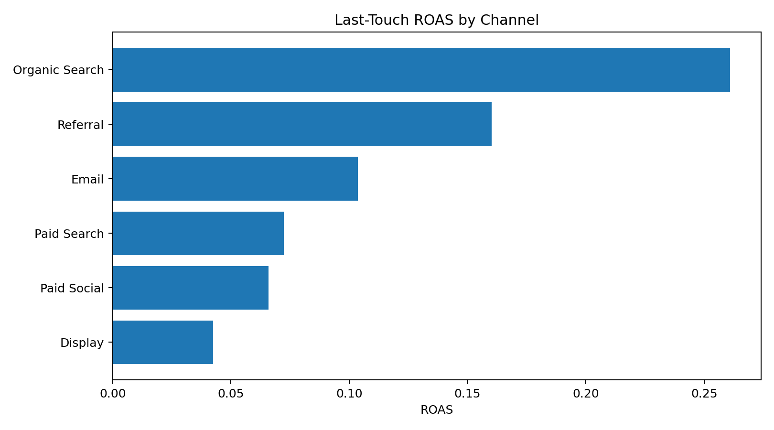
5. Channel Efficiency

Slide 7
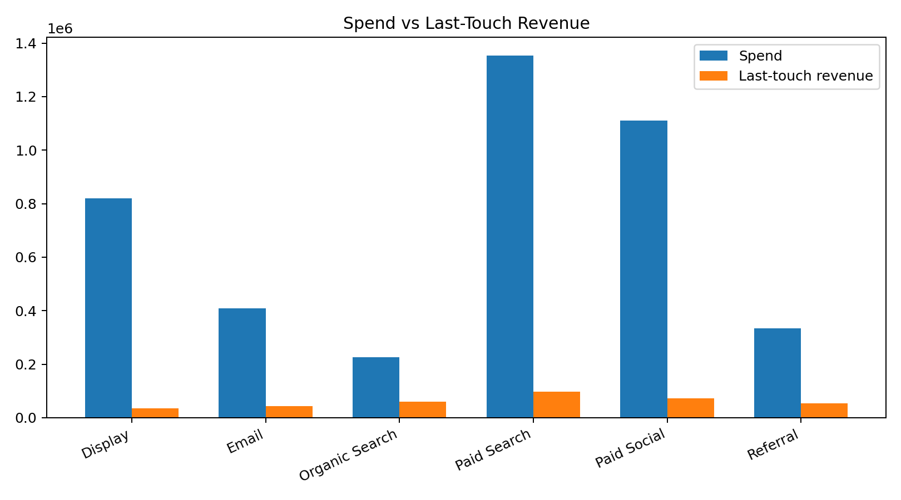
6. Spend vs Revenue

Slide 8
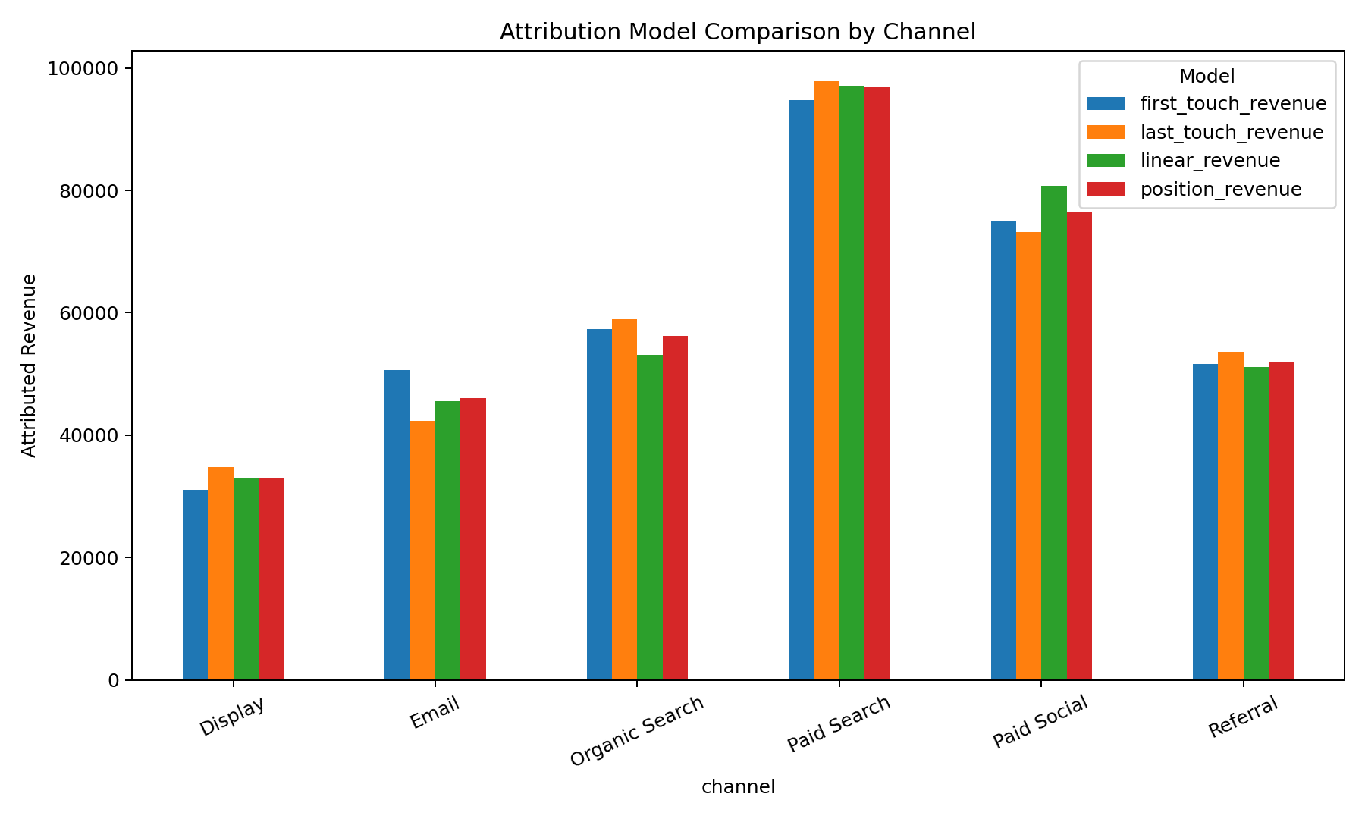
7. Attribution Model Comparison

Slide 9
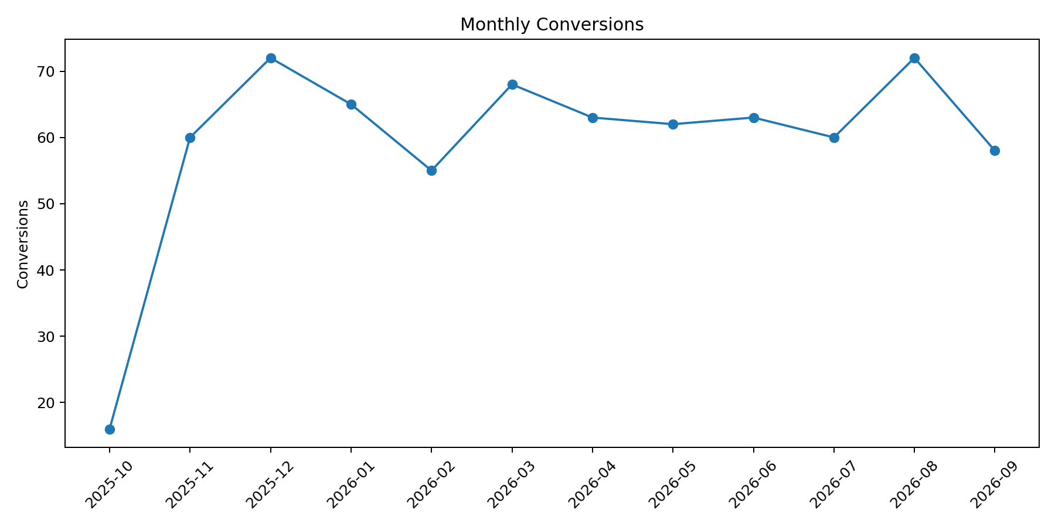
8. Conversion Trend

Slide 10
9. Attribution Findings
First-touch, last-touch, linear and position-based models distribute the same conversion revenue differently.
A channel can be important early in the journey while receiving little last-touch credit.
Compare multiple models rather than treating one attribution rule as ground truth.

Slide 11
10. Customer Journey
Analyze the number and sequence of touchpoints before conversion.
Identify recurring first-channel → last-channel combinations and high-volume journey patterns.
Use journey analysis to identify where customers stall and where nurture or retargeting assists conversion.

Slide 12
11. Budget Optimization Framework
Scale candidates: strong attributed ROAS plus meaningful conversion volume, subject to incrementality testing.
Optimization candidates: moderate ROAS where creative, audience, landing page or journey improvements may unlock efficiency.
Redesign/reduce candidates: low ROAS and high CAC after validating tracking and data quality.
Do not equate attribution with causality; use experiments or holdouts for major reallocations.

Slide 13
12. Power BI Dashboard
Page 1: Executive overview — Spend, Revenue, Conversions, CTR, CPC, ROAS and trends.
Page 2: Channel performance — channel/campaign efficiency matrix and filters.
Page 3: Attribution — model comparison and customer journey analysis.
Page 4: Campaign optimization — ranked campaigns with quantitative action flags.

Slide 14
13. Technical Deliverables
PostgreSQL-compatible schema and analytical SQL queries.
Python/Pandas notebook for KPI and attribution analysis.
Power BI-ready CSV tables and DAX measure specification.
Methodology documentation covering assumptions, attribution logic and limitations.

Slide 15
14. Key Recommendations
Optimize toward revenue and customer outcomes rather than clicks alone.
Use multiple attribution models to understand channel roles across the journey.
Segment performance by customer type and campaign intent.
Validate major budget changes using incremental testing.
Maintain a reproducible KPI layer so marketing and BI teams use the same definitions.

Slide 16
15. Limitations & Next Steps
Dataset is synthetic and demonstrates the framework, not actual Grito Labs performance.
LTV is limited without repeat-purchase history.
Attribution is observational and cannot establish causal lift.
Next step: connect source platforms, reconcile identities, validate tracking and run controlled incrementality tests.

Slide 17
Submission Package
SQL + Python notebook + Power BI-ready data + methodology + presentation

