Slide 1

ROAD HEALTH
TEAM SPECTRA

Slide 2
Introduction
Road issues such as potholes, skid-prone areas, dangerous road bends, and accident-prone zones are a major concern for drivers and passengers alike.
These issues can cause significant harm to people and vehicles and are a significant source of frustration for drivers.
To address these issues, our project aims to develop a prototype that uses Machine learning and Sensor technology to detect and monitor road issues in real-time.
We test the prototype in a variety of environments to make sure it can accurately detect and classify different types of road issues with high accuracy.

Slide 3
Requirements
ML Algorithm
Trained on images of road conditions using image augmentation and the R-CNN architecture.
Camera
Used to capture images of the road conditions as the vehicle moves.
3D Laser Scanner
Used to create a 3D model of any road issues that are detected.
Arduino
Used to provide a connection for the working of various sensors.
GPS
Used to share the location of the potholes to the authorities along with the 3D model.
System for transmitting data
Used to transmit the 3D model and other data, to the authorities for further analysis and action.
Other Sensors
Bolt Wi-Fi module : Used to provide Wi-Fi connectivity and to transfer data along wireless Wi-Fi network.
LCD : Used to alert the driver about the upcoming road conditions.

Slide 4
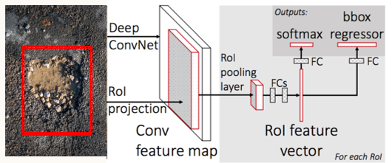
Implementation of THE prototype
The prototype consists of a machine learning algorithm that is trained on images of road conditions using image augmentation and the R-CNN architecture.
First, the data, along with the measurements of the road will be collected using the camera and 3D laser scanner mounted on the front of the vehicle.
The collected data will then be passed through the R-CNN structure for object detection. In our case, it will result in bounding boxes drawn around the potholes.
The working of the R-CNN is as follows:

Slide 5
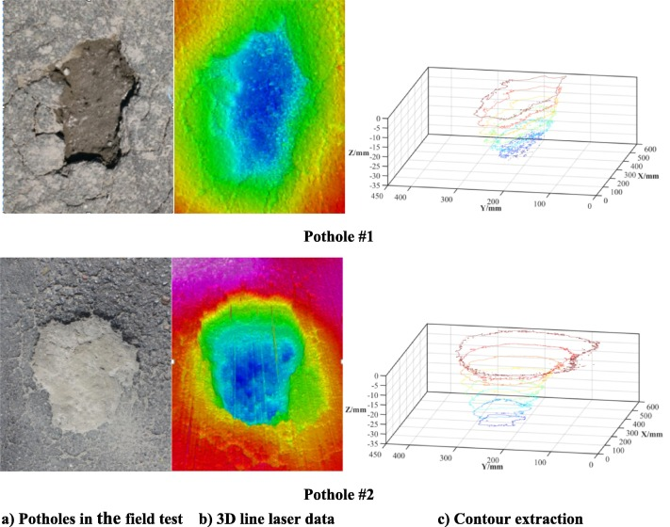
The 3D laser scanner scans the pothole which is encountered by the vehicle and designs a 3D model of the pothole.
The speed of the car and the distance to the pothole would affect the time it takes to scan the pothole.
The 3D model created, provides a more detailed and accurate representation of the pothole, including its size, shape, and location.
This data will then be pushed to a cloud server along with the geological coordinates of the pothole with the help of GPS.
The information is stored in the cloud server and a copy is sent to the respective authorities for further analysis and action.
Implementation of THE prototype
Pothole image
3D Laser Scanning
3D Model produced

Slide 6
Data Transmission
The camera captures the road condition and passes it to the ML model.
The ML model detects whether there is a pothole or not.
This information is transferred to the Arduino through serial ports.
The Arduino then triggers the 3D laser scanner and sensors such as GPS and LCD.
The 3D model of the pothole along with its geo-location will be sent to another device through serial ports and Bolt Wi-Fi module.
The second device which is linked to the cloud, will store the received data in cloud server.
A copy is sent to the authorities through cloud services such as email.

Slide 7
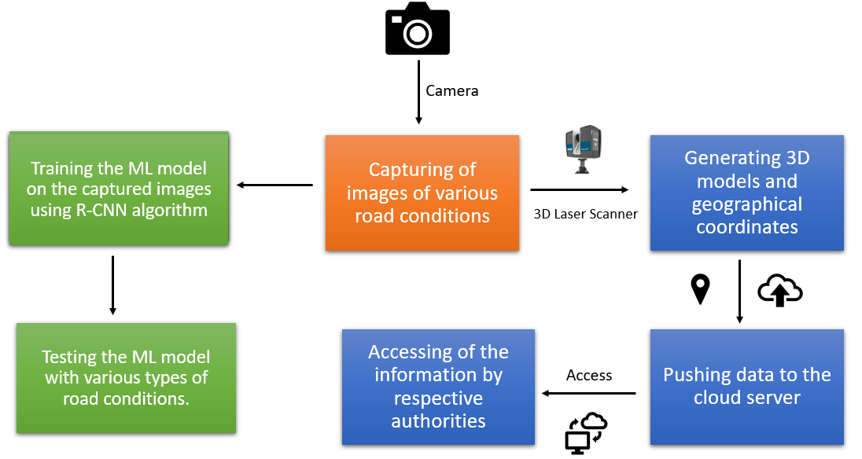
Flow of work

Slide 8
Result
When a pothole is detected, the driver gets alerted and the geo-location along with the 3-D model will be stored on the cloud.
The authorities will get informed about the issue via cloud services such as email.

Slide 9
CONCLUSION
With the help of this project we can detect the potholes and alert the driver and authorities about the road conditions. This helps in improving roads and lowering the chances of accidents.

Slide 10
THANK YOU

