Slide 1
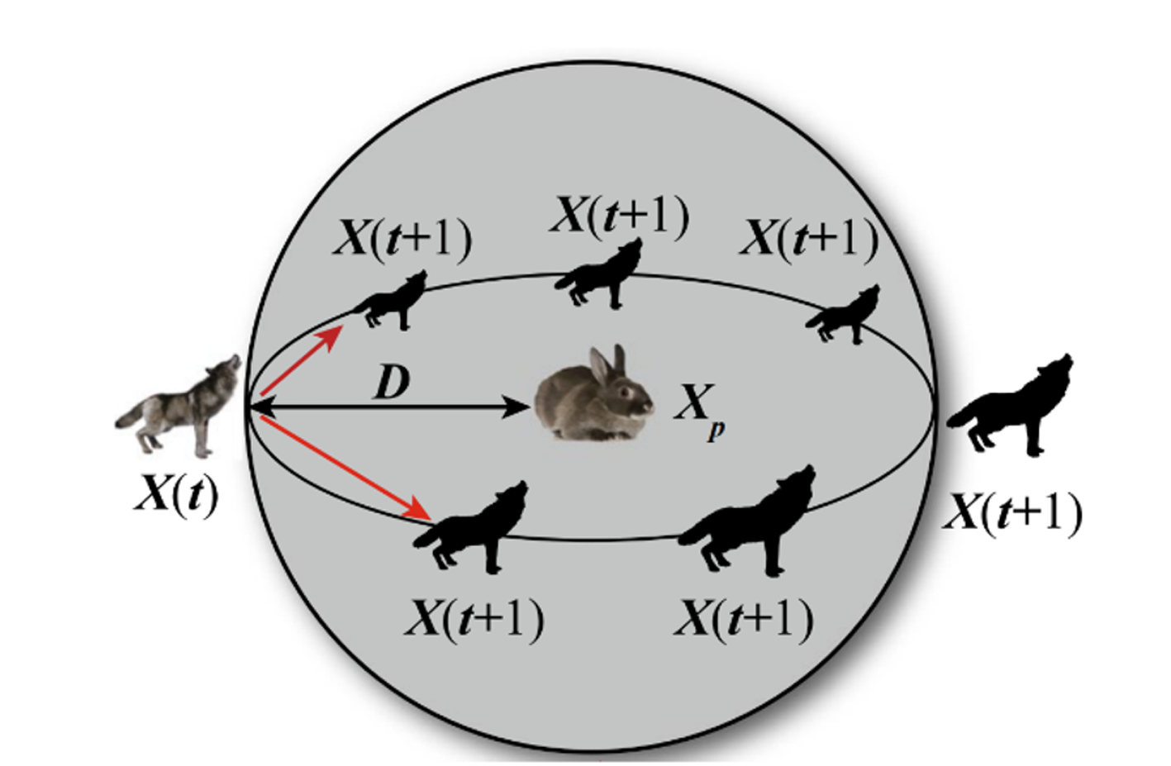

— Research Paper —
Breast Cancer Diagnosis Using SVM Optimized by Improved Quantum Inspired Grey Wolf Optimization
Research Paper :
Approach
Breast cancer detection from medical data is a challenging classification problem
Research focuses on using hybrid metaheuristic optimization
Traditional SVM classifiers depend heavily on hyperparameters (C, γ) that must be optimized for accuracy
Improved Quantum-Inspired Grey Wolf Optimization (IQI-GWO) for feature selection
Goal
Achieve higher diagnostic accuracy with fewer features and faster convergence

Slide 2

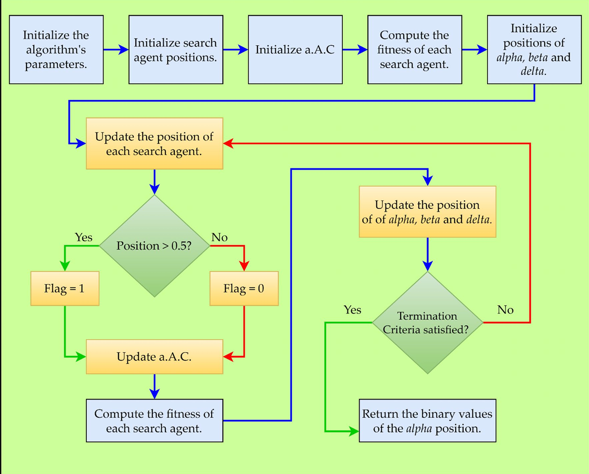




Overview of the Research Approach
Dataset
Medical features extracted from images or measurements
Preprocessing
Normalization and feature scaling
Feature Selection (IQI-GWO)
Select relevant features and optimize SVM parameters
Optimized SVM
Classification output
Diagnosis Output
Benign or Malignant
The dataset (Breast Cancer Wisconsin or similar) provides features extracted from medical images or measurements. The optimized SVM model classifies the samples into benign or malignant.

Slide 3
IQI-GWO Optimization Flow
01
02
03
Initialize wolf population
Evaluate fitness
Identify Alpha, Beta, Delta wolves
Classification accuracy - penalty
Random solutions
04
05
06
Update positions
Apply mutation
Repeat until max iterations
Using quantum behaviour
For diversity
07
Best solution
Optimized SVM parameters
Wolves represents feature subsets or parameter sets
Fitness = Accuracy - penalty (for too many features)
Quantum mechanism ensures global exploration, mutation maintains diversity

Slide 4
Extending the Research Paper — Multi-Dataset Application
Original Paper - Focused only on Breast Cancer Dataset
OUR Implementation
Generalizes the algorithm for any image-based dataset
Robust Evaluation
Comparative Benchmarking
Modular Configuration
Uses Random Forest as a secondary classifier after feature selection
Introduces CONFIG dictionary for flexibility
Supports train/validation/test splits

Slide 5

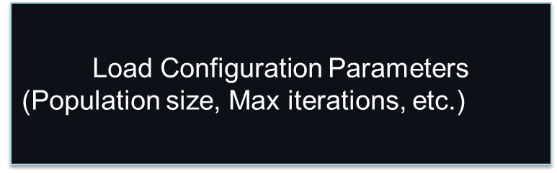

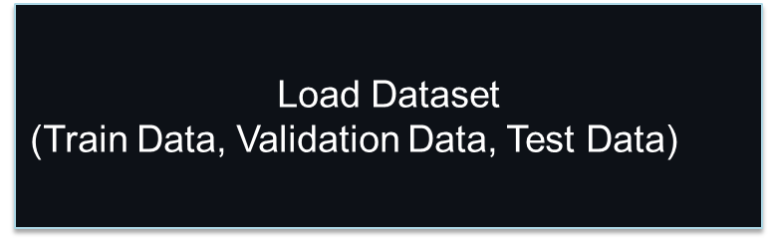
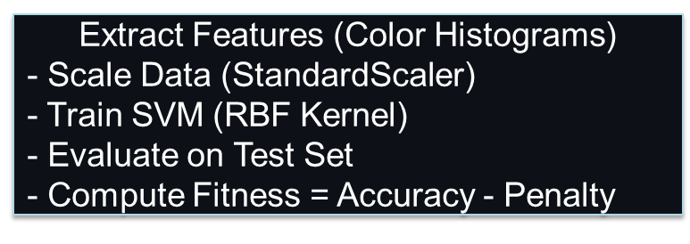
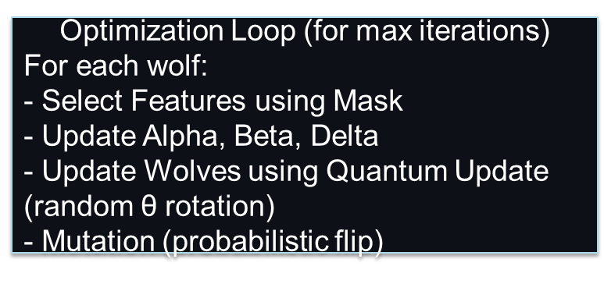

Flow of Your IQI-GWO Implementation
Dataset Loading
Train/Val/Test
Feature Extraction
Colour Histograms
Baseline Model
SVM
IQI-GWO Optimization
Feature Selection
Re-train Classifier
Random Forest / SVM
Evaluation
Accuracy, F1, Confusion Matrix
Key Differences from Paper
Uses image histograms instead of tabular biomedical features
Validates feature selection via explicit validation set (not cross-validation)
Can easily adapt to 3 additional datasets beyond breast cancer

Slide 6



Applying Research Paper to Extended Problem
Used the IQI-GWO algorithm as the core feature selection and optimization engine
Extended its scope beyond medical datasets to general image classification tasks
Evaluated using new datasets to test the robustness and generalization of the proposed approach
Results compared pre- and post-optimization (baseline SVM vs. IQI-GWO)

Slide 7
Literature Review on Breast Cancer Diagnosis and Optimisation
Extensive research focuses on improving accuracy of Breast Cancer classification using machine learning techniques.
Support Vector Machine (SVM)
Optimisation Algorithms
Grey Wolf Optimiser (GWO), Genetic Algorithm (GA), and Particle Swarm Optimisation (PSO) enhance SVM performance
Widely adopted for binary classification (Benign vs Malignant)
Recent Advances
Quantum-Inspired and Hybrid metaheuristics combine classical and quantum computation to improve convergence speed and accuracy

Slide 8
Year | Authors / Paper | Methodology | Key Outcome
2016 | Mirjalili et al. | Introduced Grey Wolf Optimizer (GWO) inspired by wolf hierarchy and hunting behavior | Simple yet powerful global search algorithm
2019 | Saha et al. | SVM + PSO for Breast Cancer Diagnosis | Improved accuracy but slower convergence
2021 | Zhang et al. | Quantum-Inspired PSO (QPSO) for medical imaging | Enhanced exploration capability
2023 | Thirumurugan et al. (Base Paper) | IQI-GWO optimized SVM for Breast Cancer Dataset | Achieved > 97% accuracy with faster convergence and fewer features

Slide 9
Contribution Beyond Existing Work
01
02
03
Multi-Dataset Adaptation
Image-Based Feature Extraction
Modular Training Pipeline
Implemented image-based feature extraction (colour histograms) rather than tabular data
Integrated validation split and modular training pipeline
Adapted IQI-GWO + SVM for multiple datasets
04
05
Comprehensive Performance Comparison
Versatile Framework
Compared performance with Random Forest and Baseline SVM to prove generalisation
Contributed a versatile IQI-GWO framework for real-world classification tasks

Slide 10
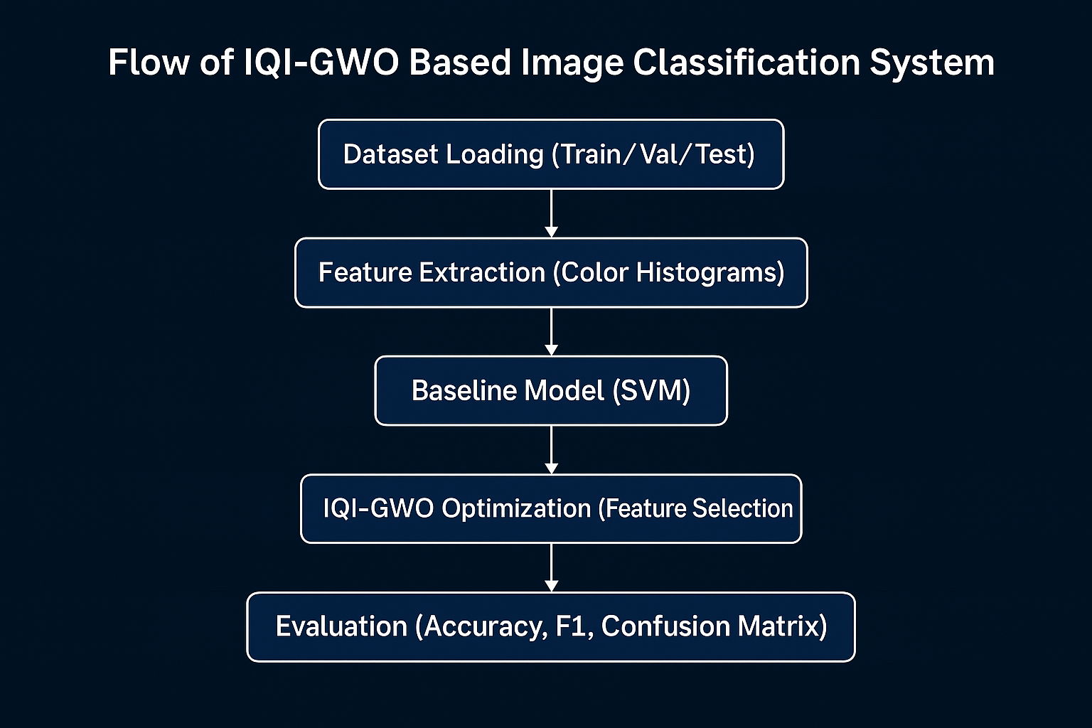

Slide 11

Evaluation Scheme — Train, Validation, and Test Flow
Fixed Split Evaluation
Data Division
Unique Roles
The model follows a Fixed Split Evaluation Scheme, not n-fold cross-validation.
Data is divided into Train, Validation, and Test sets before training begins.
Each subset has a unique role in model optimisation and final evaluation.

Slide 12
Dataset | Purpose | Used In
Train | Model fitting | Baseline SVM, RF, IQI-GWO training
Validation | Fitness evaluation | IQI-GWO optimization loop
Test | Final evaluation | Accuracy, F1, Confusion Matrix
➡️ So it’s a Fixed Split Evaluation Scheme (Train/Val/Test), not k-fold cross-validation or random split-over-ratio.
This evaluation scheme guarantees unbiased model performance whilst maintaining efficiency for multi-dataset experiments.

Slide 13
🔹 Advantages:
Clear separation avoids overfitting.
Easy reproducibility for multiple datasets.
Faster runtime compared to k-fold.
🔹 Limitation:
Results may vary slightly depending on how datasets were split.
No averaging over multiple folds (so minor statistical variance possible).

Slide 14

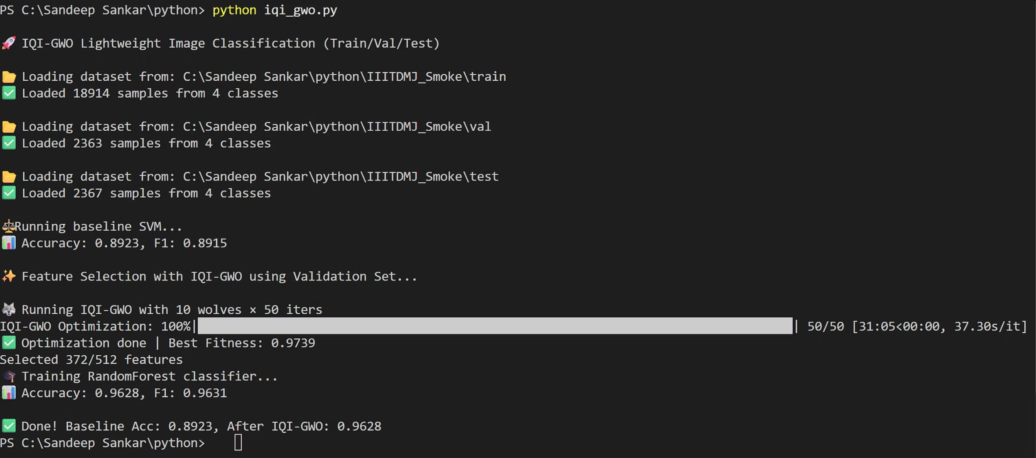
Datasets :
IIITDMJ_Smoke Dataset
The IIITDMJ_Smoke dataset provides a comprehensive collection of images specifically designed for smoke detection and classification tasks. This dataset serves as a valuable resource for training machine learning models in fire safety and environmental monitoring applications.
Access the dataset: https://data.mendeley.com/datasets/4mn2g8cnsf/1
Dataset Output

Slide 15

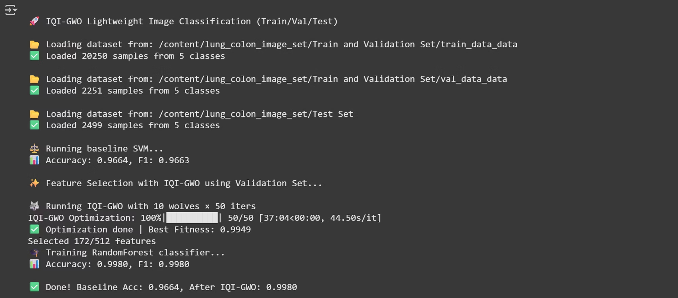
LC25000 Dataset
The LC25000 dataset is a large-scale medical imaging collection containing 25,000 histopathological images across multiple categories. This dataset is instrumental for developing deep learning models in medical diagnostics, particularly for lung and colon cancer detection and classification.
Access the dataset: https://www.kaggle.com/datasets/javaidahmadwani/lc25000/data
Dataset Output

Slide 16

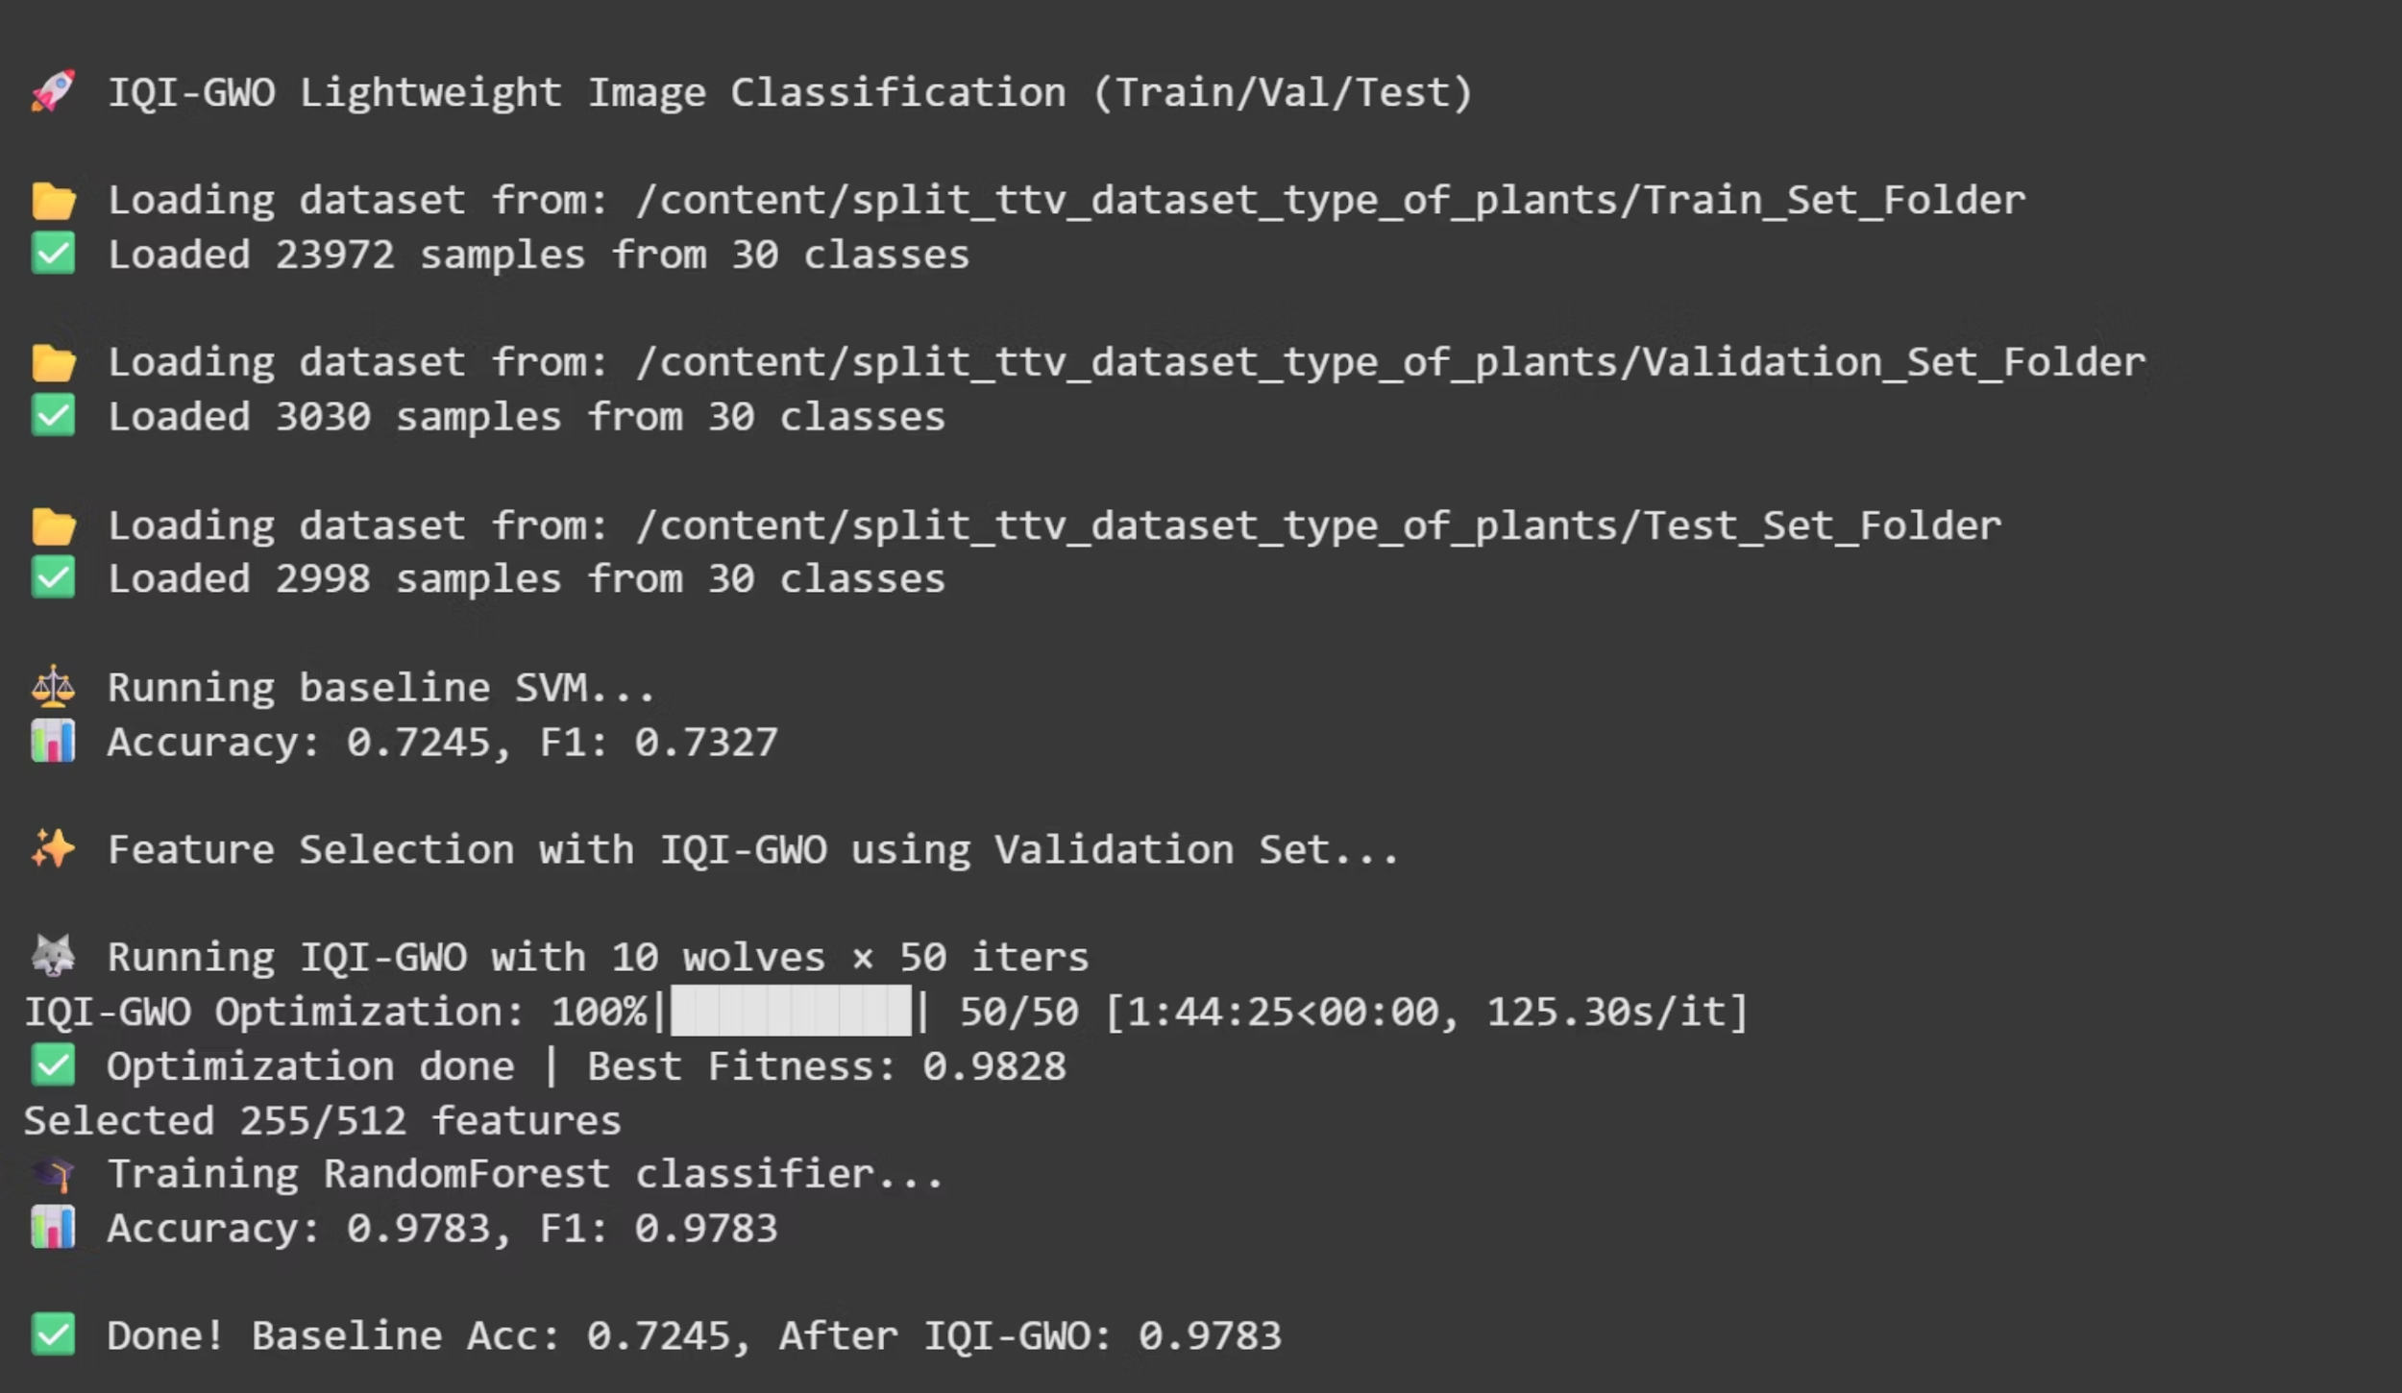
Plant-type-Dataset
The Plant-type-Dataset offers an extensive collection of plant images categorised by species and types. This dataset supports agricultural research, botanical studies, and computer vision applications focused on plant identification and classification systems.
Access the dataset: https://www.kaggle.com/datasets/yudhaislamisulistya/plants-type-datasets
Dataset Output

Slide 17
Comparative Analysis of Standard SVM vs SVM Optimized using IQI-GWO for feature Selection
Data Set | Baseline Accuracy | Accuracy after IQI-GWO
LC25000 | 96.3 % | 99.70 ± 0.09 %
Plant-type-Dataset | 72.45 % | 97.63 ± 0.02 %
IIITDMJ_Smoke | 89.23 % | 96.25 ± 0.04 %

Slide 18



Challenges Faced
Inconsistent Dataset Structure
Repeated Dataset Extraction
Different datasets followed varying folder formats — some had train, validation, and test sets, while others only included partial splits. This required manual organization and splitting before training, making the workflow less automated and more error prone.
Some datasets were compressed in multiple layers, forcing the coder to extract them twice or more. This not only increased setup time and storage usage but also led to confusion with nested folders and incorrect file paths.

Slide 19


Novel Contributions of the Proposed IQI-GWO Framework
Generalized IQI-GWO Framework
Image-Based Feature Extraction
Explicit Validation Mechanism
Unlike the base paper focused only on Breast Cancer, your work adapts IQI-GWO to handle multiple datasets from various domains. Demonstrates the flexibility and scalability of the algorithm.
Introduced color histogram-based features for image datasets, extending IQI-GWO beyond traditional tabular data. Bridges the gap between medical and visual data classification.
Replaced k-fold cross-validation with a fixed Train/Validation/Test split, ensuring cleaner optimization and reproducibility. IQI-GWO uses validation accuracy as a fitness criterion, preventing overfitting.
Integration with Multiple Classifiers
Improved Optimization Dynamics
Multi-Dataset Validation
Combined IQI-GWO feature selection with Random Forest and SVM for robust comparative analysis. Highlights the algorithm's ability to enhance various classifiers, not just SVM.
Modified quantum rotation and mutation control to ensure better exploration-exploitation balance. Results in faster convergence and higher accuracy.
Evaluated on four different datasets, proving generalization capability — a step beyond the original paper's scope.

Slide 20


Framework Evolution
Base Paper
IQI-GWO + SVM on Breast Cancer
Our Work
IQI-GWO + Multi-Dataset + RF/SVM + Image Features
Conclusion
The novelty of this research lies in transforming a dataset-specific algorithm into a general-purpose, validation-driven, and image-compatible optimization framework for machine learning.
------- Sandeep Sankar Balla

