Slide 1


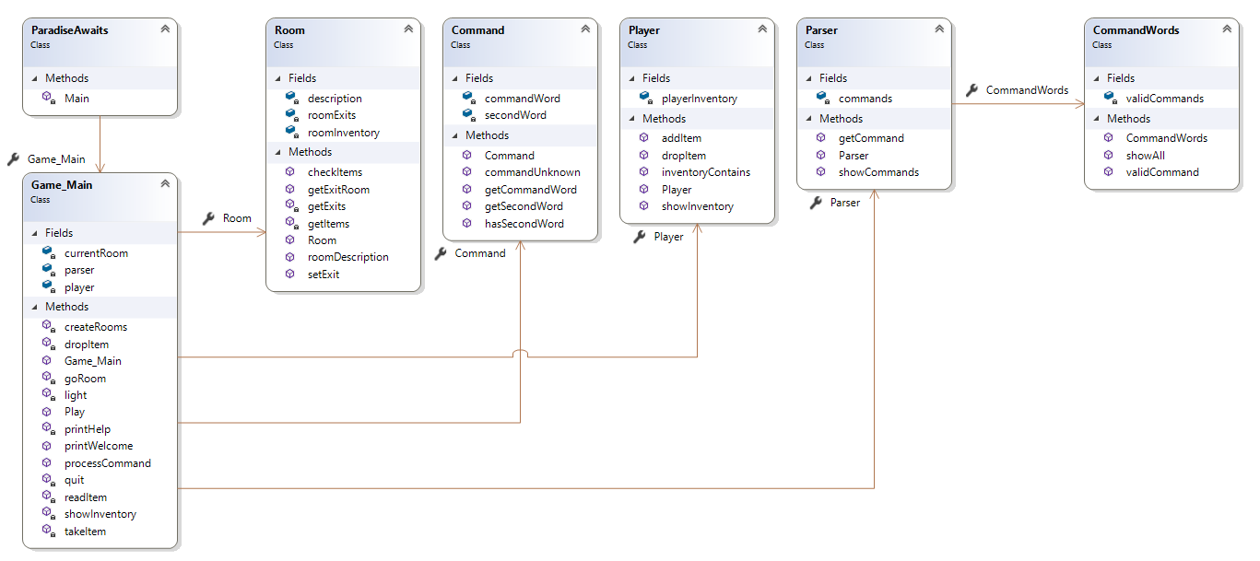

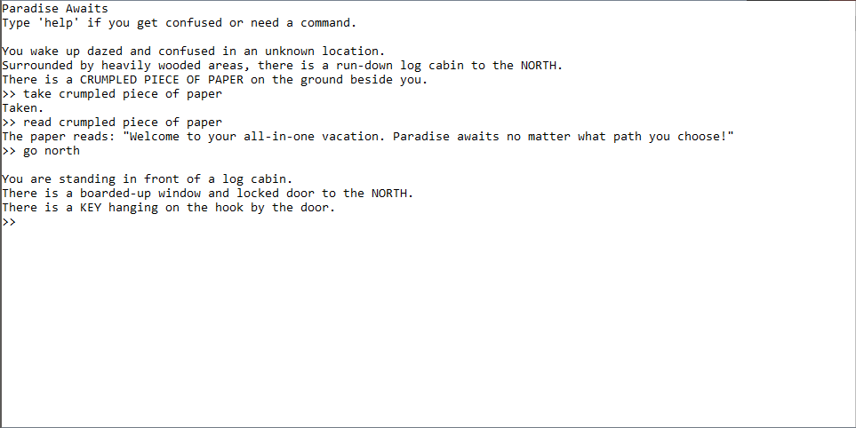



Paradise Awaits: Revisiting a Classic Interactive Fiction Game
Makayla Ballenger
CS 491, Concord University, Athens, WV.
Abstract
Game Structure
Paradise Awaits is an interactive, text-based fiction game developed using Visual Studio. The game is a redesign of Zork, a similar game that was released in the late 1970s. Written in C#, Paradise Awaits features multiple rooms that a user can explore along with interactive items that can be utilized in numerous ways. The goal of the game is to navigate the world in search of the three hidden treasures within the rooms. This game utilizes multiple object-oriented programming practices and is designed with a flexible software architecture, allowing for expansions in future iterations of the game. The architecture must be designed to adapt to the player’s choices, allowing for full authority over the game. The story is not predetermined and each game is unique.
Gameplay
The Parsing Problem
Future Work
The main challenge of this game is that the user input is unpredictable. The user does not have generic, predetermined choices and the parser has to be built to manage this.
The parser used in this game works with an array of valid command words. Some of the commands can just be used on their own, while others require more information to execute.
Auto Map Generation
Transcription of Game
Adding Additional Game Rooms
Technology Used
References
C# Player’s Guide - RB Whitaker
https://docs.microsoft.com/en-us/dotnet/csharp/how-to/parse-strings-using-split
World of Zuul Game Example

