Slide 1

KWAME NKRUMAH UNIVERSITY OF SCIENCE AND TECHNOLOGY COLLEGE OF ENGINEERING DEPARTMENT OF COMPUTER ENGINEERING

Slide 2
PRESENTATION ON ELECTRONIC CLASSREP SOFTWARE ENGINEERING
MANNSCAHFT
GROUP MEMBERS
SARAH ABOAGYE MENSAH
KWAKU SARPONG MANU
HASSAN MAAZU
JAMAL ISSAH
CYRIL YAMOAH

Slide 3
Outline
Introduction
Problem statement
Proposed solution
Discussions about the project
Design specifications
Architecture and Functionality
Desired outcome
Challenges

Slide 4
Introduction
Electronic ClassRep project seeks to ease both lecturers and students from difficulties in sharing and delays information about the details of a particular course.

Slide 5
Problem statement
Lecture – students communication challenges
Difficulty in resolving lecture timing conflict
Venue conflicts
Untimely distribution of course materials
Human error
Weak class involvement in decision making

Slide 6
People’s views on the Project
Before starting this project, members of this team went round asking for people’s views on the project and their responses were good ones
Some also suggested other ideas which were very helpful in our project
Questionnaires (Google forms) were sent out to various WhatsApp group to get people’s views

Slide 7
Proposed Solution
An app (Android, Web app) to:
Interface lecturers and students
Provide a live timetable update
Increase class participation in decision making
Provide effective channel for course material distribution

Slide 8
Discussions about the project
Many meetings were held for the discussing the progress of the project. At the various meetings, group members made suggestions that have helped in the success of this project.
Some of these suggestions from our various meetings are as follow:
Sarah showed samples(tables) of the database to the group for modifications.
Sarpong suggested that we add more features to the database like files and voting tables and also IDs to distinguish each table.
Sarah and Hassan worked on the ER diagrams for the database.

Slide 9
Suggestions From Our Meetings
Cyril showed the work he had done on the web portal.
Jamal brought up ideas to be implemented on the designs.
The CEO asked if Cyril had tested the work he had done for errors.
Hassan said he was having problems with getting his emulator to work.

Slide 10
Suggestions From Our Meetings
Sarah was to work on the use case diagram
Sarpong suggested we separate the activities into lecturers and students
Hassan provided the activities to work on
Sarah and Hassan worked on the use case diagram using Visual studio and Paint later in the day which was pushed to Git for all the members to view.

Slide 11
Design Specifications
User profiles
Bulletin boards for each course
View Current Course Allocation (CCA)
Reschedule courses(propose and vote) and update CCA

Slide 12
Architecture and Functionality
Front-end:
User authentication and privilege designation.
Features and viewable bulletin boards are designated according to user attributes (i.e lecture or student, year group, courses etc.)
Android and web app (react)
Back-end:
SQL database → Relational database keeps updated information relating to users and attributes like course of study (or course being taught by lecturer) etc.
Express.js API → Queries are made by back-end application on behalf of front end requests.

Slide 13
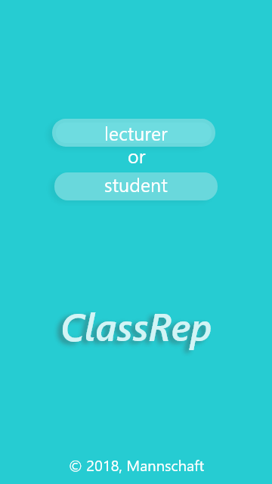
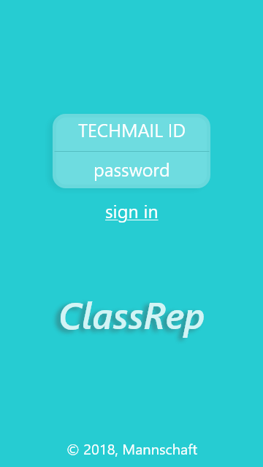
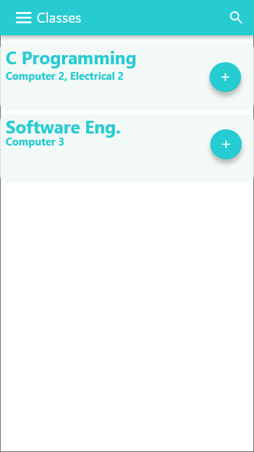
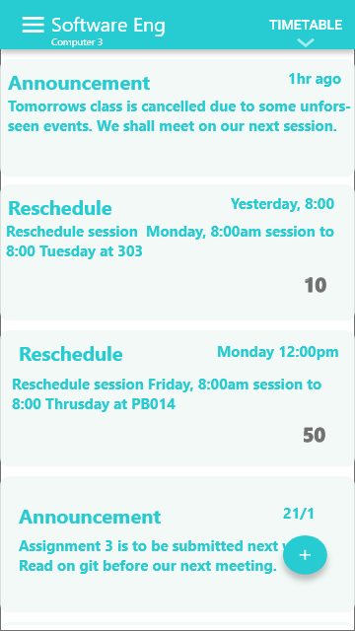
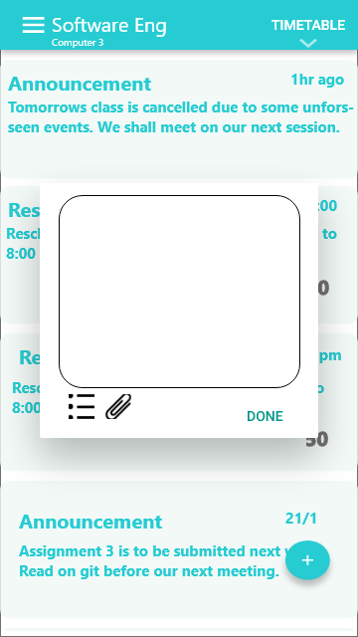
Architecture and Functionality
Instructor:

Slide 14
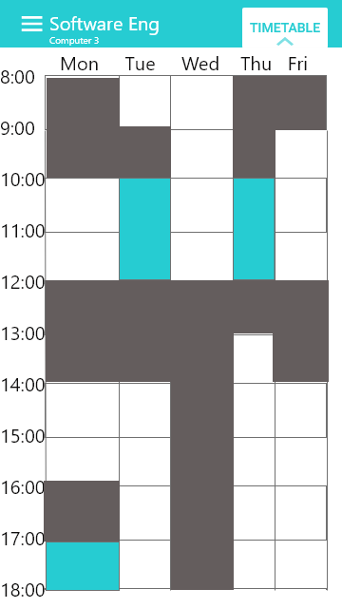
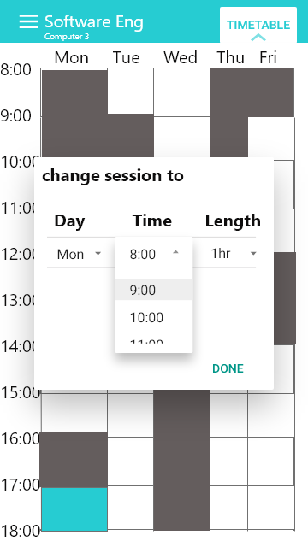
Architecture and Functionality
Instructor:

Slide 15
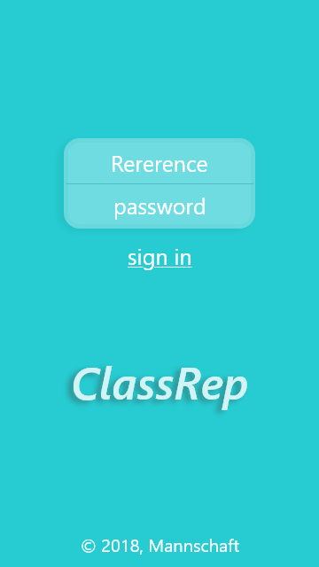
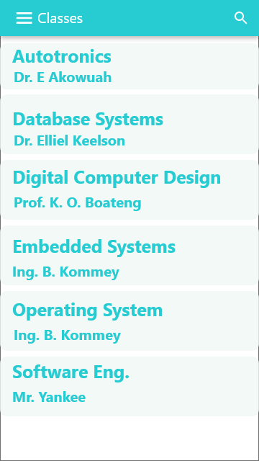
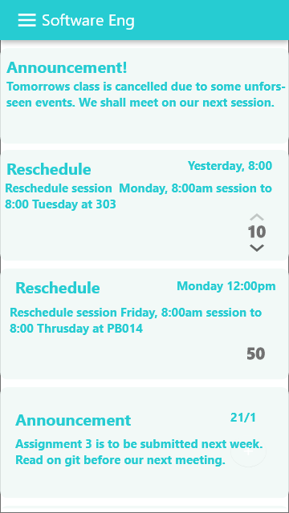
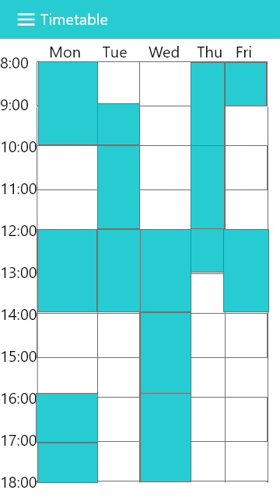
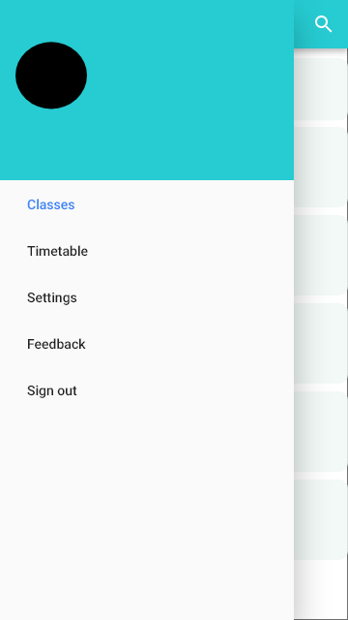
Architecture and Functionality
Students:

Slide 16
Desired outcome
We expect that:
Communication between instructors and students is clear and noise free.
Student opinions on changes are taking into consideration.
Class reschedules are carried out swiftly.
Venue conflicts are preempted/resolve effectively

Slide 17
Various Testing Done On The Project
Unit testing
API → Various API endpoints, Token creation function
Integration testing
Android App → modules and packages
API → API-Database communication
Web app → modules, packages and smoke testing

Slide 18
Software Models Used
Agile Scrum process model
Front-end
Android development used Incremental model as sub-process model
Web development used Big Bang as sub-process model
Back-end
API design used Big Bang as sub-process model

Slide 19
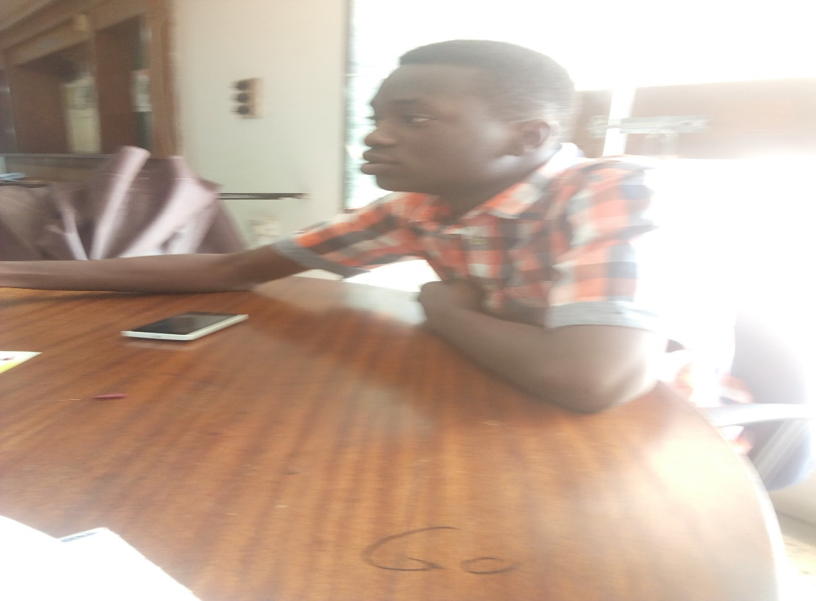
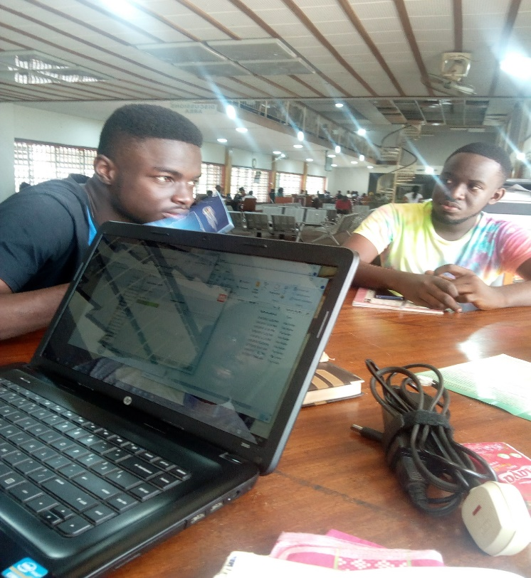
Pictures From Our Meetings

Slide 20
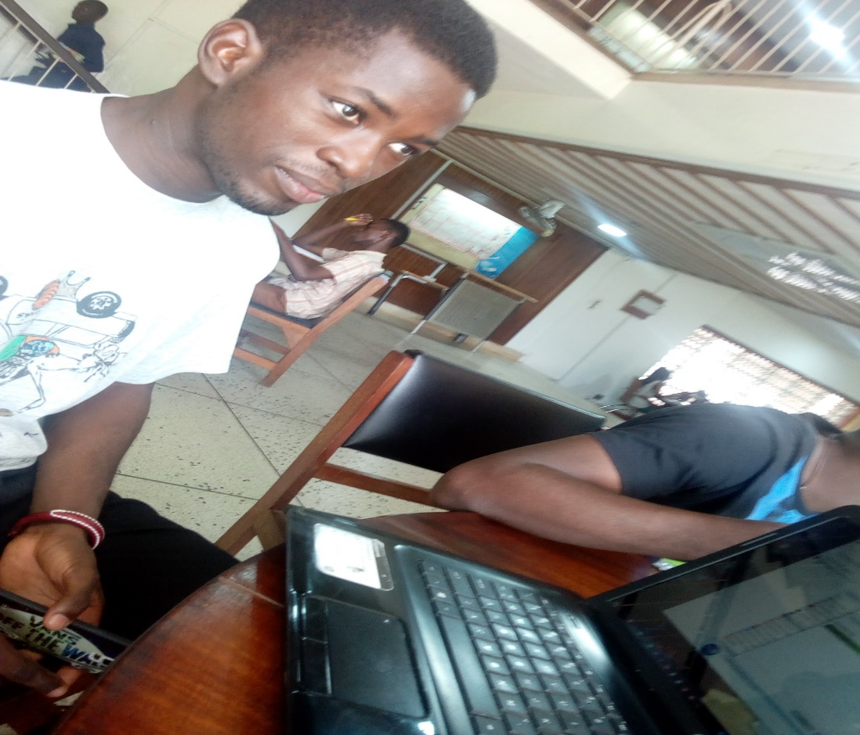
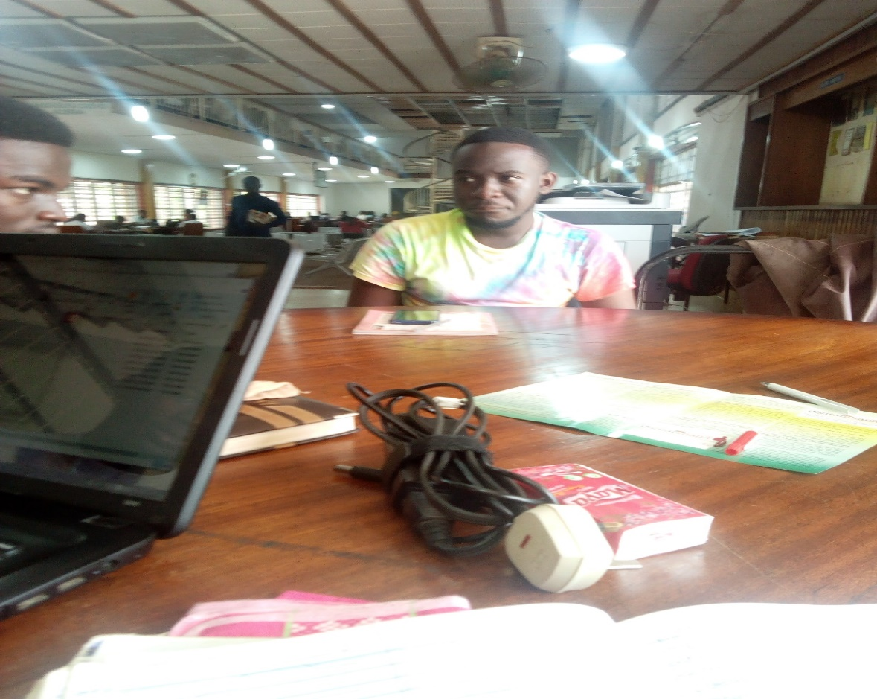
Pictures From Our Meetings

Slide 21
References
www.researchgate.net
www.square.github.io/retrofit/.com
Tutorials Point
MySQL Documentation
NPM Documentation

Slide 22
THANK YOU.

