Slide 1

KWAME NKRUMAH UNIVERSITY OF SCIENCE AND TECHNOLOGY COLLEGE OF ENGINEERING DEPARTMENT OF COMPUTER ENGINEERING

Slide 2
PRESENTATION ON ELECTRONIC CLASSREP SOFTWARE ENGINEERING
MANNSCAHFT
GROUP MEMBERS
SARAH ABOAGYE MENSAH
KWAKU SARPONG MANU
HASSA MAAZ
JAMAL ISSAH
CYRIL YAMOAH

Slide 3
Outline
Introduction
Problem statement
Proposed solution
Design specifications
Architecture and Functionality
Desired outcome

Slide 4
Introduction
Electronic Classrep project seeks to ease both lecturers and students from difficulties in sharing and delays information about the details of a particular course.

Slide 5
Problem statement
Lecture – students communication challenges
Difficulty in resolving lecture timing conflict
Venue conflicts
Untimely distribution of course materials
Human error
Weak class involvement in decision making

Slide 6
Proposed Solution
An app (Android, Web app) to:
Interface lecturers and students
Provide a live timetable update
Increase class participation in decision making
Provide effective channel for course material distribution

Slide 7
Design Specifications
User profiles
Bulletin boards for each course (with file sharing capabilities)
View Current Course Allocation (CCA)
Reschedule courses(propose and vote) and update CCA

Slide 8
Architecture and Functionality
Front-end:
User authentication and privilege designation.
Features and viewable bulleting boards are designated according to user attributes (i.e lecture or student, year group, courses etc).
Android and webapp (react)
Back-end:
Relational data keeps updated information relating to users and attributes like course of study (or course being taught by lecturer) etc.
Queries are made by back-end application on behalf of front end requests.
Node/SQL database

Slide 9
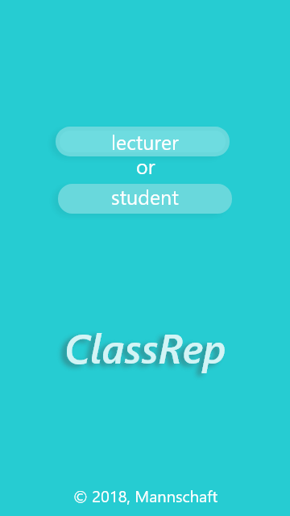
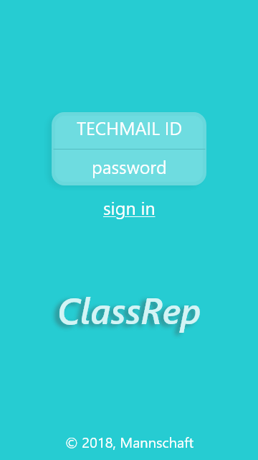

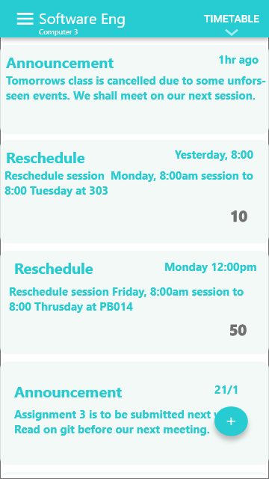
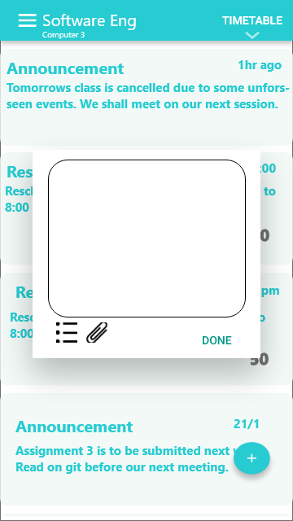
Architecture and Functionality
Instructor:

Slide 10
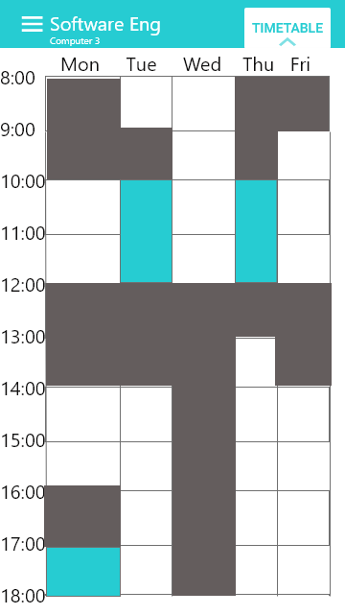
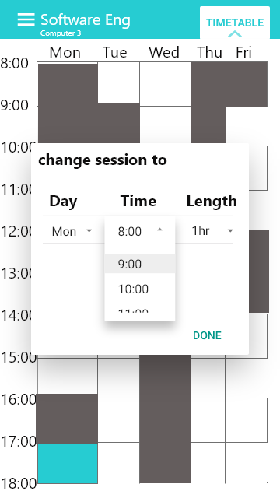
Architecture and Functionality
Instructor:

Slide 11
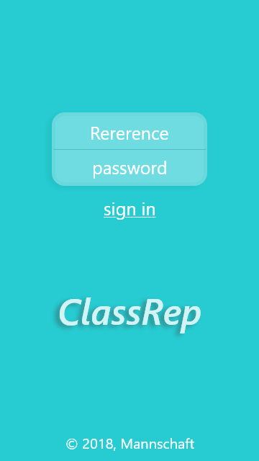
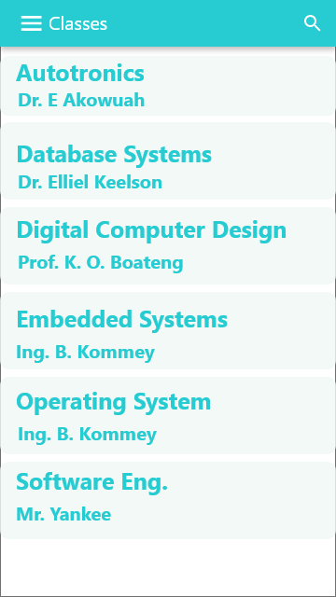
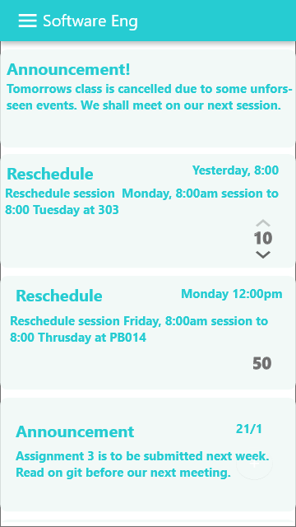
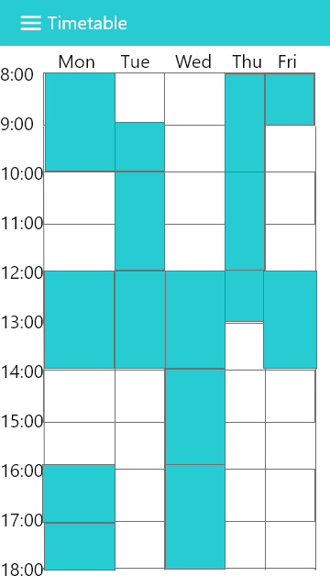
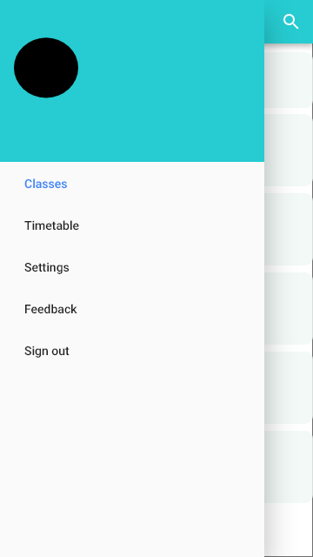
Architecture and Functionality
Students:

Slide 12
Desired outcome
We expect that:
Communication between instructors and students is clear and noise free.
Student opinions on changes are taking into consideration.
Class reschedules are carried out swiftly.
Venue conflicts are resolved faster.

