Slide 1
Automotive Hacking –Relay Attacks
By Owen Ball

Slide 2
CAN (Controller Arear Network) Bus
What is Can?
CAN is the central nervous system that enables communication between all/some parts of the car
Allows various Electronic units in cars to communicate and share data with each other. The main motive of proposing CAN was that it allowed multiple ECU to be communicated with only a single wire.
What did we use before this?
We used point-to-point wiring systems. As we started having more and more electronic components in the cars, this only became bulky and too expensive to maintain

Slide 3
Extra Information
A modern car can have as much as 70 ECUs
Components like Engine Control Unit, Airbags, Transmission, Gear Unit, Anti-lock braking system or simply ABS, infotainment systems, climate control, Windows, doors, etc.
Could be thought of as a noisy, crowded, slower version of Ethernet LAN except that the traffic is UDP rather than TCP.
Not all automobile control systems use CAN and also CAN is not only the communication protocol used in an automobile system. There could be other protocols such as Bluetooth, GSM/LTE cellular networks, satellite radios, LIN, etc.

Slide 4
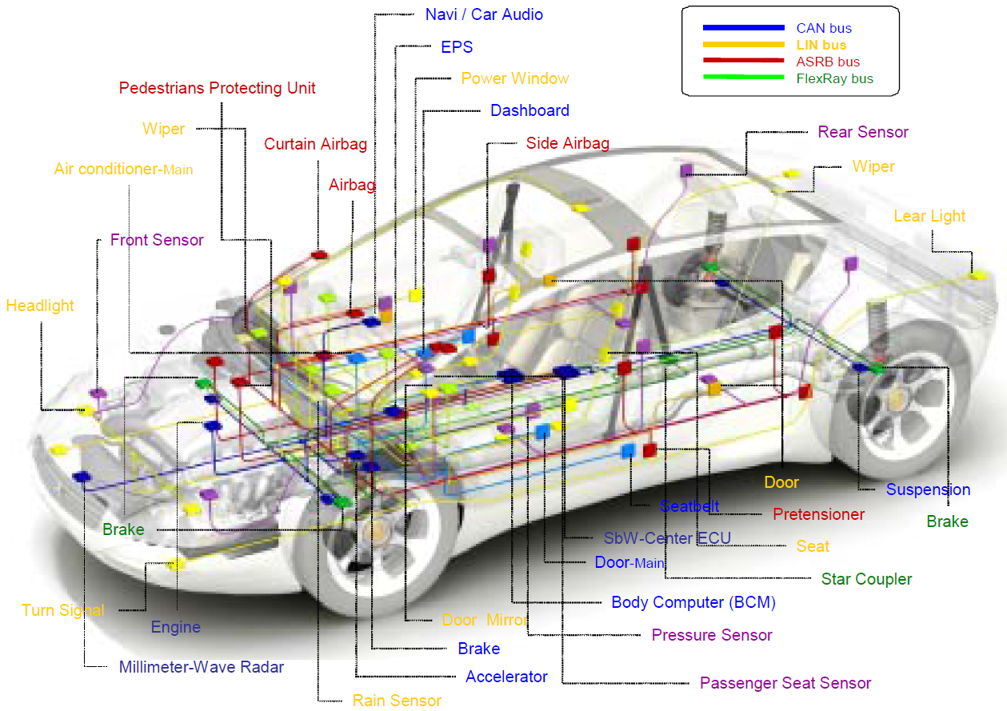
Put into prospective
Imagine, every component connected to every other component, this would have been a real mess to diagnose for any troubleshooting. But with CAN, this can be replaced with single wire and communication between each unit is much simpler.

Slide 5
What you need to know about CAN packets
This message consists of essentially an ID, which is a priority of the message and also it can contain CAN message that can be of eight bytes or less at a time
If two or more node begins sending messages at the same time, the messages sent with the dominant ID will overwrite with that of less dominant. This is called priority-based bus arbitration
Lowest ID = Highest Priority.

Slide 6
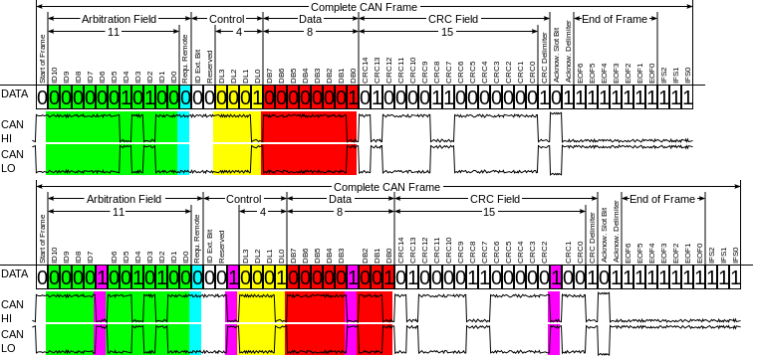
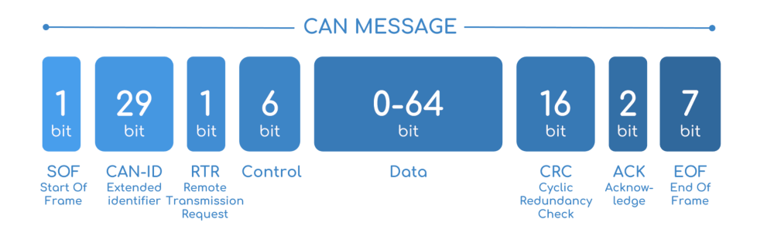
What they look like
Arbitration Identifier
Data Length Code
Data field

Slide 7
How do we access this in a real car?
You need to have access to the onboard diagnostic port, aka OBD
Basically, all the cars these days use OBD-II
This is exactly what your car mechanics uses to identify the faults in your car
most direct access to CAN
This is located somewhere near the passenger’s seat or driver’s seat. And this should be accessible without the need of a screwdriver.

Slide 8
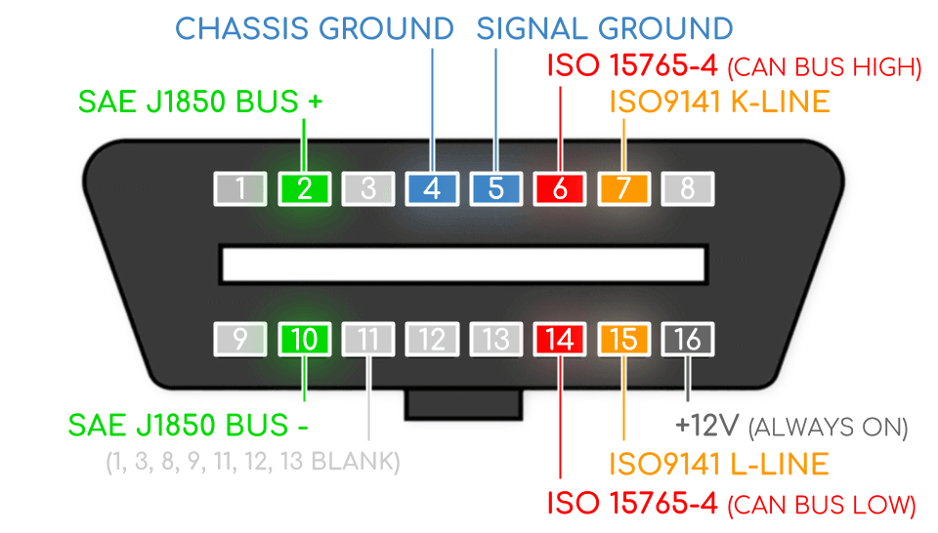
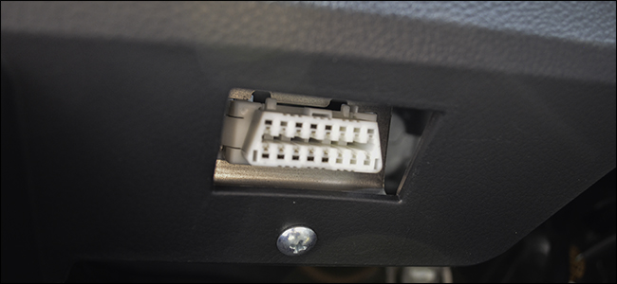
What it looks like

Slide 9
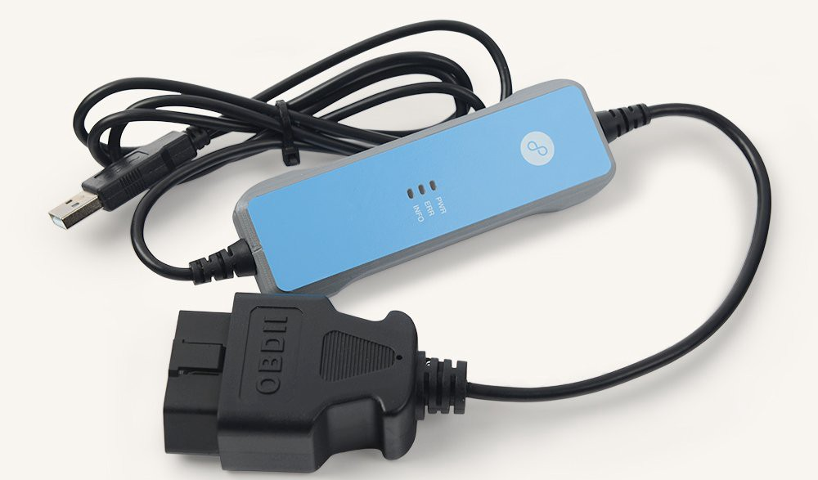
How we communicate with the car?
You need something that connects to the OBD-II port via USB so that you can send/receive the CAN packets. Also on the software, you need something that can read and/or write CAN packets as well as encode and/or decode the CAN packets. With a little bit of hardware and software, you definitely can hop into the CAN.
High-end devices include Kvaser and EMS, which are expensive and overkill
You have USB2CAN, a native can interface for Linux that offers great value for money.

Slide 10
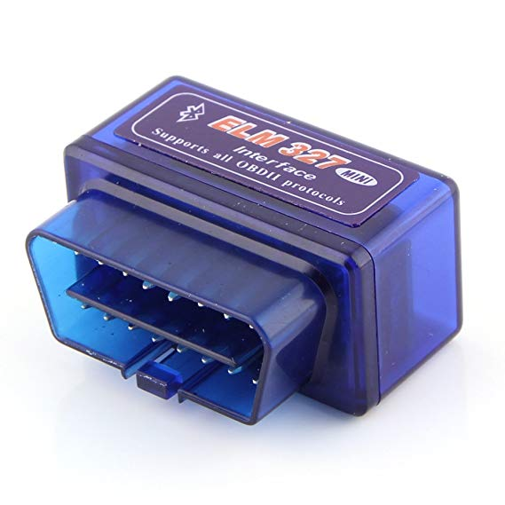
What not to use
You will come across this ELM327, Bluetooth based devices, they are terrible for hacking for a reason that they have slower data rates and you will end up losing so many packets.

Slide 11
In Action
https://www.youtube.com/watch?v=7nHtuBCqfyU

Slide 12
Software/Tools needed for exercises
Any Linux distributions (I will be using Ubuntu)
can-utils
ICSim (ICSim is an opensource Instrumentation Cluster Simulator) Can be downloaded from https://github.com/zombieCraig/ICSim
Wireshark
Pastebin =

Slide 13
Comands to run (pastebin)
sudo apt-get install libsdl2-dev libsdl2-image-dev –y
sudo apt-get install can-utils -y
Cd ICSim
Make
./setup_vcan.sh
-Check if working-
Ifconfig vcan0

Slide 14
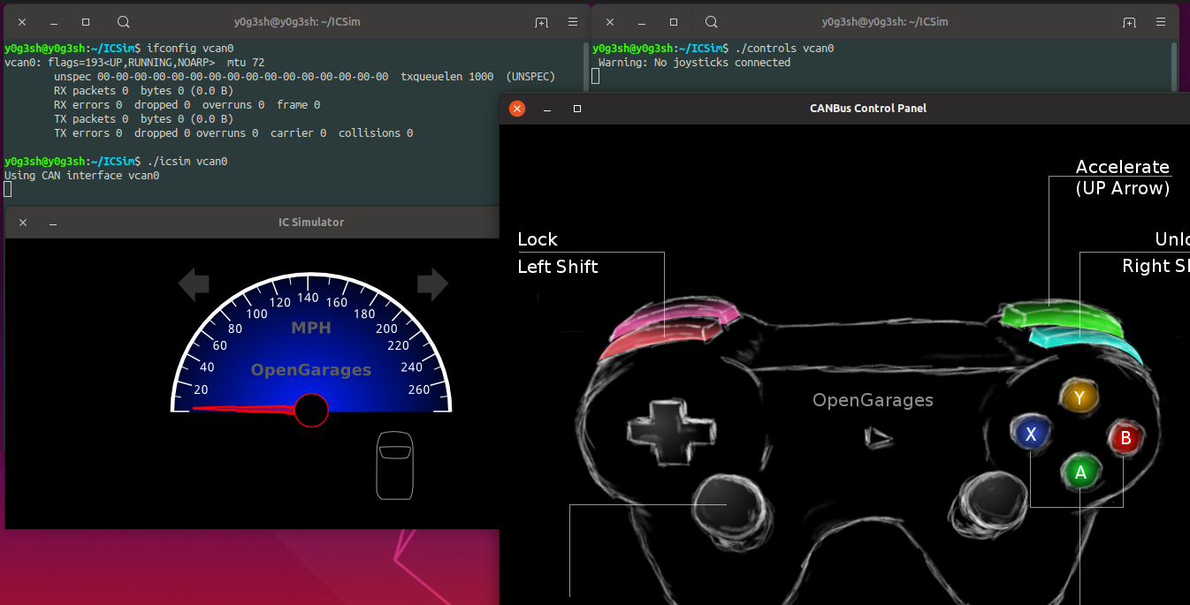
Running the Simulator
./icsim vcan0 = speedometer
./controls vcan0 = controls

Slide 15
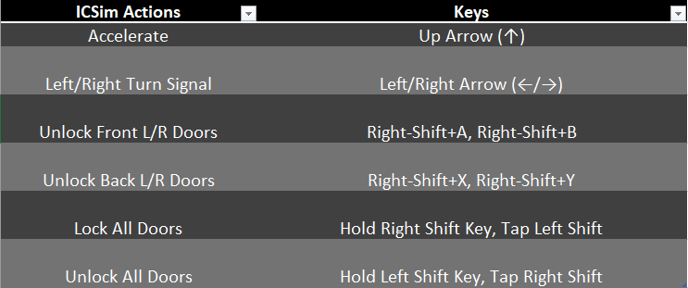
Check if it’s working
Click the controller
Use any of the following

Slide 16
Commands we can send
cansniffer for sniffing the packets
cansend for writing a packet
candump dump all received packets
canplayer to replay CAN packets
cangen to generate random CAN packets

Slide 17
Command breakdown

Slide 18
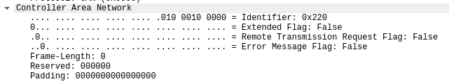
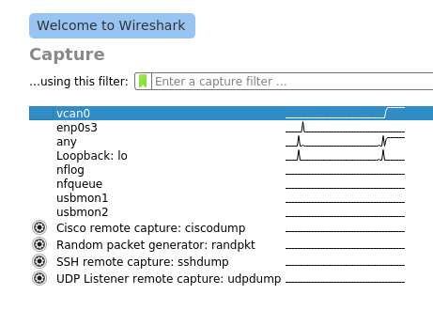
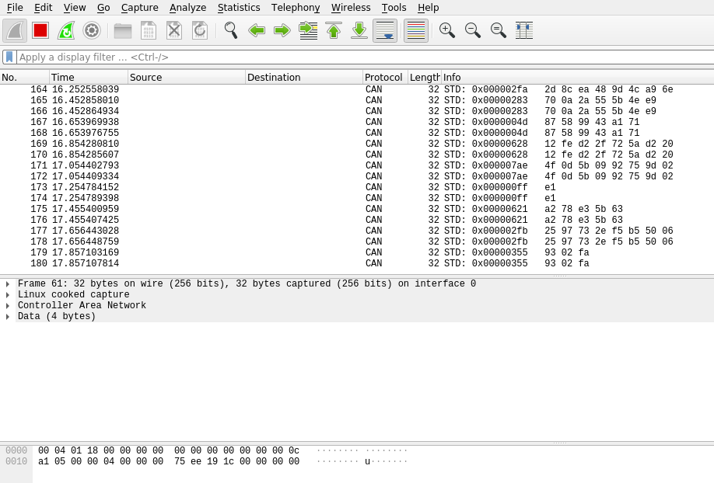
cangen vcan0

Slide 19
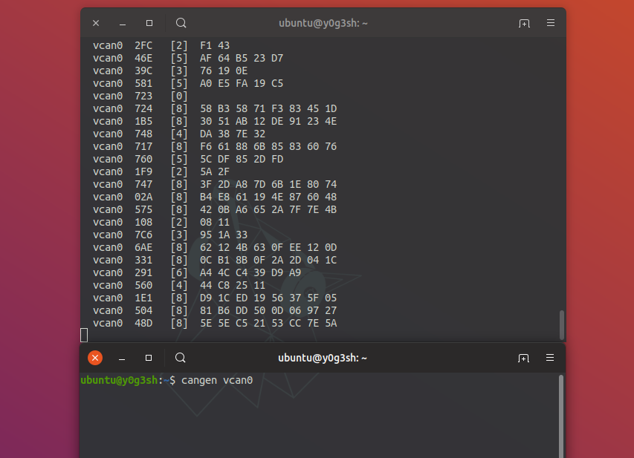
Candump vcan0
Dump the cam frames live

Slide 20
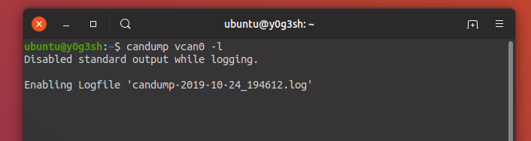
Candump –l vcan0
Dumps the can packets into a file live until ctrl + C is pressed
This can view using cat

Slide 21
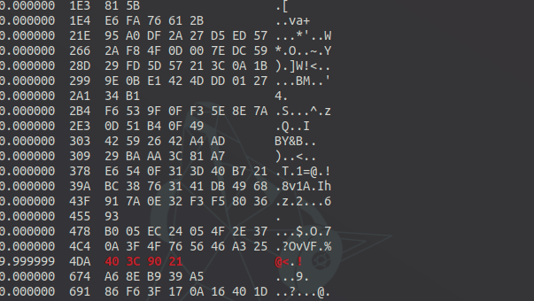
Cansniffer –c vcan0
Shows us a live feed of the packets being sent and highlighting if any changes occur
We can increase the throttle and see what’s highlighted take note of the ID then filter just this
This can be done once you start sniffing, press — and then 000000. This will first clear all the frames. Now, you can start adding the IDs using + and then the ID you want to display and hit Enter. This way you can filter the frames of individual IDs.
The -c option is used to indicate the change in bytes of the frame.
-000000 +enter, +40C (throttle)

Slide 22
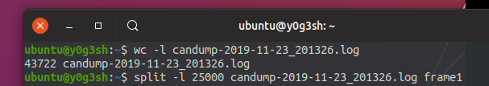
Canplayer –I canfile.log
Must be a capital I
Replays the logged can file previously captured
Divide the CAN frames

Slide 23
Challenges
Identify the arbitration ID for Throttle, Doors and turn signals!
How about unlocking the door?
Spoofing the RPM Gauge
Spoof turn signal

Slide 24
Challenges-answers
Identify the arbitration ID for Throttle, Doors and turn signals!
https://www.youtube.com/watch?v=fhqAKmihl2E How about unlocking the door?
https://www.youtube.com/watch?v=zGlzmpiY5fY
Spoofing the RPM Gauge
https://www.youtube.com/watch?v=RLEmuCXDTJc
Spoof turn signal
https://www.youtube.com/watch?v=xG9BupOQYIU

