Slide 1

Bútorprojekt
BMSzC Bolyai János Műszaki Technikum és Kollégium
Vizsgaremek
2023/24
Made by:
Balog Patrik & Cserni Krisztián

Slide 2
Introduction
Planning
Choosing the topic
Initial difficulties
Why did we choose this?

Slide 3



Teamwork
Frontend: Cserni Krisztián
Backend: Balog Patrik
Full stack separation, but we worked as a team
Communication
GitHub
Microsoft Team
Facebook / Messenger
OneDrive

Slide 4
Functions of our program
Registration
Login
User and Admin levels
CRUD operations
Profile
Search, browse
Email feedback from order
Responsiveness

Slide 5



Technologies
Frontend
HTML | CSS | JavaScript

Slide 6


Technologies
Backend
Node.js | MySql

Slide 7
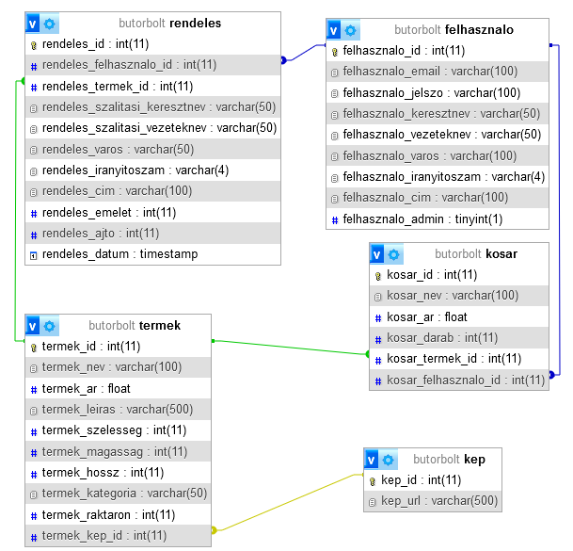
Database

Slide 8
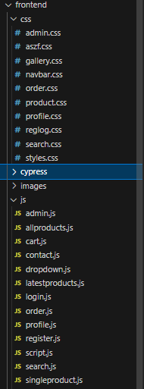
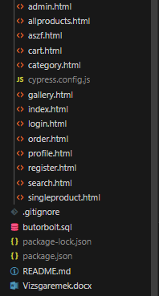
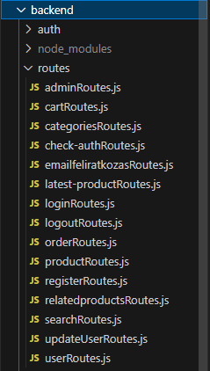
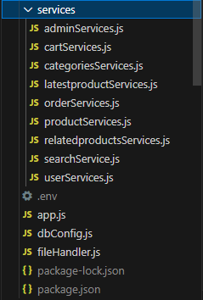
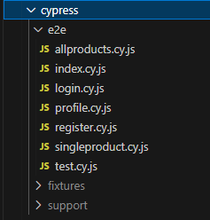
Folder structure
Frontend
Backend
Tests folder

Slide 9
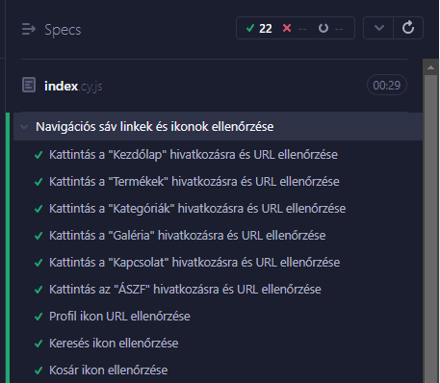
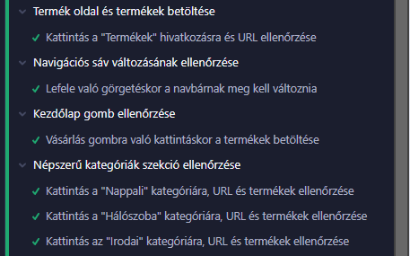
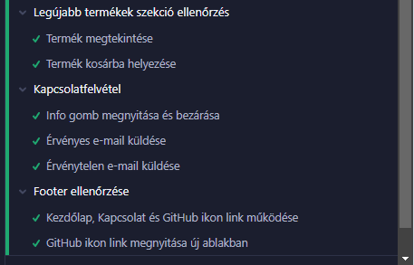
Frontend Tests
Cypress

Slide 10
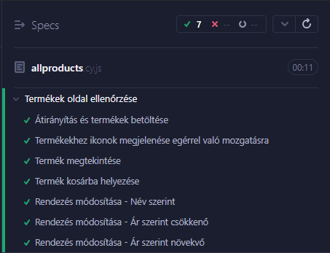
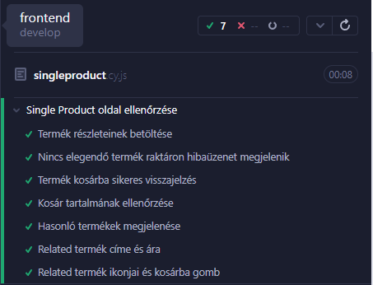
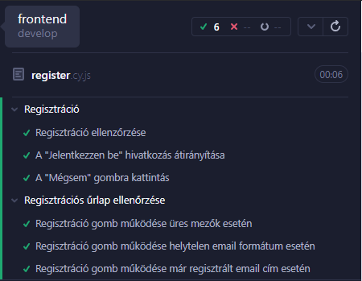
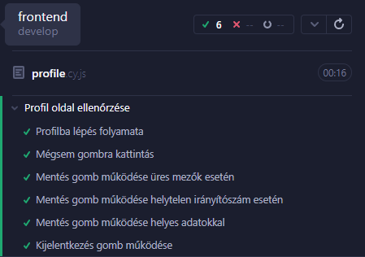
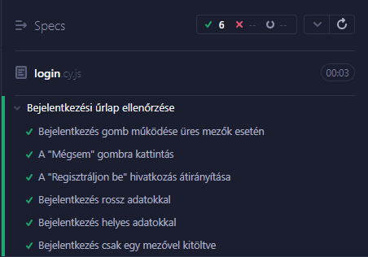
Frontend Tests
Cypress

Slide 11
Thank you for your attention!

