Slide 1

Summary
This project aims to develop a solar wind powered PowerBox that can power basic appliances in the homes of low and medium class and micro and small businesses. This project builds on the result of engagement on an existing prototype we created from past research development works. Feedback from engagement includes need for increased power output without loosing its affordability factor, more practical body designs among others.
PowerBox
1st Quarter Report

Slide 2
Literature review on state-of-the-art AI/ML/DL methodologies used in solar energy production/consumption prediction
Explanatory Variables refers to variables influencing solar energy production/consumption established from literature .
Content
Literature Review
Explanatory Variables

Slide 3
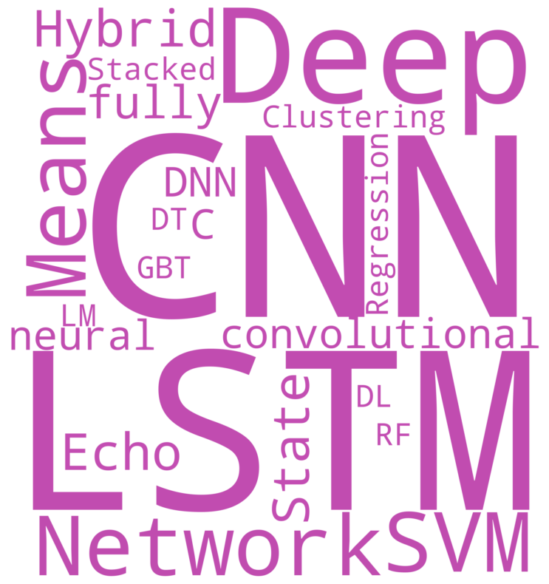
Methods used in Literatures

Slide 4
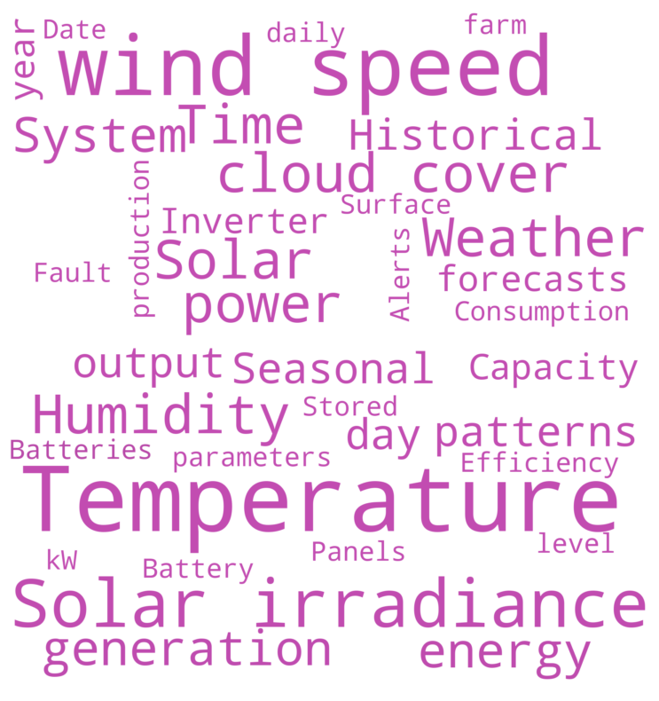
Variables used in literatures

Slide 5
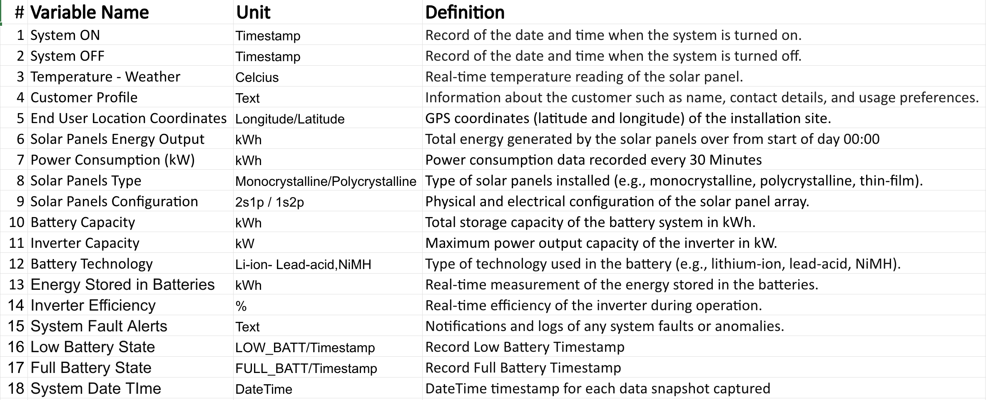
Concluded Explanatory Variables

Slide 6


