Slide 1
Impact of Style in Personalization of Large Language Models
Aashnna Soni, Balpreet Kaur, Prakriti Shetty

Slide 2
RESEARCH Problem
01
APPROACH
02
Table of contents
EXPERIMENTAL RESULTS
03
CONCLUSION
04
Defining our research question
Logical and Mathematical basis
Analysis of our results
Final takeaways

Slide 3
01
RESEARCH PROBLEM
Defining our research problem

Slide 4
Personalisation in llms
Key PRIOR ART
Personalization in LLMs aims to connect their universal capabilities with the rising demand for individualized interactions.
Linguistic style plays a crucial role in language, and recent advances have focused on developing style representations using authorship verification tasks
A.Salemi et al. (2023)
LaMP: a new framework for training and evaluating personalized LLMs
Wegmann et al. (2022)
Sentence embedding model designed explicitly to encapsulate linguistic style
Neelakanteswara et al. (2024)
Computes the average of Wegmann embeddings to encapsulate the overall stylistic tendencies of the author

Slide 5
RESEARCH QUESTION
Can we have an approach where we combine content-dependent and content-independent style representations to generate a personalised news headline for a given query document, such that it captures overall stylistic tendencies?

Slide 6
02
APPROACH
Logical and Mathematical basis of our proposed solution

Slide 7
Dense RETRIEVAL
STYLE EMBEDDINGS
HEADLINE
GENERATION
Original query input to an LLM generates 𝑘 query variants.
Dense retrieval and FAISS indexing to retrieve the top 𝑚 semantically similar documents
UNION
Employ Wegmann et al. (2022)’s model to extract style embeddings from the user profile documents
Compute the average of these embeddings to encapsulate the overall stylistic tendencies.
Arrange the inputs in descending order based on their cosine similarity to the average embedding.
Retrieve the top k results
Append the nuanced context of top k retrieved documents to the original query.
This expanded query is then sent as an input to the LLM, which then
generates our final output 𝑦𝑖 , the title of the query passage.

Slide 8
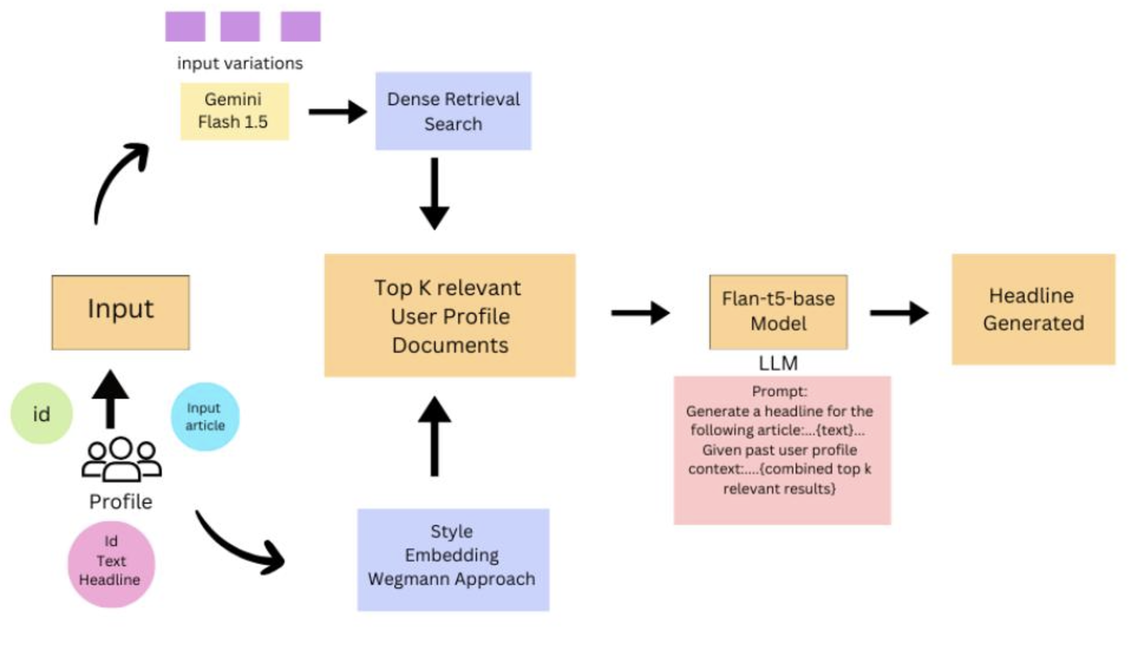
ARCHITECTURE DIAGRAM

Slide 9
03
RESULTS
Results and analysis

Slide 10
Results:
Evaluation Metrics: ROUGE-1 (unigram recall) and ROUGE-L (longest common subsequence) used to assess performance.
Best Performance: Hybrid approach outperforms all models in both ROUGE-1 (0.0985) and ROUGE-L (0.0894).
BM25 Model: Strong performance, second best for ROUGE-1 (0.0989) and ROUGE-L (0.0892).
Dense Search & Style Embedding: Lower scores, indicating reduced effectiveness in headline generation.
Metric | BM25 | Style Embedding | Dense Search | Hybrid
Rouge-1 | 0.0989 | 0.0826 | 0.0787 | 0.0985
Rouge-L | 0.0892 | 0.0787 | 0.0736 | 0.0894

Slide 11
04
CONCLUSIONS
Final Takeaways

Slide 12
Conclusions
Hybrid model combines strengths of content-dependent and content-independent embeddings.
Hybrid approach outperforms all models in both ROUGE-1 (0.0985) and ROUGE-L (0.0894).
Traditional IR methods like BM25, when optimized, still perform well in text generation tasks.
FUTURE WORK
Refining techniques: sentence embedding to extract relevant portions of the document.
Alternative LMs: for better task learning

Slide 13
THANK YOU

