Slide 1
Incubator Project Presentation

Slide 2
Name of your project?
Recommendation Engine
What is the core issue/problem it is addressing?
Recommendation engine is beneficial to both service providers and users
They reduce transaction costs of finding and selecting items, or services
Recommendation engine improves decision making process and quality
In e-commerce setting, recommendation engines enhance revenues, for the fact that they are effective means of selling more products

Slide 3
What is the solution it is providing?
It enriches the user experience which will lead to success of the system which uses recommendations smartly
Deliver right and related content
Customer Satisfaction
Who are the primary end users?
End users can be people using online shopping websites, tutorials or any kind of services
Recommendation engine predicts or recommends the likelihood that the user prefer

Slide 4
What is your focus market? size of the market? Is it a Product/Service? What will be your Business model?
Focus market will be online shopping websites, tutorials or any kind of service providing websites, apps, etc.
It can be considered as a product and service
Recommendation engine provides user satisfaction and hence increases revenue

Slide 5
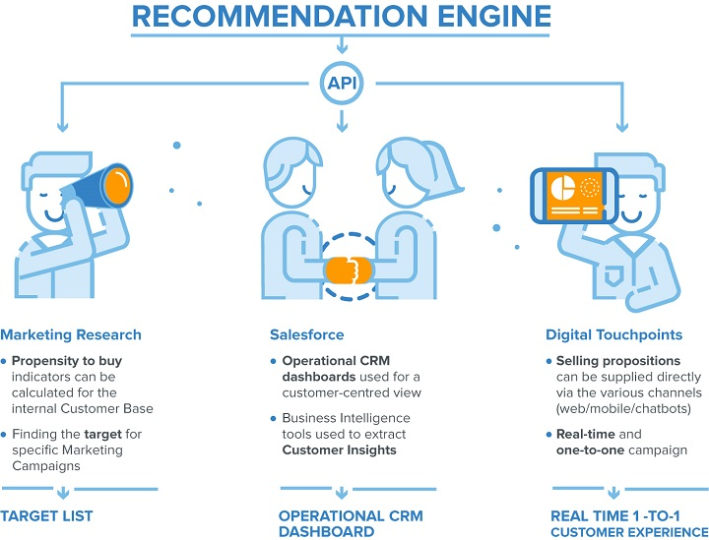

Slide 6
What are the Features? Highlights? USPs? Security Features? AI features?
Aims to provide the most relevant and accurate items to the user by filtering useful stuff from of a huge pool of information base
It discovers data patterns in the data set by learning consumer’s choices and produces the outcomes that co-relates to their needs and interests
AI features
Collaborative filtering : Comparing the taste of similar users by constructing item/user similarity matrix
Content-based filtering : Correlating item content against the user profile
Hybrid Recommendation System : To utilize the novel features of the both content and collaborative filtering approaches

Slide 7
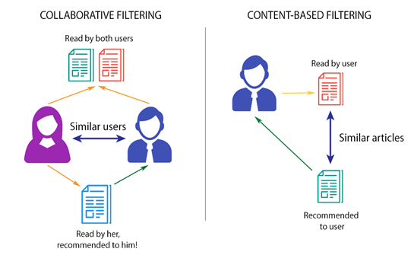

Slide 8
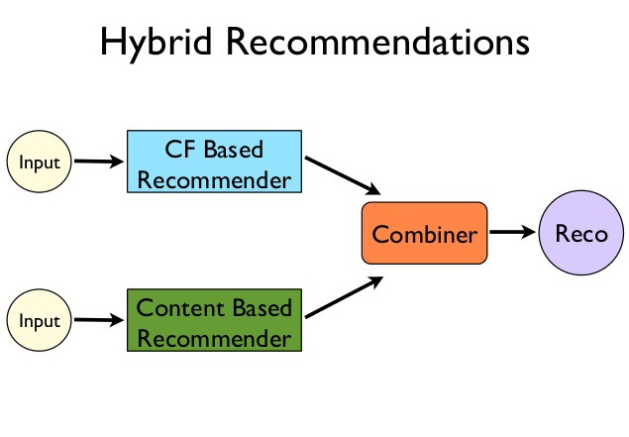

Slide 9
What will be Technology used to build it? /What is the Architecture? / Is the usage planned based on a License model? Is it Pay per use/Volumes?
It uses AI features with python as backend
Work flow
Collection of Data
Storing Data
Analyzing Data
Filtering data

Slide 10


Who are your Competitors? Other similar products/solutions similar to your project.
Amazon
Netflix

Slide 11
Thankyou

