Slide 1
Infra Management Scope Screen Completion Statis
Completed scope — prototype slots + status

Slide 2
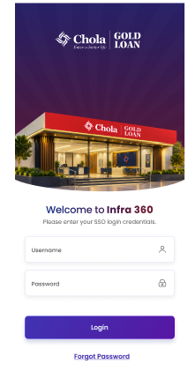
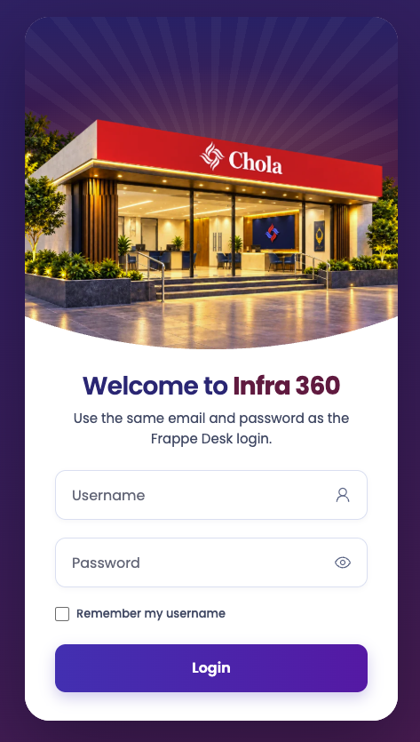
Slide layout guide
Login Screen
IMS React Portal — Completed scope review
2 / 23

Slide 3
Slide layout guide
Login Screen
IMS React Portal — Completed scope review
2 / 23

Slide 4
Scope snapshot
15
Covered
1
Covered (server-dep.)
3
Yet to detail
Completed focus areas
• Infra dashboard + pending queues (RIBP / ZIBP / RLM / Heads / Legal / Business Team)
• Proposed Branch workspace: Request Info, Property, Commercial, Facility, Owner, Queries, Activity
• MIS dashboard + request dialogs (IMS MIS User / Approver)
• New Branch create/list (Business Team) + Records browser
Still open: Operations hub screens, Reports, Administration (nav placeholders)
IMS React Portal — Completed scope review
3 / 23

Slide 5
Login
Covered
Attach designed prototype image here
Insert → Pictures | paste screenshot / Figma export
Leave this frame empty until design is ready
STATUS
Covered
ROLES
All users (unauthenticated → Frappe session)
ROUTE
/login
NOTES
Auth entry against Frappe; CSRF + session cookies via Vite proxy.
PROTOTYPE
Insert the designed screen image into the left panel.
IMS React Portal — Completed scope review
4 / 23

Slide 6
Dashboard (Infra / role queues)
Covered
Attach designed prototype image here
Insert → Pictures | paste screenshot / Figma export
Leave this frame empty until design is ready
STATUS
Covered
ROLES
RIBP, ZIBP, RLM, Heads, Legal, Business Team, Admins, HO Infra Legal / Process / Payment
ROUTE
/dashboard
NOTES
KPIs, region cards, pending queues. Request ID = PBD name; Property ID = request_no_new.
PROTOTYPE
Insert the designed screen image into the left panel.
IMS React Portal — Completed scope review
5 / 23

Slide 7
Dashboard (MIS)
Covered
Attach designed prototype image here
Insert → Pictures | paste screenshot / Figma export
Leave this frame empty until design is ready
STATUS
Covered
ROLES
IMS MIS User, IMS MIS Approver, IMS MIS
ROUTE
/dashboard
NOTES
MIS Product Wise Branch Initiate overview, FY filter, Create/View dialogs, attachments.
PROTOTYPE
Insert the designed screen image into the left panel.
IMS React Portal — Completed scope review
6 / 23

Slide 8
Pending With Me
Covered
Attach designed prototype image here
Insert → Pictures | paste screenshot / Figma export
Leave this frame empty until design is ready
STATUS
Covered
ROLES
Roles with pending module (RIBP, ZIBP, RLM, Heads, Legal, Business Team, Admins)
ROUTE
/pending
NOTES
Full task list with Request ID / Property ID columns and aging.
PROTOTYPE
Insert the designed screen image into the left panel.
IMS React Portal — Completed scope review
7 / 23

Slide 9
Branch Requests (Total Listing)
Covered
Attach designed prototype image here
Insert → Pictures | paste screenshot / Figma export
Leave this frame empty until design is ready
STATUS
Covered
ROLES
Roles with requests module
ROUTE
/infra/requests
NOTES
Proposed Branch Details listing with search and filters.
PROTOTYPE
Insert the designed screen image into the left panel.
IMS React Portal — Completed scope review
8 / 23

Slide 10
Proposed Branch — Request Info
Covered
Attach designed prototype image here
Insert → Pictures | paste screenshot / Figma export
Leave this frame empty until design is ready
STATUS
Covered
ROLES
Any role with Proposed Branch read permission
ROUTE
/infra/requests/:id
NOTES
Default workspace tab; workflow action bar on header.
PROTOTYPE
Insert the designed screen image into the left panel.
IMS React Portal — Completed scope review
9 / 23

Slide 11
Proposed Branch — Property Details
Covered
Attach designed prototype image here
Insert → Pictures | paste screenshot / Figma export
Leave this frame empty until design is ready
STATUS
Covered
ROLES
RIBP (editable at Property Details stage); others read per workflow
ROUTE
/infra/requests/:id/property-details
NOTES
Editable form driven by RIBP Field details.xlsx matrix.
PROTOTYPE
Insert the designed screen image into the left panel.
IMS React Portal — Completed scope review
10 / 23

Slide 12
Proposed Branch — Commercial Details
Covered
Attach designed prototype image here
Insert → Pictures | paste screenshot / Figma export
Leave this frame empty until design is ready
STATUS
Covered
ROLES
RIBP editable in Property Details stage; others read
ROUTE
/infra/requests/:id/commercial-details
NOTES
Promoted from Desk All-details tabs into workspace nav.
PROTOTYPE
Insert the designed screen image into the left panel.
IMS React Portal — Completed scope review
11 / 23

Slide 13
Proposed Branch — Facility Details
Covered
Attach designed prototype image here
Insert → Pictures | paste screenshot / Figma export
Leave this frame empty until design is ready
STATUS
Covered
ROLES
RIBP editable in Property Details stage; others read
ROUTE
/infra/requests/:id/facility-details
NOTES
Facility / services fields per RIBP matrix.
PROTOTYPE
Insert the designed screen image into the left panel.
IMS React Portal — Completed scope review
12 / 23

Slide 14
Proposed Branch — Owner Details
Covered
Attach designed prototype image here
Insert → Pictures | paste screenshot / Figma export
Leave this frame empty until design is ready
STATUS
Covered
ROLES
RIBP (editable owner/premise tables); others read
ROUTE
/infra/requests/:id/owner-details
NOTES
Owner Details child table and related premise documents.
PROTOTYPE
Insert the designed screen image into the left panel.
IMS React Portal — Completed scope review
13 / 23

Slide 15
Proposed Branch — Queries
Covered
Attach designed prototype image here
Insert → Pictures | paste screenshot / Figma export
Leave this frame empty until design is ready
STATUS
Covered
ROLES
Stage actors (RLM, ZIBP, Heads, Legal, RIBP, …)
ROUTE
/infra/requests/:id/queries
NOTES
Raise / respond / resolve / reopen query flows.
PROTOTYPE
Insert the designed screen image into the left panel.
IMS React Portal — Completed scope review
14 / 23

Slide 16
Proposed Branch — Activity
Covered
Attach designed prototype image here
Insert → Pictures | paste screenshot / Figma export
Leave this frame empty until design is ready
STATUS
Covered
ROLES
Roles that can read the request
ROUTE
/infra/requests/:id/activity
NOTES
Workflow comments and stage history timeline.
PROTOTYPE
Insert the designed screen image into the left panel.
IMS React Portal — Completed scope review
15 / 23

Slide 17
MIS Requests list + Create / View dialogs
Covered
Attach designed prototype image here
Insert → Pictures | paste screenshot / Figma export
Leave this frame empty until design is ready
STATUS
Covered
ROLES
IMS MIS User, IMS MIS Approver
ROUTE
/mis/requests (+ dialogs)
NOTES
Draft / In Progress / Complete; Draft editable; Approver actions.
PROTOTYPE
Insert the designed screen image into the left panel.
IMS React Portal — Completed scope review
16 / 23

Slide 18
New Branch list & Create
Covered
Attach designed prototype image here
Insert → Pictures | paste screenshot / Figma export
Leave this frame empty until design is ready
STATUS
Covered
ROLES
Business Team; System Manager / HO Infra Branch Admin
ROUTE
/new-branch , /new-branch/new
NOTES
Create New Branch Details; submit creates Proposed Branch on server.
PROTOTYPE
Insert the designed screen image into the left panel.
IMS React Portal — Completed scope review
17 / 23

Slide 19
Records (generic DocType list & detail)
Covered
Attach designed prototype image here
Insert → Pictures | paste screenshot / Figma export
Leave this frame empty until design is ready
STATUS
Covered
ROLES
Any role with Frappe read on a portal DocType
ROUTE
/documents , /documents/:doctype/:name
NOTES
Layout, PO, BAZ, Query Log, etc. via permission-scoped Records UI.
PROTOTYPE
Insert the designed screen image into the left panel.
IMS React Portal — Completed scope review
18 / 23

Slide 20
DMS attach / download
Covered (server-dependent)
Attach designed prototype image here
Insert → Pictures | paste screenshot / Figma export
Leave this frame empty until design is ready
STATUS
Covered (server-dependent)
ROLES
Roles editing Attach fields or opening attachments
ROUTE
controller.py GET_File / upload
NOTES
SPA wired; needs UAT controller + site_config dms_authorization.
PROTOTYPE
Insert the designed screen image into the left panel.
IMS React Portal — Completed scope review
19 / 23

Slide 21
Operations hub
Yet to detail
Attach designed prototype image here
Insert → Pictures | paste screenshot / Figma export
Leave this frame empty until design is ready
STATUS
Yet to detail
ROLES
HO Infra Legal; RIBP; HO Infra Process Owner; HO Infra Payment Team
ROUTE
/operations
NOTES
Placeholder. Dedicated Layout / PO / Advance / BAZ screens still to design.
PROTOTYPE
Insert the designed screen image into the left panel.
IMS React Portal — Completed scope review
20 / 23

Slide 22
Reports
Yet to detail
Attach designed prototype image here
Insert → Pictures | paste screenshot / Figma export
Leave this frame empty until design is ready
STATUS
Yet to detail
ROLES
System Manager; HO Infra Branch Admin
ROUTE
/reports
NOTES
Placeholder. Pipeline / aging / TAT reports planned.
PROTOTYPE
Insert the designed screen image into the left panel.
IMS React Portal — Completed scope review
21 / 23

Slide 23
Administration
Yet to detail
Attach designed prototype image here
Insert → Pictures | paste screenshot / Figma export
Leave this frame empty until design is ready
STATUS
Yet to detail
ROLES
System Manager; HO Infra Branch Admin; Administrator
ROUTE
/admin
NOTES
Placeholder. Role-master admin remains in Frappe Desk for this delivery.
PROTOTYPE
Insert the designed screen image into the left panel.
IMS React Portal — Completed scope review
22 / 23

Slide 24
Next: attach prototypes & close Yet-to-detail items
Priority backlog
1. Operations — Layout, PO Status, Advance Payment, BAZ Vendor screens
2. Reports — pipeline, aging, TAT
3. Administration — portal-facing role/user admin (or keep Desk)

