Slide 1
FINAL YEAR PROJECT DEFENSE
Design and Development of an Intelligent Platform for
Automated Mobile Application Analytics Reporting
Prepared by Bendhif Balsam
Supervised by: Zargayouna Mahdi
MSc AI & Digital Transformation
Academic Year 2025-2026

Slide 2
TABLE OF CONTENTS
01
Introduction
05
Data Understanding, Exploration & Preprocessing
02
Business Problem and Objectives
06
Modeling and Evaluation
03
Project Methodology and Pipeline
07
Visualisation, Data Storage and Web Integration
04
Analysis and Specification of Requirements
08
Conclusion
02

Slide 3
01
INTRODUCTION
Why this project, what it covers, and how it is organized
03

Slide 4

INTRODUCTION
This project takes mobile app reporting — which today is slow, manual, and full of mistakes — and makes it fully automatic and smart, using AI. It's built on three parts: Data Engineering, Cloud Computing, and Generative AI. And it comes from a real problem I saw during my internship at AppASO Group, which I'll explain in a minute. In the next fifteen minutes, I'll show you the problem, how I built the system, how I tested it, and what's next. Let's begin.
1. INTRODUCTION
04

Slide 5
PROBLEM STATEMENT
How can we make mobile app performance reporting fully automatic and smarter using AI?
1. INTRODUCTION
05

Slide 6
02
BUSINESS PROBLEM AND OBJECTIVES
From a slow manual process to an automatic system
06

Slide 7
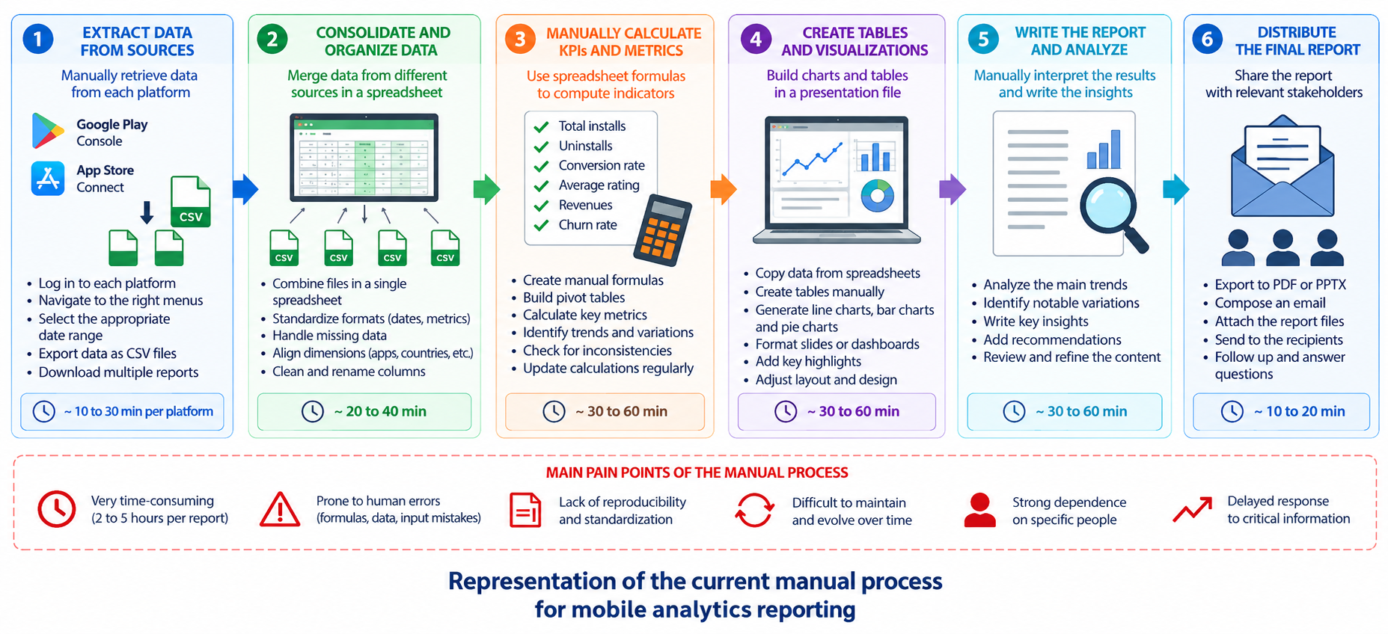
CURRENT MANUAL PROCESS & LIMITATIONS
2. BUSINESS PROBLEM
07

Slide 8
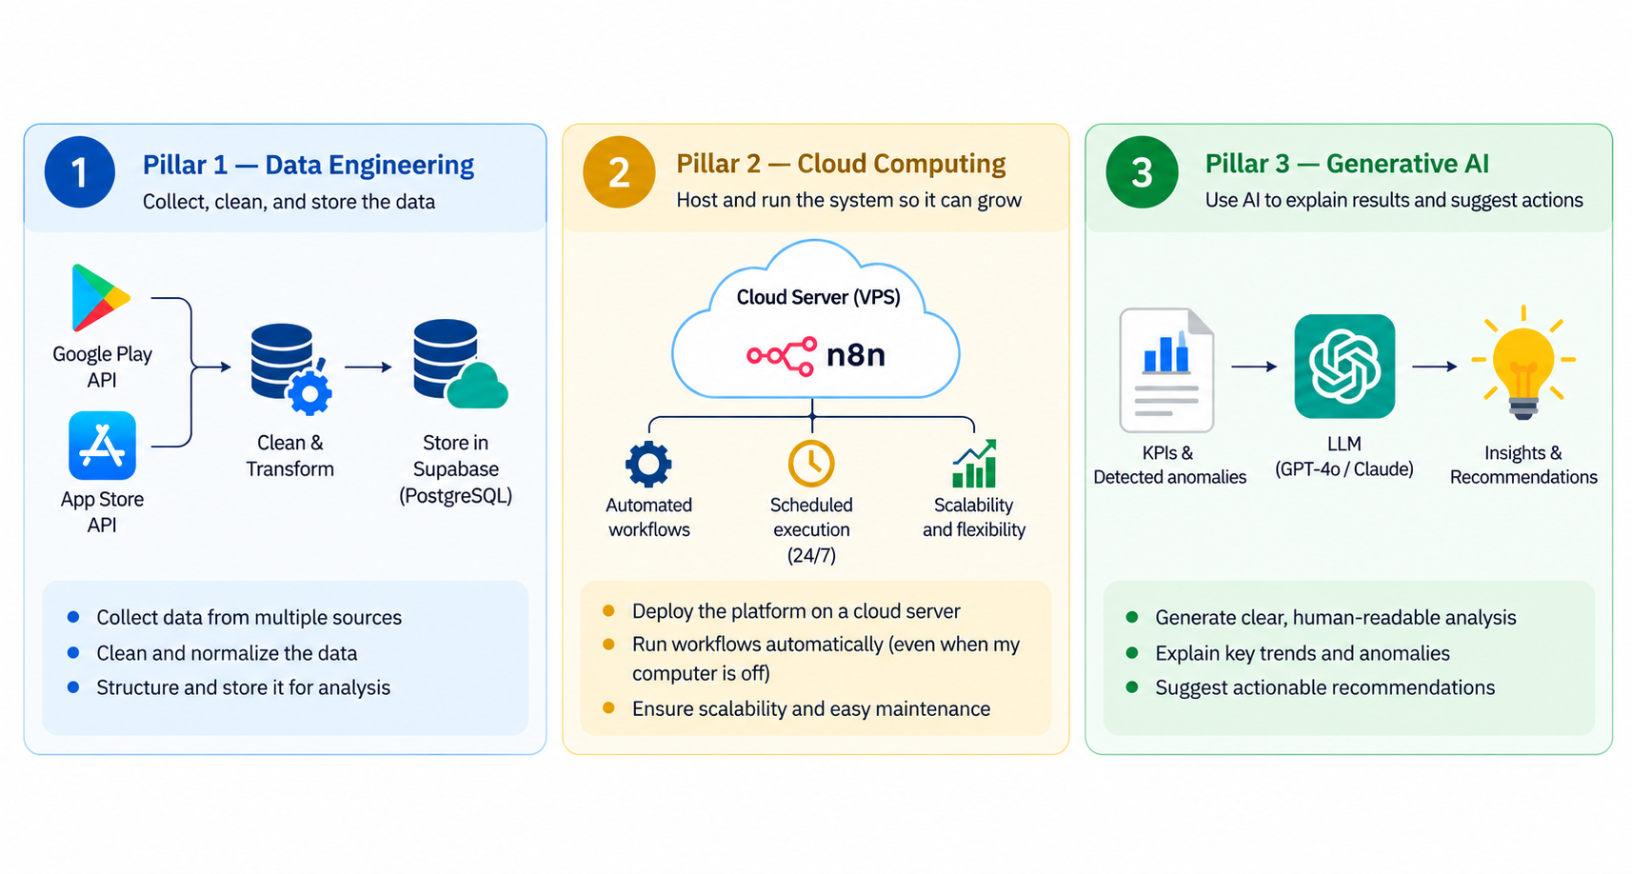
OBJECTIVES & THREE PILLARS
Goal: build a smart platform that automates mobile analytics reporting, start to finish
2. BUSINESS PROBLEM
09

Slide 9
03
PROJECT METHODOLOGY AND PIPELINE
How the pipeline works, its design, and the tools we used
10

Slide 10
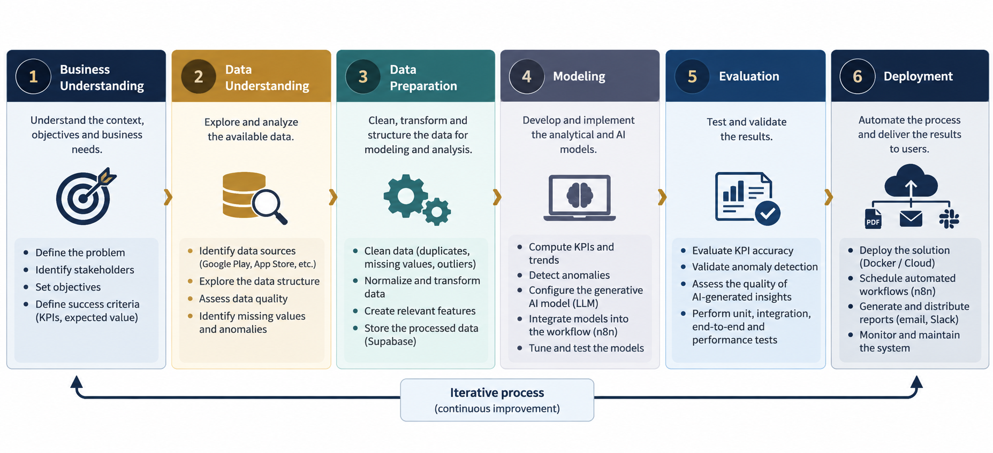
PROJECT METHODOLOGY — CRISP-DM
3. METHODOLOGY
11

Slide 11
APIS & DATA COLLECTION
Google Play Developer API
App Store Connect API
Data Collection Service
Secure login: OAuth 2.0 for Google, a signed key (JWT) for Apple
Runs automatically every week, no manual work needed
Downloads installs, ratings, reviews, and crash data
3. METHODOLOGY
12

Slide 12
PROJECT PIPELINE
The data journey, from raw data to the final report
1
2
3
4
5
Collect
›
Clean
›
Store
›
Analyze
›
Deliver
Google Play & App Store APIs
Python
Supabase / PostgreSQL
AI (GPT-4o / Claude)
PDF, PPTX, Email
Cloud Infrastructure — hosts every step
Docker — packages the automation engine (Collect, Clean, Analyze, Deliver) so it runs the same way everywhere
3. METHODOLOGY
13

Slide 13
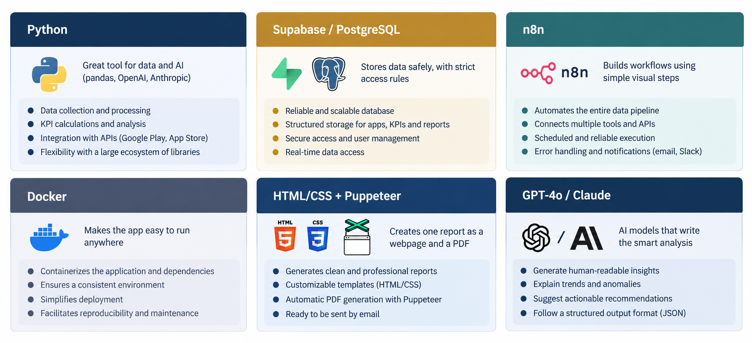
TOOLS USED & WHY
3. METHODOLOGY
17

Slide 14
DOCKER, CLOUD & N8N — WHO DOES WHAT
Containerizing an app is not the same as storing data in it
CLOUD SERVER — hosts the environment
APIs
Provide the raw data
DOCKER CONTAINER — an isolated, portable box
n8n
Supabase / PostgreSQL
Orchestrates the workflow (runs inside Docker)
Stores the data
LLM (GPT-4o / Claude)
Generates the analysis
Docker = a box that contains the application and its environment, so it can be moved and run anywhere.
3. METHODOLOGY
14

Slide 15
04
ANALYSIS AND SPECIFICATION OF REQUIREMENTS
Who uses the system, and what it needs to do
19

Slide 16
FUNCTIONAL REQUIREMENTS
Collect
Process
Get data from Google Play and the App Store
Clean the data and calculate the results
Analyze
Deliver
Find problems and explain them with AI
Send a PDF report, a slide deck, and an email
4. REQUIREMENTS
22

Slide 17
NON-FUNCTIONAL REQUIREMENTS
Reliability & Performance
Scalability & Security
Maintainability & Portability
Works correctly and finishes in minutes
Easy to add new apps; passwords stay safe
Easy to update; can run on other platforms
4. REQUIREMENTS
23

Slide 18
05
DATA UNDERSTANDING, EXPLORATION & PREPROCESSING
How the data is organized, cleaned, and checked
24

Slide 19
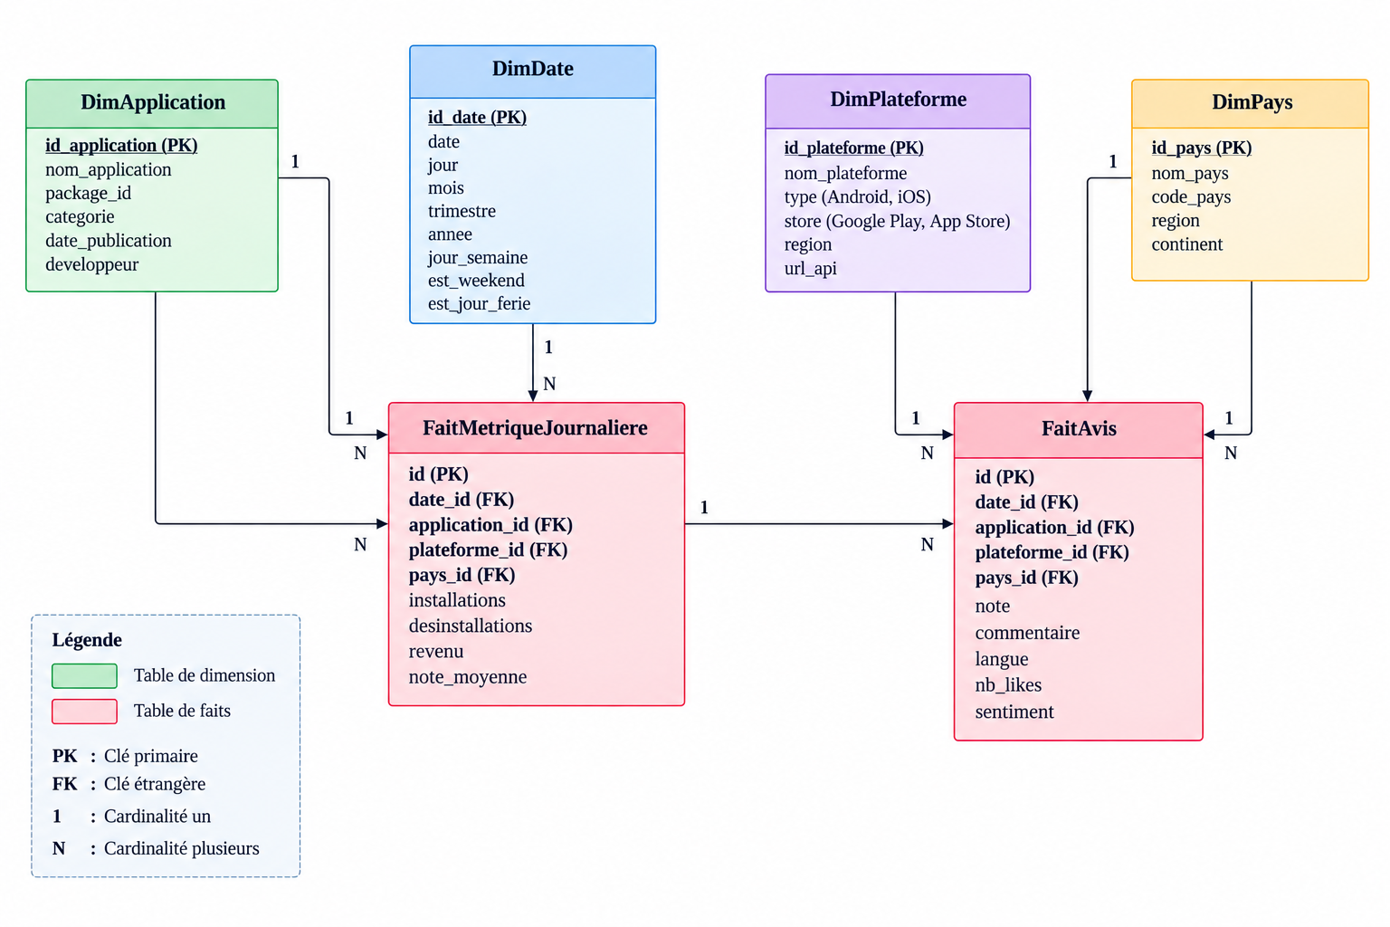
Fact Constellation
5. DATA
26

Slide 20
DATA CLEANING & KPI COMPUTATION
Remove duplicate rows and fix the date format
Fill in missing values, and flag numbers that look unusual
Calculate daily, weekly, and monthly results like growth and ratings
5. DATA
27

Slide 21
KPI CATALOGUE
Calculated daily, weekly, or monthly
KPI | How It's Calculated | Frequency
Install growth rate | % change vs. the last period | Weekly / monthly
Uninstall rate | uninstalls / installs | Daily
Weighted average rating | Average rating (recent ones count more) | Weekly
Crash rate | failed sessions / total sessions | Daily
ARPU | revenue / active users | Monthly
5. DATA
28

Slide 22
06
MODELING AND EVALUATION
How we spot problems, and how AI explains them
29

Slide 23
ANOMALY DETECTION APPROACH
A result is flagged when it's very different from its recent average
A simple math rule decides how different counts as 'too different'
The report shows how serious each problem is
6. MODELING
30

Slide 24
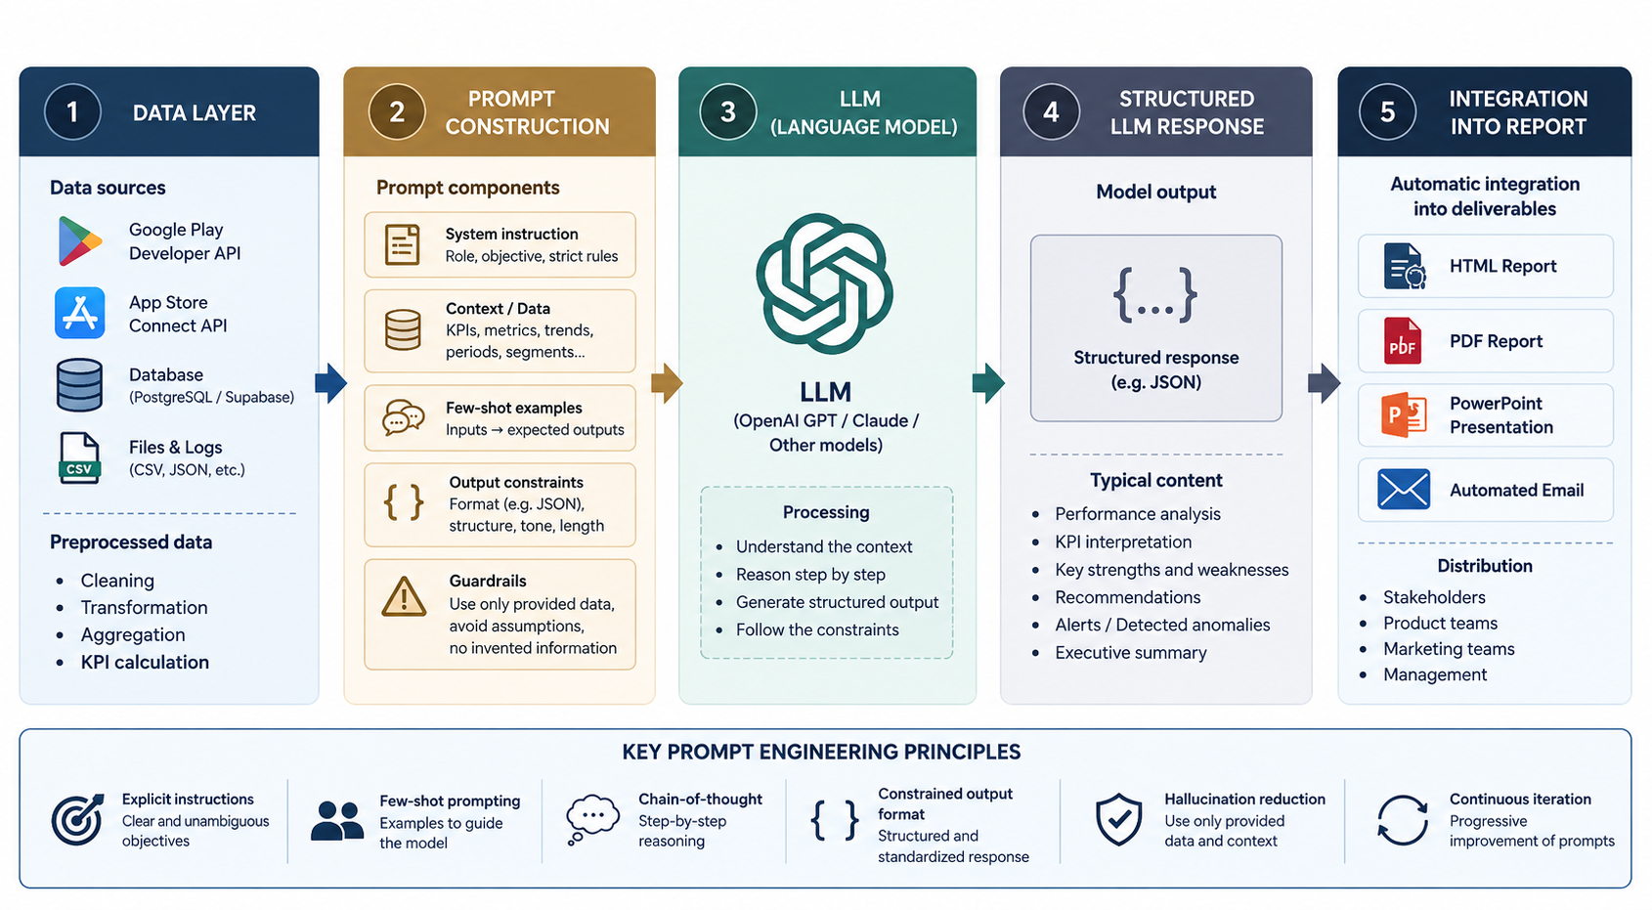
GENERATIVE AI ANALYSIS MODULE
The AI follows examples and always answers in a fixed format
6. MODELING
31

Slide 25
TESTING STRATEGY
Unit Tests
Integration Tests
End-to-End Tests
Performance Tests
LLM Validation
Check small parts, like KPI math and cleaning
Check that all parts work well together
Test the whole process, start to finish
Check speed as more apps are added
Check that the AI's answers make sense
6. MODELING
32

Slide 26
LLM ANALYSIS — VALIDATION RESULTS
What We Checked | Sample | Success Rate | Result
No made-up numbers | 20 scenarios | 100% | 20/20
Always the correct format | 20 scenarios | 100% | 20/20
Useful, relevant analysis | 20 scenarios | 90% | 18/20
Clear, specific advice | 20 scenarios | 80% | 16/20
6. MODELING
33

Slide 27
ANOMALY DETECTION RESULTS
5 out of 6 test problems were correctly found
Case | Test Problem | Found? | Severity
1 | Sudden rating drop (App 1, Android) | Yes | Critical
2 | Uninstall spike (App 2, iOS) | Yes | Critical
3 | Slow rating decline (App 3, Android) | Yes | Moderate
4 | Uninstall spike (App 1, iOS) | Yes | Critical
5 | Small crash-rate change (App 2, Android) | No | None
6 | Sudden rating drop (App 3, iOS) | Yes | Critical
6. MODELING
34

Slide 28
07
VISUALISATION, DATA STORAGE AND WEB INTEGRATION
How data is stored, automated, and shown to users
35

Slide 29
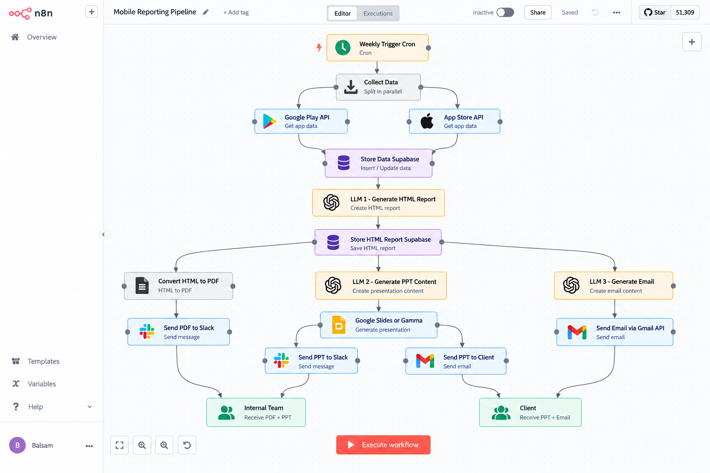
ORCHESTRATION — N8N WORKFLOW
7. VISUALISATION
37

Slide 30
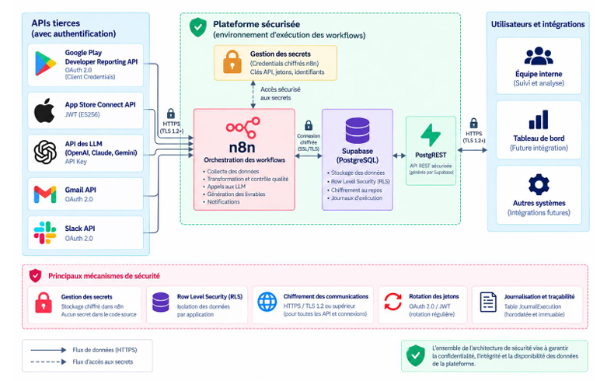
Data Storage & Security
38

Slide 31
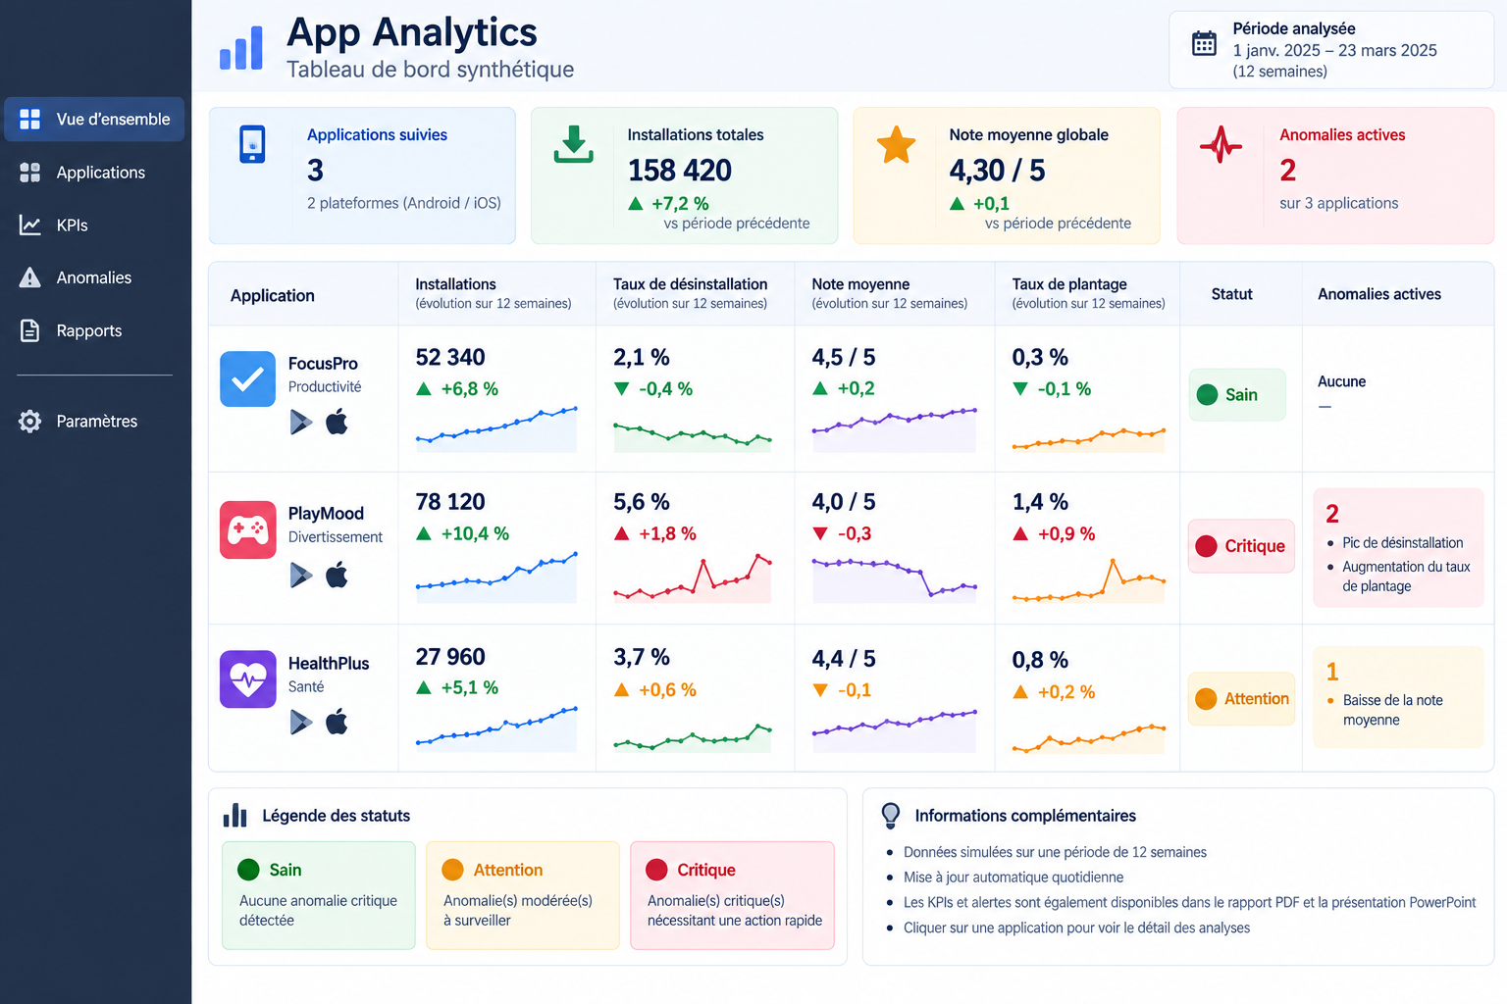
INTERACTIVE DASHBOARD
7. VISUALISATION
39

Slide 32
REAL-WORLD RESULTS — IOS VS GOOGLE PLAY
Real weekly performance report, March 1–7, 2026
iOS
Google Play
375,775
16,687
Impressions
Impressions
30,669
2,915
Installs
Installs
~10%
~17.5%
Conversion Rate
Conversion Rate
Real anomaly caught: iOS saw a spike of 117,000 impressions on March 2 with only 3.12% conversion — exactly the kind of pattern this project's anomaly detection is designed to flag.
7. VISUALISATION
40

Slide 33
08
CONCLUSION
What we achieved, what's missing, and what's next
41

Slide 34
CONTRIBUTIONS & LIMITATIONS
To summarize my contribution: I built a working system that genuinely combines data engineering, cloud infrastructure, and generative AI, and I grounded it in a real AppASO performance report rather than working purely in the abstract.
Importantly, I proved that a properly constrained LLM can be fully factually reliable in this context, across 20 test scenarios.
The system was built and validated under controlled conditions
8. CONCLUSION
42

Slide 35
THANK YOU
Questions & Discussion

