Slide 1


Movie Ticket

Slide 2


Introduction
The "Online Movie Ticket Booking System" has been developed to override the problems prevailing in the practicing manual system. This software is supported to eliminate and in some cases reduce the hardships faced by this existing system. Moreover this system is designed for the particular need of the company to carry out operations in a smooth and effective manner.

Slide 3


Motivation and Objectives
The main idea of this project is to facilitate purchases or booking tickets for movies and I wanted to try to do it on the knowledge of Java GUI. To implement the application, I needed several Java libraries and working with the JDBC driver.

Slide 4
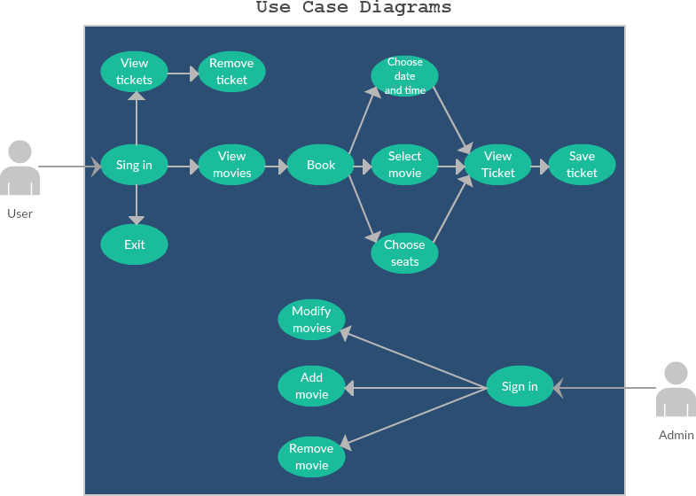

Slide 5
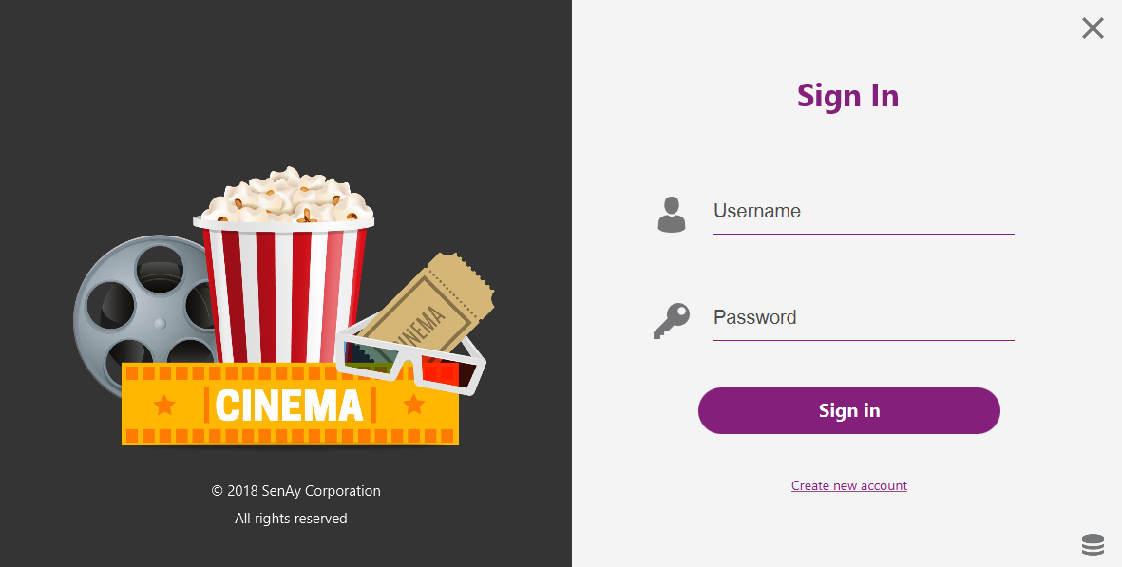
Implementation
Login page

Slide 6
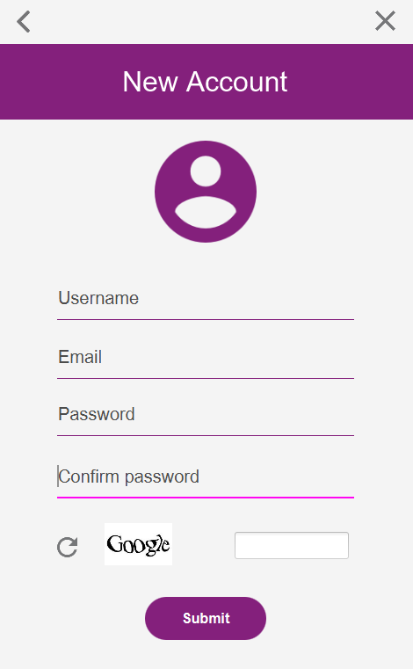
Sign up

Slide 7
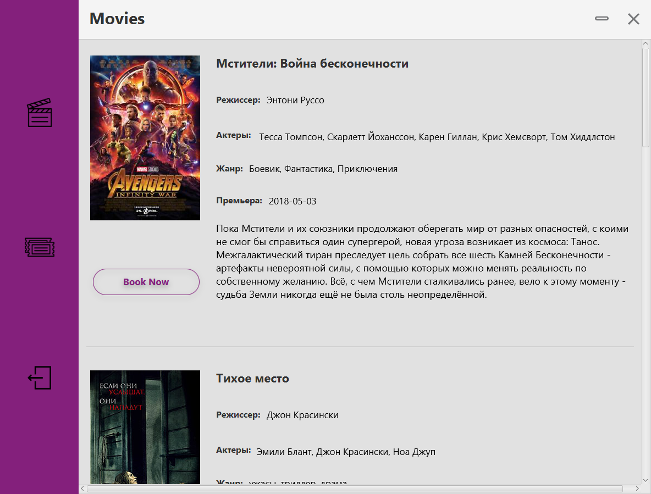
View movies

Slide 8
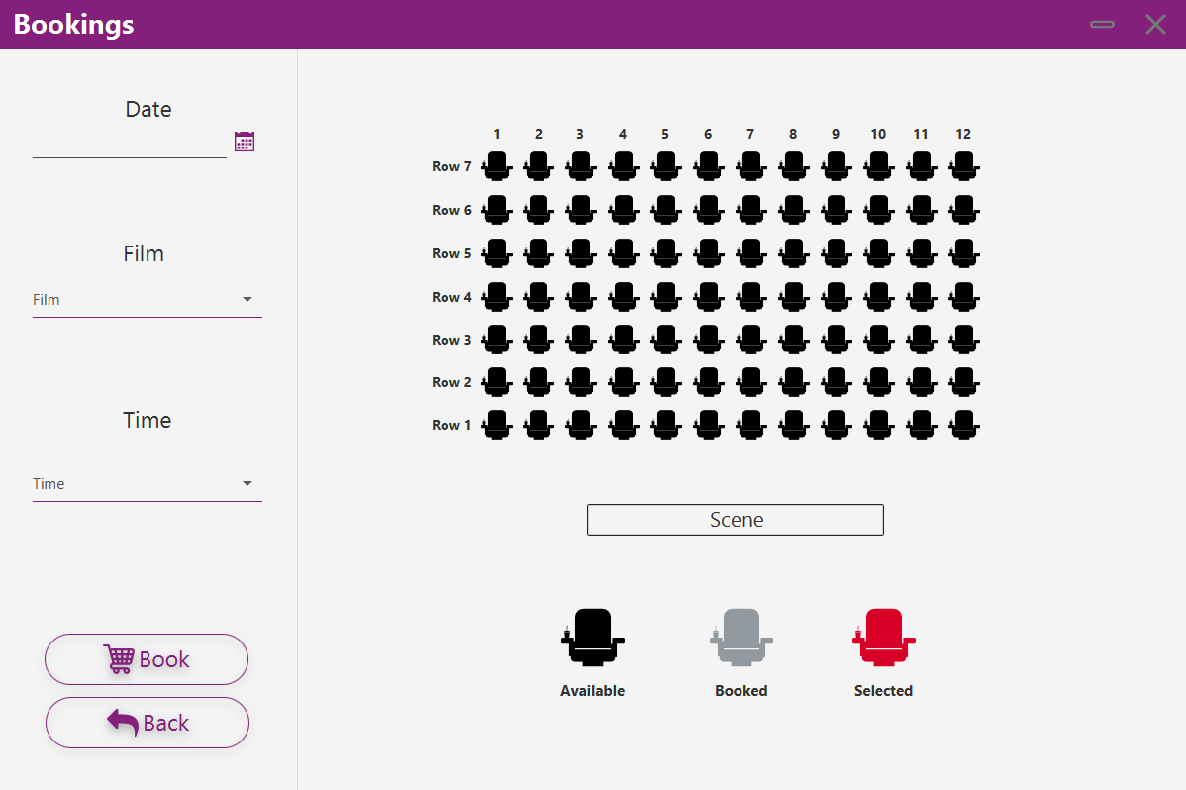
Booking ticket

Slide 9
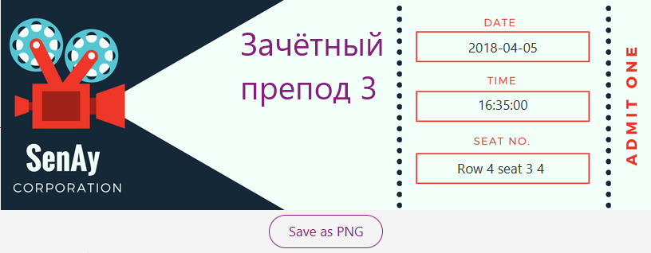
View ticket and save as PNG

Slide 10


Conclusion
Created by Baltabay
Link to GitHub:
https://github.com/Baltabay/Ticket-Booking
Thank you all who helped me

