Slide 1
git basics
Karim Heredia
https://about.me/karim.heredia

Slide 2
git basics
To be followed step by step by all of you

Slide 3
git basics
There are many ways of using it. This is just one of them.

Slide 4
What you should understand by the end
Why we need git
How to create a repository on GitHub
How to clone a repository into VS 2019
How to add a solution to the repository
Basic operations to commit changes
Understand how branches work
Flow between local and remote repositories

Slide 5
If we have time, we could
Try to use command-line git
Try to do a pull request
Learn how to stash changes

Slide 6
Why do we need git?

Slide 7
Some of the reasons why you need git
History
Teamwork
Multiple versions
Suggestions

Slide 8
Starting a new repository

Slide 9
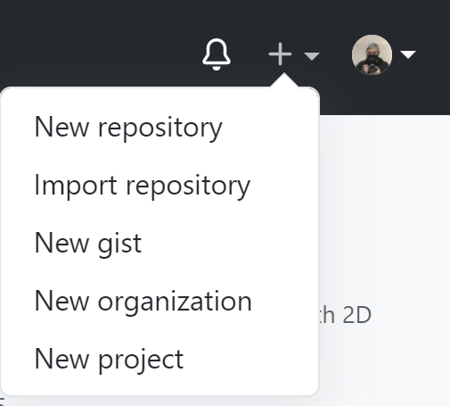
Creating a new repository

Slide 10
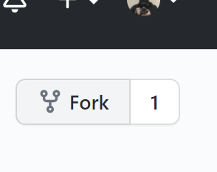
Forking a repository

Slide 11
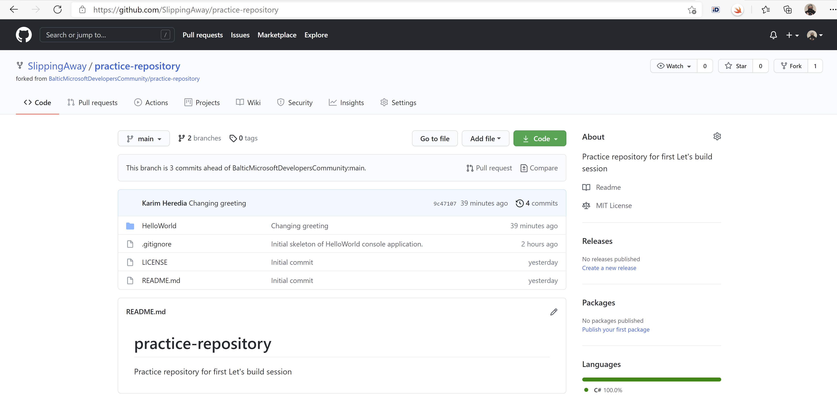
Example repository

Slide 12
Getting started with VS2019

Slide 13
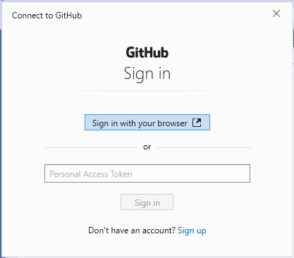
Visual Studio will ask you to authenticate with GitHub

Slide 14
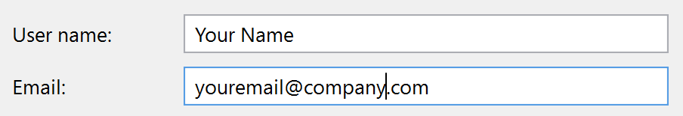
You need your name and e-mail to identify changes

Slide 15
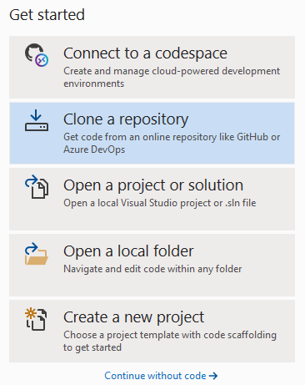
Clone repository

Slide 16
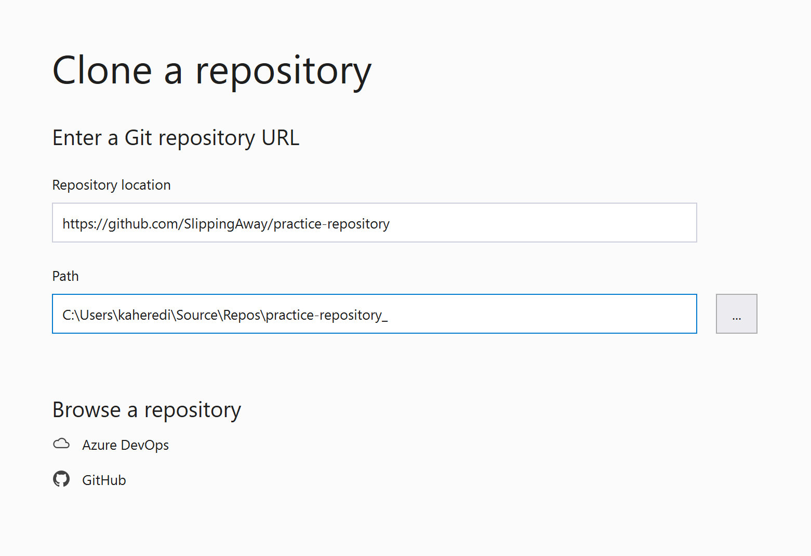
URL from GitHub

Slide 17
Let’s add a VS solution

Slide 18
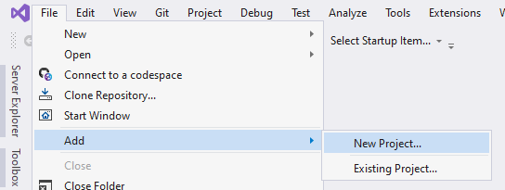
Add a new project after cloning

Slide 19
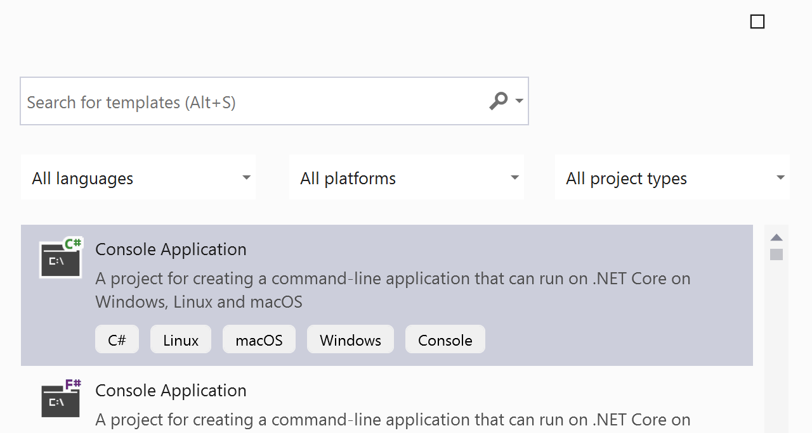
Choose project type

Slide 20
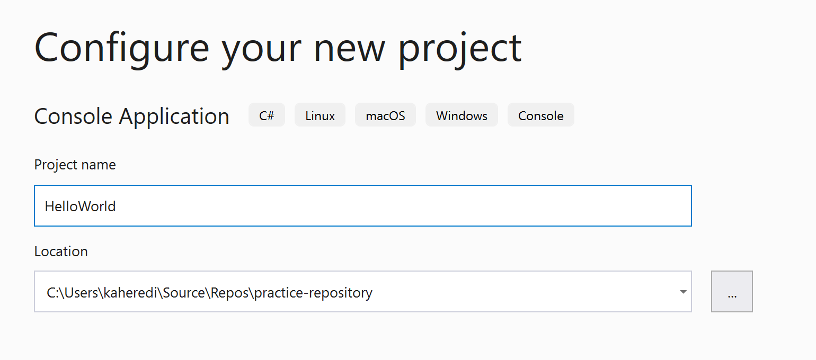
Choose a name, but location should stay untouched.

Slide 21
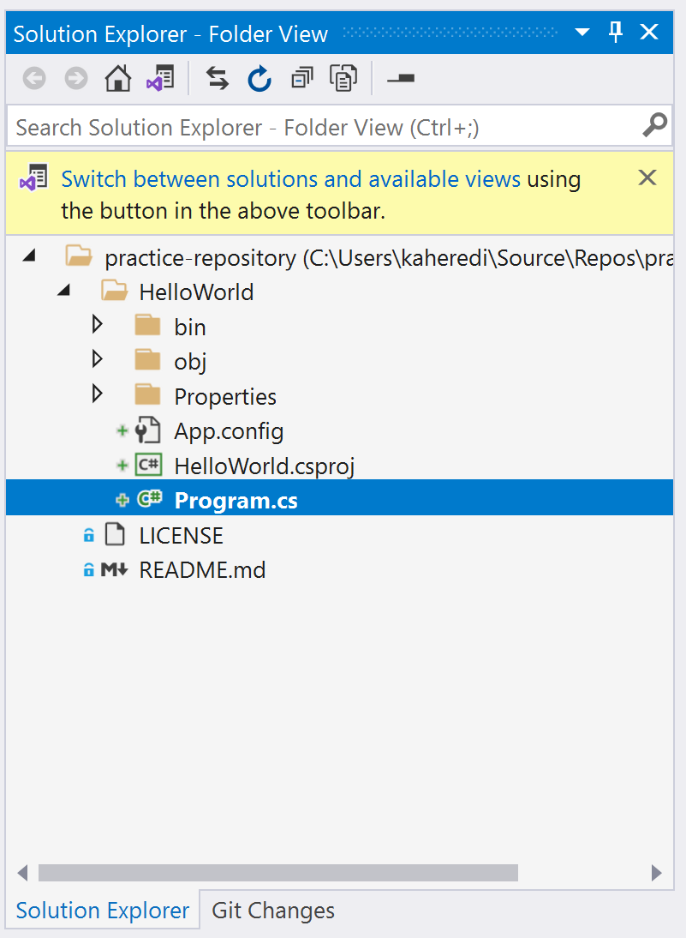
Solution explorer

Slide 22
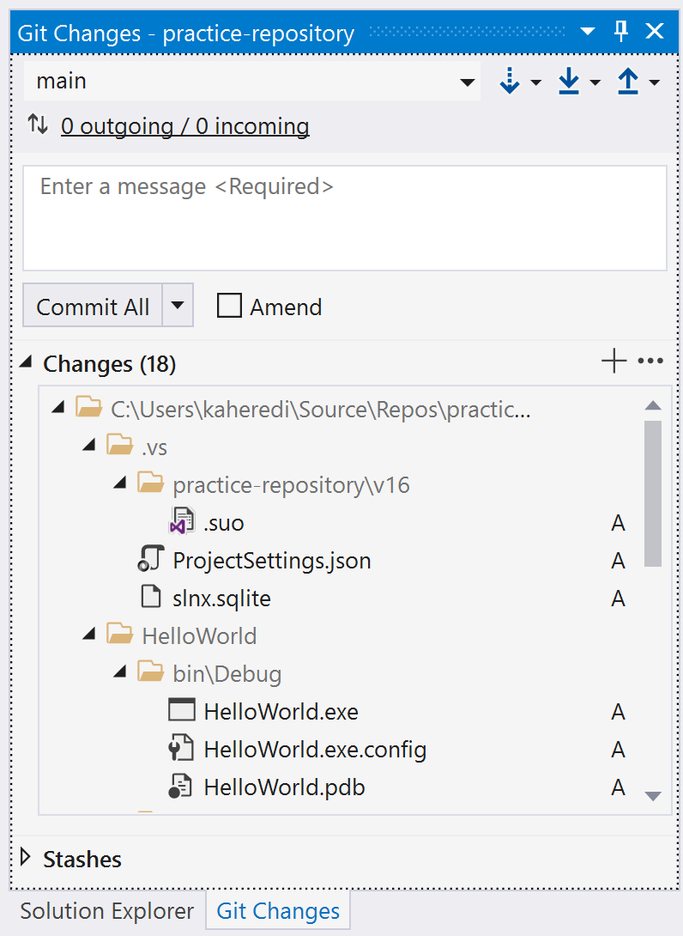
Git changes should show all new files

Slide 23
Let’s add a .gitignore file

Slide 24
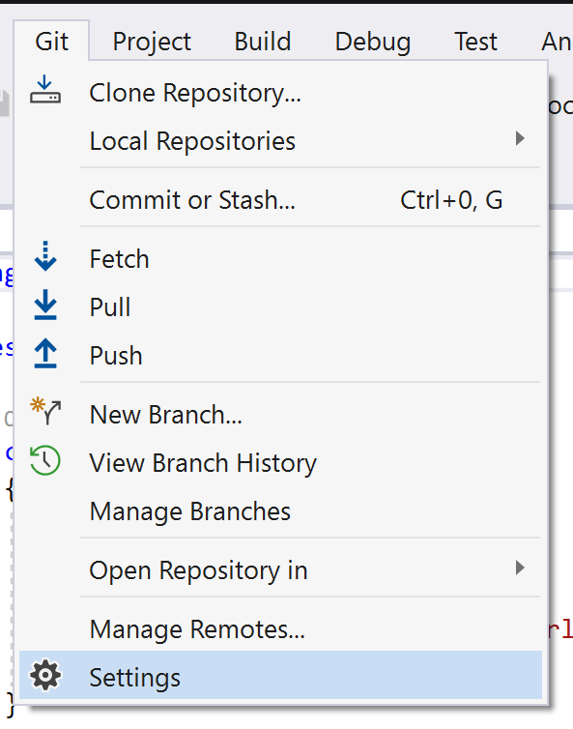
We need a .gitignore file

Slide 25
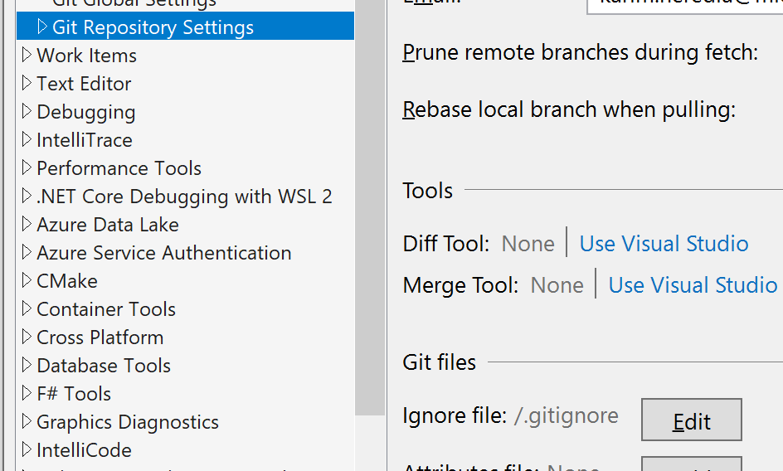
We need a .gitignore file

Slide 26
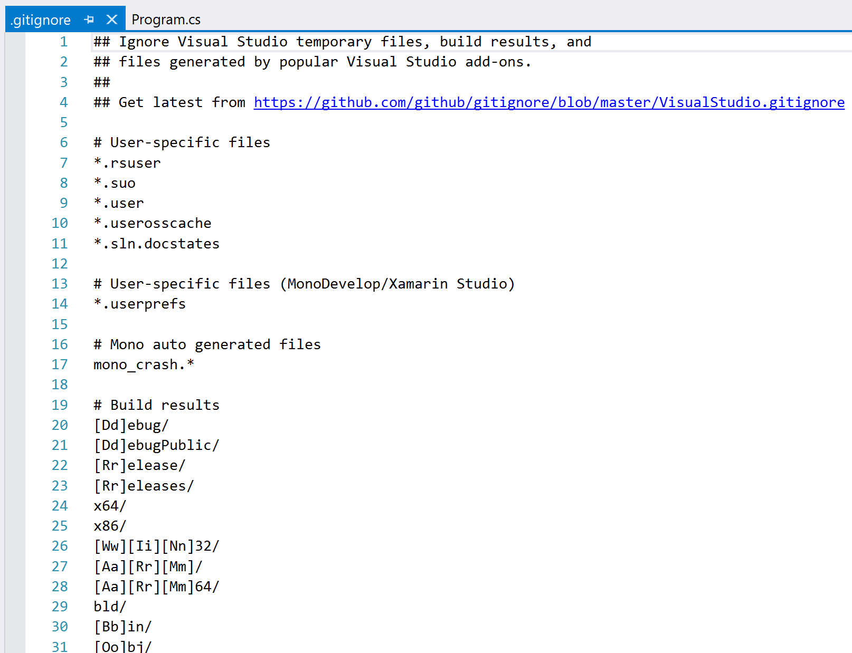
We need a .gitignore file

Slide 27
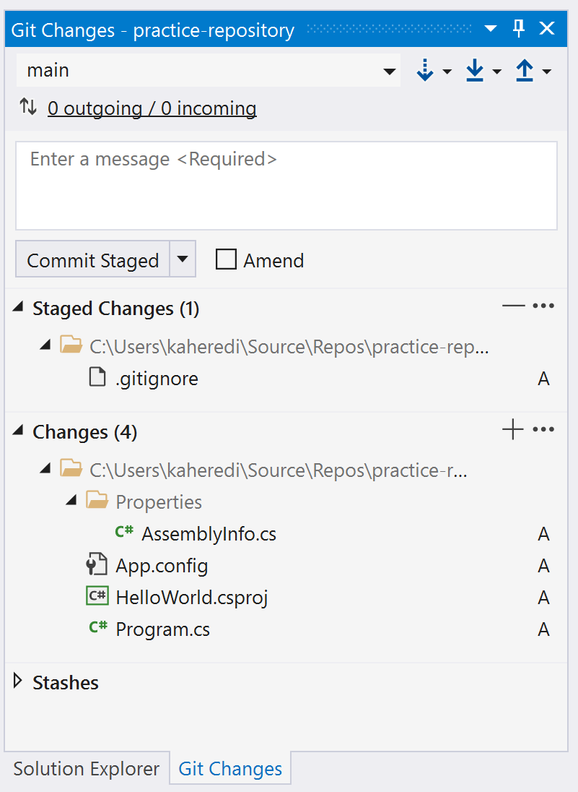
Git changes shows only source files

Slide 28
Committing and pushing

Slide 29
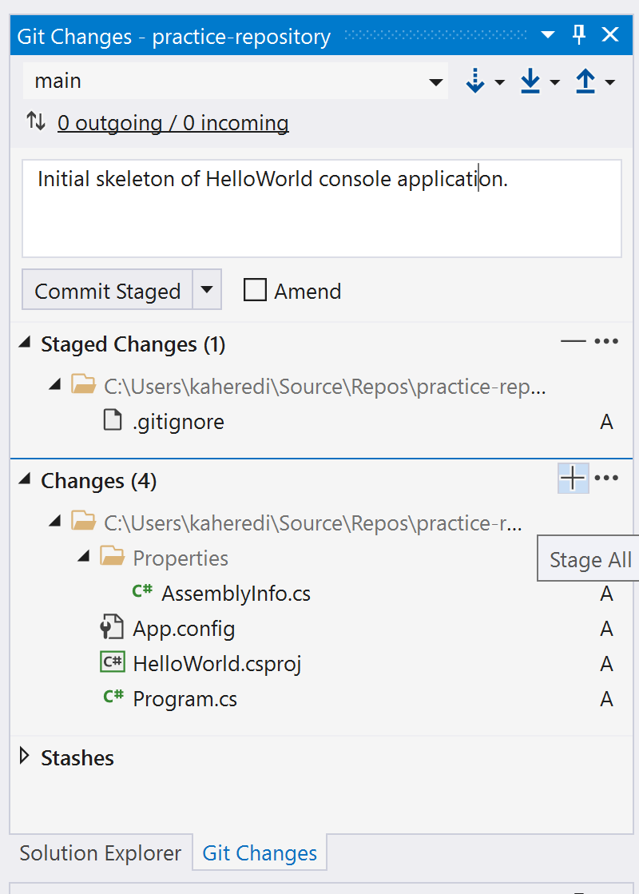
First, stage all files

Slide 30
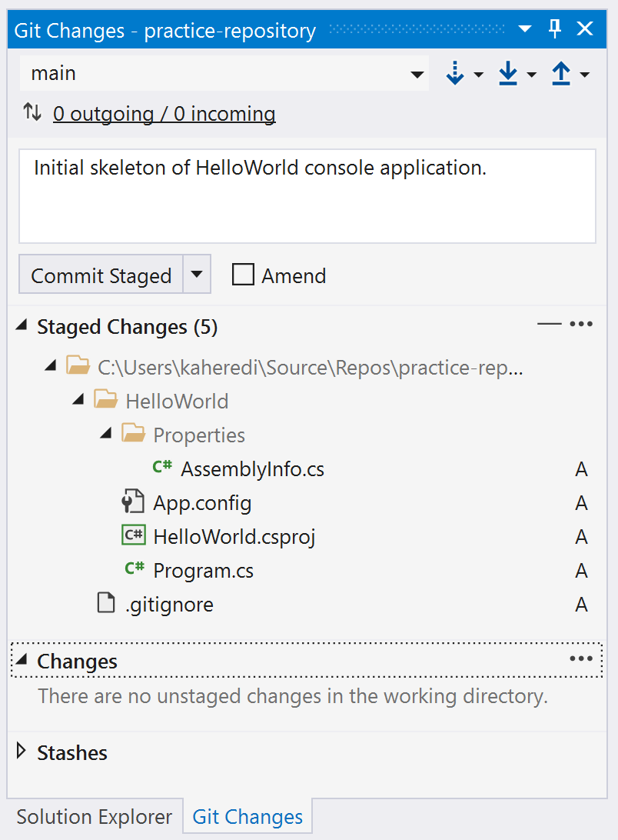
Then, commit.

Slide 31
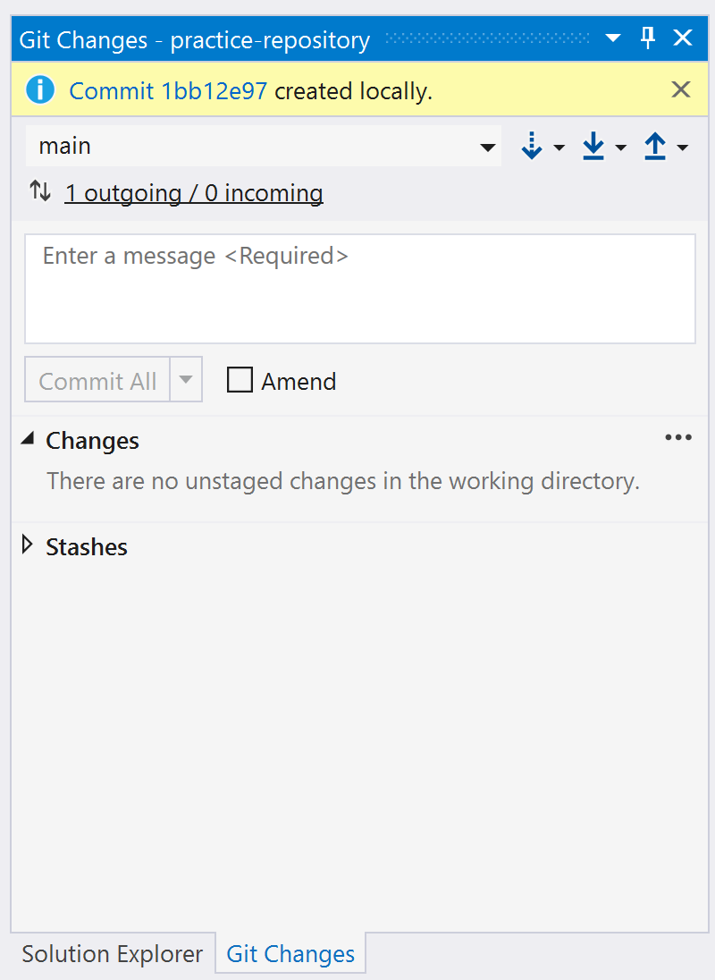
Changes in your local repository

Slide 32
Changes in project

Slide 33
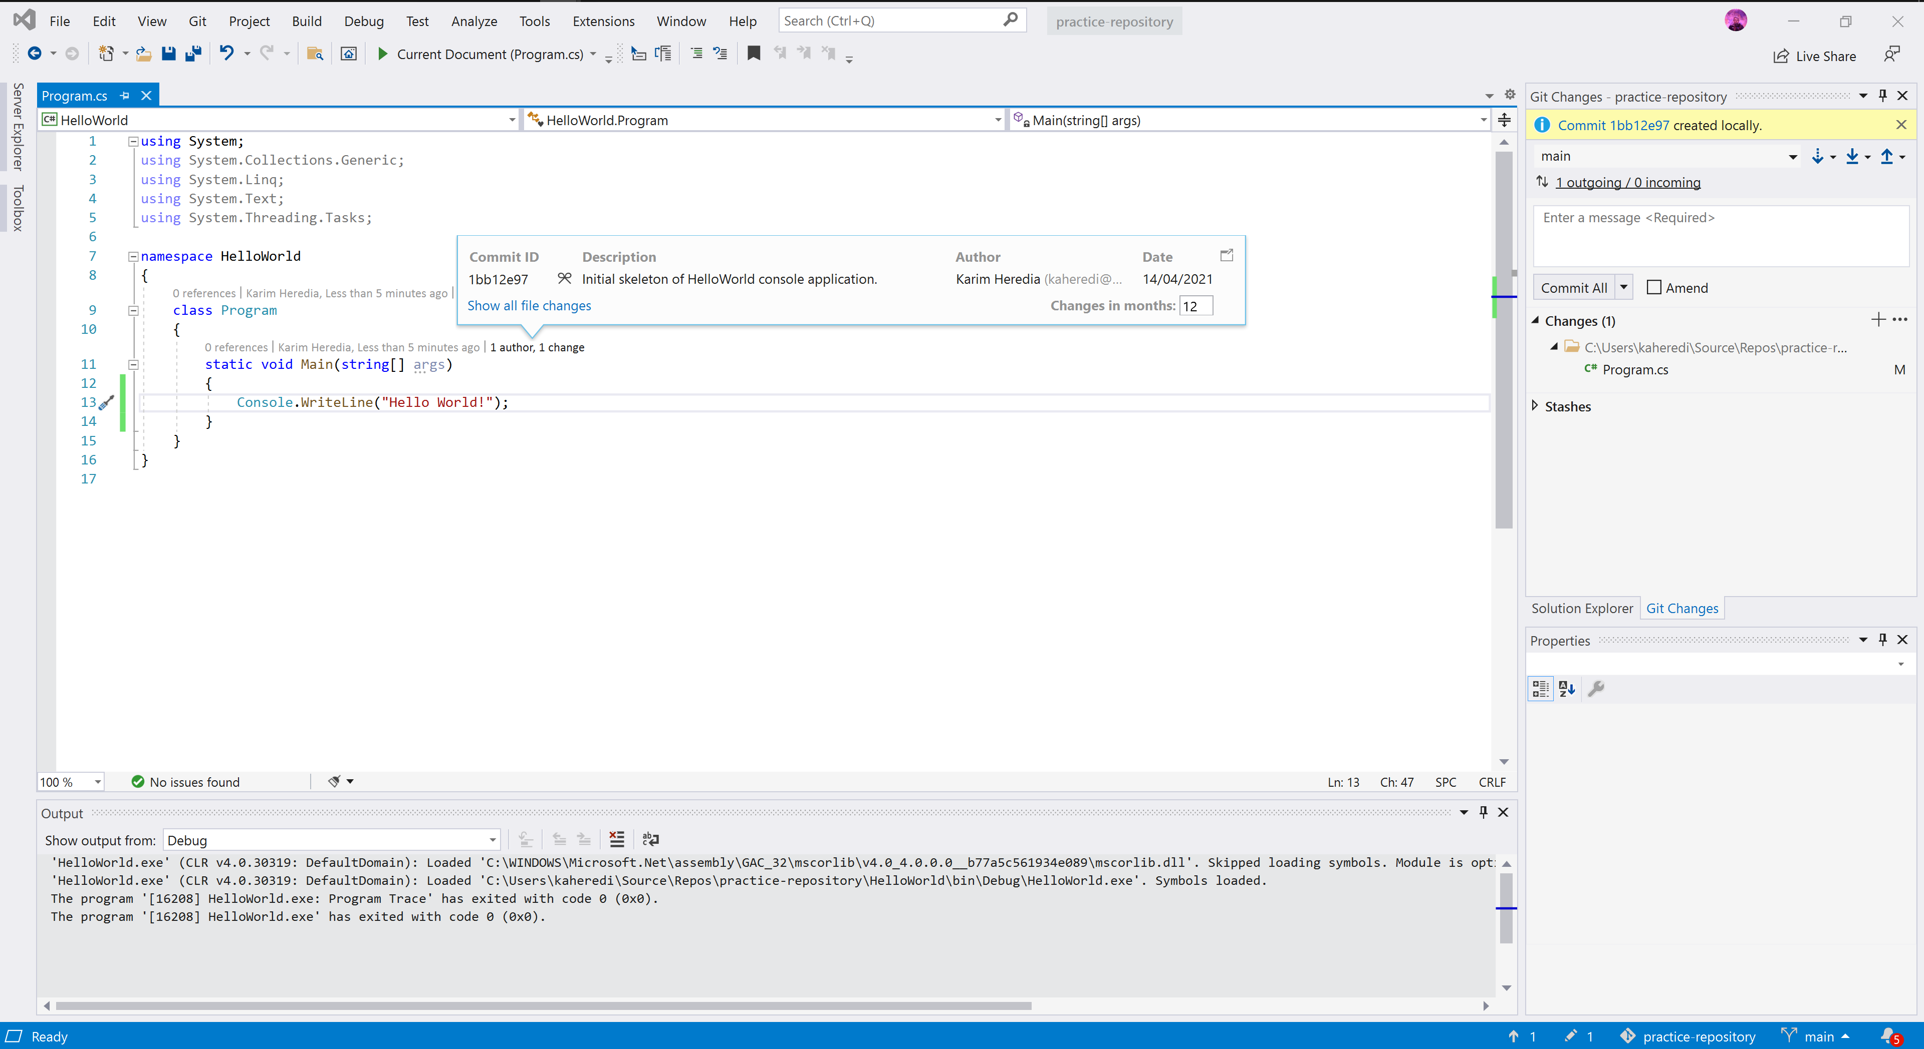

Slide 34
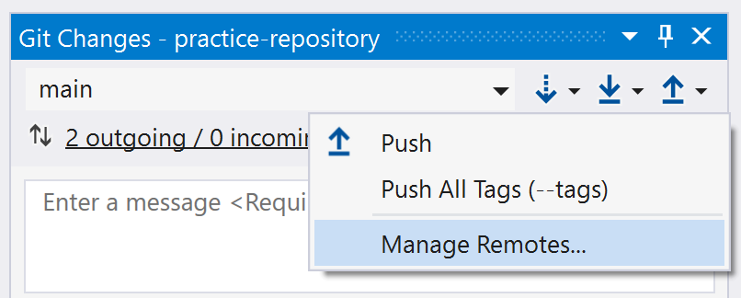
Where is origin?

Slide 35
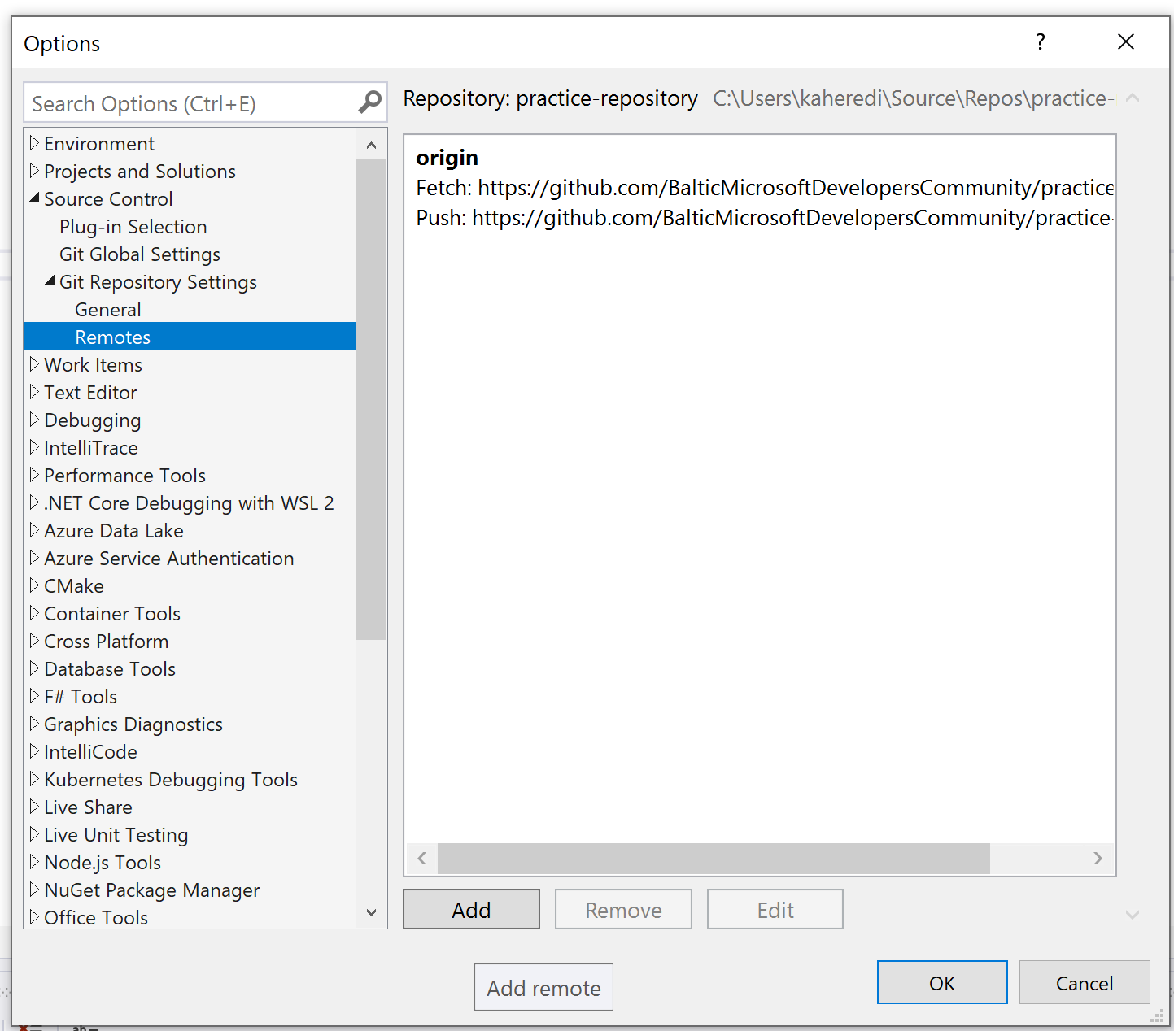
Where is origin?

Slide 36
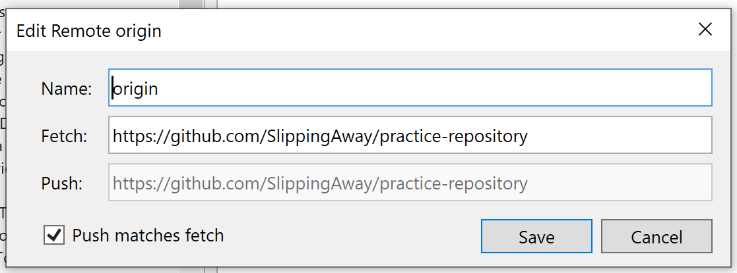
Where is origin?

Slide 37
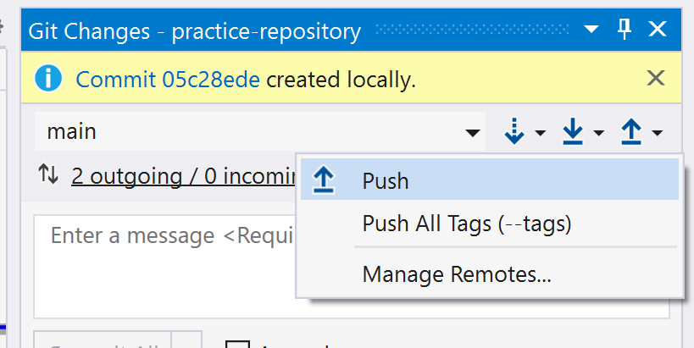
Pushing to origin

Slide 38
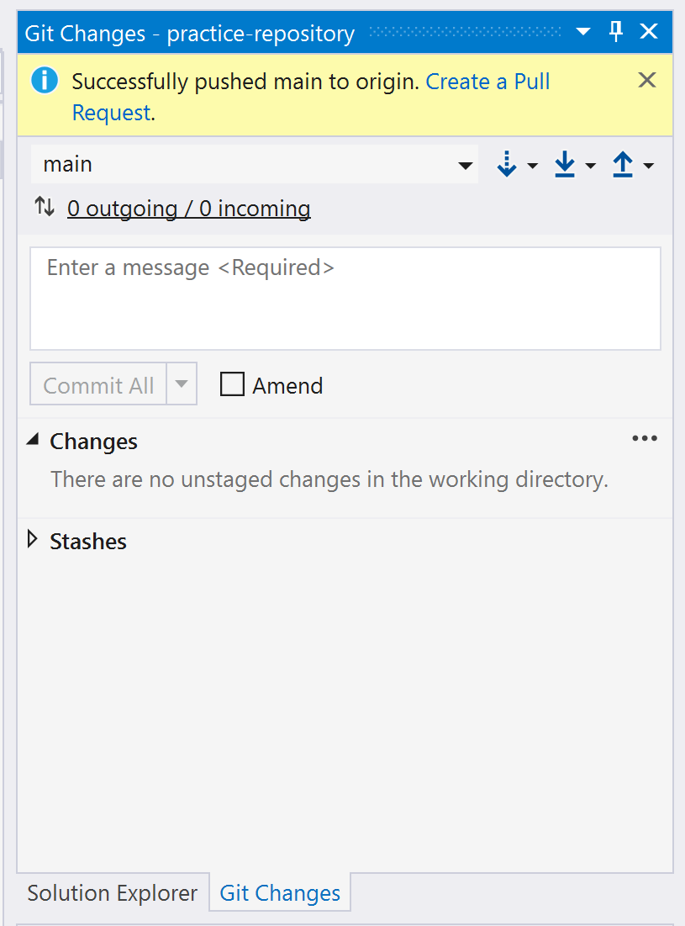
Pushing to origin

Slide 39
Understanding branches

Slide 40
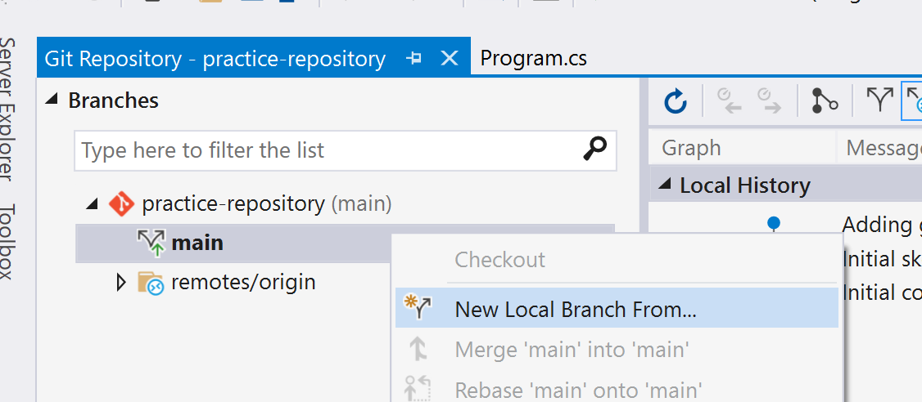
Creating a local branch

Slide 41
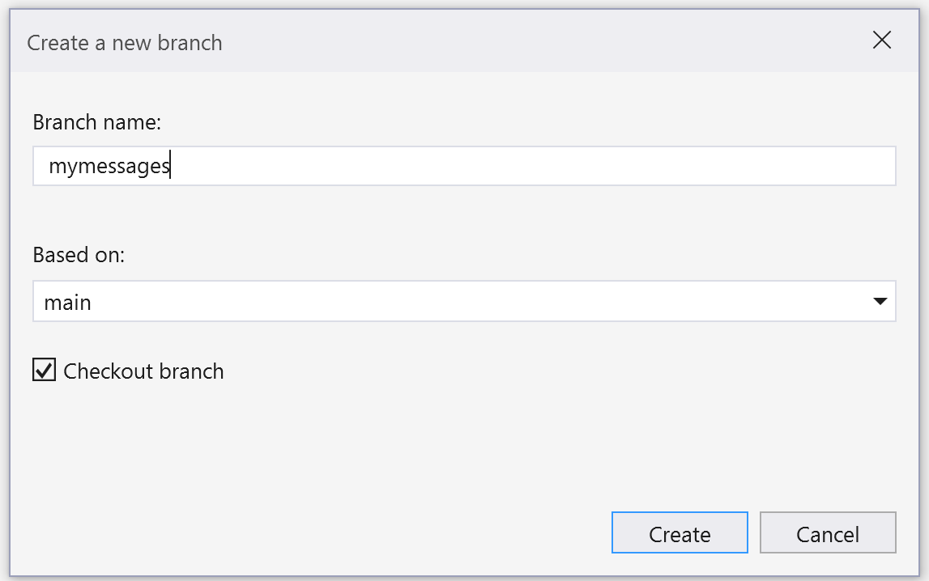
Creating a local branch

Slide 42
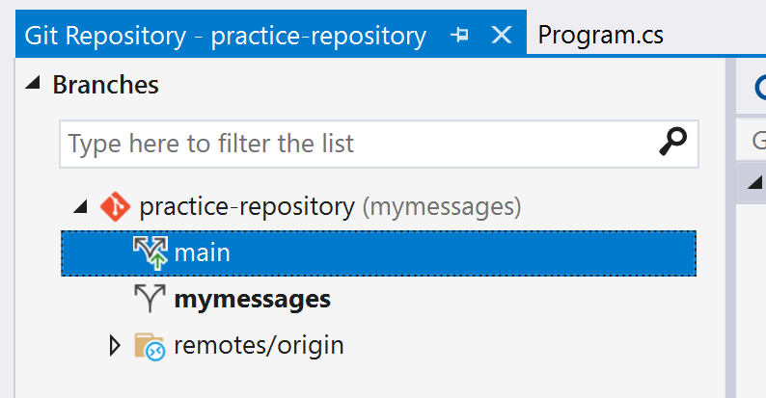
Creating a local branch

Slide 43
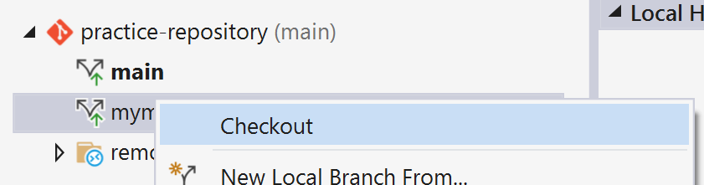
Checking out a different branch

Slide 44
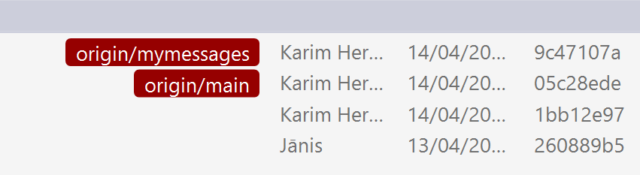
Changes can happen on any branch

Slide 45
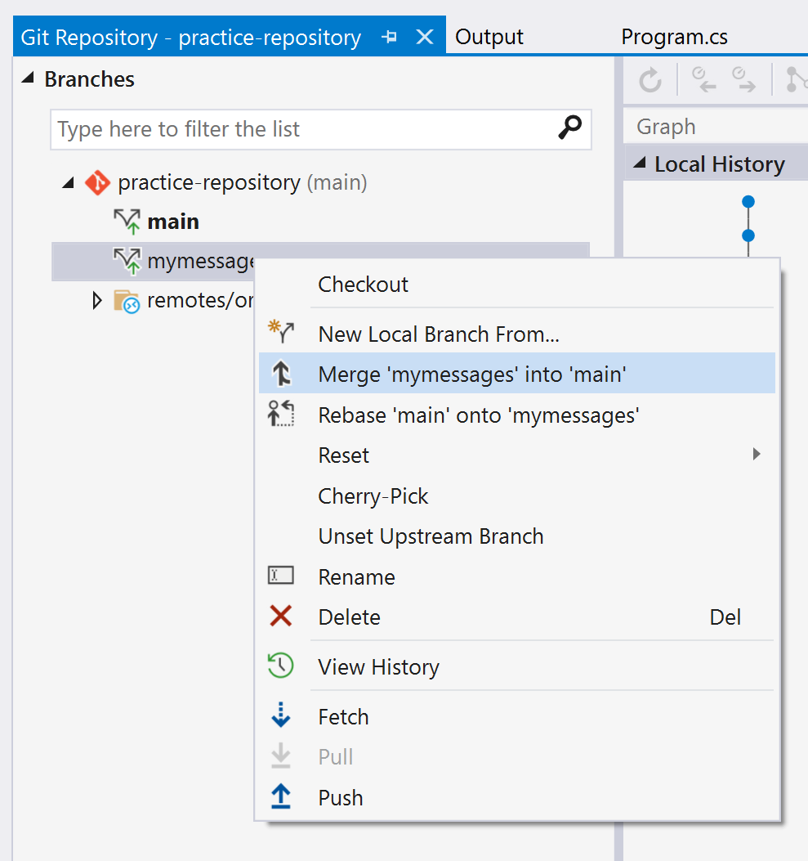
Merging changes between branches

Slide 46
Questions?

