Slide 1
git basics
Karim Heredia
https://about.me/karim.heredia

Slide 2
git basics
To be followed step by step by all of you

Slide 3
git basics
There are many ways of doing it. This is just one of them.

Slide 4
Who am I?

Slide 5
Who am I?
I’m an Engineering Manager in Microsoft.
Originally from Guatemala, and have lived also in the US, El Salvador, Germany, Ireland and Estonia.
Studied a B.Sc. in Computer Science, an M.Sc. in Information and Media Technologies, and an MBA in Technology Management.
Have worked as a software developer, accounting/HR/IT consultant, university lecturer, text formatter, manager.
I have music, reading and photography as main hobbies.

Slide 6
Our training today

Slide 7
What you’ll know
Why we need git
How to create a repository on GitHub
How to clone a repository into VS 2019
How to add a solution to the repository
Basic operations to commit changes
Understand how branches work
Flow between local and remote repositories

Slide 8
If we have time, we could
Try to use command-line git
Try to do a pull request
Learn how to stash changes

Slide 9
Why do we need git?

Slide 10
A brief history of git
Developed in 2005 in response to the need for a source-control system for Linux developers. Linus Torvalds, the creator of Linux, was the mind behind it.
The goals were speed, simple design, support for non-linear development, fully distributed and able to handle large projects.

Slide 11
What sort of software is git anyway?
It belongs to the family of tools as version control, source control or source code management systems.
Git belongs to the family of distributed version control systems (DVCS). There are a few alternatives (like Mercurial), but git is by far the leader.

Slide 12
Some of the reasons why you need git
History about your code
Teamwork on making changes
Multiple versions of the same code base
Suggestions from others about your code

Slide 13
Starting a new repository
git init

Slide 14
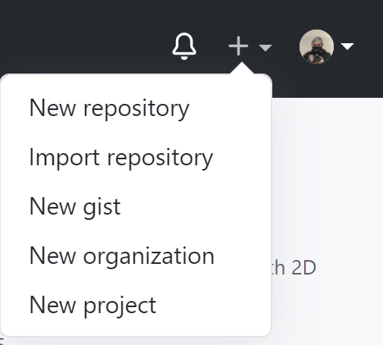
Creating a new repository

Slide 15
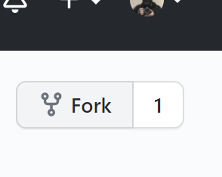
Forking a repository

Slide 16
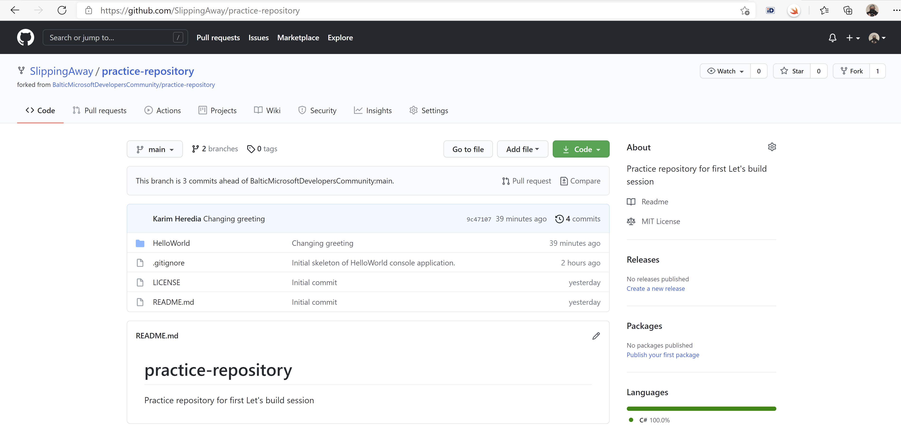
Example repository

Slide 17
Getting started with VS2019
git clone

Slide 18
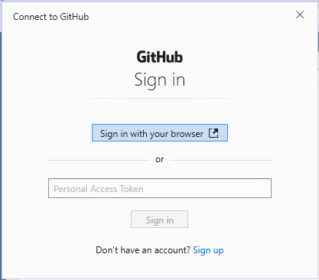
Visual Studio will ask you to authenticate with GitHub

Slide 19
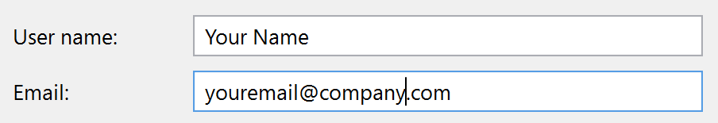
You need your name and e-mail to identify changes

Slide 20
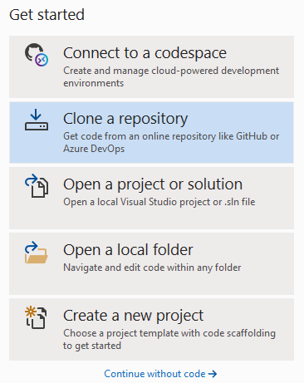
Clone repository

Slide 21
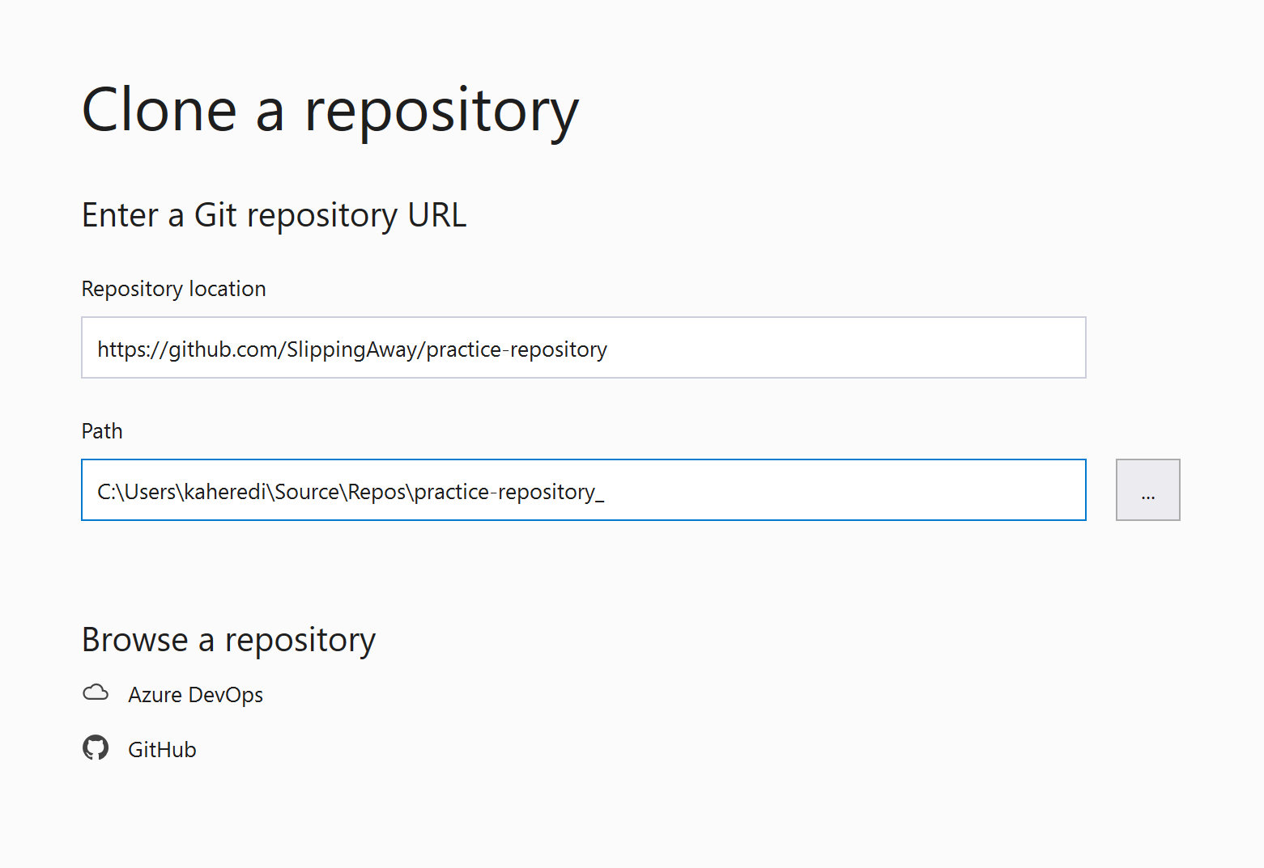
URL from GitHub

Slide 22
Let’s add a VS solution
git diff

Slide 23
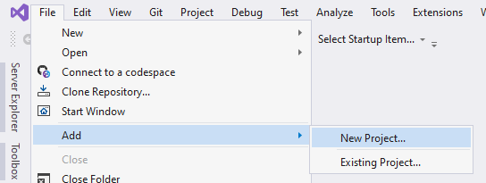
Add a new project after cloning

Slide 24
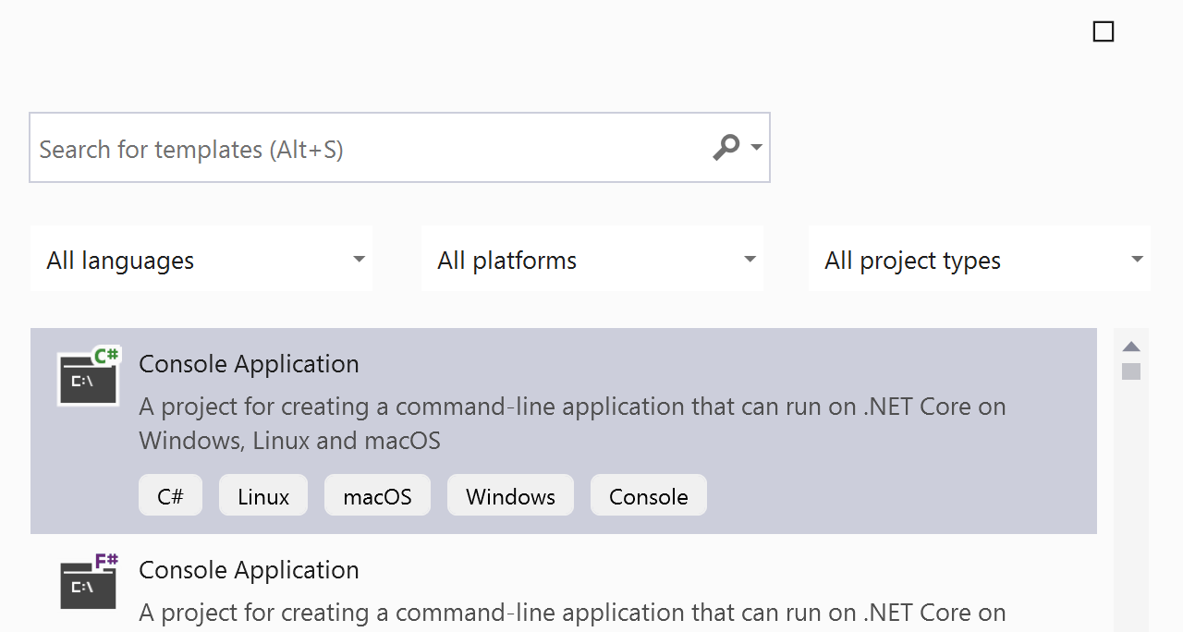
Choose project type

Slide 25
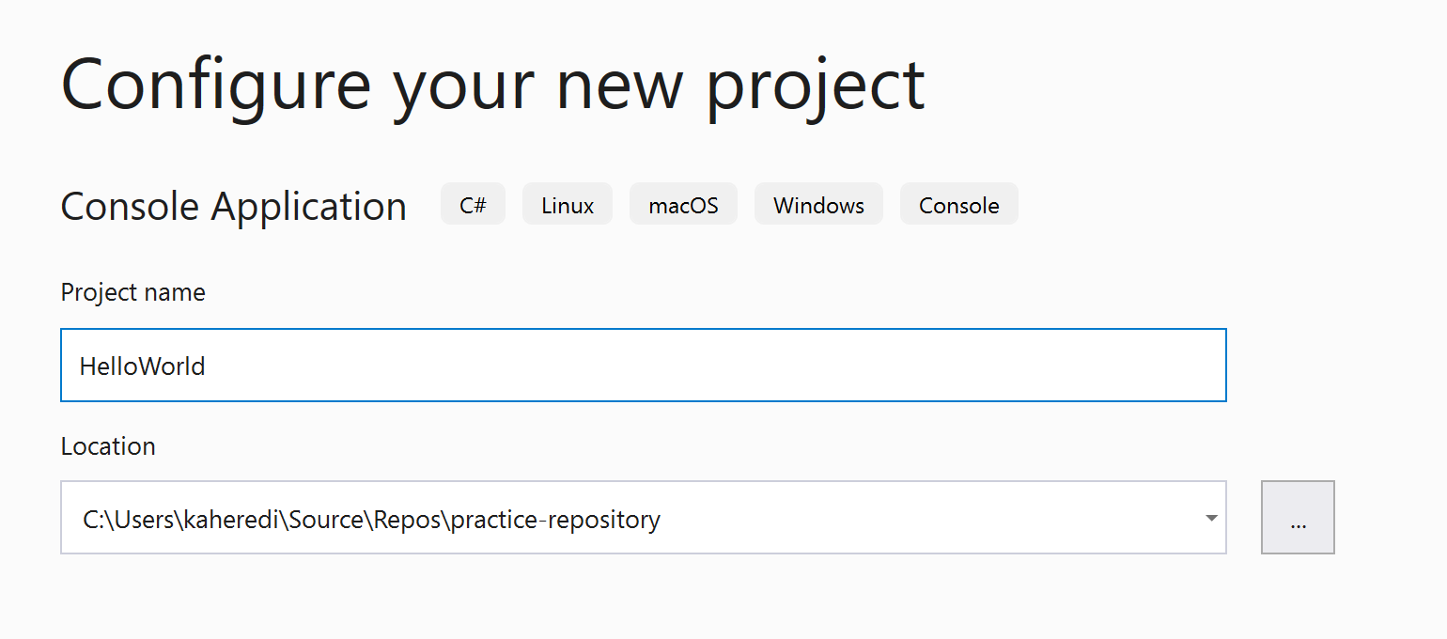
Choose a name, but location should stay untouched.

Slide 26
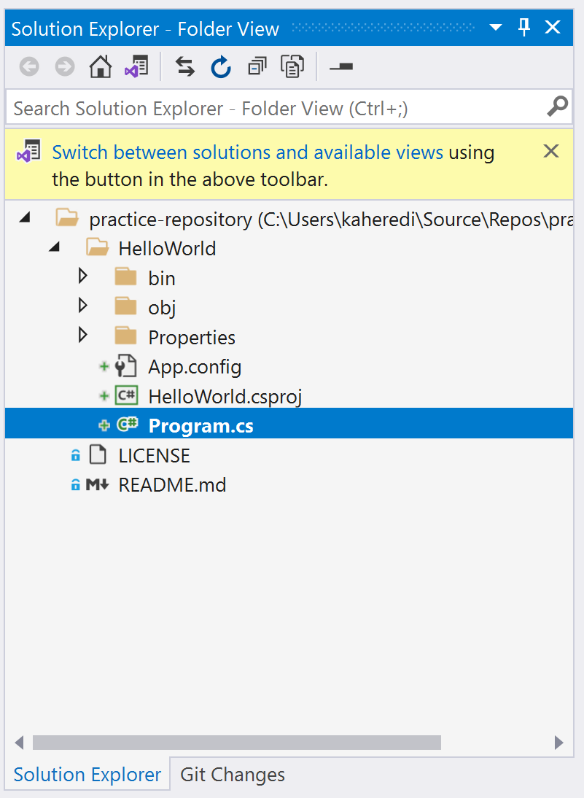
Solution explorer

Slide 27
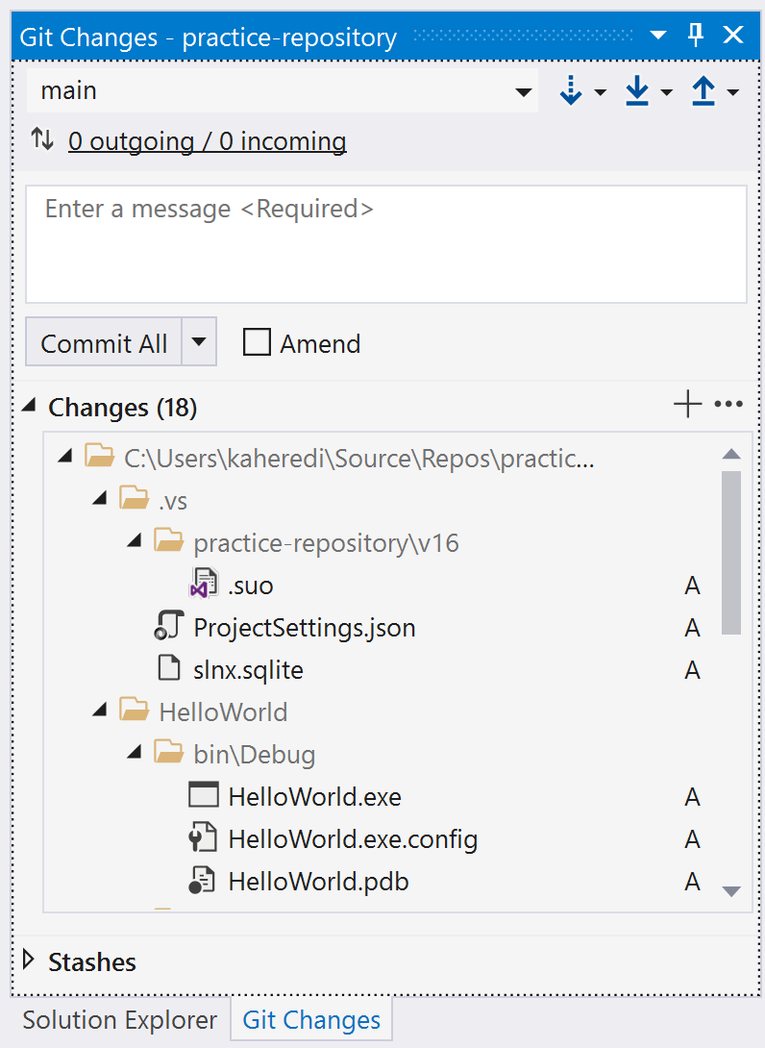
Git changes should show all new files

Slide 28
Let’s add a .gitignore file

Slide 29
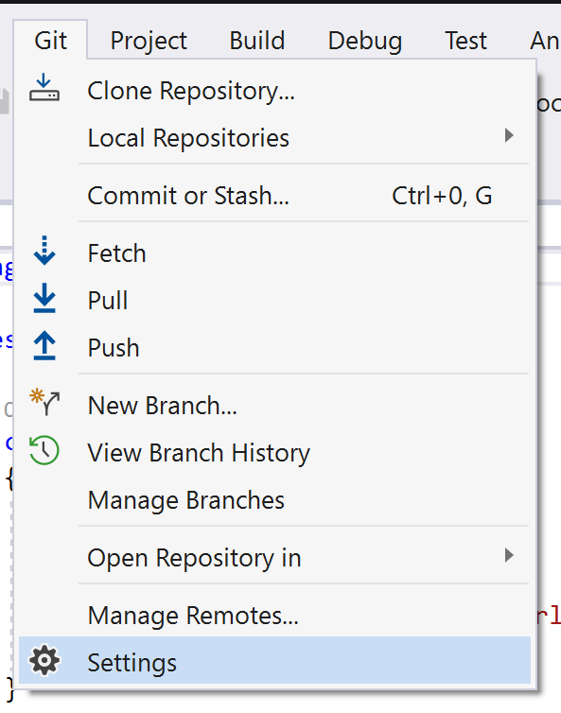
We need a .gitignore file

Slide 30
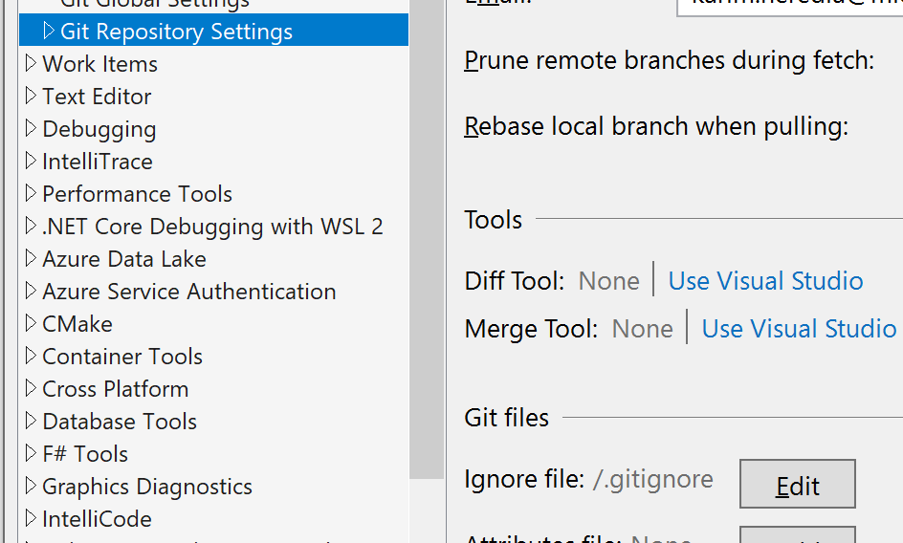
We need a .gitignore file

Slide 31
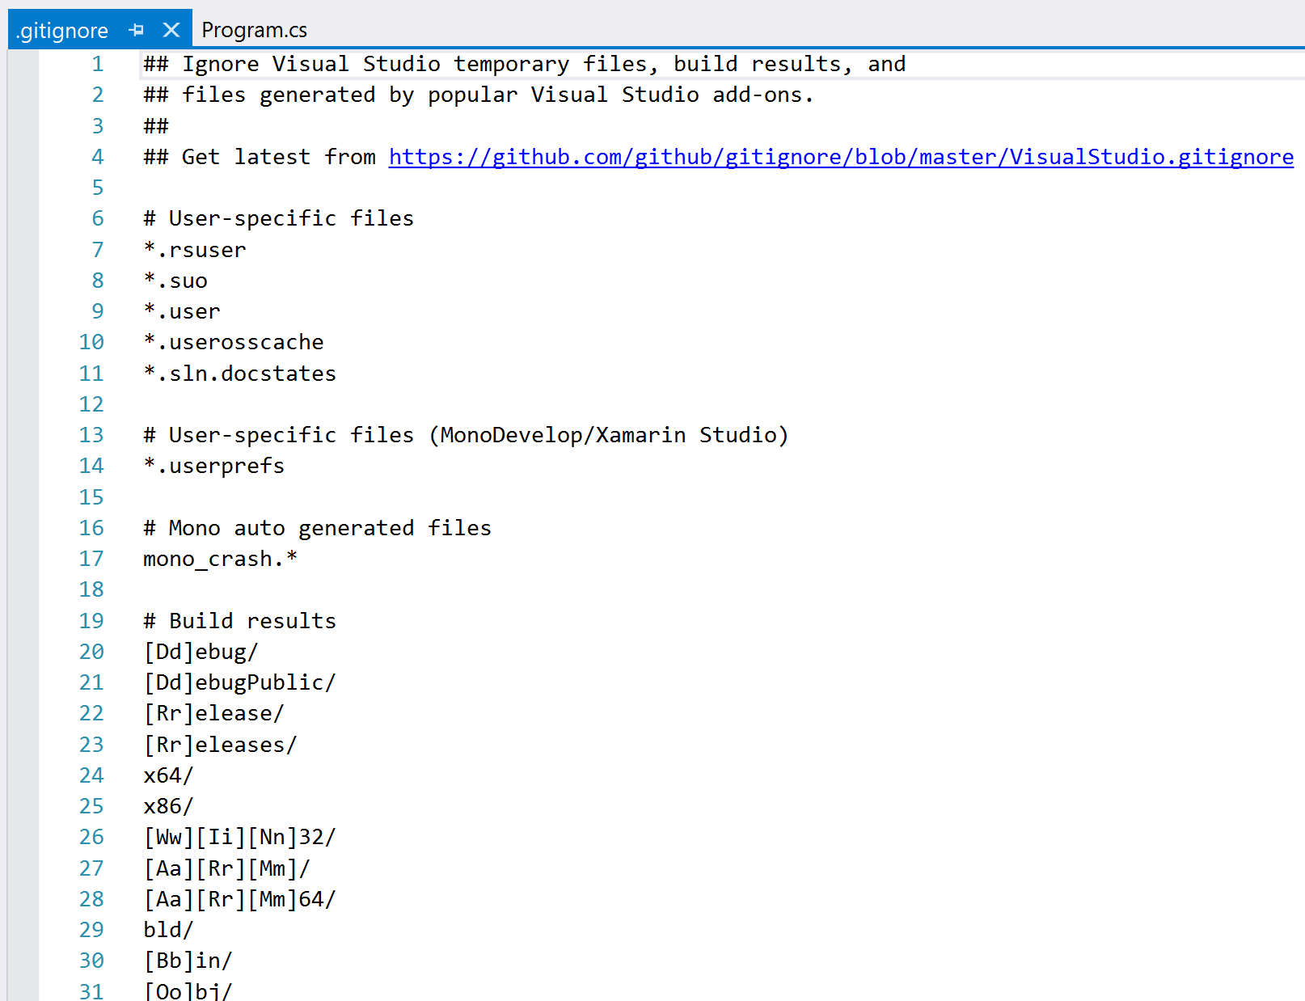
We need a .gitignore file

Slide 32
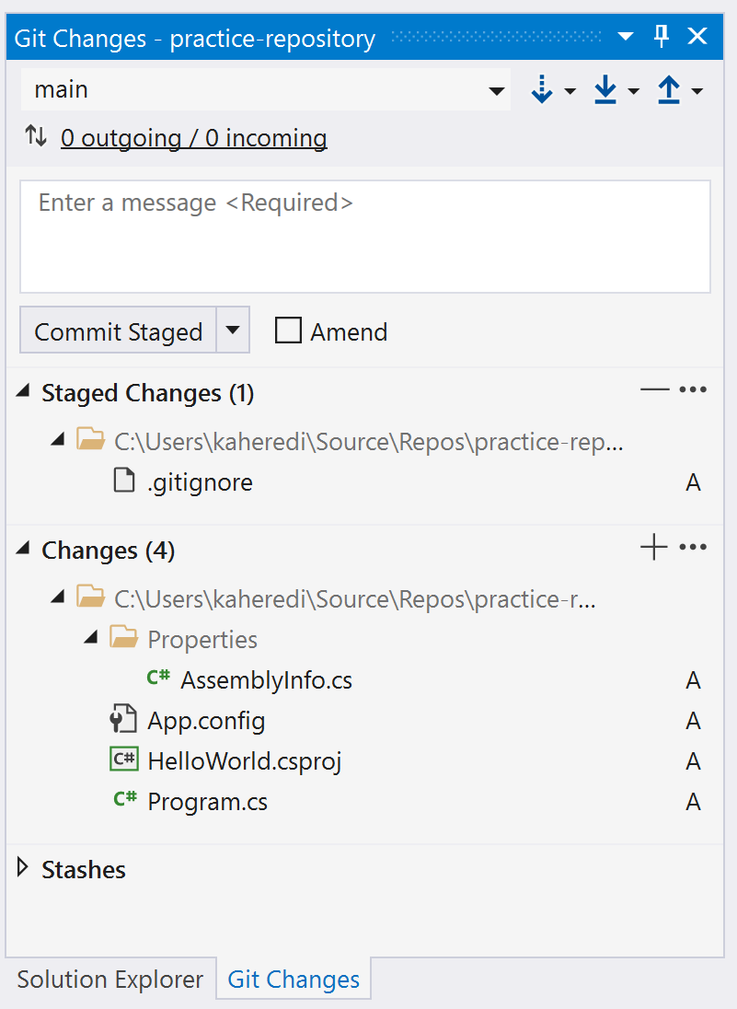
Git changes shows only source files

Slide 33
Committing
git commit

Slide 34
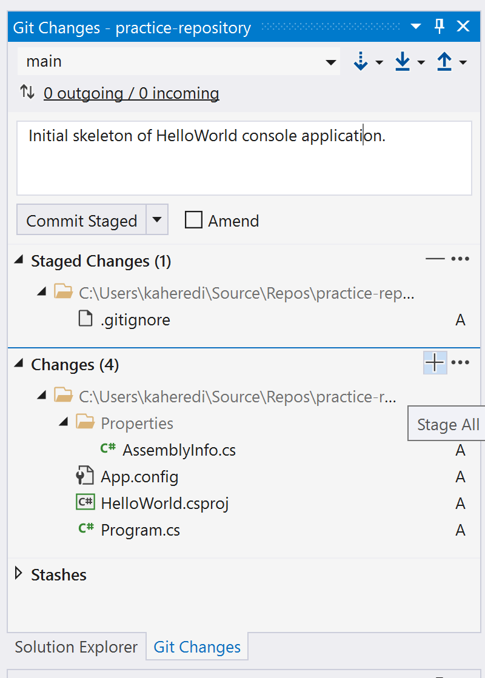
First, stage all files

Slide 35
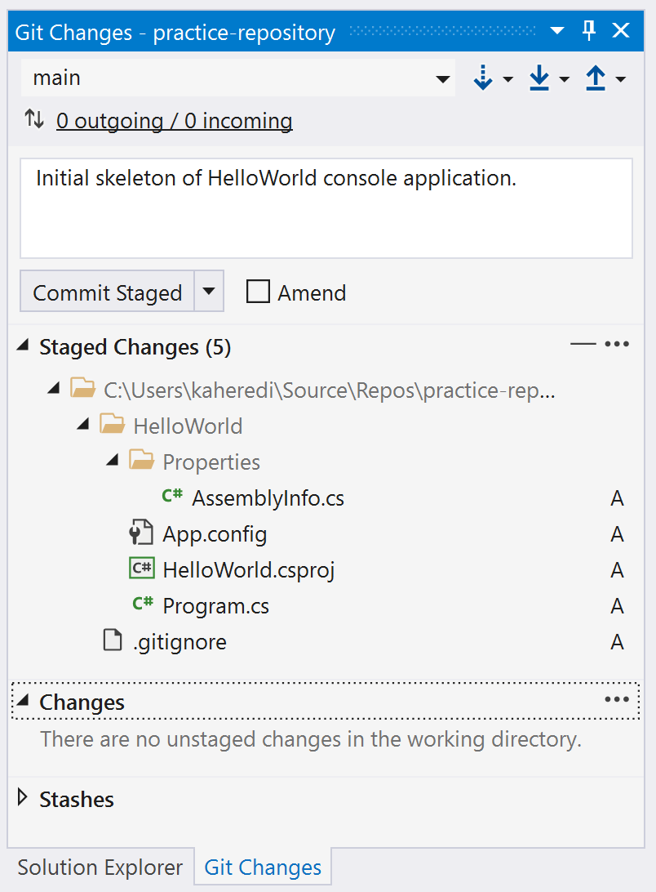
Then, commit.

Slide 36
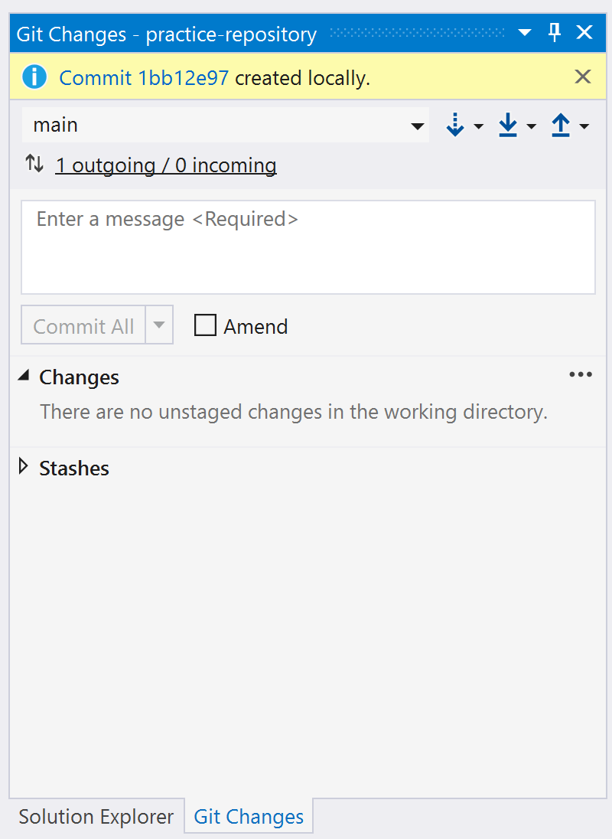
Changes in your local repository

Slide 37
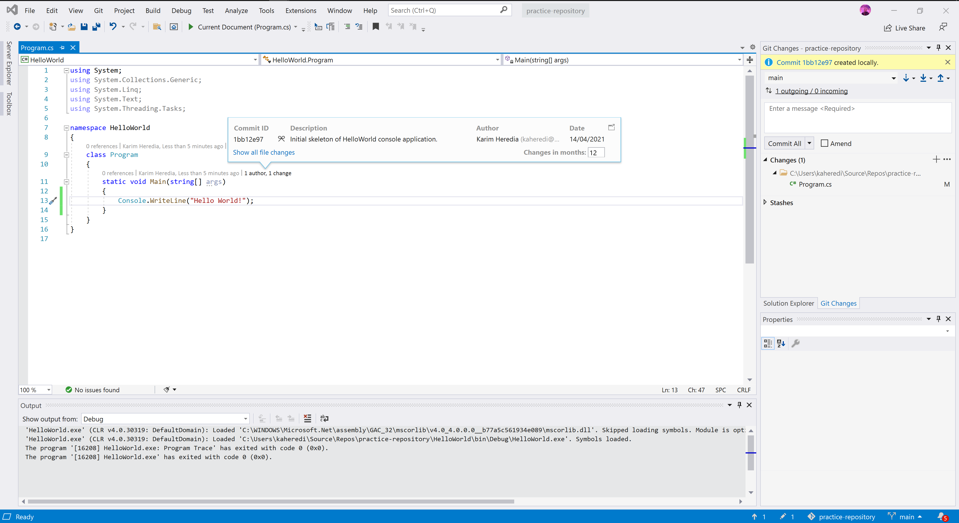

Slide 38
Project’s origin repository
git remote
git push

Slide 39
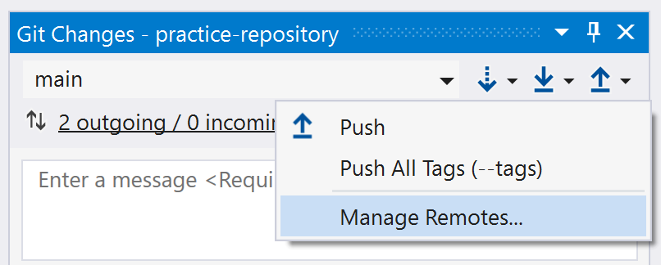
Where is origin?

Slide 40
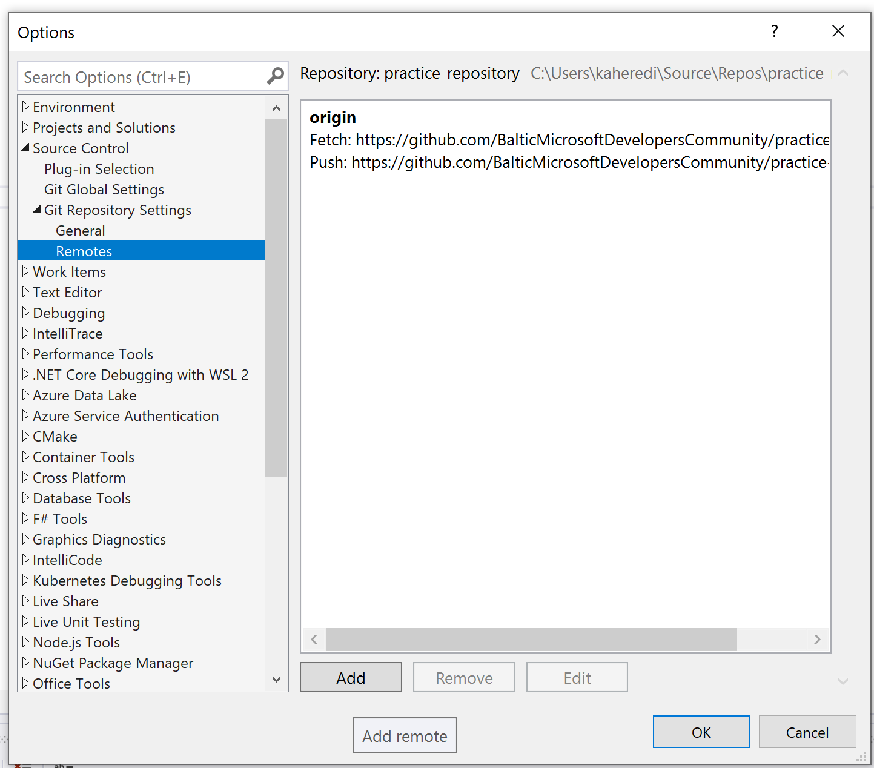
Where is origin?

Slide 41
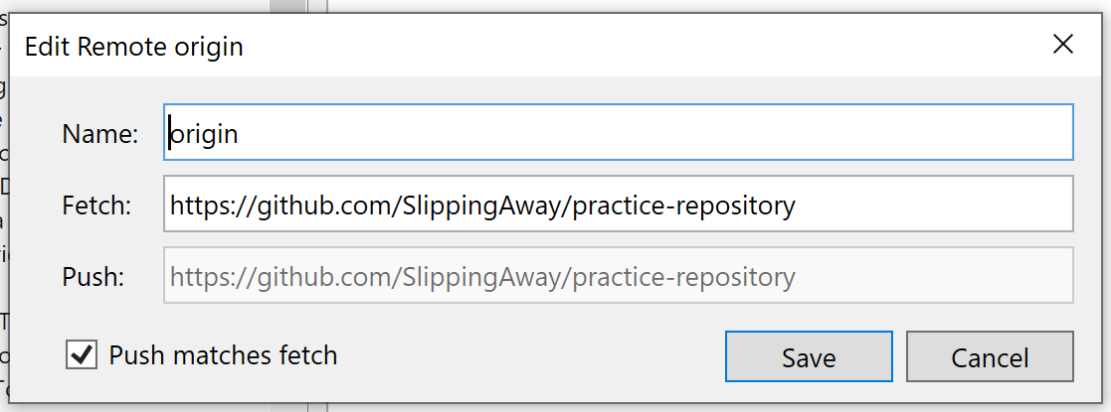
Where is origin?

Slide 42
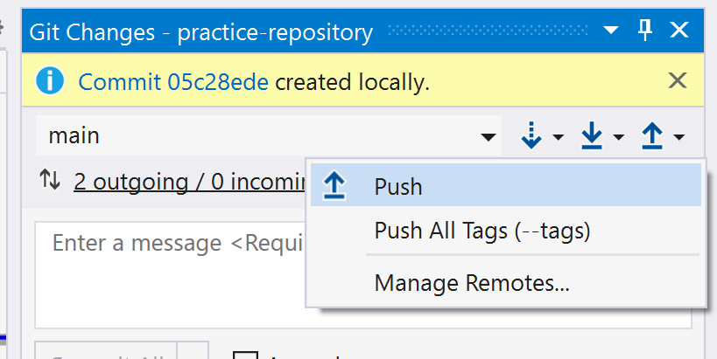
Pushing to origin

Slide 43
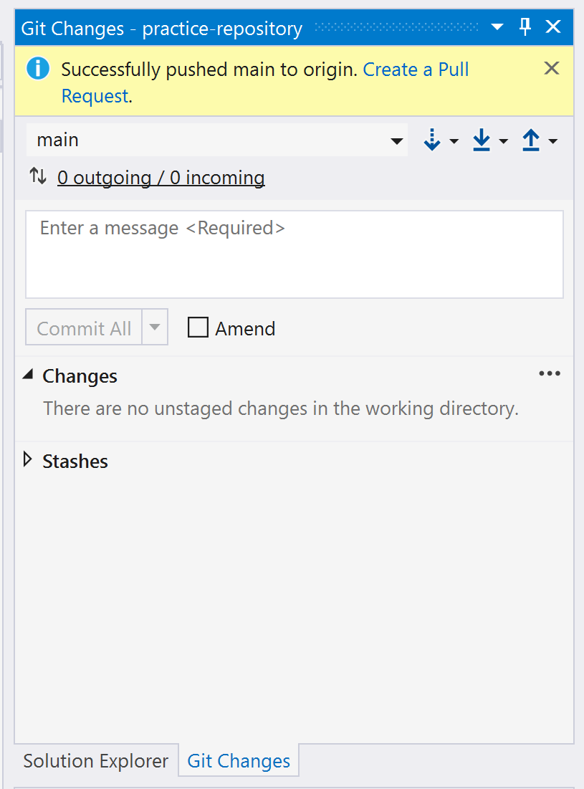
Pushing to origin

Slide 44
Understanding branches
git checkout
git branch

Slide 45
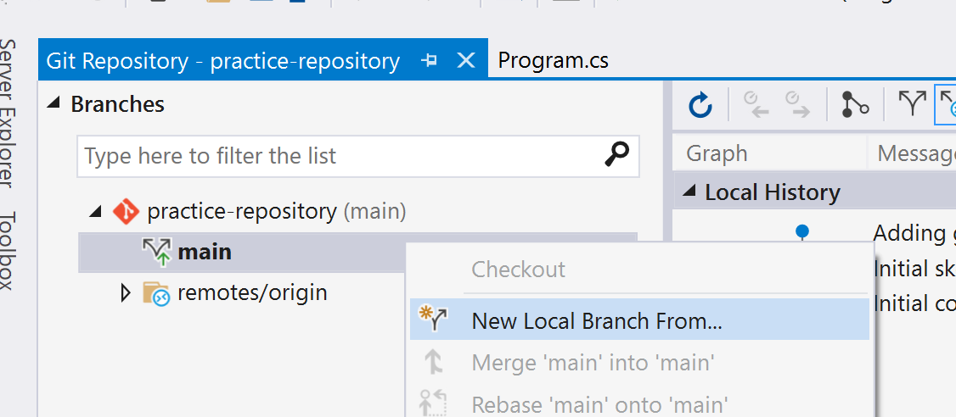
Creating a local branch

Slide 46
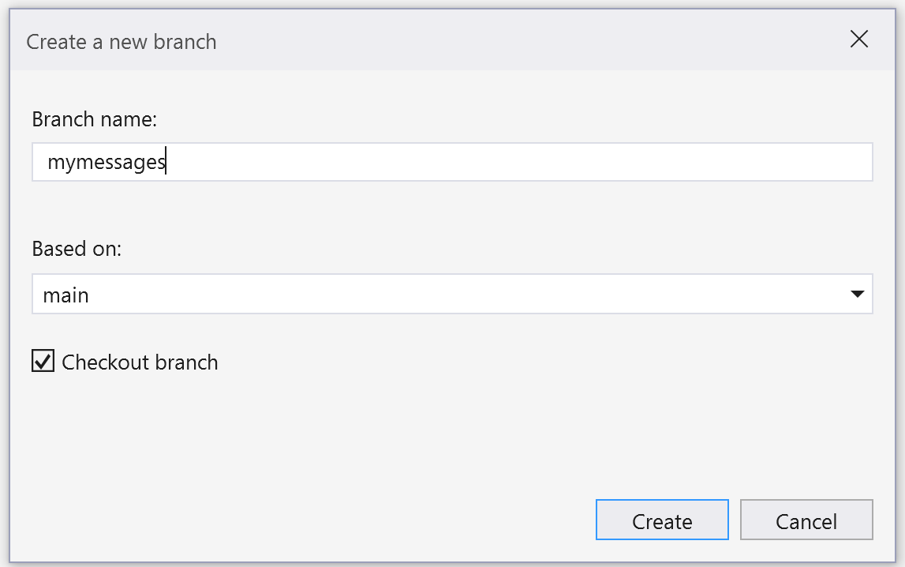
Creating a local branch

Slide 47
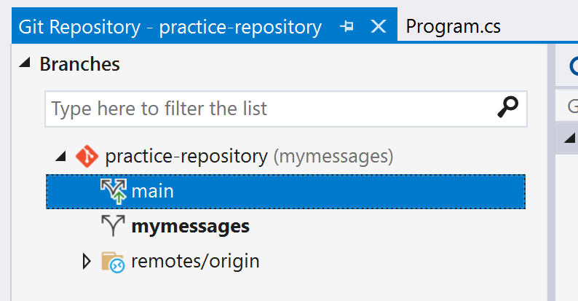
Creating a local branch

Slide 48
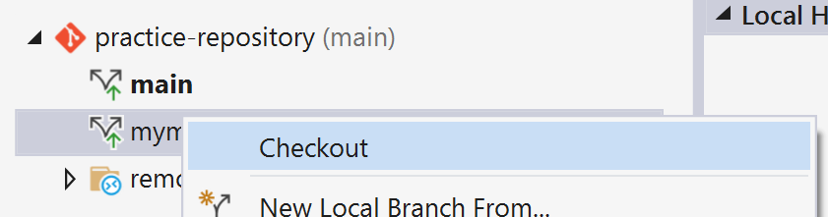
Checking out a different branch

Slide 49
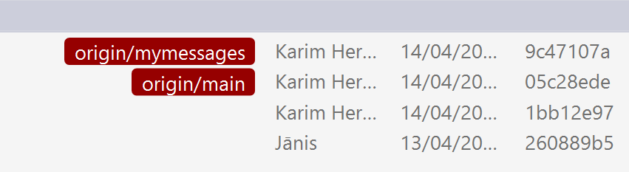
Changes can happen on any branch

Slide 50
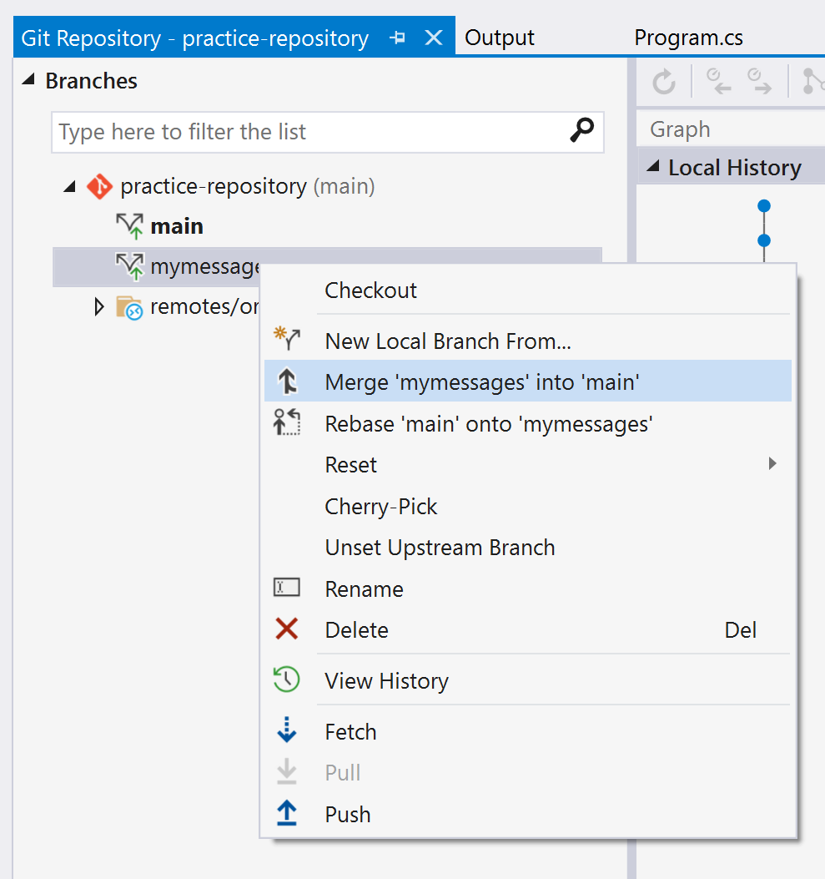
Merging changes between branches

Slide 51
Resources

Slide 52
Suggested resources
Git (git-scm.com)
Resources to learn Git (try.github.io)
GitHub Git Cheat Sheet - GitHub Cheatsheets
The Git experience in Visual Studio | Microsoft Docs
Dangit, Git!?!

Slide 53
Questions?
Karim Heredia
https://about.me/karim.heredia

