Slide 1
NEFT TEACHER
My Math Notebook
🏀
Name:
Date:
Period:
Mean, Median, and Mode
I CAN… / Yo puedo…
I can find the mean, median, and mode of a data set.
I WILL EXPLAIN… / Objetivo de lenguaje
I can explain my reasoning using the words mean, median, mode, and outlier.
6.DS.4
Unit 8 · Lesson 8-2

Slide 2
NEFT TEACHER
Learning Objectives / Objetivos
6.DS.4
Today's goals — what I will know and be able to say:
CONTENT OBJECTIVE
I can… Yo puedo…
I can find the mean, median, and mode of a data set.
LANGUAGE OBJECTIVE
I can explain… Puedo explicar…
I can explain my reasoning using the words mean, median, mode, and outlier.
Reveal Math Grade 6 · Unit 8 · Lesson 8-2
2

Slide 3
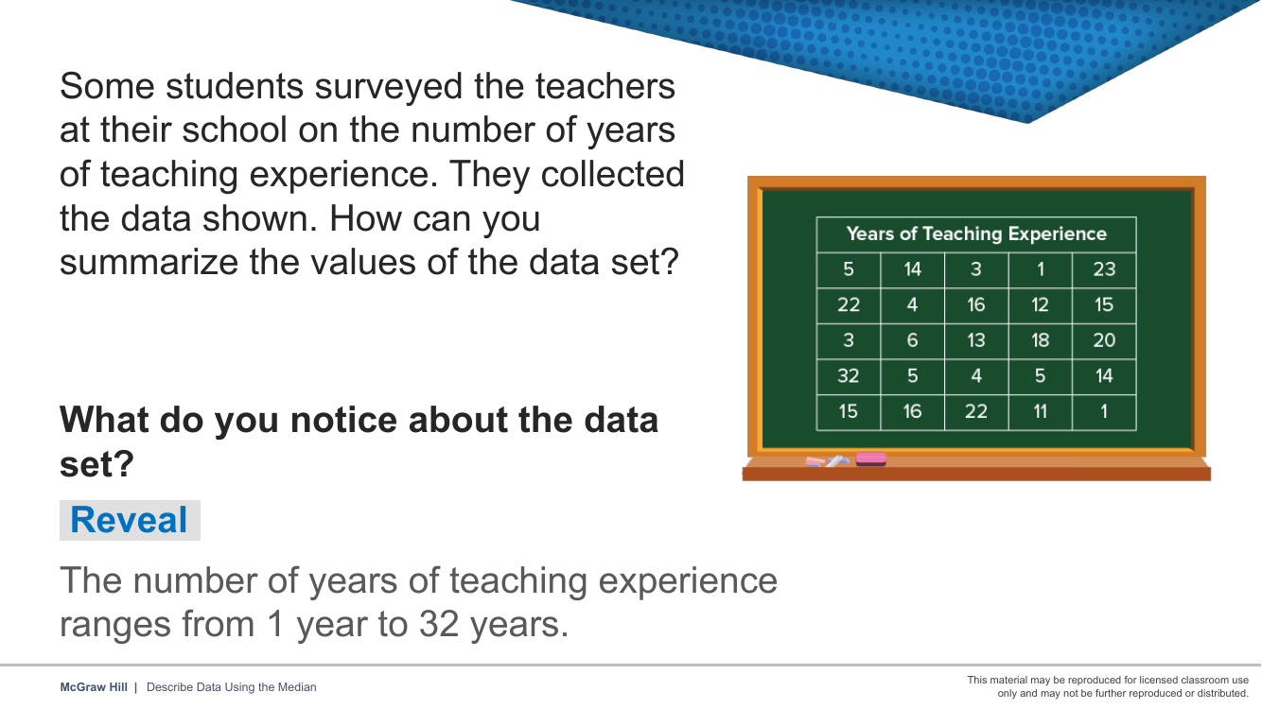
📘 Reveal 1 / 9
Notice & Wonder — what do you notice about the teaching-experience data?
Notes:
Notice & Wonder — what do you notice about the teaching-experience data?

Slide 4
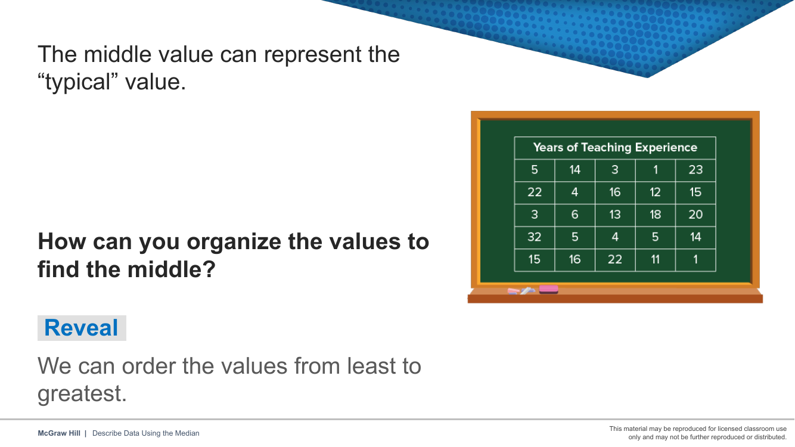
📘 Reveal 2 / 9
How can you organize the values to find the middle?
Notes:
How can you organize the values to find the middle?

Slide 5
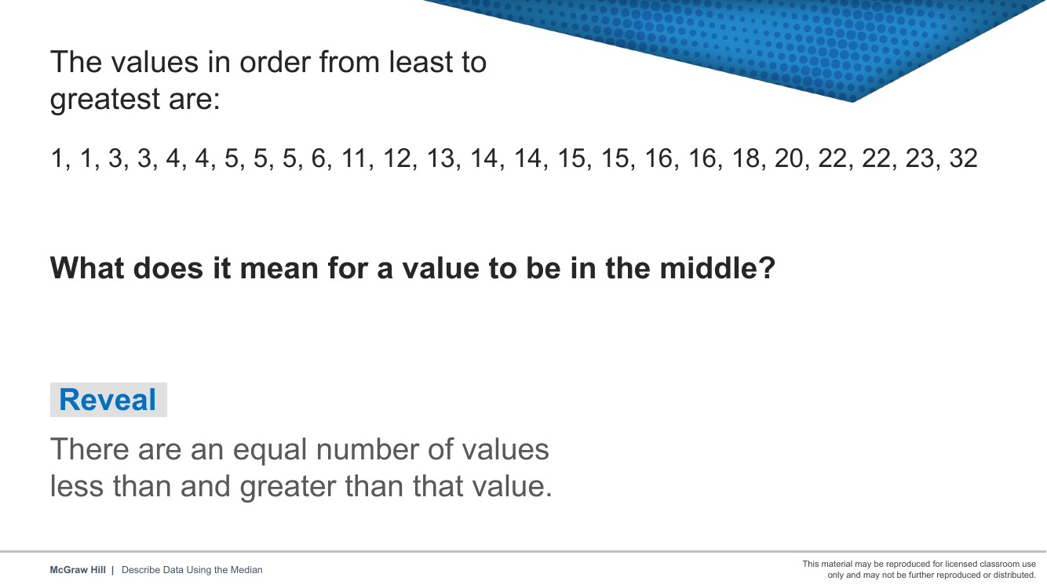
📘 Reveal 3 / 9
The values in order — what does it mean to be in the middle?
Notes:
The values in order — what does it mean to be in the middle?

Slide 6
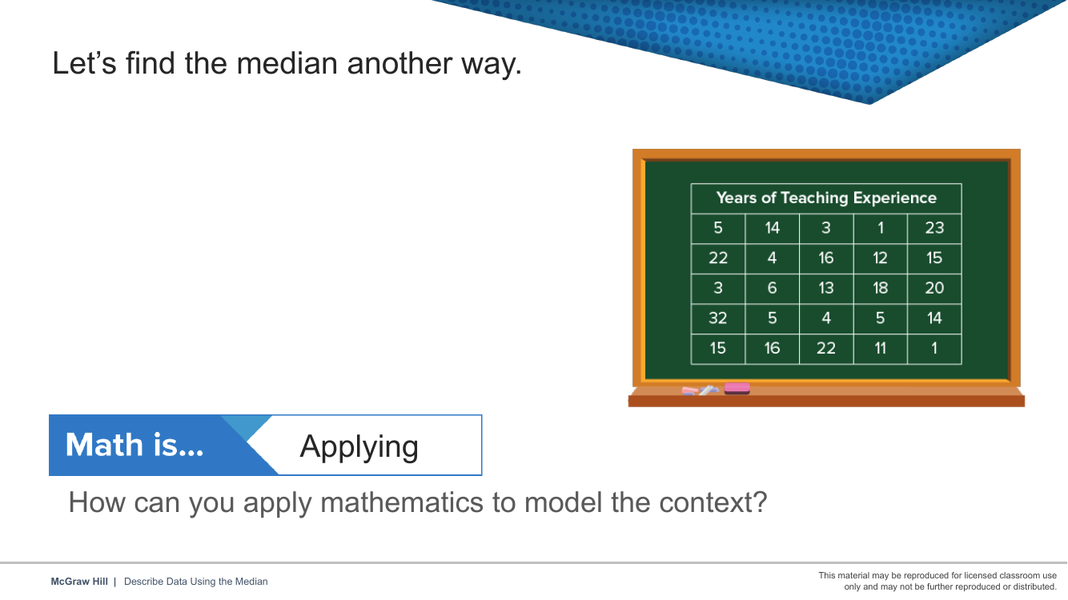
📘 Reveal 4 / 9
Math is Applying — find the median another way.
Notes:
Math is Applying — find the median another way.

Slide 7
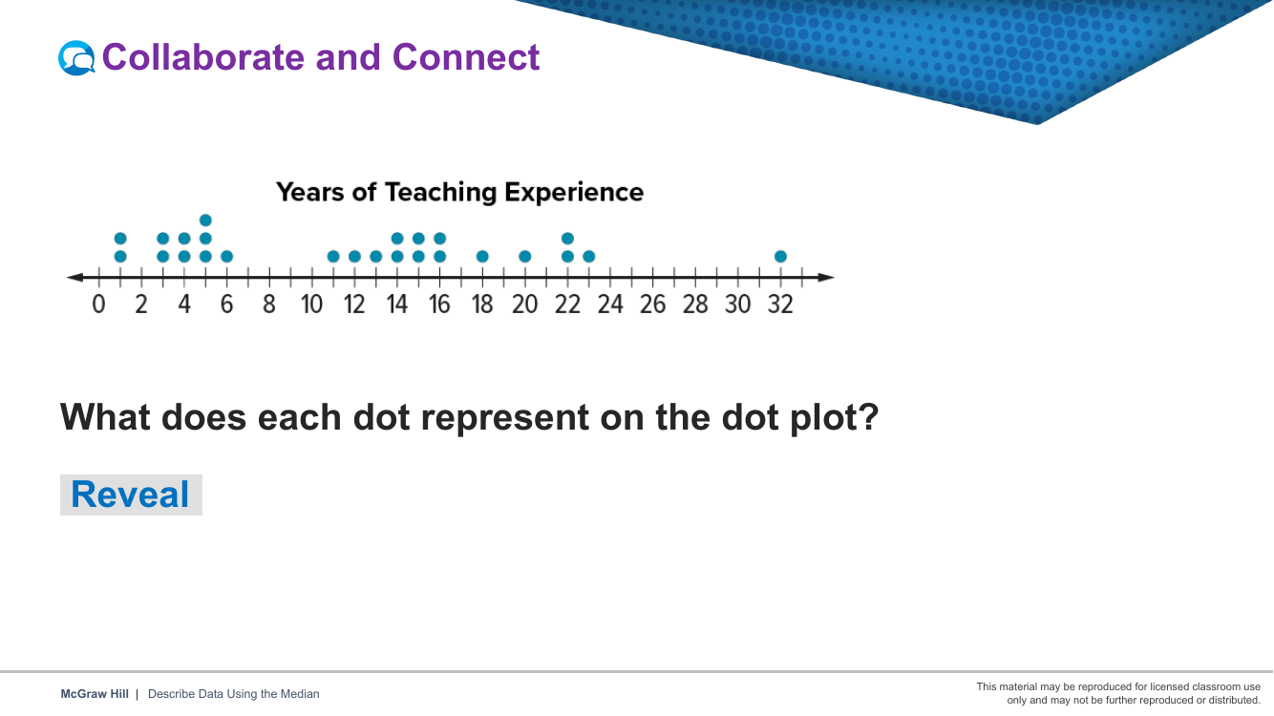
📘 Reveal 5 / 9
Collaborate & Connect — the same data on a dot plot.
Notes:
Collaborate & Connect — the same data on a dot plot.

Slide 8
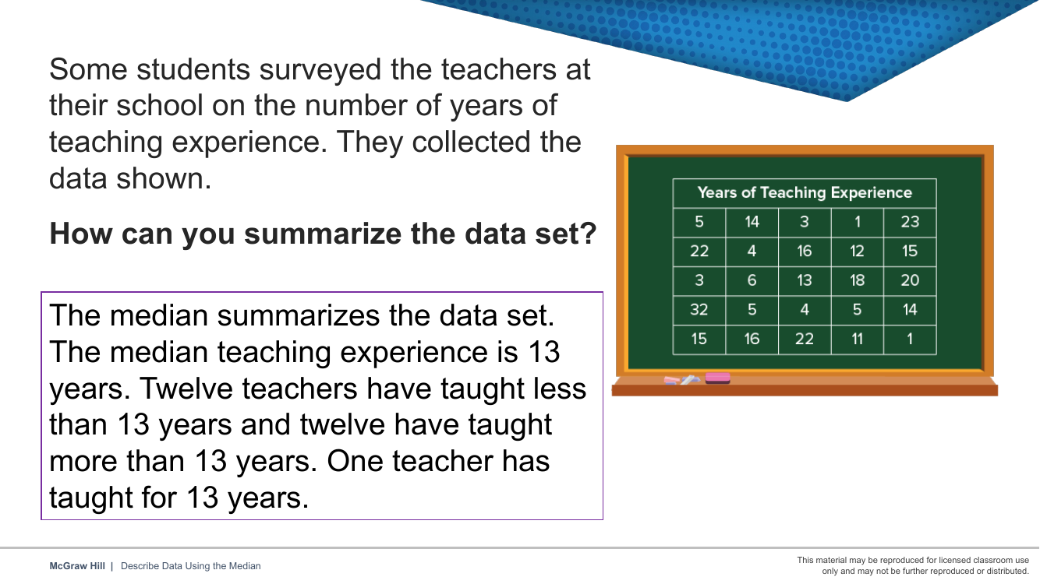
📘 Reveal 6 / 9
Worked summary — the median describes the data set.
Notes:
Worked summary — the median describes the data set.

Slide 9
NEFT TEACHER
Turn & Talk · Launch / Comenta
6.DS.4
✏️ Sentence starters
💬 LAUNCH DISCUSSION
• I think ___ because ___.
• I agree/disagree because ___.
• My evidence is ___.
Talk with your partner. Use full sentences and math words.
The team scored 42, 38, 55, 41, 38, 44, 40 points over 7 games. Which 'average' would best tell the coach the team's typical scoring: mean, median, or mode?
📚 Word bank
mean
median
mode
average
Jot your partner talk here:
data set
Reveal Math Grade 6 · Unit 8 · Lesson 8-2
3

Slide 10
NEFT TEACHER
Turn & Talk · Explore / Comenta
6.DS.4
✏️ Sentence starters
💬 EXPLORE DISCUSSION
• I think ___ because ___.
• I agree/disagree because ___.
• My evidence is ___.
Talk with your partner. Use full sentences and math words.
After ordering the scores on the number line, how do you find the median, and how is it different from the mean you calculated?
📚 Word bank
mean
median
mode
order
Jot your partner talk here:
data set
Reveal Math Grade 6 · Unit 8 · Lesson 8-2
4

Slide 11
NEFT TEACHER
Turn & Talk · Connect / Comenta
6.DS.4
✏️ Sentence starters
💬 CONNECT DISCUSSION
• I think ___ because ___.
• I agree/disagree because ___.
• My evidence is ___.
Talk with your partner. Use full sentences and math words.
Quiz scores were 85, 92, 78, 88, 92, 95, 72, 88, 92, 84. The teacher says 'most scored around 87'; a student says 'the most common score was 92.' Who used the mean, and who used the mode?
📚 Word bank
mean
median
mode
average
Jot your partner talk here:
data set
Reveal Math Grade 6 · Unit 8 · Lesson 8-2
5

Slide 12
NEFT TEACHER
Turn & Talk · Reflect / Comenta
6.DS.4
✏️ Sentence starters
💬 REFLECT DISCUSSION
• I think ___ because ___.
• I agree/disagree because ___.
• My evidence is ___.
Talk with your partner. Use full sentences and math words.
For the data set 4, 7, 10, 7, 12, talk through how you find the median.
📚 Word bank
median
mean
mode
order
Jot your partner talk here:
middle
Reveal Math Grade 6 · Unit 8 · Lesson 8-2
6

Slide 13
NEFT TEACHER
Turn & Talk · Practice / Comenta
6.DS.4
✏️ Sentence starters
💬 PRACTICE DISCUSSION
• I think ___ because ___.
• I agree/disagree because ___.
• My evidence is ___.
Talk with your partner. Use full sentences and math words.
During practice on Mean, Median, and Mode, what strategy did you use when a problem felt tricky?
📚 Word bank
Mean
Median
Mode
Outlier
Jot your partner talk here:
Reveal Math Grade 6 · Unit 8 · Lesson 8-2
7

Slide 14
NEFT TEACHER
Be Curious / Sé Curioso
6.DS.4
👁 I Notice…
VISUAL PROMPT
• What are the highest and lowest scores?
• Do any scores repeat?
• Which score seems like a typical game for this team?
Game Day Stats
You're the stats analyst for the school basketball team. Coach needs a report on the team's scoring: in the last 7 games they scored 42, 38, 55, 41, 38, 44, and 40 points. Which average best represents the team's typical performance?
💭 I Wonder…
Jot your first idea:
• Will the mean and median be the same number?
• How does the 55-point game affect the average?
Reveal Math Grade 6 · Unit 8 · Lesson 8-2
8

Slide 15
NEFT TEACHER
Vocabulary / Vocabulario
6.DS.4
Term / Término | Meaning / Significado | Example / Ejemplo
Mean Media | The average. Add all the numbers, then divide by how many there are. El promedio. Suma todos los números y divide entre cuántos hay. | Mean of 2, 4, 6: add them (2+4+6=12), divide by 3 → mean = 4
Median Mediana | The middle number when you put them in order. El número del medio cuando los pones en orden. | Data: 1, 3, 5, 7, 9 → the middle (3rd) value is 5, so median = 5
Mode Moda | The number that shows up most often. El número que aparece más veces. | Data: 2, 3, 3, 5, 7 → 3 appears twice (most often), so mode = 3
Outlier Valor atípico | A number that is much bigger or smaller than the rest. Un número mucho mayor o menor que los demás. | Data: 10, 12, 11, 13, 50 → 50 is far from the others, so 50 is an outlier
Data distribution Distribución de datos | How the data looks: where it sits and how spread out it is. Cómo se ven los datos: dónde están y qué tan separados están. | If most values cluster in the center with fewer at the ends, the distribution is symmetric
Outlier — example vs. non-example:
✓ 98 in the set 2, 4, 5, 6, 98 It is far from the other values.
✗ 5 in the set 2, 4, 5, 6, 7 It fits in with the rest of the values.
Reveal Math Grade 6 · Unit 8 · Lesson 8-2
9

Slide 16
NEFT TEACHER
Guided Practice / Práctica Guiada
6.DS.4
💬 Talk It Over
👩‍🏫 WE DO TOGETHER
What are mean, median, and mode?
The team scored 42, 38, 55, 41, 38, 44, 40 points over 7 games. Which 'average' would best tell the coach the team's typical scoring: mean, median, or mode?
1
New data set, in order: 3, 7, 7, 10, 13. First, what is the mean? Add all five, then divide by 5.
2
Next, what is the median? Which value is right in the middle?
3
Last, what is the mode? Which number appears the most times?
🔑 Key Idea
Mean = add then divide, median = the middle of the ordered numbers, mode = the value that shows up most.
Your turn — show your work:
Reveal Math Grade 6 · Unit 8 · Lesson 8-2
10

Slide 17
NEFT TEACHER
Sort It Out / Clasifícalo
6.DS.4
💬 Talk It Over
Order the scores on the number line, then find the mean, median, and mode. Place markers at: A = Mean, B = Median, C = Mode.
After ordering the scores on the number line, how do you find the median, and how is it different from the mean you calculated?
Card Bank — cut or sort these cards:
Card 1
Card 2
Card 3
Card 4
Group A
Group B
Reveal Math Grade 6 · Unit 8 · Lesson 8-2
11

Slide 18
NEFT TEACHER
Error Analysis / Análisis de Errores
6.DS.4
🛠 Explain & Fix
⚠ FIND THE ERROR
Find the Stats Error
A classmate turned in the work below. One step has a mistake — find it, name it, fix it.
The mistake was ___ because ___.
Student's work (contains an error):
1. Data set: 12, 15, 18, 15, 20
2. Find mean: Sum = 80, Count = 5, Mean = 80 ÷ 5 = 16
3. Find median: Ordered: 12, 15, 15, 18, 20 → Median = 15
Fix it — rewrite the step correctly:
4. Find mode: Mode = 18 (the biggest number)
Which step has the error? Circle it above.
Reveal Math Grade 6 · Unit 8 · Lesson 8-2
12
Notes:
Answer key — Mode = 15 (appears twice, more than any other value). Mode is the most frequent value, not the largest.

Slide 19
NEFT TEACHER
Two-Column Notes / Notas
6.DS.4
Steps / Pasos
My Example / Mi Ejemplo
1
My small data set: 2, 4, 4, 6, 9. There are 5 numbers.
Work one problem here, matching each step on the left:
2
Mean: add them, 2 + 4 + 4 + 6 + 9 = 25, then divide by 5. So the mean = 25 ÷ 5 = 5.
3
Median: the numbers are already in order. The middle (3rd) value is 4, so the median = 4.
4
Mode: the number 4 appears twice, more than any other, so the mode = 4.
Reveal Math Grade 6 · Unit 8 · Lesson 8-2
13

Slide 20
NEFT TEACHER
Choice Board / Tablero de Opciones
6.DS.4
Choose ONE to show what you know:
✏️
Draw & Label
💬
Explain It
Sketch a model for today's problem. Label it using Mean and Median.
In 2–3 sentences, explain "Mean = add then divide, median = the middle of the ordered numbers, mode = the value that shows up most." in your own words.
🧮
Solve It
🎯
Create a Problem
Work one practice problem and show every step clearly.
Write your own problem that uses Mean, then solve it and make an answer key.
Reveal Math Grade 6 · Unit 8 · Lesson 8-2
14

Slide 21
NEFT TEACHER
Independent Practice / Práctica Independiente
6.DS.4
💬 Talk It Over
✍️ ON YOUR OWN
Quiz scores were 85, 92, 78, 88, 92, 95, 72, 88, 92, 84. The teacher says 'most scored around 87'; a student says 'the most common score was 92.' Who used the mean, and who used the mode?
1. Data set: 4, 6, 6, 8, 10, 12. What is the median?
2. Find the mean of: 10, 14, 8, 12, 16
3. Find the median of: 3, 7, 2, 9, 5
Reveal Math Grade 6 · Unit 8 · Lesson 8-2
15

Slide 22
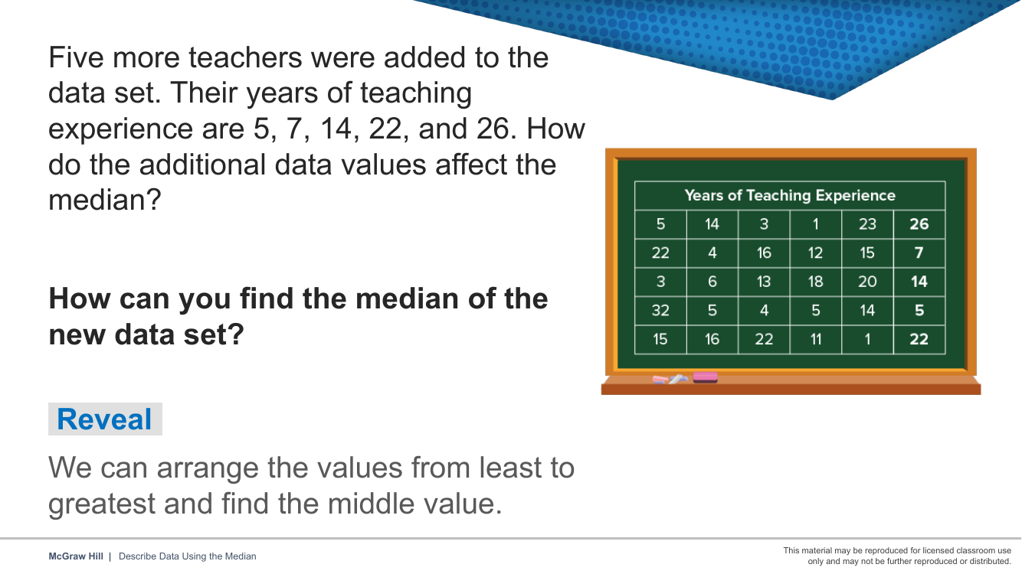
📘 Reveal 7 / 9
More teachers join the data — how does the median change?
Notes:
More teachers join the data — how does the median change?

Slide 23
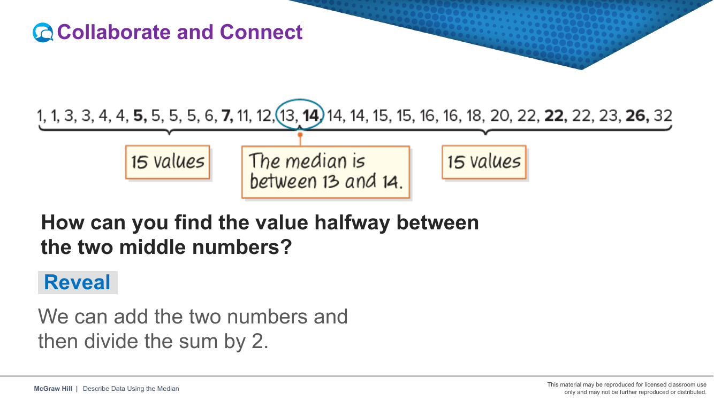
📘 Reveal 8 / 9
An even number of values — the median is halfway between the middle two.
Notes:
An even number of values — the median is halfway between the middle two.

Slide 24
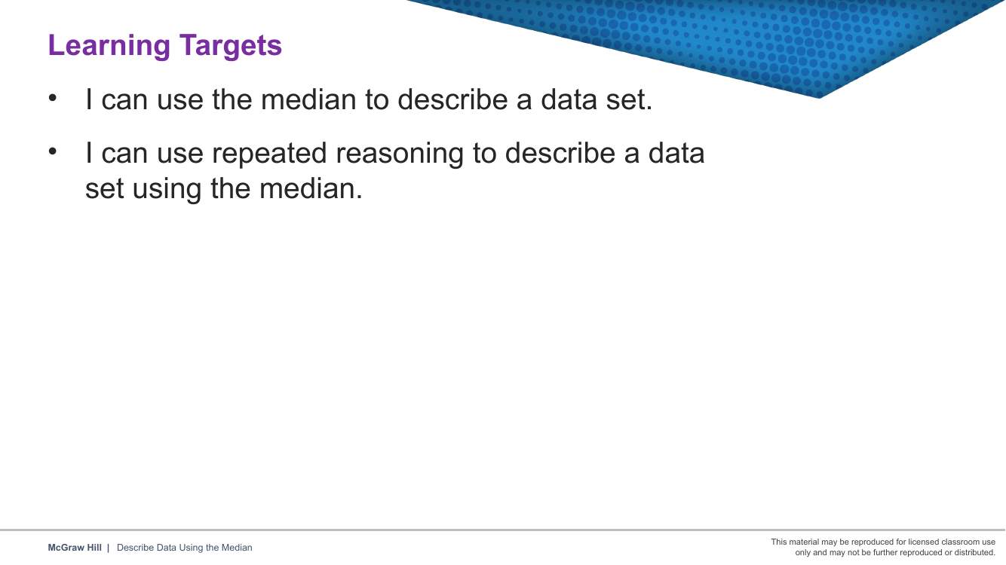
📘 Reveal 9 / 9
Learning targets — can you do these now?
Notes:
Learning targets — can you do these now?

Slide 25
NEFT TEACHER
Think–Write–Respond / Piensa y Escribe
6.DS.4
Use evidence from today's lesson to complete each frame.
Frame 1 — Explain the Rule
Today's key idea is "Mean = add then divide, median = the middle of the ordered numbers, mode = the value that shows up most." — and it works because ___.
Frame 2 — Because / But / So
Because Mean means ___, but a tricky part is ___, so I have to ___.
Frame 3 — Catch the Mistake
A common mistake with Mean is ___. It happens because ___, and the fix is ___.
Reveal Math Grade 6 · Unit 8 · Lesson 8-2
16

Slide 26
NEFT TEACHER
Exit Ticket / Boleto de Salida
6.DS.4
Reflection / Reflexión
Quick Exit Ticket
Today I learned that ___ because ___.
Tier 1 — Data set: 4, 7, 10, 7, 12. What is the median?
A. 7
B. 8
C. 10
D. 4
One thing I am still not sure about is ___.
Tier 2 — Explain how you know your answer is correct. Use at least one vocabulary word.
Reveal Math Grade 6 · Unit 8 · Lesson 8-2
17

Slide 27
NEFT TEACHER
Goal Tracker / Seguimiento de Metas
6.DS.4
My Goal: I can find the mean, median, and mode of a data set.
1
2
3
4
Not Yet
Getting There
Got It!
Can Teach It
I need more help. This does not make sense to me yet.
I understand the idea but I make mistakes when I work.
I can solve problems on my own and explain my thinking.
I can clearly teach this strategy to a classmate.
○ circle me
○ circle me
○ circle me
○ circle me
My next step: To move up one level, I will ___.
Reveal Math Grade 6 · Unit 8 · Lesson 8-2
18

