Slide 1
Unit 3 Test Review
Ratios, Rates, and Unit Rates • Version B
Notes:
Today we go over the Unit 3 test together. For each question we first read the problem, then solve it step by step.

Slide 2
How We Will Review
1
2
3
Read
Think
Solve
Read the problem together. Look at the picture or table.
What do we know? What do we need to find?
Work through simple steps. Check your answer.
Notes:
Explain the routine: first slide shows the problem, next slide shows the steps. Pause on each problem slide and ask students what they know and what they need to find.

Slide 3
Question 1: Bracelet Beads
PROBLEM
Priya is stringing beads to make a bracelet.
She uses 1 red bead for every 5 blue beads.
The bracelet has 24 beads in all.
How many of each color bead will Priya use?
Hint: 1+5 =6 and 24/6 =4
*Scale each part by x4
24
beads in all
1 red : 5 blue
WE NEED TO FIND: the number of blue beads and the number of red beads
Notes:
Ask: What is the ratio? (1 red : 5 blue). What is the total? (24). Point out that 24 is the TOTAL, not the number of blue beads.

Slide 4
Question 1: Bracelet Beads
STEPS
1
Make one group. 1 red + 5 blue = 6 beads in each group.
1 group = 1 red + 5 blue = 6 beads
Group 1
2
Count the groups. 24 ÷ 6 = 4 groups.
Group 2
3
Multiply each color by 4. Red: 1 × 4 = 4. Blue: 5 × 4 = 20.
Group 3
4
Check. 4 + 20 = 24 ✓
Group 4
Click to Show Answer
ANSWER: 20 blue beads and 4 red beads
4 groups × 6 = 24 beads
Notes:
Common mistake: 24 ÷ 5. Remind students that one group has 6 beads (1 + 5).

Slide 5
Question 2: School Groups
PROBLEM
Part A: Find the ratio of students in the Robotics Club to students on the Soccer Team. Write it as a fraction in simplest form.
Part B: Explain what your simplified ratio means.
School Group | Students
Soccer Team | 36
Art Club | 22
Robotics Club | 30
Debate Team | 16
WE NEED TO FIND: robotics to soccer as a fraction in simplest form, then explain it
Notes:
Read the question twice. Which group comes first? Robotics. Which comes second? Soccer. Ignore Art Club and Debate Team — they are extra information.

Slide 6
Question 2: School Groups
STEPS
1
Order matters. Robotics first (top), Soccer second (bottom): 30/36.
robotics → top
soccer → bottom
2
Find the GCF. The greatest common factor of 30 and 36 is 6.
30
5
÷ 6
3
Divide both by 6. 30 ÷ 6 = 5 and 36 ÷ 6 = 6 → 5/6
36
6
4
Part B: explain. For every 5 students in Robotics Club, there are 6 students on the Soccer Team.
Click to Show Answer
ANSWER: 5/6
GCF of 30 and 36 is 6
Notes:
Watch for students who wrote 36/30 or 6/5 — the order is reversed. For Part B, use the sentence: For every ___ in ___, there are ___ in ___.

Slide 7
Question 3: Jumping Jacks
PROBLEM
Darnell does 192 jumping jacks in 48 seconds.
Write this rate as a unit rate.
192
jumping jacks in 48 seconds
WE NEED TO FIND: jumping jacks in 1 second
Notes:
Ask: What does 'unit rate' mean? (The amount for ONE unit — here, 1 second.)

Slide 8
Question 3: Jumping Jacks
STEPS
1
Know the goal. A unit rate tells how many in 1 second.
2
Divide. 192 ÷ 48 = 4
Jumping jacks | 192 | 4
Seconds | 48 | 1
3
Check. 4 × 48 = 192 ✓
÷ 48 on both rows
Click to Show Answer
ANSWER: 4 jumping jacks per second
Notes:
Divide the top and bottom by the same number (48) to get down to 1 second.

Slide 9
Question 4: Trail Mix
PROBLEM
Part A: Find the unit price (price per pound) at each store.
Part B: Which store is the better buy?
Part B choices:
Fresh Market
A) Fresh Market — lower unit price
4-pound bag
$22.60
B) Nature's Pantry — lower unit price
Nature's Pantry
C) Fresh Market — bigger bag
2.5-pound bag
$13.50
D) Either store — equally good
WE NEED TO FIND: the price for 1 pound at each store, then the better buy
Notes:
Unit price = cost of 1 pound. A bigger bag is not always a better deal — we compare the price for the SAME amount (1 pound).

Slide 10
Question 4: Trail Mix
STEPS
1
Unit price = price ÷ pounds. Find the cost of 1 pound.
Fresh Market
$5.65 per pound
2
Fresh Market. $22.60 ÷ 4 = $5.65 per pound
3
Nature's Pantry. $13.50 ÷ 2.5 = $5.40 per pound
Nature's Pantry
$5.40 per pound
4
Part B: compare. $5.40 < $5.65, so Nature's Pantry is cheaper per pound.
Lower unit price = better buy
Click to Show Answer
ANSWER: $5.65 and $5.40; Nature's Pantry (lower unit price)
Notes:
For 13.50 ÷ 2.5, you can multiply both by 2: 27 ÷ 5 = 5.40. Choice C is a trap: a bigger bag does not mean a better buy.

Slide 11
Question 5: Who Earns More?
PROBLEM
Tasha earns $56 in 4 hours.
The double number line shows what Devon earns.
Complete the sentence:
[ Tasha / Devon ] earns $[ 1 / 2 / 3 / 4 ] more per hour.
Devon's earnings
0
1
2
3
4
5
Hours
Dollars
0
11
22
33
44
55
Tasha: $56 in 4 hours
WE NEED TO FIND: who earns more per hour, and how much more
Notes:
We need both people's pay for ONE hour. Tasha's is a calculation; Devon's we can read from the line.

Slide 12
Question 5: Who Earns More?
STEPS
1
Tasha per hour. $56 ÷ 4 = $14 per hour
Devon's earnings
Devon per hour. Read the line at 1 hour: $11 per hour
0
1
2
3
4
5
2
Hours
Dollars
3
Compare. $14 − $11 = $3. Tasha earns more.
0
11
22
33
44
55
1 hour → $11
Tasha: $14 vs. Devon: $11
Click to Show Answer
ANSWER: Tasha earns $3 more per hour
Notes:
Have students point to the 1-hour mark on the number line before reading the dollar amount.

Slide 13
Question 6: Milk Survey
PROBLEM
For every 4 people who like chocolate milk, 3 people like white milk.
Part A: Complete the table.
Part B: Explain how you found your answers. Start with: “I know this because…”
Chocolate : White = 4 : 3
Chocolate | 12 | 20 | 32 | 44
White | ? | ? | ? | ?
WE NEED TO FIND: the number of white milk people for each column
Notes:
The ratio is chocolate : white = 4 : 3. Every column in the table must keep this same ratio.

Slide 14
Question 6: Milk Survey
STEPS
1
Use the ratio. 4 chocolate : 3 white
Chocolate : White = 4 : 3
2
Find the groups. 12 ÷ 4 = 3 groups, so white = 3 × 3 = 9
Chocolate | 12 | 20 | 32 | 44
White | 9 | 15 | 24 | 33
3
Repeat. 20 → 15, 32 → 24, 44 → 33
÷ 4, then × 3
4
Part B. “I know this because I divided by 4 to find the groups, then multiplied by 3.”
Click to Show Answer
ANSWER: 9, 15, 24, 33
Notes:
Check one: 44 ÷ 4 = 11 groups, 11 × 3 = 33. Students who subtracted 1 (12 → 11) used adding, not multiplying.

Slide 15
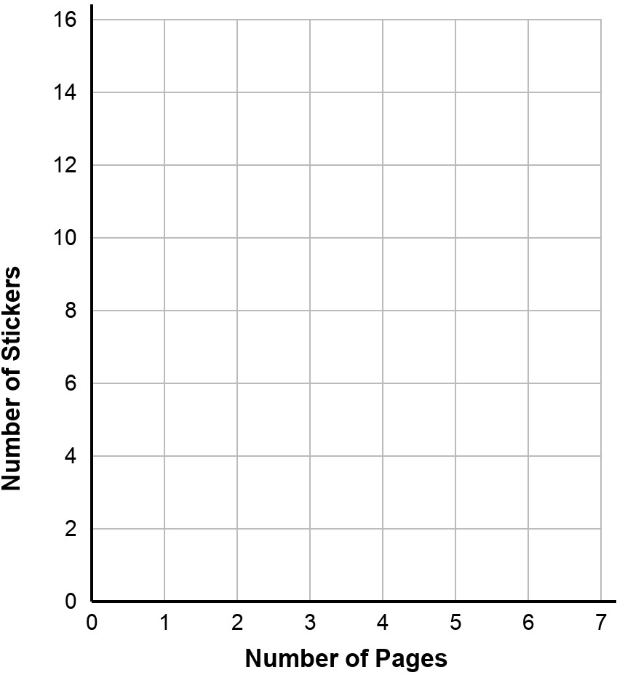
Question 7: Scrapbook Stickers
PROBLEM
Maya puts 3 stickers on each page of her scrapbook.
Plot the points to show the number of stickers for 1, 2, 3, 4, and 5 pages.
WE NEED TO FIND: 5 points: (pages, stickers)
Notes:
x-axis = pages (go RIGHT). y-axis = stickers (go UP).

Slide 16
Question 7: Scrapbook Stickers
STEPS
1
Find the rule. 3 stickers per page → stickers = pages × 3
2
Make the pairs. (1, 3) (2, 6) (3, 9) (4, 12) (5, 15)
3
Plot each point. Go right to the pages, then up to the stickers.
4
Check. The points line up in a straight line.
Click to Show Answer
ANSWER: (1, 3), (2, 6), (3, 9), (4, 12), (5, 15)
Notes:
The y-axis counts by 2s, so 3, 9 and 15 sit halfway between grid lines. That is the most common plotting error.

Slide 17
Question 8: Cereal Fiber
PROBLEM
Brand A has 3 grams of fiber per serving.
Brand B is shown in the table.
Part A: Complete the ordered pairs for 1, 2, 3, and 4 servings of each brand.
Part B: Which brand has more fiber per serving?
Brand B
Servings | 2 | 3 | 4
Fiber (g) | 8 | 12 | 16
WE NEED TO FIND: (servings, fiber) pairs for both brands, then the brand with more fiber
Notes:
Brand B does not start at 1 serving. We need to find the fiber in 1 serving first.

Slide 18
Question 8: Cereal Fiber
STEPS
1
Brand A: × 3. (1, 3) (2, 6) (3, 9) (4, 12)
2
Brand B unit rate. 8 ÷ 2 = 4 grams per serving
3
Brand B: × 4. (1, 4) (2, 8) (3, 12) (4, 16)
4
Part B: compare. 4 grams > 3 grams per serving
Click to Show Answer
ANSWER: Brand B has the greater ratio
Notes:
On the graph, the steeper line has the greater rate. Brand B's line is steeper.

Slide 19
Question 9: Jordan's Run
PROBLEM
Jordan runs 3 miles in 27 minutes.
Complete the sentences:
The unit rate is ___ minutes per mile.
At this rate, Jordan would run ___ miles in 45 minutes.
3 mi
in 27 minutes
WE NEED TO FIND: minutes for 1 mile, then miles in 45 minutes
Notes:
Unit rate here is MINUTES per mile, so minutes go on top: 27 ÷ 3.

Slide 20
Question 9: Jordan's Run
STEPS
1
Unit rate. 27 ÷ 3 = 9 minutes per mile
2
Use the unit rate. How many 9s are in 45? 45 ÷ 9 = 5
Miles | 3 | 1 | 5
Minutes | 27 | 9 | 45
3
Check. 5 miles × 9 minutes = 45 minutes ✓
1 mile = 9 minutes
Click to Show Answer
ANSWER: 9 minutes per mile; 5 miles in 45 minutes
Notes:
A ratio table helps: 3 → 1 → 5 miles, 27 → 9 → 45 minutes.

Slide 21
Question 10: Calories Burned
PROBLEM
Marcus burns 270 calories swimming for 30 minutes.
Then he burns 180 calories riding a bike for 20 minutes.
Are these rates equivalent?
Activity | Calories | Minutes
Swimming | 270 | 30
Biking | 180 | 20
WE NEED TO FIND: whether both activities burn the same calories per minute
Notes:
Equivalent rates have the same unit rate. Find calories per 1 minute for each.

Slide 22
Question 10: Calories Burned
STEPS
1
Swimming unit rate. 270 ÷ 30 = 9 calories per minute
Swimming
270 ÷ 30 = 9 cal per min
2
Biking unit rate. 180 ÷ 20 = 9 calories per minute
3
Compare. The unit rates are the same.
Biking
180 ÷ 20 = 9 cal per min
Click to Show Answer
ANSWER: Yes. Both rates are 9 calories per minute.
9 = 9 → equivalent
Notes:
A full answer says YES and gives the reason (both are 9 calories per minute).

Slide 23
Question 11: Kilograms to Pounds
PROBLEM
Tanya does squats with 60-kilogram weights.
Which is the best estimate of the weight in pounds?
Conversion | Equivalent
kilograms to pounds | 1 kg ≈ 2.2 lb
A) 27 pounds
B) 33 pounds
C) 108 pounds
D) 132 pounds
WE NEED TO FIND: 60 kilograms in pounds
Notes:
1 kilogram is MORE than 2 pounds. So the number of pounds should be bigger than 60.

Slide 24
Question 11: Kilograms to Pounds
STEPS
1
Think first. 1 kg ≈ 2.2 lb, so pounds will be a bigger number than 60.
Conversion | Equivalent
kilograms to pounds | 1 kg ≈ 2.2 lb
2
Cross out. A (27) and B (33) are smaller than 60.
A) 27 pounds
B) 33 pounds
3
Multiply. 60 × 2.2 = 132
C) 108 pounds
D) 132 pounds
Click to Show Answer
ANSWER: D) 132 pounds
Notes:
Students who picked A or B divided instead of multiplied. 60 × 2 = 120 is a quick estimate that rules out C too.

Slide 25
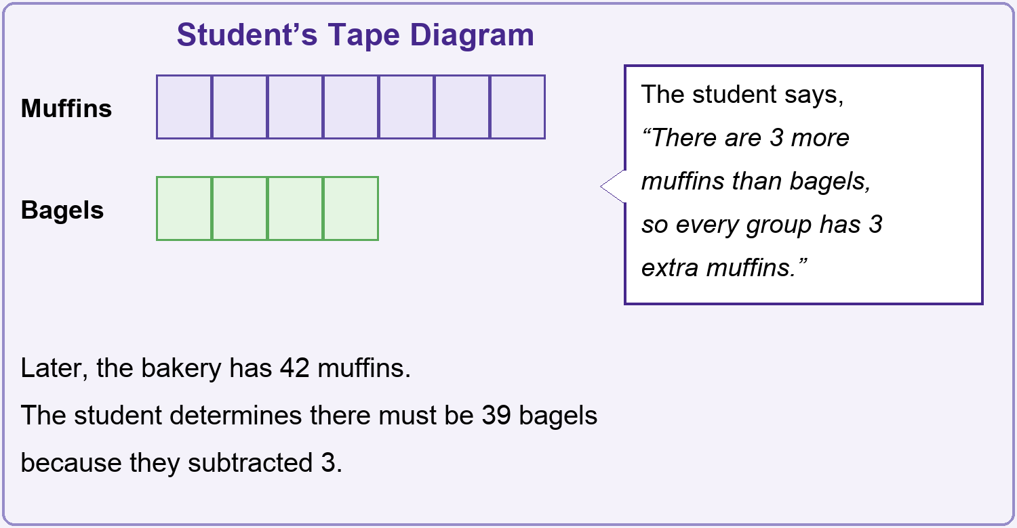
Question 12: Muffins and Bagels
PROBLEM
A bakery sells muffins and bagels in a ratio of 7 : 4.
Look at the student's work.
Part A: Explain why the student is wrong.
Part B: Label the tape diagram. Find the bagels when there are 42 muffins.
WE NEED TO FIND: the mistake, then the correct number of bagels
Notes:
Ask: Does the ratio 7 : 4 mean 'add or subtract 3'? Or does it mean groups of 7 and 4?

Slide 26
Question 12: Muffins and Bagels
STEPS
1
Find the mistake. Ratios multiply, not subtract. 42 − 3 = 39 does not keep 7 : 4.
42 ÷ 7 = 6 in each box
Find one box. 7 boxes = 42 muffins, so 42 ÷ 7 = 6 in each box.
Muffins
6
6
6
6
6
6
6
2
7 boxes = 42
3
Find the bagels. 4 boxes × 6 = 24 bagels.
Bagels
6
6
6
6
4
Explain. “I know this because each box is 6, and 4 boxes of 6 is 24.”
4 boxes = 24
Click to Show Answer
ANSWER: 24 bagels
Check: 42 : 24 = 7 : 4 ✓
Notes:
Every box in the tape diagram has the same value. Label all 11 boxes with 6.

Slide 27
Question 13: Walk to the Library
PROBLEM
Aaliyah walks to the library.
The library is 2,100 feet away.
How many yards did Aaliyah walk?
Conversion | Equivalent
yards and feet | 1 yd = 3 ft
2,100
feet
WE NEED TO FIND: 2,100 feet in yards
Notes:
A yard is bigger than a foot, so we should get FEWER yards than feet.

Slide 28
Question 13: Walk to the Library
STEPS
1
Think first. Yards are bigger, so the answer is smaller than 2,100.
3 feet make 1 yard
2
Divide by 3. 2,100 ÷ 3 = 700
1 ft
1 ft
1 ft
1 yd
3
Check. 700 × 3 = 2,100 ✓
feet → yards: divide by 3
2,100 ÷ 3 = 700
Click to Show Answer
ANSWER: 700 yards
Notes:
Students who got 6,300 multiplied. Ask: should there be more yards or fewer yards than feet?

Slide 29
Big Ideas to Remember
1
Order matters
2
Unit rate = amount for 1
Write the ratio in the order the question asks.
Divide to find how much for 1.
3
Ratios multiply
4
Lower unit price wins
Equivalent ratios multiply or divide — never add or subtract.
Compare the price of the SAME amount.
Notes:
Recap the four big ideas. Ask students which question each idea helped with.

