Slide 1
WARM-UP · THINK • TRY • CHECK
Turn and talk: compare strategies, then defend one.
Warm-Up
Lesson 2-1 · Understand Statistical Questions | Warm-Up · about 4 minutes
Try each on your own. Mark an unsure answer; explain and revise when we check.
QUESTION 1
QUESTION 2
Order least to greatest: 8, 3, 11, 5 = ______
A line runs 0 to 20 in 4 equal jumps. One jump = ______
QUESTION 3
QUESTION 4
A tally has 4 groups of five and 3 more. Total = ______
Which is greater, 78 or 87? ______
TALK IT OVER: “I got ______ because ______.” • Compare with a partner before we check as a class.
1 / 50
Notes:
TEACH IN PRACTICE | Embedded facilitation | Lesson 2.1, slide 1 | WARMUP
Focus on the existing task: Warm-Up WARM-UP · THINK • TRY • CHECK Do these four on…
GATHER EVIDENCE (T4/6): Keep the original items. Students try independently, mark an uncertain item, and explain one method before checking. Use the existing key when present.
RESPOND: Distinguish a calculation slip from a reasoning gap. Give one next step on the same item; have students revise in a second color. Use the responses to choose flexible support for today’s lesson.
PARTICIPATION (T5/6/7): Think time before volunteers; accept a written, drawn or rehearsed entry. Students ask for evidence respectfully. Recognize a specific contribution or revision and check that both partners participate.
Source: BCPS Updated Instructional Framework Rubric (June 2020), TEACH 1–7. Earlier notes and answer keys are retained below.
EARLIER NOTES / EXISTING ANSWER KEY
Warm-Up answers (teacher only): 1) 3, 5, 8, 11 2) 5 3) 23 4) 87
UIFR FULL | Lesson-specific facilitation
PREPARE 1-2 | Before teaching (UIFR PDF pp. 6-7).
Plan to gather evidence that students can identify a question that anticipates variability; describe possible data and what a dot represents. Review recent work and today’s warm-up to choose flexible groups and access supports; do not infer needs from identity or perceived ability. Use the existing lesson tasks and stated standards.
Anticipate: assuming any question with a numerical answer is statistical. If observed, revisit the existing survey and sort its possible responses before classifying the question. Offer oral rehearsal, drawing, pointing, or home-language processing as needed; retain the original mathematical demand. Ask students which support helps and fade it as evidence improves.
TEACH 6-7 | Before the first transition, agree on materials, partner roles, and how to request help. Invite students to restate the routine. Normalize revising an idea, recognize a specific contribution, and check privately when frustration blocks participation. Source: UIFR PDF pp. 13-14.

Slide 2
Today’s Math Notes
Lesson 2-1 · Understand Statistical Questions
Section 1: Math Words
Copy. Explain. Check.
SAY THE GOAL · Say today’s goal in your own words, then name one place this shows up outside math class.
Statistical Questions and Data
1
A statistical question expects varied answers
Statistical Question
2
A question where the answers will be different for different people
Non-statistical Question
3
A question that has just one fixed answer
eduwonderlab.com · Neft Teacher
2 / 50
Notes:
TEACH IN PRACTICE | Embedded facilitation | Lesson 2.1, slide 2 | NOTES
Focus on the existing task: Today’s Math Notes Section 1: Math Words Copy into your…
ROUTINE (T1/2/4): Read or copy the original notes, cover one line, and explain it using the displayed example. Reopen and correct. Copying alone is not evidence of understanding.
LOOK FOR: A link between a symbol, quantity or feature and the explanation. If missing, point back to that feature and have the student try again; fade the prompt once they can explain.
PARTICIPATION (T5/6/7): Think time before volunteers; accept a written, drawn or rehearsed entry. Students ask for evidence respectfully. Recognize a specific contribution or revision and check that both partners participate.
Source: BCPS Updated Instructional Framework Rubric (June 2020), TEACH 1–7. Earlier notes and answer keys are retained below.
EARLIER NOTES / EXISTING ANSWER KEY
Copy routine: read one line at a time; students copy, then explain that line to a partner.
Keep it brisk — the understanding work happens in the examples, not the copying.
UIFR: TEACH 1 · TEACH 6.

Slide 3
Today’s Math Notes
Lesson 2-1 · Understand Statistical Questions
Section 2: Today’s Math
Copy. Explain. Check.
Statistical Questions & Variability
Statistical Question: Expects answers that vary across people, trials, or items
1
Non-Statistical Question: Has one single fixed answer
2
CONNECT IT · What earlier lesson does this build on? Tell a partner in one sentence.
Data Collection: Gather varied data points to create a distribution
3
eduwonderlab.com · Neft Teacher
3 / 50
Notes:
TEACH IN PRACTICE | Embedded facilitation | Lesson 2.1, slide 3 | NOTES
Focus on the existing task: Today’s Math Notes Section 2: Today’s Math Copy into your…
ROUTINE (T1/2/4): Read or copy the original notes, cover one line, and explain it using the displayed example. Reopen and correct. Copying alone is not evidence of understanding.
LOOK FOR: A link between a symbol, quantity or feature and the explanation. If missing, point back to that feature and have the student try again; fade the prompt once they can explain.
PARTICIPATION (T5/6/7): Think time before volunteers; accept a written, drawn or rehearsed entry. Students ask for evidence respectfully. Recognize a specific contribution or revision and check that both partners participate.
Source: BCPS Updated Instructional Framework Rubric (June 2020), TEACH 1–7. Earlier notes and answer keys are retained below.
EARLIER NOTES / EXISTING ANSWER KEY
Copy routine: read one line at a time; students copy, then explain that line to a partner.
Keep it brisk — the understanding work happens in the examples, not the copying.
UIFR: TEACH 1 · TEACH 6.

Slide 4
Session 1
Understand Statistical Questions
PICK YOUR STRATEGY · Choose your path — picture, table, number line, or equation — and be ready to say why you chose it.
4 / 50
Notes:
TEACH IN PRACTICE | Embedded facilitation | Lesson 2.1, slide 4 | DIVIDER
Focus on the existing task: Understand Statistical Questions Session 1
TRANSITION (T6/7): Students confirm materials, roles, how to request help, and the next response routine. Ask a student to restate it. Keep teacher-only slides hidden.
PARTICIPATION (T5/6/7): Think time before volunteers; accept a written, drawn or rehearsed entry. Students ask for evidence respectfully. Recognize a specific contribution or revision and check that both partners participate.
Source: BCPS Updated Instructional Framework Rubric (June 2020), TEACH 1–7. Earlier notes and answer keys are retained below.
EARLIER NOTES / EXISTING ANSWER KEY
Transition cue: state what materials are out and what success looks like this session.
Keep the changeover under a minute.
UIFR: TEACH 6.

Slide 5
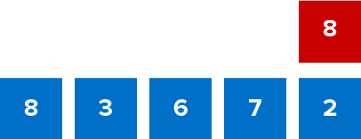
Give Me Five
Use all the numbers in any order with any operation to equal the target number (in red). ​
Explain how the information shown supports your reasoning.
5 / 50
Notes:
TEACH IN PRACTICE | Embedded facilitation | Lesson 2.1, slide 5 | WORKED
Focus on the existing task: Give Me Five Use all the numbers in any order with any operation to equal the target number (in red).
LAUNCH (T2/3/5): Ask students to explain the displayed idea or example and point to evidence. When a calculation step is shown, ask why it is valid. Have a partner restate the explanation; copying is not the check.
LOOK FOR (T4): Where this task addresses it, students can identify a question that anticipates variability. Ask which feature of their work supports the claim.
RESPOND: If this task shows the lesson misconception—assuming any question with a numerical answer is statistical—revisit the existing survey and sort its possible responses before classifying the question. Have the student revise and explain the change. Use this support only where the concept occurs in the current task; otherwise respond to the displayed question.
RECHECK: If a gap is shared, revisit the existing representation together. If it is limited, give targeted support while others compare valid methods on the same task. Check the revision before moving on.
PARTICIPATION (T5/6/7): Think time before volunteers; accept a written, drawn or rehearsed entry. Students ask for evidence respectfully. Recognize a specific contribution or revision and check that both partners participate.
Source: BCPS Updated Instructional Framework Rubric (June 2020), TEACH 1–7. Earlier notes and answer keys are retained below.
EARLIER NOTES / EXISTING ANSWER KEY
Number-sense routine — every voice in. Give quiet think time, then hear from at least three students.
Always follow with “How do you know?” — the reasoning is the point, not the answer.
There is more than one path; name and celebrate different strategies.
UIFR: TEACH 3 · TEACH 5 · TEACH 6.

Slide 6
Today’s Objectives
Lesson 2-1 · Understand Statistical Questions
Understand Statistical Questions
Maryland Standard 6.DS.1
SHOW YOUR THINKING · Show what you know — write it, draw it, or build it. A picture counts as an explanation.
CONTENT OBJECTIVE
LANGUAGE OBJECTIVE
Restate the goal in your words
Use these words to explain why
I can tell the difference between a statistical question and a non-statistical question.
I can explain my reasoning using the words statistical question, data, variability, and survey.
eduwonderlab.com · Neft Teacher
6 / 50
Notes:
TEACH IN PRACTICE | Embedded facilitation | Lesson 2.1, slide 6 | GOAL
Focus on the existing task: Today’s Objectives Understand Statistical Questions…
CONNECT (T1/4): Ask students to restate the displayed goal or key idea and connect it to earlier work. Relevant lesson evidence: identify a question that anticipates variability; describe possible data and what a dot represents. Use only the criterion that matches the current session.
SHOW PROGRESS: Students point to their own existing work, explain what improved after feedback, and name a next step. Pair confidence ratings with actual evidence.
PARTICIPATION (T5/6/7): Think time before volunteers; accept a written, drawn or rehearsed entry. Students ask for evidence respectfully. Recognize a specific contribution or revision and check that both partners participate.
Source: BCPS Updated Instructional Framework Rubric (June 2020), TEACH 1–7. Earlier notes and answer keys are retained below.
EARLIER NOTES / EXISTING ANSWER KEY
Read the objective together, then have one or two students restate today’s goal in their own words.
Connect it to what the class learned last lesson.
Return to this goal at the end of class to check it was met.
UIFR: TEACH 1.
UIFR FULL | Lesson-specific facilitation
TEACH 1 | Session 1 purpose and evidence (UIFR PDF p. 8).
Have students restate the displayed session goal in their own words and connect it to the existing context or a familiar experience they choose to share. Use the current session goal to select from these lesson-wide evidence criteria; do not frontload a later-session procedure.
Look for: identify a question that anticipates variability; describe possible data and what a dot represents. Ask: “Which part of your work would show this?” Revisit that evidence after the task; a confidence rating alone is not evidence of understanding.

Slide 7
LESSON 2.1 / OUR LEARNING
What will show your learning?
1
Identify a question that anticipates variability.
2
Describe possible data and what a dot represents.
Tell a partner: Which skill connects to something you already know?
WHY IT MATTERS · Finish this: “This is worth knowing because ______.”
Listen to understand. Ask for evidence. Make room for every voice.
Notes:
TEACH IN PRACTICE | Embedded facilitation | Lesson 2.1, slide 7 | PRIOR_INSERT
Focus on the existing task: LESSON 2.1 / OUR LEARNING What will show your learning?
CONNECT (T1/4): Ask students to restate the displayed goal or key idea and connect it to earlier work. Relevant lesson evidence: identify a question that anticipates variability; describe possible data and what a dot represents. Use only the criterion that matches the current session.
SHOW PROGRESS: Students point to their own existing work, explain what improved after feedback, and name a next step. Pair confidence ratings with actual evidence.
PARTICIPATION (T5/6/7): Think time before volunteers; accept a written, drawn or rehearsed entry. Students ask for evidence respectfully. Recognize a specific contribution or revision and check that both partners participate.
Source: BCPS Updated Instructional Framework Rubric (June 2020), TEACH 1–7.

Slide 8
Vocabulary 1 of 7
Lesson 2-1 · Understand Statistical Questions
Statistical Questions and Data
A statistical question expects varied answers that can be collected as data.
EXAMPLE · EXPLAIN WHY IT FITS
How many minutes do students in our class read each night?
USE THE MATH WORDS · Use today’s math words in your explanation — not “it” and “that thing.”
eduwonderlab.com · Neft Teacher
8 / 50
Notes:
TEACH IN PRACTICE | Embedded facilitation | Lesson 2.1, slide 8 | VOCAB
Focus on the existing task: Vocabulary 1 of 7 Statistical Questions and Data A…
ASK (T1/3/5): Where does “Statistical Questions and Data” appear in the example? Explain the meaning without reading the definition. Partner: restate the idea and ask a clarifying question.
LOOK FOR: A correct connection between the word and a feature of the example. If the student only repeats the definition, invite pointing, sketching or oral rehearsal, then ask for another explanation of this same example.
PARTICIPATION (T5/6/7): Think time before volunteers; accept a written, drawn or rehearsed entry. Students ask for evidence respectfully. Recognize a specific contribution or revision and check that both partners participate.
Source: BCPS Updated Instructional Framework Rubric (June 2020), TEACH 1–7.

Slide 9
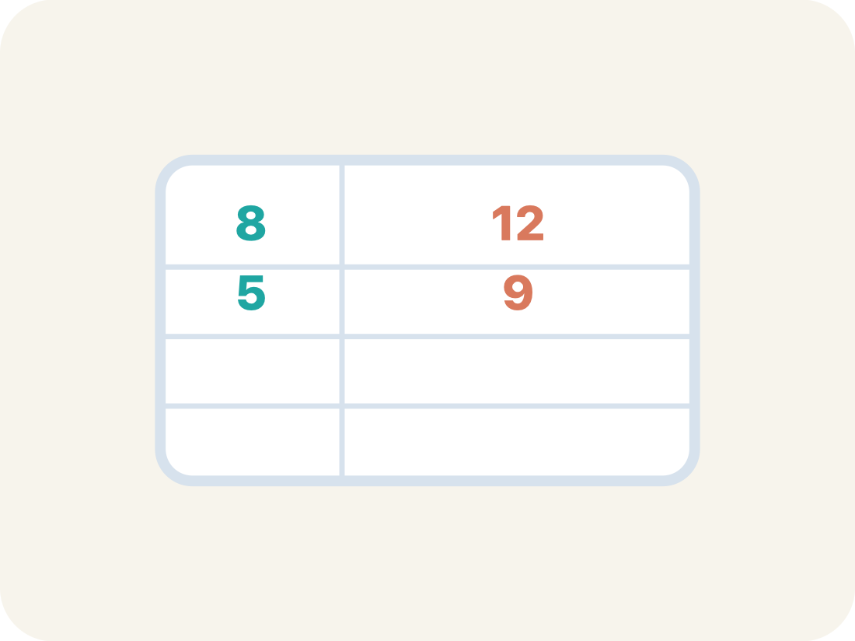
Vocabulary 2 of 7
Lesson 2-1 · Understand Statistical Questions
Statistical Question
A question where the answers will be different for different people.
EXAMPLE · EXPLAIN WHY IT FITS
“How tall are the players on the team?” → answers vary: 60 in, 63 in, 58 in, 65 in
Use “Statistical Question” to explain the example. Point to
evidence.
eduwonderlab.com · Neft Teacher
9 / 50
Notes:
TEACH IN PRACTICE | Embedded facilitation | Lesson 2.1, slide 9 | VOCAB
Focus on the existing task: Vocabulary 2 of 7 Statistical Question A question where…
ASK (T1/3/5): Where does “Statistical Question” appear in the example? Explain the meaning without reading the definition. Partner: restate the idea and ask a clarifying question.
LOOK FOR: A correct connection between the word and a feature of the example. If the student only repeats the definition, invite pointing, sketching or oral rehearsal, then ask for another explanation of this same example.
PARTICIPATION (T5/6/7): Think time before volunteers; accept a written, drawn or rehearsed entry. Students ask for evidence respectfully. Recognize a specific contribution or revision and check that both partners participate.
Source: BCPS Updated Instructional Framework Rubric (June 2020), TEACH 1–7.

Slide 10
Vocabulary 3 of 7
Lesson 2-1 · Understand Statistical Questions
Non-statistical Question
A question that has just one fixed answer that is the same no matter who you ask, so there is no data to collect.
EXAMPLE · EXPLAIN WHY IT FITS
“How tall am I?” → one answer: 60 in. Everyone who measures gets the same number.
ADD ON · Add on: “I agree because ______.” or “I see it differently because ______.”
eduwonderlab.com · Neft Teacher
10 / 50
Notes:
TEACH IN PRACTICE | Embedded facilitation | Lesson 2.1, slide 10 | VOCAB
Focus on the existing task: Vocabulary 3 of 7 Non-statistical Question A question…
ASK (T1/3/5): Where does “Non-statistical Question” appear in the example? Explain the meaning without reading the definition. Partner: restate the idea and ask a clarifying question.
LOOK FOR: A correct connection between the word and a feature of the example. If the student only repeats the definition, invite pointing, sketching or oral rehearsal, then ask for another explanation of this same example.
PARTICIPATION (T5/6/7): Think time before volunteers; accept a written, drawn or rehearsed entry. Students ask for evidence respectfully. Recognize a specific contribution or revision and check that both partners participate.
Source: BCPS Updated Instructional Framework Rubric (June 2020), TEACH 1–7.

Slide 11
Vocabulary 4 of 7
Lesson 2-1 · Understand Statistical Questions
Data
Facts and numbers you collect, like answers to a survey.
EXAMPLE · EXPLAIN WHY IT FITS
Player heights: 60 in, 63 in, 58 in, 65 in — four different measurements
Use “Data” to explain the example. Point to evidence.
eduwonderlab.com · Neft Teacher
11 / 50
Notes:
TEACH IN PRACTICE | Embedded facilitation | Lesson 2.1, slide 11 | VOCAB
Focus on the existing task: Vocabulary 4 of 7 Data Facts and numbers you collect…
ASK (T1/3/5): Where does “Data” appear in the example? Explain the meaning without reading the definition. Partner: restate the idea and ask a clarifying question.
LOOK FOR: A correct connection between the word and a feature of the example. If the student only repeats the definition, invite pointing, sketching or oral rehearsal, then ask for another explanation of this same example.
PARTICIPATION (T5/6/7): Think time before volunteers; accept a written, drawn or rehearsed entry. Students ask for evidence respectfully. Recognize a specific contribution or revision and check that both partners participate.
Source: BCPS Updated Instructional Framework Rubric (June 2020), TEACH 1–7.

Slide 12

Vocabulary 5 of 7
Lesson 2-1 · Understand Statistical Questions
Variability
How spread out the numbers are.
EXAMPLE · EXPLAIN WHY IT FITS
Scores 10, 12, 11 are close together (low variability); scores 2, 15, 30 are far apart (high variability)
Use “Variability” to explain the example. Point to evidence.
eduwonderlab.com · Neft Teacher
12 / 50
Notes:
TEACH IN PRACTICE | Embedded facilitation | Lesson 2.1, slide 12 | VOCAB
Focus on the existing task: Vocabulary 5 of 7 Variability How spread out the numbers…
ASK (T1/3/5): Where does “Variability” appear in the example? Explain the meaning without reading the definition. Partner: restate the idea and ask a clarifying question.
LOOK FOR: A correct connection between the word and a feature of the example. If the student only repeats the definition, invite pointing, sketching or oral rehearsal, then ask for another explanation of this same example.
PARTICIPATION (T5/6/7): Think time before volunteers; accept a written, drawn or rehearsed entry. Students ask for evidence respectfully. Recognize a specific contribution or revision and check that both partners participate.
Source: BCPS Updated Instructional Framework Rubric (June 2020), TEACH 1–7.

Slide 13
Vocabulary 6 of 7
Lesson 2-1 · Understand Statistical Questions
Survey
Collecting facts by asking people questions.
EXAMPLE · EXPLAIN WHY IT FITS
Asking 50 students ‘What is your favorite sport?’ and recording the answers
Use “Survey” to explain the example. Point to evidence.
eduwonderlab.com · Neft Teacher
13 / 50
Notes:
TEACH IN PRACTICE | Embedded facilitation | Lesson 2.1, slide 13 | VOCAB
Focus on the existing task: Vocabulary 6 of 7 Survey Collecting facts by asking people questions. EXAMPLE Asking 50 students ‘What is your favorite sport?
ASK (T1/3/5): Where does “Survey” appear in the example? Explain the meaning without reading the definition. Partner: restate the idea and ask a clarifying question.
LOOK FOR: A correct connection between the word and a feature of the example. If the student only repeats the definition, invite pointing, sketching or oral rehearsal, then ask for another explanation of this same example.
PARTICIPATION (T5/6/7): Think time before volunteers; accept a written, drawn or rehearsed entry. Students ask for evidence respectfully. Recognize a specific contribution or revision and check that both partners participate.
Source: BCPS Updated Instructional Framework Rubric (June 2020), TEACH 1–7.

Slide 14
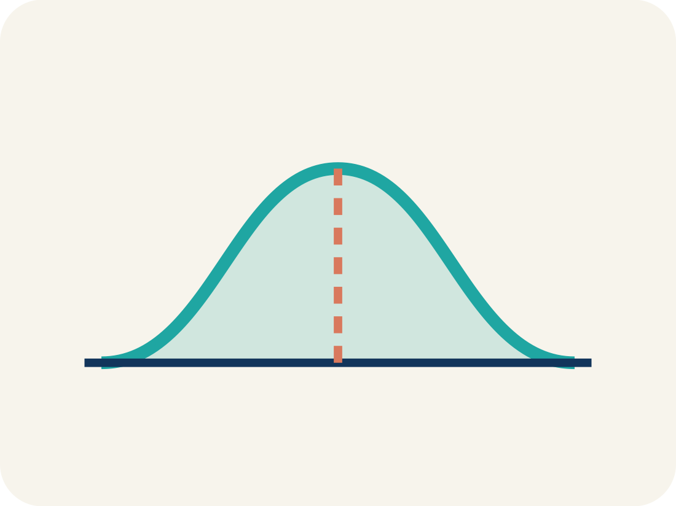
Vocabulary 7 of 7
Lesson 2-1 · Understand Statistical Questions
Data distribution
How the data looks: where it sits and how spread out it is.
EXAMPLE · EXPLAIN WHY IT FITS
If most scores cluster in the middle with fewer at the edges, the distribution is symmetric
Use “Data distribution” to explain the example. Point to
evidence.
eduwonderlab.com · Neft Teacher
14 / 50
Notes:
TEACH IN PRACTICE | Embedded facilitation | Lesson 2.1, slide 14 | VOCAB
Focus on the existing task: Vocabulary 7 of 7 Data distribution How the data looks…
ASK (T1/3/5): Where does “Data distribution” appear in the example? Explain the meaning without reading the definition. Partner: restate the idea and ask a clarifying question.
LOOK FOR: A correct connection between the word and a feature of the example. If the student only repeats the definition, invite pointing, sketching or oral rehearsal, then ask for another explanation of this same example.
PARTICIPATION (T5/6/7): Think time before volunteers; accept a written, drawn or rehearsed entry. Students ask for evidence respectfully. Recognize a specific contribution or revision and check that both partners participate.
Source: BCPS Updated Instructional Framework Rubric (June 2020), TEACH 1–7.

Slide 15
Vocabulary
Lesson 2-1 · Understand Statistical Questions
Today’s Math Words
We learn every word — what it means and what it looks like — before we use it.
Statistical Questions and Data
Statistical Question
A statistical question expects varied answers that can be collected as data
A question where the answers will be different for different people
Non-statistical Question
Data
A question that has just one fixed answer that is the same no matter who you ask, so there is no data to collect
Facts and numbers you collect, like answers to a survey
Variability
Survey
How spread out the numbers are
Collecting facts by asking people questions
Data distribution
Explain one math word using the example.
Partner: point to evidence.
How the data looks: where it sits and how spread out it is
eduwonderlab.com · Neft Teacher
15 / 50
Notes:
TEACH IN PRACTICE | Embedded facilitation | Lesson 2.1, slide 15 | VOCAB
Focus on the existing task: Vocabulary Today’s Math Words We learn every word — what…
ASK (T1/3/5): Where does “the displayed term” appear in the example? Explain the meaning without reading the definition. Partner: restate the idea and ask a clarifying question.
LOOK FOR: A correct connection between the word and a feature of the example. If the student only repeats the definition, invite pointing, sketching or oral rehearsal, then ask for another explanation of this same example.
PARTICIPATION (T5/6/7): Think time before volunteers; accept a written, drawn or rehearsed entry. Students ask for evidence respectfully. Recognize a specific contribution or revision and check that both partners participate.
Source: BCPS Updated Instructional Framework Rubric (June 2020), TEACH 1–7. Earlier notes and answer keys are retained below.
EARLIER NOTES / EXISTING ANSWER KEY
Choral-read each word, its meaning, and what it looks like.
Students should use these words out loud today — listen for them in partner talk and revoice student ideas with the academic term.
UIFR: TEACH 1 · TEACH 5.

Slide 16


Be Curious
What do you notice?
What do you wonder?
Think first. Share a notice and a question;
build on a classmate’s idea.
Mindset
What do you want your classmates to know about your math journey?
16 / 50
Notes:
TEACH IN PRACTICE | Embedded facilitation | Lesson 2.1, slide 16 | CURIOUS
Focus on the existing task: What do you notice?
LAUNCH (T2/3/5): Allow quiet observation first. Separate a notice from an inference, invite students’ own questions, and follow the existing launch before teaching a procedure.
LOOK FOR (T4): Where this task addresses it, students can describe possible data and what a dot represents. Ask which feature of their work supports the claim.
RESPOND: If this task shows the lesson misconception—assuming any question with a numerical answer is statistical—revisit the existing survey and sort its possible responses before classifying the question. Have the student revise and explain the change. Use this support only where the concept occurs in the current task; otherwise respond to the displayed question.
RECHECK: If a gap is shared, revisit the existing representation together. If it is limited, give targeted support while others compare valid methods on the same task. Check the revision before moving on.
PARTICIPATION (T5/6/7): Think time before volunteers; accept a written, drawn or rehearsed entry. Students ask for evidence respectfully. Recognize a specific contribution or revision and check that both partners participate.
Source: BCPS Updated Instructional Framework Rubric (June 2020), TEACH 1–7. Earlier notes and answer keys are retained below.
EARLIER NOTES / EXISTING ANSWER KEY
Accept all noticings and wonderings — there are no wrong answers here.
Give 20–30 seconds of quiet think time before taking responses; mix cold and warm calls so it is not always the same voices.
Read the mindset question aloud and let two students respond.
UIFR: TEACH 3 · TEACH 7.

Slide 17
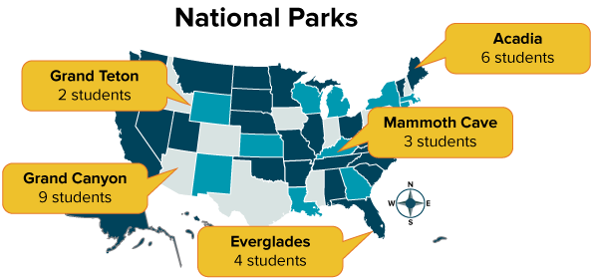
U.S. National Parks
HOW DO YOU KNOW? · Ask your partner “How do you know?” Answer by pointing to your own work.
Diamond surveyed her classmates about U.S. National Parks and organized the data.
Which of these questions could Diamond have asked her classmates?
What is your favorite national park?
Which national park have you visited?
In what state is Acadia National Park found?
When was the Everglades made a national park?
Which national park would you like to visit?
Which national park is in Kentucky?
Making Sense
What do you wonder about the problem?
17 / 50
Notes:
TEACH IN PRACTICE | Embedded facilitation | Lesson 2.1, slide 17 | TASK
Focus on the existing task: Diamond surveyed her classmates about U.S. National Parks and organized the data. Which of these questions could Diamond have asked her classmates?
LAUNCH (T2/3/5): Use the displayed question. Give private thinking time; then A explains while B asks for evidence. Switch roles. Each student records their own reasoning.
LOOK FOR (T4): Where this task addresses it, students can describe possible data and what a dot represents. Ask which feature of their work supports the claim.
RESPOND: If this task shows the lesson misconception—assuming any question with a numerical answer is statistical—revisit the existing survey and sort its possible responses before classifying the question. Have the student revise and explain the change. Use this support only where the concept occurs in the current task; otherwise respond to the displayed question.
RECHECK: If a gap is shared, revisit the existing representation together. If it is limited, give targeted support while others compare valid methods on the same task. Check the revision before moving on.
PARTICIPATION (T5/6/7): Think time before volunteers; accept a written, drawn or rehearsed entry. Students ask for evidence respectfully. Recognize a specific contribution or revision and check that both partners participate.
Source: BCPS Updated Instructional Framework Rubric (June 2020), TEACH 1–7. Earlier notes and answer keys are retained below.
EARLIER NOTES / EXISTING ANSWER KEY
Model briefly, then hand the thinking back: ask “Why does this step work?” before showing the next one.
Quick check before moving on — thumbs or whiteboards from everyone, not volunteers.
UIFR: TEACH 2 · TEACH 3 · TEACH 4.
UIFR FULL | Lesson-specific facilitation
TEACH 2-3 | Session 1 task launch (UIFR PDF pp. 9-10).
Use the problem exactly as displayed. Give individual thinking time before discussion or advancing to the explanation. If the answer is already visible, ask students to reconstruct and justify it. Invite a choice of suitable representations and have students explain why their choice helps.
At the point where this concept appears, ask: “What different answers could this question produce, and why would we need data from a group?” Wait for evidence, invite another pathway, and have a student ask a follow-up question. Do not replace students’ reasoning with a sequence of leading steps.

Slide 18
What do you notice about the survey results?
JUSTIFY IT · Say it like this: “I know ______ because ______.”
Reveal:
There is variability in the results because students’ answers included different parks.
18 / 50
Notes:
TEACH IN PRACTICE | Embedded facilitation | Lesson 2.1, slide 18 | REVEAL
Focus on the existing task: What do you notice about the survey results?
LAUNCH (T2/3/5): If an existing answer cover is present, gather an attempt before revealing. If the explanation is already visible, ask students to reconstruct and justify it. Compare reasoning and explain a revision; preserve the reveal sequence.
LOOK FOR (T4): Where this task addresses it, students can identify a question that anticipates variability. Ask which feature of their work supports the claim.
RESPOND: If this task shows the lesson misconception—assuming any question with a numerical answer is statistical—revisit the existing survey and sort its possible responses before classifying the question. Have the student revise and explain the change. Use this support only where the concept occurs in the current task; otherwise respond to the displayed question.
RECHECK: If a gap is shared, revisit the existing representation together. If it is limited, give targeted support while others compare valid methods on the same task. Check the revision before moving on.
PARTICIPATION (T5/6/7): Think time before volunteers; accept a written, drawn or rehearsed entry. Students ask for evidence respectfully. Recognize a specific contribution or revision and check that both partners participate.
Source: BCPS Updated Instructional Framework Rubric (June 2020), TEACH 1–7. Earlier notes and answer keys are retained below.
EARLIER NOTES / EXISTING ANSWER KEY
Do not click yet: collect 2–3 student answers with reasons first.
Then click to remove the cover and have students compare their thinking to the reveal — “Is this what we said? Where is it different?”
Behind the cover: There is variability in the results because students’ answers included different parks.
UIFR: TEACH 3 · TEACH 4.

Slide 19

COLLABORATE · TALK IT THROUGH • AGREE ON A MODEL
Collaborate and Connect
Variability means there can be many possible responses.
Which questions could have variability in the responses?
What is your favorite national park?
Which national park have you visited?
In what state is Acadia National Park found?
When was the Everglades made a national park?
Which national park would you like to visit?
Which national park is in Kentucky?
19 / 50
Notes:
TEACH IN PRACTICE | Embedded facilitation | Lesson 2.1, slide 19 | COLLABORATE
Focus on the existing task: Variability means there can be many possible responses. Which questions could have variability in the responses?
LAUNCH (T2/3/5): Use the displayed question. Give private thinking time; then A explains while B asks for evidence. Switch roles. Each student records their own reasoning.
LOOK FOR (T4): Where this task addresses it, students can describe possible data and what a dot represents. Ask which feature of their work supports the claim.
RESPOND: If this task shows the lesson misconception—assuming any question with a numerical answer is statistical—revisit the existing survey and sort its possible responses before classifying the question. Have the student revise and explain the change. Use this support only where the concept occurs in the current task; otherwise respond to the displayed question.
RECHECK: If a gap is shared, revisit the existing representation together. If it is limited, give targeted support while others compare valid methods on the same task. Check the revision before moving on.
PARTICIPATION (T5/6/7): Think time before volunteers; accept a written, drawn or rehearsed entry. Students ask for evidence respectfully. Recognize a specific contribution or revision and check that both partners participate.
Source: BCPS Updated Instructional Framework Rubric (June 2020), TEACH 1–7. Earlier notes and answer keys are retained below.
EARLIER NOTES / EXISTING ANSWER KEY
Routine: COLLABORATE · TALK IT THROUGH • AGREE ON A MODEL
UIFR FULL | Lesson-specific facilitation
TEACH 4-5 | Session 1 discussion and checkpoint (UIFR PDF pp. 11-12).
Collect a brief response from every student to the existing prompt before hearing volunteers. Partners take turns explaining and asking for evidence: “I understand ___; what supports ___?” Offer rehearsal or an annotated model for students who need language support. Each student records their own reasoning.
Look specifically for: assuming any question with a numerical answer is statistical. If it appears, revisit the existing survey and sort its possible responses before classifying the question; then ask the student to revise the same response and explain the change. If evidence is secure, have students compare a second valid pathway or state why their approach works. Choose the next step from the responses, not a preset pace.

Slide 20
These questions are not statistical questions. There is no variability in the responses.
In what state is Acadia National Park found?
When was the Everglades made a national park?
Which national park is in Kentucky?
What kinds of answers would you expect from these non-statistical questions?
Reveal:
We would expect there to be a single answer that is the same for everyone surveyed. Each person surveyed would give the same state, year, or national park for the questions.
20 / 50
Notes:
TEACH IN PRACTICE | Embedded facilitation | Lesson 2.1, slide 20 | REVEAL
Focus on the existing task: These questions are not statistical questions. There is no variability in the responses. In what state is Acadia National Park found?
LAUNCH (T2/3/5): If an existing answer cover is present, gather an attempt before revealing. If the explanation is already visible, ask students to reconstruct and justify it. Compare reasoning and explain a revision; preserve the reveal sequence.
LOOK FOR (T4): Where this task addresses it, students can identify a question that anticipates variability. Ask which feature of their work supports the claim.
RESPOND: If this task shows the lesson misconception—assuming any question with a numerical answer is statistical—revisit the existing survey and sort its possible responses before classifying the question. Have the student revise and explain the change. Use this support only where the concept occurs in the current task; otherwise respond to the displayed question.
RECHECK: If a gap is shared, revisit the existing representation together. If it is limited, give targeted support while others compare valid methods on the same task. Check the revision before moving on.
PARTICIPATION (T5/6/7): Think time before volunteers; accept a written, drawn or rehearsed entry. Students ask for evidence respectfully. Recognize a specific contribution or revision and check that both partners participate.
Source: BCPS Updated Instructional Framework Rubric (June 2020), TEACH 1–7. Earlier notes and answer keys are retained below.
EARLIER NOTES / EXISTING ANSWER KEY
Students should have shared predictions before this reveal.
Have them compare their thinking to what is shown: “Is this the same as what we said? Where is it different?”
Press one student to explain the reveal in their own words.
UIFR: TEACH 3 · TEACH 4.

Slide 21
Let’s Explore More
Why does a survey need to have a statistical question?
Workspace
Would you ever want to include a nonstatistical question on a survey?
Workspace
21 / 50
Notes:
TEACH IN PRACTICE | Embedded facilitation | Lesson 2.1, slide 21 | PRACTICE
Focus on the existing task: Workspace Why does a survey need to have a statistical question?
LAUNCH (T2/3/5): Use the displayed question. Give private thinking time; then A explains while B asks for evidence. Switch roles. Each student records their own reasoning.
LOOK FOR (T4): Where this task addresses it, students can identify a question that anticipates variability. Ask which feature of their work supports the claim.
RESPOND: If this task shows the lesson misconception—assuming any question with a numerical answer is statistical—revisit the existing survey and sort its possible responses before classifying the question. Have the student revise and explain the change. Use this support only where the concept occurs in the current task; otherwise respond to the displayed question.
RECHECK: If a gap is shared, revisit the existing representation together. If it is limited, give targeted support while others compare valid methods on the same task. Check the revision before moving on.
PARTICIPATION (T5/6/7): Think time before volunteers; accept a written, drawn or rehearsed entry. Students ask for evidence respectfully. Recognize a specific contribution or revision and check that both partners participate.
Source: BCPS Updated Instructional Framework Rubric (June 2020), TEACH 1–7. Earlier notes and answer keys are retained below.
EARLIER NOTES / EXISTING ANSWER KEY
Extension for partners or table groups — students choose their approach and use the workspace to show thinking.
Push with “Convince me,” and have two groups with different approaches share.
This is where students stretch past the worked example.
UIFR: TEACH 2 · TEACH 5.

Slide 22
STUDENT MOVES
Lesson 2-1
Your moves
RESTATE FIRST · Restate your partner’s idea in your own words before you give yours.
STRUGGLE FIRST · Work on your own first. Stuck is allowed — try a second strategy before you ask.
USE YOUR TOOLS · Reach for your notes, a model, or a manipulative before you reach for an answer.
22 / 50

Slide 23
LESSON 2.1 / DISCUSS THE TASK
Explain and compare
Use the task you just explored.
TAKE TURNS
What different answers could this question produce, and why would we need data from a group?
Explain
“I know this because…”
Ask
“Where does your work show that?”
Point to evidence in your work.
Then compare your approach with a partner’s.
ANOTHER PATHWAY · Did anyone get there a different way? Put both pathways side by side and compare.
Listen to understand. Ask for evidence. Make room for every voice.
Notes:
TEACH IN PRACTICE | Embedded facilitation | Lesson 2.1, slide 22 | PRIOR_INSERT
Focus on the existing task: Point to evidence in your work. Then compare your approach with a partner’s. TAKE TURNS Explain “I know this because…” Ask “Where does your work show that?
CONNECT (T1/4): Ask students to restate the displayed goal or key idea and connect it to earlier work. Relevant lesson evidence: identify a question that anticipates variability; describe possible data and what a dot represents. Use only the criterion that matches the current session.
SHOW PROGRESS: Students point to their own existing work, explain what improved after feedback, and name a next step. Pair confidence ratings with actual evidence.
PARTICIPATION (T5/6/7): Think time before volunteers; accept a written, drawn or rehearsed entry. Students ask for evidence respectfully. Recognize a specific contribution or revision and check that both partners participate.
Source: BCPS Updated Instructional Framework Rubric (June 2020), TEACH 1–7.

Slide 24
What do you notice about the questions?
What is your favorite national park?
Which national park have you visited?
In what state is Acadia National Park found?
When was the Everglades made a national park?
Which national park would you like to visit?
Which national park is in Kentucky?
Reveal:
Some of the questions can have one response and other questions can have many responses.
24 / 50
Notes:
TEACH IN PRACTICE | Embedded facilitation | Lesson 2.1, slide 23 | REVEAL
Focus on the existing task: What do you notice about the questions?
LAUNCH (T2/3/5): If an existing answer cover is present, gather an attempt before revealing. If the explanation is already visible, ask students to reconstruct and justify it. Compare reasoning and explain a revision; preserve the reveal sequence.
LOOK FOR (T4): Where this task addresses it, students can describe possible data and what a dot represents. Ask which feature of their work supports the claim.
RESPOND: If this task shows the lesson misconception—assuming any question with a numerical answer is statistical—revisit the existing survey and sort its possible responses before classifying the question. Have the student revise and explain the change. Use this support only where the concept occurs in the current task; otherwise respond to the displayed question.
RECHECK: If a gap is shared, revisit the existing representation together. If it is limited, give targeted support while others compare valid methods on the same task. Check the revision before moving on.
PARTICIPATION (T5/6/7): Think time before volunteers; accept a written, drawn or rehearsed entry. Students ask for evidence respectfully. Recognize a specific contribution or revision and check that both partners participate.
Source: BCPS Updated Instructional Framework Rubric (June 2020), TEACH 1–7.

Slide 25
What kinds of answers would you expect from these statistical questions?
What is your favorite national park?
Which national park have you visited?
Which national park would you like to visit?
Which national park is in Kentucky?
Reveal:
We would expect a range of answers that differ for everyone surveyed. For each question, a person could answer with any national park.
25 / 50
Notes:
TEACH IN PRACTICE | Embedded facilitation | Lesson 2.1, slide 24 | REVEAL
Focus on the existing task: What kinds of answers would you expect from these statistical questions?
LAUNCH (T2/3/5): If an existing answer cover is present, gather an attempt before revealing. If the explanation is already visible, ask students to reconstruct and justify it. Compare reasoning and explain a revision; preserve the reveal sequence.
LOOK FOR (T4): Where this task addresses it, students can identify a question that anticipates variability. Ask which feature of their work supports the claim.
RESPOND: If this task shows the lesson misconception—assuming any question with a numerical answer is statistical—revisit the existing survey and sort its possible responses before classifying the question. Have the student revise and explain the change. Use this support only where the concept occurs in the current task; otherwise respond to the displayed question.
RECHECK: If a gap is shared, revisit the existing representation together. If it is limited, give targeted support while others compare valid methods on the same task. Check the revision before moving on.
PARTICIPATION (T5/6/7): Think time before volunteers; accept a written, drawn or rehearsed entry. Students ask for evidence respectfully. Recognize a specific contribution or revision and check that both partners participate.
Source: BCPS Updated Instructional Framework Rubric (June 2020), TEACH 1–7.

Slide 26
STUDENT MOVES
Lesson 2-1
Your moves
PROVE IT · Find the evidence in the problem that makes your answer right — not just the answer.
HOW DO YOU KNOW? · Ask your partner “How do you know?” Answer by pointing to your own work.
26 / 50

Slide 27
TRY IT BEFORE YOU’RE SURE · Start even if you are not sure. A revised answer counts as much as a first-try answer.
Statistical Questions | Nonstatistical Questions
What is your favorite national park? Which national park have you visited? Which national park would you like to visit? | In what state is Acadia National Park found? When was the Everglades made a national park? Which national park is in Kentucky?
Why do you ask statistical questions for a survey?
Reveal:
A survey requires more than one response because it is used to gather information about a topic.
27 / 50
Notes:
TEACH IN PRACTICE | Embedded facilitation | Lesson 2.1, slide 25 | REVEAL
Focus on the existing task: Statistical Questions Nonstatistical Questions What is your favorite national park?
LAUNCH (T2/3/5): If an existing answer cover is present, gather an attempt before revealing. If the explanation is already visible, ask students to reconstruct and justify it. Compare reasoning and explain a revision; preserve the reveal sequence.
LOOK FOR (T4): Where this task addresses it, students can describe possible data and what a dot represents. Ask which feature of their work supports the claim.
RESPOND: If this task shows the lesson misconception—assuming any question with a numerical answer is statistical—revisit the existing survey and sort its possible responses before classifying the question. Have the student revise and explain the change. Use this support only where the concept occurs in the current task; otherwise respond to the displayed question.
RECHECK: If a gap is shared, revisit the existing representation together. If it is limited, give targeted support while others compare valid methods on the same task. Check the revision before moving on.
PARTICIPATION (T5/6/7): Think time before volunteers; accept a written, drawn or rehearsed entry. Students ask for evidence respectfully. Recognize a specific contribution or revision and check that both partners participate.
Source: BCPS Updated Instructional Framework Rubric (June 2020), TEACH 1–7.

Slide 28
Session 2 Warm-Up
Lesson 2-1 · Understand Statistical Questions
Session 2 Warm-Up
Quick review from Session 1 · about 4 minutes
1
Which question is a statistical question?
2
What characterizes a statistical question?
A
How tall is Mr. Neft?
A
Has exactly one answer
B
How many pets do students have?
B
Expects answers that vary
C
What is the capital of Ohio?
C
Cannot be graphed
D
How many days are in May?
D
Always equals zero
3
“How many letters are in the alphabet?” is:
4
Data collected from a statistical question forms a:
A
Statistical
A
Single constant number
B
Non-statistical
B
Distribution with variability
C
A numerical spread
C
Zero value
D
A survey distribution
D
Single coordinate point
eduwonderlab.com · Neft Teacher
28 / 50
Notes:
TEACH IN PRACTICE | Embedded facilitation | Lesson 2.1, slide 26 | WARMUP
Focus on the existing task: Session 2 Warm-Up Session 2 Warm-Up Quick review from Session 1 · about 4 minutes 1 Which question is a statistical question?
GATHER EVIDENCE (T4/6): Keep the original items. Students try independently, mark an uncertain item, and explain one method before checking. Use the existing key when present.
RESPOND: Distinguish a calculation slip from a reasoning gap. Give one next step on the same item; have students revise in a second color. Use the responses to choose flexible support for today’s lesson.
PARTICIPATION (T5/6/7): Think time before volunteers; accept a written, drawn or rehearsed entry. Students ask for evidence respectfully. Recognize a specific contribution or revision and check that both partners participate.
Source: BCPS Updated Instructional Framework Rubric (June 2020), TEACH 1–7. Earlier notes and answer keys are retained below.
EARLIER NOTES / EXISTING ANSWER KEY
Warm-up routine: students start silently on entry; keep it to about 4 minutes.
Circulate and note who is stuck — use what you see to choose who you check on first today.
Go over answers quickly; ask one student to explain a step, not just say the answer.
UIFR: TEACH 4 · TEACH 6.
UIFR FULL | Lesson-specific facilitation
TEACH 1 | Session 2 purpose and evidence (UIFR PDF p. 8).
Have students restate the displayed session goal in their own words and connect it to the existing context or a familiar experience they choose to share. Use the current session goal to select from these lesson-wide evidence criteria; do not frontload a later-session procedure.
Look for: identify a question that anticipates variability; describe possible data and what a dot represents. Ask: “Which part of your work would show this?” Revisit that evidence after the task; a confidence rating alone is not evidence of understanding.

Slide 29
STUDENT MOVES
Lesson 2-1
Your move
YOU KNOW THE ROUTINE · Read → plan → solve → check. Do all four, in that order.
29 / 50

Slide 30
Review Notes
Lesson 2-1 · Understand Statistical Questions
Review Notes — Session 2
Copy. Explain. Check.
NAME THE MATH · Point to the part of this that is new today, and say what it changes.
Statistical Questions
1
Anticipate variability in data responses rather than a single fixed answer.
Non-Statistical Questions
2
Have one specific, factual, or predetermined numerical answer.
Data Distribution
3
Shows all values and how often they occur; described by center, spread, and shape.
eduwonderlab.com · Neft Teacher
30 / 50
Notes:
TEACH IN PRACTICE | Embedded facilitation | Lesson 2.1, slide 27 | NOTES
Focus on the existing task: Review Notes Review Notes — Session 2 Copy into your…
ROUTINE (T1/2/4): Read or copy the original notes, cover one line, and explain it using the displayed example. Reopen and correct. Copying alone is not evidence of understanding.
LOOK FOR: A link between a symbol, quantity or feature and the explanation. If missing, point back to that feature and have the student try again; fade the prompt once they can explain.
PARTICIPATION (T5/6/7): Think time before volunteers; accept a written, drawn or rehearsed entry. Students ask for evidence respectfully. Recognize a specific contribution or revision and check that both partners participate.
Source: BCPS Updated Instructional Framework Rubric (June 2020), TEACH 1–7. Earlier notes and answer keys are retained below.
EARLIER NOTES / EXISTING ANSWER KEY
Copy routine: read one line at a time; students copy, then explain that line to a partner.
Keep it brisk — the understanding work happens in the examples, not the copying.
UIFR: TEACH 1 · TEACH 6.

Slide 31
Session 2
Understand Statistical Questions
TAKE TURNS · One explains, one asks a question. Then switch, so both of you talk.
31 / 50
Notes:
TEACH IN PRACTICE | Embedded facilitation | Lesson 2.1, slide 28 | DIVIDER
Focus on the existing task: Understand Statistical Questions Session 2
TRANSITION (T6/7): Students confirm materials, roles, how to request help, and the next response routine. Ask a student to restate it. Keep teacher-only slides hidden.
PARTICIPATION (T5/6/7): Think time before volunteers; accept a written, drawn or rehearsed entry. Students ask for evidence respectfully. Recognize a specific contribution or revision and check that both partners participate.
Source: BCPS Updated Instructional Framework Rubric (June 2020), TEACH 1–7. Earlier notes and answer keys are retained below.
EARLIER NOTES / EXISTING ANSWER KEY
Transition cue: state what materials are out and what success looks like this session.
Keep the changeover under a minute.
UIFR: TEACH 6.

Slide 32
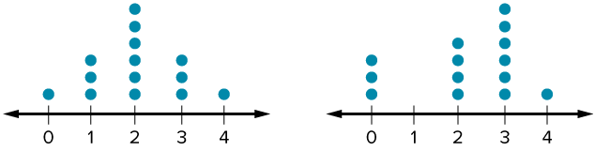
Be Curious
What do you notice?
What do you wonder?
Think first. Share a notice and a question; build on a classmate’s idea.
Mindset
What have you shared with your classmates about your math journey?
32 / 50
Notes:
TEACH IN PRACTICE | Embedded facilitation | Lesson 2.1, slide 29 | CURIOUS
Focus on the existing task: What do you notice?
LAUNCH (T2/3/5): Allow quiet observation first. Separate a notice from an inference, invite students’ own questions, and follow the existing launch before teaching a procedure.
LOOK FOR (T4): Where this task addresses it, students can describe possible data and what a dot represents. Ask which feature of their work supports the claim.
RESPOND: If this task shows the lesson misconception—assuming any question with a numerical answer is statistical—revisit the existing survey and sort its possible responses before classifying the question. Have the student revise and explain the change. Use this support only where the concept occurs in the current task; otherwise respond to the displayed question.
RECHECK: If a gap is shared, revisit the existing representation together. If it is limited, give targeted support while others compare valid methods on the same task. Check the revision before moving on.
PARTICIPATION (T5/6/7): Think time before volunteers; accept a written, drawn or rehearsed entry. Students ask for evidence respectfully. Recognize a specific contribution or revision and check that both partners participate.
Source: BCPS Updated Instructional Framework Rubric (June 2020), TEACH 1–7. Earlier notes and answer keys are retained below.
EARLIER NOTES / EXISTING ANSWER KEY
Accept all noticings and wonderings — there are no wrong answers here.
Give 20–30 seconds of quiet think time before taking responses; mix cold and warm calls so it is not always the same voices.
Read the mindset question aloud and let two students respond.
UIFR: TEACH 3 · TEACH 7.

Slide 33
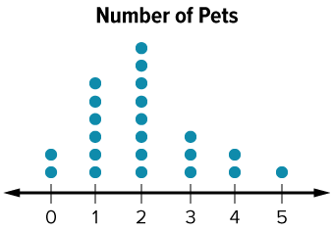
Each dot represents a student with that number of pets.
How can you determine how many students Ayasha surveyed?
Reveal:
We can count the total number of dots on the dot plot. There are 22 dots, so 22 students were surveyed.
Compare your reasoning with the explanation. Explain any revision you make.
33 / 50
Notes:
TEACH IN PRACTICE | Embedded facilitation | Lesson 2.1, slide 30 | REVEAL
Focus on the existing task: Each dot represents a student with that number of pets. How can you determine how many students Ayasha surveyed?
LAUNCH (T2/3/5): If an existing answer cover is present, gather an attempt before revealing. If the explanation is already visible, ask students to reconstruct and justify it. Compare reasoning and explain a revision; preserve the reveal sequence.
LOOK FOR (T4): Where this task addresses it, students can identify a question that anticipates variability. Ask which feature of their work supports the claim.
RESPOND: If this task shows the lesson misconception—assuming any question with a numerical answer is statistical—revisit the existing survey and sort its possible responses before classifying the question. Have the student revise and explain the change. Use this support only where the concept occurs in the current task; otherwise respond to the displayed question.
RECHECK: If a gap is shared, revisit the existing representation together. If it is limited, give targeted support while others compare valid methods on the same task. Check the revision before moving on.
PARTICIPATION (T5/6/7): Think time before volunteers; accept a written, drawn or rehearsed entry. Students ask for evidence respectfully. Recognize a specific contribution or revision and check that both partners participate.
Source: BCPS Updated Instructional Framework Rubric (June 2020), TEACH 1–7. Earlier notes and answer keys are retained below.
EARLIER NOTES / EXISTING ANSWER KEY
UIFR FULL | Lesson-specific facilitation
TEACH 2-3 | Session 2 task launch (UIFR PDF pp. 9-10).
Use the problem exactly as displayed. Give individual thinking time before discussion or advancing to the explanation. If the answer is already visible, ask students to reconstruct and justify it. Invite a choice of suitable representations and have students explain why their choice helps.
At the point where this concept appears, ask: “What different answers could this question produce, and why would we need data from a group?” Wait for evidence, invite another pathway, and have a student ask a follow-up question. Do not replace students’ reasoning with a sequence of leading steps.

Slide 34

Each dot represents a student with that number of pets.
How can you determine how many students Ayasha surveyed?
Reveal:
We can count the total number of dots on the dot plot. There are 22 dots, so 22 students were surveyed.
Persevering
How do you know your approach to the problem makes sense?
34 / 50
Notes:
TEACH IN PRACTICE | Embedded facilitation | Lesson 2.1, slide 31 | REVEAL
Focus on the existing task: Persevering How do you know your approach to the problem makes sense?
LAUNCH (T2/3/5): If an existing answer cover is present, gather an attempt before revealing. If the explanation is already visible, ask students to reconstruct and justify it. Compare reasoning and explain a revision; preserve the reveal sequence.
LOOK FOR (T4): Where this task addresses it, students can identify a question that anticipates variability. Ask which feature of their work supports the claim.
RESPOND: If this task shows the lesson misconception—assuming any question with a numerical answer is statistical—revisit the existing survey and sort its possible responses before classifying the question. Have the student revise and explain the change. Use this support only where the concept occurs in the current task; otherwise respond to the displayed question.
RECHECK: If a gap is shared, revisit the existing representation together. If it is limited, give targeted support while others compare valid methods on the same task. Check the revision before moving on.
PARTICIPATION (T5/6/7): Think time before volunteers; accept a written, drawn or rehearsed entry. Students ask for evidence respectfully. Recognize a specific contribution or revision and check that both partners participate.
Source: BCPS Updated Instructional Framework Rubric (June 2020), TEACH 1–7.

Slide 35
STUDENT MOVES
Lesson 2-1
Your move
TEACH A PARTNER · Teach this to someone who missed it. If you can teach it, you know it.
35 / 50

Slide 36
What is the most common number of pets?
Compare your reasoning with the
explanation. Explain any revision you make.
Reveal:
Two has the greatest number of dots, so two is the most common number of pets.
36 / 50
Notes:
TEACH IN PRACTICE | Embedded facilitation | Lesson 2.1, slide 32 | REVEAL
Focus on the existing task: What is the most common number of pets?
LAUNCH (T2/3/5): If an existing answer cover is present, gather an attempt before revealing. If the explanation is already visible, ask students to reconstruct and justify it. Compare reasoning and explain a revision; preserve the reveal sequence.
LOOK FOR (T4): Where this task addresses it, students can describe possible data and what a dot represents. Ask which feature of their work supports the claim.
RESPOND: If this task shows the lesson misconception—assuming any question with a numerical answer is statistical—revisit the existing survey and sort its possible responses before classifying the question. Have the student revise and explain the change. Use this support only where the concept occurs in the current task; otherwise respond to the displayed question.
RECHECK: If a gap is shared, revisit the existing representation together. If it is limited, give targeted support while others compare valid methods on the same task. Check the revision before moving on.
PARTICIPATION (T5/6/7): Think time before volunteers; accept a written, drawn or rehearsed entry. Students ask for evidence respectfully. Recognize a specific contribution or revision and check that both partners participate.
Source: BCPS Updated Instructional Framework Rubric (June 2020), TEACH 1–7.

Slide 37
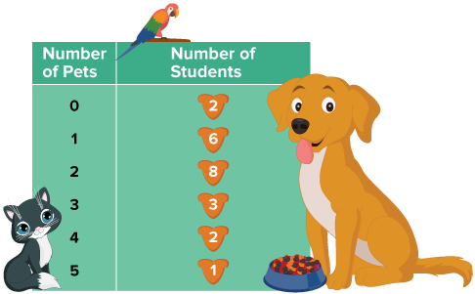
SUMMARIZE · SAY IT IN YOUR OWN WORDS
Pets
Ayasha conducted a survey about the number of pets the students in her class have. The results of her survey are shown.
How can Ayasha display the data to help her summarize her findings?
Think About It:
What are some ways you have displayed data in the past?
Think and record first. Which part of your
work supports your answer?
37 / 50
Notes:
TEACH IN PRACTICE | Embedded facilitation | Lesson 2.1, slide 33 | TASK
Focus on the existing task: Ayasha conducted a survey about the number of pets the students in her class have. The results of her survey are shown. How can Ayasha display the data to help her summarize her findings?
LAUNCH (T2/3/5): Use the displayed question. Give private thinking time; then A explains while B asks for evidence. Switch roles. Each student records their own reasoning.
LOOK FOR (T4): Where this task addresses it, students can describe possible data and what a dot represents. Ask which feature of their work supports the claim.
RESPOND: If this task shows the lesson misconception—assuming any question with a numerical answer is statistical—revisit the existing survey and sort its possible responses before classifying the question. Have the student revise and explain the change. Use this support only where the concept occurs in the current task; otherwise respond to the displayed question.
RECHECK: If a gap is shared, revisit the existing representation together. If it is limited, give targeted support while others compare valid methods on the same task. Check the revision before moving on.
PARTICIPATION (T5/6/7): Think time before volunteers; accept a written, drawn or rehearsed entry. Students ask for evidence respectfully. Recognize a specific contribution or revision and check that both partners participate.
Source: BCPS Updated Instructional Framework Rubric (June 2020), TEACH 1–7. Earlier notes and answer keys are retained below.
EARLIER NOTES / EXISTING ANSWER KEY
Routine: SUMMARIZE · SAY IT IN YOUR OWN WORDS

Slide 38
You can display the data collected in the survey by creating a dot plot. A dot plot is similar to a line plot, except it uses dots to represent the data along a number line.
What does each dot on the dot plot represent?
Reveal:
Each dot represents a student with that number of pets.
38 / 50
Notes:
TEACH IN PRACTICE | Embedded facilitation | Lesson 2.1, slide 34 | REVEAL
Focus on the existing task: You can display the data collected in the survey by creating a dot plot. A dot plot is similar to a line plot, except it uses dots to…
LAUNCH (T2/3/5): If an existing answer cover is present, gather an attempt before revealing. If the explanation is already visible, ask students to reconstruct and justify it. Compare reasoning and explain a revision; preserve the reveal sequence.
LOOK FOR (T4): Where this task addresses it, students can describe possible data and what a dot represents. Ask which feature of their work supports the claim.
RESPOND: If this task shows the lesson misconception—assuming any question with a numerical answer is statistical—revisit the existing survey and sort its possible responses before classifying the question. Have the student revise and explain the change. Use this support only where the concept occurs in the current task; otherwise respond to the displayed question.
RECHECK: If a gap is shared, revisit the existing representation together. If it is limited, give targeted support while others compare valid methods on the same task. Check the revision before moving on.
PARTICIPATION (T5/6/7): Think time before volunteers; accept a written, drawn or rehearsed entry. Students ask for evidence respectfully. Recognize a specific contribution or revision and check that both partners participate.
Source: BCPS Updated Instructional Framework Rubric (June 2020), TEACH 1–7. Earlier notes and answer keys are retained below.
EARLIER NOTES / EXISTING ANSWER KEY
Do not click yet: collect 2–3 student answers with reasons first.
Then click to remove the cover and have students compare their thinking to the reveal — “Is this what we said? Where is it different?”
Behind the cover: Each dot represents a student with that number of pets.
UIFR: TEACH 3 · TEACH 4.

Slide 39
STUDENT MOVES
Lesson 2-1
Your move
REVISE NOW · Change one answer and write why you changed it. A revision is evidence of learning.
39 / 50

Slide 40
Next, let’s analyze the data in the dot plot.
What is the least number of pets owned? What is the greatest number of pets owned?
Reveal:
The least number of pets is zero and the greatest number of pets is 5.
Record your reasoning before the
reveal. Compare, then explain
any revision.
40 / 50
Notes:
TEACH IN PRACTICE | Embedded facilitation | Lesson 2.1, slide 35 | REVEAL
Focus on the existing task: Next, let’s analyze the data in the dot plot. What is the least number of pets owned?
LAUNCH (T2/3/5): If an existing answer cover is present, gather an attempt before revealing. If the explanation is already visible, ask students to reconstruct and justify it. Compare reasoning and explain a revision; preserve the reveal sequence.
LOOK FOR (T4): Where this task addresses it, students can describe possible data and what a dot represents. Ask which feature of their work supports the claim.
RESPOND: If this task shows the lesson misconception—assuming any question with a numerical answer is statistical—revisit the existing survey and sort its possible responses before classifying the question. Have the student revise and explain the change. Use this support only where the concept occurs in the current task; otherwise respond to the displayed question.
RECHECK: If a gap is shared, revisit the existing representation together. If it is limited, give targeted support while others compare valid methods on the same task. Check the revision before moving on.
PARTICIPATION (T5/6/7): Think time before volunteers; accept a written, drawn or rehearsed entry. Students ask for evidence respectfully. Recognize a specific contribution or revision and check that both partners participate.
Source: BCPS Updated Instructional Framework Rubric (June 2020), TEACH 1–7. Earlier notes and answer keys are retained below.
EARLIER NOTES / EXISTING ANSWER KEY
Do not click yet: collect 2–3 student answers with reasons first.
Then click to remove the cover and have students compare their thinking to the reveal — “Is this what we said? Where is it different?”
Behind the cover: The least number of pets is zero and the greatest number of pets is 5.
UIFR: TEACH 3 · TEACH 4.

Slide 41
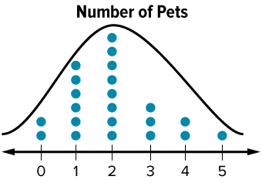
COLLABORATE · TALK IT THROUGH • AGREE ON A MODEL
Collaborate and Connect
Two is the most common number of pets.
A dot plot also shows the distribution, or the shape of the data.
What do you notice about the shape of the dot plot?
ASK THE CLASS · Write one question about this that you could ask the class.
Reveal:
Two has the most dots. The number of dots decreases as you move away from the most common value.
41 / 50
Notes:
TEACH IN PRACTICE | Embedded facilitation | Lesson 2.1, slide 36 | COLLABORATE
Focus on the existing task: Two is the most common number of pets. A dot plot also shows the distribution, or the shape of the data. What do you notice about the shape of the dot plot?
LAUNCH (T2/3/5): Use the displayed question. Give private thinking time; then A explains while B asks for evidence. Switch roles. Each student records their own reasoning.
LOOK FOR (T4): Where this task addresses it, students can describe possible data and what a dot represents. Ask which feature of their work supports the claim.
RESPOND: If this task shows the lesson misconception—assuming any question with a numerical answer is statistical—revisit the existing survey and sort its possible responses before classifying the question. Have the student revise and explain the change. Use this support only where the concept occurs in the current task; otherwise respond to the displayed question.
RECHECK: If a gap is shared, revisit the existing representation together. If it is limited, give targeted support while others compare valid methods on the same task. Check the revision before moving on.
PARTICIPATION (T5/6/7): Think time before volunteers; accept a written, drawn or rehearsed entry. Students ask for evidence respectfully. Recognize a specific contribution or revision and check that both partners participate.
Source: BCPS Updated Instructional Framework Rubric (June 2020), TEACH 1–7. Earlier notes and answer keys are retained below.
EARLIER NOTES / EXISTING ANSWER KEY
Routine: COLLABORATE · TALK IT THROUGH • AGREE ON A MODEL
UIFR FULL | Lesson-specific facilitation
TEACH 4-5 | Session 2 discussion and checkpoint (UIFR PDF pp. 11-12).
Collect a brief response from every student to the existing prompt before hearing volunteers. Partners take turns explaining and asking for evidence: “I understand ___; what supports ___?” Offer rehearsal or an annotated model for students who need language support. Each student records their own reasoning.
Look specifically for: assuming any question with a numerical answer is statistical. If it appears, revisit the existing survey and sort its possible responses before classifying the question; then ask the student to revise the same response and explain the change. If evidence is secure, have students compare a second valid pathway or state why their approach works. Choose the next step from the responses, not a preset pace.

Slide 42
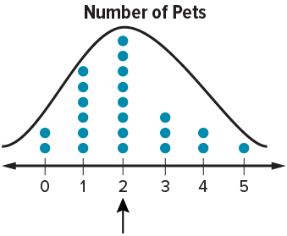
You can see the shape of the data is almost symmetric because the number of dots to the left of the highest point is almost equal to the number of dots to the right.
Data that is almost symmetric is nearly the same on the left and right sides of the distribution.
Explain how the information shown supports your reasoning.
42 / 50
Notes:
TEACH IN PRACTICE | Embedded facilitation | Lesson 2.1, slide 37 | WORKED
Focus on the existing task: You can see the shape of the data is almost symmetric because the number of dots to the left of the highest point is almost equal to the…
LAUNCH (T2/3/5): Ask students to explain the displayed idea or example and point to evidence. When a calculation step is shown, ask why it is valid. Have a partner restate the explanation; copying is not the check.
LOOK FOR (T4): Where this task addresses it, students can identify a question that anticipates variability. Ask which feature of their work supports the claim.
RESPOND: If this task shows the lesson misconception—assuming any question with a numerical answer is statistical—revisit the existing survey and sort its possible responses before classifying the question. Have the student revise and explain the change. Use this support only where the concept occurs in the current task; otherwise respond to the displayed question.
RECHECK: If a gap is shared, revisit the existing representation together. If it is limited, give targeted support while others compare valid methods on the same task. Check the revision before moving on.
PARTICIPATION (T5/6/7): Think time before volunteers; accept a written, drawn or rehearsed entry. Students ask for evidence respectfully. Recognize a specific contribution or revision and check that both partners participate.
Source: BCPS Updated Instructional Framework Rubric (June 2020), TEACH 1–7. Earlier notes and answer keys are retained below.
EARLIER NOTES / EXISTING ANSWER KEY
Model briefly, then hand the thinking back: ask “Why does this step work?” before showing the next one.
Quick check before moving on — thumbs or whiteboards from everyone, not volunteers.
UIFR: TEACH 2 · TEACH 3 · TEACH 4.

Slide 43
SUMMARIZE · SAY IT IN YOUR OWN WORDS
Let’s Explore More
Based on the data collected, how many pets would the typical student in Ayasha’s class, selected at random, have?
Workspace
How does using a visual representation allow you to summarize the data more easily?
Workspace
43 / 50
Notes:
TEACH IN PRACTICE | Embedded facilitation | Lesson 2.1, slide 38 | PRACTICE
Focus on the existing task: Workspace Based on the data collected, how many pets would the typical student in Ayasha’s class, selected at random, have?
LAUNCH (T2/3/5): Use the displayed question. Give private thinking time; then A explains while B asks for evidence. Switch roles. Each student records their own reasoning.
LOOK FOR (T4): Where this task addresses it, students can describe possible data and what a dot represents. Ask which feature of their work supports the claim.
RESPOND: If this task shows the lesson misconception—assuming any question with a numerical answer is statistical—revisit the existing survey and sort its possible responses before classifying the question. Have the student revise and explain the change. Use this support only where the concept occurs in the current task; otherwise respond to the displayed question.
RECHECK: If a gap is shared, revisit the existing representation together. If it is limited, give targeted support while others compare valid methods on the same task. Check the revision before moving on.
PARTICIPATION (T5/6/7): Think time before volunteers; accept a written, drawn or rehearsed entry. Students ask for evidence respectfully. Recognize a specific contribution or revision and check that both partners participate.
Source: BCPS Updated Instructional Framework Rubric (June 2020), TEACH 1–7. Earlier notes and answer keys are retained below.
EARLIER NOTES / EXISTING ANSWER KEY
Routine: SUMMARIZE · SAY IT IN YOUR OWN WORDS

Slide 44
STUDENT MOVES
Lesson 2-1
Your move
TWO MINUTES SOLO · Two minutes on your own, then compare. Bring one thing you tried, even if it did not work.
44 / 50

Slide 45
LESSON 2.1 / CHECK YOUR WORK
Pause. Check. Improve.
CHECK
A mistake to watch for: assuming any question with a numerical answer is statistical.
TRY
Revisit the given survey and sort its possible responses before classifying the question.
REVISE
Use that check on the task you just completed. Correct or strengthen one part, and explain why.
SELF-CHECK · Mark it: ✓ got it · ~ almost · ? stuck. Then fix one thing before we move on.
Listen to understand. Ask for evidence. Make room for every voice.
Notes:
TEACH IN PRACTICE | Embedded facilitation | Lesson 2.1, slide 39 | PRIOR_INSERT
Focus on the existing task: LESSON 2.1 / CHECK YOUR WORK Pause. Check. Improve. Listen to understand. Ask for evidence. Make room for every voice. CHECK A mistake…
CONNECT (T1/4): Ask students to restate the displayed goal or key idea and connect it to earlier work. Relevant lesson evidence: identify a question that anticipates variability; describe possible data and what a dot represents. Use only the criterion that matches the current session.
SHOW PROGRESS: Students point to their own existing work, explain what improved after feedback, and name a next step. Pair confidence ratings with actual evidence.
PARTICIPATION (T5/6/7): Think time before volunteers; accept a written, drawn or rehearsed entry. Students ask for evidence respectfully. Recognize a specific contribution or revision and check that both partners participate.
Source: BCPS Updated Instructional Framework Rubric (June 2020), TEACH 1–7.

Slide 46
SUMMARIZE · SAY IT IN YOUR OWN WORDS
Summarize: Statistical Questions
Statistics involves asking important questions that arise from a problem, followed by collecting, organizing, and interpreting pieces of information, or data to address the problem. A statistical question is a question that anticipates a variety of answers.
When data are displayed in a data display, such as a dot plot, you can summarize the data easily, including if the data are symmetric.
Statistical Questions | Not statistical Questions
How many text messages does a middle school student send each day? | What is the height in feet of the tallest mountain in Colorado?
What is the average minimum driving age in the US? | How many people attended last night’s jazz concert?
46 / 50
Notes:
TEACH IN PRACTICE | Embedded facilitation | Lesson 2.1, slide 40 | SUMMARIZE
Focus on the existing task: Statistical Questions Not statistical Questions How many text messages does a middle school student send each day?
CONNECT (T1/4): Ask students to restate the displayed goal or key idea and connect it to earlier work. Relevant lesson evidence: identify a question that anticipates variability; describe possible data and what a dot represents. Use only the criterion that matches the current session.
SHOW PROGRESS: Students point to their own existing work, explain what improved after feedback, and name a next step. Pair confidence ratings with actual evidence.
PARTICIPATION (T5/6/7): Think time before volunteers; accept a written, drawn or rehearsed entry. Students ask for evidence respectfully. Recognize a specific contribution or revision and check that both partners participate.
Source: BCPS Updated Instructional Framework Rubric (June 2020), TEACH 1–7. Earlier notes and answer keys are retained below.
EARLIER NOTES / EXISTING ANSWER KEY
Routine: SUMMARIZE · SAY IT IN YOUR OWN WORDS

Slide 47
STUDENT MOVES
Lesson 2-1
Your move
YOUR CHOICE · You choose how to show this — numbers, words, or a diagram. Make your reasoning visible.
47 / 50

Slide 48
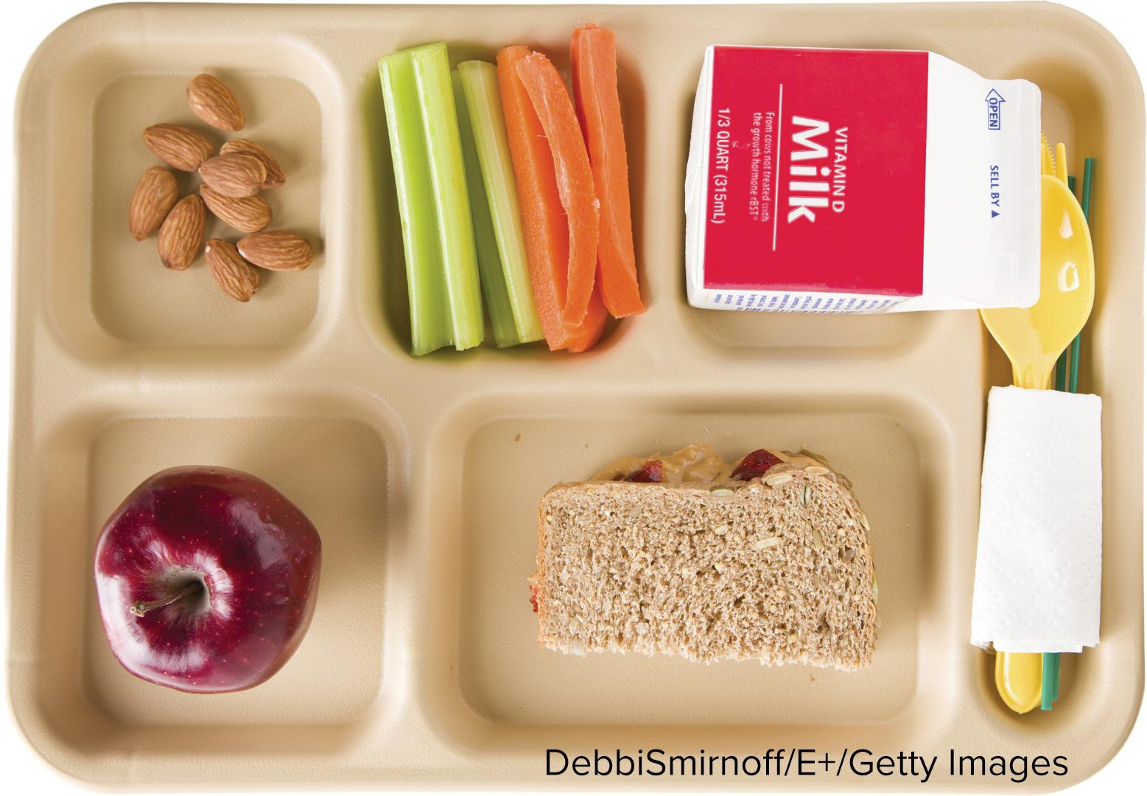
APPLY · PLAN IT • SOLVE IT • PROVE IT
Apply: Surveys and Statistics
Some sixth-grade students want to get more food choices in the cafeteria. They will conduct a survey of students who buy lunch in the cafeteria.
Question: What questions should they include in their survey? Explain your choices.
Choose a method. Solve
independently, justify your
answer, then check the goal.
48 / 50
Notes:
TEACH IN PRACTICE | Embedded facilitation | Lesson 2.1, slide 41 | APPLY
Focus on the existing task: Some sixth-grade students want to get more food choices in the cafeteria. They will conduct a survey of students who buy lunch in the cafeteria. Question: What questions should they include in their survey?
LAUNCH (T2/3/5): Use the exact application task independently first. Ask students to justify their choice of method. Collect evidence before a partner discussion or correction.
LOOK FOR (T4): Where this task addresses it, students can identify a question that anticipates variability. Ask which feature of their work supports the claim.
RESPOND: If this task shows the lesson misconception—assuming any question with a numerical answer is statistical—revisit the existing survey and sort its possible responses before classifying the question. Have the student revise and explain the change. Use this support only where the concept occurs in the current task; otherwise respond to the displayed question.
RECHECK: If a gap is shared, revisit the existing representation together. If it is limited, give targeted support while others compare valid methods on the same task. Check the revision before moving on.
PARTICIPATION (T5/6/7): Think time before volunteers; accept a written, drawn or rehearsed entry. Students ask for evidence respectfully. Recognize a specific contribution or revision and check that both partners participate.
Source: BCPS Updated Instructional Framework Rubric (June 2020), TEACH 1–7. Earlier notes and answer keys are retained below.
EARLIER NOTES / EXISTING ANSWER KEY
Routine: APPLY · PLAN IT • SOLVE IT • PROVE IT
UIFR FULL | Lesson-specific facilitation
TEACH 4 | Independent evidence and revision (UIFR PDF p. 11).
Use the existing application/exit problem as the independent check. If this is a learning-target slide, have students point to and explain their work on the preceding task. Separate initial independent evidence from the revision after feedback.
Check the relevant criteria: identify a question that anticipates variability; describe possible data and what a dot represents. Respond with one specific next step tied to the work. Students revise and annotate what changed, then identify a criterion they can now demonstrate and one they still need to practice.

Slide 49
Learning Targets
I can explain what a statistical question is.
I can explain how a dot plot is used to represent the number of observations in a data set.
I can use repeated reasoning to describe a data set based on the visual attributes of its data display.
SAY THE GOAL · Say today’s goal in your own words, then name one place this shows up outside math class.
49 / 50
Notes:
TEACH IN PRACTICE | Embedded facilitation | Lesson 2.1, slide 42 | REFLECTION
Focus on the existing task: I can explain what a statistical question is. I can explain how a dot plot is used to represent the number of observations in a data set.…
CONNECT (T1/4): Ask students to restate the displayed goal or key idea and connect it to earlier work. Relevant lesson evidence: identify a question that anticipates variability; describe possible data and what a dot represents. Use only the criterion that matches the current session.
SHOW PROGRESS: Students point to their own existing work, explain what improved after feedback, and name a next step. Pair confidence ratings with actual evidence.
PARTICIPATION (T5/6/7): Think time before volunteers; accept a written, drawn or rehearsed entry. Students ask for evidence respectfully. Recognize a specific contribution or revision and check that both partners participate.
Source: BCPS Updated Instructional Framework Rubric (June 2020), TEACH 1–7. Earlier notes and answer keys are retained below.
EARLIER NOTES / EXISTING ANSWER KEY
Read each target; students self-rate with fist-to-five or thumbs.
Tie back to the goal from the start of class: did we get there?
Note any target that rates low — revisit it tomorrow.
UIFR: TEACH 1 · TEACH 4.
UIFR FULL | Lesson-specific facilitation
REFLECT & ADJUST 1-2 | After the lesson (UIFR PDF pp. 15-16).
Sort the existing work by demonstrated reasoning, partial understanding, and the specific misconception: assuming any question with a numerical answer is statistical. Compare the initial response with the revision. Record which teaching move plausibly helped, which did not, and whose participation or access needs a different approach; do not record sensitive student details in this shared deck.
Plan the next lesson from that evidence: if the misconception persists, revisit the existing survey and sort its possible responses before classifying the question using the current example before returning to the next grade-level task; if understanding is secure, use an existing extension or ask for a general explanation. Check the targeted idea again at the next warm-up.
Ask students what supported their thinking and what would help next time. Identify one change to try and one successful practice to retain. Seek colleague feedback on anonymized work when useful; these prompts support reflection and do not establish an evaluation rating. Source: Baltimore City Public Schools, Updated Instructional Framework Rubric, June 2020 (UIFR_Full.pdf).

Slide 50
LESSON 2.1 / REFLECT ON YOUR LEARNING
Show your progress
1 SHOW EVIDENCE
2 CHOOSE A NEXT STEP
Choose one response. Point to the part that shows your reasoning.
Name a change you made after feedback—or a question you still have.
“My work shows ___ because ___.”
“Next time, I will ___ to help me ___.”
Today’s focus: Identify a question that anticipates variability.
CREDIT A CLASSMATE · Name one classmate whose idea helped you today, and say what they said.
Listen to understand. Ask for evidence. Make room for every voice.
Notes:
TEACH IN PRACTICE | Embedded facilitation | Lesson 2.1, slide 43 | PRIOR_INSERT
Focus on the existing task: LESSON 2.1 / REFLECT ON YOUR LEARNING Show your progress Listen to understand. Ask for evidence. Make room for every voice. 1 SHOW…
CONNECT (T1/4): Ask students to restate the displayed goal or key idea and connect it to earlier work. Relevant lesson evidence: identify a question that anticipates variability; describe possible data and what a dot represents. Use only the criterion that matches the current session.
SHOW PROGRESS: Students point to their own existing work, explain what improved after feedback, and name a next step. Pair confidence ratings with actual evidence.
PARTICIPATION (T5/6/7): Think time before volunteers; accept a written, drawn or rehearsed entry. Students ask for evidence respectfully. Recognize a specific contribution or revision and check that both partners participate.
Source: BCPS Updated Instructional Framework Rubric (June 2020), TEACH 1–7.

