Slide 1
WARM-UP · THINK • TRY • CHECK
Turn and talk: compare strategies, then defend one.
Warm-Up
Lesson 2-10 · Choose Appropriate Measures | Warm-Up · about 4 minutes
Try each on your own. Mark an unsure answer; explain and revise when we check.
QUESTION 1
QUESTION 2
Mean of 2, 3, 3, 4, 8 = ______
Which value sits far from the rest: 2, 3, 3, 4, 50? ______
QUESTION 3
QUESTION 4
Most dots on the left, a few far right. The shape is ______
In 2, 3, 3, 4, 50 the 50 pulls up the ______
TALK IT OVER: “I got ______ because ______.” • Compare with a partner before we check as a class.
1 / 48
Notes:
TEACH IN PRACTICE | Embedded facilitation | Lesson 2.10, slide 1 | WARMUP
Focus on the existing task: Warm-Up WARM-UP · THINK • TRY • CHECK Do these four on your…
GATHER EVIDENCE (T4/6): Keep the original items. Students try independently, mark an uncertain item, and explain one method before checking. Use the existing key when present.
RESPOND: Distinguish a calculation slip from a reasoning gap. Give one next step on the same item; have students revise in a second color. Use the responses to choose flexible support for today’s lesson.
PARTICIPATION (T5/6/7): Think time before volunteers; accept a written, drawn or rehearsed entry. Students ask for evidence respectfully. Recognize a specific contribution or revision and check that both partners participate.
Source: BCPS Updated Instructional Framework Rubric (June 2020), TEACH 1–7. Earlier notes and answer keys are retained below.
EARLIER NOTES / EXISTING ANSWER KEY
Warm-Up answers (teacher only): 1) 4 2) 50 3) stretched to the right 4) mean
UIFR FULL | Lesson-specific facilitation
PREPARE 1-2 | Before teaching (UIFR PDF pp. 6-7).
Plan to gather evidence that students can use shape and outliers to justify a measure of center and variation. Review recent work and today’s warm-up to choose flexible groups and access supports; do not infer needs from identity or perceived ability. Use the existing lesson tasks and stated standards.
Anticipate: choosing mean automatically even when an outlier pulls it. If observed, annotate clusters, gaps and outliers on the original display before comparing measures. Offer oral rehearsal, drawing, pointing, or home-language processing as needed; retain the original mathematical demand. Ask students which support helps and fade it as evidence improves.
TEACH 6-7 | Before the first transition, agree on materials, partner roles, and how to request help. Invite students to restate the routine. Normalize revising an idea, recognize a specific contribution, and check privately when frustration blocks participation. Source: UIFR PDF pp. 13-14.

Slide 2
Today’s Math Notes
Lesson 2-10 · Choose Appropriate Measures
Section 1: Math Words
Copy. Explain. Check.
SAY THE GOAL · Say today’s goal in your own words, then name one place this shows up outside math class.
Appropriate Measures of Center
1
A mean, median
Mean
2
The average
Median
3
The middle number when you put them in order
eduwonderlab.com · Neft Teacher
2 / 48
Notes:
TEACH IN PRACTICE | Embedded facilitation | Lesson 2.10, slide 2 | NOTES
Focus on the existing task: Today’s Math Notes Section 1: Math Words Copy into your…
ROUTINE (T1/2/4): Read or copy the original notes, cover one line, and explain it using the displayed example. Reopen and correct. Copying alone is not evidence of understanding.
LOOK FOR: A link between a symbol, quantity or feature and the explanation. If missing, point back to that feature and have the student try again; fade the prompt once they can explain.
PARTICIPATION (T5/6/7): Think time before volunteers; accept a written, drawn or rehearsed entry. Students ask for evidence respectfully. Recognize a specific contribution or revision and check that both partners participate.
Source: BCPS Updated Instructional Framework Rubric (June 2020), TEACH 1–7. Earlier notes and answer keys are retained below.
EARLIER NOTES / EXISTING ANSWER KEY
Copy routine: read one line at a time; students copy, then explain that line to a partner.
Keep it brisk — the understanding work happens in the examples, not the copying.
UIFR: TEACH 1 · TEACH 6.

Slide 3
Today’s Math Notes
Lesson 2-10 · Choose Appropriate Measures
Section 2: Today’s Math
Copy. Explain. Check.
Choosing Appropriate Measures of Center & Spread
Symmetric Data (No Outliers): Use Mean and MAD
1
Skewed Data (Has Outliers): Use Median and IQR (outliers distort the mean)
2
CONNECT IT · What earlier lesson does this build on? Tell a partner in one sentence.
Compare distributions using both center (typical value) and spread (variability)
3
eduwonderlab.com · Neft Teacher
3 / 48
Notes:
TEACH IN PRACTICE | Embedded facilitation | Lesson 2.10, slide 3 | NOTES
Focus on the existing task: Today’s Math Notes Section 2: Today’s Math Copy into your…
ROUTINE (T1/2/4): Read or copy the original notes, cover one line, and explain it using the displayed example. Reopen and correct. Copying alone is not evidence of understanding.
LOOK FOR: A link between a symbol, quantity or feature and the explanation. If missing, point back to that feature and have the student try again; fade the prompt once they can explain.
PARTICIPATION (T5/6/7): Think time before volunteers; accept a written, drawn or rehearsed entry. Students ask for evidence respectfully. Recognize a specific contribution or revision and check that both partners participate.
Source: BCPS Updated Instructional Framework Rubric (June 2020), TEACH 1–7. Earlier notes and answer keys are retained below.
EARLIER NOTES / EXISTING ANSWER KEY
Copy routine: read one line at a time; students copy, then explain that line to a partner.
Keep it brisk — the understanding work happens in the examples, not the copying.
UIFR: TEACH 1 · TEACH 6.

Slide 4
Session 1
Choose Appropriate Measures
PICK YOUR STRATEGY · Choose your path — picture, table, number line, or equation — and be ready to say why you chose it.
4 / 48
Notes:
TEACH IN PRACTICE | Embedded facilitation | Lesson 2.10, slide 4 | DIVIDER
Focus on the existing task: Choose Appropriate Measures Session 1
TRANSITION (T6/7): Students confirm materials, roles, how to request help, and the next response routine. Ask a student to restate it. Keep teacher-only slides hidden.
PARTICIPATION (T5/6/7): Think time before volunteers; accept a written, drawn or rehearsed entry. Students ask for evidence respectfully. Recognize a specific contribution or revision and check that both partners participate.
Source: BCPS Updated Instructional Framework Rubric (June 2020), TEACH 1–7. Earlier notes and answer keys are retained below.
EARLIER NOTES / EXISTING ANSWER KEY
Transition cue: state what materials are out and what success looks like this session.
Keep the changeover under a minute.
UIFR: TEACH 6.

Slide 5
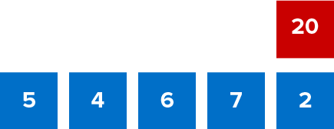
Give Me Five
Use all the numbers in any order with any operation to equal the target number (in red).
Explain how the information shown supports your reasoning.
5 / 48
Notes:
TEACH IN PRACTICE | Embedded facilitation | Lesson 2.10, slide 5 | WORKED
Focus on the existing task: Give Me Five Use all the numbers in any order with any operation to equal the target number (in red).
LAUNCH (T2/3/5): Ask students to explain the displayed idea or example and point to evidence. When a calculation step is shown, ask why it is valid. Have a partner restate the explanation; copying is not the check.
LOOK FOR (T4): Where this task addresses it, students can use shape and outliers to justify a measure of center and variation. Ask which feature of their work supports the claim.
RESPOND: If this task shows the lesson misconception—choosing mean automatically even when an outlier pulls it—annotate clusters, gaps and outliers on the original display before comparing measures. Have the student revise and explain the change. Use this support only where the concept occurs in the current task; otherwise respond to the displayed question.
RECHECK: If a gap is shared, revisit the existing representation together. If it is limited, give targeted support while others compare valid methods on the same task. Check the revision before moving on.
PARTICIPATION (T5/6/7): Think time before volunteers; accept a written, drawn or rehearsed entry. Students ask for evidence respectfully. Recognize a specific contribution or revision and check that both partners participate.
Source: BCPS Updated Instructional Framework Rubric (June 2020), TEACH 1–7. Earlier notes and answer keys are retained below.
EARLIER NOTES / EXISTING ANSWER KEY
Number-sense routine — every voice in. Give quiet think time, then hear from at least three students.
Always follow with “How do you know?” — the reasoning is the point, not the answer.
There is more than one path; name and celebrate different strategies.
UIFR: TEACH 3 · TEACH 5 · TEACH 6.

Slide 6
Today’s Objectives
Lesson 2-10 · Choose Appropriate Measures
Choose Appropriate Measures
Maryland Standard 6.DS.6d
SHOW YOUR THINKING · Show what you know — write it, draw it, or build it. A picture counts as an explanation.
CONTENT OBJECTIVE
LANGUAGE OBJECTIVE
Restate the goal in your words
Use these words to explain why
I can choose the best measure of center for a data set based on its shape.
I can explain my choice using the words mean, median, outlier, and skewed.
eduwonderlab.com · Neft Teacher
6 / 48
Notes:
TEACH IN PRACTICE | Embedded facilitation | Lesson 2.10, slide 6 | GOAL
Focus on the existing task: Today’s Objectives Choose Appropriate Measures Maryland…
CONNECT (T1/4): Ask students to restate the displayed goal or key idea and connect it to earlier work. Relevant lesson evidence: use shape and outliers to justify a measure of center and variation. Use only the criterion that matches the current session.
SHOW PROGRESS: Students point to their own existing work, explain what improved after feedback, and name a next step. Pair confidence ratings with actual evidence.
PARTICIPATION (T5/6/7): Think time before volunteers; accept a written, drawn or rehearsed entry. Students ask for evidence respectfully. Recognize a specific contribution or revision and check that both partners participate.
Source: BCPS Updated Instructional Framework Rubric (June 2020), TEACH 1–7. Earlier notes and answer keys are retained below.
EARLIER NOTES / EXISTING ANSWER KEY
Read the objective together, then have one or two students restate today’s goal in their own words.
Connect it to what the class learned last lesson.
Return to this goal at the end of class to check it was met.
UIFR: TEACH 1.
UIFR FULL | Lesson-specific facilitation
TEACH 1 | Session 1 purpose and evidence (UIFR PDF p. 8).
Have students restate the displayed session goal in their own words and connect it to the existing context or a familiar experience they choose to share. Use the current session goal to select from these lesson-wide evidence criteria; do not frontload a later-session procedure.
Look for: use shape and outliers to justify a measure of center and variation. Ask: “Which part of your work would show this?” Revisit that evidence after the task; a confidence rating alone is not evidence of understanding.

Slide 7
LESSON 2.10 / OUR LEARNING
What will show your learning?
1
Use shape and outliers to justify a measure of center and variation.
Tell a partner: Which skill connects to something you already know?
WHY IT MATTERS · Finish this: “This is worth knowing because ______.”
Listen to understand. Ask for evidence. Make room for every voice.
Notes:
TEACH IN PRACTICE | Embedded facilitation | Lesson 2.10, slide 7 | PRIOR_INSERT
Focus on the existing task: LESSON 2.10 / OUR LEARNING What will show your learning?
CONNECT (T1/4): Ask students to restate the displayed goal or key idea and connect it to earlier work. Relevant lesson evidence: use shape and outliers to justify a measure of center and variation. Use only the criterion that matches the current session.
SHOW PROGRESS: Students point to their own existing work, explain what improved after feedback, and name a next step. Pair confidence ratings with actual evidence.
PARTICIPATION (T5/6/7): Think time before volunteers; accept a written, drawn or rehearsed entry. Students ask for evidence respectfully. Recognize a specific contribution or revision and check that both partners participate.
Source: BCPS Updated Instructional Framework Rubric (June 2020), TEACH 1–7.

Slide 8
Vocabulary 1 of 7
Lesson 2-10 · Choose Appropriate Measures
Appropriate Measures of Center
A mean, median, or mode chosen because it describes a data set fairly.
EXAMPLE · EXPLAIN WHY IT FITS
Use the median when an outlier would pull the mean too far.
Use “Appropriate Measures of Center” to explain the
example. Point to evidence.
eduwonderlab.com · Neft Teacher
8 / 48
Notes:
TEACH IN PRACTICE | Embedded facilitation | Lesson 2.10, slide 8 | VOCAB
Focus on the existing task: Vocabulary 1 of 7 Appropriate Measures of Center A mean…
ASK (T1/3/5): Where does “Appropriate Measures of Center” appear in the example? Explain the meaning without reading the definition. Partner: restate the idea and ask a clarifying question.
LOOK FOR: A correct connection between the word and a feature of the example. If the student only repeats the definition, invite pointing, sketching or oral rehearsal, then ask for another explanation of this same example.
PARTICIPATION (T5/6/7): Think time before volunteers; accept a written, drawn or rehearsed entry. Students ask for evidence respectfully. Recognize a specific contribution or revision and check that both partners participate.
Source: BCPS Updated Instructional Framework Rubric (June 2020), TEACH 1–7.

Slide 9
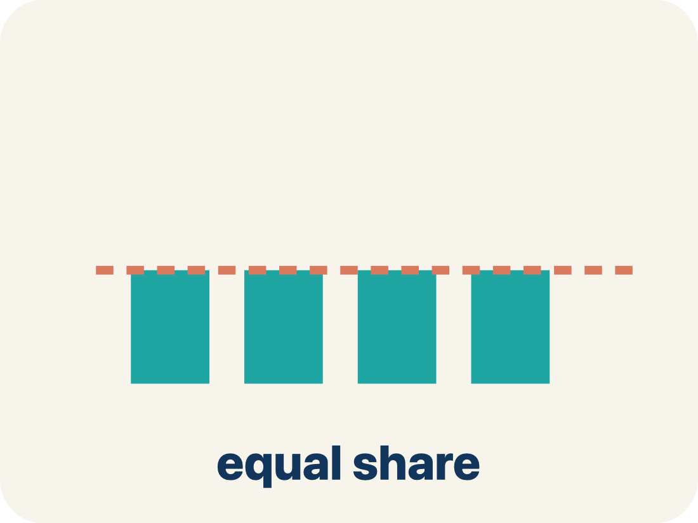
Vocabulary 2 of 7
Lesson 2-10 · Choose Appropriate Measures
Mean
The average. Add all the numbers, then divide by how many there are.
EXAMPLE · EXPLAIN WHY IT FITS
Mean of 10, 20, 30 = (10+20+30) ÷ 3 = 20
Use “Mean” to explain the example. Point to evidence.
eduwonderlab.com · Neft Teacher
9 / 48
Notes:
TEACH IN PRACTICE | Embedded facilitation | Lesson 2.10, slide 9 | VOCAB
Focus on the existing task: Vocabulary 2 of 7 Mean The average. Add all the numbers, then…
ASK (T1/3/5): Where does “Mean” appear in the example? Explain the meaning without reading the definition. Partner: restate the idea and ask a clarifying question.
LOOK FOR: A correct connection between the word and a feature of the example. If the student only repeats the definition, invite pointing, sketching or oral rehearsal, then ask for another explanation of this same example.
PARTICIPATION (T5/6/7): Think time before volunteers; accept a written, drawn or rehearsed entry. Students ask for evidence respectfully. Recognize a specific contribution or revision and check that both partners participate.
Source: BCPS Updated Instructional Framework Rubric (June 2020), TEACH 1–7.

Slide 10
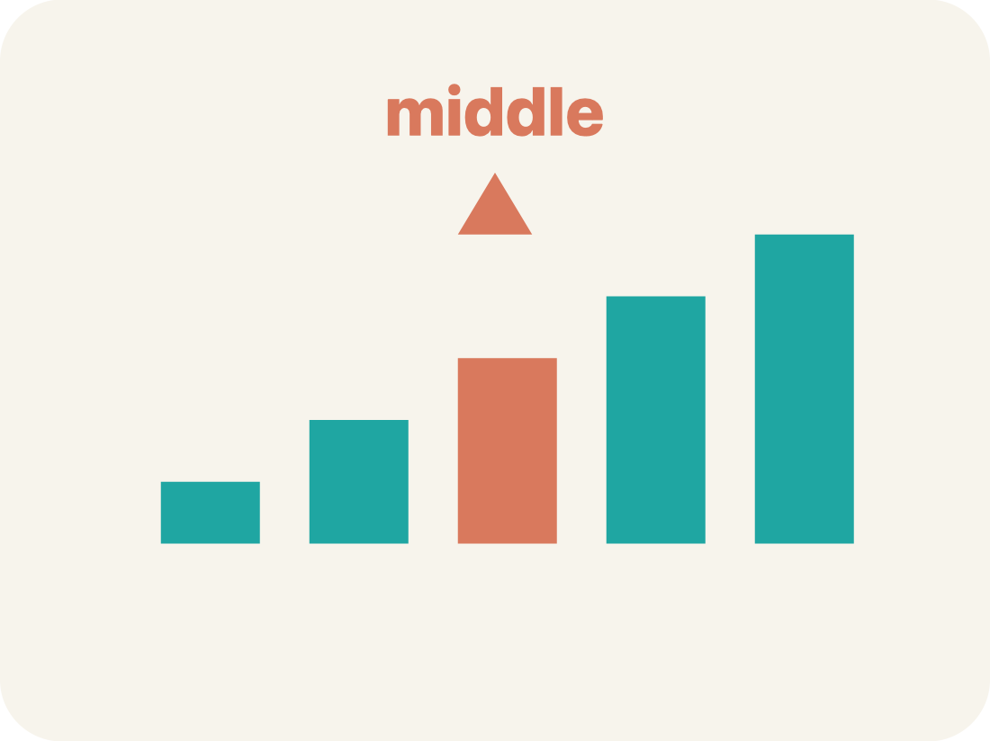
Vocabulary 3 of 7
Lesson 2-10 · Choose Appropriate Measures
Median
The middle number when you put them in order.
EXAMPLE · EXPLAIN WHY IT FITS
Data: 5, 8, 12, 15, 20 → median is 12 (the 3rd of 5 values)
Use “Median” to explain the example. Point to evidence.
eduwonderlab.com · Neft Teacher
10 / 48
Notes:
TEACH IN PRACTICE | Embedded facilitation | Lesson 2.10, slide 10 | VOCAB
Focus on the existing task: Vocabulary 3 of 7 Median The middle number when you put them…
ASK (T1/3/5): Where does “Median” appear in the example? Explain the meaning without reading the definition. Partner: restate the idea and ask a clarifying question.
LOOK FOR: A correct connection between the word and a feature of the example. If the student only repeats the definition, invite pointing, sketching or oral rehearsal, then ask for another explanation of this same example.
PARTICIPATION (T5/6/7): Think time before volunteers; accept a written, drawn or rehearsed entry. Students ask for evidence respectfully. Recognize a specific contribution or revision and check that both partners participate.
Source: BCPS Updated Instructional Framework Rubric (June 2020), TEACH 1–7.

Slide 11
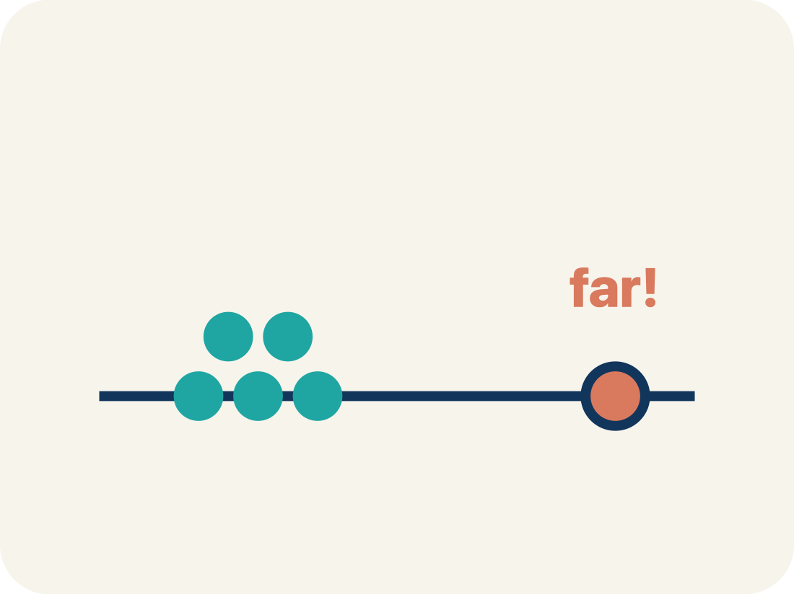
Vocabulary 4 of 7
Lesson 2-10 · Choose Appropriate Measures
Outlier
A number that is much bigger or smaller than the rest.
EXAMPLE · EXPLAIN WHY IT FITS
Data: 12, 14, 13, 15, 45 → 45 is far from the cluster, so it is an outlier
Use “Outlier” to explain the example. Point to evidence.
eduwonderlab.com · Neft Teacher
11 / 48
Notes:
TEACH IN PRACTICE | Embedded facilitation | Lesson 2.10, slide 11 | VOCAB
Focus on the existing task: Vocabulary 4 of 7 Outlier A number that is much bigger or…
ASK (T1/3/5): Where does “Outlier” appear in the example? Explain the meaning without reading the definition. Partner: restate the idea and ask a clarifying question.
LOOK FOR: A correct connection between the word and a feature of the example. If the student only repeats the definition, invite pointing, sketching or oral rehearsal, then ask for another explanation of this same example.
PARTICIPATION (T5/6/7): Think time before volunteers; accept a written, drawn or rehearsed entry. Students ask for evidence respectfully. Recognize a specific contribution or revision and check that both partners participate.
Source: BCPS Updated Instructional Framework Rubric (June 2020), TEACH 1–7.

Slide 12
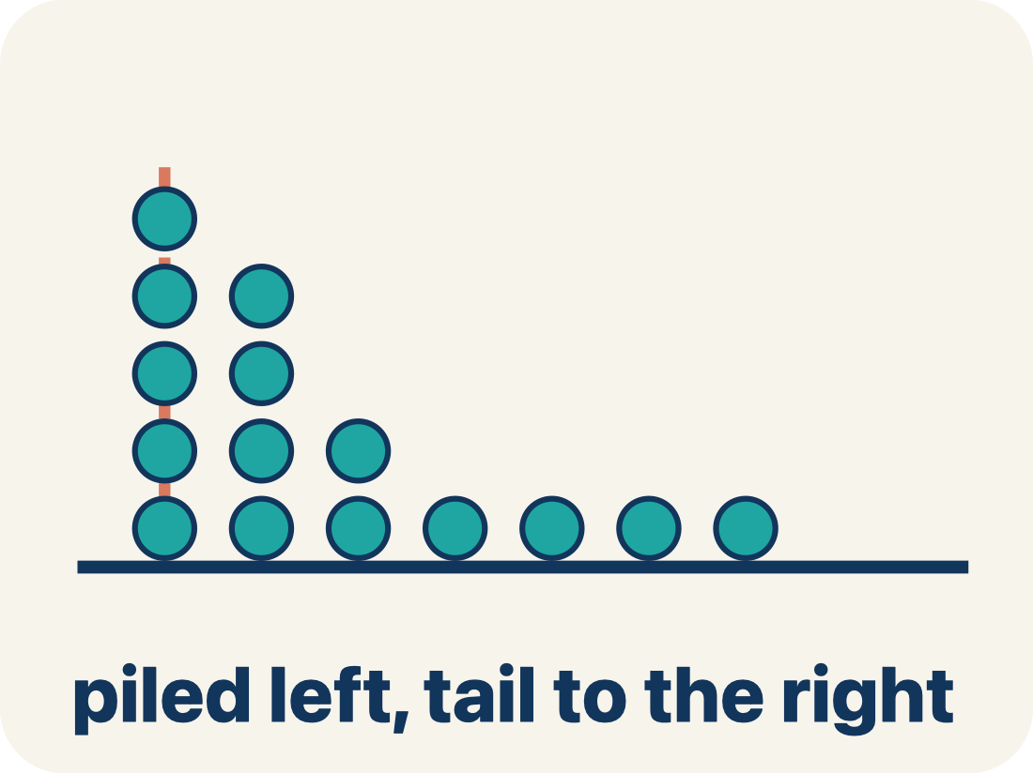
Vocabulary 5 of 7
Lesson 2-10 · Choose Appropriate Measures
Skewed
When most data sits on one side with a tail on the other.
EXAMPLE · EXPLAIN WHY IT FITS
Scores: 5, 6, 7, 8, 8, 35 → most scores are low, but 35 creates a tail to the right (skewed right)
Use “Skewed” to explain the example. Point to evidence.
eduwonderlab.com · Neft Teacher
12 / 48
Notes:
TEACH IN PRACTICE | Embedded facilitation | Lesson 2.10, slide 12 | VOCAB
Focus on the existing task: Vocabulary 5 of 7 Skewed When most data sits on one side with…
ASK (T1/3/5): Where does “Skewed” appear in the example? Explain the meaning without reading the definition. Partner: restate the idea and ask a clarifying question.
LOOK FOR: A correct connection between the word and a feature of the example. If the student only repeats the definition, invite pointing, sketching or oral rehearsal, then ask for another explanation of this same example.
PARTICIPATION (T5/6/7): Think time before volunteers; accept a written, drawn or rehearsed entry. Students ask for evidence respectfully. Recognize a specific contribution or revision and check that both partners participate.
Source: BCPS Updated Instructional Framework Rubric (June 2020), TEACH 1–7.

Slide 13
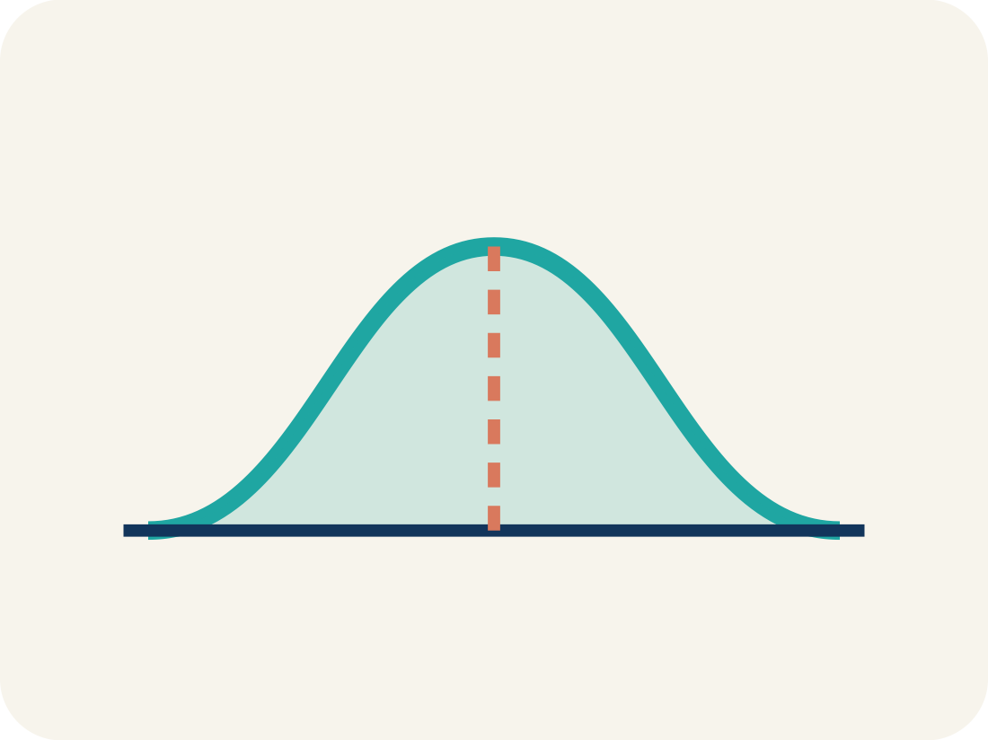
Vocabulary 6 of 7
Lesson 2-10 · Choose Appropriate Measures
Data distribution
How the data looks: where it sits and how spread out it is.
EXAMPLE · EXPLAIN WHY IT FITS
Symmetric = even on both sides. Skewed = bunched on one side with a tail
Use “Data distribution” to explain the example. Point to
evidence.
eduwonderlab.com · Neft Teacher
13 / 48
Notes:
TEACH IN PRACTICE | Embedded facilitation | Lesson 2.10, slide 13 | VOCAB
Focus on the existing task: Vocabulary 6 of 7 Data distribution How the data looks: where…
ASK (T1/3/5): Where does “Data distribution” appear in the example? Explain the meaning without reading the definition. Partner: restate the idea and ask a clarifying question.
LOOK FOR: A correct connection between the word and a feature of the example. If the student only repeats the definition, invite pointing, sketching or oral rehearsal, then ask for another explanation of this same example.
PARTICIPATION (T5/6/7): Think time before volunteers; accept a written, drawn or rehearsed entry. Students ask for evidence respectfully. Recognize a specific contribution or revision and check that both partners participate.
Source: BCPS Updated Instructional Framework Rubric (June 2020), TEACH 1–7.

Slide 14

Vocabulary 7 of 7
Lesson 2-10 · Choose Appropriate Measures
Variability
How spread out the numbers are.
EXAMPLE · EXPLAIN WHY IT FITS
88, 90, 89, 91 (low variability) vs. 50, 70, 95, 100 (high variability)
Use “Variability” to explain the example. Point to evidence.
eduwonderlab.com · Neft Teacher
14 / 48
Notes:
TEACH IN PRACTICE | Embedded facilitation | Lesson 2.10, slide 14 | VOCAB
Focus on the existing task: Vocabulary 7 of 7 Variability How spread out the numbers are.…
ASK (T1/3/5): Where does “Variability” appear in the example? Explain the meaning without reading the definition. Partner: restate the idea and ask a clarifying question.
LOOK FOR: A correct connection between the word and a feature of the example. If the student only repeats the definition, invite pointing, sketching or oral rehearsal, then ask for another explanation of this same example.
PARTICIPATION (T5/6/7): Think time before volunteers; accept a written, drawn or rehearsed entry. Students ask for evidence respectfully. Recognize a specific contribution or revision and check that both partners participate.
Source: BCPS Updated Instructional Framework Rubric (June 2020), TEACH 1–7.

Slide 15
Vocabulary
Lesson 2-10 · Choose Appropriate Measures
Today’s Math Words
We learn every word — what it means and what it looks like — before we use it.
Appropriate Measures of Center
Mean
A mean, median, or mode chosen because it describes a data set fairly
The average
Median
Outlier
The middle number when you put them in order
A number that is much bigger or smaller than the rest
Skewed
Data distribution
When most data sits on one side with a tail on the other
How the data looks: where it sits and how spread out it is
Variability
Explain one math word using the example.
Partner: point to evidence.
How spread out the numbers are
eduwonderlab.com · Neft Teacher
15 / 48
Notes:
TEACH IN PRACTICE | Embedded facilitation | Lesson 2.10, slide 15 | VOCAB
Focus on the existing task: Vocabulary Today’s Math Words We learn every word — what it…
ASK (T1/3/5): Where does “the displayed term” appear in the example? Explain the meaning without reading the definition. Partner: restate the idea and ask a clarifying question.
LOOK FOR: A correct connection between the word and a feature of the example. If the student only repeats the definition, invite pointing, sketching or oral rehearsal, then ask for another explanation of this same example.
PARTICIPATION (T5/6/7): Think time before volunteers; accept a written, drawn or rehearsed entry. Students ask for evidence respectfully. Recognize a specific contribution or revision and check that both partners participate.
Source: BCPS Updated Instructional Framework Rubric (June 2020), TEACH 1–7. Earlier notes and answer keys are retained below.
EARLIER NOTES / EXISTING ANSWER KEY
Choral-read each word, its meaning, and what it looks like.
Students should use these words out loud today — listen for them in partner talk and revoice student ideas with the academic term.
UIFR: TEACH 1 · TEACH 5.

Slide 16
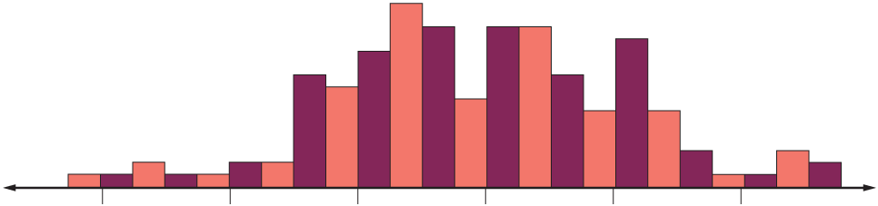

Be Curious
What do you notice?
What do you wonder?
Mindset
HOW DO YOU KNOW? · Ask your partner “How do you know?” Answer by pointing to your own work.
What classroom rules might help prevent problems from arising in math class?
16 / 48
Notes:
TEACH IN PRACTICE | Embedded facilitation | Lesson 2.10, slide 16 | CURIOUS
Focus on the existing task: Be Curious What do you notice?
LAUNCH (T2/3/5): Allow quiet observation first. Separate a notice from an inference, invite students’ own questions, and follow the existing launch before teaching a procedure.
LOOK FOR (T4): Where this task addresses it, students can use shape and outliers to justify a measure of center and variation. Ask which feature of their work supports the claim.
RESPOND: If this task shows the lesson misconception—choosing mean automatically even when an outlier pulls it—annotate clusters, gaps and outliers on the original display before comparing measures. Have the student revise and explain the change. Use this support only where the concept occurs in the current task; otherwise respond to the displayed question.
RECHECK: If a gap is shared, revisit the existing representation together. If it is limited, give targeted support while others compare valid methods on the same task. Check the revision before moving on.
PARTICIPATION (T5/6/7): Think time before volunteers; accept a written, drawn or rehearsed entry. Students ask for evidence respectfully. Recognize a specific contribution or revision and check that both partners participate.
Source: BCPS Updated Instructional Framework Rubric (June 2020), TEACH 1–7. Earlier notes and answer keys are retained below.
EARLIER NOTES / EXISTING ANSWER KEY
Accept all noticings and wonderings — there are no wrong answers here.
Give 20–30 seconds of quiet think time before taking responses; mix cold and warm calls so it is not always the same voices.
Read the mindset question aloud and let two students respond.
UIFR: TEACH 3 · TEACH 7.

Slide 17
SUMMARIZE · SAY IT IN YOUR OWN WORDS
Teaching Experience
The students want to describe the data they collected about the number of years of teaching experience of the teachers in their school.
Which measure of center and measure of variation should they use to summarize the data set?
Data Set
Teaching Experience (years)
2 | 4 | 7 | 3 | 4
32 | 3 | 2 | 8 | 3
3 | 7 | 9 | 10 | 4
4 | 2 | 2 | 3 | 11
9 | 7 | 3 | 8 | 2
Think and record first. Which part of your work supports your answer?
17 / 48
Notes:
TEACH IN PRACTICE | Embedded facilitation | Lesson 2.10, slide 17 | TASK
Focus on the existing task: Teaching Experience The students want to describe the data they collected about the number of years of teaching experience of the teachers…
LAUNCH (T2/3/5): Use the displayed question. Give private thinking time; then A explains while B asks for evidence. Switch roles. Each student records their own reasoning.
LOOK FOR (T4): Where this task addresses it, students can use shape and outliers to justify a measure of center and variation. Ask which feature of their work supports the claim.
RESPOND: If this task shows the lesson misconception—choosing mean automatically even when an outlier pulls it—annotate clusters, gaps and outliers on the original display before comparing measures. Have the student revise and explain the change. Use this support only where the concept occurs in the current task; otherwise respond to the displayed question.
RECHECK: If a gap is shared, revisit the existing representation together. If it is limited, give targeted support while others compare valid methods on the same task. Check the revision before moving on.
PARTICIPATION (T5/6/7): Think time before volunteers; accept a written, drawn or rehearsed entry. Students ask for evidence respectfully. Recognize a specific contribution or revision and check that both partners participate.
Source: BCPS Updated Instructional Framework Rubric (June 2020), TEACH 1–7. Earlier notes and answer keys are retained below.
EARLIER NOTES / EXISTING ANSWER KEY
Routine: SUMMARIZE · SAY IT IN YOUR OWN WORDS
UIFR FULL | Lesson-specific facilitation
TEACH 2-3 | Session 1 task launch (UIFR PDF pp. 9-10).
Use the problem exactly as displayed. Give individual thinking time before discussion or advancing to the explanation. If the answer is already visible, ask students to reconstruct and justify it. Invite a choice of suitable representations and have students explain why their choice helps.
At the point where this concept appears, ask: “How does the distribution support your choice of center and spread? What would the other measure emphasize?” Wait for evidence, invite another pathway, and have a student ask a follow-up question. Do not replace students’ reasoning with a sequence of leading steps.

Slide 18
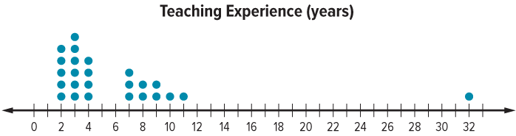
Let’s use a dot plot to analyze the distribution.
JUSTIFY IT · Say it like this: “I know ______ because ______.”
What do you notice about the distribution of the data?
Reveal:
There are two groups of data on the left, with space between them, and one value on the far right.
18 / 48
Notes:
TEACH IN PRACTICE | Embedded facilitation | Lesson 2.10, slide 18 | REVEAL
Focus on the existing task: Let’s use a dot plot to analyze the distribution. What do you notice about the distribution of the data?
LAUNCH (T2/3/5): If an existing answer cover is present, gather an attempt before revealing. If the explanation is already visible, ask students to reconstruct and justify it. Compare reasoning and explain a revision; preserve the reveal sequence.
LOOK FOR (T4): Where this task addresses it, students can use shape and outliers to justify a measure of center and variation. Ask which feature of their work supports the claim.
RESPOND: If this task shows the lesson misconception—choosing mean automatically even when an outlier pulls it—annotate clusters, gaps and outliers on the original display before comparing measures. Have the student revise and explain the change. Use this support only where the concept occurs in the current task; otherwise respond to the displayed question.
RECHECK: If a gap is shared, revisit the existing representation together. If it is limited, give targeted support while others compare valid methods on the same task. Check the revision before moving on.
PARTICIPATION (T5/6/7): Think time before volunteers; accept a written, drawn or rehearsed entry. Students ask for evidence respectfully. Recognize a specific contribution or revision and check that both partners participate.
Source: BCPS Updated Instructional Framework Rubric (June 2020), TEACH 1–7. Earlier notes and answer keys are retained below.
EARLIER NOTES / EXISTING ANSWER KEY
Do not click yet: collect 2–3 student answers with reasons first.
Then click to remove the cover and have students compare their thinking to the reveal — “Is this what we said? Where is it different?”
Behind the cover: There are two groups of data on the left, with space between them, and one value on the far right.
UIFR: TEACH 3 · TEACH 4.

Slide 19
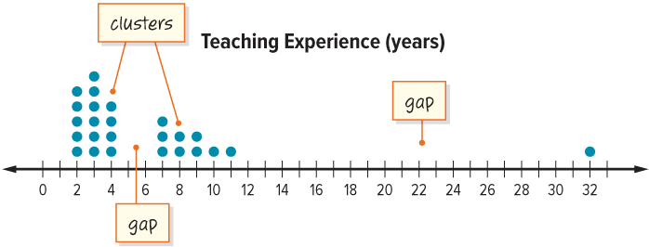
The two groups of data are called clusters. A cluster occurs when data values are grouped together.
There are two gaps in the data. A gap occurs where there is space between data values.
ANOTHER PATHWAY · Did anyone get there a different way? Put both pathways side by side and compare.
What do you notice about the data value of 32?
19 / 48
Notes:
TEACH IN PRACTICE | Embedded facilitation | Lesson 2.10, slide 19 | TASK
Focus on the existing task: The two groups of data are called clusters. A cluster occurs when data values are grouped together. What do you notice about the data value of 32?
LAUNCH (T2/3/5): Use the displayed question. Give private thinking time; then A explains while B asks for evidence. Switch roles. Each student records their own reasoning.
LOOK FOR (T4): Where this task addresses it, students can use shape and outliers to justify a measure of center and variation. Ask which feature of their work supports the claim.
RESPOND: If this task shows the lesson misconception—choosing mean automatically even when an outlier pulls it—annotate clusters, gaps and outliers on the original display before comparing measures. Have the student revise and explain the change. Use this support only where the concept occurs in the current task; otherwise respond to the displayed question.
RECHECK: If a gap is shared, revisit the existing representation together. If it is limited, give targeted support while others compare valid methods on the same task. Check the revision before moving on.
PARTICIPATION (T5/6/7): Think time before volunteers; accept a written, drawn or rehearsed entry. Students ask for evidence respectfully. Recognize a specific contribution or revision and check that both partners participate.
Source: BCPS Updated Instructional Framework Rubric (June 2020), TEACH 1–7. Earlier notes and answer keys are retained below.
EARLIER NOTES / EXISTING ANSWER KEY
Model briefly, then hand the thinking back: ask “Why does this step work?” before showing the next one.
Quick check before moving on — thumbs or whiteboards from everyone, not volunteers.
UIFR: TEACH 2 · TEACH 3 · TEACH 4.

Slide 20
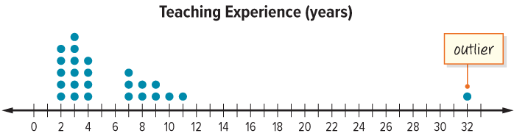
There is a large gap between the 32 and the next closest data value. 32 is called an outlier.
ASK THE CLASS · Write one question about this that you could ask the class.
What do you notice about the shape of the distribution?
Reveal:
The data is not symmetric. Almost all the values are grouped on the left.
20 / 48
Notes:
TEACH IN PRACTICE | Embedded facilitation | Lesson 2.10, slide 20 | REVEAL
Focus on the existing task: There is a large gap between the 32 and the next closest data value. 32 is called an outlier. What do you notice about the shape of the distribution?
LAUNCH (T2/3/5): If an existing answer cover is present, gather an attempt before revealing. If the explanation is already visible, ask students to reconstruct and justify it. Compare reasoning and explain a revision; preserve the reveal sequence.
LOOK FOR (T4): Where this task addresses it, students can use shape and outliers to justify a measure of center and variation. Ask which feature of their work supports the claim.
RESPOND: If this task shows the lesson misconception—choosing mean automatically even when an outlier pulls it—annotate clusters, gaps and outliers on the original display before comparing measures. Have the student revise and explain the change. Use this support only where the concept occurs in the current task; otherwise respond to the displayed question.
RECHECK: If a gap is shared, revisit the existing representation together. If it is limited, give targeted support while others compare valid methods on the same task. Check the revision before moving on.
PARTICIPATION (T5/6/7): Think time before volunteers; accept a written, drawn or rehearsed entry. Students ask for evidence respectfully. Recognize a specific contribution or revision and check that both partners participate.
Source: BCPS Updated Instructional Framework Rubric (June 2020), TEACH 1–7. Earlier notes and answer keys are retained below.
EARLIER NOTES / EXISTING ANSWER KEY
Do not click yet: collect 2–3 student answers with reasons first.
Then click to remove the cover and have students compare their thinking to the reveal — “Is this what we said? Where is it different?”
Behind the cover: The data is not symmetric. Almost all the values are grouped on the left.
UIFR: TEACH 3 · TEACH 4.

Slide 21
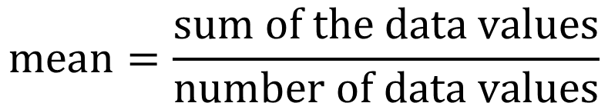
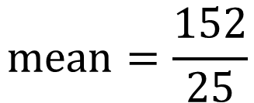

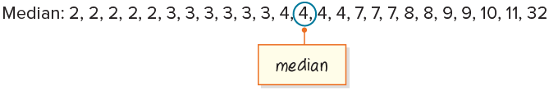
Let’s find the mean and median of the data.
Data Set
Teaching Experience (years)
2 | 4 | 7 | 3 | 4
32 | 3 | 2 | 8 | 3
3 | 7 | 9 | 10 | 4
4 | 2 | 2 | 3 | 11
9 | 7 | 3 | 8 | 2
21 / 48
Notes:
TEACH IN PRACTICE | Embedded facilitation | Lesson 2.10, slide 21 | WORKED
Focus on the existing task: Let’s find the mean and median of the data. Data Set Teaching Experience (years) 2 4 7 3 4 32 3 2 8 3 3 7 9 10 4 4 2 2 3 11 9 7 3 8…
LAUNCH (T2/3/5): Ask students to explain the displayed idea or example and point to evidence. When a calculation step is shown, ask why it is valid. Have a partner restate the explanation; copying is not the check.
LOOK FOR (T4): Where this task addresses it, students can use shape and outliers to justify a measure of center and variation. Ask which feature of their work supports the claim.
RESPOND: If this task shows the lesson misconception—choosing mean automatically even when an outlier pulls it—annotate clusters, gaps and outliers on the original display before comparing measures. Have the student revise and explain the change. Use this support only where the concept occurs in the current task; otherwise respond to the displayed question.
RECHECK: If a gap is shared, revisit the existing representation together. If it is limited, give targeted support while others compare valid methods on the same task. Check the revision before moving on.
PARTICIPATION (T5/6/7): Think time before volunteers; accept a written, drawn or rehearsed entry. Students ask for evidence respectfully. Recognize a specific contribution or revision and check that both partners participate.
Source: BCPS Updated Instructional Framework Rubric (June 2020), TEACH 1–7. Earlier notes and answer keys are retained below.
EARLIER NOTES / EXISTING ANSWER KEY
Model briefly, then hand the thinking back: ask “Why does this step work?” before showing the next one.
Quick check before moving on — thumbs or whiteboards from everyone, not volunteers.
UIFR: TEACH 2 · TEACH 3 · TEACH 4.

Slide 22
STUDENT MOVES
Lesson 2-10
Your move
USE YOUR TOOLS · Reach for your notes, a model, or a manipulative before you reach for an answer.
22 / 48

Slide 23
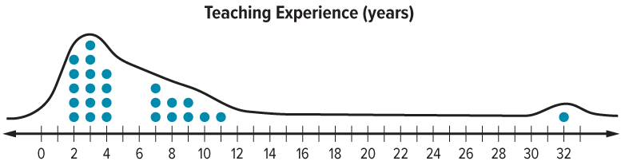
mean = 6.08
median = 4
PROVE IT · Find the evidence in the problem that makes your answer right — not just the answer.
Reveal:
The mean is greater than the median. The median is closer to the center of most of the data.
What do you notice about the mean and median?
23 / 48
Notes:
TEACH IN PRACTICE | Embedded facilitation | Lesson 2.10, slide 22 | REVEAL
Focus on the existing task: What do you notice about the mean and median?
LAUNCH (T2/3/5): If an existing answer cover is present, gather an attempt before revealing. If the explanation is already visible, ask students to reconstruct and justify it. Compare reasoning and explain a revision; preserve the reveal sequence.
LOOK FOR (T4): Where this task addresses it, students can use shape and outliers to justify a measure of center and variation. Ask which feature of their work supports the claim.
RESPOND: If this task shows the lesson misconception—choosing mean automatically even when an outlier pulls it—annotate clusters, gaps and outliers on the original display before comparing measures. Have the student revise and explain the change. Use this support only where the concept occurs in the current task; otherwise respond to the displayed question.
RECHECK: If a gap is shared, revisit the existing representation together. If it is limited, give targeted support while others compare valid methods on the same task. Check the revision before moving on.
PARTICIPATION (T5/6/7): Think time before volunteers; accept a written, drawn or rehearsed entry. Students ask for evidence respectfully. Recognize a specific contribution or revision and check that both partners participate.
Source: BCPS Updated Instructional Framework Rubric (June 2020), TEACH 1–7. Earlier notes and answer keys are retained below.
EARLIER NOTES / EXISTING ANSWER KEY
Do not click yet: collect 2–3 student answers with reasons first.
Then click to remove the cover and have students compare their thinking to the reveal — “Is this what we said? Where is it different?”
Behind the cover: The mean is greater than the median. The median is closer to the center of most of the data.
UIFR: TEACH 3 · TEACH 4.

Slide 24
When a data set is skewed or has an outlier, the mean is also skewed. So, the median is a better measure of center.
mean = 6.08
median = 4
Think and record first. Which part of your
work supports your answer?
Think About It:
How is the mean affected by the outlier?
24 / 48
Notes:
TEACH IN PRACTICE | Embedded facilitation | Lesson 2.10, slide 23 | TASK
Focus on the existing task: When a data set is skewed or has an outlier, the mean is also skewed. So, the median is a better measure of center. mean = 6.08 median = 4 Think About It: How is the mean affected by the outlier?
LAUNCH (T2/3/5): Use the displayed question. Give private thinking time; then A explains while B asks for evidence. Switch roles. Each student records their own reasoning.
LOOK FOR (T4): Where this task addresses it, students can use shape and outliers to justify a measure of center and variation. Ask which feature of their work supports the claim.
RESPOND: If this task shows the lesson misconception—choosing mean automatically even when an outlier pulls it—annotate clusters, gaps and outliers on the original display before comparing measures. Have the student revise and explain the change. Use this support only where the concept occurs in the current task; otherwise respond to the displayed question.
RECHECK: If a gap is shared, revisit the existing representation together. If it is limited, give targeted support while others compare valid methods on the same task. Check the revision before moving on.
PARTICIPATION (T5/6/7): Think time before volunteers; accept a written, drawn or rehearsed entry. Students ask for evidence respectfully. Recognize a specific contribution or revision and check that both partners participate.
Source: BCPS Updated Instructional Framework Rubric (June 2020), TEACH 1–7. Earlier notes and answer keys are retained below.
EARLIER NOTES / EXISTING ANSWER KEY
Ask the question, then hold the silence — students think or jot before anyone answers.
Take two or three responses and press with “Why?” or “How do you know?” before moving on.
UIFR: TEACH 3.

Slide 25
Let’s Explore More
What might be reasons that the teaching experience data set is skewed?
Try it yourself. Compare your
work with a partner; explain one
choice and revise.
Workspace
25 / 48
Notes:
TEACH IN PRACTICE | Embedded facilitation | Lesson 2.10, slide 24 | PRACTICE
Focus on the existing task: Let’s Explore More What might be reasons that the teaching experience data set is skewed?
LAUNCH (T2/3/5): Use the displayed question. Give private thinking time; then A explains while B asks for evidence. Switch roles. Each student records their own reasoning.
LOOK FOR (T4): Where this task addresses it, students can use shape and outliers to justify a measure of center and variation. Ask which feature of their work supports the claim.
RESPOND: If this task shows the lesson misconception—choosing mean automatically even when an outlier pulls it—annotate clusters, gaps and outliers on the original display before comparing measures. Have the student revise and explain the change. Use this support only where the concept occurs in the current task; otherwise respond to the displayed question.
RECHECK: If a gap is shared, revisit the existing representation together. If it is limited, give targeted support while others compare valid methods on the same task. Check the revision before moving on.
PARTICIPATION (T5/6/7): Think time before volunteers; accept a written, drawn or rehearsed entry. Students ask for evidence respectfully. Recognize a specific contribution or revision and check that both partners participate.
Source: BCPS Updated Instructional Framework Rubric (June 2020), TEACH 1–7. Earlier notes and answer keys are retained below.
EARLIER NOTES / EXISTING ANSWER KEY
Extension for partners or table groups — students choose their approach and use the workspace to show thinking.
Push with “Convince me,” and have two groups with different approaches share.
This is where students stretch past the worked example.
UIFR: TEACH 2 · TEACH 5.
UIFR FULL | Lesson-specific facilitation
TEACH 4-5 | Session 1 discussion and checkpoint (UIFR PDF pp. 11-12).
Collect a brief response from every student to the existing prompt before hearing volunteers. Partners take turns explaining and asking for evidence: “I understand ___; what supports ___?” Offer rehearsal or an annotated model for students who need language support. Each student records their own reasoning.
Look specifically for: choosing mean automatically even when an outlier pulls it. If it appears, annotate clusters, gaps and outliers on the original display before comparing measures; then ask the student to revise the same response and explain the change. If evidence is secure, have students compare a second valid pathway or state why their approach works. Choose the next step from the responses, not a preset pace.

Slide 26
LESSON 2.10 / DISCUSS THE TASK
Explain and compare
Use the task you just explored.
TAKE TURNS
How does the distribution support your choice of center and spread? What would the other measure emphasize?
Explain
“I know this because…”
Ask
“Where does your work show that?”
Point to evidence in your work.
Then compare your approach with a partner’s.
HOW DO YOU KNOW? · Ask your partner “How do you know?” Answer by pointing to your own work.
Listen to understand. Ask for evidence. Make room for every voice.
Notes:
TEACH IN PRACTICE | Embedded facilitation | Lesson 2.10, slide 25 | PRIOR_INSERT
Focus on the existing task: What would the other measure emphasize?
CONNECT (T1/4): Ask students to restate the displayed goal or key idea and connect it to earlier work. Relevant lesson evidence: use shape and outliers to justify a measure of center and variation. Use only the criterion that matches the current session.
SHOW PROGRESS: Students point to their own existing work, explain what improved after feedback, and name a next step. Pair confidence ratings with actual evidence.
PARTICIPATION (T5/6/7): Think time before volunteers; accept a written, drawn or rehearsed entry. Students ask for evidence respectfully. Recognize a specific contribution or revision and check that both partners participate.
Source: BCPS Updated Instructional Framework Rubric (June 2020), TEACH 1–7.

Slide 27
To determine which measures of center and variation are most appropriate to describe a data set, you must first examine the distribution of the data.
Data Set
Teaching Experience (years)
2 | 4 | 7 | 3 | 4
32 | 3 | 2 | 8 | 3
3 | 7 | 9 | 10 | 4
4 | 2 | 2 | 3 | 11
9 | 7 | 3 | 8 | 2
TRY IT BEFORE YOU’RE SURE · Start even if you are not sure. A revised answer counts as much as a first-try answer.
What tool can you use to help you analyze the distribution of a data set?
Reveal:
We can use a dot plot.
27 / 48
Notes:
TEACH IN PRACTICE | Embedded facilitation | Lesson 2.10, slide 26 | REVEAL
Focus on the existing task: To determine which measures of center and variation are most appropriate to describe a data set, you must first examine the distribution…
LAUNCH (T2/3/5): If an existing answer cover is present, gather an attempt before revealing. If the explanation is already visible, ask students to reconstruct and justify it. Compare reasoning and explain a revision; preserve the reveal sequence.
LOOK FOR (T4): Where this task addresses it, students can use shape and outliers to justify a measure of center and variation. Ask which feature of their work supports the claim.
RESPOND: If this task shows the lesson misconception—choosing mean automatically even when an outlier pulls it—annotate clusters, gaps and outliers on the original display before comparing measures. Have the student revise and explain the change. Use this support only where the concept occurs in the current task; otherwise respond to the displayed question.
RECHECK: If a gap is shared, revisit the existing representation together. If it is limited, give targeted support while others compare valid methods on the same task. Check the revision before moving on.
PARTICIPATION (T5/6/7): Think time before volunteers; accept a written, drawn or rehearsed entry. Students ask for evidence respectfully. Recognize a specific contribution or revision and check that both partners participate.
Source: BCPS Updated Instructional Framework Rubric (June 2020), TEACH 1–7.

Slide 28
mean = 6.08
median = 4
JUSTIFY IT · Say it like this: “I know ______ because ______.”
Reveal:
The mean is greater than the median. The median is closer to the center of most of the data.
What do you notice about the mean and median?
28 / 48
Notes:
TEACH IN PRACTICE | Embedded facilitation | Lesson 2.10, slide 27 | REVEAL
Focus on the existing task: What do you notice about the mean and median?
LAUNCH (T2/3/5): If an existing answer cover is present, gather an attempt before revealing. If the explanation is already visible, ask students to reconstruct and justify it. Compare reasoning and explain a revision; preserve the reveal sequence.
LOOK FOR (T4): Where this task addresses it, students can use shape and outliers to justify a measure of center and variation. Ask which feature of their work supports the claim.
RESPOND: If this task shows the lesson misconception—choosing mean automatically even when an outlier pulls it—annotate clusters, gaps and outliers on the original display before comparing measures. Have the student revise and explain the change. Use this support only where the concept occurs in the current task; otherwise respond to the displayed question.
RECHECK: If a gap is shared, revisit the existing representation together. If it is limited, give targeted support while others compare valid methods on the same task. Check the revision before moving on.
PARTICIPATION (T5/6/7): Think time before volunteers; accept a written, drawn or rehearsed entry. Students ask for evidence respectfully. Recognize a specific contribution or revision and check that both partners participate.
Source: BCPS Updated Instructional Framework Rubric (June 2020), TEACH 1–7.

Slide 29
What are some measures of variation that can be used to describe data sets?
USE THE MATH WORDS · Use today’s math words in your explanation — not “it” and “that thing.”
Think About It:
What does a measure of variation tell you about a data set?
Reveal:
mean absolute deviation, range, and interquartile range
29 / 48
Notes:
TEACH IN PRACTICE | Embedded facilitation | Lesson 2.10, slide 28 | REVEAL
Focus on the existing task: What are some measures of variation that can be used to describe data sets?
LAUNCH (T2/3/5): If an existing answer cover is present, gather an attempt before revealing. If the explanation is already visible, ask students to reconstruct and justify it. Compare reasoning and explain a revision; preserve the reveal sequence.
LOOK FOR (T4): Where this task addresses it, students can use shape and outliers to justify a measure of center and variation. Ask which feature of their work supports the claim.
RESPOND: If this task shows the lesson misconception—choosing mean automatically even when an outlier pulls it—annotate clusters, gaps and outliers on the original display before comparing measures. Have the student revise and explain the change. Use this support only where the concept occurs in the current task; otherwise respond to the displayed question.
RECHECK: If a gap is shared, revisit the existing representation together. If it is limited, give targeted support while others compare valid methods on the same task. Check the revision before moving on.
PARTICIPATION (T5/6/7): Think time before volunteers; accept a written, drawn or rehearsed entry. Students ask for evidence respectfully. Recognize a specific contribution or revision and check that both partners participate.
Source: BCPS Updated Instructional Framework Rubric (June 2020), TEACH 1–7.

Slide 30
Session 2 Warm-Up
Lesson 2-10 · Choose Appropriate Measures
Session 2 Warm-Up
Quick review from Session 1 · about 4 minutes
1
When a distribution is symmetric with no outliers, use:
2
When data is skewed or contains outliers, use:
A
Median and IQR
A
Mean and MAD
B
Mean and MAD
B
Median and IQR
C
Mode and Range
C
Range only
D
Min and Max
D
Sum only
3
Which measure of variability pairs with the median?
4
Why avoid the mean for data with extreme outliers?
A
MAD
A
Harder to add
B
IQR
B
Outliers distort the mean
C
Mean
C
Always zero
D
Standard error
D
Cannot divide
eduwonderlab.com · Neft Teacher
30 / 48
Notes:
TEACH IN PRACTICE | Embedded facilitation | Lesson 2.10, slide 29 | WARMUP
Focus on the existing task: A MAD B IQR C Mean D Standard error 4 Why avoid the mean for data with extreme outliers?
GATHER EVIDENCE (T4/6): Keep the original items. Students try independently, mark an uncertain item, and explain one method before checking. Use the existing key when present.
RESPOND: Distinguish a calculation slip from a reasoning gap. Give one next step on the same item; have students revise in a second color. Use the responses to choose flexible support for today’s lesson.
PARTICIPATION (T5/6/7): Think time before volunteers; accept a written, drawn or rehearsed entry. Students ask for evidence respectfully. Recognize a specific contribution or revision and check that both partners participate.
Source: BCPS Updated Instructional Framework Rubric (June 2020), TEACH 1–7. Earlier notes and answer keys are retained below.
EARLIER NOTES / EXISTING ANSWER KEY
Warm-up routine: students start silently on entry; keep it to about 4 minutes.
Circulate and note who is stuck — use what you see to choose who you check on first today.
Go over answers quickly; ask one student to explain a step, not just say the answer.
UIFR: TEACH 4 · TEACH 6.
UIFR FULL | Lesson-specific facilitation
TEACH 1 | Session 2 purpose and evidence (UIFR PDF p. 8).
Have students restate the displayed session goal in their own words and connect it to the existing context or a familiar experience they choose to share. Use the current session goal to select from these lesson-wide evidence criteria; do not frontload a later-session procedure.
Look for: use shape and outliers to justify a measure of center and variation. Ask: “Which part of your work would show this?” Revisit that evidence after the task; a confidence rating alone is not evidence of understanding.

Slide 31
STUDENT MOVES
Lesson 2-10
Your move
YOU KNOW THE ROUTINE · Read → plan → solve → check. Do all four, in that order.
31 / 48

Slide 32
Review Notes
Lesson 2-10 · Choose Appropriate Measures
Review Notes — Session 2
Copy. Explain. Check.
NAME THE MATH · Point to the part of this that is new today, and say what it changes.
Symmetric Strategy
1
Report the Mean for center and the MAD for variability when data shape is balanced.
Skewed Strategy
2
Report the Median for center and the IQR for variability when data has tails or outliers.
Choosing Measures
3
Match the measure of spread to the measure of center (Mean + MAD, Median + IQR).
eduwonderlab.com · Neft Teacher
32 / 48
Notes:
TEACH IN PRACTICE | Embedded facilitation | Lesson 2.10, slide 30 | NOTES
Focus on the existing task: Review Notes Review Notes — Session 2 Copy into your notebook…
ROUTINE (T1/2/4): Read or copy the original notes, cover one line, and explain it using the displayed example. Reopen and correct. Copying alone is not evidence of understanding.
LOOK FOR: A link between a symbol, quantity or feature and the explanation. If missing, point back to that feature and have the student try again; fade the prompt once they can explain.
PARTICIPATION (T5/6/7): Think time before volunteers; accept a written, drawn or rehearsed entry. Students ask for evidence respectfully. Recognize a specific contribution or revision and check that both partners participate.
Source: BCPS Updated Instructional Framework Rubric (June 2020), TEACH 1–7. Earlier notes and answer keys are retained below.
EARLIER NOTES / EXISTING ANSWER KEY
Copy routine: read one line at a time; students copy, then explain that line to a partner.
Keep it brisk — the understanding work happens in the examples, not the copying.
UIFR: TEACH 1 · TEACH 6.

Slide 33
Session 2
Choose Appropriate Measures
SELF-CHECK · Mark it: ✓ got it · ~ almost · ? stuck. Then fix one thing before we move on.
33 / 48
Notes:
TEACH IN PRACTICE | Embedded facilitation | Lesson 2.10, slide 31 | DIVIDER
Focus on the existing task: Choose Appropriate Measures Session 2
TRANSITION (T6/7): Students confirm materials, roles, how to request help, and the next response routine. Ask a student to restate it. Keep teacher-only slides hidden.
PARTICIPATION (T5/6/7): Think time before volunteers; accept a written, drawn or rehearsed entry. Students ask for evidence respectfully. Recognize a specific contribution or revision and check that both partners participate.
Source: BCPS Updated Instructional Framework Rubric (June 2020), TEACH 1–7. Earlier notes and answer keys are retained below.
EARLIER NOTES / EXISTING ANSWER KEY
Transition cue: state what materials are out and what success looks like this session.
Keep the changeover under a minute.
UIFR: TEACH 6.

Slide 34
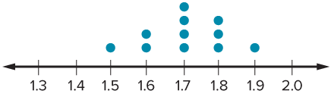
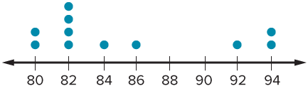
Be Curious
How are they the same?
How are they different?
Think first. Share a notice and a question; build on a classmate’s idea.
Mindset
What classroom rules are helping prevent problems arising in math class?
34 / 48
Notes:
TEACH IN PRACTICE | Embedded facilitation | Lesson 2.10, slide 32 | CURIOUS
Focus on the existing task: Be Curious How are they the same?
LAUNCH (T2/3/5): Allow quiet observation first. Separate a notice from an inference, invite students’ own questions, and follow the existing launch before teaching a procedure.
LOOK FOR (T4): Where this task addresses it, students can use shape and outliers to justify a measure of center and variation. Ask which feature of their work supports the claim.
RESPOND: If this task shows the lesson misconception—choosing mean automatically even when an outlier pulls it—annotate clusters, gaps and outliers on the original display before comparing measures. Have the student revise and explain the change. Use this support only where the concept occurs in the current task; otherwise respond to the displayed question.
RECHECK: If a gap is shared, revisit the existing representation together. If it is limited, give targeted support while others compare valid methods on the same task. Check the revision before moving on.
PARTICIPATION (T5/6/7): Think time before volunteers; accept a written, drawn or rehearsed entry. Students ask for evidence respectfully. Recognize a specific contribution or revision and check that both partners participate.
Source: BCPS Updated Instructional Framework Rubric (June 2020), TEACH 1–7. Earlier notes and answer keys are retained below.
EARLIER NOTES / EXISTING ANSWER KEY
Accept all noticings and wonderings — there are no wrong answers here.
Give 20–30 seconds of quiet think time before taking responses; mix cold and warm calls so it is not always the same voices.
Read the mindset question aloud and let two students respond.
UIFR: TEACH 3 · TEACH 7.

Slide 35
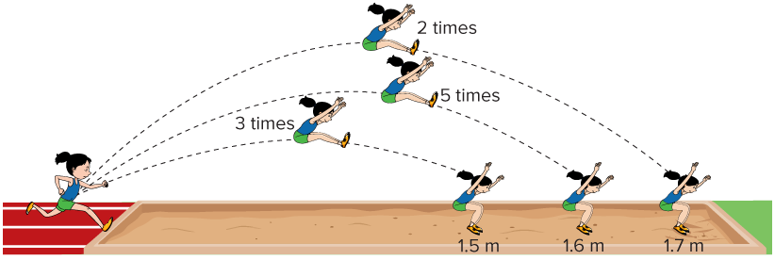
Long Jumps
Brielle participated in the long jump in ten track meets. Her jump lengths are shown.
Which measure of center and measure of variation can be used to describe the data?
35 / 48
Notes:
TEACH IN PRACTICE | Embedded facilitation | Lesson 2.10, slide 33 | TASK
Focus on the existing task: Long Jumps Brielle participated in the long jump in ten track meets. Her jump lengths are shown. Which measure of center and measure of variation can be used to describe the data?
LAUNCH (T2/3/5): Use the displayed question. Give private thinking time; then A explains while B asks for evidence. Switch roles. Each student records their own reasoning.
LOOK FOR (T4): Where this task addresses it, students can use shape and outliers to justify a measure of center and variation. Ask which feature of their work supports the claim.
RESPOND: If this task shows the lesson misconception—choosing mean automatically even when an outlier pulls it—annotate clusters, gaps and outliers on the original display before comparing measures. Have the student revise and explain the change. Use this support only where the concept occurs in the current task; otherwise respond to the displayed question.
RECHECK: If a gap is shared, revisit the existing representation together. If it is limited, give targeted support while others compare valid methods on the same task. Check the revision before moving on.
PARTICIPATION (T5/6/7): Think time before volunteers; accept a written, drawn or rehearsed entry. Students ask for evidence respectfully. Recognize a specific contribution or revision and check that both partners participate.
Source: BCPS Updated Instructional Framework Rubric (June 2020), TEACH 1–7. Earlier notes and answer keys are retained below.
EARLIER NOTES / EXISTING ANSWER KEY
Model briefly, then hand the thinking back: ask “Why does this step work?” before showing the next one.
Quick check before moving on — thumbs or whiteboards from everyone, not volunteers.
UIFR: TEACH 2 · TEACH 3 · TEACH 4.
UIFR FULL | Lesson-specific facilitation
TEACH 2-3 | Session 2 task launch (UIFR PDF pp. 9-10).
Use the problem exactly as displayed. Give individual thinking time before discussion or advancing to the explanation. If the answer is already visible, ask students to reconstruct and justify it. Invite a choice of suitable representations and have students explain why their choice helps.
At the point where this concept appears, ask: “How does the distribution support your choice of center and spread? What would the other measure emphasize?” Wait for evidence, invite another pathway, and have a student ask a follow-up question. Do not replace students’ reasoning with a sequence of leading steps.

Slide 36
STUDENT MOVES
Lesson 2-10
Your move
ANOTHER PATHWAY · Did anyone get there a different way? Put both pathways side by side and compare.
36 / 48

Slide 37
What tool can you use to determine the distribution of data values?
STRUGGLE FIRST · Work on your own first. Stuck is allowed — try a second strategy before you ask.
Reveal:
We can use a dot plot to display the data.
37 / 48
Notes:
TEACH IN PRACTICE | Embedded facilitation | Lesson 2.10, slide 34 | REVEAL
Focus on the existing task: What tool can you use to determine the distribution of data values?
LAUNCH (T2/3/5): If an existing answer cover is present, gather an attempt before revealing. If the explanation is already visible, ask students to reconstruct and justify it. Compare reasoning and explain a revision; preserve the reveal sequence.
LOOK FOR (T4): Where this task addresses it, students can use shape and outliers to justify a measure of center and variation. Ask which feature of their work supports the claim.
RESPOND: If this task shows the lesson misconception—choosing mean automatically even when an outlier pulls it—annotate clusters, gaps and outliers on the original display before comparing measures. Have the student revise and explain the change. Use this support only where the concept occurs in the current task; otherwise respond to the displayed question.
RECHECK: If a gap is shared, revisit the existing representation together. If it is limited, give targeted support while others compare valid methods on the same task. Check the revision before moving on.
PARTICIPATION (T5/6/7): Think time before volunteers; accept a written, drawn or rehearsed entry. Students ask for evidence respectfully. Recognize a specific contribution or revision and check that both partners participate.
Source: BCPS Updated Instructional Framework Rubric (June 2020), TEACH 1–7.

Slide 38
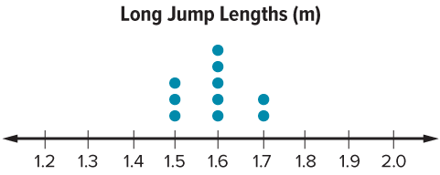
We can use a dot plot to display the data.
Compare your reasoning with the
explanation. Explain any revision you make.
What do you notice about the data and the shape of the distribution?
Reveal:
1.6 meters occurs the most. The data are nearly symmetric, with no gaps or outliers.
38 / 48
Notes:
TEACH IN PRACTICE | Embedded facilitation | Lesson 2.10, slide 35 | REVEAL
Focus on the existing task: We can use a dot plot to display the data. What do you notice about the data and the shape of the distribution?
LAUNCH (T2/3/5): If an existing answer cover is present, gather an attempt before revealing. If the explanation is already visible, ask students to reconstruct and justify it. Compare reasoning and explain a revision; preserve the reveal sequence.
LOOK FOR (T4): Where this task addresses it, students can use shape and outliers to justify a measure of center and variation. Ask which feature of their work supports the claim.
RESPOND: If this task shows the lesson misconception—choosing mean automatically even when an outlier pulls it—annotate clusters, gaps and outliers on the original display before comparing measures. Have the student revise and explain the change. Use this support only where the concept occurs in the current task; otherwise respond to the displayed question.
RECHECK: If a gap is shared, revisit the existing representation together. If it is limited, give targeted support while others compare valid methods on the same task. Check the revision before moving on.
PARTICIPATION (T5/6/7): Think time before volunteers; accept a written, drawn or rehearsed entry. Students ask for evidence respectfully. Recognize a specific contribution or revision and check that both partners participate.
Source: BCPS Updated Instructional Framework Rubric (June 2020), TEACH 1–7.

Slide 39
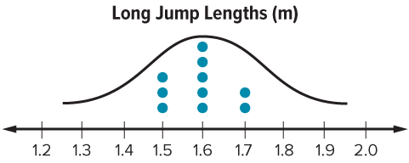
The data are nearly symmetric. There are no gaps or outliers.
Compare your reasoning with the
explanation. Explain any revision you make.
Which measure of center could be used to summarize this data set? Explain.
Reveal:
We could use the mean to summarize the data because there are no outliers to skew the measure.
39 / 48
Notes:
TEACH IN PRACTICE | Embedded facilitation | Lesson 2.10, slide 36 | REVEAL
Focus on the existing task: The data are nearly symmetric. There are no gaps or outliers. Which measure of center could be used to summarize this data set?
LAUNCH (T2/3/5): If an existing answer cover is present, gather an attempt before revealing. If the explanation is already visible, ask students to reconstruct and justify it. Compare reasoning and explain a revision; preserve the reveal sequence.
LOOK FOR (T4): Where this task addresses it, students can use shape and outliers to justify a measure of center and variation. Ask which feature of their work supports the claim.
RESPOND: If this task shows the lesson misconception—choosing mean automatically even when an outlier pulls it—annotate clusters, gaps and outliers on the original display before comparing measures. Have the student revise and explain the change. Use this support only where the concept occurs in the current task; otherwise respond to the displayed question.
RECHECK: If a gap is shared, revisit the existing representation together. If it is limited, give targeted support while others compare valid methods on the same task. Check the revision before moving on.
PARTICIPATION (T5/6/7): Think time before volunteers; accept a written, drawn or rehearsed entry. Students ask for evidence respectfully. Recognize a specific contribution or revision and check that both partners participate.
Source: BCPS Updated Instructional Framework Rubric (June 2020), TEACH 1–7.

Slide 40
SUMMARIZE · SAY IT IN YOUR OWN WORDS
When data are symmetric, the mean is an appropriate measure of center to summarize the data because there are no outliers to skew the mean.
What measure of variation should we use with the mean? Explain.
Reveal:
We should use the mean absolute deviation to describe the variation because it is related to the mean.
Record your reasoning before the
reveal. Compare, then explain
any revision.
40 / 48
Notes:
TEACH IN PRACTICE | Embedded facilitation | Lesson 2.10, slide 37 | REVEAL
Focus on the existing task: When data are symmetric, the mean is an appropriate measure of center to summarize the data because there are no outliers to skew the mean. What measure of variation should we use with the mean?
LAUNCH (T2/3/5): If an existing answer cover is present, gather an attempt before revealing. If the explanation is already visible, ask students to reconstruct and justify it. Compare reasoning and explain a revision; preserve the reveal sequence.
LOOK FOR (T4): Where this task addresses it, students can use shape and outliers to justify a measure of center and variation. Ask which feature of their work supports the claim.
RESPOND: If this task shows the lesson misconception—choosing mean automatically even when an outlier pulls it—annotate clusters, gaps and outliers on the original display before comparing measures. Have the student revise and explain the change. Use this support only where the concept occurs in the current task; otherwise respond to the displayed question.
RECHECK: If a gap is shared, revisit the existing representation together. If it is limited, give targeted support while others compare valid methods on the same task. Check the revision before moving on.
PARTICIPATION (T5/6/7): Think time before volunteers; accept a written, drawn or rehearsed entry. Students ask for evidence respectfully. Recognize a specific contribution or revision and check that both partners participate.
Source: BCPS Updated Instructional Framework Rubric (June 2020), TEACH 1–7. Earlier notes and answer keys are retained below.
EARLIER NOTES / EXISTING ANSWER KEY
Routine: SUMMARIZE · SAY IT IN YOUR OWN WORDS

Slide 41
Let’s Explore More
Suppose that Brielle had two more jumps: 1.7 meters and 0.5 meter. How would these two additional data points affect the median and mean?
Try it yourself. Compare your
work with a partner; explain one
choice and revise.
Workspace
41 / 48
Notes:
TEACH IN PRACTICE | Embedded facilitation | Lesson 2.10, slide 38 | PRACTICE
Focus on the existing task: Let’s Explore More Suppose that Brielle had two more jumps: 1.7 meters and 0.5 meter. How would these two additional data points affect the median and mean?
LAUNCH (T2/3/5): Use the displayed question. Give private thinking time; then A explains while B asks for evidence. Switch roles. Each student records their own reasoning.
LOOK FOR (T4): Where this task addresses it, students can use shape and outliers to justify a measure of center and variation. Ask which feature of their work supports the claim.
RESPOND: If this task shows the lesson misconception—choosing mean automatically even when an outlier pulls it—annotate clusters, gaps and outliers on the original display before comparing measures. Have the student revise and explain the change. Use this support only where the concept occurs in the current task; otherwise respond to the displayed question.
RECHECK: If a gap is shared, revisit the existing representation together. If it is limited, give targeted support while others compare valid methods on the same task. Check the revision before moving on.
PARTICIPATION (T5/6/7): Think time before volunteers; accept a written, drawn or rehearsed entry. Students ask for evidence respectfully. Recognize a specific contribution or revision and check that both partners participate.
Source: BCPS Updated Instructional Framework Rubric (June 2020), TEACH 1–7. Earlier notes and answer keys are retained below.
EARLIER NOTES / EXISTING ANSWER KEY
Extension for partners or table groups — students choose their approach and use the workspace to show thinking.
Push with “Convince me,” and have two groups with different approaches share.
This is where students stretch past the worked example.
UIFR: TEACH 2 · TEACH 5.
UIFR FULL | Lesson-specific facilitation
TEACH 4-5 | Session 2 discussion and checkpoint (UIFR PDF pp. 11-12).
Collect a brief response from every student to the existing prompt before hearing volunteers. Partners take turns explaining and asking for evidence: “I understand ___; what supports ___?” Offer rehearsal or an annotated model for students who need language support. Each student records their own reasoning.
Look specifically for: choosing mean automatically even when an outlier pulls it. If it appears, annotate clusters, gaps and outliers on the original display before comparing measures; then ask the student to revise the same response and explain the change. If evidence is secure, have students compare a second valid pathway or state why their approach works. Choose the next step from the responses, not a preset pace.

Slide 42
LESSON 2.10 / CHECK YOUR WORK
Pause. Check. Improve.
CHECK
A mistake to watch for: choosing mean automatically even when an outlier pulls it.
TRY
Annotate clusters, gaps and outliers on the given display before comparing measures.
REVISE
Use that check on the task you just completed. Correct or strengthen one part, and explain why.
REVISE NOW · Change one answer and write why you changed it. A revision is evidence of learning.
Listen to understand. Ask for evidence. Make room for every voice.
Notes:
TEACH IN PRACTICE | Embedded facilitation | Lesson 2.10, slide 39 | PRIOR_INSERT
Focus on the existing task: LESSON 2.10 / CHECK YOUR WORK Pause. Check. Improve. Listen to understand. Ask for evidence. Make room for every voice. CHECK A mistake…
CONNECT (T1/4): Ask students to restate the displayed goal or key idea and connect it to earlier work. Relevant lesson evidence: use shape and outliers to justify a measure of center and variation. Use only the criterion that matches the current session.
SHOW PROGRESS: Students point to their own existing work, explain what improved after feedback, and name a next step. Pair confidence ratings with actual evidence.
PARTICIPATION (T5/6/7): Think time before volunteers; accept a written, drawn or rehearsed entry. Students ask for evidence respectfully. Recognize a specific contribution or revision and check that both partners participate.
Source: BCPS Updated Instructional Framework Rubric (June 2020), TEACH 1–7.

Slide 43
SUMMARIZE · SAY IT IN YOUR OWN WORDS
Summarize: Choose Appropriate Measures (continued)
The data set is symmetric. Mean and mean absolute deviation are appropriate measures.
Explain the key idea without reading. Use today’s example as evidence.
43 / 48
Notes:
TEACH IN PRACTICE | Embedded facilitation | Lesson 2.10, slide 40 | SUMMARIZE
Focus on the existing task: The data set is symmetric. Mean and mean absolute deviation are appropriate measures. Summarize: Choose Appropriate Measures (continued)…
CONNECT (T1/4): Ask students to restate the displayed goal or key idea and connect it to earlier work. Relevant lesson evidence: use shape and outliers to justify a measure of center and variation. Use only the criterion that matches the current session.
SHOW PROGRESS: Students point to their own existing work, explain what improved after feedback, and name a next step. Pair confidence ratings with actual evidence.
PARTICIPATION (T5/6/7): Think time before volunteers; accept a written, drawn or rehearsed entry. Students ask for evidence respectfully. Recognize a specific contribution or revision and check that both partners participate.
Source: BCPS Updated Instructional Framework Rubric (June 2020), TEACH 1–7. Earlier notes and answer keys are retained below.
EARLIER NOTES / EXISTING ANSWER KEY
Routine: SUMMARIZE · SAY IT IN YOUR OWN WORDS

Slide 44
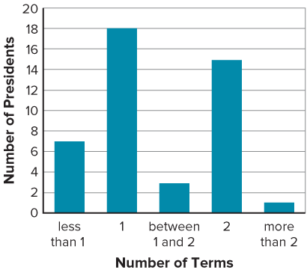
APPLY · PLAN IT • SOLVE IT • PROVE IT
Apply: Presidential Terms
A presidential term in the United States is four years. In 1947, Congress passed an amendment to limit the president to two terms. The number of terms served by each president of the United States from 1789 to 2021 is shown in the bar graph.
Question: Given this information, what prediction can you make about the number of terms the next U.S. president will serve in office?
44 / 48
Notes:
TEACH IN PRACTICE | Embedded facilitation | Lesson 2.10, slide 41 | APPLY
Focus on the existing task: Apply: Presidential Terms A presidential term in the United States is four years. In 1947, Congress passed an amendment to limit the…
LAUNCH (T2/3/5): Use the exact application task independently first. Ask students to justify their choice of method. Collect evidence before a partner discussion or correction.
LOOK FOR (T4): Where this task addresses it, students can use shape and outliers to justify a measure of center and variation. Ask which feature of their work supports the claim.
RESPOND: If this task shows the lesson misconception—choosing mean automatically even when an outlier pulls it—annotate clusters, gaps and outliers on the original display before comparing measures. Have the student revise and explain the change. Use this support only where the concept occurs in the current task; otherwise respond to the displayed question.
RECHECK: If a gap is shared, revisit the existing representation together. If it is limited, give targeted support while others compare valid methods on the same task. Check the revision before moving on.
PARTICIPATION (T5/6/7): Think time before volunteers; accept a written, drawn or rehearsed entry. Students ask for evidence respectfully. Recognize a specific contribution or revision and check that both partners participate.
Source: BCPS Updated Instructional Framework Rubric (June 2020), TEACH 1–7. Earlier notes and answer keys are retained below.
EARLIER NOTES / EXISTING ANSWER KEY
Routine: APPLY · PLAN IT • SOLVE IT • PROVE IT
UIFR FULL | Lesson-specific facilitation
TEACH 4 | Independent evidence and revision (UIFR PDF p. 11).
Use the existing application/exit problem as the independent check. If this is a learning-target slide, have students point to and explain their work on the preceding task. Separate initial independent evidence from the revision after feedback.
Check the relevant criteria: use shape and outliers to justify a measure of center and variation. Respond with one specific next step tied to the work. Students revise and annotate what changed, then identify a criterion they can now demonstrate and one they still need to practice.

Slide 45
STUDENT MOVES
Lesson 2-10
Your move
ADD ON · Add on: “I agree because ______.” or “I see it differently because ______.”
45 / 48

Slide 46
Learning Targets
I can determine the most appropriate measure of center and measure of variation to describe the data in relation to its context.
I can describe visual displays of data with reference to symmetry and measures of center and variation.
SAY THE GOAL · Say today’s goal in your own words, then name one place this shows up outside math class.
46 / 48
Notes:
TEACH IN PRACTICE | Embedded facilitation | Lesson 2.10, slide 42 | REFLECTION
Focus on the existing task: Learning Targets I can determine the most appropriate measure of center and measure of variation to describe the data in relation to its…
CONNECT (T1/4): Ask students to restate the displayed goal or key idea and connect it to earlier work. Relevant lesson evidence: use shape and outliers to justify a measure of center and variation. Use only the criterion that matches the current session.
SHOW PROGRESS: Students point to their own existing work, explain what improved after feedback, and name a next step. Pair confidence ratings with actual evidence.
PARTICIPATION (T5/6/7): Think time before volunteers; accept a written, drawn or rehearsed entry. Students ask for evidence respectfully. Recognize a specific contribution or revision and check that both partners participate.
Source: BCPS Updated Instructional Framework Rubric (June 2020), TEACH 1–7. Earlier notes and answer keys are retained below.
EARLIER NOTES / EXISTING ANSWER KEY
Read each target; students self-rate with fist-to-five or thumbs.
Tie back to the goal from the start of class: did we get there?
Note any target that rates low — revisit it tomorrow.
UIFR: TEACH 1 · TEACH 4.

Slide 47
Learning Targets
I can determine the most appropriate measure of center and measure of variation to describe the data in relation to its context.
I can describe visual displays of data with reference to symmetry and measures of center and variation.
CONNECT IT · What earlier lesson does this build on? Tell a partner in one sentence.
47 / 48
Notes:
TEACH IN PRACTICE | Embedded facilitation | Lesson 2.10, slide 43 | REFLECTION
Focus on the existing task: Learning Targets I can determine the most appropriate measure of center and measure of variation to describe the data in relation to its…
CONNECT (T1/4): Ask students to restate the displayed goal or key idea and connect it to earlier work. Relevant lesson evidence: use shape and outliers to justify a measure of center and variation. Use only the criterion that matches the current session.
SHOW PROGRESS: Students point to their own existing work, explain what improved after feedback, and name a next step. Pair confidence ratings with actual evidence.
PARTICIPATION (T5/6/7): Think time before volunteers; accept a written, drawn or rehearsed entry. Students ask for evidence respectfully. Recognize a specific contribution or revision and check that both partners participate.
Source: BCPS Updated Instructional Framework Rubric (June 2020), TEACH 1–7. Earlier notes and answer keys are retained below.
EARLIER NOTES / EXISTING ANSWER KEY
UIFR FULL | Lesson-specific facilitation
REFLECT & ADJUST 1-2 | After the lesson (UIFR PDF pp. 15-16).
Sort the existing work by demonstrated reasoning, partial understanding, and the specific misconception: choosing mean automatically even when an outlier pulls it. Compare the initial response with the revision. Record which teaching move plausibly helped, which did not, and whose participation or access needs a different approach; do not record sensitive student details in this shared deck.
Plan the next lesson from that evidence: if the misconception persists, annotate clusters, gaps and outliers on the original display before comparing measures using the current example before returning to the next grade-level task; if understanding is secure, use an existing extension or ask for a general explanation. Check the targeted idea again at the next warm-up.
Ask students what supported their thinking and what would help next time. Identify one change to try and one successful practice to retain. Seek colleague feedback on anonymized work when useful; these prompts support reflection and do not establish an evaluation rating. Source: Baltimore City Public Schools, Updated Instructional Framework Rubric, June 2020 (UIFR_Full.pdf).

Slide 48
LESSON 2.10 / REFLECT ON YOUR LEARNING
Show your progress
1 SHOW EVIDENCE
2 CHOOSE A NEXT STEP
Choose one response. Point to the part that shows your reasoning.
Name a change you made after feedback—or a question you still have.
“My work shows ___ because ___.”
“Next time, I will ___ to help me ___.”
CREDIT A CLASSMATE · Name one classmate whose idea helped you today, and say what they said.
Today’s focus: Use shape and outliers to justify a measure of center and variation.
Listen to understand. Ask for evidence. Make room for every voice.
Notes:
TEACH IN PRACTICE | Embedded facilitation | Lesson 2.10, slide 44 | PRIOR_INSERT
Focus on the existing task: LESSON 2.10 / REFLECT ON YOUR LEARNING Show your progress Listen to understand. Ask for evidence. Make room for every voice. 1 SHOW…
CONNECT (T1/4): Ask students to restate the displayed goal or key idea and connect it to earlier work. Relevant lesson evidence: use shape and outliers to justify a measure of center and variation. Use only the criterion that matches the current session.
SHOW PROGRESS: Students point to their own existing work, explain what improved after feedback, and name a next step. Pair confidence ratings with actual evidence.
PARTICIPATION (T5/6/7): Think time before volunteers; accept a written, drawn or rehearsed entry. Students ask for evidence respectfully. Recognize a specific contribution or revision and check that both partners participate.
Source: BCPS Updated Instructional Framework Rubric (June 2020), TEACH 1–7.

