Slide 1
WARM-UP · THINK • TRY • CHECK
Turn and talk: compare strategies, then defend one.
Warm-Up
Lesson 2-2 · Represent and Describe Data in a Histogram | Warm-Up · about 4 minutes
Try each on your own. Mark an unsure answer; explain and revise when we check.
QUESTION 1
QUESTION 2
Which interval holds 19: 10-19 or 20-29? ______
How many of 3, 8, 12, 15, 21 land in 10-19? ______
QUESTION 3
QUESTION 4
6 + 9 + 4 + 11 = ______
A scale counts by 5. A bar reaches line 4. Height = ______
TALK IT OVER: “I got ______ because ______.” • Compare with a partner before we check as a class.
1 / 46
Notes:
TEACH IN PRACTICE | Embedded facilitation | Lesson 2.2, slide 1 | WARMUP
Focus on the existing task: ______ QUESTION 2 How many of 3, 8, 12, 15, 21 land in 10-19?
GATHER EVIDENCE (T4/6): Keep the original items. Students try independently, mark an uncertain item, and explain one method before checking. Use the existing key when present.
RESPOND: Distinguish a calculation slip from a reasoning gap. Give one next step on the same item; have students revise in a second color. Use the responses to choose flexible support for today’s lesson.
PARTICIPATION (T5/6/7): Think time before volunteers; accept a written, drawn or rehearsed entry. Students ask for evidence respectfully. Recognize a specific contribution or revision and check that both partners participate.
Source: BCPS Updated Instructional Framework Rubric (June 2020), TEACH 1–7. Earlier notes and answer keys are retained below.
EARLIER NOTES / EXISTING ANSWER KEY
Warm-Up answers (teacher only): 1) 10-19 2) 2 3) 30 4) 20
UIFR FULL | Lesson-specific facilitation
PREPARE 1-2 | Before teaching (UIFR PDF pp. 6-7).
Plan to gather evidence that students can use equal-width intervals; count each value once; interpret frequency and distribution. Review recent work and today’s warm-up to choose flexible groups and access supports; do not infer needs from identity or perceived ability. Use the existing lesson tasks and stated standards.
Anticipate: reading a bar height as an individual data value. If observed, trace each original value into its interval and label both axes. Offer oral rehearsal, drawing, pointing, or home-language processing as needed; retain the original mathematical demand. Ask students which support helps and fade it as evidence improves.
TEACH 6-7 | Before the first transition, agree on materials, partner roles, and how to request help. Invite students to restate the routine. Normalize revising an idea, recognize a specific contribution, and check privately when frustration blocks participation. Source: UIFR PDF pp. 13-14.

Slide 2
Today’s Math Notes
Lesson 2-2 · Represent and Describe Data in a Histogram
Section 1: Math Words
Copy. Explain. Check.
SAY THE GOAL · Say today’s goal in your own words, then name one place this shows up outside math class.
Display Data with Histograms
1
Group numerical data into intervals and show each interval’s frequency
Histogram
2
A bar graph that groups data into equal ranges
Frequency
3
How many times a value shows up
eduwonderlab.com · Neft Teacher
2 / 46
Notes:
TEACH IN PRACTICE | Embedded facilitation | Lesson 2.2, slide 2 | NOTES
Focus on the existing task: Today’s Math Notes Section 1: Math Words Copy…
ROUTINE (T1/2/4): Read or copy the original notes, cover one line, and explain it using the displayed example. Reopen and correct. Copying alone is not evidence of understanding.
LOOK FOR: A link between a symbol, quantity or feature and the explanation. If missing, point back to that feature and have the student try again; fade the prompt once they can explain.
PARTICIPATION (T5/6/7): Think time before volunteers; accept a written, drawn or rehearsed entry. Students ask for evidence respectfully. Recognize a specific contribution or revision and check that both partners participate.
Source: BCPS Updated Instructional Framework Rubric (June 2020), TEACH 1–7. Earlier notes and answer keys are retained below.
EARLIER NOTES / EXISTING ANSWER KEY
Copy routine: read one line at a time; students copy, then explain that line to a partner.
Keep it brisk — the understanding work happens in the examples, not the copying.
UIFR: TEACH 1 · TEACH 6.

Slide 3
Today’s Math Notes
Lesson 2-2 · Represent and Describe Data in a Histogram
Section 2: Today’s Math
Copy. Explain. Check.
Histograms & Frequency Distributions
Set equal intervals along the horizontal axis with no gaps
1
Count the frequency (how many data values fall into each interval)
2
CONNECT IT · What earlier lesson does this build on? Tell a partner in one sentence.
Draw adjacent bars with heights equal to frequency
3
eduwonderlab.com · Neft Teacher
3 / 46
Notes:
TEACH IN PRACTICE | Embedded facilitation | Lesson 2.2, slide 3 | NOTES
Focus on the existing task: Today’s Math Notes Section 2: Today’s Math Copy…
ROUTINE (T1/2/4): Read or copy the original notes, cover one line, and explain it using the displayed example. Reopen and correct. Copying alone is not evidence of understanding.
LOOK FOR: A link between a symbol, quantity or feature and the explanation. If missing, point back to that feature and have the student try again; fade the prompt once they can explain.
PARTICIPATION (T5/6/7): Think time before volunteers; accept a written, drawn or rehearsed entry. Students ask for evidence respectfully. Recognize a specific contribution or revision and check that both partners participate.
Source: BCPS Updated Instructional Framework Rubric (June 2020), TEACH 1–7. Earlier notes and answer keys are retained below.
EARLIER NOTES / EXISTING ANSWER KEY
Copy routine: read one line at a time; students copy, then explain that line to a partner.
Keep it brisk — the understanding work happens in the examples, not the copying.
UIFR: TEACH 1 · TEACH 6.

Slide 4
Session 1
Represent and Describe Data in a Histogram
TRY IT BEFORE YOU’RE SURE · Start even if you are not sure. A revised answer counts as much as a first-try answer.
4 / 46
Notes:
TEACH IN PRACTICE | Embedded facilitation | Lesson 2.2, slide 4 | DIVIDER
Focus on the existing task: Represent and Describe Data in a Histogram Session 1
TRANSITION (T6/7): Students confirm materials, roles, how to request help, and the next response routine. Ask a student to restate it. Keep teacher-only slides hidden.
PARTICIPATION (T5/6/7): Think time before volunteers; accept a written, drawn or rehearsed entry. Students ask for evidence respectfully. Recognize a specific contribution or revision and check that both partners participate.
Source: BCPS Updated Instructional Framework Rubric (June 2020), TEACH 1–7. Earlier notes and answer keys are retained below.
EARLIER NOTES / EXISTING ANSWER KEY
Transition cue: state what materials are out and what success looks like this session.
Keep the changeover under a minute.
UIFR: TEACH 6.

Slide 5
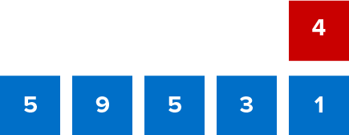
Give Me Five
Use all the numbers in any order with any operation to equal the target number (in red). ​
Explain how the information shown supports your reasoning.
5 / 46
Notes:
TEACH IN PRACTICE | Embedded facilitation | Lesson 2.2, slide 5 | WORKED
Focus on the existing task: Give Me Five Use all the numbers in any order with any operation to equal the target number (in red).
LAUNCH (T2/3/5): Ask students to explain the displayed idea or example and point to evidence. When a calculation step is shown, ask why it is valid. Have a partner restate the explanation; copying is not the check.
LOOK FOR (T4): Where this task addresses it, students can use equal-width intervals. Ask which feature of their work supports the claim.
RESPOND: If this task shows the lesson misconception—reading a bar height as an individual data value—trace each original value into its interval and label both axes. Have the student revise and explain the change. Use this support only where the concept occurs in the current task; otherwise respond to the displayed question.
RECHECK: If a gap is shared, revisit the existing representation together. If it is limited, give targeted support while others compare valid methods on the same task. Check the revision before moving on.
PARTICIPATION (T5/6/7): Think time before volunteers; accept a written, drawn or rehearsed entry. Students ask for evidence respectfully. Recognize a specific contribution or revision and check that both partners participate.
Source: BCPS Updated Instructional Framework Rubric (June 2020), TEACH 1–7. Earlier notes and answer keys are retained below.
EARLIER NOTES / EXISTING ANSWER KEY
Number-sense routine — every voice in. Give quiet think time, then hear from at least three students.
Always follow with “How do you know?” — the reasoning is the point, not the answer.
There is more than one path; name and celebrate different strategies.
UIFR: TEACH 3 · TEACH 5 · TEACH 6.

Slide 6
Today’s Objectives
Lesson 2-2 · Represent and Describe Data in a Histogram
Represent and Describe Data in a Histogram
Maryland Standard 6.DS.5
SHOW YOUR THINKING · Show what you know — write it, draw it, or build it. A picture counts as an explanation.
CONTENT OBJECTIVE
LANGUAGE OBJECTIVE
Restate the goal in your words
Use these words to explain why
I can make and read a histogram to display data in intervals.
I can explain my histogram using the words histogram, frequency, interval, and distribution.
eduwonderlab.com · Neft Teacher
6 / 46
Notes:
TEACH IN PRACTICE | Embedded facilitation | Lesson 2.2, slide 6 | GOAL
Focus on the existing task: Today’s Objectives Represent and Describe Data…
CONNECT (T1/4): Ask students to restate the displayed goal or key idea and connect it to earlier work. Relevant lesson evidence: use equal-width intervals; count each value once; interpret frequency and distribution. Use only the criterion that matches the current session.
SHOW PROGRESS: Students point to their own existing work, explain what improved after feedback, and name a next step. Pair confidence ratings with actual evidence.
PARTICIPATION (T5/6/7): Think time before volunteers; accept a written, drawn or rehearsed entry. Students ask for evidence respectfully. Recognize a specific contribution or revision and check that both partners participate.
Source: BCPS Updated Instructional Framework Rubric (June 2020), TEACH 1–7. Earlier notes and answer keys are retained below.
EARLIER NOTES / EXISTING ANSWER KEY
Read the objective together, then have one or two students restate today’s goal in their own words.
Connect it to what the class learned last lesson.
Return to this goal at the end of class to check it was met.
UIFR: TEACH 1.
UIFR FULL | Lesson-specific facilitation
TEACH 1 | Session 1 purpose and evidence (UIFR PDF p. 8).
Have students restate the displayed session goal in their own words and connect it to the existing context or a familiar experience they choose to share. Use the current session goal to select from these lesson-wide evidence criteria; do not frontload a later-session procedure.
Look for: use equal-width intervals; count each value once; interpret frequency and distribution. Ask: “Which part of your work would show this?” Revisit that evidence after the task; a confidence rating alone is not evidence of understanding.

Slide 7
LESSON 2.2 / OUR LEARNING
What will show your learning?
1
Use equal-width intervals.
2
Count each value once.
3
Interpret frequency and distribution.
Tell a partner: Which skill connects to something you already know?
WHY IT MATTERS · Finish this: “This is worth knowing because ______.”
Listen to understand. Ask for evidence. Make room for every voice.
Notes:
TEACH IN PRACTICE | Embedded facilitation | Lesson 2.2, slide 7 | PRIOR_INSERT
Focus on the existing task: LESSON 2.2 / OUR LEARNING What will show your learning?
CONNECT (T1/4): Ask students to restate the displayed goal or key idea and connect it to earlier work. Relevant lesson evidence: use equal-width intervals; count each value once; interpret frequency and distribution. Use only the criterion that matches the current session.
SHOW PROGRESS: Students point to their own existing work, explain what improved after feedback, and name a next step. Pair confidence ratings with actual evidence.
PARTICIPATION (T5/6/7): Think time before volunteers; accept a written, drawn or rehearsed entry. Students ask for evidence respectfully. Recognize a specific contribution or revision and check that both partners participate.
Source: BCPS Updated Instructional Framework Rubric (June 2020), TEACH 1–7.

Slide 8
Vocabulary 1 of 6
Lesson 2-2 · Represent and Describe Data in a Histogram
Display Data with Histograms
Group numerical data into intervals and show each interval’s frequency with a bar.
EXAMPLE · EXPLAIN WHY IT FITS
Each touching bar shows how many values fall in one interval.
USE THE MATH WORDS · Use today’s math words in your explanation — not “it” and “that thing.”
eduwonderlab.com · Neft Teacher
8 / 46
Notes:
TEACH IN PRACTICE | Embedded facilitation | Lesson 2.2, slide 8 | VOCAB
Focus on the existing task: Vocabulary 1 of 6 Display Data with Histograms…
ASK (T1/3/5): Where does “Display Data with Histograms” appear in the example? Explain the meaning without reading the definition. Partner: restate the idea and ask a clarifying question.
LOOK FOR: A correct connection between the word and a feature of the example. If the student only repeats the definition, invite pointing, sketching or oral rehearsal, then ask for another explanation of this same example.
PARTICIPATION (T5/6/7): Think time before volunteers; accept a written, drawn or rehearsed entry. Students ask for evidence respectfully. Recognize a specific contribution or revision and check that both partners participate.
Source: BCPS Updated Instructional Framework Rubric (June 2020), TEACH 1–7.

Slide 9
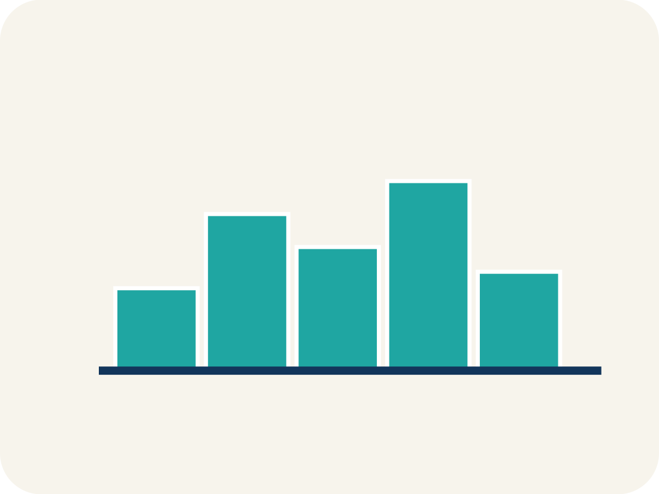
Vocabulary 2 of 6
Lesson 2-2 · Represent and Describe Data in a Histogram
Histogram
A bar graph that groups data into equal ranges. The bars touch.
EXAMPLE · EXPLAIN WHY IT FITS
Bars side by side: 0-9 pts (3 players), 10-19 pts (8 players), 20-29 pts (4 players)
Use “Histogram” to explain the example. Point to evidence.
eduwonderlab.com · Neft Teacher
9 / 46
Notes:
TEACH IN PRACTICE | Embedded facilitation | Lesson 2.2, slide 9 | VOCAB
Focus on the existing task: Vocabulary 2 of 6 Histogram A bar graph that…
ASK (T1/3/5): Where does “Histogram” appear in the example? Explain the meaning without reading the definition. Partner: restate the idea and ask a clarifying question.
LOOK FOR: A correct connection between the word and a feature of the example. If the student only repeats the definition, invite pointing, sketching or oral rehearsal, then ask for another explanation of this same example.
PARTICIPATION (T5/6/7): Think time before volunteers; accept a written, drawn or rehearsed entry. Students ask for evidence respectfully. Recognize a specific contribution or revision and check that both partners participate.
Source: BCPS Updated Instructional Framework Rubric (June 2020), TEACH 1–7.

Slide 10
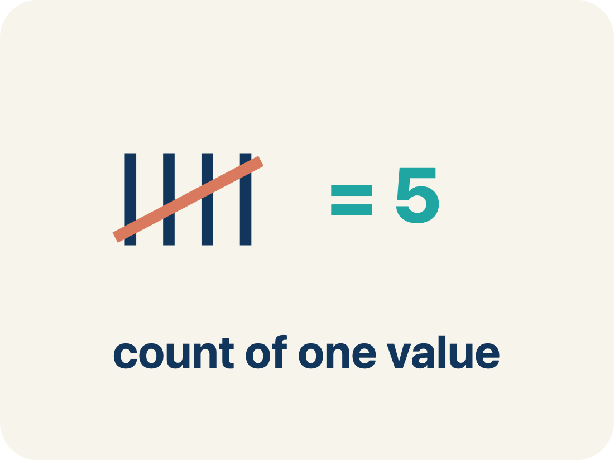
Vocabulary 3 of 6
Lesson 2-2 · Represent and Describe Data in a Histogram
Frequency
How many times a value shows up.
EXAMPLE · EXPLAIN WHY IT FITS
If 5 players scored 10-19 points, the frequency for that interval is 5
Use “Frequency” to explain the example. Point to evidence.
eduwonderlab.com · Neft Teacher
10 / 46
Notes:
TEACH IN PRACTICE | Embedded facilitation | Lesson 2.2, slide 10 | VOCAB
Focus on the existing task: Vocabulary 3 of 6 Frequency How many times a…
ASK (T1/3/5): Where does “Frequency” appear in the example? Explain the meaning without reading the definition. Partner: restate the idea and ask a clarifying question.
LOOK FOR: A correct connection between the word and a feature of the example. If the student only repeats the definition, invite pointing, sketching or oral rehearsal, then ask for another explanation of this same example.
PARTICIPATION (T5/6/7): Think time before volunteers; accept a written, drawn or rehearsed entry. Students ask for evidence respectfully. Recognize a specific contribution or revision and check that both partners participate.
Source: BCPS Updated Instructional Framework Rubric (June 2020), TEACH 1–7.

Slide 11
Vocabulary 4 of 6
Lesson 2-2 · Represent and Describe Data in a Histogram
Interval
A range of numbers used to group data.
EXAMPLE · EXPLAIN WHY IT FITS
0-9, 10-19, 20-29 are intervals of width 10 — each covers 10 values
Use “Interval” to explain the example. Point to evidence.
eduwonderlab.com · Neft Teacher
11 / 46
Notes:
TEACH IN PRACTICE | Embedded facilitation | Lesson 2.2, slide 11 | VOCAB
Focus on the existing task: Vocabulary 4 of 6 Interval A range of numbers…
ASK (T1/3/5): Where does “Interval” appear in the example? Explain the meaning without reading the definition. Partner: restate the idea and ask a clarifying question.
LOOK FOR: A correct connection between the word and a feature of the example. If the student only repeats the definition, invite pointing, sketching or oral rehearsal, then ask for another explanation of this same example.
PARTICIPATION (T5/6/7): Think time before volunteers; accept a written, drawn or rehearsed entry. Students ask for evidence respectfully. Recognize a specific contribution or revision and check that both partners participate.
Source: BCPS Updated Instructional Framework Rubric (June 2020), TEACH 1–7.

Slide 12
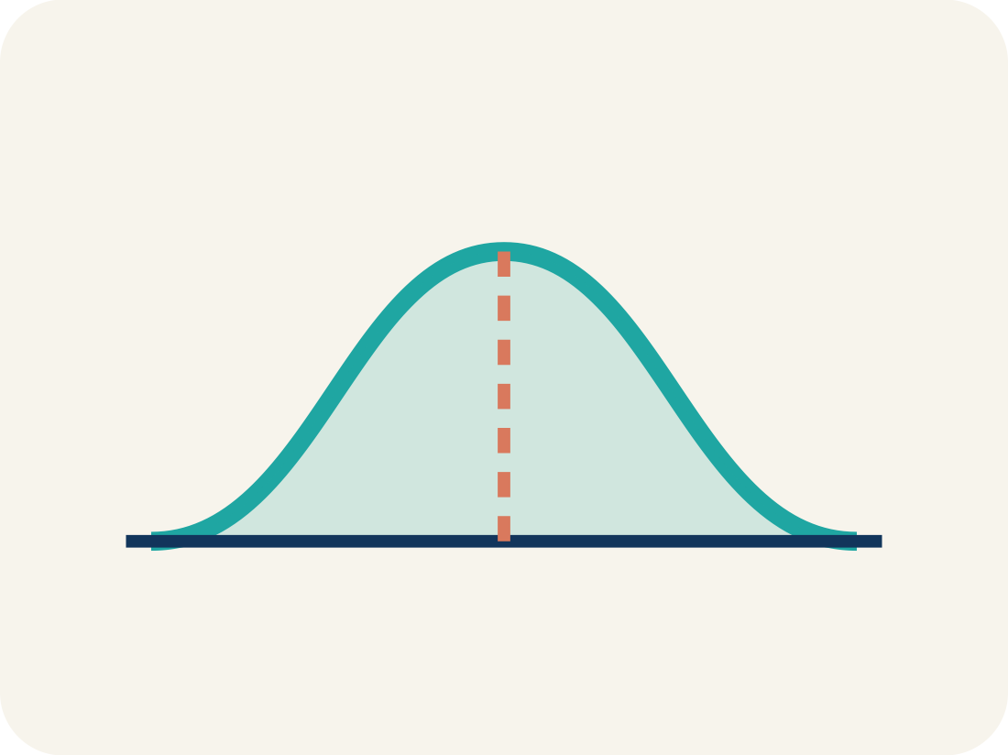
Vocabulary 5 of 6
Lesson 2-2 · Represent and Describe Data in a Histogram
Distribution
How the data is spread out.
EXAMPLE · EXPLAIN WHY IT FITS
Most data in the middle with fewer at the ends = bell-shaped; most on one side with a tail = skewed
Use “Distribution” to explain the example. Point to evidence.
eduwonderlab.com · Neft Teacher
12 / 46
Notes:
TEACH IN PRACTICE | Embedded facilitation | Lesson 2.2, slide 12 | VOCAB
Focus on the existing task: Vocabulary 5 of 6 Distribution How the data is…
ASK (T1/3/5): Where does “Distribution” appear in the example? Explain the meaning without reading the definition. Partner: restate the idea and ask a clarifying question.
LOOK FOR: A correct connection between the word and a feature of the example. If the student only repeats the definition, invite pointing, sketching or oral rehearsal, then ask for another explanation of this same example.
PARTICIPATION (T5/6/7): Think time before volunteers; accept a written, drawn or rehearsed entry. Students ask for evidence respectfully. Recognize a specific contribution or revision and check that both partners participate.
Source: BCPS Updated Instructional Framework Rubric (June 2020), TEACH 1–7.

Slide 13

Vocabulary 6 of 6
Lesson 2-2 · Represent and Describe Data in a Histogram
Variability
How spread out the numbers are.
EXAMPLE · EXPLAIN WHY IT FITS
Data in just 2 intervals = low variability. Data across 6 intervals = high variability
Use “Variability” to explain the example. Point to evidence.
eduwonderlab.com · Neft Teacher
13 / 46
Notes:
TEACH IN PRACTICE | Embedded facilitation | Lesson 2.2, slide 13 | VOCAB
Focus on the existing task: Vocabulary 6 of 6 Variability How spread out…
ASK (T1/3/5): Where does “Variability” appear in the example? Explain the meaning without reading the definition. Partner: restate the idea and ask a clarifying question.
LOOK FOR: A correct connection between the word and a feature of the example. If the student only repeats the definition, invite pointing, sketching or oral rehearsal, then ask for another explanation of this same example.
PARTICIPATION (T5/6/7): Think time before volunteers; accept a written, drawn or rehearsed entry. Students ask for evidence respectfully. Recognize a specific contribution or revision and check that both partners participate.
Source: BCPS Updated Instructional Framework Rubric (June 2020), TEACH 1–7.

Slide 14
Vocabulary
Lesson 2-2 · Represent and Describe Data in a Histogram
Today’s Math Words
We learn every word — what it means and what it looks like — before we use it.
Display Data with Histograms
Histogram
Group numerical data into intervals and show each interval’s frequency with a bar
A bar graph that groups data into equal ranges
Frequency
Interval
How many times a value shows up
A range of numbers used to group data
Distribution
Variability
How the data is spread out
How spread out the numbers are
ADD ON · Add on: “I agree because ______.” or “I see it differently because ______.”
eduwonderlab.com · Neft Teacher
14 / 46
Notes:
TEACH IN PRACTICE | Embedded facilitation | Lesson 2.2, slide 14 | VOCAB
Focus on the existing task: Vocabulary Today’s Math Words We learn every…
ASK (T1/3/5): Where does “the displayed term” appear in the example? Explain the meaning without reading the definition. Partner: restate the idea and ask a clarifying question.
LOOK FOR: A correct connection between the word and a feature of the example. If the student only repeats the definition, invite pointing, sketching or oral rehearsal, then ask for another explanation of this same example.
PARTICIPATION (T5/6/7): Think time before volunteers; accept a written, drawn or rehearsed entry. Students ask for evidence respectfully. Recognize a specific contribution or revision and check that both partners participate.
Source: BCPS Updated Instructional Framework Rubric (June 2020), TEACH 1–7. Earlier notes and answer keys are retained below.
EARLIER NOTES / EXISTING ANSWER KEY
Choral-read each word, its meaning, and what it looks like.
Students should use these words out loud today — listen for them in partner talk and revoice student ideas with the academic term.
UIFR: TEACH 1 · TEACH 5.

Slide 15
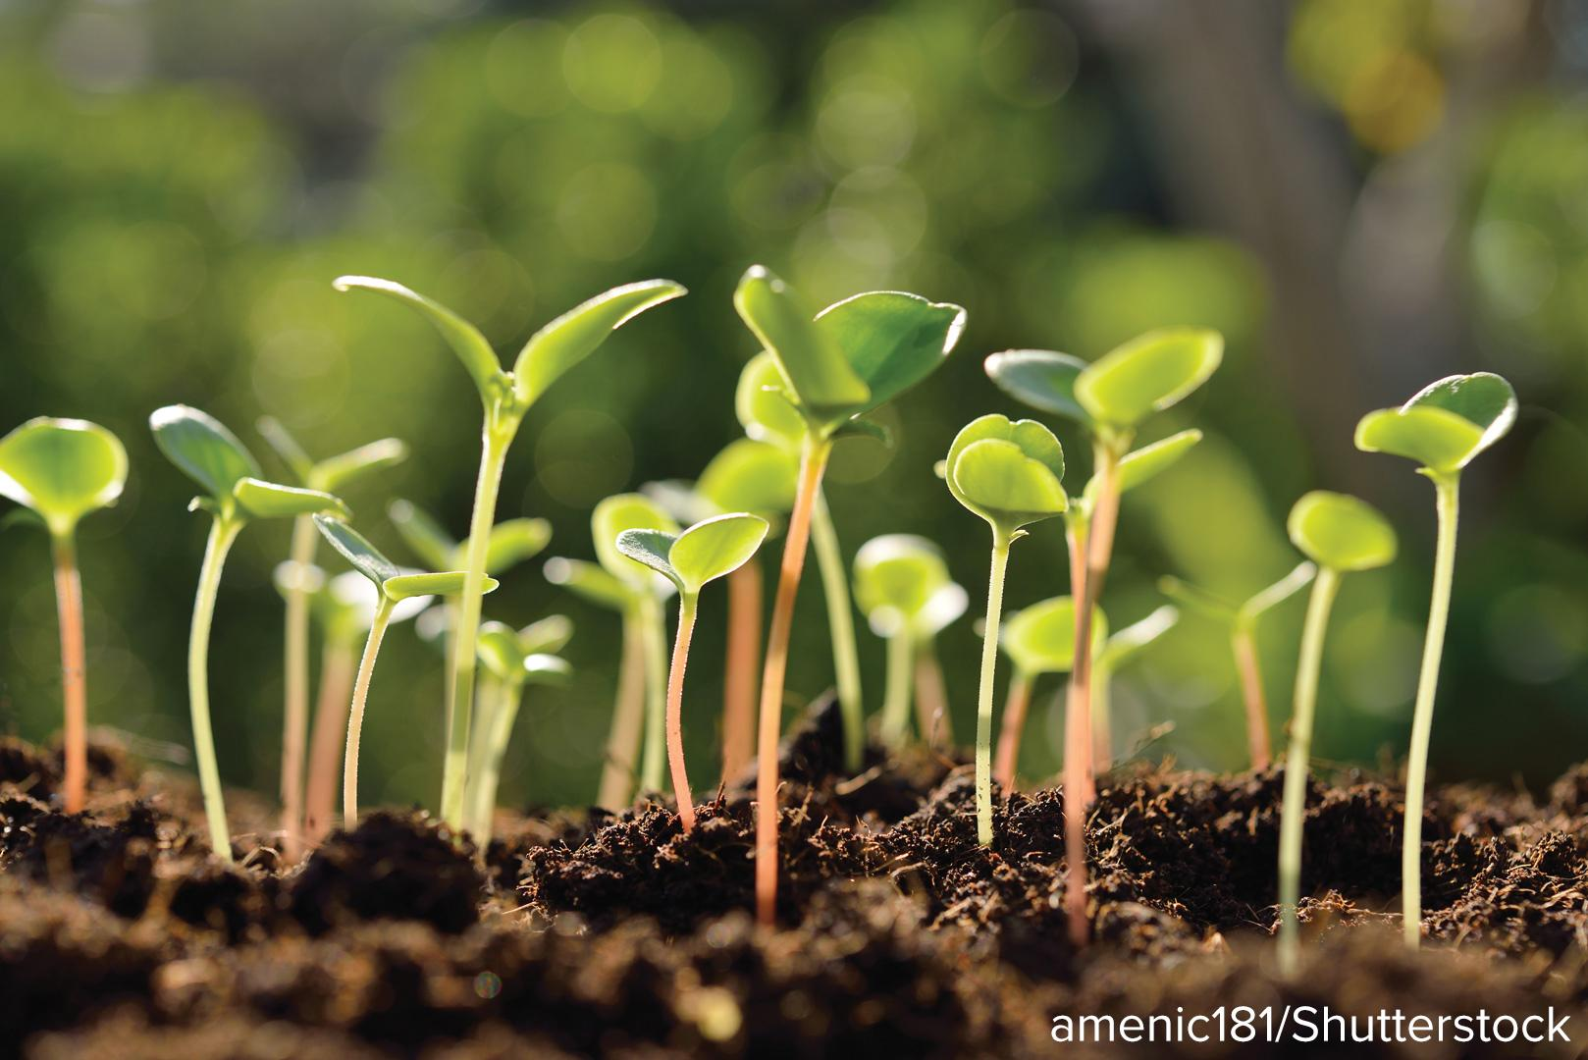

Be Curious
How are they the same?
How are they different?
Think first. Share a notice and a question;
build on a classmate’s idea.
Mindset
What goal will you set for today’s math class?
15 / 46
Notes:
TEACH IN PRACTICE | Embedded facilitation | Lesson 2.2, slide 15 | CURIOUS
Focus on the existing task: How are they the same?
LAUNCH (T2/3/5): Allow quiet observation first. Separate a notice from an inference, invite students’ own questions, and follow the existing launch before teaching a procedure.
LOOK FOR (T4): Where this task addresses it, students can use equal-width intervals. Ask which feature of their work supports the claim.
RESPOND: If this task shows the lesson misconception—reading a bar height as an individual data value—trace each original value into its interval and label both axes. Have the student revise and explain the change. Use this support only where the concept occurs in the current task; otherwise respond to the displayed question.
RECHECK: If a gap is shared, revisit the existing representation together. If it is limited, give targeted support while others compare valid methods on the same task. Check the revision before moving on.
PARTICIPATION (T5/6/7): Think time before volunteers; accept a written, drawn or rehearsed entry. Students ask for evidence respectfully. Recognize a specific contribution or revision and check that both partners participate.
Source: BCPS Updated Instructional Framework Rubric (June 2020), TEACH 1–7. Earlier notes and answer keys are retained below.
EARLIER NOTES / EXISTING ANSWER KEY
Accept all noticings and wonderings — there are no wrong answers here.
Give 20–30 seconds of quiet think time before taking responses; mix cold and warm calls so it is not always the same voices.
Read the mindset question aloud and let two students respond.
UIFR: TEACH 3 · TEACH 7.

Slide 16

Running a 5K
Fifty middle school students took part in a 5-kilometer road race. The table shows each student’s pace, or the amount of time it took each student to run one kilometer.
HOW DO YOU KNOW? · Ask your partner “How do you know?” Answer by pointing to your own work.
Minutes to Run One Kilometer
4.8 | 5.2 | 5.6 | 5.3 | 5.0 | 4.7 | 6.2 | 4.7 | 5.1 | 5.8 | 4.8 | 5.5 | 5.4
5.1 | 4.9 | 5.0 | 5.2 | 5.5 | 5.8 | 6.0 | 5.8 | 5.9 | 6.1 | 4.8 | 5.3 | 5.4
5.6 | 4.5 | 5.4 | 5.0 | 4.5 | 5.7 | 5.0 | 4.6 | 5.9 | 5.1 | 6.0 | 5.0 | 4.8
5.3 | 5.3 | 5.2 | 4.9 | 5.5 | 5.4 | 5.0 | 4.7 | 6.1 | 5.7 | 4.9
What range of paces was the most common for the students?
16 / 46
Notes:
TEACH IN PRACTICE | Embedded facilitation | Lesson 2.2, slide 16 | TASK
Focus on the existing task: What range of paces was the most common for the students?
LAUNCH (T2/3/5): Use the displayed question. Give private thinking time; then A explains while B asks for evidence. Switch roles. Each student records their own reasoning.
LOOK FOR (T4): Where this task addresses it, students can count each value once. Ask which feature of their work supports the claim.
RESPOND: If this task shows the lesson misconception—reading a bar height as an individual data value—trace each original value into its interval and label both axes. Have the student revise and explain the change. Use this support only where the concept occurs in the current task; otherwise respond to the displayed question.
RECHECK: If a gap is shared, revisit the existing representation together. If it is limited, give targeted support while others compare valid methods on the same task. Check the revision before moving on.
PARTICIPATION (T5/6/7): Think time before volunteers; accept a written, drawn or rehearsed entry. Students ask for evidence respectfully. Recognize a specific contribution or revision and check that both partners participate.
Source: BCPS Updated Instructional Framework Rubric (June 2020), TEACH 1–7. Earlier notes and answer keys are retained below.
EARLIER NOTES / EXISTING ANSWER KEY
Read the context aloud (or have a student read it).
Before any math, students restate the situation and what is being asked in their own words.
Ask: What range of paces was the most common for the students?
UIFR: TEACH 1 · TEACH 3.
UIFR FULL | Lesson-specific facilitation
TEACH 2-3 | Session 1 task launch (UIFR PDF pp. 9-10).
Use the problem exactly as displayed. Give individual thinking time before discussion or advancing to the explanation. If the answer is already visible, ask students to reconstruct and justify it. Invite a choice of suitable representations and have students explain why their choice helps.
At the point where this concept appears, ask: “What does one bar count, and what information about individual values can this display no longer show?” Wait for evidence, invite another pathway, and have a student ask a follow-up question. Do not replace students’ reasoning with a sequence of leading steps.

Slide 17

COLLABORATE · TALK IT THROUGH • AGREE ON A MODEL
Collaborate and Connect
What intervals could you use to group the students’ times?
Minutes to Run One Kilometer
4.8 | 5.2 | 5.6 | 5.3 | 5.0 | 4.7 | 6.2 | 4.7 | 5.1 | 5.8 | 4.8 | 5.5 | 5.4
5.1 | 4.9 | 5.0 | 5.2 | 5.5 | 5.8 | 6.0 | 5.8 | 5.9 | 6.1 | 4.8 | 5.3 | 5.4
5.6 | 4.5 | 5.4 | 5.0 | 4.5 | 5.7 | 5.0 | 4.6 | 5.9 | 5.1 | 6.0 | 5.0 | 4.8
5.3 | 5.3 | 5.2 | 4.9 | 5.5 | 5.4 | 5.0 | 4.7 | 6.1 | 5.7 | 4.9
TAKE TURNS · One explains, one asks a question. Then switch, so both of you talk.
Reveal:
We can use intervals that are the same width and do not overlap.
17 / 46
Notes:
TEACH IN PRACTICE | Embedded facilitation | Lesson 2.2, slide 17 | COLLABORATE
Focus on the existing task: What intervals could you use to group the students’ times?
LAUNCH (T2/3/5): Use the displayed question. Give private thinking time; then A explains while B asks for evidence. Switch roles. Each student records their own reasoning.
LOOK FOR (T4): Where this task addresses it, students can use equal-width intervals. Ask which feature of their work supports the claim.
RESPOND: If this task shows the lesson misconception—reading a bar height as an individual data value—trace each original value into its interval and label both axes. Have the student revise and explain the change. Use this support only where the concept occurs in the current task; otherwise respond to the displayed question.
RECHECK: If a gap is shared, revisit the existing representation together. If it is limited, give targeted support while others compare valid methods on the same task. Check the revision before moving on.
PARTICIPATION (T5/6/7): Think time before volunteers; accept a written, drawn or rehearsed entry. Students ask for evidence respectfully. Recognize a specific contribution or revision and check that both partners participate.
Source: BCPS Updated Instructional Framework Rubric (June 2020), TEACH 1–7. Earlier notes and answer keys are retained below.
EARLIER NOTES / EXISTING ANSWER KEY
Routine: COLLABORATE · TALK IT THROUGH • AGREE ON A MODEL
UIFR FULL | Lesson-specific facilitation
TEACH 4-5 | Session 1 discussion and checkpoint (UIFR PDF pp. 11-12).
Collect a brief response from every student to the existing prompt before hearing volunteers. Partners take turns explaining and asking for evidence: “I understand ___; what supports ___?” Offer rehearsal or an annotated model for students who need language support. Each student records their own reasoning.
Look specifically for: reading a bar height as an individual data value. If it appears, trace each original value into its interval and label both axes; then ask the student to revise the same response and explain the change. If evidence is secure, have students compare a second valid pathway or state why their approach works. Choose the next step from the responses, not a preset pace.

Slide 18
Let’s make each interval 0.5 minute.
How can you organize the data into 0.5-minute intervals?
RESTATE FIRST · Restate your partner’s idea in your own words before you give yours.
Minutes to Run One Kilometer
4.8 | 5.2 | 5.6 | 5.3 | 5.0 | 4.7 | 6.2 | 4.7 | 5.1 | 5.8 | 4.8 | 5.5 | 5.4
5.1 | 4.9 | 5.0 | 5.2 | 5.5 | 5.8 | 6.0 | 5.8 | 5.9 | 6.1 | 4.8 | 5.3 | 5.4
5.6 | 4.5 | 5.4 | 5.0 | 4.5 | 5.7 | 5.0 | 4.6 | 5.9 | 5.1 | 6.0 | 5.0 | 4.8
5.3 | 5.3 | 5.2 | 4.9 | 5.5 | 5.4 | 5.0 | 4.7 | 6.1 | 5.7 | 4.9
Reveal:
One way is to list the intervals in a table.
18 / 46
Notes:
TEACH IN PRACTICE | Embedded facilitation | Lesson 2.2, slide 18 | REVEAL
Focus on the existing task: Let’s make each interval 0.5 minute. How can you organize the data into 0.5-minute intervals?
LAUNCH (T2/3/5): If an existing answer cover is present, gather an attempt before revealing. If the explanation is already visible, ask students to reconstruct and justify it. Compare reasoning and explain a revision; preserve the reveal sequence.
LOOK FOR (T4): Where this task addresses it, students can use equal-width intervals. Ask which feature of their work supports the claim.
RESPOND: If this task shows the lesson misconception—reading a bar height as an individual data value—trace each original value into its interval and label both axes. Have the student revise and explain the change. Use this support only where the concept occurs in the current task; otherwise respond to the displayed question.
RECHECK: If a gap is shared, revisit the existing representation together. If it is limited, give targeted support while others compare valid methods on the same task. Check the revision before moving on.
PARTICIPATION (T5/6/7): Think time before volunteers; accept a written, drawn or rehearsed entry. Students ask for evidence respectfully. Recognize a specific contribution or revision and check that both partners participate.
Source: BCPS Updated Instructional Framework Rubric (June 2020), TEACH 1–7. Earlier notes and answer keys are retained below.
EARLIER NOTES / EXISTING ANSWER KEY
Do not click yet: collect 2–3 student answers with reasons first.
Then click to remove the cover and have students compare their thinking to the reveal — “Is this what we said? Where is it different?”
Behind the cover: One way is to list the intervals in a table.
UIFR: TEACH 3 · TEACH 4.

Slide 19
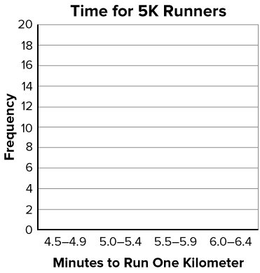
You can display the values from the frequency table in a histogram.
A histogram is a graph that shows the number of values in each interval, that is, the frequency distribution.
How can you represent the data in the frequency table on the graph?
Minutes to Run One Kilometer | Frequency
4.5–4.9 | 13
5.0–5.4 | 20
5.5–5.9 | 12
6.0–6.4 | 5
19 / 46
Notes:
TEACH IN PRACTICE | Embedded facilitation | Lesson 2.2, slide 19 | TASK
Focus on the existing task: Minutes to Run One Kilometer Frequency 4.5–4.9 13 5.0–5.4 20 5.5–5.9 12 6.0–6.4 5 You can display the values from the frequency table in a…
LAUNCH (T2/3/5): Use the displayed question. Give private thinking time; then A explains while B asks for evidence. Switch roles. Each student records their own reasoning.
LOOK FOR (T4): Where this task addresses it, students can interpret frequency and distribution. Ask which feature of their work supports the claim.
RESPOND: If this task shows the lesson misconception—reading a bar height as an individual data value—trace each original value into its interval and label both axes. Have the student revise and explain the change. Use this support only where the concept occurs in the current task; otherwise respond to the displayed question.
RECHECK: If a gap is shared, revisit the existing representation together. If it is limited, give targeted support while others compare valid methods on the same task. Check the revision before moving on.
PARTICIPATION (T5/6/7): Think time before volunteers; accept a written, drawn or rehearsed entry. Students ask for evidence respectfully. Recognize a specific contribution or revision and check that both partners participate.
Source: BCPS Updated Instructional Framework Rubric (June 2020), TEACH 1–7. Earlier notes and answer keys are retained below.
EARLIER NOTES / EXISTING ANSWER KEY
Model briefly, then hand the thinking back: ask “Why does this step work?” before showing the next one.
Quick check before moving on — thumbs or whiteboards from everyone, not volunteers.
UIFR: TEACH 2 · TEACH 3 · TEACH 4.

Slide 20
STUDENT MOVES
Lesson 2-2
Your move
TWO MINUTES SOLO · Two minutes on your own, then compare. Bring one thing you tried, even if it did not work.
20 / 46

Slide 21
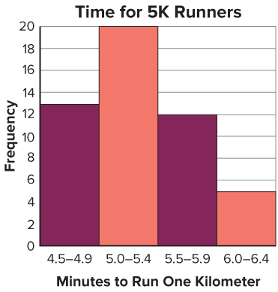

How can you determine which interval is the most common?
Record your reasoning before the reveal.
Compare, then explain any revision.
Reveal:
You can look for the tallest bar on the histogram.
Connecting Representations
How can you connect mathematical ideas to representations?
21 / 46
Notes:
TEACH IN PRACTICE | Embedded facilitation | Lesson 2.2, slide 20 | REVEAL
Focus on the existing task: How can you determine which interval is the most common?
LAUNCH (T2/3/5): If an existing answer cover is present, gather an attempt before revealing. If the explanation is already visible, ask students to reconstruct and justify it. Compare reasoning and explain a revision; preserve the reveal sequence.
LOOK FOR (T4): Where this task addresses it, students can use equal-width intervals. Ask which feature of their work supports the claim.
RESPOND: If this task shows the lesson misconception—reading a bar height as an individual data value—trace each original value into its interval and label both axes. Have the student revise and explain the change. Use this support only where the concept occurs in the current task; otherwise respond to the displayed question.
RECHECK: If a gap is shared, revisit the existing representation together. If it is limited, give targeted support while others compare valid methods on the same task. Check the revision before moving on.
PARTICIPATION (T5/6/7): Think time before volunteers; accept a written, drawn or rehearsed entry. Students ask for evidence respectfully. Recognize a specific contribution or revision and check that both partners participate.
Source: BCPS Updated Instructional Framework Rubric (June 2020), TEACH 1–7. Earlier notes and answer keys are retained below.
EARLIER NOTES / EXISTING ANSWER KEY
Do not click yet: collect 2–3 student answers with reasons first.
Then click to remove the cover and have students compare their thinking to the reveal — “Is this what we said? Where is it different?”
Behind the cover: You can look for the tallest bar on the histogram.
UIFR: TEACH 3 · TEACH 4.

Slide 22
The interval between 5.0 and 5.4 minutes contains the most data values.
Record your reasoning before the reveal.
Compare, then explain any revision.
What does this mean in the context of the problem?
Reveal:
The greatest number of students took between 5.0 minutes and 5.4 minutes to run one kilometer.
22 / 46
Notes:
TEACH IN PRACTICE | Embedded facilitation | Lesson 2.2, slide 21 | REVEAL
Focus on the existing task: What does this mean in the context of the problem?
LAUNCH (T2/3/5): If an existing answer cover is present, gather an attempt before revealing. If the explanation is already visible, ask students to reconstruct and justify it. Compare reasoning and explain a revision; preserve the reveal sequence.
LOOK FOR (T4): Where this task addresses it, students can use equal-width intervals. Ask which feature of their work supports the claim.
RESPOND: If this task shows the lesson misconception—reading a bar height as an individual data value—trace each original value into its interval and label both axes. Have the student revise and explain the change. Use this support only where the concept occurs in the current task; otherwise respond to the displayed question.
RECHECK: If a gap is shared, revisit the existing representation together. If it is limited, give targeted support while others compare valid methods on the same task. Check the revision before moving on.
PARTICIPATION (T5/6/7): Think time before volunteers; accept a written, drawn or rehearsed entry. Students ask for evidence respectfully. Recognize a specific contribution or revision and check that both partners participate.
Source: BCPS Updated Instructional Framework Rubric (June 2020), TEACH 1–7. Earlier notes and answer keys are retained below.
EARLIER NOTES / EXISTING ANSWER KEY
Do not click yet: collect 2–3 student answers with reasons first.
Then click to remove the cover and have students compare their thinking to the reveal — “Is this what we said? Where is it different?”
Behind the cover: The greatest number of students took between 5.0 minutes and 5.4 minutes to run one kilometer.
UIFR: TEACH 3 · TEACH 4.

Slide 23
Let’s Explore More
Road Race
Minutes to Run One Kilometer
4.8 | 5.2 | 5.6 | 5.3 | 5.0 | 4.7 | 6.2 | 4.7 | 5.1 | 5.8
4.8 | 5.5 | 5.4 | 5.1 | 4.9 | 5.0 | 5.2 | 5.5 | 5.8 | 6.0
5.8 | 5.9 | 6.1 | 4.8 | 5.3 | 5.4 | 5.6 | 4.5 | 5.4 | 5.0
4.5 | 5.7 | 5.0 | 4.6 | 5.9 | 5.1 | 6.0 | 5.0 | 4.8 | 5.3
5.3 | 5.2 | 4.9 | 5.5 | 5.4 | 5.0 | 4.7 | 6.1 | 5.7 | 4.9
Why might a histogram be a better choice than a dot plot for displaying the data?
PICK YOUR STRATEGY · Choose your path — picture, table, number line, or equation — and be ready to say why you chose it.
Workspace
23 / 46
Notes:
TEACH IN PRACTICE | Embedded facilitation | Lesson 2.2, slide 22 | PRACTICE
Focus on the existing task: Workspace Why might a histogram be a better choice than a dot plot for displaying the data?
LAUNCH (T2/3/5): Use the displayed question. Give private thinking time; then A explains while B asks for evidence. Switch roles. Each student records their own reasoning.
LOOK FOR (T4): Where this task addresses it, students can use equal-width intervals. Ask which feature of their work supports the claim.
RESPOND: If this task shows the lesson misconception—reading a bar height as an individual data value—trace each original value into its interval and label both axes. Have the student revise and explain the change. Use this support only where the concept occurs in the current task; otherwise respond to the displayed question.
RECHECK: If a gap is shared, revisit the existing representation together. If it is limited, give targeted support while others compare valid methods on the same task. Check the revision before moving on.
PARTICIPATION (T5/6/7): Think time before volunteers; accept a written, drawn or rehearsed entry. Students ask for evidence respectfully. Recognize a specific contribution or revision and check that both partners participate.
Source: BCPS Updated Instructional Framework Rubric (June 2020), TEACH 1–7. Earlier notes and answer keys are retained below.
EARLIER NOTES / EXISTING ANSWER KEY
Extension for partners or table groups — students choose their approach and use the workspace to show thinking.
Push with “Convince me,” and have two groups with different approaches share.
This is where students stretch past the worked example.
UIFR: TEACH 2 · TEACH 5.

Slide 24
LESSON 2.2 / DISCUSS THE TASK
Explain and compare
Use the task you just explored.
TAKE TURNS
What does one bar count, and what information about individual values can this display no longer show?
Explain
“I know this because…”
Ask
“Where does your work show that?”
Point to evidence in your work.
Then compare your approach with a partner’s.
JUSTIFY IT · Say it like this: “I know ______ because ______.”
Listen to understand. Ask for evidence. Make room for every voice.
Notes:
TEACH IN PRACTICE | Embedded facilitation | Lesson 2.2, slide 23 | PRIOR_INSERT
Focus on the existing task: Point to evidence in your work. Then compare your approach with a partner’s. TAKE TURNS Explain “I know this because…” Ask “Where does your work show that?
CONNECT (T1/4): Ask students to restate the displayed goal or key idea and connect it to earlier work. Relevant lesson evidence: use equal-width intervals; count each value once; interpret frequency and distribution. Use only the criterion that matches the current session.
SHOW PROGRESS: Students point to their own existing work, explain what improved after feedback, and name a next step. Pair confidence ratings with actual evidence.
PARTICIPATION (T5/6/7): Think time before volunteers; accept a written, drawn or rehearsed entry. Students ask for evidence respectfully. Recognize a specific contribution or revision and check that both partners participate.
Source: BCPS Updated Instructional Framework Rubric (June 2020), TEACH 1–7.

Slide 25
Fifty middle school students took part in a 5-kilometer road race. The table shows the amount of time it took each student to run one kilometer during the race. What was most common time interval for the students?
Minutes to Run One Kilometer
4.8 | 5.2 | 5.6 | 5.3 | 5.0 | 4.7 | 6.2 | 4.7 | 5.1 | 5.8 | 4.8 | 5.5 | 5.4
5.1 | 4.9 | 5.0 | 5.2 | 5.5 | 5.8 | 6.0 | 5.8 | 5.9 | 6.1 | 4.8 | 5.3 | 5.4
5.6 | 4.5 | 5.4 | 5.0 | 4.5 | 5.7 | 5.0 | 4.6 | 5.9 | 5.1 | 6.0 | 5.0 | 4.8
5.3 | 5.3 | 5.2 | 4.9 | 5.5 | 5.4 | 5.0 | 4.7 | 6.1 | 5.7 | 4.9
Reveal:
The data represent the time it took the students to run one kilometer.
What does the data in the table represent?
25 / 46
Notes:
TEACH IN PRACTICE | Embedded facilitation | Lesson 2.2, slide 24 | REVEAL
Focus on the existing task: What does the data in the table represent?
LAUNCH (T2/3/5): If an existing answer cover is present, gather an attempt before revealing. If the explanation is already visible, ask students to reconstruct and justify it. Compare reasoning and explain a revision; preserve the reveal sequence.
LOOK FOR (T4): Where this task addresses it, students can count each value once. Ask which feature of their work supports the claim.
RESPOND: If this task shows the lesson misconception—reading a bar height as an individual data value—trace each original value into its interval and label both axes. Have the student revise and explain the change. Use this support only where the concept occurs in the current task; otherwise respond to the displayed question.
RECHECK: If a gap is shared, revisit the existing representation together. If it is limited, give targeted support while others compare valid methods on the same task. Check the revision before moving on.
PARTICIPATION (T5/6/7): Think time before volunteers; accept a written, drawn or rehearsed entry. Students ask for evidence respectfully. Recognize a specific contribution or revision and check that both partners participate.
Source: BCPS Updated Instructional Framework Rubric (June 2020), TEACH 1–7.

Slide 26
STUDENT MOVES
Lesson 2-2
Your move
ASK THE CLASS · Write one question about this that you could ask the class.
26 / 46

Slide 27
Minutes to Run One Kilometer
4.8 | 5.2 | 5.6 | 5.3 | 5.0 | 4.7 | 6.2 | 4.7 | 5.1 | 5.8 | 4.8 | 5.5 | 5.4
5.1 | 4.9 | 5.0 | 5.2 | 5.5 | 5.8 | 6.0 | 5.8 | 5.9 | 6.1 | 4.8 | 5.3 | 5.4
5.6 | 4.5 | 5.4 | 5.0 | 4.5 | 5.7 | 5.0 | 4.6 | 5.9 | 5.1 | 6.0 | 5.0 | 4.8
5.3 | 5.3 | 5.2 | 4.9 | 5.5 | 5.4 | 5.0 | 4.7 | 6.1 | 5.7 | 4.9
How can you group the students’ times to make the data easier to understand and interpret?
SELF-CHECK · Mark it: ✓ got it · ~ almost · ? stuck. Then fix one thing before we move on.
Reveal:
We can group the times into ranges, or intervals.
27 / 46
Notes:
TEACH IN PRACTICE | Embedded facilitation | Lesson 2.2, slide 25 | REVEAL
Focus on the existing task: How can you group the students’ times to make the data easier to understand and interpret?
LAUNCH (T2/3/5): If an existing answer cover is present, gather an attempt before revealing. If the explanation is already visible, ask students to reconstruct and justify it. Compare reasoning and explain a revision; preserve the reveal sequence.
LOOK FOR (T4): Where this task addresses it, students can use equal-width intervals. Ask which feature of their work supports the claim.
RESPOND: If this task shows the lesson misconception—reading a bar height as an individual data value—trace each original value into its interval and label both axes. Have the student revise and explain the change. Use this support only where the concept occurs in the current task; otherwise respond to the displayed question.
RECHECK: If a gap is shared, revisit the existing representation together. If it is limited, give targeted support while others compare valid methods on the same task. Check the revision before moving on.
PARTICIPATION (T5/6/7): Think time before volunteers; accept a written, drawn or rehearsed entry. Students ask for evidence respectfully. Recognize a specific contribution or revision and check that both partners participate.
Source: BCPS Updated Instructional Framework Rubric (June 2020), TEACH 1–7.

Slide 28
How can you determine which interval is the most common?
Compare your reasoning with the
explanation. Explain any revision you make.
Reveal:
You can look for the tallest bar on the histogram.
Connecting Representations
How can you connect mathematical ideas to representations?
28 / 46
Notes:
TEACH IN PRACTICE | Embedded facilitation | Lesson 2.2, slide 26 | REVEAL
Focus on the existing task: How can you determine which interval is the most common?
LAUNCH (T2/3/5): If an existing answer cover is present, gather an attempt before revealing. If the explanation is already visible, ask students to reconstruct and justify it. Compare reasoning and explain a revision; preserve the reveal sequence.
LOOK FOR (T4): Where this task addresses it, students can use equal-width intervals. Ask which feature of their work supports the claim.
RESPOND: If this task shows the lesson misconception—reading a bar height as an individual data value—trace each original value into its interval and label both axes. Have the student revise and explain the change. Use this support only where the concept occurs in the current task; otherwise respond to the displayed question.
RECHECK: If a gap is shared, revisit the existing representation together. If it is limited, give targeted support while others compare valid methods on the same task. Check the revision before moving on.
PARTICIPATION (T5/6/7): Think time before volunteers; accept a written, drawn or rehearsed entry. Students ask for evidence respectfully. Recognize a specific contribution or revision and check that both partners participate.
Source: BCPS Updated Instructional Framework Rubric (June 2020), TEACH 1–7.

Slide 29
Session 2 Warm-Up
Lesson 2-2 · Represent and Describe Data in a Histogram
Session 2 Warm-Up
Quick review from Session 1 · about 4 minutes
1
In a histogram, what do the bars represent?
2
If intervals are 0–4, 5–9, 10–14, what is each width?
A
Individual names
A
4
B
Equal numerical intervals
B
5
C
Word categories
C
9
D
Decimals only
D
10
3
The vertical height of each bar represents:
4
Why do bars in a histogram touch each other?
A
Interval size
A
By accident
B
Frequency (data count)
B
Intervals are continuous
C
The mean value
C
To save space
D
The minimum value
D
Only when empty
eduwonderlab.com · Neft Teacher
29 / 46
Notes:
TEACH IN PRACTICE | Embedded facilitation | Lesson 2.2, slide 27 | WARMUP
Focus on the existing task: A Individual names B Equal numerical intervals C Word categories D Decimals only 2 If intervals are 0–4, 5–9, 10–14, what is each width?
GATHER EVIDENCE (T4/6): Keep the original items. Students try independently, mark an uncertain item, and explain one method before checking. Use the existing key when present.
RESPOND: Distinguish a calculation slip from a reasoning gap. Give one next step on the same item; have students revise in a second color. Use the responses to choose flexible support for today’s lesson.
PARTICIPATION (T5/6/7): Think time before volunteers; accept a written, drawn or rehearsed entry. Students ask for evidence respectfully. Recognize a specific contribution or revision and check that both partners participate.
Source: BCPS Updated Instructional Framework Rubric (June 2020), TEACH 1–7. Earlier notes and answer keys are retained below.
EARLIER NOTES / EXISTING ANSWER KEY
Warm-up routine: students start silently on entry; keep it to about 4 minutes.
Circulate and note who is stuck — use what you see to choose who you check on first today.
Go over answers quickly; ask one student to explain a step, not just say the answer.
UIFR: TEACH 4 · TEACH 6.
UIFR FULL | Lesson-specific facilitation
TEACH 1 | Session 2 purpose and evidence (UIFR PDF p. 8).
Have students restate the displayed session goal in their own words and connect it to the existing context or a familiar experience they choose to share. Use the current session goal to select from these lesson-wide evidence criteria; do not frontload a later-session procedure.
Look for: use equal-width intervals; count each value once; interpret frequency and distribution. Ask: “Which part of your work would show this?” Revisit that evidence after the task; a confidence rating alone is not evidence of understanding.

Slide 30
STUDENT MOVES
Lesson 2-2
Your move
YOU KNOW THE ROUTINE · Read → plan → solve → check. Do all four, in that order.
30 / 46

Slide 31
Review Notes
Lesson 2-2 · Represent and Describe Data in a Histogram
Review Notes — Session 2
Copy. Explain. Check.
NAME THE MATH · Point to the part of this that is new today, and say what it changes.
Histogram Intervals
1
Data is grouped into equal, non-overlapping intervals along a number line.
Frequency Representation
2
Bar heights indicate the count of data values falling inside each bin.
Continuous Scale
3
Bars touch because numerical intervals continue without gaps across the range.
eduwonderlab.com · Neft Teacher
31 / 46
Notes:
TEACH IN PRACTICE | Embedded facilitation | Lesson 2.2, slide 28 | NOTES
Focus on the existing task: Review Notes Review Notes — Session 2 Copy into…
ROUTINE (T1/2/4): Read or copy the original notes, cover one line, and explain it using the displayed example. Reopen and correct. Copying alone is not evidence of understanding.
LOOK FOR: A link between a symbol, quantity or feature and the explanation. If missing, point back to that feature and have the student try again; fade the prompt once they can explain.
PARTICIPATION (T5/6/7): Think time before volunteers; accept a written, drawn or rehearsed entry. Students ask for evidence respectfully. Recognize a specific contribution or revision and check that both partners participate.
Source: BCPS Updated Instructional Framework Rubric (June 2020), TEACH 1–7. Earlier notes and answer keys are retained below.
EARLIER NOTES / EXISTING ANSWER KEY
Copy routine: read one line at a time; students copy, then explain that line to a partner.
Keep it brisk — the understanding work happens in the examples, not the copying.
UIFR: TEACH 1 · TEACH 6.

Slide 32
Session 2
Represent and Describe Data in a Histogram
STRUGGLE FIRST · Work on your own first. Stuck is allowed — try a second strategy before you ask.
32 / 46
Notes:
TEACH IN PRACTICE | Embedded facilitation | Lesson 2.2, slide 29 | DIVIDER
Focus on the existing task: Represent and Describe Data in a Histogram Session 2
TRANSITION (T6/7): Students confirm materials, roles, how to request help, and the next response routine. Ask a student to restate it. Keep teacher-only slides hidden.
PARTICIPATION (T5/6/7): Think time before volunteers; accept a written, drawn or rehearsed entry. Students ask for evidence respectfully. Recognize a specific contribution or revision and check that both partners participate.
Source: BCPS Updated Instructional Framework Rubric (June 2020), TEACH 1–7. Earlier notes and answer keys are retained below.
EARLIER NOTES / EXISTING ANSWER KEY
Transition cue: state what materials are out and what success looks like this session.
Keep the changeover under a minute.
UIFR: TEACH 6.

Slide 33

Be Curious
Which doesn’t belong?
Think first. Share a notice and a question;
build on a classmate’s idea.
Mindset
What are you doing to meet the goal you set for today’s math class?
33 / 46
Notes:
TEACH IN PRACTICE | Embedded facilitation | Lesson 2.2, slide 30 | CURIOUS
Focus on the existing task: Which doesn’t belong?
LAUNCH (T2/3/5): Allow quiet observation first. Separate a notice from an inference, invite students’ own questions, and follow the existing launch before teaching a procedure.
LOOK FOR (T4): Where this task addresses it, students can use equal-width intervals. Ask which feature of their work supports the claim.
RESPOND: If this task shows the lesson misconception—reading a bar height as an individual data value—trace each original value into its interval and label both axes. Have the student revise and explain the change. Use this support only where the concept occurs in the current task; otherwise respond to the displayed question.
RECHECK: If a gap is shared, revisit the existing representation together. If it is limited, give targeted support while others compare valid methods on the same task. Check the revision before moving on.
PARTICIPATION (T5/6/7): Think time before volunteers; accept a written, drawn or rehearsed entry. Students ask for evidence respectfully. Recognize a specific contribution or revision and check that both partners participate.
Source: BCPS Updated Instructional Framework Rubric (June 2020), TEACH 1–7. Earlier notes and answer keys are retained below.
EARLIER NOTES / EXISTING ANSWER KEY
Accept all noticings and wonderings — there are no wrong answers here.
Give 20–30 seconds of quiet think time before taking responses; mix cold and warm calls so it is not always the same voices.
Read the mindset question aloud and let two students respond.
UIFR: TEACH 3 · TEACH 7.

Slide 34

Growing Plants
Students planted beans for a science experiment. They measured their plants after two weeks and recorded the data shown in the table.
Beanstalks
Heights of Plants (cm)
18 | 12 | 14 | 14.5 | 17.2
9.5 | 12 | 14.5 | 14.7 | 16.5
10 | 13.5 | 14.5 | 15.7 | 16.5
11.5 | 13.5 | 14.5 | 15.7 | 17.7
11.5 | 13.5 | 14 | 15.7 | 9
How can you describe the data set?
34 / 46
Notes:
TEACH IN PRACTICE | Embedded facilitation | Lesson 2.2, slide 31 | TASK
Focus on the existing task: How can you describe the data set?
LAUNCH (T2/3/5): Use the displayed question. Give private thinking time; then A explains while B asks for evidence. Switch roles. Each student records their own reasoning.
LOOK FOR (T4): Where this task addresses it, students can use equal-width intervals. Ask which feature of their work supports the claim.
RESPOND: If this task shows the lesson misconception—reading a bar height as an individual data value—trace each original value into its interval and label both axes. Have the student revise and explain the change. Use this support only where the concept occurs in the current task; otherwise respond to the displayed question.
RECHECK: If a gap is shared, revisit the existing representation together. If it is limited, give targeted support while others compare valid methods on the same task. Check the revision before moving on.
PARTICIPATION (T5/6/7): Think time before volunteers; accept a written, drawn or rehearsed entry. Students ask for evidence respectfully. Recognize a specific contribution or revision and check that both partners participate.
Source: BCPS Updated Instructional Framework Rubric (June 2020), TEACH 1–7. Earlier notes and answer keys are retained below.
EARLIER NOTES / EXISTING ANSWER KEY
Read the context aloud (or have a student read it).
Before any math, students restate the situation and what is being asked in their own words.
Ask: How can you describe the data set?
UIFR: TEACH 1 · TEACH 3.
UIFR FULL | Lesson-specific facilitation
TEACH 2-3 | Session 2 task launch (UIFR PDF pp. 9-10).
Use the problem exactly as displayed. Give individual thinking time before discussion or advancing to the explanation. If the answer is already visible, ask students to reconstruct and justify it. Invite a choice of suitable representations and have students explain why their choice helps.
At the point where this concept appears, ask: “What does one bar count, and what information about individual values can this display no longer show?” Wait for evidence, invite another pathway, and have a student ask a follow-up question. Do not replace students’ reasoning with a sequence of leading steps.

Slide 35
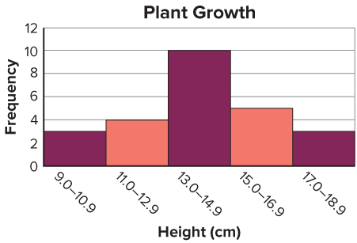
Using the data in the frequency table, we can create a histogram.
Frequency of Plant Heights
Plant Heights (cm) | Frequency
9–10.9 | 3
11–12.9 | 4
13–14.9 | 10
15–16.9 | 5
17–18.9 | 3
What do you notice about the shape of the histogram?
The middle bar is the tallest. The bars on either side get shorter as you move away from the middle bar.
35 / 46
Notes:
TEACH IN PRACTICE | Embedded facilitation | Lesson 2.2, slide 32 | TASK
Focus on the existing task: What do you notice about the shape of the histogram?
LAUNCH (T2/3/5): Use the displayed question. Give private thinking time; then A explains while B asks for evidence. Switch roles. Each student records their own reasoning.
LOOK FOR (T4): Where this task addresses it, students can interpret frequency and distribution. Ask which feature of their work supports the claim.
RESPOND: If this task shows the lesson misconception—reading a bar height as an individual data value—trace each original value into its interval and label both axes. Have the student revise and explain the change. Use this support only where the concept occurs in the current task; otherwise respond to the displayed question.
RECHECK: If a gap is shared, revisit the existing representation together. If it is limited, give targeted support while others compare valid methods on the same task. Check the revision before moving on.
PARTICIPATION (T5/6/7): Think time before volunteers; accept a written, drawn or rehearsed entry. Students ask for evidence respectfully. Recognize a specific contribution or revision and check that both partners participate.
Source: BCPS Updated Instructional Framework Rubric (June 2020), TEACH 1–7. Earlier notes and answer keys are retained below.
EARLIER NOTES / EXISTING ANSWER KEY
Model briefly, then hand the thinking back: ask “Why does this step work?” before showing the next one.
Quick check before moving on — thumbs or whiteboards from everyone, not volunteers.
UIFR: TEACH 2 · TEACH 3 · TEACH 4.

Slide 36
STUDENT MOVES
Lesson 2-2
Your moves
TEACH A PARTNER · Teach this to someone who missed it. If you can teach it, you know it.
PROVE IT · Find the evidence in the problem that makes your answer right — not just the answer.
36 / 46

Slide 37
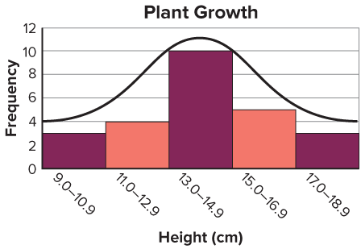
Look at the shape of the curve.
Record your reasoning before the
reveal. Compare, then explain
any revision.
What do you notice about the bars on either side of the middle bar?
Reveal:
The bars are about the same height.
37 / 46
Notes:
TEACH IN PRACTICE | Embedded facilitation | Lesson 2.2, slide 33 | REVEAL
Focus on the existing task: What do you notice about the bars on either side of the middle bar?
LAUNCH (T2/3/5): If an existing answer cover is present, gather an attempt before revealing. If the explanation is already visible, ask students to reconstruct and justify it. Compare reasoning and explain a revision; preserve the reveal sequence.
LOOK FOR (T4): Where this task addresses it, students can use equal-width intervals. Ask which feature of their work supports the claim.
RESPOND: If this task shows the lesson misconception—reading a bar height as an individual data value—trace each original value into its interval and label both axes. Have the student revise and explain the change. Use this support only where the concept occurs in the current task; otherwise respond to the displayed question.
RECHECK: If a gap is shared, revisit the existing representation together. If it is limited, give targeted support while others compare valid methods on the same task. Check the revision before moving on.
PARTICIPATION (T5/6/7): Think time before volunteers; accept a written, drawn or rehearsed entry. Students ask for evidence respectfully. Recognize a specific contribution or revision and check that both partners participate.
Source: BCPS Updated Instructional Framework Rubric (June 2020), TEACH 1–7. Earlier notes and answer keys are retained below.
EARLIER NOTES / EXISTING ANSWER KEY
Students should have shared predictions before this reveal.
Have them compare their thinking to what is shown: “Is this the same as what we said? Where is it different?”
Press one student to explain the reveal in their own words.
UIFR: TEACH 3 · TEACH 4.

Slide 38
Let’s Explore More
Describe how the heights of the plants could have been measured. How might this affect the data?
Try it yourself. Compare your
work with a partner; explain one
choice and revise.
Workspace
38 / 46
Notes:
TEACH IN PRACTICE | Embedded facilitation | Lesson 2.2, slide 34 | PRACTICE
Focus on the existing task: Workspace Describe how the heights of the plants could have been measured. How might this affect the data?
LAUNCH (T2/3/5): Use the displayed question. Give private thinking time; then A explains while B asks for evidence. Switch roles. Each student records their own reasoning.
LOOK FOR (T4): Where this task addresses it, students can use equal-width intervals. Ask which feature of their work supports the claim.
RESPOND: If this task shows the lesson misconception—reading a bar height as an individual data value—trace each original value into its interval and label both axes. Have the student revise and explain the change. Use this support only where the concept occurs in the current task; otherwise respond to the displayed question.
RECHECK: If a gap is shared, revisit the existing representation together. If it is limited, give targeted support while others compare valid methods on the same task. Check the revision before moving on.
PARTICIPATION (T5/6/7): Think time before volunteers; accept a written, drawn or rehearsed entry. Students ask for evidence respectfully. Recognize a specific contribution or revision and check that both partners participate.
Source: BCPS Updated Instructional Framework Rubric (June 2020), TEACH 1–7. Earlier notes and answer keys are retained below.
EARLIER NOTES / EXISTING ANSWER KEY
Extension for partners or table groups — students choose their approach and use the workspace to show thinking.
Push with “Convince me,” and have two groups with different approaches share.
This is where students stretch past the worked example.
UIFR: TEACH 2 · TEACH 5.
UIFR FULL | Lesson-specific facilitation
TEACH 4-5 | Session 2 discussion and checkpoint (UIFR PDF pp. 11-12).
Collect a brief response from every student to the existing prompt before hearing volunteers. Partners take turns explaining and asking for evidence: “I understand ___; what supports ___?” Offer rehearsal or an annotated model for students who need language support. Each student records their own reasoning.
Look specifically for: reading a bar height as an individual data value. If it appears, trace each original value into its interval and label both axes; then ask the student to revise the same response and explain the change. If evidence is secure, have students compare a second valid pathway or state why their approach works. Choose the next step from the responses, not a preset pace.

Slide 39
LESSON 2.2 / CHECK YOUR WORK
Pause. Check. Improve.
CHECK
A mistake to watch for: reading a bar height as an individual data value.
TRY
Trace each given value into its interval and label both axes.
REVISE
Use that check on the task you just completed. Correct or strengthen one part, and explain why.
REVISE NOW · Change one answer and write why you changed it. A revision is evidence of learning.
Listen to understand. Ask for evidence. Make room for every voice.
Notes:
TEACH IN PRACTICE | Embedded facilitation | Lesson 2.2, slide 35 | PRIOR_INSERT
Focus on the existing task: LESSON 2.2 / CHECK YOUR WORK Pause. Check. Improve. Listen to understand. Ask for evidence. Make room for every voice. CHECK A mistake…
CONNECT (T1/4): Ask students to restate the displayed goal or key idea and connect it to earlier work. Relevant lesson evidence: use equal-width intervals; count each value once; interpret frequency and distribution. Use only the criterion that matches the current session.
SHOW PROGRESS: Students point to their own existing work, explain what improved after feedback, and name a next step. Pair confidence ratings with actual evidence.
PARTICIPATION (T5/6/7): Think time before volunteers; accept a written, drawn or rehearsed entry. Students ask for evidence respectfully. Recognize a specific contribution or revision and check that both partners participate.
Source: BCPS Updated Instructional Framework Rubric (June 2020), TEACH 1–7.

Slide 40
How can you display the data?
Beanstalks
Heights of Plants (cm)
18 | 12 | 14 | 14.5 | 17.2
9.5 | 12 | 14.5 | 14.7 | 16.5
10 | 13.5 | 14.5 | 15.7 | 16.5
11.5 | 13.5 | 14.5 | 15.7 | 17.7
11.5 | 13.5 | 14 | 15.7 | 9
ANOTHER PATHWAY · Did anyone get there a different way? Put both pathways side by side and compare.
Reveal:
We can use a histogram.
40 / 46
Notes:
TEACH IN PRACTICE | Embedded facilitation | Lesson 2.2, slide 36 | REVEAL
Focus on the existing task: How can you display the data?
LAUNCH (T2/3/5): If an existing answer cover is present, gather an attempt before revealing. If the explanation is already visible, ask students to reconstruct and justify it. Compare reasoning and explain a revision; preserve the reveal sequence.
LOOK FOR (T4): Where this task addresses it, students can use equal-width intervals. Ask which feature of their work supports the claim.
RESPOND: If this task shows the lesson misconception—reading a bar height as an individual data value—trace each original value into its interval and label both axes. Have the student revise and explain the change. Use this support only where the concept occurs in the current task; otherwise respond to the displayed question.
RECHECK: If a gap is shared, revisit the existing representation together. If it is limited, give targeted support while others compare valid methods on the same task. Check the revision before moving on.
PARTICIPATION (T5/6/7): Think time before volunteers; accept a written, drawn or rehearsed entry. Students ask for evidence respectfully. Recognize a specific contribution or revision and check that both partners participate.
Source: BCPS Updated Instructional Framework Rubric (June 2020), TEACH 1–7.

Slide 41
You can display the data in a histogram.
USE YOUR TOOLS · Reach for your notes, a model, or a manipulative before you reach for an answer.
Beanstalks
Heights of Plants (cm)
18 | 12 | 14 | 14.5 | 17.2
9.5 | 12 | 14.5 | 14.7 | 16.5
10 | 13.5 | 14.5 | 15.7 | 16.5
11.5 | 13.5 | 14.5 | 15.7 | 17.7
11.5 | 13.5 | 14 | 15.7 | 9
What intervals could you use?
Reveal:
You can use intervals of 0.9 centimeters.
41 / 46
Notes:
TEACH IN PRACTICE | Embedded facilitation | Lesson 2.2, slide 37 | REVEAL
Focus on the existing task: What intervals could you use?
LAUNCH (T2/3/5): If an existing answer cover is present, gather an attempt before revealing. If the explanation is already visible, ask students to reconstruct and justify it. Compare reasoning and explain a revision; preserve the reveal sequence.
LOOK FOR (T4): Where this task addresses it, students can use equal-width intervals. Ask which feature of their work supports the claim.
RESPOND: If this task shows the lesson misconception—reading a bar height as an individual data value—trace each original value into its interval and label both axes. Have the student revise and explain the change. Use this support only where the concept occurs in the current task; otherwise respond to the displayed question.
RECHECK: If a gap is shared, revisit the existing representation together. If it is limited, give targeted support while others compare valid methods on the same task. Check the revision before moving on.
PARTICIPATION (T5/6/7): Think time before volunteers; accept a written, drawn or rehearsed entry. Students ask for evidence respectfully. Recognize a specific contribution or revision and check that both partners participate.
Source: BCPS Updated Instructional Framework Rubric (June 2020), TEACH 1–7.

Slide 42
SUMMARIZE · SAY IT IN YOUR OWN WORDS
Summarize: Represent and Describe Data in a Histogram
A frequency table organizes the data values into intervals.
A histogram displays data values in intervals. A histogram is a useful display when the data set is large.
Frequency Table
Minutes to Run One Kilometer | Frequency
4.5–4.9 | 13
5.0–5.4 | 20
5.5–5.9 | 12
6.0–6.4 | 5
42 / 46
Notes:
TEACH IN PRACTICE | Embedded facilitation | Lesson 2.2, slide 38 | SUMMARIZE
Focus on the existing task: A histogram displays data values in intervals. A histogram is a useful display when the data set is large. Frequency Table Minutes to Run…
CONNECT (T1/4): Ask students to restate the displayed goal or key idea and connect it to earlier work. Relevant lesson evidence: use equal-width intervals; count each value once; interpret frequency and distribution. Use only the criterion that matches the current session.
SHOW PROGRESS: Students point to their own existing work, explain what improved after feedback, and name a next step. Pair confidence ratings with actual evidence.
PARTICIPATION (T5/6/7): Think time before volunteers; accept a written, drawn or rehearsed entry. Students ask for evidence respectfully. Recognize a specific contribution or revision and check that both partners participate.
Source: BCPS Updated Instructional Framework Rubric (June 2020), TEACH 1–7. Earlier notes and answer keys are retained below.
EARLIER NOTES / EXISTING ANSWER KEY
Routine: SUMMARIZE · SAY IT IN YOUR OWN WORDS

Slide 43
STUDENT MOVES
Lesson 2-2
Your move
SPECIFIC FEEDBACK · Trade work. Give one specific comment: “This part is clear because ______.”
43 / 46

Slide 44
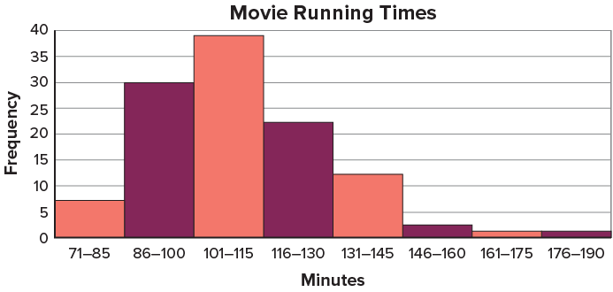
APPLY · PLAN IT • SOLVE IT • PROVE IT
Apply: Making Moves
A group of friends are planning to make a movie. They research the running times of movies made. The data they collected are shown in the histogram. They have asked for your advice on how long their movie should run.
Question: What do you recommend? Explain your recommendation based on the data presented in the histogram.
Choose a method. Solve
independently, justify your
answer, then check the goal.
44 / 46
Notes:
TEACH IN PRACTICE | Embedded facilitation | Lesson 2.2, slide 39 | APPLY
Focus on the existing task: A group of friends are planning to make a movie. They research the running times of movies made. The data they collected are shown in the…
LAUNCH (T2/3/5): Use the exact application task independently first. Ask students to justify their choice of method. Collect evidence before a partner discussion or correction.
LOOK FOR (T4): Where this task addresses it, students can use equal-width intervals. Ask which feature of their work supports the claim.
RESPOND: If this task shows the lesson misconception—reading a bar height as an individual data value—trace each original value into its interval and label both axes. Have the student revise and explain the change. Use this support only where the concept occurs in the current task; otherwise respond to the displayed question.
RECHECK: If a gap is shared, revisit the existing representation together. If it is limited, give targeted support while others compare valid methods on the same task. Check the revision before moving on.
PARTICIPATION (T5/6/7): Think time before volunteers; accept a written, drawn or rehearsed entry. Students ask for evidence respectfully. Recognize a specific contribution or revision and check that both partners participate.
Source: BCPS Updated Instructional Framework Rubric (June 2020), TEACH 1–7. Earlier notes and answer keys are retained below.
EARLIER NOTES / EXISTING ANSWER KEY
Routine: APPLY · PLAN IT • SOLVE IT • PROVE IT
UIFR FULL | Lesson-specific facilitation
TEACH 4 | Independent evidence and revision (UIFR PDF p. 11).
Use the existing application/exit problem as the independent check. If this is a learning-target slide, have students point to and explain their work on the preceding task. Separate initial independent evidence from the revision after feedback.
Check the relevant criteria: use equal-width intervals; count each value once; interpret frequency and distribution. Respond with one specific next step tied to the work. Students revise and annotate what changed, then identify a criterion they can now demonstrate and one they still need to practice.

Slide 45
Learning Targets
I can display numerical data in a histogram and explain how this type of display is different from a dot plot.
I can use repetition to describe the data by its shape.
SAY THE GOAL · Say today’s goal in your own words, then name one place this shows up outside math class.
45 / 46
Notes:
TEACH IN PRACTICE | Embedded facilitation | Lesson 2.2, slide 40 | REFLECTION
Focus on the existing task: I can display numerical data in a histogram and explain how this type of display is different from a dot plot. I can use repetition to…
CONNECT (T1/4): Ask students to restate the displayed goal or key idea and connect it to earlier work. Relevant lesson evidence: use equal-width intervals; count each value once; interpret frequency and distribution. Use only the criterion that matches the current session.
SHOW PROGRESS: Students point to their own existing work, explain what improved after feedback, and name a next step. Pair confidence ratings with actual evidence.
PARTICIPATION (T5/6/7): Think time before volunteers; accept a written, drawn or rehearsed entry. Students ask for evidence respectfully. Recognize a specific contribution or revision and check that both partners participate.
Source: BCPS Updated Instructional Framework Rubric (June 2020), TEACH 1–7. Earlier notes and answer keys are retained below.
EARLIER NOTES / EXISTING ANSWER KEY
Read each target; students self-rate with fist-to-five or thumbs.
Tie back to the goal from the start of class: did we get there?
Note any target that rates low — revisit it tomorrow.
UIFR: TEACH 1 · TEACH 4.
UIFR FULL | Lesson-specific facilitation
REFLECT & ADJUST 1-2 | After the lesson (UIFR PDF pp. 15-16).
Sort the existing work by demonstrated reasoning, partial understanding, and the specific misconception: reading a bar height as an individual data value. Compare the initial response with the revision. Record which teaching move plausibly helped, which did not, and whose participation or access needs a different approach; do not record sensitive student details in this shared deck.
Plan the next lesson from that evidence: if the misconception persists, trace each original value into its interval and label both axes using the current example before returning to the next grade-level task; if understanding is secure, use an existing extension or ask for a general explanation. Check the targeted idea again at the next warm-up.
Ask students what supported their thinking and what would help next time. Identify one change to try and one successful practice to retain. Seek colleague feedback on anonymized work when useful; these prompts support reflection and do not establish an evaluation rating. Source: Baltimore City Public Schools, Updated Instructional Framework Rubric, June 2020 (UIFR_Full.pdf).

Slide 46
LESSON 2.2 / REFLECT ON YOUR LEARNING
Show your progress
1 SHOW EVIDENCE
2 CHOOSE A NEXT STEP
Choose one response. Point to the part that shows your reasoning.
Name a change you made after feedback—or a question you still have.
“My work shows ___ because ___.”
“Next time, I will ___ to help me ___.”
Today’s focus: Use equal-width intervals.
CREDIT A CLASSMATE · Name one classmate whose idea helped you today, and say what they said.
Listen to understand. Ask for evidence. Make room for every voice.
Notes:
TEACH IN PRACTICE | Embedded facilitation | Lesson 2.2, slide 41 | PRIOR_INSERT
Focus on the existing task: LESSON 2.2 / REFLECT ON YOUR LEARNING Show your progress Listen to understand. Ask for evidence. Make room for every voice. 1 SHOW…
CONNECT (T1/4): Ask students to restate the displayed goal or key idea and connect it to earlier work. Relevant lesson evidence: use equal-width intervals; count each value once; interpret frequency and distribution. Use only the criterion that matches the current session.
SHOW PROGRESS: Students point to their own existing work, explain what improved after feedback, and name a next step. Pair confidence ratings with actual evidence.
PARTICIPATION (T5/6/7): Think time before volunteers; accept a written, drawn or rehearsed entry. Students ask for evidence respectfully. Recognize a specific contribution or revision and check that both partners participate.
Source: BCPS Updated Instructional Framework Rubric (June 2020), TEACH 1–7.

