Slide 1
WARM-UP · THINK • TRY • CHECK
Turn and talk: compare strategies, then defend one.
Warm-Up
Lesson 2-3 · Describe the Data Using the Median | Warm-Up · about 4 minutes
Try each on your own. Mark an unsure answer; explain and revise when we check.
QUESTION 1
QUESTION 2
Order least to greatest: 9, 4, 15, 6, 11 = ______
In an ordered list of 7, the middle is the ______ number.
QUESTION 3
QUESTION 4
What number is halfway between 12 and 17? ______
38 ÷ 2 = ______
TALK IT OVER: “I got ______ because ______.” • Compare with a partner before we check as a class.
1 / 44
Notes:
TEACH IN PRACTICE | Embedded facilitation | Lesson 2.3, slide 1 | WARMUP
Focus on the existing task: Warm-Up WARM-UP · THINK • TRY • CHECK Do these four on…
GATHER EVIDENCE (T4/6): Keep the original items. Students try independently, mark an uncertain item, and explain one method before checking. Use the existing key when present.
RESPOND: Distinguish a calculation slip from a reasoning gap. Give one next step on the same item; have students revise in a second color. Use the responses to choose flexible support for today’s lesson.
PARTICIPATION (T5/6/7): Think time before volunteers; accept a written, drawn or rehearsed entry. Students ask for evidence respectfully. Recognize a specific contribution or revision and check that both partners participate.
Source: BCPS Updated Instructional Framework Rubric (June 2020), TEACH 1–7. Earlier notes and answer keys are retained below.
EARLIER NOTES / EXISTING ANSWER KEY
Warm-Up answers (teacher only): 1) 4, 6, 9, 11, 15 2) 4th 3) 14.5 4) 19
UIFR FULL | Lesson-specific facilitation
PREPARE 1-2 | Before teaching (UIFR PDF pp. 6-7).
Plan to gather evidence that students can order the values; locate the middle; explain the two-middle-value case. Review recent work and today’s warm-up to choose flexible groups and access supports; do not infer needs from identity or perceived ability. Use the existing lesson tasks and stated standards.
Anticipate: choosing the middle of the unsorted list. If observed, mark paired values from the ends of the ordered list. Offer oral rehearsal, drawing, pointing, or home-language processing as needed; retain the original mathematical demand. Ask students which support helps and fade it as evidence improves.
TEACH 6-7 | Before the first transition, agree on materials, partner roles, and how to request help. Invite students to restate the routine. Normalize revising an idea, recognize a specific contribution, and check privately when frustration blocks participation. Source: UIFR PDF pp. 13-14.

Slide 2
Today’s Math Notes
Lesson 2-3 · Describe the Data Using the Median
Section 1: Math Words
Copy. Explain. Check.
SAY THE GOAL · Say today’s goal in your own words, then name one place this shows up outside math class.
Describe the Data Using the Median
1
Using the middle value of the ordered data to say what
Median
2
The middle number when you put them in order
Mode
3
The number that shows up most often
eduwonderlab.com · Neft Teacher
2 / 44
Notes:
TEACH IN PRACTICE | Embedded facilitation | Lesson 2.3, slide 2 | NOTES
Focus on the existing task: Today’s Math Notes Section 1: Math Words Copy into your…
ROUTINE (T1/2/4): Read or copy the original notes, cover one line, and explain it using the displayed example. Reopen and correct. Copying alone is not evidence of understanding.
LOOK FOR: A link between a symbol, quantity or feature and the explanation. If missing, point back to that feature and have the student try again; fade the prompt once they can explain.
PARTICIPATION (T5/6/7): Think time before volunteers; accept a written, drawn or rehearsed entry. Students ask for evidence respectfully. Recognize a specific contribution or revision and check that both partners participate.
Source: BCPS Updated Instructional Framework Rubric (June 2020), TEACH 1–7. Earlier notes and answer keys are retained below.
EARLIER NOTES / EXISTING ANSWER KEY
Copy routine: read one line at a time; students copy, then explain that line to a partner.
Keep it brisk — the understanding work happens in the examples, not the copying.
UIFR: TEACH 1 · TEACH 6.

Slide 3
Today’s Math Notes
Lesson 2-3 · Describe the Data Using the Median
Section 2: Today’s Math
Copy. Explain. Check.
Measures of Center: Median
Median = Middle value in an ordered set
Read, cover, explain. Reopen your notes to
check and improve your explanation.
1
Order all data values from least to greatest
2
Odd count: The median is the exact center number
3
Even count: The median is the mean of the two middle numbers
eduwonderlab.com · Neft Teacher
3 / 44
Notes:
TEACH IN PRACTICE | Embedded facilitation | Lesson 2.3, slide 3 | NOTES
Focus on the existing task: Today’s Math Notes Section 2: Today’s Math Copy into…
ROUTINE (T1/2/4): Read or copy the original notes, cover one line, and explain it using the displayed example. Reopen and correct. Copying alone is not evidence of understanding.
LOOK FOR: A link between a symbol, quantity or feature and the explanation. If missing, point back to that feature and have the student try again; fade the prompt once they can explain.
PARTICIPATION (T5/6/7): Think time before volunteers; accept a written, drawn or rehearsed entry. Students ask for evidence respectfully. Recognize a specific contribution or revision and check that both partners participate.
Source: BCPS Updated Instructional Framework Rubric (June 2020), TEACH 1–7. Earlier notes and answer keys are retained below.
EARLIER NOTES / EXISTING ANSWER KEY
Copy routine: read one line at a time; students copy, then explain that line to a partner.
Keep it brisk — the understanding work happens in the examples, not the copying.
UIFR: TEACH 1 · TEACH 6.

Slide 4
Session 1
Describe Data Using the Median​
PICK YOUR STRATEGY · Choose your path — picture, table, number line, or equation — and be ready to say why you chose it.
4 / 44
Notes:
TEACH IN PRACTICE | Embedded facilitation | Lesson 2.3, slide 4 | DIVIDER
Focus on the existing task: Describe Data Using the Median Session 1
TRANSITION (T6/7): Students confirm materials, roles, how to request help, and the next response routine. Ask a student to restate it. Keep teacher-only slides hidden.
PARTICIPATION (T5/6/7): Think time before volunteers; accept a written, drawn or rehearsed entry. Students ask for evidence respectfully. Recognize a specific contribution or revision and check that both partners participate.
Source: BCPS Updated Instructional Framework Rubric (June 2020), TEACH 1–7. Earlier notes and answer keys are retained below.
EARLIER NOTES / EXISTING ANSWER KEY
Transition cue: state what materials are out and what success looks like this session.
Keep the changeover under a minute.
UIFR: TEACH 6.

Slide 5
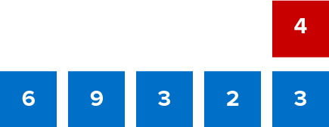
Give Me Five
Use all the numbers in any order with any operation to equal the target number (in red). ​
Explain how the information shown supports your reasoning.
5 / 44
Notes:
TEACH IN PRACTICE | Embedded facilitation | Lesson 2.3, slide 5 | WORKED
Focus on the existing task: Use all the numbers in any order with any operation to equal the target number (in red). Give Me Five
LAUNCH (T2/3/5): Ask students to explain the displayed idea or example and point to evidence. When a calculation step is shown, ask why it is valid. Have a partner restate the explanation; copying is not the check.
LOOK FOR (T4): Where this task addresses it, students can order the values. Ask which feature of their work supports the claim.
RESPOND: If this task shows the lesson misconception—choosing the middle of the unsorted list—mark paired values from the ends of the ordered list. Have the student revise and explain the change. Use this support only where the concept occurs in the current task; otherwise respond to the displayed question.
RECHECK: If a gap is shared, revisit the existing representation together. If it is limited, give targeted support while others compare valid methods on the same task. Check the revision before moving on.
PARTICIPATION (T5/6/7): Think time before volunteers; accept a written, drawn or rehearsed entry. Students ask for evidence respectfully. Recognize a specific contribution or revision and check that both partners participate.
Source: BCPS Updated Instructional Framework Rubric (June 2020), TEACH 1–7. Earlier notes and answer keys are retained below.
EARLIER NOTES / EXISTING ANSWER KEY
Number-sense routine — every voice in. Give quiet think time, then hear from at least three students.
Always follow with “How do you know?” — the reasoning is the point, not the answer.
There is more than one path; name and celebrate different strategies.
UIFR: TEACH 3 · TEACH 5 · TEACH 6.

Slide 6
Today’s Objectives
Lesson 2-3 · Describe the Data Using the Median
Describe the Data Using the Median
Maryland Standard 6.DS.4
CONNECT IT · What earlier lesson does this build on? Tell a partner in one sentence.
CONTENT OBJECTIVE
LANGUAGE OBJECTIVE
Restate the goal in your words
Use these words to explain why
I can find the median of a data set and use it to describe what is typical.
I can explain the median using the words order, middle, typical, and half.
eduwonderlab.com · Neft Teacher
6 / 44
Notes:
TEACH IN PRACTICE | Embedded facilitation | Lesson 2.3, slide 6 | GOAL
Focus on the existing task: Today’s Objectives Describe the Data Using the Median…
CONNECT (T1/4): Ask students to restate the displayed goal or key idea and connect it to earlier work. Relevant lesson evidence: order the values; locate the middle; explain the two-middle-value case. Use only the criterion that matches the current session.
SHOW PROGRESS: Students point to their own existing work, explain what improved after feedback, and name a next step. Pair confidence ratings with actual evidence.
PARTICIPATION (T5/6/7): Think time before volunteers; accept a written, drawn or rehearsed entry. Students ask for evidence respectfully. Recognize a specific contribution or revision and check that both partners participate.
Source: BCPS Updated Instructional Framework Rubric (June 2020), TEACH 1–7. Earlier notes and answer keys are retained below.
EARLIER NOTES / EXISTING ANSWER KEY
Read the objective together, then have one or two students restate today’s goal in their own words.
Connect it to what the class learned last lesson.
Return to this goal at the end of class to check it was met.
UIFR: TEACH 1.
UIFR FULL | Lesson-specific facilitation
TEACH 1 | Session 1 purpose and evidence (UIFR PDF p. 8).
Have students restate the displayed session goal in their own words and connect it to the existing context or a familiar experience they choose to share. Use the current session goal to select from these lesson-wide evidence criteria; do not frontload a later-session procedure.
Look for: order the values; locate the middle; explain the two-middle-value case. Ask: “Which part of your work would show this?” Revisit that evidence after the task; a confidence rating alone is not evidence of understanding.

Slide 7
LESSON 2.3 / OUR LEARNING
What will show your learning?
1
Order the values.
2
Locate the middle.
3
Explain the two-middle-value case.
Tell a partner: Which skill connects to something you already know?
SHOW YOUR THINKING · Show what you know — write it, draw it, or build it. A picture counts as an explanation.
Listen to understand. Ask for evidence. Make room for every voice.
Notes:
TEACH IN PRACTICE | Embedded facilitation | Lesson 2.3, slide 7 | PRIOR_INSERT
Focus on the existing task: LESSON 2.3 / OUR LEARNING What will show your learning?
CONNECT (T1/4): Ask students to restate the displayed goal or key idea and connect it to earlier work. Relevant lesson evidence: order the values; locate the middle; explain the two-middle-value case. Use only the criterion that matches the current session.
SHOW PROGRESS: Students point to their own existing work, explain what improved after feedback, and name a next step. Pair confidence ratings with actual evidence.
PARTICIPATION (T5/6/7): Think time before volunteers; accept a written, drawn or rehearsed entry. Students ask for evidence respectfully. Recognize a specific contribution or revision and check that both partners participate.
Source: BCPS Updated Instructional Framework Rubric (June 2020), TEACH 1–7.

Slide 8
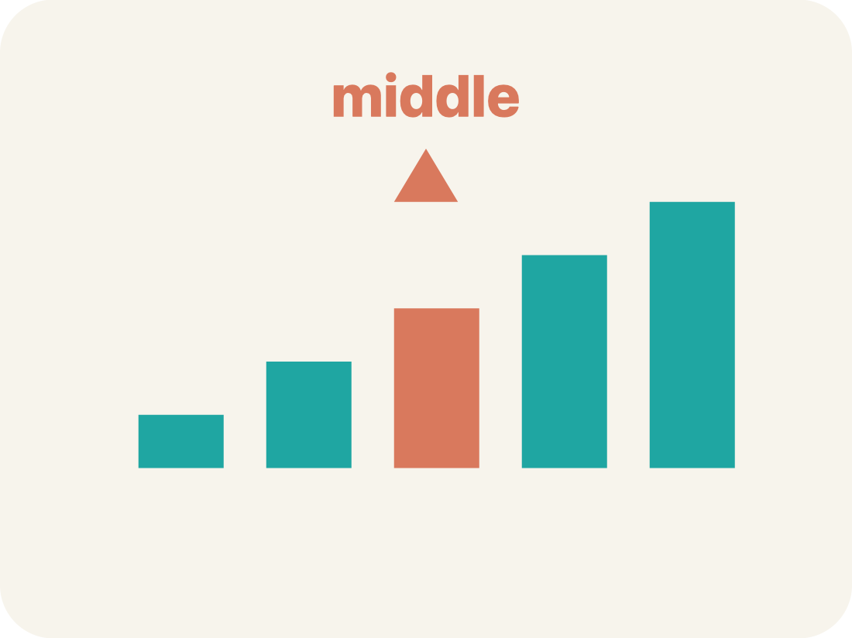
Vocabulary 1 of 6
Lesson 2-3 · Describe the Data Using the Median
Describe the Data Using the Median
Using the middle value of the ordered data to say what is typical for the whole set.
EXAMPLE · EXPLAIN WHY IT FITS
2, 4, 4, 6, 9 → median 4
USE THE MATH WORDS · Use today’s math words in your explanation — not “it” and “that thing.”
eduwonderlab.com · Neft Teacher
8 / 44
Notes:
TEACH IN PRACTICE | Embedded facilitation | Lesson 2.3, slide 8 | VOCAB
Focus on the existing task: Vocabulary 1 of 6 Describe the Data Using the Median…
ASK (T1/3/5): Where does “Describe the Data Using the Median” appear in the example? Explain the meaning without reading the definition. Partner: restate the idea and ask a clarifying question.
LOOK FOR: A correct connection between the word and a feature of the example. If the student only repeats the definition, invite pointing, sketching or oral rehearsal, then ask for another explanation of this same example.
PARTICIPATION (T5/6/7): Think time before volunteers; accept a written, drawn or rehearsed entry. Students ask for evidence respectfully. Recognize a specific contribution or revision and check that both partners participate.
Source: BCPS Updated Instructional Framework Rubric (June 2020), TEACH 1–7.

Slide 9
Vocabulary 2 of 6
Lesson 2-3 · Describe the Data Using the Median
Median
The middle number when you put them in order.
EXAMPLE · EXPLAIN WHY IT FITS
Data: 1, 3, 5, 7, 9 → the middle (3rd) value is 5, so median = 5
Use “Median” to explain the example. Point to evidence.
eduwonderlab.com · Neft Teacher
9 / 44
Notes:
TEACH IN PRACTICE | Embedded facilitation | Lesson 2.3, slide 9 | VOCAB
Focus on the existing task: Vocabulary 2 of 6 Median The middle number when you put…
ASK (T1/3/5): Where does “Median” appear in the example? Explain the meaning without reading the definition. Partner: restate the idea and ask a clarifying question.
LOOK FOR: A correct connection between the word and a feature of the example. If the student only repeats the definition, invite pointing, sketching or oral rehearsal, then ask for another explanation of this same example.
PARTICIPATION (T5/6/7): Think time before volunteers; accept a written, drawn or rehearsed entry. Students ask for evidence respectfully. Recognize a specific contribution or revision and check that both partners participate.
Source: BCPS Updated Instructional Framework Rubric (June 2020), TEACH 1–7.

Slide 10
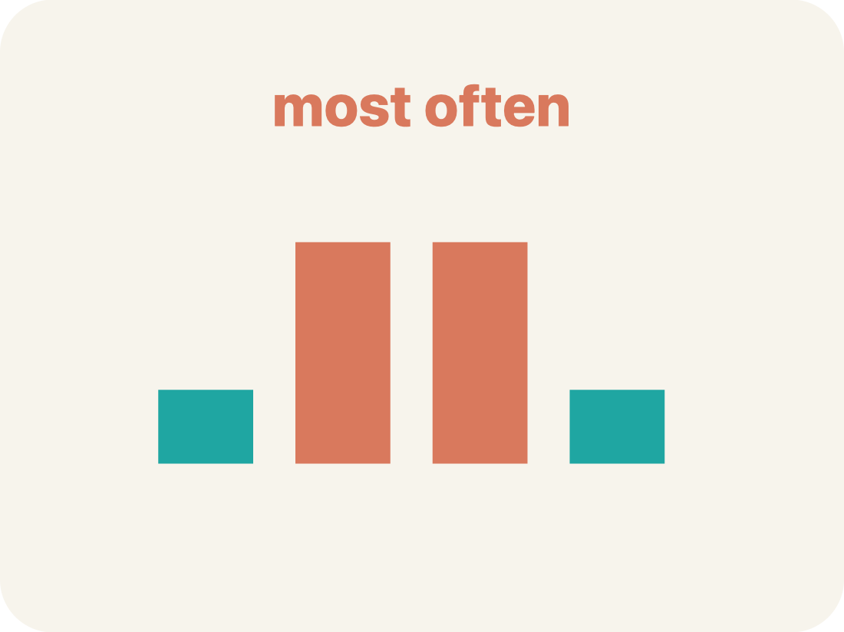
Vocabulary 3 of 6
Lesson 2-3 · Describe the Data Using the Median
Mode
The number that shows up most often.
EXAMPLE · EXPLAIN WHY IT FITS
Data: 2, 3, 3, 5, 7 → 3 appears twice (most often), so mode = 3
Use “Mode” to explain the example. Point to evidence.
eduwonderlab.com · Neft Teacher
10 / 44
Notes:
TEACH IN PRACTICE | Embedded facilitation | Lesson 2.3, slide 10 | VOCAB
Focus on the existing task: Vocabulary 3 of 6 Mode The number that shows up most…
ASK (T1/3/5): Where does “Mode” appear in the example? Explain the meaning without reading the definition. Partner: restate the idea and ask a clarifying question.
LOOK FOR: A correct connection between the word and a feature of the example. If the student only repeats the definition, invite pointing, sketching or oral rehearsal, then ask for another explanation of this same example.
PARTICIPATION (T5/6/7): Think time before volunteers; accept a written, drawn or rehearsed entry. Students ask for evidence respectfully. Recognize a specific contribution or revision and check that both partners participate.
Source: BCPS Updated Instructional Framework Rubric (June 2020), TEACH 1–7.

Slide 11
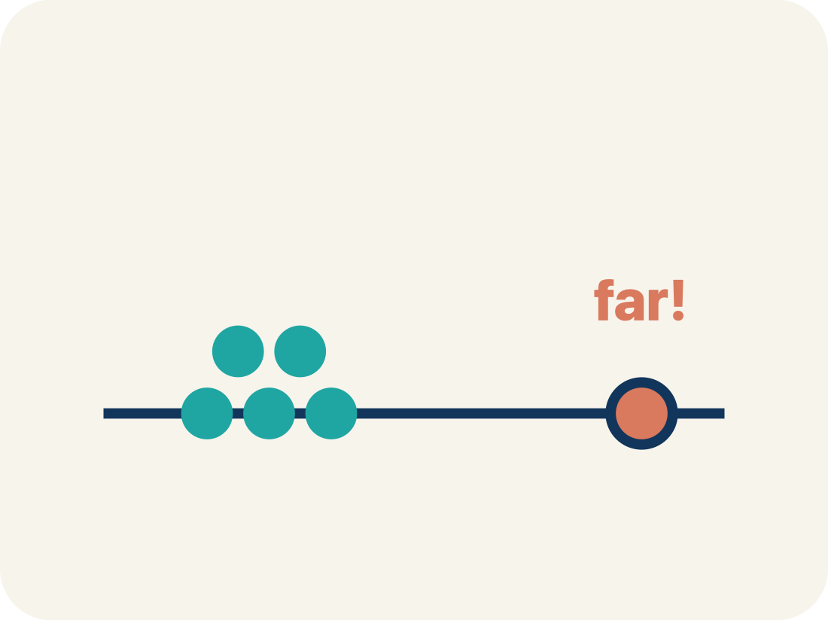
Vocabulary 4 of 6
Lesson 2-3 · Describe the Data Using the Median
Outlier
A number that is much bigger or smaller than the rest.
EXAMPLE · EXPLAIN WHY IT FITS
Data: 10, 12, 11, 13, 50 → 50 is far from the others, so 50 is an outlier
Use “Outlier” to explain the example. Point to evidence.
eduwonderlab.com · Neft Teacher
11 / 44
Notes:
TEACH IN PRACTICE | Embedded facilitation | Lesson 2.3, slide 11 | VOCAB
Focus on the existing task: Vocabulary 4 of 6 Outlier A number that is much bigger…
ASK (T1/3/5): Where does “Outlier” appear in the example? Explain the meaning without reading the definition. Partner: restate the idea and ask a clarifying question.
LOOK FOR: A correct connection between the word and a feature of the example. If the student only repeats the definition, invite pointing, sketching or oral rehearsal, then ask for another explanation of this same example.
PARTICIPATION (T5/6/7): Think time before volunteers; accept a written, drawn or rehearsed entry. Students ask for evidence respectfully. Recognize a specific contribution or revision and check that both partners participate.
Source: BCPS Updated Instructional Framework Rubric (June 2020), TEACH 1–7.

Slide 12
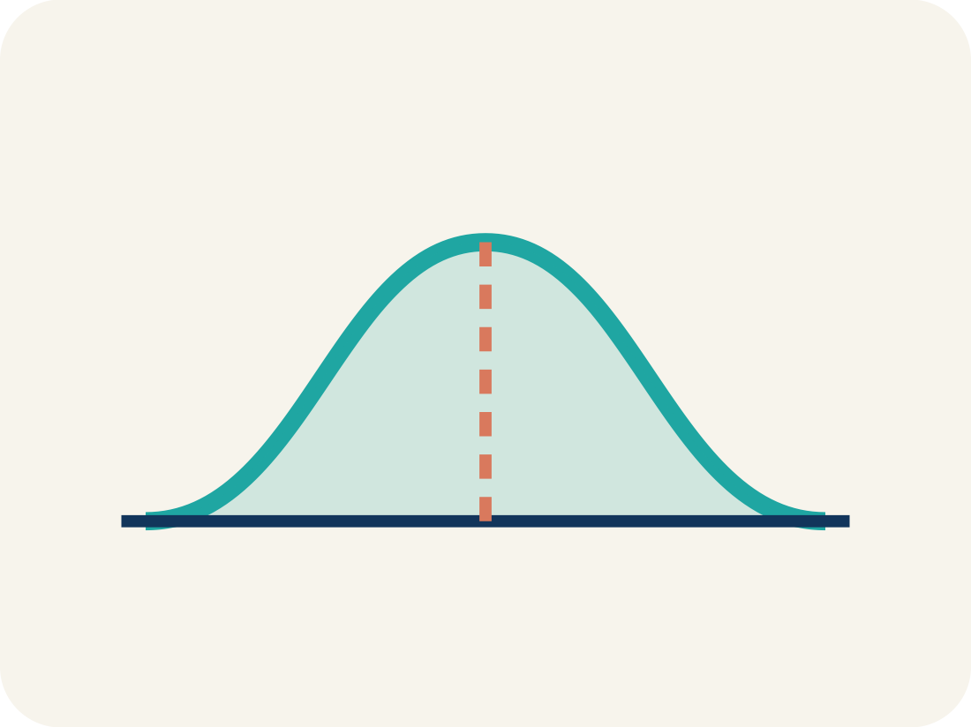
Vocabulary 5 of 6
Lesson 2-3 · Describe the Data Using the Median
Data distribution
How the data looks: where it sits and how spread out it is.
EXAMPLE · EXPLAIN WHY IT FITS
If most values cluster in the center with fewer at the ends, the distribution is symmetric
Use “Data distribution” to explain the example. Point to
evidence.
eduwonderlab.com · Neft Teacher
12 / 44
Notes:
TEACH IN PRACTICE | Embedded facilitation | Lesson 2.3, slide 12 | VOCAB
Focus on the existing task: Vocabulary 5 of 6 Data distribution How the data looks…
ASK (T1/3/5): Where does “Data distribution” appear in the example? Explain the meaning without reading the definition. Partner: restate the idea and ask a clarifying question.
LOOK FOR: A correct connection between the word and a feature of the example. If the student only repeats the definition, invite pointing, sketching or oral rehearsal, then ask for another explanation of this same example.
PARTICIPATION (T5/6/7): Think time before volunteers; accept a written, drawn or rehearsed entry. Students ask for evidence respectfully. Recognize a specific contribution or revision and check that both partners participate.
Source: BCPS Updated Instructional Framework Rubric (June 2020), TEACH 1–7.

Slide 13

Vocabulary 6 of 6
Lesson 2-3 · Describe the Data Using the Median
Variability
How spread out the numbers are.
EXAMPLE · EXPLAIN WHY IT FITS
8, 9, 10, 11 has low variability (close together); 2, 10, 25, 40 has high variability (far apart)
Use “Variability” to explain the example. Point to evidence.
eduwonderlab.com · Neft Teacher
13 / 44
Notes:
TEACH IN PRACTICE | Embedded facilitation | Lesson 2.3, slide 13 | VOCAB
Focus on the existing task: Vocabulary 6 of 6 Variability How spread out the…
ASK (T1/3/5): Where does “Variability” appear in the example? Explain the meaning without reading the definition. Partner: restate the idea and ask a clarifying question.
LOOK FOR: A correct connection between the word and a feature of the example. If the student only repeats the definition, invite pointing, sketching or oral rehearsal, then ask for another explanation of this same example.
PARTICIPATION (T5/6/7): Think time before volunteers; accept a written, drawn or rehearsed entry. Students ask for evidence respectfully. Recognize a specific contribution or revision and check that both partners participate.
Source: BCPS Updated Instructional Framework Rubric (June 2020), TEACH 1–7.

Slide 14
Vocabulary
Lesson 2-3 · Describe the Data Using the Median
Today’s Math Words
We learn every word — what it means and what it looks like — before we use it.
Describe the Data Using the Median
Median
Using the middle value of the ordered data to say what is typical for the whole set
The middle number when you put them in order
Mode
Outlier
The number that shows up most often
A number that is much bigger or smaller than the rest
Data distribution
Variability
How the data looks: where it sits and how spread out it is
How spread out the numbers are
ADD ON · Add on: “I agree because ______.” or “I see it differently because ______.”
eduwonderlab.com · Neft Teacher
14 / 44
Notes:
TEACH IN PRACTICE | Embedded facilitation | Lesson 2.3, slide 14 | VOCAB
Focus on the existing task: Vocabulary Today’s Math Words We learn every word — what…
ASK (T1/3/5): Where does “the displayed term” appear in the example? Explain the meaning without reading the definition. Partner: restate the idea and ask a clarifying question.
LOOK FOR: A correct connection between the word and a feature of the example. If the student only repeats the definition, invite pointing, sketching or oral rehearsal, then ask for another explanation of this same example.
PARTICIPATION (T5/6/7): Think time before volunteers; accept a written, drawn or rehearsed entry. Students ask for evidence respectfully. Recognize a specific contribution or revision and check that both partners participate.
Source: BCPS Updated Instructional Framework Rubric (June 2020), TEACH 1–7. Earlier notes and answer keys are retained below.
EARLIER NOTES / EXISTING ANSWER KEY
Choral-read each word, its meaning, and what it looks like.
Students should use these words out loud today — listen for them in partner talk and revoice student ideas with the academic term.
UIFR: TEACH 1 · TEACH 5.

Slide 15


Be Curious
What do you notice?
What do you wonder?
Think first. Share a notice and a question;
build on a classmate’s idea.
Mindset
How can you show that you understand someone else’s ideas?
15 / 44
Notes:
TEACH IN PRACTICE | Embedded facilitation | Lesson 2.3, slide 15 | CURIOUS
Focus on the existing task: What do you notice?
LAUNCH (T2/3/5): Allow quiet observation first. Separate a notice from an inference, invite students’ own questions, and follow the existing launch before teaching a procedure.
LOOK FOR (T4): Where this task addresses it, students can order the values. Ask which feature of their work supports the claim.
RESPOND: If this task shows the lesson misconception—choosing the middle of the unsorted list—mark paired values from the ends of the ordered list. Have the student revise and explain the change. Use this support only where the concept occurs in the current task; otherwise respond to the displayed question.
RECHECK: If a gap is shared, revisit the existing representation together. If it is limited, give targeted support while others compare valid methods on the same task. Check the revision before moving on.
PARTICIPATION (T5/6/7): Think time before volunteers; accept a written, drawn or rehearsed entry. Students ask for evidence respectfully. Recognize a specific contribution or revision and check that both partners participate.
Source: BCPS Updated Instructional Framework Rubric (June 2020), TEACH 1–7. Earlier notes and answer keys are retained below.
EARLIER NOTES / EXISTING ANSWER KEY
Accept all noticings and wonderings — there are no wrong answers here.
Give 20–30 seconds of quiet think time before taking responses; mix cold and warm calls so it is not always the same voices.
Read the mindset question aloud and let two students respond.
UIFR: TEACH 3 · TEACH 7.

Slide 16
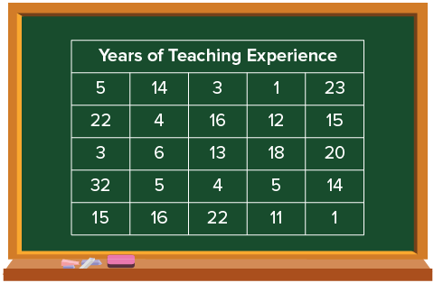
SUMMARIZE · SAY IT IN YOUR OWN WORDS
Teaching Experience
Some students surveyed the teachers at their school on the number of years of teaching experience. They collected the data shown.
How can you summarize the data set?
Think and record first. Which part of your work supports your answer?
16 / 44
Notes:
TEACH IN PRACTICE | Embedded facilitation | Lesson 2.3, slide 16 | TASK
Focus on the existing task: How can you summarize the data set?
LAUNCH (T2/3/5): Use the displayed question. Give private thinking time; then A explains while B asks for evidence. Switch roles. Each student records their own reasoning.
LOOK FOR (T4): Where this task addresses it, students can order the values. Ask which feature of their work supports the claim.
RESPOND: If this task shows the lesson misconception—choosing the middle of the unsorted list—mark paired values from the ends of the ordered list. Have the student revise and explain the change. Use this support only where the concept occurs in the current task; otherwise respond to the displayed question.
RECHECK: If a gap is shared, revisit the existing representation together. If it is limited, give targeted support while others compare valid methods on the same task. Check the revision before moving on.
PARTICIPATION (T5/6/7): Think time before volunteers; accept a written, drawn or rehearsed entry. Students ask for evidence respectfully. Recognize a specific contribution or revision and check that both partners participate.
Source: BCPS Updated Instructional Framework Rubric (June 2020), TEACH 1–7. Earlier notes and answer keys are retained below.
EARLIER NOTES / EXISTING ANSWER KEY
Routine: SUMMARIZE · SAY IT IN YOUR OWN WORDS
UIFR FULL | Lesson-specific facilitation
TEACH 2-3 | Session 1 task launch (UIFR PDF pp. 9-10).
Use the problem exactly as displayed. Give individual thinking time before discussion or advancing to the explanation. If the answer is already visible, ask students to reconstruct and justify it. Invite a choice of suitable representations and have students explain why their choice helps.
At the point where this concept appears, ask: “How does your ordering show that half of the observations lie on either side of the median?” Wait for evidence, invite another pathway, and have a student ask a follow-up question. Do not replace students’ reasoning with a sequence of leading steps.

Slide 17
There are 25 values in the data set.​
HOW DO YOU KNOW? · Ask your partner “How do you know?” Answer by pointing to your own work.
1, 1, 3, 3, 4, 4, 5, 5, 5, 6, 11, 12, 13, 14, 14, 15, 15, 16, 16, 18, 20, 22, 22, 23, 32
What is one way you can find the middle value
of the data set?
Reveal:
You can count an equal number of data values on either side until you meet in the middle.
17 / 44
Notes:
TEACH IN PRACTICE | Embedded facilitation | Lesson 2.3, slide 17 | REVEAL
Focus on the existing task: Reveal: You can count an equal number of data values on either side until you meet in the middle. There are 25 values in the data set.
LAUNCH (T2/3/5): If an existing answer cover is present, gather an attempt before revealing. If the explanation is already visible, ask students to reconstruct and justify it. Compare reasoning and explain a revision; preserve the reveal sequence.
LOOK FOR (T4): Where this task addresses it, students can explain the two-middle-value case. Ask which feature of their work supports the claim.
RESPOND: If this task shows the lesson misconception—choosing the middle of the unsorted list—mark paired values from the ends of the ordered list. Have the student revise and explain the change. Use this support only where the concept occurs in the current task; otherwise respond to the displayed question.
RECHECK: If a gap is shared, revisit the existing representation together. If it is limited, give targeted support while others compare valid methods on the same task. Check the revision before moving on.
PARTICIPATION (T5/6/7): Think time before volunteers; accept a written, drawn or rehearsed entry. Students ask for evidence respectfully. Recognize a specific contribution or revision and check that both partners participate.
Source: BCPS Updated Instructional Framework Rubric (June 2020), TEACH 1–7. Earlier notes and answer keys are retained below.
EARLIER NOTES / EXISTING ANSWER KEY
Do not click yet: collect 2–3 student answers with reasons first.
Then click to remove the cover and have students compare their thinking to the reveal — “Is this what we said? Where is it different?”
Behind the cover: You can count an equal number of data values on either side until you meet in the middle.
UIFR: TEACH 3 · TEACH 4.

Slide 18
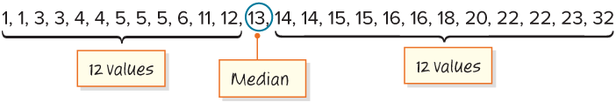
SUMMARIZE · SAY IT IN YOUR OWN WORDS
One measure of center is the median. The median is the middle value of a data set when the values are arranged from least to greatest. It summarizes all the values of the data set with a single number.​
Explain how the information shown supports your reasoning.
18 / 44
Notes:
TEACH IN PRACTICE | Embedded facilitation | Lesson 2.3, slide 18 | WORKED
Focus on the existing task: One measure of center is the median. The median is the middle value of a data set when the values are arranged from least to greatest.…
LAUNCH (T2/3/5): Ask students to explain the displayed idea or example and point to evidence. When a calculation step is shown, ask why it is valid. Have a partner restate the explanation; copying is not the check.
LOOK FOR (T4): Where this task addresses it, students can explain the two-middle-value case. Ask which feature of their work supports the claim.
RESPOND: If this task shows the lesson misconception—choosing the middle of the unsorted list—mark paired values from the ends of the ordered list. Have the student revise and explain the change. Use this support only where the concept occurs in the current task; otherwise respond to the displayed question.
RECHECK: If a gap is shared, revisit the existing representation together. If it is limited, give targeted support while others compare valid methods on the same task. Check the revision before moving on.
PARTICIPATION (T5/6/7): Think time before volunteers; accept a written, drawn or rehearsed entry. Students ask for evidence respectfully. Recognize a specific contribution or revision and check that both partners participate.
Source: BCPS Updated Instructional Framework Rubric (June 2020), TEACH 1–7. Earlier notes and answer keys are retained below.
EARLIER NOTES / EXISTING ANSWER KEY
Routine: SUMMARIZE · SAY IT IN YOUR OWN WORDS

Slide 19
Let’s find the median another way.
Think and record first. Which part of your
work supports your answer?
Think About It:
What are some ways you have displayed data in the past?
19 / 44
Notes:
TEACH IN PRACTICE | Embedded facilitation | Lesson 2.3, slide 19 | TASK
Focus on the existing task: Let’s find the median another way. Think About It: What are some ways you have displayed data in the past?
LAUNCH (T2/3/5): Use the displayed question. Give private thinking time; then A explains while B asks for evidence. Switch roles. Each student records their own reasoning.
LOOK FOR (T4): Where this task addresses it, students can order the values. Ask which feature of their work supports the claim.
RESPOND: If this task shows the lesson misconception—choosing the middle of the unsorted list—mark paired values from the ends of the ordered list. Have the student revise and explain the change. Use this support only where the concept occurs in the current task; otherwise respond to the displayed question.
RECHECK: If a gap is shared, revisit the existing representation together. If it is limited, give targeted support while others compare valid methods on the same task. Check the revision before moving on.
PARTICIPATION (T5/6/7): Think time before volunteers; accept a written, drawn or rehearsed entry. Students ask for evidence respectfully. Recognize a specific contribution or revision and check that both partners participate.
Source: BCPS Updated Instructional Framework Rubric (June 2020), TEACH 1–7. Earlier notes and answer keys are retained below.
EARLIER NOTES / EXISTING ANSWER KEY
Ask the question, then hold the silence — students think or jot before anyone answers.
Take two or three responses and press with “Why?” or “How do you know?” before moving on.
UIFR: TEACH 3.

Slide 20
Let’s find the median another way.
How can you display the data to find the median?
Record your reasoning before the reveal.
Compare, then explain any revision.
Reveal:
We could use a dot plot to display the data.
20 / 44
Notes:
TEACH IN PRACTICE | Embedded facilitation | Lesson 2.3, slide 20 | REVEAL
Focus on the existing task: Let’s find the median another way. How can you display the data to find the median?
LAUNCH (T2/3/5): If an existing answer cover is present, gather an attempt before revealing. If the explanation is already visible, ask students to reconstruct and justify it. Compare reasoning and explain a revision; preserve the reveal sequence.
LOOK FOR (T4): Where this task addresses it, students can order the values. Ask which feature of their work supports the claim.
RESPOND: If this task shows the lesson misconception—choosing the middle of the unsorted list—mark paired values from the ends of the ordered list. Have the student revise and explain the change. Use this support only where the concept occurs in the current task; otherwise respond to the displayed question.
RECHECK: If a gap is shared, revisit the existing representation together. If it is limited, give targeted support while others compare valid methods on the same task. Check the revision before moving on.
PARTICIPATION (T5/6/7): Think time before volunteers; accept a written, drawn or rehearsed entry. Students ask for evidence respectfully. Recognize a specific contribution or revision and check that both partners participate.
Source: BCPS Updated Instructional Framework Rubric (June 2020), TEACH 1–7. Earlier notes and answer keys are retained below.
EARLIER NOTES / EXISTING ANSWER KEY
Do not click yet: collect 2–3 student answers with reasons first.
Then click to remove the cover and have students compare their thinking to the reveal — “Is this what we said? Where is it different?”
Behind the cover: We could use a dot plot to display the data.
UIFR: TEACH 3 · TEACH 4.

Slide 21

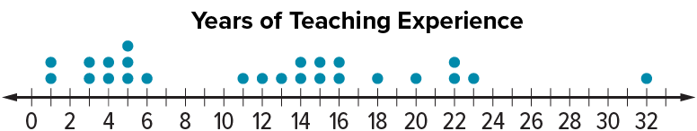
COLLABORATE · TALK IT THROUGH • AGREE ON A MODEL
Collaborate and Connect
TAKE TURNS · One explains, one asks a question. Then switch, so both of you talk.
What does each dot represent on the dot plot?
Reveal:
Each dot represents the number of years of teaching experience of one teacher.
21 / 44
Notes:
TEACH IN PRACTICE | Embedded facilitation | Lesson 2.3, slide 21 | COLLABORATE
Focus on the existing task: What does each dot represent on the dot plot?
LAUNCH (T2/3/5): Use the displayed question. Give private thinking time; then A explains while B asks for evidence. Switch roles. Each student records their own reasoning.
LOOK FOR (T4): Where this task addresses it, students can order the values. Ask which feature of their work supports the claim.
RESPOND: If this task shows the lesson misconception—choosing the middle of the unsorted list—mark paired values from the ends of the ordered list. Have the student revise and explain the change. Use this support only where the concept occurs in the current task; otherwise respond to the displayed question.
RECHECK: If a gap is shared, revisit the existing representation together. If it is limited, give targeted support while others compare valid methods on the same task. Check the revision before moving on.
PARTICIPATION (T5/6/7): Think time before volunteers; accept a written, drawn or rehearsed entry. Students ask for evidence respectfully. Recognize a specific contribution or revision and check that both partners participate.
Source: BCPS Updated Instructional Framework Rubric (June 2020), TEACH 1–7. Earlier notes and answer keys are retained below.
EARLIER NOTES / EXISTING ANSWER KEY
Routine: COLLABORATE · TALK IT THROUGH • AGREE ON A MODEL
UIFR FULL | Lesson-specific facilitation
TEACH 4-5 | Session 1 discussion and checkpoint (UIFR PDF pp. 11-12).
Collect a brief response from every student to the existing prompt before hearing volunteers. Partners take turns explaining and asking for evidence: “I understand ___; what supports ___?” Offer rehearsal or an annotated model for students who need language support. Each student records their own reasoning.
Look specifically for: choosing the middle of the unsorted list. If it appears, mark paired values from the ends of the ordered list; then ask the student to revise the same response and explain the change. If evidence is secure, have students compare a second valid pathway or state why their approach works. Choose the next step from the responses, not a preset pace.

Slide 22
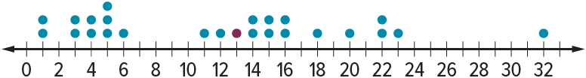
Let’s Explore More
Why do you think the median is called a “measure of center”?​
Workspace
How might a value in the data set that is much larger or much smaller than the rest of the data affect the median?
Workspace
22 / 44
Notes:
TEACH IN PRACTICE | Embedded facilitation | Lesson 2.3, slide 22 | PRACTICE
Focus on the existing task: Let’s Explore More Workspace Why do you think the median is called a “measure of center”?
LAUNCH (T2/3/5): Use the displayed question. Give private thinking time; then A explains while B asks for evidence. Switch roles. Each student records their own reasoning.
LOOK FOR (T4): Where this task addresses it, students can explain the two-middle-value case. Ask which feature of their work supports the claim.
RESPOND: If this task shows the lesson misconception—choosing the middle of the unsorted list—mark paired values from the ends of the ordered list. Have the student revise and explain the change. Use this support only where the concept occurs in the current task; otherwise respond to the displayed question.
RECHECK: If a gap is shared, revisit the existing representation together. If it is limited, give targeted support while others compare valid methods on the same task. Check the revision before moving on.
PARTICIPATION (T5/6/7): Think time before volunteers; accept a written, drawn or rehearsed entry. Students ask for evidence respectfully. Recognize a specific contribution or revision and check that both partners participate.
Source: BCPS Updated Instructional Framework Rubric (June 2020), TEACH 1–7. Earlier notes and answer keys are retained below.
EARLIER NOTES / EXISTING ANSWER KEY
Extension for partners or table groups — students choose their approach and use the workspace to show thinking.
Push with “Convince me,” and have two groups with different approaches share.
This is where students stretch past the worked example.
UIFR: TEACH 2 · TEACH 5.

Slide 23
STUDENT MOVES
Lesson 2-3
Your move
STRUGGLE FIRST · Work on your own first. Stuck is allowed — try a second strategy before you ask.
23 / 44

Slide 24
LESSON 2.3 / DISCUSS THE TASK
Explain and compare
Use the task you just explored.
TAKE TURNS
How does the ordered list show why your value is the median?
Explain
“I know this because…”
Ask
“Where does your work show that?”
Point to evidence in your work.
Then compare your approach with a partner’s.
JUSTIFY IT · Say it like this: “I know ______ because ______.”
Listen to understand. Ask for evidence. Make room for every voice.
Notes:
TEACH IN PRACTICE | Embedded facilitation | Lesson 2.3, slide 23 | PRIOR_INSERT
Focus on the existing task: Point to evidence in your work. Then compare your approach with a partner’s. TAKE TURNS Explain “I know this because…” Ask “Where does your work show that?
CONNECT (T1/4): Ask students to restate the displayed goal or key idea and connect it to earlier work. Relevant lesson evidence: order the values; locate the middle; explain the two-middle-value case. Use only the criterion that matches the current session.
SHOW PROGRESS: Students point to their own existing work, explain what improved after feedback, and name a next step. Pair confidence ratings with actual evidence.
PARTICIPATION (T5/6/7): Think time before volunteers; accept a written, drawn or rehearsed entry. Students ask for evidence respectfully. Recognize a specific contribution or revision and check that both partners participate.
Source: BCPS Updated Instructional Framework Rubric (June 2020), TEACH 1–7.

Slide 25
Some students surveyed the teachers at their school on the number of years of teaching experience. They collected the data shown. How can you summarize the values of the data set?
ANOTHER PATHWAY · Did anyone get there a different way? Put both pathways side by side and compare.
What do you notice about the data set?
Reveal:
The number of years of teaching experience ranges from 1 year to 32 years.
25 / 44
Notes:
TEACH IN PRACTICE | Embedded facilitation | Lesson 2.3, slide 24 | REVEAL
Focus on the existing task: What do you notice about the data set?
LAUNCH (T2/3/5): If an existing answer cover is present, gather an attempt before revealing. If the explanation is already visible, ask students to reconstruct and justify it. Compare reasoning and explain a revision; preserve the reveal sequence.
LOOK FOR (T4): Where this task addresses it, students can order the values. Ask which feature of their work supports the claim.
RESPOND: If this task shows the lesson misconception—choosing the middle of the unsorted list—mark paired values from the ends of the ordered list. Have the student revise and explain the change. Use this support only where the concept occurs in the current task; otherwise respond to the displayed question.
RECHECK: If a gap is shared, revisit the existing representation together. If it is limited, give targeted support while others compare valid methods on the same task. Check the revision before moving on.
PARTICIPATION (T5/6/7): Think time before volunteers; accept a written, drawn or rehearsed entry. Students ask for evidence respectfully. Recognize a specific contribution or revision and check that both partners participate.
Source: BCPS Updated Instructional Framework Rubric (June 2020), TEACH 1–7.

Slide 26
The number of years ranges from 1 year to 32 years.
How can you determine the typical number of years of teaching experience for the teachers at the school?
Reveal:
We can find the middle number of the data set.
Compare your reasoning with the
explanation. Explain any revision
you make.
26 / 44
Notes:
TEACH IN PRACTICE | Embedded facilitation | Lesson 2.3, slide 25 | REVEAL
Focus on the existing task: How can you determine the typical number of years of teaching experience for the teachers at the school?
LAUNCH (T2/3/5): If an existing answer cover is present, gather an attempt before revealing. If the explanation is already visible, ask students to reconstruct and justify it. Compare reasoning and explain a revision; preserve the reveal sequence.
LOOK FOR (T4): Where this task addresses it, students can locate the middle. Ask which feature of their work supports the claim.
RESPOND: If this task shows the lesson misconception—choosing the middle of the unsorted list—mark paired values from the ends of the ordered list. Have the student revise and explain the change. Use this support only where the concept occurs in the current task; otherwise respond to the displayed question.
RECHECK: If a gap is shared, revisit the existing representation together. If it is limited, give targeted support while others compare valid methods on the same task. Check the revision before moving on.
PARTICIPATION (T5/6/7): Think time before volunteers; accept a written, drawn or rehearsed entry. Students ask for evidence respectfully. Recognize a specific contribution or revision and check that both partners participate.
Source: BCPS Updated Instructional Framework Rubric (June 2020), TEACH 1–7.

Slide 27
The values in order from least to greatest are:
1, 1, 3, 3, 4, 4, 5, 5, 5, 6, 11, 12, 13, 14, 14, 15, 15, 16, 16, 18, 20, 22, 22, 23, 32
What does it mean for a value to be in the middle?
Reveal:
There are an equal number of values less than and greater than that value.​
Compare your reasoning with the
explanation. Explain any revision
you make.
27 / 44
Notes:
TEACH IN PRACTICE | Embedded facilitation | Lesson 2.3, slide 26 | REVEAL
Focus on the existing task: The values in order from least to greatest are: Reveal: There are an equal number of values less than and greater than that value. 1…
LAUNCH (T2/3/5): If an existing answer cover is present, gather an attempt before revealing. If the explanation is already visible, ask students to reconstruct and justify it. Compare reasoning and explain a revision; preserve the reveal sequence.
LOOK FOR (T4): Where this task addresses it, students can order the values. Ask which feature of their work supports the claim.
RESPOND: If this task shows the lesson misconception—choosing the middle of the unsorted list—mark paired values from the ends of the ordered list. Have the student revise and explain the change. Use this support only where the concept occurs in the current task; otherwise respond to the displayed question.
RECHECK: If a gap is shared, revisit the existing representation together. If it is limited, give targeted support while others compare valid methods on the same task. Check the revision before moving on.
PARTICIPATION (T5/6/7): Think time before volunteers; accept a written, drawn or rehearsed entry. Students ask for evidence respectfully. Recognize a specific contribution or revision and check that both partners participate.
Source: BCPS Updated Instructional Framework Rubric (June 2020), TEACH 1–7.

Slide 28
Session 2 Warm-Up
Lesson 2-3 · Describe the Data Using the Median
Session 2 Warm-Up
Quick review from Session 1 · about 4 minutes
1
What is the first step when finding the median?
2
What is the median of 3, 5, 8, 12, 14?
A
Add all numbers
A
5
B
Order least to greatest
B
8
C
Divide by 2
C
12
D
Find the highest number
D
8.4
3
What is the median of 4, 6, 8, 12?
4
The median divides an ordered dataset into:
A
6
A
Three parts
B
7
B
Two equal halves (50/50)
C
8
C
Unequal sections
D
14
D
Odd numbers only
eduwonderlab.com · Neft Teacher
28 / 44
Notes:
TEACH IN PRACTICE | Embedded facilitation | Lesson 2.3, slide 27 | WARMUP
Focus on the existing task: A Add all numbers B Order least to greatest C Divide by 2 D Find the highest number 2 What is the median of 3, 5, 8, 12, 14?
GATHER EVIDENCE (T4/6): Keep the original items. Students try independently, mark an uncertain item, and explain one method before checking. Use the existing key when present.
RESPOND: Distinguish a calculation slip from a reasoning gap. Give one next step on the same item; have students revise in a second color. Use the responses to choose flexible support for today’s lesson.
PARTICIPATION (T5/6/7): Think time before volunteers; accept a written, drawn or rehearsed entry. Students ask for evidence respectfully. Recognize a specific contribution or revision and check that both partners participate.
Source: BCPS Updated Instructional Framework Rubric (June 2020), TEACH 1–7. Earlier notes and answer keys are retained below.
EARLIER NOTES / EXISTING ANSWER KEY
Warm-up routine: students start silently on entry; keep it to about 4 minutes.
Circulate and note who is stuck — use what you see to choose who you check on first today.
Go over answers quickly; ask one student to explain a step, not just say the answer.
UIFR: TEACH 4 · TEACH 6.
UIFR FULL | Lesson-specific facilitation
TEACH 1 | Session 2 purpose and evidence (UIFR PDF p. 8).
Have students restate the displayed session goal in their own words and connect it to the existing context or a familiar experience they choose to share. Use the current session goal to select from these lesson-wide evidence criteria; do not frontload a later-session procedure.
Look for: order the values; locate the middle; explain the two-middle-value case. Ask: “Which part of your work would show this?” Revisit that evidence after the task; a confidence rating alone is not evidence of understanding.

Slide 29
STUDENT MOVES
Lesson 2-3
Your move
YOU KNOW THE ROUTINE · Read → plan → solve → check. Do all four, in that order.
29 / 44

Slide 30
Review Notes
Lesson 2-3 · Describe the Data Using the Median
Review Notes — Session 2
Copy. Explain. Check.
WHY IT MATTERS · Finish this: “This is worth knowing because ______.”
Locating the Median
1
Always arrange values in order from least to greatest before identifying the center.
Even Number of Values
2
When there is an even number of points, take the mean of the two central numbers.
Measure of Center
3
The median is resistant to extreme outliers and divides data into top and bottom 50%.
eduwonderlab.com · Neft Teacher
30 / 44
Notes:
TEACH IN PRACTICE | Embedded facilitation | Lesson 2.3, slide 28 | NOTES
Focus on the existing task: Review Notes Review Notes — Session 2 Copy into your…
ROUTINE (T1/2/4): Read or copy the original notes, cover one line, and explain it using the displayed example. Reopen and correct. Copying alone is not evidence of understanding.
LOOK FOR: A link between a symbol, quantity or feature and the explanation. If missing, point back to that feature and have the student try again; fade the prompt once they can explain.
PARTICIPATION (T5/6/7): Think time before volunteers; accept a written, drawn or rehearsed entry. Students ask for evidence respectfully. Recognize a specific contribution or revision and check that both partners participate.
Source: BCPS Updated Instructional Framework Rubric (June 2020), TEACH 1–7. Earlier notes and answer keys are retained below.
EARLIER NOTES / EXISTING ANSWER KEY
Copy routine: read one line at a time; students copy, then explain that line to a partner.
Keep it brisk — the understanding work happens in the examples, not the copying.
UIFR: TEACH 1 · TEACH 6.

Slide 31
Session 2
Describe Data Using the Median​
TRY IT BEFORE YOU’RE SURE · Start even if you are not sure. A revised answer counts as much as a first-try answer.
31 / 44
Notes:
TEACH IN PRACTICE | Embedded facilitation | Lesson 2.3, slide 29 | DIVIDER
Focus on the existing task: Describe Data Using the Median Session 2
TRANSITION (T6/7): Students confirm materials, roles, how to request help, and the next response routine. Ask a student to restate it. Keep teacher-only slides hidden.
PARTICIPATION (T5/6/7): Think time before volunteers; accept a written, drawn or rehearsed entry. Students ask for evidence respectfully. Recognize a specific contribution or revision and check that both partners participate.
Source: BCPS Updated Instructional Framework Rubric (June 2020), TEACH 1–7. Earlier notes and answer keys are retained below.
EARLIER NOTES / EXISTING ANSWER KEY
Transition cue: state what materials are out and what success looks like this session.
Keep the changeover under a minute.
UIFR: TEACH 6.

Slide 32
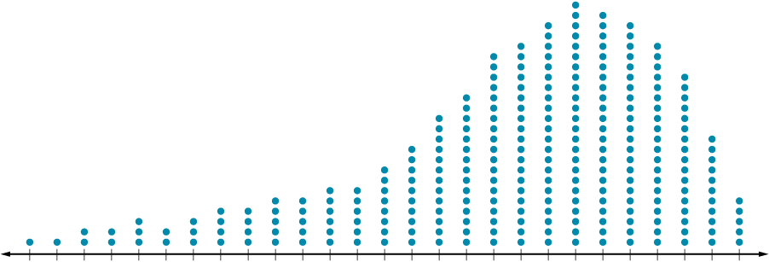
Be Curious
What do you notice?
What do you wonder?
Think first. Share a notice and a question; build on a classmate’s idea.
Mindset
How are you showing that you understand someone else’s ideas?
32 / 44
Notes:
TEACH IN PRACTICE | Embedded facilitation | Lesson 2.3, slide 30 | CURIOUS
Focus on the existing task: What do you notice?
LAUNCH (T2/3/5): Allow quiet observation first. Separate a notice from an inference, invite students’ own questions, and follow the existing launch before teaching a procedure.
LOOK FOR (T4): Where this task addresses it, students can order the values. Ask which feature of their work supports the claim.
RESPOND: If this task shows the lesson misconception—choosing the middle of the unsorted list—mark paired values from the ends of the ordered list. Have the student revise and explain the change. Use this support only where the concept occurs in the current task; otherwise respond to the displayed question.
RECHECK: If a gap is shared, revisit the existing representation together. If it is limited, give targeted support while others compare valid methods on the same task. Check the revision before moving on.
PARTICIPATION (T5/6/7): Think time before volunteers; accept a written, drawn or rehearsed entry. Students ask for evidence respectfully. Recognize a specific contribution or revision and check that both partners participate.
Source: BCPS Updated Instructional Framework Rubric (June 2020), TEACH 1–7. Earlier notes and answer keys are retained below.
EARLIER NOTES / EXISTING ANSWER KEY
Accept all noticings and wonderings — there are no wrong answers here.
Give 20–30 seconds of quiet think time before taking responses; mix cold and warm calls so it is not always the same voices.
Read the mindset question aloud and let two students respond.
UIFR: TEACH 3 · TEACH 7.

Slide 33
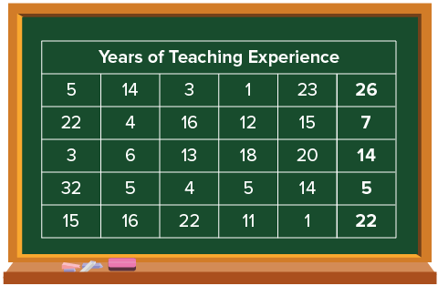
More Teaching Experience
Five more teachers were added to the data set. Their years of teaching experience are 5, 7, 14, 22, and 26.
How do the additional data values affect the median?
Think and record first. Which part of your work supports your answer?
33 / 44
Notes:
TEACH IN PRACTICE | Embedded facilitation | Lesson 2.3, slide 31 | TASK
Focus on the existing task: How do the additional data values affect the median?
LAUNCH (T2/3/5): Use the displayed question. Give private thinking time; then A explains while B asks for evidence. Switch roles. Each student records their own reasoning.
LOOK FOR (T4): Where this task addresses it, students can order the values. Ask which feature of their work supports the claim.
RESPOND: If this task shows the lesson misconception—choosing the middle of the unsorted list—mark paired values from the ends of the ordered list. Have the student revise and explain the change. Use this support only where the concept occurs in the current task; otherwise respond to the displayed question.
RECHECK: If a gap is shared, revisit the existing representation together. If it is limited, give targeted support while others compare valid methods on the same task. Check the revision before moving on.
PARTICIPATION (T5/6/7): Think time before volunteers; accept a written, drawn or rehearsed entry. Students ask for evidence respectfully. Recognize a specific contribution or revision and check that both partners participate.
Source: BCPS Updated Instructional Framework Rubric (June 2020), TEACH 1–7. Earlier notes and answer keys are retained below.
EARLIER NOTES / EXISTING ANSWER KEY
Model briefly, then hand the thinking back: ask “Why does this step work?” before showing the next one.
Quick check before moving on — thumbs or whiteboards from everyone, not volunteers.
UIFR: TEACH 2 · TEACH 3 · TEACH 4.
UIFR FULL | Lesson-specific facilitation
TEACH 2-3 | Session 2 task launch (UIFR PDF pp. 9-10).
Use the problem exactly as displayed. Give individual thinking time before discussion or advancing to the explanation. If the answer is already visible, ask students to reconstruct and justify it. Invite a choice of suitable representations and have students explain why their choice helps.
At the point where this concept appears, ask: “How does your ordering show that half of the observations lie on either side of the median?” Wait for evidence, invite another pathway, and have a student ask a follow-up question. Do not replace students’ reasoning with a sequence of leading steps.

Slide 34
Let’s look at the data set arranged in order.​
Record your reasoning before the reveal. Compare, then explain any revision.
What do you notice about the new data values? How many data values are there?
Reveal:
Two of the values are below 13, the previous median, and three are greater than 13. There are now 30 values.
34 / 44
Notes:
TEACH IN PRACTICE | Embedded facilitation | Lesson 2.3, slide 32 | REVEAL
Focus on the existing task: What do you notice about the new data values?
LAUNCH (T2/3/5): If an existing answer cover is present, gather an attempt before revealing. If the explanation is already visible, ask students to reconstruct and justify it. Compare reasoning and explain a revision; preserve the reveal sequence.
LOOK FOR (T4): Where this task addresses it, students can order the values. Ask which feature of their work supports the claim.
RESPOND: If this task shows the lesson misconception—choosing the middle of the unsorted list—mark paired values from the ends of the ordered list. Have the student revise and explain the change. Use this support only where the concept occurs in the current task; otherwise respond to the displayed question.
RECHECK: If a gap is shared, revisit the existing representation together. If it is limited, give targeted support while others compare valid methods on the same task. Check the revision before moving on.
PARTICIPATION (T5/6/7): Think time before volunteers; accept a written, drawn or rehearsed entry. Students ask for evidence respectfully. Recognize a specific contribution or revision and check that both partners participate.
Source: BCPS Updated Instructional Framework Rubric (June 2020), TEACH 1–7. Earlier notes and answer keys are retained below.
EARLIER NOTES / EXISTING ANSWER KEY
Do not click yet: collect 2–3 student answers with reasons first.
Then click to remove the cover and have students compare their thinking to the reveal — “Is this what we said? Where is it different?”
Behind the cover: Two of the values are below 13, the previous median, and three are greater than 13. There are now 30 values.
UIFR: TEACH 3 · TEACH 4.

Slide 35
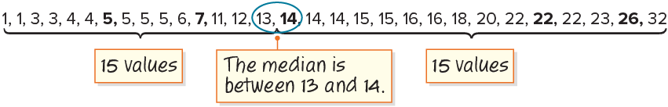
COLLABORATE · TALK IT THROUGH • AGREE ON A MODEL
Collaborate and Connect
How can you find the value halfway between the two middle numbers?
Reveal:
We can add the two numbers and then divide the sum by 2.
Think first. A explains; B asks for
evidence. Switch roles; both
revise.
35 / 44
Notes:
TEACH IN PRACTICE | Embedded facilitation | Lesson 2.3, slide 33 | COLLABORATE
Focus on the existing task: Collaborate and Connect Reveal: We can add the two numbers and then divide the sum by 2. How can you find the value halfway between the two middle numbers?
LAUNCH (T2/3/5): Use the displayed question. Give private thinking time; then A explains while B asks for evidence. Switch roles. Each student records their own reasoning.
LOOK FOR (T4): Where this task addresses it, students can explain the two-middle-value case. Ask which feature of their work supports the claim.
RESPOND: If this task shows the lesson misconception—choosing the middle of the unsorted list—mark paired values from the ends of the ordered list. Have the student revise and explain the change. Use this support only where the concept occurs in the current task; otherwise respond to the displayed question.
RECHECK: If a gap is shared, revisit the existing representation together. If it is limited, give targeted support while others compare valid methods on the same task. Check the revision before moving on.
PARTICIPATION (T5/6/7): Think time before volunteers; accept a written, drawn or rehearsed entry. Students ask for evidence respectfully. Recognize a specific contribution or revision and check that both partners participate.
Source: BCPS Updated Instructional Framework Rubric (June 2020), TEACH 1–7. Earlier notes and answer keys are retained below.
EARLIER NOTES / EXISTING ANSWER KEY
Routine: COLLABORATE · TALK IT THROUGH • AGREE ON A MODEL
UIFR FULL | Lesson-specific facilitation
TEACH 4-5 | Session 2 discussion and checkpoint (UIFR PDF pp. 11-12).
Collect a brief response from every student to the existing prompt before hearing volunteers. Partners take turns explaining and asking for evidence: “I understand ___; what supports ___?” Offer rehearsal or an annotated model for students who need language support. Each student records their own reasoning.
Look specifically for: choosing the middle of the unsorted list. If it appears, mark paired values from the ends of the ordered list; then ask the student to revise the same response and explain the change. If evidence is secure, have students compare a second valid pathway or state why their approach works. Choose the next step from the responses, not a preset pace.

Slide 36
Let’s Explore More
How would the median change if all five additional data points were greater than 13? less than 13?
Workspace
How would the median change if the values of the three data points greater than 13–14, 22, and 26–were changed to 32, 35, and 41?
Try it yourself. Compare your
work with a partner; explain one
choice and revise.
Workspace
36 / 44
Notes:
TEACH IN PRACTICE | Embedded facilitation | Lesson 2.3, slide 34 | PRACTICE
Focus on the existing task: Workspace How would the median change if all five additional data points were greater than 13?
LAUNCH (T2/3/5): Use the displayed question. Give private thinking time; then A explains while B asks for evidence. Switch roles. Each student records their own reasoning.
LOOK FOR (T4): Where this task addresses it, students can order the values. Ask which feature of their work supports the claim.
RESPOND: If this task shows the lesson misconception—choosing the middle of the unsorted list—mark paired values from the ends of the ordered list. Have the student revise and explain the change. Use this support only where the concept occurs in the current task; otherwise respond to the displayed question.
RECHECK: If a gap is shared, revisit the existing representation together. If it is limited, give targeted support while others compare valid methods on the same task. Check the revision before moving on.
PARTICIPATION (T5/6/7): Think time before volunteers; accept a written, drawn or rehearsed entry. Students ask for evidence respectfully. Recognize a specific contribution or revision and check that both partners participate.
Source: BCPS Updated Instructional Framework Rubric (June 2020), TEACH 1–7. Earlier notes and answer keys are retained below.
EARLIER NOTES / EXISTING ANSWER KEY
Extension for partners or table groups — students choose their approach and use the workspace to show thinking.
Push with “Convince me,” and have two groups with different approaches share.
This is where students stretch past the worked example.
UIFR: TEACH 2 · TEACH 5.

Slide 37
LESSON 2.3 / CHECK YOUR WORK
Pause. Check. Improve.
CHECK
A mistake to watch for: choosing the middle of the unsorted list.
TRY
Mark paired values from the ends of the ordered list.
REVISE
Use that check on the task you just completed. Correct or strengthen one part, and explain why.
SELF-CHECK · Mark it: ✓ got it · ~ almost · ? stuck. Then fix one thing before we move on.
Listen to understand. Ask for evidence. Make room for every voice.
Notes:
TEACH IN PRACTICE | Embedded facilitation | Lesson 2.3, slide 35 | PRIOR_INSERT
Focus on the existing task: LESSON 2.3 / CHECK YOUR WORK Pause. Check. Improve. Listen to understand. Ask for evidence. Make room for every voice. CHECK A mistake…
CONNECT (T1/4): Ask students to restate the displayed goal or key idea and connect it to earlier work. Relevant lesson evidence: order the values; locate the middle; explain the two-middle-value case. Use only the criterion that matches the current session.
SHOW PROGRESS: Students point to their own existing work, explain what improved after feedback, and name a next step. Pair confidence ratings with actual evidence.
PARTICIPATION (T5/6/7): Think time before volunteers; accept a written, drawn or rehearsed entry. Students ask for evidence respectfully. Recognize a specific contribution or revision and check that both partners participate.
Source: BCPS Updated Instructional Framework Rubric (June 2020), TEACH 1–7.

Slide 38
Five more teachers were added to the data set. Their years of teaching experience are 5, 7, 14, 22, and 26. How do the additional data values affect the median?​
How can you find the median of the new data set?​
Reveal:
We can arrange the values from least to greatest and find the middle value.
Compare your reasoning with the
explanation. Explain any revision
you make.
38 / 44
Notes:
TEACH IN PRACTICE | Embedded facilitation | Lesson 2.3, slide 36 | REVEAL
Focus on the existing task: How can you find the median of the new data set?
LAUNCH (T2/3/5): If an existing answer cover is present, gather an attempt before revealing. If the explanation is already visible, ask students to reconstruct and justify it. Compare reasoning and explain a revision; preserve the reveal sequence.
LOOK FOR (T4): Where this task addresses it, students can explain the two-middle-value case. Ask which feature of their work supports the claim.
RESPOND: If this task shows the lesson misconception—choosing the middle of the unsorted list—mark paired values from the ends of the ordered list. Have the student revise and explain the change. Use this support only where the concept occurs in the current task; otherwise respond to the displayed question.
RECHECK: If a gap is shared, revisit the existing representation together. If it is limited, give targeted support while others compare valid methods on the same task. Check the revision before moving on.
PARTICIPATION (T5/6/7): Think time before volunteers; accept a written, drawn or rehearsed entry. Students ask for evidence respectfully. Recognize a specific contribution or revision and check that both partners participate.
Source: BCPS Updated Instructional Framework Rubric (June 2020), TEACH 1–7.

Slide 39
Collaborate and Connect
How can you find the value halfway between the two middle numbers?
Reveal:
We can add the two numbers and then divide the sum by 2.
Think first. A explains; B asks for
evidence. Switch roles; both
revise.
39 / 44
Notes:
TEACH IN PRACTICE | Embedded facilitation | Lesson 2.3, slide 37 | COLLABORATE
Focus on the existing task: Collaborate and Connect Reveal: We can add the two numbers and then divide the sum by 2. How can you find the value halfway between the two middle numbers?
LAUNCH (T2/3/5): Use the displayed question. Give private thinking time; then A explains while B asks for evidence. Switch roles. Each student records their own reasoning.
LOOK FOR (T4): Where this task addresses it, students can explain the two-middle-value case. Ask which feature of their work supports the claim.
RESPOND: If this task shows the lesson misconception—choosing the middle of the unsorted list—mark paired values from the ends of the ordered list. Have the student revise and explain the change. Use this support only where the concept occurs in the current task; otherwise respond to the displayed question.
RECHECK: If a gap is shared, revisit the existing representation together. If it is limited, give targeted support while others compare valid methods on the same task. Check the revision before moving on.
PARTICIPATION (T5/6/7): Think time before volunteers; accept a written, drawn or rehearsed entry. Students ask for evidence respectfully. Recognize a specific contribution or revision and check that both partners participate.
Source: BCPS Updated Instructional Framework Rubric (June 2020), TEACH 1–7.

Slide 40
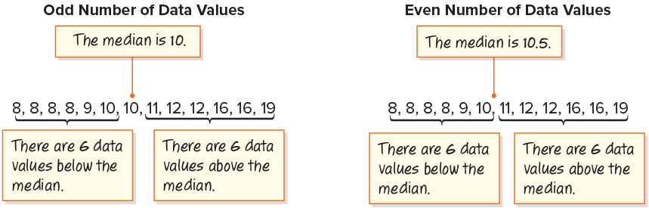
SUMMARIZE · SAY IT IN YOUR OWN WORDS
Summarize: Describe Data Using the Median​
A measure of center used to describe a numerical data set is the median, which is the middle value when the data are ordered from least to greatest. When the number of values in a data set is odd, the median is the middle data value. When the number of values in a data set is even, the median is the sum of the two middle values divided by 2.
40 / 44
Notes:
TEACH IN PRACTICE | Embedded facilitation | Lesson 2.3, slide 38 | SUMMARIZE
Focus on the existing task: A measure of center used to describe a numerical data set is the median, which is the middle value when the data are ordered from least to…
CONNECT (T1/4): Ask students to restate the displayed goal or key idea and connect it to earlier work. Relevant lesson evidence: order the values; locate the middle; explain the two-middle-value case. Use only the criterion that matches the current session.
SHOW PROGRESS: Students point to their own existing work, explain what improved after feedback, and name a next step. Pair confidence ratings with actual evidence.
PARTICIPATION (T5/6/7): Think time before volunteers; accept a written, drawn or rehearsed entry. Students ask for evidence respectfully. Recognize a specific contribution or revision and check that both partners participate.
Source: BCPS Updated Instructional Framework Rubric (June 2020), TEACH 1–7. Earlier notes and answer keys are retained below.
EARLIER NOTES / EXISTING ANSWER KEY
Routine: SUMMARIZE · SAY IT IN YOUR OWN WORDS

Slide 41
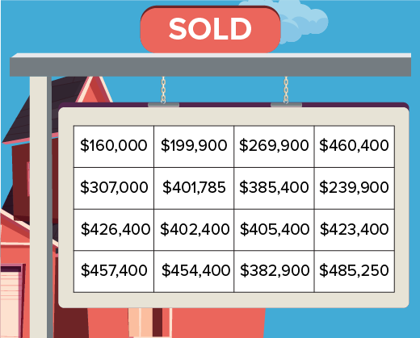
APPLY · PLAN IT • SOLVE IT • PROVE IT
Apply: Real Estate
Terrance is helping his grandmother sell her house. He uses a real estate website to look at the recent sale prices of similarly-sized houses in their area and collects the information in the table shown.
Question: What do you think would be a fair, but competitive selling price for Terrance’s grandmother’s house?
41 / 44
Notes:
TEACH IN PRACTICE | Embedded facilitation | Lesson 2.3, slide 39 | APPLY
Focus on the existing task: Terrance is helping his grandmother sell her house. He uses a real estate website to look at the recent sale prices of similarly-sized…
LAUNCH (T2/3/5): Use the exact application task independently first. Ask students to justify their choice of method. Collect evidence before a partner discussion or correction.
LOOK FOR (T4): Where this task addresses it, students can order the values. Ask which feature of their work supports the claim.
RESPOND: If this task shows the lesson misconception—choosing the middle of the unsorted list—mark paired values from the ends of the ordered list. Have the student revise and explain the change. Use this support only where the concept occurs in the current task; otherwise respond to the displayed question.
RECHECK: If a gap is shared, revisit the existing representation together. If it is limited, give targeted support while others compare valid methods on the same task. Check the revision before moving on.
PARTICIPATION (T5/6/7): Think time before volunteers; accept a written, drawn or rehearsed entry. Students ask for evidence respectfully. Recognize a specific contribution or revision and check that both partners participate.
Source: BCPS Updated Instructional Framework Rubric (June 2020), TEACH 1–7. Earlier notes and answer keys are retained below.
EARLIER NOTES / EXISTING ANSWER KEY
Routine: APPLY · PLAN IT • SOLVE IT • PROVE IT
UIFR FULL | Lesson-specific facilitation
TEACH 4 | Independent evidence and revision (UIFR PDF p. 11).
Use the existing application/exit problem as the independent check. If this is a learning-target slide, have students point to and explain their work on the preceding task. Separate initial independent evidence from the revision after feedback.
Check the relevant criteria: order the values; locate the middle; explain the two-middle-value case. Respond with one specific next step tied to the work. Students revise and annotate what changed, then identify a criterion they can now demonstrate and one they still need to practice.

Slide 42
STUDENT MOVES
Lesson 2-3
Your moves
USE YOUR TOOLS · Reach for your notes, a model, or a manipulative before you reach for an answer.
ASK THE CLASS · Write one question about this that you could ask the class.
42 / 44

Slide 43
Learning Targets
I can use the median to describe a data set.
I can use repeated reasoning to describe a data set using the median.
NAME THE MATH · Point to the part of this that is new today, and say what it changes.
43 / 44
Notes:
TEACH IN PRACTICE | Embedded facilitation | Lesson 2.3, slide 40 | REFLECTION
Focus on the existing task: I can use the median to describe a data set. I can use repeated reasoning to describe a data set using the median. Learning Targets
CONNECT (T1/4): Ask students to restate the displayed goal or key idea and connect it to earlier work. Relevant lesson evidence: order the values; locate the middle; explain the two-middle-value case. Use only the criterion that matches the current session.
SHOW PROGRESS: Students point to their own existing work, explain what improved after feedback, and name a next step. Pair confidence ratings with actual evidence.
PARTICIPATION (T5/6/7): Think time before volunteers; accept a written, drawn or rehearsed entry. Students ask for evidence respectfully. Recognize a specific contribution or revision and check that both partners participate.
Source: BCPS Updated Instructional Framework Rubric (June 2020), TEACH 1–7. Earlier notes and answer keys are retained below.
EARLIER NOTES / EXISTING ANSWER KEY
Read each target; students self-rate with fist-to-five or thumbs.
Tie back to the goal from the start of class: did we get there?
Note any target that rates low — revisit it tomorrow.
UIFR: TEACH 1 · TEACH 4.
UIFR FULL | Lesson-specific facilitation
REFLECT & ADJUST 1-2 | After the lesson (UIFR PDF pp. 15-16).
Sort the existing work by demonstrated reasoning, partial understanding, and the specific misconception: choosing the middle of the unsorted list. Compare the initial response with the revision. Record which teaching move plausibly helped, which did not, and whose participation or access needs a different approach; do not record sensitive student details in this shared deck.
Plan the next lesson from that evidence: if the misconception persists, mark paired values from the ends of the ordered list using the current example before returning to the next grade-level task; if understanding is secure, use an existing extension or ask for a general explanation. Check the targeted idea again at the next warm-up.
Ask students what supported their thinking and what would help next time. Identify one change to try and one successful practice to retain. Seek colleague feedback on anonymized work when useful; these prompts support reflection and do not establish an evaluation rating. Source: Baltimore City Public Schools, Updated Instructional Framework Rubric, June 2020 (UIFR_Full.pdf).

Slide 44
LESSON 2.3 / REFLECT ON YOUR LEARNING
Show your progress
1 SHOW EVIDENCE
2 CHOOSE A NEXT STEP
Choose one response. Point to the part that shows your reasoning.
Name a change you made after feedback—or a question you still have.
“My work shows ___ because ___.”
“Next time, I will ___ to help me ___.”
Today’s focus: Order the values.
CREDIT A CLASSMATE · Name one classmate whose idea helped you today, and say what they said.
Listen to understand. Ask for evidence. Make room for every voice.
Notes:
TEACH IN PRACTICE | Embedded facilitation | Lesson 2.3, slide 41 | PRIOR_INSERT
Focus on the existing task: LESSON 2.3 / REFLECT ON YOUR LEARNING Show your progress Listen to understand. Ask for evidence. Make room for every voice. 1 SHOW…
CONNECT (T1/4): Ask students to restate the displayed goal or key idea and connect it to earlier work. Relevant lesson evidence: order the values; locate the middle; explain the two-middle-value case. Use only the criterion that matches the current session.
SHOW PROGRESS: Students point to their own existing work, explain what improved after feedback, and name a next step. Pair confidence ratings with actual evidence.
PARTICIPATION (T5/6/7): Think time before volunteers; accept a written, drawn or rehearsed entry. Students ask for evidence respectfully. Recognize a specific contribution or revision and check that both partners participate.
Source: BCPS Updated Instructional Framework Rubric (June 2020), TEACH 1–7.

