Slide 1
WARM-UP · THINK • TRY • CHECK
Turn and talk: compare strategies, then defend one.
Warm-Up
Lesson 2-4 · Represent and Describe Data in a Box Plot | Warm-Up · about 4 minutes
Try each on your own. Mark an unsure answer; explain and revise when we check.
QUESTION 1
QUESTION 2
Median of 3, 5, 8, 10, 12, 14 = ______
Ordered: 2, 4, 6, 8, 10, 12. The lower half is ______
QUESTION 3
QUESTION 4
63 − 28 = ______
A line runs 0 to 50 with a tick every 10. 35 sits between ______
TALK IT OVER: “I got ______ because ______.” • Compare with a partner before we check as a class.
1 / 47
Notes:
TEACH IN PRACTICE | Embedded facilitation | Lesson 2.4, slide 1 | WARMUP
Focus on the existing task: Warm-Up WARM-UP · THINK • TRY • CHECK Do these…
GATHER EVIDENCE (T4/6): Keep the original items. Students try independently, mark an uncertain item, and explain one method before checking. Use the existing key when present.
RESPOND: Distinguish a calculation slip from a reasoning gap. Give one next step on the same item; have students revise in a second color. Use the responses to choose flexible support for today’s lesson.
PARTICIPATION (T5/6/7): Think time before volunteers; accept a written, drawn or rehearsed entry. Students ask for evidence respectfully. Recognize a specific contribution or revision and check that both partners participate.
Source: BCPS Updated Instructional Framework Rubric (June 2020), TEACH 1–7. Earlier notes and answer keys are retained below.
EARLIER NOTES / EXISTING ANSWER KEY
Warm-Up answers (teacher only): 1) 9 2) 2, 4, 6 3) 35 4) 30 and 40
UIFR FULL | Lesson-specific facilitation
PREPARE 1-2 | Before teaching (UIFR PDF pp. 6-7).
Plan to gather evidence that students can locate minimum, quartiles, median and maximum; compare center and spread in context. Review recent work and today’s warm-up to choose flexible groups and access supports; do not infer needs from identity or perceived ability. Use the existing lesson tasks and stated standards.
Anticipate: assuming a longer box section contains more observations. If observed, connect the ordered source data to each boundary of the existing box plot. Offer oral rehearsal, drawing, pointing, or home-language processing as needed; retain the original mathematical demand. Ask students which support helps and fade it as evidence improves.
TEACH 6-7 | Before the first transition, agree on materials, partner roles, and how to request help. Invite students to restate the routine. Normalize revising an idea, recognize a specific contribution, and check privately when frustration blocks participation. Source: UIFR PDF pp. 13-14.

Slide 2
Today’s Math Notes
Lesson 2-4 · Represent and Describe Data in a Box Plot
Section 1: Math Words
Copy. Explain. Check.
SAY THE GOAL · Say today’s goal in your own words, then name one place this shows up outside math class.
Display Data with Box Plots
1
Show a data set’s five-number summary in a box-and-whisker display
Box Plot
2
A graph
Median
3
The middle number when you put them in order
eduwonderlab.com · Neft Teacher
2 / 47
Notes:
TEACH IN PRACTICE | Embedded facilitation | Lesson 2.4, slide 2 | NOTES
Focus on the existing task: Today’s Math Notes Section 1: Math Words Copy…
ROUTINE (T1/2/4): Read or copy the original notes, cover one line, and explain it using the displayed example. Reopen and correct. Copying alone is not evidence of understanding.
LOOK FOR: A link between a symbol, quantity or feature and the explanation. If missing, point back to that feature and have the student try again; fade the prompt once they can explain.
PARTICIPATION (T5/6/7): Think time before volunteers; accept a written, drawn or rehearsed entry. Students ask for evidence respectfully. Recognize a specific contribution or revision and check that both partners participate.
Source: BCPS Updated Instructional Framework Rubric (June 2020), TEACH 1–7. Earlier notes and answer keys are retained below.
EARLIER NOTES / EXISTING ANSWER KEY
Copy routine: read one line at a time; students copy, then explain that line to a partner.
Keep it brisk — the understanding work happens in the examples, not the copying.
UIFR: TEACH 1 · TEACH 6.

Slide 3
Today’s Math Notes
Lesson 2-4 · Represent and Describe Data in a Box Plot
Section 2: Today’s Math
Copy. Explain. Check.
Box Plots & 5-Number Summary
IQR = Q3 − Q1
Read, cover, explain. Reopen your notes to
check and improve your explanation.
1
5-Number Summary: Minimum, Lower Quartile (Q1), Median (Q2), Upper Quartile (Q3), Maximum
2
Draw the Box: The box spans from Q1 to Q3 and contains the middle 50% of data
3
Whiskers: Draw lines from the box out to the minimum and maximum
eduwonderlab.com · Neft Teacher
3 / 47
Notes:
TEACH IN PRACTICE | Embedded facilitation | Lesson 2.4, slide 3 | NOTES
Focus on the existing task: Today’s Math Notes Section 2: Today’s Math Copy…
ROUTINE (T1/2/4): Read or copy the original notes, cover one line, and explain it using the displayed example. Reopen and correct. Copying alone is not evidence of understanding.
LOOK FOR: A link between a symbol, quantity or feature and the explanation. If missing, point back to that feature and have the student try again; fade the prompt once they can explain.
PARTICIPATION (T5/6/7): Think time before volunteers; accept a written, drawn or rehearsed entry. Students ask for evidence respectfully. Recognize a specific contribution or revision and check that both partners participate.
Source: BCPS Updated Instructional Framework Rubric (June 2020), TEACH 1–7. Earlier notes and answer keys are retained below.
EARLIER NOTES / EXISTING ANSWER KEY
Copy routine: read one line at a time; students copy, then explain that line to a partner.
Keep it brisk — the understanding work happens in the examples, not the copying.
UIFR: TEACH 1 · TEACH 6.

Slide 4
Session 1
Represent and Describe Data in a Box Plot​
PICK YOUR STRATEGY · Choose your path — picture, table, number line, or equation — and be ready to say why you chose it.
4 / 47
Notes:
TEACH IN PRACTICE | Embedded facilitation | Lesson 2.4, slide 4 | DIVIDER
Focus on the existing task: Represent and Describe Data in a Box Plot Session 1
TRANSITION (T6/7): Students confirm materials, roles, how to request help, and the next response routine. Ask a student to restate it. Keep teacher-only slides hidden.
PARTICIPATION (T5/6/7): Think time before volunteers; accept a written, drawn or rehearsed entry. Students ask for evidence respectfully. Recognize a specific contribution or revision and check that both partners participate.
Source: BCPS Updated Instructional Framework Rubric (June 2020), TEACH 1–7. Earlier notes and answer keys are retained below.
EARLIER NOTES / EXISTING ANSWER KEY
Transition cue: state what materials are out and what success looks like this session.
Keep the changeover under a minute.
UIFR: TEACH 6.

Slide 5
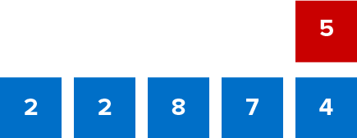
Give Me Five
Use all the numbers in any order with any operation to equal the target number (in red). ​
Explain how the information shown supports your reasoning.
5 / 47
Notes:
TEACH IN PRACTICE | Embedded facilitation | Lesson 2.4, slide 5 | WORKED
Focus on the existing task: Use all the numbers in any order with any operation to equal the target number (in red). Give Me Five
LAUNCH (T2/3/5): Ask students to explain the displayed idea or example and point to evidence. When a calculation step is shown, ask why it is valid. Have a partner restate the explanation; copying is not the check.
LOOK FOR (T4): Where this task addresses it, students can locate minimum, quartiles, median and maximum. Ask which feature of their work supports the claim.
RESPOND: If this task shows the lesson misconception—assuming a longer box section contains more observations—connect the ordered source data to each boundary of the existing box plot. Have the student revise and explain the change. Use this support only where the concept occurs in the current task; otherwise respond to the displayed question.
RECHECK: If a gap is shared, revisit the existing representation together. If it is limited, give targeted support while others compare valid methods on the same task. Check the revision before moving on.
PARTICIPATION (T5/6/7): Think time before volunteers; accept a written, drawn or rehearsed entry. Students ask for evidence respectfully. Recognize a specific contribution or revision and check that both partners participate.
Source: BCPS Updated Instructional Framework Rubric (June 2020), TEACH 1–7. Earlier notes and answer keys are retained below.
EARLIER NOTES / EXISTING ANSWER KEY
Number-sense routine — every voice in. Give quiet think time, then hear from at least three students.
Always follow with “How do you know?” — the reasoning is the point, not the answer.
There is more than one path; name and celebrate different strategies.
UIFR: TEACH 3 · TEACH 5 · TEACH 6.

Slide 6
Today’s Objectives
Lesson 2-4 · Represent and Describe Data in a Box Plot
Represent and Describe Data in a Box Plot
Maryland Standard 6.DS.5
CONNECT IT · What earlier lesson does this build on? Tell a partner in one sentence.
CONTENT OBJECTIVE
LANGUAGE OBJECTIVE
Restate the goal in your words
Use these words to explain why
I can make and read a box plot to summarize a data set.
I can explain my box plot using the words box plot, median, quartile, and interquartile range.
eduwonderlab.com · Neft Teacher
6 / 47
Notes:
TEACH IN PRACTICE | Embedded facilitation | Lesson 2.4, slide 6 | GOAL
Focus on the existing task: Today’s Objectives Represent and Describe Data in…
CONNECT (T1/4): Ask students to restate the displayed goal or key idea and connect it to earlier work. Relevant lesson evidence: locate minimum, quartiles, median and maximum; compare center and spread in context. Use only the criterion that matches the current session.
SHOW PROGRESS: Students point to their own existing work, explain what improved after feedback, and name a next step. Pair confidence ratings with actual evidence.
PARTICIPATION (T5/6/7): Think time before volunteers; accept a written, drawn or rehearsed entry. Students ask for evidence respectfully. Recognize a specific contribution or revision and check that both partners participate.
Source: BCPS Updated Instructional Framework Rubric (June 2020), TEACH 1–7. Earlier notes and answer keys are retained below.
EARLIER NOTES / EXISTING ANSWER KEY
Read the objective together, then have one or two students restate today’s goal in their own words.
Connect it to what the class learned last lesson.
Return to this goal at the end of class to check it was met.
UIFR: TEACH 1.
UIFR FULL | Lesson-specific facilitation
TEACH 1 | Session 1 purpose and evidence (UIFR PDF p. 8).
Have students restate the displayed session goal in their own words and connect it to the existing context or a familiar experience they choose to share. Use the current session goal to select from these lesson-wide evidence criteria; do not frontload a later-session procedure.
Look for: locate minimum, quartiles, median and maximum; compare center and spread in context. Ask: “Which part of your work would show this?” Revisit that evidence after the task; a confidence rating alone is not evidence of understanding.

Slide 7
LESSON 2.4 / OUR LEARNING
What will show your learning?
1
Locate minimum, quartiles, median and maximum.
2
Compare center and spread in context.
Tell a partner: Which skill connects to something you already know?
SHOW YOUR THINKING · Show what you know — write it, draw it, or build it. A picture counts as an explanation.
Listen to understand. Ask for evidence. Make room for every voice.
Notes:
TEACH IN PRACTICE | Embedded facilitation | Lesson 2.4, slide 7 | PRIOR_INSERT
Focus on the existing task: LESSON 2.4 / OUR LEARNING What will show your learning?
CONNECT (T1/4): Ask students to restate the displayed goal or key idea and connect it to earlier work. Relevant lesson evidence: locate minimum, quartiles, median and maximum; compare center and spread in context. Use only the criterion that matches the current session.
SHOW PROGRESS: Students point to their own existing work, explain what improved after feedback, and name a next step. Pair confidence ratings with actual evidence.
PARTICIPATION (T5/6/7): Think time before volunteers; accept a written, drawn or rehearsed entry. Students ask for evidence respectfully. Recognize a specific contribution or revision and check that both partners participate.
Source: BCPS Updated Instructional Framework Rubric (June 2020), TEACH 1–7.

Slide 8
Vocabulary 1 of 7
Lesson 2-4 · Represent and Describe Data in a Box Plot
Display Data with Box Plots
Show a data set’s five-number summary in a box-and-whisker display.
EXAMPLE · EXPLAIN WHY IT FITS
minimum | Q1 [ median ] Q3 | maximum
Use “Display Data with Box Plots” to explain the example.
Point to evidence.
eduwonderlab.com · Neft Teacher
8 / 47
Notes:
TEACH IN PRACTICE | Embedded facilitation | Lesson 2.4, slide 8 | VOCAB
Focus on the existing task: Vocabulary 1 of 7 Display Data with Box Plots…
ASK (T1/3/5): Where does “Display Data with Box Plots” appear in the example? Explain the meaning without reading the definition. Partner: restate the idea and ask a clarifying question.
LOOK FOR: A correct connection between the word and a feature of the example. If the student only repeats the definition, invite pointing, sketching or oral rehearsal, then ask for another explanation of this same example.
PARTICIPATION (T5/6/7): Think time before volunteers; accept a written, drawn or rehearsed entry. Students ask for evidence respectfully. Recognize a specific contribution or revision and check that both partners participate.
Source: BCPS Updated Instructional Framework Rubric (June 2020), TEACH 1–7.

Slide 9
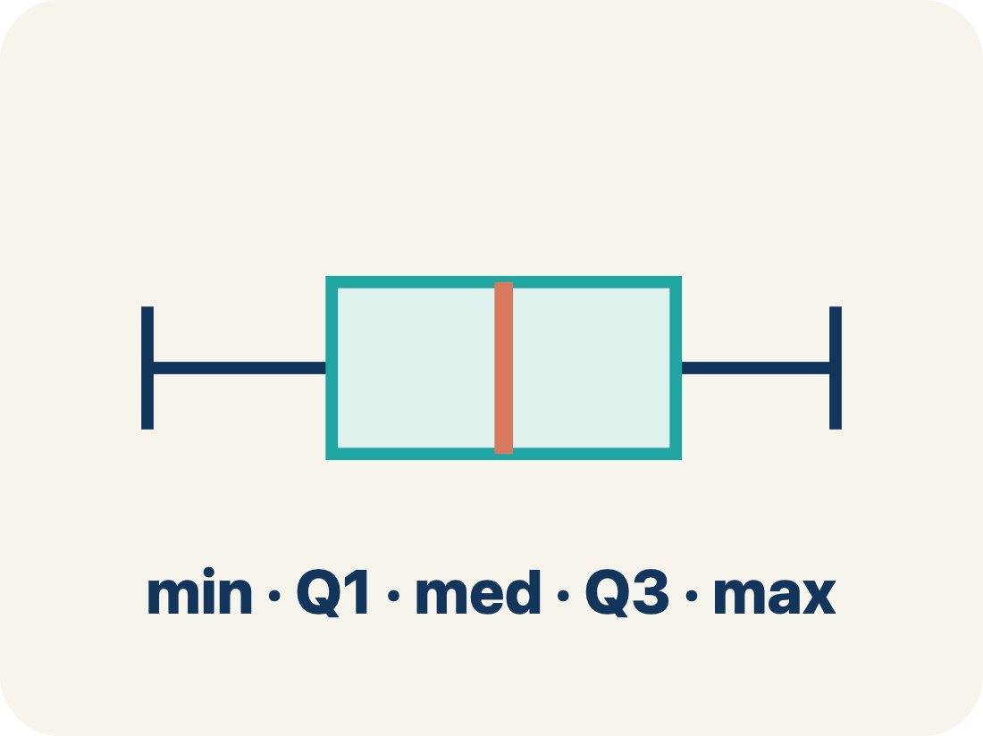
Vocabulary 2 of 7
Lesson 2-4 · Represent and Describe Data in a Box Plot
Box Plot
A graph that shows how data is spread using five key numbers.
EXAMPLE · EXPLAIN WHY IT FITS
A box from Q1 to Q3 with a line at the median, and whiskers from min to max
Use “Box Plot” to explain the example. Point to evidence.
eduwonderlab.com · Neft Teacher
9 / 47
Notes:
TEACH IN PRACTICE | Embedded facilitation | Lesson 2.4, slide 9 | VOCAB
Focus on the existing task: Vocabulary 2 of 7 Box Plot A graph that shows…
ASK (T1/3/5): Where does “Box Plot” appear in the example? Explain the meaning without reading the definition. Partner: restate the idea and ask a clarifying question.
LOOK FOR: A correct connection between the word and a feature of the example. If the student only repeats the definition, invite pointing, sketching or oral rehearsal, then ask for another explanation of this same example.
PARTICIPATION (T5/6/7): Think time before volunteers; accept a written, drawn or rehearsed entry. Students ask for evidence respectfully. Recognize a specific contribution or revision and check that both partners participate.
Source: BCPS Updated Instructional Framework Rubric (June 2020), TEACH 1–7.

Slide 10
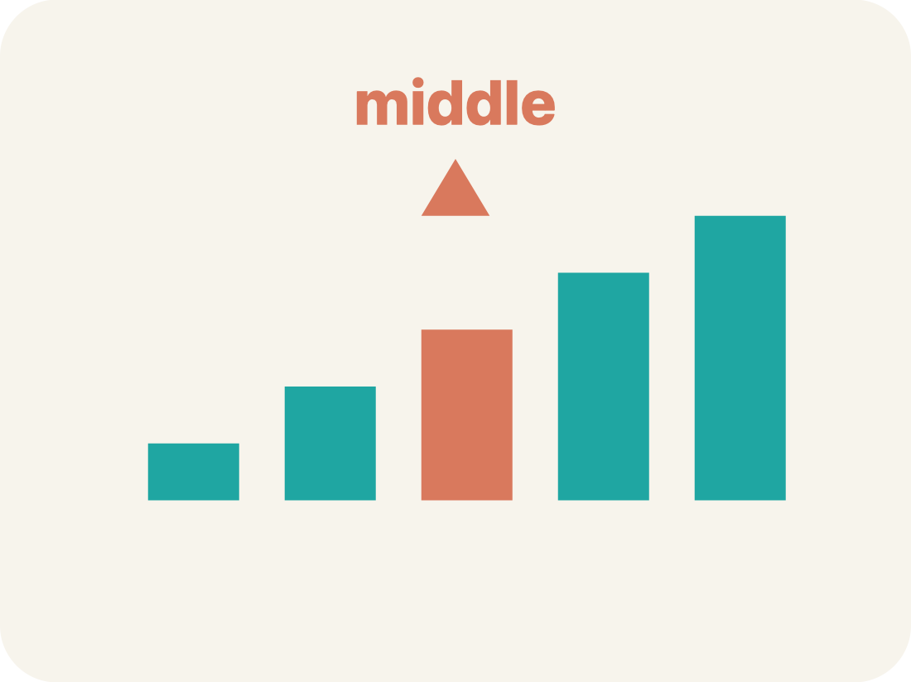
Vocabulary 3 of 7
Lesson 2-4 · Represent and Describe Data in a Box Plot
Median
The middle number when you put them in order.
EXAMPLE · EXPLAIN WHY IT FITS
Data: 10, 15, 20, 25, 30 → median is 20 (the 3rd value)
Use “Median” to explain the example. Point to evidence.
eduwonderlab.com · Neft Teacher
10 / 47
Notes:
TEACH IN PRACTICE | Embedded facilitation | Lesson 2.4, slide 10 | VOCAB
Focus on the existing task: Vocabulary 3 of 7 Median The middle number when…
ASK (T1/3/5): Where does “Median” appear in the example? Explain the meaning without reading the definition. Partner: restate the idea and ask a clarifying question.
LOOK FOR: A correct connection between the word and a feature of the example. If the student only repeats the definition, invite pointing, sketching or oral rehearsal, then ask for another explanation of this same example.
PARTICIPATION (T5/6/7): Think time before volunteers; accept a written, drawn or rehearsed entry. Students ask for evidence respectfully. Recognize a specific contribution or revision and check that both partners participate.
Source: BCPS Updated Instructional Framework Rubric (June 2020), TEACH 1–7.

Slide 11
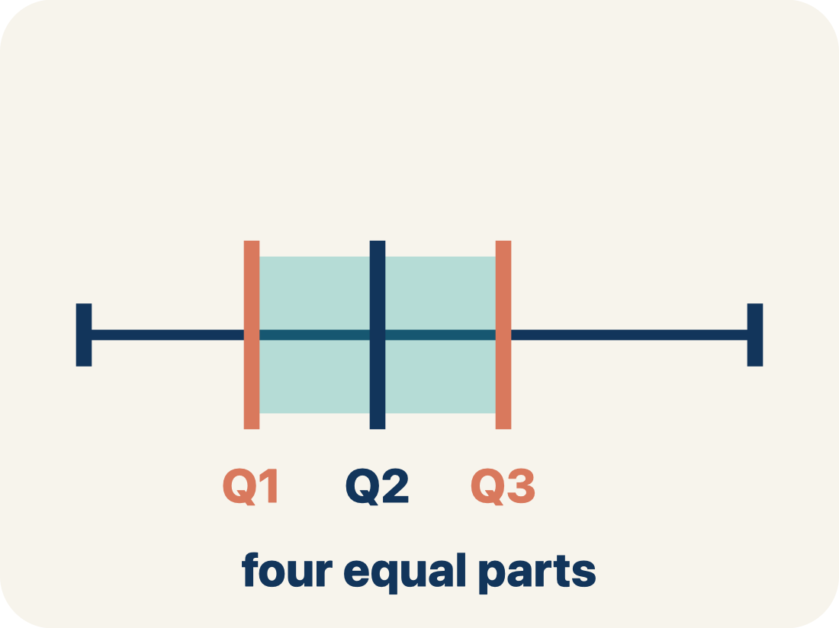
Vocabulary 4 of 7
Lesson 2-4 · Represent and Describe Data in a Box Plot
Quartile
Numbers that split the data into four equal parts.
EXAMPLE · EXPLAIN WHY IT FITS
Data: 2, 4, 6, 8, 10, 12, 14 → Q1 = 4 (median of lower half), Q3 = 12 (median of upper half)
Use “Quartile” to explain the example. Point to evidence.
eduwonderlab.com · Neft Teacher
11 / 47
Notes:
TEACH IN PRACTICE | Embedded facilitation | Lesson 2.4, slide 11 | VOCAB
Focus on the existing task: Vocabulary 4 of 7 Quartile Numbers that split…
ASK (T1/3/5): Where does “Quartile” appear in the example? Explain the meaning without reading the definition. Partner: restate the idea and ask a clarifying question.
LOOK FOR: A correct connection between the word and a feature of the example. If the student only repeats the definition, invite pointing, sketching or oral rehearsal, then ask for another explanation of this same example.
PARTICIPATION (T5/6/7): Think time before volunteers; accept a written, drawn or rehearsed entry. Students ask for evidence respectfully. Recognize a specific contribution or revision and check that both partners participate.
Source: BCPS Updated Instructional Framework Rubric (June 2020), TEACH 1–7.

Slide 12
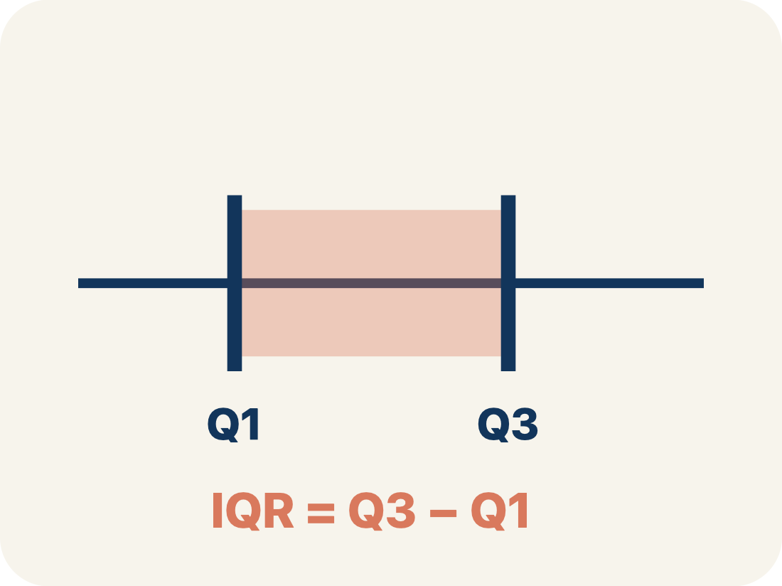
Vocabulary 5 of 7
Lesson 2-4 · Represent and Describe Data in a Box Plot
Interquartile Range
The spread of the middle half of the data (Q3 − Q1).
EXAMPLE · EXPLAIN WHY IT FITS
If Q1 = 12 and Q3 = 20, then IQR = 20 − 12 = 8 — the middle 50% spans 8 units
Use “Interquartile Range” to explain the example. Point to
evidence.
eduwonderlab.com · Neft Teacher
12 / 47
Notes:
TEACH IN PRACTICE | Embedded facilitation | Lesson 2.4, slide 12 | VOCAB
Focus on the existing task: Vocabulary 5 of 7 Interquartile Range The spread…
ASK (T1/3/5): Where does “Interquartile Range” appear in the example? Explain the meaning without reading the definition. Partner: restate the idea and ask a clarifying question.
LOOK FOR: A correct connection between the word and a feature of the example. If the student only repeats the definition, invite pointing, sketching or oral rehearsal, then ask for another explanation of this same example.
PARTICIPATION (T5/6/7): Think time before volunteers; accept a written, drawn or rehearsed entry. Students ask for evidence respectfully. Recognize a specific contribution or revision and check that both partners participate.
Source: BCPS Updated Instructional Framework Rubric (June 2020), TEACH 1–7.

Slide 13
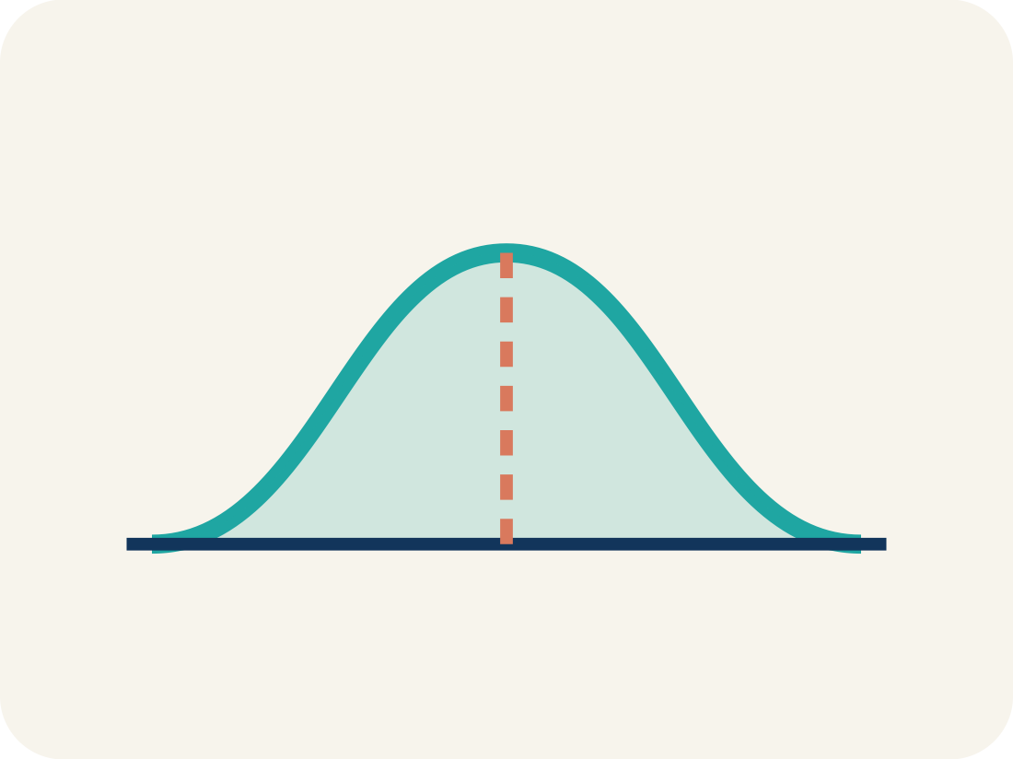
Vocabulary 6 of 7
Lesson 2-4 · Represent and Describe Data in a Box Plot
Data distribution
How the data looks: where it sits and how spread out it is.
EXAMPLE · EXPLAIN WHY IT FITS
A box plot where the median is centered in the box shows symmetric distribution
Use “Data distribution” to explain the example. Point to
evidence.
eduwonderlab.com · Neft Teacher
13 / 47
Notes:
TEACH IN PRACTICE | Embedded facilitation | Lesson 2.4, slide 13 | VOCAB
Focus on the existing task: Vocabulary 6 of 7 Data distribution How the data…
ASK (T1/3/5): Where does “Data distribution” appear in the example? Explain the meaning without reading the definition. Partner: restate the idea and ask a clarifying question.
LOOK FOR: A correct connection between the word and a feature of the example. If the student only repeats the definition, invite pointing, sketching or oral rehearsal, then ask for another explanation of this same example.
PARTICIPATION (T5/6/7): Think time before volunteers; accept a written, drawn or rehearsed entry. Students ask for evidence respectfully. Recognize a specific contribution or revision and check that both partners participate.
Source: BCPS Updated Instructional Framework Rubric (June 2020), TEACH 1–7.

Slide 14

Vocabulary 7 of 7
Lesson 2-4 · Represent and Describe Data in a Box Plot
Variability
How spread out the numbers are.
EXAMPLE · EXPLAIN WHY IT FITS
Small IQR = low variability in the middle 50%. Large IQR = high variability
Use “Variability” to explain the example. Point to evidence.
eduwonderlab.com · Neft Teacher
14 / 47
Notes:
TEACH IN PRACTICE | Embedded facilitation | Lesson 2.4, slide 14 | VOCAB
Focus on the existing task: Vocabulary 7 of 7 Variability How spread out the…
ASK (T1/3/5): Where does “Variability” appear in the example? Explain the meaning without reading the definition. Partner: restate the idea and ask a clarifying question.
LOOK FOR: A correct connection between the word and a feature of the example. If the student only repeats the definition, invite pointing, sketching or oral rehearsal, then ask for another explanation of this same example.
PARTICIPATION (T5/6/7): Think time before volunteers; accept a written, drawn or rehearsed entry. Students ask for evidence respectfully. Recognize a specific contribution or revision and check that both partners participate.
Source: BCPS Updated Instructional Framework Rubric (June 2020), TEACH 1–7.

Slide 15
Vocabulary
Lesson 2-4 · Represent and Describe Data in a Box Plot
Today’s Math Words
We learn every word — what it means and what it looks like — before we use it.
Display Data with Box Plots
Box Plot
Show a data set’s five-number summary in a box-and-whisker display
A graph that shows how data is spread using five key numbers
Median
Quartile
The middle number when you put them in order
Numbers that split the data into four equal parts
Interquartile Range
Data distribution
The spread of the middle half of the data (Q3 − Q1)
How the data looks: where it sits and how spread out it is
Variability
Explain one math word using the example.
Partner: point to evidence.
How spread out the numbers are
eduwonderlab.com · Neft Teacher
15 / 47
Notes:
TEACH IN PRACTICE | Embedded facilitation | Lesson 2.4, slide 15 | VOCAB
Focus on the existing task: Vocabulary Today’s Math Words We learn every word…
ASK (T1/3/5): Where does “the displayed term” appear in the example? Explain the meaning without reading the definition. Partner: restate the idea and ask a clarifying question.
LOOK FOR: A correct connection between the word and a feature of the example. If the student only repeats the definition, invite pointing, sketching or oral rehearsal, then ask for another explanation of this same example.
PARTICIPATION (T5/6/7): Think time before volunteers; accept a written, drawn or rehearsed entry. Students ask for evidence respectfully. Recognize a specific contribution or revision and check that both partners participate.
Source: BCPS Updated Instructional Framework Rubric (June 2020), TEACH 1–7. Earlier notes and answer keys are retained below.
EARLIER NOTES / EXISTING ANSWER KEY
Choral-read each word, its meaning, and what it looks like.
Students should use these words out loud today — listen for them in partner talk and revoice student ideas with the academic term.
UIFR: TEACH 1 · TEACH 5.

Slide 16
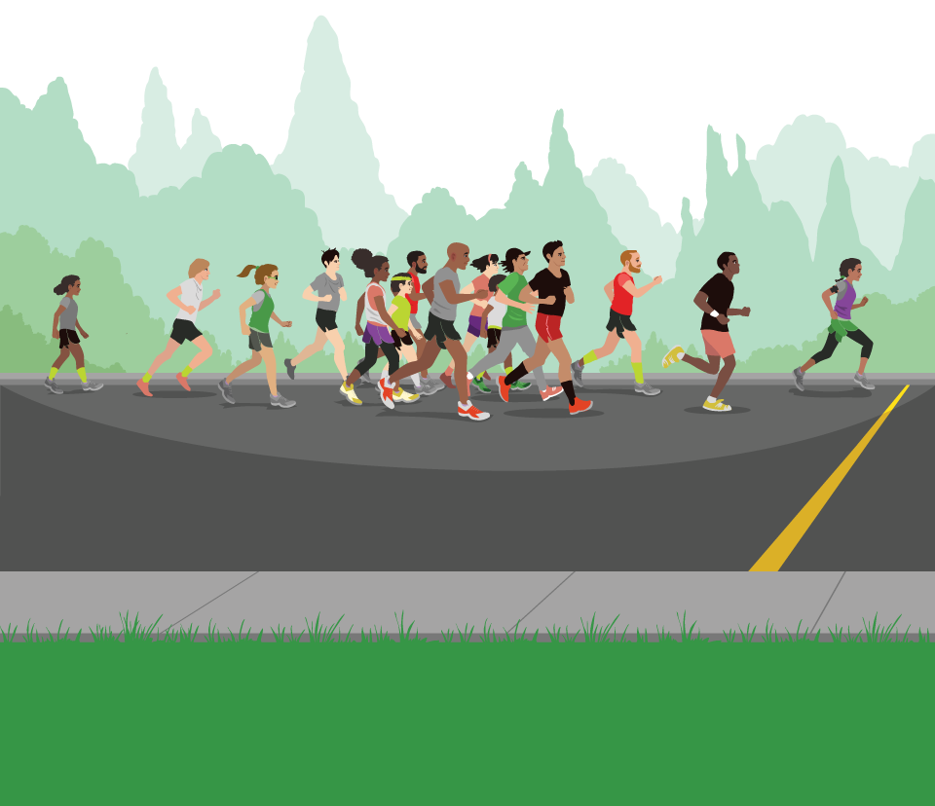

Be Curious
What do you notice?
What do you wonder?
Think first. Share a notice and a question;
build on a classmate’s idea.
Mindset
What are some ways you can contribute in math class today?
16 / 47
Notes:
TEACH IN PRACTICE | Embedded facilitation | Lesson 2.4, slide 16 | CURIOUS
Focus on the existing task: What do you notice?
LAUNCH (T2/3/5): Allow quiet observation first. Separate a notice from an inference, invite students’ own questions, and follow the existing launch before teaching a procedure.
LOOK FOR (T4): Where this task addresses it, students can locate minimum, quartiles, median and maximum. Ask which feature of their work supports the claim.
RESPOND: If this task shows the lesson misconception—assuming a longer box section contains more observations—connect the ordered source data to each boundary of the existing box plot. Have the student revise and explain the change. Use this support only where the concept occurs in the current task; otherwise respond to the displayed question.
RECHECK: If a gap is shared, revisit the existing representation together. If it is limited, give targeted support while others compare valid methods on the same task. Check the revision before moving on.
PARTICIPATION (T5/6/7): Think time before volunteers; accept a written, drawn or rehearsed entry. Students ask for evidence respectfully. Recognize a specific contribution or revision and check that both partners participate.
Source: BCPS Updated Instructional Framework Rubric (June 2020), TEACH 1–7. Earlier notes and answer keys are retained below.
EARLIER NOTES / EXISTING ANSWER KEY
Accept all noticings and wonderings — there are no wrong answers here.
Give 20–30 seconds of quiet think time before taking responses; mix cold and warm calls so it is not always the same voices.
Read the mindset question aloud and let two students respond.
UIFR: TEACH 3 · TEACH 7.

Slide 17
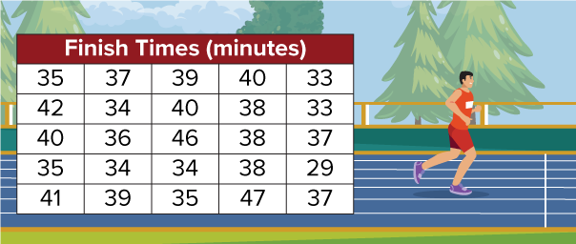

Running a Road Race
The table shows 25 sixth graders’ times to finish a 5-kilometer road race.
How can you use a data display to show and explain the distribution of the values in the data set?
TRY IT BEFORE YOU’RE SURE · Start even if you are not sure. A revised answer counts as much as a first-try answer.
Think About It:
Where have you heard or used the word distribution before?
Describing Quantities
What are the important quantities in this problem?
17 / 47
Notes:
TEACH IN PRACTICE | Embedded facilitation | Lesson 2.4, slide 17 | TASK
Focus on the existing task: The table shows 25 sixth graders’ times to finish a 5-kilometer road race. How can you use a data display to show and explain the distribution of the values in the data set?
LAUNCH (T2/3/5): Use the displayed question. Give private thinking time; then A explains while B asks for evidence. Switch roles. Each student records their own reasoning.
LOOK FOR (T4): Where this task addresses it, students can locate minimum, quartiles, median and maximum. Ask which feature of their work supports the claim.
RESPOND: If this task shows the lesson misconception—assuming a longer box section contains more observations—connect the ordered source data to each boundary of the existing box plot. Have the student revise and explain the change. Use this support only where the concept occurs in the current task; otherwise respond to the displayed question.
RECHECK: If a gap is shared, revisit the existing representation together. If it is limited, give targeted support while others compare valid methods on the same task. Check the revision before moving on.
PARTICIPATION (T5/6/7): Think time before volunteers; accept a written, drawn or rehearsed entry. Students ask for evidence respectfully. Recognize a specific contribution or revision and check that both partners participate.
Source: BCPS Updated Instructional Framework Rubric (June 2020), TEACH 1–7. Earlier notes and answer keys are retained below.
EARLIER NOTES / EXISTING ANSWER KEY
Ask the question, then hold the silence — students think or jot before anyone answers.
Take two or three responses and press with “Why?” or “How do you know?” before moving on.
UIFR: TEACH 3.
UIFR FULL | Lesson-specific facilitation
TEACH 2-3 | Session 1 task launch (UIFR PDF pp. 9-10).
Use the problem exactly as displayed. Give individual thinking time before discussion or advancing to the explanation. If the answer is already visible, ask students to reconstruct and justify it. Invite a choice of suitable representations and have students explain why their choice helps.
At the point where this concept appears, ask: “What does the length of each section tell us, and what does it not tell us about the number of observations?” Wait for evidence, invite another pathway, and have a student ask a follow-up question. Do not replace students’ reasoning with a sequence of leading steps.

Slide 18
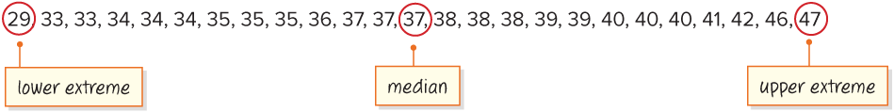
What do you notice about the number of values on either side of the median?
Record your reasoning before the reveal. Compare, then explain any revision.
Reveal:
Each side has the same number of values.
18 / 47
Notes:
TEACH IN PRACTICE | Embedded facilitation | Lesson 2.4, slide 18 | REVEAL
Focus on the existing task: Reveal: Each side has the same number of values. What do you notice about the number of values on either side of the median?
LAUNCH (T2/3/5): If an existing answer cover is present, gather an attempt before revealing. If the explanation is already visible, ask students to reconstruct and justify it. Compare reasoning and explain a revision; preserve the reveal sequence.
LOOK FOR (T4): Where this task addresses it, students can locate minimum, quartiles, median and maximum. Ask which feature of their work supports the claim.
RESPOND: If this task shows the lesson misconception—assuming a longer box section contains more observations—connect the ordered source data to each boundary of the existing box plot. Have the student revise and explain the change. Use this support only where the concept occurs in the current task; otherwise respond to the displayed question.
RECHECK: If a gap is shared, revisit the existing representation together. If it is limited, give targeted support while others compare valid methods on the same task. Check the revision before moving on.
PARTICIPATION (T5/6/7): Think time before volunteers; accept a written, drawn or rehearsed entry. Students ask for evidence respectfully. Recognize a specific contribution or revision and check that both partners participate.
Source: BCPS Updated Instructional Framework Rubric (June 2020), TEACH 1–7. Earlier notes and answer keys are retained below.
EARLIER NOTES / EXISTING ANSWER KEY
Do not click yet: collect 2–3 student answers with reasons first.
Then click to remove the cover and have students compare their thinking to the reveal — “Is this what we said? Where is it different?”
Behind the cover: Each side has the same number of values.
UIFR: TEACH 3 · TEACH 4.

Slide 19
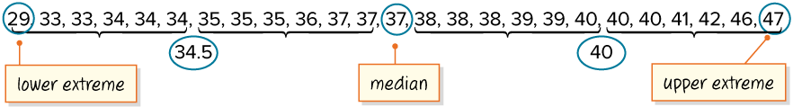
Let’s find the median of each half of the data set.
Record your reasoning before the reveal. Compare, then explain any revision.
What do you notice about how the median and medians of each half divide the data?
Reveal:
They divide the data into fourths.
19 / 47
Notes:
TEACH IN PRACTICE | Embedded facilitation | Lesson 2.4, slide 19 | REVEAL
Focus on the existing task: Let’s find the median of each half of the data set. Reveal: They divide the data into fourths. What do you notice about how the median and medians of each half divide the data?
LAUNCH (T2/3/5): If an existing answer cover is present, gather an attempt before revealing. If the explanation is already visible, ask students to reconstruct and justify it. Compare reasoning and explain a revision; preserve the reveal sequence.
LOOK FOR (T4): Where this task addresses it, students can locate minimum, quartiles, median and maximum. Ask which feature of their work supports the claim.
RESPOND: If this task shows the lesson misconception—assuming a longer box section contains more observations—connect the ordered source data to each boundary of the existing box plot. Have the student revise and explain the change. Use this support only where the concept occurs in the current task; otherwise respond to the displayed question.
RECHECK: If a gap is shared, revisit the existing representation together. If it is limited, give targeted support while others compare valid methods on the same task. Check the revision before moving on.
PARTICIPATION (T5/6/7): Think time before volunteers; accept a written, drawn or rehearsed entry. Students ask for evidence respectfully. Recognize a specific contribution or revision and check that both partners participate.
Source: BCPS Updated Instructional Framework Rubric (June 2020), TEACH 1–7. Earlier notes and answer keys are retained below.
EARLIER NOTES / EXISTING ANSWER KEY
Do not click yet: collect 2–3 student answers with reasons first.
Then click to remove the cover and have students compare their thinking to the reveal — “Is this what we said? Where is it different?”
Behind the cover: They divide the data into fourths.
UIFR: TEACH 3 · TEACH 4.

Slide 20
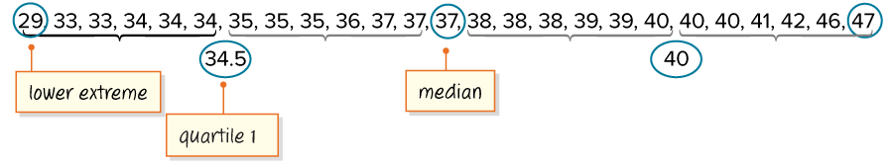
Now the data is divided into four equal parts by values called quartiles.
USE THE MATH WORDS · Use today’s math words in your explanation — not “it” and “that thing.”
The median of the lower half is quartile 1. It is another marker used to describe a set of data.​
One quarter of the data lies between the lower extreme and the first quartile.​
20 / 47
Notes:
TEACH IN PRACTICE | Embedded facilitation | Lesson 2.4, slide 20 | WORKED
Focus on the existing task: Now the data is divided into four equal parts by values called quartiles. The median of the lower half is quartile 1. It is another…
LAUNCH (T2/3/5): Ask students to explain the displayed idea or example and point to evidence. When a calculation step is shown, ask why it is valid. Have a partner restate the explanation; copying is not the check.
LOOK FOR (T4): Where this task addresses it, students can locate minimum, quartiles, median and maximum. Ask which feature of their work supports the claim.
RESPOND: If this task shows the lesson misconception—assuming a longer box section contains more observations—connect the ordered source data to each boundary of the existing box plot. Have the student revise and explain the change. Use this support only where the concept occurs in the current task; otherwise respond to the displayed question.
RECHECK: If a gap is shared, revisit the existing representation together. If it is limited, give targeted support while others compare valid methods on the same task. Check the revision before moving on.
PARTICIPATION (T5/6/7): Think time before volunteers; accept a written, drawn or rehearsed entry. Students ask for evidence respectfully. Recognize a specific contribution or revision and check that both partners participate.
Source: BCPS Updated Instructional Framework Rubric (June 2020), TEACH 1–7. Earlier notes and answer keys are retained below.
EARLIER NOTES / EXISTING ANSWER KEY
Model briefly, then hand the thinking back: ask “Why does this step work?” before showing the next one.
Quick check before moving on — thumbs or whiteboards from everyone, not volunteers.
UIFR: TEACH 2 · TEACH 3 · TEACH 4.

Slide 21
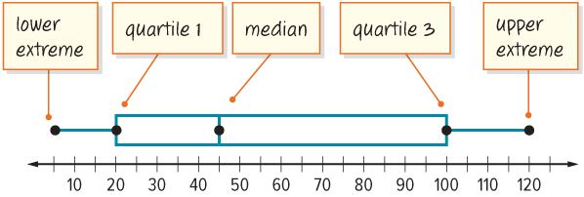
A box plot, or a box and whisker plot, is a data display that shows the distribution of the data using five markers.
Point to the labeled values that support your comparison of center or spread.
21 / 47
Notes:
TEACH IN PRACTICE | Embedded facilitation | Lesson 2.4, slide 21 | WORKED
Focus on the existing task: A box plot, or a box and whisker plot, is a data display that shows the distribution of the data using five markers.
LAUNCH (T2/3/5): Ask students to explain the displayed idea or example and point to evidence. When a calculation step is shown, ask why it is valid. Have a partner restate the explanation; copying is not the check.
LOOK FOR (T4): Where this task addresses it, students can locate minimum, quartiles, median and maximum. Ask which feature of their work supports the claim.
RESPOND: If this task shows the lesson misconception—assuming a longer box section contains more observations—connect the ordered source data to each boundary of the existing box plot. Have the student revise and explain the change. Use this support only where the concept occurs in the current task; otherwise respond to the displayed question.
RECHECK: If a gap is shared, revisit the existing representation together. If it is limited, give targeted support while others compare valid methods on the same task. Check the revision before moving on.
PARTICIPATION (T5/6/7): Think time before volunteers; accept a written, drawn or rehearsed entry. Students ask for evidence respectfully. Recognize a specific contribution or revision and check that both partners participate.
Source: BCPS Updated Instructional Framework Rubric (June 2020), TEACH 1–7. Earlier notes and answer keys are retained below.
EARLIER NOTES / EXISTING ANSWER KEY
Model briefly, then hand the thinking back: ask “Why does this step work?” before showing the next one.
Quick check before moving on — thumbs or whiteboards from everyone, not volunteers.
UIFR: TEACH 2 · TEACH 3 · TEACH 4.

Slide 22
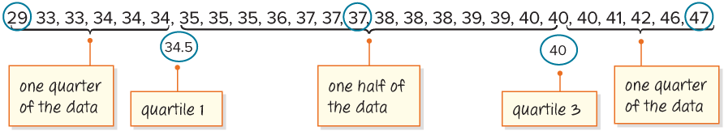
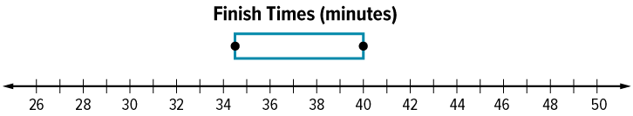
Let’s create a box plot for the data set. First, draw the box of the box plot.
HOW DO YOU KNOW? · Ask your partner “How do you know?” Answer by pointing to your own work.
Reveal:
It begins at quartile 1 and ends at quartile 3.
What do you notice about the box of a box plot?
22 / 47
Notes:
TEACH IN PRACTICE | Embedded facilitation | Lesson 2.4, slide 22 | REVEAL
Focus on the existing task: What do you notice about the box of a box plot?
LAUNCH (T2/3/5): If an existing answer cover is present, gather an attempt before revealing. If the explanation is already visible, ask students to reconstruct and justify it. Compare reasoning and explain a revision; preserve the reveal sequence.
LOOK FOR (T4): Where this task addresses it, students can locate minimum, quartiles, median and maximum. Ask which feature of their work supports the claim.
RESPOND: If this task shows the lesson misconception—assuming a longer box section contains more observations—connect the ordered source data to each boundary of the existing box plot. Have the student revise and explain the change. Use this support only where the concept occurs in the current task; otherwise respond to the displayed question.
RECHECK: If a gap is shared, revisit the existing representation together. If it is limited, give targeted support while others compare valid methods on the same task. Check the revision before moving on.
PARTICIPATION (T5/6/7): Think time before volunteers; accept a written, drawn or rehearsed entry. Students ask for evidence respectfully. Recognize a specific contribution or revision and check that both partners participate.
Source: BCPS Updated Instructional Framework Rubric (June 2020), TEACH 1–7. Earlier notes and answer keys are retained below.
EARLIER NOTES / EXISTING ANSWER KEY
Do not click yet: collect 2–3 student answers with reasons first.
Then click to remove the cover and have students compare their thinking to the reveal — “Is this what we said? Where is it different?”
Behind the cover: It begins at quartile 1 and ends at quartile 3.
UIFR: TEACH 3 · TEACH 4.

Slide 23
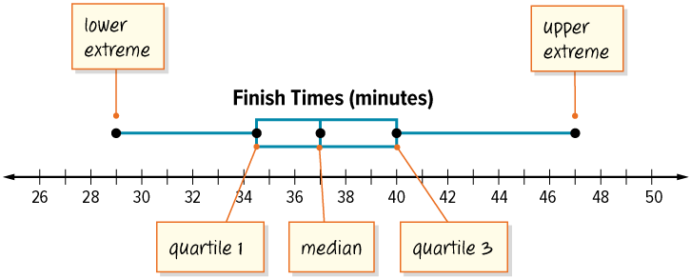
Two quarters, or one half, of the data lie between the first quartile and the third quartile.
Between which two values does the middle half of the data fall?
Reveal:
34.5 minutes and 40 minutes
Record your reasoning before the reveal.
Compare, then explain any revision.
23 / 47
Notes:
TEACH IN PRACTICE | Embedded facilitation | Lesson 2.4, slide 23 | REVEAL
Focus on the existing task: Between which two values does the middle half of the data fall?
LAUNCH (T2/3/5): If an existing answer cover is present, gather an attempt before revealing. If the explanation is already visible, ask students to reconstruct and justify it. Compare reasoning and explain a revision; preserve the reveal sequence.
LOOK FOR (T4): Where this task addresses it, students can locate minimum, quartiles, median and maximum. Ask which feature of their work supports the claim.
RESPOND: If this task shows the lesson misconception—assuming a longer box section contains more observations—connect the ordered source data to each boundary of the existing box plot. Have the student revise and explain the change. Use this support only where the concept occurs in the current task; otherwise respond to the displayed question.
RECHECK: If a gap is shared, revisit the existing representation together. If it is limited, give targeted support while others compare valid methods on the same task. Check the revision before moving on.
PARTICIPATION (T5/6/7): Think time before volunteers; accept a written, drawn or rehearsed entry. Students ask for evidence respectfully. Recognize a specific contribution or revision and check that both partners participate.
Source: BCPS Updated Instructional Framework Rubric (June 2020), TEACH 1–7. Earlier notes and answer keys are retained below.
EARLIER NOTES / EXISTING ANSWER KEY
Students should have shared predictions before this reveal.
Have them compare their thinking to what is shown: “Is this the same as what we said? Where is it different?”
Press one student to explain the reveal in their own words.
UIFR: TEACH 3 · TEACH 4.

Slide 24
Let’s Explore More
What does the length of the box and whiskers tell you about the spread of the data in the box plot?​
Try first. Point to the labeled
values that support your
comparison of center or spread.
Workspace
24 / 47
Notes:
TEACH IN PRACTICE | Embedded facilitation | Lesson 2.4, slide 24 | PRACTICE
Focus on the existing task: Let’s Explore More Workspace What does the length of the box and whiskers tell you about the spread of the data in the box plot?
LAUNCH (T2/3/5): Use the displayed question. Give private thinking time; then A explains while B asks for evidence. Switch roles. Each student records their own reasoning.
LOOK FOR (T4): Where this task addresses it, students can compare center and spread in context. Ask which feature of their work supports the claim.
RESPOND: If this task shows the lesson misconception—assuming a longer box section contains more observations—connect the ordered source data to each boundary of the existing box plot. Have the student revise and explain the change. Use this support only where the concept occurs in the current task; otherwise respond to the displayed question.
RECHECK: If a gap is shared, revisit the existing representation together. If it is limited, give targeted support while others compare valid methods on the same task. Check the revision before moving on.
PARTICIPATION (T5/6/7): Think time before volunteers; accept a written, drawn or rehearsed entry. Students ask for evidence respectfully. Recognize a specific contribution or revision and check that both partners participate.
Source: BCPS Updated Instructional Framework Rubric (June 2020), TEACH 1–7. Earlier notes and answer keys are retained below.
EARLIER NOTES / EXISTING ANSWER KEY
Extension for partners or table groups — students choose their approach and use the workspace to show thinking.
Push with “Convince me,” and have two groups with different approaches share.
This is where students stretch past the worked example.
UIFR: TEACH 2 · TEACH 5.
UIFR FULL | Lesson-specific facilitation
TEACH 4-5 | Session 1 discussion and checkpoint (UIFR PDF pp. 11-12).
Collect a brief response from every student to the existing prompt before hearing volunteers. Partners take turns explaining and asking for evidence: “I understand ___; what supports ___?” Offer rehearsal or an annotated model for students who need language support. Each student records their own reasoning.
Look specifically for: assuming a longer box section contains more observations. If it appears, connect the ordered source data to each boundary of the existing box plot; then ask the student to revise the same response and explain the change. If evidence is secure, have students compare a second valid pathway or state why their approach works. Choose the next step from the responses, not a preset pace.

Slide 25
LESSON 2.4 / DISCUSS THE TASK
Explain and compare
Use the task you just explored.
TAKE TURNS
What does the length of each section tell us, and what does it not tell us about the number of observations?
Explain
“I know this because…”
Ask
“Where does your work show that?”
Point to evidence in your work.
Then compare your approach with a partner’s.
JUSTIFY IT · Say it like this: “I know ______ because ______.”
Listen to understand. Ask for evidence. Make room for every voice.
Notes:
TEACH IN PRACTICE | Embedded facilitation | Lesson 2.4, slide 25 | PRIOR_INSERT
Focus on the existing task: Point to evidence in your work. Then compare your approach with a partner’s. TAKE TURNS Explain “I know this because…” Ask “Where does your work show that?
CONNECT (T1/4): Ask students to restate the displayed goal or key idea and connect it to earlier work. Relevant lesson evidence: locate minimum, quartiles, median and maximum; compare center and spread in context. Use only the criterion that matches the current session.
SHOW PROGRESS: Students point to their own existing work, explain what improved after feedback, and name a next step. Pair confidence ratings with actual evidence.
PARTICIPATION (T5/6/7): Think time before volunteers; accept a written, drawn or rehearsed entry. Students ask for evidence respectfully. Recognize a specific contribution or revision and check that both partners participate.
Source: BCPS Updated Instructional Framework Rubric (June 2020), TEACH 1–7.

Slide 26
How can you organize the data?
Compare your reasoning with the explanation. Explain any revision you make.
Reveal:
We can order the values from least to greatest.
26 / 47
Notes:
TEACH IN PRACTICE | Embedded facilitation | Lesson 2.4, slide 26 | REVEAL
Focus on the existing task: How can you organize the data?
LAUNCH (T2/3/5): If an existing answer cover is present, gather an attempt before revealing. If the explanation is already visible, ask students to reconstruct and justify it. Compare reasoning and explain a revision; preserve the reveal sequence.
LOOK FOR (T4): Where this task addresses it, students can locate minimum, quartiles, median and maximum. Ask which feature of their work supports the claim.
RESPOND: If this task shows the lesson misconception—assuming a longer box section contains more observations—connect the ordered source data to each boundary of the existing box plot. Have the student revise and explain the change. Use this support only where the concept occurs in the current task; otherwise respond to the displayed question.
RECHECK: If a gap is shared, revisit the existing representation together. If it is limited, give targeted support while others compare valid methods on the same task. Check the revision before moving on.
PARTICIPATION (T5/6/7): Think time before volunteers; accept a written, drawn or rehearsed entry. Students ask for evidence respectfully. Recognize a specific contribution or revision and check that both partners participate.
Source: BCPS Updated Instructional Framework Rubric (June 2020), TEACH 1–7.

Slide 27
There are an equal number of values on either side of the median. The median divides the data set into two halves—a lower half and an upper half.
How can you represent the center of the lower and upper halves of the data?
Reveal:
We can find the median of each half.
27 / 47
Notes:
TEACH IN PRACTICE | Embedded facilitation | Lesson 2.4, slide 27 | REVEAL
Focus on the existing task: How can you represent the center of the lower and upper halves of the data?
LAUNCH (T2/3/5): If an existing answer cover is present, gather an attempt before revealing. If the explanation is already visible, ask students to reconstruct and justify it. Compare reasoning and explain a revision; preserve the reveal sequence.
LOOK FOR (T4): Where this task addresses it, students can locate minimum, quartiles, median and maximum. Ask which feature of their work supports the claim.
RESPOND: If this task shows the lesson misconception—assuming a longer box section contains more observations—connect the ordered source data to each boundary of the existing box plot. Have the student revise and explain the change. Use this support only where the concept occurs in the current task; otherwise respond to the displayed question.
RECHECK: If a gap is shared, revisit the existing representation together. If it is limited, give targeted support while others compare valid methods on the same task. Check the revision before moving on.
PARTICIPATION (T5/6/7): Think time before volunteers; accept a written, drawn or rehearsed entry. Students ask for evidence respectfully. Recognize a specific contribution or revision and check that both partners participate.
Source: BCPS Updated Instructional Framework Rubric (June 2020), TEACH 1–7.

Slide 28
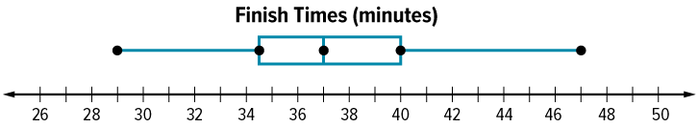
A line divides the box at the median. Finally, draw the “whiskers” of the box plot.
Reveal:
They go from the box edge to the lower and upper extremes.
What do you notice about the “whiskers”?
28 / 47
Notes:
TEACH IN PRACTICE | Embedded facilitation | Lesson 2.4, slide 28 | REVEAL
Focus on the existing task: What do you notice about the “whiskers”?
LAUNCH (T2/3/5): If an existing answer cover is present, gather an attempt before revealing. If the explanation is already visible, ask students to reconstruct and justify it. Compare reasoning and explain a revision; preserve the reveal sequence.
LOOK FOR (T4): Where this task addresses it, students can locate minimum, quartiles, median and maximum. Ask which feature of their work supports the claim.
RESPOND: If this task shows the lesson misconception—assuming a longer box section contains more observations—connect the ordered source data to each boundary of the existing box plot. Have the student revise and explain the change. Use this support only where the concept occurs in the current task; otherwise respond to the displayed question.
RECHECK: If a gap is shared, revisit the existing representation together. If it is limited, give targeted support while others compare valid methods on the same task. Check the revision before moving on.
PARTICIPATION (T5/6/7): Think time before volunteers; accept a written, drawn or rehearsed entry. Students ask for evidence respectfully. Recognize a specific contribution or revision and check that both partners participate.
Source: BCPS Updated Instructional Framework Rubric (June 2020), TEACH 1–7.

Slide 29
Session 2 Warm-Up
Lesson 2-4 · Represent and Describe Data in a Box Plot
Session 2 Warm-Up
Quick review from Session 1 · about 4 minutes
1
How many values make up a box plot summary?
2
The central box in a box plot spans from:
A
3
A
Min to Max
B
4
B
Q1 to Q3
C
5
C
0 to 100
D
6
D
Mean to Mode
3
What percent of data lies inside the central box?
4
The line drawn inside the box represents the:
A
25%
A
Mean
B
50%
B
Median (Q2)
C
75%
C
Range
D
100%
D
Minimum
eduwonderlab.com · Neft Teacher
29 / 47
Notes:
TEACH IN PRACTICE | Embedded facilitation | Lesson 2.4, slide 29 | WARMUP
Focus on the existing task: A 3 B 4 C 5 D 6 2 The central box in a box plot spans from: A Min to Max B Q1 to Q3 C 0 to 100 D Mean to Mode 3 What percent of data lies inside the central box?
GATHER EVIDENCE (T4/6): Keep the original items. Students try independently, mark an uncertain item, and explain one method before checking. Use the existing key when present.
RESPOND: Distinguish a calculation slip from a reasoning gap. Give one next step on the same item; have students revise in a second color. Use the responses to choose flexible support for today’s lesson.
PARTICIPATION (T5/6/7): Think time before volunteers; accept a written, drawn or rehearsed entry. Students ask for evidence respectfully. Recognize a specific contribution or revision and check that both partners participate.
Source: BCPS Updated Instructional Framework Rubric (June 2020), TEACH 1–7. Earlier notes and answer keys are retained below.
EARLIER NOTES / EXISTING ANSWER KEY
Warm-up routine: students start silently on entry; keep it to about 4 minutes.
Circulate and note who is stuck — use what you see to choose who you check on first today.
Go over answers quickly; ask one student to explain a step, not just say the answer.
UIFR: TEACH 4 · TEACH 6.
UIFR FULL | Lesson-specific facilitation
TEACH 1 | Session 2 purpose and evidence (UIFR PDF p. 8).
Have students restate the displayed session goal in their own words and connect it to the existing context or a familiar experience they choose to share. Use the current session goal to select from these lesson-wide evidence criteria; do not frontload a later-session procedure.
Look for: locate minimum, quartiles, median and maximum; compare center and spread in context. Ask: “Which part of your work would show this?” Revisit that evidence after the task; a confidence rating alone is not evidence of understanding.

Slide 30
STUDENT MOVES
Lesson 2-4
Your moves
USE YOUR TOOLS · Reach for your notes, a model, or a manipulative before you reach for an answer.
ASK THE CLASS · Write one question about this that you could ask the class.
YOU KNOW THE ROUTINE · Read → plan → solve → check. Do all four, in that order.
30 / 47

Slide 31
Review Notes
Lesson 2-4 · Represent and Describe Data in a Box Plot
Review Notes — Session 2
Copy. Explain. Check.
WHY IT MATTERS · Finish this: “This is worth knowing because ______.”
Five-Number Summary
1
Box plots display Minimum, First Quartile (Q1), Median, Third Quartile (Q3), and Maximum.
Quartile Distribution
2
Each whisker and each half of the box holds exactly 25% of all data values.
Interquartile Spread
3
The box length shows the middle 50% of the distribution.
eduwonderlab.com · Neft Teacher
31 / 47
Notes:
TEACH IN PRACTICE | Embedded facilitation | Lesson 2.4, slide 30 | NOTES
Focus on the existing task: Review Notes Review Notes — Session 2 Copy into…
ROUTINE (T1/2/4): Read or copy the original notes, cover one line, and explain it using the displayed example. Reopen and correct. Copying alone is not evidence of understanding.
LOOK FOR: A link between a symbol, quantity or feature and the explanation. If missing, point back to that feature and have the student try again; fade the prompt once they can explain.
PARTICIPATION (T5/6/7): Think time before volunteers; accept a written, drawn or rehearsed entry. Students ask for evidence respectfully. Recognize a specific contribution or revision and check that both partners participate.
Source: BCPS Updated Instructional Framework Rubric (June 2020), TEACH 1–7. Earlier notes and answer keys are retained below.
EARLIER NOTES / EXISTING ANSWER KEY
Copy routine: read one line at a time; students copy, then explain that line to a partner.
Keep it brisk — the understanding work happens in the examples, not the copying.
UIFR: TEACH 1 · TEACH 6.

Slide 32
Session 2
Represent and Describe Data in a Box Plot​
SELF-CHECK · Mark it: ✓ got it · ~ almost · ? stuck. Then fix one thing before we move on.
32 / 47
Notes:
TEACH IN PRACTICE | Embedded facilitation | Lesson 2.4, slide 31 | DIVIDER
Focus on the existing task: Session 2 Represent and Describe Data in a Box Plot
TRANSITION (T6/7): Students confirm materials, roles, how to request help, and the next response routine. Ask a student to restate it. Keep teacher-only slides hidden.
PARTICIPATION (T5/6/7): Think time before volunteers; accept a written, drawn or rehearsed entry. Students ask for evidence respectfully. Recognize a specific contribution or revision and check that both partners participate.
Source: BCPS Updated Instructional Framework Rubric (June 2020), TEACH 1–7. Earlier notes and answer keys are retained below.
EARLIER NOTES / EXISTING ANSWER KEY
Transition cue: state what materials are out and what success looks like this session.
Keep the changeover under a minute.
UIFR: TEACH 6.

Slide 33
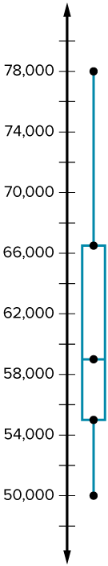
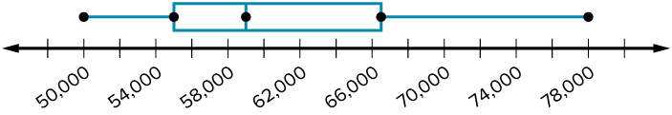
Be Curious
How are they the same?
How are they different?
Think first. Share a notice and a
question; build on a classmate’s
idea.
Mindset
What are some ways you are contributing in math class today?
33 / 47
Notes:
TEACH IN PRACTICE | Embedded facilitation | Lesson 2.4, slide 32 | CURIOUS
Focus on the existing task: How are they the same?
LAUNCH (T2/3/5): Allow quiet observation first. Separate a notice from an inference, invite students’ own questions, and follow the existing launch before teaching a procedure.
LOOK FOR (T4): Where this task addresses it, students can locate minimum, quartiles, median and maximum. Ask which feature of their work supports the claim.
RESPOND: If this task shows the lesson misconception—assuming a longer box section contains more observations—connect the ordered source data to each boundary of the existing box plot. Have the student revise and explain the change. Use this support only where the concept occurs in the current task; otherwise respond to the displayed question.
RECHECK: If a gap is shared, revisit the existing representation together. If it is limited, give targeted support while others compare valid methods on the same task. Check the revision before moving on.
PARTICIPATION (T5/6/7): Think time before volunteers; accept a written, drawn or rehearsed entry. Students ask for evidence respectfully. Recognize a specific contribution or revision and check that both partners participate.
Source: BCPS Updated Instructional Framework Rubric (June 2020), TEACH 1–7. Earlier notes and answer keys are retained below.
EARLIER NOTES / EXISTING ANSWER KEY
Accept all noticings and wonderings — there are no wrong answers here.
Give 20–30 seconds of quiet think time before taking responses; mix cold and warm calls so it is not always the same voices.
Read the mindset question aloud and let two students respond.
UIFR: TEACH 3 · TEACH 7.

Slide 34
Who Ran Faster?
The sixth graders and seventh graders want to compare their finish times in the 5-kilometer road race.
Representing
How can you represent the relationship between quantities?
Grade 6 Road Race
Grade 6 Finish Times (minutes)
35 | 37 | 39 | 40 | 33
42 | 34 | 40 | 38 | 33
40 | 36 | 46 | 38 | 37
35 | 34 | 34 | 38 | 29
41 | 39 | 35 | 47 | 37
Grade 7 Road Race
Grade 7 Finish Times (minutes)
29 | 30 | 40 | 37 | 48
35 | 38 | 31 | 37 | 35
38 | 32 | 37 | 34 | 34
36 | 36 | 35 | 35 | 36
40 | 34 | 41 | 33 | 39
How do the finish times of the students in the two grades compare?
34 / 47
Notes:
TEACH IN PRACTICE | Embedded facilitation | Lesson 2.4, slide 33 | TASK
Focus on the existing task: How do the finish times of the students in the two grades compare?
LAUNCH (T2/3/5): Use the displayed question. Give private thinking time; then A explains while B asks for evidence. Switch roles. Each student records their own reasoning.
LOOK FOR (T4): Where this task addresses it, students can compare center and spread in context. Ask which feature of their work supports the claim.
RESPOND: If this task shows the lesson misconception—assuming a longer box section contains more observations—connect the ordered source data to each boundary of the existing box plot. Have the student revise and explain the change. Use this support only where the concept occurs in the current task; otherwise respond to the displayed question.
RECHECK: If a gap is shared, revisit the existing representation together. If it is limited, give targeted support while others compare valid methods on the same task. Check the revision before moving on.
PARTICIPATION (T5/6/7): Think time before volunteers; accept a written, drawn or rehearsed entry. Students ask for evidence respectfully. Recognize a specific contribution or revision and check that both partners participate.
Source: BCPS Updated Instructional Framework Rubric (June 2020), TEACH 1–7. Earlier notes and answer keys are retained below.
EARLIER NOTES / EXISTING ANSWER KEY
Model briefly, then hand the thinking back: ask “Why does this step work?” before showing the next one.
Quick check before moving on — thumbs or whiteboards from everyone, not volunteers.
UIFR: TEACH 2 · TEACH 3 · TEACH 4.
UIFR FULL | Lesson-specific facilitation
TEACH 2-3 | Session 2 task launch (UIFR PDF pp. 9-10).
Use the problem exactly as displayed. Give individual thinking time before discussion or advancing to the explanation. If the answer is already visible, ask students to reconstruct and justify it. Invite a choice of suitable representations and have students explain why their choice helps.
At the point where this concept appears, ask: “What does the length of each section tell us, and what does it not tell us about the number of observations?” Wait for evidence, invite another pathway, and have a student ask a follow-up question. Do not replace students’ reasoning with a sequence of leading steps.

Slide 35
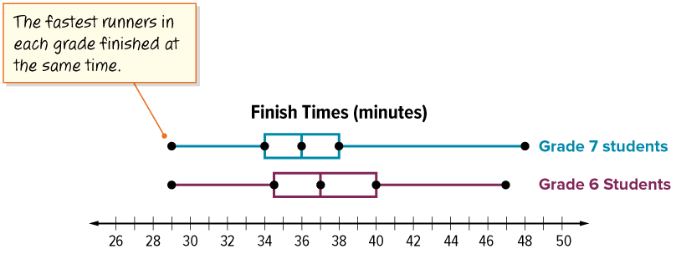
How do the median times for each grade compare?
Reveal:
The median time for Grade 7 is 36 minutes. The median time for Grade 6 is 37 minutes. So, the median time for Grade 7 is 1 minute faster.
35 / 47
Notes:
TEACH IN PRACTICE | Embedded facilitation | Lesson 2.4, slide 34 | REVEAL
Focus on the existing task: Reveal: The median time for Grade 7 is 36 minutes. The median time for Grade 6 is 37 minutes. So, the median time for Grade 7 is 1 minute faster. How do the median times for each grade compare?
LAUNCH (T2/3/5): If an existing answer cover is present, gather an attempt before revealing. If the explanation is already visible, ask students to reconstruct and justify it. Compare reasoning and explain a revision; preserve the reveal sequence.
LOOK FOR (T4): Where this task addresses it, students can locate minimum, quartiles, median and maximum. Ask which feature of their work supports the claim.
RESPOND: If this task shows the lesson misconception—assuming a longer box section contains more observations—connect the ordered source data to each boundary of the existing box plot. Have the student revise and explain the change. Use this support only where the concept occurs in the current task; otherwise respond to the displayed question.
RECHECK: If a gap is shared, revisit the existing representation together. If it is limited, give targeted support while others compare valid methods on the same task. Check the revision before moving on.
PARTICIPATION (T5/6/7): Think time before volunteers; accept a written, drawn or rehearsed entry. Students ask for evidence respectfully. Recognize a specific contribution or revision and check that both partners participate.
Source: BCPS Updated Instructional Framework Rubric (June 2020), TEACH 1–7. Earlier notes and answer keys are retained below.
EARLIER NOTES / EXISTING ANSWER KEY
Do not click yet: collect 2–3 student answers with reasons first.
Then click to remove the cover and have students compare their thinking to the reveal — “Is this what we said? Where is it different?”
Behind the cover: The median time for Grade 7 is 36 minutes. The median time for Grade 6 is 37 minutes. So, the median time for Grade 7 is 1 minute faster.
UIFR: TEACH 3 · TEACH 4.

Slide 36
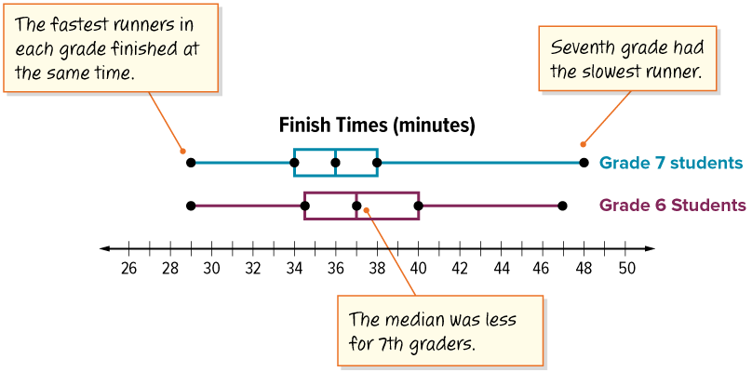
Let’s Explore More
How do the slowest and fastest finish times compare between the sixth and seventh graders?
36 / 47
Notes:
TEACH IN PRACTICE | Embedded facilitation | Lesson 2.4, slide 35 | PRACTICE
Focus on the existing task: How do the slowest and fastest finish times compare between the sixth and seventh graders?
LAUNCH (T2/3/5): Use the displayed question. Give private thinking time; then A explains while B asks for evidence. Switch roles. Each student records their own reasoning.
LOOK FOR (T4): Where this task addresses it, students can compare center and spread in context. Ask which feature of their work supports the claim.
RESPOND: If this task shows the lesson misconception—assuming a longer box section contains more observations—connect the ordered source data to each boundary of the existing box plot. Have the student revise and explain the change. Use this support only where the concept occurs in the current task; otherwise respond to the displayed question.
RECHECK: If a gap is shared, revisit the existing representation together. If it is limited, give targeted support while others compare valid methods on the same task. Check the revision before moving on.
PARTICIPATION (T5/6/7): Think time before volunteers; accept a written, drawn or rehearsed entry. Students ask for evidence respectfully. Recognize a specific contribution or revision and check that both partners participate.
Source: BCPS Updated Instructional Framework Rubric (June 2020), TEACH 1–7. Earlier notes and answer keys are retained below.
EARLIER NOTES / EXISTING ANSWER KEY
Extension for partners or table groups — students choose their approach and use the workspace to show thinking.
Push with “Convince me,” and have two groups with different approaches share.
This is where students stretch past the worked example.
UIFR: TEACH 2 · TEACH 5.
UIFR FULL | Lesson-specific facilitation
TEACH 4-5 | Session 2 discussion and checkpoint (UIFR PDF pp. 11-12).
Collect a brief response from every student to the existing prompt before hearing volunteers. Partners take turns explaining and asking for evidence: “I understand ___; what supports ___?” Offer rehearsal or an annotated model for students who need language support. Each student records their own reasoning.
Look specifically for: assuming a longer box section contains more observations. If it appears, connect the ordered source data to each boundary of the existing box plot; then ask the student to revise the same response and explain the change. If evidence is secure, have students compare a second valid pathway or state why their approach works. Choose the next step from the responses, not a preset pace.

Slide 37
STUDENT MOVES
Lesson 2-4
Your moves
PROVE IT · Find the evidence in the problem that makes your answer right — not just the answer.
ADD ON · Add on: “I agree because ______.” or “I see it differently because ______.”
TWO MINUTES SOLO · Two minutes on your own, then compare. Bring one thing you tried, even if it did not work.
37 / 47

Slide 38
LESSON 2.4 / CHECK YOUR WORK
Pause. Check. Improve.
CHECK
A mistake to watch for: assuming a longer box section contains more observations.
TRY
Connect the ordered source data to each boundary of the given box plot.
REVISE
Use that check on the task you just completed. Correct or strengthen one part, and explain why.
REVISE NOW · Change one answer and write why you changed it. A revision is evidence of learning.
Listen to understand. Ask for evidence. Make room for every voice.
Notes:
TEACH IN PRACTICE | Embedded facilitation | Lesson 2.4, slide 36 | PRIOR_INSERT
Focus on the existing task: LESSON 2.4 / CHECK YOUR WORK Pause. Check. Improve. Listen to understand. Ask for evidence. Make room for every voice. CHECK A mistake…
CONNECT (T1/4): Ask students to restate the displayed goal or key idea and connect it to earlier work. Relevant lesson evidence: locate minimum, quartiles, median and maximum; compare center and spread in context. Use only the criterion that matches the current session.
SHOW PROGRESS: Students point to their own existing work, explain what improved after feedback, and name a next step. Pair confidence ratings with actual evidence.
PARTICIPATION (T5/6/7): Think time before volunteers; accept a written, drawn or rehearsed entry. Students ask for evidence respectfully. Recognize a specific contribution or revision and check that both partners participate.
Source: BCPS Updated Instructional Framework Rubric (June 2020), TEACH 1–7.

Slide 39
The sixth graders and seventh graders want to compare their finish times in the 5-kilometer road race. How do the finish times of the students in the two grades compare?
Grade 6 Road Race
Grade 6 Finish Times (minutes)
35 | 37 | 39 | 40 | 33
42 | 34 | 40 | 38 | 33
40 | 36 | 46 | 38 | 37
35 | 34 | 34 | 38 | 29
41 | 39 | 35 | 47 | 37
Grade 7 Road Race
Grade 7 Finish Times (minutes)
29 | 30 | 40 | 37 | 48
35 | 38 | 31 | 37 | 35
38 | 32 | 37 | 34 | 34
36 | 36 | 35 | 35 | 36
40 | 34 | 41 | 33 | 39
Reveal:
Each data value represents the time it takes one sixth or seventh grader to finish a 5-kilometer race.
What does each value represent in the data set?
39 / 47
Notes:
TEACH IN PRACTICE | Embedded facilitation | Lesson 2.4, slide 37 | REVEAL
Focus on the existing task: What does each value represent in the data set?
LAUNCH (T2/3/5): If an existing answer cover is present, gather an attempt before revealing. If the explanation is already visible, ask students to reconstruct and justify it. Compare reasoning and explain a revision; preserve the reveal sequence.
LOOK FOR (T4): Where this task addresses it, students can compare center and spread in context. Ask which feature of their work supports the claim.
RESPOND: If this task shows the lesson misconception—assuming a longer box section contains more observations—connect the ordered source data to each boundary of the existing box plot. Have the student revise and explain the change. Use this support only where the concept occurs in the current task; otherwise respond to the displayed question.
RECHECK: If a gap is shared, revisit the existing representation together. If it is limited, give targeted support while others compare valid methods on the same task. Check the revision before moving on.
PARTICIPATION (T5/6/7): Think time before volunteers; accept a written, drawn or rehearsed entry. Students ask for evidence respectfully. Recognize a specific contribution or revision and check that both partners participate.
Source: BCPS Updated Instructional Framework Rubric (June 2020), TEACH 1–7.

Slide 40
STUDENT MOVES
Lesson 2-4
Your move
SPECIFIC FEEDBACK · Trade work. Give one specific comment: “This part is clear because ______.”
40 / 47

Slide 41
The sixth graders and seventh graders want to compare their finish times in the 5-kilometer road race. How do the finish times of the students in the two grades compare?
Grade 6 Road Race
Grade 6 Finish Times (minutes)
35 | 37 | 39 | 40 | 33
42 | 34 | 40 | 38 | 33
40 | 36 | 46 | 38 | 37
35 | 34 | 34 | 38 | 29
41 | 39 | 35 | 47 | 37
Grade 7 Road Race
Grade 7 Finish Times (minutes)
29 | 30 | 40 | 37 | 48
35 | 38 | 31 | 37 | 35
38 | 32 | 37 | 34 | 34
36 | 36 | 35 | 35 | 36
40 | 34 | 41 | 33 | 39
Reveal:
We can create box plots to make it easier to compare markers for the two data sets.
How can you use a data display to compare the two data sets?
41 / 47
Notes:
TEACH IN PRACTICE | Embedded facilitation | Lesson 2.4, slide 38 | REVEAL
Focus on the existing task: How can you use a data display to compare the two data sets?
LAUNCH (T2/3/5): If an existing answer cover is present, gather an attempt before revealing. If the explanation is already visible, ask students to reconstruct and justify it. Compare reasoning and explain a revision; preserve the reveal sequence.
LOOK FOR (T4): Where this task addresses it, students can compare center and spread in context. Ask which feature of their work supports the claim.
RESPOND: If this task shows the lesson misconception—assuming a longer box section contains more observations—connect the ordered source data to each boundary of the existing box plot. Have the student revise and explain the change. Use this support only where the concept occurs in the current task; otherwise respond to the displayed question.
RECHECK: If a gap is shared, revisit the existing representation together. If it is limited, give targeted support while others compare valid methods on the same task. Check the revision before moving on.
PARTICIPATION (T5/6/7): Think time before volunteers; accept a written, drawn or rehearsed entry. Students ask for evidence respectfully. Recognize a specific contribution or revision and check that both partners participate.
Source: BCPS Updated Instructional Framework Rubric (June 2020), TEACH 1–7.

Slide 42
How do the times of the slowest runners from each grade compare?
Reveal:
The slowest Grade 6 runner (47 minutes) was faster than the slowest Grade 7 runner (48 minutes).
42 / 47
Notes:
TEACH IN PRACTICE | Embedded facilitation | Lesson 2.4, slide 39 | REVEAL
Focus on the existing task: How do the times of the slowest runners from each grade compare?
LAUNCH (T2/3/5): If an existing answer cover is present, gather an attempt before revealing. If the explanation is already visible, ask students to reconstruct and justify it. Compare reasoning and explain a revision; preserve the reveal sequence.
LOOK FOR (T4): Where this task addresses it, students can compare center and spread in context. Ask which feature of their work supports the claim.
RESPOND: If this task shows the lesson misconception—assuming a longer box section contains more observations—connect the ordered source data to each boundary of the existing box plot. Have the student revise and explain the change. Use this support only where the concept occurs in the current task; otherwise respond to the displayed question.
RECHECK: If a gap is shared, revisit the existing representation together. If it is limited, give targeted support while others compare valid methods on the same task. Check the revision before moving on.
PARTICIPATION (T5/6/7): Think time before volunteers; accept a written, drawn or rehearsed entry. Students ask for evidence respectfully. Recognize a specific contribution or revision and check that both partners participate.
Source: BCPS Updated Instructional Framework Rubric (June 2020), TEACH 1–7.

Slide 43
SUMMARIZE · SAY IT IN YOUR OWN WORDS
Summarize: Represent and Describe Data in a Box Plot​
A box plot, or a box-and-whisker plot, is a type of data display. The data is divided into four parts, called quartiles, with the same number of data values in each part. It shows the distribution of the values in a data set on a number line and uses five markers to describe the data: the median, quartile 1 and quartile 3, and lower and upper extreme values.
43 / 47
Notes:
TEACH IN PRACTICE | Embedded facilitation | Lesson 2.4, slide 40 | SUMMARIZE
Focus on the existing task: A box plot, or a box-and-whisker plot, is a type of data display. The data is divided into four parts, called quartiles, with the same…
CONNECT (T1/4): Ask students to restate the displayed goal or key idea and connect it to earlier work. Relevant lesson evidence: locate minimum, quartiles, median and maximum; compare center and spread in context. Use only the criterion that matches the current session.
SHOW PROGRESS: Students point to their own existing work, explain what improved after feedback, and name a next step. Pair confidence ratings with actual evidence.
PARTICIPATION (T5/6/7): Think time before volunteers; accept a written, drawn or rehearsed entry. Students ask for evidence respectfully. Recognize a specific contribution or revision and check that both partners participate.
Source: BCPS Updated Instructional Framework Rubric (June 2020), TEACH 1–7. Earlier notes and answer keys are retained below.
EARLIER NOTES / EXISTING ANSWER KEY
Routine: SUMMARIZE · SAY IT IN YOUR OWN WORDS

Slide 44
STUDENT MOVES
Lesson 2-4
Your moves
YOUR CHOICE · You choose how to show this — numbers, words, or a diagram. Make your reasoning visible.
HOW DO YOU KNOW? · Ask your partner “How do you know?” Answer by pointing to your own work.
44 / 47

Slide 45
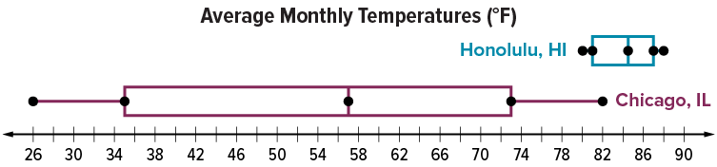
APPLY · PLAN IT • SOLVE IT • PROVE IT
Apply: Average Monthly Temperatures
The box plots show the average monthly temperatures for the same month in Chicago, IL, and Honolulu, HI.
Question: How do the monthly temperatures between the two cities compare?​
ANOTHER PATHWAY · Did anyone get there a different way? Put both pathways side by side and compare.
45 / 47
Notes:
TEACH IN PRACTICE | Embedded facilitation | Lesson 2.4, slide 41 | APPLY
Focus on the existing task: The box plots show the average monthly temperatures for the same month in Chicago, IL, and Honolulu, HI. Question: How do the monthly temperatures between the two cities compare?
LAUNCH (T2/3/5): Use the exact application task independently first. Ask students to justify their choice of method. Collect evidence before a partner discussion or correction.
LOOK FOR (T4): Where this task addresses it, students can compare center and spread in context. Ask which feature of their work supports the claim.
RESPOND: If this task shows the lesson misconception—assuming a longer box section contains more observations—connect the ordered source data to each boundary of the existing box plot. Have the student revise and explain the change. Use this support only where the concept occurs in the current task; otherwise respond to the displayed question.
RECHECK: If a gap is shared, revisit the existing representation together. If it is limited, give targeted support while others compare valid methods on the same task. Check the revision before moving on.
PARTICIPATION (T5/6/7): Think time before volunteers; accept a written, drawn or rehearsed entry. Students ask for evidence respectfully. Recognize a specific contribution or revision and check that both partners participate.
Source: BCPS Updated Instructional Framework Rubric (June 2020), TEACH 1–7. Earlier notes and answer keys are retained below.
EARLIER NOTES / EXISTING ANSWER KEY
Routine: APPLY · PLAN IT • SOLVE IT • PROVE IT
UIFR FULL | Lesson-specific facilitation
TEACH 4 | Independent evidence and revision (UIFR PDF p. 11).
Use the existing application/exit problem as the independent check. If this is a learning-target slide, have students point to and explain their work on the preceding task. Separate initial independent evidence from the revision after feedback.
Check the relevant criteria: locate minimum, quartiles, median and maximum; compare center and spread in context. Respond with one specific next step tied to the work. Students revise and annotate what changed, then identify a criterion they can now demonstrate and one they still need to practice.

Slide 46
Learning Targets
I can describe a data set displayed in a box and whisker plot in terms of median, quartiles, and spread.
I can attend to precision to compare two data sets displayed in box plots in terms of data distribution.
NAME THE MATH · Point to the part of this that is new today, and say what it changes.
46 / 47
Notes:
TEACH IN PRACTICE | Embedded facilitation | Lesson 2.4, slide 42 | REFLECTION
Focus on the existing task: I can describe a data set displayed in a box and whisker plot in terms of median, quartiles, and spread. I can attend to precision to…
CONNECT (T1/4): Ask students to restate the displayed goal or key idea and connect it to earlier work. Relevant lesson evidence: locate minimum, quartiles, median and maximum; compare center and spread in context. Use only the criterion that matches the current session.
SHOW PROGRESS: Students point to their own existing work, explain what improved after feedback, and name a next step. Pair confidence ratings with actual evidence.
PARTICIPATION (T5/6/7): Think time before volunteers; accept a written, drawn or rehearsed entry. Students ask for evidence respectfully. Recognize a specific contribution or revision and check that both partners participate.
Source: BCPS Updated Instructional Framework Rubric (June 2020), TEACH 1–7. Earlier notes and answer keys are retained below.
EARLIER NOTES / EXISTING ANSWER KEY
Read each target; students self-rate with fist-to-five or thumbs.
Tie back to the goal from the start of class: did we get there?
Note any target that rates low — revisit it tomorrow.
UIFR: TEACH 1 · TEACH 4.
UIFR FULL | Lesson-specific facilitation
REFLECT & ADJUST 1-2 | After the lesson (UIFR PDF pp. 15-16).
Sort the existing work by demonstrated reasoning, partial understanding, and the specific misconception: assuming a longer box section contains more observations. Compare the initial response with the revision. Record which teaching move plausibly helped, which did not, and whose participation or access needs a different approach; do not record sensitive student details in this shared deck.
Plan the next lesson from that evidence: if the misconception persists, connect the ordered source data to each boundary of the existing box plot using the current example before returning to the next grade-level task; if understanding is secure, use an existing extension or ask for a general explanation. Check the targeted idea again at the next warm-up.
Ask students what supported their thinking and what would help next time. Identify one change to try and one successful practice to retain. Seek colleague feedback on anonymized work when useful; these prompts support reflection and do not establish an evaluation rating. Source: Baltimore City Public Schools, Updated Instructional Framework Rubric, June 2020 (UIFR_Full.pdf).

Slide 47
LESSON 2.4 / REFLECT ON YOUR LEARNING
Show your progress
1 SHOW EVIDENCE
2 CHOOSE A NEXT STEP
Choose one response. Point to the part that shows your reasoning.
Name a change you made after feedback—or a question you still have.
“My work shows ___ because ___.”
“Next time, I will ___ to help me ___.”
Today’s focus: Locate minimum, quartiles, median and maximum.
CREDIT A CLASSMATE · Name one classmate whose idea helped you today, and say what they said.
Listen to understand. Ask for evidence. Make room for every voice.
Notes:
TEACH IN PRACTICE | Embedded facilitation | Lesson 2.4, slide 43 | PRIOR_INSERT
Focus on the existing task: LESSON 2.4 / REFLECT ON YOUR LEARNING Show your progress Listen to understand. Ask for evidence. Make room for every voice. 1 SHOW…
CONNECT (T1/4): Ask students to restate the displayed goal or key idea and connect it to earlier work. Relevant lesson evidence: locate minimum, quartiles, median and maximum; compare center and spread in context. Use only the criterion that matches the current session.
SHOW PROGRESS: Students point to their own existing work, explain what improved after feedback, and name a next step. Pair confidence ratings with actual evidence.
PARTICIPATION (T5/6/7): Think time before volunteers; accept a written, drawn or rehearsed entry. Students ask for evidence respectfully. Recognize a specific contribution or revision and check that both partners participate.
Source: BCPS Updated Instructional Framework Rubric (June 2020), TEACH 1–7.

