Slide 1
WARM-UP · THINK • TRY • CHECK
Turn and talk: compare strategies, then defend one.
Warm-Up
Lesson 2-5 · Describe Data by Range and Interquartile Range | Warm-Up · about 4 minutes
Try each on your own. Mark an unsure answer; explain and revise when we check.
QUESTION 1
QUESTION 2
The largest of 12, 7, 19, 4, 15 is ______
600 − 247 = ______
QUESTION 3
QUESTION 4
Ordered: 5, 8, 10, 14, 18, 20, 25. Q1 = ______
Which spread is larger, 20 − 6 or 15 − 9? ______
TALK IT OVER: “I got ______ because ______.” • Compare with a partner before we check as a class.
1 / 46
Notes:
TEACH IN PRACTICE | Embedded facilitation | Lesson 2.5, slide 1 | WARMUP
Focus on the existing task: Warm-Up WARM-UP · THINK • TRY • CHECK Do…
GATHER EVIDENCE (T4/6): Keep the original items. Students try independently, mark an uncertain item, and explain one method before checking. Use the existing key when present.
RESPOND: Distinguish a calculation slip from a reasoning gap. Give one next step on the same item; have students revise in a second color. Use the responses to choose flexible support for today’s lesson.
PARTICIPATION (T5/6/7): Think time before volunteers; accept a written, drawn or rehearsed entry. Students ask for evidence respectfully. Recognize a specific contribution or revision and check that both partners participate.
Source: BCPS Updated Instructional Framework Rubric (June 2020), TEACH 1–7. Earlier notes and answer keys are retained below.
EARLIER NOTES / EXISTING ANSWER KEY
Warm-Up answers (teacher only): 1) 19 2) 353 3) 8 4) 20 − 6
UIFR FULL | Lesson-specific facilitation
PREPARE 1-2 | Before teaching (UIFR PDF pp. 6-7).
Plan to gather evidence that students can distinguish full spread from middle-half spread; compute range and IQR; interpret units. Review recent work and today’s warm-up to choose flexible groups and access supports; do not infer needs from identity or perceived ability. Use the existing lesson tasks and stated standards.
Anticipate: using the median as a measure of spread. If observed, label minimum, Q1, Q3 and maximum on the existing box plots. Offer oral rehearsal, drawing, pointing, or home-language processing as needed; retain the original mathematical demand. Ask students which support helps and fade it as evidence improves.
TEACH 6-7 | Before the first transition, agree on materials, partner roles, and how to request help. Invite students to restate the routine. Normalize revising an idea, recognize a specific contribution, and check privately when frustration blocks participation. Source: UIFR PDF pp. 13-14.

Slide 2
Today’s Math Notes
Lesson 2-5 · Describe Data by Range and Interquartile Range
Section 1: Math Words
Copy. Explain. Check.
SAY THE GOAL · Say today’s goal in your own words, then name one place this shows up outside math class.
Range and Interquartile Range
1
Two numbers that describe spread
Range
2
The distance from the least value to the greatest value
Quartile
3
One of the three values
eduwonderlab.com · Neft Teacher
2 / 46
Notes:
TEACH IN PRACTICE | Embedded facilitation | Lesson 2.5, slide 2 | NOTES
Focus on the existing task: Today’s Math Notes Section 1: Math Words…
ROUTINE (T1/2/4): Read or copy the original notes, cover one line, and explain it using the displayed example. Reopen and correct. Copying alone is not evidence of understanding.
LOOK FOR: A link between a symbol, quantity or feature and the explanation. If missing, point back to that feature and have the student try again; fade the prompt once they can explain.
PARTICIPATION (T5/6/7): Think time before volunteers; accept a written, drawn or rehearsed entry. Students ask for evidence respectfully. Recognize a specific contribution or revision and check that both partners participate.
Source: BCPS Updated Instructional Framework Rubric (June 2020), TEACH 1–7. Earlier notes and answer keys are retained below.
EARLIER NOTES / EXISTING ANSWER KEY
Copy routine: read one line at a time; students copy, then explain that line to a partner.
Keep it brisk — the understanding work happens in the examples, not the copying.
UIFR: TEACH 1 · TEACH 6.

Slide 3
Today’s Math Notes
Lesson 2-5 · Describe Data by Range and Interquartile Range
Section 2: Today’s Math
Copy. Explain. Check.
CONNECT IT · What earlier lesson does this build on? Tell a partner in one sentence.
Measures of Variability: Range & IQR
Range = Maximum − Minimum
IQR = Q3 − Q1
1
Range measures the total spread across the entire data set
2
IQR (Interquartile Range) measures the spread of the middle 50% of data
3
Both are non-negative distance measures of variability
eduwonderlab.com · Neft Teacher
3 / 46
Notes:
TEACH IN PRACTICE | Embedded facilitation | Lesson 2.5, slide 3 | NOTES
Focus on the existing task: Today’s Math Notes Section 2: Today’s Math…
ROUTINE (T1/2/4): Read or copy the original notes, cover one line, and explain it using the displayed example. Reopen and correct. Copying alone is not evidence of understanding.
LOOK FOR: A link between a symbol, quantity or feature and the explanation. If missing, point back to that feature and have the student try again; fade the prompt once they can explain.
PARTICIPATION (T5/6/7): Think time before volunteers; accept a written, drawn or rehearsed entry. Students ask for evidence respectfully. Recognize a specific contribution or revision and check that both partners participate.
Source: BCPS Updated Instructional Framework Rubric (June 2020), TEACH 1–7. Earlier notes and answer keys are retained below.
EARLIER NOTES / EXISTING ANSWER KEY
Copy routine: read one line at a time; students copy, then explain that line to a partner.
Keep it brisk — the understanding work happens in the examples, not the copying.
UIFR: TEACH 1 · TEACH 6.

Slide 4
Session 1
Describe Data by Range and Interquartile Range
PICK YOUR STRATEGY · Choose your path — picture, table, number line, or equation — and be ready to say why you chose it.
4 / 46
Notes:
TEACH IN PRACTICE | Embedded facilitation | Lesson 2.5, slide 4 | DIVIDER
Focus on the existing task: Describe Data by Range and Interquartile Range Session 1
TRANSITION (T6/7): Students confirm materials, roles, how to request help, and the next response routine. Ask a student to restate it. Keep teacher-only slides hidden.
PARTICIPATION (T5/6/7): Think time before volunteers; accept a written, drawn or rehearsed entry. Students ask for evidence respectfully. Recognize a specific contribution or revision and check that both partners participate.
Source: BCPS Updated Instructional Framework Rubric (June 2020), TEACH 1–7. Earlier notes and answer keys are retained below.
EARLIER NOTES / EXISTING ANSWER KEY
Transition cue: state what materials are out and what success looks like this session.
Keep the changeover under a minute.
UIFR: TEACH 6.

Slide 5
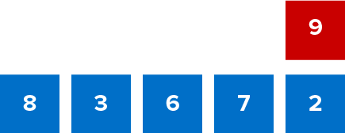
Give Me Five
Use all the numbers in any order with any operation to equal the target number (in red). ​
Explain how the information shown supports your reasoning.
5 / 46
Notes:
TEACH IN PRACTICE | Embedded facilitation | Lesson 2.5, slide 5 | WORKED
Focus on the existing task: Use all the numbers in any order with any operation to equal the target number (in red). Give Me Five
LAUNCH (T2/3/5): Ask students to explain the displayed idea or example and point to evidence. When a calculation step is shown, ask why it is valid. Have a partner restate the explanation; copying is not the check.
LOOK FOR (T4): Where this task addresses it, students can distinguish full spread from middle-half spread. Ask which feature of their work supports the claim.
RESPOND: If this task shows the lesson misconception—using the median as a measure of spread—label minimum, Q1, Q3 and maximum on the existing box plots. Have the student revise and explain the change. Use this support only where the concept occurs in the current task; otherwise respond to the displayed question.
RECHECK: If a gap is shared, revisit the existing representation together. If it is limited, give targeted support while others compare valid methods on the same task. Check the revision before moving on.
PARTICIPATION (T5/6/7): Think time before volunteers; accept a written, drawn or rehearsed entry. Students ask for evidence respectfully. Recognize a specific contribution or revision and check that both partners participate.
Source: BCPS Updated Instructional Framework Rubric (June 2020), TEACH 1–7. Earlier notes and answer keys are retained below.
EARLIER NOTES / EXISTING ANSWER KEY
Number-sense routine — every voice in. Give quiet think time, then hear from at least three students.
Always follow with “How do you know?” — the reasoning is the point, not the answer.
There is more than one path; name and celebrate different strategies.
UIFR: TEACH 3 · TEACH 5 · TEACH 6.

Slide 6
Today’s Objectives
Lesson 2-5 · Describe Data by Range and Interquartile Range
Describe Data by Range and Interquartile Range
Maryland Standard 6.DS.3
SHOW YOUR THINKING · Show what you know — write it, draw it, or build it. A picture counts as an explanation.
CONTENT OBJECTIVE
LANGUAGE OBJECTIVE
Restate the goal in your words
Use these words to explain why
I can find the range and the interquartile range of a data set and use them to describe how spread out the data is.
I can explain what the spread of a data set is using the words range, quartile, interquartile range, and vary.
eduwonderlab.com · Neft Teacher
6 / 46
Notes:
TEACH IN PRACTICE | Embedded facilitation | Lesson 2.5, slide 6 | GOAL
Focus on the existing task: Today’s Objectives Describe Data by Range…
CONNECT (T1/4): Ask students to restate the displayed goal or key idea and connect it to earlier work. Relevant lesson evidence: distinguish full spread from middle-half spread; compute range and IQR; interpret units. Use only the criterion that matches the current session.
SHOW PROGRESS: Students point to their own existing work, explain what improved after feedback, and name a next step. Pair confidence ratings with actual evidence.
PARTICIPATION (T5/6/7): Think time before volunteers; accept a written, drawn or rehearsed entry. Students ask for evidence respectfully. Recognize a specific contribution or revision and check that both partners participate.
Source: BCPS Updated Instructional Framework Rubric (June 2020), TEACH 1–7. Earlier notes and answer keys are retained below.
EARLIER NOTES / EXISTING ANSWER KEY
Read the objective together, then have one or two students restate today’s goal in their own words.
Connect it to what the class learned last lesson.
Return to this goal at the end of class to check it was met.
UIFR: TEACH 1.
UIFR FULL | Lesson-specific facilitation
TEACH 1 | Session 1 purpose and evidence (UIFR PDF p. 8).
Have students restate the displayed session goal in their own words and connect it to the existing context or a familiar experience they choose to share. Use the current session goal to select from these lesson-wide evidence criteria; do not frontload a later-session procedure.
Look for: distinguish full spread from middle-half spread; compute range and IQR; interpret units. Ask: “Which part of your work would show this?” Revisit that evidence after the task; a confidence rating alone is not evidence of understanding.

Slide 7
LESSON 2.5 / OUR LEARNING
What will show your learning?
1
Distinguish full spread from middle-half spread.
2
Compute range and IQR.
3
Interpret units.
Tell a partner: Which skill connects to something you already know?
WHY IT MATTERS · Finish this: “This is worth knowing because ______.”
Listen to understand. Ask for evidence. Make room for every voice.
Notes:
TEACH IN PRACTICE | Embedded facilitation | Lesson 2.5, slide 7 | PRIOR_INSERT
Focus on the existing task: LESSON 2.5 / OUR LEARNING What will show your learning?
CONNECT (T1/4): Ask students to restate the displayed goal or key idea and connect it to earlier work. Relevant lesson evidence: distinguish full spread from middle-half spread; compute range and IQR; interpret units. Use only the criterion that matches the current session.
SHOW PROGRESS: Students point to their own existing work, explain what improved after feedback, and name a next step. Pair confidence ratings with actual evidence.
PARTICIPATION (T5/6/7): Think time before volunteers; accept a written, drawn or rehearsed entry. Students ask for evidence respectfully. Recognize a specific contribution or revision and check that both partners participate.
Source: BCPS Updated Instructional Framework Rubric (June 2020), TEACH 1–7.

Slide 8
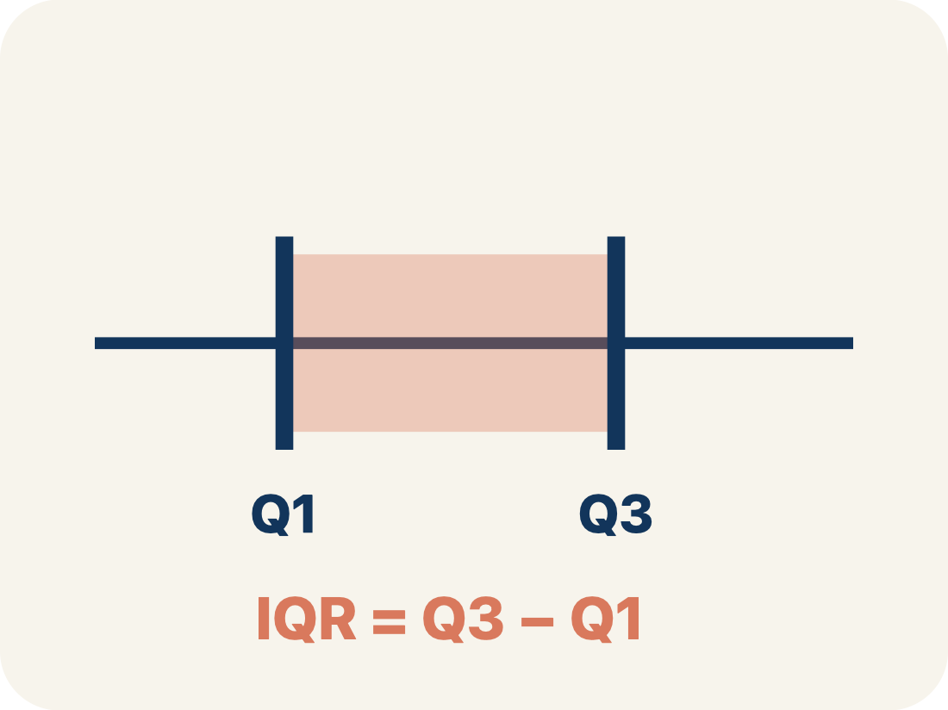
Vocabulary 1 of 6
Lesson 2-5 · Describe Data by Range and Interquartile Range
USE THE MATH WORDS · Use today’s math words in your explanation — not “it” and “that thing.”
Range and Interquartile Range
Two numbers that describe spread: the range covers all the data, and the interquartile range covers only the middle half.
EXAMPLE · EXPLAIN WHY IT FITS
Range 26 covers 68 to 94; IQR 12.5 covers only 75.5 to 88
eduwonderlab.com · Neft Teacher
8 / 46
Notes:
TEACH IN PRACTICE | Embedded facilitation | Lesson 2.5, slide 8 | VOCAB
Focus on the existing task: Vocabulary 1 of 6 Range and Interquartile…
ASK (T1/3/5): Where does “Range and Interquartile Range” appear in the example? Explain the meaning without reading the definition. Partner: restate the idea and ask a clarifying question.
LOOK FOR: A correct connection between the word and a feature of the example. If the student only repeats the definition, invite pointing, sketching or oral rehearsal, then ask for another explanation of this same example.
PARTICIPATION (T5/6/7): Think time before volunteers; accept a written, drawn or rehearsed entry. Students ask for evidence respectfully. Recognize a specific contribution or revision and check that both partners participate.
Source: BCPS Updated Instructional Framework Rubric (June 2020), TEACH 1–7.

Slide 9

Vocabulary 2 of 6
Lesson 2-5 · Describe Data by Range and Interquartile Range
Range
The distance from the least value to the greatest value, found by subtracting: greatest − least.
EXAMPLE · EXPLAIN WHY IT FITS
94 − 68 = 26
Use “Range” to explain the example. Point to evidence.
eduwonderlab.com · Neft Teacher
9 / 46
Notes:
TEACH IN PRACTICE | Embedded facilitation | Lesson 2.5, slide 9 | VOCAB
Focus on the existing task: Vocabulary 2 of 6 Range The distance from…
ASK (T1/3/5): Where does “Range” appear in the example? Explain the meaning without reading the definition. Partner: restate the idea and ask a clarifying question.
LOOK FOR: A correct connection between the word and a feature of the example. If the student only repeats the definition, invite pointing, sketching or oral rehearsal, then ask for another explanation of this same example.
PARTICIPATION (T5/6/7): Think time before volunteers; accept a written, drawn or rehearsed entry. Students ask for evidence respectfully. Recognize a specific contribution or revision and check that both partners participate.
Source: BCPS Updated Instructional Framework Rubric (June 2020), TEACH 1–7.

Slide 10
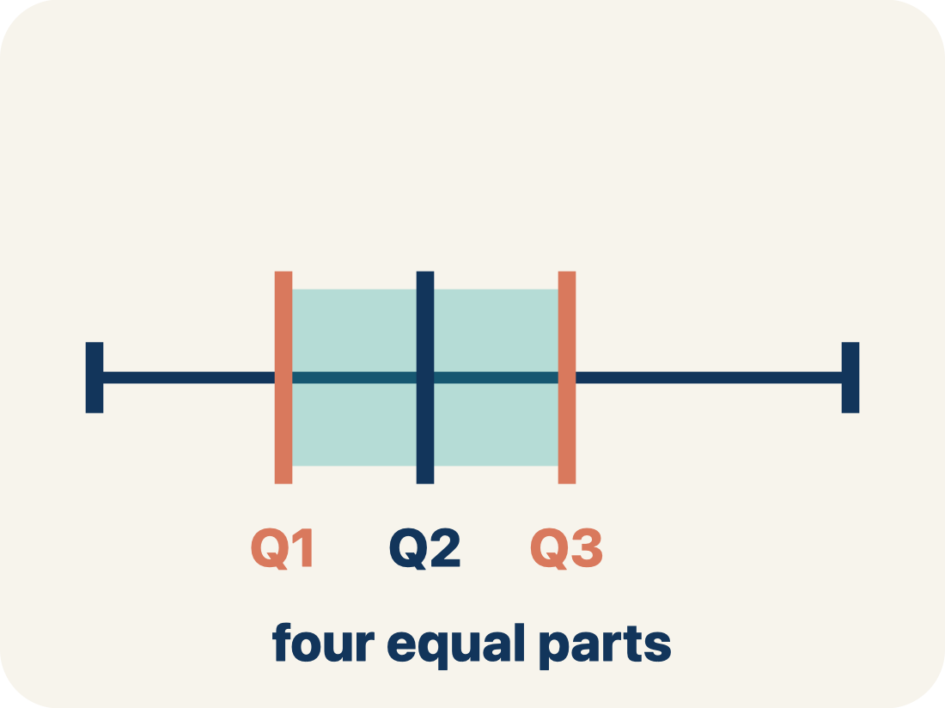
Vocabulary 3 of 6
Lesson 2-5 · Describe Data by Range and Interquartile Range
Quartile
One of the three values that cut an ordered data set into four equal-sized groups.
EXAMPLE · EXPLAIN WHY IT FITS
Q1 = 75.5, median = 83.5, Q3 = 88
Use “Quartile” to explain the example. Point to evidence.
eduwonderlab.com · Neft Teacher
10 / 46
Notes:
TEACH IN PRACTICE | Embedded facilitation | Lesson 2.5, slide 10 | VOCAB
Focus on the existing task: Vocabulary 3 of 6 Quartile One of the three…
ASK (T1/3/5): Where does “Quartile” appear in the example? Explain the meaning without reading the definition. Partner: restate the idea and ask a clarifying question.
LOOK FOR: A correct connection between the word and a feature of the example. If the student only repeats the definition, invite pointing, sketching or oral rehearsal, then ask for another explanation of this same example.
PARTICIPATION (T5/6/7): Think time before volunteers; accept a written, drawn or rehearsed entry. Students ask for evidence respectfully. Recognize a specific contribution or revision and check that both partners participate.
Source: BCPS Updated Instructional Framework Rubric (June 2020), TEACH 1–7.

Slide 11
Vocabulary 4 of 6
Lesson 2-5 · Describe Data by Range and Interquartile Range
Interquartile range
The distance across the middle half of the data, found by subtracting the first quartile from the third: Q3 − Q1.
EXAMPLE · EXPLAIN WHY IT FITS
88 − 75.5 = 12.5 — the width of the box on a box plot
ADD ON · Add on: “I agree because ______.” or “I see it differently because ______.”
eduwonderlab.com · Neft Teacher
11 / 46
Notes:
TEACH IN PRACTICE | Embedded facilitation | Lesson 2.5, slide 11 | VOCAB
Focus on the existing task: Vocabulary 4 of 6 Interquartile range The…
ASK (T1/3/5): Where does “Interquartile range” appear in the example? Explain the meaning without reading the definition. Partner: restate the idea and ask a clarifying question.
LOOK FOR: A correct connection between the word and a feature of the example. If the student only repeats the definition, invite pointing, sketching or oral rehearsal, then ask for another explanation of this same example.
PARTICIPATION (T5/6/7): Think time before volunteers; accept a written, drawn or rehearsed entry. Students ask for evidence respectfully. Recognize a specific contribution or revision and check that both partners participate.
Source: BCPS Updated Instructional Framework Rubric (June 2020), TEACH 1–7.

Slide 12
Vocabulary 5 of 6
Lesson 2-5 · Describe Data by Range and Interquartile Range
Variability
How much the values in a data set differ from one another — whether they sit close together or far apart.
EXAMPLE · EXPLAIN WHY IT FITS
Close together = low variability; spread apart = high variability
Use “Variability” to explain the example. Point to evidence.
eduwonderlab.com · Neft Teacher
12 / 46
Notes:
TEACH IN PRACTICE | Embedded facilitation | Lesson 2.5, slide 12 | VOCAB
Focus on the existing task: Vocabulary 5 of 6 Variability How much the…
ASK (T1/3/5): Where does “Variability” appear in the example? Explain the meaning without reading the definition. Partner: restate the idea and ask a clarifying question.
LOOK FOR: A correct connection between the word and a feature of the example. If the student only repeats the definition, invite pointing, sketching or oral rehearsal, then ask for another explanation of this same example.
PARTICIPATION (T5/6/7): Think time before volunteers; accept a written, drawn or rehearsed entry. Students ask for evidence respectfully. Recognize a specific contribution or revision and check that both partners participate.
Source: BCPS Updated Instructional Framework Rubric (June 2020), TEACH 1–7.

Slide 13
Vocabulary 6 of 6
Lesson 2-5 · Describe Data by Range and Interquartile Range
Measure of variation
A single number that describes the spread of a whole data set. The range and the IQR are both measures of variation.
EXAMPLE · EXPLAIN WHY IT FITS
One number stands in for the spread of all 20 scores
TAKE TURNS · One explains, one asks a question. Then switch, so both of you talk.
eduwonderlab.com · Neft Teacher
13 / 46
Notes:
TEACH IN PRACTICE | Embedded facilitation | Lesson 2.5, slide 13 | VOCAB
Focus on the existing task: Vocabulary 6 of 6 Measure of variation A…
ASK (T1/3/5): Where does “Measure of variation” appear in the example? Explain the meaning without reading the definition. Partner: restate the idea and ask a clarifying question.
LOOK FOR: A correct connection between the word and a feature of the example. If the student only repeats the definition, invite pointing, sketching or oral rehearsal, then ask for another explanation of this same example.
PARTICIPATION (T5/6/7): Think time before volunteers; accept a written, drawn or rehearsed entry. Students ask for evidence respectfully. Recognize a specific contribution or revision and check that both partners participate.
Source: BCPS Updated Instructional Framework Rubric (June 2020), TEACH 1–7.

Slide 14
Vocabulary
Lesson 2-5 · Describe Data by Range and Interquartile Range
Today’s Math Words
We learn every word — what it means and what it looks like — before we use it.
Range and Interquartile Range
Range
Two numbers that describe spread: the range covers all the data, and the interquartile range covers only the middle half
The distance from the least value to the greatest value, found by subtracting: greatest − least
Quartile
Interquartile range
One of the three values that cut an ordered data set into four equal-sized groups
The distance across the middle half of the data, found by subtracting the first quartile from the third: Q3 − Q1
Variability
Measure of variation
How much the values in a data set differ from one another — whether they sit close together or far apart
A single number that describes the spread of a whole data set
RESTATE FIRST · Restate your partner’s idea in your own words before you give yours.
eduwonderlab.com · Neft Teacher
14 / 46
Notes:
TEACH IN PRACTICE | Embedded facilitation | Lesson 2.5, slide 14 | VOCAB
Focus on the existing task: Vocabulary Today’s Math Words We learn every…
ASK (T1/3/5): Where does “the displayed term” appear in the example? Explain the meaning without reading the definition. Partner: restate the idea and ask a clarifying question.
LOOK FOR: A correct connection between the word and a feature of the example. If the student only repeats the definition, invite pointing, sketching or oral rehearsal, then ask for another explanation of this same example.
PARTICIPATION (T5/6/7): Think time before volunteers; accept a written, drawn or rehearsed entry. Students ask for evidence respectfully. Recognize a specific contribution or revision and check that both partners participate.
Source: BCPS Updated Instructional Framework Rubric (June 2020), TEACH 1–7. Earlier notes and answer keys are retained below.
EARLIER NOTES / EXISTING ANSWER KEY
Choral-read each word, its meaning, and what it looks like.
Students should use these words out loud today — listen for them in partner talk and revoice student ideas with the academic term.
UIFR: TEACH 1 · TEACH 5.

Slide 15
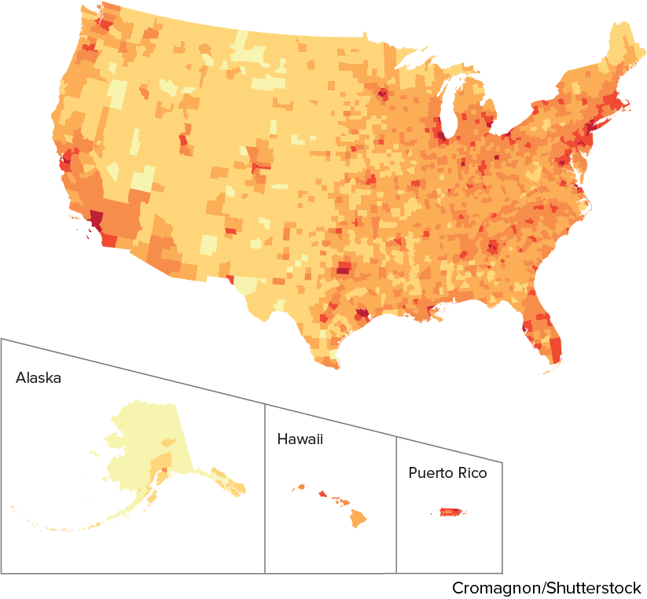

Be Curious
What do you notice?
What do you wonder?
Think first. Share a notice and a
question; build on a classmate’s
idea.
Mindset
What is your responsibility in building a safe and positive math class culture?
15 / 46
Notes:
TEACH IN PRACTICE | Embedded facilitation | Lesson 2.5, slide 15 | CURIOUS
Focus on the existing task: What do you notice?
LAUNCH (T2/3/5): Allow quiet observation first. Separate a notice from an inference, invite students’ own questions, and follow the existing launch before teaching a procedure.
LOOK FOR (T4): Where this task addresses it, students can distinguish full spread from middle-half spread. Ask which feature of their work supports the claim.
RESPOND: If this task shows the lesson misconception—using the median as a measure of spread—label minimum, Q1, Q3 and maximum on the existing box plots. Have the student revise and explain the change. Use this support only where the concept occurs in the current task; otherwise respond to the displayed question.
RECHECK: If a gap is shared, revisit the existing representation together. If it is limited, give targeted support while others compare valid methods on the same task. Check the revision before moving on.
PARTICIPATION (T5/6/7): Think time before volunteers; accept a written, drawn or rehearsed entry. Students ask for evidence respectfully. Recognize a specific contribution or revision and check that both partners participate.
Source: BCPS Updated Instructional Framework Rubric (June 2020), TEACH 1–7. Earlier notes and answer keys are retained below.
EARLIER NOTES / EXISTING ANSWER KEY
Accept all noticings and wonderings — there are no wrong answers here.
Give 20–30 seconds of quiet think time before taking responses; mix cold and warm calls so it is not always the same voices.
Read the mindset question aloud and let two students respond.
UIFR: TEACH 3 · TEACH 7.

Slide 16

Test Scores
The number of points students scored on a recent history test are shown.
Data Table
History Test Scores
68 | 84 | 83 | 90 | 76
90 | 94 | 86 | 82 | 85
80 | 75 | 77 | 88 | 74
73 | 86 | 93 | 88 | 70
How can you describe the data set?
Try first. Explain what a row or column represents. Use it as evidence for your answer.
16 / 46
Notes:
TEACH IN PRACTICE | Embedded facilitation | Lesson 2.5, slide 16 | TASK
Focus on the existing task: How can you describe the data set?
LAUNCH (T2/3/5): Use the displayed question. Give private thinking time; then A explains while B asks for evidence. Switch roles. Each student records their own reasoning.
LOOK FOR (T4): Where this task addresses it, students can distinguish full spread from middle-half spread. Ask which feature of their work supports the claim.
RESPOND: If this task shows the lesson misconception—using the median as a measure of spread—label minimum, Q1, Q3 and maximum on the existing box plots. Have the student revise and explain the change. Use this support only where the concept occurs in the current task; otherwise respond to the displayed question.
RECHECK: If a gap is shared, revisit the existing representation together. If it is limited, give targeted support while others compare valid methods on the same task. Check the revision before moving on.
PARTICIPATION (T5/6/7): Think time before volunteers; accept a written, drawn or rehearsed entry. Students ask for evidence respectfully. Recognize a specific contribution or revision and check that both partners participate.
Source: BCPS Updated Instructional Framework Rubric (June 2020), TEACH 1–7. Earlier notes and answer keys are retained below.
EARLIER NOTES / EXISTING ANSWER KEY
Model briefly, then hand the thinking back: ask “Why does this step work?” before showing the next one.
Quick check before moving on — thumbs or whiteboards from everyone, not volunteers.
UIFR: TEACH 2 · TEACH 3 · TEACH 4.
UIFR FULL | Lesson-specific facilitation
TEACH 2-3 | Session 1 task launch (UIFR PDF pp. 9-10).
Use the problem exactly as displayed. Give individual thinking time before discussion or advancing to the explanation. If the answer is already visible, ask students to reconstruct and justify it. Invite a choice of suitable representations and have students explain why their choice helps.
At the point where this concept appears, ask: “Which values determine the range and which determine the IQR? Why might the two comparisons tell different stories?” Wait for evidence, invite another pathway, and have a student ask a follow-up question. Do not replace students’ reasoning with a sequence of leading steps.

Slide 17
SUMMARIZE · SAY IT IN YOUR OWN WORDS
The number of points students scored on a recent history test are shown. How can you describe the data set?
Data Table
History Test Scores
68 | 84 | 83 | 90 | 76
90 | 94 | 86 | 82 | 85
80 | 75 | 77 | 88 | 74
73 | 86 | 93 | 88 | 70
What are some ways you can describe a data distribution?
Reveal:
We can use numbers that summarize a data distribution such as the median and quartiles, describe how close together the numbers are, and the shape of the distribution.
17 / 46
Notes:
TEACH IN PRACTICE | Embedded facilitation | Lesson 2.5, slide 17 | REVEAL
Focus on the existing task: What are some ways you can describe a data distribution?
LAUNCH (T2/3/5): If an existing answer cover is present, gather an attempt before revealing. If the explanation is already visible, ask students to reconstruct and justify it. Compare reasoning and explain a revision; preserve the reveal sequence.
LOOK FOR (T4): Where this task addresses it, students can distinguish full spread from middle-half spread. Ask which feature of their work supports the claim.
RESPOND: If this task shows the lesson misconception—using the median as a measure of spread—label minimum, Q1, Q3 and maximum on the existing box plots. Have the student revise and explain the change. Use this support only where the concept occurs in the current task; otherwise respond to the displayed question.
RECHECK: If a gap is shared, revisit the existing representation together. If it is limited, give targeted support while others compare valid methods on the same task. Check the revision before moving on.
PARTICIPATION (T5/6/7): Think time before volunteers; accept a written, drawn or rehearsed entry. Students ask for evidence respectfully. Recognize a specific contribution or revision and check that both partners participate.
Source: BCPS Updated Instructional Framework Rubric (June 2020), TEACH 1–7. Earlier notes and answer keys are retained below.
EARLIER NOTES / EXISTING ANSWER KEY
Routine: SUMMARIZE · SAY IT IN YOUR OWN WORDS

Slide 18
One way to describe the data is by its variability, or by how much the values in the data set vary.
What do you think variability means in the context of a data distribution?
Data Table
History Test Scores
68 | 84 | 83 | 90 | 76
90 | 94 | 86 | 82 | 85
80 | 75 | 77 | 88 | 74
73 | 86 | 93 | 88 | 70
Reveal:
It means how different the data values are from one another; whether the values are somewhat similar (close together) or very different (spread apart).
18 / 46
Notes:
TEACH IN PRACTICE | Embedded facilitation | Lesson 2.5, slide 18 | REVEAL
Focus on the existing task: One way to describe the data is by its variability, or by how much the values in the data set vary. What do you think variability means in the context of a data distribution?
LAUNCH (T2/3/5): If an existing answer cover is present, gather an attempt before revealing. If the explanation is already visible, ask students to reconstruct and justify it. Compare reasoning and explain a revision; preserve the reveal sequence.
LOOK FOR (T4): Where this task addresses it, students can distinguish full spread from middle-half spread. Ask which feature of their work supports the claim.
RESPOND: If this task shows the lesson misconception—using the median as a measure of spread—label minimum, Q1, Q3 and maximum on the existing box plots. Have the student revise and explain the change. Use this support only where the concept occurs in the current task; otherwise respond to the displayed question.
RECHECK: If a gap is shared, revisit the existing representation together. If it is limited, give targeted support while others compare valid methods on the same task. Check the revision before moving on.
PARTICIPATION (T5/6/7): Think time before volunteers; accept a written, drawn or rehearsed entry. Students ask for evidence respectfully. Recognize a specific contribution or revision and check that both partners participate.
Source: BCPS Updated Instructional Framework Rubric (June 2020), TEACH 1–7. Earlier notes and answer keys are retained below.
EARLIER NOTES / EXISTING ANSWER KEY
Do not click yet: collect 2–3 student answers with reasons first.
Then click to remove the cover and have students compare their thinking to the reveal — “Is this what we said? Where is it different?”
Behind the cover: It means how different the data values are from one another; whether the values are somewhat similar (close together) or very different (spread apart).
UIFR: TEACH 3 · TEACH 4.

Slide 19
STUDENT MOVES
Lesson 2-5
Your moves
PICK YOUR STRATEGY · Choose your path — picture, table, number line, or equation — and be ready to say why you chose it.
PROVE IT · Find the evidence in the problem that makes your answer right — not just the answer.
19 / 46

Slide 20
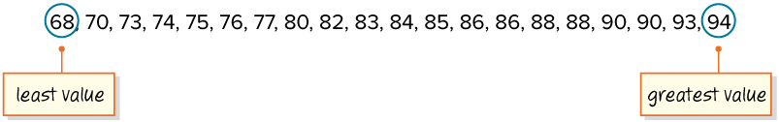
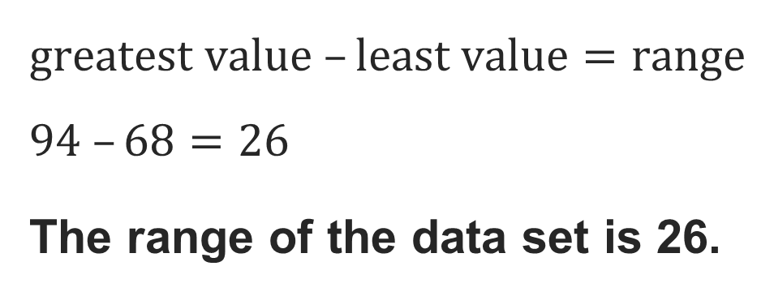
Let’s find the difference between the greatest and least values, or the range, to determine the variability of the data set.
HOW DO YOU KNOW? · Ask your partner “How do you know?” Answer by pointing to your own work.
Think About It:
Where have you heard or used the word distribution before?
20 / 46
Notes:
TEACH IN PRACTICE | Embedded facilitation | Lesson 2.5, slide 19 | TASK
Focus on the existing task: Let’s find the difference between the greatest and least values, or the range, to determine the variability of the data set. Think About It: Where have you heard or used the word distribution before?
LAUNCH (T2/3/5): Use the displayed question. Give private thinking time; then A explains while B asks for evidence. Switch roles. Each student records their own reasoning.
LOOK FOR (T4): Where this task addresses it, students can compute range and IQR. Ask which feature of their work supports the claim.
RESPOND: If this task shows the lesson misconception—using the median as a measure of spread—label minimum, Q1, Q3 and maximum on the existing box plots. Have the student revise and explain the change. Use this support only where the concept occurs in the current task; otherwise respond to the displayed question.
RECHECK: If a gap is shared, revisit the existing representation together. If it is limited, give targeted support while others compare valid methods on the same task. Check the revision before moving on.
PARTICIPATION (T5/6/7): Think time before volunteers; accept a written, drawn or rehearsed entry. Students ask for evidence respectfully. Recognize a specific contribution or revision and check that both partners participate.
Source: BCPS Updated Instructional Framework Rubric (June 2020), TEACH 1–7. Earlier notes and answer keys are retained below.
EARLIER NOTES / EXISTING ANSWER KEY
Ask the question, then hold the silence — students think or jot before anyone answers.
Take two or three responses and press with “Why?” or “How do you know?” before moving on.
UIFR: TEACH 3.

Slide 21
Let’s create a box plot to analyze the data set.
What five markers do you need to create the box plot?
TRY IT BEFORE YOU’RE SURE · Start even if you are not sure. A revised answer counts as much as a first-try answer.
Reveal:
We need to find the lower extreme, first quartile, median, third quartile, and upper extreme.
21 / 46
Notes:
TEACH IN PRACTICE | Embedded facilitation | Lesson 2.5, slide 20 | REVEAL
Focus on the existing task: Let’s create a box plot to analyze the data set. Reveal: We need to find the lower extreme, first quartile, median, third quartile, and upper extreme. What five markers do you need to create the box plot?
LAUNCH (T2/3/5): If an existing answer cover is present, gather an attempt before revealing. If the explanation is already visible, ask students to reconstruct and justify it. Compare reasoning and explain a revision; preserve the reveal sequence.
LOOK FOR (T4): Where this task addresses it, students can distinguish full spread from middle-half spread. Ask which feature of their work supports the claim.
RESPOND: If this task shows the lesson misconception—using the median as a measure of spread—label minimum, Q1, Q3 and maximum on the existing box plots. Have the student revise and explain the change. Use this support only where the concept occurs in the current task; otherwise respond to the displayed question.
RECHECK: If a gap is shared, revisit the existing representation together. If it is limited, give targeted support while others compare valid methods on the same task. Check the revision before moving on.
PARTICIPATION (T5/6/7): Think time before volunteers; accept a written, drawn or rehearsed entry. Students ask for evidence respectfully. Recognize a specific contribution or revision and check that both partners participate.
Source: BCPS Updated Instructional Framework Rubric (June 2020), TEACH 1–7. Earlier notes and answer keys are retained below.
EARLIER NOTES / EXISTING ANSWER KEY
Do not click yet: collect 2–3 student answers with reasons first.
Then click to remove the cover and have students compare their thinking to the reveal — “Is this what we said? Where is it different?”
Behind the cover: We need to find the lower extreme, first quartile, median, third quartile, and upper extreme.
UIFR: TEACH 3 · TEACH 4.

Slide 22
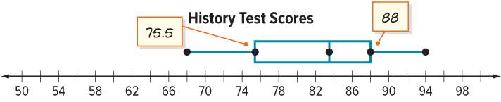
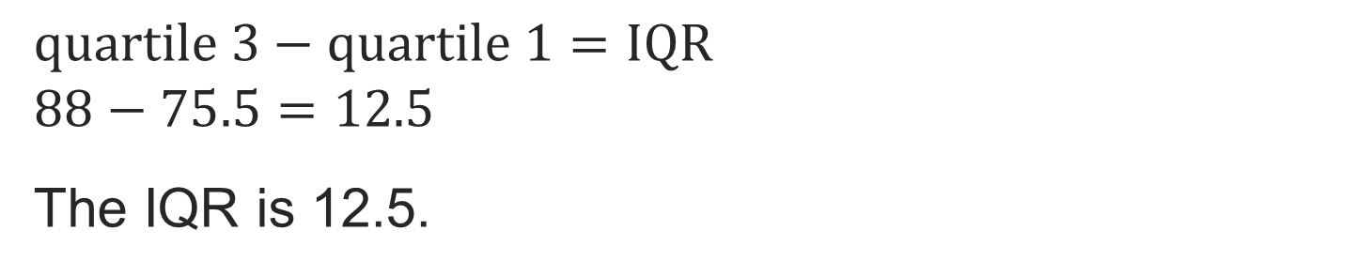
Let’s find the interquartile range (IQR) of this data set.
Explain how the information shown supports your reasoning.
22 / 46
Notes:
TEACH IN PRACTICE | Embedded facilitation | Lesson 2.5, slide 21 | WORKED
Focus on the existing task: Let’s find the interquartile range (IQR) of this data set.
LAUNCH (T2/3/5): Ask students to explain the displayed idea or example and point to evidence. When a calculation step is shown, ask why it is valid. Have a partner restate the explanation; copying is not the check.
LOOK FOR (T4): Where this task addresses it, students can compute range and IQR. Ask which feature of their work supports the claim.
RESPOND: If this task shows the lesson misconception—using the median as a measure of spread—label minimum, Q1, Q3 and maximum on the existing box plots. Have the student revise and explain the change. Use this support only where the concept occurs in the current task; otherwise respond to the displayed question.
RECHECK: If a gap is shared, revisit the existing representation together. If it is limited, give targeted support while others compare valid methods on the same task. Check the revision before moving on.
PARTICIPATION (T5/6/7): Think time before volunteers; accept a written, drawn or rehearsed entry. Students ask for evidence respectfully. Recognize a specific contribution or revision and check that both partners participate.
Source: BCPS Updated Instructional Framework Rubric (June 2020), TEACH 1–7. Earlier notes and answer keys are retained below.
EARLIER NOTES / EXISTING ANSWER KEY
Model briefly, then hand the thinking back: ask “Why does this step work?” before showing the next one.
Quick check before moving on — thumbs or whiteboards from everyone, not volunteers.
UIFR: TEACH 2 · TEACH 3 · TEACH 4.

Slide 23
Let’s Explore More
If the median describes the center of a data set, what does the interquartile range describe?​
Try it yourself. Compare your
work with a partner; explain one
choice and revise.
Workspace
Which value, the range or the interquartile range, tells you more about the spread of the data values? Explain your reasoning.
Workspace
23 / 46
Notes:
TEACH IN PRACTICE | Embedded facilitation | Lesson 2.5, slide 22 | PRACTICE
Focus on the existing task: Let’s Explore More Workspace If the median describes the center of a data set, what does the interquartile range describe?
LAUNCH (T2/3/5): Use the displayed question. Give private thinking time; then A explains while B asks for evidence. Switch roles. Each student records their own reasoning.
LOOK FOR (T4): Where this task addresses it, students can distinguish full spread from middle-half spread. Ask which feature of their work supports the claim.
RESPOND: If this task shows the lesson misconception—using the median as a measure of spread—label minimum, Q1, Q3 and maximum on the existing box plots. Have the student revise and explain the change. Use this support only where the concept occurs in the current task; otherwise respond to the displayed question.
RECHECK: If a gap is shared, revisit the existing representation together. If it is limited, give targeted support while others compare valid methods on the same task. Check the revision before moving on.
PARTICIPATION (T5/6/7): Think time before volunteers; accept a written, drawn or rehearsed entry. Students ask for evidence respectfully. Recognize a specific contribution or revision and check that both partners participate.
Source: BCPS Updated Instructional Framework Rubric (June 2020), TEACH 1–7. Earlier notes and answer keys are retained below.
EARLIER NOTES / EXISTING ANSWER KEY
Extension for partners or table groups — students choose their approach and use the workspace to show thinking.
Push with “Convince me,” and have two groups with different approaches share.
This is where students stretch past the worked example.
UIFR: TEACH 2 · TEACH 5.
UIFR FULL | Lesson-specific facilitation
TEACH 4-5 | Session 1 discussion and checkpoint (UIFR PDF pp. 11-12).
Collect a brief response from every student to the existing prompt before hearing volunteers. Partners take turns explaining and asking for evidence: “I understand ___; what supports ___?” Offer rehearsal or an annotated model for students who need language support. Each student records their own reasoning.
Look specifically for: using the median as a measure of spread. If it appears, label minimum, Q1, Q3 and maximum on the existing box plots; then ask the student to revise the same response and explain the change. If evidence is secure, have students compare a second valid pathway or state why their approach works. Choose the next step from the responses, not a preset pace.

Slide 24
LESSON 2.5 / DISCUSS THE TASK
Explain and compare
Use the task you just explored.
TAKE TURNS
Which values determine the range and which determine the IQR? Why might the two comparisons tell different stories?
Explain
“I know this because…”
Ask
“Where does your work show that?”
Point to evidence in your work.
Then compare your approach with a partner’s.
JUSTIFY IT · Say it like this: “I know ______ because ______.”
Listen to understand. Ask for evidence. Make room for every voice.
Notes:
TEACH IN PRACTICE | Embedded facilitation | Lesson 2.5, slide 23 | PRIOR_INSERT
Focus on the existing task: Why might the two comparisons tell different stories?
CONNECT (T1/4): Ask students to restate the displayed goal or key idea and connect it to earlier work. Relevant lesson evidence: distinguish full spread from middle-half spread; compute range and IQR; interpret units. Use only the criterion that matches the current session.
SHOW PROGRESS: Students point to their own existing work, explain what improved after feedback, and name a next step. Pair confidence ratings with actual evidence.
PARTICIPATION (T5/6/7): Think time before volunteers; accept a written, drawn or rehearsed entry. Students ask for evidence respectfully. Recognize a specific contribution or revision and check that both partners participate.
Source: BCPS Updated Instructional Framework Rubric (June 2020), TEACH 1–7.

Slide 25
We can use numbers called measures of variation to describe the variability, or spread, of a data set. A measure of variation can describe all values of a data set with a single number.
Data Table
History Test Scores
68 | 84 | 83 | 90 | 76
90 | 94 | 86 | 82 | 85
80 | 75 | 77 | 88 | 74
73 | 86 | 93 | 88 | 70
How might you organize the data to help you see the variability?
SELF-CHECK · Mark it: ✓ got it · ~ almost · ? stuck. Then fix one thing before we move on.
Reveal:
We could list the data in order from least to greatest.
25 / 46
Notes:
TEACH IN PRACTICE | Embedded facilitation | Lesson 2.5, slide 24 | REVEAL
Focus on the existing task: How might you organize the data to help you see the variability?
LAUNCH (T2/3/5): If an existing answer cover is present, gather an attempt before revealing. If the explanation is already visible, ask students to reconstruct and justify it. Compare reasoning and explain a revision; preserve the reveal sequence.
LOOK FOR (T4): Where this task addresses it, students can distinguish full spread from middle-half spread. Ask which feature of their work supports the claim.
RESPOND: If this task shows the lesson misconception—using the median as a measure of spread—label minimum, Q1, Q3 and maximum on the existing box plots. Have the student revise and explain the change. Use this support only where the concept occurs in the current task; otherwise respond to the displayed question.
RECHECK: If a gap is shared, revisit the existing representation together. If it is limited, give targeted support while others compare valid methods on the same task. Check the revision before moving on.
PARTICIPATION (T5/6/7): Think time before volunteers; accept a written, drawn or rehearsed entry. Students ask for evidence respectfully. Recognize a specific contribution or revision and check that both partners participate.
Source: BCPS Updated Instructional Framework Rubric (June 2020), TEACH 1–7.

Slide 26
The range of the data set is 26.
What tool can you use to further analyze the distribution of a data set?
Compare your reasoning with the explanation. Explain any revision you make.
Reveal:
We can use a box plot.
26 / 46
Notes:
TEACH IN PRACTICE | Embedded facilitation | Lesson 2.5, slide 25 | REVEAL
Focus on the existing task: What tool can you use to further analyze the distribution of a data set?
LAUNCH (T2/3/5): If an existing answer cover is present, gather an attempt before revealing. If the explanation is already visible, ask students to reconstruct and justify it. Compare reasoning and explain a revision; preserve the reveal sequence.
LOOK FOR (T4): Where this task addresses it, students can compute range and IQR. Ask which feature of their work supports the claim.
RESPOND: If this task shows the lesson misconception—using the median as a measure of spread—label minimum, Q1, Q3 and maximum on the existing box plots. Have the student revise and explain the change. Use this support only where the concept occurs in the current task; otherwise respond to the displayed question.
RECHECK: If a gap is shared, revisit the existing representation together. If it is limited, give targeted support while others compare valid methods on the same task. Check the revision before moving on.
PARTICIPATION (T5/6/7): Think time before volunteers; accept a written, drawn or rehearsed entry. Students ask for evidence respectfully. Recognize a specific contribution or revision and check that both partners participate.
Source: BCPS Updated Instructional Framework Rubric (June 2020), TEACH 1–7.

Slide 27
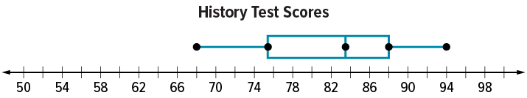
STRUGGLE FIRST · Work on your own first. Stuck is allowed — try a second strategy before you ask.
How can you determine the spread of the values in the middle half of the data set?
Reveal:
We can find the difference between the value that marks the right edge of the box, quartile 3, and the value that marks the left side of the box, quartile 1.
27 / 46
Notes:
TEACH IN PRACTICE | Embedded facilitation | Lesson 2.5, slide 26 | REVEAL
Focus on the existing task: How can you determine the spread of the values in the middle half of the data set?
LAUNCH (T2/3/5): If an existing answer cover is present, gather an attempt before revealing. If the explanation is already visible, ask students to reconstruct and justify it. Compare reasoning and explain a revision; preserve the reveal sequence.
LOOK FOR (T4): Where this task addresses it, students can distinguish full spread from middle-half spread. Ask which feature of their work supports the claim.
RESPOND: If this task shows the lesson misconception—using the median as a measure of spread—label minimum, Q1, Q3 and maximum on the existing box plots. Have the student revise and explain the change. Use this support only where the concept occurs in the current task; otherwise respond to the displayed question.
RECHECK: If a gap is shared, revisit the existing representation together. If it is limited, give targeted support while others compare valid methods on the same task. Check the revision before moving on.
PARTICIPATION (T5/6/7): Think time before volunteers; accept a written, drawn or rehearsed entry. Students ask for evidence respectfully. Recognize a specific contribution or revision and check that both partners participate.
Source: BCPS Updated Instructional Framework Rubric (June 2020), TEACH 1–7.

Slide 28
Session 2 Warm-Up
Lesson 2-5 · Describe Data by Range and Interquartile Range
Session 2 Warm-Up
Quick review from Session 1 · about 4 minutes
1
How is the overall range of a dataset calculated?
2
How is the interquartile range (IQR) calculated?
A
Max + Min
A
Max − Min
B
Max − Min
B
Q3 − Q1
C
Q3 − Q1
C
Q1 + Q3
D
Mean ÷ 2
D
Median ÷ 2
3
If Q1 = 14 and Q3 = 30, what is the IQR?
4
The IQR describes the variability of the:
A
14
A
Outliers only
B
16
B
Middle 50% of data
C
22
C
Full range
D
44
D
Smallest quarter
eduwonderlab.com · Neft Teacher
28 / 46
Notes:
TEACH IN PRACTICE | Embedded facilitation | Lesson 2.5, slide 27 | WARMUP
Focus on the existing task: A Max + Min B Max − Min C Q3 − Q1 D Mean ÷ 2 2 How is the interquartile range (IQR) calculated?
GATHER EVIDENCE (T4/6): Keep the original items. Students try independently, mark an uncertain item, and explain one method before checking. Use the existing key when present.
RESPOND: Distinguish a calculation slip from a reasoning gap. Give one next step on the same item; have students revise in a second color. Use the responses to choose flexible support for today’s lesson.
PARTICIPATION (T5/6/7): Think time before volunteers; accept a written, drawn or rehearsed entry. Students ask for evidence respectfully. Recognize a specific contribution or revision and check that both partners participate.
Source: BCPS Updated Instructional Framework Rubric (June 2020), TEACH 1–7. Earlier notes and answer keys are retained below.
EARLIER NOTES / EXISTING ANSWER KEY
Warm-up routine: students start silently on entry; keep it to about 4 minutes.
Circulate and note who is stuck — use what you see to choose who you check on first today.
Go over answers quickly; ask one student to explain a step, not just say the answer.
UIFR: TEACH 4 · TEACH 6.
UIFR FULL | Lesson-specific facilitation
TEACH 1 | Session 2 purpose and evidence (UIFR PDF p. 8).
Have students restate the displayed session goal in their own words and connect it to the existing context or a familiar experience they choose to share. Use the current session goal to select from these lesson-wide evidence criteria; do not frontload a later-session procedure.
Look for: distinguish full spread from middle-half spread; compute range and IQR; interpret units. Ask: “Which part of your work would show this?” Revisit that evidence after the task; a confidence rating alone is not evidence of understanding.

Slide 29
STUDENT MOVES
Lesson 2-5
Your move
YOU KNOW THE ROUTINE · Read → plan → solve → check. Do all four, in that order.
29 / 46

Slide 30
Review Notes
Lesson 2-5 · Describe Data by Range and Interquartile Range
Review Notes — Session 2
Copy. Explain. Check.
NAME THE MATH · Point to the part of this that is new today, and say what it changes.
Range Calculation
1
Total spread across all data: Range = Maximum − Minimum.
IQR Calculation
2
Spread of the central cluster: Interquartile Range (IQR) = Q3 − Q1.
Outlier Resistance
3
IQR is unaffected by extreme high or low values, making it ideal for skewed sets.
eduwonderlab.com · Neft Teacher
30 / 46
Notes:
TEACH IN PRACTICE | Embedded facilitation | Lesson 2.5, slide 28 | NOTES
Focus on the existing task: Review Notes Review Notes — Session 2 Copy…
ROUTINE (T1/2/4): Read or copy the original notes, cover one line, and explain it using the displayed example. Reopen and correct. Copying alone is not evidence of understanding.
LOOK FOR: A link between a symbol, quantity or feature and the explanation. If missing, point back to that feature and have the student try again; fade the prompt once they can explain.
PARTICIPATION (T5/6/7): Think time before volunteers; accept a written, drawn or rehearsed entry. Students ask for evidence respectfully. Recognize a specific contribution or revision and check that both partners participate.
Source: BCPS Updated Instructional Framework Rubric (June 2020), TEACH 1–7. Earlier notes and answer keys are retained below.
EARLIER NOTES / EXISTING ANSWER KEY
Copy routine: read one line at a time; students copy, then explain that line to a partner.
Keep it brisk — the understanding work happens in the examples, not the copying.
UIFR: TEACH 1 · TEACH 6.

Slide 31
Session 2
Describe Data by Range and Interquartile Range
ANOTHER PATHWAY · Did anyone get there a different way? Put both pathways side by side and compare.
31 / 46
Notes:
TEACH IN PRACTICE | Embedded facilitation | Lesson 2.5, slide 29 | DIVIDER
Focus on the existing task: Describe Data by Range and Interquartile Range Session 2
TRANSITION (T6/7): Students confirm materials, roles, how to request help, and the next response routine. Ask a student to restate it. Keep teacher-only slides hidden.
PARTICIPATION (T5/6/7): Think time before volunteers; accept a written, drawn or rehearsed entry. Students ask for evidence respectfully. Recognize a specific contribution or revision and check that both partners participate.
Source: BCPS Updated Instructional Framework Rubric (June 2020), TEACH 1–7. Earlier notes and answer keys are retained below.
EARLIER NOTES / EXISTING ANSWER KEY
Transition cue: state what materials are out and what success looks like this session.
Keep the changeover under a minute.
UIFR: TEACH 6.

Slide 32
Be Curious
Is it always true?
The median is exactly in the middle of the first and third quartiles.
Think first. Share a notice and a question;
build on a classmate’s idea.
Mindset
How are you being responsible for building a safe and positive math class culture?
32 / 46
Notes:
TEACH IN PRACTICE | Embedded facilitation | Lesson 2.5, slide 30 | CURIOUS
Focus on the existing task: The median is exactly in the middle of the first and third quartiles. Is it always true?
LAUNCH (T2/3/5): Allow quiet observation first. Separate a notice from an inference, invite students’ own questions, and follow the existing launch before teaching a procedure.
LOOK FOR (T4): Where this task addresses it, students can distinguish full spread from middle-half spread. Ask which feature of their work supports the claim.
RESPOND: If this task shows the lesson misconception—using the median as a measure of spread—label minimum, Q1, Q3 and maximum on the existing box plots. Have the student revise and explain the change. Use this support only where the concept occurs in the current task; otherwise respond to the displayed question.
RECHECK: If a gap is shared, revisit the existing representation together. If it is limited, give targeted support while others compare valid methods on the same task. Check the revision before moving on.
PARTICIPATION (T5/6/7): Think time before volunteers; accept a written, drawn or rehearsed entry. Students ask for evidence respectfully. Recognize a specific contribution or revision and check that both partners participate.
Source: BCPS Updated Instructional Framework Rubric (June 2020), TEACH 1–7. Earlier notes and answer keys are retained below.
EARLIER NOTES / EXISTING ANSWER KEY
Accept all noticings and wonderings — there are no wrong answers here.
Give 20–30 seconds of quiet think time before taking responses; mix cold and warm calls so it is not always the same voices.
Read the mindset question aloud and let two students respond.
UIFR: TEACH 3 · TEACH 7.

Slide 33
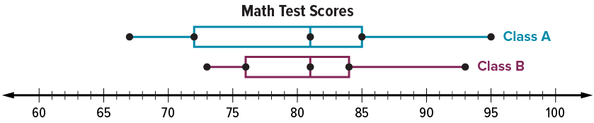
Who Scored Better?
The box plots represent the number of points scored on a recent math test for students in two sixth grade classes.
USE YOUR TOOLS · Reach for your notes, a model, or a manipulative before you reach for an answer.
Which class scored better overall on the test?
Precision
Does the problem call for an estimate or an exact solution?
33 / 46
Notes:
TEACH IN PRACTICE | Embedded facilitation | Lesson 2.5, slide 31 | TASK
Focus on the existing task: Which class scored better overall on the test?
LAUNCH (T2/3/5): Use the displayed question. Give private thinking time; then A explains while B asks for evidence. Switch roles. Each student records their own reasoning.
LOOK FOR (T4): Where this task addresses it, students can distinguish full spread from middle-half spread. Ask which feature of their work supports the claim.
RESPOND: If this task shows the lesson misconception—using the median as a measure of spread—label minimum, Q1, Q3 and maximum on the existing box plots. Have the student revise and explain the change. Use this support only where the concept occurs in the current task; otherwise respond to the displayed question.
RECHECK: If a gap is shared, revisit the existing representation together. If it is limited, give targeted support while others compare valid methods on the same task. Check the revision before moving on.
PARTICIPATION (T5/6/7): Think time before volunteers; accept a written, drawn or rehearsed entry. Students ask for evidence respectfully. Recognize a specific contribution or revision and check that both partners participate.
Source: BCPS Updated Instructional Framework Rubric (June 2020), TEACH 1–7. Earlier notes and answer keys are retained below.
EARLIER NOTES / EXISTING ANSWER KEY
Model briefly, then hand the thinking back: ask “Why does this step work?” before showing the next one.
Quick check before moving on — thumbs or whiteboards from everyone, not volunteers.
UIFR: TEACH 2 · TEACH 3 · TEACH 4.
UIFR FULL | Lesson-specific facilitation
TEACH 2-3 | Session 2 task launch (UIFR PDF pp. 9-10).
Use the problem exactly as displayed. Give individual thinking time before discussion or advancing to the explanation. If the answer is already visible, ask students to reconstruct and justify it. Invite a choice of suitable representations and have students explain why their choice helps.
At the point where this concept appears, ask: “Which values determine the range and which determine the IQR? Why might the two comparisons tell different stories?” Wait for evidence, invite another pathway, and have a student ask a follow-up question. Do not replace students’ reasoning with a sequence of leading steps.

Slide 34
How do the ranges of Class A and Class B compare?
Record your reasoning before the reveal. Compare, then explain any revision.
Range of Class A: 28
Range of Class B: 20
Reveal:
The range for Class A is 28, which is greater than that for Class B, which is 20.
34 / 46
Notes:
TEACH IN PRACTICE | Embedded facilitation | Lesson 2.5, slide 32 | REVEAL
Focus on the existing task: Range of Class B: 20 Range of Class A: 28 Reveal: The range for Class A is 28, which is greater than that for Class B, which is 20. How do the ranges of Class A and Class B compare?
LAUNCH (T2/3/5): If an existing answer cover is present, gather an attempt before revealing. If the explanation is already visible, ask students to reconstruct and justify it. Compare reasoning and explain a revision; preserve the reveal sequence.
LOOK FOR (T4): Where this task addresses it, students can compute range and IQR. Ask which feature of their work supports the claim.
RESPOND: If this task shows the lesson misconception—using the median as a measure of spread—label minimum, Q1, Q3 and maximum on the existing box plots. Have the student revise and explain the change. Use this support only where the concept occurs in the current task; otherwise respond to the displayed question.
RECHECK: If a gap is shared, revisit the existing representation together. If it is limited, give targeted support while others compare valid methods on the same task. Check the revision before moving on.
PARTICIPATION (T5/6/7): Think time before volunteers; accept a written, drawn or rehearsed entry. Students ask for evidence respectfully. Recognize a specific contribution or revision and check that both partners participate.
Source: BCPS Updated Instructional Framework Rubric (June 2020), TEACH 1–7. Earlier notes and answer keys are retained below.
EARLIER NOTES / EXISTING ANSWER KEY
Students should have shared predictions before this reveal.
Have them compare their thinking to what is shown: “Is this the same as what we said? Where is it different?”
Press one student to explain the reveal in their own words.
UIFR: TEACH 3 · TEACH 4.

Slide 35
How do the interquartile ranges of Class A and Class B compare?
Record your reasoning before the reveal. Compare, then explain any revision.
Think About It:
What does a low value for the interquartile range indicate about the data set?
IQR of Class A: 13
IQR of Class B: 8
Reveal:
The interquartile range for Class A is 13, which is greater than that for Class B, 8.
35 / 46
Notes:
TEACH IN PRACTICE | Embedded facilitation | Lesson 2.5, slide 33 | REVEAL
Focus on the existing task: How do the interquartile ranges of Class A and Class B compare?
LAUNCH (T2/3/5): If an existing answer cover is present, gather an attempt before revealing. If the explanation is already visible, ask students to reconstruct and justify it. Compare reasoning and explain a revision; preserve the reveal sequence.
LOOK FOR (T4): Where this task addresses it, students can compute range and IQR. Ask which feature of their work supports the claim.
RESPOND: If this task shows the lesson misconception—using the median as a measure of spread—label minimum, Q1, Q3 and maximum on the existing box plots. Have the student revise and explain the change. Use this support only where the concept occurs in the current task; otherwise respond to the displayed question.
RECHECK: If a gap is shared, revisit the existing representation together. If it is limited, give targeted support while others compare valid methods on the same task. Check the revision before moving on.
PARTICIPATION (T5/6/7): Think time before volunteers; accept a written, drawn or rehearsed entry. Students ask for evidence respectfully. Recognize a specific contribution or revision and check that both partners participate.
Source: BCPS Updated Instructional Framework Rubric (June 2020), TEACH 1–7. Earlier notes and answer keys are retained below.
EARLIER NOTES / EXISTING ANSWER KEY
Ask the question, then hold the silence — students think or jot before anyone answers.
Take two or three responses and press with “Why?” or “How do you know?” before moving on.
UIFR: TEACH 3.

Slide 36
Let’s Explore More
The box plots represent the scores on a recent math test for students in two sixth grade classes.
What does the interquartile range describe in the context of the problem?
TWO MINUTES SOLO · Two minutes on your own, then compare. Bring one thing you tried, even if it did not work.
Workspace
36 / 46
Notes:
TEACH IN PRACTICE | Embedded facilitation | Lesson 2.5, slide 34 | PRACTICE
Focus on the existing task: The box plots represent the scores on a recent math test for students in two sixth grade classes. What does the interquartile range describe in the context of the problem?
LAUNCH (T2/3/5): Use the displayed question. Give private thinking time; then A explains while B asks for evidence. Switch roles. Each student records their own reasoning.
LOOK FOR (T4): Where this task addresses it, students can compute range and IQR. Ask which feature of their work supports the claim.
RESPOND: If this task shows the lesson misconception—using the median as a measure of spread—label minimum, Q1, Q3 and maximum on the existing box plots. Have the student revise and explain the change. Use this support only where the concept occurs in the current task; otherwise respond to the displayed question.
RECHECK: If a gap is shared, revisit the existing representation together. If it is limited, give targeted support while others compare valid methods on the same task. Check the revision before moving on.
PARTICIPATION (T5/6/7): Think time before volunteers; accept a written, drawn or rehearsed entry. Students ask for evidence respectfully. Recognize a specific contribution or revision and check that both partners participate.
Source: BCPS Updated Instructional Framework Rubric (June 2020), TEACH 1–7. Earlier notes and answer keys are retained below.
EARLIER NOTES / EXISTING ANSWER KEY
Extension for partners or table groups — students choose their approach and use the workspace to show thinking.
Push with “Convince me,” and have two groups with different approaches share.
This is where students stretch past the worked example.
UIFR: TEACH 2 · TEACH 5.
UIFR FULL | Lesson-specific facilitation
TEACH 4-5 | Session 2 discussion and checkpoint (UIFR PDF pp. 11-12).
Collect a brief response from every student to the existing prompt before hearing volunteers. Partners take turns explaining and asking for evidence: “I understand ___; what supports ___?” Offer rehearsal or an annotated model for students who need language support. Each student records their own reasoning.
Look specifically for: using the median as a measure of spread. If it appears, label minimum, Q1, Q3 and maximum on the existing box plots; then ask the student to revise the same response and explain the change. If evidence is secure, have students compare a second valid pathway or state why their approach works. Choose the next step from the responses, not a preset pace.

Slide 37
Let’s Explore More
The box plots represent the scores on a recent math test for students in two sixth grade classes.
Two students, one in Class A and one in Class B were absent and took the test later. Both scored 80 on the test. How do these new scores change the distribution?
YOUR CHOICE · You choose how to show this — numbers, words, or a diagram. Make your reasoning visible.
Workspace
37 / 46
Notes:
TEACH IN PRACTICE | Embedded facilitation | Lesson 2.5, slide 35 | PRACTICE
Focus on the existing task: The box plots represent the scores on a recent math test for students in two sixth grade classes. Two students, one in Class A and one in…
LAUNCH (T2/3/5): Use the displayed question. Give private thinking time; then A explains while B asks for evidence. Switch roles. Each student records their own reasoning.
LOOK FOR (T4): Where this task addresses it, students can distinguish full spread from middle-half spread. Ask which feature of their work supports the claim.
RESPOND: If this task shows the lesson misconception—using the median as a measure of spread—label minimum, Q1, Q3 and maximum on the existing box plots. Have the student revise and explain the change. Use this support only where the concept occurs in the current task; otherwise respond to the displayed question.
RECHECK: If a gap is shared, revisit the existing representation together. If it is limited, give targeted support while others compare valid methods on the same task. Check the revision before moving on.
PARTICIPATION (T5/6/7): Think time before volunteers; accept a written, drawn or rehearsed entry. Students ask for evidence respectfully. Recognize a specific contribution or revision and check that both partners participate.
Source: BCPS Updated Instructional Framework Rubric (June 2020), TEACH 1–7. Earlier notes and answer keys are retained below.
EARLIER NOTES / EXISTING ANSWER KEY
Extension for partners or table groups — students choose their approach and use the workspace to show thinking.
Push with “Convince me,” and have two groups with different approaches share.
This is where students stretch past the worked example.
UIFR: TEACH 2 · TEACH 5.

Slide 38
LESSON 2.5 / CHECK YOUR WORK
Pause. Check. Improve.
CHECK
A mistake to watch for: using the median as a measure of spread.
TRY
Label minimum, Q1, Q3 and maximum on the given box plots.
REVISE
Use that check on the task you just completed. Correct or strengthen one part, and explain why.
REVISE NOW · Change one answer and write why you changed it. A revision is evidence of learning.
Listen to understand. Ask for evidence. Make room for every voice.
Notes:
TEACH IN PRACTICE | Embedded facilitation | Lesson 2.5, slide 36 | PRIOR_INSERT
Focus on the existing task: LESSON 2.5 / CHECK YOUR WORK Pause. Check. Improve. Listen to understand. Ask for evidence. Make room for every voice. CHECK A mistake…
CONNECT (T1/4): Ask students to restate the displayed goal or key idea and connect it to earlier work. Relevant lesson evidence: distinguish full spread from middle-half spread; compute range and IQR; interpret units. Use only the criterion that matches the current session.
SHOW PROGRESS: Students point to their own existing work, explain what improved after feedback, and name a next step. Pair confidence ratings with actual evidence.
PARTICIPATION (T5/6/7): Think time before volunteers; accept a written, drawn or rehearsed entry. Students ask for evidence respectfully. Recognize a specific contribution or revision and check that both partners participate.
Source: BCPS Updated Instructional Framework Rubric (June 2020), TEACH 1–7.

Slide 39
The box plots represent the scores on a recent math test for students in two sixth grade classes. Which class scored better overall on the test?
How can you use the box plot to compare the scores for each class?
Reveal:
We can use markers such as the median, the quartiles, and the interquartile range.
ASK THE CLASS · Write one question about this that you could ask the class.
39 / 46
Notes:
TEACH IN PRACTICE | Embedded facilitation | Lesson 2.5, slide 37 | REVEAL
Focus on the existing task: How can you use the box plot to compare the scores for each class?
LAUNCH (T2/3/5): If an existing answer cover is present, gather an attempt before revealing. If the explanation is already visible, ask students to reconstruct and justify it. Compare reasoning and explain a revision; preserve the reveal sequence.
LOOK FOR (T4): Where this task addresses it, students can compute range and IQR. Ask which feature of their work supports the claim.
RESPOND: If this task shows the lesson misconception—using the median as a measure of spread—label minimum, Q1, Q3 and maximum on the existing box plots. Have the student revise and explain the change. Use this support only where the concept occurs in the current task; otherwise respond to the displayed question.
RECHECK: If a gap is shared, revisit the existing representation together. If it is limited, give targeted support while others compare valid methods on the same task. Check the revision before moving on.
PARTICIPATION (T5/6/7): Think time before volunteers; accept a written, drawn or rehearsed entry. Students ask for evidence respectfully. Recognize a specific contribution or revision and check that both partners participate.
Source: BCPS Updated Instructional Framework Rubric (June 2020), TEACH 1–7.

Slide 40
Each class had a median score of 81.
How can you determine the variability of the data?
Compare your reasoning with the explanation. Explain any revision you make.
Reveal:
We can determine how much the data values vary using the range and interquartile range.
40 / 46
Notes:
TEACH IN PRACTICE | Embedded facilitation | Lesson 2.5, slide 38 | REVEAL
Focus on the existing task: Each class had a median score of 81. Reveal: We can determine how much the data values vary using the range and interquartile range. How can you determine the variability of the data?
LAUNCH (T2/3/5): If an existing answer cover is present, gather an attempt before revealing. If the explanation is already visible, ask students to reconstruct and justify it. Compare reasoning and explain a revision; preserve the reveal sequence.
LOOK FOR (T4): Where this task addresses it, students can compute range and IQR. Ask which feature of their work supports the claim.
RESPOND: If this task shows the lesson misconception—using the median as a measure of spread—label minimum, Q1, Q3 and maximum on the existing box plots. Have the student revise and explain the change. Use this support only where the concept occurs in the current task; otherwise respond to the displayed question.
RECHECK: If a gap is shared, revisit the existing representation together. If it is limited, give targeted support while others compare valid methods on the same task. Check the revision before moving on.
PARTICIPATION (T5/6/7): Think time before volunteers; accept a written, drawn or rehearsed entry. Students ask for evidence respectfully. Recognize a specific contribution or revision and check that both partners participate.
Source: BCPS Updated Instructional Framework Rubric (June 2020), TEACH 1–7.

Slide 41
How do the interquartile ranges of Class A and Class B compare?
Compare your reasoning with the explanation. Explain any revision you make.
Think About It:
What does a low value for the interquartile range indicate about the data set?
IQR of Class A: 13
IQR of Class B: 8
Reveal:
The interquartile range for Class A is 13, which is greater than that for Class B, 8.
41 / 46
Notes:
TEACH IN PRACTICE | Embedded facilitation | Lesson 2.5, slide 39 | REVEAL
Focus on the existing task: How do the interquartile ranges of Class A and Class B compare?
LAUNCH (T2/3/5): If an existing answer cover is present, gather an attempt before revealing. If the explanation is already visible, ask students to reconstruct and justify it. Compare reasoning and explain a revision; preserve the reveal sequence.
LOOK FOR (T4): Where this task addresses it, students can compute range and IQR. Ask which feature of their work supports the claim.
RESPOND: If this task shows the lesson misconception—using the median as a measure of spread—label minimum, Q1, Q3 and maximum on the existing box plots. Have the student revise and explain the change. Use this support only where the concept occurs in the current task; otherwise respond to the displayed question.
RECHECK: If a gap is shared, revisit the existing representation together. If it is limited, give targeted support while others compare valid methods on the same task. Check the revision before moving on.
PARTICIPATION (T5/6/7): Think time before volunteers; accept a written, drawn or rehearsed entry. Students ask for evidence respectfully. Recognize a specific contribution or revision and check that both partners participate.
Source: BCPS Updated Instructional Framework Rubric (June 2020), TEACH 1–7.

Slide 42

SUMMARIZE · SAY IT IN YOUR OWN WORDS
Summarize: Range and Interquartile Range
The range and interquartile range are measures of variability of a data set.
The range is the difference between the greatest value and the least value of a data set.
The interquartile range is the difference between the first quartile and third quartile. It describes how spread out the middle half of the values are around the median.
42 / 46
Notes:
TEACH IN PRACTICE | Embedded facilitation | Lesson 2.5, slide 40 | SUMMARIZE
Focus on the existing task: The range and interquartile range are measures of variability of a data set. The range is the difference between the greatest value and…
CONNECT (T1/4): Ask students to restate the displayed goal or key idea and connect it to earlier work. Relevant lesson evidence: distinguish full spread from middle-half spread; compute range and IQR; interpret units. Use only the criterion that matches the current session.
SHOW PROGRESS: Students point to their own existing work, explain what improved after feedback, and name a next step. Pair confidence ratings with actual evidence.
PARTICIPATION (T5/6/7): Think time before volunteers; accept a written, drawn or rehearsed entry. Students ask for evidence respectfully. Recognize a specific contribution or revision and check that both partners participate.
Source: BCPS Updated Instructional Framework Rubric (June 2020), TEACH 1–7. Earlier notes and answer keys are retained below.
EARLIER NOTES / EXISTING ANSWER KEY
Routine: SUMMARIZE · SAY IT IN YOUR OWN WORDS

Slide 43
STUDENT MOVES
Lesson 2-5
Your move
USE THE MATH WORDS · Use today’s math words in your explanation — not “it” and “that thing.”
43 / 46

Slide 44
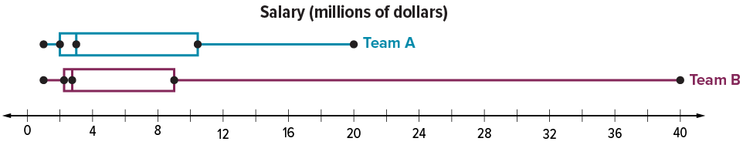
APPLY · PLAN IT • SOLVE IT • PROVE IT
Apply: Professional Basketball
The two box plots show the salaries for 15 players on two different professional basketball teams.
Question: A basketball player hopes to be drafted by a professional basketball team. Should he hope to be drafted by Team A or Team B?
TEACH A PARTNER · Teach this to someone who missed it. If you can teach it, you know it.
44 / 46
Notes:
TEACH IN PRACTICE | Embedded facilitation | Lesson 2.5, slide 41 | APPLY
Focus on the existing task: The two box plots show the salaries for 15 players on two different professional basketball teams. Question: A basketball player hopes to…
LAUNCH (T2/3/5): Use the exact application task independently first. Ask students to justify their choice of method. Collect evidence before a partner discussion or correction.
LOOK FOR (T4): Where this task addresses it, students can distinguish full spread from middle-half spread. Ask which feature of their work supports the claim.
RESPOND: If this task shows the lesson misconception—using the median as a measure of spread—label minimum, Q1, Q3 and maximum on the existing box plots. Have the student revise and explain the change. Use this support only where the concept occurs in the current task; otherwise respond to the displayed question.
RECHECK: If a gap is shared, revisit the existing representation together. If it is limited, give targeted support while others compare valid methods on the same task. Check the revision before moving on.
PARTICIPATION (T5/6/7): Think time before volunteers; accept a written, drawn or rehearsed entry. Students ask for evidence respectfully. Recognize a specific contribution or revision and check that both partners participate.
Source: BCPS Updated Instructional Framework Rubric (June 2020), TEACH 1–7. Earlier notes and answer keys are retained below.
EARLIER NOTES / EXISTING ANSWER KEY
Routine: APPLY · PLAN IT • SOLVE IT • PROVE IT
UIFR FULL | Lesson-specific facilitation
TEACH 4 | Independent evidence and revision (UIFR PDF p. 11).
Use the existing application/exit problem as the independent check. If this is a learning-target slide, have students point to and explain their work on the preceding task. Separate initial independent evidence from the revision after feedback.
Check the relevant criteria: distinguish full spread from middle-half spread; compute range and IQR; interpret units. Respond with one specific next step tied to the work. Students revise and annotate what changed, then identify a criterion they can now demonstrate and one they still need to practice.

Slide 45
Learning Targets
I can use the interquartile range to describe the variability in a data set.
I can use repeated reasoning to compare two data sets displayed in box plots.
SAY THE GOAL · Say today’s goal in your own words, then name one place this shows up outside math class.
45 / 46
Notes:
TEACH IN PRACTICE | Embedded facilitation | Lesson 2.5, slide 42 | REFLECTION
Focus on the existing task: I can use the interquartile range to describe the variability in a data set. I can use repeated reasoning to compare two data sets…
CONNECT (T1/4): Ask students to restate the displayed goal or key idea and connect it to earlier work. Relevant lesson evidence: distinguish full spread from middle-half spread; compute range and IQR; interpret units. Use only the criterion that matches the current session.
SHOW PROGRESS: Students point to their own existing work, explain what improved after feedback, and name a next step. Pair confidence ratings with actual evidence.
PARTICIPATION (T5/6/7): Think time before volunteers; accept a written, drawn or rehearsed entry. Students ask for evidence respectfully. Recognize a specific contribution or revision and check that both partners participate.
Source: BCPS Updated Instructional Framework Rubric (June 2020), TEACH 1–7. Earlier notes and answer keys are retained below.
EARLIER NOTES / EXISTING ANSWER KEY
Read each target; students self-rate with fist-to-five or thumbs.
Tie back to the goal from the start of class: did we get there?
Note any target that rates low — revisit it tomorrow.
UIFR: TEACH 1 · TEACH 4.
UIFR FULL | Lesson-specific facilitation
REFLECT & ADJUST 1-2 | After the lesson (UIFR PDF pp. 15-16).
Sort the existing work by demonstrated reasoning, partial understanding, and the specific misconception: using the median as a measure of spread. Compare the initial response with the revision. Record which teaching move plausibly helped, which did not, and whose participation or access needs a different approach; do not record sensitive student details in this shared deck.
Plan the next lesson from that evidence: if the misconception persists, label minimum, Q1, Q3 and maximum on the existing box plots using the current example before returning to the next grade-level task; if understanding is secure, use an existing extension or ask for a general explanation. Check the targeted idea again at the next warm-up.
Ask students what supported their thinking and what would help next time. Identify one change to try and one successful practice to retain. Seek colleague feedback on anonymized work when useful; these prompts support reflection and do not establish an evaluation rating. Source: Baltimore City Public Schools, Updated Instructional Framework Rubric, June 2020 (UIFR_Full.pdf).

Slide 46
LESSON 2.5 / REFLECT ON YOUR LEARNING
Show your progress
1 SHOW EVIDENCE
2 CHOOSE A NEXT STEP
Choose one response. Point to the part that shows your reasoning.
Name a change you made after feedback—or a question you still have.
“My work shows ___ because ___.”
“Next time, I will ___ to help me ___.”
Today’s focus: Distinguish full spread from middle-half spread.
CREDIT A CLASSMATE · Name one classmate whose idea helped you today, and say what they said.
Listen to understand. Ask for evidence. Make room for every voice.
Notes:
TEACH IN PRACTICE | Embedded facilitation | Lesson 2.5, slide 43 | PRIOR_INSERT
Focus on the existing task: LESSON 2.5 / REFLECT ON YOUR LEARNING Show your progress Listen to understand. Ask for evidence. Make room for every voice. 1 SHOW…
CONNECT (T1/4): Ask students to restate the displayed goal or key idea and connect it to earlier work. Relevant lesson evidence: distinguish full spread from middle-half spread; compute range and IQR; interpret units. Use only the criterion that matches the current session.
SHOW PROGRESS: Students point to their own existing work, explain what improved after feedback, and name a next step. Pair confidence ratings with actual evidence.
PARTICIPATION (T5/6/7): Think time before volunteers; accept a written, drawn or rehearsed entry. Students ask for evidence respectfully. Recognize a specific contribution or revision and check that both partners participate.
Source: BCPS Updated Instructional Framework Rubric (June 2020), TEACH 1–7.

