Slide 1
WARM-UP · THINK • TRY • CHECK
Turn and talk: compare strategies, then defend one.
Warm-Up
Lesson 2-7 · Divide Decimals Using an Algorithm | Warm-Up · about 4 minutes
Try each on your own. Mark an unsure answer; explain and revise when we check.
QUESTION 1
QUESTION 2
72 ÷ 9 = ______
84 ÷ 4 = ______
QUESTION 3
QUESTION 4
0.6 × 100 = ______
4.8 ÷ 2 = ______
TALK IT OVER: “I got ______ because ______.” • Compare with a partner before we check as a class.
1 / 43
Notes:
TEACH IN PRACTICE | Embedded facilitation | Lesson 2.7, slide 1 | WARMUP
Focus on the existing task: Warm-Up WARM-UP · THINK • TRY • CHECK Do these four on…
GATHER EVIDENCE (T4/6): Keep the original items. Students try independently, mark an uncertain item, and explain one method before checking. Use the existing key when present.
RESPOND: Distinguish a calculation slip from a reasoning gap. Give one next step on the same item; have students revise in a second color. Use the responses to choose flexible support for today’s lesson.
PARTICIPATION (T5/6/7): Think time before volunteers; accept a written, drawn or rehearsed entry. Students ask for evidence respectfully. Recognize a specific contribution or revision and check that both partners participate.
Source: BCPS Updated Instructional Framework Rubric (June 2020), TEACH 1–7. Earlier notes and answer keys are retained below.
EARLIER NOTES / EXISTING ANSWER KEY
Warm-Up answers (teacher only): 1) 8 2) 21 3) 60 4) 2.4
UIFR FULL | Lesson-specific facilitation
PREPARE 1-2 | Before teaching (UIFR PDF pp. 6-7).
Plan to gather evidence that students can create an equivalent division with a whole-number divisor; preserve place value; check the quotient. Review recent work and today’s warm-up to choose flexible groups and access supports; do not infer needs from identity or perceived ability. Use the existing lesson tasks and stated standards.
Anticipate: moving the decimal point in only the divisor. If observed, annotate the same power-of-ten scaling on both original numbers. Offer oral rehearsal, drawing, pointing, or home-language processing as needed; retain the original mathematical demand. Ask students which support helps and fade it as evidence improves.
TEACH 6-7 | Before the first transition, agree on materials, partner roles, and how to request help. Invite students to restate the routine. Normalize revising an idea, recognize a specific contribution, and check privately when frustration blocks participation. Source: UIFR PDF pp. 13-14.

Slide 2
Today’s Math Notes
Lesson 2-7 · Divide Decimals Using an Algorithm
Section 1: Math Words
Copy. Explain. Check.
Divide Decimals
1
Find a quotient with decimals by sliding both decimal points right
Decimal Division Algorithm
2
The steps for dividing decimals
Read, cover, explain. Reopen your notes to check and improve your explanation.
eduwonderlab.com · Neft Teacher
2 / 43
Notes:
TEACH IN PRACTICE | Embedded facilitation | Lesson 2.7, slide 2 | NOTES
Focus on the existing task: Today’s Math Notes Section 1: Math Words Copy into your…
ROUTINE (T1/2/4): Read or copy the original notes, cover one line, and explain it using the displayed example. Reopen and correct. Copying alone is not evidence of understanding.
LOOK FOR: A link between a symbol, quantity or feature and the explanation. If missing, point back to that feature and have the student try again; fade the prompt once they can explain.
PARTICIPATION (T5/6/7): Think time before volunteers; accept a written, drawn or rehearsed entry. Students ask for evidence respectfully. Recognize a specific contribution or revision and check that both partners participate.
Source: BCPS Updated Instructional Framework Rubric (June 2020), TEACH 1–7. Earlier notes and answer keys are retained below.
EARLIER NOTES / EXISTING ANSWER KEY
Copy routine: read one line at a time; students copy, then explain that line to a partner.
Keep it brisk — the understanding work happens in the examples, not the copying.
UIFR: TEACH 1 · TEACH 6.

Slide 3
Today’s Math Notes
Lesson 2-7 · Divide Decimals Using an Algorithm
Section 2: Today’s Math
Copy. Explain. Check.
Decimal Division Algorithm
Make the divisor a whole number: slide its decimal point to the right
1
Slide the dividend’s decimal point to the right the same number of places
2
SAY THE GOAL · Say today’s goal in your own words, then name one place this shows up outside math class.
Write the answer’s decimal point in the column directly above the dividend’s point, then divide as whole numbers using Divide → Multiply → Subtract → Bring Down
3
eduwonderlab.com · Neft Teacher
3 / 43
Notes:
TEACH IN PRACTICE | Embedded facilitation | Lesson 2.7, slide 3 | NOTES
Focus on the existing task: Today’s Math Notes Section 2: Today’s Math Copy into…
ROUTINE (T1/2/4): Read or copy the original notes, cover one line, and explain it using the displayed example. Reopen and correct. Copying alone is not evidence of understanding.
LOOK FOR: A link between a symbol, quantity or feature and the explanation. If missing, point back to that feature and have the student try again; fade the prompt once they can explain.
PARTICIPATION (T5/6/7): Think time before volunteers; accept a written, drawn or rehearsed entry. Students ask for evidence respectfully. Recognize a specific contribution or revision and check that both partners participate.
Source: BCPS Updated Instructional Framework Rubric (June 2020), TEACH 1–7. Earlier notes and answer keys are retained below.
EARLIER NOTES / EXISTING ANSWER KEY
Copy routine: read one line at a time; students copy, then explain that line to a partner.
Keep it brisk — the understanding work happens in the examples, not the copying.
UIFR: TEACH 1 · TEACH 6.

Slide 4
Session 1
Divide Decimals Using an Algorithm
PICK YOUR STRATEGY · Choose your path — picture, table, number line, or equation — and be ready to say why you chose it.
4 / 43
Notes:
TEACH IN PRACTICE | Embedded facilitation | Lesson 2.7, slide 4 | DIVIDER
Focus on the existing task: Divide Decimals Using an Algorithm Session 1
TRANSITION (T6/7): Students confirm materials, roles, how to request help, and the next response routine. Ask a student to restate it. Keep teacher-only slides hidden.
PARTICIPATION (T5/6/7): Think time before volunteers; accept a written, drawn or rehearsed entry. Students ask for evidence respectfully. Recognize a specific contribution or revision and check that both partners participate.
Source: BCPS Updated Instructional Framework Rubric (June 2020), TEACH 1–7. Earlier notes and answer keys are retained below.
EARLIER NOTES / EXISTING ANSWER KEY
Transition cue: state what materials are out and what success looks like this session.
Keep the changeover under a minute.
UIFR: TEACH 6.

Slide 5
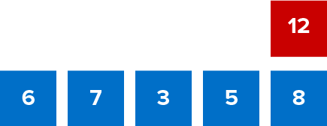
Give Me Five
Use all the numbers in any order with any operation to equal the target number (in red).
Explain how the information shown supports your reasoning.
5 / 43
Notes:
TEACH IN PRACTICE | Embedded facilitation | Lesson 2.7, slide 5 | WORKED
Focus on the existing task: Give Me Five Use all the numbers in any order with any operation to equal the target number (in red).
LAUNCH (T2/3/5): Ask students to explain the displayed idea or example and point to evidence. When a calculation step is shown, ask why it is valid. Have a partner restate the explanation; copying is not the check.
LOOK FOR (T4): Where this task addresses it, students can create an equivalent division with a whole-number divisor. Ask which feature of their work supports the claim.
RESPOND: If this task shows the lesson misconception—moving the decimal point in only the divisor—annotate the same power-of-ten scaling on both original numbers. Have the student revise and explain the change. Use this support only where the concept occurs in the current task; otherwise respond to the displayed question.
RECHECK: If a gap is shared, revisit the existing representation together. If it is limited, give targeted support while others compare valid methods on the same task. Check the revision before moving on.
PARTICIPATION (T5/6/7): Think time before volunteers; accept a written, drawn or rehearsed entry. Students ask for evidence respectfully. Recognize a specific contribution or revision and check that both partners participate.
Source: BCPS Updated Instructional Framework Rubric (June 2020), TEACH 1–7. Earlier notes and answer keys are retained below.
EARLIER NOTES / EXISTING ANSWER KEY
Number-sense routine — every voice in. Give quiet think time, then hear from at least three students.
Always follow with “How do you know?” — the reasoning is the point, not the answer.
There is more than one path; name and celebrate different strategies.
UIFR: TEACH 3 · TEACH 5 · TEACH 6.

Slide 6
Today’s Objectives
Lesson 2-7 · Divide Decimals Using an Algorithm
Divide Decimals Using an Algorithm
Maryland Standard 6.NOS.3
CONNECT IT · What earlier lesson does this build on? Tell a partner in one sentence.
CONTENT OBJECTIVE
LANGUAGE OBJECTIVE
Restate the goal in your words
Use these words to explain why
I can divide with decimals by making the divisor a whole number first.
I can explain my work using the words dividend, divisor, quotient, and equivalent division.
eduwonderlab.com · Neft Teacher
6 / 43
Notes:
TEACH IN PRACTICE | Embedded facilitation | Lesson 2.7, slide 6 | GOAL
Focus on the existing task: Today’s Objectives Divide Decimals Using an Algorithm…
CONNECT (T1/4): Ask students to restate the displayed goal or key idea and connect it to earlier work. Relevant lesson evidence: create an equivalent division with a whole-number divisor; preserve place value; check the quotient. Use only the criterion that matches the current session.
SHOW PROGRESS: Students point to their own existing work, explain what improved after feedback, and name a next step. Pair confidence ratings with actual evidence.
PARTICIPATION (T5/6/7): Think time before volunteers; accept a written, drawn or rehearsed entry. Students ask for evidence respectfully. Recognize a specific contribution or revision and check that both partners participate.
Source: BCPS Updated Instructional Framework Rubric (June 2020), TEACH 1–7. Earlier notes and answer keys are retained below.
EARLIER NOTES / EXISTING ANSWER KEY
Read the objective together, then have one or two students restate today’s goal in their own words.
Connect it to what the class learned last lesson.
Return to this goal at the end of class to check it was met.
UIFR: TEACH 1.
UIFR FULL | Lesson-specific facilitation
TEACH 1 | Session 1 purpose and evidence (UIFR PDF p. 8).
Have students restate the displayed session goal in their own words and connect it to the existing context or a familiar experience they choose to share. Use the current session goal to select from these lesson-wide evidence criteria; do not frontload a later-session procedure.
Look for: create an equivalent division with a whole-number divisor; preserve place value; check the quotient. Ask: “Which part of your work would show this?” Revisit that evidence after the task; a confidence rating alone is not evidence of understanding.

Slide 7
LESSON 2.7 / OUR LEARNING
What will show your learning?
1
Create an equivalent division with a whole-number divisor.
2
Preserve place value.
3
Check the quotient.
Tell a partner: Which skill connects to something you already know?
SHOW YOUR THINKING · Show what you know — write it, draw it, or build it. A picture counts as an explanation.
Listen to understand. Ask for evidence. Make room for every voice.
Notes:
TEACH IN PRACTICE | Embedded facilitation | Lesson 2.7, slide 7 | PRIOR_INSERT
Focus on the existing task: LESSON 2.7 / OUR LEARNING What will show your learning?
CONNECT (T1/4): Ask students to restate the displayed goal or key idea and connect it to earlier work. Relevant lesson evidence: create an equivalent division with a whole-number divisor; preserve place value; check the quotient. Use only the criterion that matches the current session.
SHOW PROGRESS: Students point to their own existing work, explain what improved after feedback, and name a next step. Pair confidence ratings with actual evidence.
PARTICIPATION (T5/6/7): Think time before volunteers; accept a written, drawn or rehearsed entry. Students ask for evidence respectfully. Recognize a specific contribution or revision and check that both partners participate.
Source: BCPS Updated Instructional Framework Rubric (June 2020), TEACH 1–7.

Slide 8
Vocabulary 1 of 6
Lesson 2-7 · Divide Decimals Using an Algorithm
Divide Decimals
Find a quotient with decimals by sliding both decimal points right until the divisor is a whole number.
EXAMPLE · EXPLAIN WHY IT FITS
8.4 ÷ 2.1 = 84 ÷ 21 = 4
USE THE MATH WORDS · Use today’s math words in your explanation — not “it” and “that thing.”
eduwonderlab.com · Neft Teacher
8 / 43
Notes:
TEACH IN PRACTICE | Embedded facilitation | Lesson 2.7, slide 8 | VOCAB
Focus on the existing task: Vocabulary 1 of 6 Divide Decimals Find a quotient with…
ASK (T1/3/5): Where does “Divide Decimals” appear in the example? Explain the meaning without reading the definition. Partner: restate the idea and ask a clarifying question.
LOOK FOR: A correct connection between the word and a feature of the example. If the student only repeats the definition, invite pointing, sketching or oral rehearsal, then ask for another explanation of this same example.
PARTICIPATION (T5/6/7): Think time before volunteers; accept a written, drawn or rehearsed entry. Students ask for evidence respectfully. Recognize a specific contribution or revision and check that both partners participate.
Source: BCPS Updated Instructional Framework Rubric (June 2020), TEACH 1–7.

Slide 9
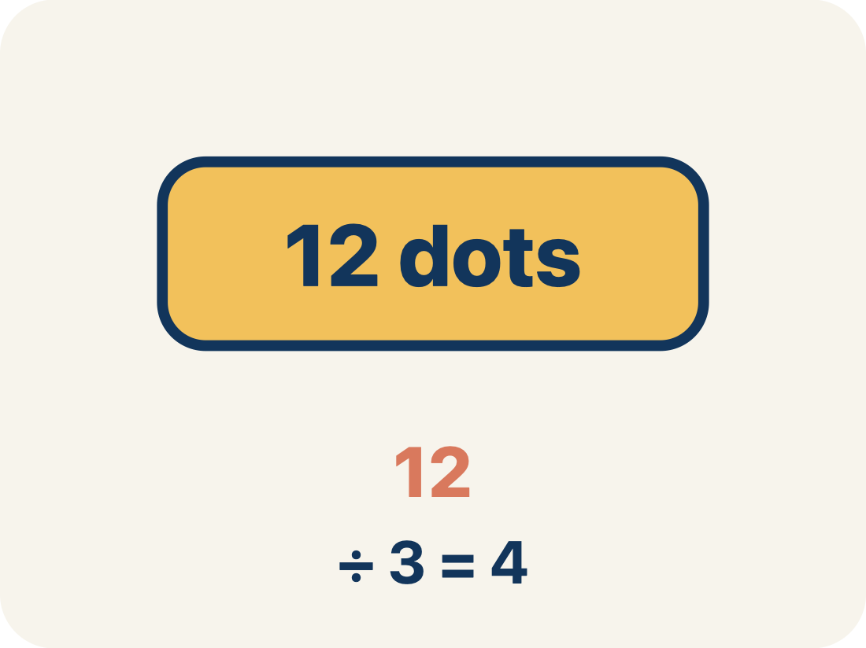
Vocabulary 2 of 6
Lesson 2-7 · Divide Decimals Using an Algorithm
Dividend
The total number being divided into equal groups (the number inside the division bracket).
EXAMPLE · EXPLAIN WHY IT FITS
In 8.4 ÷ 2.1 = 4, the dividend is 8.4 — the total amount being divided
Use “Dividend” to explain the example. Point to evidence.
eduwonderlab.com · Neft Teacher
9 / 43
Notes:
TEACH IN PRACTICE | Embedded facilitation | Lesson 2.7, slide 9 | VOCAB
Focus on the existing task: Vocabulary 2 of 6 Dividend The total number being…
ASK (T1/3/5): Where does “Dividend” appear in the example? Explain the meaning without reading the definition. Partner: restate the idea and ask a clarifying question.
LOOK FOR: A correct connection between the word and a feature of the example. If the student only repeats the definition, invite pointing, sketching or oral rehearsal, then ask for another explanation of this same example.
PARTICIPATION (T5/6/7): Think time before volunteers; accept a written, drawn or rehearsed entry. Students ask for evidence respectfully. Recognize a specific contribution or revision and check that both partners participate.
Source: BCPS Updated Instructional Framework Rubric (June 2020), TEACH 1–7.

Slide 10
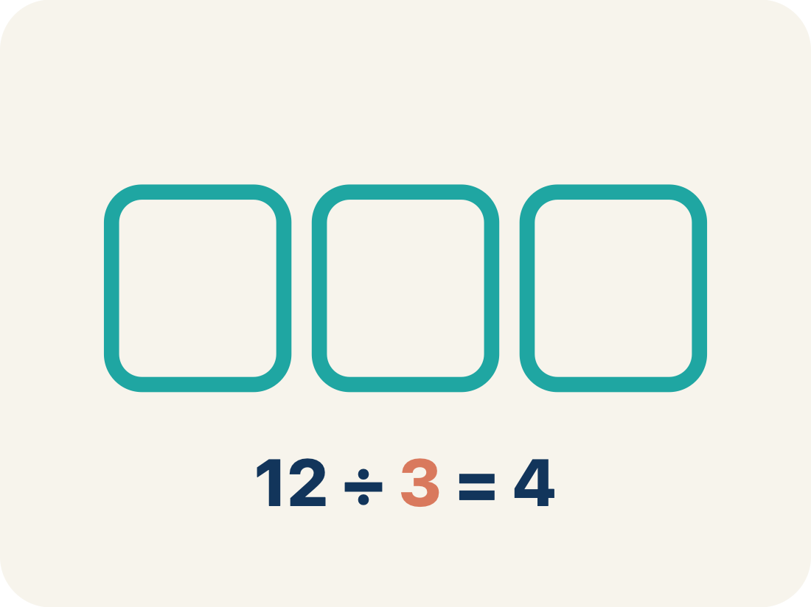
Vocabulary 3 of 6
Lesson 2-7 · Divide Decimals Using an Algorithm
Divisor
The number of equal groups you are dividing into (the number outside the division bracket).
EXAMPLE · EXPLAIN WHY IT FITS
In 8.4 ÷ 2.1 = 4, the divisor is 2.1 — the number of equal groups
Use “Divisor” to explain the example. Point to evidence.
eduwonderlab.com · Neft Teacher
10 / 43
Notes:
TEACH IN PRACTICE | Embedded facilitation | Lesson 2.7, slide 10 | VOCAB
Focus on the existing task: Vocabulary 3 of 6 Divisor The number of equal groups…
ASK (T1/3/5): Where does “Divisor” appear in the example? Explain the meaning without reading the definition. Partner: restate the idea and ask a clarifying question.
LOOK FOR: A correct connection between the word and a feature of the example. If the student only repeats the definition, invite pointing, sketching or oral rehearsal, then ask for another explanation of this same example.
PARTICIPATION (T5/6/7): Think time before volunteers; accept a written, drawn or rehearsed entry. Students ask for evidence respectfully. Recognize a specific contribution or revision and check that both partners participate.
Source: BCPS Updated Instructional Framework Rubric (June 2020), TEACH 1–7.

Slide 11
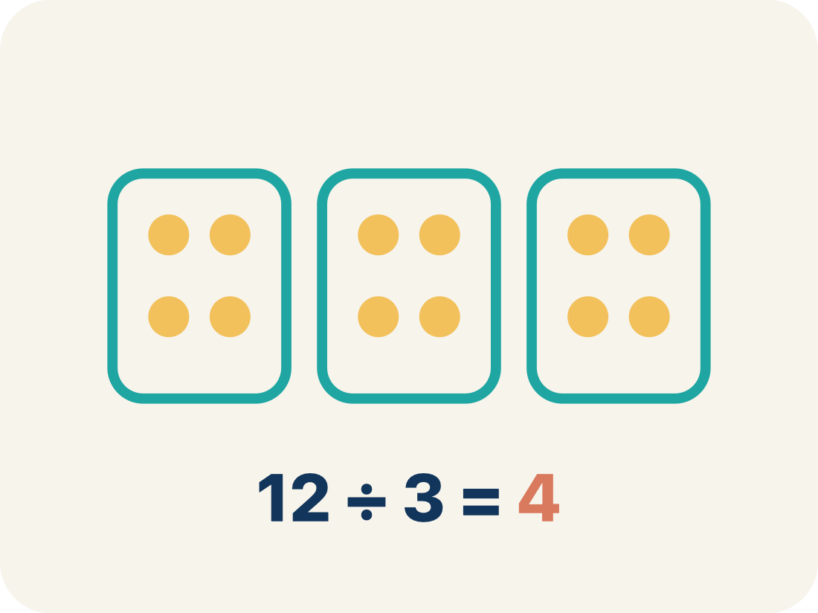
Vocabulary 4 of 6
Lesson 2-7 · Divide Decimals Using an Algorithm
Quotient
The answer when you divide.
EXAMPLE · EXPLAIN WHY IT FITS
In 8.4 ÷ 2.1 = 4, the quotient is 4 — there are 4 groups
Use “Quotient” to explain the example. Point to evidence.
eduwonderlab.com · Neft Teacher
11 / 43
Notes:
TEACH IN PRACTICE | Embedded facilitation | Lesson 2.7, slide 11 | VOCAB
Focus on the existing task: Vocabulary 4 of 6 Quotient The answer when you divide.…
ASK (T1/3/5): Where does “Quotient” appear in the example? Explain the meaning without reading the definition. Partner: restate the idea and ask a clarifying question.
LOOK FOR: A correct connection between the word and a feature of the example. If the student only repeats the definition, invite pointing, sketching or oral rehearsal, then ask for another explanation of this same example.
PARTICIPATION (T5/6/7): Think time before volunteers; accept a written, drawn or rehearsed entry. Students ask for evidence respectfully. Recognize a specific contribution or revision and check that both partners participate.
Source: BCPS Updated Instructional Framework Rubric (June 2020), TEACH 1–7.

Slide 12
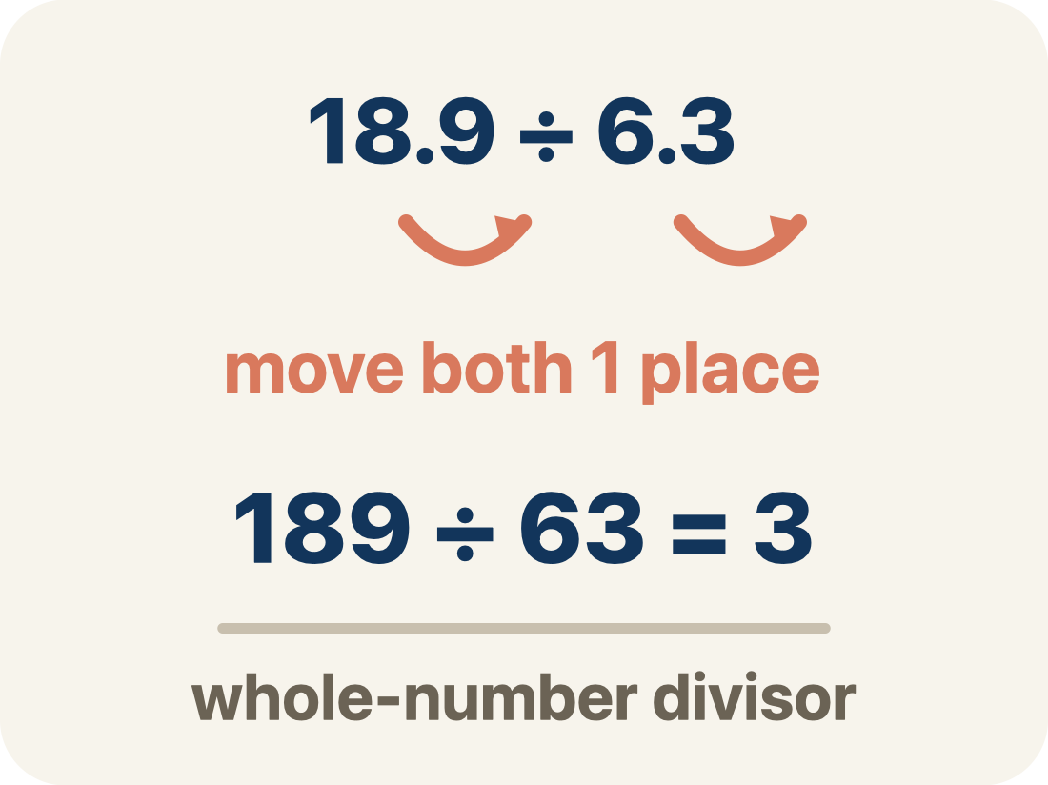
Vocabulary 5 of 6
Lesson 2-7 · Divide Decimals Using an Algorithm
ADD ON · Add on: “I agree because ______.” or “I see it differently because ______.”
Decimal Division Algorithm
The steps for dividing decimals: slide the divisor’s decimal point right until the divisor is a whole number, slide the dividend’s point right the same number of places, then divide.
EXAMPLE · EXPLAIN WHY IT FITS
8.4 ÷ 2.1 → move the point in both → 84 ÷ 21 → divide, multiply, subtract, bring down → 4
eduwonderlab.com · Neft Teacher
12 / 43
Notes:
TEACH IN PRACTICE | Embedded facilitation | Lesson 2.7, slide 12 | VOCAB
Focus on the existing task: Vocabulary 5 of 6 Decimal Division Algorithm The steps…
ASK (T1/3/5): Where does “Decimal Division Algorithm” appear in the example? Explain the meaning without reading the definition. Partner: restate the idea and ask a clarifying question.
LOOK FOR: A correct connection between the word and a feature of the example. If the student only repeats the definition, invite pointing, sketching or oral rehearsal, then ask for another explanation of this same example.
PARTICIPATION (T5/6/7): Think time before volunteers; accept a written, drawn or rehearsed entry. Students ask for evidence respectfully. Recognize a specific contribution or revision and check that both partners participate.
Source: BCPS Updated Instructional Framework Rubric (June 2020), TEACH 1–7.

Slide 13
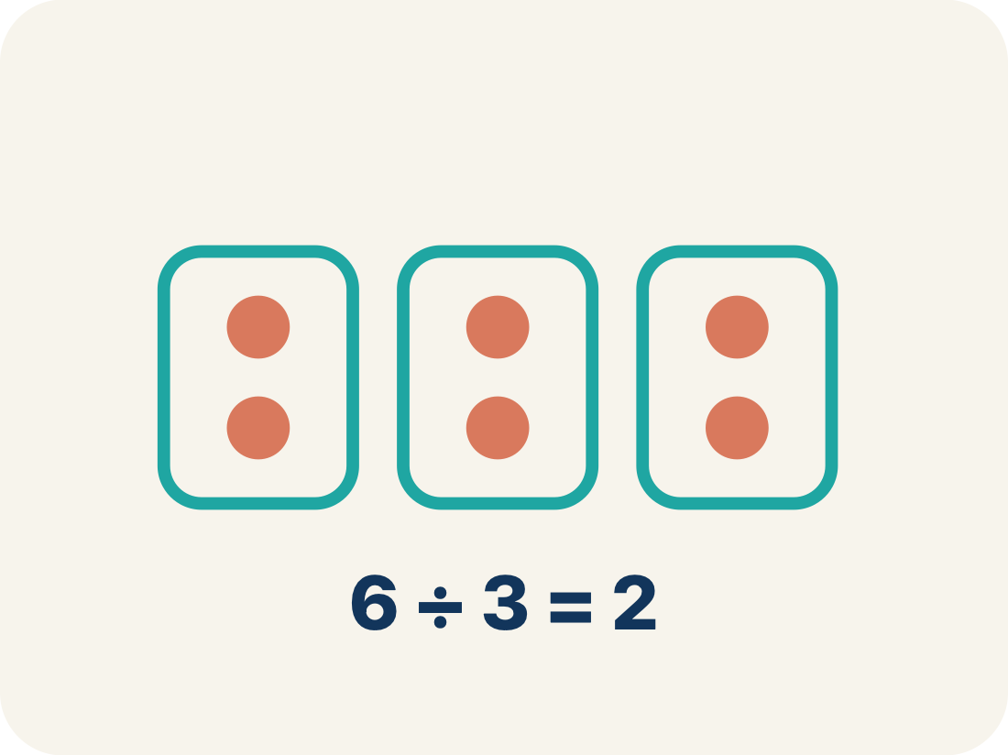
Vocabulary 6 of 6
Lesson 2-7 · Divide Decimals Using an Algorithm
Equivalent division
Multiplying both numbers by 10 or 100 gives the same answer.
EXAMPLE · EXPLAIN WHY IT FITS
7.56 ÷ 0.12 = 756 ÷ 12 = 63 (both multiplied by 100)
Use “Equivalent division” to explain the example. Point to
evidence.
eduwonderlab.com · Neft Teacher
13 / 43
Notes:
TEACH IN PRACTICE | Embedded facilitation | Lesson 2.7, slide 13 | VOCAB
Focus on the existing task: Vocabulary 6 of 6 Equivalent division Multiplying both…
ASK (T1/3/5): Where does “Equivalent division” appear in the example? Explain the meaning without reading the definition. Partner: restate the idea and ask a clarifying question.
LOOK FOR: A correct connection between the word and a feature of the example. If the student only repeats the definition, invite pointing, sketching or oral rehearsal, then ask for another explanation of this same example.
PARTICIPATION (T5/6/7): Think time before volunteers; accept a written, drawn or rehearsed entry. Students ask for evidence respectfully. Recognize a specific contribution or revision and check that both partners participate.
Source: BCPS Updated Instructional Framework Rubric (June 2020), TEACH 1–7.

Slide 14
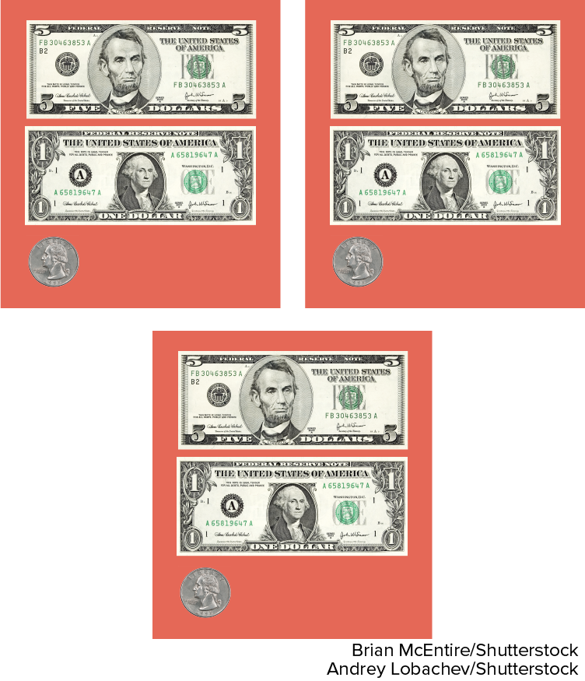

Be Curious
What could the question be?
$18.75
Think first. Share a notice and a
question; build on a classmate’s
idea.
Mindset
What actions can you take to achieve your goal today?
14 / 43
Notes:
TEACH IN PRACTICE | Embedded facilitation | Lesson 2.7, slide 14 | CURIOUS
Focus on the existing task: Be Curious What could the question be?
LAUNCH (T2/3/5): Allow quiet observation first. Separate a notice from an inference, invite students’ own questions, and follow the existing launch before teaching a procedure.
LOOK FOR (T4): Where this task addresses it, students can create an equivalent division with a whole-number divisor. Ask which feature of their work supports the claim.
RESPOND: If this task shows the lesson misconception—moving the decimal point in only the divisor—annotate the same power-of-ten scaling on both original numbers. Have the student revise and explain the change. Use this support only where the concept occurs in the current task; otherwise respond to the displayed question.
RECHECK: If a gap is shared, revisit the existing representation together. If it is limited, give targeted support while others compare valid methods on the same task. Check the revision before moving on.
PARTICIPATION (T5/6/7): Think time before volunteers; accept a written, drawn or rehearsed entry. Students ask for evidence respectfully. Recognize a specific contribution or revision and check that both partners participate.
Source: BCPS Updated Instructional Framework Rubric (June 2020), TEACH 1–7.

Slide 15
Vocabulary
Lesson 2-7 · Divide Decimals Using an Algorithm
Today’s Math Words
We learn every word — what it means and what it looks like — before we use it.
Divide Decimals
Dividend
Find a quotient with decimals by sliding both decimal points right until the divisor is a whole number
The total number being divided into equal groups (the number inside the division bracket)
Divisor
Quotient
The number of equal groups you are dividing into (the number outside the division bracket)
The answer when you divide
Decimal Division Algorithm
Equivalent division
The steps for dividing decimals: slide the divisor’s decimal point right until the divisor is a whole number, slide the dividend’s point right the same number of places, then divide
Multiplying both numbers by 10 or 100 gives the same answer
TAKE TURNS · One explains, one asks a question. Then switch, so both of you talk.
eduwonderlab.com · Neft Teacher
15 / 43
Notes:
TEACH IN PRACTICE | Embedded facilitation | Lesson 2.7, slide 15 | VOCAB
Focus on the existing task: Vocabulary Today’s Math Words We learn every word — what…
ASK (T1/3/5): Where does “the displayed term” appear in the example? Explain the meaning without reading the definition. Partner: restate the idea and ask a clarifying question.
LOOK FOR: A correct connection between the word and a feature of the example. If the student only repeats the definition, invite pointing, sketching or oral rehearsal, then ask for another explanation of this same example.
PARTICIPATION (T5/6/7): Think time before volunteers; accept a written, drawn or rehearsed entry. Students ask for evidence respectfully. Recognize a specific contribution or revision and check that both partners participate.
Source: BCPS Updated Instructional Framework Rubric (June 2020), TEACH 1–7. Earlier notes and answer keys are retained below.
EARLIER NOTES / EXISTING ANSWER KEY
Choral-read each word, its meaning, and what it looks like.
Students should use these words out loud today — listen for them in partner talk and revoice student ideas with the academic term.
UIFR: TEACH 1 · TEACH 5.

Slide 16
Be Curious
What could the question be?
$18.75
Think first. Share a notice and a
question; build on a classmate’s
idea.
Mindset
16 / 43
Notes:
TEACH IN PRACTICE | Embedded facilitation | Lesson 2.7, slide 16 | CURIOUS
Focus on the existing task: Be Curious What could the question be?
LAUNCH (T2/3/5): Allow quiet observation first. Separate a notice from an inference, invite students’ own questions, and follow the existing launch before teaching a procedure.
LOOK FOR (T4): Where this task addresses it, students can create an equivalent division with a whole-number divisor. Ask which feature of their work supports the claim.
RESPOND: If this task shows the lesson misconception—moving the decimal point in only the divisor—annotate the same power-of-ten scaling on both original numbers. Have the student revise and explain the change. Use this support only where the concept occurs in the current task; otherwise respond to the displayed question.
RECHECK: If a gap is shared, revisit the existing representation together. If it is limited, give targeted support while others compare valid methods on the same task. Check the revision before moving on.
PARTICIPATION (T5/6/7): Think time before volunteers; accept a written, drawn or rehearsed entry. Students ask for evidence respectfully. Recognize a specific contribution or revision and check that both partners participate.
Source: BCPS Updated Instructional Framework Rubric (June 2020), TEACH 1–7. Earlier notes and answer keys are retained below.
EARLIER NOTES / EXISTING ANSWER KEY
Accept all noticings and wonderings — there are no wrong answers here.
Give 20–30 seconds of quiet think time before taking responses; mix cold and warm calls so it is not always the same voices.
Read the mindset question aloud and let two students respond.
UIFR: TEACH 3 · TEACH 7.
UIFR FULL | Lesson-specific facilitation
TEACH 2-3 | Session 1 task launch (UIFR PDF pp. 9-10).
Use the problem exactly as displayed. Give individual thinking time before discussion or advancing to the explanation. If the answer is already visible, ask students to reconstruct and justify it. Invite a choice of suitable representations and have students explain why their choice helps.
At the point where this concept appears, ask: “Why must both numbers be multiplied by the same power of ten? How can multiplication check the quotient?” Wait for evidence, invite another pathway, and have a student ask a follow-up question. Do not replace students’ reasoning with a sequence of leading steps.

Slide 17
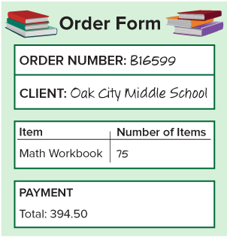
Textbook Purchases
A school bought new math workbooks as shown in the order form.
What is the cost of each workbook?
Think and record first. Which part of your work supports your answer?
17 / 43
Notes:
TEACH IN PRACTICE | Embedded facilitation | Lesson 2.7, slide 17 | TASK
Focus on the existing task: Textbook Purchases A school bought new math workbooks as shown in the order form. What is the cost of each workbook?
LAUNCH (T2/3/5): Use the displayed question. Give private thinking time; then A explains while B asks for evidence. Switch roles. Each student records their own reasoning.
LOOK FOR (T4): Where this task addresses it, students can create an equivalent division with a whole-number divisor. Ask which feature of their work supports the claim.
RESPOND: If this task shows the lesson misconception—moving the decimal point in only the divisor—annotate the same power-of-ten scaling on both original numbers. Have the student revise and explain the change. Use this support only where the concept occurs in the current task; otherwise respond to the displayed question.
RECHECK: If a gap is shared, revisit the existing representation together. If it is limited, give targeted support while others compare valid methods on the same task. Check the revision before moving on.
PARTICIPATION (T5/6/7): Think time before volunteers; accept a written, drawn or rehearsed entry. Students ask for evidence respectfully. Recognize a specific contribution or revision and check that both partners participate.
Source: BCPS Updated Instructional Framework Rubric (June 2020), TEACH 1–7. Earlier notes and answer keys are retained below.
EARLIER NOTES / EXISTING ANSWER KEY
Model briefly, then hand the thinking back: ask “Why does this step work?” before showing the next one.
Quick check before moving on — thumbs or whiteboards from everyone, not volunteers.
UIFR: TEACH 2 · TEACH 3 · TEACH 4.

Slide 18
What is an efficient method for division that you can use?
394.50 ÷ 75 = w
Record your reasoning before the reveal. Compare, then explain any revision.
Reveal:
We can use an algorithm to divide.
18 / 43
Notes:
TEACH IN PRACTICE | Embedded facilitation | Lesson 2.7, slide 18 | REVEAL
Focus on the existing task: Reveal: We can use an algorithm to divide. What is an efficient method for division that you can use?
LAUNCH (T2/3/5): If an existing answer cover is present, gather an attempt before revealing. If the explanation is already visible, ask students to reconstruct and justify it. Compare reasoning and explain a revision; preserve the reveal sequence.
LOOK FOR (T4): Where this task addresses it, students can create an equivalent division with a whole-number divisor. Ask which feature of their work supports the claim.
RESPOND: If this task shows the lesson misconception—moving the decimal point in only the divisor—annotate the same power-of-ten scaling on both original numbers. Have the student revise and explain the change. Use this support only where the concept occurs in the current task; otherwise respond to the displayed question.
RECHECK: If a gap is shared, revisit the existing representation together. If it is limited, give targeted support while others compare valid methods on the same task. Check the revision before moving on.
PARTICIPATION (T5/6/7): Think time before volunteers; accept a written, drawn or rehearsed entry. Students ask for evidence respectfully. Recognize a specific contribution or revision and check that both partners participate.
Source: BCPS Updated Instructional Framework Rubric (June 2020), TEACH 1–7. Earlier notes and answer keys are retained below.
EARLIER NOTES / EXISTING ANSWER KEY
Do not click yet: collect 2–3 student answers with reasons first.
Then click to remove the cover and have students compare their thinking to the reveal — “Is this what we said? Where is it different?”
Behind the cover: We can use an algorithm to divide.
UIFR: TEACH 3 · TEACH 4.

Slide 19

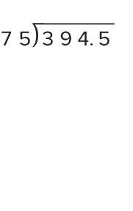
COLLABORATE · TALK IT THROUGH • AGREE ON A MODEL
Collaborate and Connect
394.50 ÷ 75 = w
Think first. A explains; B asks for evidence.
Switch roles; both revise.
With which place value should you begin when using the division algorithm?
Reveal:
the ones
19 / 43
Notes:
TEACH IN PRACTICE | Embedded facilitation | Lesson 2.7, slide 19 | COLLABORATE
Focus on the existing task: 394.50 ÷ 75 = w With which place value should you begin when using the division algorithm?
LAUNCH (T2/3/5): Use the displayed question. Give private thinking time; then A explains while B asks for evidence. Switch roles. Each student records their own reasoning.
LOOK FOR (T4): Where this task addresses it, students can create an equivalent division with a whole-number divisor. Ask which feature of their work supports the claim.
RESPOND: If this task shows the lesson misconception—moving the decimal point in only the divisor—annotate the same power-of-ten scaling on both original numbers. Have the student revise and explain the change. Use this support only where the concept occurs in the current task; otherwise respond to the displayed question.
RECHECK: If a gap is shared, revisit the existing representation together. If it is limited, give targeted support while others compare valid methods on the same task. Check the revision before moving on.
PARTICIPATION (T5/6/7): Think time before volunteers; accept a written, drawn or rehearsed entry. Students ask for evidence respectfully. Recognize a specific contribution or revision and check that both partners participate.
Source: BCPS Updated Instructional Framework Rubric (June 2020), TEACH 1–7. Earlier notes and answer keys are retained below.
EARLIER NOTES / EXISTING ANSWER KEY
Routine: COLLABORATE · TALK IT THROUGH • AGREE ON A MODEL
UIFR FULL | Lesson-specific facilitation
TEACH 4-5 | Session 1 discussion and checkpoint (UIFR PDF pp. 11-12).
Collect a brief response from every student to the existing prompt before hearing volunteers. Partners take turns explaining and asking for evidence: “I understand ___; what supports ___?” Offer rehearsal or an annotated model for students who need language support. Each student records their own reasoning.
Look specifically for: moving the decimal point in only the divisor. If it appears, annotate the same power-of-ten scaling on both original numbers; then ask the student to revise the same response and explain the change. If evidence is secure, have students compare a second valid pathway or state why their approach works. Choose the next step from the responses, not a preset pace.

Slide 20
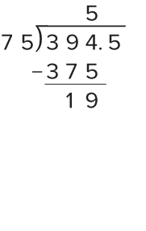
Let’s start by dividing the ones.
There are five 75s in 394.
HOW DO YOU KNOW? · Ask your partner “How do you know?” Answer by pointing to your own work.
When using the algorithm for division, what should you do once you have subtracted the product, 375?
Reveal:
We should bring down the digit in the next place value.
20 / 43
Notes:
TEACH IN PRACTICE | Embedded facilitation | Lesson 2.7, slide 20 | REVEAL
Focus on the existing task: Let’s start by dividing the ones. There are five 75s in 394. When using the algorithm for division, what should you do once you have subtracted the product, 375?
LAUNCH (T2/3/5): If an existing answer cover is present, gather an attempt before revealing. If the explanation is already visible, ask students to reconstruct and justify it. Compare reasoning and explain a revision; preserve the reveal sequence.
LOOK FOR (T4): Where this task addresses it, students can preserve place value. Ask which feature of their work supports the claim.
RESPOND: If this task shows the lesson misconception—moving the decimal point in only the divisor—annotate the same power-of-ten scaling on both original numbers. Have the student revise and explain the change. Use this support only where the concept occurs in the current task; otherwise respond to the displayed question.
RECHECK: If a gap is shared, revisit the existing representation together. If it is limited, give targeted support while others compare valid methods on the same task. Check the revision before moving on.
PARTICIPATION (T5/6/7): Think time before volunteers; accept a written, drawn or rehearsed entry. Students ask for evidence respectfully. Recognize a specific contribution or revision and check that both partners participate.
Source: BCPS Updated Instructional Framework Rubric (June 2020), TEACH 1–7. Earlier notes and answer keys are retained below.
EARLIER NOTES / EXISTING ANSWER KEY
Do not click yet: collect 2–3 student answers with reasons first.
Then click to remove the cover and have students compare their thinking to the reveal — “Is this what we said? Where is it different?”
Behind the cover: We should bring down the digit in the next place value.
UIFR: TEACH 3 · TEACH 4.

Slide 21
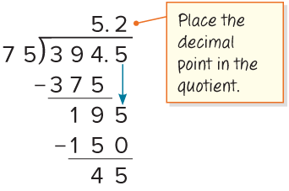
Let’s bring down the digit in the next place value. Regroup the ones as tenths to continue the division.
There are two 75s in 195.
How can you address the remainder?
Record your reasoning before the
reveal. Compare, then explain
any revision.
Reveal:
We can annex a zero to the hundredths place.
21 / 43
Notes:
TEACH IN PRACTICE | Embedded facilitation | Lesson 2.7, slide 21 | REVEAL
Focus on the existing task: Let’s bring down the digit in the next place value. Regroup the ones as tenths to continue the division. There are two 75s in 195. How can you address the remainder?
LAUNCH (T2/3/5): If an existing answer cover is present, gather an attempt before revealing. If the explanation is already visible, ask students to reconstruct and justify it. Compare reasoning and explain a revision; preserve the reveal sequence.
LOOK FOR (T4): Where this task addresses it, students can preserve place value. Ask which feature of their work supports the claim.
RESPOND: If this task shows the lesson misconception—moving the decimal point in only the divisor—annotate the same power-of-ten scaling on both original numbers. Have the student revise and explain the change. Use this support only where the concept occurs in the current task; otherwise respond to the displayed question.
RECHECK: If a gap is shared, revisit the existing representation together. If it is limited, give targeted support while others compare valid methods on the same task. Check the revision before moving on.
PARTICIPATION (T5/6/7): Think time before volunteers; accept a written, drawn or rehearsed entry. Students ask for evidence respectfully. Recognize a specific contribution or revision and check that both partners participate.
Source: BCPS Updated Instructional Framework Rubric (June 2020), TEACH 1–7. Earlier notes and answer keys are retained below.
EARLIER NOTES / EXISTING ANSWER KEY
Do not click yet: collect 2–3 student answers with reasons first.
Then click to remove the cover and have students compare their thinking to the reveal — “Is this what we said? Where is it different?”
Behind the cover: We can annex a zero to the hundredths place.
UIFR: TEACH 3 · TEACH 4.

Slide 22
Let’s Explore More
When dividing a decimal using an algorithm, what can you do when there is a remainder?
Workspace
How can estimation help you verify your quotient?
Workspace
22 / 43
Notes:
TEACH IN PRACTICE | Embedded facilitation | Lesson 2.7, slide 22 | PRACTICE
Focus on the existing task: Let’s Explore More When dividing a decimal using an algorithm, what can you do when there is a remainder?
LAUNCH (T2/3/5): Use the displayed question. Give private thinking time; then A explains while B asks for evidence. Switch roles. Each student records their own reasoning.
LOOK FOR (T4): Where this task addresses it, students can check the quotient. Ask which feature of their work supports the claim.
RESPOND: If this task shows the lesson misconception—moving the decimal point in only the divisor—annotate the same power-of-ten scaling on both original numbers. Have the student revise and explain the change. Use this support only where the concept occurs in the current task; otherwise respond to the displayed question.
RECHECK: If a gap is shared, revisit the existing representation together. If it is limited, give targeted support while others compare valid methods on the same task. Check the revision before moving on.
PARTICIPATION (T5/6/7): Think time before volunteers; accept a written, drawn or rehearsed entry. Students ask for evidence respectfully. Recognize a specific contribution or revision and check that both partners participate.
Source: BCPS Updated Instructional Framework Rubric (June 2020), TEACH 1–7. Earlier notes and answer keys are retained below.
EARLIER NOTES / EXISTING ANSWER KEY
Extension for partners or table groups — students choose their approach and use the workspace to show thinking.
Push with “Convince me,” and have two groups with different approaches share.
This is where students stretch past the worked example.
UIFR: TEACH 2 · TEACH 5.

Slide 23
STUDENT MOVES
Lesson 2-7
Your move
STRUGGLE FIRST · Work on your own first. Stuck is allowed — try a second strategy before you ask.
23 / 43

Slide 24
LESSON 2.7 / DISCUSS THE TASK
Explain and compare
Use the task you just explored.
TAKE TURNS
Why must both numbers be multiplied by the same power of ten? How can multiplication check the quotient?
Explain
“I know this because…”
Ask
“Where does your work show that?”
Point to evidence in your work.
Then compare your approach with a partner’s.
JUSTIFY IT · Say it like this: “I know ______ because ______.”
Listen to understand. Ask for evidence. Make room for every voice.
Notes:
TEACH IN PRACTICE | Embedded facilitation | Lesson 2.7, slide 23 | PRIOR_INSERT
Focus on the existing task: How can multiplication check the quotient?
CONNECT (T1/4): Ask students to restate the displayed goal or key idea and connect it to earlier work. Relevant lesson evidence: create an equivalent division with a whole-number divisor; preserve place value; check the quotient. Use only the criterion that matches the current session.
SHOW PROGRESS: Students point to their own existing work, explain what improved after feedback, and name a next step. Pair confidence ratings with actual evidence.
PARTICIPATION (T5/6/7): Think time before volunteers; accept a written, drawn or rehearsed entry. Students ask for evidence respectfully. Recognize a specific contribution or revision and check that both partners participate.
Source: BCPS Updated Instructional Framework Rubric (June 2020), TEACH 1–7.

Slide 25
A school bought new math workbooks as shown in the order form. What is the cost of each workbook?
How can you determine the cost of each workbook?
TRY IT BEFORE YOU’RE SURE · Start even if you are not sure. A revised answer counts as much as a first-try answer.
Reveal:
We can divide the total cost by the number of books.
25 / 43
Notes:
TEACH IN PRACTICE | Embedded facilitation | Lesson 2.7, slide 24 | REVEAL
Focus on the existing task: A school bought new math workbooks as shown in the order form. What is the cost of each workbook?
LAUNCH (T2/3/5): If an existing answer cover is present, gather an attempt before revealing. If the explanation is already visible, ask students to reconstruct and justify it. Compare reasoning and explain a revision; preserve the reveal sequence.
LOOK FOR (T4): Where this task addresses it, students can create an equivalent division with a whole-number divisor. Ask which feature of their work supports the claim.
RESPOND: If this task shows the lesson misconception—moving the decimal point in only the divisor—annotate the same power-of-ten scaling on both original numbers. Have the student revise and explain the change. Use this support only where the concept occurs in the current task; otherwise respond to the displayed question.
RECHECK: If a gap is shared, revisit the existing representation together. If it is limited, give targeted support while others compare valid methods on the same task. Check the revision before moving on.
PARTICIPATION (T5/6/7): Think time before volunteers; accept a written, drawn or rehearsed entry. Students ask for evidence respectfully. Recognize a specific contribution or revision and check that both partners participate.
Source: BCPS Updated Instructional Framework Rubric (June 2020), TEACH 1–7.

Slide 26
Session 2 Warm-Up
Lesson 2-7 · Divide Decimals Using an Algorithm
Session 2 Warm-Up
Quick review from Session 1 · about 4 minutes
1
To divide 4.8 ÷ 0.6, shift decimals to calculate:
2
What is 48 ÷ 6?
A
48 ÷ 6
A
0.8
B
4.8 ÷ 6
B
8
C
480 ÷ 6
C
80
D
48 ÷ 60
D
6
3
What is 7.2 ÷ 0.09?
4
In long division, decimal in quotient aligns:
A
0.8
A
At the right edge
B
8
B
Directly above dividend decimal
C
80
C
Under the divisor
D
800
D
At index zero
eduwonderlab.com · Neft Teacher
26 / 43
Notes:
TEACH IN PRACTICE | Embedded facilitation | Lesson 2.7, slide 25 | WARMUP
Focus on the existing task: A 0.8 B 8 C 80 D 6 3 What is 7.2 ÷ 0.09?
GATHER EVIDENCE (T4/6): Keep the original items. Students try independently, mark an uncertain item, and explain one method before checking. Use the existing key when present.
RESPOND: Distinguish a calculation slip from a reasoning gap. Give one next step on the same item; have students revise in a second color. Use the responses to choose flexible support for today’s lesson.
PARTICIPATION (T5/6/7): Think time before volunteers; accept a written, drawn or rehearsed entry. Students ask for evidence respectfully. Recognize a specific contribution or revision and check that both partners participate.
Source: BCPS Updated Instructional Framework Rubric (June 2020), TEACH 1–7. Earlier notes and answer keys are retained below.
EARLIER NOTES / EXISTING ANSWER KEY
Warm-up routine: students start silently on entry; keep it to about 4 minutes.
Circulate and note who is stuck — use what you see to choose who you check on first today.
Go over answers quickly; ask one student to explain a step, not just say the answer.
UIFR: TEACH 4 · TEACH 6.
UIFR FULL | Lesson-specific facilitation
TEACH 1 | Session 2 purpose and evidence (UIFR PDF p. 8).
Have students restate the displayed session goal in their own words and connect it to the existing context or a familiar experience they choose to share. Use the current session goal to select from these lesson-wide evidence criteria; do not frontload a later-session procedure.
Look for: create an equivalent division with a whole-number divisor; preserve place value; check the quotient. Ask: “Which part of your work would show this?” Revisit that evidence after the task; a confidence rating alone is not evidence of understanding.

Slide 27
STUDENT MOVES
Lesson 2-7
Your move
YOU KNOW THE ROUTINE · Read → plan → solve → check. Do all four, in that order.
27 / 43

Slide 28
Review Notes
Lesson 2-7 · Divide Decimals Using an Algorithm
Review Notes — Session 2
Copy. Explain. Check.
WHY IT MATTERS · Finish this: “This is worth knowing because ______.”
Whole Number Divisor
1
Multiply both divisor and dividend by powers of 10 until divisor is a whole integer.
Decimal Alignment
2
Place the decimal point in the quotient directly above the adjusted dividend point.
Algorithm Precision
3
Divide place by place, bringing down zeros after the decimal point as needed.
eduwonderlab.com · Neft Teacher
28 / 43
Notes:
TEACH IN PRACTICE | Embedded facilitation | Lesson 2.7, slide 26 | NOTES
Focus on the existing task: Review Notes Review Notes — Session 2 Copy into your…
ROUTINE (T1/2/4): Read or copy the original notes, cover one line, and explain it using the displayed example. Reopen and correct. Copying alone is not evidence of understanding.
LOOK FOR: A link between a symbol, quantity or feature and the explanation. If missing, point back to that feature and have the student try again; fade the prompt once they can explain.
PARTICIPATION (T5/6/7): Think time before volunteers; accept a written, drawn or rehearsed entry. Students ask for evidence respectfully. Recognize a specific contribution or revision and check that both partners participate.
Source: BCPS Updated Instructional Framework Rubric (June 2020), TEACH 1–7. Earlier notes and answer keys are retained below.
EARLIER NOTES / EXISTING ANSWER KEY
Copy routine: read one line at a time; students copy, then explain that line to a partner.
Keep it brisk — the understanding work happens in the examples, not the copying.
UIFR: TEACH 1 · TEACH 6.

Slide 29
Session 2
Divide Decimals Using an Algorithm
SELF-CHECK · Mark it: ✓ got it · ~ almost · ? stuck. Then fix one thing before we move on.
29 / 43
Notes:
TEACH IN PRACTICE | Embedded facilitation | Lesson 2.7, slide 27 | DIVIDER
Focus on the existing task: Divide Decimals Using an Algorithm Session 2
TRANSITION (T6/7): Students confirm materials, roles, how to request help, and the next response routine. Ask a student to restate it. Keep teacher-only slides hidden.
PARTICIPATION (T5/6/7): Think time before volunteers; accept a written, drawn or rehearsed entry. Students ask for evidence respectfully. Recognize a specific contribution or revision and check that both partners participate.
Source: BCPS Updated Instructional Framework Rubric (June 2020), TEACH 1–7. Earlier notes and answer keys are retained below.
EARLIER NOTES / EXISTING ANSWER KEY
Transition cue: state what materials are out and what success looks like this session.
Keep the changeover under a minute.
UIFR: TEACH 6.

Slide 30
Be Curious
What math do you see in this problem?
Michael and his mother are building some bookshelves. They want each shelf to be a certain length.
Think first. Share a notice and a question;
build on a classmate’s idea.
Mindset
What actions are you taking to achieve your goal today?
30 / 43
Notes:
TEACH IN PRACTICE | Embedded facilitation | Lesson 2.7, slide 28 | CURIOUS
Focus on the existing task: Be Curious What math do you see in this problem?
LAUNCH (T2/3/5): Allow quiet observation first. Separate a notice from an inference, invite students’ own questions, and follow the existing launch before teaching a procedure.
LOOK FOR (T4): Where this task addresses it, students can create an equivalent division with a whole-number divisor. Ask which feature of their work supports the claim.
RESPOND: If this task shows the lesson misconception—moving the decimal point in only the divisor—annotate the same power-of-ten scaling on both original numbers. Have the student revise and explain the change. Use this support only where the concept occurs in the current task; otherwise respond to the displayed question.
RECHECK: If a gap is shared, revisit the existing representation together. If it is limited, give targeted support while others compare valid methods on the same task. Check the revision before moving on.
PARTICIPATION (T5/6/7): Think time before volunteers; accept a written, drawn or rehearsed entry. Students ask for evidence respectfully. Recognize a specific contribution or revision and check that both partners participate.
Source: BCPS Updated Instructional Framework Rubric (June 2020), TEACH 1–7. Earlier notes and answer keys are retained below.
EARLIER NOTES / EXISTING ANSWER KEY
Accept all noticings and wonderings — there are no wrong answers here.
Give 20–30 seconds of quiet think time before taking responses; mix cold and warm calls so it is not always the same voices.
Read the mindset question aloud and let two students respond.
UIFR: TEACH 3 · TEACH 7.

Slide 31
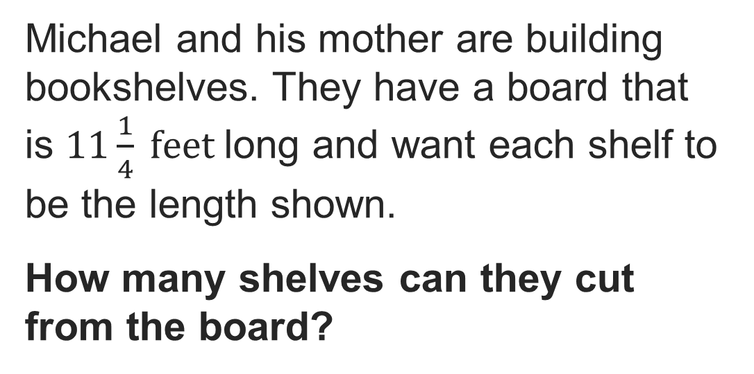

Building Bookshelves
Explain how the information shown supports your reasoning.
31 / 43
Notes:
TEACH IN PRACTICE | Embedded facilitation | Lesson 2.7, slide 29 | WORKED
Focus on the existing task: Building Bookshelves
LAUNCH (T2/3/5): Ask students to explain the displayed idea or example and point to evidence. When a calculation step is shown, ask why it is valid. Have a partner restate the explanation; copying is not the check.
LOOK FOR (T4): Where this task addresses it, students can create an equivalent division with a whole-number divisor. Ask which feature of their work supports the claim.
RESPOND: If this task shows the lesson misconception—moving the decimal point in only the divisor—annotate the same power-of-ten scaling on both original numbers. Have the student revise and explain the change. Use this support only where the concept occurs in the current task; otherwise respond to the displayed question.
RECHECK: If a gap is shared, revisit the existing representation together. If it is limited, give targeted support while others compare valid methods on the same task. Check the revision before moving on.
PARTICIPATION (T5/6/7): Think time before volunteers; accept a written, drawn or rehearsed entry. Students ask for evidence respectfully. Recognize a specific contribution or revision and check that both partners participate.
Source: BCPS Updated Instructional Framework Rubric (June 2020), TEACH 1–7. Earlier notes and answer keys are retained below.
EARLIER NOTES / EXISTING ANSWER KEY
Model briefly, then hand the thinking back: ask “Why does this step work?” before showing the next one.
Quick check before moving on — thumbs or whiteboards from everyone, not volunteers.
UIFR: TEACH 2 · TEACH 3 · TEACH 4.

Slide 32
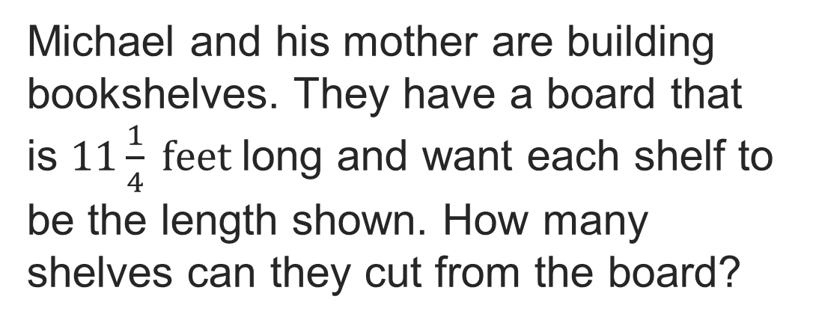
Record your reasoning before the reveal.
Compare, then explain any revision.
How can you represent the problem?
Reveal:
We can use a division equation to represent the problem.
32 / 43
Notes:
TEACH IN PRACTICE | Embedded facilitation | Lesson 2.7, slide 30 | REVEAL
Focus on the existing task: How can you represent the problem?
LAUNCH (T2/3/5): If an existing answer cover is present, gather an attempt before revealing. If the explanation is already visible, ask students to reconstruct and justify it. Compare reasoning and explain a revision; preserve the reveal sequence.
LOOK FOR (T4): Where this task addresses it, students can create an equivalent division with a whole-number divisor. Ask which feature of their work supports the claim.
RESPOND: If this task shows the lesson misconception—moving the decimal point in only the divisor—annotate the same power-of-ten scaling on both original numbers. Have the student revise and explain the change. Use this support only where the concept occurs in the current task; otherwise respond to the displayed question.
RECHECK: If a gap is shared, revisit the existing representation together. If it is limited, give targeted support while others compare valid methods on the same task. Check the revision before moving on.
PARTICIPATION (T5/6/7): Think time before volunteers; accept a written, drawn or rehearsed entry. Students ask for evidence respectfully. Recognize a specific contribution or revision and check that both partners participate.
Source: BCPS Updated Instructional Framework Rubric (June 2020), TEACH 1–7. Earlier notes and answer keys are retained below.
EARLIER NOTES / EXISTING ANSWER KEY
Do not click yet: collect 2–3 student answers with reasons first.
Then click to remove the cover and have students compare their thinking to the reveal — “Is this what we said? Where is it different?”
Behind the cover: We can use a division equation to represent the problem.
UIFR: TEACH 3 · TEACH 4.
UIFR FULL | Lesson-specific facilitation
TEACH 2-3 | Session 2 task launch (UIFR PDF pp. 9-10).
Use the problem exactly as displayed. Give individual thinking time before discussion or advancing to the explanation. If the answer is already visible, ask students to reconstruct and justify it. Invite a choice of suitable representations and have students explain why their choice helps.
At the point where this concept appears, ask: “Why must both numbers be multiplied by the same power of ten? How can multiplication check the quotient?” Wait for evidence, invite another pathway, and have a student ask a follow-up question. Do not replace students’ reasoning with a sequence of leading steps.

Slide 33

Use an algorithm to find the quotient.
n = 112.5 ÷ 25
Compare your reasoning with the explanation. Explain any revision you make.
What is the quotient?
Reveal:
33 / 43
Notes:
TEACH IN PRACTICE | Embedded facilitation | Lesson 2.7, slide 31 | REVEAL
Focus on the existing task: Use an algorithm to find the quotient. n = 112.5 ÷ 25 What is the quotient?
LAUNCH (T2/3/5): If an existing answer cover is present, gather an attempt before revealing. If the explanation is already visible, ask students to reconstruct and justify it. Compare reasoning and explain a revision; preserve the reveal sequence.
LOOK FOR (T4): Where this task addresses it, students can check the quotient. Ask which feature of their work supports the claim.
RESPOND: If this task shows the lesson misconception—moving the decimal point in only the divisor—annotate the same power-of-ten scaling on both original numbers. Have the student revise and explain the change. Use this support only where the concept occurs in the current task; otherwise respond to the displayed question.
RECHECK: If a gap is shared, revisit the existing representation together. If it is limited, give targeted support while others compare valid methods on the same task. Check the revision before moving on.
PARTICIPATION (T5/6/7): Think time before volunteers; accept a written, drawn or rehearsed entry. Students ask for evidence respectfully. Recognize a specific contribution or revision and check that both partners participate.
Source: BCPS Updated Instructional Framework Rubric (June 2020), TEACH 1–7. Earlier notes and answer keys are retained below.
EARLIER NOTES / EXISTING ANSWER KEY
Students should have shared predictions before this reveal.
Have them compare their thinking to what is shown: “Is this the same as what we said? Where is it different?”
Press one student to explain the reveal in their own words.
UIFR: TEACH 3 · TEACH 4.

Slide 34
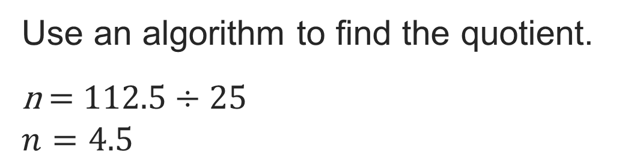
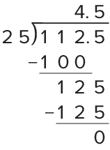
What is the quotient?
Reveal:
4.5
Record your reasoning before the reveal. Compare, then
explain any revision.
34 / 43
Notes:
TEACH IN PRACTICE | Embedded facilitation | Lesson 2.7, slide 32 | REVEAL
Focus on the existing task: What is the quotient?
LAUNCH (T2/3/5): If an existing answer cover is present, gather an attempt before revealing. If the explanation is already visible, ask students to reconstruct and justify it. Compare reasoning and explain a revision; preserve the reveal sequence.
LOOK FOR (T4): Where this task addresses it, students can check the quotient. Ask which feature of their work supports the claim.
RESPOND: If this task shows the lesson misconception—moving the decimal point in only the divisor—annotate the same power-of-ten scaling on both original numbers. Have the student revise and explain the change. Use this support only where the concept occurs in the current task; otherwise respond to the displayed question.
RECHECK: If a gap is shared, revisit the existing representation together. If it is limited, give targeted support while others compare valid methods on the same task. Check the revision before moving on.
PARTICIPATION (T5/6/7): Think time before volunteers; accept a written, drawn or rehearsed entry. Students ask for evidence respectfully. Recognize a specific contribution or revision and check that both partners participate.
Source: BCPS Updated Instructional Framework Rubric (June 2020), TEACH 1–7. Earlier notes and answer keys are retained below.
EARLIER NOTES / EXISTING ANSWER KEY
Do not click yet: collect 2–3 student answers with reasons first.
Then click to remove the cover and have students compare their thinking to the reveal — “Is this what we said? Where is it different?”
Behind the cover: 4.5
UIFR: TEACH 3 · TEACH 4.

Slide 35
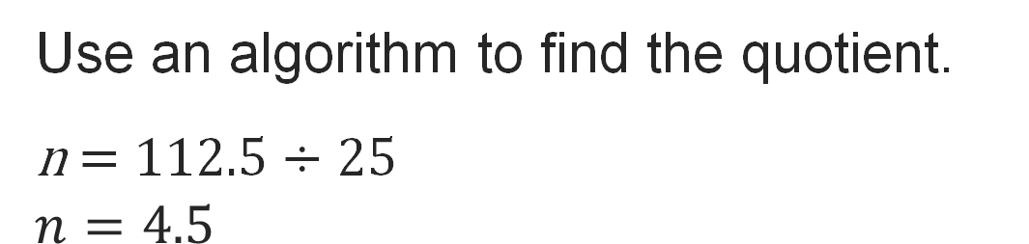

Think and record first. Which part of your
work supports your answer?
Recognizing Repetition
What about the process is repeating?
35 / 43
Notes:
TEACH IN PRACTICE | Embedded facilitation | Lesson 2.7, slide 33 | TASK
Focus on the existing task: Recognizing Repetition What about the process is repeating?
LAUNCH (T2/3/5): Use the displayed question. Give private thinking time; then A explains while B asks for evidence. Switch roles. Each student records their own reasoning.
LOOK FOR (T4): Where this task addresses it, students can create an equivalent division with a whole-number divisor. Ask which feature of their work supports the claim.
RESPOND: If this task shows the lesson misconception—moving the decimal point in only the divisor—annotate the same power-of-ten scaling on both original numbers. Have the student revise and explain the change. Use this support only where the concept occurs in the current task; otherwise respond to the displayed question.
RECHECK: If a gap is shared, revisit the existing representation together. If it is limited, give targeted support while others compare valid methods on the same task. Check the revision before moving on.
PARTICIPATION (T5/6/7): Think time before volunteers; accept a written, drawn or rehearsed entry. Students ask for evidence respectfully. Recognize a specific contribution or revision and check that both partners participate.
Source: BCPS Updated Instructional Framework Rubric (June 2020), TEACH 1–7. Earlier notes and answer keys are retained below.
EARLIER NOTES / EXISTING ANSWER KEY
Model briefly, then hand the thinking back: ask “Why does this step work?” before showing the next one.
Quick check before moving on — thumbs or whiteboards from everyone, not volunteers.
UIFR: TEACH 2 · TEACH 3 · TEACH 4.

Slide 36
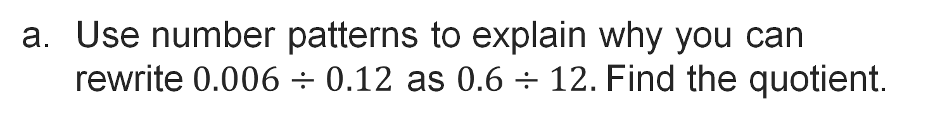
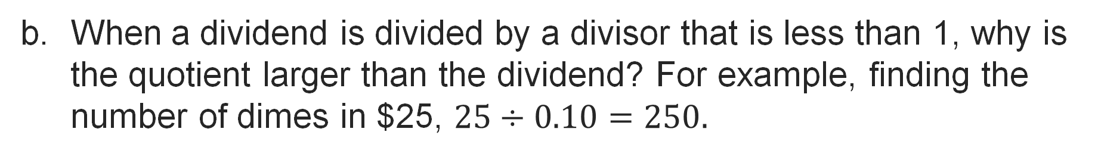
Let’s Explore More
Workspace
Try it yourself. Compare your
work with a partner; explain one
choice and revise.
Workspace
36 / 43
Notes:
TEACH IN PRACTICE | Embedded facilitation | Lesson 2.7, slide 34 | PRACTICE
Focus on the existing task: Let’s Explore More Workspace Workspace
LAUNCH (T2/3/5): Use the displayed question. Give private thinking time; then A explains while B asks for evidence. Switch roles. Each student records their own reasoning.
LOOK FOR (T4): Where this task addresses it, students can create an equivalent division with a whole-number divisor. Ask which feature of their work supports the claim.
RESPOND: If this task shows the lesson misconception—moving the decimal point in only the divisor—annotate the same power-of-ten scaling on both original numbers. Have the student revise and explain the change. Use this support only where the concept occurs in the current task; otherwise respond to the displayed question.
RECHECK: If a gap is shared, revisit the existing representation together. If it is limited, give targeted support while others compare valid methods on the same task. Check the revision before moving on.
PARTICIPATION (T5/6/7): Think time before volunteers; accept a written, drawn or rehearsed entry. Students ask for evidence respectfully. Recognize a specific contribution or revision and check that both partners participate.
Source: BCPS Updated Instructional Framework Rubric (June 2020), TEACH 1–7. Earlier notes and answer keys are retained below.
EARLIER NOTES / EXISTING ANSWER KEY
Extension for partners or table groups — students choose their approach and use the workspace to show thinking.
Push with “Convince me,” and have two groups with different approaches share.
This is where students stretch past the worked example.
UIFR: TEACH 2 · TEACH 5.
UIFR FULL | Lesson-specific facilitation
TEACH 4-5 | Session 2 discussion and checkpoint (UIFR PDF pp. 11-12).
Collect a brief response from every student to the existing prompt before hearing volunteers. Partners take turns explaining and asking for evidence: “I understand ___; what supports ___?” Offer rehearsal or an annotated model for students who need language support. Each student records their own reasoning.
Look specifically for: moving the decimal point in only the divisor. If it appears, annotate the same power-of-ten scaling on both original numbers; then ask the student to revise the same response and explain the change. If evidence is secure, have students compare a second valid pathway or state why their approach works. Choose the next step from the responses, not a preset pace.

Slide 37
LESSON 2.7 / CHECK YOUR WORK
Pause. Check. Improve.
CHECK
A mistake to watch for: moving the decimal point in only the divisor.
TRY
Annotate the same power-of-ten scaling on both given numbers.
REVISE
Use that check on the task you just completed. Correct or strengthen one part, and explain why.
REVISE NOW · Change one answer and write why you changed it. A revision is evidence of learning.
Listen to understand. Ask for evidence. Make room for every voice.
Notes:
TEACH IN PRACTICE | Embedded facilitation | Lesson 2.7, slide 35 | PRIOR_INSERT
Focus on the existing task: LESSON 2.7 / CHECK YOUR WORK Pause. Check. Improve. Listen to understand. Ask for evidence. Make room for every voice. CHECK A mistake…
CONNECT (T1/4): Ask students to restate the displayed goal or key idea and connect it to earlier work. Relevant lesson evidence: create an equivalent division with a whole-number divisor; preserve place value; check the quotient. Use only the criterion that matches the current session.
SHOW PROGRESS: Students point to their own existing work, explain what improved after feedback, and name a next step. Pair confidence ratings with actual evidence.
PARTICIPATION (T5/6/7): Think time before volunteers; accept a written, drawn or rehearsed entry. Students ask for evidence respectfully. Recognize a specific contribution or revision and check that both partners participate.
Source: BCPS Updated Instructional Framework Rubric (June 2020), TEACH 1–7.

Slide 38
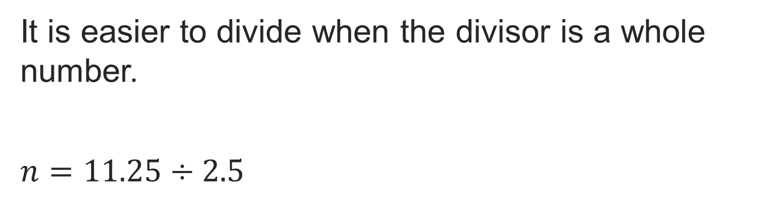
Collaborate and Connect
How can you make the divisor a whole number? Explain.
Think first. A explains; B asks for evidence. Switch roles; both revise.
Reveal:
We can multiply both the dividend and divisor by 10.
38 / 43
Notes:
TEACH IN PRACTICE | Embedded facilitation | Lesson 2.7, slide 36 | COLLABORATE
Focus on the existing task: How can you make the divisor a whole number?
LAUNCH (T2/3/5): Use the displayed question. Give private thinking time; then A explains while B asks for evidence. Switch roles. Each student records their own reasoning.
LOOK FOR (T4): Where this task addresses it, students can create an equivalent division with a whole-number divisor. Ask which feature of their work supports the claim.
RESPOND: If this task shows the lesson misconception—moving the decimal point in only the divisor—annotate the same power-of-ten scaling on both original numbers. Have the student revise and explain the change. Use this support only where the concept occurs in the current task; otherwise respond to the displayed question.
RECHECK: If a gap is shared, revisit the existing representation together. If it is limited, give targeted support while others compare valid methods on the same task. Check the revision before moving on.
PARTICIPATION (T5/6/7): Think time before volunteers; accept a written, drawn or rehearsed entry. Students ask for evidence respectfully. Recognize a specific contribution or revision and check that both partners participate.
Source: BCPS Updated Instructional Framework Rubric (June 2020), TEACH 1–7.

Slide 39
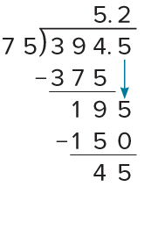
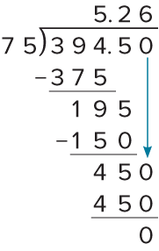
SUMMARIZE · SAY IT IN YOUR OWN WORDS
Summarize: Divide Decimals Using an Algorithm
You can use an algorithm to divide multi-digit decimal numbers.
When the dividend is a decimal and the divisor a whole number, place the decimal point in the quotient above the decimal point in the dividend.
When the divisor is a decimal, multiply both the divisor and the dividend by the same power of 10 so that the divisor is a whole number.
Explain the key idea without
reading. Use today’s example as
evidence.
39 / 43
Notes:
TEACH IN PRACTICE | Embedded facilitation | Lesson 2.7, slide 37 | SUMMARIZE
Focus on the existing task: You can use an algorithm to divide multi-digit decimal numbers. When the dividend is a decimal and the divisor a whole number, place the…
CONNECT (T1/4): Ask students to restate the displayed goal or key idea and connect it to earlier work. Relevant lesson evidence: create an equivalent division with a whole-number divisor; preserve place value; check the quotient. Use only the criterion that matches the current session.
SHOW PROGRESS: Students point to their own existing work, explain what improved after feedback, and name a next step. Pair confidence ratings with actual evidence.
PARTICIPATION (T5/6/7): Think time before volunteers; accept a written, drawn or rehearsed entry. Students ask for evidence respectfully. Recognize a specific contribution or revision and check that both partners participate.
Source: BCPS Updated Instructional Framework Rubric (June 2020), TEACH 1–7. Earlier notes and answer keys are retained below.
EARLIER NOTES / EXISTING ANSWER KEY
Routine: SUMMARIZE · SAY IT IN YOUR OWN WORDS

Slide 40
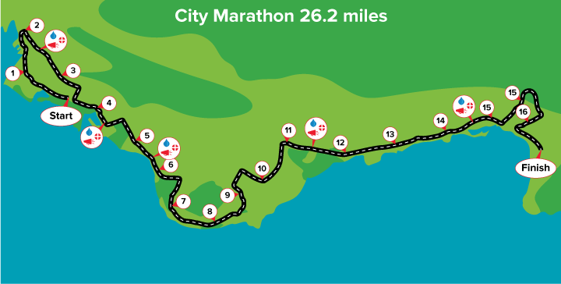
APPLY · PLAN IT • SOLVE IT • PROVE IT
Apply: Running a Marathon
Evelyn is training to run a marathon on the path shown. Evelyn expects that she will need at least 4 hours to finish the race but hopes to finish in less than 5 hours.
Question: How many miles should Evelyn try to run each hour to achieve her goal?
Choose a method. Solve
independently, justify your
answer, then check the goal.
40 / 43
Notes:
TEACH IN PRACTICE | Embedded facilitation | Lesson 2.7, slide 38 | APPLY
Focus on the existing task: Apply: Running a Marathon Evelyn is training to run a marathon on the path shown. Evelyn expects that she will need at least 4 hours to…
LAUNCH (T2/3/5): Use the exact application task independently first. Ask students to justify their choice of method. Collect evidence before a partner discussion or correction.
LOOK FOR (T4): Where this task addresses it, students can create an equivalent division with a whole-number divisor. Ask which feature of their work supports the claim.
RESPOND: If this task shows the lesson misconception—moving the decimal point in only the divisor—annotate the same power-of-ten scaling on both original numbers. Have the student revise and explain the change. Use this support only where the concept occurs in the current task; otherwise respond to the displayed question.
RECHECK: If a gap is shared, revisit the existing representation together. If it is limited, give targeted support while others compare valid methods on the same task. Check the revision before moving on.
PARTICIPATION (T5/6/7): Think time before volunteers; accept a written, drawn or rehearsed entry. Students ask for evidence respectfully. Recognize a specific contribution or revision and check that both partners participate.
Source: BCPS Updated Instructional Framework Rubric (June 2020), TEACH 1–7. Earlier notes and answer keys are retained below.
EARLIER NOTES / EXISTING ANSWER KEY
Routine: APPLY · PLAN IT • SOLVE IT • PROVE IT
UIFR FULL | Lesson-specific facilitation
TEACH 4 | Independent evidence and revision (UIFR PDF p. 11).
Use the existing application/exit problem as the independent check. If this is a learning-target slide, have students point to and explain their work on the preceding task. Separate initial independent evidence from the revision after feedback.
Check the relevant criteria: create an equivalent division with a whole-number divisor; preserve place value; check the quotient. Respond with one specific next step tied to the work. Students revise and annotate what changed, then identify a criterion they can now demonstrate and one they still need to practice.

Slide 41
Learning Targets
I can divide a multi-digit decimal by a whole number using an algorithm.
I can divide a multi-digit decimal by a decimal using an algorithm.
I can use place-value patterns to divide with decimals.
NAME THE MATH · Point to the part of this that is new today, and say what it changes.
41 / 43
Notes:
TEACH IN PRACTICE | Embedded facilitation | Lesson 2.7, slide 39 | REFLECTION
Focus on the existing task: Learning Targets I can divide a multi-digit decimal by a whole number using an algorithm. I can divide a multi-digit decimal by a decimal…
CONNECT (T1/4): Ask students to restate the displayed goal or key idea and connect it to earlier work. Relevant lesson evidence: create an equivalent division with a whole-number divisor; preserve place value; check the quotient. Use only the criterion that matches the current session.
SHOW PROGRESS: Students point to their own existing work, explain what improved after feedback, and name a next step. Pair confidence ratings with actual evidence.
PARTICIPATION (T5/6/7): Think time before volunteers; accept a written, drawn or rehearsed entry. Students ask for evidence respectfully. Recognize a specific contribution or revision and check that both partners participate.
Source: BCPS Updated Instructional Framework Rubric (June 2020), TEACH 1–7. Earlier notes and answer keys are retained below.
EARLIER NOTES / EXISTING ANSWER KEY
Read each target; students self-rate with fist-to-five or thumbs.
Tie back to the goal from the start of class: did we get there?
Note any target that rates low — revisit it tomorrow.
UIFR: TEACH 1 · TEACH 4.

Slide 42
Learning Targets
I can divide a multi-digit decimal by a whole number using an algorithm.
I can divide a multi-digit decimal by a decimal using an algorithm.
I can use place-value patterns to divide with decimals.
SAY THE GOAL · Say today’s goal in your own words, then name one place this shows up outside math class.
42 / 43
Notes:
TEACH IN PRACTICE | Embedded facilitation | Lesson 2.7, slide 40 | REFLECTION
Focus on the existing task: Learning Targets I can divide a multi-digit decimal by a whole number using an algorithm. I can divide a multi-digit decimal by a decimal…
CONNECT (T1/4): Ask students to restate the displayed goal or key idea and connect it to earlier work. Relevant lesson evidence: create an equivalent division with a whole-number divisor; preserve place value; check the quotient. Use only the criterion that matches the current session.
SHOW PROGRESS: Students point to their own existing work, explain what improved after feedback, and name a next step. Pair confidence ratings with actual evidence.
PARTICIPATION (T5/6/7): Think time before volunteers; accept a written, drawn or rehearsed entry. Students ask for evidence respectfully. Recognize a specific contribution or revision and check that both partners participate.
Source: BCPS Updated Instructional Framework Rubric (June 2020), TEACH 1–7. Earlier notes and answer keys are retained below.
EARLIER NOTES / EXISTING ANSWER KEY
UIFR FULL | Lesson-specific facilitation
REFLECT & ADJUST 1-2 | After the lesson (UIFR PDF pp. 15-16).
Sort the existing work by demonstrated reasoning, partial understanding, and the specific misconception: moving the decimal point in only the divisor. Compare the initial response with the revision. Record which teaching move plausibly helped, which did not, and whose participation or access needs a different approach; do not record sensitive student details in this shared deck.
Plan the next lesson from that evidence: if the misconception persists, annotate the same power-of-ten scaling on both original numbers using the current example before returning to the next grade-level task; if understanding is secure, use an existing extension or ask for a general explanation. Check the targeted idea again at the next warm-up.
Ask students what supported their thinking and what would help next time. Identify one change to try and one successful practice to retain. Seek colleague feedback on anonymized work when useful; these prompts support reflection and do not establish an evaluation rating. Source: Baltimore City Public Schools, Updated Instructional Framework Rubric, June 2020 (UIFR_Full.pdf).

Slide 43
LESSON 2.7 / REFLECT ON YOUR LEARNING
Show your progress
1 SHOW EVIDENCE
2 CHOOSE A NEXT STEP
Choose one response. Point to the part that shows your reasoning.
Name a change you made after feedback—or a question you still have.
“My work shows ___ because ___.”
“Next time, I will ___ to help me ___.”
Today’s focus: Create an equivalent division with a whole-number divisor.
CREDIT A CLASSMATE · Name one classmate whose idea helped you today, and say what they said.
Listen to understand. Ask for evidence. Make room for every voice.
Notes:
TEACH IN PRACTICE | Embedded facilitation | Lesson 2.7, slide 41 | PRIOR_INSERT
Focus on the existing task: LESSON 2.7 / REFLECT ON YOUR LEARNING Show your progress Listen to understand. Ask for evidence. Make room for every voice. 1 SHOW…
CONNECT (T1/4): Ask students to restate the displayed goal or key idea and connect it to earlier work. Relevant lesson evidence: create an equivalent division with a whole-number divisor; preserve place value; check the quotient. Use only the criterion that matches the current session.
SHOW PROGRESS: Students point to their own existing work, explain what improved after feedback, and name a next step. Pair confidence ratings with actual evidence.
PARTICIPATION (T5/6/7): Think time before volunteers; accept a written, drawn or rehearsed entry. Students ask for evidence respectfully. Recognize a specific contribution or revision and check that both partners participate.
Source: BCPS Updated Instructional Framework Rubric (June 2020), TEACH 1–7.

