Slide 1
WARM-UP · THINK • TRY • CHECK
Turn and talk: compare strategies, then defend one.
Warm-Up
Lesson 2-8 · Describe Data Using the Mean | Warm-Up · about 4 minutes
Try each on your own. Mark an unsure answer; explain and revise when we check.
QUESTION 1
QUESTION 2
10 + 14 + 8 + 12 + 16 = ______
252 ÷ 6 = ______
QUESTION 3
QUESTION 4
How many values are in 7, 9, 9, 11, 13, 15? ______
48 + ______ = 60
TALK IT OVER: “I got ______ because ______.” • Compare with a partner before we check as a class.
1 / 45
Notes:
TEACH IN PRACTICE | Embedded facilitation | Lesson 2.8, slide 1 | WARMUP
Focus on the existing task: Warm-Up WARM-UP · THINK • TRY • CHECK Do these four on your…
GATHER EVIDENCE (T4/6): Keep the original items. Students try independently, mark an uncertain item, and explain one method before checking. Use the existing key when present.
RESPOND: Distinguish a calculation slip from a reasoning gap. Give one next step on the same item; have students revise in a second color. Use the responses to choose flexible support for today’s lesson.
PARTICIPATION (T5/6/7): Think time before volunteers; accept a written, drawn or rehearsed entry. Students ask for evidence respectfully. Recognize a specific contribution or revision and check that both partners participate.
Source: BCPS Updated Instructional Framework Rubric (June 2020), TEACH 1–7. Earlier notes and answer keys are retained below.
EARLIER NOTES / EXISTING ANSWER KEY
Warm-Up answers (teacher only): 1) 60 2) 42 3) 6 4) 12
UIFR FULL | Lesson-specific facilitation
PREPARE 1-2 | Before teaching (UIFR PDF pp. 6-7).
Plan to gather evidence that students can interpret mean as fair share and balance point; use total and count to find a missing value. Review recent work and today’s warm-up to choose flexible groups and access supports; do not infer needs from identity or perceived ability. Use the existing lesson tasks and stated standards.
Anticipate: dividing by the wrong number of observations. If observed, organize the existing values as a sum and mark the number of observations. Offer oral rehearsal, drawing, pointing, or home-language processing as needed; retain the original mathematical demand. Ask students which support helps and fade it as evidence improves.
TEACH 6-7 | Before the first transition, agree on materials, partner roles, and how to request help. Invite students to restate the routine. Normalize revising an idea, recognize a specific contribution, and check privately when frustration blocks participation. Source: UIFR PDF pp. 13-14.

Slide 2
Today’s Math Notes
Lesson 2-8 · Describe Data Using the Mean
Section 1: Math Words
Copy. Explain. Check.
SAY THE GOAL · Say today’s goal in your own words, then name one place this shows up outside math class.
Mean
1
The average of a data set
Average
2
Another word for the mean
Measure of center
3
A single number used to describe the middle
eduwonderlab.com · Neft Teacher
2 / 45
Notes:
TEACH IN PRACTICE | Embedded facilitation | Lesson 2.8, slide 2 | NOTES
Focus on the existing task: Today’s Math Notes Section 1: Math Words Copy into your…
ROUTINE (T1/2/4): Read or copy the original notes, cover one line, and explain it using the displayed example. Reopen and correct. Copying alone is not evidence of understanding.
LOOK FOR: A link between a symbol, quantity or feature and the explanation. If missing, point back to that feature and have the student try again; fade the prompt once they can explain.
PARTICIPATION (T5/6/7): Think time before volunteers; accept a written, drawn or rehearsed entry. Students ask for evidence respectfully. Recognize a specific contribution or revision and check that both partners participate.
Source: BCPS Updated Instructional Framework Rubric (June 2020), TEACH 1–7. Earlier notes and answer keys are retained below.
EARLIER NOTES / EXISTING ANSWER KEY
Copy routine: read one line at a time; students copy, then explain that line to a partner.
Keep it brisk — the understanding work happens in the examples, not the copying.
UIFR: TEACH 1 · TEACH 6.

Slide 3
Today’s Math Notes
Lesson 2-8 · Describe Data Using the Mean
Section 2: Today’s Math
Copy. Explain. Check.
Measures of Center: Mean
Mean = (Sum of all values) ÷ (Total number of values)
Read, cover, explain. Reopen your notes to
check and improve your explanation.
1
Add all data values together to find the total sum
2
Divide the sum by the count of data values
3
Concept: The mean represents the fair share or balance point of the data
eduwonderlab.com · Neft Teacher
3 / 45
Notes:
TEACH IN PRACTICE | Embedded facilitation | Lesson 2.8, slide 3 | NOTES
Focus on the existing task: Today’s Math Notes Section 2: Today’s Math Copy into your…
ROUTINE (T1/2/4): Read or copy the original notes, cover one line, and explain it using the displayed example. Reopen and correct. Copying alone is not evidence of understanding.
LOOK FOR: A link between a symbol, quantity or feature and the explanation. If missing, point back to that feature and have the student try again; fade the prompt once they can explain.
PARTICIPATION (T5/6/7): Think time before volunteers; accept a written, drawn or rehearsed entry. Students ask for evidence respectfully. Recognize a specific contribution or revision and check that both partners participate.
Source: BCPS Updated Instructional Framework Rubric (June 2020), TEACH 1–7. Earlier notes and answer keys are retained below.
EARLIER NOTES / EXISTING ANSWER KEY
Copy routine: read one line at a time; students copy, then explain that line to a partner.
Keep it brisk — the understanding work happens in the examples, not the copying.
UIFR: TEACH 1 · TEACH 6.

Slide 4
Session 1
Describe Data Using the Mean
PICK YOUR STRATEGY · Choose your path — picture, table, number line, or equation — and be ready to say why you chose it.
4 / 45
Notes:
TEACH IN PRACTICE | Embedded facilitation | Lesson 2.8, slide 4 | DIVIDER
Focus on the existing task: Describe Data Using the Mean Session 1
TRANSITION (T6/7): Students confirm materials, roles, how to request help, and the next response routine. Ask a student to restate it. Keep teacher-only slides hidden.
PARTICIPATION (T5/6/7): Think time before volunteers; accept a written, drawn or rehearsed entry. Students ask for evidence respectfully. Recognize a specific contribution or revision and check that both partners participate.
Source: BCPS Updated Instructional Framework Rubric (June 2020), TEACH 1–7. Earlier notes and answer keys are retained below.
EARLIER NOTES / EXISTING ANSWER KEY
Transition cue: state what materials are out and what success looks like this session.
Keep the changeover under a minute.
UIFR: TEACH 6.

Slide 5
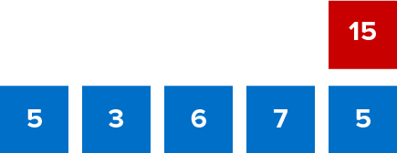
Give Me Five
Use all the numbers in any order with any operation to equal the target number (in red).
Explain how the information shown supports your reasoning.
5 / 45
Notes:
TEACH IN PRACTICE | Embedded facilitation | Lesson 2.8, slide 5 | WORKED
Focus on the existing task: Give Me Five Use all the numbers in any order with any operation to equal the target number (in red).
LAUNCH (T2/3/5): Ask students to explain the displayed idea or example and point to evidence. When a calculation step is shown, ask why it is valid. Have a partner restate the explanation; copying is not the check.
LOOK FOR (T4): Where this task addresses it, students can interpret mean as fair share and balance point. Ask which feature of their work supports the claim.
RESPOND: If this task shows the lesson misconception—dividing by the wrong number of observations—organize the existing values as a sum and mark the number of observations. Have the student revise and explain the change. Use this support only where the concept occurs in the current task; otherwise respond to the displayed question.
RECHECK: If a gap is shared, revisit the existing representation together. If it is limited, give targeted support while others compare valid methods on the same task. Check the revision before moving on.
PARTICIPATION (T5/6/7): Think time before volunteers; accept a written, drawn or rehearsed entry. Students ask for evidence respectfully. Recognize a specific contribution or revision and check that both partners participate.
Source: BCPS Updated Instructional Framework Rubric (June 2020), TEACH 1–7. Earlier notes and answer keys are retained below.
EARLIER NOTES / EXISTING ANSWER KEY
Number-sense routine — every voice in. Give quiet think time, then hear from at least three students.
Always follow with “How do you know?” — the reasoning is the point, not the answer.
There is more than one path; name and celebrate different strategies.
UIFR: TEACH 3 · TEACH 5 · TEACH 6.

Slide 6
Today’s Objectives
Lesson 2-8 · Describe Data Using the Mean
Describe Data Using the Mean
Maryland Standard 6.DS.4
CONNECT IT · What earlier lesson does this build on? Tell a partner in one sentence.
CONTENT OBJECTIVE
LANGUAGE OBJECTIVE
Restate the goal in your words
Use these words to explain why
I can determine the mean of a data set, use a target mean to find a missing value, and explain the mean as the fair share and the balance point of the data.
I can explain my reasoning using the words mean, average, measure of center, balance point, and data set.
eduwonderlab.com · Neft Teacher
6 / 45
Notes:
TEACH IN PRACTICE | Embedded facilitation | Lesson 2.8, slide 6 | GOAL
Focus on the existing task: Today’s Objectives Describe Data Using the Mean Maryland…
CONNECT (T1/4): Ask students to restate the displayed goal or key idea and connect it to earlier work. Relevant lesson evidence: interpret mean as fair share and balance point; use total and count to find a missing value. Use only the criterion that matches the current session.
SHOW PROGRESS: Students point to their own existing work, explain what improved after feedback, and name a next step. Pair confidence ratings with actual evidence.
PARTICIPATION (T5/6/7): Think time before volunteers; accept a written, drawn or rehearsed entry. Students ask for evidence respectfully. Recognize a specific contribution or revision and check that both partners participate.
Source: BCPS Updated Instructional Framework Rubric (June 2020), TEACH 1–7. Earlier notes and answer keys are retained below.
EARLIER NOTES / EXISTING ANSWER KEY
Read the objective together, then have one or two students restate today’s goal in their own words.
Connect it to what the class learned last lesson.
Return to this goal at the end of class to check it was met.
UIFR: TEACH 1.
UIFR FULL | Lesson-specific facilitation
TEACH 1 | Session 1 purpose and evidence (UIFR PDF p. 8).
Have students restate the displayed session goal in their own words and connect it to the existing context or a familiar experience they choose to share. Use the current session goal to select from these lesson-wide evidence criteria; do not frontload a later-session procedure.
Look for: interpret mean as fair share and balance point; use total and count to find a missing value. Ask: “Which part of your work would show this?” Revisit that evidence after the task; a confidence rating alone is not evidence of understanding.

Slide 7
LESSON 2.8 / OUR LEARNING
What will show your learning?
1
Interpret mean as fair share and balance point.
2
Use total and count to find a missing value.
Tell a partner: Which skill connects to something you already know?
SHOW YOUR THINKING · Show what you know — write it, draw it, or build it. A picture counts as an explanation.
Listen to understand. Ask for evidence. Make room for every voice.
Notes:
TEACH IN PRACTICE | Embedded facilitation | Lesson 2.8, slide 7 | PRIOR_INSERT
Focus on the existing task: LESSON 2.8 / OUR LEARNING What will show your learning?
CONNECT (T1/4): Ask students to restate the displayed goal or key idea and connect it to earlier work. Relevant lesson evidence: interpret mean as fair share and balance point; use total and count to find a missing value. Use only the criterion that matches the current session.
SHOW PROGRESS: Students point to their own existing work, explain what improved after feedback, and name a next step. Pair confidence ratings with actual evidence.
PARTICIPATION (T5/6/7): Think time before volunteers; accept a written, drawn or rehearsed entry. Students ask for evidence respectfully. Recognize a specific contribution or revision and check that both partners participate.
Source: BCPS Updated Instructional Framework Rubric (June 2020), TEACH 1–7.

Slide 8
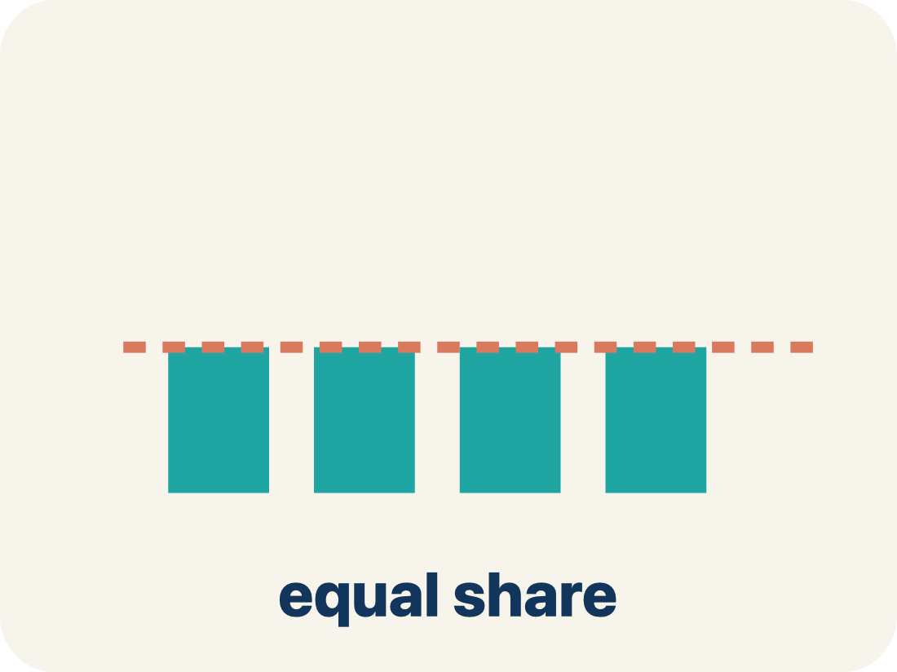
Vocabulary 1 of 5
Lesson 2-8 · Describe Data Using the Mean
Mean
The average of a data set. Add all the values, then divide by how many values there are.
EXAMPLE · EXPLAIN WHY IT FITS
Miguel earned $60 in 4 days: 60 ÷ 4 = 15, so the mean is $15 per day.
Use “Mean” to explain the example. Point to evidence.
eduwonderlab.com · Neft Teacher
8 / 45
Notes:
TEACH IN PRACTICE | Embedded facilitation | Lesson 2.8, slide 8 | VOCAB
Focus on the existing task: Vocabulary 1 of 5 Mean The average of a data set. Add all the…
ASK (T1/3/5): Where does “Mean” appear in the example? Explain the meaning without reading the definition. Partner: restate the idea and ask a clarifying question.
LOOK FOR: A correct connection between the word and a feature of the example. If the student only repeats the definition, invite pointing, sketching or oral rehearsal, then ask for another explanation of this same example.
PARTICIPATION (T5/6/7): Think time before volunteers; accept a written, drawn or rehearsed entry. Students ask for evidence respectfully. Recognize a specific contribution or revision and check that both partners participate.
Source: BCPS Updated Instructional Framework Rubric (June 2020), TEACH 1–7.

Slide 9
Vocabulary 2 of 5
Lesson 2-8 · Describe Data Using the Mean
Average
Another word for the mean — the amount each value would be if the total were shared equally.
EXAMPLE · EXPLAIN WHY IT FITS
A player averages 15 points per game, so over 10 games she scores 15 × 10 = 150 points in all.
Use “Average” to explain the example. Point to evidence.
eduwonderlab.com · Neft Teacher
9 / 45
Notes:
TEACH IN PRACTICE | Embedded facilitation | Lesson 2.8, slide 9 | VOCAB
Focus on the existing task: Vocabulary 2 of 5 Average Another word for the mean — the…
ASK (T1/3/5): Where does “Average” appear in the example? Explain the meaning without reading the definition. Partner: restate the idea and ask a clarifying question.
LOOK FOR: A correct connection between the word and a feature of the example. If the student only repeats the definition, invite pointing, sketching or oral rehearsal, then ask for another explanation of this same example.
PARTICIPATION (T5/6/7): Think time before volunteers; accept a written, drawn or rehearsed entry. Students ask for evidence respectfully. Recognize a specific contribution or revision and check that both partners participate.
Source: BCPS Updated Instructional Framework Rubric (June 2020), TEACH 1–7.

Slide 10
Vocabulary 3 of 5
Lesson 2-8 · Describe Data Using the Mean
Measure of center
A single number used to describe the middle, or typical value, of a whole data set.
EXAMPLE · EXPLAIN WHY IT FITS
The mean, $15, is one measure of center that describes all four of Miguel’s days at once.
Use “Measure of center” to explain the example. Point to
evidence.
eduwonderlab.com · Neft Teacher
10 / 45
Notes:
TEACH IN PRACTICE | Embedded facilitation | Lesson 2.8, slide 10 | VOCAB
Focus on the existing task: Vocabulary 3 of 5 Measure of center A single number used to…
ASK (T1/3/5): Where does “Measure of center” appear in the example? Explain the meaning without reading the definition. Partner: restate the idea and ask a clarifying question.
LOOK FOR: A correct connection between the word and a feature of the example. If the student only repeats the definition, invite pointing, sketching or oral rehearsal, then ask for another explanation of this same example.
PARTICIPATION (T5/6/7): Think time before volunteers; accept a written, drawn or rehearsed entry. Students ask for evidence respectfully. Recognize a specific contribution or revision and check that both partners participate.
Source: BCPS Updated Instructional Framework Rubric (June 2020), TEACH 1–7.

Slide 11
Vocabulary 4 of 5
Lesson 2-8 · Describe Data Using the Mean
Balance point
The value where the total distance of the data above it equals the total distance below it. The mean is the balance point.
EXAMPLE · EXPLAIN WHY IT FITS
With a target mean of 15, points totaling 13 below must be matched by points totaling 13 above.
Use “Balance point” to explain the
example. Point to evidence.
eduwonderlab.com · Neft Teacher
11 / 45
Notes:
TEACH IN PRACTICE | Embedded facilitation | Lesson 2.8, slide 11 | VOCAB
Focus on the existing task: Vocabulary 4 of 5 Balance point The value where the total…
ASK (T1/3/5): Where does “Balance point” appear in the example? Explain the meaning without reading the definition. Partner: restate the idea and ask a clarifying question.
LOOK FOR: A correct connection between the word and a feature of the example. If the student only repeats the definition, invite pointing, sketching or oral rehearsal, then ask for another explanation of this same example.
PARTICIPATION (T5/6/7): Think time before volunteers; accept a written, drawn or rehearsed entry. Students ask for evidence respectfully. Recognize a specific contribution or revision and check that both partners participate.
Source: BCPS Updated Instructional Framework Rubric (June 2020), TEACH 1–7.

Slide 12
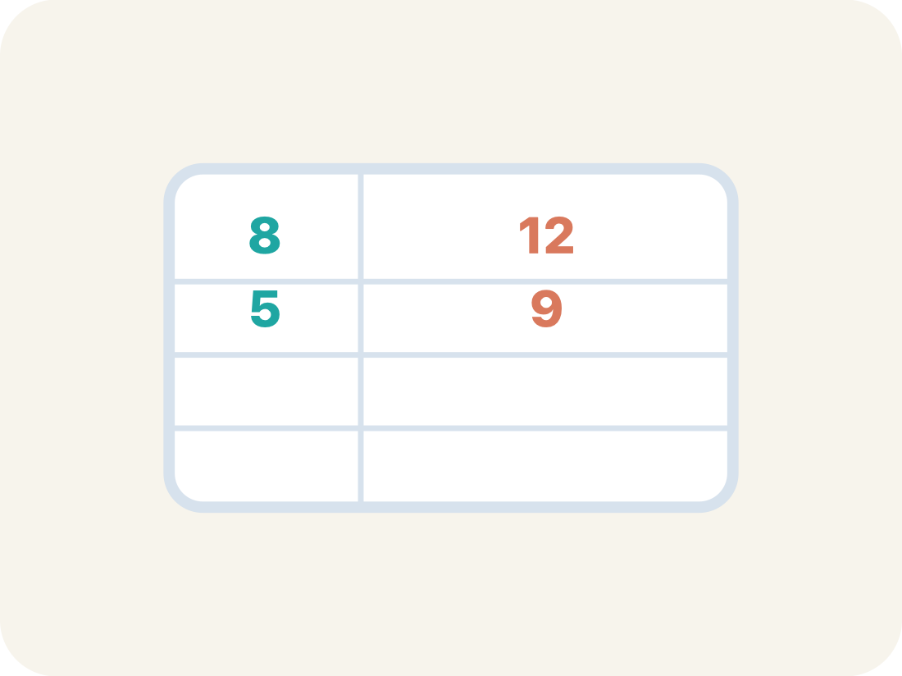
Vocabulary 5 of 5
Lesson 2-8 · Describe Data Using the Mean
Data set
The whole collection of values that were gathered or measured.
EXAMPLE · EXPLAIN WHY IT FITS
Sofia’s points in games 1–9 — 12, 20, 16, 11, 17, 14, 15, 10, 18 — form one data set.
Use “Data set” to explain the example. Point to evidence.
eduwonderlab.com · Neft Teacher
12 / 45
Notes:
TEACH IN PRACTICE | Embedded facilitation | Lesson 2.8, slide 12 | VOCAB
Focus on the existing task: Vocabulary 5 of 5 Data set The whole collection of values…
ASK (T1/3/5): Where does “Data set” appear in the example? Explain the meaning without reading the definition. Partner: restate the idea and ask a clarifying question.
LOOK FOR: A correct connection between the word and a feature of the example. If the student only repeats the definition, invite pointing, sketching or oral rehearsal, then ask for another explanation of this same example.
PARTICIPATION (T5/6/7): Think time before volunteers; accept a written, drawn or rehearsed entry. Students ask for evidence respectfully. Recognize a specific contribution or revision and check that both partners participate.
Source: BCPS Updated Instructional Framework Rubric (June 2020), TEACH 1–7.

Slide 13
Vocabulary
Lesson 2-8 · Describe Data Using the Mean
Today’s Math Words
We learn every word — what it means and what it looks like — before we use it.
Mean
Average
The average of a data set
Another word for the mean — the amount each value would be if the total were shared equally
Measure of center
Balance point
A single number used to describe the middle, or typical value, of a whole data set
The value where the total distance of the data above it equals the total distance below it
Data set
The whole collection of values that were gathered or measured
Explain one math word using the example.
Partner: point to evidence.
eduwonderlab.com · Neft Teacher
13 / 45
Notes:
TEACH IN PRACTICE | Embedded facilitation | Lesson 2.8, slide 13 | VOCAB
Focus on the existing task: Vocabulary Today’s Math Words We learn every word — what it…
ASK (T1/3/5): Where does “the displayed term” appear in the example? Explain the meaning without reading the definition. Partner: restate the idea and ask a clarifying question.
LOOK FOR: A correct connection between the word and a feature of the example. If the student only repeats the definition, invite pointing, sketching or oral rehearsal, then ask for another explanation of this same example.
PARTICIPATION (T5/6/7): Think time before volunteers; accept a written, drawn or rehearsed entry. Students ask for evidence respectfully. Recognize a specific contribution or revision and check that both partners participate.
Source: BCPS Updated Instructional Framework Rubric (June 2020), TEACH 1–7. Earlier notes and answer keys are retained below.
EARLIER NOTES / EXISTING ANSWER KEY
Choral-read each word, its meaning, and what it looks like.
Students should use these words out loud today — listen for them in partner talk and revoice student ideas with the academic term.
UIFR: TEACH 1 · TEACH 5.

Slide 14

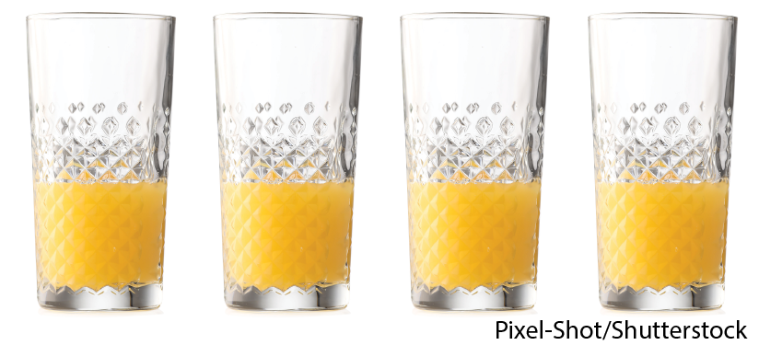

Be Curious
What do you notice?
What do you wonder?
Mindset
HOW DO YOU KNOW? · Ask your partner “How do you know?” Answer by pointing to your own work.
What can you learn about math from listening to different ideas and reasoning?
14 / 45
Notes:
TEACH IN PRACTICE | Embedded facilitation | Lesson 2.8, slide 14 | CURIOUS
Focus on the existing task: Be Curious What do you notice?
LAUNCH (T2/3/5): Allow quiet observation first. Separate a notice from an inference, invite students’ own questions, and follow the existing launch before teaching a procedure.
LOOK FOR (T4): Where this task addresses it, students can interpret mean as fair share and balance point. Ask which feature of their work supports the claim.
RESPOND: If this task shows the lesson misconception—dividing by the wrong number of observations—organize the existing values as a sum and mark the number of observations. Have the student revise and explain the change. Use this support only where the concept occurs in the current task; otherwise respond to the displayed question.
RECHECK: If a gap is shared, revisit the existing representation together. If it is limited, give targeted support while others compare valid methods on the same task. Check the revision before moving on.
PARTICIPATION (T5/6/7): Think time before volunteers; accept a written, drawn or rehearsed entry. Students ask for evidence respectfully. Recognize a specific contribution or revision and check that both partners participate.
Source: BCPS Updated Instructional Framework Rubric (June 2020), TEACH 1–7. Earlier notes and answer keys are retained below.
EARLIER NOTES / EXISTING ANSWER KEY
Accept all noticings and wonderings — there are no wrong answers here.
Give 20–30 seconds of quiet think time before taking responses; mix cold and warm calls so it is not always the same voices.
Read the mindset question aloud and let two students respond.
UIFR: TEACH 3 · TEACH 7.

Slide 15
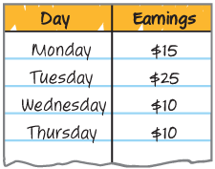
Every week, Miguel walks dogs after school to earn some money. He keeps track of his earnings in his notebook. How can Miguel describe his earnings on a typical day?
Record your reasoning before the reveal.
Compare, then explain any revision.
What is the question asking you to find?
Reveal:
We need to find a number that describes the amount of money Miguel makes walking dogs on a typical day.
15 / 45
Notes:
TEACH IN PRACTICE | Embedded facilitation | Lesson 2.8, slide 15 | REVEAL
Focus on the existing task: Every week, Miguel walks dogs after school to earn some money. He keeps track of his earnings in his notebook. How can Miguel describe his earnings on a typical day?
LAUNCH (T2/3/5): If an existing answer cover is present, gather an attempt before revealing. If the explanation is already visible, ask students to reconstruct and justify it. Compare reasoning and explain a revision; preserve the reveal sequence.
LOOK FOR (T4): Where this task addresses it, students can use total and count to find a missing value. Ask which feature of their work supports the claim.
RESPOND: If this task shows the lesson misconception—dividing by the wrong number of observations—organize the existing values as a sum and mark the number of observations. Have the student revise and explain the change. Use this support only where the concept occurs in the current task; otherwise respond to the displayed question.
RECHECK: If a gap is shared, revisit the existing representation together. If it is limited, give targeted support while others compare valid methods on the same task. Check the revision before moving on.
PARTICIPATION (T5/6/7): Think time before volunteers; accept a written, drawn or rehearsed entry. Students ask for evidence respectfully. Recognize a specific contribution or revision and check that both partners participate.
Source: BCPS Updated Instructional Framework Rubric (June 2020), TEACH 1–7. Earlier notes and answer keys are retained below.
EARLIER NOTES / EXISTING ANSWER KEY
Do not click yet: collect 2–3 student answers with reasons first.
Then click to remove the cover and have students compare their thinking to the reveal — “Is this what we said? Where is it different?”
Behind the cover: We need to find a number that describes the amount of money Miguel makes walking dogs on a typical day.
UIFR: TEACH 3 · TEACH 4.
UIFR FULL | Lesson-specific facilitation
TEACH 2-3 | Session 1 task launch (UIFR PDF pp. 9-10).
Use the problem exactly as displayed. Give individual thinking time before discussion or advancing to the explanation. If the answer is already visible, ask students to reconstruct and justify it. Invite a choice of suitable representations and have students explain why their choice helps.
At the point where this concept appears, ask: “How does the mean determine the total? What must the missing value contribute to that total?” Wait for evidence, invite another pathway, and have a student ask a follow-up question. Do not replace students’ reasoning with a sequence of leading steps.

Slide 16
Every week, Miguel walks dogs after school to earn some money. He keeps track of his earnings in his notebook. How can Miguel describe his earnings on a typical day?
Record your reasoning before the reveal.
Compare, then explain any revision.
What does typical day mean in the context of the problem?
Reveal:
It indicates the amount of money Miguel would make if he earned the same amount of money each day.
16 / 45
Notes:
TEACH IN PRACTICE | Embedded facilitation | Lesson 2.8, slide 16 | REVEAL
Focus on the existing task: What does typical day mean in the context of the problem?
LAUNCH (T2/3/5): If an existing answer cover is present, gather an attempt before revealing. If the explanation is already visible, ask students to reconstruct and justify it. Compare reasoning and explain a revision; preserve the reveal sequence.
LOOK FOR (T4): Where this task addresses it, students can interpret mean as fair share and balance point. Ask which feature of their work supports the claim.
RESPOND: If this task shows the lesson misconception—dividing by the wrong number of observations—organize the existing values as a sum and mark the number of observations. Have the student revise and explain the change. Use this support only where the concept occurs in the current task; otherwise respond to the displayed question.
RECHECK: If a gap is shared, revisit the existing representation together. If it is limited, give targeted support while others compare valid methods on the same task. Check the revision before moving on.
PARTICIPATION (T5/6/7): Think time before volunteers; accept a written, drawn or rehearsed entry. Students ask for evidence respectfully. Recognize a specific contribution or revision and check that both partners participate.
Source: BCPS Updated Instructional Framework Rubric (June 2020), TEACH 1–7. Earlier notes and answer keys are retained below.
EARLIER NOTES / EXISTING ANSWER KEY
Do not click yet: collect 2–3 student answers with reasons first.
Then click to remove the cover and have students compare their thinking to the reveal — “Is this what we said? Where is it different?”
Behind the cover: It indicates the amount of money Miguel would make if he earned the same amount of money each day.
UIFR: TEACH 3 · TEACH 4.

Slide 17
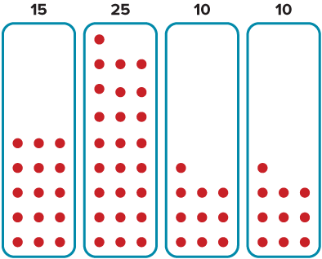
We can display each day’s earnings using counters.
How can you use the counters to show how much Miguel makes on a typical day?
TRY IT BEFORE YOU’RE SURE · Start even if you are not sure. A revised answer counts as much as a first-try answer.
Reveal:
We can combine and then redistribute the counters equally among the 4 days to level the values in the data set.
17 / 45
Notes:
TEACH IN PRACTICE | Embedded facilitation | Lesson 2.8, slide 17 | REVEAL
Focus on the existing task: We can display each day’s earnings using counters. How can you use the counters to show how much Miguel makes on a typical day?
LAUNCH (T2/3/5): If an existing answer cover is present, gather an attempt before revealing. If the explanation is already visible, ask students to reconstruct and justify it. Compare reasoning and explain a revision; preserve the reveal sequence.
LOOK FOR (T4): Where this task addresses it, students can interpret mean as fair share and balance point. Ask which feature of their work supports the claim.
RESPOND: If this task shows the lesson misconception—dividing by the wrong number of observations—organize the existing values as a sum and mark the number of observations. Have the student revise and explain the change. Use this support only where the concept occurs in the current task; otherwise respond to the displayed question.
RECHECK: If a gap is shared, revisit the existing representation together. If it is limited, give targeted support while others compare valid methods on the same task. Check the revision before moving on.
PARTICIPATION (T5/6/7): Think time before volunteers; accept a written, drawn or rehearsed entry. Students ask for evidence respectfully. Recognize a specific contribution or revision and check that both partners participate.
Source: BCPS Updated Instructional Framework Rubric (June 2020), TEACH 1–7. Earlier notes and answer keys are retained below.
EARLIER NOTES / EXISTING ANSWER KEY
Do not click yet: collect 2–3 student answers with reasons first.
Then click to remove the cover and have students compare their thinking to the reveal — “Is this what we said? Where is it different?”
Behind the cover: We can combine and then redistribute the counters equally among the 4 days to level the values in the data set.
UIFR: TEACH 3 · TEACH 4.

Slide 18

COLLABORATE · TALK IT THROUGH • AGREE ON A MODEL
Collaborate and Connect
Another Way
USE THE MATH WORDS · Use today’s math words in your explanation — not “it” and “that thing.”
How can you mathematically calculate the amount Miguel makes on a typical day?
Think About It:
How can you relate the steps we used for the model to using arithmetic?
Reveal:
We can find the total amount Miguel earned and divide it by the number of days, 4.
18 / 45
Notes:
TEACH IN PRACTICE | Embedded facilitation | Lesson 2.8, slide 18 | COLLABORATE
Focus on the existing task: Another Way How can you mathematically calculate the amount Miguel makes on a typical day?
LAUNCH (T2/3/5): Use the displayed question. Give private thinking time; then A explains while B asks for evidence. Switch roles. Each student records their own reasoning.
LOOK FOR (T4): Where this task addresses it, students can use total and count to find a missing value. Ask which feature of their work supports the claim.
RESPOND: If this task shows the lesson misconception—dividing by the wrong number of observations—organize the existing values as a sum and mark the number of observations. Have the student revise and explain the change. Use this support only where the concept occurs in the current task; otherwise respond to the displayed question.
RECHECK: If a gap is shared, revisit the existing representation together. If it is limited, give targeted support while others compare valid methods on the same task. Check the revision before moving on.
PARTICIPATION (T5/6/7): Think time before volunteers; accept a written, drawn or rehearsed entry. Students ask for evidence respectfully. Recognize a specific contribution or revision and check that both partners participate.
Source: BCPS Updated Instructional Framework Rubric (June 2020), TEACH 1–7. Earlier notes and answer keys are retained below.
EARLIER NOTES / EXISTING ANSWER KEY
Routine: COLLABORATE · TALK IT THROUGH • AGREE ON A MODEL
UIFR FULL | Lesson-specific facilitation
TEACH 4-5 | Session 1 discussion and checkpoint (UIFR PDF pp. 11-12).
Collect a brief response from every student to the existing prompt before hearing volunteers. Partners take turns explaining and asking for evidence: “I understand ___; what supports ___?” Offer rehearsal or an annotated model for students who need language support. Each student records their own reasoning.
Look specifically for: dividing by the wrong number of observations. If it appears, organize the existing values as a sum and mark the number of observations; then ask the student to revise the same response and explain the change. If evidence is secure, have students compare a second valid pathway or state why their approach works. Choose the next step from the responses, not a preset pace.

Slide 19
We can use $15 to describe Miguel’s typical daily earnings. This is also known as the mean.
The mean, or arithmetic average, is a measure of center that describes a data set. It represents a “leveling” of the values in a data set.
Explain how the information
shown supports your reasoning.
19 / 45
Notes:
TEACH IN PRACTICE | Embedded facilitation | Lesson 2.8, slide 19 | WORKED
Focus on the existing task: We can use $15 to describe Miguel’s typical daily earnings. This is also known as the mean. The mean, or arithmetic average, is a…
LAUNCH (T2/3/5): Ask students to explain the displayed idea or example and point to evidence. When a calculation step is shown, ask why it is valid. Have a partner restate the explanation; copying is not the check.
LOOK FOR (T4): Where this task addresses it, students can interpret mean as fair share and balance point. Ask which feature of their work supports the claim.
RESPOND: If this task shows the lesson misconception—dividing by the wrong number of observations—organize the existing values as a sum and mark the number of observations. Have the student revise and explain the change. Use this support only where the concept occurs in the current task; otherwise respond to the displayed question.
RECHECK: If a gap is shared, revisit the existing representation together. If it is limited, give targeted support while others compare valid methods on the same task. Check the revision before moving on.
PARTICIPATION (T5/6/7): Think time before volunteers; accept a written, drawn or rehearsed entry. Students ask for evidence respectfully. Recognize a specific contribution or revision and check that both partners participate.
Source: BCPS Updated Instructional Framework Rubric (June 2020), TEACH 1–7. Earlier notes and answer keys are retained below.
EARLIER NOTES / EXISTING ANSWER KEY
Model briefly, then hand the thinking back: ask “Why does this step work?” before showing the next one.
Quick check before moving on — thumbs or whiteboards from everyone, not volunteers.
UIFR: TEACH 2 · TEACH 3 · TEACH 4.

Slide 20
Let’s Explore More
What information does the mean provide that is different from what the median provides?
Workspace
How is determining the mean different from determining the median? How are the two measures similar?
Workspace
20 / 45
Notes:
TEACH IN PRACTICE | Embedded facilitation | Lesson 2.8, slide 20 | PRACTICE
Focus on the existing task: Let’s Explore More What information does the mean provide that is different from what the median provides?
LAUNCH (T2/3/5): Use the displayed question. Give private thinking time; then A explains while B asks for evidence. Switch roles. Each student records their own reasoning.
LOOK FOR (T4): Where this task addresses it, students can interpret mean as fair share and balance point. Ask which feature of their work supports the claim.
RESPOND: If this task shows the lesson misconception—dividing by the wrong number of observations—organize the existing values as a sum and mark the number of observations. Have the student revise and explain the change. Use this support only where the concept occurs in the current task; otherwise respond to the displayed question.
RECHECK: If a gap is shared, revisit the existing representation together. If it is limited, give targeted support while others compare valid methods on the same task. Check the revision before moving on.
PARTICIPATION (T5/6/7): Think time before volunteers; accept a written, drawn or rehearsed entry. Students ask for evidence respectfully. Recognize a specific contribution or revision and check that both partners participate.
Source: BCPS Updated Instructional Framework Rubric (June 2020), TEACH 1–7. Earlier notes and answer keys are retained below.
EARLIER NOTES / EXISTING ANSWER KEY
Extension for partners or table groups — students choose their approach and use the workspace to show thinking.
Push with “Convince me,” and have two groups with different approaches share.
This is where students stretch past the worked example.
UIFR: TEACH 2 · TEACH 5.

Slide 21
STUDENT MOVES
Lesson 2-8
Your move
YOUR CHOICE · You choose how to show this — numbers, words, or a diagram. Make your reasoning visible.
21 / 45

Slide 22
LESSON 2.8 / DISCUSS THE TASK
Explain and compare
Use the task you just explored.
TAKE TURNS
How does the mean determine the total? What must the missing value contribute to that total?
Explain
“I know this because…”
Ask
“Where does your work show that?”
Point to evidence in your work.
Then compare your approach with a partner’s.
JUSTIFY IT · Say it like this: “I know ______ because ______.”
Listen to understand. Ask for evidence. Make room for every voice.
Notes:
TEACH IN PRACTICE | Embedded facilitation | Lesson 2.8, slide 21 | PRIOR_INSERT
Focus on the existing task: LESSON 2.8 / DISCUSS THE TASK Explain and compare Listen to understand. Ask for evidence. Make room for every voice. Use the task you just explored. How does the mean determine the total?
CONNECT (T1/4): Ask students to restate the displayed goal or key idea and connect it to earlier work. Relevant lesson evidence: interpret mean as fair share and balance point; use total and count to find a missing value. Use only the criterion that matches the current session.
SHOW PROGRESS: Students point to their own existing work, explain what improved after feedback, and name a next step. Pair confidence ratings with actual evidence.
PARTICIPATION (T5/6/7): Think time before volunteers; accept a written, drawn or rehearsed entry. Students ask for evidence respectfully. Recognize a specific contribution or revision and check that both partners participate.
Source: BCPS Updated Instructional Framework Rubric (June 2020), TEACH 1–7.

Slide 23
Every week, Miguel walks dogs after school to earn some money. He keeps track of his earnings in his notebook. How can Miguel describe his earnings on a typical day?
Compare your reasoning with the
explanation. Explain any revision you make.
What does typical day mean in the context of the problem?
Reveal:
It indicates the amount of money Miguel would make if he earned the same amount of money each day.
23 / 45
Notes:
TEACH IN PRACTICE | Embedded facilitation | Lesson 2.8, slide 22 | REVEAL
Focus on the existing task: What does typical day mean in the context of the problem?
LAUNCH (T2/3/5): If an existing answer cover is present, gather an attempt before revealing. If the explanation is already visible, ask students to reconstruct and justify it. Compare reasoning and explain a revision; preserve the reveal sequence.
LOOK FOR (T4): Where this task addresses it, students can interpret mean as fair share and balance point. Ask which feature of their work supports the claim.
RESPOND: If this task shows the lesson misconception—dividing by the wrong number of observations—organize the existing values as a sum and mark the number of observations. Have the student revise and explain the change. Use this support only where the concept occurs in the current task; otherwise respond to the displayed question.
RECHECK: If a gap is shared, revisit the existing representation together. If it is limited, give targeted support while others compare valid methods on the same task. Check the revision before moving on.
PARTICIPATION (T5/6/7): Think time before volunteers; accept a written, drawn or rehearsed entry. Students ask for evidence respectfully. Recognize a specific contribution or revision and check that both partners participate.
Source: BCPS Updated Instructional Framework Rubric (June 2020), TEACH 1–7.

Slide 24
Every week, Miguel walks dogs after school to earn some money. He keeps track of his earnings in his notebook. How can Miguel describe his earnings on a typical day?
How can you visually represent each day’s earnings?
Reveal:
We can use counters.
Compare your reasoning with the
explanation. Explain any revision you make.
24 / 45
Notes:
TEACH IN PRACTICE | Embedded facilitation | Lesson 2.8, slide 23 | REVEAL
Focus on the existing task: How can you visually represent each day’s earnings?
LAUNCH (T2/3/5): If an existing answer cover is present, gather an attempt before revealing. If the explanation is already visible, ask students to reconstruct and justify it. Compare reasoning and explain a revision; preserve the reveal sequence.
LOOK FOR (T4): Where this task addresses it, students can interpret mean as fair share and balance point. Ask which feature of their work supports the claim.
RESPOND: If this task shows the lesson misconception—dividing by the wrong number of observations—organize the existing values as a sum and mark the number of observations. Have the student revise and explain the change. Use this support only where the concept occurs in the current task; otherwise respond to the displayed question.
RECHECK: If a gap is shared, revisit the existing representation together. If it is limited, give targeted support while others compare valid methods on the same task. Check the revision before moving on.
PARTICIPATION (T5/6/7): Think time before volunteers; accept a written, drawn or rehearsed entry. Students ask for evidence respectfully. Recognize a specific contribution or revision and check that both partners participate.
Source: BCPS Updated Instructional Framework Rubric (June 2020), TEACH 1–7.

Slide 25
Session 2 Warm-Up
Lesson 2-8 · Describe Data Using the Mean
Session 2 Warm-Up
Quick review from Session 1 · about 4 minutes
1
How do you calculate the mean of a data set?
2
What is the mean of 6, 10, 14?
A
Find the middle value
A
8
B
Sum values ÷ count of values
B
10
C
Max minus min
C
12
D
Count total numbers
D
30
3
Conceptually, the mean represents the:
4
Four scores are 5, 5, 10, 20. What is the mean?
A
Most common number
A
5
B
Fair share or balance point
B
10
C
Distance to zero
C
15
D
Bottom quarter
D
40
eduwonderlab.com · Neft Teacher
25 / 45
Notes:
TEACH IN PRACTICE | Embedded facilitation | Lesson 2.8, slide 24 | WARMUP
Focus on the existing task: Session 2 Warm-Up Session 2 Warm-Up Quick review from Session 1 · about 4 minutes 1 How do you calculate the mean of a data set?
GATHER EVIDENCE (T4/6): Keep the original items. Students try independently, mark an uncertain item, and explain one method before checking. Use the existing key when present.
RESPOND: Distinguish a calculation slip from a reasoning gap. Give one next step on the same item; have students revise in a second color. Use the responses to choose flexible support for today’s lesson.
PARTICIPATION (T5/6/7): Think time before volunteers; accept a written, drawn or rehearsed entry. Students ask for evidence respectfully. Recognize a specific contribution or revision and check that both partners participate.
Source: BCPS Updated Instructional Framework Rubric (June 2020), TEACH 1–7. Earlier notes and answer keys are retained below.
EARLIER NOTES / EXISTING ANSWER KEY
Warm-up routine: students start silently on entry; keep it to about 4 minutes.
Circulate and note who is stuck — use what you see to choose who you check on first today.
Go over answers quickly; ask one student to explain a step, not just say the answer.
UIFR: TEACH 4 · TEACH 6.
UIFR FULL | Lesson-specific facilitation
TEACH 1 | Session 2 purpose and evidence (UIFR PDF p. 8).
Have students restate the displayed session goal in their own words and connect it to the existing context or a familiar experience they choose to share. Use the current session goal to select from these lesson-wide evidence criteria; do not frontload a later-session procedure.
Look for: interpret mean as fair share and balance point; use total and count to find a missing value. Ask: “Which part of your work would show this?” Revisit that evidence after the task; a confidence rating alone is not evidence of understanding.

Slide 26
STUDENT MOVES
Lesson 2-8
Your move
YOU KNOW THE ROUTINE · Read → plan → solve → check. Do all four, in that order.
26 / 45

Slide 27
Review Notes
Lesson 2-8 · Describe Data Using the Mean
Review Notes — Session 2
Copy. Explain. Check.
WHY IT MATTERS · Finish this: “This is worth knowing because ______.”
Mean Formula
1
Mean = (Sum of all data values) ÷ (Total count of data values).
Fair Share Model
2
The mean levels out all values into equal shares across the population.
Sensitivity to Outliers
3
An extreme high or low value pulls the mean toward that extreme.
eduwonderlab.com · Neft Teacher
27 / 45
Notes:
TEACH IN PRACTICE | Embedded facilitation | Lesson 2.8, slide 25 | NOTES
Focus on the existing task: Review Notes Review Notes — Session 2 Copy into your notebook…
ROUTINE (T1/2/4): Read or copy the original notes, cover one line, and explain it using the displayed example. Reopen and correct. Copying alone is not evidence of understanding.
LOOK FOR: A link between a symbol, quantity or feature and the explanation. If missing, point back to that feature and have the student try again; fade the prompt once they can explain.
PARTICIPATION (T5/6/7): Think time before volunteers; accept a written, drawn or rehearsed entry. Students ask for evidence respectfully. Recognize a specific contribution or revision and check that both partners participate.
Source: BCPS Updated Instructional Framework Rubric (June 2020), TEACH 1–7. Earlier notes and answer keys are retained below.
EARLIER NOTES / EXISTING ANSWER KEY
Copy routine: read one line at a time; students copy, then explain that line to a partner.
Keep it brisk — the understanding work happens in the examples, not the copying.
UIFR: TEACH 1 · TEACH 6.

Slide 28
Session 2
Describe Data Using the Mean
ADD ON · Add on: “I agree because ______.” or “I see it differently because ______.”
28 / 45
Notes:
TEACH IN PRACTICE | Embedded facilitation | Lesson 2.8, slide 26 | DIVIDER
Focus on the existing task: Describe Data Using the Mean Session 2
TRANSITION (T6/7): Students confirm materials, roles, how to request help, and the next response routine. Ask a student to restate it. Keep teacher-only slides hidden.
PARTICIPATION (T5/6/7): Think time before volunteers; accept a written, drawn or rehearsed entry. Students ask for evidence respectfully. Recognize a specific contribution or revision and check that both partners participate.
Source: BCPS Updated Instructional Framework Rubric (June 2020), TEACH 1–7. Earlier notes and answer keys are retained below.
EARLIER NOTES / EXISTING ANSWER KEY
Transition cue: state what materials are out and what success looks like this session.
Keep the changeover under a minute.
UIFR: TEACH 6.

Slide 29
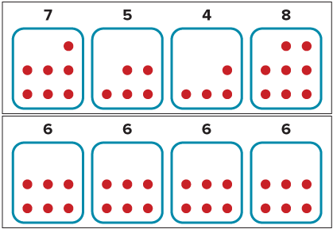
Be Curious
How are they the same?
How are they different?
Mindset
ANOTHER PATHWAY · Did anyone get there a different way? Put both pathways side by side and compare.
What are you learning about math from listening to different ideas and reasoning?
29 / 45
Notes:
TEACH IN PRACTICE | Embedded facilitation | Lesson 2.8, slide 27 | CURIOUS
Focus on the existing task: Be Curious How are they the same?
LAUNCH (T2/3/5): Allow quiet observation first. Separate a notice from an inference, invite students’ own questions, and follow the existing launch before teaching a procedure.
LOOK FOR (T4): Where this task addresses it, students can interpret mean as fair share and balance point. Ask which feature of their work supports the claim.
RESPOND: If this task shows the lesson misconception—dividing by the wrong number of observations—organize the existing values as a sum and mark the number of observations. Have the student revise and explain the change. Use this support only where the concept occurs in the current task; otherwise respond to the displayed question.
RECHECK: If a gap is shared, revisit the existing representation together. If it is limited, give targeted support while others compare valid methods on the same task. Check the revision before moving on.
PARTICIPATION (T5/6/7): Think time before volunteers; accept a written, drawn or rehearsed entry. Students ask for evidence respectfully. Recognize a specific contribution or revision and check that both partners participate.
Source: BCPS Updated Instructional Framework Rubric (June 2020), TEACH 1–7. Earlier notes and answer keys are retained below.
EARLIER NOTES / EXISTING ANSWER KEY
Accept all noticings and wonderings — there are no wrong answers here.
Give 20–30 seconds of quiet think time before taking responses; mix cold and warm calls so it is not always the same voices.
Read the mindset question aloud and let two students respond.
UIFR: TEACH 3 · TEACH 7.

Slide 30
Sofia tracks the number of points she scores in each basketball game she plays in. She wants to end the season with a mean of 15 points per game. How many points does she need to score in the last game to hit her goal?
Basketball Season
Game | 1 | 2 | 3 | 4 | 5 | 6 | 7 | 8 | 9 | 10
Points Scored | 12 | 20 | 16 | 11 | 17 | 14 | 15 | 10 | 18 | p
SELF-CHECK · Mark it: ✓ got it · ~ almost · ? stuck. Then fix one thing before we move on.
What does it mean for Sofia to hit her target mean?
Reveal:
It means that her average number of points scored each game will be 15.
30 / 45
Notes:
TEACH IN PRACTICE | Embedded facilitation | Lesson 2.8, slide 28 | REVEAL
Focus on the existing task: What does it mean for Sofia to hit her target mean?
LAUNCH (T2/3/5): If an existing answer cover is present, gather an attempt before revealing. If the explanation is already visible, ask students to reconstruct and justify it. Compare reasoning and explain a revision; preserve the reveal sequence.
LOOK FOR (T4): Where this task addresses it, students can interpret mean as fair share and balance point. Ask which feature of their work supports the claim.
RESPOND: If this task shows the lesson misconception—dividing by the wrong number of observations—organize the existing values as a sum and mark the number of observations. Have the student revise and explain the change. Use this support only where the concept occurs in the current task; otherwise respond to the displayed question.
RECHECK: If a gap is shared, revisit the existing representation together. If it is limited, give targeted support while others compare valid methods on the same task. Check the revision before moving on.
PARTICIPATION (T5/6/7): Think time before volunteers; accept a written, drawn or rehearsed entry. Students ask for evidence respectfully. Recognize a specific contribution or revision and check that both partners participate.
Source: BCPS Updated Instructional Framework Rubric (June 2020), TEACH 1–7. Earlier notes and answer keys are retained below.
EARLIER NOTES / EXISTING ANSWER KEY
Do not click yet: collect 2–3 student answers with reasons first.
Then click to remove the cover and have students compare their thinking to the reveal — “Is this what we said? Where is it different?”
Behind the cover: It means that her average number of points scored each game will be 15.
UIFR: TEACH 3 · TEACH 4.
UIFR FULL | Lesson-specific facilitation
TEACH 2-3 | Session 2 task launch (UIFR PDF pp. 9-10).
Use the problem exactly as displayed. Give individual thinking time before discussion or advancing to the explanation. If the answer is already visible, ask students to reconstruct and justify it. Invite a choice of suitable representations and have students explain why their choice helps.
At the point where this concept appears, ask: “How does the mean determine the total? What must the missing value contribute to that total?” Wait for evidence, invite another pathway, and have a student ask a follow-up question. Do not replace students’ reasoning with a sequence of leading steps.

Slide 31
The target mean, 15, is the balance point of the data set.
Basketball Season
Game | 1 | 2 | 3 | 4 | 5 | 6 | 7 | 8 | 9 | 10
Points Scored | 12 | 20 | 16 | 11 | 17 | 14 | 15 | 10 | 18 | p
Target Mean | 15 | 15 | 15 | 15 | 15 | 15 | 15 | 15 | 15 | 15
Think and record first. Which part of your work supports your
answer?
Think About It:
What does it mean for something to be balanced?
31 / 45
Notes:
TEACH IN PRACTICE | Embedded facilitation | Lesson 2.8, slide 29 | TASK
Focus on the existing task: The target mean, 15, is the balance point of the data set. Think About It: What does it mean for something to be balanced?
LAUNCH (T2/3/5): Use the displayed question. Give private thinking time; then A explains while B asks for evidence. Switch roles. Each student records their own reasoning.
LOOK FOR (T4): Where this task addresses it, students can interpret mean as fair share and balance point. Ask which feature of their work supports the claim.
RESPOND: If this task shows the lesson misconception—dividing by the wrong number of observations—organize the existing values as a sum and mark the number of observations. Have the student revise and explain the change. Use this support only where the concept occurs in the current task; otherwise respond to the displayed question.
RECHECK: If a gap is shared, revisit the existing representation together. If it is limited, give targeted support while others compare valid methods on the same task. Check the revision before moving on.
PARTICIPATION (T5/6/7): Think time before volunteers; accept a written, drawn or rehearsed entry. Students ask for evidence respectfully. Recognize a specific contribution or revision and check that both partners participate.
Source: BCPS Updated Instructional Framework Rubric (June 2020), TEACH 1–7. Earlier notes and answer keys are retained below.
EARLIER NOTES / EXISTING ANSWER KEY
Ask the question, then hold the silence — students think or jot before anyone answers.
Take two or three responses and press with “Why?” or “How do you know?” before moving on.
UIFR: TEACH 3.

Slide 32


The total number of points below the target mean is 2 more than the number of points above the target mean.
total points above:
total points below:
What must be true about the score in the 10th game for Sofia to balance the total points above and total points below?
Reveal:
The score must be two above the target mean to balance.
32 / 45
Notes:
TEACH IN PRACTICE | Embedded facilitation | Lesson 2.8, slide 30 | REVEAL
Focus on the existing task: The total number of points below the target mean is 2 more than the number of points above the target mean. What must be true about the…
LAUNCH (T2/3/5): If an existing answer cover is present, gather an attempt before revealing. If the explanation is already visible, ask students to reconstruct and justify it. Compare reasoning and explain a revision; preserve the reveal sequence.
LOOK FOR (T4): Where this task addresses it, students can interpret mean as fair share and balance point. Ask which feature of their work supports the claim.
RESPOND: If this task shows the lesson misconception—dividing by the wrong number of observations—organize the existing values as a sum and mark the number of observations. Have the student revise and explain the change. Use this support only where the concept occurs in the current task; otherwise respond to the displayed question.
RECHECK: If a gap is shared, revisit the existing representation together. If it is limited, give targeted support while others compare valid methods on the same task. Check the revision before moving on.
PARTICIPATION (T5/6/7): Think time before volunteers; accept a written, drawn or rehearsed entry. Students ask for evidence respectfully. Recognize a specific contribution or revision and check that both partners participate.
Source: BCPS Updated Instructional Framework Rubric (June 2020), TEACH 1–7. Earlier notes and answer keys are retained below.
EARLIER NOTES / EXISTING ANSWER KEY
Students should have shared predictions before this reveal.
Have them compare their thinking to what is shown: “Is this the same as what we said? Where is it different?”
Press one student to explain the reveal in their own words.
UIFR: TEACH 3 · TEACH 4.

Slide 33
STUDENT MOVES
Lesson 2-8
Your move
PICK YOUR STRATEGY · Choose your path — picture, table, number line, or equation — and be ready to say why you chose it.
33 / 45

Slide 34
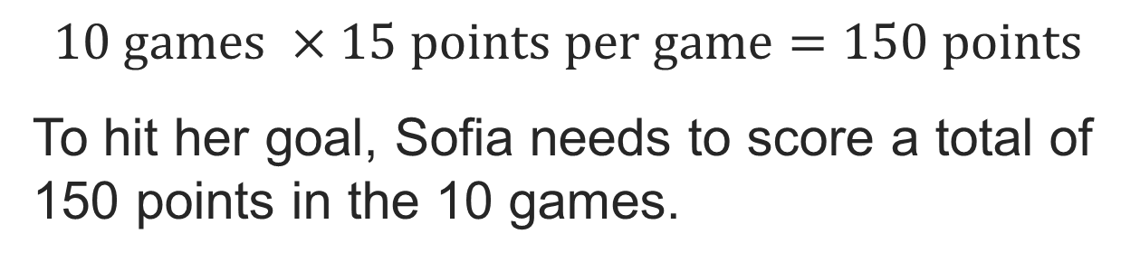
STRUGGLE FIRST · Work on your own first. Stuck is allowed — try a second strategy before you ask.
Basketball Season
Game | 1 | 2 | 3 | 4 | 5 | 6 | 7 | 8 | 9 | 10
Points Scored | 12 | 20 | 16 | 11 | 17 | 14 | 15 | 10 | 18 | p
Target Mean | 15 | 15 | 15 | 15 | 15 | 15 | 15 | 15 | 15 | 15
How can you compare the number of points Sofia needs to the number of points Sofia currently has?
Reveal:
We can find the total number of points scored and subtract the sum from the number of points needed.
34 / 45
Notes:
TEACH IN PRACTICE | Embedded facilitation | Lesson 2.8, slide 31 | REVEAL
Focus on the existing task: How can you compare the number of points Sofia needs to the number of points Sofia currently has?
LAUNCH (T2/3/5): If an existing answer cover is present, gather an attempt before revealing. If the explanation is already visible, ask students to reconstruct and justify it. Compare reasoning and explain a revision; preserve the reveal sequence.
LOOK FOR (T4): Where this task addresses it, students can use total and count to find a missing value. Ask which feature of their work supports the claim.
RESPOND: If this task shows the lesson misconception—dividing by the wrong number of observations—organize the existing values as a sum and mark the number of observations. Have the student revise and explain the change. Use this support only where the concept occurs in the current task; otherwise respond to the displayed question.
RECHECK: If a gap is shared, revisit the existing representation together. If it is limited, give targeted support while others compare valid methods on the same task. Check the revision before moving on.
PARTICIPATION (T5/6/7): Think time before volunteers; accept a written, drawn or rehearsed entry. Students ask for evidence respectfully. Recognize a specific contribution or revision and check that both partners participate.
Source: BCPS Updated Instructional Framework Rubric (June 2020), TEACH 1–7. Earlier notes and answer keys are retained below.
EARLIER NOTES / EXISTING ANSWER KEY
Students should have shared predictions before this reveal.
Have them compare their thinking to what is shown: “Is this the same as what we said? Where is it different?”
Press one student to explain the reveal in their own words.
UIFR: TEACH 3 · TEACH 4.

Slide 35
Let’s Explore More
Basketball Season
Game | 1 | 2 | 3 | 4 | 5 | 6 | 7 | 8 | 9 | 10
Points Scored | 12 | 20 | 16 | 11 | 17 | 14 | 15 | 10 | 18 | p
Sofia realized that she had an error and had scored 12 points in Game 8. How does that change the number of points she needs to score in Game 10?
USE YOUR TOOLS · Reach for your notes, a model, or a manipulative before you reach for an answer.
Workspace
35 / 45
Notes:
TEACH IN PRACTICE | Embedded facilitation | Lesson 2.8, slide 32 | PRACTICE
Focus on the existing task: Let’s Explore More Sofia realized that she had an error and had scored 12 points in Game 8. How does that change the number of points she needs to score in Game 10?
LAUNCH (T2/3/5): Use the displayed question. Give private thinking time; then A explains while B asks for evidence. Switch roles. Each student records their own reasoning.
LOOK FOR (T4): Where this task addresses it, students can interpret mean as fair share and balance point. Ask which feature of their work supports the claim.
RESPOND: If this task shows the lesson misconception—dividing by the wrong number of observations—organize the existing values as a sum and mark the number of observations. Have the student revise and explain the change. Use this support only where the concept occurs in the current task; otherwise respond to the displayed question.
RECHECK: If a gap is shared, revisit the existing representation together. If it is limited, give targeted support while others compare valid methods on the same task. Check the revision before moving on.
PARTICIPATION (T5/6/7): Think time before volunteers; accept a written, drawn or rehearsed entry. Students ask for evidence respectfully. Recognize a specific contribution or revision and check that both partners participate.
Source: BCPS Updated Instructional Framework Rubric (June 2020), TEACH 1–7. Earlier notes and answer keys are retained below.
EARLIER NOTES / EXISTING ANSWER KEY
Extension for partners or table groups — students choose their approach and use the workspace to show thinking.
Push with “Convince me,” and have two groups with different approaches share.
This is where students stretch past the worked example.
UIFR: TEACH 2 · TEACH 5.
UIFR FULL | Lesson-specific facilitation
TEACH 4-5 | Session 2 discussion and checkpoint (UIFR PDF pp. 11-12).
Collect a brief response from every student to the existing prompt before hearing volunteers. Partners take turns explaining and asking for evidence: “I understand ___; what supports ___?” Offer rehearsal or an annotated model for students who need language support. Each student records their own reasoning.
Look specifically for: dividing by the wrong number of observations. If it appears, organize the existing values as a sum and mark the number of observations; then ask the student to revise the same response and explain the change. If evidence is secure, have students compare a second valid pathway or state why their approach works. Choose the next step from the responses, not a preset pace.

Slide 36
LESSON 2.8 / CHECK YOUR WORK
Pause. Check. Improve.
CHECK
A mistake to watch for: dividing by the wrong number of observations.
TRY
Organize the given values as a sum and mark the number of observations.
REVISE
Use that check on the task you just completed. Correct or strengthen one part, and explain why.
REVISE NOW · Change one answer and write why you changed it. A revision is evidence of learning.
Listen to understand. Ask for evidence. Make room for every voice.
Notes:
TEACH IN PRACTICE | Embedded facilitation | Lesson 2.8, slide 33 | PRIOR_INSERT
Focus on the existing task: LESSON 2.8 / CHECK YOUR WORK Pause. Check. Improve. Listen to understand. Ask for evidence. Make room for every voice. CHECK A mistake…
CONNECT (T1/4): Ask students to restate the displayed goal or key idea and connect it to earlier work. Relevant lesson evidence: interpret mean as fair share and balance point; use total and count to find a missing value. Use only the criterion that matches the current session.
SHOW PROGRESS: Students point to their own existing work, explain what improved after feedback, and name a next step. Pair confidence ratings with actual evidence.
PARTICIPATION (T5/6/7): Think time before volunteers; accept a written, drawn or rehearsed entry. Students ask for evidence respectfully. Recognize a specific contribution or revision and check that both partners participate.
Source: BCPS Updated Instructional Framework Rubric (June 2020), TEACH 1–7.

Slide 37
Sofia wants to average 15 points for each of the 10 games.
Basketball Season
Game | 1 | 2 | 3 | 4 | 5 | 6 | 7 | 8 | 9 | 10
Points Scored | 12 | 20 | 16 | 11 | 17 | 14 | 15 | 10 | 18 | p
Target Mean | 15 | 15 | 15 | 15 | 15 | 15 | 15 | 15 | 15 | 15
How does the target mean compare to the actual points scored in each game?
ASK THE CLASS · Write one question about this that you could ask the class.
Reveal:
For some games, Sofia scored below the target mean. For others, she scored above the target mean. In game 7, she scored her target mean of 15 points.
37 / 45
Notes:
TEACH IN PRACTICE | Embedded facilitation | Lesson 2.8, slide 34 | REVEAL
Focus on the existing task: Reveal: For some games, Sofia scored below the target mean. For others, she scored above the target mean. In game 7, she scored her…
LAUNCH (T2/3/5): If an existing answer cover is present, gather an attempt before revealing. If the explanation is already visible, ask students to reconstruct and justify it. Compare reasoning and explain a revision; preserve the reveal sequence.
LOOK FOR (T4): Where this task addresses it, students can interpret mean as fair share and balance point. Ask which feature of their work supports the claim.
RESPOND: If this task shows the lesson misconception—dividing by the wrong number of observations—organize the existing values as a sum and mark the number of observations. Have the student revise and explain the change. Use this support only where the concept occurs in the current task; otherwise respond to the displayed question.
RECHECK: If a gap is shared, revisit the existing representation together. If it is limited, give targeted support while others compare valid methods on the same task. Check the revision before moving on.
PARTICIPATION (T5/6/7): Think time before volunteers; accept a written, drawn or rehearsed entry. Students ask for evidence respectfully. Recognize a specific contribution or revision and check that both partners participate.
Source: BCPS Updated Instructional Framework Rubric (June 2020), TEACH 1–7.

Slide 38
What do you notice about the total number of points above and the total number of points below the target mean?
Basketball Season
Game | 1 | 2 | 3 | 4 | 5 | 6 | 7 | 8 | 9 | 10
Points Scored | 12 | 20 | 16 | 11 | 17 | 14 | 15 | 10 | 18 | p
Target Mean | 15 | 15 | 15 | 15 | 15 | 15 | 15 | 15 | 15 | 15
Points Above or Below Target Mean | 3 below | 5 above | 1 above | 4 below | 2 above | 1 below | even | 5 below | 3 above | ?
Reveal:
The total number of points below is 2 more than the number of points above.
PROVE IT · Find the evidence in the problem that makes your answer right — not just the answer.
38 / 45
Notes:
TEACH IN PRACTICE | Embedded facilitation | Lesson 2.8, slide 35 | REVEAL
Focus on the existing task: What do you notice about the total number of points above and the total number of points below the target mean?
LAUNCH (T2/3/5): If an existing answer cover is present, gather an attempt before revealing. If the explanation is already visible, ask students to reconstruct and justify it. Compare reasoning and explain a revision; preserve the reveal sequence.
LOOK FOR (T4): Where this task addresses it, students can interpret mean as fair share and balance point. Ask which feature of their work supports the claim.
RESPOND: If this task shows the lesson misconception—dividing by the wrong number of observations—organize the existing values as a sum and mark the number of observations. Have the student revise and explain the change. Use this support only where the concept occurs in the current task; otherwise respond to the displayed question.
RECHECK: If a gap is shared, revisit the existing representation together. If it is limited, give targeted support while others compare valid methods on the same task. Check the revision before moving on.
PARTICIPATION (T5/6/7): Think time before volunteers; accept a written, drawn or rehearsed entry. Students ask for evidence respectfully. Recognize a specific contribution or revision and check that both partners participate.
Source: BCPS Updated Instructional Framework Rubric (June 2020), TEACH 1–7.

Slide 39
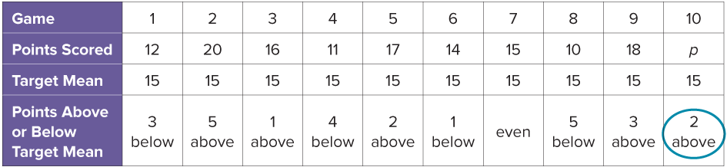
To reach the balance point, Sofia needs to score 2 points above the target mean in game 10.
How can you use this information to find the value of p?
Reveal:
We can add 2 points to the target mean.
39 / 45
Notes:
TEACH IN PRACTICE | Embedded facilitation | Lesson 2.8, slide 36 | REVEAL
Focus on the existing task: To reach the balance point, Sofia needs to score 2 points above the target mean in game 10. How can you use this information to find the value of p?
LAUNCH (T2/3/5): If an existing answer cover is present, gather an attempt before revealing. If the explanation is already visible, ask students to reconstruct and justify it. Compare reasoning and explain a revision; preserve the reveal sequence.
LOOK FOR (T4): Where this task addresses it, students can interpret mean as fair share and balance point. Ask which feature of their work supports the claim.
RESPOND: If this task shows the lesson misconception—dividing by the wrong number of observations—organize the existing values as a sum and mark the number of observations. Have the student revise and explain the change. Use this support only where the concept occurs in the current task; otherwise respond to the displayed question.
RECHECK: If a gap is shared, revisit the existing representation together. If it is limited, give targeted support while others compare valid methods on the same task. Check the revision before moving on.
PARTICIPATION (T5/6/7): Think time before volunteers; accept a written, drawn or rehearsed entry. Students ask for evidence respectfully. Recognize a specific contribution or revision and check that both partners participate.
Source: BCPS Updated Instructional Framework Rubric (June 2020), TEACH 1–7.

Slide 40
STUDENT MOVES
Lesson 2-8
Your move
HOW DO YOU KNOW? · Ask your partner “How do you know?” Answer by pointing to your own work.
40 / 45

Slide 41
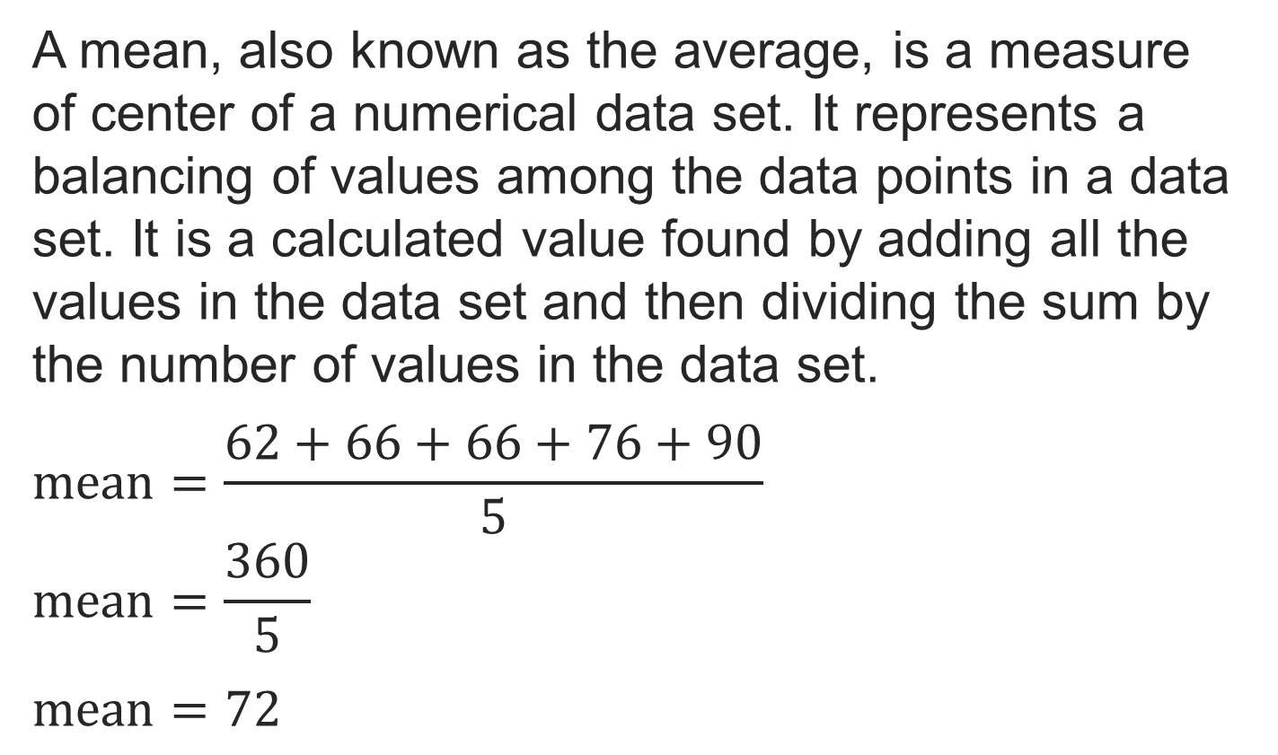
SUMMARIZE · SAY IT IN YOUR OWN WORDS
Summarize: Describe Data Using the Mean
TWO MINUTES SOLO · Two minutes on your own, then compare. Bring one thing you tried, even if it did not work.
41 / 45
Notes:
TEACH IN PRACTICE | Embedded facilitation | Lesson 2.8, slide 37 | SUMMARIZE
Focus on the existing task: Summarize: Describe Data Using the Mean SUMMARIZE · SAY IT IN YOUR OWN WORDS
CONNECT (T1/4): Ask students to restate the displayed goal or key idea and connect it to earlier work. Relevant lesson evidence: interpret mean as fair share and balance point; use total and count to find a missing value. Use only the criterion that matches the current session.
SHOW PROGRESS: Students point to their own existing work, explain what improved after feedback, and name a next step. Pair confidence ratings with actual evidence.
PARTICIPATION (T5/6/7): Think time before volunteers; accept a written, drawn or rehearsed entry. Students ask for evidence respectfully. Recognize a specific contribution or revision and check that both partners participate.
Source: BCPS Updated Instructional Framework Rubric (June 2020), TEACH 1–7. Earlier notes and answer keys are retained below.
EARLIER NOTES / EXISTING ANSWER KEY
Routine: SUMMARIZE · SAY IT IN YOUR OWN WORDS

Slide 42
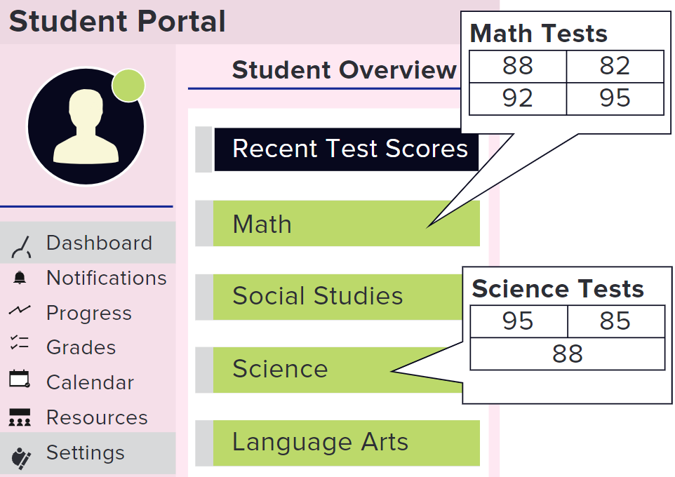
APPLY · PLAN IT • SOLVE IT • PROVE IT
Apply: Honor Roll
Shanice wants to be on the honor roll for the next marking period. She determines that her mean test score needs to be a least 90 in both math and science to be on the honor roll. Her test scores in math and science so far this grading period are shown.
Question: How likely is it that Shanice will make the honor roll?
Choose a method. Solve
independently, justify your
answer, then check the goal.
42 / 45
Notes:
TEACH IN PRACTICE | Embedded facilitation | Lesson 2.8, slide 38 | APPLY
Focus on the existing task: Apply: Honor Roll Shanice wants to be on the honor roll for the next marking period. She determines that her mean test score needs to be…
LAUNCH (T2/3/5): Use the exact application task independently first. Ask students to justify their choice of method. Collect evidence before a partner discussion or correction.
LOOK FOR (T4): Where this task addresses it, students can interpret mean as fair share and balance point. Ask which feature of their work supports the claim.
RESPOND: If this task shows the lesson misconception—dividing by the wrong number of observations—organize the existing values as a sum and mark the number of observations. Have the student revise and explain the change. Use this support only where the concept occurs in the current task; otherwise respond to the displayed question.
RECHECK: If a gap is shared, revisit the existing representation together. If it is limited, give targeted support while others compare valid methods on the same task. Check the revision before moving on.
PARTICIPATION (T5/6/7): Think time before volunteers; accept a written, drawn or rehearsed entry. Students ask for evidence respectfully. Recognize a specific contribution or revision and check that both partners participate.
Source: BCPS Updated Instructional Framework Rubric (June 2020), TEACH 1–7. Earlier notes and answer keys are retained below.
EARLIER NOTES / EXISTING ANSWER KEY
Routine: APPLY · PLAN IT • SOLVE IT • PROVE IT
UIFR FULL | Lesson-specific facilitation
TEACH 4 | Independent evidence and revision (UIFR PDF p. 11).
Use the existing application/exit problem as the independent check. If this is a learning-target slide, have students point to and explain their work on the preceding task. Separate initial independent evidence from the revision after feedback.
Check the relevant criteria: interpret mean as fair share and balance point; use total and count to find a missing value. Respond with one specific next step tied to the work. Students revise and annotate what changed, then identify a criterion they can now demonstrate and one they still need to practice.

Slide 43
Learning Targets
I can determine the mean of a data set.
I can use a target mean to find a missing value in a data set.
I can connect strategies for determining the mean.
NAME THE MATH · Point to the part of this that is new today, and say what it changes.
43 / 45
Notes:
TEACH IN PRACTICE | Embedded facilitation | Lesson 2.8, slide 39 | REFLECTION
Focus on the existing task: Learning Targets I can determine the mean of a data set. I can use a target mean to find a missing value in a data set. I can connect…
CONNECT (T1/4): Ask students to restate the displayed goal or key idea and connect it to earlier work. Relevant lesson evidence: interpret mean as fair share and balance point; use total and count to find a missing value. Use only the criterion that matches the current session.
SHOW PROGRESS: Students point to their own existing work, explain what improved after feedback, and name a next step. Pair confidence ratings with actual evidence.
PARTICIPATION (T5/6/7): Think time before volunteers; accept a written, drawn or rehearsed entry. Students ask for evidence respectfully. Recognize a specific contribution or revision and check that both partners participate.
Source: BCPS Updated Instructional Framework Rubric (June 2020), TEACH 1–7. Earlier notes and answer keys are retained below.
EARLIER NOTES / EXISTING ANSWER KEY
Read each target; students self-rate with fist-to-five or thumbs.
Tie back to the goal from the start of class: did we get there?
Note any target that rates low — revisit it tomorrow.
UIFR: TEACH 1 · TEACH 4.

Slide 44
Learning Targets
I can determine the mean of a data set.
I can use a target mean to find a missing value in a data set.
I can connect strategies for determining the mean.
SAY THE GOAL · Say today’s goal in your own words, then name one place this shows up outside math class.
44 / 45
Notes:
TEACH IN PRACTICE | Embedded facilitation | Lesson 2.8, slide 40 | REFLECTION
Focus on the existing task: Learning Targets I can determine the mean of a data set. I can use a target mean to find a missing value in a data set. I can connect…
CONNECT (T1/4): Ask students to restate the displayed goal or key idea and connect it to earlier work. Relevant lesson evidence: interpret mean as fair share and balance point; use total and count to find a missing value. Use only the criterion that matches the current session.
SHOW PROGRESS: Students point to their own existing work, explain what improved after feedback, and name a next step. Pair confidence ratings with actual evidence.
PARTICIPATION (T5/6/7): Think time before volunteers; accept a written, drawn or rehearsed entry. Students ask for evidence respectfully. Recognize a specific contribution or revision and check that both partners participate.
Source: BCPS Updated Instructional Framework Rubric (June 2020), TEACH 1–7. Earlier notes and answer keys are retained below.
EARLIER NOTES / EXISTING ANSWER KEY
UIFR FULL | Lesson-specific facilitation
REFLECT & ADJUST 1-2 | After the lesson (UIFR PDF pp. 15-16).
Sort the existing work by demonstrated reasoning, partial understanding, and the specific misconception: dividing by the wrong number of observations. Compare the initial response with the revision. Record which teaching move plausibly helped, which did not, and whose participation or access needs a different approach; do not record sensitive student details in this shared deck.
Plan the next lesson from that evidence: if the misconception persists, organize the existing values as a sum and mark the number of observations using the current example before returning to the next grade-level task; if understanding is secure, use an existing extension or ask for a general explanation. Check the targeted idea again at the next warm-up.
Ask students what supported their thinking and what would help next time. Identify one change to try and one successful practice to retain. Seek colleague feedback on anonymized work when useful; these prompts support reflection and do not establish an evaluation rating. Source: Baltimore City Public Schools, Updated Instructional Framework Rubric, June 2020 (UIFR_Full.pdf).

Slide 45
LESSON 2.8 / REFLECT ON YOUR LEARNING
Show your progress
1 SHOW EVIDENCE
2 CHOOSE A NEXT STEP
Choose one response. Point to the part that shows your reasoning.
Name a change you made after feedback—or a question you still have.
“My work shows ___ because ___.”
“Next time, I will ___ to help me ___.”
Today’s focus: Interpret mean as fair share and balance point.
CREDIT A CLASSMATE · Name one classmate whose idea helped you today, and say what they said.
Listen to understand. Ask for evidence. Make room for every voice.
Notes:
TEACH IN PRACTICE | Embedded facilitation | Lesson 2.8, slide 41 | PRIOR_INSERT
Focus on the existing task: LESSON 2.8 / REFLECT ON YOUR LEARNING Show your progress Listen to understand. Ask for evidence. Make room for every voice. 1 SHOW…
CONNECT (T1/4): Ask students to restate the displayed goal or key idea and connect it to earlier work. Relevant lesson evidence: interpret mean as fair share and balance point; use total and count to find a missing value. Use only the criterion that matches the current session.
SHOW PROGRESS: Students point to their own existing work, explain what improved after feedback, and name a next step. Pair confidence ratings with actual evidence.
PARTICIPATION (T5/6/7): Think time before volunteers; accept a written, drawn or rehearsed entry. Students ask for evidence respectfully. Recognize a specific contribution or revision and check that both partners participate.
Source: BCPS Updated Instructional Framework Rubric (June 2020), TEACH 1–7.

