Slide 1
WARM-UP · THINK • TRY • CHECK
Turn and talk: compare strategies, then defend one.
Warm-Up
Lesson 2-9 · Describe Data by Mean Absolute Deviation | Warm-Up · about 4 minutes
Try each on your own. Mark an unsure answer; explain and revise when we check.
QUESTION 1
QUESTION 2
Mean of 6, 8, 10, 12, 14 = ______
The mean is 20. How far is 26 from the mean? ______
QUESTION 3
QUESTION 4
4 + 2 + 0 + 2 + 4 = ______
12 ÷ 5 = ______
TALK IT OVER: “I got ______ because ______.” • Compare with a partner before we check as a class.
1 / 46
Notes:
TEACH IN PRACTICE | Embedded facilitation | Lesson 2.9, slide 1 | WARMUP
Focus on the existing task: Warm-Up WARM-UP · THINK • TRY • CHECK Do these…
GATHER EVIDENCE (T4/6): Keep the original items. Students try independently, mark an uncertain item, and explain one method before checking. Use the existing key when present.
RESPOND: Distinguish a calculation slip from a reasoning gap. Give one next step on the same item; have students revise in a second color. Use the responses to choose flexible support for today’s lesson.
PARTICIPATION (T5/6/7): Think time before volunteers; accept a written, drawn or rehearsed entry. Students ask for evidence respectfully. Recognize a specific contribution or revision and check that both partners participate.
Source: BCPS Updated Instructional Framework Rubric (June 2020), TEACH 1–7. Earlier notes and answer keys are retained below.
EARLIER NOTES / EXISTING ANSWER KEY
Warm-Up answers (teacher only): 1) 10 2) 6 3) 12 4) 2.4
UIFR FULL | Lesson-specific facilitation
PREPARE 1-2 | Before teaching (UIFR PDF pp. 6-7).
Plan to gather evidence that students can find the mean; find nonnegative distances from it; average those distances; interpret MAD. Review recent work and today’s warm-up to choose flexible groups and access supports; do not infer needs from identity or perceived ability. Use the existing lesson tasks and stated standards.
Anticipate: allowing positive and negative deviations to cancel. If observed, organize the original data into value, distance from mean, and total distance columns. Offer oral rehearsal, drawing, pointing, or home-language processing as needed; retain the original mathematical demand. Ask students which support helps and fade it as evidence improves.
TEACH 6-7 | Before the first transition, agree on materials, partner roles, and how to request help. Invite students to restate the routine. Normalize revising an idea, recognize a specific contribution, and check privately when frustration blocks participation. Source: UIFR PDF pp. 13-14.

Slide 2
Today’s Math Notes
Lesson 2-9 · Describe Data by Mean Absolute Deviation
Section 1: Math Words
Copy. Explain. Check.
SAY THE GOAL · Say today’s goal in your own words, then name one place this shows up outside math class.
Mean Absolute Deviation
1
The average distance of data values from the mean
Deviation
2
How far a number is from the mean
Absolute Value
3
How far a number is from zero
eduwonderlab.com · Neft Teacher
2 / 46
Notes:
TEACH IN PRACTICE | Embedded facilitation | Lesson 2.9, slide 2 | NOTES
Focus on the existing task: Today’s Math Notes Section 1: Math Words Copy into…
ROUTINE (T1/2/4): Read or copy the original notes, cover one line, and explain it using the displayed example. Reopen and correct. Copying alone is not evidence of understanding.
LOOK FOR: A link between a symbol, quantity or feature and the explanation. If missing, point back to that feature and have the student try again; fade the prompt once they can explain.
PARTICIPATION (T5/6/7): Think time before volunteers; accept a written, drawn or rehearsed entry. Students ask for evidence respectfully. Recognize a specific contribution or revision and check that both partners participate.
Source: BCPS Updated Instructional Framework Rubric (June 2020), TEACH 1–7. Earlier notes and answer keys are retained below.
EARLIER NOTES / EXISTING ANSWER KEY
Copy routine: read one line at a time; students copy, then explain that line to a partner.
Keep it brisk — the understanding work happens in the examples, not the copying.
UIFR: TEACH 1 · TEACH 6.

Slide 3
Today’s Math Notes
Lesson 2-9 · Describe Data by Mean Absolute Deviation
Section 2: Today’s Math
Copy. Explain. Check.
Mean Absolute Deviation (MAD)
MAD = (Sum of distances from mean) ÷ (Total count)
Read, cover, explain. Reopen your notes to
check and improve your explanation.
1
Calculate the mean of the data set
2
Find the distance (absolute difference |value − mean|) for each data point
3
Average the distances: Add all distances and divide by the count
eduwonderlab.com · Neft Teacher
3 / 46
Notes:
TEACH IN PRACTICE | Embedded facilitation | Lesson 2.9, slide 3 | NOTES
Focus on the existing task: Today’s Math Notes Section 2: Today’s Math Copy…
ROUTINE (T1/2/4): Read or copy the original notes, cover one line, and explain it using the displayed example. Reopen and correct. Copying alone is not evidence of understanding.
LOOK FOR: A link between a symbol, quantity or feature and the explanation. If missing, point back to that feature and have the student try again; fade the prompt once they can explain.
PARTICIPATION (T5/6/7): Think time before volunteers; accept a written, drawn or rehearsed entry. Students ask for evidence respectfully. Recognize a specific contribution or revision and check that both partners participate.
Source: BCPS Updated Instructional Framework Rubric (June 2020), TEACH 1–7. Earlier notes and answer keys are retained below.
EARLIER NOTES / EXISTING ANSWER KEY
Copy routine: read one line at a time; students copy, then explain that line to a partner.
Keep it brisk — the understanding work happens in the examples, not the copying.
UIFR: TEACH 1 · TEACH 6.

Slide 4
Session 1
Describe Data by Mean Absolute Deviation
PICK YOUR STRATEGY · Choose your path — picture, table, number line, or equation — and be ready to say why you chose it.
4 / 46
Notes:
TEACH IN PRACTICE | Embedded facilitation | Lesson 2.9, slide 4 | DIVIDER
Focus on the existing task: Describe Data by Mean Absolute Deviation Session 1
TRANSITION (T6/7): Students confirm materials, roles, how to request help, and the next response routine. Ask a student to restate it. Keep teacher-only slides hidden.
PARTICIPATION (T5/6/7): Think time before volunteers; accept a written, drawn or rehearsed entry. Students ask for evidence respectfully. Recognize a specific contribution or revision and check that both partners participate.
Source: BCPS Updated Instructional Framework Rubric (June 2020), TEACH 1–7. Earlier notes and answer keys are retained below.
EARLIER NOTES / EXISTING ANSWER KEY
Transition cue: state what materials are out and what success looks like this session.
Keep the changeover under a minute.
UIFR: TEACH 6.

Slide 5
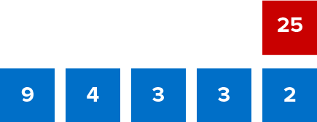
Give Me Five
Use all the numbers in any order with any operation to equal the target number (in red).
Explain how the information shown supports your reasoning.
5 / 46
Notes:
TEACH IN PRACTICE | Embedded facilitation | Lesson 2.9, slide 5 | WORKED
Focus on the existing task: Give Me Five Use all the numbers in any order with any operation to equal the target number (in red).
LAUNCH (T2/3/5): Ask students to explain the displayed idea or example and point to evidence. When a calculation step is shown, ask why it is valid. Have a partner restate the explanation; copying is not the check.
LOOK FOR (T4): Where this task addresses it, students can find the mean. Ask which feature of their work supports the claim.
RESPOND: If this task shows the lesson misconception—allowing positive and negative deviations to cancel—organize the original data into value, distance from mean, and total distance columns. Have the student revise and explain the change. Use this support only where the concept occurs in the current task; otherwise respond to the displayed question.
RECHECK: If a gap is shared, revisit the existing representation together. If it is limited, give targeted support while others compare valid methods on the same task. Check the revision before moving on.
PARTICIPATION (T5/6/7): Think time before volunteers; accept a written, drawn or rehearsed entry. Students ask for evidence respectfully. Recognize a specific contribution or revision and check that both partners participate.
Source: BCPS Updated Instructional Framework Rubric (June 2020), TEACH 1–7. Earlier notes and answer keys are retained below.
EARLIER NOTES / EXISTING ANSWER KEY
Number-sense routine — every voice in. Give quiet think time, then hear from at least three students.
Always follow with “How do you know?” — the reasoning is the point, not the answer.
There is more than one path; name and celebrate different strategies.
UIFR: TEACH 3 · TEACH 5 · TEACH 6.

Slide 6
Today’s Objectives
Lesson 2-9 · Describe Data by Mean Absolute Deviation
Describe Data by Mean Absolute Deviation
Maryland Standard 6.DS.6c
CONNECT IT · What earlier lesson does this build on? Tell a partner in one sentence.
CONTENT OBJECTIVE
LANGUAGE OBJECTIVE
Restate the goal in your words
Use these words to explain why
I can find the mean absolute deviation (MAD) to describe how spread out data is.
I can explain my work using the words mean absolute deviation, deviation, absolute value, and spread.
eduwonderlab.com · Neft Teacher
6 / 46
Notes:
TEACH IN PRACTICE | Embedded facilitation | Lesson 2.9, slide 6 | GOAL
Focus on the existing task: Today’s Objectives Describe Data by Mean Absolute…
CONNECT (T1/4): Ask students to restate the displayed goal or key idea and connect it to earlier work. Relevant lesson evidence: find the mean; find nonnegative distances from it; average those distances; interpret MAD. Use only the criterion that matches the current session.
SHOW PROGRESS: Students point to their own existing work, explain what improved after feedback, and name a next step. Pair confidence ratings with actual evidence.
PARTICIPATION (T5/6/7): Think time before volunteers; accept a written, drawn or rehearsed entry. Students ask for evidence respectfully. Recognize a specific contribution or revision and check that both partners participate.
Source: BCPS Updated Instructional Framework Rubric (June 2020), TEACH 1–7. Earlier notes and answer keys are retained below.
EARLIER NOTES / EXISTING ANSWER KEY
Read the objective together, then have one or two students restate today’s goal in their own words.
Connect it to what the class learned last lesson.
Return to this goal at the end of class to check it was met.
UIFR: TEACH 1.
UIFR FULL | Lesson-specific facilitation
TEACH 1 | Session 1 purpose and evidence (UIFR PDF p. 8).
Have students restate the displayed session goal in their own words and connect it to the existing context or a familiar experience they choose to share. Use the current session goal to select from these lesson-wide evidence criteria; do not frontload a later-session procedure.
Look for: find the mean; find nonnegative distances from it; average those distances; interpret MAD. Ask: “Which part of your work would show this?” Revisit that evidence after the task; a confidence rating alone is not evidence of understanding.

Slide 7
LESSON 2.9 / OUR LEARNING
What will show your learning?
1
Find the mean.
2
Find nonnegative distances from it.
3
Average those distances.
4
Interpret MAD.
Tell a partner: Which skill connects to something you already know?
SHOW YOUR THINKING · Show what you know — write it, draw it, or build it. A picture counts as an explanation.
Listen to understand. Ask for evidence. Make room for every voice.
Notes:
TEACH IN PRACTICE | Embedded facilitation | Lesson 2.9, slide 7 | PRIOR_INSERT
Focus on the existing task: LESSON 2.9 / OUR LEARNING What will show your learning?
CONNECT (T1/4): Ask students to restate the displayed goal or key idea and connect it to earlier work. Relevant lesson evidence: find the mean; find nonnegative distances from it; average those distances; interpret MAD. Use only the criterion that matches the current session.
SHOW PROGRESS: Students point to their own existing work, explain what improved after feedback, and name a next step. Pair confidence ratings with actual evidence.
PARTICIPATION (T5/6/7): Think time before volunteers; accept a written, drawn or rehearsed entry. Students ask for evidence respectfully. Recognize a specific contribution or revision and check that both partners participate.
Source: BCPS Updated Instructional Framework Rubric (June 2020), TEACH 1–7.

Slide 8
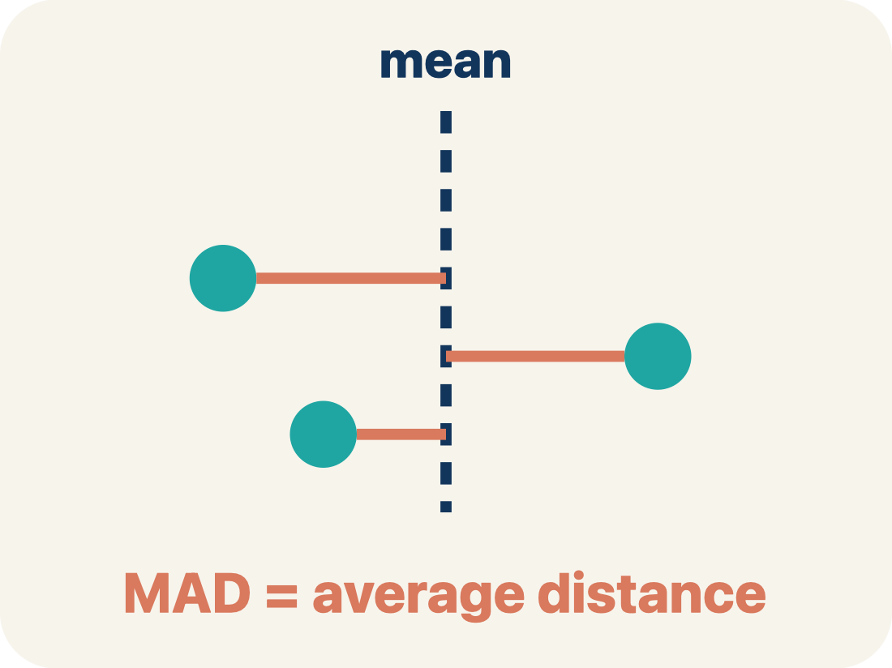
Vocabulary 1 of 6
Lesson 2-9 · Describe Data by Mean Absolute Deviation
Mean Absolute Deviation
The average distance of data values from the mean; it describes spread.
EXAMPLE · EXPLAIN WHY IT FITS
MAD = sum of absolute distances from the mean ÷ number of values.
Use “Mean Absolute Deviation” to explain the example. Point
to evidence.
eduwonderlab.com · Neft Teacher
8 / 46
Notes:
TEACH IN PRACTICE | Embedded facilitation | Lesson 2.9, slide 8 | VOCAB
Focus on the existing task: Vocabulary 1 of 6 Mean Absolute Deviation The…
ASK (T1/3/5): Where does “Mean Absolute Deviation” appear in the example? Explain the meaning without reading the definition. Partner: restate the idea and ask a clarifying question.
LOOK FOR: A correct connection between the word and a feature of the example. If the student only repeats the definition, invite pointing, sketching or oral rehearsal, then ask for another explanation of this same example.
PARTICIPATION (T5/6/7): Think time before volunteers; accept a written, drawn or rehearsed entry. Students ask for evidence respectfully. Recognize a specific contribution or revision and check that both partners participate.
Source: BCPS Updated Instructional Framework Rubric (June 2020), TEACH 1–7.

Slide 9
Vocabulary 2 of 6
Lesson 2-9 · Describe Data by Mean Absolute Deviation
Deviation
How far a number is from the mean.
EXAMPLE · EXPLAIN WHY IT FITS
If mean = 20 and value = 17, deviation = 17 − 20 = −3 (3 below the mean)
Use “Deviation” to explain the example. Point to evidence.
eduwonderlab.com · Neft Teacher
9 / 46
Notes:
TEACH IN PRACTICE | Embedded facilitation | Lesson 2.9, slide 9 | VOCAB
Focus on the existing task: Vocabulary 2 of 6 Deviation How far a number is…
ASK (T1/3/5): Where does “Deviation” appear in the example? Explain the meaning without reading the definition. Partner: restate the idea and ask a clarifying question.
LOOK FOR: A correct connection between the word and a feature of the example. If the student only repeats the definition, invite pointing, sketching or oral rehearsal, then ask for another explanation of this same example.
PARTICIPATION (T5/6/7): Think time before volunteers; accept a written, drawn or rehearsed entry. Students ask for evidence respectfully. Recognize a specific contribution or revision and check that both partners participate.
Source: BCPS Updated Instructional Framework Rubric (June 2020), TEACH 1–7.

Slide 10
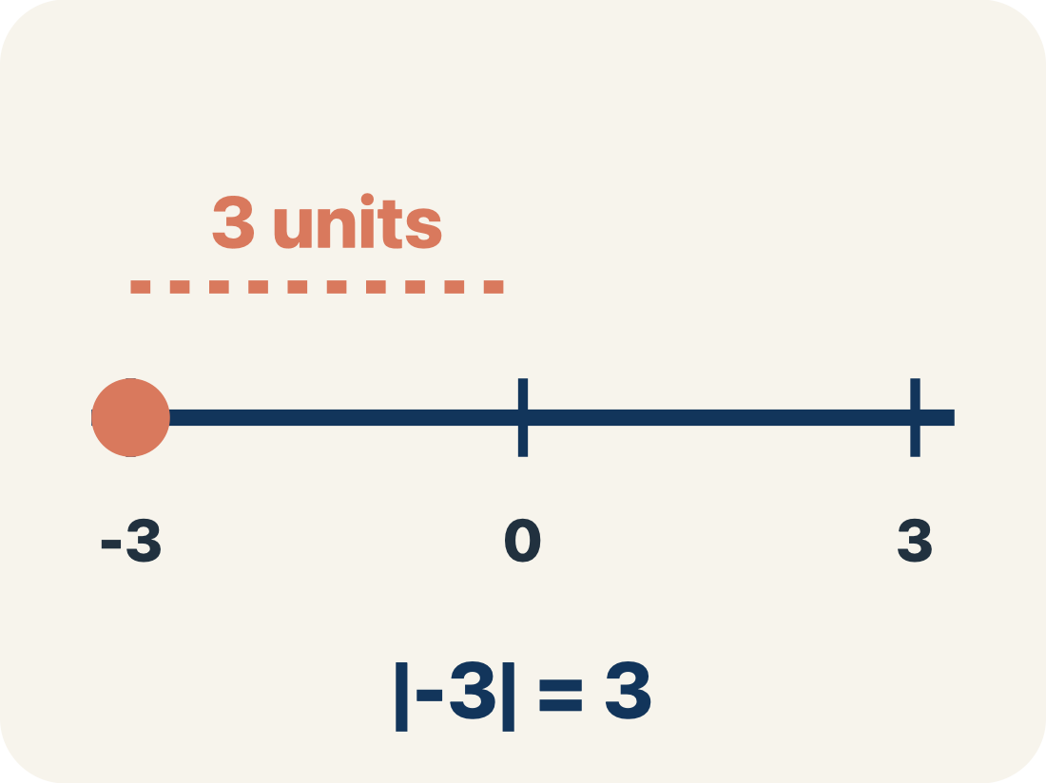
Vocabulary 3 of 6
Lesson 2-9 · Describe Data by Mean Absolute Deviation
Absolute Value
How far a number is from zero. It is never negative.
EXAMPLE · EXPLAIN WHY IT FITS
|−3| = 3 and |3| = 3 — both are 3 units from zero
Use “Absolute Value” to explain the example. Point to
evidence.
eduwonderlab.com · Neft Teacher
10 / 46
Notes:
TEACH IN PRACTICE | Embedded facilitation | Lesson 2.9, slide 10 | VOCAB
Focus on the existing task: Vocabulary 3 of 6 Absolute Value How far a number…
ASK (T1/3/5): Where does “Absolute Value” appear in the example? Explain the meaning without reading the definition. Partner: restate the idea and ask a clarifying question.
LOOK FOR: A correct connection between the word and a feature of the example. If the student only repeats the definition, invite pointing, sketching or oral rehearsal, then ask for another explanation of this same example.
PARTICIPATION (T5/6/7): Think time before volunteers; accept a written, drawn or rehearsed entry. Students ask for evidence respectfully. Recognize a specific contribution or revision and check that both partners participate.
Source: BCPS Updated Instructional Framework Rubric (June 2020), TEACH 1–7.

Slide 11

Vocabulary 4 of 6
Lesson 2-9 · Describe Data by Mean Absolute Deviation
Spread
How far apart the numbers are.
EXAMPLE · EXPLAIN WHY IT FITS
Low spread: 8, 9, 10, 11 (close together). High spread: 2, 9, 10, 25 (far apart)
Use “Spread” to explain the example. Point to evidence.
eduwonderlab.com · Neft Teacher
11 / 46
Notes:
TEACH IN PRACTICE | Embedded facilitation | Lesson 2.9, slide 11 | VOCAB
Focus on the existing task: Vocabulary 4 of 6 Spread How far apart the…
ASK (T1/3/5): Where does “Spread” appear in the example? Explain the meaning without reading the definition. Partner: restate the idea and ask a clarifying question.
LOOK FOR: A correct connection between the word and a feature of the example. If the student only repeats the definition, invite pointing, sketching or oral rehearsal, then ask for another explanation of this same example.
PARTICIPATION (T5/6/7): Think time before volunteers; accept a written, drawn or rehearsed entry. Students ask for evidence respectfully. Recognize a specific contribution or revision and check that both partners participate.
Source: BCPS Updated Instructional Framework Rubric (June 2020), TEACH 1–7.

Slide 12
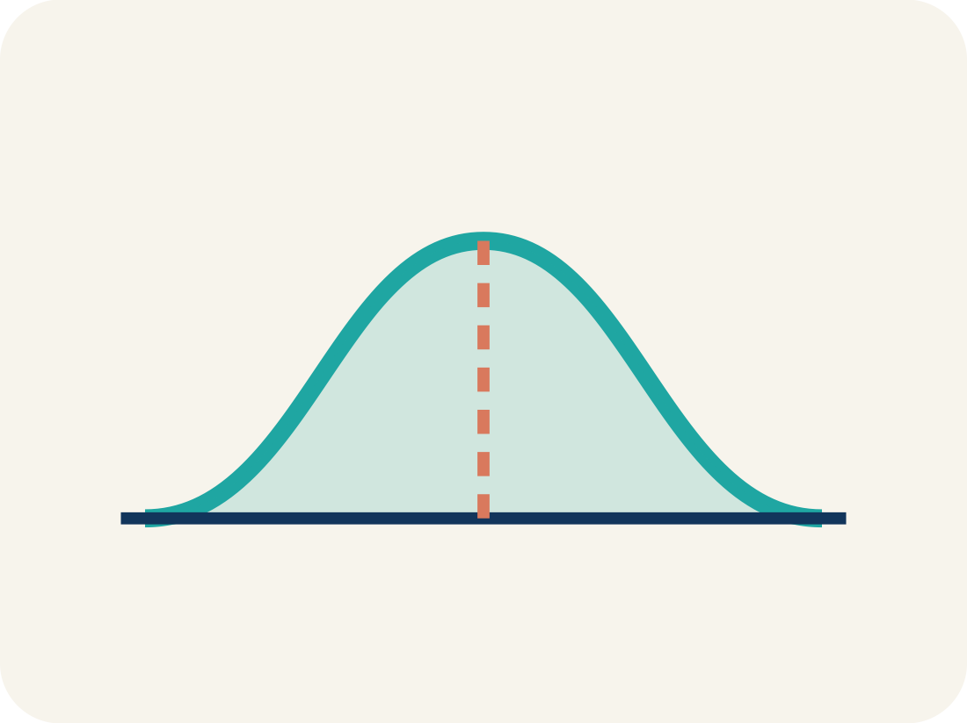
Vocabulary 5 of 6
Lesson 2-9 · Describe Data by Mean Absolute Deviation
Data distribution
How the data looks: where it sits and how spread out it is.
EXAMPLE · EXPLAIN WHY IT FITS
A set clustered tightly around the mean has low MAD; a set spread far from the mean has high MAD
Use “Data distribution” to explain the example. Point to
evidence.
eduwonderlab.com · Neft Teacher
12 / 46
Notes:
TEACH IN PRACTICE | Embedded facilitation | Lesson 2.9, slide 12 | VOCAB
Focus on the existing task: Vocabulary 5 of 6 Data distribution How the data…
ASK (T1/3/5): Where does “Data distribution” appear in the example? Explain the meaning without reading the definition. Partner: restate the idea and ask a clarifying question.
LOOK FOR: A correct connection between the word and a feature of the example. If the student only repeats the definition, invite pointing, sketching or oral rehearsal, then ask for another explanation of this same example.
PARTICIPATION (T5/6/7): Think time before volunteers; accept a written, drawn or rehearsed entry. Students ask for evidence respectfully. Recognize a specific contribution or revision and check that both partners participate.
Source: BCPS Updated Instructional Framework Rubric (June 2020), TEACH 1–7.

Slide 13
Vocabulary 6 of 6
Lesson 2-9 · Describe Data by Mean Absolute Deviation
Variability
How spread out the numbers are.
EXAMPLE · EXPLAIN WHY IT FITS
Low variability (MAD = 1): very consistent. High variability (MAD = 8): very spread out
Use “Variability” to explain the example. Point to evidence.
eduwonderlab.com · Neft Teacher
13 / 46
Notes:
TEACH IN PRACTICE | Embedded facilitation | Lesson 2.9, slide 13 | VOCAB
Focus on the existing task: Vocabulary 6 of 6 Variability How spread out the…
ASK (T1/3/5): Where does “Variability” appear in the example? Explain the meaning without reading the definition. Partner: restate the idea and ask a clarifying question.
LOOK FOR: A correct connection between the word and a feature of the example. If the student only repeats the definition, invite pointing, sketching or oral rehearsal, then ask for another explanation of this same example.
PARTICIPATION (T5/6/7): Think time before volunteers; accept a written, drawn or rehearsed entry. Students ask for evidence respectfully. Recognize a specific contribution or revision and check that both partners participate.
Source: BCPS Updated Instructional Framework Rubric (June 2020), TEACH 1–7.

Slide 14
Vocabulary
Lesson 2-9 · Describe Data by Mean Absolute Deviation
Today’s Math Words
We learn every word — what it means and what it looks like — before we use it.
Mean Absolute Deviation
Deviation
The average distance of data values from the mean; it describes spread
How far a number is from the mean
Absolute Value
Spread
How far a number is from zero
How far apart the numbers are
Data distribution
Variability
How the data looks: where it sits and how spread out it is
How spread out the numbers are
USE THE MATH WORDS · Use today’s math words in your explanation — not “it” and “that thing.”
eduwonderlab.com · Neft Teacher
14 / 46
Notes:
TEACH IN PRACTICE | Embedded facilitation | Lesson 2.9, slide 14 | VOCAB
Focus on the existing task: Vocabulary Today’s Math Words We learn every word…
ASK (T1/3/5): Where does “the displayed term” appear in the example? Explain the meaning without reading the definition. Partner: restate the idea and ask a clarifying question.
LOOK FOR: A correct connection between the word and a feature of the example. If the student only repeats the definition, invite pointing, sketching or oral rehearsal, then ask for another explanation of this same example.
PARTICIPATION (T5/6/7): Think time before volunteers; accept a written, drawn or rehearsed entry. Students ask for evidence respectfully. Recognize a specific contribution or revision and check that both partners participate.
Source: BCPS Updated Instructional Framework Rubric (June 2020), TEACH 1–7. Earlier notes and answer keys are retained below.
EARLIER NOTES / EXISTING ANSWER KEY
Choral-read each word, its meaning, and what it looks like.
Students should use these words out loud today — listen for them in partner talk and revoice student ideas with the academic term.
UIFR: TEACH 1 · TEACH 5.

Slide 15


Be Curious
How are they the same?
How are they different?
Mindset
HOW DO YOU KNOW? · Ask your partner “How do you know?” Answer by pointing to your own work.
How do you show your classmates that you are listening attentively to their explanations?
15 / 46
Notes:
TEACH IN PRACTICE | Embedded facilitation | Lesson 2.9, slide 15 | CURIOUS
Focus on the existing task: Be Curious How are they the same?
LAUNCH (T2/3/5): Allow quiet observation first. Separate a notice from an inference, invite students’ own questions, and follow the existing launch before teaching a procedure.
LOOK FOR (T4): Where this task addresses it, students can find the mean. Ask which feature of their work supports the claim.
RESPOND: If this task shows the lesson misconception—allowing positive and negative deviations to cancel—organize the original data into value, distance from mean, and total distance columns. Have the student revise and explain the change. Use this support only where the concept occurs in the current task; otherwise respond to the displayed question.
RECHECK: If a gap is shared, revisit the existing representation together. If it is limited, give targeted support while others compare valid methods on the same task. Check the revision before moving on.
PARTICIPATION (T5/6/7): Think time before volunteers; accept a written, drawn or rehearsed entry. Students ask for evidence respectfully. Recognize a specific contribution or revision and check that both partners participate.
Source: BCPS Updated Instructional Framework Rubric (June 2020), TEACH 1–7. Earlier notes and answer keys are retained below.
EARLIER NOTES / EXISTING ANSWER KEY
Accept all noticings and wonderings — there are no wrong answers here.
Give 20–30 seconds of quiet think time before taking responses; mix cold and warm calls so it is not always the same voices.
Read the mindset question aloud and let two students respond.
UIFR: TEACH 3 · TEACH 7.

Slide 16
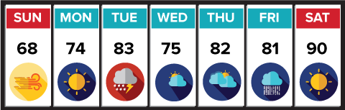
The forecast shows the expected high temperatures for a week. The mean high temperature for the week is 79°F. How can you describe the variation in high temperatures over the week?
Record your reasoning before the reveal. Compare, then explain any revision.
What do you notice about the high temperatures?
Reveal:
They vary from 68°F to 90°F.
16 / 46
Notes:
TEACH IN PRACTICE | Embedded facilitation | Lesson 2.9, slide 16 | REVEAL
Focus on the existing task: The forecast shows the expected high temperatures for a week. The mean high temperature for the week is 79°F. How can you describe the variation in high temperatures over the week?
LAUNCH (T2/3/5): If an existing answer cover is present, gather an attempt before revealing. If the explanation is already visible, ask students to reconstruct and justify it. Compare reasoning and explain a revision; preserve the reveal sequence.
LOOK FOR (T4): Where this task addresses it, students can find the mean. Ask which feature of their work supports the claim.
RESPOND: If this task shows the lesson misconception—allowing positive and negative deviations to cancel—organize the original data into value, distance from mean, and total distance columns. Have the student revise and explain the change. Use this support only where the concept occurs in the current task; otherwise respond to the displayed question.
RECHECK: If a gap is shared, revisit the existing representation together. If it is limited, give targeted support while others compare valid methods on the same task. Check the revision before moving on.
PARTICIPATION (T5/6/7): Think time before volunteers; accept a written, drawn or rehearsed entry. Students ask for evidence respectfully. Recognize a specific contribution or revision and check that both partners participate.
Source: BCPS Updated Instructional Framework Rubric (June 2020), TEACH 1–7. Earlier notes and answer keys are retained below.
EARLIER NOTES / EXISTING ANSWER KEY
Do not click yet: collect 2–3 student answers with reasons first.
Then click to remove the cover and have students compare their thinking to the reveal — “Is this what we said? Where is it different?”
Behind the cover: They vary from 68 ° F to 90 ° F.
UIFR: TEACH 3 · TEACH 4.
UIFR FULL | Lesson-specific facilitation
TEACH 2-3 | Session 1 task launch (UIFR PDF pp. 9-10).
Use the problem exactly as displayed. Give individual thinking time before discussion or advancing to the explanation. If the answer is already visible, ask students to reconstruct and justify it. Invite a choice of suitable representations and have students explain why their choice helps.
At the point where this concept appears, ask: “Why do we use distance from the mean, and what does the final average distance tell us?” Wait for evidence, invite another pathway, and have a student ask a follow-up question. Do not replace students’ reasoning with a sequence of leading steps.

Slide 17
The forecast shows the expected high temperatures for a week. The mean high temperature for the week is 79°F. How can you describe the variation in high temperatures over the week?
How do the high temperatures each day compare to the mean high temperature?
TRY IT BEFORE YOU’RE SURE · Start even if you are not sure. A revised answer counts as much as a first-try answer.
Reveal:
Some temperatures are below the mean, and some are above the mean.
17 / 46
Notes:
TEACH IN PRACTICE | Embedded facilitation | Lesson 2.9, slide 17 | REVEAL
Focus on the existing task: The forecast shows the expected high temperatures for a week. The mean high temperature for the week is 79°F. How can you describe the variation in high temperatures over the week?
LAUNCH (T2/3/5): If an existing answer cover is present, gather an attempt before revealing. If the explanation is already visible, ask students to reconstruct and justify it. Compare reasoning and explain a revision; preserve the reveal sequence.
LOOK FOR (T4): Where this task addresses it, students can find the mean. Ask which feature of their work supports the claim.
RESPOND: If this task shows the lesson misconception—allowing positive and negative deviations to cancel—organize the original data into value, distance from mean, and total distance columns. Have the student revise and explain the change. Use this support only where the concept occurs in the current task; otherwise respond to the displayed question.
RECHECK: If a gap is shared, revisit the existing representation together. If it is limited, give targeted support while others compare valid methods on the same task. Check the revision before moving on.
PARTICIPATION (T5/6/7): Think time before volunteers; accept a written, drawn or rehearsed entry. Students ask for evidence respectfully. Recognize a specific contribution or revision and check that both partners participate.
Source: BCPS Updated Instructional Framework Rubric (June 2020), TEACH 1–7. Earlier notes and answer keys are retained below.
EARLIER NOTES / EXISTING ANSWER KEY
Do not click yet: collect 2–3 student answers with reasons first.
Then click to remove the cover and have students compare their thinking to the reveal — “Is this what we said? Where is it different?”
Behind the cover: Some temperatures are below the mean, and some are above the mean.
UIFR: TEACH 3 · TEACH 4.

Slide 18
The mean absolute deviation describes by how much the values in a data set deviate, or differ, from the mean.
Record your reasoning before the reveal.
Compare, then explain any revision.
How can you determine by how much each value differs from the mean?
Reveal:
We can find the distance between each data value and the mean of the data.
18 / 46
Notes:
TEACH IN PRACTICE | Embedded facilitation | Lesson 2.9, slide 18 | REVEAL
Focus on the existing task: The mean absolute deviation describes by how much the values in a data set deviate, or differ, from the mean. How can you determine by how much each value differs from the mean?
LAUNCH (T2/3/5): If an existing answer cover is present, gather an attempt before revealing. If the explanation is already visible, ask students to reconstruct and justify it. Compare reasoning and explain a revision; preserve the reveal sequence.
LOOK FOR (T4): Where this task addresses it, students can find the mean. Ask which feature of their work supports the claim.
RESPOND: If this task shows the lesson misconception—allowing positive and negative deviations to cancel—organize the original data into value, distance from mean, and total distance columns. Have the student revise and explain the change. Use this support only where the concept occurs in the current task; otherwise respond to the displayed question.
RECHECK: If a gap is shared, revisit the existing representation together. If it is limited, give targeted support while others compare valid methods on the same task. Check the revision before moving on.
PARTICIPATION (T5/6/7): Think time before volunteers; accept a written, drawn or rehearsed entry. Students ask for evidence respectfully. Recognize a specific contribution or revision and check that both partners participate.
Source: BCPS Updated Instructional Framework Rubric (June 2020), TEACH 1–7. Earlier notes and answer keys are retained below.
EARLIER NOTES / EXISTING ANSWER KEY
Do not click yet: collect 2–3 student answers with reasons first.
Then click to remove the cover and have students compare their thinking to the reveal — “Is this what we said? Where is it different?”
Behind the cover: We can find the distance between each data value and the mean of the data.
UIFR: TEACH 3 · TEACH 4.

Slide 19

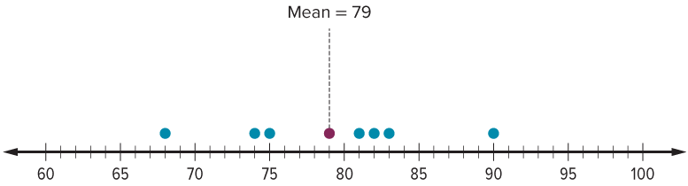
COLLABORATE · TALK IT THROUGH • AGREE ON A MODEL
Collaborate and Connect
Step 1: Let’s determine how much each value deviates from the mean.
The absolute deviation does not consider whether the value is above or below the mean.
By how much does each value deviate from the mean?
19 / 46
Notes:
TEACH IN PRACTICE | Embedded facilitation | Lesson 2.9, slide 19 | COLLABORATE
Focus on the existing task: Step 1: Let’s determine how much each value deviates from the mean. By how much does each value deviate from the mean?
LAUNCH (T2/3/5): Use the displayed question. Give private thinking time; then A explains while B asks for evidence. Switch roles. Each student records their own reasoning.
LOOK FOR (T4): Where this task addresses it, students can find the mean. Ask which feature of their work supports the claim.
RESPOND: If this task shows the lesson misconception—allowing positive and negative deviations to cancel—organize the original data into value, distance from mean, and total distance columns. Have the student revise and explain the change. Use this support only where the concept occurs in the current task; otherwise respond to the displayed question.
RECHECK: If a gap is shared, revisit the existing representation together. If it is limited, give targeted support while others compare valid methods on the same task. Check the revision before moving on.
PARTICIPATION (T5/6/7): Think time before volunteers; accept a written, drawn or rehearsed entry. Students ask for evidence respectfully. Recognize a specific contribution or revision and check that both partners participate.
Source: BCPS Updated Instructional Framework Rubric (June 2020), TEACH 1–7. Earlier notes and answer keys are retained below.
EARLIER NOTES / EXISTING ANSWER KEY
Routine: COLLABORATE · TALK IT THROUGH • AGREE ON A MODEL
UIFR FULL | Lesson-specific facilitation
TEACH 4-5 | Session 1 discussion and checkpoint (UIFR PDF pp. 11-12).
Collect a brief response from every student to the existing prompt before hearing volunteers. Partners take turns explaining and asking for evidence: “I understand ___; what supports ___?” Offer rehearsal or an annotated model for students who need language support. Each student records their own reasoning.
Look specifically for: allowing positive and negative deviations to cancel. If it appears, organize the original data into value, distance from mean, and total distance columns; then ask the student to revise the same response and explain the change. If evidence is secure, have students compare a second valid pathway or state why their approach works. Choose the next step from the responses, not a preset pace.

Slide 20
STUDENT MOVES
Lesson 2-9
Your move
TAKE TURNS · One explains, one asks a question. Then switch, so both of you talk.
20 / 46

Slide 21
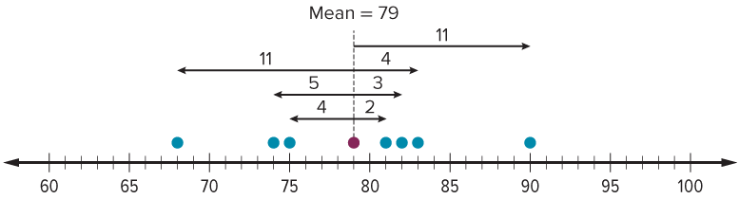
Given the absolute deviation of each data value, how do you think you can find the mean absolute deviation?
Record your reasoning before the reveal. Compare, then explain any revision.
Reveal:
We can find the mean of the absolute deviations.
21 / 46
Notes:
TEACH IN PRACTICE | Embedded facilitation | Lesson 2.9, slide 20 | REVEAL
Focus on the existing task: Given the absolute deviation of each data value, how do you think you can find the mean absolute deviation?
LAUNCH (T2/3/5): If an existing answer cover is present, gather an attempt before revealing. If the explanation is already visible, ask students to reconstruct and justify it. Compare reasoning and explain a revision; preserve the reveal sequence.
LOOK FOR (T4): Where this task addresses it, students can find the mean. Ask which feature of their work supports the claim.
RESPOND: If this task shows the lesson misconception—allowing positive and negative deviations to cancel—organize the original data into value, distance from mean, and total distance columns. Have the student revise and explain the change. Use this support only where the concept occurs in the current task; otherwise respond to the displayed question.
RECHECK: If a gap is shared, revisit the existing representation together. If it is limited, give targeted support while others compare valid methods on the same task. Check the revision before moving on.
PARTICIPATION (T5/6/7): Think time before volunteers; accept a written, drawn or rehearsed entry. Students ask for evidence respectfully. Recognize a specific contribution or revision and check that both partners participate.
Source: BCPS Updated Instructional Framework Rubric (June 2020), TEACH 1–7. Earlier notes and answer keys are retained below.
EARLIER NOTES / EXISTING ANSWER KEY
Do not click yet: collect 2–3 student answers with reasons first.
Then click to remove the cover and have students compare their thinking to the reveal — “Is this what we said? Where is it different?”
Behind the cover: We can find the mean of the absolute deviations.
UIFR: TEACH 3 · TEACH 4.

Slide 22
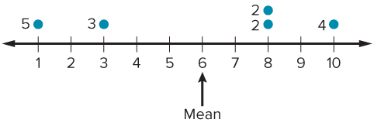
Let’s Explore More
Maria found the mean of the data set and the data distances from the mean. Explain how Maria can use this information to find the mean absolute deviation.
Workspace
Four students in the fourth grade are asked their ages. Each student is 8 years old. How does the data vary? What is the mean and mean absolute deviation of the data?
Workspace
22 / 46
Notes:
TEACH IN PRACTICE | Embedded facilitation | Lesson 2.9, slide 21 | PRACTICE
Focus on the existing task: What is the mean and mean absolute deviation of the data?
LAUNCH (T2/3/5): Use the displayed question. Give private thinking time; then A explains while B asks for evidence. Switch roles. Each student records their own reasoning.
LOOK FOR (T4): Where this task addresses it, students can find nonnegative distances from it. Ask which feature of their work supports the claim.
RESPOND: If this task shows the lesson misconception—allowing positive and negative deviations to cancel—organize the original data into value, distance from mean, and total distance columns. Have the student revise and explain the change. Use this support only where the concept occurs in the current task; otherwise respond to the displayed question.
RECHECK: If a gap is shared, revisit the existing representation together. If it is limited, give targeted support while others compare valid methods on the same task. Check the revision before moving on.
PARTICIPATION (T5/6/7): Think time before volunteers; accept a written, drawn or rehearsed entry. Students ask for evidence respectfully. Recognize a specific contribution or revision and check that both partners participate.
Source: BCPS Updated Instructional Framework Rubric (June 2020), TEACH 1–7. Earlier notes and answer keys are retained below.
EARLIER NOTES / EXISTING ANSWER KEY
Extension for partners or table groups — students choose their approach and use the workspace to show thinking.
Push with “Convince me,” and have two groups with different approaches share.
This is where students stretch past the worked example.
UIFR: TEACH 2 · TEACH 5.

Slide 23
STUDENT MOVES
Lesson 2-9
Your move
USE YOUR TOOLS · Reach for your notes, a model, or a manipulative before you reach for an answer.
23 / 46

Slide 24
LESSON 2.9 / DISCUSS THE TASK
Explain and compare
Use the task you just explored.
TAKE TURNS
Why do we use distance from the mean, and what does the final average distance tell us?
Explain
“I know this because…”
Ask
“Where does your work show that?”
Point to evidence in your work.
Then compare your approach with a partner’s.
JUSTIFY IT · Say it like this: “I know ______ because ______.”
Listen to understand. Ask for evidence. Make room for every voice.
Notes:
TEACH IN PRACTICE | Embedded facilitation | Lesson 2.9, slide 22 | PRIOR_INSERT
Focus on the existing task: Point to evidence in your work. Then compare your approach with a partner’s. TAKE TURNS Explain “I know this because…” Ask “Where does your work show that?
CONNECT (T1/4): Ask students to restate the displayed goal or key idea and connect it to earlier work. Relevant lesson evidence: find the mean; find nonnegative distances from it; average those distances; interpret MAD. Use only the criterion that matches the current session.
SHOW PROGRESS: Students point to their own existing work, explain what improved after feedback, and name a next step. Pair confidence ratings with actual evidence.
PARTICIPATION (T5/6/7): Think time before volunteers; accept a written, drawn or rehearsed entry. Students ask for evidence respectfully. Recognize a specific contribution or revision and check that both partners participate.
Source: BCPS Updated Instructional Framework Rubric (June 2020), TEACH 1–7.

Slide 25
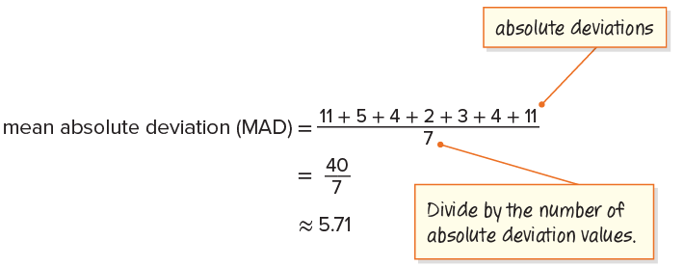
What does the mean absolute deviation describe?
ADD ON · Add on: “I agree because ______.” or “I see it differently because ______.”
Reveal:
It describes that each data value is about 5.71 degrees above or below the mean of 79 degrees.
25 / 46
Notes:
TEACH IN PRACTICE | Embedded facilitation | Lesson 2.9, slide 23 | REVEAL
Focus on the existing task: Reveal: It describes that each data value is about 5.71 degrees above or below the mean of 79 degrees. What does the mean absolute deviation describe?
LAUNCH (T2/3/5): If an existing answer cover is present, gather an attempt before revealing. If the explanation is already visible, ask students to reconstruct and justify it. Compare reasoning and explain a revision; preserve the reveal sequence.
LOOK FOR (T4): Where this task addresses it, students can find the mean. Ask which feature of their work supports the claim.
RESPOND: If this task shows the lesson misconception—allowing positive and negative deviations to cancel—organize the original data into value, distance from mean, and total distance columns. Have the student revise and explain the change. Use this support only where the concept occurs in the current task; otherwise respond to the displayed question.
RECHECK: If a gap is shared, revisit the existing representation together. If it is limited, give targeted support while others compare valid methods on the same task. Check the revision before moving on.
PARTICIPATION (T5/6/7): Think time before volunteers; accept a written, drawn or rehearsed entry. Students ask for evidence respectfully. Recognize a specific contribution or revision and check that both partners participate.
Source: BCPS Updated Instructional Framework Rubric (June 2020), TEACH 1–7.

Slide 26
Session 2 Warm-Up
Lesson 2-9 · Describe Data by Mean Absolute Deviation
Session 2 Warm-Up
Quick review from Session 1 · about 4 minutes
1
What does MAD stand for?
2
MAD measures the average distance of values from:
A
Median Area Data
A
Zero
B
Mean Absolute Deviation
B
The mean
C
Maximum Array Division
C
The median
D
Middle And Distance
D
The maximum
3
If mean = 20, what is the absolute deviation of 15?
4
A smaller MAD indicates that data values are:
A
−5
A
More spread out
B
5
B
More clustered near the mean
C
15
C
All negative
D
35
D
Equal to zero
eduwonderlab.com · Neft Teacher
26 / 46
Notes:
TEACH IN PRACTICE | Embedded facilitation | Lesson 2.9, slide 24 | WARMUP
Focus on the existing task: Session 2 Warm-Up Session 2 Warm-Up Quick review from Session 1 · about 4 minutes 1 What does MAD stand for?
GATHER EVIDENCE (T4/6): Keep the original items. Students try independently, mark an uncertain item, and explain one method before checking. Use the existing key when present.
RESPOND: Distinguish a calculation slip from a reasoning gap. Give one next step on the same item; have students revise in a second color. Use the responses to choose flexible support for today’s lesson.
PARTICIPATION (T5/6/7): Think time before volunteers; accept a written, drawn or rehearsed entry. Students ask for evidence respectfully. Recognize a specific contribution or revision and check that both partners participate.
Source: BCPS Updated Instructional Framework Rubric (June 2020), TEACH 1–7. Earlier notes and answer keys are retained below.
EARLIER NOTES / EXISTING ANSWER KEY
Warm-up routine: students start silently on entry; keep it to about 4 minutes.
Circulate and note who is stuck — use what you see to choose who you check on first today.
Go over answers quickly; ask one student to explain a step, not just say the answer.
UIFR: TEACH 4 · TEACH 6.
UIFR FULL | Lesson-specific facilitation
TEACH 1 | Session 2 purpose and evidence (UIFR PDF p. 8).
Have students restate the displayed session goal in their own words and connect it to the existing context or a familiar experience they choose to share. Use the current session goal to select from these lesson-wide evidence criteria; do not frontload a later-session procedure.
Look for: find the mean; find nonnegative distances from it; average those distances; interpret MAD. Ask: “Which part of your work would show this?” Revisit that evidence after the task; a confidence rating alone is not evidence of understanding.

Slide 27
STUDENT MOVES
Lesson 2-9
Your move
YOU KNOW THE ROUTINE · Read → plan → solve → check. Do all four, in that order.
27 / 46

Slide 28
Review Notes
Lesson 2-9 · Describe Data by Mean Absolute Deviation
Review Notes — Session 2
Copy. Explain. Check.
WHY IT MATTERS · Finish this: “This is worth knowing because ______.”
MAD Definition
1
The Mean Absolute Deviation is the average distance between each data value and the mean.
Three Steps to MAD
2
1. Find the mean. 2. Calculate |value − mean| for each point. 3. Find the mean of those distances.
Interpreting MAD
3
A lower MAD signifies higher consistency and less variation in the data.
eduwonderlab.com · Neft Teacher
28 / 46
Notes:
TEACH IN PRACTICE | Embedded facilitation | Lesson 2.9, slide 25 | NOTES
Focus on the existing task: Review Notes Review Notes — Session 2 Copy into…
ROUTINE (T1/2/4): Read or copy the original notes, cover one line, and explain it using the displayed example. Reopen and correct. Copying alone is not evidence of understanding.
LOOK FOR: A link between a symbol, quantity or feature and the explanation. If missing, point back to that feature and have the student try again; fade the prompt once they can explain.
PARTICIPATION (T5/6/7): Think time before volunteers; accept a written, drawn or rehearsed entry. Students ask for evidence respectfully. Recognize a specific contribution or revision and check that both partners participate.
Source: BCPS Updated Instructional Framework Rubric (June 2020), TEACH 1–7. Earlier notes and answer keys are retained below.
EARLIER NOTES / EXISTING ANSWER KEY
Copy routine: read one line at a time; students copy, then explain that line to a partner.
Keep it brisk — the understanding work happens in the examples, not the copying.
UIFR: TEACH 1 · TEACH 6.

Slide 29
Session 2
Describe Data by Mean Absolute Deviation
SELF-CHECK · Mark it: ✓ got it · ~ almost · ? stuck. Then fix one thing before we move on.
29 / 46
Notes:
TEACH IN PRACTICE | Embedded facilitation | Lesson 2.9, slide 26 | DIVIDER
Focus on the existing task: Describe Data by Mean Absolute Deviation Session 2
TRANSITION (T6/7): Students confirm materials, roles, how to request help, and the next response routine. Ask a student to restate it. Keep teacher-only slides hidden.
PARTICIPATION (T5/6/7): Think time before volunteers; accept a written, drawn or rehearsed entry. Students ask for evidence respectfully. Recognize a specific contribution or revision and check that both partners participate.
Source: BCPS Updated Instructional Framework Rubric (June 2020), TEACH 1–7. Earlier notes and answer keys are retained below.
EARLIER NOTES / EXISTING ANSWER KEY
Transition cue: state what materials are out and what success looks like this session.
Keep the changeover under a minute.
UIFR: TEACH 6.

Slide 30
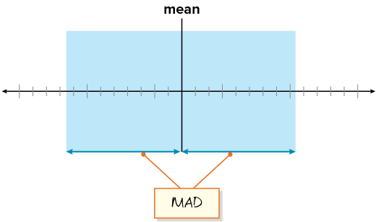
Be Curious
ANOTHER PATHWAY · Did anyone get there a different way? Put both pathways side by side and compare.
What do you notice?
What do you wonder?
Mindset
How are you showing your classmates that you are listening attentively to their explanations?
30 / 46
Notes:
TEACH IN PRACTICE | Embedded facilitation | Lesson 2.9, slide 27 | CURIOUS
Focus on the existing task: Be Curious What do you notice?
LAUNCH (T2/3/5): Allow quiet observation first. Separate a notice from an inference, invite students’ own questions, and follow the existing launch before teaching a procedure.
LOOK FOR (T4): Where this task addresses it, students can find the mean. Ask which feature of their work supports the claim.
RESPOND: If this task shows the lesson misconception—allowing positive and negative deviations to cancel—organize the original data into value, distance from mean, and total distance columns. Have the student revise and explain the change. Use this support only where the concept occurs in the current task; otherwise respond to the displayed question.
RECHECK: If a gap is shared, revisit the existing representation together. If it is limited, give targeted support while others compare valid methods on the same task. Check the revision before moving on.
PARTICIPATION (T5/6/7): Think time before volunteers; accept a written, drawn or rehearsed entry. Students ask for evidence respectfully. Recognize a specific contribution or revision and check that both partners participate.
Source: BCPS Updated Instructional Framework Rubric (June 2020), TEACH 1–7. Earlier notes and answer keys are retained below.
EARLIER NOTES / EXISTING ANSWER KEY
Accept all noticings and wonderings — there are no wrong answers here.
Give 20–30 seconds of quiet think time before taking responses; mix cold and warm calls so it is not always the same voices.
Read the mindset question aloud and let two students respond.
UIFR: TEACH 3 · TEACH 7.

Slide 31
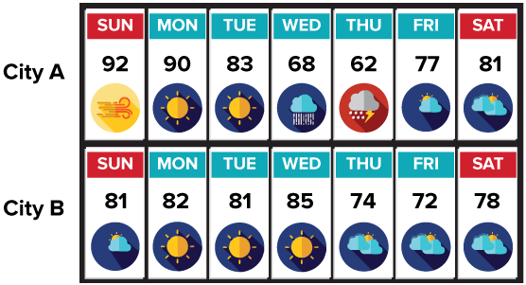
The forecasted high temperatures for two cities are shown. The mean forecasted high temperature for each city is 79°F. Which city will have less variation in the high temperatures?
What do you know about the forecasted temperatures in each city?
Reveal:
Both cities have a forecasted mean high temperature of 79°F. City A’s temperatures range from 62°F to 92°F, while City B’s temperatures range from 72°F to 85°F.
31 / 46
Notes:
TEACH IN PRACTICE | Embedded facilitation | Lesson 2.9, slide 28 | REVEAL
Focus on the existing task: The forecasted high temperatures for two cities are shown. The mean forecasted high temperature for each city is 79°F. Which city will have less variation in the high temperatures?
LAUNCH (T2/3/5): If an existing answer cover is present, gather an attempt before revealing. If the explanation is already visible, ask students to reconstruct and justify it. Compare reasoning and explain a revision; preserve the reveal sequence.
LOOK FOR (T4): Where this task addresses it, students can find the mean. Ask which feature of their work supports the claim.
RESPOND: If this task shows the lesson misconception—allowing positive and negative deviations to cancel—organize the original data into value, distance from mean, and total distance columns. Have the student revise and explain the change. Use this support only where the concept occurs in the current task; otherwise respond to the displayed question.
RECHECK: If a gap is shared, revisit the existing representation together. If it is limited, give targeted support while others compare valid methods on the same task. Check the revision before moving on.
PARTICIPATION (T5/6/7): Think time before volunteers; accept a written, drawn or rehearsed entry. Students ask for evidence respectfully. Recognize a specific contribution or revision and check that both partners participate.
Source: BCPS Updated Instructional Framework Rubric (June 2020), TEACH 1–7. Earlier notes and answer keys are retained below.
EARLIER NOTES / EXISTING ANSWER KEY
Do not click yet: collect 2–3 student answers with reasons first.
Then click to remove the cover and have students compare their thinking to the reveal — “Is this what we said? Where is it different?”
Behind the cover: Both cities have a forecasted mean high temperature of 79 ° F. City A’s temperatures range from 62 ° F to 92 ° F, while City B’s temperatures range from 72 ° F to 85 ° F.
UIFR: TEACH 3 · TEACH 4.
UIFR FULL | Lesson-specific facilitation
TEACH 2-3 | Session 2 task launch (UIFR PDF pp. 9-10).
Use the problem exactly as displayed. Give individual thinking time before discussion or advancing to the explanation. If the answer is already visible, ask students to reconstruct and justify it. Invite a choice of suitable representations and have students explain why their choice helps.
At the point where this concept appears, ask: “Why do we use distance from the mean, and what does the final average distance tell us?” Wait for evidence, invite another pathway, and have a student ask a follow-up question. Do not replace students’ reasoning with a sequence of leading steps.

Slide 32
STUDENT MOVES
Lesson 2-9
Your move
TWO MINUTES SOLO · Two minutes on your own, then compare. Bring one thing you tried, even if it did not work.
32 / 46

Slide 33
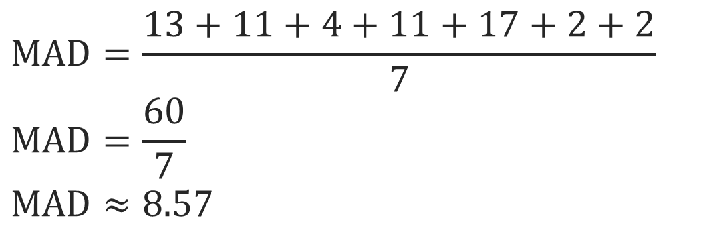
Let’s add the absolute deviations and divide the sum by the number of deviations.
The mean absolute deviation of City A is 8.57°F.
Explain how the information
shown supports your reasoning.
33 / 46
Notes:
TEACH IN PRACTICE | Embedded facilitation | Lesson 2.9, slide 29 | WORKED
Focus on the existing task: Let’s add the absolute deviations and divide the sum by the number of deviations. The mean absolute deviation of City A is 8.57°F.
LAUNCH (T2/3/5): Ask students to explain the displayed idea or example and point to evidence. When a calculation step is shown, ask why it is valid. Have a partner restate the explanation; copying is not the check.
LOOK FOR (T4): Where this task addresses it, students can find the mean. Ask which feature of their work supports the claim.
RESPOND: If this task shows the lesson misconception—allowing positive and negative deviations to cancel—organize the original data into value, distance from mean, and total distance columns. Have the student revise and explain the change. Use this support only where the concept occurs in the current task; otherwise respond to the displayed question.
RECHECK: If a gap is shared, revisit the existing representation together. If it is limited, give targeted support while others compare valid methods on the same task. Check the revision before moving on.
PARTICIPATION (T5/6/7): Think time before volunteers; accept a written, drawn or rehearsed entry. Students ask for evidence respectfully. Recognize a specific contribution or revision and check that both partners participate.
Source: BCPS Updated Instructional Framework Rubric (June 2020), TEACH 1–7. Earlier notes and answer keys are retained below.
EARLIER NOTES / EXISTING ANSWER KEY
Model briefly, then hand the thinking back: ask “Why does this step work?” before showing the next one.
Quick check before moving on — thumbs or whiteboards from everyone, not volunteers.
UIFR: TEACH 2 · TEACH 3 · TEACH 4.

Slide 34
City A
MAD = 8.57
City B
MAD = 3.71
How do the mean absolute deviations compare?
STRUGGLE FIRST · Work on your own first. Stuck is allowed — try a second strategy before you ask.
Reveal:
The MAD for City A is greater than the MAD for City B.
34 / 46
Notes:
TEACH IN PRACTICE | Embedded facilitation | Lesson 2.9, slide 30 | REVEAL
Focus on the existing task: City A MAD = 8.57 City B MAD = 3.71 How do the mean absolute deviations compare?
LAUNCH (T2/3/5): If an existing answer cover is present, gather an attempt before revealing. If the explanation is already visible, ask students to reconstruct and justify it. Compare reasoning and explain a revision; preserve the reveal sequence.
LOOK FOR (T4): Where this task addresses it, students can find the mean. Ask which feature of their work supports the claim.
RESPOND: If this task shows the lesson misconception—allowing positive and negative deviations to cancel—organize the original data into value, distance from mean, and total distance columns. Have the student revise and explain the change. Use this support only where the concept occurs in the current task; otherwise respond to the displayed question.
RECHECK: If a gap is shared, revisit the existing representation together. If it is limited, give targeted support while others compare valid methods on the same task. Check the revision before moving on.
PARTICIPATION (T5/6/7): Think time before volunteers; accept a written, drawn or rehearsed entry. Students ask for evidence respectfully. Recognize a specific contribution or revision and check that both partners participate.
Source: BCPS Updated Instructional Framework Rubric (June 2020), TEACH 1–7. Earlier notes and answer keys are retained below.
EARLIER NOTES / EXISTING ANSWER KEY
Do not click yet: collect 2–3 student answers with reasons first.
Then click to remove the cover and have students compare their thinking to the reveal — “Is this what we said? Where is it different?”
Behind the cover: The MAD for City A is greater than the MAD for City B.
UIFR: TEACH 3 · TEACH 4.

Slide 35
Let’s Explore More
What do you notice about the absolute deviations for each city that can help you determine which data set will have a greater mean absolute deviation?
City A MAD = 8.57
City B MAD = 3.71
Absolute Deviations
Absolute Deviations
Try it yourself. Compare your
work with a partner; explain one
choice and revise.
Workspace
35 / 46
Notes:
TEACH IN PRACTICE | Embedded facilitation | Lesson 2.9, slide 31 | PRACTICE
Focus on the existing task: Let’s Explore More What do you notice about the absolute deviations for each city that can help you determine which data set will have a greater mean absolute deviation?
LAUNCH (T2/3/5): Use the displayed question. Give private thinking time; then A explains while B asks for evidence. Switch roles. Each student records their own reasoning.
LOOK FOR (T4): Where this task addresses it, students can find the mean. Ask which feature of their work supports the claim.
RESPOND: If this task shows the lesson misconception—allowing positive and negative deviations to cancel—organize the original data into value, distance from mean, and total distance columns. Have the student revise and explain the change. Use this support only where the concept occurs in the current task; otherwise respond to the displayed question.
RECHECK: If a gap is shared, revisit the existing representation together. If it is limited, give targeted support while others compare valid methods on the same task. Check the revision before moving on.
PARTICIPATION (T5/6/7): Think time before volunteers; accept a written, drawn or rehearsed entry. Students ask for evidence respectfully. Recognize a specific contribution or revision and check that both partners participate.
Source: BCPS Updated Instructional Framework Rubric (June 2020), TEACH 1–7. Earlier notes and answer keys are retained below.
EARLIER NOTES / EXISTING ANSWER KEY
Extension for partners or table groups — students choose their approach and use the workspace to show thinking.
Push with “Convince me,” and have two groups with different approaches share.
This is where students stretch past the worked example.
UIFR: TEACH 2 · TEACH 5.
UIFR FULL | Lesson-specific facilitation
TEACH 4-5 | Session 2 discussion and checkpoint (UIFR PDF pp. 11-12).
Collect a brief response from every student to the existing prompt before hearing volunteers. Partners take turns explaining and asking for evidence: “I understand ___; what supports ___?” Offer rehearsal or an annotated model for students who need language support. Each student records their own reasoning.
Look specifically for: allowing positive and negative deviations to cancel. If it appears, organize the original data into value, distance from mean, and total distance columns; then ask the student to revise the same response and explain the change. If evidence is secure, have students compare a second valid pathway or state why their approach works. Choose the next step from the responses, not a preset pace.

Slide 36
Let’s Explore More
How are the mean absolute deviation and interquartile range similar and how are they different?
Try it yourself. Compare your
work with a partner; explain one
choice and revise.
Workspace
36 / 46
Notes:
TEACH IN PRACTICE | Embedded facilitation | Lesson 2.9, slide 32 | PRACTICE
Focus on the existing task: Let’s Explore More How are the mean absolute deviation and interquartile range similar and how are they different?
LAUNCH (T2/3/5): Use the displayed question. Give private thinking time; then A explains while B asks for evidence. Switch roles. Each student records their own reasoning.
LOOK FOR (T4): Where this task addresses it, students can find the mean. Ask which feature of their work supports the claim.
RESPOND: If this task shows the lesson misconception—allowing positive and negative deviations to cancel—organize the original data into value, distance from mean, and total distance columns. Have the student revise and explain the change. Use this support only where the concept occurs in the current task; otherwise respond to the displayed question.
RECHECK: If a gap is shared, revisit the existing representation together. If it is limited, give targeted support while others compare valid methods on the same task. Check the revision before moving on.
PARTICIPATION (T5/6/7): Think time before volunteers; accept a written, drawn or rehearsed entry. Students ask for evidence respectfully. Recognize a specific contribution or revision and check that both partners participate.
Source: BCPS Updated Instructional Framework Rubric (June 2020), TEACH 1–7. Earlier notes and answer keys are retained below.
EARLIER NOTES / EXISTING ANSWER KEY
Extension for partners or table groups — students choose their approach and use the workspace to show thinking.
Push with “Convince me,” and have two groups with different approaches share.
This is where students stretch past the worked example.
UIFR: TEACH 2 · TEACH 5.

Slide 37
LESSON 2.9 / CHECK YOUR WORK
Pause. Check. Improve.
CHECK
A mistake to watch for: allowing positive and negative deviations to cancel.
TRY
Organize the given data into value, distance from mean, and total distance columns.
REVISE
Use that check on the task you just completed. Correct or strengthen one part, and explain why.
REVISE NOW · Change one answer and write why you changed it. A revision is evidence of learning.
Listen to understand. Ask for evidence. Make room for every voice.
Notes:
TEACH IN PRACTICE | Embedded facilitation | Lesson 2.9, slide 33 | PRIOR_INSERT
Focus on the existing task: LESSON 2.9 / CHECK YOUR WORK Pause. Check. Improve. Listen to understand. Ask for evidence. Make room for every voice. CHECK A mistake…
CONNECT (T1/4): Ask students to restate the displayed goal or key idea and connect it to earlier work. Relevant lesson evidence: find the mean; find nonnegative distances from it; average those distances; interpret MAD. Use only the criterion that matches the current session.
SHOW PROGRESS: Students point to their own existing work, explain what improved after feedback, and name a next step. Pair confidence ratings with actual evidence.
PARTICIPATION (T5/6/7): Think time before volunteers; accept a written, drawn or rehearsed entry. Students ask for evidence respectfully. Recognize a specific contribution or revision and check that both partners participate.
Source: BCPS Updated Instructional Framework Rubric (June 2020), TEACH 1–7.

Slide 38
Both cities have a forecasted mean high temperature of 79°F. City A’s temperatures range from 62°F to 92°F, while City B’s temperatures range from 72°F to 85°F.
How can you use the mean absolute deviation to verify your assumption?
Compare your reasoning with the
explanation. Explain any revision
you make.
Reveal:
We can find the MAD for each city and compare them.
38 / 46
Notes:
TEACH IN PRACTICE | Embedded facilitation | Lesson 2.9, slide 34 | REVEAL
Focus on the existing task: How can you use the mean absolute deviation to verify your assumption?
LAUNCH (T2/3/5): If an existing answer cover is present, gather an attempt before revealing. If the explanation is already visible, ask students to reconstruct and justify it. Compare reasoning and explain a revision; preserve the reveal sequence.
LOOK FOR (T4): Where this task addresses it, students can find the mean. Ask which feature of their work supports the claim.
RESPOND: If this task shows the lesson misconception—allowing positive and negative deviations to cancel—organize the original data into value, distance from mean, and total distance columns. Have the student revise and explain the change. Use this support only where the concept occurs in the current task; otherwise respond to the displayed question.
RECHECK: If a gap is shared, revisit the existing representation together. If it is limited, give targeted support while others compare valid methods on the same task. Check the revision before moving on.
PARTICIPATION (T5/6/7): Think time before volunteers; accept a written, drawn or rehearsed entry. Students ask for evidence respectfully. Recognize a specific contribution or revision and check that both partners participate.
Source: BCPS Updated Instructional Framework Rubric (June 2020), TEACH 1–7.

Slide 39
Both cities have a mean forecasted high temperature of 79°F.
We can compare the mean absolute deviations for the cities.
What operation can you use to find the absolute deviation for each value? Explain.
Reveal:
Because we want to find how much each value differs from the mean, we can use subtraction to find the difference between each value and the mean.
39 / 46
Notes:
TEACH IN PRACTICE | Embedded facilitation | Lesson 2.9, slide 35 | REVEAL
Focus on the existing task: What operation can you use to find the absolute deviation for each value?
LAUNCH (T2/3/5): If an existing answer cover is present, gather an attempt before revealing. If the explanation is already visible, ask students to reconstruct and justify it. Compare reasoning and explain a revision; preserve the reveal sequence.
LOOK FOR (T4): Where this task addresses it, students can find the mean. Ask which feature of their work supports the claim.
RESPOND: If this task shows the lesson misconception—allowing positive and negative deviations to cancel—organize the original data into value, distance from mean, and total distance columns. Have the student revise and explain the change. Use this support only where the concept occurs in the current task; otherwise respond to the displayed question.
RECHECK: If a gap is shared, revisit the existing representation together. If it is limited, give targeted support while others compare valid methods on the same task. Check the revision before moving on.
PARTICIPATION (T5/6/7): Think time before volunteers; accept a written, drawn or rehearsed entry. Students ask for evidence respectfully. Recognize a specific contribution or revision and check that both partners participate.
Source: BCPS Updated Instructional Framework Rubric (June 2020), TEACH 1–7.

Slide 40
STUDENT MOVES
Lesson 2-9
Your move
PROVE IT · Find the evidence in the problem that makes your answer right — not just the answer.
40 / 46

Slide 41
SUMMARIZE · SAY IT IN YOUR OWN WORDS
Summarize: Describe Data by Mean Absolute Deviation
Mean absolute deviation is a measure of variation. It is the mean of all the absolute deviations, or the absolute difference between each value and the mean.
The greater the mean absolute deviation, the greater the spread of the data.
ASK THE CLASS · Write one question about this that you could ask the class.
41 / 46
Notes:
TEACH IN PRACTICE | Embedded facilitation | Lesson 2.9, slide 36 | SUMMARIZE
Focus on the existing task: Mean absolute deviation is a measure of variation. It is the mean of all the absolute deviations, or the absolute difference between each…
CONNECT (T1/4): Ask students to restate the displayed goal or key idea and connect it to earlier work. Relevant lesson evidence: find the mean; find nonnegative distances from it; average those distances; interpret MAD. Use only the criterion that matches the current session.
SHOW PROGRESS: Students point to their own existing work, explain what improved after feedback, and name a next step. Pair confidence ratings with actual evidence.
PARTICIPATION (T5/6/7): Think time before volunteers; accept a written, drawn or rehearsed entry. Students ask for evidence respectfully. Recognize a specific contribution or revision and check that both partners participate.
Source: BCPS Updated Instructional Framework Rubric (June 2020), TEACH 1–7. Earlier notes and answer keys are retained below.
EARLIER NOTES / EXISTING ANSWER KEY
Routine: SUMMARIZE · SAY IT IN YOUR OWN WORDS

Slide 42
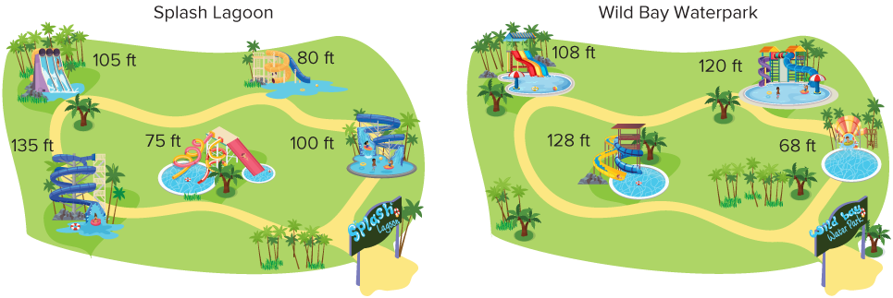
APPLY · PLAN IT • SOLVE IT • PROVE IT
Apply: Water Parks
Andrew and his friends want to visit a waterpark, but Andrew must take his younger sister who is 8 years old and can only ride waterslides that are less than 100 feet high.
Question: Which waterpark should they visit? Include the heights of the slides at the two parks in your recommendation.
42 / 46
Notes:
TEACH IN PRACTICE | Embedded facilitation | Lesson 2.9, slide 37 | APPLY
Focus on the existing task: Apply: Water Parks Andrew and his friends want to visit a waterpark, but Andrew must take his younger sister who is 8 years old and can…
LAUNCH (T2/3/5): Use the exact application task independently first. Ask students to justify their choice of method. Collect evidence before a partner discussion or correction.
LOOK FOR (T4): Where this task addresses it, students can find the mean. Ask which feature of their work supports the claim.
RESPOND: If this task shows the lesson misconception—allowing positive and negative deviations to cancel—organize the original data into value, distance from mean, and total distance columns. Have the student revise and explain the change. Use this support only where the concept occurs in the current task; otherwise respond to the displayed question.
RECHECK: If a gap is shared, revisit the existing representation together. If it is limited, give targeted support while others compare valid methods on the same task. Check the revision before moving on.
PARTICIPATION (T5/6/7): Think time before volunteers; accept a written, drawn or rehearsed entry. Students ask for evidence respectfully. Recognize a specific contribution or revision and check that both partners participate.
Source: BCPS Updated Instructional Framework Rubric (June 2020), TEACH 1–7. Earlier notes and answer keys are retained below.
EARLIER NOTES / EXISTING ANSWER KEY
Routine: APPLY · PLAN IT • SOLVE IT • PROVE IT
UIFR FULL | Lesson-specific facilitation
TEACH 4 | Independent evidence and revision (UIFR PDF p. 11).
Use the existing application/exit problem as the independent check. If this is a learning-target slide, have students point to and explain their work on the preceding task. Separate initial independent evidence from the revision after feedback.
Check the relevant criteria: find the mean; find nonnegative distances from it; average those distances; interpret MAD. Respond with one specific next step tied to the work. Students revise and annotate what changed, then identify a criterion they can now demonstrate and one they still need to practice.

Slide 43
STUDENT MOVES
Lesson 2-9
Your move
RESTATE FIRST · Restate your partner’s idea in your own words before you give yours.
43 / 46

Slide 44
Learning Targets
I can determine the mean absolute deviation (MAD) of a data set.
I can compare data sets using the mean absolute deviation.
I can explain the concept of mean absolute deviation and how to determine it for a data set.
NAME THE MATH · Point to the part of this that is new today, and say what it changes.
44 / 46
Notes:
TEACH IN PRACTICE | Embedded facilitation | Lesson 2.9, slide 38 | REFLECTION
Focus on the existing task: Learning Targets I can determine the mean absolute deviation (MAD) of a data set. I can compare data sets using the mean absolute deviation.
CONNECT (T1/4): Ask students to restate the displayed goal or key idea and connect it to earlier work. Relevant lesson evidence: find the mean; find nonnegative distances from it; average those distances; interpret MAD. Use only the criterion that matches the current session.
SHOW PROGRESS: Students point to their own existing work, explain what improved after feedback, and name a next step. Pair confidence ratings with actual evidence.
PARTICIPATION (T5/6/7): Think time before volunteers; accept a written, drawn or rehearsed entry. Students ask for evidence respectfully. Recognize a specific contribution or revision and check that both partners participate.
Source: BCPS Updated Instructional Framework Rubric (June 2020), TEACH 1–7. Earlier notes and answer keys are retained below.
EARLIER NOTES / EXISTING ANSWER KEY
Read each target; students self-rate with fist-to-five or thumbs.
Tie back to the goal from the start of class: did we get there?
Note any target that rates low — revisit it tomorrow.
UIFR: TEACH 1 · TEACH 4.

Slide 45
Learning Targets
I can determine the mean absolute deviation (MAD) of a data set.
I can compare data sets using the mean absolute deviation.
I can explain the concept of mean absolute deviation and how to determine it for a data set.
SAY THE GOAL · Say today’s goal in your own words, then name one place this shows up outside math class.
45 / 46
Notes:
TEACH IN PRACTICE | Embedded facilitation | Lesson 2.9, slide 39 | REFLECTION
Focus on the existing task: Learning Targets I can determine the mean absolute deviation (MAD) of a data set. I can compare data sets using the mean absolute deviation.
CONNECT (T1/4): Ask students to restate the displayed goal or key idea and connect it to earlier work. Relevant lesson evidence: find the mean; find nonnegative distances from it; average those distances; interpret MAD. Use only the criterion that matches the current session.
SHOW PROGRESS: Students point to their own existing work, explain what improved after feedback, and name a next step. Pair confidence ratings with actual evidence.
PARTICIPATION (T5/6/7): Think time before volunteers; accept a written, drawn or rehearsed entry. Students ask for evidence respectfully. Recognize a specific contribution or revision and check that both partners participate.
Source: BCPS Updated Instructional Framework Rubric (June 2020), TEACH 1–7. Earlier notes and answer keys are retained below.
EARLIER NOTES / EXISTING ANSWER KEY
UIFR FULL | Lesson-specific facilitation
REFLECT & ADJUST 1-2 | After the lesson (UIFR PDF pp. 15-16).
Sort the existing work by demonstrated reasoning, partial understanding, and the specific misconception: allowing positive and negative deviations to cancel. Compare the initial response with the revision. Record which teaching move plausibly helped, which did not, and whose participation or access needs a different approach; do not record sensitive student details in this shared deck.
Plan the next lesson from that evidence: if the misconception persists, organize the original data into value, distance from mean, and total distance columns using the current example before returning to the next grade-level task; if understanding is secure, use an existing extension or ask for a general explanation. Check the targeted idea again at the next warm-up.
Ask students what supported their thinking and what would help next time. Identify one change to try and one successful practice to retain. Seek colleague feedback on anonymized work when useful; these prompts support reflection and do not establish an evaluation rating. Source: Baltimore City Public Schools, Updated Instructional Framework Rubric, June 2020 (UIFR_Full.pdf).

Slide 46
LESSON 2.9 / REFLECT ON YOUR LEARNING
Show your progress
1 SHOW EVIDENCE
2 CHOOSE A NEXT STEP
Choose one response. Point to the part that shows your reasoning.
Name a change you made after feedback—or a question you still have.
“My work shows ___ because ___.”
“Next time, I will ___ to help me ___.”
Today’s focus: Find the mean.
CREDIT A CLASSMATE · Name one classmate whose idea helped you today, and say what they said.
Listen to understand. Ask for evidence. Make room for every voice.
Notes:
TEACH IN PRACTICE | Embedded facilitation | Lesson 2.9, slide 40 | PRIOR_INSERT
Focus on the existing task: LESSON 2.9 / REFLECT ON YOUR LEARNING Show your progress Listen to understand. Ask for evidence. Make room for every voice. 1 SHOW…
CONNECT (T1/4): Ask students to restate the displayed goal or key idea and connect it to earlier work. Relevant lesson evidence: find the mean; find nonnegative distances from it; average those distances; interpret MAD. Use only the criterion that matches the current session.
SHOW PROGRESS: Students point to their own existing work, explain what improved after feedback, and name a next step. Pair confidence ratings with actual evidence.
PARTICIPATION (T5/6/7): Think time before volunteers; accept a written, drawn or rehearsed entry. Students ask for evidence respectfully. Recognize a specific contribution or revision and check that both partners participate.
Source: BCPS Updated Instructional Framework Rubric (June 2020), TEACH 1–7.

