Slide 1
WARM-UP · THINK • TRY • CHECK
Turn and talk: compare strategies, then defend one.
Warm-Up
Lesson 3-1 · Understand Ratios | Warm-Up · about 4 minutes
Try each on your own. Mark an unsure answer; explain and revise when we check.
QUESTION 1
QUESTION 2
6 × 4 = ______
There are 3 dogs and 5 cats.
How many animals in all? ______
QUESTION 3
QUESTION 4
Keep the pattern going:
2, 4, 6, 8, ______, ______
3 of the 8 students wear glasses.
Write that as a fraction: ______
TALK IT OVER: “I got ______ because ______.” • Compare with a partner before we check as a class.
1 / 55
Notes:
TEACH IN PRACTICE | Embedded facilitation | Lesson 3.1, slide 1 | WARMUP
Focus on the existing task: Warm-Up WARM-UP · THINK • TRY • CHECK Do these four on your own. We will…
GATHER EVIDENCE (T4/6): Keep the original items. Students try independently, mark an uncertain item, and explain one method before checking. Use the existing key when present.
RESPOND: Distinguish a calculation slip from a reasoning gap. Give one next step on the same item; have students revise in a second color. Use the responses to choose flexible support for today’s lesson.
PARTICIPATION (T5/6/7): Think time before volunteers; accept a written, drawn or rehearsed entry. Students ask for evidence respectfully. Recognize a specific contribution or revision and check that both partners participate.
Source: BCPS Updated Instructional Framework Rubric (June 2020), TEACH 1–7. Earlier notes and answer keys are retained below.
EARLIER NOTES / EXISTING ANSWER KEY
Warm-Up answers (teacher only): 1) 24 2) 8 animals 3) 10, 12 4) 3/8
UIFR FULL | Lesson-specific facilitation
PREPARE 1-2 | Before teaching (UIFR PDF pp. 6-7).
Plan to gather evidence that students can name the compared quantities in order; distinguish part-to-part and part-to-whole; scale both quantities together. Review recent work and today’s warm-up to choose flexible groups and access supports; do not infer needs from identity or perceived ability. Use the existing lesson tasks and stated standards.
Anticipate: reversing the ratio or confusing a part with the total. If observed, label the two quantities on the existing tape diagram or double number line. Offer oral rehearsal, drawing, pointing, or home-language processing as needed; retain the original mathematical demand. Ask students which support helps and fade it as evidence improves.
TEACH 6-7 | Before the first transition, agree on materials, partner roles, and how to request help. Invite students to restate the routine. Normalize revising an idea, recognize a specific contribution, and check privately when frustration blocks participation. Source: UIFR PDF pp. 13-14.

Slide 2
STUDENT NOTES · COPY LESS • UNDERSTAND MORE
Partner talk: connect today’s idea to prior learning.
Today’s Math Notes
Lesson 3-1 · Understand Ratios
Two Types of Ratios — ask what the SECOND quantity represents.
PART-TO-PART = part → part
PART-TO-WHOLE = part → total
Compare one part to another part.
Compare one part to the TOTAL.
Example: 3 apples and 2 oranges
Same example: 3 apples + 2 oranges
total = 5 (3 apples + 2 oranges)
apples : total = 3 : 5
apples : oranges = 3 : 2
CLUE: both quantities are pieces/parts.
Do NOT add them first.
CLUE: one quantity is the whole/total.
Find the total first.
FAST CHECK: another PART → part-to-part | the TOTAL/WHOLE → part-to-whole
Read the words in order → write the numbers in the same order.
2 / 55
Notes:
TEACH IN PRACTICE | Embedded facilitation | Lesson 3.1, slide 2 | NOTES
Focus on the existing task: Today’s Math Notes Lesson 3-1 · Understand Ratio s STUDENT NOTES · COPY LESS • UNDERSTAND MORE Read the words in order → write the…
ROUTINE (T1/2/4): Read or copy the original notes, cover one line, and explain it using the displayed example. Reopen and correct. Copying alone is not evidence of understanding.
LOOK FOR: A link between a symbol, quantity or feature and the explanation. If missing, point back to that feature and have the student try again; fade the prompt once they can explain.
PARTICIPATION (T5/6/7): Think time before volunteers; accept a written, drawn or rehearsed entry. Students ask for evidence respectfully. Recognize a specific contribution or revision and check that both partners participate.
Source: BCPS Updated Instructional Framework Rubric (June 2020), TEACH 1–7. Earlier notes and answer keys are retained below.
EARLIER NOTES / EXISTING ANSWER KEY
Students copy only the boxed idea into their notebooks — two minutes, then pens down. Emphasize that a ratio compares two quantities and that order matters. Watch for students copying numbers without the labels; the labels are the point.

Slide 3
Session 1
Understand Ratios​
COMPARE • REPRESENT • EXPLAIN
PICK YOUR STRATEGY · Choose your path — picture, table, number line, or equation — and be ready to say why you chose it.
3 / 55
Notes:
TEACH IN PRACTICE | Embedded facilitation | Lesson 3.1, slide 3 | DIVIDER
Focus on the existing task: Understand Ratio s Session 1 COMPARE • REPRESENT • EXPLAIN
TRANSITION (T6/7): Students confirm materials, roles, how to request help, and the next response routine. Ask a student to restate it. Keep teacher-only slides hidden.
PARTICIPATION (T5/6/7): Think time before volunteers; accept a written, drawn or rehearsed entry. Students ask for evidence respectfully. Recognize a specific contribution or revision and check that both partners participate.
Source: BCPS Updated Instructional Framework Rubric (June 2020), TEACH 1–7. Earlier notes and answer keys are retained below.
EARLIER NOTES / EXISTING ANSWER KEY
Session 1 launch. Frame the goal in one sentence: today we learn what a ratio is and how part-to-part differs from part-to-whole. Keep the transition under thirty seconds.

Slide 4
LEARNING TARGET · COMPARE • WRITE • EXPLAIN
Tell a partner the goal and why it matters.
Learning Target — Session 1
Lesson 3-1 · Understand Ratios | Maryland Standard 6.AT.1
Today I will compare two quantities, write the ratio in order, and explain what the comparison means.
CONTENT OBJECTIVE
LANGUAGE OBJECTIVE
I can compare two quantities and write the ratio in the correct order.
I can explain a ratio using “for every…,” part-to-part, and part-to-whole.
SUCCESS CHECK
WHY THIS MATTERS
✓ Name the two quantities.
✓ Write the ratio as a to b or a:b.
✓ Explain what the numbers mean.
Ratios help us compare recipes, teams, prices, mixtures, and many other real-world relationships.
MATH COMMUNITY: Different strategies are welcome • Ask before telling • Revising your thinking is part of learning
4 / 55
Notes:
TEACH IN PRACTICE | Embedded facilitation | Lesson 3.1, slide 4 | GOAL
Focus on the existing task: Learning Target — Session 1 | Maryland Standard 6.AT.1 LEARNING TARGET · COMPARE • WRITE • EXPLAIN…
CONNECT (T1/4): Ask students to restate the displayed goal or key idea and connect it to earlier work. Relevant lesson evidence: name the compared quantities in order; distinguish part-to-part and part-to-whole; scale both quantities together. Use only the criterion that matches the current session.
SHOW PROGRESS: Students point to their own existing work, explain what improved after feedback, and name a next step. Pair confidence ratings with actual evidence.
PARTICIPATION (T5/6/7): Think time before volunteers; accept a written, drawn or rehearsed entry. Students ask for evidence respectfully. Recognize a specific contribution or revision and check that both partners participate.
Source: BCPS Updated Instructional Framework Rubric (June 2020), TEACH 1–7. Earlier notes and answer keys are retained below.
EARLIER NOTES / EXISTING ANSWER KEY
Read the target aloud, then have students restate it to a partner in their own words. Ask: what two things will we compare today? Listen for ‘order matters’ — it returns all lesson.
UIFR FULL | Lesson-specific facilitation
TEACH 1 | Session 1 purpose and evidence (UIFR PDF p. 8).
Have students restate the displayed session goal in their own words and connect it to the existing context or a familiar experience they choose to share. Use the current session goal to select from these lesson-wide evidence criteria; do not frontload a later-session procedure.
Look for: name the compared quantities in order; distinguish part-to-part and part-to-whole; scale both quantities together. Ask: “Which part of your work would show this?” Revisit that evidence after the task; a confidence rating alone is not evidence of understanding.

Slide 5
Vocabulary 1 of 8
Lesson 3-1 · Understand Ratios
Understand Ratios
Use a ratio to compare two quantities by division.
EXAMPLE · EXPLAIN WHY IT FITS
3 red tiles to 5 blue tiles can be written 3:5 or 3/5.
Use “Understand Ratios” to explain the example. Point to
evidence.
eduwonderlab.com · Neft Teacher
5 / 55
Notes:
TEACH IN PRACTICE | Embedded facilitation | Lesson 3.1, slide 5 | VOCAB
Focus on the existing task: Vocabulary 1 of 8 Understand Ratios Use a ratio to compare two…
ASK (T1/3/5): Where does “Understand Ratios” appear in the example? Explain the meaning without reading the definition. Partner: restate the idea and ask a clarifying question.
LOOK FOR: A correct connection between the word and a feature of the example. If the student only repeats the definition, invite pointing, sketching or oral rehearsal, then ask for another explanation of this same example.
PARTICIPATION (T5/6/7): Think time before volunteers; accept a written, drawn or rehearsed entry. Students ask for evidence respectfully. Recognize a specific contribution or revision and check that both partners participate.
Source: BCPS Updated Instructional Framework Rubric (June 2020), TEACH 1–7.

Slide 6
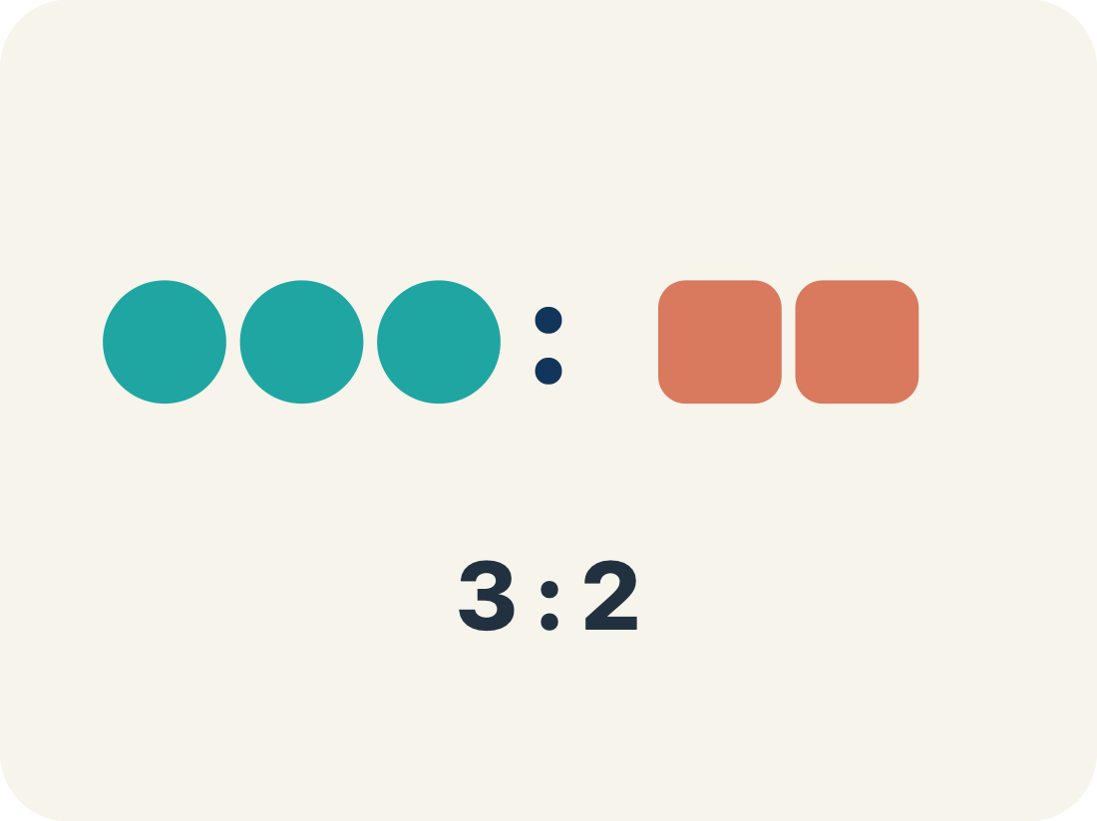
Vocabulary 2 of 8
Lesson 3-1 · Understand Ratios
Ratio
A way to compare two amounts, like 3 to 2.
EXAMPLE · EXPLAIN WHY IT FITS
3 cups flour to 2 cups sugar → 3:2
Use “Ratio” to explain the example. Point to evidence.
eduwonderlab.com · Neft Teacher
6 / 55
Notes:
TEACH IN PRACTICE | Embedded facilitation | Lesson 3.1, slide 6 | VOCAB
Focus on the existing task: Vocabulary 2 of 8 Ratio A way to compare two amounts, like 3 to 2.…
ASK (T1/3/5): Where does “Ratio” appear in the example? Explain the meaning without reading the definition. Partner: restate the idea and ask a clarifying question.
LOOK FOR: A correct connection between the word and a feature of the example. If the student only repeats the definition, invite pointing, sketching or oral rehearsal, then ask for another explanation of this same example.
PARTICIPATION (T5/6/7): Think time before volunteers; accept a written, drawn or rehearsed entry. Students ask for evidence respectfully. Recognize a specific contribution or revision and check that both partners participate.
Source: BCPS Updated Instructional Framework Rubric (June 2020), TEACH 1–7.

Slide 7
Vocabulary 3 of 8
Lesson 3-1 · Understand Ratios
Comparison
Looking at two or more amounts to see how they are related.
EXAMPLE · EXPLAIN WHY IT FITS
5 eggs vs. 3 eggs — which recipe uses more?
Use “Comparison” to explain the example. Point to evidence.
eduwonderlab.com · Neft Teacher
7 / 55
Notes:
TEACH IN PRACTICE | Embedded facilitation | Lesson 3.1, slide 7 | VOCAB
Focus on the existing task: Vocabulary 3 of 8 Comparison Looking at two or more amounts to see how they are related. EXAMPLE 5 eggs vs. 3 eggs — which recipe uses more?
ASK (T1/3/5): Where does “Comparison” appear in the example? Explain the meaning without reading the definition. Partner: restate the idea and ask a clarifying question.
LOOK FOR: A correct connection between the word and a feature of the example. If the student only repeats the definition, invite pointing, sketching or oral rehearsal, then ask for another explanation of this same example.
PARTICIPATION (T5/6/7): Think time before volunteers; accept a written, drawn or rehearsed entry. Students ask for evidence respectfully. Recognize a specific contribution or revision and check that both partners participate.
Source: BCPS Updated Instructional Framework Rubric (June 2020), TEACH 1–7.

Slide 8
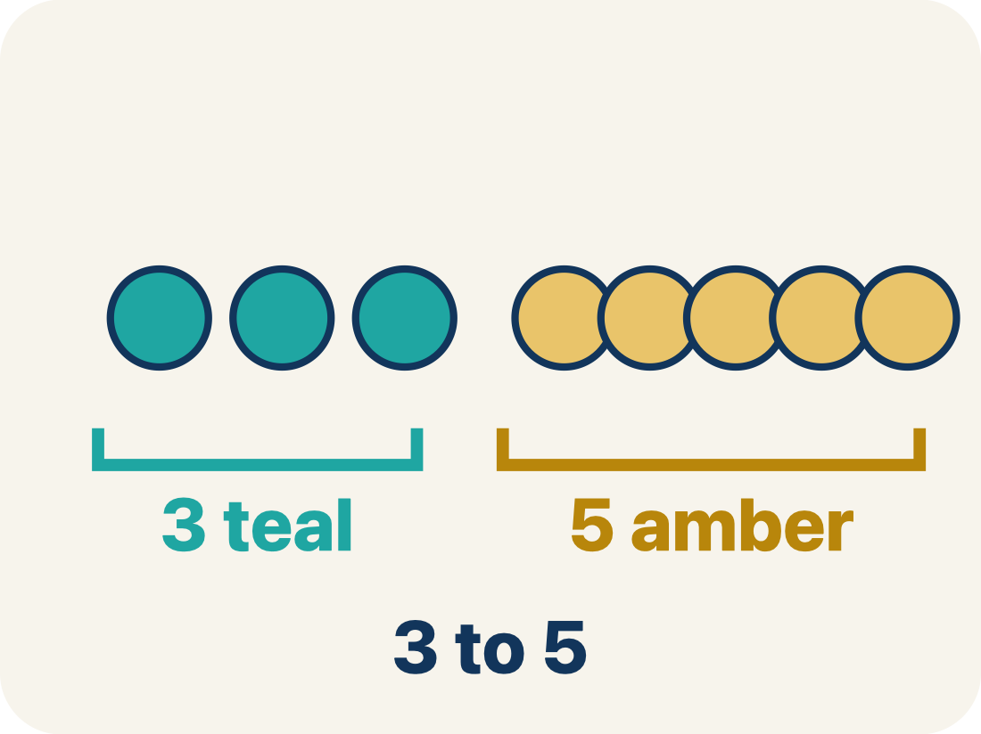
Vocabulary 4 of 8
Lesson 3-1 · Understand Ratios
Part-to-part
A ratio comparing one part of a group to another part.
EXAMPLE · EXPLAIN WHY IT FITS
3 cups flour : 2 cups sugar (ingredient to ingredient)
Use “Part-to-part” to explain the example. Point to evidence.
eduwonderlab.com · Neft Teacher
8 / 55
Notes:
TEACH IN PRACTICE | Embedded facilitation | Lesson 3.1, slide 8 | VOCAB
Focus on the existing task: Vocabulary 4 of 8 Part-to-part A ratio comparing one part of a group to…
ASK (T1/3/5): Where does “Part-to-part” appear in the example? Explain the meaning without reading the definition. Partner: restate the idea and ask a clarifying question.
LOOK FOR: A correct connection between the word and a feature of the example. If the student only repeats the definition, invite pointing, sketching or oral rehearsal, then ask for another explanation of this same example.
PARTICIPATION (T5/6/7): Think time before volunteers; accept a written, drawn or rehearsed entry. Students ask for evidence respectfully. Recognize a specific contribution or revision and check that both partners participate.
Source: BCPS Updated Instructional Framework Rubric (June 2020), TEACH 1–7.

Slide 9
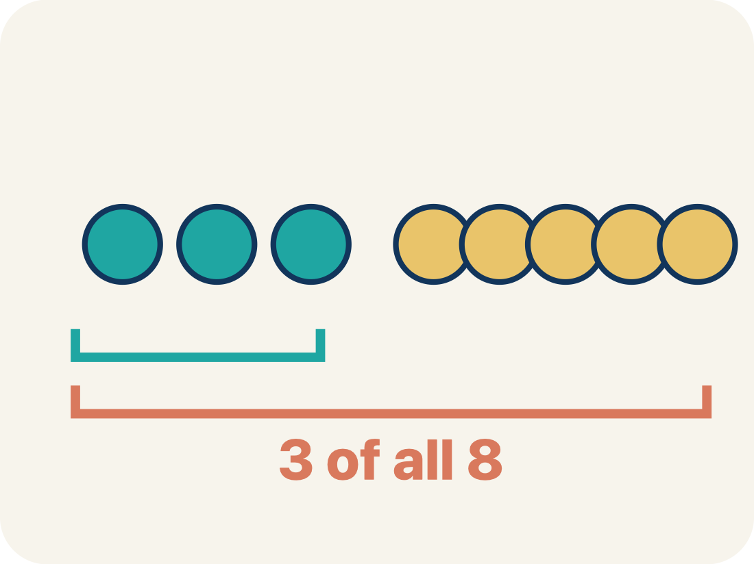
Vocabulary 5 of 8
Lesson 3-1 · Understand Ratios
Part-to-whole
A ratio comparing one part to the whole group.
EXAMPLE · EXPLAIN WHY IT FITS
3 cups flour out of 5 cups total → 3:5
Use “Part-to-whole” to explain the example. Point to
evidence.
eduwonderlab.com · Neft Teacher
9 / 55
Notes:
TEACH IN PRACTICE | Embedded facilitation | Lesson 3.1, slide 9 | VOCAB
Focus on the existing task: Vocabulary 5 of 8 Part-to-whole A ratio comparing one part to the whole…
ASK (T1/3/5): Where does “Part-to-whole” appear in the example? Explain the meaning without reading the definition. Partner: restate the idea and ask a clarifying question.
LOOK FOR: A correct connection between the word and a feature of the example. If the student only repeats the definition, invite pointing, sketching or oral rehearsal, then ask for another explanation of this same example.
PARTICIPATION (T5/6/7): Think time before volunteers; accept a written, drawn or rehearsed entry. Students ask for evidence respectfully. Recognize a specific contribution or revision and check that both partners participate.
Source: BCPS Updated Instructional Framework Rubric (June 2020), TEACH 1–7.

Slide 10
Vocabulary 6 of 8
Lesson 3-1 · Understand Ratios
Colon notation
Writing a ratio with two dots between the numbers, like 3:2.
EXAMPLE · EXPLAIN WHY IT FITS
3 to 2 can be written as 3:2
Use “Colon notation” to explain the example. Point to
evidence.
eduwonderlab.com · Neft Teacher
10 / 55
Notes:
TEACH IN PRACTICE | Embedded facilitation | Lesson 3.1, slide 10 | VOCAB
Focus on the existing task: Vocabulary 6 of 8 Colon notation Writing a ratio with two dots between…
ASK (T1/3/5): Where does “Colon notation” appear in the example? Explain the meaning without reading the definition. Partner: restate the idea and ask a clarifying question.
LOOK FOR: A correct connection between the word and a feature of the example. If the student only repeats the definition, invite pointing, sketching or oral rehearsal, then ask for another explanation of this same example.
PARTICIPATION (T5/6/7): Think time before volunteers; accept a written, drawn or rehearsed entry. Students ask for evidence respectfully. Recognize a specific contribution or revision and check that both partners participate.
Source: BCPS Updated Instructional Framework Rubric (June 2020), TEACH 1–7.

Slide 11
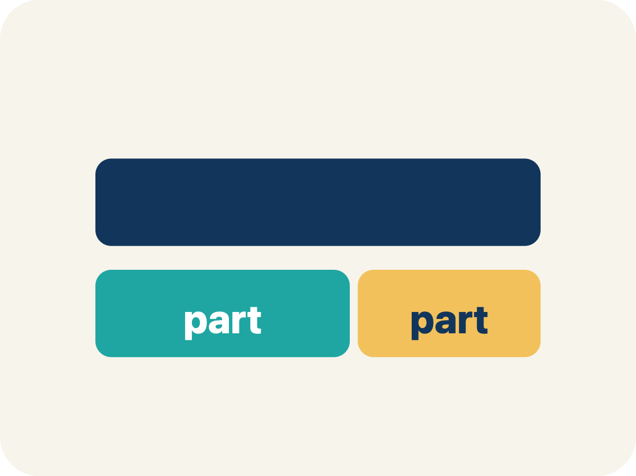
Vocabulary 7 of 8
Lesson 3-1 · Understand Ratios
Tape diagram
A bar cut into equal parts that shows how two amounts in a ratio compare, and how they make up the whole.
EXAMPLE · EXPLAIN WHY IT FITS
3 equal parts of apple juice beside 2 equal parts of sparkling water — 5 parts of fruit drink in all.
Use “Tape diagram” to explain
the example. Point to evidence.
eduwonderlab.com · Neft Teacher
11 / 55
Notes:
TEACH IN PRACTICE | Embedded facilitation | Lesson 3.1, slide 11 | VOCAB
Focus on the existing task: Vocabulary 7 of 8 Tape diagram A bar cut into equal parts that shows how…
ASK (T1/3/5): Where does “Tape diagram” appear in the example? Explain the meaning without reading the definition. Partner: restate the idea and ask a clarifying question.
LOOK FOR: A correct connection between the word and a feature of the example. If the student only repeats the definition, invite pointing, sketching or oral rehearsal, then ask for another explanation of this same example.
PARTICIPATION (T5/6/7): Think time before volunteers; accept a written, drawn or rehearsed entry. Students ask for evidence respectfully. Recognize a specific contribution or revision and check that both partners participate.
Source: BCPS Updated Instructional Framework Rubric (June 2020), TEACH 1–7.

Slide 12
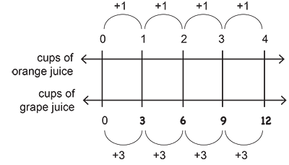
Vocabulary 8 of 8
Lesson 3-1 · Understand Ratios
Double number line
Two number lines lined up so matching tick marks show the two quantities in a ratio at the same time.
EXAMPLE · EXPLAIN WHY IT FITS
Cups of orange juice 0, 1, 2, 3, 4
Cups of grap juice: 0 , 3, 6, 9, 12
USE THE MATH WORDS · Use today’s math words in your explanation — not “it” and “that thing.”
eduwonderlab.com · Neft Teacher
12 / 55
Notes:
TEACH IN PRACTICE | Embedded facilitation | Lesson 3.1, slide 12 | VOCAB
Focus on the existing task: Vocabulary 8 of 8 Double number line Two number lines lined up so…
ASK (T1/3/5): Where does “Double number line” appear in the example? Explain the meaning without reading the definition. Partner: restate the idea and ask a clarifying question.
LOOK FOR: A correct connection between the word and a feature of the example. If the student only repeats the definition, invite pointing, sketching or oral rehearsal, then ask for another explanation of this same example.
PARTICIPATION (T5/6/7): Think time before volunteers; accept a written, drawn or rehearsed entry. Students ask for evidence respectfully. Recognize a specific contribution or revision and check that both partners participate.
Source: BCPS Updated Instructional Framework Rubric (June 2020), TEACH 1–7.

Slide 13
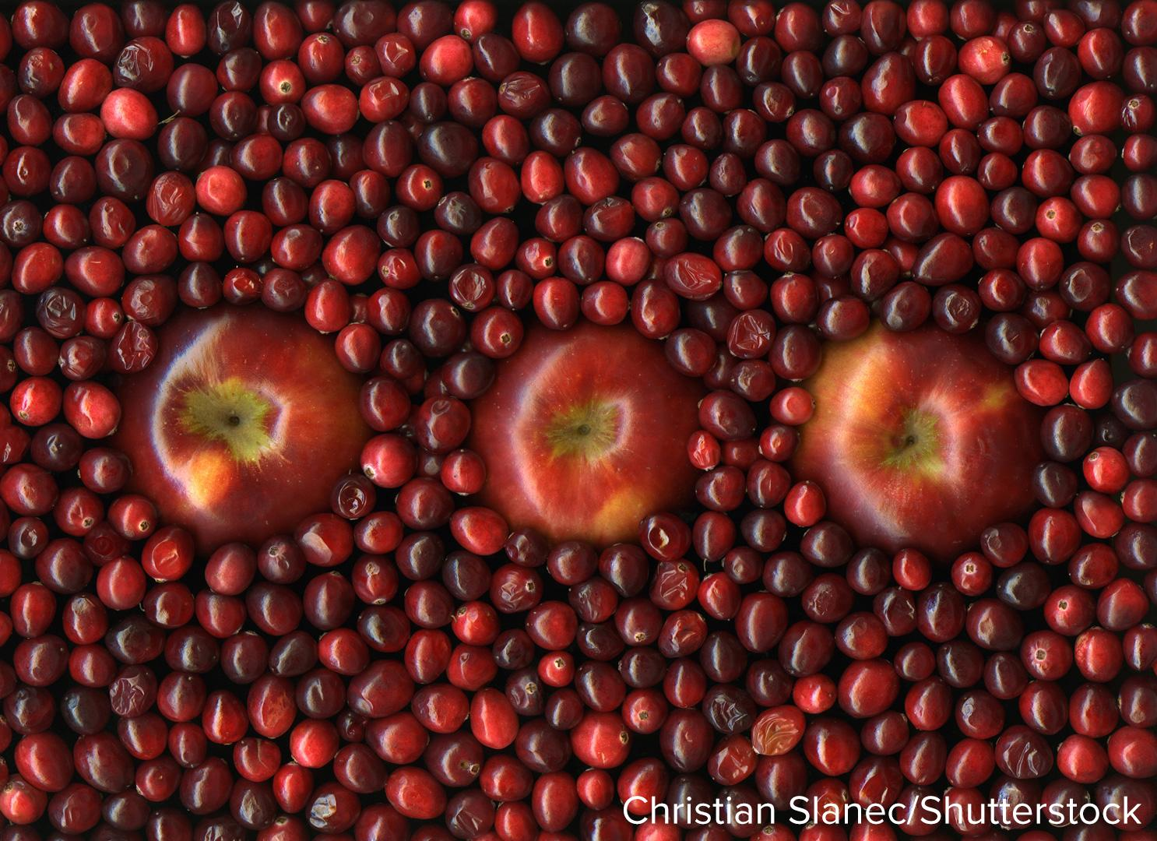

Be Curious
What do you notice?
What do you wonder?
Think first. Share a notice and a question;
build on a classmate’s idea.
Mindset
How can you build your confidence when engaging in math?
13 / 55
Notes:
TEACH IN PRACTICE | Embedded facilitation | Lesson 3.1, slide 13 | CURIOUS
Focus on the existing task: Be Curious What do you notice?
LAUNCH (T2/3/5): Allow quiet observation first. Separate a notice from an inference, invite students’ own questions, and follow the existing launch before teaching a procedure.
LOOK FOR (T4): Where this task addresses it, students can name the compared quantities in order. Ask which feature of their work supports the claim.
RESPOND: If this task shows the lesson misconception—reversing the ratio or confusing a part with the total—label the two quantities on the existing tape diagram or double number line. Have the student revise and explain the change. Use this support only where the concept occurs in the current task; otherwise respond to the displayed question.
RECHECK: If a gap is shared, revisit the existing representation together. If it is limited, give targeted support while others compare valid methods on the same task. Check the revision before moving on.
PARTICIPATION (T5/6/7): Think time before volunteers; accept a written, drawn or rehearsed entry. Students ask for evidence respectfully. Recognize a specific contribution or revision and check that both partners participate.
Source: BCPS Updated Instructional Framework Rubric (June 2020), TEACH 1–7.

Slide 14

STUDENT MOVE · NOTICE • WONDER • LISTEN
Partner press: ask Why? and answer with evidence.
Be Curious
What do you notice?
What do you wonder?
Think first. Share a notice and a
question; build on a classmate’s
idea.
DISCUSSION MOVES
Mindset
I notice ___ because ___.
I wonder ___.
I agree / disagree because ___.
14 / 55
Notes:
TEACH IN PRACTICE | Embedded facilitation | Lesson 3.1, slide 14 | CURIOUS
Focus on the existing task: Be Curious What do you notice?
LAUNCH (T2/3/5): Allow quiet observation first. Separate a notice from an inference, invite students’ own questions, and follow the existing launch before teaching a procedure.
LOOK FOR (T4): Where this task addresses it, students can name the compared quantities in order. Ask which feature of their work supports the claim.
RESPOND: If this task shows the lesson misconception—reversing the ratio or confusing a part with the total—label the two quantities on the existing tape diagram or double number line. Have the student revise and explain the change. Use this support only where the concept occurs in the current task; otherwise respond to the displayed question.
RECHECK: If a gap is shared, revisit the existing representation together. If it is limited, give targeted support while others compare valid methods on the same task. Check the revision before moving on.
PARTICIPATION (T5/6/7): Think time before volunteers; accept a written, drawn or rehearsed entry. Students ask for evidence respectfully. Recognize a specific contribution or revision and check that both partners participate.
Source: BCPS Updated Instructional Framework Rubric (June 2020), TEACH 1–7. Earlier notes and answer keys are retained below.
EARLIER NOTES / EXISTING ANSWER KEY
Give one quiet minute to notice and wonder about the image before any hands go up. Collect three notices and two wonders. Resolve nothing yet — curiosity is the goal here.
UIFR FULL | Lesson-specific facilitation
TEACH 2-3 | Session 1 task launch (UIFR PDF pp. 9-10).
Use the problem exactly as displayed. Give individual thinking time before discussion or advancing to the explanation. If the answer is already visible, ask students to reconstruct and justify it. Invite a choice of suitable representations and have students explain why their choice helps.
At the point where this concept appears, ask: “Which two quantities does this ratio compare, and how does your model preserve that comparison?” Wait for evidence, invite another pathway, and have a student ask a follow-up question. Do not replace students’ reasoning with a sequence of leading steps.

Slide 15
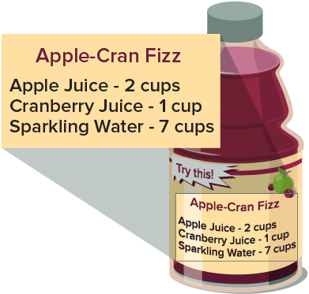
STUDENT MOVE · SOLO THINK → PARTNER TALK
Ask a partner a question; choose a model together.
Making a Fruit Drink
The recipe shows the ingredients needed to make one batch of sparkling cranberry-apple fruit drink.
How can you describe the relationship between the apple juice and the fruit drink? between the apple juice and sparkling water?
Same recipe. Two different ratio types.
PART-TO-WHOLE
apple juice → fruit drink
2 cups → 10 cups TOTAL
PART-TO-PART
apple juice → sparkling water
2 cups → 7 cups (another part)
TALK TOOL
For every ___, there are ___.
This is part-to-___ because ___.
Ask: Is the second quantity another PART, or is it the WHOLE?
15 / 55
Notes:
TEACH IN PRACTICE | Embedded facilitation | Lesson 3.1, slide 15 | TASK
Focus on the existing task: Making a Fruit Drink The recipe shows the ingredients needed to make one batch of sparkling cranberry-apple fruit drink. How can you describe the relationship between the apple juice and the fruit drink?
LAUNCH (T2/3/5): Use the displayed question. Give private thinking time; then A explains while B asks for evidence. Switch roles. Each student records their own reasoning.
LOOK FOR (T4): Where this task addresses it, students can distinguish part-to-part and part-to-whole. Ask which feature of their work supports the claim.
RESPOND: If this task shows the lesson misconception—reversing the ratio or confusing a part with the total—label the two quantities on the existing tape diagram or double number line. Have the student revise and explain the change. Use this support only where the concept occurs in the current task; otherwise respond to the displayed question.
RECHECK: If a gap is shared, revisit the existing representation together. If it is limited, give targeted support while others compare valid methods on the same task. Check the revision before moving on.
PARTICIPATION (T5/6/7): Think time before volunteers; accept a written, drawn or rehearsed entry. Students ask for evidence respectfully. Recognize a specific contribution or revision and check that both partners participate.
Source: BCPS Updated Instructional Framework Rubric (June 2020), TEACH 1–7. Earlier notes and answer keys are retained below.
EARLIER NOTES / EXISTING ANSWER KEY
Solo think first, then partner talk. The key question: is the second quantity another part, or the whole? Common slip: reading 2 to 10 as part-to-part because both numbers are in the recipe.

Slide 16
STUDENT MOVE · CHOOSE A CHALLENGE • JUSTIFY
Let’s Explore More
What kind of ratio is the cranberry juice to fruit drink relationship? Justify your thinking.
PART → WHOLE
TALK TOOL
For every ___, there are ___.
This is part-to-___ because ___.
Show your thinking
Solve → Explain → Revise
16 / 55
Notes:
TEACH IN PRACTICE | Embedded facilitation | Lesson 3.1, slide 16 | PRACTICE
Focus on the existing task: Let’s Explore More What kind of ratio is the cranberry juice to fruit drink relationship?
LAUNCH (T2/3/5): Use the displayed question. Give private thinking time; then A explains while B asks for evidence. Switch roles. Each student records their own reasoning.
LOOK FOR (T4): Where this task addresses it, students can distinguish part-to-part and part-to-whole. Ask which feature of their work supports the claim.
RESPOND: If this task shows the lesson misconception—reversing the ratio or confusing a part with the total—label the two quantities on the existing tape diagram or double number line. Have the student revise and explain the change. Use this support only where the concept occurs in the current task; otherwise respond to the displayed question.
RECHECK: If a gap is shared, revisit the existing representation together. If it is limited, give targeted support while others compare valid methods on the same task. Check the revision before moving on.
PARTICIPATION (T5/6/7): Think time before volunteers; accept a written, drawn or rehearsed entry. Students ask for evidence respectfully. Recognize a specific contribution or revision and check that both partners participate.
Source: BCPS Updated Instructional Framework Rubric (June 2020), TEACH 1–7. Earlier notes and answer keys are retained below.
EARLIER NOTES / EXISTING ANSWER KEY
Students choose a challenge level and must justify their ratio type with ‘because.’ Early finishers write one part-to-part and one part-to-whole ratio from the same recipe.
UIFR FULL | Lesson-specific facilitation
TEACH 4-5 | Session 1 discussion and checkpoint (UIFR PDF pp. 11-12).
Collect a brief response from every student to the existing prompt before hearing volunteers. Partners take turns explaining and asking for evidence: “I understand ___; what supports ___?” Offer rehearsal or an annotated model for students who need language support. Each student records their own reasoning.
Look specifically for: reversing the ratio or confusing a part with the total. If it appears, label the two quantities on the existing tape diagram or double number line; then ask the student to revise the same response and explain the change. If evidence is secure, have students compare a second valid pathway or state why their approach works. Choose the next step from the responses, not a preset pace.

Slide 17
STUDENT MOVES
Lesson 3-1
Your move
USE YOUR TOOLS · Reach for your notes, a model, or a manipulative before you reach for an answer.
17 / 55

Slide 18
LESSON 3.1 / DISCUSS THE TASK
Explain and compare
Use the task you just explored.
TAKE TURNS
Which two quantities does this ratio compare, and how does your model preserve that comparison?
Explain
“I know this because…”
Ask
“Where does your work show that?”
Point to evidence in your work.
Then compare your approach with a partner’s.
HOW DO YOU KNOW? · Ask your partner “How do you know?” Answer by pointing to your own work.
Listen to understand. Ask for evidence. Make room for every voice.
Notes:
TEACH IN PRACTICE | Embedded facilitation | Lesson 3.1, slide 17 | PRIOR_INSERT
Focus on the existing task: Point to evidence in your work. Then compare your approach with a partner’s. TAKE TURNS Explain “I know this because…” Ask “Where does your work show that?
CONNECT (T1/4): Ask students to restate the displayed goal or key idea and connect it to earlier work. Relevant lesson evidence: name the compared quantities in order; distinguish part-to-part and part-to-whole; scale both quantities together. Use only the criterion that matches the current session.
SHOW PROGRESS: Students point to their own existing work, explain what improved after feedback, and name a next step. Pair confidence ratings with actual evidence.
PARTICIPATION (T5/6/7): Think time before volunteers; accept a written, drawn or rehearsed entry. Students ask for evidence respectfully. Recognize a specific contribution or revision and check that both partners participate.
Source: BCPS Updated Instructional Framework Rubric (June 2020), TEACH 1–7.

Slide 19
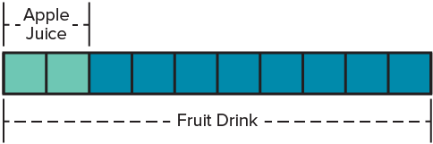
STUDENT MOVE · CLASSIFY • JUSTIFY
For 2 cups of apple juice used,
10 cups of fruit drink are made.
TRY IT BEFORE YOU’RE SURE · Start even if you are not sure. A revised answer counts as much as a first-try answer.
Use the tape diagram to answer both:
How is 2 cups related to 10 cups? Is this part-to-part or part-to-whole?
Apple juice is a PART. Fruit drink is the WHOLE.
PART → WHOLE
So 2 : 10 is PART-TO-WHOLE. Why is 10 the whole?
TALK TOOL
For every ___, there are ___.
This is part-to-___ because ___.
Think → Pair → Share: Explain how the model proves your answer.
19 / 55
Notes:
TEACH IN PRACTICE | Embedded facilitation | Lesson 3.1, slide 18 | TASK
Focus on the existing task: For 2 cups of apple juice used, 10 cups of fruit drink are made. Use the tape diagram to answer both: How is 2 cups related to 10 cups?
LAUNCH (T2/3/5): Use the displayed question. Give private thinking time; then A explains while B asks for evidence. Switch roles. Each student records their own reasoning.
LOOK FOR (T4): Where this task addresses it, students can distinguish part-to-part and part-to-whole. Ask which feature of their work supports the claim.
RESPOND: If this task shows the lesson misconception—reversing the ratio or confusing a part with the total—label the two quantities on the existing tape diagram or double number line. Have the student revise and explain the change. Use this support only where the concept occurs in the current task; otherwise respond to the displayed question.
RECHECK: If a gap is shared, revisit the existing representation together. If it is limited, give targeted support while others compare valid methods on the same task. Check the revision before moving on.
PARTICIPATION (T5/6/7): Think time before volunteers; accept a written, drawn or rehearsed entry. Students ask for evidence respectfully. Recognize a specific contribution or revision and check that both partners participate.
Source: BCPS Updated Instructional Framework Rubric (June 2020), TEACH 1–7. Earlier notes and answer keys are retained below.
EARLIER NOTES / EXISTING ANSWER KEY
Teacher reference: The apple juice is part of the fruit drink.
Combined from the former relationship, representation, and classification sequence. Pause before the model discussion so students still generate an idea first.

Slide 20
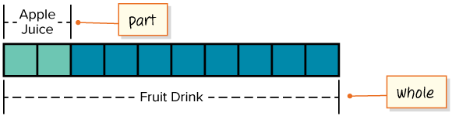
STUDENT MOVE · SAY IT IN YOUR OWN WORDS
Apple juice = part. Fruit drink = whole.
That makes this a part-to-whole ratio.
PART → WHOLE
PART : WHOLE = 2 : 10
Explain how the information shown supports your reasoning.
20 / 55
Notes:
TEACH IN PRACTICE | Embedded facilitation | Lesson 3.1, slide 19 | WORKED
Focus on the existing task: Apple juice = part. Fruit drink = whole. That makes this a part-to-whole ratio. STUDENT MOVE · SAY IT IN YOUR OWN WORDS PART →…
LAUNCH (T2/3/5): Ask students to explain the displayed idea or example and point to evidence. When a calculation step is shown, ask why it is valid. Have a partner restate the explanation; copying is not the check.
LOOK FOR (T4): Where this task addresses it, students can distinguish part-to-part and part-to-whole. Ask which feature of their work supports the claim.
RESPOND: If this task shows the lesson misconception—reversing the ratio or confusing a part with the total—label the two quantities on the existing tape diagram or double number line. Have the student revise and explain the change. Use this support only where the concept occurs in the current task; otherwise respond to the displayed question.
RECHECK: If a gap is shared, revisit the existing representation together. If it is limited, give targeted support while others compare valid methods on the same task. Check the revision before moving on.
PARTICIPATION (T5/6/7): Think time before volunteers; accept a written, drawn or rehearsed entry. Students ask for evidence respectfully. Recognize a specific contribution or revision and check that both partners participate.
Source: BCPS Updated Instructional Framework Rubric (June 2020), TEACH 1–7. Earlier notes and answer keys are retained below.
EARLIER NOTES / EXISTING ANSWER KEY
Combined part/whole identification with the part-to-whole classification.

Slide 21
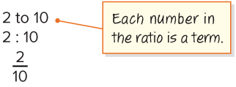
STUDENT MOVE · WRITE IT 3 WAYS • CHECK ORDER
A ratio compares two quantities, and order matters.
2 cups of apple juice are compared with 10 cups of fruit drink.
A part-to-whole ratio can be written three ways.
WHY? 10 means ALL of the fruit drink.
Second quantity = TOTAL.
PART → WHOLE
ADD ON · Add on: “I agree because ______.” or “I see it differently because ______.”
21 / 55
Notes:
TEACH IN PRACTICE | Embedded facilitation | Lesson 3.1, slide 20 | TASK
Focus on the existing task: A ratio compares two quantities, and order matters. 2 cups of apple juice are compared with 10 cups of fruit drink. A part-to-whole…
LAUNCH (T2/3/5): Use the displayed question. Give private thinking time; then A explains while B asks for evidence. Switch roles. Each student records their own reasoning.
LOOK FOR (T4): Where this task addresses it, students can name the compared quantities in order. Ask which feature of their work supports the claim.
RESPOND: If this task shows the lesson misconception—reversing the ratio or confusing a part with the total—label the two quantities on the existing tape diagram or double number line. Have the student revise and explain the change. Use this support only where the concept occurs in the current task; otherwise respond to the displayed question.
RECHECK: If a gap is shared, revisit the existing representation together. If it is limited, give targeted support while others compare valid methods on the same task. Check the revision before moving on.
PARTICIPATION (T5/6/7): Think time before volunteers; accept a written, drawn or rehearsed entry. Students ask for evidence respectfully. Recognize a specific contribution or revision and check that both partners participate.
Source: BCPS Updated Instructional Framework Rubric (June 2020), TEACH 1–7. Earlier notes and answer keys are retained below.
EARLIER NOTES / EXISTING ANSWER KEY
Combined ratio definition with the three symbolic/word forms.

Slide 22
STUDENT MOVE · PART-TO-PART • PROVE IT
How can you describe apple juice to sparkling water?
Both are parts of the fruit drink → Part to ____ ratio.
For every 2 cups of apple juice, there are 7 cups of sparkling water.
Apple juice and sparkling water are BOTH ingredients.
Neither number is the total.
PART → ______
Think and record first. Which part of your work supports your answer?
22 / 55
Notes:
TEACH IN PRACTICE | Embedded facilitation | Lesson 3.1, slide 21 | TASK
Focus on the existing task: How can you describe apple juice to sparkling water?
LAUNCH (T2/3/5): Use the displayed question. Give private thinking time; then A explains while B asks for evidence. Switch roles. Each student records their own reasoning.
LOOK FOR (T4): Where this task addresses it, students can distinguish part-to-part and part-to-whole. Ask which feature of their work supports the claim.
RESPOND: If this task shows the lesson misconception—reversing the ratio or confusing a part with the total—label the two quantities on the existing tape diagram or double number line. Have the student revise and explain the change. Use this support only where the concept occurs in the current task; otherwise respond to the displayed question.
RECHECK: If a gap is shared, revisit the existing representation together. If it is limited, give targeted support while others compare valid methods on the same task. Check the revision before moving on.
PARTICIPATION (T5/6/7): Think time before volunteers; accept a written, drawn or rehearsed entry. Students ask for evidence respectfully. Recognize a specific contribution or revision and check that both partners participate.
Source: BCPS Updated Instructional Framework Rubric (June 2020), TEACH 1–7. Earlier notes and answer keys are retained below.
EARLIER NOTES / EXISTING ANSWER KEY
Combined the part-to-part launch question and conclusion.

Slide 23
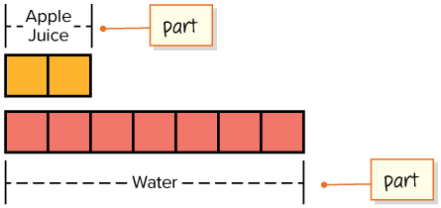

STUDENT MOVE · CONNECT 2 REPRESENTATIONS
Student-led talk: paraphrase, agree or disagree, add on.
This tape diagram represents a part-to-part ratio. For every 2 cups of apple juice, there are 7 cups of sparkling water.
What is another way you can represent a part-to-part ratio?
Partner challenge: Choose a representation. Then explain how it connects to the tape diagram.
PART → PART
Connecting Representations
23 / 55
Notes:
TEACH IN PRACTICE | Embedded facilitation | Lesson 3.1, slide 22 | TASK
Focus on the existing task: This tape diagram represents a part-to-part ratio. For every 2 cups of apple juice, there are 7 cups of sparkling water. What is another way you can represent a part-to-part ratio?
LAUNCH (T2/3/5): Use the displayed question. Give private thinking time; then A explains while B asks for evidence. Switch roles. Each student records their own reasoning.
LOOK FOR (T4): Where this task addresses it, students can distinguish part-to-part and part-to-whole. Ask which feature of their work supports the claim.
RESPOND: If this task shows the lesson misconception—reversing the ratio or confusing a part with the total—label the two quantities on the existing tape diagram or double number line. Have the student revise and explain the change. Use this support only where the concept occurs in the current task; otherwise respond to the displayed question.
RECHECK: If a gap is shared, revisit the existing representation together. If it is limited, give targeted support while others compare valid methods on the same task. Check the revision before moving on.
PARTICIPATION (T5/6/7): Think time before volunteers; accept a written, drawn or rehearsed entry. Students ask for evidence respectfully. Recognize a specific contribution or revision and check that both partners participate.
Source: BCPS Updated Instructional Framework Rubric (June 2020), TEACH 1–7. Earlier notes and answer keys are retained below.
EARLIER NOTES / EXISTING ANSWER KEY
Teacher reference: The relationship can also be represented with numbers.
Combined the representation-choice prompt with the connecting-representations slide.

Slide 24
STUDENT MOVE · READ IT ALOUD • CHECK ORDER
For every two cups of apple juice in the fruit drink, there are seven cups of water.
You can represent a part-to-part ratio with numbers in two ways.
PART → PART
2 to 7
PART : PART
2 : 7
No total is used.
2 : 7
Explain how the information
shown supports your reasoning.
24 / 55
Notes:
TEACH IN PRACTICE | Embedded facilitation | Lesson 3.1, slide 23 | WORKED
Focus on the existing task: For every two cups of apple juice in the fruit drink, there are seven cups of water. You can represent a part-to-part ratio with…
LAUNCH (T2/3/5): Ask students to explain the displayed idea or example and point to evidence. When a calculation step is shown, ask why it is valid. Have a partner restate the explanation; copying is not the check.
LOOK FOR (T4): Where this task addresses it, students can name the compared quantities in order. Ask which feature of their work supports the claim.
RESPOND: If this task shows the lesson misconception—reversing the ratio or confusing a part with the total—label the two quantities on the existing tape diagram or double number line. Have the student revise and explain the change. Use this support only where the concept occurs in the current task; otherwise respond to the displayed question.
RECHECK: If a gap is shared, revisit the existing representation together. If it is limited, give targeted support while others compare valid methods on the same task. Check the revision before moving on.
PARTICIPATION (T5/6/7): Think time before volunteers; accept a written, drawn or rehearsed entry. Students ask for evidence respectfully. Recognize a specific contribution or revision and check that both partners participate.
Source: BCPS Updated Instructional Framework Rubric (June 2020), TEACH 1–7. Earlier notes and answer keys are retained below.
EARLIER NOTES / EXISTING ANSWER KEY
Have two or three students read the sentence aloud, filling in the blanks. Check that the order of quantities matches the order of the words — reversed order reads fine aloud but breaks the ratio.

Slide 25
STUDENT MOVE · SELF-EXPLAIN • PART VS. WHOLE
Don’t Mix Them Up
Use the SAME recipe. Look at what the second quantity is.
PART-TO-PART
PART-TO-WHOLE
apple juice : sparkling water
apple juice : fruit drink
2 : 7
2 : 10
7 cups is another PART.
Compare one ingredient to another.
10 cups is the WHOLE drink.
Compare one ingredient to the total.
PART : PART
PART : TOTAL
DECISION RULE: second quantity is another part → PART-TO-PART | second quantity is total → PART-TO-WHOLE
SELF-CHECK · Mark it: ✓ got it · ~ almost · ? stuck. Then fix one thing before we move on.
25 / 55
Notes:
TEACH IN PRACTICE | Embedded facilitation | Lesson 3.1, slide 24 | TASK
Focus on the existing task: STUDENT MOVE · SELF-EXPLAIN • PART VS. WHOLE Don’t Mix Them Up Use the SAME recipe. Look at what the second quantity is. PART-TO-PART…
LAUNCH (T2/3/5): Use the displayed question. Give private thinking time; then A explains while B asks for evidence. Switch roles. Each student records their own reasoning.
LOOK FOR (T4): Where this task addresses it, students can distinguish part-to-part and part-to-whole. Ask which feature of their work supports the claim.
RESPOND: If this task shows the lesson misconception—reversing the ratio or confusing a part with the total—label the two quantities on the existing tape diagram or double number line. Have the student revise and explain the change. Use this support only where the concept occurs in the current task; otherwise respond to the displayed question.
RECHECK: If a gap is shared, revisit the existing representation together. If it is limited, give targeted support while others compare valid methods on the same task. Check the revision before moving on.
PARTICIPATION (T5/6/7): Think time before volunteers; accept a written, drawn or rehearsed entry. Students ask for evidence respectfully. Recognize a specific contribution or revision and check that both partners participate.
Source: BCPS Updated Instructional Framework Rubric (June 2020), TEACH 1–7. Earlier notes and answer keys are retained below.
EARLIER NOTES / EXISTING ANSWER KEY
Self-explain routine: each student tells a partner the difference between part-to-part and part-to-whole using the fruit-drink numbers. Listen for ‘the whole includes every part.’

Slide 26
FORMATIVE CHECK · SOLO → CHECK → REVISE
Defend your method; partner gives one specific next step.
60-Second Check
Work independently first. Your response tells us what to do next.
USE THIS RECIPE INFORMATION
2 cups apple juice • 1 cup cranberry juice • 7 cups sparkling water • 10 cups total fruit drink
1 — REPRESENT
2 — CLASSIFY + PROVE
3 — SELF-MONITOR
Write the ratio of apple juice to sparkling water in TWO ways.
Is apple juice : fruit drink part-to-part or part-to-whole? Explain how you know.
Circle one:
READY — I can explain it.
ALMOST — I need one hint.
NOT YET — I need a model.
Partner feedback: Ask “How do you know?” The solver may clarify or revise before sharing.
26 / 55
Notes:
TEACH IN PRACTICE | Embedded facilitation | Lesson 3.1, slide 25 | TASK
Focus on the existing task: Explain how you know. 3 — SELF-MONITOR Circle one: READY — I can explain it. ALMOST — I need one hint. NOT YET — I need a model. Partner feedback: Ask “How do you know?
LAUNCH (T2/3/5): Use the displayed question. Give private thinking time; then A explains while B asks for evidence. Switch roles. Each student records their own reasoning.
LOOK FOR (T4): Where this task addresses it, students can distinguish part-to-part and part-to-whole. Ask which feature of their work supports the claim.
RESPOND: If this task shows the lesson misconception—reversing the ratio or confusing a part with the total—label the two quantities on the existing tape diagram or double number line. Have the student revise and explain the change. Use this support only where the concept occurs in the current task; otherwise respond to the displayed question.
RECHECK: If a gap is shared, revisit the existing representation together. If it is limited, give targeted support while others compare valid methods on the same task. Check the revision before moving on.
PARTICIPATION (T5/6/7): Think time before volunteers; accept a written, drawn or rehearsed entry. Students ask for evidence respectfully. Recognize a specific contribution or revision and check that both partners participate.
Source: BCPS Updated Instructional Framework Rubric (June 2020), TEACH 1–7. Earlier notes and answer keys are retained below.
EARLIER NOTES / EXISTING ANSWER KEY
Students work the three panels solo, then check with a partner. The READY / ALMOST / NOT YET line tells you who needs the model tomorrow — record it.

Slide 27
What do you know about the cups of apple juice and total cups of fruit drink in one batch?
Compare your reasoning with the
explanation. Explain any revision you make.
Reveal:
Two cups of apple juice are needed to make 10 cups of fruit drink.
27 / 55
Notes:
TEACH IN PRACTICE | Embedded facilitation | Lesson 3.1, slide 26 | REVEAL
Focus on the existing task: What do you know about the cups of apple juice and total cups of fruit drink in one batch?
LAUNCH (T2/3/5): If an existing answer cover is present, gather an attempt before revealing. If the explanation is already visible, ask students to reconstruct and justify it. Compare reasoning and explain a revision; preserve the reveal sequence.
LOOK FOR (T4): Where this task addresses it, students can name the compared quantities in order. Ask which feature of their work supports the claim.
RESPOND: If this task shows the lesson misconception—reversing the ratio or confusing a part with the total—label the two quantities on the existing tape diagram or double number line. Have the student revise and explain the change. Use this support only where the concept occurs in the current task; otherwise respond to the displayed question.
RECHECK: If a gap is shared, revisit the existing representation together. If it is limited, give targeted support while others compare valid methods on the same task. Check the revision before moving on.
PARTICIPATION (T5/6/7): Think time before volunteers; accept a written, drawn or rehearsed entry. Students ask for evidence respectfully. Recognize a specific contribution or revision and check that both partners participate.
Source: BCPS Updated Instructional Framework Rubric (June 2020), TEACH 1–7.

Slide 28
For 2 cups of apple juice used,
10 cups of fruit drink are made.
How might you represent this relationship?
Reveal:
One way is to use a tape diagram.
Compare your reasoning with the
explanation. Explain any revision
you make.
28 / 55
Notes:
TEACH IN PRACTICE | Embedded facilitation | Lesson 3.1, slide 27 | REVEAL
Focus on the existing task: For 2 cups of apple juice used, 10 cups of fruit drink are made. How might you represent this relationship?
LAUNCH (T2/3/5): If an existing answer cover is present, gather an attempt before revealing. If the explanation is already visible, ask students to reconstruct and justify it. Compare reasoning and explain a revision; preserve the reveal sequence.
LOOK FOR (T4): Where this task addresses it, students can name the compared quantities in order. Ask which feature of their work supports the claim.
RESPOND: If this task shows the lesson misconception—reversing the ratio or confusing a part with the total—label the two quantities on the existing tape diagram or double number line. Have the student revise and explain the change. Use this support only where the concept occurs in the current task; otherwise respond to the displayed question.
RECHECK: If a gap is shared, revisit the existing representation together. If it is limited, give targeted support while others compare valid methods on the same task. Check the revision before moving on.
PARTICIPATION (T5/6/7): Think time before volunteers; accept a written, drawn or rehearsed entry. Students ask for evidence respectfully. Recognize a specific contribution or revision and check that both partners participate.
Source: BCPS Updated Instructional Framework Rubric (June 2020), TEACH 1–7.

Slide 29
For 2 cups of apple juice used,
10 cups of fruit drink are made.
How are the two liquids related?
STRUGGLE FIRST · Work on your own first. Stuck is allowed — try a second strategy before you ask.
Reveal:
The apple juice is part of the fruit drink.
29 / 55
Notes:
TEACH IN PRACTICE | Embedded facilitation | Lesson 3.1, slide 28 | REVEAL
Focus on the existing task: For 2 cups of apple juice used, 10 cups of fruit drink are made. How are the two liquids related?
LAUNCH (T2/3/5): If an existing answer cover is present, gather an attempt before revealing. If the explanation is already visible, ask students to reconstruct and justify it. Compare reasoning and explain a revision; preserve the reveal sequence.
LOOK FOR (T4): Where this task addresses it, students can distinguish part-to-part and part-to-whole. Ask which feature of their work supports the claim.
RESPOND: If this task shows the lesson misconception—reversing the ratio or confusing a part with the total—label the two quantities on the existing tape diagram or double number line. Have the student revise and explain the change. Use this support only where the concept occurs in the current task; otherwise respond to the displayed question.
RECHECK: If a gap is shared, revisit the existing representation together. If it is limited, give targeted support while others compare valid methods on the same task. Check the revision before moving on.
PARTICIPATION (T5/6/7): Think time before volunteers; accept a written, drawn or rehearsed entry. Students ask for evidence respectfully. Recognize a specific contribution or revision and check that both partners participate.
Source: BCPS Updated Instructional Framework Rubric (June 2020), TEACH 1–7.

Slide 30
Next, let’s look at the relationship between the apple juice and the sparkling water.
How can you describe the relationship?
Reveal:
Both are parts of the fruit drink.
Compare your reasoning with the
explanation. Explain any revision
you make.
30 / 55
Notes:
TEACH IN PRACTICE | Embedded facilitation | Lesson 3.1, slide 29 | REVEAL
Focus on the existing task: Next, let’s look at the relationship between the apple juice and the sparkling water. How can you describe the relationship?
LAUNCH (T2/3/5): If an existing answer cover is present, gather an attempt before revealing. If the explanation is already visible, ask students to reconstruct and justify it. Compare reasoning and explain a revision; preserve the reveal sequence.
LOOK FOR (T4): Where this task addresses it, students can scale both quantities together. Ask which feature of their work supports the claim.
RESPOND: If this task shows the lesson misconception—reversing the ratio or confusing a part with the total—label the two quantities on the existing tape diagram or double number line. Have the student revise and explain the change. Use this support only where the concept occurs in the current task; otherwise respond to the displayed question.
RECHECK: If a gap is shared, revisit the existing representation together. If it is limited, give targeted support while others compare valid methods on the same task. Check the revision before moving on.
PARTICIPATION (T5/6/7): Think time before volunteers; accept a written, drawn or rehearsed entry. Students ask for evidence respectfully. Recognize a specific contribution or revision and check that both partners participate.
Source: BCPS Updated Instructional Framework Rubric (June 2020), TEACH 1–7.

Slide 31
Session 2
Understand Ratios
SCALE • MODEL • EXPLAIN
CREDIT A CLASSMATE · Name one classmate whose idea helped you today, and say what they said.
31 / 55
Notes:
TEACH IN PRACTICE | Embedded facilitation | Lesson 3.1, slide 30 | DIVIDER
Focus on the existing task: Understand Ratio s Session 2 SCALE • MODEL • EXPLAIN
TRANSITION (T6/7): Students confirm materials, roles, how to request help, and the next response routine. Ask a student to restate it. Keep teacher-only slides hidden.
PARTICIPATION (T5/6/7): Think time before volunteers; accept a written, drawn or rehearsed entry. Students ask for evidence respectfully. Recognize a specific contribution or revision and check that both partners participate.
Source: BCPS Updated Instructional Framework Rubric (June 2020), TEACH 1–7. Earlier notes and answer keys are retained below.
EARLIER NOTES / EXISTING ANSWER KEY
Session 2 launch. One-sentence recap of Session 1 (a ratio compares two quantities, order matters), then frame today: modeling ratios with tape diagrams and double number lines.

Slide 32
WARM-UP · THINK • TRY • CHECK
Turn and talk: compare strategies, then defend one.
Session 2 Warm-Up
Lesson 3-1 · Understand Ratios | Session 2 Warm-Up · about 4 minutes
Try each on your own. Mark an unsure answer; explain and revise when we check.
QUESTION 1
QUESTION 2
Write 3 red counters to 5 blue counters as a ratio in two ways.
A drink has 2 cups apple juice and 8 cups water.
How many cups total? ______
QUESTION 3
QUESTION 4
Is apples : total part-to-part or part-to-whole? ______
Scale 2 : 7 by 3.
Equivalent ratio: ______ : ______
TALK IT OVER: “I got ______ because ______.” • Compare with a partner before we check as a class.
32 / 55
Notes:
TEACH IN PRACTICE | Embedded facilitation | Lesson 3.1, slide 31 | WARMUP
Focus on the existing task: ______ QUESTION 3 Is apples: total part-to-part or part-to-whole?
GATHER EVIDENCE (T4/6): Keep the original items. Students try independently, mark an uncertain item, and explain one method before checking. Use the existing key when present.
RESPOND: Distinguish a calculation slip from a reasoning gap. Give one next step on the same item; have students revise in a second color. Use the responses to choose flexible support for today’s lesson.
PARTICIPATION (T5/6/7): Think time before volunteers; accept a written, drawn or rehearsed entry. Students ask for evidence respectfully. Recognize a specific contribution or revision and check that both partners participate.
Source: BCPS Updated Instructional Framework Rubric (June 2020), TEACH 1–7. Earlier notes and answer keys are retained below.
EARLIER NOTES / EXISTING ANSWER KEY
Warm-up routine: students start silently on entry; keep it to about 4 minutes.
Circulate and note who is stuck — use what you see to choose who you check on first today.
Go over answers quickly; ask one student to explain a step, not just say the answer.
UIFR: TEACH 4 · TEACH 6.

Slide 33
REVIEW NOTES · RECALL • CONNECT • APPLY
Partner check: explain one idea without looking.
Review Notes — Session 2
Lesson 3-1 · Understand Ratios | Review before Session 2
Two Types of Ratios — ask what the SECOND quantity represents.
PART-TO-PART = part → part
PART-TO-WHOLE = part → total
Compare one part to another part.
Compare one part to the TOTAL.
Example: 3 apples and 2 oranges
Same example: 3 apples + 2 oranges
apples : oranges = 3 : 2
total = 5 → apples : total = 3 : 5
CLUE: both quantities are pieces/parts.
Do NOT add them first.
CLUE: one quantity is the whole/total.
Find the total first.
FAST CHECK: another PART → part-to-part | the TOTAL/WHOLE → part-to-whole
Read the words in order → write the numbers in the same order.
33 / 55
Notes:
TEACH IN PRACTICE | Embedded facilitation | Lesson 3.1, slide 32 | NOTES
Focus on the existing task: Review Notes — Session 2 | Review before Session 2 REVIEW NOTES · RECALL • CONNECT • APPLY Read the…
ROUTINE (T1/2/4): Read or copy the original notes, cover one line, and explain it using the displayed example. Reopen and correct. Copying alone is not evidence of understanding.
LOOK FOR: A link between a symbol, quantity or feature and the explanation. If missing, point back to that feature and have the student try again; fade the prompt once they can explain.
PARTICIPATION (T5/6/7): Think time before volunteers; accept a written, drawn or rehearsed entry. Students ask for evidence respectfully. Recognize a specific contribution or revision and check that both partners participate.
Source: BCPS Updated Instructional Framework Rubric (June 2020), TEACH 1–7. Earlier notes and answer keys are retained below.
EARLIER NOTES / EXISTING ANSWER KEY
Copy routine: read one line at a time; students copy, then explain that line to a partner.
Keep it brisk — the understanding work happens in the examples, not the copying.
UIFR: TEACH 1 · TEACH 6.

Slide 34
LEARNING TARGET · MODEL • SCALE • EXPLAIN
Tell a partner the new goal and how you will show it.
Learning Target — Session 2
Lesson 3-1 · Understand Ratios | Maryland Standard 6.AT.1
Today I will keep ratios equivalent as the quantities grow and show the relationship with a tape diagram or double number line.
CONTENT OBJECTIVE
LANGUAGE OBJECTIVE
I can use a tape diagram or double number line to represent equivalent ratios.
I can explain how both quantities change using “both quantities were multiplied by ___.”
SUCCESS CHECK
WHY THIS MATTERS
✓ Read the starting ratio.
✓ Scale both quantities by the same factor.
✓ Use a model and explain the pattern.
Equivalent ratios keep recipes, mixtures, scale drawings, and comparisons consistent.
MATH COMMUNITY: Different strategies are welcome • Ask before telling • Revising your thinking is part of learning
34 / 55
Notes:
TEACH IN PRACTICE | Embedded facilitation | Lesson 3.1, slide 33 | GOAL
Focus on the existing task: Learning Target — Session 2 | Maryland Standard 6.AT.1 LEARNING TARGET · MODEL • SCALE • EXPLAIN…
CONNECT (T1/4): Ask students to restate the displayed goal or key idea and connect it to earlier work. Relevant lesson evidence: name the compared quantities in order; distinguish part-to-part and part-to-whole; scale both quantities together. Use only the criterion that matches the current session.
SHOW PROGRESS: Students point to their own existing work, explain what improved after feedback, and name a next step. Pair confidence ratings with actual evidence.
PARTICIPATION (T5/6/7): Think time before volunteers; accept a written, drawn or rehearsed entry. Students ask for evidence respectfully. Recognize a specific contribution or revision and check that both partners participate.
Source: BCPS Updated Instructional Framework Rubric (June 2020), TEACH 1–7. Earlier notes and answer keys are retained below.
EARLIER NOTES / EXISTING ANSWER KEY
Read the target, partners restate it. Ask what a model is for — seeing the relationship, not decorating the page.
UIFR FULL | Lesson-specific facilitation
TEACH 1 | Session 2 purpose and evidence (UIFR PDF p. 8).
Have students restate the displayed session goal in their own words and connect it to the existing context or a familiar experience they choose to share. Use the current session goal to select from these lesson-wide evidence criteria; do not frontload a later-session procedure.
Look for: name the compared quantities in order; distinguish part-to-part and part-to-whole; scale both quantities together. Ask: “Which part of your work would show this?” Revisit that evidence after the task; a confidence rating alone is not evidence of understanding.

Slide 35
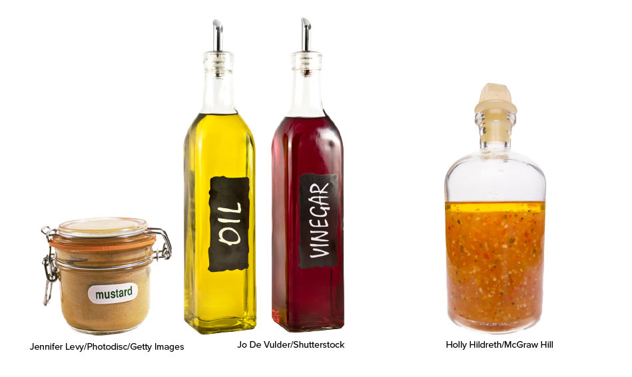
Be Curious
How are they the same?
How are they different?
Mindset
JUSTIFY IT · Say it like this: “I know ______ because ______.”
How are you building your confidence when engaging with math?
35 / 55
Notes:
TEACH IN PRACTICE | Embedded facilitation | Lesson 3.1, slide 34 | CURIOUS
Focus on the existing task: Be Curious How are they the same?
LAUNCH (T2/3/5): Allow quiet observation first. Separate a notice from an inference, invite students’ own questions, and follow the existing launch before teaching a procedure.
LOOK FOR (T4): Where this task addresses it, students can name the compared quantities in order. Ask which feature of their work supports the claim.
RESPOND: If this task shows the lesson misconception—reversing the ratio or confusing a part with the total—label the two quantities on the existing tape diagram or double number line. Have the student revise and explain the change. Use this support only where the concept occurs in the current task; otherwise respond to the displayed question.
RECHECK: If a gap is shared, revisit the existing representation together. If it is limited, give targeted support while others compare valid methods on the same task. Check the revision before moving on.
PARTICIPATION (T5/6/7): Think time before volunteers; accept a written, drawn or rehearsed entry. Students ask for evidence respectfully. Recognize a specific contribution or revision and check that both partners participate.
Source: BCPS Updated Instructional Framework Rubric (June 2020), TEACH 1–7.

Slide 36
STUDENT MOVE · NOTICE • COMPARE • EXPLAIN
Be Curious
How are they the same?
How are they different?
DISCUSSION MOVES
Mindset
I notice ___ because ___.
I wonder ___.
I agree / disagree because ___.
ANOTHER PATHWAY · Did anyone get there a different way? Put both pathways side by side and compare.
36 / 55
Notes:
TEACH IN PRACTICE | Embedded facilitation | Lesson 3.1, slide 35 | CURIOUS
Focus on the existing task: Be Curious How are they the same?
LAUNCH (T2/3/5): Allow quiet observation first. Separate a notice from an inference, invite students’ own questions, and follow the existing launch before teaching a procedure.
LOOK FOR (T4): Where this task addresses it, students can name the compared quantities in order. Ask which feature of their work supports the claim.
RESPOND: If this task shows the lesson misconception—reversing the ratio or confusing a part with the total—label the two quantities on the existing tape diagram or double number line. Have the student revise and explain the change. Use this support only where the concept occurs in the current task; otherwise respond to the displayed question.
RECHECK: If a gap is shared, revisit the existing representation together. If it is limited, give targeted support while others compare valid methods on the same task. Check the revision before moving on.
PARTICIPATION (T5/6/7): Think time before volunteers; accept a written, drawn or rehearsed entry. Students ask for evidence respectfully. Recognize a specific contribution or revision and check that both partners participate.
Source: BCPS Updated Instructional Framework Rubric (June 2020), TEACH 1–7. Earlier notes and answer keys are retained below.
EARLIER NOTES / EXISTING ANSWER KEY
One quiet minute with the recipe image. Collect notices and wonders and steer nothing. If someone predicts the question, park it on the board for two slides from now.
UIFR FULL | Lesson-specific facilitation
TEACH 2-3 | Session 2 task launch (UIFR PDF pp. 9-10).
Use the problem exactly as displayed. Give individual thinking time before discussion or advancing to the explanation. If the answer is already visible, ask students to reconstruct and justify it. Invite a choice of suitable representations and have students explain why their choice helps.
At the point where this concept appears, ask: “Which two quantities does this ratio compare, and how does your model preserve that comparison?” Wait for evidence, invite another pathway, and have a student ask a follow-up question. Do not replace students’ reasoning with a sequence of leading steps.

Slide 37
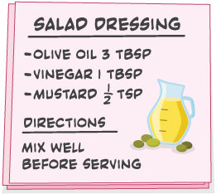
STUDENT MOVE · MAKE A PREDICTION • EXPLAIN
Compare strategies; defend one with evidence.
Making Salad Dressing
Tahira is making a salad dressing using the recipe shown. She plans to use 4 tablespoons of vinegar.
How can she determine the amount of olive oil she will need to keep the taste of the salad dressing the same?
PART → PART
FIRST QUESTION
How do vinegar and olive oil relate: part-to-part or part-to-whole?
MAKE A PREDICTION
“If the vinegar is ×4, I predict the olive oil will be ___ because ___.”
37 / 55
Notes:
TEACH IN PRACTICE | Embedded facilitation | Lesson 3.1, slide 36 | TASK
Focus on the existing task: Tahira is making a salad dressing using the recipe shown. She plans to use 4 tablespoons of vinegar. How can she determine the amount of…
LAUNCH (T2/3/5): Use the displayed question. Give private thinking time; then A explains while B asks for evidence. Switch roles. Each student records their own reasoning.
LOOK FOR (T4): Where this task addresses it, students can distinguish part-to-part and part-to-whole. Ask which feature of their work supports the claim.
RESPOND: If this task shows the lesson misconception—reversing the ratio or confusing a part with the total—label the two quantities on the existing tape diagram or double number line. Have the student revise and explain the change. Use this support only where the concept occurs in the current task; otherwise respond to the displayed question.
RECHECK: If a gap is shared, revisit the existing representation together. If it is limited, give targeted support while others compare valid methods on the same task. Check the revision before moving on.
PARTICIPATION (T5/6/7): Think time before volunteers; accept a written, drawn or rehearsed entry. Students ask for evidence respectfully. Recognize a specific contribution or revision and check that both partners participate.
Source: BCPS Updated Instructional Framework Rubric (June 2020), TEACH 1–7. Earlier notes and answer keys are retained below.
EARLIER NOTES / EXISTING ANSWER KEY
Combined the salad-dressing launch with the question about how the two ingredients relate.

Slide 38
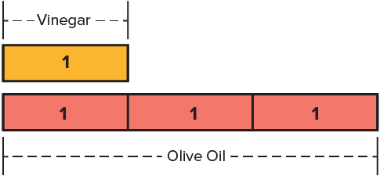
STUDENT MOVE · READ THE DIAGRAM • EXPLAIN
Both ingredients are parts → part-to-part. One way to model the relationship is a tape diagram.
How do the tablespoons of vinegar relate to the tablespoons of olive oil?
PART → PART
Think first:
Explain your reasoning to a partner before the next slide.
Try first. Explain what each part
of the tape diagram represents in
the problem.
38 / 55
Notes:
TEACH IN PRACTICE | Embedded facilitation | Lesson 3.1, slide 37 | TASK
Focus on the existing task: Both ingredients are parts → part-to-part. One way to model the relationship is a tape diagram. How do the tablespoons of vinegar relate to the tablespoons of olive oil?
LAUNCH (T2/3/5): Use the displayed question. Give private thinking time; then A explains while B asks for evidence. Switch roles. Each student records their own reasoning.
LOOK FOR (T4): Where this task addresses it, students can distinguish part-to-part and part-to-whole. Ask which feature of their work supports the claim.
RESPOND: If this task shows the lesson misconception—reversing the ratio or confusing a part with the total—label the two quantities on the existing tape diagram or double number line. Have the student revise and explain the change. Use this support only where the concept occurs in the current task; otherwise respond to the displayed question.
RECHECK: If a gap is shared, revisit the existing representation together. If it is limited, give targeted support while others compare valid methods on the same task. Check the revision before moving on.
PARTICIPATION (T5/6/7): Think time before volunteers; accept a written, drawn or rehearsed entry. Students ask for evidence respectfully. Recognize a specific contribution or revision and check that both partners participate.
Source: BCPS Updated Instructional Framework Rubric (June 2020), TEACH 1–7. Earlier notes and answer keys are retained below.
EARLIER NOTES / EXISTING ANSWER KEY
Teacher reference: For every 1 tablespoon of vinegar, there are 3 tablespoons of olive oil.
Combined part-to-part classification with the tape-diagram reading task.

Slide 39
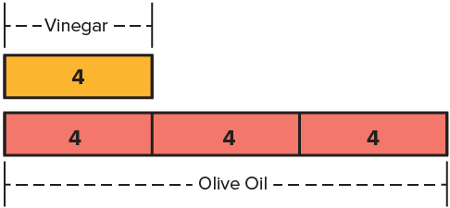
STUDENT MOVE · SCALE BOTH PARTS • CHECK
Student-led talk: assign roles and monitor group progress.
Collaborate and Connect (continued)
Tahira can change the value in each box of the tape diagram from 1 to 4.
PART → PART
SOLVE + EXPLAIN
How much olive oil is needed for 4 tbsp vinegar? Use addition OR multiplication, then explain why the ratio stays 1:3.
39 / 55
Notes:
TEACH IN PRACTICE | Embedded facilitation | Lesson 3.1, slide 38 | COLLABORATE
Focus on the existing task: Collaborate and Connect (continued) Tahira can change the value in each box of the tape diagram from 1 to 4. STUDENT MOVE · SCALE…
LAUNCH (T2/3/5): Use the displayed question. Give private thinking time; then A explains while B asks for evidence. Switch roles. Each student records their own reasoning.
LOOK FOR (T4): Where this task addresses it, students can scale both quantities together. Ask which feature of their work supports the claim.
RESPOND: If this task shows the lesson misconception—reversing the ratio or confusing a part with the total—label the two quantities on the existing tape diagram or double number line. Have the student revise and explain the change. Use this support only where the concept occurs in the current task; otherwise respond to the displayed question.
RECHECK: If a gap is shared, revisit the existing representation together. If it is limited, give targeted support while others compare valid methods on the same task. Check the revision before moving on.
PARTICIPATION (T5/6/7): Think time before volunteers; accept a written, drawn or rehearsed entry. Students ask for evidence respectfully. Recognize a specific contribution or revision and check that both partners participate.
Source: BCPS Updated Instructional Framework Rubric (June 2020), TEACH 1–7. Earlier notes and answer keys are retained below.
EARLIER NOTES / EXISTING ANSWER KEY
Combined the scale-the-model, solve, and multiple-strategy prompts.
UIFR FULL | Lesson-specific facilitation
TEACH 4-5 | Session 2 discussion and checkpoint (UIFR PDF pp. 11-12).
Collect a brief response from every student to the existing prompt before hearing volunteers. Partners take turns explaining and asking for evidence: “I understand ___; what supports ___?” Offer rehearsal or an annotated model for students who need language support. Each student records their own reasoning.
Look specifically for: reversing the ratio or confusing a part with the total. If it appears, label the two quantities on the existing tape diagram or double number line; then ask the student to revise the same response and explain the change. If evidence is secure, have students compare a second valid pathway or state why their approach works. Choose the next step from the responses, not a preset pace.

Slide 40
STUDENT MOVE · CHOOSE A CHALLENGE • SHOW YOUR THINKING
Let’s Explore More
How can Tahira determine the amount of salad dressing she will have if she uses 6 tablespoons of vinegar?
Show your thinking
Tahira added 4 teaspoons of mustard to the 4 tablespoons of vinegar. How will her salad dressing taste?
Show your thinking
Solve → Explain → Revise
40 / 55
Notes:
TEACH IN PRACTICE | Embedded facilitation | Lesson 3.1, slide 39 | PRACTICE
Focus on the existing task: Let’s Explore More How can Tahira determine the amount of salad dressing she will have if she uses 6 tablespoons of vinegar?
LAUNCH (T2/3/5): Use the displayed question. Give private thinking time; then A explains while B asks for evidence. Switch roles. Each student records their own reasoning.
LOOK FOR (T4): Where this task addresses it, students can name the compared quantities in order. Ask which feature of their work supports the claim.
RESPOND: If this task shows the lesson misconception—reversing the ratio or confusing a part with the total—label the two quantities on the existing tape diagram or double number line. Have the student revise and explain the change. Use this support only where the concept occurs in the current task; otherwise respond to the displayed question.
RECHECK: If a gap is shared, revisit the existing representation together. If it is limited, give targeted support while others compare valid methods on the same task. Check the revision before moving on.
PARTICIPATION (T5/6/7): Think time before volunteers; accept a written, drawn or rehearsed entry. Students ask for evidence respectfully. Recognize a specific contribution or revision and check that both partners participate.
Source: BCPS Updated Instructional Framework Rubric (June 2020), TEACH 1–7. Earlier notes and answer keys are retained below.
EARLIER NOTES / EXISTING ANSWER KEY
Choice slide: students pick a challenge and show their thinking in the notebook. Press for a model — tape diagram or double number line — not just an answer.

Slide 41
STUDENT MOVES
Lesson 3-1
Your move
TWO MINUTES SOLO · Two minutes on your own, then compare. Bring one thing you tried, even if it did not work.
41 / 55

Slide 42
LESSON 3.1 / CHECK YOUR WORK
Pause. Check. Improve.
CHECK
A mistake to watch for: reversing the ratio or confusing a part with the total.
TRY
Label the two quantities on the given tape diagram or double number line.
REVISE
Use that check on the task you just completed. Correct or strengthen one part, and explain why.
REVISE NOW · Change one answer and write why you changed it. A revision is evidence of learning.
Listen to understand. Ask for evidence. Make room for every voice.
Notes:
TEACH IN PRACTICE | Embedded facilitation | Lesson 3.1, slide 40 | PRIOR_INSERT
Focus on the existing task: LESSON 3.1 / CHECK YOUR WORK Pause. Check. Improve. Listen to understand. Ask for evidence. Make room for every voice. CHECK A mistake…
CONNECT (T1/4): Ask students to restate the displayed goal or key idea and connect it to earlier work. Relevant lesson evidence: name the compared quantities in order; distinguish part-to-part and part-to-whole; scale both quantities together. Use only the criterion that matches the current session.
SHOW PROGRESS: Students point to their own existing work, explain what improved after feedback, and name a next step. Pair confidence ratings with actual evidence.
PARTICIPATION (T5/6/7): Think time before volunteers; accept a written, drawn or rehearsed entry. Students ask for evidence respectfully. Recognize a specific contribution or revision and check that both partners participate.
Source: BCPS Updated Instructional Framework Rubric (June 2020), TEACH 1–7.

Slide 43
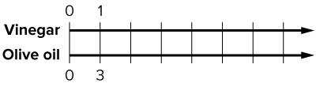
STUDENT MOVE · NOTICE A PATTERN • EXPLAIN
A double number line can be used to represent the relationship. A double number line consists of two number lines.
PATTERN TALK
Top line: +1 each step
Bottom line: +3 each step
Why does this keep the ratio 1:3?
Complete the double number line. What pattern do you notice?
PART → PART
Think first:
Explain your reasoning to a partner before the next slide.
Try first. Use the scale and
positions on the number line to
justify your answer.
43 / 55
Notes:
TEACH IN PRACTICE | Embedded facilitation | Lesson 3.1, slide 41 | TASK
Focus on the existing task: A double number line can be used to represent the relationship. A double number line consists of two number lines. Complete the double number line. What pattern do you notice?
LAUNCH (T2/3/5): Use the displayed question. Give private thinking time; then A explains while B asks for evidence. Switch roles. Each student records their own reasoning.
LOOK FOR (T4): Where this task addresses it, students can distinguish part-to-part and part-to-whole. Ask which feature of their work supports the claim.
RESPOND: If this task shows the lesson misconception—reversing the ratio or confusing a part with the total—label the two quantities on the existing tape diagram or double number line. Have the student revise and explain the change. Use this support only where the concept occurs in the current task; otherwise respond to the displayed question.
RECHECK: If a gap is shared, revisit the existing representation together. If it is limited, give targeted support while others compare valid methods on the same task. Check the revision before moving on.
PARTICIPATION (T5/6/7): Think time before volunteers; accept a written, drawn or rehearsed entry. Students ask for evidence respectfully. Recognize a specific contribution or revision and check that both partners participate.
Source: BCPS Updated Instructional Framework Rubric (June 2020), TEACH 1–7. Earlier notes and answer keys are retained below.
EARLIER NOTES / EXISTING ANSWER KEY
Teacher reference: The top number line increases by 1; the bottom number line increases by 3.
Combined prediction of another model, double-number-line introduction, and pattern analysis.

Slide 44
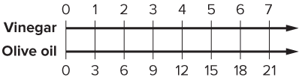
STUDENT MOVE · USE THE MODEL • EXPLAIN
How can you use the double number line to determine how many tablespoons of olive oil are needed for 4 tablespoons of vinegar?
PART → PART
Think first:
Explain your reasoning to a partner before the next slide.
Try first. Use the scale and
positions on the number line to
justify your answer.
44 / 55
Notes:
TEACH IN PRACTICE | Embedded facilitation | Lesson 3.1, slide 42 | TASK
Focus on the existing task: How can you use the double number line to determine how many tablespoons of olive oil are needed for 4 tablespoons of vinegar?
LAUNCH (T2/3/5): Use the displayed question. Give private thinking time; then A explains while B asks for evidence. Switch roles. Each student records their own reasoning.
LOOK FOR (T4): Where this task addresses it, students can distinguish part-to-part and part-to-whole. Ask which feature of their work supports the claim.
RESPOND: If this task shows the lesson misconception—reversing the ratio or confusing a part with the total—label the two quantities on the existing tape diagram or double number line. Have the student revise and explain the change. Use this support only where the concept occurs in the current task; otherwise respond to the displayed question.
RECHECK: If a gap is shared, revisit the existing representation together. If it is limited, give targeted support while others compare valid methods on the same task. Check the revision before moving on.
PARTICIPATION (T5/6/7): Think time before volunteers; accept a written, drawn or rehearsed entry. Students ask for evidence respectfully. Recognize a specific contribution or revision and check that both partners participate.
Source: BCPS Updated Instructional Framework Rubric (June 2020), TEACH 1–7. Earlier notes and answer keys are retained below.
EARLIER NOTES / EXISTING ANSWER KEY
Solo think, then partner explain. The move is reading straight down between the two lines: tablespoons of vinegar line up with tablespoons of olive oil. Listen for students counting tick marks without naming units.

Slide 45
STUDENT MOVE · EXPLAIN WHY THE PATTERN WORKS
CHECK YOUR MODEL: 4 tbsp vinegar → 12 tbsp olive oil.
How does the double number line prove the relationship stays 1:3?
Try first. Use the scale and
positions on the number line to
justify your answer.
PART → PART
Check + Explain
Explain using either the +3 pattern or the ×4 scale factor. Which explanation is clearer to you?
45 / 55
Notes:
TEACH IN PRACTICE | Embedded facilitation | Lesson 3.1, slide 43 | TASK
Focus on the existing task: CHECK YOUR MODEL: 4 tbsp vinegar → 12 tbsp olive oil. How does the double number line prove the relationship stays 1:3?
LAUNCH (T2/3/5): Use the displayed question. Give private thinking time; then A explains while B asks for evidence. Switch roles. Each student records their own reasoning.
LOOK FOR (T4): Where this task addresses it, students can distinguish part-to-part and part-to-whole. Ask which feature of their work supports the claim.
RESPOND: If this task shows the lesson misconception—reversing the ratio or confusing a part with the total—label the two quantities on the existing tape diagram or double number line. Have the student revise and explain the change. Use this support only where the concept occurs in the current task; otherwise respond to the displayed question.
RECHECK: If a gap is shared, revisit the existing representation together. If it is limited, give targeted support while others compare valid methods on the same task. Check the revision before moving on.
PARTICIPATION (T5/6/7): Think time before volunteers; accept a written, drawn or rehearsed entry. Students ask for evidence respectfully. Recognize a specific contribution or revision and check that both partners participate.
Source: BCPS Updated Instructional Framework Rubric (June 2020), TEACH 1–7. Earlier notes and answer keys are retained below.
EARLIER NOTES / EXISTING ANSWER KEY
Combined solve/check, looking-for-structure, and final 12-tablespoon conclusion.

Slide 46
Both vinegar and olive oil are parts of the recipe. The relationship is a part-to-part ratio.
What is one way to represent the relationship?
Compare your reasoning with the
explanation. Explain any revision you make.
Reveal:
A tape diagram can represent the relationship.
46 / 55
Notes:
TEACH IN PRACTICE | Embedded facilitation | Lesson 3.1, slide 44 | REVEAL
Focus on the existing task: Both vinegar and olive oil are parts of the recipe. The relationship is a part-to-part ratio. What is one way to represent the relationship?
LAUNCH (T2/3/5): If an existing answer cover is present, gather an attempt before revealing. If the explanation is already visible, ask students to reconstruct and justify it. Compare reasoning and explain a revision; preserve the reveal sequence.
LOOK FOR (T4): Where this task addresses it, students can distinguish part-to-part and part-to-whole. Ask which feature of their work supports the claim.
RESPOND: If this task shows the lesson misconception—reversing the ratio or confusing a part with the total—label the two quantities on the existing tape diagram or double number line. Have the student revise and explain the change. Use this support only where the concept occurs in the current task; otherwise respond to the displayed question.
RECHECK: If a gap is shared, revisit the existing representation together. If it is limited, give targeted support while others compare valid methods on the same task. Check the revision before moving on.
PARTICIPATION (T5/6/7): Think time before volunteers; accept a written, drawn or rehearsed entry. Students ask for evidence respectfully. Recognize a specific contribution or revision and check that both partners participate.
Source: BCPS Updated Instructional Framework Rubric (June 2020), TEACH 1–7.

Slide 47
The tape diagram shows a part-to-part relationship.
How do the tablespoons of vinegar relate to the tablespoons of olive oil?
Reveal:
For every one tablespoon of vinegar, there are 3 tablespoons of olive oil.
Compare your reasoning with the
explanation. Explain any revision
you make.
47 / 55
Notes:
TEACH IN PRACTICE | Embedded facilitation | Lesson 3.1, slide 45 | REVEAL
Focus on the existing task: The tape diagram shows a part-to-part relationship. How do the tablespoons of vinegar relate to the tablespoons of olive oil?
LAUNCH (T2/3/5): If an existing answer cover is present, gather an attempt before revealing. If the explanation is already visible, ask students to reconstruct and justify it. Compare reasoning and explain a revision; preserve the reveal sequence.
LOOK FOR (T4): Where this task addresses it, students can distinguish part-to-part and part-to-whole. Ask which feature of their work supports the claim.
RESPOND: If this task shows the lesson misconception—reversing the ratio or confusing a part with the total—label the two quantities on the existing tape diagram or double number line. Have the student revise and explain the change. Use this support only where the concept occurs in the current task; otherwise respond to the displayed question.
RECHECK: If a gap is shared, revisit the existing representation together. If it is limited, give targeted support while others compare valid methods on the same task. Check the revision before moving on.
PARTICIPATION (T5/6/7): Think time before volunteers; accept a written, drawn or rehearsed entry. Students ask for evidence respectfully. Recognize a specific contribution or revision and check that both partners participate.
Source: BCPS Updated Instructional Framework Rubric (June 2020), TEACH 1–7.

Slide 48
How can Tahira determine how much olive oil to use with 4 tablespoons of vinegar?
Reveal:
She can add the values in the tape diagram, or she can multiply 4 by 3.
Compare your reasoning with the
explanation. Explain any revision
you make.
48 / 55
Notes:
TEACH IN PRACTICE | Embedded facilitation | Lesson 3.1, slide 46 | REVEAL
Focus on the existing task: How can Tahira determine how much olive oil to use with 4 tablespoons of vinegar?
LAUNCH (T2/3/5): If an existing answer cover is present, gather an attempt before revealing. If the explanation is already visible, ask students to reconstruct and justify it. Compare reasoning and explain a revision; preserve the reveal sequence.
LOOK FOR (T4): Where this task addresses it, students can name the compared quantities in order. Ask which feature of their work supports the claim.
RESPOND: If this task shows the lesson misconception—reversing the ratio or confusing a part with the total—label the two quantities on the existing tape diagram or double number line. Have the student revise and explain the change. Use this support only where the concept occurs in the current task; otherwise respond to the displayed question.
RECHECK: If a gap is shared, revisit the existing representation together. If it is limited, give targeted support while others compare valid methods on the same task. Check the revision before moving on.
PARTICIPATION (T5/6/7): Think time before volunteers; accept a written, drawn or rehearsed entry. Students ask for evidence respectfully. Recognize a specific contribution or revision and check that both partners participate.
Source: BCPS Updated Instructional Framework Rubric (June 2020), TEACH 1–7.

Slide 49
What could be another way to represent the part-to-part relationship?
Reveal:
A double number line can represent the relationship.
Compare your reasoning with the
explanation. Explain any revision
you make.
49 / 55
Notes:
TEACH IN PRACTICE | Embedded facilitation | Lesson 3.1, slide 47 | REVEAL
Focus on the existing task: What could be another way to represent the part-to-part relationship?
LAUNCH (T2/3/5): If an existing answer cover is present, gather an attempt before revealing. If the explanation is already visible, ask students to reconstruct and justify it. Compare reasoning and explain a revision; preserve the reveal sequence.
LOOK FOR (T4): Where this task addresses it, students can distinguish part-to-part and part-to-whole. Ask which feature of their work supports the claim.
RESPOND: If this task shows the lesson misconception—reversing the ratio or confusing a part with the total—label the two quantities on the existing tape diagram or double number line. Have the student revise and explain the change. Use this support only where the concept occurs in the current task; otherwise respond to the displayed question.
RECHECK: If a gap is shared, revisit the existing representation together. If it is limited, give targeted support while others compare valid methods on the same task. Check the revision before moving on.
PARTICIPATION (T5/6/7): Think time before volunteers; accept a written, drawn or rehearsed entry. Students ask for evidence respectfully. Recognize a specific contribution or revision and check that both partners participate.
Source: BCPS Updated Instructional Framework Rubric (June 2020), TEACH 1–7.

Slide 50
STUDENT MOVE · SUMMARIZE YOUR STRATEGY
Tahira is making a salad dressing using the recipe shown. She plans to use 4 tablespoons of vinegar.
How can she determine the amount of olive oil she will need to keep the taste of the salad dressing the same?
Tahira can use a tape diagram or a double number line to determine that 12 tablespoons of olive oil are needed when using 4 tablespoons of vinegar.
50 / 55
Notes:
TEACH IN PRACTICE | Embedded facilitation | Lesson 3.1, slide 48 | TASK
Focus on the existing task: Tahira can use a tape diagram or a double number line to determine that 12 tablespoons of olive oil are needed when using 4…
LAUNCH (T2/3/5): Use the displayed question. Give private thinking time; then A explains while B asks for evidence. Switch roles. Each student records their own reasoning.
LOOK FOR (T4): Where this task addresses it, students can name the compared quantities in order. Ask which feature of their work supports the claim.
RESPOND: If this task shows the lesson misconception—reversing the ratio or confusing a part with the total—label the two quantities on the existing tape diagram or double number line. Have the student revise and explain the change. Use this support only where the concept occurs in the current task; otherwise respond to the displayed question.
RECHECK: If a gap is shared, revisit the existing representation together. If it is limited, give targeted support while others compare valid methods on the same task. Check the revision before moving on.
PARTICIPATION (T5/6/7): Think time before volunteers; accept a written, drawn or rehearsed entry. Students ask for evidence respectfully. Recognize a specific contribution or revision and check that both partners participate.
Source: BCPS Updated Instructional Framework Rubric (June 2020), TEACH 1–7. Earlier notes and answer keys are retained below.
EARLIER NOTES / EXISTING ANSWER KEY
Summarize the strategy: both models answer the same question. Partners name one thing the tape diagram shows better and one thing the double number line shows better.

Slide 51
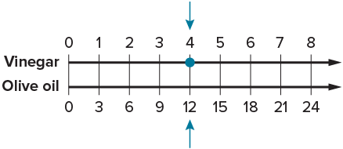
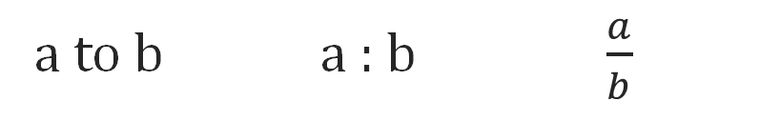
STUDENT MOVE · SUMMARIZE • TEACH A PARTNER
Summarize: Understand Ratios
Summarize: Two Ratio Types
Classify the comparison BEFORE you calculate.
PART-TO-PART
PART-TO-WHOLE
part : part
part : total
Example: apple juice : water = 2 : 7
Example: apple juice : drink = 2 : 10
A ratio can be represented symbolically in three ways.
a to b a : b $\frac{a}{b}$
51 / 55
Notes:
TEACH IN PRACTICE | Embedded facilitation | Lesson 3.1, slide 49 | SUMMARIZE
Focus on the existing task: Summarize: Understand Ratio s A ratio can be represented symbolically in three ways. a to b a: b STUDENT MOVE · SUMMARIZE •…
CONNECT (T1/4): Ask students to restate the displayed goal or key idea and connect it to earlier work. Relevant lesson evidence: name the compared quantities in order; distinguish part-to-part and part-to-whole; scale both quantities together. Use only the criterion that matches the current session.
SHOW PROGRESS: Students point to their own existing work, explain what improved after feedback, and name a next step. Pair confidence ratings with actual evidence.
PARTICIPATION (T5/6/7): Think time before volunteers; accept a written, drawn or rehearsed entry. Students ask for evidence respectfully. Recognize a specific contribution or revision and check that both partners participate.
Source: BCPS Updated Instructional Framework Rubric (June 2020), TEACH 1–7. Earlier notes and answer keys are retained below.
EARLIER NOTES / EXISTING ANSWER KEY
Students teach a partner the two ratio types using the anchor examples. ‘Classify BEFORE you calculate’ is the takeaway — have the class say it once together.

Slide 52
STUDENT MOVES
Lesson 3-1
Your moves
YOUR CHOICE · You choose how to show this — numbers, words, or a diagram. Make your reasoning visible.
ASK THE CLASS · Write one question about this that you could ask the class.
52 / 55

Slide 53
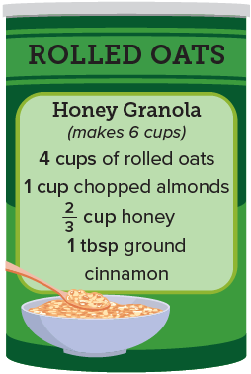
STUDENT MOVE · VOICE + CHOICE • PROVE IT
Apply: Middle School Fundraiser
Some sixth-grade students will make 50 bags of honey granola to sell at a fundraising event using the recipe shown. They will put 2 cups of granola in each bag and will sell each bag for $5.
Choose one question to answer.
QUESTION 1:
How many cups of rolled oats will the students need to buy?
QUESTION 2:
One pound of almonds costs $9.99 and has 3 cups of almonds. How much will the students need to budget for almonds?
BEFORE YOU FINISH
Choose a method. Solve independently, justify your answer,
then check the goal.
Label units. Show a model or equation. Write one sentence that proves your answer.
53 / 55
Notes:
TEACH IN PRACTICE | Embedded facilitation | Lesson 3.1, slide 50 | APPLY
Focus on the existing task: QUESTION 2: One pound of almonds costs $9.99 and has 3 cups of almonds. How much will the students need to budget for almonds?
LAUNCH (T2/3/5): Use the exact application task independently first. Ask students to justify their choice of method. Collect evidence before a partner discussion or correction.
LOOK FOR (T4): Where this task addresses it, students can name the compared quantities in order. Ask which feature of their work supports the claim.
RESPOND: If this task shows the lesson misconception—reversing the ratio or confusing a part with the total—label the two quantities on the existing tape diagram or double number line. Have the student revise and explain the change. Use this support only where the concept occurs in the current task; otherwise respond to the displayed question.
RECHECK: If a gap is shared, revisit the existing representation together. If it is limited, give targeted support while others compare valid methods on the same task. Check the revision before moving on.
PARTICIPATION (T5/6/7): Think time before volunteers; accept a written, drawn or rehearsed entry. Students ask for evidence respectfully. Recognize a specific contribution or revision and check that both partners participate.
Source: BCPS Updated Instructional Framework Rubric (June 2020), TEACH 1–7. Earlier notes and answer keys are retained below.
EARLIER NOTES / EXISTING ANSWER KEY
Voice and choice: students pick a representation and defend it. Debrief by sharing two pairs who chose different models for the same ratio.

Slide 54
STUDENT MOVE · SELF-ASSESS • NAME YOUR NEXT STEP
Partner debrief: name your evidence and one next step.
Exit Ticket + Self-Check
Trail mix uses 2 cups of pretzels for every 5 cups of cereal.
SELF-CHECK
If you use 8 cups of pretzels, how many cups of cereal are needed?
1. I can describe a ratio.
□ Alone □ With a hint □ Not yet
2. I can represent and scale a ratio.
□ Alone □ With a hint □ Not yet
My next step:
____________________
Show your thinking with a tape diagram, double number line, or scale factor.
Explain: “I multiplied both quantities by ___, so ___.”
PART → PART
Work independently and show why. Use feedback to revise
in a second color.
54 / 55
Notes:
TEACH IN PRACTICE | Embedded facilitation | Lesson 3.1, slide 51 | ASSESSMENT
Focus on the existing task: Exit Ticket + Self-Check STUDENT MOVE · SELF-ASSESS • NAME YOUR NEXT STEP Trail mix uses 2 cups of pretzels for every 5 cups of cereal. If you use 8 cups of pretzels, how many cups of cereal are needed?
LAUNCH (T2/3/5): Gather an independent response before feedback. Students choose a suitable representation and justify it. Keep the first attempt separate from the revision.
LOOK FOR (T4): Where this task addresses it, students can scale both quantities together. Ask which feature of their work supports the claim.
RESPOND: If this task shows the lesson misconception—reversing the ratio or confusing a part with the total—label the two quantities on the existing tape diagram or double number line. Have the student revise and explain the change. Use this support only where the concept occurs in the current task; otherwise respond to the displayed question.
RECHECK: If a gap is shared, revisit the existing representation together. If it is limited, give targeted support while others compare valid methods on the same task. Check the revision before moving on.
PARTICIPATION (T5/6/7): Think time before volunteers; accept a written, drawn or rehearsed entry. Students ask for evidence respectfully. Recognize a specific contribution or revision and check that both partners participate.
Source: BCPS Updated Instructional Framework Rubric (June 2020), TEACH 1–7. Earlier notes and answer keys are retained below.
EARLIER NOTES / EXISTING ANSWER KEY
Collect exit tickets before students self-assess. The READY / ALMOST / NOT YET line sets tomorrow’s small groups — record it before dismissal.
UIFR FULL | Lesson-specific facilitation
TEACH 4 | Independent evidence and revision (UIFR PDF p. 11).
Use the existing application/exit problem as the independent check. If this is a learning-target slide, have students point to and explain their work on the preceding task. Separate initial independent evidence from the revision after feedback.
Check the relevant criteria: name the compared quantities in order; distinguish part-to-part and part-to-whole; scale both quantities together. Respond with one specific next step tied to the work. Students revise and annotate what changed, then identify a criterion they can now demonstrate and one they still need to practice.

Slide 55
Learning Targets
I can describe the relationship between quantities using ratios.
I can make sense of quantities to represent ratios using tape diagrams and double number lines.
SAY THE GOAL · Say today’s goal in your own words, then name one place this shows up outside math class.
55 / 55
Notes:
TEACH IN PRACTICE | Embedded facilitation | Lesson 3.1, slide 52 | REFLECTION
Focus on the existing task: Learning Targets I can describe the relationship between quantities using ratios. I can make sense of quantities to represent ratios using…
CONNECT (T1/4): Ask students to restate the displayed goal or key idea and connect it to earlier work. Relevant lesson evidence: name the compared quantities in order; distinguish part-to-part and part-to-whole; scale both quantities together. Use only the criterion that matches the current session.
SHOW PROGRESS: Students point to their own existing work, explain what improved after feedback, and name a next step. Pair confidence ratings with actual evidence.
PARTICIPATION (T5/6/7): Think time before volunteers; accept a written, drawn or rehearsed entry. Students ask for evidence respectfully. Recognize a specific contribution or revision and check that both partners participate.
Source: BCPS Updated Instructional Framework Rubric (June 2020), TEACH 1–7. Earlier notes and answer keys are retained below.
EARLIER NOTES / EXISTING ANSWER KEY
UIFR FULL | Lesson-specific facilitation
REFLECT & ADJUST 1-2 | After the lesson (UIFR PDF pp. 15-16).
Sort the existing work by demonstrated reasoning, partial understanding, and the specific misconception: reversing the ratio or confusing a part with the total. Compare the initial response with the revision. Record which teaching move plausibly helped, which did not, and whose participation or access needs a different approach; do not record sensitive student details in this shared deck.
Plan the next lesson from that evidence: if the misconception persists, label the two quantities on the existing tape diagram or double number line using the current example before returning to the next grade-level task; if understanding is secure, use an existing extension or ask for a general explanation. Check the targeted idea again at the next warm-up.
Ask students what supported their thinking and what would help next time. Identify one change to try and one successful practice to retain. Seek colleague feedback on anonymized work when useful; these prompts support reflection and do not establish an evaluation rating. Source: Baltimore City Public Schools, Updated Instructional Framework Rubric, June 2020 (UIFR_Full.pdf).

