Slide 1

WARM-UP · THINK • TRY • CHECK
Turn and talk: compare strategies, then defend one.
Warm-Up
Lesson 3-2 · Rates and Unit Rates | Warm-Up · about 4 minutes
Try each on your own. Mark an unsure answer; explain and revise when we check.
QUESTION 1
QUESTION 2
60 ÷ 4 = ______
Keep the pattern going:
5, 10, 15, 20, ______, ______
QUESTION 3
QUESTION 4
A car goes 120 miles in 2 hours.
How far in 1 hour? ______
3 apples cost $6.
What does 1 apple cost? ______
TALK IT OVER: “I got ______ because ______.” • Compare with a partner before we check as a class.
1 / 40
Notes:
TEACH IN PRACTICE | Embedded facilitation | Lesson 3.2, slide 1 | WARMUP
Focus on the existing task: ______ QUESTION 4 3 apples cost $6. What does 1 apple cost?
GATHER EVIDENCE (T4/6): Keep the original items. Students try independently, mark an uncertain item, and explain one method before checking. Use the existing key when present.
RESPOND: Distinguish a calculation slip from a reasoning gap. Give one next step on the same item; have students revise in a second color. Use the responses to choose flexible support for today’s lesson.
PARTICIPATION (T5/6/7): Think time before volunteers; accept a written, drawn or rehearsed entry. Students ask for evidence respectfully. Recognize a specific contribution or revision and check that both partners participate.
Source: BCPS Updated Instructional Framework Rubric (June 2020), TEACH 1–7. Earlier notes and answer keys are retained below.
EARLIER NOTES / EXISTING ANSWER KEY
Warm-Up answers (teacher only): 1) 15 2) 25, 30 3) 60 miles 4) $2
UIFR FULL | Lesson-specific facilitation
PREPARE 1-2 | Before teaching (UIFR PDF pp. 6-7).
Plan to gather evidence that students can label both units; interpret a rate per one unit; use the rate in the existing travel model. Review recent work and today’s warm-up to choose flexible groups and access supports; do not infer needs from identity or perceived ability. Use the existing lesson tasks and stated standards.
Anticipate: giving a rate without units or reversing the comparison. If observed, label distance and time separately on the existing representation. Offer oral rehearsal, drawing, pointing, or home-language processing as needed; retain the original mathematical demand. Ask students which support helps and fade it as evidence improves.
TEACH 6-7 | Before the first transition, agree on materials, partner roles, and how to request help. Invite students to restate the routine. Normalize revising an idea, recognize a specific contribution, and check privately when frustration blocks participation. Source: UIFR PDF pp. 13-14.

Slide 2
STUDENT NOTES · COPY LESS • UNDERSTAND MORE
Partner talk: connect today’s idea to prior learning.
Math Notes — Session 1
Keep the idea from Metro Trains.
COPY, EXPLAIN, THEN CHECK
LOOK BACK AT THE EXAMPLE
01
A rate compares amounts with different units.
Hours | Miles
1 | 150
2 | 300
3 | 450
02
Per hour means “for each hour.”
03
Keep the same rate as both amounts change.
450 miles takes 3 hours at 150 miles per hour.
2 / 40
Notes:
TEACH IN PRACTICE | Embedded facilitation | Lesson 3.2, slide 2 | NOTES
Focus on the existing task: Math Notes — Session 1 Keep the idea from Metro Trains. COPY THESE THREE LINES 01 A rate compares amounts with different units. 02 Per…
ROUTINE (T1/2/4): Read or copy the original notes, cover one line, and explain it using the displayed example. Reopen and correct. Copying alone is not evidence of understanding.
LOOK FOR: A link between a symbol, quantity or feature and the explanation. If missing, point back to that feature and have the student try again; fade the prompt once they can explain.
PARTICIPATION (T5/6/7): Think time before volunteers; accept a written, drawn or rehearsed entry. Students ask for evidence respectfully. Recognize a specific contribution or revision and check that both partners participate.
Source: BCPS Updated Instructional Framework Rubric (June 2020), TEACH 1–7. Earlier notes and answer keys are retained below.
EARLIER NOTES / EXISTING ANSWER KEY
Use this slide only after the original worked example. Students copy the three lines on the left; the table is a reference and does not need copying. Read one line at a time. Ask one student to connect a note to the example.

Slide 3
LEARNING TARGET · LABEL • MODEL • EXPLAIN
Tell a partner the goal and why it matters.
Learning Target — Session 1
Lesson 3-2 · Rates and Unit Rates | Maryland Standard 6.AT.2
Today I will connect distance and time, then explain what a rate means.
CONTENT OBJECTIVE
LANGUAGE OBJECTIVE
I can describe a rate and use a model to find a travel time.
I can explain “150 miles per hour” using distance and time units.
SUCCESS CHECK
WHY THIS MATTERS
✓ Name both units.
✓ Show 150 miles for each hour.
✓ Use a model to find travel time.
Unit rates help us compare prices and plan travel.
MATH COMMUNITY: Different strategies are welcome • Ask before telling • Revise your thinking
3 / 40
Notes:
TEACH IN PRACTICE | Embedded facilitation | Lesson 3.2, slide 3 | GOAL
Focus on the existing task: Learning Target — Session 1 | Maryland Standard 6.AT.2 LEARNING TARGET · LABEL • MODEL • EXPLAIN…
CONNECT (T1/4): Ask students to restate the displayed goal or key idea and connect it to earlier work. Relevant lesson evidence: label both units; interpret a rate per one unit; use the rate in the existing travel model. Use only the criterion that matches the current session.
SHOW PROGRESS: Students point to their own existing work, explain what improved after feedback, and name a next step. Pair confidence ratings with actual evidence.
PARTICIPATION (T5/6/7): Think time before volunteers; accept a written, drawn or rehearsed entry. Students ask for evidence respectfully. Recognize a specific contribution or revision and check that both partners participate.
Source: BCPS Updated Instructional Framework Rubric (June 2020), TEACH 1–7. Earlier notes and answer keys are retained below.
EARLIER NOTES / EXISTING ANSWER KEY
Name today’s content and language goals. Briefly read the success criteria; do not teach procedures here. The original context and model follow. Return to these criteria after the worked example.
UIFR FULL | Lesson-specific facilitation
TEACH 1 | Session 1 purpose and evidence (UIFR PDF p. 8).
Have students restate the displayed session goal in their own words and connect it to the existing context or a familiar experience they choose to share. Use the current session goal to select from these lesson-wide evidence criteria; do not frontload a later-session procedure.
Look for: label both units; interpret a rate per one unit; use the rate in the existing travel model. Ask: “Which part of your work would show this?” Revisit that evidence after the task; a confidence rating alone is not evidence of understanding.

Slide 4
Vocabulary 1 of 8
Lesson 3-2 · Understand Rates and Unit Rates
Rates and Unit Rates
A rate compares different units; a unit rate compares a quantity to 1 unit.
EXAMPLE · EXPLAIN WHY IT FITS
180 miles in 3 hours = 60 miles per 1 hour.
USE THE MATH WORDS · Use today’s math words in your explanation — not “it” and “that thing.”
eduwonderlab.com · Neft Teacher
4 / 40
Notes:
TEACH IN PRACTICE | Embedded facilitation | Lesson 3.2, slide 4 | VOCAB
Focus on the existing task: Vocabulary 1 of 8 Rates and Unit Rates A rate compares…
ASK (T1/3/5): Where does “Rates and Unit Rates” appear in the example? Explain the meaning without reading the definition. Partner: restate the idea and ask a clarifying question.
LOOK FOR: A correct connection between the word and a feature of the example. If the student only repeats the definition, invite pointing, sketching or oral rehearsal, then ask for another explanation of this same example.
PARTICIPATION (T5/6/7): Think time before volunteers; accept a written, drawn or rehearsed entry. Students ask for evidence respectfully. Recognize a specific contribution or revision and check that both partners participate.
Source: BCPS Updated Instructional Framework Rubric (June 2020), TEACH 1–7.

Slide 5
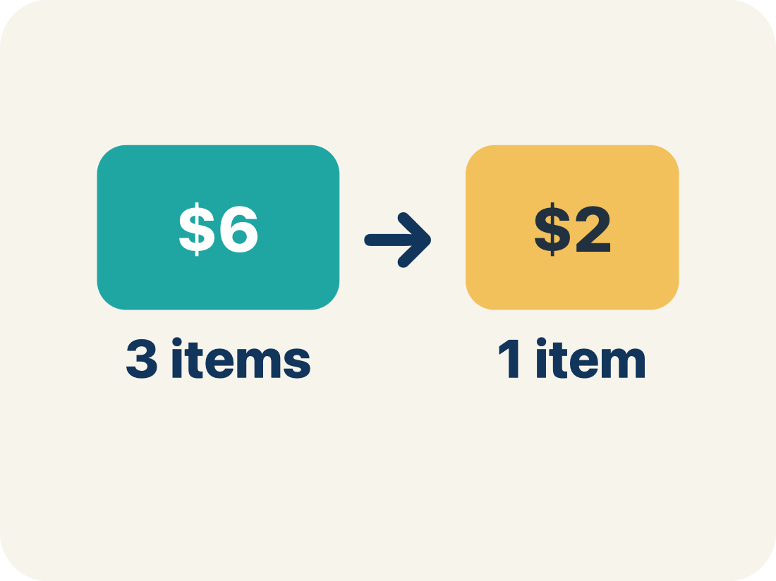
Vocabulary 2 of 8
Lesson 3-2 · Understand Rates and Unit Rates
Rate
A ratio comparing two amounts with different units, like miles per hour.
EXAMPLE · EXPLAIN WHY IT FITS
$12 for 4 games is a rate
Use “Rate” to explain the example. Point to evidence.
eduwonderlab.com · Neft Teacher
5 / 40
Notes:
TEACH IN PRACTICE | Embedded facilitation | Lesson 3.2, slide 5 | VOCAB
Focus on the existing task: Vocabulary 2 of 8 Rate A ratio comparing two amounts with…
ASK (T1/3/5): Where does “Rate” appear in the example? Explain the meaning without reading the definition. Partner: restate the idea and ask a clarifying question.
LOOK FOR: A correct connection between the word and a feature of the example. If the student only repeats the definition, invite pointing, sketching or oral rehearsal, then ask for another explanation of this same example.
PARTICIPATION (T5/6/7): Think time before volunteers; accept a written, drawn or rehearsed entry. Students ask for evidence respectfully. Recognize a specific contribution or revision and check that both partners participate.
Source: BCPS Updated Instructional Framework Rubric (June 2020), TEACH 1–7.

Slide 6
Vocabulary 3 of 8
Lesson 3-2 · Understand Rates and Unit Rates
Unit Rate
A rate for just 1 of something, like cost for 1 item.
EXAMPLE · EXPLAIN WHY IT FITS
$3 per 1 game
Use “Unit Rate” to explain the example. Point to evidence.
eduwonderlab.com · Neft Teacher
6 / 40
Notes:
TEACH IN PRACTICE | Embedded facilitation | Lesson 3.2, slide 6 | VOCAB
Focus on the existing task: Vocabulary 3 of 8 Unit Rate A rate for just 1 of…
ASK (T1/3/5): Where does “Unit Rate” appear in the example? Explain the meaning without reading the definition. Partner: restate the idea and ask a clarifying question.
LOOK FOR: A correct connection between the word and a feature of the example. If the student only repeats the definition, invite pointing, sketching or oral rehearsal, then ask for another explanation of this same example.
PARTICIPATION (T5/6/7): Think time before volunteers; accept a written, drawn or rehearsed entry. Students ask for evidence respectfully. Recognize a specific contribution or revision and check that both partners participate.
Source: BCPS Updated Instructional Framework Rubric (June 2020), TEACH 1–7.

Slide 7
Vocabulary 4 of 8
Lesson 3-2 · Understand Rates and Unit Rates
Per
For each one. Example: 5 dollars per book.
EXAMPLE · EXPLAIN WHY IT FITS
60 miles per hour means 60 miles for every 1 hour
Use “Per” to explain the example. Point to evidence.
eduwonderlab.com · Neft Teacher
7 / 40
Notes:
TEACH IN PRACTICE | Embedded facilitation | Lesson 3.2, slide 7 | VOCAB
Focus on the existing task: Vocabulary 4 of 8 Per For each one. Example: 5 dollars per…
ASK (T1/3/5): Where does “Per” appear in the example? Explain the meaning without reading the definition. Partner: restate the idea and ask a clarifying question.
LOOK FOR: A correct connection between the word and a feature of the example. If the student only repeats the definition, invite pointing, sketching or oral rehearsal, then ask for another explanation of this same example.
PARTICIPATION (T5/6/7): Think time before volunteers; accept a written, drawn or rehearsed entry. Students ask for evidence respectfully. Recognize a specific contribution or revision and check that both partners participate.
Source: BCPS Updated Instructional Framework Rubric (June 2020), TEACH 1–7.

Slide 8
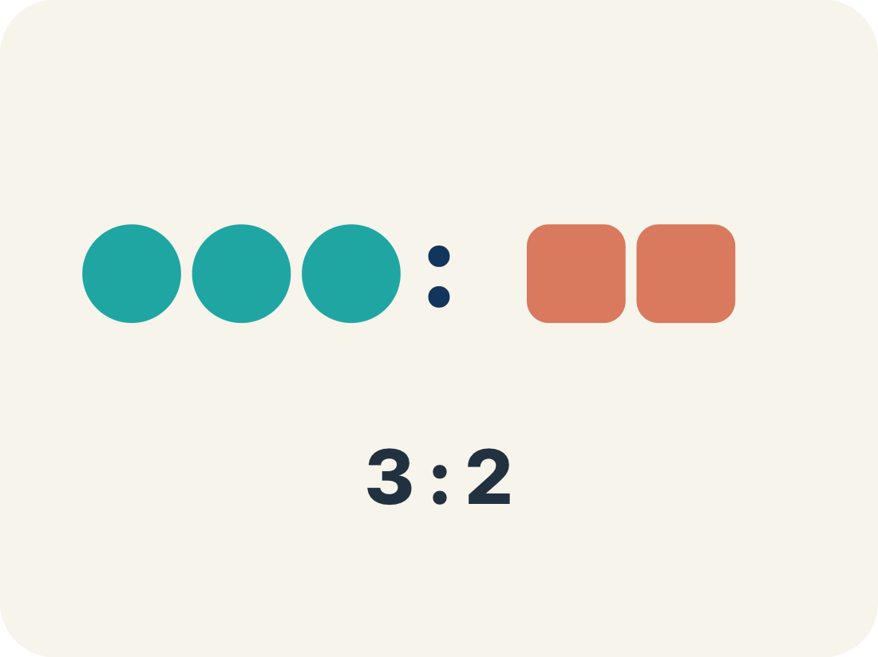
Vocabulary 5 of 8
Lesson 3-2 · Understand Rates and Unit Rates
Ratio
A way to compare two amounts, like 3 to 2.
EXAMPLE · EXPLAIN WHY IT FITS
5 to 3 or 5:3
Use “Ratio” to explain the example. Point to evidence.
eduwonderlab.com · Neft Teacher
8 / 40
Notes:
TEACH IN PRACTICE | Embedded facilitation | Lesson 3.2, slide 8 | VOCAB
Focus on the existing task: Vocabulary 5 of 8 Ratio A way to compare two amounts, like…
ASK (T1/3/5): Where does “Ratio” appear in the example? Explain the meaning without reading the definition. Partner: restate the idea and ask a clarifying question.
LOOK FOR: A correct connection between the word and a feature of the example. If the student only repeats the definition, invite pointing, sketching or oral rehearsal, then ask for another explanation of this same example.
PARTICIPATION (T5/6/7): Think time before volunteers; accept a written, drawn or rehearsed entry. Students ask for evidence respectfully. Recognize a specific contribution or revision and check that both partners participate.
Source: BCPS Updated Instructional Framework Rubric (June 2020), TEACH 1–7.

Slide 9
Vocabulary 6 of 8
Lesson 3-2 · Understand Rates and Unit Rates
Unit price
A unit rate that gives the cost of exactly 1 item, like $0.60 per game.
EXAMPLE · EXPLAIN WHY IT FITS
$3 for 5 games → $0.60 per 1 game
Use “Unit price” to explain the example. Point to evidence.
eduwonderlab.com · Neft Teacher
9 / 40
Notes:
TEACH IN PRACTICE | Embedded facilitation | Lesson 3.2, slide 9 | VOCAB
Focus on the existing task: Vocabulary 6 of 8 Unit price A unit rate that gives the…
ASK (T1/3/5): Where does “Unit price” appear in the example? Explain the meaning without reading the definition. Partner: restate the idea and ask a clarifying question.
LOOK FOR: A correct connection between the word and a feature of the example. If the student only repeats the definition, invite pointing, sketching or oral rehearsal, then ask for another explanation of this same example.
PARTICIPATION (T5/6/7): Think time before volunteers; accept a written, drawn or rehearsed entry. Students ask for evidence respectfully. Recognize a specific contribution or revision and check that both partners participate.
Source: BCPS Updated Instructional Framework Rubric (June 2020), TEACH 1–7.

Slide 10
Vocabulary 7 of 8
Lesson 3-2 · Understand Rates and Unit Rates
Better Buy
The choice that costs less for each item.
EXAMPLE · EXPLAIN WHY IT FITS
Pack A: $0.50 per pencil vs Pack B: $0.40 per pencil — Pack B is the better buy
Use “Better Buy” to explain the example. Point to evidence.
eduwonderlab.com · Neft Teacher
10 / 40
Notes:
TEACH IN PRACTICE | Embedded facilitation | Lesson 3.2, slide 10 | VOCAB
Focus on the existing task: Vocabulary 7 of 8 Better Buy The choice that costs less…
ASK (T1/3/5): Where does “Better Buy” appear in the example? Explain the meaning without reading the definition. Partner: restate the idea and ask a clarifying question.
LOOK FOR: A correct connection between the word and a feature of the example. If the student only repeats the definition, invite pointing, sketching or oral rehearsal, then ask for another explanation of this same example.
PARTICIPATION (T5/6/7): Think time before volunteers; accept a written, drawn or rehearsed entry. Students ask for evidence respectfully. Recognize a specific contribution or revision and check that both partners participate.
Source: BCPS Updated Instructional Framework Rubric (June 2020), TEACH 1–7.

Slide 11
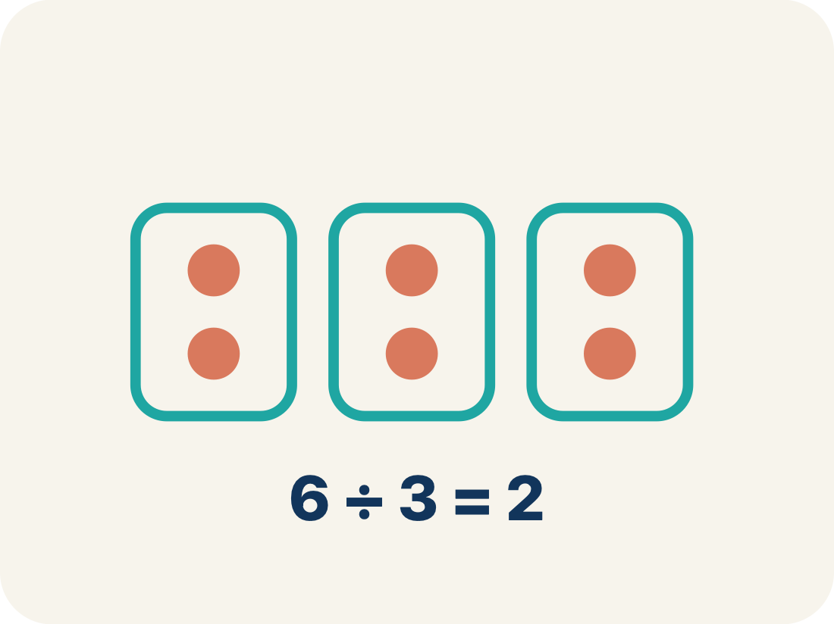
Vocabulary 8 of 8
Lesson 3-2 · Understand Rates and Unit Rates
Divide
Splitting a total into equal groups.
EXAMPLE · EXPLAIN WHY IT FITS
$12 ÷ 4 games = $3 per game
Use “Divide” to explain the example. Point to evidence.
eduwonderlab.com · Neft Teacher
11 / 40
Notes:
TEACH IN PRACTICE | Embedded facilitation | Lesson 3.2, slide 11 | VOCAB
Focus on the existing task: Vocabulary 8 of 8 Divide Splitting a total into equal…
ASK (T1/3/5): Where does “Divide” appear in the example? Explain the meaning without reading the definition. Partner: restate the idea and ask a clarifying question.
LOOK FOR: A correct connection between the word and a feature of the example. If the student only repeats the definition, invite pointing, sketching or oral rehearsal, then ask for another explanation of this same example.
PARTICIPATION (T5/6/7): Think time before volunteers; accept a written, drawn or rehearsed entry. Students ask for evidence respectfully. Recognize a specific contribution or revision and check that both partners participate.
Source: BCPS Updated Instructional Framework Rubric (June 2020), TEACH 1–7.

Slide 12
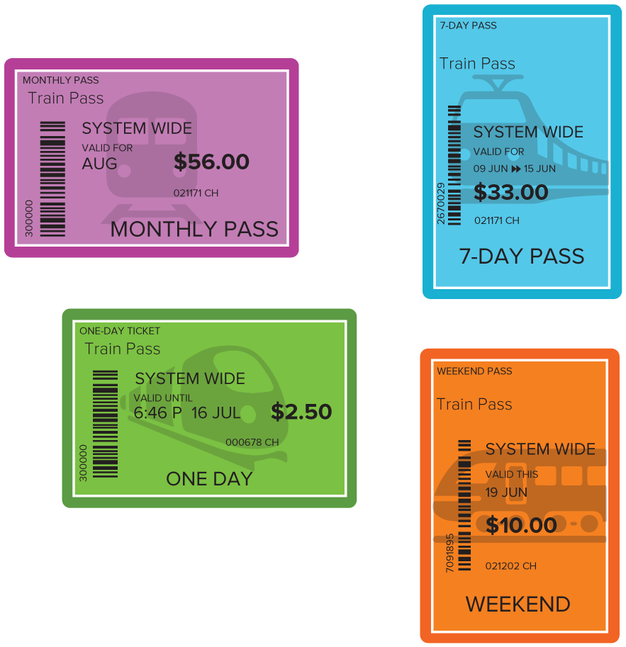

Be Curious
How are they the same?
How are they different?
Mindset
HOW DO YOU KNOW? · Ask your partner “How do you know?” Answer by pointing to your own work.
What does success in math look like for you?
12 / 40
Notes:
TEACH IN PRACTICE | Embedded facilitation | Lesson 3.2, slide 12 | CURIOUS
Focus on the existing task: Be Curious How are they the same?
LAUNCH (T2/3/5): Allow quiet observation first. Separate a notice from an inference, invite students’ own questions, and follow the existing launch before teaching a procedure.
LOOK FOR (T4): Where this task addresses it, students can label both units. Ask which feature of their work supports the claim.
RESPOND: If this task shows the lesson misconception—giving a rate without units or reversing the comparison—label distance and time separately on the existing representation. Have the student revise and explain the change. Use this support only where the concept occurs in the current task; otherwise respond to the displayed question.
RECHECK: If a gap is shared, revisit the existing representation together. If it is limited, give targeted support while others compare valid methods on the same task. Check the revision before moving on.
PARTICIPATION (T5/6/7): Think time before volunteers; accept a written, drawn or rehearsed entry. Students ask for evidence respectfully. Recognize a specific contribution or revision and check that both partners participate.
Source: BCPS Updated Instructional Framework Rubric (June 2020), TEACH 1–7.

Slide 13
STUDENT MOVE · ESTIMATE • DEFEND • COMPARE
Partner press: ask Why? and answer with evidence.
More or Less Than 1,000
Estimate first. Choose one expression and defend your estimate.
43 × 52
15 × 91
37 × 38
EXPLAIN YOUR THINKING
“I estimate more/less than 1,000 because ___.”
Think and record first. Which part of your work supports your answer?
13 / 40
Notes:
TEACH IN PRACTICE | Embedded facilitation | Lesson 3.2, slide 13 | TASK
Focus on the existing task: More or Less Than 1,000 43 × 52 15 × 91 37 × 38 STUDENT MOVE · ESTIMATE • DEFEND • COMPARE EXPLAIN YOUR THINKING “I estimate…
LAUNCH (T2/3/5): Use the displayed question. Give private thinking time; then A explains while B asks for evidence. Switch roles. Each student records their own reasoning.
LOOK FOR (T4): Where this task addresses it, students can label both units. Ask which feature of their work supports the claim.
RESPOND: If this task shows the lesson misconception—giving a rate without units or reversing the comparison—label distance and time separately on the existing representation. Have the student revise and explain the change. Use this support only where the concept occurs in the current task; otherwise respond to the displayed question.
RECHECK: If a gap is shared, revisit the existing representation together. If it is limited, give targeted support while others compare valid methods on the same task. Check the revision before moving on.
PARTICIPATION (T5/6/7): Think time before volunteers; accept a written, drawn or rehearsed entry. Students ask for evidence respectfully. Recognize a specific contribution or revision and check that both partners participate.
Source: BCPS Updated Instructional Framework Rubric (June 2020), TEACH 1–7. Earlier notes and answer keys are retained below.
EARLIER NOTES / EXISTING ANSWER KEY
Student move: Partner press: ask Why? and answer with evidence.
UIFR FULL | Lesson-specific facilitation
TEACH 2-3 | Session 1 task launch (UIFR PDF pp. 9-10).
Use the problem exactly as displayed. Give individual thinking time before discussion or advancing to the explanation. If the answer is already visible, ask students to reconstruct and justify it. Invite a choice of suitable representations and have students explain why their choice helps.
At the point where this concept appears, ask: “What does one unit of the second quantity correspond to, and how can the model show it?” Wait for evidence, invite another pathway, and have a student ask a follow-up question. Do not replace students’ reasoning with a sequence of leading steps.

Slide 14
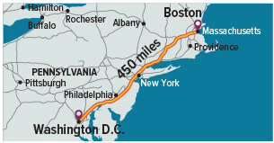
STUDENT MOVE · PREDICT • MODEL • EXPLAIN
Ask a partner a question; choose a model together.
Metro Trains
A high-speed train can travel 150 miles per hour. Some tracks require slower speeds.
If it traveled at 150 miles per hour for all 450 miles from Boston to Washington, D.C., how long would the trip take?
TALK TOOL
“For every ___ hour(s), the train travels ___ miles.”
Try first. Connect a feature of the model to a
step in your reasoning.
14 / 40
Notes:
TEACH IN PRACTICE | Embedded facilitation | Lesson 3.2, slide 14 | TASK
Focus on the existing task: Metro Trains A high-speed train can travel 150 miles per hour. Some tracks require slower speeds. If it traveled at 150 miles per hour for…
LAUNCH (T2/3/5): Use the displayed question. Give private thinking time; then A explains while B asks for evidence. Switch roles. Each student records their own reasoning.
LOOK FOR (T4): Where this task addresses it, students can use the rate in the existing travel model. Ask which feature of their work supports the claim.
RESPOND: If this task shows the lesson misconception—giving a rate without units or reversing the comparison—label distance and time separately on the existing representation. Have the student revise and explain the change. Use this support only where the concept occurs in the current task; otherwise respond to the displayed question.
RECHECK: If a gap is shared, revisit the existing representation together. If it is limited, give targeted support while others compare valid methods on the same task. Check the revision before moving on.
PARTICIPATION (T5/6/7): Think time before volunteers; accept a written, drawn or rehearsed entry. Students ask for evidence respectfully. Recognize a specific contribution or revision and check that both partners participate.
Source: BCPS Updated Instructional Framework Rubric (June 2020), TEACH 1–7. Earlier notes and answer keys are retained below.
EARLIER NOTES / EXISTING ANSWER KEY
Student move: Ask a partner a question; choose a model together.

Slide 15
STUDENT MOVE · NAME BOTH UNITS
Rates and unit rates
A rate compares two quantities with different units.
Distance (miles) | Time (hours)
150 | 1
450 | ?
A unit rate gives the amount for 1 unit. “Per hour” means for each hour.
The train travels 150 miles per hour. We need the time for 450 miles.
Think and record first. Which part of your
work supports your answer?
Explain: “150 miles per hour means ___ miles for every ___ hour.”
15 / 40
Notes:
TEACH IN PRACTICE | Embedded facilitation | Lesson 3.2, slide 15 | TASK
Focus on the existing task: Rates and unit rates A rate compares two quantities with different units. A unit rate gives the amount for 1 unit. “ Per hour ”…
LAUNCH (T2/3/5): Use the displayed question. Give private thinking time; then A explains while B asks for evidence. Switch roles. Each student records their own reasoning.
LOOK FOR (T4): Where this task addresses it, students can label both units. Ask which feature of their work supports the claim.
RESPOND: If this task shows the lesson misconception—giving a rate without units or reversing the comparison—label distance and time separately on the existing representation. Have the student revise and explain the change. Use this support only where the concept occurs in the current task; otherwise respond to the displayed question.
RECHECK: If a gap is shared, revisit the existing representation together. If it is limited, give targeted support while others compare valid methods on the same task. Check the revision before moving on.
PARTICIPATION (T5/6/7): Think time before volunteers; accept a written, drawn or rehearsed entry. Students ask for evidence respectfully. Recognize a specific contribution or revision and check that both partners participate.
Source: BCPS Updated Instructional Framework Rubric (June 2020), TEACH 1–7. Earlier notes and answer keys are retained below.
EARLIER NOTES / EXISTING ANSWER KEY
Teach this step before assigning independent practice. Read the highlighted term and connect it to the example. Model the calculation, then ask students to explain why the same factor applies to both quantities. Give thinking time and invite a partner explanation. Source content: supplied McGraw Hill Unit 3 lesson presentation.

Slide 16
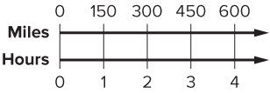
STUDENT MOVE · READ THE MODEL • CHECK
We can label the top number line with intervals of 150 miles, and the bottom number with intervals of 1 hour.
How many hours will it take the train to travel 450 miles?
PICK YOUR STRATEGY · Choose your path — picture, table, number line, or equation — and be ready to say why you chose it.
CHECK THE RELATIONSHIP
“450 ÷ 150 = ___, so the trip takes ___ hours.”
Check:
3 hours
16 / 40
Notes:
TEACH IN PRACTICE | Embedded facilitation | Lesson 3.2, slide 16 | REVEAL
Focus on the existing task: We can label the top number line with intervals of 150 miles, and the bottom number with intervals of 1 hour. How many hours will it take the train to travel 450 miles?
LAUNCH (T2/3/5): If an existing answer cover is present, gather an attempt before revealing. If the explanation is already visible, ask students to reconstruct and justify it. Compare reasoning and explain a revision; preserve the reveal sequence.
LOOK FOR (T4): Where this task addresses it, students can use the rate in the existing travel model. Ask which feature of their work supports the claim.
RESPOND: If this task shows the lesson misconception—giving a rate without units or reversing the comparison—label distance and time separately on the existing representation. Have the student revise and explain the change. Use this support only where the concept occurs in the current task; otherwise respond to the displayed question.
RECHECK: If a gap is shared, revisit the existing representation together. If it is limited, give targeted support while others compare valid methods on the same task. Check the revision before moving on.
PARTICIPATION (T5/6/7): Think time before volunteers; accept a written, drawn or rehearsed entry. Students ask for evidence respectfully. Recognize a specific contribution or revision and check that both partners participate.
Source: BCPS Updated Instructional Framework Rubric (June 2020), TEACH 1–7. Earlier notes and answer keys are retained below.
EARLIER NOTES / EXISTING ANSWER KEY
Walk the double number line left to right: every 150 miles pairs with 1 hour. Ask how the model shows 450 miles before clicking the check open. Common slip: students label only one of the two lines.

Slide 17
STUDENT MOVE · LABEL UNITS • CONNECT
Student-led talk: paraphrase, agree or disagree, add on.
Let’s Explore More
What do the two units in a rate tell you?
Try it yourself. Compare your
work with a partner; explain one
choice and revise.
A bus travels 10 meters each second. How far in 10 minutes?
(1 minute = 60 seconds)
MATCH THE TIME UNITS
Convert minutes to seconds first. Then use 10 meters for each second.
17 / 40
Notes:
TEACH IN PRACTICE | Embedded facilitation | Lesson 3.2, slide 17 | PRACTICE
Focus on the existing task: Let’s Explore More What do the two units in a rate tell you?
LAUNCH (T2/3/5): Use the displayed question. Give private thinking time; then A explains while B asks for evidence. Switch roles. Each student records their own reasoning.
LOOK FOR (T4): Where this task addresses it, students can label both units. Ask which feature of their work supports the claim.
RESPOND: If this task shows the lesson misconception—giving a rate without units or reversing the comparison—label distance and time separately on the existing representation. Have the student revise and explain the change. Use this support only where the concept occurs in the current task; otherwise respond to the displayed question.
RECHECK: If a gap is shared, revisit the existing representation together. If it is limited, give targeted support while others compare valid methods on the same task. Check the revision before moving on.
PARTICIPATION (T5/6/7): Think time before volunteers; accept a written, drawn or rehearsed entry. Students ask for evidence respectfully. Recognize a specific contribution or revision and check that both partners participate.
Source: BCPS Updated Instructional Framework Rubric (June 2020), TEACH 1–7. Earlier notes and answer keys are retained below.
EARLIER NOTES / EXISTING ANSWER KEY
Student move: Student-led talk: paraphrase, agree or disagree, add on.
UIFR FULL | Lesson-specific facilitation
TEACH 4-5 | Session 1 discussion and checkpoint (UIFR PDF pp. 11-12).
Collect a brief response from every student to the existing prompt before hearing volunteers. Partners take turns explaining and asking for evidence: “I understand ___; what supports ___?” Offer rehearsal or an annotated model for students who need language support. Each student records their own reasoning.
Look specifically for: giving a rate without units or reversing the comparison. If it appears, label distance and time separately on the existing representation; then ask the student to revise the same response and explain the change. If evidence is secure, have students compare a second valid pathway or state why their approach works. Choose the next step from the responses, not a preset pace.

Slide 18
LESSON 3.2 / DISCUSS THE TASK
Explain and compare
Use the task you just explored.
TAKE TURNS
What does one unit of the second quantity correspond to, and how can the model show it?
Explain
“I know this because…”
Ask
“Where does your work show that?”
Point to evidence in your work.
Then compare your approach with a partner’s.
JUSTIFY IT · Say it like this: “I know ______ because ______.”
Listen to understand. Ask for evidence. Make room for every voice.
Notes:
TEACH IN PRACTICE | Embedded facilitation | Lesson 3.2, slide 18 | PRIOR_INSERT
Focus on the existing task: Point to evidence in your work. Then compare your approach with a partner’s. TAKE TURNS Explain “I know this because…” Ask “Where does your work show that?
CONNECT (T1/4): Ask students to restate the displayed goal or key idea and connect it to earlier work. Relevant lesson evidence: label both units; interpret a rate per one unit; use the rate in the existing travel model. Use only the criterion that matches the current session.
SHOW PROGRESS: Students point to their own existing work, explain what improved after feedback, and name a next step. Pair confidence ratings with actual evidence.
PARTICIPATION (T5/6/7): Think time before volunteers; accept a written, drawn or rehearsed entry. Students ask for evidence respectfully. Recognize a specific contribution or revision and check that both partners participate.
Source: BCPS Updated Instructional Framework Rubric (June 2020), TEACH 1–7.

Slide 19
A high-speed train can travel at a maximum speed of 150 miles per hour. In many places, the tracks do not allow the train to travel at its maximum speed.
If the train were able to travel at its maximum speed for the 450 miles between Boston and Washington D.C., how long would the trip take?
Reveal:
We need to find out how long it will take the train to travel 450 miles.
What do you need to find in this problem?
TRY IT BEFORE YOU’RE SURE · Start even if you are not sure. A revised answer counts as much as a first-try answer.
19 / 40
Notes:
TEACH IN PRACTICE | Embedded facilitation | Lesson 3.2, slide 19 | REVEAL
Focus on the existing task: What do you need to find in this problem?
LAUNCH (T2/3/5): If an existing answer cover is present, gather an attempt before revealing. If the explanation is already visible, ask students to reconstruct and justify it. Compare reasoning and explain a revision; preserve the reveal sequence.
LOOK FOR (T4): Where this task addresses it, students can use the rate in the existing travel model. Ask which feature of their work supports the claim.
RESPOND: If this task shows the lesson misconception—giving a rate without units or reversing the comparison—label distance and time separately on the existing representation. Have the student revise and explain the change. Use this support only where the concept occurs in the current task; otherwise respond to the displayed question.
RECHECK: If a gap is shared, revisit the existing representation together. If it is limited, give targeted support while others compare valid methods on the same task. Check the revision before moving on.
PARTICIPATION (T5/6/7): Think time before volunteers; accept a written, drawn or rehearsed entry. Students ask for evidence respectfully. Recognize a specific contribution or revision and check that both partners participate.
Source: BCPS Updated Instructional Framework Rubric (June 2020), TEACH 1–7.

Slide 20
We know the train is traveling a distance of 450 miles at a speed of 150 miles per hour.
How can you interpret the information about the maximum speed of the train for the entire duration of the trip?
Reveal:
We are considering a constant speed for the duration of the trip.
Compare your reasoning with the
explanation. Explain any revision
you make.
20 / 40
Notes:
TEACH IN PRACTICE | Embedded facilitation | Lesson 3.2, slide 20 | REVEAL
Focus on the existing task: We know the train is traveling a distance of 450 miles at a speed of 150 miles per hour. How can you interpret the information about the maximum speed of the train for the entire duration of the trip?
LAUNCH (T2/3/5): If an existing answer cover is present, gather an attempt before revealing. If the explanation is already visible, ask students to reconstruct and justify it. Compare reasoning and explain a revision; preserve the reveal sequence.
LOOK FOR (T4): Where this task addresses it, students can interpret a rate per one unit. Ask which feature of their work supports the claim.
RESPOND: If this task shows the lesson misconception—giving a rate without units or reversing the comparison—label distance and time separately on the existing representation. Have the student revise and explain the change. Use this support only where the concept occurs in the current task; otherwise respond to the displayed question.
RECHECK: If a gap is shared, revisit the existing representation together. If it is limited, give targeted support while others compare valid methods on the same task. Check the revision before moving on.
PARTICIPATION (T5/6/7): Think time before volunteers; accept a written, drawn or rehearsed entry. Students ask for evidence respectfully. Recognize a specific contribution or revision and check that both partners participate.
Source: BCPS Updated Instructional Framework Rubric (June 2020), TEACH 1–7.

Slide 21


Collaborate and Connect
A rate is a ratio that compares two related quantities with different units.
What does “per hour” represent in this rate?
Reveal:
“Per hour” means the distance traveled in one hour so, 150 miles for every hour traveled.
Think first. A explains; B asks for
evidence. Switch roles; both
revise.
21 / 40
Notes:
TEACH IN PRACTICE | Embedded facilitation | Lesson 3.2, slide 21 | COLLABORATE
Focus on the existing task: A rate is a ratio that compares two related quantities with different units. What does “per hour” represent in this rate?
LAUNCH (T2/3/5): Use the displayed question. Give private thinking time; then A explains while B asks for evidence. Switch roles. Each student records their own reasoning.
LOOK FOR (T4): Where this task addresses it, students can label both units. Ask which feature of their work supports the claim.
RESPOND: If this task shows the lesson misconception—giving a rate without units or reversing the comparison—label distance and time separately on the existing representation. Have the student revise and explain the change. Use this support only where the concept occurs in the current task; otherwise respond to the displayed question.
RECHECK: If a gap is shared, revisit the existing representation together. If it is limited, give targeted support while others compare valid methods on the same task. Check the revision before moving on.
PARTICIPATION (T5/6/7): Think time before volunteers; accept a written, drawn or rehearsed entry. Students ask for evidence respectfully. Recognize a specific contribution or revision and check that both partners participate.
Source: BCPS Updated Instructional Framework Rubric (June 2020), TEACH 1–7.

Slide 22
STUDENT MOVE · SOLO → CHECK → REVISE
Defend your method; partner gives one specific next step.
Quick Check — Session 1
Use the model to explain your thinking.
A train travels 150 miles each hour.
How far does it travel in 2 hours at that rate?
Show a model or equation. Include the unit.
EXPLAIN YOUR MODEL
“Each hour adds ___ miles, so in 2 hours ___.”
22 / 40
Notes:
TEACH IN PRACTICE | Embedded facilitation | Lesson 3.2, slide 22 | ASSESSMENT
Focus on the existing task: Quick Check — Session 1 Use the model to explain your thinking. A train travels 150 miles each hour. How far does it travel in 2 hours at that rate?
LAUNCH (T2/3/5): Gather an independent response before feedback. Students choose a suitable representation and justify it. Keep the first attempt separate from the revision.
LOOK FOR (T4): Where this task addresses it, students can use the rate in the existing travel model. Ask which feature of their work supports the claim.
RESPOND: If this task shows the lesson misconception—giving a rate without units or reversing the comparison—label distance and time separately on the existing representation. Have the student revise and explain the change. Use this support only where the concept occurs in the current task; otherwise respond to the displayed question.
RECHECK: If a gap is shared, revisit the existing representation together. If it is limited, give targeted support while others compare valid methods on the same task. Check the revision before moving on.
PARTICIPATION (T5/6/7): Think time before volunteers; accept a written, drawn or rehearsed entry. Students ask for evidence respectfully. Recognize a specific contribution or revision and check that both partners participate.
Source: BCPS Updated Instructional Framework Rubric (June 2020), TEACH 1–7. Earlier notes and answer keys are retained below.
EARLIER NOTES / EXISTING ANSWER KEY
Answer: 300 miles. 2 × 150 = 300. Give quiet thinking time before sharing. If a student is stuck, point back to the relevant worked model without doing the task for them. Give specific feedback, then allow a correction.

Slide 23
WARM-UP · THINK • TRY • CHECK
Turn and talk: compare strategies, then defend one.
Session 2 Warm-Up
Lesson 3-2 · Rates and Unit Rates | Session 2 Warm-Up · about 4 minutes
Try each on your own. Mark an unsure answer; explain and revise when we check.
QUESTION 1
QUESTION 2
A train travels 150 miles each hour.
How far in 2 hours? ______
450 miles in 3 hours = ______ miles per hour
QUESTION 3
QUESTION 4
Circle the unit rate:
150 miles in 1 hour or 300 miles in 2 hours
A 7-day pass costs $35.
Cost per day: $______
TALK IT OVER: “I got ______ because ______.” • Compare with a partner before we check as a class.
23 / 40
Notes:
TEACH IN PRACTICE | Embedded facilitation | Lesson 3.2, slide 23 | WARMUP
Focus on the existing task: Session 2 Warm-Up | Session 2 Warm-Up · about 4 minutes WARM-UP · THINK • TRY • CHECK Do these…
GATHER EVIDENCE (T4/6): Keep the original items. Students try independently, mark an uncertain item, and explain one method before checking. Use the existing key when present.
RESPOND: Distinguish a calculation slip from a reasoning gap. Give one next step on the same item; have students revise in a second color. Use the responses to choose flexible support for today’s lesson.
PARTICIPATION (T5/6/7): Think time before volunteers; accept a written, drawn or rehearsed entry. Students ask for evidence respectfully. Recognize a specific contribution or revision and check that both partners participate.
Source: BCPS Updated Instructional Framework Rubric (June 2020), TEACH 1–7. Earlier notes and answer keys are retained below.
EARLIER NOTES / EXISTING ANSWER KEY
Warm-up routine: students start silently on entry; keep it to about 4 minutes.
Circulate and note who is stuck — use what you see to choose who you check on first today.
Go over answers quickly; ask one student to explain a step, not just say the answer.
UIFR: TEACH 4 · TEACH 6.

Slide 24
REVIEW NOTES · RECALL • CONNECT • APPLY
Partner check: explain one idea without looking.
Review Notes — Session 2
Review the key ideas before Session 2.
COPY, EXPLAIN, THEN CHECK
LOOK BACK AT THE EXAMPLE
01
A rate compares amounts with different units.
Hours | Miles
1 | 150
2 | 300
3 | 450
02
Per hour means “for each hour.”
03
Keep the same rate as both amounts change.
450 miles takes 3 hours at 150 miles per hour.
24 / 40
Notes:
TEACH IN PRACTICE | Embedded facilitation | Lesson 3.2, slide 24 | NOTES
Focus on the existing task: Review Notes — Session 2 Review the key ideas before Session 2. COPY THESE THREE LINES 01 A rate compares amounts with different units.…
ROUTINE (T1/2/4): Read or copy the original notes, cover one line, and explain it using the displayed example. Reopen and correct. Copying alone is not evidence of understanding.
LOOK FOR: A link between a symbol, quantity or feature and the explanation. If missing, point back to that feature and have the student try again; fade the prompt once they can explain.
PARTICIPATION (T5/6/7): Think time before volunteers; accept a written, drawn or rehearsed entry. Students ask for evidence respectfully. Recognize a specific contribution or revision and check that both partners participate.
Source: BCPS Updated Instructional Framework Rubric (June 2020), TEACH 1–7. Earlier notes and answer keys are retained below.
EARLIER NOTES / EXISTING ANSWER KEY
Copy routine: read one line at a time; students copy, then explain that line to a partner.
Keep it brisk — the understanding work happens in the examples, not the copying.
UIFR: TEACH 1 · TEACH 6.

Slide 25
LEARNING TARGET · DIVIDE • COMPARE • JUSTIFY
Tell a partner the new goal and how you will show it.
Learning Target — Session 2
Lesson 3-2 · Rates and Unit Rates | Maryland Standard 6.AT.2
Today I will find a cost for one day and use it to compare train passes.
CONTENT OBJECTIVE
LANGUAGE OBJECTIVE
I can find a unit price and compare the cost of train passes.
I can explain a comparison using “cost per day” and “total cost.”
SUCCESS CHECK
WHY THIS MATTERS
✓ Find the cost for one day.
✓ Compare the same number of days.
✓ Explain which option costs less.
A lower unit price does not always mean a lower total cost for the amount we need.
MATH COMMUNITY: Different strategies are welcome • Ask before telling • Revise your thinking
25 / 40
Notes:
TEACH IN PRACTICE | Embedded facilitation | Lesson 3.2, slide 25 | GOAL
Focus on the existing task: Learning Target — Session 2 | Maryland Standard 6.AT.2 LEARNING TARGET · DIVIDE • COMPARE • JUSTIFY…
CONNECT (T1/4): Ask students to restate the displayed goal or key idea and connect it to earlier work. Relevant lesson evidence: label both units; interpret a rate per one unit; use the rate in the existing travel model. Use only the criterion that matches the current session.
SHOW PROGRESS: Students point to their own existing work, explain what improved after feedback, and name a next step. Pair confidence ratings with actual evidence.
PARTICIPATION (T5/6/7): Think time before volunteers; accept a written, drawn or rehearsed entry. Students ask for evidence respectfully. Recognize a specific contribution or revision and check that both partners participate.
Source: BCPS Updated Instructional Framework Rubric (June 2020), TEACH 1–7. Earlier notes and answer keys are retained below.
EARLIER NOTES / EXISTING ANSWER KEY
Name today’s content and language goals. Briefly read the success criteria; do not teach procedures here. The original context and model follow. Return to these criteria after the worked example.
UIFR FULL | Lesson-specific facilitation
TEACH 1 | Session 2 purpose and evidence (UIFR PDF p. 8).
Have students restate the displayed session goal in their own words and connect it to the existing context or a familiar experience they choose to share. Use the current session goal to select from these lesson-wide evidence criteria; do not frontload a later-session procedure.
Look for: label both units; interpret a rate per one unit; use the rate in the existing travel model. Ask: “Which part of your work would show this?” Revisit that evidence after the task; a confidence rating alone is not evidence of understanding.

Slide 26

Be Curious
What do you see?
Think first. Share a notice and a question;
build on a classmate’s idea.
Mindset
What is success in math looking like for you?
26 / 40
Notes:
TEACH IN PRACTICE | Embedded facilitation | Lesson 3.2, slide 26 | CURIOUS
Focus on the existing task: Be Curious What do you see?
LAUNCH (T2/3/5): Allow quiet observation first. Separate a notice from an inference, invite students’ own questions, and follow the existing launch before teaching a procedure.
LOOK FOR (T4): Where this task addresses it, students can label both units. Ask which feature of their work supports the claim.
RESPOND: If this task shows the lesson misconception—giving a rate without units or reversing the comparison—label distance and time separately on the existing representation. Have the student revise and explain the change. Use this support only where the concept occurs in the current task; otherwise respond to the displayed question.
RECHECK: If a gap is shared, revisit the existing representation together. If it is limited, give targeted support while others compare valid methods on the same task. Check the revision before moving on.
PARTICIPATION (T5/6/7): Think time before volunteers; accept a written, drawn or rehearsed entry. Students ask for evidence respectfully. Recognize a specific contribution or revision and check that both partners participate.
Source: BCPS Updated Instructional Framework Rubric (June 2020), TEACH 1–7.

Slide 27
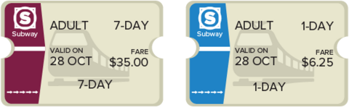
STUDENT MOVE · PREDICT • COMPARE COSTS
Compare strategies; defend one with evidence.
Metro Train Pass Cost
Yelina will take the train into the city each day for one week.
Which pass offers her the lower cost per day?
TALK TOOL
“The ___-day pass costs $___ for one day because ___.”
27 / 40
Notes:
TEACH IN PRACTICE | Embedded facilitation | Lesson 3.2, slide 27 | TASK
Focus on the existing task: Metro Train Pass Cost Yelina will take the train into the city each day for one week. Which pass offers her the lower cost per day?
LAUNCH (T2/3/5): Use the displayed question. Give private thinking time; then A explains while B asks for evidence. Switch roles. Each student records their own reasoning.
LOOK FOR (T4): Where this task addresses it, students can label both units. Ask which feature of their work supports the claim.
RESPOND: If this task shows the lesson misconception—giving a rate without units or reversing the comparison—label distance and time separately on the existing representation. Have the student revise and explain the change. Use this support only where the concept occurs in the current task; otherwise respond to the displayed question.
RECHECK: If a gap is shared, revisit the existing representation together. If it is limited, give targeted support while others compare valid methods on the same task. Check the revision before moving on.
PARTICIPATION (T5/6/7): Think time before volunteers; accept a written, drawn or rehearsed entry. Students ask for evidence respectfully. Recognize a specific contribution or revision and check that both partners participate.
Source: BCPS Updated Instructional Framework Rubric (June 2020), TEACH 1–7. Earlier notes and answer keys are retained below.
EARLIER NOTES / EXISTING ANSWER KEY
Student move: Compare strategies; defend one with evidence.
UIFR FULL | Lesson-specific facilitation
TEACH 2-3 | Session 2 task launch (UIFR PDF pp. 9-10).
Use the problem exactly as displayed. Give individual thinking time before discussion or advancing to the explanation. If the answer is already visible, ask students to reconstruct and justify it. Invite a choice of suitable representations and have students explain why their choice helps.
At the point where this concept appears, ask: “What does one unit of the second quantity correspond to, and how can the model show it?” Wait for evidence, invite another pathway, and have a student ask a follow-up question. Do not replace students’ reasoning with a sequence of leading steps.

Slide 28
STUDENT MOVE · DIVIDE • LABEL • COMPARE
Unit price: cost for one day
Unit price is the cost for 1 item or unit.
Pass | Cost per day
1 day: $6.25 | $6.25 ÷ 1 = $6.25
7 days: $35 | $35 ÷ 7 = $5
Divide the total cost by the number of days.
Compare both passes in dollars per day.
Think and record first. Which part of your
work supports your answer?
Explain: “$35 ÷ 7 = $5 per day. This is $1.25 less per day if all 7 days are used.”
28 / 40
Notes:
TEACH IN PRACTICE | Embedded facilitation | Lesson 3.2, slide 28 | TASK
Focus on the existing task: Unit price: cost for one day Unit price is the cost for 1 item or unit. Divide the total cost by the number of days. Compare both passes…
LAUNCH (T2/3/5): Use the displayed question. Give private thinking time; then A explains while B asks for evidence. Switch roles. Each student records their own reasoning.
LOOK FOR (T4): Where this task addresses it, students can label both units. Ask which feature of their work supports the claim.
RESPOND: If this task shows the lesson misconception—giving a rate without units or reversing the comparison—label distance and time separately on the existing representation. Have the student revise and explain the change. Use this support only where the concept occurs in the current task; otherwise respond to the displayed question.
RECHECK: If a gap is shared, revisit the existing representation together. If it is limited, give targeted support while others compare valid methods on the same task. Check the revision before moving on.
PARTICIPATION (T5/6/7): Think time before volunteers; accept a written, drawn or rehearsed entry. Students ask for evidence respectfully. Recognize a specific contribution or revision and check that both partners participate.
Source: BCPS Updated Instructional Framework Rubric (June 2020), TEACH 1–7. Earlier notes and answer keys are retained below.
EARLIER NOTES / EXISTING ANSWER KEY
Teach this step before assigning independent practice. Read the highlighted term and connect it to the example. Model the calculation, then ask students to explain why the same factor applies to both quantities. Give thinking time and invite a partner explanation. Source content: supplied McGraw Hill Unit 3 lesson presentation.

Slide 29
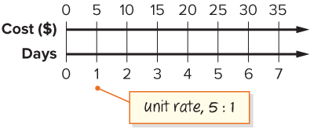
STUDENT MOVE · READ THE MODEL • EXPLAIN
The 7-day pass costs $35 for every 7 days.
We can label the cost number line with intervals
of 5 and the days number line with intervals of 1.
The double number line shows that the cost per day for a 7-day pass is $5.
READ ONE INTERVAL
“Each step is $___ and ___ day, so the unit price is ___.”
Use the scale and positions on the number line to justify your answer.
29 / 40
Notes:
TEACH IN PRACTICE | Embedded facilitation | Lesson 3.2, slide 29 | WORKED
Focus on the existing task: The 7-day pass costs $35 for every 7 days. We can label the cost number line with intervals of 5 and the days number line with intervals…
LAUNCH (T2/3/5): Ask students to explain the displayed idea or example and point to evidence. When a calculation step is shown, ask why it is valid. Have a partner restate the explanation; copying is not the check.
LOOK FOR (T4): Where this task addresses it, students can label both units. Ask which feature of their work supports the claim.
RESPOND: If this task shows the lesson misconception—giving a rate without units or reversing the comparison—label distance and time separately on the existing representation. Have the student revise and explain the change. Use this support only where the concept occurs in the current task; otherwise respond to the displayed question.
RECHECK: If a gap is shared, revisit the existing representation together. If it is limited, give targeted support while others compare valid methods on the same task. Check the revision before moving on.
PARTICIPATION (T5/6/7): Think time before volunteers; accept a written, drawn or rehearsed entry. Students ask for evidence respectfully. Recognize a specific contribution or revision and check that both partners participate.
Source: BCPS Updated Instructional Framework Rubric (June 2020), TEACH 1–7. Earlier notes and answer keys are retained below.
EARLIER NOTES / EXISTING ANSWER KEY
Same reading move as Session 1: each $5 on the cost line pairs with 1 day. Have a student explain why 35 divided by 7 and the number line tell the same story.

Slide 30
STUDENT NOTES · COPY LESS • UNDERSTAND MORE
Math Notes — Session 2
Keep the idea from Train Pass Cost.
COPY, EXPLAIN, THEN CHECK
LOOK BACK AT THE EXAMPLE
01
A unit rate tells the amount for 1 unit.
Pass | Cost per day
1-day | $6.25
7-day | $35 ÷ 7 = $5
02
Unit price = total cost ÷ number of units.
The 7-day pass costs $1.25 less per day.
03
Compare prices using the same unit.
SAY THE GOAL · Say today’s goal in your own words, then name one place this shows up outside math class.
30 / 40
Notes:
TEACH IN PRACTICE | Embedded facilitation | Lesson 3.2, slide 30 | NOTES
Focus on the existing task: Math Notes — Session 2 Keep the idea from Train Pass Cost. COPY THESE THREE LINES 01 A unit rate tells the amount for 1 unit. 02 Unit…
ROUTINE (T1/2/4): Read or copy the original notes, cover one line, and explain it using the displayed example. Reopen and correct. Copying alone is not evidence of understanding.
LOOK FOR: A link between a symbol, quantity or feature and the explanation. If missing, point back to that feature and have the student try again; fade the prompt once they can explain.
PARTICIPATION (T5/6/7): Think time before volunteers; accept a written, drawn or rehearsed entry. Students ask for evidence respectfully. Recognize a specific contribution or revision and check that both partners participate.
Source: BCPS Updated Instructional Framework Rubric (June 2020), TEACH 1–7. Earlier notes and answer keys are retained below.
EARLIER NOTES / EXISTING ANSWER KEY
Use this slide only after the original worked example. Students copy the three lines on the left; the table is a reference and does not need copying. Read one line at a time. Ask one student to connect a note to the example.

Slide 31
STUDENT MOVE · COMPARE TOTALS • JUSTIFY
Compare pathways with a partner; name one revision.
Let’s Explore More
Which pass would you recommend Yelina buys if she only takes the train on weekdays? Explain.
COMPARE WHAT SHE NEEDS
Find the total cost for 5 daily passes. Compare it with $35 for the weekly pass.
31 / 40
Notes:
TEACH IN PRACTICE | Embedded facilitation | Lesson 3.2, slide 31 | PRACTICE
Focus on the existing task: Let’s Explore More Which pass would you recommend Yelina buys if she only takes the train on weekdays?
LAUNCH (T2/3/5): Use the displayed question. Give private thinking time; then A explains while B asks for evidence. Switch roles. Each student records their own reasoning.
LOOK FOR (T4): Where this task addresses it, students can label both units. Ask which feature of their work supports the claim.
RESPOND: If this task shows the lesson misconception—giving a rate without units or reversing the comparison—label distance and time separately on the existing representation. Have the student revise and explain the change. Use this support only where the concept occurs in the current task; otherwise respond to the displayed question.
RECHECK: If a gap is shared, revisit the existing representation together. If it is limited, give targeted support while others compare valid methods on the same task. Check the revision before moving on.
PARTICIPATION (T5/6/7): Think time before volunteers; accept a written, drawn or rehearsed entry. Students ask for evidence respectfully. Recognize a specific contribution or revision and check that both partners participate.
Source: BCPS Updated Instructional Framework Rubric (June 2020), TEACH 1–7. Earlier notes and answer keys are retained below.
EARLIER NOTES / EXISTING ANSWER KEY
Student move: Compare pathways with a partner; name one revision.
UIFR FULL | Lesson-specific facilitation
TEACH 4-5 | Session 2 discussion and checkpoint (UIFR PDF pp. 11-12).
Collect a brief response from every student to the existing prompt before hearing volunteers. Partners take turns explaining and asking for evidence: “I understand ___; what supports ___?” Offer rehearsal or an annotated model for students who need language support. Each student records their own reasoning.
Look specifically for: giving a rate without units or reversing the comparison. If it appears, label distance and time separately on the existing representation; then ask the student to revise the same response and explain the change. If evidence is secure, have students compare a second valid pathway or state why their approach works. Choose the next step from the responses, not a preset pace.

Slide 32
LESSON 3.2 / CHECK YOUR WORK
Pause. Check. Improve.
CHECK
A mistake to watch for: giving a rate without units or reversing the comparison.
TRY
Label both quantities and their units in the given representation.
REVISE
Use that check on the task you just completed. Correct or strengthen one part, and explain why.
SELF-CHECK · Mark it: ✓ got it · ~ almost · ? stuck. Then fix one thing before we move on.
Listen to understand. Ask for evidence. Make room for every voice.
Notes:
TEACH IN PRACTICE | Embedded facilitation | Lesson 3.2, slide 32 | PRIOR_INSERT
Focus on the existing task: LESSON 3.2 / CHECK YOUR WORK Pause. Check. Improve. Listen to understand. Ask for evidence. Make room for every voice. CHECK A mistake…
CONNECT (T1/4): Ask students to restate the displayed goal or key idea and connect it to earlier work. Relevant lesson evidence: label both units; interpret a rate per one unit; use the rate in the existing travel model. Use only the criterion that matches the current session.
SHOW PROGRESS: Students point to their own existing work, explain what improved after feedback, and name a next step. Pair confidence ratings with actual evidence.
PARTICIPATION (T5/6/7): Think time before volunteers; accept a written, drawn or rehearsed entry. Students ask for evidence respectfully. Recognize a specific contribution or revision and check that both partners participate.
Source: BCPS Updated Instructional Framework Rubric (June 2020), TEACH 1–7.

Slide 33
Yelina will take the train into the city each day for one week. Which pass offers her the lower cost per day?
What information is given in the problem?
Compare your reasoning with the explanation. Explain any revision you make.
Reveal:
The cost of a 1-day pass and the cost of a 7-day pass.
33 / 40
Notes:
TEACH IN PRACTICE | Embedded facilitation | Lesson 3.2, slide 33 | REVEAL
Focus on the existing task: Yelina will take the train into the city each day for one week. Which pass offers her the lower cost per day?
LAUNCH (T2/3/5): If an existing answer cover is present, gather an attempt before revealing. If the explanation is already visible, ask students to reconstruct and justify it. Compare reasoning and explain a revision; preserve the reveal sequence.
LOOK FOR (T4): Where this task addresses it, students can label both units. Ask which feature of their work supports the claim.
RESPOND: If this task shows the lesson misconception—giving a rate without units or reversing the comparison—label distance and time separately on the existing representation. Have the student revise and explain the change. Use this support only where the concept occurs in the current task; otherwise respond to the displayed question.
RECHECK: If a gap is shared, revisit the existing representation together. If it is limited, give targeted support while others compare valid methods on the same task. Check the revision before moving on.
PARTICIPATION (T5/6/7): Think time before volunteers; accept a written, drawn or rehearsed entry. Students ask for evidence respectfully. Recognize a specific contribution or revision and check that both partners participate.
Source: BCPS Updated Instructional Framework Rubric (June 2020), TEACH 1–7.

Slide 34
How can you express the cost of a 1-day pass as a rate?
Reveal:
The rate of a 1-day pass is 6.25 to 1 or 6.25 : 1.
Compare your reasoning with the
explanation. Explain any revision
you make.
34 / 40
Notes:
TEACH IN PRACTICE | Embedded facilitation | Lesson 3.2, slide 34 | REVEAL
Focus on the existing task: How can you express the cost of a 1-day pass as a rate?
LAUNCH (T2/3/5): If an existing answer cover is present, gather an attempt before revealing. If the explanation is already visible, ask students to reconstruct and justify it. Compare reasoning and explain a revision; preserve the reveal sequence.
LOOK FOR (T4): Where this task addresses it, students can interpret a rate per one unit. Ask which feature of their work supports the claim.
RESPOND: If this task shows the lesson misconception—giving a rate without units or reversing the comparison—label distance and time separately on the existing representation. Have the student revise and explain the change. Use this support only where the concept occurs in the current task; otherwise respond to the displayed question.
RECHECK: If a gap is shared, revisit the existing representation together. If it is limited, give targeted support while others compare valid methods on the same task. Check the revision before moving on.
PARTICIPATION (T5/6/7): Think time before volunteers; accept a written, drawn or rehearsed entry. Students ask for evidence respectfully. Recognize a specific contribution or revision and check that both partners participate.
Source: BCPS Updated Instructional Framework Rubric (June 2020), TEACH 1–7.

Slide 35
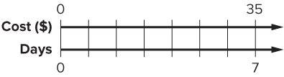
The 7-day pass costs $35 for every 7 days.
What is the rate for a 7-day pass?
Reveal:
The rate for a 7-day pass is 35 to 7 or 35 : 7.
Compare your reasoning with the
explanation. Explain any revision
you make.
35 / 40
Notes:
TEACH IN PRACTICE | Embedded facilitation | Lesson 3.2, slide 35 | REVEAL
Focus on the existing task: The 7-day pass costs $35 for every 7 days. What is the rate for a 7-day pass?
LAUNCH (T2/3/5): If an existing answer cover is present, gather an attempt before revealing. If the explanation is already visible, ask students to reconstruct and justify it. Compare reasoning and explain a revision; preserve the reveal sequence.
LOOK FOR (T4): Where this task addresses it, students can interpret a rate per one unit. Ask which feature of their work supports the claim.
RESPOND: If this task shows the lesson misconception—giving a rate without units or reversing the comparison—label distance and time separately on the existing representation. Have the student revise and explain the change. Use this support only where the concept occurs in the current task; otherwise respond to the displayed question.
RECHECK: If a gap is shared, revisit the existing representation together. If it is limited, give targeted support while others compare valid methods on the same task. Check the revision before moving on.
PARTICIPATION (T5/6/7): Think time before volunteers; accept a written, drawn or rehearsed entry. Students ask for evidence respectfully. Recognize a specific contribution or revision and check that both partners participate.
Source: BCPS Updated Instructional Framework Rubric (June 2020), TEACH 1–7.

Slide 36
STUDENT MOVE · CONNECT RATE TO UNIT RATE
Summarize: Rates and Unit Rates
  Rates and Unit Rates
 | Rate | Unit Rates
A babysitter earns $44 after working 4 hours. | $44 for 4 hours 44 : 4 | $11 for 1 hour $11 per hour 11 : 1
A car drives 200 miles in 5 hours at a constant speed. | 200 miles in 5 hours 200 : 5 | 40 miles in 1 hour 40 miles per hour 40 : 1
CREDIT A CLASSMATE · Name one classmate whose idea helped you today, and say what they said.
36 / 40
Notes:
TEACH IN PRACTICE | Embedded facilitation | Lesson 3.2, slide 36 | SUMMARIZE
Focus on the existing task: Summarize: Rates and Unit Rates Rate Unit Rates A babysitter earns $44 after working 4 hours. $44 for 4 hours 44: 4 $11 for 1 hour…
CONNECT (T1/4): Ask students to restate the displayed goal or key idea and connect it to earlier work. Relevant lesson evidence: label both units; interpret a rate per one unit; use the rate in the existing travel model. Use only the criterion that matches the current session.
SHOW PROGRESS: Students point to their own existing work, explain what improved after feedback, and name a next step. Pair confidence ratings with actual evidence.
PARTICIPATION (T5/6/7): Think time before volunteers; accept a written, drawn or rehearsed entry. Students ask for evidence respectfully. Recognize a specific contribution or revision and check that both partners participate.
Source: BCPS Updated Instructional Framework Rubric (June 2020), TEACH 1–7. Earlier notes and answer keys are retained below.
EARLIER NOTES / EXISTING ANSWER KEY
Partner teach-back: what is a rate, and what makes it a UNIT rate. Keep the table on screen while partners talk. Listen for the phrase ‘for every one.’

Slide 37
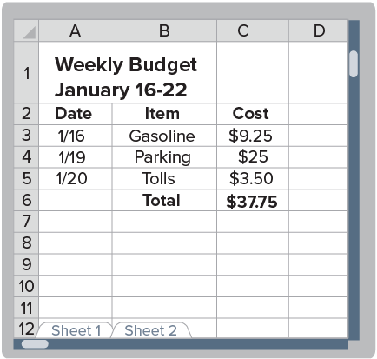
STUDENT MOVE · RECOMMEND • SUPPORT IT
Apply: Metro Train Versus Car Cost
REVISE NOW · Change one answer and write why you changed it. A revision is evidence of learning.
Yelina’s mother is considering a monthly transit pass for $145. The walk from the station to work takes about 25 minutes. Her current commuting budget is shown.
What do you recommend? Estimate a 4-week month using the weekly budget shown. Compare costs and explain how travel time affects your choice.
SUPPORT YOUR RECOMMENDATION
“I recommend ___ because the monthly cost is ___ and ___.”
37 / 40
Notes:
TEACH IN PRACTICE | Embedded facilitation | Lesson 3.2, slide 37 | APPLY
Focus on the existing task: Apply: Metro Train Versus Car Cost Yelina’s mother is considering a monthly transit pass for $145. The walk from the station to work…
LAUNCH (T2/3/5): Use the exact application task independently first. Ask students to justify their choice of method. Collect evidence before a partner discussion or correction.
LOOK FOR (T4): Where this task addresses it, students can use the rate in the existing travel model. Ask which feature of their work supports the claim.
RESPOND: If this task shows the lesson misconception—giving a rate without units or reversing the comparison—label distance and time separately on the existing representation. Have the student revise and explain the change. Use this support only where the concept occurs in the current task; otherwise respond to the displayed question.
RECHECK: If a gap is shared, revisit the existing representation together. If it is limited, give targeted support while others compare valid methods on the same task. Check the revision before moving on.
PARTICIPATION (T5/6/7): Think time before volunteers; accept a written, drawn or rehearsed entry. Students ask for evidence respectfully. Recognize a specific contribution or revision and check that both partners participate.
Source: BCPS Updated Instructional Framework Rubric (June 2020), TEACH 1–7. Earlier notes and answer keys are retained below.
EARLIER NOTES / EXISTING ANSWER KEY
Students recommend train or car and support it with a unit-rate comparison. Any supported recommendation is acceptable — the comparison is the math. Share two answers that disagree and let the class test both.

Slide 38
STUDENT MOVE · SELF-ASSESS • NAME YOUR NEXT STEP
Partner debrief: name your evidence and one next step.
Exit Ticket + Self-Check
A 1-day pass costs $6.25. A 7-day pass costs $35.
SELF-CHECK
Yelina needs to travel on 5 days. Which option costs less in total?
1. I can find a unit price.
□ Alone □ With a hint
□ Not yet
2. I can compare total costs.
□ Alone □ With a hint
□ Not yet
My next step:
________________
Show both totals. Label dollars and days. Explain why the lower daily rate may not be the better choice.
Explain: “For 5 days, ___ costs $___, so I recommend ___.”
SOLVE • EXPLAIN
Work independently and show why. Use feedback to revise
in a second color.
38 / 40
Notes:
TEACH IN PRACTICE | Embedded facilitation | Lesson 3.2, slide 38 | ASSESSMENT
Focus on the existing task: Exit Ticket + Self-Check STUDENT MOVE · SELF-ASSESS • NAME YOUR NEXT STEP A 1-day pass costs $6.25. A 7-day pass costs $35. Yelina needs to travel on 5 days. Which option costs less in total?
LAUNCH (T2/3/5): Gather an independent response before feedback. Students choose a suitable representation and justify it. Keep the first attempt separate from the revision.
LOOK FOR (T4): Where this task addresses it, students can label both units. Ask which feature of their work supports the claim.
RESPOND: If this task shows the lesson misconception—giving a rate without units or reversing the comparison—label distance and time separately on the existing representation. Have the student revise and explain the change. Use this support only where the concept occurs in the current task; otherwise respond to the displayed question.
RECHECK: If a gap is shared, revisit the existing representation together. If it is limited, give targeted support while others compare valid methods on the same task. Check the revision before moving on.
PARTICIPATION (T5/6/7): Think time before volunteers; accept a written, drawn or rehearsed entry. Students ask for evidence respectfully. Recognize a specific contribution or revision and check that both partners participate.
Source: BCPS Updated Instructional Framework Rubric (June 2020), TEACH 1–7. Earlier notes and answer keys are retained below.
EARLIER NOTES / EXISTING ANSWER KEY
Answer: Five 1-day passes cost $31.25; the 7-day pass costs $35. The daily passes save $3.75. Give quiet thinking time before sharing. If a student is stuck, point back to the relevant worked model without doing the task for them. Give specific feedback, then allow a correction.
UIFR FULL | Lesson-specific facilitation
TEACH 4 | Independent evidence and revision (UIFR PDF p. 11).
Use the existing application/exit problem as the independent check. If this is a learning-target slide, have students point to and explain their work on the preceding task. Separate initial independent evidence from the revision after feedback.
Check the relevant criteria: label both units; interpret a rate per one unit; use the rate in the existing travel model. Respond with one specific next step tied to the work. Students revise and annotate what changed, then identify a criterion they can now demonstrate and one they still need to practice.

Slide 39
Learning Targets
I can describe a rate as a kind of ratio.
I can make use of structure to describe a unit rate as a rate with 1 as the second term.
CONNECT IT · What earlier lesson does this build on? Tell a partner in one sentence.
39 / 40
Notes:
TEACH IN PRACTICE | Embedded facilitation | Lesson 3.2, slide 39 | REFLECTION
Focus on the existing task: Learning Targets I can describe a rate as a kind of ratio. I can make use of structure to describe a unit rate as a rate with 1 as the…
CONNECT (T1/4): Ask students to restate the displayed goal or key idea and connect it to earlier work. Relevant lesson evidence: label both units; interpret a rate per one unit; use the rate in the existing travel model. Use only the criterion that matches the current session.
SHOW PROGRESS: Students point to their own existing work, explain what improved after feedback, and name a next step. Pair confidence ratings with actual evidence.
PARTICIPATION (T5/6/7): Think time before volunteers; accept a written, drawn or rehearsed entry. Students ask for evidence respectfully. Recognize a specific contribution or revision and check that both partners participate.
Source: BCPS Updated Instructional Framework Rubric (June 2020), TEACH 1–7. Earlier notes and answer keys are retained below.
EARLIER NOTES / EXISTING ANSWER KEY
UIFR FULL | Lesson-specific facilitation
REFLECT & ADJUST 1-2 | After the lesson (UIFR PDF pp. 15-16).
Sort the existing work by demonstrated reasoning, partial understanding, and the specific misconception: giving a rate without units or reversing the comparison. Compare the initial response with the revision. Record which teaching move plausibly helped, which did not, and whose participation or access needs a different approach; do not record sensitive student details in this shared deck.
Plan the next lesson from that evidence: if the misconception persists, label distance and time separately on the existing representation using the current example before returning to the next grade-level task; if understanding is secure, use an existing extension or ask for a general explanation. Check the targeted idea again at the next warm-up.
Ask students what supported their thinking and what would help next time. Identify one change to try and one successful practice to retain. Seek colleague feedback on anonymized work when useful; these prompts support reflection and do not establish an evaluation rating. Source: Baltimore City Public Schools, Updated Instructional Framework Rubric, June 2020 (UIFR_Full.pdf).

Slide 40
UIFR TEACH — Teacher Reference
Teacher reference • hidden from the student slideshow
TEACH 1 · Session goals, purpose, and content-linked success criteria.
TEACH 2 · Original models precede checks and independent application.
TEACH 3 · Original inquiry questions prompt reasoning and justification.
TEACH 4 · Checks, feedback, and time to revise follow instruction.
TEACH 5 · Think time and purposeful partner explanations.
TEACH 6 · Consistent model → notes → practice sequence.
TEACH 7 · Brief notes, scaffolds, and respectful sharing of strategies.
SHOW YOUR THINKING · Show what you know — write it, draw it, or build it. A picture counts as an explanation.
40 / 40
Notes:
TEACH IN PRACTICE | Embedded facilitation | Lesson 3.2, slide 40 | REFERENCE
Focus on the existing task: UIFR TEACH — Teacher Reference Teacher reference • hidden from the student slideshow TEACH 1 · Session goals, purpose, and content-linked…
TRANSITION (T6/7): Students confirm materials, roles, how to request help, and the next response routine. Ask a student to restate it. Keep teacher-only slides hidden.
PARTICIPATION (T5/6/7): Think time before volunteers; accept a written, drawn or rehearsed entry. Students ask for evidence respectfully. Recognize a specific contribution or revision and check that both partners participate.
Source: BCPS Updated Instructional Framework Rubric (June 2020), TEACH 1–7. Earlier notes and answer keys are retained below.
EARLIER NOTES / EXISTING ANSWER KEY
Source: Baltimore City Public Schools, Updated Instructional Framework Rubric, June 2020. Teacher enactment determines the quality of instruction; this is a support map.

