Slide 1

WARM-UP · THINK • TRY • CHECK
Turn and talk: compare strategies, then defend one.
Warm-Up
Lesson 3-3 · Equivalent Ratios Using Tables | Warm-Up · about 4 minutes
Try each on your own. Mark an unsure answer; explain and revise when we check.
QUESTION 1
QUESTION 2
2 × 5 = ______ and 3 × 5 = ______
Keep the pattern going:
4, 8, 12, ______, ______
QUESTION 3
QUESTION 4
Fill in the missing number:
3/4 = ______/8
One batch uses 2 cups.
How many cups for 4 batches? ______
TALK IT OVER: “I got ______ because ______.” • Compare with a partner before we check as a class.
1 / 38
Notes:
TEACH IN PRACTICE | Embedded facilitation | Lesson 3.3, slide 1 | WARMUP
Focus on the existing task: Warm-Up WARM-UP · THINK • TRY • CHECK Do these four on your…
GATHER EVIDENCE (T4/6): Keep the original items. Students try independently, mark an uncertain item, and explain one method before checking. Use the existing key when present.
RESPOND: Distinguish a calculation slip from a reasoning gap. Give one next step on the same item; have students revise in a second color. Use the responses to choose flexible support for today’s lesson.
PARTICIPATION (T5/6/7): Think time before volunteers; accept a written, drawn or rehearsed entry. Students ask for evidence respectfully. Recognize a specific contribution or revision and check that both partners participate.
Source: BCPS Updated Instructional Framework Rubric (June 2020), TEACH 1–7. Earlier notes and answer keys are retained below.
EARLIER NOTES / EXISTING ANSWER KEY
Warm-Up answers (teacher only): 1) 10 and 15 2) 16, 20 3) 6 4) 8 cups
UIFR FULL | Lesson-specific facilitation
PREPARE 1-2 | Before teaching (UIFR PDF pp. 6-7).
Plan to gather evidence that students can label ratio-table columns; multiply or divide both quantities by the same factor. Review recent work and today’s warm-up to choose flexible groups and access supports; do not infer needs from identity or perceived ability. Use the existing lesson tasks and stated standards.
Anticipate: adding the same amount to both entries to claim equivalence. If observed, draw matching scale-factor arrows between existing table rows. Offer oral rehearsal, drawing, pointing, or home-language processing as needed; retain the original mathematical demand. Ask students which support helps and fade it as evidence improves.
TEACH 6-7 | Before the first transition, agree on materials, partner roles, and how to request help. Invite students to restate the routine. Normalize revising an idea, recognize a specific contribution, and check privately when frustration blocks participation. Source: UIFR PDF pp. 13-14.

Slide 2
STUDENT NOTES · COPY LESS • UNDERSTAND MORE
Partner talk: connect today’s idea to prior learning.
Math Notes — Session 1
Keep the idea from Homemade Clay.
COPY, EXPLAIN, THEN CHECK
LOOK BACK AT THE EXAMPLE
01
A ratio table organizes matching pairs.
Baking soda (cups) | Cornstarch (cups)
2 | 1
4 | 2
6 | 3
02
Multiply both amounts by the same number.
03
Equivalent ratios keep the same relationship.
3 batches: multiply 2 and 1 by 3.
2 / 38
Notes:
TEACH IN PRACTICE | Embedded facilitation | Lesson 3.3, slide 2 | NOTES
Focus on the existing task: Math Notes — Session 1 Keep the idea from Homemade Clay. COPY THESE THREE LINES 01 A ratio table organizes matching pairs. 02 Multiply…
ROUTINE (T1/2/4): Read or copy the original notes, cover one line, and explain it using the displayed example. Reopen and correct. Copying alone is not evidence of understanding.
LOOK FOR: A link between a symbol, quantity or feature and the explanation. If missing, point back to that feature and have the student try again; fade the prompt once they can explain.
PARTICIPATION (T5/6/7): Think time before volunteers; accept a written, drawn or rehearsed entry. Students ask for evidence respectfully. Recognize a specific contribution or revision and check that both partners participate.
Source: BCPS Updated Instructional Framework Rubric (June 2020), TEACH 1–7. Earlier notes and answer keys are retained below.
EARLIER NOTES / EXISTING ANSWER KEY
Use this slide only after the original worked example. Students copy the three lines on the left; the table is a reference and does not need copying. Read one line at a time. Ask one student to connect a note to the example.

Slide 3
LEARNING TARGET · LABEL • SCALE • EXPLAIN
Tell a partner the goal and why it matters.
Learning Target — Session 1
Lesson 3-3 · Equivalent Ratios Using Tables | Maryland Standard 6.AT.3a
Today I will scale a recipe and show equivalent ratios in a table.
CONTENT OBJECTIVE
LANGUAGE OBJECTIVE
I can use multiplication to build a table of equivalent ratios.
I can explain why both quantities use the same scale factor.
SUCCESS CHECK
WHY THIS MATTERS
✓ Label both quantities and units.
✓ Multiply both by the same number.
✓ Explain what one pair means.
Ratio tables help us resize recipes without changing the mixture.
MATH COMMUNITY: Different strategies are welcome • Ask before telling • Revise your thinking
3 / 38
Notes:
TEACH IN PRACTICE | Embedded facilitation | Lesson 3.3, slide 3 | GOAL
Focus on the existing task: Learning Target — Session 1 | Maryland Standard 6.AT.3a LEARNING TARGET · LABEL • SCALE •…
CONNECT (T1/4): Ask students to restate the displayed goal or key idea and connect it to earlier work. Relevant lesson evidence: label ratio-table columns; multiply or divide both quantities by the same factor. Use only the criterion that matches the current session.
SHOW PROGRESS: Students point to their own existing work, explain what improved after feedback, and name a next step. Pair confidence ratings with actual evidence.
PARTICIPATION (T5/6/7): Think time before volunteers; accept a written, drawn or rehearsed entry. Students ask for evidence respectfully. Recognize a specific contribution or revision and check that both partners participate.
Source: BCPS Updated Instructional Framework Rubric (June 2020), TEACH 1–7. Earlier notes and answer keys are retained below.
EARLIER NOTES / EXISTING ANSWER KEY
Name today’s content and language goals. Briefly read the success criteria; do not teach procedures here. The original context and model follow. Return to these criteria after the worked example.
UIFR FULL | Lesson-specific facilitation
TEACH 1 | Session 1 purpose and evidence (UIFR PDF p. 8).
Have students restate the displayed session goal in their own words and connect it to the existing context or a familiar experience they choose to share. Use the current session goal to select from these lesson-wide evidence criteria; do not frontload a later-session procedure.
Look for: label ratio-table columns; multiply or divide both quantities by the same factor. Ask: “Which part of your work would show this?” Revisit that evidence after the task; a confidence rating alone is not evidence of understanding.

Slide 4
Vocabulary 1 of 6
Lesson 3-3 · Determine Equivalent Ratios Using Tables
Ratio Tables
Tables that organize pairs of equivalent ratios.
EXAMPLE · EXPLAIN WHY IT FITS
2:3, 4:6, and 6:9 belong in the same ratio table.
Use “Ratio Tables” to explain the example. Point to evidence.
eduwonderlab.com · Neft Teacher
4 / 38
Notes:
TEACH IN PRACTICE | Embedded facilitation | Lesson 3.3, slide 4 | VOCAB
Focus on the existing task: Vocabulary 1 of 6 Ratio Tables Tables that…
ASK (T1/3/5): Where does “Ratio Tables” appear in the example? Explain the meaning without reading the definition. Partner: restate the idea and ask a clarifying question.
LOOK FOR: A correct connection between the word and a feature of the example. If the student only repeats the definition, invite pointing, sketching or oral rehearsal, then ask for another explanation of this same example.
PARTICIPATION (T5/6/7): Think time before volunteers; accept a written, drawn or rehearsed entry. Students ask for evidence respectfully. Recognize a specific contribution or revision and check that both partners participate.
Source: BCPS Updated Instructional Framework Rubric (June 2020), TEACH 1–7.

Slide 5
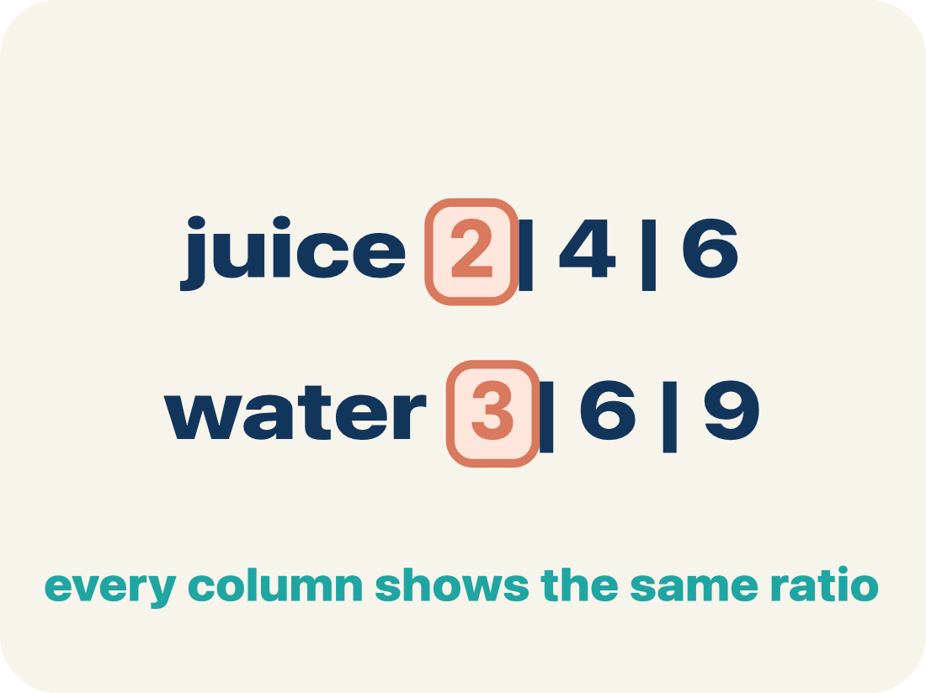
Vocabulary 2 of 6
Lesson 3-3 · Determine Equivalent Ratios Using Tables
Ratio table
A table of equal ratios that shows a pattern.
EXAMPLE · EXPLAIN WHY IT FITS
Cups of juice: 2, 4, 6 | Cups of water: 3, 6, 9
Use “Ratio table” to explain the example. Point to evidence.
eduwonderlab.com · Neft Teacher
5 / 38
Notes:
TEACH IN PRACTICE | Embedded facilitation | Lesson 3.3, slide 5 | VOCAB
Focus on the existing task: Vocabulary 2 of 6 Ratio table A table of equal…
ASK (T1/3/5): Where does “Ratio table” appear in the example? Explain the meaning without reading the definition. Partner: restate the idea and ask a clarifying question.
LOOK FOR: A correct connection between the word and a feature of the example. If the student only repeats the definition, invite pointing, sketching or oral rehearsal, then ask for another explanation of this same example.
PARTICIPATION (T5/6/7): Think time before volunteers; accept a written, drawn or rehearsed entry. Students ask for evidence respectfully. Recognize a specific contribution or revision and check that both partners participate.
Source: BCPS Updated Instructional Framework Rubric (June 2020), TEACH 1–7.

Slide 6
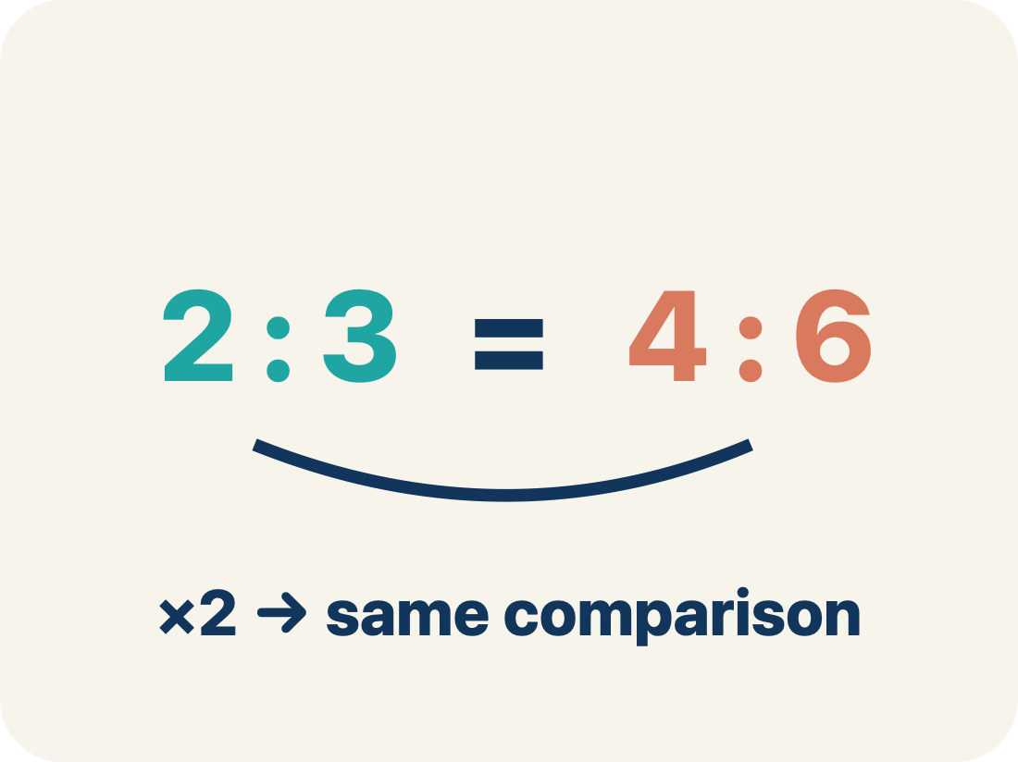
Vocabulary 3 of 6
Lesson 3-3 · Determine Equivalent Ratios Using Tables
Equivalent ratio
Two ratios that mean the same thing, like 1:2 and 2:4.
EXAMPLE · EXPLAIN WHY IT FITS
2:3 = 4:6 = 6:9
Use “Equivalent ratio” to explain the example. Point to
evidence.
eduwonderlab.com · Neft Teacher
6 / 38
Notes:
TEACH IN PRACTICE | Embedded facilitation | Lesson 3.3, slide 6 | VOCAB
Focus on the existing task: Vocabulary 3 of 6 Equivalent ratio Two ratios…
ASK (T1/3/5): Where does “Equivalent ratio” appear in the example? Explain the meaning without reading the definition. Partner: restate the idea and ask a clarifying question.
LOOK FOR: A correct connection between the word and a feature of the example. If the student only repeats the definition, invite pointing, sketching or oral rehearsal, then ask for another explanation of this same example.
PARTICIPATION (T5/6/7): Think time before volunteers; accept a written, drawn or rehearsed entry. Students ask for evidence respectfully. Recognize a specific contribution or revision and check that both partners participate.
Source: BCPS Updated Instructional Framework Rubric (June 2020), TEACH 1–7.

Slide 7
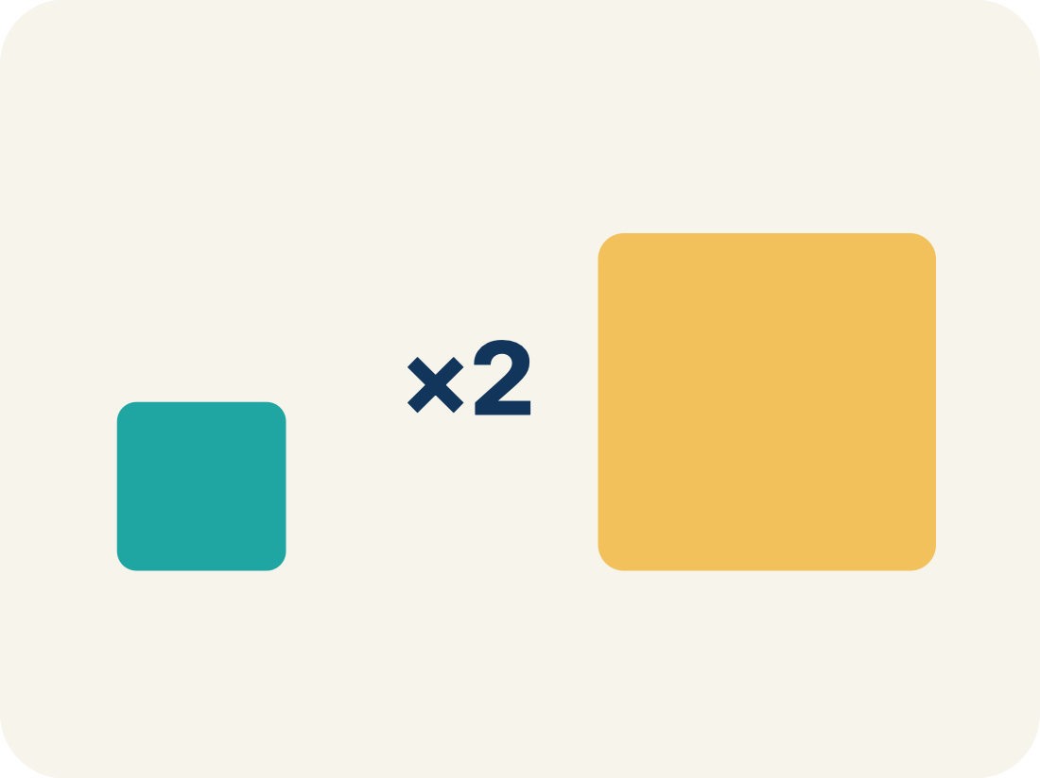
Vocabulary 4 of 6
Lesson 3-3 · Determine Equivalent Ratios Using Tables
Scale factor
The number you multiply both parts of a ratio by to get an equal ratio.
EXAMPLE · EXPLAIN WHY IT FITS
2:3 × 2 → 4:6 (scale factor is 2)
Use “Scale factor” to explain the example. Point to evidence.
eduwonderlab.com · Neft Teacher
7 / 38
Notes:
TEACH IN PRACTICE | Embedded facilitation | Lesson 3.3, slide 7 | VOCAB
Focus on the existing task: Vocabulary 4 of 6 Scale factor The number you…
ASK (T1/3/5): Where does “Scale factor” appear in the example? Explain the meaning without reading the definition. Partner: restate the idea and ask a clarifying question.
LOOK FOR: A correct connection between the word and a feature of the example. If the student only repeats the definition, invite pointing, sketching or oral rehearsal, then ask for another explanation of this same example.
PARTICIPATION (T5/6/7): Think time before volunteers; accept a written, drawn or rehearsed entry. Students ask for evidence respectfully. Recognize a specific contribution or revision and check that both partners participate.
Source: BCPS Updated Instructional Framework Rubric (June 2020), TEACH 1–7.

Slide 8
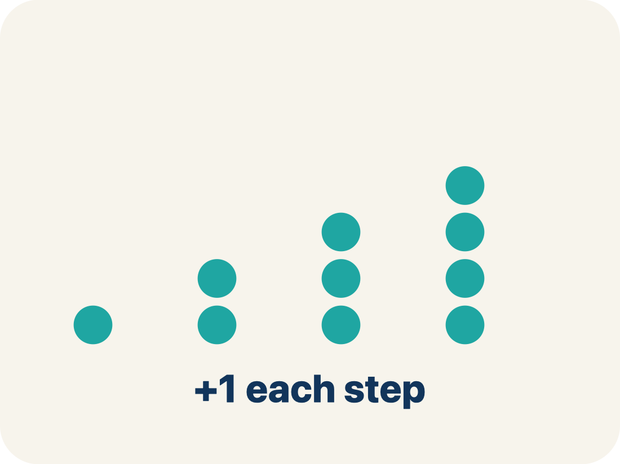
Vocabulary 5 of 6
Lesson 3-3 · Determine Equivalent Ratios Using Tables
Pattern
A rule that numbers follow again and again.
EXAMPLE · EXPLAIN WHY IT FITS
Each row adds 2 cups juice and 3 cups water
Use “Pattern” to explain the example. Point to evidence.
eduwonderlab.com · Neft Teacher
8 / 38
Notes:
TEACH IN PRACTICE | Embedded facilitation | Lesson 3.3, slide 8 | VOCAB
Focus on the existing task: Vocabulary 5 of 6 Pattern A rule that numbers…
ASK (T1/3/5): Where does “Pattern” appear in the example? Explain the meaning without reading the definition. Partner: restate the idea and ask a clarifying question.
LOOK FOR: A correct connection between the word and a feature of the example. If the student only repeats the definition, invite pointing, sketching or oral rehearsal, then ask for another explanation of this same example.
PARTICIPATION (T5/6/7): Think time before volunteers; accept a written, drawn or rehearsed entry. Students ask for evidence respectfully. Recognize a specific contribution or revision and check that both partners participate.
Source: BCPS Updated Instructional Framework Rubric (June 2020), TEACH 1–7.

Slide 9
Vocabulary 6 of 6
Lesson 3-3 · Determine Equivalent Ratios Using Tables
Additive pattern
Building new rows of a ratio table by adding each column’s own constant amount, so the two columns grow together.
EXAMPLE · EXPLAIN WHY IT FITS
2:3 → 4:6 → 6:9 (add 2 and 3 each time)
Use “Additive pattern” to explain
the example. Point to evidence.
eduwonderlab.com · Neft Teacher
9 / 38
Notes:
TEACH IN PRACTICE | Embedded facilitation | Lesson 3.3, slide 9 | VOCAB
Focus on the existing task: Vocabulary 6 of 6 Additive pattern Building new…
ASK (T1/3/5): Where does “Additive pattern” appear in the example? Explain the meaning without reading the definition. Partner: restate the idea and ask a clarifying question.
LOOK FOR: A correct connection between the word and a feature of the example. If the student only repeats the definition, invite pointing, sketching or oral rehearsal, then ask for another explanation of this same example.
PARTICIPATION (T5/6/7): Think time before volunteers; accept a written, drawn or rehearsed entry. Students ask for evidence respectfully. Recognize a specific contribution or revision and check that both partners participate.
Source: BCPS Updated Instructional Framework Rubric (June 2020), TEACH 1–7.

Slide 10

Be Curious
What is the question?
  Brian makes homemade clay by mixing some water and some flour in a bowl. His nephew also wants to make something with clay, so Brian needs to increase the amount of clay he makes.
Think first. Share a notice and a question;
build on a classmate’s idea.
Mindset
How can you show your classmates that you respect their ideas about math?
10 / 38
Notes:
TEACH IN PRACTICE | Embedded facilitation | Lesson 3.3, slide 10 | CURIOUS
Focus on the existing task: Be Curious What is the question?
LAUNCH (T2/3/5): Allow quiet observation first. Separate a notice from an inference, invite students’ own questions, and follow the existing launch before teaching a procedure.
LOOK FOR (T4): Where this task addresses it, students can label ratio-table columns. Ask which feature of their work supports the claim.
RESPOND: If this task shows the lesson misconception—adding the same amount to both entries to claim equivalence—draw matching scale-factor arrows between existing table rows. Have the student revise and explain the change. Use this support only where the concept occurs in the current task; otherwise respond to the displayed question.
RECHECK: If a gap is shared, revisit the existing representation together. If it is limited, give targeted support while others compare valid methods on the same task. Check the revision before moving on.
PARTICIPATION (T5/6/7): Think time before volunteers; accept a written, drawn or rehearsed entry. Students ask for evidence respectfully. Recognize a specific contribution or revision and check that both partners participate.
Source: BCPS Updated Instructional Framework Rubric (June 2020), TEACH 1–7.

Slide 11
STUDENT MOVE · ESTIMATE • DEFEND • COMPARE
Partner press: ask Why? and answer with evidence.
More or Less Than 50
Estimate first. Choose one expression and defend your estimate.
437 ÷ 6
717 ÷ 8
935 ÷ 50
EXPLAIN YOUR THINKING
“I estimate more/less than 50 because ___.”
Think and record first. Which part of your work supports your answer?
11 / 38
Notes:
TEACH IN PRACTICE | Embedded facilitation | Lesson 3.3, slide 11 | TASK
Focus on the existing task: More or Less Than 50 437 ÷ 6 717 ÷ 8 935 ÷ 50 STUDENT MOVE · ESTIMATE • DEFEND • COMPARE EXPLAIN YOUR THINKING “I estimate more/less…
LAUNCH (T2/3/5): Use the displayed question. Give private thinking time; then A explains while B asks for evidence. Switch roles. Each student records their own reasoning.
LOOK FOR (T4): Where this task addresses it, students can label ratio-table columns. Ask which feature of their work supports the claim.
RESPOND: If this task shows the lesson misconception—adding the same amount to both entries to claim equivalence—draw matching scale-factor arrows between existing table rows. Have the student revise and explain the change. Use this support only where the concept occurs in the current task; otherwise respond to the displayed question.
RECHECK: If a gap is shared, revisit the existing representation together. If it is limited, give targeted support while others compare valid methods on the same task. Check the revision before moving on.
PARTICIPATION (T5/6/7): Think time before volunteers; accept a written, drawn or rehearsed entry. Students ask for evidence respectfully. Recognize a specific contribution or revision and check that both partners participate.
Source: BCPS Updated Instructional Framework Rubric (June 2020), TEACH 1–7. Earlier notes and answer keys are retained below.
EARLIER NOTES / EXISTING ANSWER KEY
Student move: Partner press: ask Why? and answer with evidence.
UIFR FULL | Lesson-specific facilitation
TEACH 2-3 | Session 1 task launch (UIFR PDF pp. 9-10).
Use the problem exactly as displayed. Give individual thinking time before discussion or advancing to the explanation. If the answer is already visible, ask students to reconstruct and justify it. Invite a choice of suitable representations and have students explain why their choice helps.
At the point where this concept appears, ask: “What multiplicative relationship stays unchanged from one row to another?” Wait for evidence, invite another pathway, and have a student ask a follow-up question. Do not replace students’ reasoning with a sequence of leading steps.

Slide 12
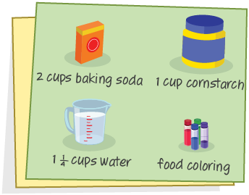
STUDENT MOVE · PREDICT • KEEP THE MIXTURE
Ask a partner a question; choose a model together.
Making Homemade Clay
Brian will use the recipe shown to make clay. He needs to make multiple batches of clay.
How can Brian determine how much baking soda and cornstarch he needs for multiple batches of clay to get the same consistency?
TALK TOOL
“For ___ batches, multiply both ingredients by ___ because ___.”
Try first. Connect a feature of the model to a
step in your reasoning.
12 / 38
Notes:
TEACH IN PRACTICE | Embedded facilitation | Lesson 3.3, slide 12 | TASK
Focus on the existing task: Making Homemade Clay Brian will use the recipe shown to make clay. He needs to make multiple batches of clay. How can Brian determine how…
LAUNCH (T2/3/5): Use the displayed question. Give private thinking time; then A explains while B asks for evidence. Switch roles. Each student records their own reasoning.
LOOK FOR (T4): Where this task addresses it, students can multiply or divide both quantities by the same factor. Ask which feature of their work supports the claim.
RESPOND: If this task shows the lesson misconception—adding the same amount to both entries to claim equivalence—draw matching scale-factor arrows between existing table rows. Have the student revise and explain the change. Use this support only where the concept occurs in the current task; otherwise respond to the displayed question.
RECHECK: If a gap is shared, revisit the existing representation together. If it is limited, give targeted support while others compare valid methods on the same task. Check the revision before moving on.
PARTICIPATION (T5/6/7): Think time before volunteers; accept a written, drawn or rehearsed entry. Students ask for evidence respectfully. Recognize a specific contribution or revision and check that both partners participate.
Source: BCPS Updated Instructional Framework Rubric (June 2020), TEACH 1–7. Earlier notes and answer keys are retained below.
EARLIER NOTES / EXISTING ANSWER KEY
Student move: Ask a partner a question; choose a model together.
UIFR FULL | Lesson-specific facilitation
TEACH 4-5 | Session 1 discussion and checkpoint (UIFR PDF pp. 11-12).
Collect a brief response from every student to the existing prompt before hearing volunteers. Partners take turns explaining and asking for evidence: “I understand ___; what supports ___?” Offer rehearsal or an annotated model for students who need language support. Each student records their own reasoning.
Look specifically for: adding the same amount to both entries to claim equivalence. If it appears, draw matching scale-factor arrows between existing table rows; then ask the student to revise the same response and explain the change. If evidence is secure, have students compare a second valid pathway or state why their approach works. Choose the next step from the responses, not a preset pace.

Slide 13
STUDENT MOVE · LABEL • READ EACH PAIR
Ratio tables and equivalent ratios
A ratio table organizes pairs of related quantities.
Baking soda (cups) | Cornstarch (cups)
2 | 1
4 | 2
Equivalent ratios describe the same relationship.
For this clay recipe, every 2 cups of baking soda go with 1 cup of cornstarch.
Try first. Explain how the table keeps the
same relationship between the two
quantities.
Explain: “2 : 1 and 4 : 2 are equivalent because both amounts were multiplied by ___.”
13 / 38
Notes:
TEACH IN PRACTICE | Embedded facilitation | Lesson 3.3, slide 13 | TASK
Focus on the existing task: Ratio tables and equivalent ratios A ratio table organizes pairs of related quantities. Equivalent ratios describe the same…
LAUNCH (T2/3/5): Use the displayed question. Give private thinking time; then A explains while B asks for evidence. Switch roles. Each student records their own reasoning.
LOOK FOR (T4): Where this task addresses it, students can label ratio-table columns. Ask which feature of their work supports the claim.
RESPOND: If this task shows the lesson misconception—adding the same amount to both entries to claim equivalence—draw matching scale-factor arrows between existing table rows. Have the student revise and explain the change. Use this support only where the concept occurs in the current task; otherwise respond to the displayed question.
RECHECK: If a gap is shared, revisit the existing representation together. If it is limited, give targeted support while others compare valid methods on the same task. Check the revision before moving on.
PARTICIPATION (T5/6/7): Think time before volunteers; accept a written, drawn or rehearsed entry. Students ask for evidence respectfully. Recognize a specific contribution or revision and check that both partners participate.
Source: BCPS Updated Instructional Framework Rubric (June 2020), TEACH 1–7. Earlier notes and answer keys are retained below.
EARLIER NOTES / EXISTING ANSWER KEY
Teach this step before assigning independent practice. Read the highlighted term and connect it to the example. Model the calculation, then ask students to explain why the same factor applies to both quantities. Give thinking time and invite a partner explanation. Source content: supplied McGraw Hill Unit 3 lesson presentation.

Slide 14
STUDENT MOVE · SCALE BOTH • EXPLAIN WHY
One scale factor for both quantities
A scale factor tells how many times as much.
Batches | Baking soda | Cornstarch
1 | 2 cups | 1 cup
2 | 4 cups | 2 cups
3 | 6 cups | 3 cups
4
For 3 batches, multiply both amounts by 3: 2 × 3 = 6 and 1 × 3 = 3.
For 4 batches, multiply both amounts by 4.
TRY IT BEFORE YOU’RE SURE · Start even if you are not sure. A revised answer counts as much as a first-try answer.
Explain: “For 3 batches, both quantities are ×3, so the ratio stays 2 : 1.”
14 / 38
Notes:
TEACH IN PRACTICE | Embedded facilitation | Lesson 3.3, slide 14 | TASK
Focus on the existing task: One scale factor for both quantities A scale factor tells how many times as much. For 3 batches, multiply both amounts by 3: 2 × 3 = 6…
LAUNCH (T2/3/5): Use the displayed question. Give private thinking time; then A explains while B asks for evidence. Switch roles. Each student records their own reasoning.
LOOK FOR (T4): Where this task addresses it, students can multiply or divide both quantities by the same factor. Ask which feature of their work supports the claim.
RESPOND: If this task shows the lesson misconception—adding the same amount to both entries to claim equivalence—draw matching scale-factor arrows between existing table rows. Have the student revise and explain the change. Use this support only where the concept occurs in the current task; otherwise respond to the displayed question.
RECHECK: If a gap is shared, revisit the existing representation together. If it is limited, give targeted support while others compare valid methods on the same task. Check the revision before moving on.
PARTICIPATION (T5/6/7): Think time before volunteers; accept a written, drawn or rehearsed entry. Students ask for evidence respectfully. Recognize a specific contribution or revision and check that both partners participate.
Source: BCPS Updated Instructional Framework Rubric (June 2020), TEACH 1–7. Earlier notes and answer keys are retained below.
EARLIER NOTES / EXISTING ANSWER KEY
Teach this step before assigning independent practice. Read the highlighted term and connect it to the example. Model the calculation, then ask students to explain why the same factor applies to both quantities. Give thinking time and invite a partner explanation. Source content: supplied McGraw Hill Unit 3 lesson presentation.

Slide 15
STUDENT MOVE · SOLVE • COMPARE • REVISE
Student-led talk: paraphrase, agree or disagree, add on.
Practice: the same clay recipe
One batch uses 2 cups of baking soda and 1 cup of cornstarch.
1. Find both amounts for 8 batches. Show the scale factor.
2. Explain what might happen if only the baking soda amount doubles.
Explain: “Changing only one ingredient would change ___ because ___.”
15 / 38
Notes:
TEACH IN PRACTICE | Embedded facilitation | Lesson 3.3, slide 15 | PRACTICE
Focus on the existing task: Practice: the same clay recipe One batch uses 2 cups of baking soda and 1 cup of cornstarch. 1. Find both amounts for 8 batches. Show the…
LAUNCH (T2/3/5): Use the displayed question. Give private thinking time; then A explains while B asks for evidence. Switch roles. Each student records their own reasoning.
LOOK FOR (T4): Where this task addresses it, students can multiply or divide both quantities by the same factor. Ask which feature of their work supports the claim.
RESPOND: If this task shows the lesson misconception—adding the same amount to both entries to claim equivalence—draw matching scale-factor arrows between existing table rows. Have the student revise and explain the change. Use this support only where the concept occurs in the current task; otherwise respond to the displayed question.
RECHECK: If a gap is shared, revisit the existing representation together. If it is limited, give targeted support while others compare valid methods on the same task. Check the revision before moving on.
PARTICIPATION (T5/6/7): Think time before volunteers; accept a written, drawn or rehearsed entry. Students ask for evidence respectfully. Recognize a specific contribution or revision and check that both partners participate.
Source: BCPS Updated Instructional Framework Rubric (June 2020), TEACH 1–7. Earlier notes and answer keys are retained below.
EARLIER NOTES / EXISTING ANSWER KEY
Teach this step before assigning independent practice. Read the highlighted term and connect it to the example. Model the calculation, then ask students to explain why the same factor applies to both quantities. Give thinking time and invite a partner explanation. Source content: supplied McGraw Hill Unit 3 lesson presentation.

Slide 16
LESSON 3.3 / DISCUSS THE TASK
Explain and compare
Use the task you just explored.
TAKE TURNS
What multiplicative relationship stays unchanged from one row to another?
Explain
“I know this because…”
Ask
“Where does your work show that?”
Point to evidence in your work.
Then compare your approach with a partner’s.
HOW DO YOU KNOW? · Ask your partner “How do you know?” Answer by pointing to your own work.
Listen to understand. Ask for evidence. Make room for every voice.
Notes:
TEACH IN PRACTICE | Embedded facilitation | Lesson 3.3, slide 16 | PRIOR_INSERT
Focus on the existing task: Point to evidence in your work. Then compare your approach with a partner’s. TAKE TURNS Explain “I know this because…” Ask “Where does your work show that?
CONNECT (T1/4): Ask students to restate the displayed goal or key idea and connect it to earlier work. Relevant lesson evidence: label ratio-table columns; multiply or divide both quantities by the same factor. Use only the criterion that matches the current session.
SHOW PROGRESS: Students point to their own existing work, explain what improved after feedback, and name a next step. Pair confidence ratings with actual evidence.
PARTICIPATION (T5/6/7): Think time before volunteers; accept a written, drawn or rehearsed entry. Students ask for evidence respectfully. Recognize a specific contribution or revision and check that both partners participate.
Source: BCPS Updated Instructional Framework Rubric (June 2020), TEACH 1–7.

Slide 17
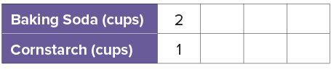
We can show the relationship between the quantities of clay using a table.
CREDIT A CLASSMATE · Name one classmate whose idea helped you today, and say what they said.
How does the table show the relationship between the quantity of baking soda and cornstarch?
Reveal:
The table shows that for one batch of clay, there are 2 cups of baking soda for every 1 cup of cornstarch.
17 / 38
Notes:
TEACH IN PRACTICE | Embedded facilitation | Lesson 3.3, slide 17 | REVEAL
Focus on the existing task: We can show the relationship between the quantities of clay using a table. How does the table show the relationship between the quantity of baking soda and cornstarch?
LAUNCH (T2/3/5): If an existing answer cover is present, gather an attempt before revealing. If the explanation is already visible, ask students to reconstruct and justify it. Compare reasoning and explain a revision; preserve the reveal sequence.
LOOK FOR (T4): Where this task addresses it, students can label ratio-table columns. Ask which feature of their work supports the claim.
RESPOND: If this task shows the lesson misconception—adding the same amount to both entries to claim equivalence—draw matching scale-factor arrows between existing table rows. Have the student revise and explain the change. Use this support only where the concept occurs in the current task; otherwise respond to the displayed question.
RECHECK: If a gap is shared, revisit the existing representation together. If it is limited, give targeted support while others compare valid methods on the same task. Check the revision before moving on.
PARTICIPATION (T5/6/7): Think time before volunteers; accept a written, drawn or rehearsed entry. Students ask for evidence respectfully. Recognize a specific contribution or revision and check that both partners participate.
Source: BCPS Updated Instructional Framework Rubric (June 2020), TEACH 1–7.

Slide 18
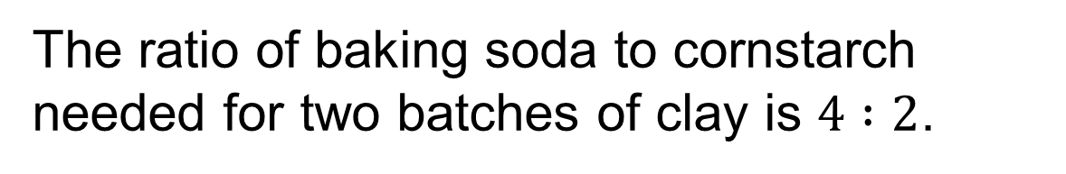
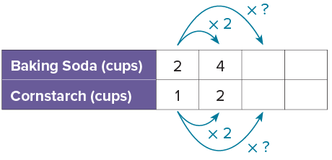
How can you find the quantity of baking soda and cornstarch needed for three batches of clay?
Reveal:
I can multiply each term in the ratio 2 : 1 by 3.
Compare your reasoning with the
explanation. Explain any revision
you make.
18 / 38
Notes:
TEACH IN PRACTICE | Embedded facilitation | Lesson 3.3, slide 18 | REVEAL
Focus on the existing task: How can you find the quantity of baking soda and cornstarch needed for three batches of clay?
LAUNCH (T2/3/5): If an existing answer cover is present, gather an attempt before revealing. If the explanation is already visible, ask students to reconstruct and justify it. Compare reasoning and explain a revision; preserve the reveal sequence.
LOOK FOR (T4): Where this task addresses it, students can label ratio-table columns. Ask which feature of their work supports the claim.
RESPOND: If this task shows the lesson misconception—adding the same amount to both entries to claim equivalence—draw matching scale-factor arrows between existing table rows. Have the student revise and explain the change. Use this support only where the concept occurs in the current task; otherwise respond to the displayed question.
RECHECK: If a gap is shared, revisit the existing representation together. If it is limited, give targeted support while others compare valid methods on the same task. Check the revision before moving on.
PARTICIPATION (T5/6/7): Think time before volunteers; accept a written, drawn or rehearsed entry. Students ask for evidence respectfully. Recognize a specific contribution or revision and check that both partners participate.
Source: BCPS Updated Instructional Framework Rubric (June 2020), TEACH 1–7.

Slide 19
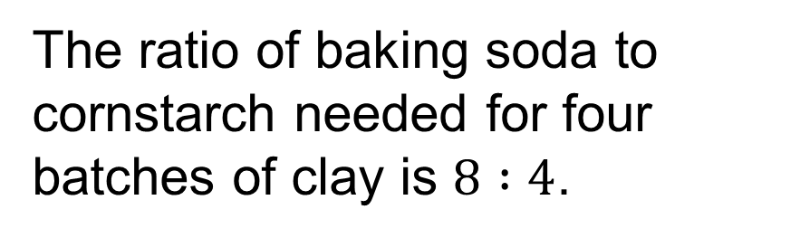
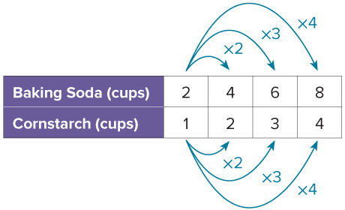
What pattern do you see in the ratio table?
Reveal:
Each ratio is related to the original ratio by a factor.
Compare your reasoning with the
explanation. Explain any revision
you make.
19 / 38
Notes:
TEACH IN PRACTICE | Embedded facilitation | Lesson 3.3, slide 19 | REVEAL
Focus on the existing task: What pattern do you see in the ratio table?
LAUNCH (T2/3/5): If an existing answer cover is present, gather an attempt before revealing. If the explanation is already visible, ask students to reconstruct and justify it. Compare reasoning and explain a revision; preserve the reveal sequence.
LOOK FOR (T4): Where this task addresses it, students can label ratio-table columns. Ask which feature of their work supports the claim.
RESPOND: If this task shows the lesson misconception—adding the same amount to both entries to claim equivalence—draw matching scale-factor arrows between existing table rows. Have the student revise and explain the change. Use this support only where the concept occurs in the current task; otherwise respond to the displayed question.
RECHECK: If a gap is shared, revisit the existing representation together. If it is limited, give targeted support while others compare valid methods on the same task. Check the revision before moving on.
PARTICIPATION (T5/6/7): Think time before volunteers; accept a written, drawn or rehearsed entry. Students ask for evidence respectfully. Recognize a specific contribution or revision and check that both partners participate.
Source: BCPS Updated Instructional Framework Rubric (June 2020), TEACH 1–7.

Slide 20
STUDENT MOVE · SOLO → CHECK → REVISE
Defend your method; partner gives one specific next step.
Quick Check — Session 1
Use the model to explain your thinking.
One batch uses 2 cups baking soda and 1 cup cornstarch.
How much of each ingredient makes 5 batches?
Show the same scale factor for both quantities.
EXPLAIN YOUR SCALE FACTOR
“I multiplied both amounts by ___, so I need ___ and ___.”
20 / 38
Notes:
TEACH IN PRACTICE | Embedded facilitation | Lesson 3.3, slide 20 | ASSESSMENT
Focus on the existing task: Quick Check — Session 1 Use the model to explain your thinking. One batch uses 2 cups baking soda and 1 cup cornstarch. How much of each ingredient makes 5 batches?
LAUNCH (T2/3/5): Gather an independent response before feedback. Students choose a suitable representation and justify it. Keep the first attempt separate from the revision.
LOOK FOR (T4): Where this task addresses it, students can multiply or divide both quantities by the same factor. Ask which feature of their work supports the claim.
RESPOND: If this task shows the lesson misconception—adding the same amount to both entries to claim equivalence—draw matching scale-factor arrows between existing table rows. Have the student revise and explain the change. Use this support only where the concept occurs in the current task; otherwise respond to the displayed question.
RECHECK: If a gap is shared, revisit the existing representation together. If it is limited, give targeted support while others compare valid methods on the same task. Check the revision before moving on.
PARTICIPATION (T5/6/7): Think time before volunteers; accept a written, drawn or rehearsed entry. Students ask for evidence respectfully. Recognize a specific contribution or revision and check that both partners participate.
Source: BCPS Updated Instructional Framework Rubric (June 2020), TEACH 1–7. Earlier notes and answer keys are retained below.
EARLIER NOTES / EXISTING ANSWER KEY
Answer: 10 cups baking soda and 5 cups cornstarch; ×5. Give quiet thinking time before sharing. If a student is stuck, point back to the relevant worked model without doing the task for them. Give specific feedback, then allow a correction.

Slide 21
WARM-UP · THINK • TRY • CHECK
Turn and talk: compare strategies, then defend one.
Session 2 Warm-Up
Lesson 3-3 · Equivalent Ratios Using Tables | Session 2 Warm-Up · about 4 minutes
Try each on your own. Mark an unsure answer; explain and revise when we check.
QUESTION 1
QUESTION 2
Scale 2 : 1 by 4.
Equivalent ratio: ______ : ______
Divide both numbers in 8 : 4 by 2.
______ : ______
QUESTION 3
QUESTION 4
Complete the equivalent ratio:
3 : 2 = 12 : ______
One batch uses 2 cups and 1 cup.
For 5 batches: ______ cups and ______ cups
TALK IT OVER: “I got ______ because ______.” • Compare with a partner before we check as a class.
21 / 38
Notes:
TEACH IN PRACTICE | Embedded facilitation | Lesson 3.3, slide 21 | WARMUP
Focus on the existing task: Session 2 Warm-Up | Session 2 Warm-Up · about 4 minutes WARM-UP · THINK • TRY • CHECK Do…
GATHER EVIDENCE (T4/6): Keep the original items. Students try independently, mark an uncertain item, and explain one method before checking. Use the existing key when present.
RESPOND: Distinguish a calculation slip from a reasoning gap. Give one next step on the same item; have students revise in a second color. Use the responses to choose flexible support for today’s lesson.
PARTICIPATION (T5/6/7): Think time before volunteers; accept a written, drawn or rehearsed entry. Students ask for evidence respectfully. Recognize a specific contribution or revision and check that both partners participate.
Source: BCPS Updated Instructional Framework Rubric (June 2020), TEACH 1–7. Earlier notes and answer keys are retained below.
EARLIER NOTES / EXISTING ANSWER KEY
Warm-up routine: students start silently on entry; keep it to about 4 minutes.
Circulate and note who is stuck — use what you see to choose who you check on first today.
Go over answers quickly; ask one student to explain a step, not just say the answer.
UIFR: TEACH 4 · TEACH 6.

Slide 22
REVIEW NOTES · RECALL • CONNECT • APPLY
Partner check: explain one idea without looking.
Review Notes — Session 2
Review the key ideas before Session 2.
COPY, EXPLAIN, THEN CHECK
LOOK BACK AT THE EXAMPLE
01
A ratio table organizes matching pairs.
Baking soda (cups) | Cornstarch (cups)
2 | 1
4 | 2
6 | 3
02
Multiply both amounts by the same number.
03
Equivalent ratios keep the same relationship.
3 batches: multiply 2 and 1 by 3.
22 / 38
Notes:
TEACH IN PRACTICE | Embedded facilitation | Lesson 3.3, slide 22 | NOTES
Focus on the existing task: Review Notes — Session 2 Review the key ideas before Session 2. COPY THESE THREE LINES 01 A ratio table organizes matching pairs. 02…
ROUTINE (T1/2/4): Read or copy the original notes, cover one line, and explain it using the displayed example. Reopen and correct. Copying alone is not evidence of understanding.
LOOK FOR: A link between a symbol, quantity or feature and the explanation. If missing, point back to that feature and have the student try again; fade the prompt once they can explain.
PARTICIPATION (T5/6/7): Think time before volunteers; accept a written, drawn or rehearsed entry. Students ask for evidence respectfully. Recognize a specific contribution or revision and check that both partners participate.
Source: BCPS Updated Instructional Framework Rubric (June 2020), TEACH 1–7. Earlier notes and answer keys are retained below.
EARLIER NOTES / EXISTING ANSWER KEY
Copy routine: read one line at a time; students copy, then explain that line to a partner.
Keep it brisk — the understanding work happens in the examples, not the copying.
UIFR: TEACH 1 · TEACH 6.

Slide 23
LEARNING TARGET · DIVIDE • CHECK • JUSTIFY
Tell a partner the new goal and how you will show it.
Learning Target — Session 2
Lesson 3-3 · Equivalent Ratios Using Tables | Maryland Standard 6.AT.3a
Today I will scale a mixture down and use a ratio table to find a missing amount.
CONTENT OBJECTIVE
LANGUAGE OBJECTIVE
I can use division to find a missing value in a ratio table.
I can explain how dividing both quantities keeps ratios equivalent.
SUCCESS CHECK
WHY THIS MATTERS
✓ Identify the known and missing amounts.
✓ Divide both by the same number.
✓ Check against the original ratio.
Scaling both ingredients by the same factor keeps the paint the same shade.
MATH COMMUNITY: Different strategies are welcome • Ask before telling • Revise your thinking
23 / 38
Notes:
TEACH IN PRACTICE | Embedded facilitation | Lesson 3.3, slide 23 | GOAL
Focus on the existing task: Learning Target — Session 2 | Maryland Standard 6.AT.3a LEARNING TARGET · DIVIDE • CHECK •…
CONNECT (T1/4): Ask students to restate the displayed goal or key idea and connect it to earlier work. Relevant lesson evidence: label ratio-table columns; multiply or divide both quantities by the same factor. Use only the criterion that matches the current session.
SHOW PROGRESS: Students point to their own existing work, explain what improved after feedback, and name a next step. Pair confidence ratings with actual evidence.
PARTICIPATION (T5/6/7): Think time before volunteers; accept a written, drawn or rehearsed entry. Students ask for evidence respectfully. Recognize a specific contribution or revision and check that both partners participate.
Source: BCPS Updated Instructional Framework Rubric (June 2020), TEACH 1–7. Earlier notes and answer keys are retained below.
EARLIER NOTES / EXISTING ANSWER KEY
Name today’s content and language goals. Briefly read the success criteria; do not teach procedures here. The original context and model follow. Return to these criteria after the worked example.
UIFR FULL | Lesson-specific facilitation
TEACH 1 | Session 2 purpose and evidence (UIFR PDF p. 8).
Have students restate the displayed session goal in their own words and connect it to the existing context or a familiar experience they choose to share. Use the current session goal to select from these lesson-wide evidence criteria; do not frontload a later-session procedure.
Look for: label ratio-table columns; multiply or divide both quantities by the same factor. Ask: “Which part of your work would show this?” Revisit that evidence after the task; a confidence rating alone is not evidence of understanding.

Slide 24

Be Curious
What do you notice?
What do you wonder?
Think first. Share a notice and a question;
build on a classmate’s idea.
Mindset
How are you showing your classmates that you respect their ideas about math?
24 / 38
Notes:
TEACH IN PRACTICE | Embedded facilitation | Lesson 3.3, slide 24 | CURIOUS
Focus on the existing task: Be Curious What do you notice?
LAUNCH (T2/3/5): Allow quiet observation first. Separate a notice from an inference, invite students’ own questions, and follow the existing launch before teaching a procedure.
LOOK FOR (T4): Where this task addresses it, students can label ratio-table columns. Ask which feature of their work supports the claim.
RESPOND: If this task shows the lesson misconception—adding the same amount to both entries to claim equivalence—draw matching scale-factor arrows between existing table rows. Have the student revise and explain the change. Use this support only where the concept occurs in the current task; otherwise respond to the displayed question.
RECHECK: If a gap is shared, revisit the existing representation together. If it is limited, give targeted support while others compare valid methods on the same task. Check the revision before moving on.
PARTICIPATION (T5/6/7): Think time before volunteers; accept a written, drawn or rehearsed entry. Students ask for evidence respectfully. Recognize a specific contribution or revision and check that both partners participate.
Source: BCPS Updated Instructional Framework Rubric (June 2020), TEACH 1–7.

Slide 25
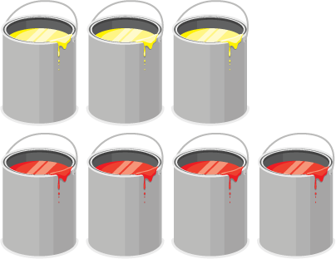
STUDENT MOVE · PREDICT • SCALE DOWN
Compare strategies; defend one with evidence.
Mixing Paint
Sofia mixes 4 cans of red paint with 3 cans of yellow paint to make orange. Her friend has only 1 can of yellow paint.
Predict: will the red amount be more or less than 4 cans?
TALK TOOL
“3 yellow cans become 1, so divide both amounts by ___.”
How much red paint will keep the same shade? Show your reasoning.
Think and record first. Which part of your work supports your answer?
25 / 38
Notes:
TEACH IN PRACTICE | Embedded facilitation | Lesson 3.3, slide 25 | TASK
Focus on the existing task: Mixing Paint Sofia mixes 4 cans of red paint with 3 cans of yellow paint to make orange. Her friend has only 1 can of yellow paint. Predict: will the red amount be more or less than 4 cans?
LAUNCH (T2/3/5): Use the displayed question. Give private thinking time; then A explains while B asks for evidence. Switch roles. Each student records their own reasoning.
LOOK FOR (T4): Where this task addresses it, students can multiply or divide both quantities by the same factor. Ask which feature of their work supports the claim.
RESPOND: If this task shows the lesson misconception—adding the same amount to both entries to claim equivalence—draw matching scale-factor arrows between existing table rows. Have the student revise and explain the change. Use this support only where the concept occurs in the current task; otherwise respond to the displayed question.
RECHECK: If a gap is shared, revisit the existing representation together. If it is limited, give targeted support while others compare valid methods on the same task. Check the revision before moving on.
PARTICIPATION (T5/6/7): Think time before volunteers; accept a written, drawn or rehearsed entry. Students ask for evidence respectfully. Recognize a specific contribution or revision and check that both partners participate.
Source: BCPS Updated Instructional Framework Rubric (June 2020), TEACH 1–7. Earlier notes and answer keys are retained below.
EARLIER NOTES / EXISTING ANSWER KEY
Student move: Compare strategies; defend one with evidence.
UIFR FULL | Lesson-specific facilitation
TEACH 2-3 | Session 2 task launch (UIFR PDF pp. 9-10).
Use the problem exactly as displayed. Give individual thinking time before discussion or advancing to the explanation. If the answer is already visible, ask students to reconstruct and justify it. Invite a choice of suitable representations and have students explain why their choice helps.
At the point where this concept appears, ask: “What multiplicative relationship stays unchanged from one row to another?” Wait for evidence, invite another pathway, and have a student ask a follow-up question. Do not replace students’ reasoning with a sequence of leading steps.

Slide 26
STUDENT MOVE · DIVIDE BOTH • CHECK
Scaling down to one can
The missing term is the unknown amount. The starting ratio of red to yellow is 4 : 3.
Red paint (cans) | Yellow paint (cans)
4 | 3
4 ÷ 3 = 1⅓ | 3 ÷ 3 = 1
To change 3 yellow cans to 1, divide by 3.
Divide the red amount by the same number: 4 ÷ 3 = 1⅓.
Record your reasoning before the reveal.
Compare, then explain any revision.
Check: 1⅓ × 3 = 4 and 1 × 3 = 3. Both amounts return to the starting ratio.
26 / 38
Notes:
TEACH IN PRACTICE | Embedded facilitation | Lesson 3.3, slide 26 | REVEAL
Focus on the existing task: Scaling down to one can The missing term is the unknown amount. The starting ratio of red to yellow is 4: 3. To change 3 yellow cans to…
LAUNCH (T2/3/5): If an existing answer cover is present, gather an attempt before revealing. If the explanation is already visible, ask students to reconstruct and justify it. Compare reasoning and explain a revision; preserve the reveal sequence.
LOOK FOR (T4): Where this task addresses it, students can multiply or divide both quantities by the same factor. Ask which feature of their work supports the claim.
RESPOND: If this task shows the lesson misconception—adding the same amount to both entries to claim equivalence—draw matching scale-factor arrows between existing table rows. Have the student revise and explain the change. Use this support only where the concept occurs in the current task; otherwise respond to the displayed question.
RECHECK: If a gap is shared, revisit the existing representation together. If it is limited, give targeted support while others compare valid methods on the same task. Check the revision before moving on.
PARTICIPATION (T5/6/7): Think time before volunteers; accept a written, drawn or rehearsed entry. Students ask for evidence respectfully. Recognize a specific contribution or revision and check that both partners participate.
Source: BCPS Updated Instructional Framework Rubric (June 2020), TEACH 1–7. Earlier notes and answer keys are retained below.
EARLIER NOTES / EXISTING ANSWER KEY
Teach this step before assigning independent practice. Read the highlighted term and connect it to the example. Model the calculation, then ask students to explain why the same factor applies to both quantities. Give thinking time and invite a partner explanation. Source content: supplied McGraw Hill Unit 3 lesson presentation.

Slide 27
STUDENT NOTES · COPY LESS • UNDERSTAND MORE
Math Notes — Session 2
Keep the idea from Mixing Paint.
COPY, EXPLAIN, THEN CHECK
LOOK BACK AT THE EXAMPLE
01
Divide both amounts by the same number.
Red paint (cans) | Yellow paint (cans)
4 | 3
4 ÷ 3 = 1⅓ | 3 ÷ 3 = 1
02
The missing amount can be a fraction.
1⅓ cans of red paint for 1 can of yellow paint.
03
Check the new pair against the starting ratio.
SAY THE GOAL · Say today’s goal in your own words, then name one place this shows up outside math class.
27 / 38
Notes:
TEACH IN PRACTICE | Embedded facilitation | Lesson 3.3, slide 27 | NOTES
Focus on the existing task: Math Notes — Session 2 Keep the idea from Mixing Paint. COPY THESE THREE LINES 01 Divide both amounts by the same number. 02 The missing…
ROUTINE (T1/2/4): Read or copy the original notes, cover one line, and explain it using the displayed example. Reopen and correct. Copying alone is not evidence of understanding.
LOOK FOR: A link between a symbol, quantity or feature and the explanation. If missing, point back to that feature and have the student try again; fade the prompt once they can explain.
PARTICIPATION (T5/6/7): Think time before volunteers; accept a written, drawn or rehearsed entry. Students ask for evidence respectfully. Recognize a specific contribution or revision and check that both partners participate.
Source: BCPS Updated Instructional Framework Rubric (June 2020), TEACH 1–7. Earlier notes and answer keys are retained below.
EARLIER NOTES / EXISTING ANSWER KEY
Use this slide only after the original worked example. Students copy the three lines on the left; the table is a reference and does not need copying. Read one line at a time. Ask one student to connect a note to the example.

Slide 28
STUDENT MOVE · CONNECT TWO MODELS
Compare pathways with a partner; name one revision.
Let’s Explore More
How can you use the ratio table to determine the number of cans of yellow paint needed for 8 cans of red paint to make the same shade of orange?
Red Paint (cans) |  | 4
Yellow Paint (cans) | 1 | 3
How is a double number line similar to a ratio table? How are the two different?
CONNECT THE MODELS
“Both models show ___. A table uses ___; a number line uses ___.”
28 / 38
Notes:
TEACH IN PRACTICE | Embedded facilitation | Lesson 3.3, slide 28 | PRACTICE
Focus on the existing task: Let’s Explore More How can you use the ratio table to determine the number of cans of yellow paint needed for 8 cans of red paint to make the same shade of orange?
LAUNCH (T2/3/5): Use the displayed question. Give private thinking time; then A explains while B asks for evidence. Switch roles. Each student records their own reasoning.
LOOK FOR (T4): Where this task addresses it, students can label ratio-table columns. Ask which feature of their work supports the claim.
RESPOND: If this task shows the lesson misconception—adding the same amount to both entries to claim equivalence—draw matching scale-factor arrows between existing table rows. Have the student revise and explain the change. Use this support only where the concept occurs in the current task; otherwise respond to the displayed question.
RECHECK: If a gap is shared, revisit the existing representation together. If it is limited, give targeted support while others compare valid methods on the same task. Check the revision before moving on.
PARTICIPATION (T5/6/7): Think time before volunteers; accept a written, drawn or rehearsed entry. Students ask for evidence respectfully. Recognize a specific contribution or revision and check that both partners participate.
Source: BCPS Updated Instructional Framework Rubric (June 2020), TEACH 1–7. Earlier notes and answer keys are retained below.
EARLIER NOTES / EXISTING ANSWER KEY
Student move: Compare pathways with a partner; name one revision.
UIFR FULL | Lesson-specific facilitation
TEACH 4-5 | Session 2 discussion and checkpoint (UIFR PDF pp. 11-12).
Collect a brief response from every student to the existing prompt before hearing volunteers. Partners take turns explaining and asking for evidence: “I understand ___; what supports ___?” Offer rehearsal or an annotated model for students who need language support. Each student records their own reasoning.
Look specifically for: adding the same amount to both entries to claim equivalence. If it appears, draw matching scale-factor arrows between existing table rows; then ask the student to revise the same response and explain the change. If evidence is secure, have students compare a second valid pathway or state why their approach works. Choose the next step from the responses, not a preset pace.

Slide 29
LESSON 3.3 / CHECK YOUR WORK
Pause. Check. Improve.
CHECK
A mistake to watch for: adding the same amount to both entries to claim equivalence.
TRY
Draw matching scale-factor arrows between given table rows.
REVISE
Use that check on the task you just completed. Correct or strengthen one part, and explain why.
SELF-CHECK · Mark it: ✓ got it · ~ almost · ? stuck. Then fix one thing before we move on.
Listen to understand. Ask for evidence. Make room for every voice.
Notes:
TEACH IN PRACTICE | Embedded facilitation | Lesson 3.3, slide 29 | PRIOR_INSERT
Focus on the existing task: LESSON 3.3 / CHECK YOUR WORK Pause. Check. Improve. Listen to understand. Ask for evidence. Make room for every voice. CHECK A mistake…
CONNECT (T1/4): Ask students to restate the displayed goal or key idea and connect it to earlier work. Relevant lesson evidence: label ratio-table columns; multiply or divide both quantities by the same factor. Use only the criterion that matches the current session.
SHOW PROGRESS: Students point to their own existing work, explain what improved after feedback, and name a next step. Pair confidence ratings with actual evidence.
PARTICIPATION (T5/6/7): Think time before volunteers; accept a written, drawn or rehearsed entry. Students ask for evidence respectfully. Recognize a specific contribution or revision and check that both partners participate.
Source: BCPS Updated Instructional Framework Rubric (June 2020), TEACH 1–7.

Slide 30
Sofia mixes the cans of paint shown to create her favorite shade of orange paint. Her friend wants to create the same shade of orange paint, but she has only one can of yellow paint. How can Sofia’s friend create the same shade of orange paint?
What information is needed to answer the question?
Reveal:
The amount of red paint and the amount of yellow paint Sofia uses to make her shade of orange paint, and the fact that her friend only has one can of yellow paint.
30 / 38
Notes:
TEACH IN PRACTICE | Embedded facilitation | Lesson 3.3, slide 30 | REVEAL
Focus on the existing task: What information is needed to answer the question?
LAUNCH (T2/3/5): If an existing answer cover is present, gather an attempt before revealing. If the explanation is already visible, ask students to reconstruct and justify it. Compare reasoning and explain a revision; preserve the reveal sequence.
LOOK FOR (T4): Where this task addresses it, students can multiply or divide both quantities by the same factor. Ask which feature of their work supports the claim.
RESPOND: If this task shows the lesson misconception—adding the same amount to both entries to claim equivalence—draw matching scale-factor arrows between existing table rows. Have the student revise and explain the change. Use this support only where the concept occurs in the current task; otherwise respond to the displayed question.
RECHECK: If a gap is shared, revisit the existing representation together. If it is limited, give targeted support while others compare valid methods on the same task. Check the revision before moving on.
PARTICIPATION (T5/6/7): Think time before volunteers; accept a written, drawn or rehearsed entry. Students ask for evidence respectfully. Recognize a specific contribution or revision and check that both partners participate.
Source: BCPS Updated Instructional Framework Rubric (June 2020), TEACH 1–7.

Slide 31
STUDENT MOVES
Lesson 3-3
Your move
STRUGGLE FIRST · Work on your own first. Stuck is allowed — try a second strategy before you ask.
31 / 38

Slide 32
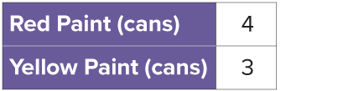
How can you express the relationship between the cans of red paint and yellow paint as a ratio?
Compare your reasoning with the explanation. Explain any revision you make.
Reveal:
We can express the relationship as a ratio of 4 to 3 or 4 : 3.
32 / 38
Notes:
TEACH IN PRACTICE | Embedded facilitation | Lesson 3.3, slide 31 | REVEAL
Focus on the existing task: How can you express the relationship between the cans of red paint and yellow paint as a ratio?
LAUNCH (T2/3/5): If an existing answer cover is present, gather an attempt before revealing. If the explanation is already visible, ask students to reconstruct and justify it. Compare reasoning and explain a revision; preserve the reveal sequence.
LOOK FOR (T4): Where this task addresses it, students can label ratio-table columns. Ask which feature of their work supports the claim.
RESPOND: If this task shows the lesson misconception—adding the same amount to both entries to claim equivalence—draw matching scale-factor arrows between existing table rows. Have the student revise and explain the change. Use this support only where the concept occurs in the current task; otherwise respond to the displayed question.
RECHECK: If a gap is shared, revisit the existing representation together. If it is limited, give targeted support while others compare valid methods on the same task. Check the revision before moving on.
PARTICIPATION (T5/6/7): Think time before volunteers; accept a written, drawn or rehearsed entry. Students ask for evidence respectfully. Recognize a specific contribution or revision and check that both partners participate.
Source: BCPS Updated Instructional Framework Rubric (June 2020), TEACH 1–7.

Slide 33
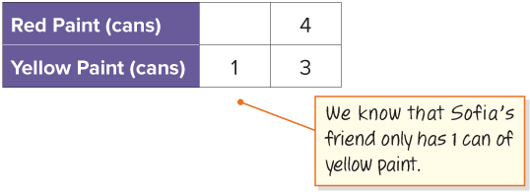
How can you describe the relationship between 3 and 1?
USE THE MATH WORDS · Use today’s math words in your explanation — not “it” and “that thing.”
Reveal:
We can divide 3 into 3 equal parts and the size of each part will be 1.
33 / 38
Notes:
TEACH IN PRACTICE | Embedded facilitation | Lesson 3.3, slide 32 | REVEAL
Focus on the existing task: Reveal: We can divide 3 into 3 equal parts and the size of each part will be 1. How can you describe the relationship between 3 and 1?
LAUNCH (T2/3/5): If an existing answer cover is present, gather an attempt before revealing. If the explanation is already visible, ask students to reconstruct and justify it. Compare reasoning and explain a revision; preserve the reveal sequence.
LOOK FOR (T4): Where this task addresses it, students can multiply or divide both quantities by the same factor. Ask which feature of their work supports the claim.
RESPOND: If this task shows the lesson misconception—adding the same amount to both entries to claim equivalence—draw matching scale-factor arrows between existing table rows. Have the student revise and explain the change. Use this support only where the concept occurs in the current task; otherwise respond to the displayed question.
RECHECK: If a gap is shared, revisit the existing representation together. If it is limited, give targeted support while others compare valid methods on the same task. Check the revision before moving on.
PARTICIPATION (T5/6/7): Think time before volunteers; accept a written, drawn or rehearsed entry. Students ask for evidence respectfully. Recognize a specific contribution or revision and check that both partners participate.
Source: BCPS Updated Instructional Framework Rubric (June 2020), TEACH 1–7.

Slide 34
STUDENT MOVE · SUMMARIZE • TEACH A PARTNER
Summarize: Equivalent Ratios
Multiply or divide BOTH quantities by the same number. Each column of the table shows a ratio equivalent to the first.
One number scales both quantities — up to make more, down to make less. Same factor, same mixture.
RATIO TABLE
SCALE FACTOR
Key idea: Equivalent ratios keep the same relationship because both quantities change by the same factor.
Teach a partner: How do you scale a recipe up or down without changing the mixture?
REVISE NOW · Change one answer and write why you changed it. A revision is evidence of learning.
34 / 38
Notes:
TEACH IN PRACTICE | Embedded facilitation | Lesson 3.3, slide 33 | SUMMARIZE
Focus on the existing task: STUDENT MOVE · SUMMARIZE • TEACH A PARTNER Summarize: Equivalent Ratios Multiply or divide BOTH quantities by the same number. Each…
CONNECT (T1/4): Ask students to restate the displayed goal or key idea and connect it to earlier work. Relevant lesson evidence: label ratio-table columns; multiply or divide both quantities by the same factor. Use only the criterion that matches the current session.
SHOW PROGRESS: Students point to their own existing work, explain what improved after feedback, and name a next step. Pair confidence ratings with actual evidence.
PARTICIPATION (T5/6/7): Think time before volunteers; accept a written, drawn or rehearsed entry. Students ask for evidence respectfully. Recognize a specific contribution or revision and check that both partners participate.
Source: BCPS Updated Instructional Framework Rubric (June 2020), TEACH 1–7. Earlier notes and answer keys are retained below.
EARLIER NOTES / EXISTING ANSWER KEY
Model briefly, then hand the thinking back: ask “Why does this step work?” before showing the next one.
Quick check before moving on — thumbs or whiteboards from everyone, not volunteers.
UIFR: TEACH 2 · TEACH 3 · TEACH 4.

Slide 35
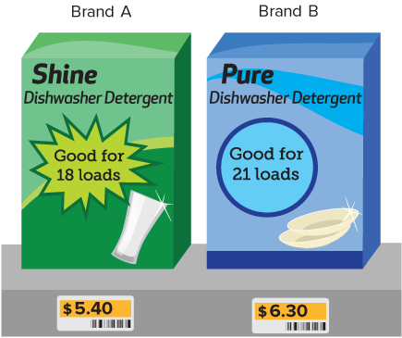
STUDENT MOVE · COMPARE FAIRLY • JUSTIFY
Apply: Which Brand to Buy?
Deon needs dishwasher detergent. Compare the two brands shown.
Which brand should he buy? Use a ratio table to compare the cost for the same number of loads.
Show your work and label the units.
PICK YOUR STRATEGY · Choose your path — picture, table, number line, or equation — and be ready to say why you chose it.
EXPLAIN A FAIR COMPARISON
“For ___ loads, Brand ___ costs ___, so I recommend ___.”
35 / 38
Notes:
TEACH IN PRACTICE | Embedded facilitation | Lesson 3.3, slide 34 | APPLY
Focus on the existing task: Apply: Which Brand to Buy?
LAUNCH (T2/3/5): Use the exact application task independently first. Ask students to justify their choice of method. Collect evidence before a partner discussion or correction.
LOOK FOR (T4): Where this task addresses it, students can label ratio-table columns. Ask which feature of their work supports the claim.
RESPOND: If this task shows the lesson misconception—adding the same amount to both entries to claim equivalence—draw matching scale-factor arrows between existing table rows. Have the student revise and explain the change. Use this support only where the concept occurs in the current task; otherwise respond to the displayed question.
RECHECK: If a gap is shared, revisit the existing representation together. If it is limited, give targeted support while others compare valid methods on the same task. Check the revision before moving on.
PARTICIPATION (T5/6/7): Think time before volunteers; accept a written, drawn or rehearsed entry. Students ask for evidence respectfully. Recognize a specific contribution or revision and check that both partners participate.
Source: BCPS Updated Instructional Framework Rubric (June 2020), TEACH 1–7. Earlier notes and answer keys are retained below.
EARLIER NOTES / EXISTING ANSWER KEY
Students compare brands using equivalent ratios or a unit amount — either route works. Press for a fair comparison: same number of cans or same price before deciding. Debrief one pair from each route.

Slide 36
STUDENT MOVE · SELF-ASSESS • NAME YOUR NEXT STEP
Partner debrief: name your evidence and one next step.
Exit Ticket + Self-Check
Orange paint uses 4 cans of red for every 3 cans of yellow.
SELF-CHECK
How many cans of red paint go with 6 cans of yellow?
1. I can build a ratio table.
□ Alone □ With a hint
□ Not yet
2. I can explain a scale factor.
□ Alone □ With a hint
□ Not yet
My next step:
________________
Show a ratio table. Label both ingredients and draw the same scale factor for each.
Explain: “3 became 6 by ×___, so 4 becomes ___.”
SOLVE • EXPLAIN
Work independently and show why. Use feedback to revise
in a second color.
36 / 38
Notes:
TEACH IN PRACTICE | Embedded facilitation | Lesson 3.3, slide 35 | ASSESSMENT
Focus on the existing task: Exit Ticket + Self-Check STUDENT MOVE · SELF-ASSESS • NAME YOUR NEXT STEP Orange paint uses 4 cans of red for every 3 cans of yellow. How many cans of red paint go with 6 cans of yellow?
LAUNCH (T2/3/5): Gather an independent response before feedback. Students choose a suitable representation and justify it. Keep the first attempt separate from the revision.
LOOK FOR (T4): Where this task addresses it, students can label ratio-table columns. Ask which feature of their work supports the claim.
RESPOND: If this task shows the lesson misconception—adding the same amount to both entries to claim equivalence—draw matching scale-factor arrows between existing table rows. Have the student revise and explain the change. Use this support only where the concept occurs in the current task; otherwise respond to the displayed question.
RECHECK: If a gap is shared, revisit the existing representation together. If it is limited, give targeted support while others compare valid methods on the same task. Check the revision before moving on.
PARTICIPATION (T5/6/7): Think time before volunteers; accept a written, drawn or rehearsed entry. Students ask for evidence respectfully. Recognize a specific contribution or revision and check that both partners participate.
Source: BCPS Updated Instructional Framework Rubric (June 2020), TEACH 1–7. Earlier notes and answer keys are retained below.
EARLIER NOTES / EXISTING ANSWER KEY
Answer: 8 cans red; multiply both 4 and 3 by 2. Give quiet thinking time before sharing. If a student is stuck, point back to the relevant worked model without doing the task for them. Give specific feedback, then allow a correction.
UIFR FULL | Lesson-specific facilitation
TEACH 4 | Independent evidence and revision (UIFR PDF p. 11).
Use the existing application/exit problem as the independent check. If this is a learning-target slide, have students point to and explain their work on the preceding task. Separate initial independent evidence from the revision after feedback.
Check the relevant criteria: label ratio-table columns; multiply or divide both quantities by the same factor. Respond with one specific next step tied to the work. Students revise and annotate what changed, then identify a criterion they can now demonstrate and one they still need to practice.

Slide 37
Learning Targets
I can use multiplication and division to generate equivalent ratios.
I can use appropriate tools to explain whether a set of ratios is equivalent.
CONNECT IT · What earlier lesson does this build on? Tell a partner in one sentence.
37 / 38
Notes:
TEACH IN PRACTICE | Embedded facilitation | Lesson 3.3, slide 36 | REFLECTION
Focus on the existing task: Learning Targets I can use multiplication and division to generate equivalent ratios. I can use appropriate tools to explain whether a set…
CONNECT (T1/4): Ask students to restate the displayed goal or key idea and connect it to earlier work. Relevant lesson evidence: label ratio-table columns; multiply or divide both quantities by the same factor. Use only the criterion that matches the current session.
SHOW PROGRESS: Students point to their own existing work, explain what improved after feedback, and name a next step. Pair confidence ratings with actual evidence.
PARTICIPATION (T5/6/7): Think time before volunteers; accept a written, drawn or rehearsed entry. Students ask for evidence respectfully. Recognize a specific contribution or revision and check that both partners participate.
Source: BCPS Updated Instructional Framework Rubric (June 2020), TEACH 1–7. Earlier notes and answer keys are retained below.
EARLIER NOTES / EXISTING ANSWER KEY
UIFR FULL | Lesson-specific facilitation
REFLECT & ADJUST 1-2 | After the lesson (UIFR PDF pp. 15-16).
Sort the existing work by demonstrated reasoning, partial understanding, and the specific misconception: adding the same amount to both entries to claim equivalence. Compare the initial response with the revision. Record which teaching move plausibly helped, which did not, and whose participation or access needs a different approach; do not record sensitive student details in this shared deck.
Plan the next lesson from that evidence: if the misconception persists, draw matching scale-factor arrows between existing table rows using the current example before returning to the next grade-level task; if understanding is secure, use an existing extension or ask for a general explanation. Check the targeted idea again at the next warm-up.
Ask students what supported their thinking and what would help next time. Identify one change to try and one successful practice to retain. Seek colleague feedback on anonymized work when useful; these prompts support reflection and do not establish an evaluation rating. Source: Baltimore City Public Schools, Updated Instructional Framework Rubric, June 2020 (UIFR_Full.pdf).

Slide 38
UIFR TEACH — Teacher Reference
Teacher reference • hidden from the student slideshow
TEACH 1 · Session goals, purpose, and content-linked success criteria.
TEACH 2 · Original models precede checks and independent application.
TEACH 3 · Original inquiry questions prompt reasoning and justification.
TEACH 4 · Checks, feedback, and time to revise follow instruction.
TEACH 5 · Think time and purposeful partner explanations.
TEACH 6 · Consistent model → notes → practice sequence.
TEACH 7 · Brief notes, scaffolds, and respectful sharing of strategies.
SHOW YOUR THINKING · Show what you know — write it, draw it, or build it. A picture counts as an explanation.
38 / 38
Notes:
TEACH IN PRACTICE | Embedded facilitation | Lesson 3.3, slide 37 | REFERENCE
Focus on the existing task: UIFR TEACH — Teacher Reference Teacher reference • hidden from the student slideshow TEACH 1 · Session goals, purpose, and content-linked…
TRANSITION (T6/7): Students confirm materials, roles, how to request help, and the next response routine. Ask a student to restate it. Keep teacher-only slides hidden.
PARTICIPATION (T5/6/7): Think time before volunteers; accept a written, drawn or rehearsed entry. Students ask for evidence respectfully. Recognize a specific contribution or revision and check that both partners participate.
Source: BCPS Updated Instructional Framework Rubric (June 2020), TEACH 1–7. Earlier notes and answer keys are retained below.
EARLIER NOTES / EXISTING ANSWER KEY
Source: Baltimore City Public Schools, Updated Instructional Framework Rubric, June 2020. Teacher enactment determines the quality of instruction; this is a support map.

