Slide 1
WARM-UP · THINK • TRY • CHECK
Turn and talk: compare strategies, then defend one.
Warm-Up
Lesson 3-4 · Equivalent Ratios Using Graphs | Warm-Up · about 4 minutes
Try each on your own. Mark an unsure answer; explain and revise when we check.
QUESTION 1
QUESTION 2
Start at (0, 0). Move 3 right and 2 up.
Write the ordered pair: ( ____ , ____ )
In the pair (5, 8), which number tells you
how far to move RIGHT? ______
QUESTION 3
QUESTION 4
Keep the pattern going:
(1, 4), (2, 8), (3, ______ )
4 × 6 = ______
TALK IT OVER: “I got ______ because ______.” • Compare with a partner before we check as a class.
1 / 41
Notes:
TEACH IN PRACTICE | Embedded facilitation | Lesson 3.4, slide 1 | WARMUP
Focus on the existing task: Warm-Up WARM-UP · THINK • TRY • CHECK Do these four on your…
GATHER EVIDENCE (T4/6): Keep the original items. Students try independently, mark an uncertain item, and explain one method before checking. Use the existing key when present.
RESPOND: Distinguish a calculation slip from a reasoning gap. Give one next step on the same item; have students revise in a second color. Use the responses to choose flexible support for today’s lesson.
PARTICIPATION (T5/6/7): Think time before volunteers; accept a written, drawn or rehearsed entry. Students ask for evidence respectfully. Recognize a specific contribution or revision and check that both partners participate.
Source: BCPS Updated Instructional Framework Rubric (June 2020), TEACH 1–7. Earlier notes and answer keys are retained below.
EARLIER NOTES / EXISTING ANSWER KEY
Warm-Up answers (teacher only): 1) (3, 2) 2) 5 3) 12 4) 24
UIFR FULL | Lesson-specific facilitation
PREPARE 1-2 | Before teaching (UIFR PDF pp. 6-7).
Plan to gather evidence that students can match table entries to ordered pairs; use axis labels and scales; explain points as ratios. Review recent work and today’s warm-up to choose flexible groups and access supports; do not infer needs from identity or perceived ability. Use the existing lesson tasks and stated standards.
Anticipate: swapping coordinates or ignoring the axis scale. If observed, trace one original table row to the corresponding horizontal and vertical coordinates. Offer oral rehearsal, drawing, pointing, or home-language processing as needed; retain the original mathematical demand. Ask students which support helps and fade it as evidence improves.
TEACH 6-7 | Before the first transition, agree on materials, partner roles, and how to request help. Invite students to restate the routine. Normalize revising an idea, recognize a specific contribution, and check privately when frustration blocks participation. Source: UIFR PDF pp. 13-14.

Slide 2
STUDENT NOTES · COPY LESS • UNDERSTAND MORE
Partner talk: connect today’s idea to prior learning.
Today’s Math Notes — Session 1
ORDERED PAIR = (x, y)
CHECK THE SCALE
Read the axis labels first.
x tells how far across.
y tells how far up.
(2, 12) means 2 bags hold 12 balls.
Each bag holds 6 balls.
Move 1 bag right → 6 balls up.
Explain: “The point (__, __) means __ bags hold __ balls.”
Read x first, then y. Name BOTH quantities.
2 / 41
Notes:
TEACH IN PRACTICE | Embedded facilitation | Lesson 3.4, slide 2 | NOTES
Focus on the existing task: Today’s Math Notes — Session 1 STUDENT NOTES · COPY LESS • UNDERSTAND MORE ORDERED PAIR = (x, y) Read the axis labels first. x tells…
ROUTINE (T1/2/4): Read or copy the original notes, cover one line, and explain it using the displayed example. Reopen and correct. Copying alone is not evidence of understanding.
LOOK FOR: A link between a symbol, quantity or feature and the explanation. If missing, point back to that feature and have the student try again; fade the prompt once they can explain.
PARTICIPATION (T5/6/7): Think time before volunteers; accept a written, drawn or rehearsed entry. Students ask for evidence respectfully. Recognize a specific contribution or revision and check that both partners participate.
Source: BCPS Updated Instructional Framework Rubric (June 2020), TEACH 1–7. Earlier notes and answer keys are retained below.
EARLIER NOTES / EXISTING ANSWER KEY
Use this slide only after the original worked example. Students copy the three lines on the left; the table is a reference and does not need copying. Read one line at a time. Ask one student to connect a note to the example.

Slide 3
LEARNING TARGET · PLOT • READ • EXPLAIN
Tell a partner the goal and why it matters.
Learning Target — Session 1
Lesson 3-4 · Equivalent Ratios Using Graphs | Maryland Standard 6.AT.3a
Today I will connect a ratio table, an ordered pair, and a point on a graph.
CONTENT OBJECTIVE
LANGUAGE OBJECTIVE
I can turn a ratio table into ordered pairs and plot them.
I can explain a point using the names of the quantities on each axis.
SUCCESS CHECK
WHY THIS MATTERS
✓ Name the quantities on both axes.
✓ Write each pair in (x, y) order.
✓ Use the axis scales to plot the points.
A graph helps us see a ratio pattern and predict other amounts.
MATH COMMUNITY: Different strategies are welcome • Ask before telling • Revising your thinking is part of learning
3 / 41
Notes:
TEACH IN PRACTICE | Embedded facilitation | Lesson 3.4, slide 3 | GOAL
Focus on the existing task: Learning Target — Session 1 | Maryland Standard 6.AT.3a LEARNING TARGET · PLOT • READ •…
CONNECT (T1/4): Ask students to restate the displayed goal or key idea and connect it to earlier work. Relevant lesson evidence: match table entries to ordered pairs; use axis labels and scales; explain points as ratios. Use only the criterion that matches the current session.
SHOW PROGRESS: Students point to their own existing work, explain what improved after feedback, and name a next step. Pair confidence ratings with actual evidence.
PARTICIPATION (T5/6/7): Think time before volunteers; accept a written, drawn or rehearsed entry. Students ask for evidence respectfully. Recognize a specific contribution or revision and check that both partners participate.
Source: BCPS Updated Instructional Framework Rubric (June 2020), TEACH 1–7. Earlier notes and answer keys are retained below.
EARLIER NOTES / EXISTING ANSWER KEY
Name today’s content and language goals. Briefly read the success criteria; do not teach procedures here. The original context and model follow. Return to these criteria after the worked example.
UIFR FULL | Lesson-specific facilitation
TEACH 1 | Session 1 purpose and evidence (UIFR PDF p. 8).
Have students restate the displayed session goal in their own words and connect it to the existing context or a familiar experience they choose to share. Use the current session goal to select from these lesson-wide evidence criteria; do not frontload a later-session procedure.
Look for: match table entries to ordered pairs; use axis labels and scales; explain points as ratios. Ask: “Which part of your work would show this?” Revisit that evidence after the task; a confidence rating alone is not evidence of understanding.

Slide 4
Vocabulary 1 of 7
Lesson 3-4 · Determine Equivalent Ratios Using Graphs
Graph Ratio Tables
Plot the paired values from a ratio table as ordered pairs.
EXAMPLE · EXPLAIN WHY IT FITS
The ratio pairs 2:3 and 4:6 become points (2,3) and (4,6).
Use “Graph Ratio Tables” to explain the example. Point to
evidence.
eduwonderlab.com · Neft Teacher
4 / 41
Notes:
TEACH IN PRACTICE | Embedded facilitation | Lesson 3.4, slide 4 | VOCAB
Focus on the existing task: Vocabulary 1 of 7 Graph Ratio Tables Plot the…
ASK (T1/3/5): Where does “Graph Ratio Tables” appear in the example? Explain the meaning without reading the definition. Partner: restate the idea and ask a clarifying question.
LOOK FOR: A correct connection between the word and a feature of the example. If the student only repeats the definition, invite pointing, sketching or oral rehearsal, then ask for another explanation of this same example.
PARTICIPATION (T5/6/7): Think time before volunteers; accept a written, drawn or rehearsed entry. Students ask for evidence respectfully. Recognize a specific contribution or revision and check that both partners participate.
Source: BCPS Updated Instructional Framework Rubric (June 2020), TEACH 1–7.

Slide 5
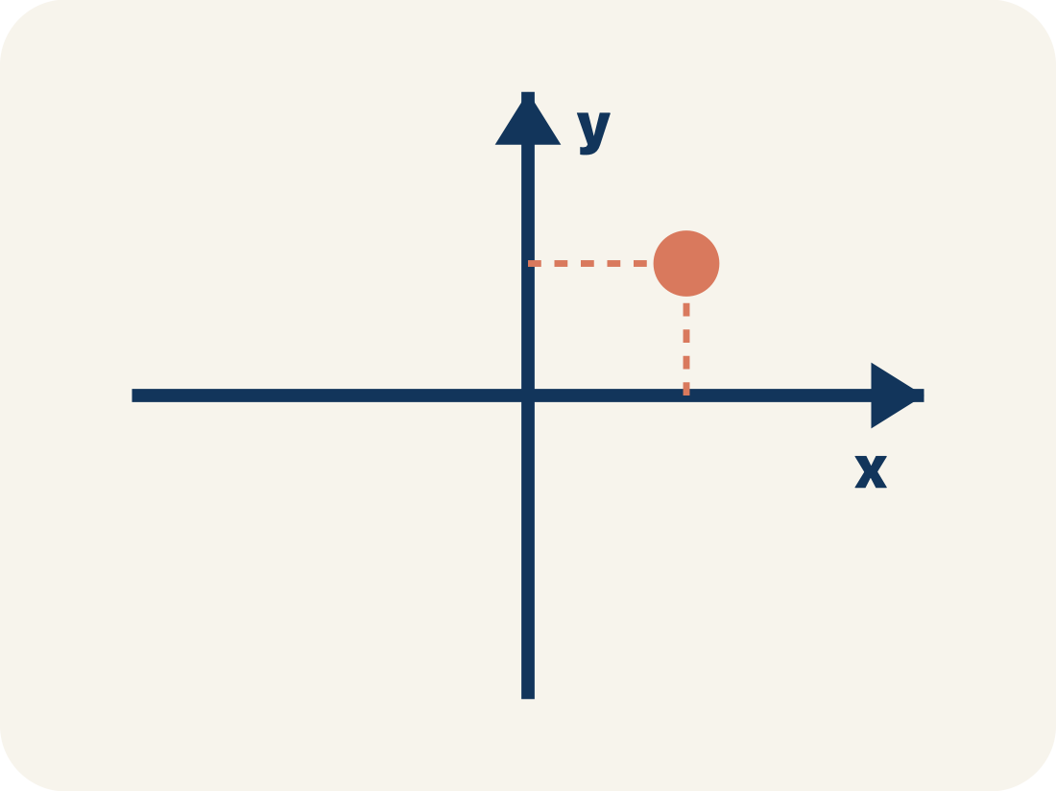
Vocabulary 2 of 7
Lesson 3-4 · Determine Equivalent Ratios Using Graphs
Coordinate plane
A grid with a line going across and a line going up to plot points.
EXAMPLE · EXPLAIN WHY IT FITS
A + shape made by two number lines crossing at the center point (0, 0)
Use “Coordinate plane” to explain the example. Point to
evidence.
eduwonderlab.com · Neft Teacher
5 / 41
Notes:
TEACH IN PRACTICE | Embedded facilitation | Lesson 3.4, slide 5 | VOCAB
Focus on the existing task: Vocabulary 2 of 7 Coordinate plane A grid with a…
ASK (T1/3/5): Where does “Coordinate plane” appear in the example? Explain the meaning without reading the definition. Partner: restate the idea and ask a clarifying question.
LOOK FOR: A correct connection between the word and a feature of the example. If the student only repeats the definition, invite pointing, sketching or oral rehearsal, then ask for another explanation of this same example.
PARTICIPATION (T5/6/7): Think time before volunteers; accept a written, drawn or rehearsed entry. Students ask for evidence respectfully. Recognize a specific contribution or revision and check that both partners participate.
Source: BCPS Updated Instructional Framework Rubric (June 2020), TEACH 1–7.

Slide 6
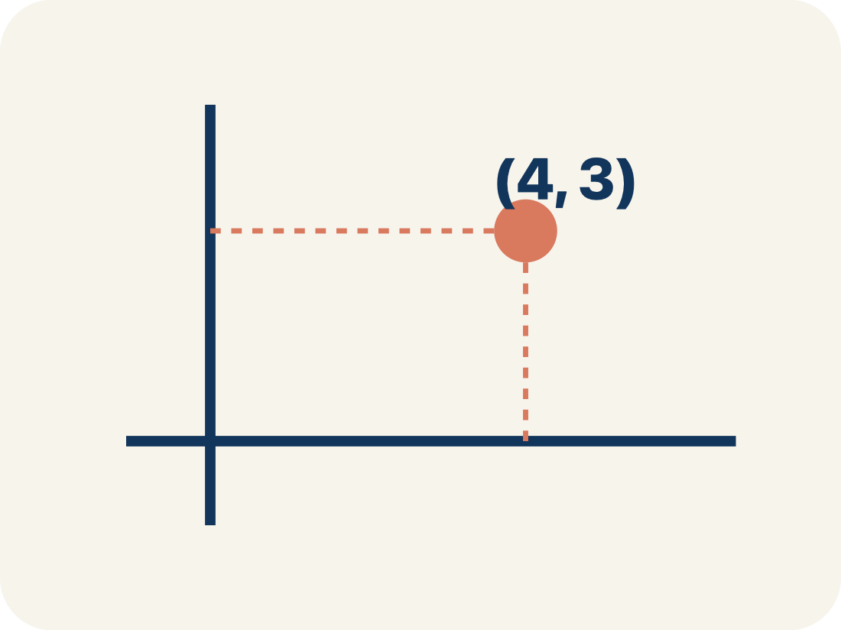
Vocabulary 3 of 7
Lesson 3-4 · Determine Equivalent Ratios Using Graphs
Ordered pair
Two numbers (x, y) that tell where a point is on a grid.
EXAMPLE · EXPLAIN WHY IT FITS
(3, 6) means go right 3, up 6
Use “Ordered pair” to explain the example. Point to evidence.
eduwonderlab.com · Neft Teacher
6 / 41
Notes:
TEACH IN PRACTICE | Embedded facilitation | Lesson 3.4, slide 6 | VOCAB
Focus on the existing task: Vocabulary 3 of 7 Ordered pair Two numbers (x, y)…
ASK (T1/3/5): Where does “Ordered pair” appear in the example? Explain the meaning without reading the definition. Partner: restate the idea and ask a clarifying question.
LOOK FOR: A correct connection between the word and a feature of the example. If the student only repeats the definition, invite pointing, sketching or oral rehearsal, then ask for another explanation of this same example.
PARTICIPATION (T5/6/7): Think time before volunteers; accept a written, drawn or rehearsed entry. Students ask for evidence respectfully. Recognize a specific contribution or revision and check that both partners participate.
Source: BCPS Updated Instructional Framework Rubric (June 2020), TEACH 1–7.

Slide 7
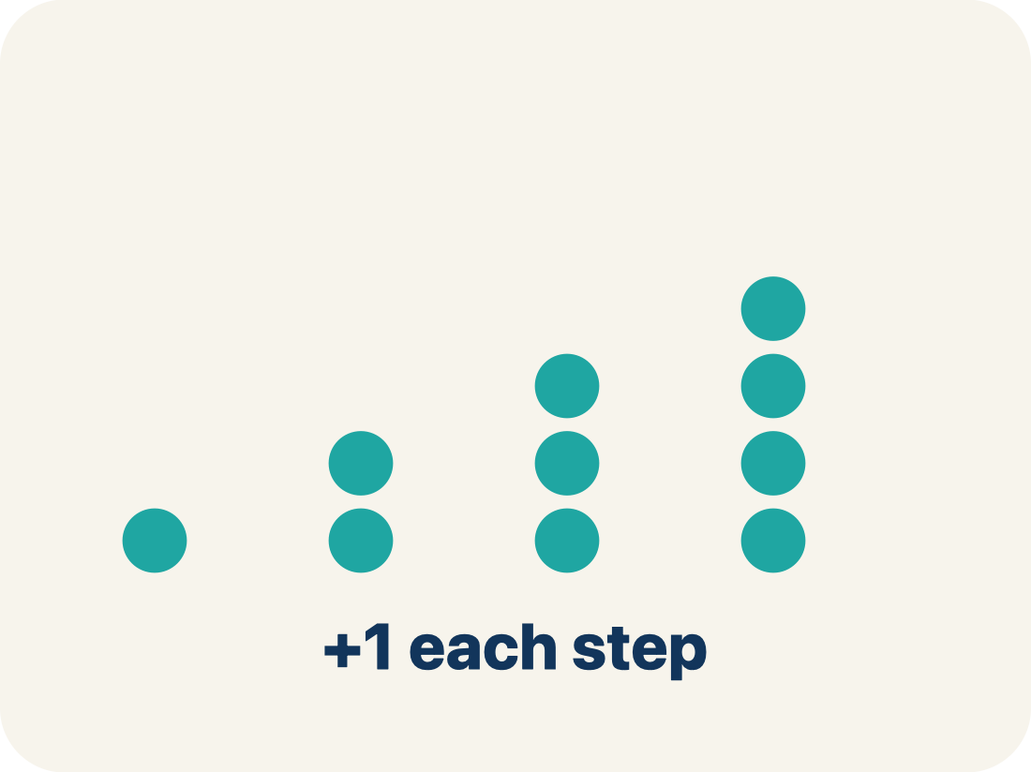
Vocabulary 4 of 7
Lesson 3-4 · Determine Equivalent Ratios Using Graphs
Linear pattern
Points that make a straight line on a grid.
EXAMPLE · EXPLAIN WHY IT FITS
(1,2), (2,4), (3,6) all line up
Use “Linear pattern” to explain the example. Point to
evidence.
eduwonderlab.com · Neft Teacher
7 / 41
Notes:
TEACH IN PRACTICE | Embedded facilitation | Lesson 3.4, slide 7 | VOCAB
Focus on the existing task: Vocabulary 4 of 7 Linear pattern Points that make…
ASK (T1/3/5): Where does “Linear pattern” appear in the example? Explain the meaning without reading the definition. Partner: restate the idea and ask a clarifying question.
LOOK FOR: A correct connection between the word and a feature of the example. If the student only repeats the definition, invite pointing, sketching or oral rehearsal, then ask for another explanation of this same example.
PARTICIPATION (T5/6/7): Think time before volunteers; accept a written, drawn or rehearsed entry. Students ask for evidence respectfully. Recognize a specific contribution or revision and check that both partners participate.
Source: BCPS Updated Instructional Framework Rubric (June 2020), TEACH 1–7.

Slide 8
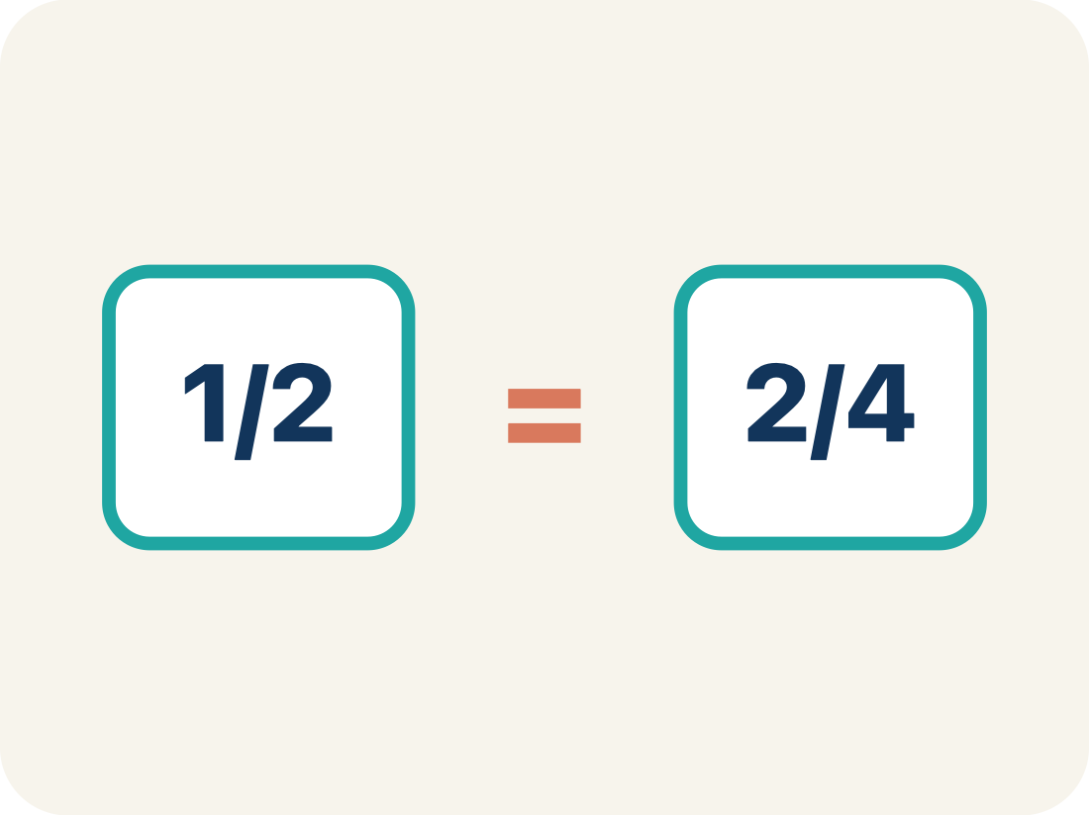
Vocabulary 5 of 7
Lesson 3-4 · Determine Equivalent Ratios Using Graphs
Proportional
Two amounts that grow together at the same rate.
EXAMPLE · EXPLAIN WHY IT FITS
A straight line from (0,0) through (2,6) and (4,12)
Use “Proportional” to explain the example. Point to evidence.
eduwonderlab.com · Neft Teacher
8 / 41
Notes:
TEACH IN PRACTICE | Embedded facilitation | Lesson 3.4, slide 8 | VOCAB
Focus on the existing task: Vocabulary 5 of 7 Proportional Two amounts that…
ASK (T1/3/5): Where does “Proportional” appear in the example? Explain the meaning without reading the definition. Partner: restate the idea and ask a clarifying question.
LOOK FOR: A correct connection between the word and a feature of the example. If the student only repeats the definition, invite pointing, sketching or oral rehearsal, then ask for another explanation of this same example.
PARTICIPATION (T5/6/7): Think time before volunteers; accept a written, drawn or rehearsed entry. Students ask for evidence respectfully. Recognize a specific contribution or revision and check that both partners participate.
Source: BCPS Updated Instructional Framework Rubric (June 2020), TEACH 1–7.

Slide 9
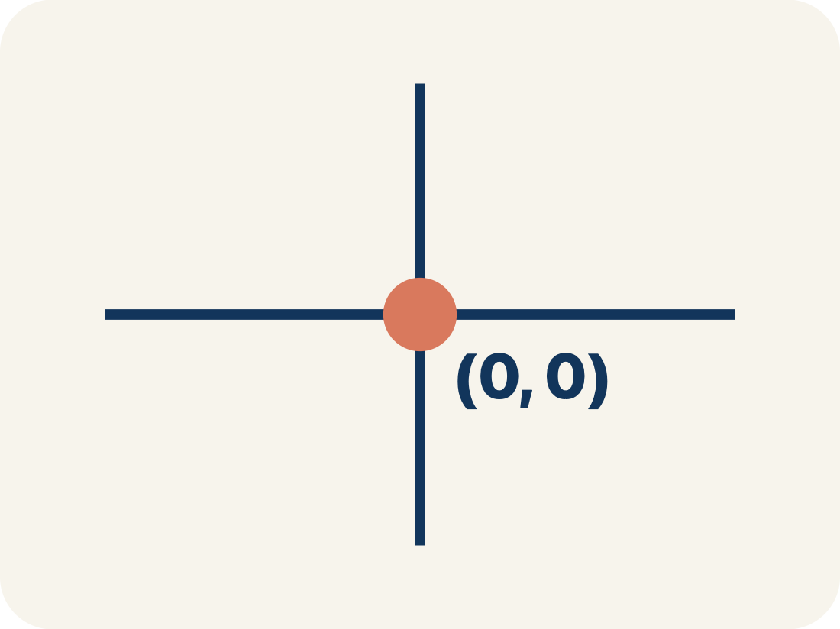
Vocabulary 6 of 7
Lesson 3-4 · Determine Equivalent Ratios Using Graphs
Origin
The point (0, 0) where the two grid lines cross.
EXAMPLE · EXPLAIN WHY IT FITS
The starting corner of the grid at (0, 0)
Use “Origin” to explain the example. Point to evidence.
eduwonderlab.com · Neft Teacher
9 / 41
Notes:
TEACH IN PRACTICE | Embedded facilitation | Lesson 3.4, slide 9 | VOCAB
Focus on the existing task: Vocabulary 6 of 7 Origin The point (0, 0) where…
ASK (T1/3/5): Where does “Origin” appear in the example? Explain the meaning without reading the definition. Partner: restate the idea and ask a clarifying question.
LOOK FOR: A correct connection between the word and a feature of the example. If the student only repeats the definition, invite pointing, sketching or oral rehearsal, then ask for another explanation of this same example.
PARTICIPATION (T5/6/7): Think time before volunteers; accept a written, drawn or rehearsed entry. Students ask for evidence respectfully. Recognize a specific contribution or revision and check that both partners participate.
Source: BCPS Updated Instructional Framework Rubric (June 2020), TEACH 1–7.

Slide 10
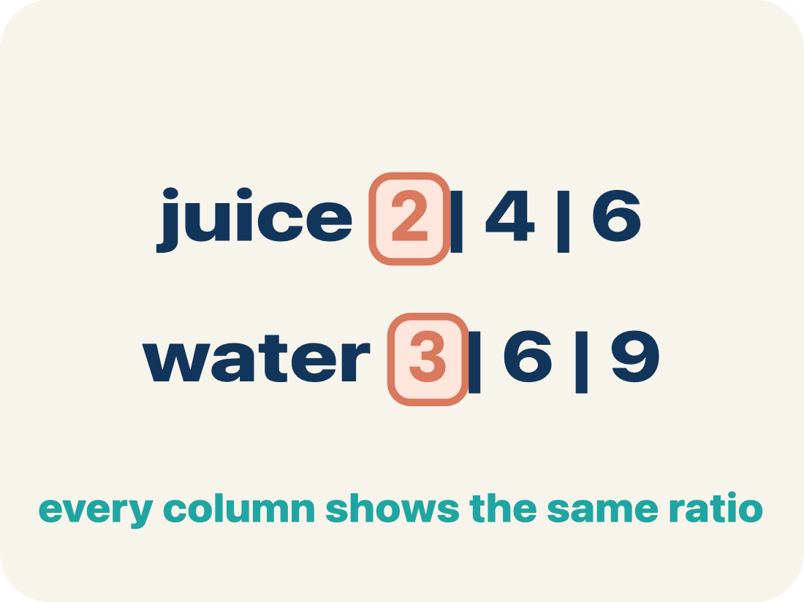
Vocabulary 7 of 7
Lesson 3-4 · Determine Equivalent Ratios Using Graphs
Ratio table
A table of equal ratios that shows a pattern.
EXAMPLE · EXPLAIN WHY IT FITS
Cups of juice: 2, 4, 6 | Cups of water: 3, 6, 9
Use “Ratio table” to explain the example. Point to evidence.
eduwonderlab.com · Neft Teacher
10 / 41
Notes:
TEACH IN PRACTICE | Embedded facilitation | Lesson 3.4, slide 10 | VOCAB
Focus on the existing task: Vocabulary 7 of 7 Ratio table A table of equal…
ASK (T1/3/5): Where does “Ratio table” appear in the example? Explain the meaning without reading the definition. Partner: restate the idea and ask a clarifying question.
LOOK FOR: A correct connection between the word and a feature of the example. If the student only repeats the definition, invite pointing, sketching or oral rehearsal, then ask for another explanation of this same example.
PARTICIPATION (T5/6/7): Think time before volunteers; accept a written, drawn or rehearsed entry. Students ask for evidence respectfully. Recognize a specific contribution or revision and check that both partners participate.
Source: BCPS Updated Instructional Framework Rubric (June 2020), TEACH 1–7.

Slide 11
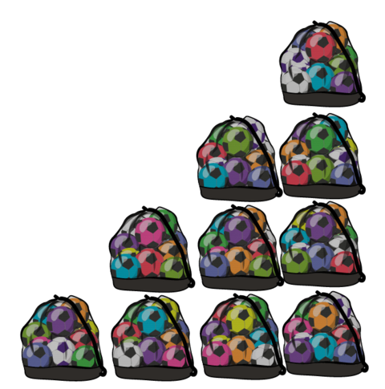

Be Curious
What do you notice?
What do you Wonder?
Think first. Share a notice and a question;
build on a classmate’s idea.
Mindset
How can working as a team help you achieve your math goals?
11 / 41
Notes:
TEACH IN PRACTICE | Embedded facilitation | Lesson 3.4, slide 11 | CURIOUS
Focus on the existing task: Be Curious What do you notice?
LAUNCH (T2/3/5): Allow quiet observation first. Separate a notice from an inference, invite students’ own questions, and follow the existing launch before teaching a procedure.
LOOK FOR (T4): Where this task addresses it, students can match table entries to ordered pairs. Ask which feature of their work supports the claim.
RESPOND: If this task shows the lesson misconception—swapping coordinates or ignoring the axis scale—trace one original table row to the corresponding horizontal and vertical coordinates. Have the student revise and explain the change. Use this support only where the concept occurs in the current task; otherwise respond to the displayed question.
RECHECK: If a gap is shared, revisit the existing representation together. If it is limited, give targeted support while others compare valid methods on the same task. Check the revision before moving on.
PARTICIPATION (T5/6/7): Think time before volunteers; accept a written, drawn or rehearsed entry. Students ask for evidence respectfully. Recognize a specific contribution or revision and check that both partners participate.
Source: BCPS Updated Instructional Framework Rubric (June 2020), TEACH 1–7.

Slide 12
STUDENT MOVE · ESTIMATE • DEFEND • COMPARE
Partner press: ask Why? and answer with evidence.
More or Less Than 25
Estimate first. Choose one expression and defend whether the value is above or below 25.
1,128 ÷ 41
1,850 ÷ 29
624 ÷ 12
EXPLAIN YOUR THINKING
“My estimate is above/below 25 because ___.”
Think and record first. Which part of your work supports your answer?
12 / 41
Notes:
TEACH IN PRACTICE | Embedded facilitation | Lesson 3.4, slide 12 | TASK
Focus on the existing task: More or Less Than 25 1,128 ÷ 41 1,850 ÷ 29 624 ÷ 12 STUDENT MOVE · ESTIMATE • DEFEND • COMPARE Estimate first. Choose one…
LAUNCH (T2/3/5): Use the displayed question. Give private thinking time; then A explains while B asks for evidence. Switch roles. Each student records their own reasoning.
LOOK FOR (T4): Where this task addresses it, students can explain points as ratios. Ask which feature of their work supports the claim.
RESPOND: If this task shows the lesson misconception—swapping coordinates or ignoring the axis scale—trace one original table row to the corresponding horizontal and vertical coordinates. Have the student revise and explain the change. Use this support only where the concept occurs in the current task; otherwise respond to the displayed question.
RECHECK: If a gap is shared, revisit the existing representation together. If it is limited, give targeted support while others compare valid methods on the same task. Check the revision before moving on.
PARTICIPATION (T5/6/7): Think time before volunteers; accept a written, drawn or rehearsed entry. Students ask for evidence respectfully. Recognize a specific contribution or revision and check that both partners participate.
Source: BCPS Updated Instructional Framework Rubric (June 2020), TEACH 1–7. Earlier notes and answer keys are retained below.
EARLIER NOTES / EXISTING ANSWER KEY
Student move: Partner press: ask Why? and answer with evidence.
Routine: STUDENT MOVE · ESTIMATE • DEFEND • COMPARE
UIFR FULL | Lesson-specific facilitation
TEACH 2-3 | Session 1 task launch (UIFR PDF pp. 9-10).
Use the problem exactly as displayed. Give individual thinking time before discussion or advancing to the explanation. If the answer is already visible, ask students to reconstruct and justify it. Invite a choice of suitable representations and have students explain why their choice helps.
At the point where this concept appears, ask: “How does this plotted point show the same comparison as its row in the table?” Wait for evidence, invite another pathway, and have a student ask a follow-up question. Do not replace students’ reasoning with a sequence of leading steps.

Slide 13

STUDENT MOVE · SOLO THINK → PARTNER TALK
Ask a partner a question; choose a model together.
Soccer Balls
The organizers of a soccer league ordered 6 of the bags shown to hold soccer balls. Each bag holds the same number of soccer balls.
How many soccer balls will the bags hold?
Try first. Connect a feature of the
model to a step in your
reasoning.
PLAN WITH A PARTNER
“One bag holds __ balls. Six bags will hold __ because ___.”
13 / 41
Notes:
TEACH IN PRACTICE | Embedded facilitation | Lesson 3.4, slide 13 | TASK
Focus on the existing task: Soccer Balls The organizers of a soccer league ordered 6 of the bags shown to hold soccer balls. Each bag holds the same number of soccer balls. How many soccer balls will the bags hold?
LAUNCH (T2/3/5): Use the displayed question. Give private thinking time; then A explains while B asks for evidence. Switch roles. Each student records their own reasoning.
LOOK FOR (T4): Where this task addresses it, students can match table entries to ordered pairs. Ask which feature of their work supports the claim.
RESPOND: If this task shows the lesson misconception—swapping coordinates or ignoring the axis scale—trace one original table row to the corresponding horizontal and vertical coordinates. Have the student revise and explain the change. Use this support only where the concept occurs in the current task; otherwise respond to the displayed question.
RECHECK: If a gap is shared, revisit the existing representation together. If it is limited, give targeted support while others compare valid methods on the same task. Check the revision before moving on.
PARTICIPATION (T5/6/7): Think time before volunteers; accept a written, drawn or rehearsed entry. Students ask for evidence respectfully. Recognize a specific contribution or revision and check that both partners participate.
Source: BCPS Updated Instructional Framework Rubric (June 2020), TEACH 1–7. Earlier notes and answer keys are retained below.
EARLIER NOTES / EXISTING ANSWER KEY
Student move: Ask a partner a question; choose a model together.
Routine: STUDENT MOVE · SOLO THINK → PARTNER TALK

Slide 14
STUDENT MOVE · NOTICE → MODEL → EXPLAIN
From a ratio table to ordered pairs
An ordered pair (x, y) locates a point on a coordinate plane.
Bags (x) | Balls (y) | Ordered pair
1 | 6 | (1, 6)
2 | 12 | (2, 12)
6 | 36 | (6, 36)
Here, x represents bags and y represents soccer balls.
Read across each table row: 2 bags and 12 balls become (2, 12).
Explain how the table keeps the same
relationship between the two quantities.
EXPLAIN THE CONNECTION
“The pair (__, __) means __ bags and __ balls. I plot __ across, then __ up.”
14 / 41
Notes:
TEACH IN PRACTICE | Embedded facilitation | Lesson 3.4, slide 14 | WORKED
Focus on the existing task: From a ratio table to ordered pairs An ordered pair (x, y) locates a point on a coordinate plane. Here, x represents bags and y…
LAUNCH (T2/3/5): Ask students to explain the displayed idea or example and point to evidence. When a calculation step is shown, ask why it is valid. Have a partner restate the explanation; copying is not the check.
LOOK FOR (T4): Where this task addresses it, students can match table entries to ordered pairs. Ask which feature of their work supports the claim.
RESPOND: If this task shows the lesson misconception—swapping coordinates or ignoring the axis scale—trace one original table row to the corresponding horizontal and vertical coordinates. Have the student revise and explain the change. Use this support only where the concept occurs in the current task; otherwise respond to the displayed question.
RECHECK: If a gap is shared, revisit the existing representation together. If it is limited, give targeted support while others compare valid methods on the same task. Check the revision before moving on.
PARTICIPATION (T5/6/7): Think time before volunteers; accept a written, drawn or rehearsed entry. Students ask for evidence respectfully. Recognize a specific contribution or revision and check that both partners participate.
Source: BCPS Updated Instructional Framework Rubric (June 2020), TEACH 1–7. Earlier notes and answer keys are retained below.
EARLIER NOTES / EXISTING ANSWER KEY
Teach this step before assigning independent practice. Read the highlighted term and connect it to the example. Model the calculation, then ask students to explain why the same factor applies to both quantities. Give thinking time and invite a partner explanation. Source content: supplied McGraw Hill Unit 3 lesson presentation.

Slide 15

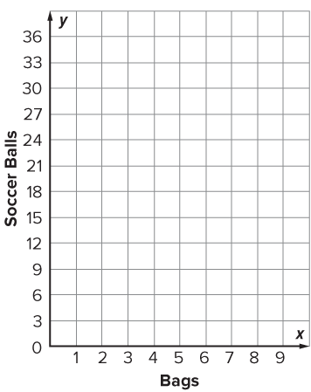
STUDENT MOVE · SOLO THINK → PARTNER TALK
Student-led talk: paraphrase, agree or disagree, add on.
Collaborate and Connect
How can you plot the ordered pairs on the coordinate plane?
Ordered pair
(1, 6)
(2, 12)
(3, 18)
(4, 24)
(5, 30)
(6, 36)
Think first. A explains; B asks for
evidence. Switch roles; both
revise.
Check:
Plot each point: move across to x, then up to y.
15 / 41
Notes:
TEACH IN PRACTICE | Embedded facilitation | Lesson 3.4, slide 15 | COLLABORATE
Focus on the existing task: How can you plot the ordered pairs on the coordinate plane?
LAUNCH (T2/3/5): Use the displayed question. Give private thinking time; then A explains while B asks for evidence. Switch roles. Each student records their own reasoning.
LOOK FOR (T4): Where this task addresses it, students can match table entries to ordered pairs. Ask which feature of their work supports the claim.
RESPOND: If this task shows the lesson misconception—swapping coordinates or ignoring the axis scale—trace one original table row to the corresponding horizontal and vertical coordinates. Have the student revise and explain the change. Use this support only where the concept occurs in the current task; otherwise respond to the displayed question.
RECHECK: If a gap is shared, revisit the existing representation together. If it is limited, give targeted support while others compare valid methods on the same task. Check the revision before moving on.
PARTICIPATION (T5/6/7): Think time before volunteers; accept a written, drawn or rehearsed entry. Students ask for evidence respectfully. Recognize a specific contribution or revision and check that both partners participate.
Source: BCPS Updated Instructional Framework Rubric (June 2020), TEACH 1–7. Earlier notes and answer keys are retained below.
EARLIER NOTES / EXISTING ANSWER KEY
Student move: Student-led talk: paraphrase, agree or disagree, add on.
Routine: STUDENT MOVE · SOLO THINK → PARTNER TALK
UIFR FULL | Lesson-specific facilitation
TEACH 4-5 | Session 1 discussion and checkpoint (UIFR PDF pp. 11-12).
Collect a brief response from every student to the existing prompt before hearing volunteers. Partners take turns explaining and asking for evidence: “I understand ___; what supports ___?” Offer rehearsal or an annotated model for students who need language support. Each student records their own reasoning.
Look specifically for: swapping coordinates or ignoring the axis scale. If it appears, trace one original table row to the corresponding horizontal and vertical coordinates; then ask the student to revise the same response and explain the change. If evidence is secure, have students compare a second valid pathway or state why their approach works. Choose the next step from the responses, not a preset pace.

Slide 16
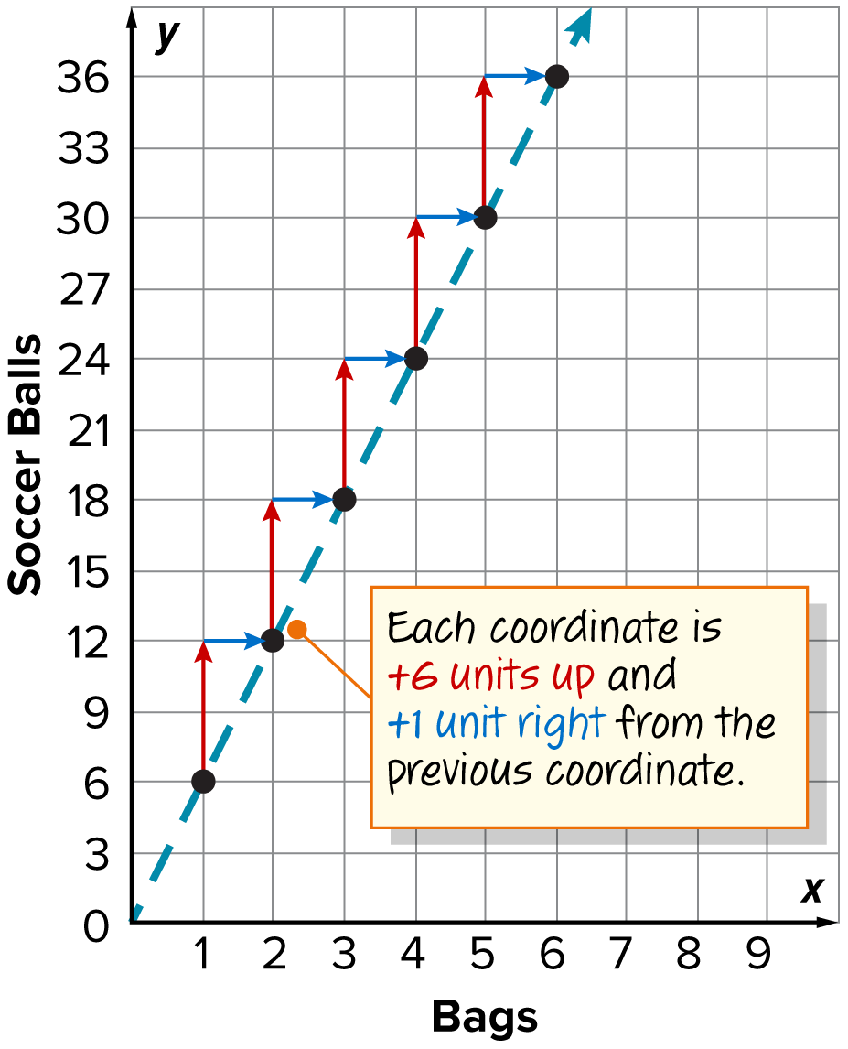
STUDENT MOVE · SOLO THINK → PARTNER TALK
Read the Graph’s Pattern
Equivalent ratio points form a straight line through (0, 0).
What relationship do you notice between the coordinate pairs?
CREDIT A CLASSMATE · Name one classmate whose idea helped you today, and say what they said.
Check:
Each coordinate is +6 units up and +1 unit right from the previous coordinate.
16 / 41
Notes:
TEACH IN PRACTICE | Embedded facilitation | Lesson 3.4, slide 16 | REVEAL
Focus on the existing task: Check: Each coordinate is +6 units up and +1 unit right from the previous coordinate. Equivalent ratio points form a straight line…
LAUNCH (T2/3/5): If an existing answer cover is present, gather an attempt before revealing. If the explanation is already visible, ask students to reconstruct and justify it. Compare reasoning and explain a revision; preserve the reveal sequence.
LOOK FOR (T4): Where this task addresses it, students can match table entries to ordered pairs. Ask which feature of their work supports the claim.
RESPOND: If this task shows the lesson misconception—swapping coordinates or ignoring the axis scale—trace one original table row to the corresponding horizontal and vertical coordinates. Have the student revise and explain the change. Use this support only where the concept occurs in the current task; otherwise respond to the displayed question.
RECHECK: If a gap is shared, revisit the existing representation together. If it is limited, give targeted support while others compare valid methods on the same task. Check the revision before moving on.
PARTICIPATION (T5/6/7): Think time before volunteers; accept a written, drawn or rehearsed entry. Students ask for evidence respectfully. Recognize a specific contribution or revision and check that both partners participate.
Source: BCPS Updated Instructional Framework Rubric (June 2020), TEACH 1–7. Earlier notes and answer keys are retained below.
EARLIER NOTES / EXISTING ANSWER KEY
Routine: STUDENT MOVE · SOLO THINK → PARTNER TALK

Slide 17
STUDENT MOVE · NOTICE → MODEL → EXPLAIN
Practice: bags and soccer balls
Each bag holds 6 soccer balls. Let x = bags and y = balls.
1. Explain the multiplication relationship between bags and balls.
2. Find the number of balls for 10 bags. Write the ordered pair.
PICK YOUR STRATEGY · Choose your path — picture, table, number line, or equation — and be ready to say why you chose it.
EXPLAIN THE CONNECTION
“The point (__, __) means __ bags hold __ balls. I used the rule ___.”
17 / 41
Notes:
TEACH IN PRACTICE | Embedded facilitation | Lesson 3.4, slide 17 | PRACTICE
Focus on the existing task: Practice: bags and soccer balls Each bag holds 6 soccer balls. Let x = bags and y = balls. 1. Explain the multiplication relationship…
LAUNCH (T2/3/5): Use the displayed question. Give private thinking time; then A explains while B asks for evidence. Switch roles. Each student records their own reasoning.
LOOK FOR (T4): Where this task addresses it, students can match table entries to ordered pairs. Ask which feature of their work supports the claim.
RESPOND: If this task shows the lesson misconception—swapping coordinates or ignoring the axis scale—trace one original table row to the corresponding horizontal and vertical coordinates. Have the student revise and explain the change. Use this support only where the concept occurs in the current task; otherwise respond to the displayed question.
RECHECK: If a gap is shared, revisit the existing representation together. If it is limited, give targeted support while others compare valid methods on the same task. Check the revision before moving on.
PARTICIPATION (T5/6/7): Think time before volunteers; accept a written, drawn or rehearsed entry. Students ask for evidence respectfully. Recognize a specific contribution or revision and check that both partners participate.
Source: BCPS Updated Instructional Framework Rubric (June 2020), TEACH 1–7. Earlier notes and answer keys are retained below.
EARLIER NOTES / EXISTING ANSWER KEY
Teach this step before assigning independent practice. Read the highlighted term and connect it to the example. Model the calculation, then ask students to explain why the same factor applies to both quantities. Give thinking time and invite a partner explanation. Source content: supplied McGraw Hill Unit 3 lesson presentation.

Slide 18
LESSON 3.4 / DISCUSS THE TASK
Explain and compare
Use the task you just explored.
TAKE TURNS
How does this plotted point show the same comparison as its row in the table?
Explain
“I know this because…”
Ask
“Where does your work show that?”
Point to evidence in your work.
Then compare your approach with a partner’s.
HOW DO YOU KNOW? · Ask your partner “How do you know?” Answer by pointing to your own work.
Listen to understand. Ask for evidence. Make room for every voice.
Notes:
TEACH IN PRACTICE | Embedded facilitation | Lesson 3.4, slide 18 | PRIOR_INSERT
Focus on the existing task: Point to evidence in your work. Then compare your approach with a partner’s. TAKE TURNS Explain “I know this because…” Ask “Where does your work show that?
CONNECT (T1/4): Ask students to restate the displayed goal or key idea and connect it to earlier work. Relevant lesson evidence: match table entries to ordered pairs; use axis labels and scales; explain points as ratios. Use only the criterion that matches the current session.
SHOW PROGRESS: Students point to their own existing work, explain what improved after feedback, and name a next step. Pair confidence ratings with actual evidence.
PARTICIPATION (T5/6/7): Think time before volunteers; accept a written, drawn or rehearsed entry. Students ask for evidence respectfully. Recognize a specific contribution or revision and check that both partners participate.
Source: BCPS Updated Instructional Framework Rubric (June 2020), TEACH 1–7.

Slide 19
FORMATIVE CHECK · SOLO → CHECK → REVISE
Defend your method; partner gives one specific next step.
60-Second Check
Work independently first. Your response tells us what to do next.
USE THIS INFORMATION
Each bag holds 6 soccer balls. x = bags; y = soccer balls.
1 — REPRESENT
2 — PLOT + EXPLAIN
3 — SELF-MONITOR
Write the ordered pair for 4 bags. Label what x and y represent.
Sketch axes and plot the point. Explain how you know it belongs to the ratio pattern.
Circle one:
READY — I can explain it.
ALMOST — I need one hint.
NOT YET — I need a model.
Partner feedback: Ask “How do you know?” The solver may clarify or revise before sharing.
19 / 41
Notes:
TEACH IN PRACTICE | Embedded facilitation | Lesson 3.4, slide 19 | TASK
Focus on the existing task: 60-Second Check Work independently first. Your response tells us what to do next. FORMATIVE CHECK · SOLO → CHECK → REVISE USE THIS…
LAUNCH (T2/3/5): Use the displayed question. Give private thinking time; then A explains while B asks for evidence. Switch roles. Each student records their own reasoning.
LOOK FOR (T4): Where this task addresses it, students can match table entries to ordered pairs. Ask which feature of their work supports the claim.
RESPOND: If this task shows the lesson misconception—swapping coordinates or ignoring the axis scale—trace one original table row to the corresponding horizontal and vertical coordinates. Have the student revise and explain the change. Use this support only where the concept occurs in the current task; otherwise respond to the displayed question.
RECHECK: If a gap is shared, revisit the existing representation together. If it is limited, give targeted support while others compare valid methods on the same task. Check the revision before moving on.
PARTICIPATION (T5/6/7): Think time before volunteers; accept a written, drawn or rehearsed entry. Students ask for evidence respectfully. Recognize a specific contribution or revision and check that both partners participate.
Source: BCPS Updated Instructional Framework Rubric (June 2020), TEACH 1–7. Earlier notes and answer keys are retained below.
EARLIER NOTES / EXISTING ANSWER KEY
Answer: (4, 24): 4 bags and 24 balls. Give quiet thinking time before sharing. If a student is stuck, point back to the relevant worked model without doing the task for them. Give specific feedback, then allow a correction.

Slide 20
For each bag, there are 6 soccer balls.
The ratio of bags to soccer balls is 1 : 6.
How can you find equivalent ratios?
Reveal:
We can use a table.
Compare your reasoning with the
explanation. Explain any revision
you make.
20 / 41
Notes:
TEACH IN PRACTICE | Embedded facilitation | Lesson 3.4, slide 20 | REVEAL
Focus on the existing task: For each bag, there are 6 soccer balls. The ratio of bags to soccer balls is 1: 6. How can you find equivalent ratios?
LAUNCH (T2/3/5): If an existing answer cover is present, gather an attempt before revealing. If the explanation is already visible, ask students to reconstruct and justify it. Compare reasoning and explain a revision; preserve the reveal sequence.
LOOK FOR (T4): Where this task addresses it, students can match table entries to ordered pairs. Ask which feature of their work supports the claim.
RESPOND: If this task shows the lesson misconception—swapping coordinates or ignoring the axis scale—trace one original table row to the corresponding horizontal and vertical coordinates. Have the student revise and explain the change. Use this support only where the concept occurs in the current task; otherwise respond to the displayed question.
RECHECK: If a gap is shared, revisit the existing representation together. If it is limited, give targeted support while others compare valid methods on the same task. Check the revision before moving on.
PARTICIPATION (T5/6/7): Think time before volunteers; accept a written, drawn or rehearsed entry. Students ask for evidence respectfully. Recognize a specific contribution or revision and check that both partners participate.
Source: BCPS Updated Instructional Framework Rubric (June 2020), TEACH 1–7.

Slide 21
Six bags will hold 36 soccer balls.
Equivalent ratios from a table can be displayed in other ways.
What is another way to display the information in the table?
1 | 6
2 | 12
3 | 18
4 | 24
5 | 30
6 | 36
TRY IT BEFORE YOU’RE SURE · Start even if you are not sure. A revised answer counts as much as a first-try answer.
Reveal:
We can create a graph from the data.
21 / 41
Notes:
TEACH IN PRACTICE | Embedded facilitation | Lesson 3.4, slide 21 | REVEAL
Focus on the existing task: Reveal: We can create a graph from the data. Six bags will hold 36 soccer balls. Equivalent ratios from a table can be displayed in other ways. What is another way to display the information in the table?
LAUNCH (T2/3/5): If an existing answer cover is present, gather an attempt before revealing. If the explanation is already visible, ask students to reconstruct and justify it. Compare reasoning and explain a revision; preserve the reveal sequence.
LOOK FOR (T4): Where this task addresses it, students can match table entries to ordered pairs. Ask which feature of their work supports the claim.
RESPOND: If this task shows the lesson misconception—swapping coordinates or ignoring the axis scale—trace one original table row to the corresponding horizontal and vertical coordinates. Have the student revise and explain the change. Use this support only where the concept occurs in the current task; otherwise respond to the displayed question.
RECHECK: If a gap is shared, revisit the existing representation together. If it is limited, give targeted support while others compare valid methods on the same task. Check the revision before moving on.
PARTICIPATION (T5/6/7): Think time before volunteers; accept a written, drawn or rehearsed entry. Students ask for evidence respectfully. Recognize a specific contribution or revision and check that both partners participate.
Source: BCPS Updated Instructional Framework Rubric (June 2020), TEACH 1–7.

Slide 22
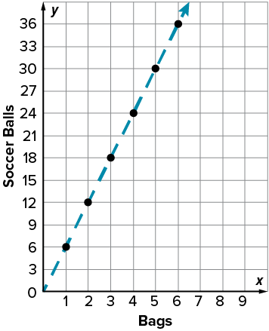
Connecting the points to form a graph can then help you interpret the data.
What do you notice about the plotted points?
JUSTIFY IT · Say it like this: “I know ______ because ______.”
Reveal:
The coordinates form a straight line.
22 / 41
Notes:
TEACH IN PRACTICE | Embedded facilitation | Lesson 3.4, slide 22 | REVEAL
Focus on the existing task: Reveal: The coordinates form a straight line. Connecting the points to form a graph can then help you interpret the data. What do you notice about the plotted points?
LAUNCH (T2/3/5): If an existing answer cover is present, gather an attempt before revealing. If the explanation is already visible, ask students to reconstruct and justify it. Compare reasoning and explain a revision; preserve the reveal sequence.
LOOK FOR (T4): Where this task addresses it, students can explain points as ratios. Ask which feature of their work supports the claim.
RESPOND: If this task shows the lesson misconception—swapping coordinates or ignoring the axis scale—trace one original table row to the corresponding horizontal and vertical coordinates. Have the student revise and explain the change. Use this support only where the concept occurs in the current task; otherwise respond to the displayed question.
RECHECK: If a gap is shared, revisit the existing representation together. If it is limited, give targeted support while others compare valid methods on the same task. Check the revision before moving on.
PARTICIPATION (T5/6/7): Think time before volunteers; accept a written, drawn or rehearsed entry. Students ask for evidence respectfully. Recognize a specific contribution or revision and check that both partners participate.
Source: BCPS Updated Instructional Framework Rubric (June 2020), TEACH 1–7.

Slide 23
WARM-UP · THINK • TRY • CHECK
Turn and talk: compare strategies, then defend one.
Session 2 Warm-Up
Lesson 3-4 · Equivalent Ratios Using Graphs | Session 2 Warm-Up · about 4 minutes
Try each on your own. Mark an unsure answer; explain and revise when we check.
QUESTION 1
QUESTION 2
Each bag holds 6 balls.
Complete the ordered pair: (2, ______)
In the ordered pair (4, 24),
which number is x? ______
QUESTION 3
QUESTION 4
Continue the pattern:
(1, 6), (2, 12), (3, ______)
Equivalent-ratio points form a ______ line through (0, 0).
TALK IT OVER: “I got ______ because ______.” • Compare with a partner before we check as a class.
23 / 41
Notes:
TEACH IN PRACTICE | Embedded facilitation | Lesson 3.4, slide 23 | WARMUP
Focus on the existing task: Session 2 Warm-Up | Session 2 Warm-Up · about 4 minutes WARM-UP · THINK • TRY • CHECK…
GATHER EVIDENCE (T4/6): Keep the original items. Students try independently, mark an uncertain item, and explain one method before checking. Use the existing key when present.
RESPOND: Distinguish a calculation slip from a reasoning gap. Give one next step on the same item; have students revise in a second color. Use the responses to choose flexible support for today’s lesson.
PARTICIPATION (T5/6/7): Think time before volunteers; accept a written, drawn or rehearsed entry. Students ask for evidence respectfully. Recognize a specific contribution or revision and check that both partners participate.
Source: BCPS Updated Instructional Framework Rubric (June 2020), TEACH 1–7. Earlier notes and answer keys are retained below.
EARLIER NOTES / EXISTING ANSWER KEY
Warm-up routine: students start silently on entry; keep it to about 4 minutes.
Circulate and note who is stuck — use what you see to choose who you check on first today.
Go over answers quickly; ask one student to explain a step, not just say the answer.
UIFR: TEACH 4 · TEACH 6.

Slide 24
REVIEW NOTES · RECALL • CONNECT • APPLY
Partner check: explain one idea without looking.
Review Notes — Session 2
ORDERED PAIR = (x, y)
CHECK THE SCALE
Read the axis labels first.
x tells how far across.
y tells how far up.
(2, 12) means 2 bags hold 12 balls.
Each bag holds 6 balls.
Move 1 bag right → 6 balls up.
Explain: “The point (__, __) means __ bags hold __ balls.”
Read x first, then y. Name BOTH quantities.
24 / 41
Notes:
TEACH IN PRACTICE | Embedded facilitation | Lesson 3.4, slide 24 | NOTES
Focus on the existing task: Review Notes — Session 2 REVIEW NOTES · RECALL • CONNECT • APPLY ORDERED PAIR = (x, y) Read the axis labels first. x tells how far…
ROUTINE (T1/2/4): Read or copy the original notes, cover one line, and explain it using the displayed example. Reopen and correct. Copying alone is not evidence of understanding.
LOOK FOR: A link between a symbol, quantity or feature and the explanation. If missing, point back to that feature and have the student try again; fade the prompt once they can explain.
PARTICIPATION (T5/6/7): Think time before volunteers; accept a written, drawn or rehearsed entry. Students ask for evidence respectfully. Recognize a specific contribution or revision and check that both partners participate.
Source: BCPS Updated Instructional Framework Rubric (June 2020), TEACH 1–7. Earlier notes and answer keys are retained below.
EARLIER NOTES / EXISTING ANSWER KEY
Copy routine: read one line at a time; students copy, then explain that line to a partner.
Keep it brisk — the understanding work happens in the examples, not the copying.
UIFR: TEACH 1 · TEACH 6.

Slide 25
LEARNING TARGET · PLOT • READ • EXPLAIN
Tell a partner the new goal and how you will show it.
Learning Target — Session 2
Lesson 3-4 · Equivalent Ratios Using Graphs | Maryland Standard 6.AT.3a
Today I will read a graph and explain how a new point keeps the same ratio.
CONTENT OBJECTIVE
LANGUAGE OBJECTIVE
I can read a graph to find another equivalent ratio.
I can describe how a point on the graph represents an equivalent ratio.
SUCCESS CHECK
WHY THIS MATTERS
✓ Read x first, then the matching y.
✓ Check the point follows the ratio.
✓ Explain both values in context.
A graph helps us see a ratio pattern and predict other amounts.
MATH COMMUNITY: Different strategies are welcome • Ask before telling • Revising your thinking is part of learning
25 / 41
Notes:
TEACH IN PRACTICE | Embedded facilitation | Lesson 3.4, slide 25 | GOAL
Focus on the existing task: Learning Target — Session 2 | Maryland Standard 6.AT.3a LEARNING TARGET · PLOT • READ •…
CONNECT (T1/4): Ask students to restate the displayed goal or key idea and connect it to earlier work. Relevant lesson evidence: match table entries to ordered pairs; use axis labels and scales; explain points as ratios. Use only the criterion that matches the current session.
SHOW PROGRESS: Students point to their own existing work, explain what improved after feedback, and name a next step. Pair confidence ratings with actual evidence.
PARTICIPATION (T5/6/7): Think time before volunteers; accept a written, drawn or rehearsed entry. Students ask for evidence respectfully. Recognize a specific contribution or revision and check that both partners participate.
Source: BCPS Updated Instructional Framework Rubric (June 2020), TEACH 1–7. Earlier notes and answer keys are retained below.
EARLIER NOTES / EXISTING ANSWER KEY
Name today’s content and language goals. Briefly read the success criteria; do not teach procedures here. The original context and model follow. Return to these criteria after the worked example.
UIFR FULL | Lesson-specific facilitation
TEACH 1 | Session 2 purpose and evidence (UIFR PDF p. 8).
Have students restate the displayed session goal in their own words and connect it to the existing context or a familiar experience they choose to share. Use the current session goal to select from these lesson-wide evidence criteria; do not frontload a later-session procedure.
Look for: match table entries to ordered pairs; use axis labels and scales; explain points as ratios. Ask: “Which part of your work would show this?” Revisit that evidence after the task; a confidence rating alone is not evidence of understanding.

Slide 26
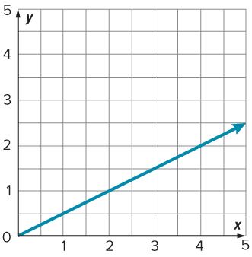
Be Curious
What do you notice?
What do you wonder?
Think first. Share a notice and a question;
build on a classmate’s idea.
Mindset
How is working as a team helping you achieve your math goals?
26 / 41
Notes:
TEACH IN PRACTICE | Embedded facilitation | Lesson 3.4, slide 26 | CURIOUS
Focus on the existing task: Be Curious What do you notice?
LAUNCH (T2/3/5): Allow quiet observation first. Separate a notice from an inference, invite students’ own questions, and follow the existing launch before teaching a procedure.
LOOK FOR (T4): Where this task addresses it, students can match table entries to ordered pairs. Ask which feature of their work supports the claim.
RESPOND: If this task shows the lesson misconception—swapping coordinates or ignoring the axis scale—trace one original table row to the corresponding horizontal and vertical coordinates. Have the student revise and explain the change. Use this support only where the concept occurs in the current task; otherwise respond to the displayed question.
RECHECK: If a gap is shared, revisit the existing representation together. If it is limited, give targeted support while others compare valid methods on the same task. Check the revision before moving on.
PARTICIPATION (T5/6/7): Think time before volunteers; accept a written, drawn or rehearsed entry. Students ask for evidence respectfully. Recognize a specific contribution or revision and check that both partners participate.
Source: BCPS Updated Instructional Framework Rubric (June 2020), TEACH 1–7.

Slide 27
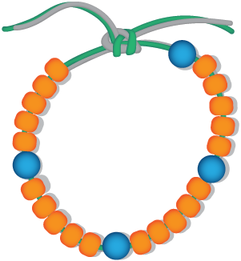
STUDENT MOVE · SOLO THINK → PARTNER TALK
Compare strategies; defend one with evidence.
Lucy’s Bracelets
Lucy is making charm bracelets for her friends. She uses 25 orange beads and 5 blue charms for one kind of bracelet and the beads and charms shown for another kind.
If Lucy always uses the same ratio of charms to beads, how many beads does she use for each charm?
27 / 41
Notes:
TEACH IN PRACTICE | Embedded facilitation | Lesson 3.4, slide 27 | TASK
Focus on the existing task: Lucy’s Bracelets Lucy is making charm bracelets for her friends. She uses 25 orange beads and 5 blue charms for one kind of bracelet and…
LAUNCH (T2/3/5): Use the displayed question. Give private thinking time; then A explains while B asks for evidence. Switch roles. Each student records their own reasoning.
LOOK FOR (T4): Where this task addresses it, students can match table entries to ordered pairs. Ask which feature of their work supports the claim.
RESPOND: If this task shows the lesson misconception—swapping coordinates or ignoring the axis scale—trace one original table row to the corresponding horizontal and vertical coordinates. Have the student revise and explain the change. Use this support only where the concept occurs in the current task; otherwise respond to the displayed question.
RECHECK: If a gap is shared, revisit the existing representation together. If it is limited, give targeted support while others compare valid methods on the same task. Check the revision before moving on.
PARTICIPATION (T5/6/7): Think time before volunteers; accept a written, drawn or rehearsed entry. Students ask for evidence respectfully. Recognize a specific contribution or revision and check that both partners participate.
Source: BCPS Updated Instructional Framework Rubric (June 2020), TEACH 1–7. Earlier notes and answer keys are retained below.
EARLIER NOTES / EXISTING ANSWER KEY
Student move: Compare strategies; defend one with evidence.
Routine: STUDENT MOVE · SOLO THINK → PARTNER TALK
UIFR FULL | Lesson-specific facilitation
TEACH 2-3 | Session 2 task launch (UIFR PDF pp. 9-10).
Use the problem exactly as displayed. Give individual thinking time before discussion or advancing to the explanation. If the answer is already visible, ask students to reconstruct and justify it. Invite a choice of suitable representations and have students explain why their choice helps.
At the point where this concept appears, ask: “How does this plotted point show the same comparison as its row in the table?” Wait for evidence, invite another pathway, and have a student ask a follow-up question. Do not replace students’ reasoning with a sequence of leading steps.

Slide 28
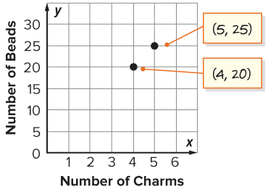
STUDENT MOVE · SOLO THINK → PARTNER TALK
The ratios of charms to beads for the bracelets are 4 : 20 and 5 : 25, so the ordered pairs for these values are (4, 20) and (5, 25).
Talk About It:
How do graphs help you interpret data?
Try first. Read the labels and scale. Use a
point or feature to justify your answer.
28 / 41
Notes:
TEACH IN PRACTICE | Embedded facilitation | Lesson 3.4, slide 28 | TASK
Focus on the existing task: The ratios of charms to beads for the bracelets are 4: 20 and 5: 25, so the ordered pairs for these values are (4, 20) and (5, 25). Talk About It: How do graphs help you interpret data?
LAUNCH (T2/3/5): Use the displayed question. Give private thinking time; then A explains while B asks for evidence. Switch roles. Each student records their own reasoning.
LOOK FOR (T4): Where this task addresses it, students can match table entries to ordered pairs. Ask which feature of their work supports the claim.
RESPOND: If this task shows the lesson misconception—swapping coordinates or ignoring the axis scale—trace one original table row to the corresponding horizontal and vertical coordinates. Have the student revise and explain the change. Use this support only where the concept occurs in the current task; otherwise respond to the displayed question.
RECHECK: If a gap is shared, revisit the existing representation together. If it is limited, give targeted support while others compare valid methods on the same task. Check the revision before moving on.
PARTICIPATION (T5/6/7): Think time before volunteers; accept a written, drawn or rehearsed entry. Students ask for evidence respectfully. Recognize a specific contribution or revision and check that both partners participate.
Source: BCPS Updated Instructional Framework Rubric (June 2020), TEACH 1–7. Earlier notes and answer keys are retained below.
EARLIER NOTES / EXISTING ANSWER KEY
Routine: STUDENT MOVE · SOLO THINK → PARTNER TALK

Slide 29
STUDENT MOVE · NOTICE → MODEL → EXPLAIN
Reading an equivalent ratio on a graph
Equivalent ratios lie on one straight line through the origin, (0, 0).
Charms (x) | Beads (y)
1 | 5
4 | 20
5 | 25
To find beads for 1 charm, locate 1 on the x-axis.
Move up to the ratio line. Read the matching y-value: 5 beads.
Read the labels and scale. Use a point or
feature to justify your answer.
EXPLAIN THE CONNECTION
“At x = 1 charm, y = 5 beads. For __ charms, the graph shows __ beads.”
29 / 41
Notes:
TEACH IN PRACTICE | Embedded facilitation | Lesson 3.4, slide 29 | WORKED
Focus on the existing task: Reading an equivalent ratio on a graph Equivalent ratios lie on one straight line through the origin, (0, 0). To find beads for 1…
LAUNCH (T2/3/5): Ask students to explain the displayed idea or example and point to evidence. When a calculation step is shown, ask why it is valid. Have a partner restate the explanation; copying is not the check.
LOOK FOR (T4): Where this task addresses it, students can explain points as ratios. Ask which feature of their work supports the claim.
RESPOND: If this task shows the lesson misconception—swapping coordinates or ignoring the axis scale—trace one original table row to the corresponding horizontal and vertical coordinates. Have the student revise and explain the change. Use this support only where the concept occurs in the current task; otherwise respond to the displayed question.
RECHECK: If a gap is shared, revisit the existing representation together. If it is limited, give targeted support while others compare valid methods on the same task. Check the revision before moving on.
PARTICIPATION (T5/6/7): Think time before volunteers; accept a written, drawn or rehearsed entry. Students ask for evidence respectfully. Recognize a specific contribution or revision and check that both partners participate.
Source: BCPS Updated Instructional Framework Rubric (June 2020), TEACH 1–7. Earlier notes and answer keys are retained below.
EARLIER NOTES / EXISTING ANSWER KEY
Teach this step before assigning independent practice. Read the highlighted term and connect it to the example. Model the calculation, then ask students to explain why the same factor applies to both quantities. Give thinking time and invite a partner explanation. Source content: supplied McGraw Hill Unit 3 lesson presentation.

Slide 30
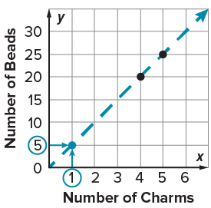
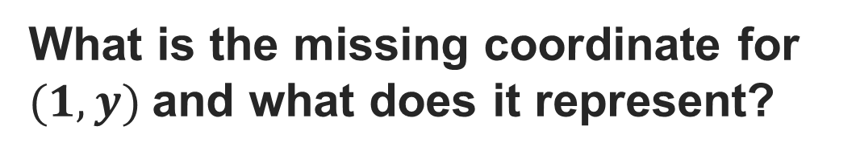
STUDENT MOVE · SOLO THINK → PARTNER TALK
What is the missing coordinate for (1, y) and what does it represent?
Record your reasoning before the reveal.
Compare, then explain any revision.
Check:
5 is the missing coordinate, and it represents the number of beads for every charm.
30 / 41
Notes:
TEACH IN PRACTICE | Embedded facilitation | Lesson 3.4, slide 30 | REVEAL
Focus on the existing task: What is the missing coordinate for (1, y ) and what does it represent?
LAUNCH (T2/3/5): If an existing answer cover is present, gather an attempt before revealing. If the explanation is already visible, ask students to reconstruct and justify it. Compare reasoning and explain a revision; preserve the reveal sequence.
LOOK FOR (T4): Where this task addresses it, students can match table entries to ordered pairs. Ask which feature of their work supports the claim.
RESPOND: If this task shows the lesson misconception—swapping coordinates or ignoring the axis scale—trace one original table row to the corresponding horizontal and vertical coordinates. Have the student revise and explain the change. Use this support only where the concept occurs in the current task; otherwise respond to the displayed question.
RECHECK: If a gap is shared, revisit the existing representation together. If it is limited, give targeted support while others compare valid methods on the same task. Check the revision before moving on.
PARTICIPATION (T5/6/7): Think time before volunteers; accept a written, drawn or rehearsed entry. Students ask for evidence respectfully. Recognize a specific contribution or revision and check that both partners participate.
Source: BCPS Updated Instructional Framework Rubric (June 2020), TEACH 1–7. Earlier notes and answer keys are retained below.
EARLIER NOTES / EXISTING ANSWER KEY
Routine: STUDENT MOVE · SOLO THINK → PARTNER TALK

Slide 31
STUDENT NOTES · COPY LESS • UNDERSTAND MORE
Today’s Math Notes — Session 2
SAY THE GOAL · Say today’s goal in your own words, then name one place this shows up outside math class.
ONE RATIO, ONE LINE
READ A RELATED PAIR
Equivalent ratio points lie on a straight line through (0, 0).
For Lucy’s bracelets:
1 charm → 5 beads.
Locate the number of charms on x. Move up to the ratio line. Read beads on y.
Explain: “For __ charms, the graph shows __ beads.”
Read x first, then y. Name BOTH quantities.
31 / 41
Notes:
TEACH IN PRACTICE | Embedded facilitation | Lesson 3.4, slide 31 | NOTES
Focus on the existing task: Today’s Math Notes — Session 2 STUDENT NOTES · COPY LESS • UNDERSTAND MORE ONE RATIO, ONE LINE Equivalent ratio points lie on a…
ROUTINE (T1/2/4): Read or copy the original notes, cover one line, and explain it using the displayed example. Reopen and correct. Copying alone is not evidence of understanding.
LOOK FOR: A link between a symbol, quantity or feature and the explanation. If missing, point back to that feature and have the student try again; fade the prompt once they can explain.
PARTICIPATION (T5/6/7): Think time before volunteers; accept a written, drawn or rehearsed entry. Students ask for evidence respectfully. Recognize a specific contribution or revision and check that both partners participate.
Source: BCPS Updated Instructional Framework Rubric (June 2020), TEACH 1–7. Earlier notes and answer keys are retained below.
EARLIER NOTES / EXISTING ANSWER KEY
Use this slide only after the original worked example. Students copy the three lines on the left; the table is a reference and does not need copying. Read one line at a time. Ask one student to connect a note to the example.

Slide 32
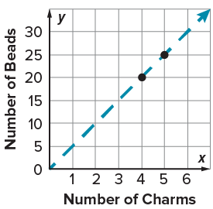
STUDENT MOVE · SOLO THINK → PARTNER TALK
Compare pathways with a partner; name one revision.
Let’s Explore More
How do a ratio table and the graph both illustrate the same ratio relationship? Which representation helps you visualize a ratio relationship more clearly?
How can Lucy use the graph to determine the number of beads she will need if she uses 3 charms?
USE THE AXIS LABELS
“For 3 charms, y is __ beads. The table and graph both show ___.”
32 / 41
Notes:
TEACH IN PRACTICE | Embedded facilitation | Lesson 3.4, slide 32 | PRACTICE
Focus on the existing task: Let’s Explore More How do a ratio table and the graph both illustrate the same ratio relationship?
LAUNCH (T2/3/5): Use the displayed question. Give private thinking time; then A explains while B asks for evidence. Switch roles. Each student records their own reasoning.
LOOK FOR (T4): Where this task addresses it, students can use axis labels and scales. Ask which feature of their work supports the claim.
RESPOND: If this task shows the lesson misconception—swapping coordinates or ignoring the axis scale—trace one original table row to the corresponding horizontal and vertical coordinates. Have the student revise and explain the change. Use this support only where the concept occurs in the current task; otherwise respond to the displayed question.
RECHECK: If a gap is shared, revisit the existing representation together. If it is limited, give targeted support while others compare valid methods on the same task. Check the revision before moving on.
PARTICIPATION (T5/6/7): Think time before volunteers; accept a written, drawn or rehearsed entry. Students ask for evidence respectfully. Recognize a specific contribution or revision and check that both partners participate.
Source: BCPS Updated Instructional Framework Rubric (June 2020), TEACH 1–7. Earlier notes and answer keys are retained below.
EARLIER NOTES / EXISTING ANSWER KEY
Student move: Compare pathways with a partner; name one revision.
Routine: STUDENT MOVE · SOLO THINK → PARTNER TALK
UIFR FULL | Lesson-specific facilitation
TEACH 4-5 | Session 2 discussion and checkpoint (UIFR PDF pp. 11-12).
Collect a brief response from every student to the existing prompt before hearing volunteers. Partners take turns explaining and asking for evidence: “I understand ___; what supports ___?” Offer rehearsal or an annotated model for students who need language support. Each student records their own reasoning.
Look specifically for: swapping coordinates or ignoring the axis scale. If it appears, trace one original table row to the corresponding horizontal and vertical coordinates; then ask the student to revise the same response and explain the change. If evidence is secure, have students compare a second valid pathway or state why their approach works. Choose the next step from the responses, not a preset pace.

Slide 33
LESSON 3.4 / CHECK YOUR WORK
Pause. Check. Improve.
CHECK
A mistake to watch for: swapping coordinates or ignoring the axis scale.
TRY
Trace one given table row to the corresponding horizontal and vertical coordinates.
REVISE
Use that check on the task you just completed. Correct or strengthen one part, and explain why.
SELF-CHECK · Mark it: ✓ got it · ~ almost · ? stuck. Then fix one thing before we move on.
Listen to understand. Ask for evidence. Make room for every voice.
Notes:
TEACH IN PRACTICE | Embedded facilitation | Lesson 3.4, slide 33 | PRIOR_INSERT
Focus on the existing task: LESSON 3.4 / CHECK YOUR WORK Pause. Check. Improve. Listen to understand. Ask for evidence. Make room for every voice. CHECK A mistake…
CONNECT (T1/4): Ask students to restate the displayed goal or key idea and connect it to earlier work. Relevant lesson evidence: match table entries to ordered pairs; use axis labels and scales; explain points as ratios. Use only the criterion that matches the current session.
SHOW PROGRESS: Students point to their own existing work, explain what improved after feedback, and name a next step. Pair confidence ratings with actual evidence.
PARTICIPATION (T5/6/7): Think time before volunteers; accept a written, drawn or rehearsed entry. Students ask for evidence respectfully. Recognize a specific contribution or revision and check that both partners participate.
Source: BCPS Updated Instructional Framework Rubric (June 2020), TEACH 1–7.

Slide 34
Collaborate and Connect
Connect the coordinates with a dotted line.
How can you use the graph to find equivalent ratios?
Think first. A explains; B asks for evidence.
Switch roles; both revise.
Reveal:
We can find points on the line where the x- and y-coordinates meet and use those coordinates as the equivalent ratios.
34 / 41
Notes:
TEACH IN PRACTICE | Embedded facilitation | Lesson 3.4, slide 34 | COLLABORATE
Focus on the existing task: Connect the coordinates with a dotted line. How can you use the graph to find equivalent ratios?
LAUNCH (T2/3/5): Use the displayed question. Give private thinking time; then A explains while B asks for evidence. Switch roles. Each student records their own reasoning.
LOOK FOR (T4): Where this task addresses it, students can explain points as ratios. Ask which feature of their work supports the claim.
RESPOND: If this task shows the lesson misconception—swapping coordinates or ignoring the axis scale—trace one original table row to the corresponding horizontal and vertical coordinates. Have the student revise and explain the change. Use this support only where the concept occurs in the current task; otherwise respond to the displayed question.
RECHECK: If a gap is shared, revisit the existing representation together. If it is limited, give targeted support while others compare valid methods on the same task. Check the revision before moving on.
PARTICIPATION (T5/6/7): Think time before volunteers; accept a written, drawn or rehearsed entry. Students ask for evidence respectfully. Recognize a specific contribution or revision and check that both partners participate.
Source: BCPS Updated Instructional Framework Rubric (June 2020), TEACH 1–7.

Slide 35
The graph contains the ratios equivalent to 4 : 20 and 5 : 25.
How can you use the line to find the number of beads she uses for every 1 charm?
Reveal:
We can move right to 1 on the x-axis and then move up to the dotted line to find the missing coordinate on the y-axis.
Compare your reasoning with the
explanation. Explain any revision
you make.
35 / 41
Notes:
TEACH IN PRACTICE | Embedded facilitation | Lesson 3.4, slide 35 | REVEAL
Focus on the existing task: The graph contains the ratios equivalent to 4: 20 and 5: 25. How can you use the line to find the number of beads she uses for every 1 charm?
LAUNCH (T2/3/5): If an existing answer cover is present, gather an attempt before revealing. If the explanation is already visible, ask students to reconstruct and justify it. Compare reasoning and explain a revision; preserve the reveal sequence.
LOOK FOR (T4): Where this task addresses it, students can use axis labels and scales. Ask which feature of their work supports the claim.
RESPOND: If this task shows the lesson misconception—swapping coordinates or ignoring the axis scale—trace one original table row to the corresponding horizontal and vertical coordinates. Have the student revise and explain the change. Use this support only where the concept occurs in the current task; otherwise respond to the displayed question.
RECHECK: If a gap is shared, revisit the existing representation together. If it is limited, give targeted support while others compare valid methods on the same task. Check the revision before moving on.
PARTICIPATION (T5/6/7): Think time before volunteers; accept a written, drawn or rehearsed entry. Students ask for evidence respectfully. Recognize a specific contribution or revision and check that both partners participate.
Source: BCPS Updated Instructional Framework Rubric (June 2020), TEACH 1–7.

Slide 36
STUDENT MOVE · SUMMARIZE • TEACH A PARTNER
Summarize: Graphs of Ratios
Each column of a ratio table becomes an ordered pair (x, y). Plot across to x, then up to y.
Points from equivalent ratios line up on a straight line through (0, 0). The pattern on the graph IS the ratio.
TABLE → POINTS
READ THE GRAPH
Key idea: A graph shows every equivalent ratio at once — including ones the table never listed.
Teach a partner: How do you find a missing value using the graph?
USE THE MATH WORDS · Use today’s math words in your explanation — not “it” and “that thing.”
36 / 41
Notes:
TEACH IN PRACTICE | Embedded facilitation | Lesson 3.4, slide 36 | SUMMARIZE
Focus on the existing task: STUDENT MOVE · SUMMARIZE • TEACH A PARTNER Summarize: Graphs of Ratios Each column of a ratio table becomes an ordered pair (x, y).…
CONNECT (T1/4): Ask students to restate the displayed goal or key idea and connect it to earlier work. Relevant lesson evidence: match table entries to ordered pairs; use axis labels and scales; explain points as ratios. Use only the criterion that matches the current session.
SHOW PROGRESS: Students point to their own existing work, explain what improved after feedback, and name a next step. Pair confidence ratings with actual evidence.
PARTICIPATION (T5/6/7): Think time before volunteers; accept a written, drawn or rehearsed entry. Students ask for evidence respectfully. Recognize a specific contribution or revision and check that both partners participate.
Source: BCPS Updated Instructional Framework Rubric (June 2020), TEACH 1–7. Earlier notes and answer keys are retained below.
EARLIER NOTES / EXISTING ANSWER KEY
Model briefly, then hand the thinking back: ask “Why does this step work?” before showing the next one.
Quick check before moving on — thumbs or whiteboards from everyone, not volunteers.
UIFR: TEACH 2 · TEACH 3 · TEACH 4.

Slide 37
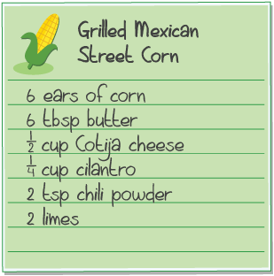
STUDENT MOVE · SOLO THINK → PARTNER TALK
Apply: Street Corn Recipe
Eduardo is going to make 30 ears of grilled Mexican street corn for a party using the recipe shown. He has all the ingredients except Cotija cheese. Eduardo tells a friend he will buy four 10-ounce packages of cheese that each contains 2 cups.
Question: How would you respond to Eduardo?
CHECK THE CLAIM
“For 30 ears, __ cups are needed. Compare that with 8 cups.”
37 / 41
Notes:
TEACH IN PRACTICE | Embedded facilitation | Lesson 3.4, slide 37 | APPLY
Focus on the existing task: Apply: Street Corn Recipe Eduardo is going to make 30 ears of grilled Mexican street corn for a party using the recipe shown. He has all…
LAUNCH (T2/3/5): Use the exact application task independently first. Ask students to justify their choice of method. Collect evidence before a partner discussion or correction.
LOOK FOR (T4): Where this task addresses it, students can match table entries to ordered pairs. Ask which feature of their work supports the claim.
RESPOND: If this task shows the lesson misconception—swapping coordinates or ignoring the axis scale—trace one original table row to the corresponding horizontal and vertical coordinates. Have the student revise and explain the change. Use this support only where the concept occurs in the current task; otherwise respond to the displayed question.
RECHECK: If a gap is shared, revisit the existing representation together. If it is limited, give targeted support while others compare valid methods on the same task. Check the revision before moving on.
PARTICIPATION (T5/6/7): Think time before volunteers; accept a written, drawn or rehearsed entry. Students ask for evidence respectfully. Recognize a specific contribution or revision and check that both partners participate.
Source: BCPS Updated Instructional Framework Rubric (June 2020), TEACH 1–7. Earlier notes and answer keys are retained below.
EARLIER NOTES / EXISTING ANSWER KEY
Routine: STUDENT MOVE · SOLO THINK → PARTNER TALK

Slide 38
STUDENT MOVES
Lesson 3-4
Your move
STRUGGLE FIRST · Work on your own first. Stuck is allowed — try a second strategy before you ask.
38 / 41

Slide 39
STUDENT MOVE · SELF-ASSESS • NAME YOUR NEXT STEP
Partner debrief: name your evidence and one next step.
Exit Ticket + Self-Check
Lucy uses 5 beads for every 1 charm.
SELF-CHECK
What point represents 3 charms? Use x = charms and y = beads.
1. I can plot and read a point.
□ Alone □ With a hint □ Not yet
2. I can justify an equivalent ratio.
□ Alone □ With a hint □ Not yet
My next step:
____________________
Show the point on labeled axes. Explain why it fits the same ratio as (4, 20).
Explain: “Both points follow the rule ___ because ___.”
PLOT → EXPLAIN
Work independently and show why. Use feedback to revise
in a second color.
39 / 41
Notes:
TEACH IN PRACTICE | Embedded facilitation | Lesson 3.4, slide 38 | ASSESSMENT
Focus on the existing task: Exit Ticket + Self-Check STUDENT MOVE · SELF-ASSESS • NAME YOUR NEXT STEP Lucy uses 5 beads for every 1 charm. What point represents 3 charms?
LAUNCH (T2/3/5): Gather an independent response before feedback. Students choose a suitable representation and justify it. Keep the first attempt separate from the revision.
LOOK FOR (T4): Where this task addresses it, students can explain points as ratios. Ask which feature of their work supports the claim.
RESPOND: If this task shows the lesson misconception—swapping coordinates or ignoring the axis scale—trace one original table row to the corresponding horizontal and vertical coordinates. Have the student revise and explain the change. Use this support only where the concept occurs in the current task; otherwise respond to the displayed question.
RECHECK: If a gap is shared, revisit the existing representation together. If it is limited, give targeted support while others compare valid methods on the same task. Check the revision before moving on.
PARTICIPATION (T5/6/7): Think time before volunteers; accept a written, drawn or rehearsed entry. Students ask for evidence respectfully. Recognize a specific contribution or revision and check that both partners participate.
Source: BCPS Updated Instructional Framework Rubric (June 2020), TEACH 1–7. Earlier notes and answer keys are retained below.
EARLIER NOTES / EXISTING ANSWER KEY
Answer: (3, 15); 15 ÷ 3 = 20 ÷ 4 = 5 beads per charm. Give quiet thinking time before sharing. If a student is stuck, point back to the relevant worked model without doing the task for them. Give specific feedback, then allow a correction.
UIFR FULL | Lesson-specific facilitation
TEACH 4 | Independent evidence and revision (UIFR PDF p. 11).
Use the existing application/exit problem as the independent check. If this is a learning-target slide, have students point to and explain their work on the preceding task. Separate initial independent evidence from the revision after feedback.
Check the relevant criteria: match table entries to ordered pairs; use axis labels and scales; explain points as ratios. Respond with one specific next step tied to the work. Students revise and annotate what changed, then identify a criterion they can now demonstrate and one they still need to practice.

Slide 40
Learning Targets
I can represent ratios on a coordinate plane.
I can look for structure on the graph of a ratio relationship to determine equivalent ratios.
CONNECT IT · What earlier lesson does this build on? Tell a partner in one sentence.
40 / 41
Notes:
TEACH IN PRACTICE | Embedded facilitation | Lesson 3.4, slide 39 | REFLECTION
Focus on the existing task: Learning Targets I can represent ratios on a coordinate plane. I can look for structure on the graph of a ratio relationship to determine…
CONNECT (T1/4): Ask students to restate the displayed goal or key idea and connect it to earlier work. Relevant lesson evidence: match table entries to ordered pairs; use axis labels and scales; explain points as ratios. Use only the criterion that matches the current session.
SHOW PROGRESS: Students point to their own existing work, explain what improved after feedback, and name a next step. Pair confidence ratings with actual evidence.
PARTICIPATION (T5/6/7): Think time before volunteers; accept a written, drawn or rehearsed entry. Students ask for evidence respectfully. Recognize a specific contribution or revision and check that both partners participate.
Source: BCPS Updated Instructional Framework Rubric (June 2020), TEACH 1–7. Earlier notes and answer keys are retained below.
EARLIER NOTES / EXISTING ANSWER KEY
UIFR FULL | Lesson-specific facilitation
REFLECT & ADJUST 1-2 | After the lesson (UIFR PDF pp. 15-16).
Sort the existing work by demonstrated reasoning, partial understanding, and the specific misconception: swapping coordinates or ignoring the axis scale. Compare the initial response with the revision. Record which teaching move plausibly helped, which did not, and whose participation or access needs a different approach; do not record sensitive student details in this shared deck.
Plan the next lesson from that evidence: if the misconception persists, trace one original table row to the corresponding horizontal and vertical coordinates using the current example before returning to the next grade-level task; if understanding is secure, use an existing extension or ask for a general explanation. Check the targeted idea again at the next warm-up.
Ask students what supported their thinking and what would help next time. Identify one change to try and one successful practice to retain. Seek colleague feedback on anonymized work when useful; these prompts support reflection and do not establish an evaluation rating. Source: Baltimore City Public Schools, Updated Instructional Framework Rubric, June 2020 (UIFR_Full.pdf).

Slide 41
Teacher Reference — Graphs and Ratios
Hidden from the student slideshow; use checks to choose the next step.
Session 1: label both axes, read the scale, and interpret (x, y) in context.
Quick check: 4 bags → 24 balls, so (4, 24). Move 4 across, then 24 up.
Listen for reversed coordinates or counting grid marks instead of units.
If needed, model (1, 6), then ask the student to plot and explain (2, 12).
Session 2: Lucy uses 5 beads per charm; every point follows y = 5x.
Exit: (3, 15). Both (3, 15) and (4, 20) have 5 beads for each charm.
Feedback: ask for axis labels and a reason; allow a revision before sharing.
REVISE NOW · Change one answer and write why you changed it. A revision is evidence of learning.
41 / 41
Notes:
TEACH IN PRACTICE | Embedded facilitation | Lesson 3.4, slide 40 | REFERENCE
Focus on the existing task: Teacher Reference — Graphs and Ratios Hidden from the student slideshow; use checks to choose the next step. Session 1: label both axes…
TRANSITION (T6/7): Students confirm materials, roles, how to request help, and the next response routine. Ask a student to restate it. Keep teacher-only slides hidden.
PARTICIPATION (T5/6/7): Think time before volunteers; accept a written, drawn or rehearsed entry. Students ask for evidence respectfully. Recognize a specific contribution or revision and check that both partners participate.
Source: BCPS Updated Instructional Framework Rubric (June 2020), TEACH 1–7. Earlier notes and answer keys are retained below.
EARLIER NOTES / EXISTING ANSWER KEY
Source: Baltimore City Public Schools, Updated Instructional Framework Rubric, June 2020. Teacher enactment determines the quality of instruction; this is a support map.

