Slide 1
WARM-UP · THINK • TRY • CHECK
Turn and talk: compare strategies, then defend one.
Warm-Up
Lesson 3-5 · Comparing Ratio Relationships | Warm-Up · about 4 minutes
Try each on your own. Mark an unsure answer; explain and revise when we check.
QUESTION 1
QUESTION 2
Which number is greater:
12 or 9? ______
What do you multiply 3 by to get 12? ______
QUESTION 3
QUESTION 4
Fill in the missing number:
2 : 5 = 4 : ______
Kai reads 20 pages in 2 days.
How many pages in 1 day? ______
TALK IT OVER: “I got ______ because ______.” • Compare with a partner before we check as a class.
1 / 42
Notes:
TEACH IN PRACTICE | Embedded facilitation | Lesson 3.5, slide 1 | WARMUP
Focus on the existing task: ______ QUESTION 2 What do you multiply 3 by to get 12?
GATHER EVIDENCE (T4/6): Keep the original items. Students try independently, mark an uncertain item, and explain one method before checking. Use the existing key when present.
RESPOND: Distinguish a calculation slip from a reasoning gap. Give one next step on the same item; have students revise in a second color. Use the responses to choose flexible support for today’s lesson.
PARTICIPATION (T5/6/7): Think time before volunteers; accept a written, drawn or rehearsed entry. Students ask for evidence respectfully. Recognize a specific contribution or revision and check that both partners participate.
Source: BCPS Updated Instructional Framework Rubric (June 2020), TEACH 1–7. Earlier notes and answer keys are retained below.
EARLIER NOTES / EXISTING ANSWER KEY
Warm-Up answers (teacher only): 1) 12 2) 4 3) 10 4) 10 pages
UIFR FULL | Lesson-specific facilitation
PREPARE 1-2 | Before teaching (UIFR PDF pp. 6-7).
Plan to gather evidence that students can match one quantity before comparing; preserve ratio order; justify the comparison. Review recent work and today’s warm-up to choose flexible groups and access supports; do not infer needs from identity or perceived ability. Use the existing lesson tasks and stated standards.
Anticipate: comparing unmatched amounts as if they were equivalent wholes. If observed, mark equivalent ratios that share one quantity before comparing the other. Offer oral rehearsal, drawing, pointing, or home-language processing as needed; retain the original mathematical demand. Ask students which support helps and fade it as evidence improves.
TEACH 6-7 | Before the first transition, agree on materials, partner roles, and how to request help. Invite students to restate the routine. Normalize revising an idea, recognize a specific contribution, and check privately when frustration blocks participation. Source: UIFR PDF pp. 13-14.

Slide 2
STUDENT NOTES · COPY LESS • UNDERSTAND MORE
Partner talk: connect today’s idea to prior learning.
Today’s Math Notes — Session 1
MAKE A FAIR COMPARISON
SAME RED → COMPARE BLUE
Keep the quantities in the same order. Make the red amounts equal. Then compare blue.
Scale BOTH quantities in each ratio.
Reginald: 6 red, 8 blue
Anwar: 6 red, 9 blue
“For the same 6 red cans, Anwar has more blue because 9 > 8.”
Same quantity first. Compare and explain the other.
2 / 42
Notes:
TEACH IN PRACTICE | Embedded facilitation | Lesson 3.5, slide 2 | NOTES
Focus on the existing task: Today’s Math Notes — Session 1 STUDENT NOTES · COPY LESS • UNDERSTAND MORE MAKE A FAIR COMPARISON Keep the quantities in the same…
ROUTINE (T1/2/4): Read or copy the original notes, cover one line, and explain it using the displayed example. Reopen and correct. Copying alone is not evidence of understanding.
LOOK FOR: A link between a symbol, quantity or feature and the explanation. If missing, point back to that feature and have the student try again; fade the prompt once they can explain.
PARTICIPATION (T5/6/7): Think time before volunteers; accept a written, drawn or rehearsed entry. Students ask for evidence respectfully. Recognize a specific contribution or revision and check that both partners participate.
Source: BCPS Updated Instructional Framework Rubric (June 2020), TEACH 1–7. Earlier notes and answer keys are retained below.
EARLIER NOTES / EXISTING ANSWER KEY
Use this slide only after the original worked example. Students copy the three lines on the left; the table is a reference and does not need copying. Read one line at a time. Ask one student to connect a note to the example.

Slide 3
LEARNING TARGET · MATCH • COMPARE • JUSTIFY
Tell a partner the goal and why it matters.
Learning Target — Session 1
Lesson 3-5 · Comparing Ratio Relationships | Maryland Standard 6.AT.3
Today I will make a fair comparison by matching one quantity in each ratio.
CONTENT OBJECTIVE
LANGUAGE OBJECTIVE
I can compare two mixtures using equivalent ratios.
I can explain a fair comparison using “for the same amount of.”
SUCCESS CHECK
WHY THIS MATTERS
✓ Keep red and blue in the same order.
✓ Make the amount of red equal.
✓ Compare blue for that amount of red.
Fair ratio comparisons help us judge mixtures and prices.
MATH COMMUNITY: Different strategies are welcome • Ask before telling • Revising your thinking is part of learning
3 / 42
Notes:
TEACH IN PRACTICE | Embedded facilitation | Lesson 3.5, slide 3 | GOAL
Focus on the existing task: Learning Target — Session 1 | Maryland Standard 6.AT.3 LEARNING TARGET · MATCH • COMPARE •…
CONNECT (T1/4): Ask students to restate the displayed goal or key idea and connect it to earlier work. Relevant lesson evidence: match one quantity before comparing; preserve ratio order; justify the comparison. Use only the criterion that matches the current session.
SHOW PROGRESS: Students point to their own existing work, explain what improved after feedback, and name a next step. Pair confidence ratings with actual evidence.
PARTICIPATION (T5/6/7): Think time before volunteers; accept a written, drawn or rehearsed entry. Students ask for evidence respectfully. Recognize a specific contribution or revision and check that both partners participate.
Source: BCPS Updated Instructional Framework Rubric (June 2020), TEACH 1–7. Earlier notes and answer keys are retained below.
EARLIER NOTES / EXISTING ANSWER KEY
Name today’s content and language goals. Briefly read the success criteria; do not teach procedures here. The original context and model follow. Return to these criteria after the worked example.
UIFR FULL | Lesson-specific facilitation
TEACH 1 | Session 1 purpose and evidence (UIFR PDF p. 8).
Have students restate the displayed session goal in their own words and connect it to the existing context or a familiar experience they choose to share. Use the current session goal to select from these lesson-wide evidence criteria; do not frontload a later-session procedure.
Look for: match one quantity before comparing; preserve ratio order; justify the comparison. Ask: “Which part of your work would show this?” Revisit that evidence after the task; a confidence rating alone is not evidence of understanding.

Slide 4
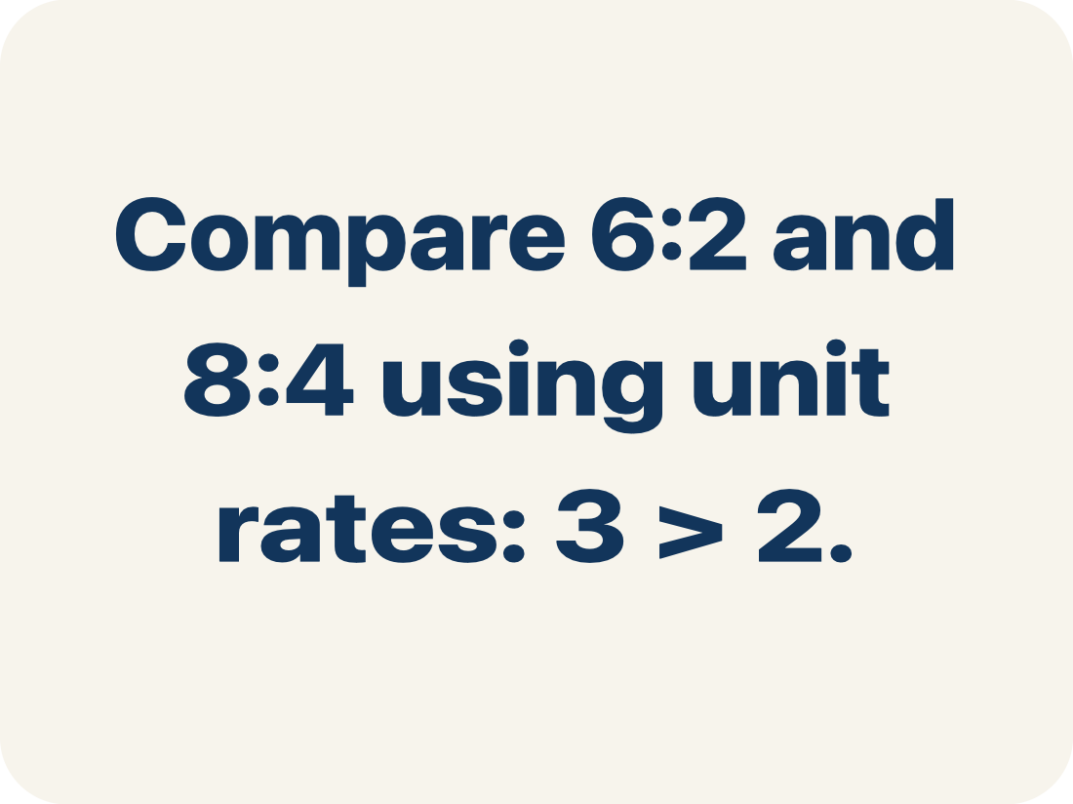
Vocabulary 1 of 6
Lesson 3-5 · Compare Ratio Relationships
Compare Ratios
Decide which ratio is greater, less, or equal by using equivalent ratios or unit rates.
EXAMPLE · EXPLAIN WHY IT FITS
Compare 6:2 and 8:4 using unit rates: 3 > 2.
Use “Compare Ratios” to explain the example. Point to
evidence.
eduwonderlab.com · Neft Teacher
4 / 42
Notes:
TEACH IN PRACTICE | Embedded facilitation | Lesson 3.5, slide 4 | VOCAB
Focus on the existing task: Vocabulary 1 of 6 Compare Ratios Decide which ratio is…
ASK (T1/3/5): Where does “Compare Ratios” appear in the example? Explain the meaning without reading the definition. Partner: restate the idea and ask a clarifying question.
LOOK FOR: A correct connection between the word and a feature of the example. If the student only repeats the definition, invite pointing, sketching or oral rehearsal, then ask for another explanation of this same example.
PARTICIPATION (T5/6/7): Think time before volunteers; accept a written, drawn or rehearsed entry. Students ask for evidence respectfully. Recognize a specific contribution or revision and check that both partners participate.
Source: BCPS Updated Instructional Framework Rubric (June 2020), TEACH 1–7.

Slide 5
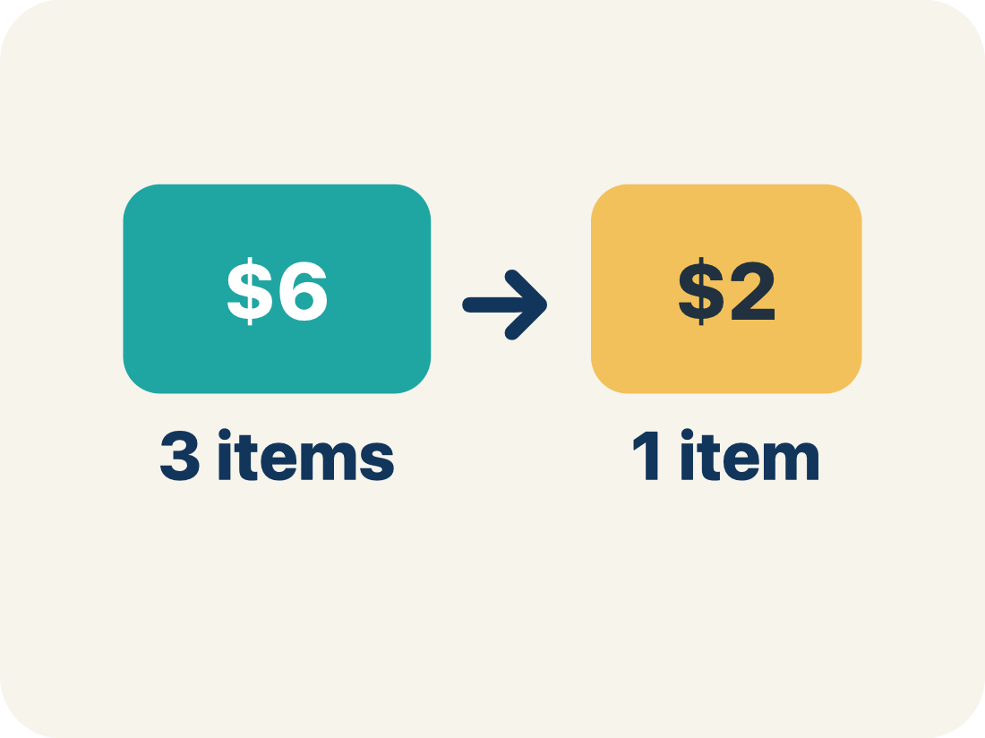
Vocabulary 2 of 6
Lesson 3-5 · Compare Ratio Relationships
Unit rate
A rate for just 1 of something, like cost for 1 item.
EXAMPLE · EXPLAIN WHY IT FITS
$3 per 1 pound → unit rate is $3/lb
Use “Unit rate” to explain the example. Point to evidence.
eduwonderlab.com · Neft Teacher
5 / 42
Notes:
TEACH IN PRACTICE | Embedded facilitation | Lesson 3.5, slide 5 | VOCAB
Focus on the existing task: Vocabulary 2 of 6 Unit rate A rate for just 1 of something…
ASK (T1/3/5): Where does “Unit rate” appear in the example? Explain the meaning without reading the definition. Partner: restate the idea and ask a clarifying question.
LOOK FOR: A correct connection between the word and a feature of the example. If the student only repeats the definition, invite pointing, sketching or oral rehearsal, then ask for another explanation of this same example.
PARTICIPATION (T5/6/7): Think time before volunteers; accept a written, drawn or rehearsed entry. Students ask for evidence respectfully. Recognize a specific contribution or revision and check that both partners participate.
Source: BCPS Updated Instructional Framework Rubric (June 2020), TEACH 1–7.

Slide 6
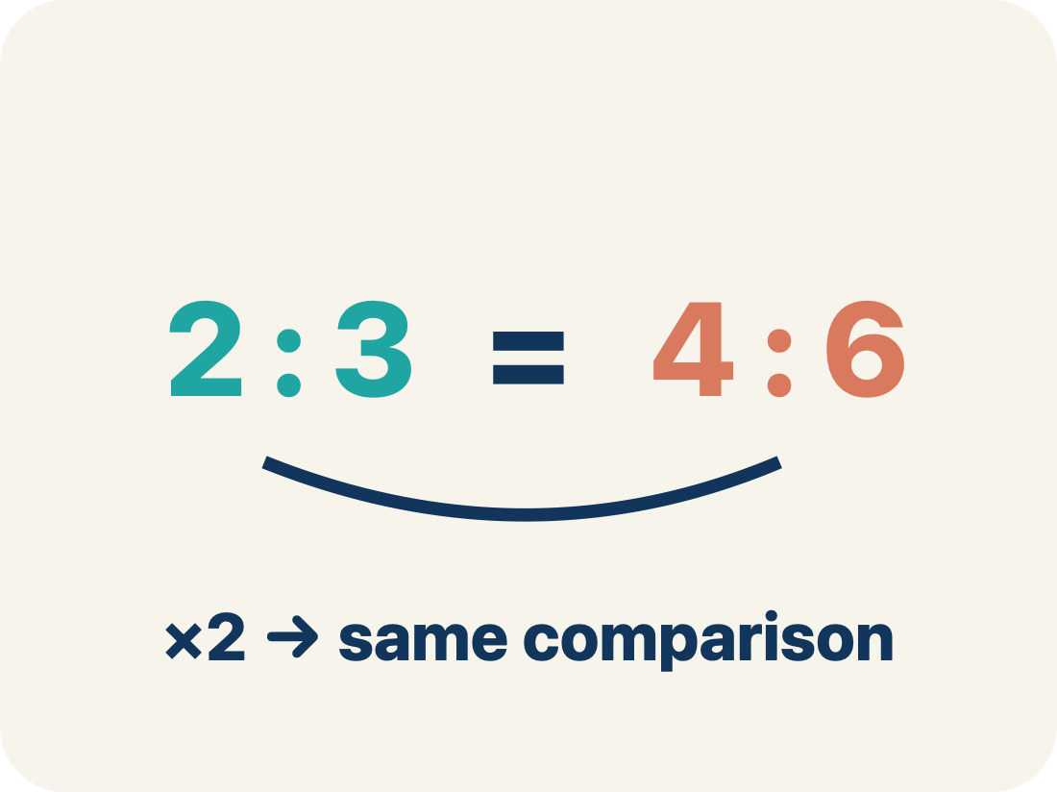
Vocabulary 3 of 6
Lesson 3-5 · Compare Ratio Relationships
Equivalent ratio
Two ratios that mean the same thing.
EXAMPLE · EXPLAIN WHY IT FITS
4:6 and 2:3 are equivalent (both simplify to 2:3)
Use “Equivalent ratio” to explain the example. Point to
evidence.
eduwonderlab.com · Neft Teacher
6 / 42
Notes:
TEACH IN PRACTICE | Embedded facilitation | Lesson 3.5, slide 6 | VOCAB
Focus on the existing task: Vocabulary 3 of 6 Equivalent ratio Two ratios that mean the…
ASK (T1/3/5): Where does “Equivalent ratio” appear in the example? Explain the meaning without reading the definition. Partner: restate the idea and ask a clarifying question.
LOOK FOR: A correct connection between the word and a feature of the example. If the student only repeats the definition, invite pointing, sketching or oral rehearsal, then ask for another explanation of this same example.
PARTICIPATION (T5/6/7): Think time before volunteers; accept a written, drawn or rehearsed entry. Students ask for evidence respectfully. Recognize a specific contribution or revision and check that both partners participate.
Source: BCPS Updated Instructional Framework Rubric (June 2020), TEACH 1–7.

Slide 7
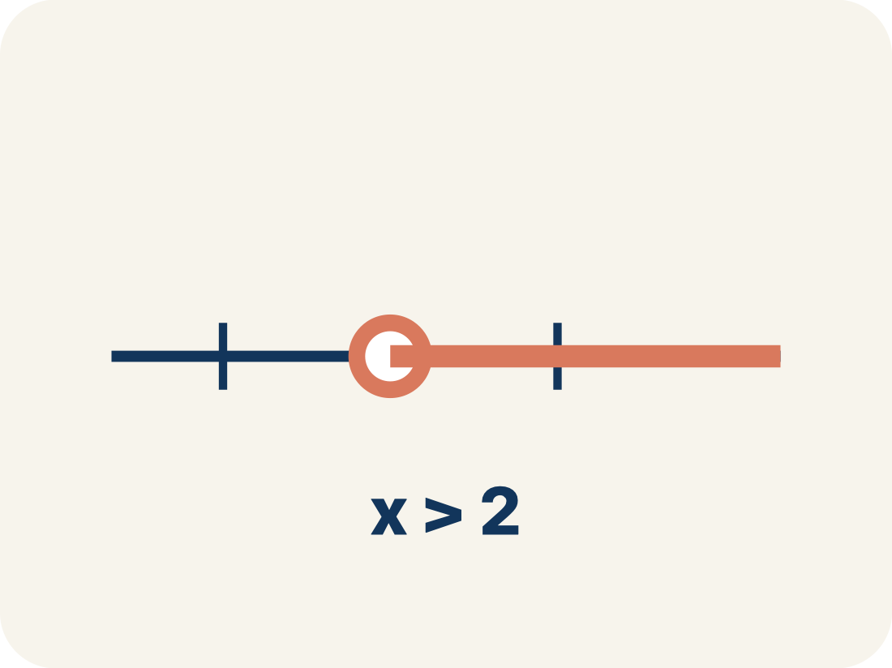
Vocabulary 4 of 6
Lesson 3-5 · Compare Ratio Relationships
Compare
To look at ratios and see which is bigger, smaller, or equal.
EXAMPLE · EXPLAIN WHY IT FITS
3:4 vs. 2:5 — which has more of the first ingredient per unit?
Use “Compare” to explain the example. Point to evidence.
eduwonderlab.com · Neft Teacher
7 / 42
Notes:
TEACH IN PRACTICE | Embedded facilitation | Lesson 3.5, slide 7 | VOCAB
Focus on the existing task: Vocabulary 4 of 6 Compare To look at ratios and see which is…
ASK (T1/3/5): Where does “Compare” appear in the example? Explain the meaning without reading the definition. Partner: restate the idea and ask a clarifying question.
LOOK FOR: A correct connection between the word and a feature of the example. If the student only repeats the definition, invite pointing, sketching or oral rehearsal, then ask for another explanation of this same example.
PARTICIPATION (T5/6/7): Think time before volunteers; accept a written, drawn or rehearsed entry. Students ask for evidence respectfully. Recognize a specific contribution or revision and check that both partners participate.
Source: BCPS Updated Instructional Framework Rubric (June 2020), TEACH 1–7.

Slide 8
Vocabulary 5 of 6
Lesson 3-5 · Compare Ratio Relationships
Simplify
To write a ratio with smaller numbers that still compares the same way. 6:8 and 3:4 are the same ratio.
EXAMPLE · EXPLAIN WHY IT FITS
8:12 → divide both by 4 → 2:3
Use “Simplify” to explain the example. Point to evidence.
eduwonderlab.com · Neft Teacher
8 / 42
Notes:
TEACH IN PRACTICE | Embedded facilitation | Lesson 3.5, slide 8 | VOCAB
Focus on the existing task: Vocabulary 5 of 6 Simplify To write a ratio with smaller…
ASK (T1/3/5): Where does “Simplify” appear in the example? Explain the meaning without reading the definition. Partner: restate the idea and ask a clarifying question.
LOOK FOR: A correct connection between the word and a feature of the example. If the student only repeats the definition, invite pointing, sketching or oral rehearsal, then ask for another explanation of this same example.
PARTICIPATION (T5/6/7): Think time before volunteers; accept a written, drawn or rehearsed entry. Students ask for evidence respectfully. Recognize a specific contribution or revision and check that both partners participate.
Source: BCPS Updated Instructional Framework Rubric (June 2020), TEACH 1–7.

Slide 9
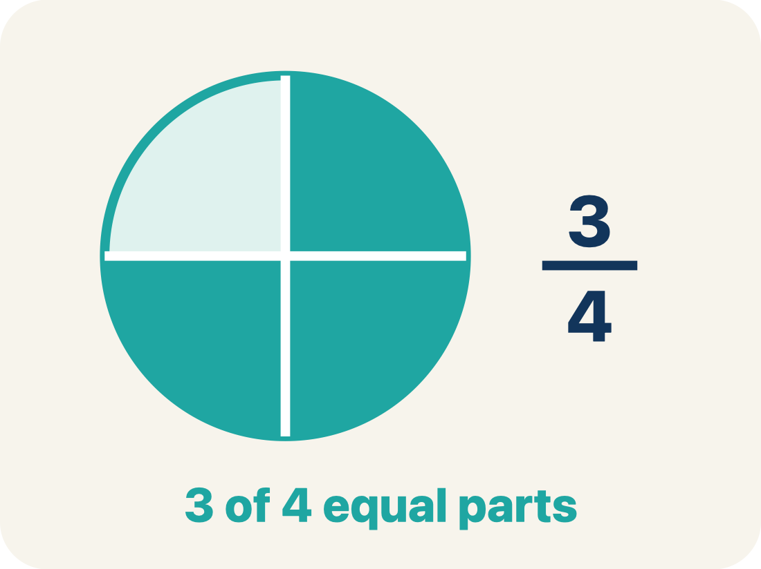
Vocabulary 6 of 6
Lesson 3-5 · Compare Ratio Relationships
Common denominator
A bottom number that two fractions can share so you can compare them.
EXAMPLE · EXPLAIN WHY IT FITS
To compare 3/5 and 4/7, use LCD 35: 21/35 vs 20/35
Use “Common denominator” to explain the example. Point to
evidence.
eduwonderlab.com · Neft Teacher
9 / 42
Notes:
TEACH IN PRACTICE | Embedded facilitation | Lesson 3.5, slide 9 | VOCAB
Focus on the existing task: Vocabulary 6 of 6 Common denominator A bottom number that two…
ASK (T1/3/5): Where does “Common denominator” appear in the example? Explain the meaning without reading the definition. Partner: restate the idea and ask a clarifying question.
LOOK FOR: A correct connection between the word and a feature of the example. If the student only repeats the definition, invite pointing, sketching or oral rehearsal, then ask for another explanation of this same example.
PARTICIPATION (T5/6/7): Think time before volunteers; accept a written, drawn or rehearsed entry. Students ask for evidence respectfully. Recognize a specific contribution or revision and check that both partners participate.
Source: BCPS Updated Instructional Framework Rubric (June 2020), TEACH 1–7.

Slide 10


Be Curious
What do you notice?
What do you wonder?
Think first. Share a notice and a question;
build on a classmate’s idea.
Mindset
How can creative thinking help you solve a math problem?
10 / 42
Notes:
TEACH IN PRACTICE | Embedded facilitation | Lesson 3.5, slide 10 | CURIOUS
Focus on the existing task: Be Curious What do you notice?
LAUNCH (T2/3/5): Allow quiet observation first. Separate a notice from an inference, invite students’ own questions, and follow the existing launch before teaching a procedure.
LOOK FOR (T4): Where this task addresses it, students can match one quantity before comparing. Ask which feature of their work supports the claim.
RESPOND: If this task shows the lesson misconception—comparing unmatched amounts as if they were equivalent wholes—mark equivalent ratios that share one quantity before comparing the other. Have the student revise and explain the change. Use this support only where the concept occurs in the current task; otherwise respond to the displayed question.
RECHECK: If a gap is shared, revisit the existing representation together. If it is limited, give targeted support while others compare valid methods on the same task. Check the revision before moving on.
PARTICIPATION (T5/6/7): Think time before volunteers; accept a written, drawn or rehearsed entry. Students ask for evidence respectfully. Recognize a specific contribution or revision and check that both partners participate.
Source: BCPS Updated Instructional Framework Rubric (June 2020), TEACH 1–7.

Slide 11
STUDENT MOVE · ESTIMATE • DEFEND • COMPARE
Partner press: ask Why? and answer with evidence.
More or Less Than 50
Estimate first. Choose one expression and defend whether the value is above or below 50.
0.49 + 37.9
23.87 + 28.05
41.86 + 8.93
EXPLAIN YOUR THINKING
“My estimate is above/below 50 because ___.”
Think and record first. Which part of your work supports your answer?
11 / 42
Notes:
TEACH IN PRACTICE | Embedded facilitation | Lesson 3.5, slide 11 | TASK
Focus on the existing task: More or Less Than 50 0.49 + 37.9 23.87 + 28.05 41.86 + 8.93 STUDENT MOVE · ESTIMATE • DEFEND • COMPARE Estimate first. Choose one…
LAUNCH (T2/3/5): Use the displayed question. Give private thinking time; then A explains while B asks for evidence. Switch roles. Each student records their own reasoning.
LOOK FOR (T4): Where this task addresses it, students can match one quantity before comparing. Ask which feature of their work supports the claim.
RESPOND: If this task shows the lesson misconception—comparing unmatched amounts as if they were equivalent wholes—mark equivalent ratios that share one quantity before comparing the other. Have the student revise and explain the change. Use this support only where the concept occurs in the current task; otherwise respond to the displayed question.
RECHECK: If a gap is shared, revisit the existing representation together. If it is limited, give targeted support while others compare valid methods on the same task. Check the revision before moving on.
PARTICIPATION (T5/6/7): Think time before volunteers; accept a written, drawn or rehearsed entry. Students ask for evidence respectfully. Recognize a specific contribution or revision and check that both partners participate.
Source: BCPS Updated Instructional Framework Rubric (June 2020), TEACH 1–7. Earlier notes and answer keys are retained below.
EARLIER NOTES / EXISTING ANSWER KEY
Estimation warm-up: students commit to more or less than 50, defend it in one sentence, then compare with a partner. Keep it under three minutes; the defense matters more than the estimate.
UIFR FULL | Lesson-specific facilitation
TEACH 2-3 | Session 1 task launch (UIFR PDF pp. 9-10).
Use the problem exactly as displayed. Give individual thinking time before discussion or advancing to the explanation. If the answer is already visible, ask students to reconstruct and justify it. Invite a choice of suitable representations and have students explain why their choice helps.
At the point where this concept appears, ask: “What must be held equal to make this a fair comparison, and how does your table show that?” Wait for evidence, invite another pathway, and have a student ask a follow-up question. Do not replace students’ reasoning with a sequence of leading steps.

Slide 12
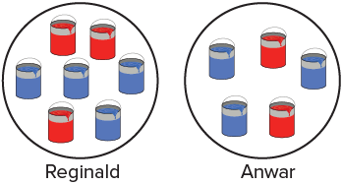
STUDENT MOVE · SOLO THINK → PARTNER TALK
Ask a partner a question; choose a model together.
Purple Paint Mixture
Two friends used the paint shown to create shades of purple paint.
Whose mixture has more blue relative to red?
Try first. Connect a feature of the model to a step in your reasoning.
Mindset
What do you already know about the problem?
12 / 42
Notes:
TEACH IN PRACTICE | Embedded facilitation | Lesson 3.5, slide 12 | TASK
Focus on the existing task: Purple Paint Mixture Two friends used the paint shown to create shades of purple paint. Whose mixture has more blue relative to red?
LAUNCH (T2/3/5): Use the displayed question. Give private thinking time; then A explains while B asks for evidence. Switch roles. Each student records their own reasoning.
LOOK FOR (T4): Where this task addresses it, students can match one quantity before comparing. Ask which feature of their work supports the claim.
RESPOND: If this task shows the lesson misconception—comparing unmatched amounts as if they were equivalent wholes—mark equivalent ratios that share one quantity before comparing the other. Have the student revise and explain the change. Use this support only where the concept occurs in the current task; otherwise respond to the displayed question.
RECHECK: If a gap is shared, revisit the existing representation together. If it is limited, give targeted support while others compare valid methods on the same task. Check the revision before moving on.
PARTICIPATION (T5/6/7): Think time before volunteers; accept a written, drawn or rehearsed entry. Students ask for evidence respectfully. Recognize a specific contribution or revision and check that both partners participate.
Source: BCPS Updated Instructional Framework Rubric (June 2020), TEACH 1–7. Earlier notes and answer keys are retained below.
EARLIER NOTES / EXISTING ANSWER KEY
Student move: Ask a partner a question; choose a model together.
Routine: STUDENT MOVE · SOLO THINK → PARTNER TALK

Slide 13
STUDENT MOVE · NOTICE → MODEL → EXPLAIN
A fair comparison of mixtures
Keep the ratio order the same: red paint to blue paint.
Mixture | Red cans | Blue cans
Reginald | 3 | 4
Anwar | 2 | 3
Equivalent ratios let us compare mixtures with the same amount of red.
Comparing only the total number of cans does not compare the shades.
Connect a feature of the model to a step in
your reasoning.
EXPLAIN THE CONNECTION
“I will match __ red cans because both 3 and 2 can be scaled to ___.”
13 / 42
Notes:
TEACH IN PRACTICE | Embedded facilitation | Lesson 3.5, slide 13 | WORKED
Focus on the existing task: A fair comparison of mixtures Keep the ratio order the same: red paint to blue paint. Equivalent ratios let us compare mixtures with…
LAUNCH (T2/3/5): Ask students to explain the displayed idea or example and point to evidence. When a calculation step is shown, ask why it is valid. Have a partner restate the explanation; copying is not the check.
LOOK FOR (T4): Where this task addresses it, students can match one quantity before comparing. Ask which feature of their work supports the claim.
RESPOND: If this task shows the lesson misconception—comparing unmatched amounts as if they were equivalent wholes—mark equivalent ratios that share one quantity before comparing the other. Have the student revise and explain the change. Use this support only where the concept occurs in the current task; otherwise respond to the displayed question.
RECHECK: If a gap is shared, revisit the existing representation together. If it is limited, give targeted support while others compare valid methods on the same task. Check the revision before moving on.
PARTICIPATION (T5/6/7): Think time before volunteers; accept a written, drawn or rehearsed entry. Students ask for evidence respectfully. Recognize a specific contribution or revision and check that both partners participate.
Source: BCPS Updated Instructional Framework Rubric (June 2020), TEACH 1–7. Earlier notes and answer keys are retained below.
EARLIER NOTES / EXISTING ANSWER KEY
Teach this step before assigning independent practice. Read the highlighted term and connect it to the example. Model the calculation, then ask students to explain why the same factor applies to both quantities. Give thinking time and invite a partner explanation. Source content: supplied McGraw Hill Unit 3 lesson presentation.

Slide 14
STUDENT MOVE · NOTICE → MODEL → EXPLAIN
Matching the red paint amounts
Reginald: multiply both quantities by 2.
Mixture | Red cans | Blue cans
Reginald | 3 × 2 = 6 | 4 × 2 = 8
Anwar | 2 × 3 = 6 | 3 × 3 = 9
Anwar: multiply both quantities by 3.
For the same 6 red cans, compare 8 blue cans with 9 blue cans.
Connect a feature of the model to a step in
your reasoning.
EXPLAIN THE CONNECTION
“For the same 6 red cans, Anwar has 9 blue and Reginald has 8, so ___.”
14 / 42
Notes:
TEACH IN PRACTICE | Embedded facilitation | Lesson 3.5, slide 14 | WORKED
Focus on the existing task: Matching the red paint amounts Reginald: multiply both quantities by 2. Anwar: multiply both quantities by 3. For the same 6 red cans…
LAUNCH (T2/3/5): Ask students to explain the displayed idea or example and point to evidence. When a calculation step is shown, ask why it is valid. Have a partner restate the explanation; copying is not the check.
LOOK FOR (T4): Where this task addresses it, students can match one quantity before comparing. Ask which feature of their work supports the claim.
RESPOND: If this task shows the lesson misconception—comparing unmatched amounts as if they were equivalent wholes—mark equivalent ratios that share one quantity before comparing the other. Have the student revise and explain the change. Use this support only where the concept occurs in the current task; otherwise respond to the displayed question.
RECHECK: If a gap is shared, revisit the existing representation together. If it is limited, give targeted support while others compare valid methods on the same task. Check the revision before moving on.
PARTICIPATION (T5/6/7): Think time before volunteers; accept a written, drawn or rehearsed entry. Students ask for evidence respectfully. Recognize a specific contribution or revision and check that both partners participate.
Source: BCPS Updated Instructional Framework Rubric (June 2020), TEACH 1–7. Earlier notes and answer keys are retained below.
EARLIER NOTES / EXISTING ANSWER KEY
Teach this step before assigning independent practice. Read the highlighted term and connect it to the example. Model the calculation, then ask students to explain why the same factor applies to both quantities. Give thinking time and invite a partner explanation. Source content: supplied McGraw Hill Unit 3 lesson presentation.

Slide 15



STUDENT MOVE · SOLO THINK → PARTNER TALK
Student-led talk: paraphrase, agree or disagree, add on.
Collaborate and Connect
Let’s look at another similar problem.
Marisa’s Mixture
Shannon’s Mixture
For 6 blue cans, who uses more yellow?
MAKE IT FAIR
“For 6 blue cans, __ uses __ yellow cans and __ uses __.”
15 / 42
Notes:
TEACH IN PRACTICE | Embedded facilitation | Lesson 3.5, slide 15 | COLLABORATE
Focus on the existing task: Marisa’s Mixture Shannon’s Mixture Let’s look at another similar problem. For 6 blue cans, who uses more yellow?
LAUNCH (T2/3/5): Use the displayed question. Give private thinking time; then A explains while B asks for evidence. Switch roles. Each student records their own reasoning.
LOOK FOR (T4): Where this task addresses it, students can match one quantity before comparing. Ask which feature of their work supports the claim.
RESPOND: If this task shows the lesson misconception—comparing unmatched amounts as if they were equivalent wholes—mark equivalent ratios that share one quantity before comparing the other. Have the student revise and explain the change. Use this support only where the concept occurs in the current task; otherwise respond to the displayed question.
RECHECK: If a gap is shared, revisit the existing representation together. If it is limited, give targeted support while others compare valid methods on the same task. Check the revision before moving on.
PARTICIPATION (T5/6/7): Think time before volunteers; accept a written, drawn or rehearsed entry. Students ask for evidence respectfully. Recognize a specific contribution or revision and check that both partners participate.
Source: BCPS Updated Instructional Framework Rubric (June 2020), TEACH 1–7. Earlier notes and answer keys are retained below.
EARLIER NOTES / EXISTING ANSWER KEY
Student move: Student-led talk: paraphrase, agree or disagree, add on.
Routine: STUDENT MOVE · SOLO THINK → PARTNER TALK
UIFR FULL | Lesson-specific facilitation
TEACH 4-5 | Session 1 discussion and checkpoint (UIFR PDF pp. 11-12).
Collect a brief response from every student to the existing prompt before hearing volunteers. Partners take turns explaining and asking for evidence: “I understand ___; what supports ___?” Offer rehearsal or an annotated model for students who need language support. Each student records their own reasoning.
Look specifically for: comparing unmatched amounts as if they were equivalent wholes. If it appears, mark equivalent ratios that share one quantity before comparing the other; then ask the student to revise the same response and explain the change. If evidence is secure, have students compare a second valid pathway or state why their approach works. Choose the next step from the responses, not a preset pace.

Slide 16
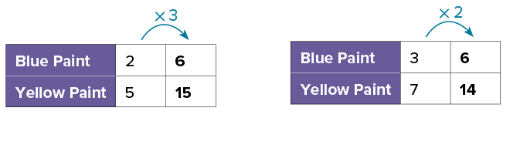
STUDENT MOVE · SOLO THINK → PARTNER TALK
Collaborate and Connect (continued)
Or you can extend the patterns using multiplication to find the equivalent ratios.
Marisa’s Mixture
Shannon’s Mixture
For 6 blue cans, who uses more yellow?
Check:
Marisa: 15 yellow cans compared with 14.
16 / 42
Notes:
TEACH IN PRACTICE | Embedded facilitation | Lesson 3.5, slide 16 | COLLABORATE
Focus on the existing task: Collaborate and Connect (continued) Or you can extend the patterns using multiplication to find the equivalent ratios. Marisa’s Mixture Shannon’s Mixture For 6 blue cans, who uses more yellow?
LAUNCH (T2/3/5): Use the displayed question. Give private thinking time; then A explains while B asks for evidence. Switch roles. Each student records their own reasoning.
LOOK FOR (T4): Where this task addresses it, students can match one quantity before comparing. Ask which feature of their work supports the claim.
RESPOND: If this task shows the lesson misconception—comparing unmatched amounts as if they were equivalent wholes—mark equivalent ratios that share one quantity before comparing the other. Have the student revise and explain the change. Use this support only where the concept occurs in the current task; otherwise respond to the displayed question.
RECHECK: If a gap is shared, revisit the existing representation together. If it is limited, give targeted support while others compare valid methods on the same task. Check the revision before moving on.
PARTICIPATION (T5/6/7): Think time before volunteers; accept a written, drawn or rehearsed entry. Students ask for evidence respectfully. Recognize a specific contribution or revision and check that both partners participate.
Source: BCPS Updated Instructional Framework Rubric (June 2020), TEACH 1–7. Earlier notes and answer keys are retained below.
EARLIER NOTES / EXISTING ANSWER KEY
Routine: STUDENT MOVE · SOLO THINK → PARTNER TALK

Slide 17
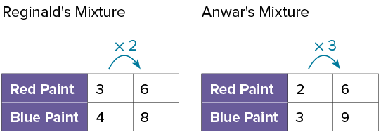
STUDENT MOVE · SOLO THINK → PARTNER TALK
Let’s Explore More
When the two friends each use 6 cans of red paint to create their mixture, how much purple paint will each person have?
DISTINGUISH PART FROM WHOLE
“Total purple paint = red + blue. Reginald has __ cans; Anwar has __ cans.”
17 / 42
Notes:
TEACH IN PRACTICE | Embedded facilitation | Lesson 3.5, slide 17 | PRACTICE
Focus on the existing task: Let’s Explore More When the two friends each use 6 cans of red paint to create their mixture, how much purple paint will each person have?
LAUNCH (T2/3/5): Use the displayed question. Give private thinking time; then A explains while B asks for evidence. Switch roles. Each student records their own reasoning.
LOOK FOR (T4): Where this task addresses it, students can match one quantity before comparing. Ask which feature of their work supports the claim.
RESPOND: If this task shows the lesson misconception—comparing unmatched amounts as if they were equivalent wholes—mark equivalent ratios that share one quantity before comparing the other. Have the student revise and explain the change. Use this support only where the concept occurs in the current task; otherwise respond to the displayed question.
RECHECK: If a gap is shared, revisit the existing representation together. If it is limited, give targeted support while others compare valid methods on the same task. Check the revision before moving on.
PARTICIPATION (T5/6/7): Think time before volunteers; accept a written, drawn or rehearsed entry. Students ask for evidence respectfully. Recognize a specific contribution or revision and check that both partners participate.
Source: BCPS Updated Instructional Framework Rubric (June 2020), TEACH 1–7. Earlier notes and answer keys are retained below.
EARLIER NOTES / EXISTING ANSWER KEY
Routine: STUDENT MOVE · SOLO THINK → PARTNER TALK

Slide 18
STUDENT MOVES
Lesson 3-5
Your moves
ADD ON · Add on: “I agree because ______.” or “I see it differently because ______.”
STRUGGLE FIRST · Work on your own first. Stuck is allowed — try a second strategy before you ask.
18 / 42

Slide 19
LESSON 3.5 / DISCUSS THE TASK
Explain and compare
Use the task you just explored.
TAKE TURNS
What must be held equal to make this a fair comparison, and how does your table show that?
Explain
“I know this because…”
Ask
“Where does your work show that?”
Point to evidence in your work.
Then compare your approach with a partner’s.
HOW DO YOU KNOW? · Ask your partner “How do you know?” Answer by pointing to your own work.
Listen to understand. Ask for evidence. Make room for every voice.
Notes:
TEACH IN PRACTICE | Embedded facilitation | Lesson 3.5, slide 18 | PRIOR_INSERT
Focus on the existing task: Point to evidence in your work. Then compare your approach with a partner’s. TAKE TURNS Explain “I know this because…” Ask “Where does your work show that?
CONNECT (T1/4): Ask students to restate the displayed goal or key idea and connect it to earlier work. Relevant lesson evidence: match one quantity before comparing; preserve ratio order; justify the comparison. Use only the criterion that matches the current session.
SHOW PROGRESS: Students point to their own existing work, explain what improved after feedback, and name a next step. Pair confidence ratings with actual evidence.
PARTICIPATION (T5/6/7): Think time before volunteers; accept a written, drawn or rehearsed entry. Students ask for evidence respectfully. Recognize a specific contribution or revision and check that both partners participate.
Source: BCPS Updated Instructional Framework Rubric (June 2020), TEACH 1–7.

Slide 20
FORMATIVE CHECK · SOLO → CHECK → REVISE
Defend your method; partner gives one specific next step.
60-Second Check
Work independently first. Your response tells us what to do next.
USE THIS INFORMATION
Reginald: 3 red to 4 blue. Anwar: 2 red to 3 blue.
1 — REPRESENT
2 — COMPARE + PROVE
3 — SELF-MONITOR
Find each mixture’s blue cans for 12 red cans. Show how you scaled BOTH quantities.
Whose mixture has more blue for the same red? Use your numbers to justify your answer.
Circle one:
READY — I can explain it.
ALMOST — I need one hint.
NOT YET — I need a model.
Partner feedback: Ask “How do you know?” The solver may clarify or revise before sharing.
20 / 42
Notes:
TEACH IN PRACTICE | Embedded facilitation | Lesson 3.5, slide 19 | TASK
Focus on the existing task: Use your numbers to justify your answer. 3 — SELF-MONITOR Circle one: READY — I can explain it. ALMOST — I need one hint. NOT YET — I need a model. Partner feedback: Ask “How do you know?
LAUNCH (T2/3/5): Use the displayed question. Give private thinking time; then A explains while B asks for evidence. Switch roles. Each student records their own reasoning.
LOOK FOR (T4): Where this task addresses it, students can match one quantity before comparing. Ask which feature of their work supports the claim.
RESPOND: If this task shows the lesson misconception—comparing unmatched amounts as if they were equivalent wholes—mark equivalent ratios that share one quantity before comparing the other. Have the student revise and explain the change. Use this support only where the concept occurs in the current task; otherwise respond to the displayed question.
RECHECK: If a gap is shared, revisit the existing representation together. If it is limited, give targeted support while others compare valid methods on the same task. Check the revision before moving on.
PARTICIPATION (T5/6/7): Think time before volunteers; accept a written, drawn or rehearsed entry. Students ask for evidence respectfully. Recognize a specific contribution or revision and check that both partners participate.
Source: BCPS Updated Instructional Framework Rubric (June 2020), TEACH 1–7. Earlier notes and answer keys are retained below.
EARLIER NOTES / EXISTING ANSWER KEY
Answer: Reginald 12:16; Anwar 12:18. Anwar has more blue relative to red. Give quiet thinking time before sharing. If a student is stuck, point back to the relevant worked model without doing the task for them. Give specific feedback, then allow a correction.

Slide 21
Two friends used the paint shown to create shades of purple paint. Whose mixture contains the most blue paint?
Compare your reasoning with the
explanation. Explain any revision you make.
How do the numbers of cans of red paint compare?
Reveal:
Reginald used 3 cans of red paint, and Anwar used 2 cans.
21 / 42
Notes:
TEACH IN PRACTICE | Embedded facilitation | Lesson 3.5, slide 20 | REVEAL
Focus on the existing task: Two friends used the paint shown to create shades of purple paint. Whose mixture contains the most blue paint?
LAUNCH (T2/3/5): If an existing answer cover is present, gather an attempt before revealing. If the explanation is already visible, ask students to reconstruct and justify it. Compare reasoning and explain a revision; preserve the reveal sequence.
LOOK FOR (T4): Where this task addresses it, students can match one quantity before comparing. Ask which feature of their work supports the claim.
RESPOND: If this task shows the lesson misconception—comparing unmatched amounts as if they were equivalent wholes—mark equivalent ratios that share one quantity before comparing the other. Have the student revise and explain the change. Use this support only where the concept occurs in the current task; otherwise respond to the displayed question.
RECHECK: If a gap is shared, revisit the existing representation together. If it is limited, give targeted support while others compare valid methods on the same task. Check the revision before moving on.
PARTICIPATION (T5/6/7): Think time before volunteers; accept a written, drawn or rehearsed entry. Students ask for evidence respectfully. Recognize a specific contribution or revision and check that both partners participate.
Source: BCPS Updated Instructional Framework Rubric (June 2020), TEACH 1–7.

Slide 22
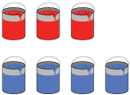
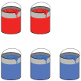
Reginald’s Mixture
Anwar’s Mixture
Compare your reasoning with the explanation. Explain any revision you make.
How can you represent the relationship between the red paint and blue paint for Reginald and Anwar’s mixtures?
Reveal:
One way is to use a table.
22 / 42
Notes:
TEACH IN PRACTICE | Embedded facilitation | Lesson 3.5, slide 21 | REVEAL
Focus on the existing task: How can you represent the relationship between the red paint and blue paint for Reginald and Anwar’s mixtures?
LAUNCH (T2/3/5): If an existing answer cover is present, gather an attempt before revealing. If the explanation is already visible, ask students to reconstruct and justify it. Compare reasoning and explain a revision; preserve the reveal sequence.
LOOK FOR (T4): Where this task addresses it, students can match one quantity before comparing. Ask which feature of their work supports the claim.
RESPOND: If this task shows the lesson misconception—comparing unmatched amounts as if they were equivalent wholes—mark equivalent ratios that share one quantity before comparing the other. Have the student revise and explain the change. Use this support only where the concept occurs in the current task; otherwise respond to the displayed question.
RECHECK: If a gap is shared, revisit the existing representation together. If it is limited, give targeted support while others compare valid methods on the same task. Check the revision before moving on.
PARTICIPATION (T5/6/7): Think time before volunteers; accept a written, drawn or rehearsed entry. Students ask for evidence respectfully. Recognize a specific contribution or revision and check that both partners participate.
Source: BCPS Updated Instructional Framework Rubric (June 2020), TEACH 1–7.

Slide 23
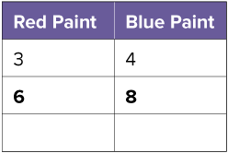
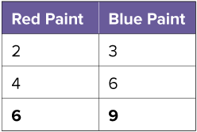
When the first term in each student’s ratio is the same, 6, how do the second terms compare?
Reginald’s Mixture
Anwar’s Mixture
Reveal:
The second term in the ratio for Reginald’s mixture is less than the second term in the ratio for Anwar’s mixture.
23 / 42
Notes:
TEACH IN PRACTICE | Embedded facilitation | Lesson 3.5, slide 22 | REVEAL
Focus on the existing task: When the first term in each student’s ratio is the same, 6, how do the second terms compare?
LAUNCH (T2/3/5): If an existing answer cover is present, gather an attempt before revealing. If the explanation is already visible, ask students to reconstruct and justify it. Compare reasoning and explain a revision; preserve the reveal sequence.
LOOK FOR (T4): Where this task addresses it, students can preserve ratio order. Ask which feature of their work supports the claim.
RESPOND: If this task shows the lesson misconception—comparing unmatched amounts as if they were equivalent wholes—mark equivalent ratios that share one quantity before comparing the other. Have the student revise and explain the change. Use this support only where the concept occurs in the current task; otherwise respond to the displayed question.
RECHECK: If a gap is shared, revisit the existing representation together. If it is limited, give targeted support while others compare valid methods on the same task. Check the revision before moving on.
PARTICIPATION (T5/6/7): Think time before volunteers; accept a written, drawn or rehearsed entry. Students ask for evidence respectfully. Recognize a specific contribution or revision and check that both partners participate.
Source: BCPS Updated Instructional Framework Rubric (June 2020), TEACH 1–7.

Slide 24
STUDENT MOVES
Lesson 3-5
Your move
USE YOUR TOOLS · Reach for your notes, a model, or a manipulative before you reach for an answer.
24 / 42

Slide 25
WARM-UP · THINK • TRY • CHECK
Turn and talk: compare strategies, then defend one.
Session 2 Warm-Up
Lesson 3-5 · Comparing Ratio Relationships | Session 2 Warm-Up · about 4 minutes
Try each on your own. Mark an unsure answer; explain and revise when we check.
QUESTION 1
QUESTION 2
Scale 2 : 3 so the first number is 6.
6 : ______
Scale 3 : 4 so the first number is 6.
6 : ______
QUESTION 3
QUESTION 4
Compare the second amounts:
9 ______ 8
For the same first quantity, which relationship has more of the second?
TALK IT OVER: “I got ______ because ______.” • Compare with a partner before we check as a class.
25 / 42
Notes:
TEACH IN PRACTICE | Embedded facilitation | Lesson 3.5, slide 23 | WARMUP
Focus on the existing task: Session 2 Warm-Up | Session 2 Warm-Up · about 4 minutes WARM-UP · THINK • TRY • CHECK Do…
GATHER EVIDENCE (T4/6): Keep the original items. Students try independently, mark an uncertain item, and explain one method before checking. Use the existing key when present.
RESPOND: Distinguish a calculation slip from a reasoning gap. Give one next step on the same item; have students revise in a second color. Use the responses to choose flexible support for today’s lesson.
PARTICIPATION (T5/6/7): Think time before volunteers; accept a written, drawn or rehearsed entry. Students ask for evidence respectfully. Recognize a specific contribution or revision and check that both partners participate.
Source: BCPS Updated Instructional Framework Rubric (June 2020), TEACH 1–7. Earlier notes and answer keys are retained below.
EARLIER NOTES / EXISTING ANSWER KEY
Warm-up routine: students start silently on entry; keep it to about 4 minutes.
Circulate and note who is stuck — use what you see to choose who you check on first today.
Go over answers quickly; ask one student to explain a step, not just say the answer.
UIFR: TEACH 4 · TEACH 6.

Slide 26
REVIEW NOTES · RECALL • CONNECT • APPLY
Partner check: explain one idea without looking.
Review Notes — Session 2
MAKE A FAIR COMPARISON
SAME RED → COMPARE BLUE
Keep the quantities in the same order. Make the red amounts equal. Then compare blue.
Scale BOTH quantities in each ratio.
Reginald: 6 red, 8 blue
Anwar: 6 red, 9 blue
“For the same 6 red cans, Anwar has more blue because 9 > 8.”
Same quantity first. Compare and explain the other.
26 / 42
Notes:
TEACH IN PRACTICE | Embedded facilitation | Lesson 3.5, slide 24 | NOTES
Focus on the existing task: Review Notes — Session 2 REVIEW NOTES · RECALL • CONNECT • APPLY MAKE A FAIR COMPARISON Keep the quantities in the same order. Make…
ROUTINE (T1/2/4): Read or copy the original notes, cover one line, and explain it using the displayed example. Reopen and correct. Copying alone is not evidence of understanding.
LOOK FOR: A link between a symbol, quantity or feature and the explanation. If missing, point back to that feature and have the student try again; fade the prompt once they can explain.
PARTICIPATION (T5/6/7): Think time before volunteers; accept a written, drawn or rehearsed entry. Students ask for evidence respectfully. Recognize a specific contribution or revision and check that both partners participate.
Source: BCPS Updated Instructional Framework Rubric (June 2020), TEACH 1–7. Earlier notes and answer keys are retained below.
EARLIER NOTES / EXISTING ANSWER KEY
Copy routine: read one line at a time; students copy, then explain that line to a partner.
Keep it brisk — the understanding work happens in the examples, not the copying.
UIFR: TEACH 1 · TEACH 6.

Slide 27
LEARNING TARGET · MATCH • COMPARE • JUSTIFY
Tell a partner the new goal and how you will show it.
Learning Target — Session 2
Lesson 3-5 · Comparing Ratio Relationships | Maryland Standard 6.AT.3
Today I will make a fair comparison by matching one quantity in each ratio.
CONTENT OBJECTIVE
LANGUAGE OBJECTIVE
I can compare three ratios by making one quantity equal.
I can justify which game has the most points for the same number of matches.
SUCCESS CHECK
WHY THIS MATTERS
✓ Choose points or matches to hold equal.
✓ Scale every ratio consistently.
✓ Explain what your comparison means.
Fair ratio comparisons help us judge mixtures and prices.
MATH COMMUNITY: Different strategies are welcome • Ask before telling • Revising your thinking is part of learning
27 / 42
Notes:
TEACH IN PRACTICE | Embedded facilitation | Lesson 3.5, slide 25 | GOAL
Focus on the existing task: Learning Target — Session 2 | Maryland Standard 6.AT.3 LEARNING TARGET · MATCH • COMPARE •…
CONNECT (T1/4): Ask students to restate the displayed goal or key idea and connect it to earlier work. Relevant lesson evidence: match one quantity before comparing; preserve ratio order; justify the comparison. Use only the criterion that matches the current session.
SHOW PROGRESS: Students point to their own existing work, explain what improved after feedback, and name a next step. Pair confidence ratings with actual evidence.
PARTICIPATION (T5/6/7): Think time before volunteers; accept a written, drawn or rehearsed entry. Students ask for evidence respectfully. Recognize a specific contribution or revision and check that both partners participate.
Source: BCPS Updated Instructional Framework Rubric (June 2020), TEACH 1–7. Earlier notes and answer keys are retained below.
EARLIER NOTES / EXISTING ANSWER KEY
Name today’s content and language goals. Briefly read the success criteria; do not teach procedures here. The original context and model follow. Return to these criteria after the worked example.
UIFR FULL | Lesson-specific facilitation
TEACH 1 | Session 2 purpose and evidence (UIFR PDF p. 8).
Have students restate the displayed session goal in their own words and connect it to the existing context or a familiar experience they choose to share. Use the current session goal to select from these lesson-wide evidence criteria; do not frontload a later-session procedure.
Look for: match one quantity before comparing; preserve ratio order; justify the comparison. Ask: “Which part of your work would show this?” Revisit that evidence after the task; a confidence rating alone is not evidence of understanding.

Slide 28

Be Curious
How are they the same?
How are they different?
Think first. Share a notice and a question;
build on a classmate’s idea.
Mindset
How is creative thinking helping you solve a math problem?
28 / 42
Notes:
TEACH IN PRACTICE | Embedded facilitation | Lesson 3.5, slide 26 | CURIOUS
Focus on the existing task: Be Curious How are they the same?
LAUNCH (T2/3/5): Allow quiet observation first. Separate a notice from an inference, invite students’ own questions, and follow the existing launch before teaching a procedure.
LOOK FOR (T4): Where this task addresses it, students can match one quantity before comparing. Ask which feature of their work supports the claim.
RESPOND: If this task shows the lesson misconception—comparing unmatched amounts as if they were equivalent wholes—mark equivalent ratios that share one quantity before comparing the other. Have the student revise and explain the change. Use this support only where the concept occurs in the current task; otherwise respond to the displayed question.
RECHECK: If a gap is shared, revisit the existing representation together. If it is limited, give targeted support while others compare valid methods on the same task. Check the revision before moving on.
PARTICIPATION (T5/6/7): Think time before volunteers; accept a written, drawn or rehearsed entry. Students ask for evidence respectfully. Recognize a specific contribution or revision and check that both partners participate.
Source: BCPS Updated Instructional Framework Rubric (June 2020), TEACH 1–7.

Slide 29
STUDENT MOVE · SOLO THINK → PARTNER TALK
Compare strategies; defend one with evidence.
Designing Games
Brielle, Andrew, and Sheng are designing video games.
BRIELLE
Brielle’s game awards 2 points for every 5 matches.
ANDREW
Andrew’s game awards 3 points for every 6 matches.
SHENG
Sheng’s game awards 1 point for every 3 matches.
Whose game has the greatest ratio of points to matches?
Think and record first. Which part of your
work supports your answer?
Planning
How can you begin solving the problem? What might be a first strategy to try?
29 / 42
Notes:
TEACH IN PRACTICE | Embedded facilitation | Lesson 3.5, slide 27 | TASK
Focus on the existing task: Designing Games Brielle, Andrew, and Sheng are designing video games. Planning How can you begin solving the problem?
LAUNCH (T2/3/5): Use the displayed question. Give private thinking time; then A explains while B asks for evidence. Switch roles. Each student records their own reasoning.
LOOK FOR (T4): Where this task addresses it, students can preserve ratio order. Ask which feature of their work supports the claim.
RESPOND: If this task shows the lesson misconception—comparing unmatched amounts as if they were equivalent wholes—mark equivalent ratios that share one quantity before comparing the other. Have the student revise and explain the change. Use this support only where the concept occurs in the current task; otherwise respond to the displayed question.
RECHECK: If a gap is shared, revisit the existing representation together. If it is limited, give targeted support while others compare valid methods on the same task. Check the revision before moving on.
PARTICIPATION (T5/6/7): Think time before volunteers; accept a written, drawn or rehearsed entry. Students ask for evidence respectfully. Recognize a specific contribution or revision and check that both partners participate.
Source: BCPS Updated Instructional Framework Rubric (June 2020), TEACH 1–7. Earlier notes and answer keys are retained below.
EARLIER NOTES / EXISTING ANSWER KEY
Student move: Compare strategies; defend one with evidence.
Routine: STUDENT MOVE · SOLO THINK → PARTNER TALK
UIFR FULL | Lesson-specific facilitation
TEACH 2-3 | Session 2 task launch (UIFR PDF pp. 9-10).
Use the problem exactly as displayed. Give individual thinking time before discussion or advancing to the explanation. If the answer is already visible, ask students to reconstruct and justify it. Invite a choice of suitable representations and have students explain why their choice helps.
At the point where this concept appears, ask: “What must be held equal to make this a fair comparison, and how does your table show that?” Wait for evidence, invite another pathway, and have a student ask a follow-up question. Do not replace students’ reasoning with a sequence of leading steps.

Slide 30
STUDENT MOVE · NOTICE → MODEL → EXPLAIN
Comparing games for 30 matches
Use equivalent ratios to make the matches equal.
Game | Points : matches | For 30 matches
Brielle | 2 : 5 (×6) | 12 points
Andrew | 3 : 6 (×5) | 15 points
Sheng | 1 : 3 (×10) | 10 points
Scale each game’s points and matches by the same factor.
Then compare the points earned in 30 matches.
Connect a feature of the model to a step in
your reasoning.
EXPLAIN THE CONNECTION
“For 30 matches, Andrew earns __ points. That is more than __ and __.”
30 / 42
Notes:
TEACH IN PRACTICE | Embedded facilitation | Lesson 3.5, slide 28 | WORKED
Focus on the existing task: Comparing games for 30 matches Use equivalent ratios to make the matches equal. Scale each game’s points and matches by the same factor.…
LAUNCH (T2/3/5): Ask students to explain the displayed idea or example and point to evidence. When a calculation step is shown, ask why it is valid. Have a partner restate the explanation; copying is not the check.
LOOK FOR (T4): Where this task addresses it, students can match one quantity before comparing. Ask which feature of their work supports the claim.
RESPOND: If this task shows the lesson misconception—comparing unmatched amounts as if they were equivalent wholes—mark equivalent ratios that share one quantity before comparing the other. Have the student revise and explain the change. Use this support only where the concept occurs in the current task; otherwise respond to the displayed question.
RECHECK: If a gap is shared, revisit the existing representation together. If it is limited, give targeted support while others compare valid methods on the same task. Check the revision before moving on.
PARTICIPATION (T5/6/7): Think time before volunteers; accept a written, drawn or rehearsed entry. Students ask for evidence respectfully. Recognize a specific contribution or revision and check that both partners participate.
Source: BCPS Updated Instructional Framework Rubric (June 2020), TEACH 1–7. Earlier notes and answer keys are retained below.
EARLIER NOTES / EXISTING ANSWER KEY
Teach this step before assigning independent practice. Read the highlighted term and connect it to the example. Model the calculation, then ask students to explain why the same factor applies to both quantities. Give thinking time and invite a partner explanation. Source content: supplied McGraw Hill Unit 3 lesson presentation.

Slide 31
STUDENT MOVE · NOTICE → MODEL → EXPLAIN
Another comparison: the same points
We can also make the number of points equal.
Game | Points | Matches
Brielle | 6 | 15
Andrew | 6 | 12
Sheng | 6 | 18
Compare the matches needed to earn 6 points.
Fewer matches for the same points means more points per match.
Try first. Connect a feature of the model to a
step in your reasoning.
EXPLAIN THE CONNECTION
“For the same 6 points, Andrew needs __ matches, fewer than __ and __.”
31 / 42
Notes:
TEACH IN PRACTICE | Embedded facilitation | Lesson 3.5, slide 29 | TASK
Focus on the existing task: Another comparison: the same points We can also make the number of points equal. Compare the matches needed to earn 6 points. Fewer…
LAUNCH (T2/3/5): Use the displayed question. Give private thinking time; then A explains while B asks for evidence. Switch roles. Each student records their own reasoning.
LOOK FOR (T4): Where this task addresses it, students can match one quantity before comparing. Ask which feature of their work supports the claim.
RESPOND: If this task shows the lesson misconception—comparing unmatched amounts as if they were equivalent wholes—mark equivalent ratios that share one quantity before comparing the other. Have the student revise and explain the change. Use this support only where the concept occurs in the current task; otherwise respond to the displayed question.
RECHECK: If a gap is shared, revisit the existing representation together. If it is limited, give targeted support while others compare valid methods on the same task. Check the revision before moving on.
PARTICIPATION (T5/6/7): Think time before volunteers; accept a written, drawn or rehearsed entry. Students ask for evidence respectfully. Recognize a specific contribution or revision and check that both partners participate.
Source: BCPS Updated Instructional Framework Rubric (June 2020), TEACH 1–7. Earlier notes and answer keys are retained below.
EARLIER NOTES / EXISTING ANSWER KEY
Teach this step before assigning independent practice. Read the highlighted term and connect it to the example. Model the calculation, then ask students to explain why the same factor applies to both quantities. Give thinking time and invite a partner explanation. Source content: supplied McGraw Hill Unit 3 lesson presentation.

Slide 32
STUDENT NOTES · COPY LESS • UNDERSTAND MORE
Today’s Math Notes — Session 2
SAY THE GOAL · Say today’s goal in your own words, then name one place this shows up outside math class.
HOLD ONE QUANTITY EQUAL
EXPLAIN THE DIRECTION
Same matches → compare points.
Same points → compare matches.
Keep each ratio equivalent when you scale.
More points for the same matches is better.
Fewer matches for the same points is better.
Both methods favor Andrew’s game.
Same quantity first. Compare and explain the other.
32 / 42
Notes:
TEACH IN PRACTICE | Embedded facilitation | Lesson 3.5, slide 30 | NOTES
Focus on the existing task: Today’s Math Notes — Session 2 STUDENT NOTES · COPY LESS • UNDERSTAND MORE HOLD ONE QUANTITY EQUAL Same matches → compare points.…
ROUTINE (T1/2/4): Read or copy the original notes, cover one line, and explain it using the displayed example. Reopen and correct. Copying alone is not evidence of understanding.
LOOK FOR: A link between a symbol, quantity or feature and the explanation. If missing, point back to that feature and have the student try again; fade the prompt once they can explain.
PARTICIPATION (T5/6/7): Think time before volunteers; accept a written, drawn or rehearsed entry. Students ask for evidence respectfully. Recognize a specific contribution or revision and check that both partners participate.
Source: BCPS Updated Instructional Framework Rubric (June 2020), TEACH 1–7. Earlier notes and answer keys are retained below.
EARLIER NOTES / EXISTING ANSWER KEY
Use this slide only after the original worked example. Students copy the three lines on the left; the table is a reference and does not need copying. Read one line at a time. Ask one student to connect a note to the example.

Slide 33
STUDENT MOVE · SOLO THINK → PARTNER TALK
Compare pathways with a partner; name one revision.
Let’s Explore More
Brielle changes her game to 2 points for 4 matches. Compare her ratio with Andrew’s 3 : 6 and Sheng’s 1 : 3.
How can comparing rates and ratios help you in real-world situations?
33 / 42
Notes:
TEACH IN PRACTICE | Embedded facilitation | Lesson 3.5, slide 31 | PRACTICE
Focus on the existing task: Let’s Explore More Brielle changes her game to 2 points for 4 matches. Compare her ratio with Andrew’s 3: 6 and Sheng’s 1: 3. How can comparing rates and ratios help you in real-world situations?
LAUNCH (T2/3/5): Use the displayed question. Give private thinking time; then A explains while B asks for evidence. Switch roles. Each student records their own reasoning.
LOOK FOR (T4): Where this task addresses it, students can match one quantity before comparing. Ask which feature of their work supports the claim.
RESPOND: If this task shows the lesson misconception—comparing unmatched amounts as if they were equivalent wholes—mark equivalent ratios that share one quantity before comparing the other. Have the student revise and explain the change. Use this support only where the concept occurs in the current task; otherwise respond to the displayed question.
RECHECK: If a gap is shared, revisit the existing representation together. If it is limited, give targeted support while others compare valid methods on the same task. Check the revision before moving on.
PARTICIPATION (T5/6/7): Think time before volunteers; accept a written, drawn or rehearsed entry. Students ask for evidence respectfully. Recognize a specific contribution or revision and check that both partners participate.
Source: BCPS Updated Instructional Framework Rubric (June 2020), TEACH 1–7. Earlier notes and answer keys are retained below.
EARLIER NOTES / EXISTING ANSWER KEY
Student move: Compare pathways with a partner; name one revision.
Routine: STUDENT MOVE · SOLO THINK → PARTNER TALK
UIFR FULL | Lesson-specific facilitation
TEACH 4-5 | Session 2 discussion and checkpoint (UIFR PDF pp. 11-12).
Collect a brief response from every student to the existing prompt before hearing volunteers. Partners take turns explaining and asking for evidence: “I understand ___; what supports ___?” Offer rehearsal or an annotated model for students who need language support. Each student records their own reasoning.
Look specifically for: comparing unmatched amounts as if they were equivalent wholes. If it appears, mark equivalent ratios that share one quantity before comparing the other; then ask the student to revise the same response and explain the change. If evidence is secure, have students compare a second valid pathway or state why their approach works. Choose the next step from the responses, not a preset pace.

Slide 34
LESSON 3.5 / CHECK YOUR WORK
Pause. Check. Improve.
CHECK
A mistake to watch for: comparing unmatched amounts as if they were equivalent wholes.
TRY
Mark equivalent ratios that share one quantity before comparing the other.
REVISE
Use that check on the task you just completed. Correct or strengthen one part, and explain why.
SELF-CHECK · Mark it: ✓ got it · ~ almost · ? stuck. Then fix one thing before we move on.
Listen to understand. Ask for evidence. Make room for every voice.
Notes:
TEACH IN PRACTICE | Embedded facilitation | Lesson 3.5, slide 32 | PRIOR_INSERT
Focus on the existing task: LESSON 3.5 / CHECK YOUR WORK Pause. Check. Improve. Listen to understand. Ask for evidence. Make room for every voice. CHECK A mistake…
CONNECT (T1/4): Ask students to restate the displayed goal or key idea and connect it to earlier work. Relevant lesson evidence: match one quantity before comparing; preserve ratio order; justify the comparison. Use only the criterion that matches the current session.
SHOW PROGRESS: Students point to their own existing work, explain what improved after feedback, and name a next step. Pair confidence ratings with actual evidence.
PARTICIPATION (T5/6/7): Think time before volunteers; accept a written, drawn or rehearsed entry. Students ask for evidence respectfully. Recognize a specific contribution or revision and check that both partners participate.
Source: BCPS Updated Instructional Framework Rubric (June 2020), TEACH 1–7.

Slide 35
Brielle, Andrew, and Sheng are designing video games. Brielle’s game awards 2 points for every 5 matches, Andrew’s game awards 3 points for every 6 matches, and Sheng’s game awards 1 point for every 3 matches. Whose game has the greatest ratio of points to matches?
How can you represent the problem?
Reveal:
We can use tables to show each game.
Compare your reasoning with the
explanation. Explain any revision
you make.
35 / 42
Notes:
TEACH IN PRACTICE | Embedded facilitation | Lesson 3.5, slide 33 | REVEAL
Focus on the existing task: How can you represent the problem?
LAUNCH (T2/3/5): If an existing answer cover is present, gather an attempt before revealing. If the explanation is already visible, ask students to reconstruct and justify it. Compare reasoning and explain a revision; preserve the reveal sequence.
LOOK FOR (T4): Where this task addresses it, students can preserve ratio order. Ask which feature of their work supports the claim.
RESPOND: If this task shows the lesson misconception—comparing unmatched amounts as if they were equivalent wholes—mark equivalent ratios that share one quantity before comparing the other. Have the student revise and explain the change. Use this support only where the concept occurs in the current task; otherwise respond to the displayed question.
RECHECK: If a gap is shared, revisit the existing representation together. If it is limited, give targeted support while others compare valid methods on the same task. Check the revision before moving on.
PARTICIPATION (T5/6/7): Think time before volunteers; accept a written, drawn or rehearsed entry. Students ask for evidence respectfully. Recognize a specific contribution or revision and check that both partners participate.
Source: BCPS Updated Instructional Framework Rubric (June 2020), TEACH 1–7.

Slide 36



Let’s determine equivalent ratios that have the same value for the second term.
Brielle’s Game
Andrew’s Game
Sheng’s Game
PICK YOUR STRATEGY · Choose your path — picture, table, number line, or equation — and be ready to say why you chose it.
How can you determine what number to multiply each ratio by so that the second terms are the same?
Reveal:
Find a number that is divisible by three, five, and six. 30 is divisible by these numbers.
36 / 42
Notes:
TEACH IN PRACTICE | Embedded facilitation | Lesson 3.5, slide 34 | REVEAL
Focus on the existing task: Let’s determine equivalent ratios that have the same value for the second term. How can you determine what number to multiply each ratio by so that the second terms are the same?
LAUNCH (T2/3/5): If an existing answer cover is present, gather an attempt before revealing. If the explanation is already visible, ask students to reconstruct and justify it. Compare reasoning and explain a revision; preserve the reveal sequence.
LOOK FOR (T4): Where this task addresses it, students can preserve ratio order. Ask which feature of their work supports the claim.
RESPOND: If this task shows the lesson misconception—comparing unmatched amounts as if they were equivalent wholes—mark equivalent ratios that share one quantity before comparing the other. Have the student revise and explain the change. Use this support only where the concept occurs in the current task; otherwise respond to the displayed question.
RECHECK: If a gap is shared, revisit the existing representation together. If it is limited, give targeted support while others compare valid methods on the same task. Check the revision before moving on.
PARTICIPATION (T5/6/7): Think time before volunteers; accept a written, drawn or rehearsed entry. Students ask for evidence respectfully. Recognize a specific contribution or revision and check that both partners participate.
Source: BCPS Updated Instructional Framework Rubric (June 2020), TEACH 1–7.

Slide 37
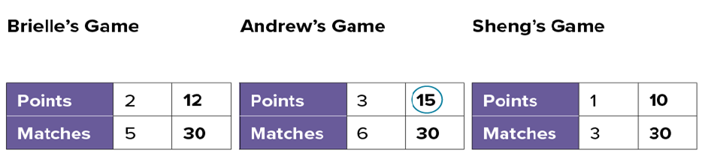
Find the values of the second terms.
CREDIT A CLASSMATE · Name one classmate whose idea helped you today, and say what they said.
Which person’s game awards the greatest number of points when the matches are the same?
Reveal:
Andrew’s game awards the greatest number of points per match.
37 / 42
Notes:
TEACH IN PRACTICE | Embedded facilitation | Lesson 3.5, slide 35 | REVEAL
Focus on the existing task: Find the values of the second terms. Which person’s game awards the greatest number of points when the matches are the same?
LAUNCH (T2/3/5): If an existing answer cover is present, gather an attempt before revealing. If the explanation is already visible, ask students to reconstruct and justify it. Compare reasoning and explain a revision; preserve the reveal sequence.
LOOK FOR (T4): Where this task addresses it, students can match one quantity before comparing. Ask which feature of their work supports the claim.
RESPOND: If this task shows the lesson misconception—comparing unmatched amounts as if they were equivalent wholes—mark equivalent ratios that share one quantity before comparing the other. Have the student revise and explain the change. Use this support only where the concept occurs in the current task; otherwise respond to the displayed question.
RECHECK: If a gap is shared, revisit the existing representation together. If it is limited, give targeted support while others compare valid methods on the same task. Check the revision before moving on.
PARTICIPATION (T5/6/7): Think time before volunteers; accept a written, drawn or rehearsed entry. Students ask for evidence respectfully. Recognize a specific contribution or revision and check that both partners participate.
Source: BCPS Updated Instructional Framework Rubric (June 2020), TEACH 1–7.

Slide 38
STUDENT MOVE · SUMMARIZE • TEACH A PARTNER
Summarize: Compare Ratios
Scale both ratios until one quantity matches. Matching amounts are what make a comparison fair.
Once one quantity is equal in both ratios, compare the other quantity directly.
MAKE IT FAIR
THEN COMPARE
Key idea: Two ratios can only be compared fairly when one quantity is the same in both.
Teach a partner: How would you decide which paint mixture makes a darker purple?
USE THE MATH WORDS · Use today’s math words in your explanation — not “it” and “that thing.”
38 / 42
Notes:
TEACH IN PRACTICE | Embedded facilitation | Lesson 3.5, slide 36 | SUMMARIZE
Focus on the existing task: STUDENT MOVE · SUMMARIZE • TEACH A PARTNER Summarize: Compare Ratios Scale both ratios until one quantity matches. Matching amounts are…
CONNECT (T1/4): Ask students to restate the displayed goal or key idea and connect it to earlier work. Relevant lesson evidence: match one quantity before comparing; preserve ratio order; justify the comparison. Use only the criterion that matches the current session.
SHOW PROGRESS: Students point to their own existing work, explain what improved after feedback, and name a next step. Pair confidence ratings with actual evidence.
PARTICIPATION (T5/6/7): Think time before volunteers; accept a written, drawn or rehearsed entry. Students ask for evidence respectfully. Recognize a specific contribution or revision and check that both partners participate.
Source: BCPS Updated Instructional Framework Rubric (June 2020), TEACH 1–7. Earlier notes and answer keys are retained below.
EARLIER NOTES / EXISTING ANSWER KEY
Model briefly, then hand the thinking back: ask “Why does this step work?” before showing the next one.
Quick check before moving on — thumbs or whiteboards from everyone, not volunteers.
UIFR: TEACH 2 · TEACH 3 · TEACH 4.

Slide 39
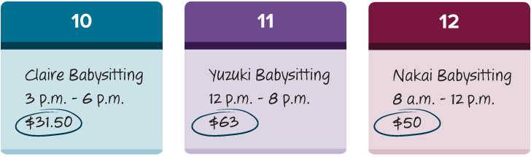
STUDENT MOVE · SOLO THINK → PARTNER TALK
Apply: Babysitting Pay
Claire, Yuzuki, and Nakai compared their time babysitting and their earnings from the previous weekend. A new family is looking for a babysitter and is offering $10.75 per hour.
Question: Who would want to take this offer based on what they were paid the previous weekend?
TRY IT BEFORE YOU’RE SURE · Start even if you are not sure. A revised answer counts as much as a first-try answer.
39 / 42
Notes:
TEACH IN PRACTICE | Embedded facilitation | Lesson 3.5, slide 37 | APPLY
Focus on the existing task: Apply: Babysitting Pay Claire, Yuzuki, and Nakai compared their time babysitting and their earnings from the previous weekend. A new…
LAUNCH (T2/3/5): Use the exact application task independently first. Ask students to justify their choice of method. Collect evidence before a partner discussion or correction.
LOOK FOR (T4): Where this task addresses it, students can match one quantity before comparing. Ask which feature of their work supports the claim.
RESPOND: If this task shows the lesson misconception—comparing unmatched amounts as if they were equivalent wholes—mark equivalent ratios that share one quantity before comparing the other. Have the student revise and explain the change. Use this support only where the concept occurs in the current task; otherwise respond to the displayed question.
RECHECK: If a gap is shared, revisit the existing representation together. If it is limited, give targeted support while others compare valid methods on the same task. Check the revision before moving on.
PARTICIPATION (T5/6/7): Think time before volunteers; accept a written, drawn or rehearsed entry. Students ask for evidence respectfully. Recognize a specific contribution or revision and check that both partners participate.
Source: BCPS Updated Instructional Framework Rubric (June 2020), TEACH 1–7. Earlier notes and answer keys are retained below.
EARLIER NOTES / EXISTING ANSWER KEY
Routine: STUDENT MOVE · SOLO THINK → PARTNER TALK

Slide 40
STUDENT MOVE · SELF-ASSESS • NAME YOUR NEXT STEP
Partner debrief: name your evidence and one next step.
Exit Ticket + Self-Check
Brielle now awards 2 points for 4 matches. Andrew awards 3 points for 6 matches.
SELF-CHECK
Do the two games now have the same ratio? Show why.
1. I can make one quantity equal.
□ Alone □ With a hint □ Not yet
2. I can justify a comparison.
□ Alone □ With a hint □ Not yet
My next step:
____________________
Use a table or equivalent ratios. Label points and matches, and show your scale factors.
Explain: “For the same ___ matches, both games ___.”
MATCH → COMPARE
Work independently and show why. Use feedback to revise
in a second color.
40 / 42
Notes:
TEACH IN PRACTICE | Embedded facilitation | Lesson 3.5, slide 38 | ASSESSMENT
Focus on the existing task: Exit Ticket + Self-Check STUDENT MOVE · SELF-ASSESS • NAME YOUR NEXT STEP Brielle now awards 2 points for 4 matches. Andrew awards 3 points for 6 matches. Do the two games now have the same ratio?
LAUNCH (T2/3/5): Gather an independent response before feedback. Students choose a suitable representation and justify it. Keep the first attempt separate from the revision.
LOOK FOR (T4): Where this task addresses it, students can match one quantity before comparing. Ask which feature of their work supports the claim.
RESPOND: If this task shows the lesson misconception—comparing unmatched amounts as if they were equivalent wholes—mark equivalent ratios that share one quantity before comparing the other. Have the student revise and explain the change. Use this support only where the concept occurs in the current task; otherwise respond to the displayed question.
RECHECK: If a gap is shared, revisit the existing representation together. If it is limited, give targeted support while others compare valid methods on the same task. Check the revision before moving on.
PARTICIPATION (T5/6/7): Think time before volunteers; accept a written, drawn or rehearsed entry. Students ask for evidence respectfully. Recognize a specific contribution or revision and check that both partners participate.
Source: BCPS Updated Instructional Framework Rubric (June 2020), TEACH 1–7. Earlier notes and answer keys are retained below.
EARLIER NOTES / EXISTING ANSWER KEY
Answer: Yes. For 12 matches each gives 6 points, or each gives 1 point per 2 matches. Give quiet thinking time before sharing. If a student is stuck, point back to the relevant worked model without doing the task for them. Give specific feedback, then allow a correction.
UIFR FULL | Lesson-specific facilitation
TEACH 4 | Independent evidence and revision (UIFR PDF p. 11).
Use the existing application/exit problem as the independent check. If this is a learning-target slide, have students point to and explain their work on the preceding task. Separate initial independent evidence from the revision after feedback.
Check the relevant criteria: match one quantity before comparing; preserve ratio order; justify the comparison. Respond with one specific next step tied to the work. Students revise and annotate what changed, then identify a criterion they can now demonstrate and one they still need to practice.

Slide 41
Learning Targets
I can compare ratio relationships using tables.
I can make sense of ratio problems and formulate a strategy to solve them.
Point to evidence in your work. Name what improved and your next step.
41 / 42
Notes:
TEACH IN PRACTICE | Embedded facilitation | Lesson 3.5, slide 39 | REFLECTION
Focus on the existing task: Learning Targets I can compare ratio relationships using tables. I can make sense of ratio problems and formulate a strategy to solve them.
CONNECT (T1/4): Ask students to restate the displayed goal or key idea and connect it to earlier work. Relevant lesson evidence: match one quantity before comparing; preserve ratio order; justify the comparison. Use only the criterion that matches the current session.
SHOW PROGRESS: Students point to their own existing work, explain what improved after feedback, and name a next step. Pair confidence ratings with actual evidence.
PARTICIPATION (T5/6/7): Think time before volunteers; accept a written, drawn or rehearsed entry. Students ask for evidence respectfully. Recognize a specific contribution or revision and check that both partners participate.
Source: BCPS Updated Instructional Framework Rubric (June 2020), TEACH 1–7. Earlier notes and answer keys are retained below.
EARLIER NOTES / EXISTING ANSWER KEY
UIFR FULL | Lesson-specific facilitation
REFLECT & ADJUST 1-2 | After the lesson (UIFR PDF pp. 15-16).
Sort the existing work by demonstrated reasoning, partial understanding, and the specific misconception: comparing unmatched amounts as if they were equivalent wholes. Compare the initial response with the revision. Record which teaching move plausibly helped, which did not, and whose participation or access needs a different approach; do not record sensitive student details in this shared deck.
Plan the next lesson from that evidence: if the misconception persists, mark equivalent ratios that share one quantity before comparing the other using the current example before returning to the next grade-level task; if understanding is secure, use an existing extension or ask for a general explanation. Check the targeted idea again at the next warm-up.
Ask students what supported their thinking and what would help next time. Identify one change to try and one successful practice to retain. Seek colleague feedback on anonymized work when useful; these prompts support reflection and do not establish an evaluation rating. Source: Baltimore City Public Schools, Updated Instructional Framework Rubric, June 2020 (UIFR_Full.pdf).

Slide 42
Teacher Reference — Fair Ratio Comparisons
Hidden from the student slideshow; use checks to choose the next step.
Session 1: compare the same red amount; scale BOTH parts of each mixture.
Quick check: 12 red → Reginald 16 blue; Anwar 18 blue. Anwar has more.
Listen for comparing raw blue amounts without matching the red amounts.
If needed, model 6 red → 8 blue and 6 red → 9 blue, then retry 12 red.
Session 2: 30 matches → Brielle 12, Andrew 15, Sheng 10 points.
Exit: yes. 2:4 and 3:6 both become 6:12 (or simplify to 1:2).
Feedback: ask which quantity was held equal and how that makes it fair.
REVISE NOW · Change one answer and write why you changed it. A revision is evidence of learning.
42 / 42
Notes:
TEACH IN PRACTICE | Embedded facilitation | Lesson 3.5, slide 40 | REFERENCE
Focus on the existing task: Teacher Reference — Fair Ratio Comparisons Hidden from the student slideshow; use checks to choose the next step. Session 1: compare the…
TRANSITION (T6/7): Students confirm materials, roles, how to request help, and the next response routine. Ask a student to restate it. Keep teacher-only slides hidden.
PARTICIPATION (T5/6/7): Think time before volunteers; accept a written, drawn or rehearsed entry. Students ask for evidence respectfully. Recognize a specific contribution or revision and check that both partners participate.
Source: BCPS Updated Instructional Framework Rubric (June 2020), TEACH 1–7. Earlier notes and answer keys are retained below.
EARLIER NOTES / EXISTING ANSWER KEY
Source: Baltimore City Public Schools, Updated Instructional Framework Rubric, June 2020. Teacher enactment determines the quality of instruction; this is a support map.

