Slide 1
WARM-UP · THINK • TRY • CHECK
Turn and talk: compare strategies, then defend one.
Warm-Up
Lesson 3-6 · Converting Within One System | Warm-Up · about 4 minutes
Try each on your own. Mark an unsure answer; explain and revise when we check.
QUESTION 1
QUESTION 2
12 × 4 = ______
1 foot = ______ inches
QUESTION 3
QUESTION 4
1,000 × 3 = ______
60 ÷ 12 = ______
TALK IT OVER: “I got ______ because ______.” • Compare with a partner before we check as a class.
1 / 40
Notes:
TEACH IN PRACTICE | Embedded facilitation | Lesson 3.6, slide 1 | WARMUP
Focus on the existing task: Warm-Up WARM-UP · THINK • TRY • CHECK Do these four on your…
GATHER EVIDENCE (T4/6): Keep the original items. Students try independently, mark an uncertain item, and explain one method before checking. Use the existing key when present.
RESPOND: Distinguish a calculation slip from a reasoning gap. Give one next step on the same item; have students revise in a second color. Use the responses to choose flexible support for today’s lesson.
PARTICIPATION (T5/6/7): Think time before volunteers; accept a written, drawn or rehearsed entry. Students ask for evidence respectfully. Recognize a specific contribution or revision and check that both partners participate.
Source: BCPS Updated Instructional Framework Rubric (June 2020), TEACH 1–7. Earlier notes and answer keys are retained below.
EARLIER NOTES / EXISTING ANSWER KEY
Warm-Up answers (teacher only): 1) 48 2) 12 inches 3) 3,000 4) 5
UIFR FULL | Lesson-specific facilitation
PREPARE 1-2 | Before teaching (UIFR PDF pp. 6-7).
Plan to gather evidence that students can use a same-system conversion ratio; preserve the amount; compare using matching units. Review recent work and today’s warm-up to choose flexible groups and access supports; do not infer needs from identity or perceived ability. Use the existing lesson tasks and stated standards.
Anticipate: multiplying or dividing without considering unit size. If observed, label units on each step of the original conversion and reason whether the count should increase. Offer oral rehearsal, drawing, pointing, or home-language processing as needed; retain the original mathematical demand. Ask students which support helps and fade it as evidence improves.
TEACH 6-7 | Before the first transition, agree on materials, partner roles, and how to request help. Invite students to restate the routine. Normalize revising an idea, recognize a specific contribution, and check privately when frustration blocks participation. Source: UIFR PDF pp. 13-14.

Slide 2
STUDENT NOTES · COPY LESS • UNDERSTAND MORE
Partner talk: connect today’s idea to prior learning.
Today’s Math Notes — Session 1
Keep the idea from Riding the Attractions.
COPY THESE 3 LINES
LOOK BACK AT THE EXAMPLE
01
Convert means write the same amount in another unit.
Feet | Inches
1 | 12
4 | 48
02
Start with a known conversion fact.
4 feet = 48 inches, which is above 44 inches.
03
Use equivalent ratios to find the new number.
EXPLAIN THE CONNECTION
“The units changed from ___ to ___, but the amount stayed the same.”
2 / 40
Notes:
TEACH IN PRACTICE | Embedded facilitation | Lesson 3.6, slide 2 | NOTES
Focus on the existing task: Today’s Math Notes — Session 1 Keep the idea from Riding the Attractions. COPY THESE 3 LINES 01 Convert means write the same amount in…
ROUTINE (T1/2/4): Read or copy the original notes, cover one line, and explain it using the displayed example. Reopen and correct. Copying alone is not evidence of understanding.
LOOK FOR: A link between a symbol, quantity or feature and the explanation. If missing, point back to that feature and have the student try again; fade the prompt once they can explain.
PARTICIPATION (T5/6/7): Think time before volunteers; accept a written, drawn or rehearsed entry. Students ask for evidence respectfully. Recognize a specific contribution or revision and check that both partners participate.
Source: BCPS Updated Instructional Framework Rubric (June 2020), TEACH 1–7. Earlier notes and answer keys are retained below.
EARLIER NOTES / EXISTING ANSWER KEY
Use this slide only after the original worked example. Students copy the three lines on the left; the table is a reference and does not need copying. Read one line at a time. Ask one student to connect a note to the example.

Slide 3
LEARNING TARGET · CONVERT • COMPARE • EXPLAIN
Tell a partner the goal and why it matters.
Learning Target — Session 1
Lesson 3-6 · Converting Within One System | Maryland Standard 6.AT.3
Today I will convert to matching units and explain what the result means.
CONTENT OBJECTIVE
LANGUAGE OBJECTIVE
I can use a ratio to convert feet to inches and compare heights.
I can explain why converting changes the unit but not the height.
SUCCESS CHECK
WHY THIS MATTERS
✓ Write 1 foot = 12 inches.
✓ Scale the two amounts together.
✓ Compare heights in the same unit.
Matching units helps us compare heights and measure ingredients.
MATH COMMUNITY: Different strategies are welcome • Ask before telling • Revising your thinking is part of learning
3 / 40
Notes:
TEACH IN PRACTICE | Embedded facilitation | Lesson 3.6, slide 3 | GOAL
Focus on the existing task: Learning Target — Session 1 | Maryland Standard 6.AT.3 LEARNING TARGET · CONVERT •…
CONNECT (T1/4): Ask students to restate the displayed goal or key idea and connect it to earlier work. Relevant lesson evidence: use a same-system conversion ratio; preserve the amount; compare using matching units. Use only the criterion that matches the current session.
SHOW PROGRESS: Students point to their own existing work, explain what improved after feedback, and name a next step. Pair confidence ratings with actual evidence.
PARTICIPATION (T5/6/7): Think time before volunteers; accept a written, drawn or rehearsed entry. Students ask for evidence respectfully. Recognize a specific contribution or revision and check that both partners participate.
Source: BCPS Updated Instructional Framework Rubric (June 2020), TEACH 1–7. Earlier notes and answer keys are retained below.
EARLIER NOTES / EXISTING ANSWER KEY
Name today’s content and language goals. Briefly read the success criteria; do not teach procedures here. The original context and model follow. Return to these criteria after the worked example.
UIFR FULL | Lesson-specific facilitation
TEACH 1 | Session 1 purpose and evidence (UIFR PDF p. 8).
Have students restate the displayed session goal in their own words and connect it to the existing context or a familiar experience they choose to share. Use the current session goal to select from these lesson-wide evidence criteria; do not frontload a later-session procedure.
Look for: use a same-system conversion ratio; preserve the amount; compare using matching units. Ask: “Which part of your work would show this?” Revisit that evidence after the task; a confidence rating alone is not evidence of understanding.

Slide 4
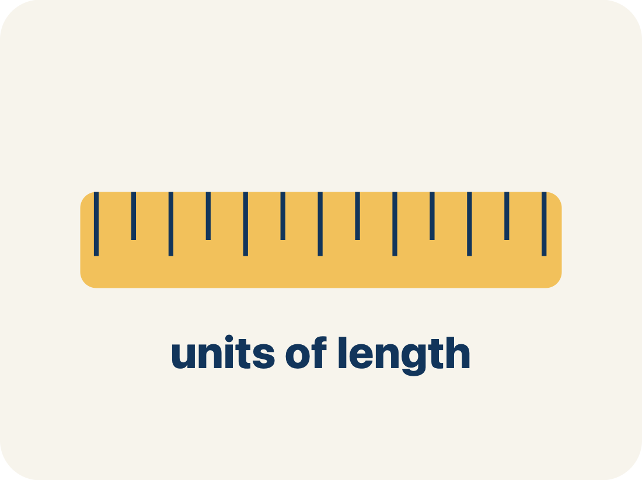
Vocabulary 1 of 7
Lesson 3-6 · Ratio Reasoning: Convert Measurements within the Same System
Convert Measurements within the Same System
Rewriting a measurement in a different unit of the SAME system, such as feet into inches or liters into milliliters.
EXAMPLE · EXPLAIN WHY IT FITS
4 feet = 48 inches; 4 liters = 4,000 milliliters
USE THE MATH WORDS · Use today’s math words in your explanation — not “it” and “that thing.”
eduwonderlab.com · Neft Teacher
4 / 40
Notes:
TEACH IN PRACTICE | Embedded facilitation | Lesson 3.6, slide 4 | VOCAB
Focus on the existing task: Vocabulary 1 of 7 Convert…
ASK (T1/3/5): Where does “Convert Measurements within the Same System” appear in the example? Explain the meaning without reading the definition. Partner: restate the idea and ask a clarifying question.
LOOK FOR: A correct connection between the word and a feature of the example. If the student only repeats the definition, invite pointing, sketching or oral rehearsal, then ask for another explanation of this same example.
PARTICIPATION (T5/6/7): Think time before volunteers; accept a written, drawn or rehearsed entry. Students ask for evidence respectfully. Recognize a specific contribution or revision and check that both partners participate.
Source: BCPS Updated Instructional Framework Rubric (June 2020), TEACH 1–7.

Slide 5
Vocabulary 2 of 7
Lesson 3-6 · Ratio Reasoning: Convert Measurements within the Same System
Conversion factor
The ratio that links two units in the same measurement system, such as 12 inches to 1 foot. Within one system it is exact.
EXAMPLE · EXPLAIN WHY IT FITS
1 ft = 12 in. · 1 L = 1,000 mL · 1 lb = 16 oz
ADD ON · Add on: “I agree because ______.” or “I see it differently because ______.”
eduwonderlab.com · Neft Teacher
5 / 40
Notes:
TEACH IN PRACTICE | Embedded facilitation | Lesson 3.6, slide 5 | VOCAB
Focus on the existing task: Vocabulary 2 of 7 Conversion…
ASK (T1/3/5): Where does “Conversion factor” appear in the example? Explain the meaning without reading the definition. Partner: restate the idea and ask a clarifying question.
LOOK FOR: A correct connection between the word and a feature of the example. If the student only repeats the definition, invite pointing, sketching or oral rehearsal, then ask for another explanation of this same example.
PARTICIPATION (T5/6/7): Think time before volunteers; accept a written, drawn or rehearsed entry. Students ask for evidence respectfully. Recognize a specific contribution or revision and check that both partners participate.
Source: BCPS Updated Instructional Framework Rubric (June 2020), TEACH 1–7.

Slide 6
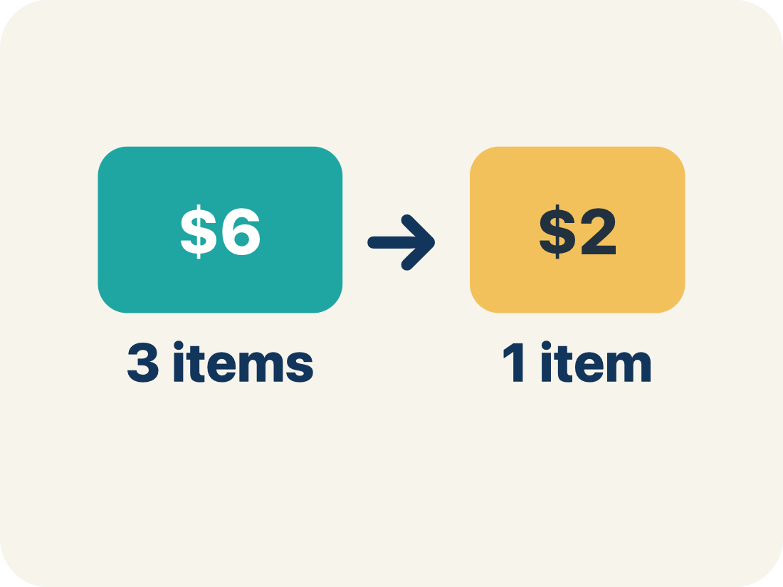
Vocabulary 3 of 7
Lesson 3-6 · Ratio Reasoning: Convert Measurements within the Same System
Unit ratio
A ratio that compares an amount to exactly 1 unit of another quantity, like 12 inches to 1 foot.
EXAMPLE · EXPLAIN WHY IT FITS
12 : 1 — twelve inches for every one foot
Use “Unit ratio” to explain the example. Point to evidence.
eduwonderlab.com · Neft Teacher
6 / 40
Notes:
TEACH IN PRACTICE | Embedded facilitation | Lesson 3.6, slide 6 | VOCAB
Focus on the existing task: Vocabulary 3 of 7 Unit ratio…
ASK (T1/3/5): Where does “Unit ratio” appear in the example? Explain the meaning without reading the definition. Partner: restate the idea and ask a clarifying question.
LOOK FOR: A correct connection between the word and a feature of the example. If the student only repeats the definition, invite pointing, sketching or oral rehearsal, then ask for another explanation of this same example.
PARTICIPATION (T5/6/7): Think time before volunteers; accept a written, drawn or rehearsed entry. Students ask for evidence respectfully. Recognize a specific contribution or revision and check that both partners participate.
Source: BCPS Updated Instructional Framework Rubric (June 2020), TEACH 1–7.

Slide 7
Vocabulary 4 of 7
Lesson 3-6 · Ratio Reasoning: Convert Measurements within the Same System
Convert
To change a measurement from one unit to another without changing how much it is.
EXAMPLE · EXPLAIN WHY IT FITS
4 ft and 48 in are the same height, written two ways
Use “Convert” to explain the example. Point to evidence.
eduwonderlab.com · Neft Teacher
7 / 40
Notes:
TEACH IN PRACTICE | Embedded facilitation | Lesson 3.6, slide 7 | VOCAB
Focus on the existing task: Vocabulary 4 of 7 Convert To…
ASK (T1/3/5): Where does “Convert” appear in the example? Explain the meaning without reading the definition. Partner: restate the idea and ask a clarifying question.
LOOK FOR: A correct connection between the word and a feature of the example. If the student only repeats the definition, invite pointing, sketching or oral rehearsal, then ask for another explanation of this same example.
PARTICIPATION (T5/6/7): Think time before volunteers; accept a written, drawn or rehearsed entry. Students ask for evidence respectfully. Recognize a specific contribution or revision and check that both partners participate.
Source: BCPS Updated Instructional Framework Rubric (June 2020), TEACH 1–7.

Slide 8
Vocabulary 5 of 7
Lesson 3-6 · Ratio Reasoning: Convert Measurements within the Same System
Measurement system
A family of units that go together — customary units like inches and feet, or metric units like milliliters and liters.
EXAMPLE · EXPLAIN WHY IT FITS
Customary: 12 in = 1 ft · Metric: 1,000 mL = 1 L
TAKE TURNS · One explains, one asks a question. Then switch, so both of you talk.
eduwonderlab.com · Neft Teacher
8 / 40
Notes:
TEACH IN PRACTICE | Embedded facilitation | Lesson 3.6, slide 8 | VOCAB
Focus on the existing task: Vocabulary 5 of 7 Measurement…
ASK (T1/3/5): Where does “Measurement system” appear in the example? Explain the meaning without reading the definition. Partner: restate the idea and ask a clarifying question.
LOOK FOR: A correct connection between the word and a feature of the example. If the student only repeats the definition, invite pointing, sketching or oral rehearsal, then ask for another explanation of this same example.
PARTICIPATION (T5/6/7): Think time before volunteers; accept a written, drawn or rehearsed entry. Students ask for evidence respectfully. Recognize a specific contribution or revision and check that both partners participate.
Source: BCPS Updated Instructional Framework Rubric (June 2020), TEACH 1–7.

Slide 9

Vocabulary 6 of 7
Lesson 3-6 · Ratio Reasoning: Convert Measurements within the Same System
Double number line
Two number lines lined up so matching tick marks show two units for the same amount.
EXAMPLE · EXPLAIN WHY IT FITS
Liters 0, 1, 2, 3, 4 above milliliters 0, 1,000, 2,000, 3,000, 4,000
Use “Double number line” to explain the example. Point to
evidence.
eduwonderlab.com · Neft Teacher
9 / 40
Notes:
TEACH IN PRACTICE | Embedded facilitation | Lesson 3.6, slide 9 | VOCAB
Focus on the existing task: Vocabulary 6 of 7 Double…
ASK (T1/3/5): Where does “Double number line” appear in the example? Explain the meaning without reading the definition. Partner: restate the idea and ask a clarifying question.
LOOK FOR: A correct connection between the word and a feature of the example. If the student only repeats the definition, invite pointing, sketching or oral rehearsal, then ask for another explanation of this same example.
PARTICIPATION (T5/6/7): Think time before volunteers; accept a written, drawn or rehearsed entry. Students ask for evidence respectfully. Recognize a specific contribution or revision and check that both partners participate.
Source: BCPS Updated Instructional Framework Rubric (June 2020), TEACH 1–7.

Slide 10
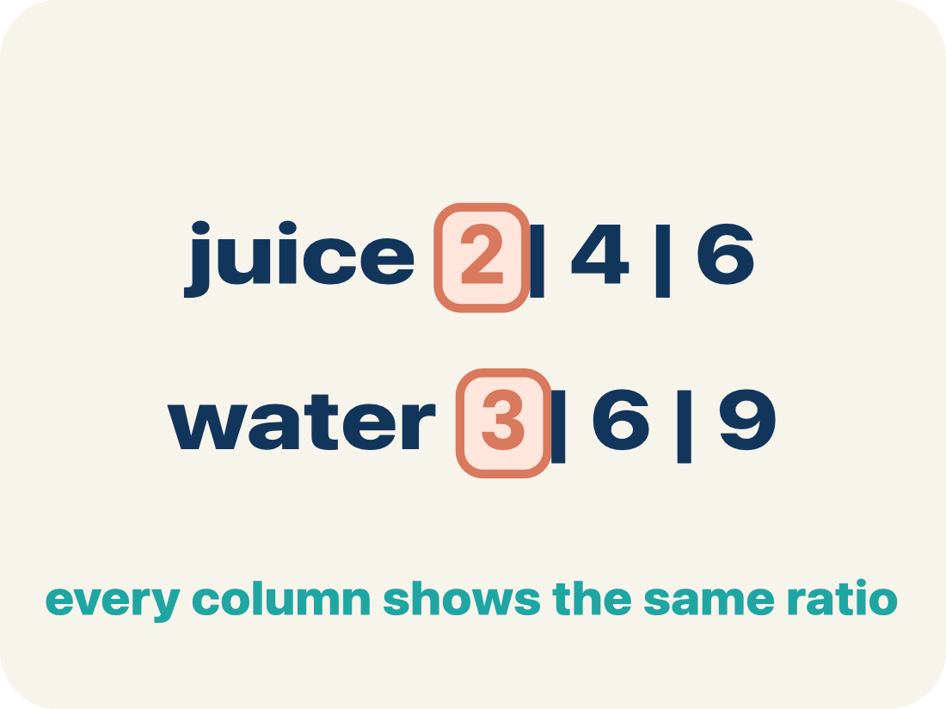
Vocabulary 7 of 7
Lesson 3-6 · Ratio Reasoning: Convert Measurements within the Same System
Ratio table
A table of equal ratios that lets you scale a conversion up or down one row at a time.
EXAMPLE · EXPLAIN WHY IT FITS
1 ft : 12 in, 2 ft : 24 in, 4 ft : 48 in
Use “Ratio table” to explain the example. Point to evidence.
eduwonderlab.com · Neft Teacher
10 / 40
Notes:
TEACH IN PRACTICE | Embedded facilitation | Lesson 3.6, slide 10 | VOCAB
Focus on the existing task: Vocabulary 7 of 7 Ratio table…
ASK (T1/3/5): Where does “Ratio table” appear in the example? Explain the meaning without reading the definition. Partner: restate the idea and ask a clarifying question.
LOOK FOR: A correct connection between the word and a feature of the example. If the student only repeats the definition, invite pointing, sketching or oral rehearsal, then ask for another explanation of this same example.
PARTICIPATION (T5/6/7): Think time before volunteers; accept a written, drawn or rehearsed entry. Students ask for evidence respectfully. Recognize a specific contribution or revision and check that both partners participate.
Source: BCPS Updated Instructional Framework Rubric (June 2020), TEACH 1–7.

Slide 11
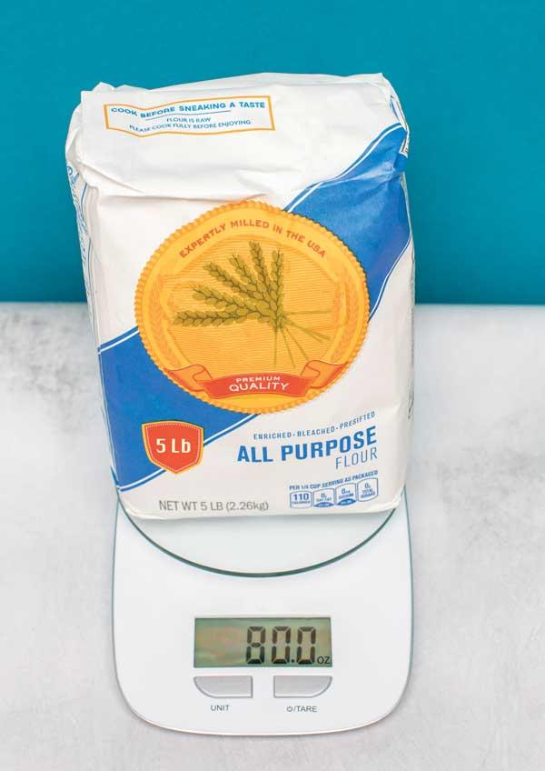

Be Curious
What is the question?
Mindset
HOW DO YOU KNOW? · Ask your partner “How do you know?” Answer by pointing to your own work.
How can you use your abilities and strengths in other areas to be successful in math?
11 / 40
Notes:
TEACH IN PRACTICE | Embedded facilitation | Lesson 3.6, slide 11 | CURIOUS
Focus on the existing task: Be Curious What is the question?
LAUNCH (T2/3/5): Allow quiet observation first. Separate a notice from an inference, invite students’ own questions, and follow the existing launch before teaching a procedure.
LOOK FOR (T4): Where this task addresses it, students can use a same-system conversion ratio. Ask which feature of their work supports the claim.
RESPOND: If this task shows the lesson misconception—multiplying or dividing without considering unit size—label units on each step of the original conversion and reason whether the count should increase. Have the student revise and explain the change. Use this support only where the concept occurs in the current task; otherwise respond to the displayed question.
RECHECK: If a gap is shared, revisit the existing representation together. If it is limited, give targeted support while others compare valid methods on the same task. Check the revision before moving on.
PARTICIPATION (T5/6/7): Think time before volunteers; accept a written, drawn or rehearsed entry. Students ask for evidence respectfully. Recognize a specific contribution or revision and check that both partners participate.
Source: BCPS Updated Instructional Framework Rubric (June 2020), TEACH 1–7.

Slide 12
STUDENT MOVE · ESTIMATE • DEFEND • COMPARE
Partner press: ask Why? and answer with evidence.
More or Less Than 10
Estimate first. Choose one expression and defend your estimate.
0.35 + 9.18
3.098 + 6.145
4.509 + 5.294
Think and record first. Which part of your work supports your answer?
EXPLAIN YOUR THINKING
“I think it is more/less than 10 because ___.” Compare strategies.
12 / 40
Notes:
TEACH IN PRACTICE | Embedded facilitation | Lesson 3.6, slide 12 | TASK
Focus on the existing task: More or Less Than 10 0.35 + 9.18 3.098 + 6.145 4.509 + 5.294 STUDENT MOVE · ESTIMATE • DEFEND • COMPARE Estimate first. Choose one…
LAUNCH (T2/3/5): Use the displayed question. Give private thinking time; then A explains while B asks for evidence. Switch roles. Each student records their own reasoning.
LOOK FOR (T4): Where this task addresses it, students can compare using matching units. Ask which feature of their work supports the claim.
RESPOND: If this task shows the lesson misconception—multiplying or dividing without considering unit size—label units on each step of the original conversion and reason whether the count should increase. Have the student revise and explain the change. Use this support only where the concept occurs in the current task; otherwise respond to the displayed question.
RECHECK: If a gap is shared, revisit the existing representation together. If it is limited, give targeted support while others compare valid methods on the same task. Check the revision before moving on.
PARTICIPATION (T5/6/7): Think time before volunteers; accept a written, drawn or rehearsed entry. Students ask for evidence respectfully. Recognize a specific contribution or revision and check that both partners participate.
Source: BCPS Updated Instructional Framework Rubric (June 2020), TEACH 1–7. Earlier notes and answer keys are retained below.
EARLIER NOTES / EXISTING ANSWER KEY
Student move: Partner press: ask Why? and answer with evidence.
Routine: STUDENT MOVE · ESTIMATE • DEFEND • COMPARE
UIFR FULL | Lesson-specific facilitation
TEACH 2-3 | Session 1 task launch (UIFR PDF pp. 9-10).
Use the problem exactly as displayed. Give individual thinking time before discussion or advancing to the explanation. If the answer is already visible, ask students to reconstruct and justify it. Invite a choice of suitable representations and have students explain why their choice helps.
At the point where this concept appears, ask: “Why does the number change while the actual measurement stays the same?” Wait for evidence, invite another pathway, and have a student ask a follow-up question. Do not replace students’ reasoning with a sequence of leading steps.

Slide 13
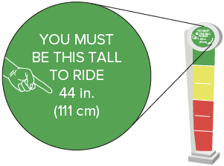
STUDENT MOVE · THINK → PARTNER TALK → EXPLAIN
Ask a partner a question; choose a model together.
Riding the Attractions
At an amusement park, one attraction has the height requirement shown.
If there are 12 inches in every foot, can a child who is 4 feet tall go on the attraction?
MAKE A PREDICTION
“I need to compare ___ and ___ in the same unit. I can start with ___.”
Try first. Connect a feature of the model to a step in your reasoning.
13 / 40
Notes:
TEACH IN PRACTICE | Embedded facilitation | Lesson 3.6, slide 13 | TASK
Focus on the existing task: Riding the Attractions At an amusement park, one attraction has the height requirement shown. If there are 12 inches in every foot, can a child who is 4 feet tall go on the attraction?
LAUNCH (T2/3/5): Use the displayed question. Give private thinking time; then A explains while B asks for evidence. Switch roles. Each student records their own reasoning.
LOOK FOR (T4): Where this task addresses it, students can use a same-system conversion ratio. Ask which feature of their work supports the claim.
RESPOND: If this task shows the lesson misconception—multiplying or dividing without considering unit size—label units on each step of the original conversion and reason whether the count should increase. Have the student revise and explain the change. Use this support only where the concept occurs in the current task; otherwise respond to the displayed question.
RECHECK: If a gap is shared, revisit the existing representation together. If it is limited, give targeted support while others compare valid methods on the same task. Check the revision before moving on.
PARTICIPATION (T5/6/7): Think time before volunteers; accept a written, drawn or rehearsed entry. Students ask for evidence respectfully. Recognize a specific contribution or revision and check that both partners participate.
Source: BCPS Updated Instructional Framework Rubric (June 2020), TEACH 1–7. Earlier notes and answer keys are retained below.
EARLIER NOTES / EXISTING ANSWER KEY
Student move: Ask a partner a question; choose a model together.
Routine: STUDENT MOVE · THINK → PARTNER TALK → EXPLAIN

Slide 14
STUDENT MOVE · SCALE • LABEL • EXPLAIN
Feet → Inches
A conversion factor relates equal measurements in different units.
Feet | Inches
1 | 12
2 | 24
4 | 48
The unit ratio is 12 inches for 1 foot. Both are customary units.
Multiply both quantities by 4: 4 feet = 48 inches.
Explain how the information shown supports
your reasoning.
TALK TOOL
“I multiplied 1 foot and 12 inches by ___. The height stayed ___.”
14 / 40
Notes:
TEACH IN PRACTICE | Embedded facilitation | Lesson 3.6, slide 14 | WORKED
Focus on the existing task: Feet → Inches A conversion factor relates equal measurements in different units. The unit ratio is 12 inches for 1 foot. Both are…
LAUNCH (T2/3/5): Ask students to explain the displayed idea or example and point to evidence. When a calculation step is shown, ask why it is valid. Have a partner restate the explanation; copying is not the check.
LOOK FOR (T4): Where this task addresses it, students can use a same-system conversion ratio. Ask which feature of their work supports the claim.
RESPOND: If this task shows the lesson misconception—multiplying or dividing without considering unit size—label units on each step of the original conversion and reason whether the count should increase. Have the student revise and explain the change. Use this support only where the concept occurs in the current task; otherwise respond to the displayed question.
RECHECK: If a gap is shared, revisit the existing representation together. If it is limited, give targeted support while others compare valid methods on the same task. Check the revision before moving on.
PARTICIPATION (T5/6/7): Think time before volunteers; accept a written, drawn or rehearsed entry. Students ask for evidence respectfully. Recognize a specific contribution or revision and check that both partners participate.
Source: BCPS Updated Instructional Framework Rubric (June 2020), TEACH 1–7. Earlier notes and answer keys are retained below.
EARLIER NOTES / EXISTING ANSWER KEY
Teach this step before assigning independent practice. Read the highlighted term and connect it to the example. Model the calculation, then ask students to explain why the same factor applies to both quantities. Give thinking time and invite a partner explanation. Source content: supplied McGraw Hill Unit 3 lesson presentation.

Slide 15

STUDENT MOVE · THINK → PARTNER TALK → EXPLAIN
Student-led talk: paraphrase, agree or disagree, add on.
At an amusement park, one attraction has
the height requirement shown.
If there are 12 inches in every foot, can a child who is 4 feet tall go on the attraction?
4 feet = 48 inches
48 inches > 44 inches
A 4-foot-tall child can go on the attraction.
CHOOSE A TOOL
Use a ratio table or double number line. Explain how it proves that 48 inches is above 44 inches.
15 / 40
Notes:
TEACH IN PRACTICE | Embedded facilitation | Lesson 3.6, slide 15 | TASK
Focus on the existing task: At an amusement park, one attraction has the height requirement shown. If there are 12 inches in every foot, can a child who is 4 feet tall go on the attraction?
LAUNCH (T2/3/5): Use the displayed question. Give private thinking time; then A explains while B asks for evidence. Switch roles. Each student records their own reasoning.
LOOK FOR (T4): Where this task addresses it, students can use a same-system conversion ratio. Ask which feature of their work supports the claim.
RESPOND: If this task shows the lesson misconception—multiplying or dividing without considering unit size—label units on each step of the original conversion and reason whether the count should increase. Have the student revise and explain the change. Use this support only where the concept occurs in the current task; otherwise respond to the displayed question.
RECHECK: If a gap is shared, revisit the existing representation together. If it is limited, give targeted support while others compare valid methods on the same task. Check the revision before moving on.
PARTICIPATION (T5/6/7): Think time before volunteers; accept a written, drawn or rehearsed entry. Students ask for evidence respectfully. Recognize a specific contribution or revision and check that both partners participate.
Source: BCPS Updated Instructional Framework Rubric (June 2020), TEACH 1–7. Earlier notes and answer keys are retained below.
EARLIER NOTES / EXISTING ANSWER KEY
Student move: Student-led talk: paraphrase, agree or disagree, add on.
Routine: STUDENT MOVE · THINK → PARTNER TALK → EXPLAIN

Slide 16
STUDENT MOVE · SCALE • LABEL • EXPLAIN
Practice: Customary Conversions
1. Use 1 quart = 32 fluid ounces. How many fluid ounces are in 5 quarts?
2. Use 1 pound = 16 ounces. Write ounces : pounds and pounds : ounces.
Explain why the order of the quantities matters.
PICK YOUR STRATEGY · Choose your path — picture, table, number line, or equation — and be ready to say why you chose it.
TALK TOOL
“The ratio ___ compares ounces to pounds. Reversing the order gives ___.”
16 / 40
Notes:
TEACH IN PRACTICE | Embedded facilitation | Lesson 3.6, slide 16 | PRACTICE
Focus on the existing task: Practice: Customary Conversions 1. Use 1 quart = 32 fluid ounces. How many fluid ounces are in 5 quarts?
LAUNCH (T2/3/5): Use the displayed question. Give private thinking time; then A explains while B asks for evidence. Switch roles. Each student records their own reasoning.
LOOK FOR (T4): Where this task addresses it, students can use a same-system conversion ratio. Ask which feature of their work supports the claim.
RESPOND: If this task shows the lesson misconception—multiplying or dividing without considering unit size—label units on each step of the original conversion and reason whether the count should increase. Have the student revise and explain the change. Use this support only where the concept occurs in the current task; otherwise respond to the displayed question.
RECHECK: If a gap is shared, revisit the existing representation together. If it is limited, give targeted support while others compare valid methods on the same task. Check the revision before moving on.
PARTICIPATION (T5/6/7): Think time before volunteers; accept a written, drawn or rehearsed entry. Students ask for evidence respectfully. Recognize a specific contribution or revision and check that both partners participate.
Source: BCPS Updated Instructional Framework Rubric (June 2020), TEACH 1–7. Earlier notes and answer keys are retained below.
EARLIER NOTES / EXISTING ANSWER KEY
Teach this step before assigning independent practice. Read the highlighted term and connect it to the example. Model the calculation, then ask students to explain why the same factor applies to both quantities. Give thinking time and invite a partner explanation. Source content: supplied McGraw Hill Unit 3 lesson presentation.

Slide 17
LESSON 3.6 / DISCUSS THE TASK
Explain and compare
Use the task you just explored.
TAKE TURNS
Why does the number change while the actual measurement stays the same?
Explain
“I know this because…”
Ask
“Where does your work show that?”
Point to evidence in your work.
Then compare your approach with a partner’s.
JUSTIFY IT · Say it like this: “I know ______ because ______.”
Listen to understand. Ask for evidence. Make room for every voice.
Notes:
TEACH IN PRACTICE | Embedded facilitation | Lesson 3.6, slide 17 | PRIOR_INSERT
Focus on the existing task: Point to evidence in your work. Then compare your approach with a partner’s. TAKE TURNS Explain “I know this because…” Ask “Where does your work show that?
CONNECT (T1/4): Ask students to restate the displayed goal or key idea and connect it to earlier work. Relevant lesson evidence: use a same-system conversion ratio; preserve the amount; compare using matching units. Use only the criterion that matches the current session.
SHOW PROGRESS: Students point to their own existing work, explain what improved after feedback, and name a next step. Pair confidence ratings with actual evidence.
PARTICIPATION (T5/6/7): Think time before volunteers; accept a written, drawn or rehearsed entry. Students ask for evidence respectfully. Recognize a specific contribution or revision and check that both partners participate.
Source: BCPS Updated Instructional Framework Rubric (June 2020), TEACH 1–7.

Slide 18
FORMATIVE CHECK · SOLO → CHECK → REVISE
Defend your method; partner gives one specific next step.
60-Second Check
Work independently first. Your response tells us what to do next.
USE THIS CONVERSION FACT
1 foot = 12 inches. A child is 5 feet tall.
1 — CONVERT
2 — EXPLAIN + PROVE
3 — SELF-MONITOR
How tall is the child in inches? Show a ratio table or equation.
Why does the number change while the height stays the same?
Circle one:
READY — I can explain it.
ALMOST — I need one hint.
NOT YET — I need a model.
Partner feedback: Ask “How do you know?” The solver may clarify or revise before sharing.
18 / 40
Notes:
TEACH IN PRACTICE | Embedded facilitation | Lesson 3.6, slide 18 | TASK
Focus on the existing task: Show a ratio table or equation. 2 — EXPLAIN + PROVE Why does the number change while the height stays the same?
LAUNCH (T2/3/5): Use the displayed question. Give private thinking time; then A explains while B asks for evidence. Switch roles. Each student records their own reasoning.
LOOK FOR (T4): Where this task addresses it, students can use a same-system conversion ratio. Ask which feature of their work supports the claim.
RESPOND: If this task shows the lesson misconception—multiplying or dividing without considering unit size—label units on each step of the original conversion and reason whether the count should increase. Have the student revise and explain the change. Use this support only where the concept occurs in the current task; otherwise respond to the displayed question.
RECHECK: If a gap is shared, revisit the existing representation together. If it is limited, give targeted support while others compare valid methods on the same task. Check the revision before moving on.
PARTICIPATION (T5/6/7): Think time before volunteers; accept a written, drawn or rehearsed entry. Students ask for evidence respectfully. Recognize a specific contribution or revision and check that both partners participate.
Source: BCPS Updated Instructional Framework Rubric (June 2020), TEACH 1–7. Earlier notes and answer keys are retained below.
EARLIER NOTES / EXISTING ANSWER KEY
Answer: 60 inches; 5 × 12. The same height is measured using smaller units. Give quiet thinking time before sharing. If a student is stuck, point back to the relevant worked model without doing the task for them. Give specific feedback, then allow a correction.

Slide 19
At an amusement park, one attraction has the height requirement shown. If there are 12 inches in every foot, can a child who is 4 feet tall go on the attraction?
Compare your reasoning with the
explanation. Explain any revision you make.
What do you notice about the measurement units in the problem?
Reveal:
I notice the measurement units, feet and inches, are different from each other.
19 / 40
Notes:
TEACH IN PRACTICE | Embedded facilitation | Lesson 3.6, slide 19 | REVEAL
Focus on the existing task: What do you notice about the measurement units in the problem?
LAUNCH (T2/3/5): If an existing answer cover is present, gather an attempt before revealing. If the explanation is already visible, ask students to reconstruct and justify it. Compare reasoning and explain a revision; preserve the reveal sequence.
LOOK FOR (T4): Where this task addresses it, students can compare using matching units. Ask which feature of their work supports the claim.
RESPOND: If this task shows the lesson misconception—multiplying or dividing without considering unit size—label units on each step of the original conversion and reason whether the count should increase. Have the student revise and explain the change. Use this support only where the concept occurs in the current task; otherwise respond to the displayed question.
RECHECK: If a gap is shared, revisit the existing representation together. If it is limited, give targeted support while others compare valid methods on the same task. Check the revision before moving on.
PARTICIPATION (T5/6/7): Think time before volunteers; accept a written, drawn or rehearsed entry. Students ask for evidence respectfully. Recognize a specific contribution or revision and check that both partners participate.
Source: BCPS Updated Instructional Framework Rubric (June 2020), TEACH 1–7.

Slide 20
How many inches are in one foot?
Compare your reasoning with the explanation. Explain any revision you make.
Reveal:
There are 12 inches in one foot.
20 / 40
Notes:
TEACH IN PRACTICE | Embedded facilitation | Lesson 3.6, slide 20 | REVEAL
Focus on the existing task: How many inches are in one foot?
LAUNCH (T2/3/5): If an existing answer cover is present, gather an attempt before revealing. If the explanation is already visible, ask students to reconstruct and justify it. Compare reasoning and explain a revision; preserve the reveal sequence.
LOOK FOR (T4): Where this task addresses it, students can use a same-system conversion ratio. Ask which feature of their work supports the claim.
RESPOND: If this task shows the lesson misconception—multiplying or dividing without considering unit size—label units on each step of the original conversion and reason whether the count should increase. Have the student revise and explain the change. Use this support only where the concept occurs in the current task; otherwise respond to the displayed question.
RECHECK: If a gap is shared, revisit the existing representation together. If it is limited, give targeted support while others compare valid methods on the same task. Check the revision before moving on.
PARTICIPATION (T5/6/7): Think time before volunteers; accept a written, drawn or rehearsed entry. Students ask for evidence respectfully. Recognize a specific contribution or revision and check that both partners participate.
Source: BCPS Updated Instructional Framework Rubric (June 2020), TEACH 1–7.

Slide 21

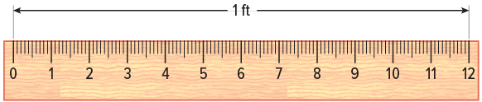
Collaborate and Connect
The ratio of inches to feet is 12 : 1.
This special type of ratio relationship in which a quantity is compared to 1 unit of another quantity is called a unit ratio.
How can you use the unit ratio to convert 4 feet to inches?
Reveal:
We can create a table of equivalent ratios.
Think first. A explains; B asks for
evidence. Switch roles; both
revise.
21 / 40
Notes:
TEACH IN PRACTICE | Embedded facilitation | Lesson 3.6, slide 21 | COLLABORATE
Focus on the existing task: The ratio of inches to feet is 12: 1. How can you use the unit ratio to convert 4 feet to inches?
LAUNCH (T2/3/5): Use the displayed question. Give private thinking time; then A explains while B asks for evidence. Switch roles. Each student records their own reasoning.
LOOK FOR (T4): Where this task addresses it, students can use a same-system conversion ratio. Ask which feature of their work supports the claim.
RESPOND: If this task shows the lesson misconception—multiplying or dividing without considering unit size—label units on each step of the original conversion and reason whether the count should increase. Have the student revise and explain the change. Use this support only where the concept occurs in the current task; otherwise respond to the displayed question.
RECHECK: If a gap is shared, revisit the existing representation together. If it is limited, give targeted support while others compare valid methods on the same task. Check the revision before moving on.
PARTICIPATION (T5/6/7): Think time before volunteers; accept a written, drawn or rehearsed entry. Students ask for evidence respectfully. Recognize a specific contribution or revision and check that both partners participate.
Source: BCPS Updated Instructional Framework Rubric (June 2020), TEACH 1–7. Earlier notes and answer keys are retained below.
EARLIER NOTES / EXISTING ANSWER KEY
UIFR FULL | Lesson-specific facilitation
TEACH 4-5 | Session 1 discussion and checkpoint (UIFR PDF pp. 11-12).
Collect a brief response from every student to the existing prompt before hearing volunteers. Partners take turns explaining and asking for evidence: “I understand ___; what supports ___?” Offer rehearsal or an annotated model for students who need language support. Each student records their own reasoning.
Look specifically for: multiplying or dividing without considering unit size. If it appears, label units on each step of the original conversion and reason whether the count should increase; then ask the student to revise the same response and explain the change. If evidence is secure, have students compare a second valid pathway or state why their approach works. Choose the next step from the responses, not a preset pace.

Slide 22
WARM-UP · THINK • TRY • CHECK
Turn and talk: compare strategies, then defend one.
Session 2 Warm-Up
Lesson 3-6 · Converting Within One System | Session 2 Warm-Up · about 4 minutes
Try each on your own. Mark an unsure answer; explain and revise when we check.
QUESTION 1
QUESTION 2
1 foot = 12 inches
3 feet = ______ inches
1 liter = 1,000 milliliters
4 liters = ______ milliliters
QUESTION 3
QUESTION 4
48 inches = ______ feet
2,000 milliliters = ______ liters
TALK IT OVER: “I got ______ because ______.” • Compare with a partner before we check as a class.
22 / 40
Notes:
TEACH IN PRACTICE | Embedded facilitation | Lesson 3.6, slide 22 | WARMUP
Focus on the existing task: Session 2 Warm-Up | Session 2 Warm-Up · about 4 minutes WARM-UP · THINK • TRY • CHECK Do…
GATHER EVIDENCE (T4/6): Keep the original items. Students try independently, mark an uncertain item, and explain one method before checking. Use the existing key when present.
RESPOND: Distinguish a calculation slip from a reasoning gap. Give one next step on the same item; have students revise in a second color. Use the responses to choose flexible support for today’s lesson.
PARTICIPATION (T5/6/7): Think time before volunteers; accept a written, drawn or rehearsed entry. Students ask for evidence respectfully. Recognize a specific contribution or revision and check that both partners participate.
Source: BCPS Updated Instructional Framework Rubric (June 2020), TEACH 1–7. Earlier notes and answer keys are retained below.
EARLIER NOTES / EXISTING ANSWER KEY
Warm-up routine: students start silently on entry; keep it to about 4 minutes.
Circulate and note who is stuck — use what you see to choose who you check on first today.
Go over answers quickly; ask one student to explain a step, not just say the answer.
UIFR: TEACH 4 · TEACH 6.

Slide 23
REVIEW NOTES · RECALL • CONNECT • APPLY
Partner check: explain one idea without looking.
Review Notes — Session 2
Review the key ideas before Session 2.
COPY THESE 3 LINES
LOOK BACK AT THE EXAMPLE
01
Convert means write the same amount in another unit.
Feet | Inches
1 | 12
4 | 48
02
Start with a known conversion fact.
4 feet = 48 inches, which is above 44 inches.
03
Use equivalent ratios to find the new number.
EXPLAIN THE CONNECTION
“The units changed from ___ to ___, but the amount stayed the same.”
23 / 40
Notes:
TEACH IN PRACTICE | Embedded facilitation | Lesson 3.6, slide 23 | NOTES
Focus on the existing task: Review Notes — Session 2 Review the key ideas before Session 2. COPY THESE 3 LINES 01 Convert means write the same amount in another…
ROUTINE (T1/2/4): Read or copy the original notes, cover one line, and explain it using the displayed example. Reopen and correct. Copying alone is not evidence of understanding.
LOOK FOR: A link between a symbol, quantity or feature and the explanation. If missing, point back to that feature and have the student try again; fade the prompt once they can explain.
PARTICIPATION (T5/6/7): Think time before volunteers; accept a written, drawn or rehearsed entry. Students ask for evidence respectfully. Recognize a specific contribution or revision and check that both partners participate.
Source: BCPS Updated Instructional Framework Rubric (June 2020), TEACH 1–7. Earlier notes and answer keys are retained below.
EARLIER NOTES / EXISTING ANSWER KEY
Copy routine: read one line at a time; students copy, then explain that line to a partner.
Keep it brisk — the understanding work happens in the examples, not the copying.
UIFR: TEACH 1 · TEACH 6.

Slide 24
LEARNING TARGET · CONVERT • COMPARE • EXPLAIN
Tell a partner the new goal and how you will show it.
Learning Target — Session 2
Lesson 3-6 · Converting Within One System | Maryland Standard 6.AT.3
Today I will convert to matching units and explain what the result means.
CONTENT OBJECTIVE
LANGUAGE OBJECTIVE
I can convert liters to milliliters and solve a capacity problem.
I can explain a conversion and label liters and milliliters correctly.
SUCCESS CHECK
WHY THIS MATTERS
✓ Write 1 liter = 1,000 milliliters.
✓ Convert before comparing capacities.
✓ Explain the number of bottle fills.
Matching units helps us compare heights and measure ingredients.
MATH COMMUNITY: Different strategies are welcome • Ask before telling • Revising your thinking is part of learning
24 / 40
Notes:
TEACH IN PRACTICE | Embedded facilitation | Lesson 3.6, slide 24 | GOAL
Focus on the existing task: Learning Target — Session 2 | Maryland Standard 6.AT.3 LEARNING TARGET · CONVERT •…
CONNECT (T1/4): Ask students to restate the displayed goal or key idea and connect it to earlier work. Relevant lesson evidence: use a same-system conversion ratio; preserve the amount; compare using matching units. Use only the criterion that matches the current session.
SHOW PROGRESS: Students point to their own existing work, explain what improved after feedback, and name a next step. Pair confidence ratings with actual evidence.
PARTICIPATION (T5/6/7): Think time before volunteers; accept a written, drawn or rehearsed entry. Students ask for evidence respectfully. Recognize a specific contribution or revision and check that both partners participate.
Source: BCPS Updated Instructional Framework Rubric (June 2020), TEACH 1–7. Earlier notes and answer keys are retained below.
EARLIER NOTES / EXISTING ANSWER KEY
Name today’s content and language goals. Briefly read the success criteria; do not teach procedures here. The original context and model follow. Return to these criteria after the worked example.
UIFR FULL | Lesson-specific facilitation
TEACH 1 | Session 2 purpose and evidence (UIFR PDF p. 8).
Have students restate the displayed session goal in their own words and connect it to the existing context or a familiar experience they choose to share. Use the current session goal to select from these lesson-wide evidence criteria; do not frontload a later-session procedure.
Look for: use a same-system conversion ratio; preserve the amount; compare using matching units. Ask: “Which part of your work would show this?” Revisit that evidence after the task; a confidence rating alone is not evidence of understanding.

Slide 25
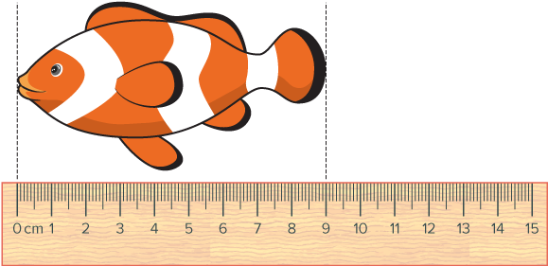
Be Curious
What do you notice?
What do you wonder?
Think first. Share a notice and a question;
build on a classmate’s idea.
Mindset
How are you using your abilities and strengths in other areas to be successful in math?
25 / 40
Notes:
TEACH IN PRACTICE | Embedded facilitation | Lesson 3.6, slide 25 | CURIOUS
Focus on the existing task: Be Curious What do you notice?
LAUNCH (T2/3/5): Allow quiet observation first. Separate a notice from an inference, invite students’ own questions, and follow the existing launch before teaching a procedure.
LOOK FOR (T4): Where this task addresses it, students can compare using matching units. Ask which feature of their work supports the claim.
RESPOND: If this task shows the lesson misconception—multiplying or dividing without considering unit size—label units on each step of the original conversion and reason whether the count should increase. Have the student revise and explain the change. Use this support only where the concept occurs in the current task; otherwise respond to the displayed question.
RECHECK: If a gap is shared, revisit the existing representation together. If it is limited, give targeted support while others compare valid methods on the same task. Check the revision before moving on.
PARTICIPATION (T5/6/7): Think time before volunteers; accept a written, drawn or rehearsed entry. Students ask for evidence respectfully. Recognize a specific contribution or revision and check that both partners participate.
Source: BCPS Updated Instructional Framework Rubric (June 2020), TEACH 1–7.

Slide 26

STUDENT MOVE · THINK → PARTNER TALK → EXPLAIN
Compare strategies; defend one with evidence.
Hydrating
Diamond wants to drink 4 liters of water each day. She has a water bottle that holds 500 milliliters of water.
How many times will she need to fill the water bottle each day to reach her goal?
PLAN BEFORE YOU CALCULATE
“First I will convert ___ to ___. Then I will find how many groups of ___ fit.”
Think and record first. Which part of your work supports your answer?
26 / 40
Notes:
TEACH IN PRACTICE | Embedded facilitation | Lesson 3.6, slide 26 | TASK
Focus on the existing task: Hydrating Diamond wants to drink 4 liters of water each day. She has a water bottle that holds 500 milliliters of water. How many times will she need to fill the water bottle each day to reach her goal?
LAUNCH (T2/3/5): Use the displayed question. Give private thinking time; then A explains while B asks for evidence. Switch roles. Each student records their own reasoning.
LOOK FOR (T4): Where this task addresses it, students can compare using matching units. Ask which feature of their work supports the claim.
RESPOND: If this task shows the lesson misconception—multiplying or dividing without considering unit size—label units on each step of the original conversion and reason whether the count should increase. Have the student revise and explain the change. Use this support only where the concept occurs in the current task; otherwise respond to the displayed question.
RECHECK: If a gap is shared, revisit the existing representation together. If it is limited, give targeted support while others compare valid methods on the same task. Check the revision before moving on.
PARTICIPATION (T5/6/7): Think time before volunteers; accept a written, drawn or rehearsed entry. Students ask for evidence respectfully. Recognize a specific contribution or revision and check that both partners participate.
Source: BCPS Updated Instructional Framework Rubric (June 2020), TEACH 1–7. Earlier notes and answer keys are retained below.
EARLIER NOTES / EXISTING ANSWER KEY
Student move: Compare strategies; defend one with evidence.
Routine: STUDENT MOVE · THINK → PARTNER TALK → EXPLAIN
UIFR FULL | Lesson-specific facilitation
TEACH 2-3 | Session 2 task launch (UIFR PDF pp. 9-10).
Use the problem exactly as displayed. Give individual thinking time before discussion or advancing to the explanation. If the answer is already visible, ask students to reconstruct and justify it. Invite a choice of suitable representations and have students explain why their choice helps.
At the point where this concept appears, ask: “Why does the number change while the actual measurement stays the same?” Wait for evidence, invite another pathway, and have a student ask a follow-up question. Do not replace students’ reasoning with a sequence of leading steps.

Slide 27
STUDENT MOVE · SCALE • LABEL • EXPLAIN
Liters → Milliliters
Liters and milliliters are metric units of volume.
Liters | Milliliters
1 | 1,000
2 | 2,000
4 | 4,000
The conversion factor is 1 liter = 1,000 milliliters.
For 4 liters, multiply both quantities by 4.
Explain how the information shown supports
your reasoning.
TALK TOOL
“Both quantities were multiplied by ___. So 4 liters equals ___ milliliters.”
27 / 40
Notes:
TEACH IN PRACTICE | Embedded facilitation | Lesson 3.6, slide 27 | WORKED
Focus on the existing task: Liters → Milliliters Liters and milliliters are metric units of volume. The conversion factor is 1 liter = 1,000 milliliters. For…
LAUNCH (T2/3/5): Ask students to explain the displayed idea or example and point to evidence. When a calculation step is shown, ask why it is valid. Have a partner restate the explanation; copying is not the check.
LOOK FOR (T4): Where this task addresses it, students can use a same-system conversion ratio. Ask which feature of their work supports the claim.
RESPOND: If this task shows the lesson misconception—multiplying or dividing without considering unit size—label units on each step of the original conversion and reason whether the count should increase. Have the student revise and explain the change. Use this support only where the concept occurs in the current task; otherwise respond to the displayed question.
RECHECK: If a gap is shared, revisit the existing representation together. If it is limited, give targeted support while others compare valid methods on the same task. Check the revision before moving on.
PARTICIPATION (T5/6/7): Think time before volunteers; accept a written, drawn or rehearsed entry. Students ask for evidence respectfully. Recognize a specific contribution or revision and check that both partners participate.
Source: BCPS Updated Instructional Framework Rubric (June 2020), TEACH 1–7. Earlier notes and answer keys are retained below.
EARLIER NOTES / EXISTING ANSWER KEY
Teach this step before assigning independent practice. Read the highlighted term and connect it to the example. Model the calculation, then ask students to explain why the same factor applies to both quantities. Give thinking time and invite a partner explanation. Source content: supplied McGraw Hill Unit 3 lesson presentation.

Slide 28
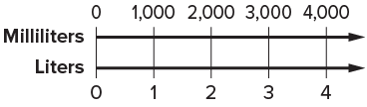
STUDENT MOVE · THINK → PARTNER TALK → EXPLAIN
There are 4,000 milliliters in 4 liters.
4,000 milliliters = 4 liters
Explain how the information
shown supports your reasoning.
SAME AMOUNT • NEW UNIT
“Four liters and 4,000 milliliters name the same volume because ___.”
28 / 40
Notes:
TEACH IN PRACTICE | Embedded facilitation | Lesson 3.6, slide 28 | WORKED
Focus on the existing task: There are 4,000 milliliters in 4 liters. 4,000 milliliters = 4 liters STUDENT MOVE · THINK → PARTNER TALK → EXPLAIN SAME AMOUNT…
LAUNCH (T2/3/5): Ask students to explain the displayed idea or example and point to evidence. When a calculation step is shown, ask why it is valid. Have a partner restate the explanation; copying is not the check.
LOOK FOR (T4): Where this task addresses it, students can use a same-system conversion ratio. Ask which feature of their work supports the claim.
RESPOND: If this task shows the lesson misconception—multiplying or dividing without considering unit size—label units on each step of the original conversion and reason whether the count should increase. Have the student revise and explain the change. Use this support only where the concept occurs in the current task; otherwise respond to the displayed question.
RECHECK: If a gap is shared, revisit the existing representation together. If it is limited, give targeted support while others compare valid methods on the same task. Check the revision before moving on.
PARTICIPATION (T5/6/7): Think time before volunteers; accept a written, drawn or rehearsed entry. Students ask for evidence respectfully. Recognize a specific contribution or revision and check that both partners participate.
Source: BCPS Updated Instructional Framework Rubric (June 2020), TEACH 1–7. Earlier notes and answer keys are retained below.
EARLIER NOTES / EXISTING ANSWER KEY
Routine: STUDENT MOVE · THINK → PARTNER TALK → EXPLAIN

Slide 29
STUDENT MOVE · SCALE • LABEL • EXPLAIN
Milliliters → Bottle Fills
Diamond’s target is 4 liters, or 4,000 milliliters.
Bottle fills | Total milliliters
1 | 500
4 | 2,000
8 | 4,000
Each bottle holds 500 milliliters.
Divide to find the number of fills: 4,000 ÷ 500 = 8.
Explain how the information shown supports
your reasoning.
TALK TOOL
“I divided ___ by ___ because each full bottle holds ___.”
29 / 40
Notes:
TEACH IN PRACTICE | Embedded facilitation | Lesson 3.6, slide 29 | WORKED
Focus on the existing task: Milliliters → Bottle Fills Diamond’s target is 4 liters, or 4,000 milliliters. Each bottle holds 500 milliliters. Divide to find the…
LAUNCH (T2/3/5): Ask students to explain the displayed idea or example and point to evidence. When a calculation step is shown, ask why it is valid. Have a partner restate the explanation; copying is not the check.
LOOK FOR (T4): Where this task addresses it, students can use a same-system conversion ratio. Ask which feature of their work supports the claim.
RESPOND: If this task shows the lesson misconception—multiplying or dividing without considering unit size—label units on each step of the original conversion and reason whether the count should increase. Have the student revise and explain the change. Use this support only where the concept occurs in the current task; otherwise respond to the displayed question.
RECHECK: If a gap is shared, revisit the existing representation together. If it is limited, give targeted support while others compare valid methods on the same task. Check the revision before moving on.
PARTICIPATION (T5/6/7): Think time before volunteers; accept a written, drawn or rehearsed entry. Students ask for evidence respectfully. Recognize a specific contribution or revision and check that both partners participate.
Source: BCPS Updated Instructional Framework Rubric (June 2020), TEACH 1–7. Earlier notes and answer keys are retained below.
EARLIER NOTES / EXISTING ANSWER KEY
Teach this step before assigning independent practice. Read the highlighted term and connect it to the example. Model the calculation, then ask students to explain why the same factor applies to both quantities. Give thinking time and invite a partner explanation. Source content: supplied McGraw Hill Unit 3 lesson presentation.

Slide 30
STUDENT NOTES · COPY LESS • UNDERSTAND MORE
Today’s Math Notes — Session 2
Keep the idea from Hydrating.
SAY THE GOAL · Say today’s goal in your own words, then name one place this shows up outside math class.
COPY THESE 3 LINES
LOOK BACK AT THE EXAMPLE
01
1 liter = 1,000 milliliters.
Liters | Milliliters
1 | 1,000
4 | 4,000
02
Use the same units before comparing amounts.
4,000 ÷ 500 = 8 bottle fills.
03
Check that the answer fits the situation.
EXPLAIN THE CONNECTION
“The units changed from ___ to ___, but the amount stayed the same.”
30 / 40
Notes:
TEACH IN PRACTICE | Embedded facilitation | Lesson 3.6, slide 30 | NOTES
Focus on the existing task: Today’s Math Notes — Session 2 Keep the idea from Hydrating. COPY THESE 3 LINES 01 1 liter = 1,000 milliliters. 02 Use the same units…
ROUTINE (T1/2/4): Read or copy the original notes, cover one line, and explain it using the displayed example. Reopen and correct. Copying alone is not evidence of understanding.
LOOK FOR: A link between a symbol, quantity or feature and the explanation. If missing, point back to that feature and have the student try again; fade the prompt once they can explain.
PARTICIPATION (T5/6/7): Think time before volunteers; accept a written, drawn or rehearsed entry. Students ask for evidence respectfully. Recognize a specific contribution or revision and check that both partners participate.
Source: BCPS Updated Instructional Framework Rubric (June 2020), TEACH 1–7. Earlier notes and answer keys are retained below.
EARLIER NOTES / EXISTING ANSWER KEY
Use this slide only after the original worked example. Students copy the three lines on the left; the table is a reference and does not need copying. Read one line at a time. Ask one student to connect a note to the example.

Slide 31
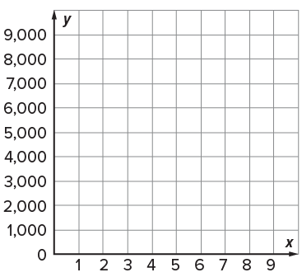
STUDENT MOVE · THINK → PARTNER TALK → EXPLAIN
Compare pathways with a partner; name one revision.
Let’s Explore More
How does the graph show the relationship between liters and milliliters? Connect a point to the double number line.
CONNECT THE REPRESENTATIONS
“The point (___, ___) matches the ratio ___ because ___.”
How are the ratios between units in the metric system alike? How are they different?
COMPARE THE FACTORS
“These metric conversions use powers of ten. The factor changes because ___.”
31 / 40
Notes:
TEACH IN PRACTICE | Embedded facilitation | Lesson 3.6, slide 31 | PRACTICE
Focus on the existing task: Let’s Explore More How does the graph show the relationship between liters and milliliters?
LAUNCH (T2/3/5): Use the displayed question. Give private thinking time; then A explains while B asks for evidence. Switch roles. Each student records their own reasoning.
LOOK FOR (T4): Where this task addresses it, students can use a same-system conversion ratio. Ask which feature of their work supports the claim.
RESPOND: If this task shows the lesson misconception—multiplying or dividing without considering unit size—label units on each step of the original conversion and reason whether the count should increase. Have the student revise and explain the change. Use this support only where the concept occurs in the current task; otherwise respond to the displayed question.
RECHECK: If a gap is shared, revisit the existing representation together. If it is limited, give targeted support while others compare valid methods on the same task. Check the revision before moving on.
PARTICIPATION (T5/6/7): Think time before volunteers; accept a written, drawn or rehearsed entry. Students ask for evidence respectfully. Recognize a specific contribution or revision and check that both partners participate.
Source: BCPS Updated Instructional Framework Rubric (June 2020), TEACH 1–7. Earlier notes and answer keys are retained below.
EARLIER NOTES / EXISTING ANSWER KEY
Student move: Compare pathways with a partner; name one revision.
Routine: STUDENT MOVE · THINK → PARTNER TALK → EXPLAIN
UIFR FULL | Lesson-specific facilitation
TEACH 4-5 | Session 2 discussion and checkpoint (UIFR PDF pp. 11-12).
Collect a brief response from every student to the existing prompt before hearing volunteers. Partners take turns explaining and asking for evidence: “I understand ___; what supports ___?” Offer rehearsal or an annotated model for students who need language support. Each student records their own reasoning.
Look specifically for: multiplying or dividing without considering unit size. If it appears, label units on each step of the original conversion and reason whether the count should increase; then ask the student to revise the same response and explain the change. If evidence is secure, have students compare a second valid pathway or state why their approach works. Choose the next step from the responses, not a preset pace.

Slide 32
LESSON 3.6 / CHECK YOUR WORK
Pause. Check. Improve.
CHECK
A mistake to watch for: multiplying or dividing without considering unit size.
TRY
Label units on each step of the given conversion and reason whether the count should increase.
REVISE
Use that check on the task you just completed. Correct or strengthen one part, and explain why.
SELF-CHECK · Mark it: ✓ got it · ~ almost · ? stuck. Then fix one thing before we move on.
Listen to understand. Ask for evidence. Make room for every voice.
Notes:
TEACH IN PRACTICE | Embedded facilitation | Lesson 3.6, slide 32 | PRIOR_INSERT
Focus on the existing task: LESSON 3.6 / CHECK YOUR WORK Pause. Check. Improve. Listen to understand. Ask for evidence. Make room for every voice. CHECK A mistake…
CONNECT (T1/4): Ask students to restate the displayed goal or key idea and connect it to earlier work. Relevant lesson evidence: use a same-system conversion ratio; preserve the amount; compare using matching units. Use only the criterion that matches the current session.
SHOW PROGRESS: Students point to their own existing work, explain what improved after feedback, and name a next step. Pair confidence ratings with actual evidence.
PARTICIPATION (T5/6/7): Think time before volunteers; accept a written, drawn or rehearsed entry. Students ask for evidence respectfully. Recognize a specific contribution or revision and check that both partners participate.
Source: BCPS Updated Instructional Framework Rubric (June 2020), TEACH 1–7.

Slide 33
Diamond wants to drink 4 liters of water each day. She has a water bottle that holds 500 milliliters of water. How many times will she need to fill the water bottle each day to reach her goal?
What could be the first step when solving this problem?
Reveal:
Determine how many milliliters are in 4 liters.
Compare your reasoning with the
explanation. Explain any revision
you make.
33 / 40
Notes:
TEACH IN PRACTICE | Embedded facilitation | Lesson 3.6, slide 33 | REVEAL
Focus on the existing task: What could be the first step when solving this problem?
LAUNCH (T2/3/5): If an existing answer cover is present, gather an attempt before revealing. If the explanation is already visible, ask students to reconstruct and justify it. Compare reasoning and explain a revision; preserve the reveal sequence.
LOOK FOR (T4): Where this task addresses it, students can use a same-system conversion ratio. Ask which feature of their work supports the claim.
RESPOND: If this task shows the lesson misconception—multiplying or dividing without considering unit size—label units on each step of the original conversion and reason whether the count should increase. Have the student revise and explain the change. Use this support only where the concept occurs in the current task; otherwise respond to the displayed question.
RECHECK: If a gap is shared, revisit the existing representation together. If it is limited, give targeted support while others compare valid methods on the same task. Check the revision before moving on.
PARTICIPATION (T5/6/7): Think time before volunteers; accept a written, drawn or rehearsed entry. Students ask for evidence respectfully. Recognize a specific contribution or revision and check that both partners participate.
Source: BCPS Updated Instructional Framework Rubric (June 2020), TEACH 1–7.

Slide 34
What visual representation can you use to determine the number of milliliters in 4 liters?
Compare your reasoning with the explanation. Explain any revision you make.
Reveal:
We can use a double number line to determine the number of milliliters in 4 liters.
34 / 40
Notes:
TEACH IN PRACTICE | Embedded facilitation | Lesson 3.6, slide 34 | REVEAL
Focus on the existing task: What visual representation can you use to determine the number of milliliters in 4 liters?
LAUNCH (T2/3/5): If an existing answer cover is present, gather an attempt before revealing. If the explanation is already visible, ask students to reconstruct and justify it. Compare reasoning and explain a revision; preserve the reveal sequence.
LOOK FOR (T4): Where this task addresses it, students can use a same-system conversion ratio. Ask which feature of their work supports the claim.
RESPOND: If this task shows the lesson misconception—multiplying or dividing without considering unit size—label units on each step of the original conversion and reason whether the count should increase. Have the student revise and explain the change. Use this support only where the concept occurs in the current task; otherwise respond to the displayed question.
RECHECK: If a gap is shared, revisit the existing representation together. If it is limited, give targeted support while others compare valid methods on the same task. Check the revision before moving on.
PARTICIPATION (T5/6/7): Think time before volunteers; accept a written, drawn or rehearsed entry. Students ask for evidence respectfully. Recognize a specific contribution or revision and check that both partners participate.
Source: BCPS Updated Instructional Framework Rubric (June 2020), TEACH 1–7.

Slide 35
How can you use the number line to find the number of milliliters in 4 liters?
Reveal:
We can identify the label on the milliliters number line that corresponds to the 4-liter mark on the liters number line.
Compare your reasoning with the
explanation. Explain any revision
you make.
35 / 40
Notes:
TEACH IN PRACTICE | Embedded facilitation | Lesson 3.6, slide 35 | REVEAL
Focus on the existing task: How can you use the number line to find the number of milliliters in 4 liters?
LAUNCH (T2/3/5): If an existing answer cover is present, gather an attempt before revealing. If the explanation is already visible, ask students to reconstruct and justify it. Compare reasoning and explain a revision; preserve the reveal sequence.
LOOK FOR (T4): Where this task addresses it, students can use a same-system conversion ratio. Ask which feature of their work supports the claim.
RESPOND: If this task shows the lesson misconception—multiplying or dividing without considering unit size—label units on each step of the original conversion and reason whether the count should increase. Have the student revise and explain the change. Use this support only where the concept occurs in the current task; otherwise respond to the displayed question.
RECHECK: If a gap is shared, revisit the existing representation together. If it is limited, give targeted support while others compare valid methods on the same task. Check the revision before moving on.
PARTICIPATION (T5/6/7): Think time before volunteers; accept a written, drawn or rehearsed entry. Students ask for evidence respectfully. Recognize a specific contribution or revision and check that both partners participate.
Source: BCPS Updated Instructional Framework Rubric (June 2020), TEACH 1–7.

Slide 36
STUDENT MOVE · SUMMARIZE • TEACH A PARTNER
Summarize: Convert Units
Every conversion is a ratio — like 12 inches for every 1 foot, or 1,000 milliliters for every 1 liter.
To compare two measurements, convert them into the same unit first — then compare the numbers.
CONVERSION RATIO
SAME UNIT FIRST
Key idea: Converting units multiplies by a conversion ratio — the amount stays the same, the label changes.
Teach a partner: How do you decide whether to multiply or divide when converting?
CREDIT A CLASSMATE · Name one classmate whose idea helped you today, and say what they said.
36 / 40
Notes:
TEACH IN PRACTICE | Embedded facilitation | Lesson 3.6, slide 36 | SUMMARIZE
Focus on the existing task: STUDENT MOVE · SUMMARIZE • TEACH A PARTNER Summarize: Convert Units Every conversion is a ratio — like 12 inches for every 1 foot, or…
CONNECT (T1/4): Ask students to restate the displayed goal or key idea and connect it to earlier work. Relevant lesson evidence: use a same-system conversion ratio; preserve the amount; compare using matching units. Use only the criterion that matches the current session.
SHOW PROGRESS: Students point to their own existing work, explain what improved after feedback, and name a next step. Pair confidence ratings with actual evidence.
PARTICIPATION (T5/6/7): Think time before volunteers; accept a written, drawn or rehearsed entry. Students ask for evidence respectfully. Recognize a specific contribution or revision and check that both partners participate.
Source: BCPS Updated Instructional Framework Rubric (June 2020), TEACH 1–7. Earlier notes and answer keys are retained below.
EARLIER NOTES / EXISTING ANSWER KEY
Model briefly, then hand the thinking back: ask “Why does this step work?” before showing the next one.
Quick check before moving on — thumbs or whiteboards from everyone, not volunteers.
UIFR: TEACH 2 · TEACH 3 · TEACH 4.

Slide 37
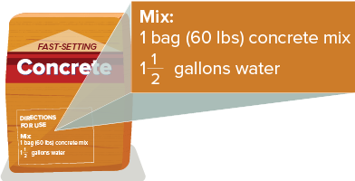
STUDENT MOVE · THINK → PARTNER TALK → EXPLAIN
Apply: Making Concrete
Michael’s mother needs to secure four posts for her garden fence. She uses the concrete mix shown for the project. Each post requires 250 ounces of concrete mix.
Question: How many bags of concrete mix and quarts of water will she need?
BEFORE YOU FINISH
Find the total mix for all 4 posts. Match the units, then explain how you found bags and water.
TRY IT BEFORE YOU’RE SURE · Start even if you are not sure. A revised answer counts as much as a first-try answer.
37 / 40
Notes:
TEACH IN PRACTICE | Embedded facilitation | Lesson 3.6, slide 37 | APPLY
Focus on the existing task: Apply: Making Concrete Question: How many bags of concrete mix and quarts of water will she need?
LAUNCH (T2/3/5): Use the exact application task independently first. Ask students to justify their choice of method. Collect evidence before a partner discussion or correction.
LOOK FOR (T4): Where this task addresses it, students can compare using matching units. Ask which feature of their work supports the claim.
RESPOND: If this task shows the lesson misconception—multiplying or dividing without considering unit size—label units on each step of the original conversion and reason whether the count should increase. Have the student revise and explain the change. Use this support only where the concept occurs in the current task; otherwise respond to the displayed question.
RECHECK: If a gap is shared, revisit the existing representation together. If it is limited, give targeted support while others compare valid methods on the same task. Check the revision before moving on.
PARTICIPATION (T5/6/7): Think time before volunteers; accept a written, drawn or rehearsed entry. Students ask for evidence respectfully. Recognize a specific contribution or revision and check that both partners participate.
Source: BCPS Updated Instructional Framework Rubric (June 2020), TEACH 1–7. Earlier notes and answer keys are retained below.
EARLIER NOTES / EXISTING ANSWER KEY
Routine: STUDENT MOVE · THINK → PARTNER TALK → EXPLAIN

Slide 38
STUDENT MOVE · SELF-ASSESS • NAME YOUR NEXT STEP
Partner debrief: name your evidence and one next step.
Exit Ticket + Self-Check
A container holds 2 liters. A bottle holds 500 milliliters.
SELF-CHECK
How many full bottles fill the container?
1. I can convert to matching units.
□ Alone □ With a hint □ Not yet
2. I can explain my result.
□ Alone □ With a hint □ Not yet
My next step:
____________________
Use 1 L = 1,000 mL. Show the conversion, then find the number of bottles.
Explain: “I changed ___ to ___ so I could compare ___.”
CONVERT → CHECK
Work independently and show why. Use feedback to revise
in a second color.
38 / 40
Notes:
TEACH IN PRACTICE | Embedded facilitation | Lesson 3.6, slide 38 | ASSESSMENT
Focus on the existing task: Exit Ticket + Self-Check STUDENT MOVE · SELF-ASSESS • NAME YOUR NEXT STEP A container holds 2 liters. A bottle holds 500 milliliters. How many full bottles fill the container?
LAUNCH (T2/3/5): Gather an independent response before feedback. Students choose a suitable representation and justify it. Keep the first attempt separate from the revision.
LOOK FOR (T4): Where this task addresses it, students can compare using matching units. Ask which feature of their work supports the claim.
RESPOND: If this task shows the lesson misconception—multiplying or dividing without considering unit size—label units on each step of the original conversion and reason whether the count should increase. Have the student revise and explain the change. Use this support only where the concept occurs in the current task; otherwise respond to the displayed question.
RECHECK: If a gap is shared, revisit the existing representation together. If it is limited, give targeted support while others compare valid methods on the same task. Check the revision before moving on.
PARTICIPATION (T5/6/7): Think time before volunteers; accept a written, drawn or rehearsed entry. Students ask for evidence respectfully. Recognize a specific contribution or revision and check that both partners participate.
Source: BCPS Updated Instructional Framework Rubric (June 2020), TEACH 1–7. Earlier notes and answer keys are retained below.
EARLIER NOTES / EXISTING ANSWER KEY
Answer: 2 L = 2,000 mL; 2,000 ÷ 500 = 4 bottles. Give quiet thinking time before sharing. If a student is stuck, point back to the relevant worked model without doing the task for them. Give specific feedback, then allow a correction.
UIFR FULL | Lesson-specific facilitation
TEACH 4 | Independent evidence and revision (UIFR PDF p. 11).
Use the existing application/exit problem as the independent check. If this is a learning-target slide, have students point to and explain their work on the preceding task. Separate initial independent evidence from the revision after feedback.
Check the relevant criteria: use a same-system conversion ratio; preserve the amount; compare using matching units. Respond with one specific next step tied to the work. Students revise and annotate what changed, then identify a criterion they can now demonstrate and one they still need to practice.

Slide 39
Learning Targets
I can use ratio reasoning to convert between units of the same measurement system.
I can reason abstractly and quantitatively to manipulate and transform units of measure.
CONNECT IT · What earlier lesson does this build on? Tell a partner in one sentence.
39 / 40
Notes:
TEACH IN PRACTICE | Embedded facilitation | Lesson 3.6, slide 39 | REFLECTION
Focus on the existing task: Learning Targets I can use ratio reasoning to convert between units of the same measurement system. I can reason abstractly and…
CONNECT (T1/4): Ask students to restate the displayed goal or key idea and connect it to earlier work. Relevant lesson evidence: use a same-system conversion ratio; preserve the amount; compare using matching units. Use only the criterion that matches the current session.
SHOW PROGRESS: Students point to their own existing work, explain what improved after feedback, and name a next step. Pair confidence ratings with actual evidence.
PARTICIPATION (T5/6/7): Think time before volunteers; accept a written, drawn or rehearsed entry. Students ask for evidence respectfully. Recognize a specific contribution or revision and check that both partners participate.
Source: BCPS Updated Instructional Framework Rubric (June 2020), TEACH 1–7. Earlier notes and answer keys are retained below.
EARLIER NOTES / EXISTING ANSWER KEY
UIFR FULL | Lesson-specific facilitation
REFLECT & ADJUST 1-2 | After the lesson (UIFR PDF pp. 15-16).
Sort the existing work by demonstrated reasoning, partial understanding, and the specific misconception: multiplying or dividing without considering unit size. Compare the initial response with the revision. Record which teaching move plausibly helped, which did not, and whose participation or access needs a different approach; do not record sensitive student details in this shared deck.
Plan the next lesson from that evidence: if the misconception persists, label units on each step of the original conversion and reason whether the count should increase using the current example before returning to the next grade-level task; if understanding is secure, use an existing extension or ask for a general explanation. Check the targeted idea again at the next warm-up.
Ask students what supported their thinking and what would help next time. Identify one change to try and one successful practice to retain. Seek colleague feedback on anonymized work when useful; these prompts support reflection and do not establish an evaluation rating. Source: Baltimore City Public Schools, Updated Instructional Framework Rubric, June 2020 (UIFR_Full.pdf).

Slide 40
UIFR TEACH — Teacher Reference
Teacher reference • hidden from the student slideshow
TEACH 1 · Session goals, purpose, and content-linked success criteria.
TEACH 2 · Original models precede checks and independent application.
TEACH 3 · Original inquiry questions prompt reasoning and justification.
TEACH 4 · Checks, feedback, and time to revise follow instruction.
TEACH 5 · Think time and purposeful partner explanations.
TEACH 6 · Consistent model → notes → practice sequence.
TEACH 7 · Brief notes, scaffolds, and respectful sharing of strategies.
SHOW YOUR THINKING · Show what you know — write it, draw it, or build it. A picture counts as an explanation.
40 / 40
Notes:
TEACH IN PRACTICE | Embedded facilitation | Lesson 3.6, slide 40 | REFERENCE
Focus on the existing task: UIFR TEACH — Teacher Reference Teacher reference • hidden from the student slideshow TEACH 1 · Session goals, purpose, and content-linked…
TRANSITION (T6/7): Students confirm materials, roles, how to request help, and the next response routine. Ask a student to restate it. Keep teacher-only slides hidden.
PARTICIPATION (T5/6/7): Think time before volunteers; accept a written, drawn or rehearsed entry. Students ask for evidence respectfully. Recognize a specific contribution or revision and check that both partners participate.
Source: BCPS Updated Instructional Framework Rubric (June 2020), TEACH 1–7. Earlier notes and answer keys are retained below.
EARLIER NOTES / EXISTING ANSWER KEY
Source: Baltimore City Public Schools, Updated Instructional Framework Rubric, June 2020. Teacher enactment determines the quality of instruction; this is a support map.

