Slide 1
WARM-UP · THINK • TRY • CHECK
Turn and talk: compare strategies, then defend one.
Warm-Up
Lesson 3-7 · Converting Between Systems | Warm-Up · about 4 minutes
Try each on your own. Mark an unsure answer; explain and revise when we check.
QUESTION 1
QUESTION 2
4 × 1.6 = ______
10 × 0.45 = ______
QUESTION 3
QUESTION 4
Round 13.95 to the nearest
whole number: ______
5 × 2.2 = ______
TALK IT OVER: “I got ______ because ______.” • Compare with a partner before we check as a class.
1 / 41
Notes:
TEACH IN PRACTICE | Embedded facilitation | Lesson 3.7, slide 1 | WARMUP
Focus on the existing task: Warm-Up WARM-UP · THINK • TRY • CHECK Do these four on your own.
GATHER EVIDENCE (T4/6): Keep the original items. Students try independently, mark an uncertain item, and explain one method before checking. Use the existing key when present.
RESPOND: Distinguish a calculation slip from a reasoning gap. Give one next step on the same item; have students revise in a second color. Use the responses to choose flexible support for today’s lesson.
PARTICIPATION (T5/6/7): Think time before volunteers; accept a written, drawn or rehearsed entry. Students ask for evidence respectfully. Recognize a specific contribution or revision and check that both partners participate.
Source: BCPS Updated Instructional Framework Rubric (June 2020), TEACH 1–7. Earlier notes and answer keys are retained below.
EARLIER NOTES / EXISTING ANSWER KEY
Warm-Up answers (teacher only): 1) 6.4 2) 4.5 3) 14 4) 11
UIFR FULL | Lesson-specific facilitation
PREPARE 1-2 | Before teaching (UIFR PDF pp. 6-7).
Plan to gather evidence that students can use the stated cross-system factor; compare matching units; identify approximate results. Review recent work and today’s warm-up to choose flexible groups and access supports; do not infer needs from identity or perceived ability. Use the existing lesson tasks and stated standards.
Anticipate: treating a rounded conversion factor as exact. If observed, write the given conversion with its units and retain its stated precision. Offer oral rehearsal, drawing, pointing, or home-language processing as needed; retain the original mathematical demand. Ask students which support helps and fade it as evidence improves.
TEACH 6-7 | Before the first transition, agree on materials, partner roles, and how to request help. Invite students to restate the routine. Normalize revising an idea, recognize a specific contribution, and check privately when frustration blocks participation. Source: UIFR PDF pp. 13-14.

Slide 2
STUDENT NOTES · COPY LESS • UNDERSTAND MORE
Partner talk: connect today’s idea to prior learning.
Today’s Math Notes — Session 1
Keep the idea from Speed Limit.
COPY THESE 3 LINES
LOOK BACK AT THE EXAMPLE
01
A conversion factor links two measurement units.
Kilometers | Miles (about)
1 | 0.6
10 | 6
100 | 60
02
Scale both quantities by the same number.
03
Use ≈ when the conversion factor is rounded.
100 km/h ≈ 60 mi/h, so it is slower than 100 mi/h.
EXPLAIN THE CONNECTION
“I used ≈ because ___. Both quantities were multiplied by ___.”
2 / 41
Notes:
TEACH IN PRACTICE | Embedded facilitation | Lesson 3.7, slide 2 | NOTES
Focus on the existing task: Today’s Math Notes — Session 1 Keep the idea from Speed Limit. COPY THESE 3 LINES 01 A conversion factor links two measurement units.
ROUTINE (T1/2/4): Read or copy the original notes, cover one line, and explain it using the displayed example. Reopen and correct. Copying alone is not evidence of understanding.
LOOK FOR: A link between a symbol, quantity or feature and the explanation. If missing, point back to that feature and have the student try again; fade the prompt once they can explain.
PARTICIPATION (T5/6/7): Think time before volunteers; accept a written, drawn or rehearsed entry. Students ask for evidence respectfully. Recognize a specific contribution or revision and check that both partners participate.
Source: BCPS Updated Instructional Framework Rubric (June 2020), TEACH 1–7. Earlier notes and answer keys are retained below.
EARLIER NOTES / EXISTING ANSWER KEY
Use this slide only after the original worked example. Students copy the three lines on the left; the table is a reference and does not need copying. Read one line at a time. Ask one student to connect a note to the example.

Slide 3
LEARNING TARGET · CONVERT • COMPARE • EXPLAIN
Tell a partner the goal and why it matters.
Learning Target — Session 1
Lesson 3-7 · Converting Between Systems | Maryland Standard 6.AT.3
Today I will convert to matching units and explain what the result means.
CONTENT OBJECTIVE
LANGUAGE OBJECTIVE
I can use a conversion factor to compare kilometers and miles.
I can explain an approximate comparison using the same units.
SUCCESS CHECK
WHY THIS MATTERS
✓ Write the given conversion factor.
✓ Convert to matching units.
✓ Use “about” when the factor is rounded.
Converting units helps us understand measurements used in different places.
MATH COMMUNITY: Different strategies are welcome • Ask before telling • Revising your thinking is part of learning
3 / 41
Notes:
TEACH IN PRACTICE | Embedded facilitation | Lesson 3.7, slide 3 | GOAL
Focus on the existing task: Learning Target — Session 1 | Maryland Standard 6.AT.3 LEARNING TARGET · CONVERT • COMPARE…
CONNECT (T1/4): Ask students to restate the displayed goal or key idea and connect it to earlier work. Relevant lesson evidence: use the stated cross-system factor; compare matching units; identify approximate results. Use only the criterion that matches the current session.
SHOW PROGRESS: Students point to their own existing work, explain what improved after feedback, and name a next step. Pair confidence ratings with actual evidence.
PARTICIPATION (T5/6/7): Think time before volunteers; accept a written, drawn or rehearsed entry. Students ask for evidence respectfully. Recognize a specific contribution or revision and check that both partners participate.
Source: BCPS Updated Instructional Framework Rubric (June 2020), TEACH 1–7. Earlier notes and answer keys are retained below.
EARLIER NOTES / EXISTING ANSWER KEY
Name today’s content and language goals. Briefly read the success criteria; do not teach procedures here. The original context and model follow. Return to these criteria after the worked example.
UIFR FULL | Lesson-specific facilitation
TEACH 1 | Session 1 purpose and evidence (UIFR PDF p. 8).
Have students restate the displayed session goal in their own words and connect it to the existing context or a familiar experience they choose to share. Use the current session goal to select from these lesson-wide evidence criteria; do not frontload a later-session procedure.
Look for: use the stated cross-system factor; compare matching units; identify approximate results. Ask: “Which part of your work would show this?” Revisit that evidence after the task; a confidence rating alone is not evidence of understanding.

Slide 4
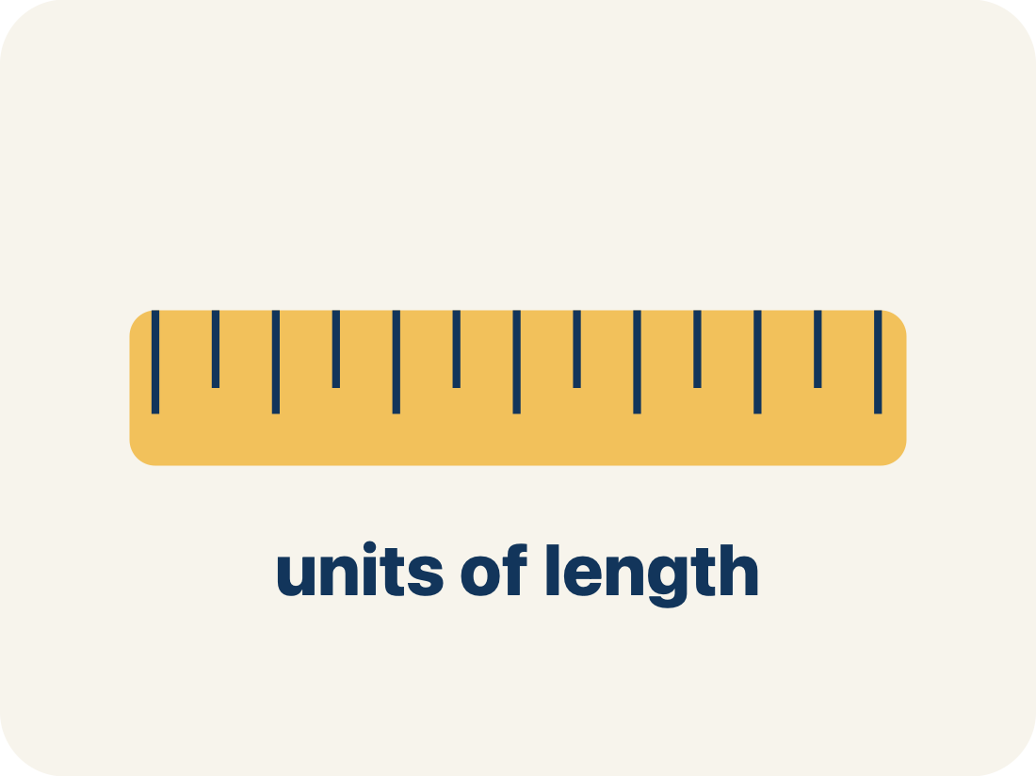
Vocabulary 1 of 6
Lesson 3-7 · Ratio Reasoning: Convert Measurements Between Systems
Convert Measurements Between Systems
Rewriting a customary measurement as a metric one, or the reverse, so two amounts can be compared.
EXAMPLE · EXPLAIN WHY IT FITS
100 kilometers ≈ 60 miles
USE THE MATH WORDS · Use today’s math words in your explanation — not “it” and “that thing.”
eduwonderlab.com · Neft Teacher
4 / 41
Notes:
TEACH IN PRACTICE | Embedded facilitation | Lesson 3.7, slide 4 | VOCAB
Focus on the existing task: Vocabulary 1 of 6 Convert…
ASK (T1/3/5): Where does “Convert Measurements Between Systems” appear in the example? Explain the meaning without reading the definition. Partner: restate the idea and ask a clarifying question.
LOOK FOR: A correct connection between the word and a feature of the example. If the student only repeats the definition, invite pointing, sketching or oral rehearsal, then ask for another explanation of this same example.
PARTICIPATION (T5/6/7): Think time before volunteers; accept a written, drawn or rehearsed entry. Students ask for evidence respectfully. Recognize a specific contribution or revision and check that both partners participate.
Source: BCPS Updated Instructional Framework Rubric (June 2020), TEACH 1–7.

Slide 5
Vocabulary 2 of 6
Lesson 3-7 · Ratio Reasoning: Convert Measurements Between Systems
Conversion factor
The ratio that links a unit in one system to a unit in the other, such as 1 mile to about 1.609 kilometers.
EXAMPLE · EXPLAIN WHY IT FITS
1 lb ≈ 0.45 kg · 1 in ≈ 2.54 cm
ADD ON · Add on: “I agree because ______.” or “I see it differently because ______.”
eduwonderlab.com · Neft Teacher
5 / 41
Notes:
TEACH IN PRACTICE | Embedded facilitation | Lesson 3.7, slide 5 | VOCAB
Focus on the existing task: Vocabulary 2 of 6 Conversion factor…
ASK (T1/3/5): Where does “Conversion factor” appear in the example? Explain the meaning without reading the definition. Partner: restate the idea and ask a clarifying question.
LOOK FOR: A correct connection between the word and a feature of the example. If the student only repeats the definition, invite pointing, sketching or oral rehearsal, then ask for another explanation of this same example.
PARTICIPATION (T5/6/7): Think time before volunteers; accept a written, drawn or rehearsed entry. Students ask for evidence respectfully. Recognize a specific contribution or revision and check that both partners participate.
Source: BCPS Updated Instructional Framework Rubric (June 2020), TEACH 1–7.

Slide 6
Vocabulary 3 of 6
Lesson 3-7 · Ratio Reasoning: Convert Measurements Between Systems
Customary system
The measurement system used in the United States: inches, feet, miles, ounces, pounds, cups, quarts, gallons.
EXAMPLE · EXPLAIN WHY IT FITS
in · ft · mi · oz · lb · qt · gal
TAKE TURNS · One explains, one asks a question. Then switch, so both of you talk.
eduwonderlab.com · Neft Teacher
6 / 41
Notes:
TEACH IN PRACTICE | Embedded facilitation | Lesson 3.7, slide 6 | VOCAB
Focus on the existing task: Vocabulary 3 of 6 Customary system…
ASK (T1/3/5): Where does “Customary system” appear in the example? Explain the meaning without reading the definition. Partner: restate the idea and ask a clarifying question.
LOOK FOR: A correct connection between the word and a feature of the example. If the student only repeats the definition, invite pointing, sketching or oral rehearsal, then ask for another explanation of this same example.
PARTICIPATION (T5/6/7): Think time before volunteers; accept a written, drawn or rehearsed entry. Students ask for evidence respectfully. Recognize a specific contribution or revision and check that both partners participate.
Source: BCPS Updated Instructional Framework Rubric (June 2020), TEACH 1–7.

Slide 7
Vocabulary 4 of 6
Lesson 3-7 · Ratio Reasoning: Convert Measurements Between Systems
Metric system
The measurement system used in most of the world, built on tens: centimeters, meters, kilometers, grams, kilograms, liters.
EXAMPLE · EXPLAIN WHY IT FITS
cm · m · km · g · kg · mL · L
Use “Metric system” to explain
the example. Point to evidence.
eduwonderlab.com · Neft Teacher
7 / 41
Notes:
TEACH IN PRACTICE | Embedded facilitation | Lesson 3.7, slide 7 | VOCAB
Focus on the existing task: Vocabulary 4 of 6 Metric system The…
ASK (T1/3/5): Where does “Metric system” appear in the example? Explain the meaning without reading the definition. Partner: restate the idea and ask a clarifying question.
LOOK FOR: A correct connection between the word and a feature of the example. If the student only repeats the definition, invite pointing, sketching or oral rehearsal, then ask for another explanation of this same example.
PARTICIPATION (T5/6/7): Think time before volunteers; accept a written, drawn or rehearsed entry. Students ask for evidence respectfully. Recognize a specific contribution or revision and check that both partners participate.
Source: BCPS Updated Instructional Framework Rubric (June 2020), TEACH 1–7.

Slide 8
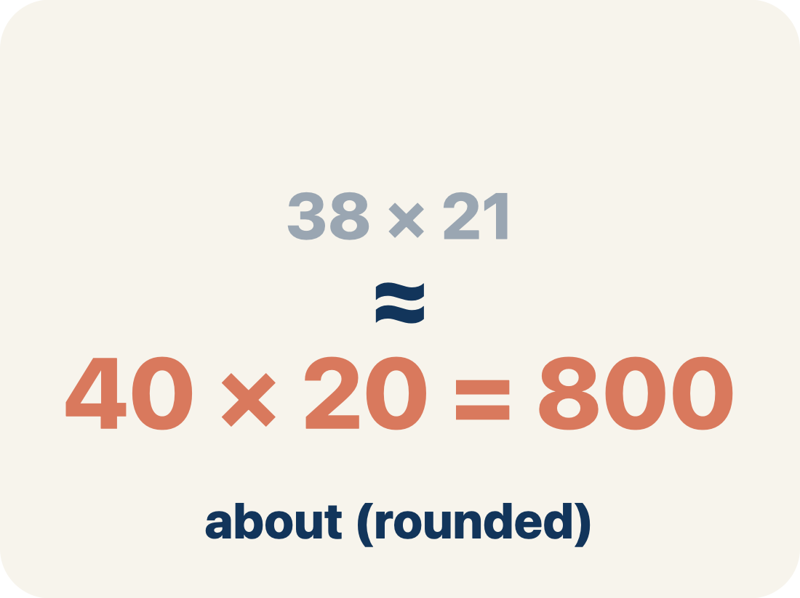
Vocabulary 5 of 6
Lesson 3-7 · Ratio Reasoning: Convert Measurements Between Systems
Approximately
Close to, but not exactly equal. Conversions between systems are almost always approximate, so they use the ≈ sign.
EXAMPLE · EXPLAIN WHY IT FITS
1 km ≈ 0.6 mi, not exactly 0.6
Use “Approximately” to explain
the example. Point to evidence.
eduwonderlab.com · Neft Teacher
8 / 41
Notes:
TEACH IN PRACTICE | Embedded facilitation | Lesson 3.7, slide 8 | VOCAB
Focus on the existing task: Vocabulary 5 of 6 Approximately…
ASK (T1/3/5): Where does “Approximately” appear in the example? Explain the meaning without reading the definition. Partner: restate the idea and ask a clarifying question.
LOOK FOR: A correct connection between the word and a feature of the example. If the student only repeats the definition, invite pointing, sketching or oral rehearsal, then ask for another explanation of this same example.
PARTICIPATION (T5/6/7): Think time before volunteers; accept a written, drawn or rehearsed entry. Students ask for evidence respectfully. Recognize a specific contribution or revision and check that both partners participate.
Source: BCPS Updated Instructional Framework Rubric (June 2020), TEACH 1–7.

Slide 9
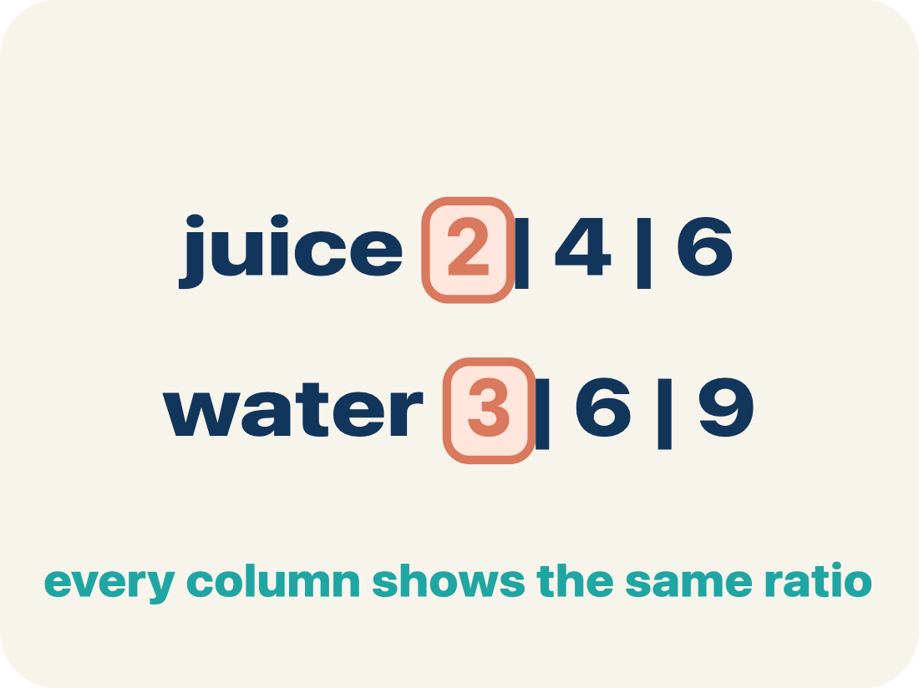
Vocabulary 6 of 6
Lesson 3-7 · Ratio Reasoning: Convert Measurements Between Systems
Ratio table
A table of equal ratios used to scale a conversion factor up to the amount you actually need.
EXAMPLE · EXPLAIN WHY IT FITS
km: 1, 10, 100 · mi: 0.6, 6, 60
Use “Ratio table” to explain the example. Point to evidence.
eduwonderlab.com · Neft Teacher
9 / 41
Notes:
TEACH IN PRACTICE | Embedded facilitation | Lesson 3.7, slide 9 | VOCAB
Focus on the existing task: Vocabulary 6 of 6 Ratio table A…
ASK (T1/3/5): Where does “Ratio table” appear in the example? Explain the meaning without reading the definition. Partner: restate the idea and ask a clarifying question.
LOOK FOR: A correct connection between the word and a feature of the example. If the student only repeats the definition, invite pointing, sketching or oral rehearsal, then ask for another explanation of this same example.
PARTICIPATION (T5/6/7): Think time before volunteers; accept a written, drawn or rehearsed entry. Students ask for evidence respectfully. Recognize a specific contribution or revision and check that both partners participate.
Source: BCPS Updated Instructional Framework Rubric (June 2020), TEACH 1–7.

Slide 10
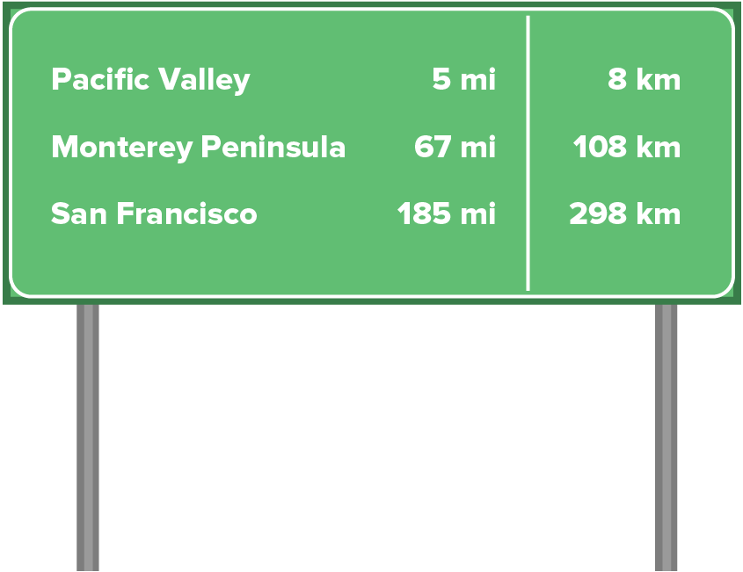

Be Curious
What do you notice?
What do you wonder?
Mindset
HOW DO YOU KNOW? · Ask your partner “How do you know?” Answer by pointing to your own work.
What strategies can you use to help you be more successful in math class?
10 / 41
Notes:
TEACH IN PRACTICE | Embedded facilitation | Lesson 3.7, slide 10 | CURIOUS
Focus on the existing task: Be Curious What do you notice?
LAUNCH (T2/3/5): Allow quiet observation first. Separate a notice from an inference, invite students’ own questions, and follow the existing launch before teaching a procedure.
LOOK FOR (T4): Where this task addresses it, students can use the stated cross-system factor. Ask which feature of their work supports the claim.
RESPOND: If this task shows the lesson misconception—treating a rounded conversion factor as exact—write the given conversion with its units and retain its stated precision. Have the student revise and explain the change. Use this support only where the concept occurs in the current task; otherwise respond to the displayed question.
RECHECK: If a gap is shared, revisit the existing representation together. If it is limited, give targeted support while others compare valid methods on the same task. Check the revision before moving on.
PARTICIPATION (T5/6/7): Think time before volunteers; accept a written, drawn or rehearsed entry. Students ask for evidence respectfully. Recognize a specific contribution or revision and check that both partners participate.
Source: BCPS Updated Instructional Framework Rubric (June 2020), TEACH 1–7.

Slide 11
STUDENT MOVE · ESTIMATE • DEFEND • COMPARE
Partner press: ask Why? and answer with evidence.
More or Less Than 5
Estimate first. Choose one expression and defend your estimate.
13.58 − 7.08
18.09 − 13.67
7.86 − 2.33
Think and record first. Which part of your work supports your answer?
EXPLAIN YOUR THINKING
“I think it is more/less than 5 because ___.” Compare strategies.
11 / 41
Notes:
TEACH IN PRACTICE | Embedded facilitation | Lesson 3.7, slide 11 | TASK
Focus on the existing task: More or Less Than 5 13.58 − 7.08 18.09 − 13.67 7.86 − 2.33 STUDENT MOVE · ESTIMATE • DEFEND • COMPARE Estimate first. Choose one…
LAUNCH (T2/3/5): Use the displayed question. Give private thinking time; then A explains while B asks for evidence. Switch roles. Each student records their own reasoning.
LOOK FOR (T4): Where this task addresses it, students can compare matching units. Ask which feature of their work supports the claim.
RESPOND: If this task shows the lesson misconception—treating a rounded conversion factor as exact—write the given conversion with its units and retain its stated precision. Have the student revise and explain the change. Use this support only where the concept occurs in the current task; otherwise respond to the displayed question.
RECHECK: If a gap is shared, revisit the existing representation together. If it is limited, give targeted support while others compare valid methods on the same task. Check the revision before moving on.
PARTICIPATION (T5/6/7): Think time before volunteers; accept a written, drawn or rehearsed entry. Students ask for evidence respectfully. Recognize a specific contribution or revision and check that both partners participate.
Source: BCPS Updated Instructional Framework Rubric (June 2020), TEACH 1–7. Earlier notes and answer keys are retained below.
EARLIER NOTES / EXISTING ANSWER KEY
Student move: Partner press: ask Why? and answer with evidence.
Routine: STUDENT MOVE · ESTIMATE • DEFEND • COMPARE
UIFR FULL | Lesson-specific facilitation
TEACH 2-3 | Session 1 task launch (UIFR PDF pp. 9-10).
Use the problem exactly as displayed. Give individual thinking time before discussion or advancing to the explanation. If the answer is already visible, ask students to reconstruct and justify it. Invite a choice of suitable representations and have students explain why their choice helps.
At the point where this concept appears, ask: “Where does the approximation enter your comparison, and how should that affect your explanation?” Wait for evidence, invite another pathway, and have a student ask a follow-up question. Do not replace students’ reasoning with a sequence of leading steps.

Slide 12
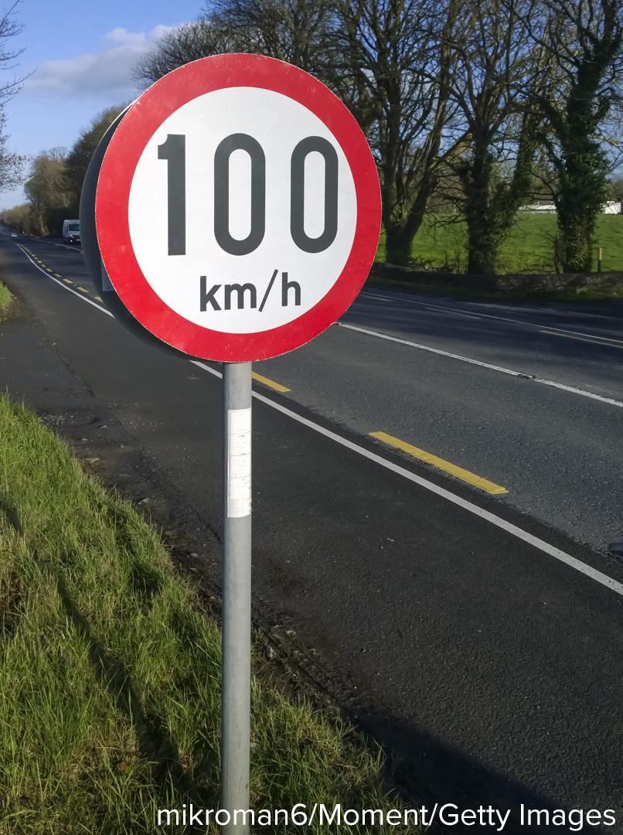
STUDENT MOVE · THINK → PARTNER TALK → EXPLAIN
Ask a partner a question; choose a model together.
Speed Limit
Evelyn is visiting family in Canada. She sees the sign shown on the highway and wonders whether the speed limit shown is faster or slower than 100 miles per hour.
How can Evelyn determine which is faster: 100 kilometers per hour or 100 miles per hour?
COMPARE FAIRLY
“Both numbers are 100, but the units differ. I need to convert ___ to ___.”
12 / 41
Notes:
TEACH IN PRACTICE | Embedded facilitation | Lesson 3.7, slide 12 | TASK
Focus on the existing task: Speed Limit Evelyn is visiting family in Canada. She sees the sign shown on the highway and wonders whether the speed limit shown is…
LAUNCH (T2/3/5): Use the displayed question. Give private thinking time; then A explains while B asks for evidence. Switch roles. Each student records their own reasoning.
LOOK FOR (T4): Where this task addresses it, students can compare matching units. Ask which feature of their work supports the claim.
RESPOND: If this task shows the lesson misconception—treating a rounded conversion factor as exact—write the given conversion with its units and retain its stated precision. Have the student revise and explain the change. Use this support only where the concept occurs in the current task; otherwise respond to the displayed question.
RECHECK: If a gap is shared, revisit the existing representation together. If it is limited, give targeted support while others compare valid methods on the same task. Check the revision before moving on.
PARTICIPATION (T5/6/7): Think time before volunteers; accept a written, drawn or rehearsed entry. Students ask for evidence respectfully. Recognize a specific contribution or revision and check that both partners participate.
Source: BCPS Updated Instructional Framework Rubric (June 2020), TEACH 1–7. Earlier notes and answer keys are retained below.
EARLIER NOTES / EXISTING ANSWER KEY
Student move: Ask a partner a question; choose a model together.
Routine: STUDENT MOVE · THINK → PARTNER TALK → EXPLAIN

Slide 13
STUDENT MOVE · SCALE • LABEL • EXPLAIN
Kilometers → Miles
Kilometers are metric units. Miles are customary units.
Kilometers | Miles (about)
1 | 0.6
Speed tells distance traveled per unit of time.
Use the approximate conversion factor: 1 kilometer ≈ 0.6 mile.
Explain how the information shown supports
your reasoning.
TALK TOOL
“The symbol ≈ means ___. This conversion is approximate because ___.”
13 / 41
Notes:
TEACH IN PRACTICE | Embedded facilitation | Lesson 3.7, slide 13 | WORKED
Focus on the existing task: Kilometers → Miles Kilometers are metric units. Miles are customary units. Speed tells distance traveled per unit of time. Use the…
LAUNCH (T2/3/5): Ask students to explain the displayed idea or example and point to evidence. When a calculation step is shown, ask why it is valid. Have a partner restate the explanation; copying is not the check.
LOOK FOR (T4): Where this task addresses it, students can use the stated cross-system factor. Ask which feature of their work supports the claim.
RESPOND: If this task shows the lesson misconception—treating a rounded conversion factor as exact—write the given conversion with its units and retain its stated precision. Have the student revise and explain the change. Use this support only where the concept occurs in the current task; otherwise respond to the displayed question.
RECHECK: If a gap is shared, revisit the existing representation together. If it is limited, give targeted support while others compare valid methods on the same task. Check the revision before moving on.
PARTICIPATION (T5/6/7): Think time before volunteers; accept a written, drawn or rehearsed entry. Students ask for evidence respectfully. Recognize a specific contribution or revision and check that both partners participate.
Source: BCPS Updated Instructional Framework Rubric (June 2020), TEACH 1–7. Earlier notes and answer keys are retained below.
EARLIER NOTES / EXISTING ANSWER KEY
Teach this step before assigning independent practice. Read the highlighted term and connect it to the example. Model the calculation, then ask students to explain why the same factor applies to both quantities. Give thinking time and invite a partner explanation. Source content: supplied McGraw Hill Unit 3 lesson presentation.

Slide 14
STUDENT MOVE · SCALE • LABEL • EXPLAIN
Student-led talk: paraphrase, agree or disagree, add on.
Compare in the Same Unit
Multiply both quantities by 100.
Kilometers | Miles (about)
1 | 0.6
10 | 6
100 | 60
100 kilometers is about 60 miles.
So 100 km/h is about 60 mi/h, which is slower than 100 mi/h.
Think and record first. Which part of your
work supports your answer?
TALK TOOL
“100 km/h is about ___ mi/h. I can compare them because the units ___.”
14 / 41
Notes:
TEACH IN PRACTICE | Embedded facilitation | Lesson 3.7, slide 14 | TASK
Focus on the existing task: Compare in the Same Unit Multiply both quantities by 100. 100 kilometers is about 60 miles. So 100 km/h is about 60 mi/h, which is slower…
LAUNCH (T2/3/5): Use the displayed question. Give private thinking time; then A explains while B asks for evidence. Switch roles. Each student records their own reasoning.
LOOK FOR (T4): Where this task addresses it, students can compare matching units. Ask which feature of their work supports the claim.
RESPOND: If this task shows the lesson misconception—treating a rounded conversion factor as exact—write the given conversion with its units and retain its stated precision. Have the student revise and explain the change. Use this support only where the concept occurs in the current task; otherwise respond to the displayed question.
RECHECK: If a gap is shared, revisit the existing representation together. If it is limited, give targeted support while others compare valid methods on the same task. Check the revision before moving on.
PARTICIPATION (T5/6/7): Think time before volunteers; accept a written, drawn or rehearsed entry. Students ask for evidence respectfully. Recognize a specific contribution or revision and check that both partners participate.
Source: BCPS Updated Instructional Framework Rubric (June 2020), TEACH 1–7. Earlier notes and answer keys are retained below.
EARLIER NOTES / EXISTING ANSWER KEY
Teach this step before assigning independent practice. Read the highlighted term and connect it to the example. Model the calculation, then ask students to explain why the same factor applies to both quantities. Give thinking time and invite a partner explanation. Source content: supplied McGraw Hill Unit 3 lesson presentation.

Slide 15
STUDENT MOVE · THINK → PARTNER TALK → EXPLAIN
Let’s Explore More
The ratio of kilometers to miles is about 1.61 : 1. Why is the ratio of kilometers to miles different from the ratio of miles to kilometers?
ORDER MATTERS
“Kilometers : miles is about 1.61 : 1. Reversing the order gives ___.”
One meter is about the same length as one yard. Knowing that one meter equals 100 centimeters and one yard equals 36 inches, what can you conclude about the ratio of centimeters to inches?
MAKE AN ESTIMATE
“Using 1 m ≈ 1 yd gives about 100 cm : 36 in. This is an estimate because ___.”
15 / 41
Notes:
TEACH IN PRACTICE | Embedded facilitation | Lesson 3.7, slide 15 | PRACTICE
Focus on the existing task: Let’s Explore More The ratio of kilometers to miles is about 1.61: 1. Why is the ratio of kilometers to miles different from the ratio of miles to kilometers?
LAUNCH (T2/3/5): Use the displayed question. Give private thinking time; then A explains while B asks for evidence. Switch roles. Each student records their own reasoning.
LOOK FOR (T4): Where this task addresses it, students can use the stated cross-system factor. Ask which feature of their work supports the claim.
RESPOND: If this task shows the lesson misconception—treating a rounded conversion factor as exact—write the given conversion with its units and retain its stated precision. Have the student revise and explain the change. Use this support only where the concept occurs in the current task; otherwise respond to the displayed question.
RECHECK: If a gap is shared, revisit the existing representation together. If it is limited, give targeted support while others compare valid methods on the same task. Check the revision before moving on.
PARTICIPATION (T5/6/7): Think time before volunteers; accept a written, drawn or rehearsed entry. Students ask for evidence respectfully. Recognize a specific contribution or revision and check that both partners participate.
Source: BCPS Updated Instructional Framework Rubric (June 2020), TEACH 1–7. Earlier notes and answer keys are retained below.
EARLIER NOTES / EXISTING ANSWER KEY
Routine: STUDENT MOVE · THINK → PARTNER TALK → EXPLAIN
UIFR FULL | Lesson-specific facilitation
TEACH 4-5 | Session 1 discussion and checkpoint (UIFR PDF pp. 11-12).
Collect a brief response from every student to the existing prompt before hearing volunteers. Partners take turns explaining and asking for evidence: “I understand ___; what supports ___?” Offer rehearsal or an annotated model for students who need language support. Each student records their own reasoning.
Look specifically for: treating a rounded conversion factor as exact. If it appears, write the given conversion with its units and retain its stated precision; then ask the student to revise the same response and explain the change. If evidence is secure, have students compare a second valid pathway or state why their approach works. Choose the next step from the responses, not a preset pace.

Slide 16
STUDENT MOVES
Lesson 3-7
Your move
STRUGGLE FIRST · Work on your own first. Stuck is allowed — try a second strategy before you ask.
16 / 41

Slide 17
LESSON 3.7 / DISCUSS THE TASK
Explain and compare
Use the task you just explored.
TAKE TURNS
Where does the approximation enter your comparison, and how should that affect your explanation?
Explain
“I know this because…”
Ask
“Where does your work show that?”
Point to evidence in your work.
Then compare your approach with a partner’s.
JUSTIFY IT · Say it like this: “I know ______ because ______.”
Listen to understand. Ask for evidence. Make room for every voice.
Notes:
TEACH IN PRACTICE | Embedded facilitation | Lesson 3.7, slide 16 | PRIOR_INSERT
Focus on the existing task: Point to evidence in your work. Then compare your approach with a partner’s. TAKE TURNS Explain “I know this because…” Ask “Where does your work show that?
CONNECT (T1/4): Ask students to restate the displayed goal or key idea and connect it to earlier work. Relevant lesson evidence: use the stated cross-system factor; compare matching units; identify approximate results. Use only the criterion that matches the current session.
SHOW PROGRESS: Students point to their own existing work, explain what improved after feedback, and name a next step. Pair confidence ratings with actual evidence.
PARTICIPATION (T5/6/7): Think time before volunteers; accept a written, drawn or rehearsed entry. Students ask for evidence respectfully. Recognize a specific contribution or revision and check that both partners participate.
Source: BCPS Updated Instructional Framework Rubric (June 2020), TEACH 1–7.

Slide 18
FORMATIVE CHECK · SOLO → CHECK → REVISE
Defend your method; partner gives one specific next step.
60-Second Check
Work independently first. Your response tells us what to do next.
USE THIS CONVERSION FACT
1 kilometer ≈ 0.6 mile. A route is 20 kilometers.
1 — CONVERT
2 — EXPLAIN + PROVE
3 — SELF-MONITOR
About how many miles long is the route? Show a ratio table or equation.
Why is the result approximate? Explain what the ≈ sign tells us.
Circle one:
READY — I can explain it.
ALMOST — I need one hint.
NOT YET — I need a model.
Partner feedback: Ask “How do you know?” The solver may clarify or revise before sharing.
18 / 41
Notes:
TEACH IN PRACTICE | Embedded facilitation | Lesson 3.7, slide 17 | TASK
Focus on the existing task: Show a ratio table or equation. 2 — EXPLAIN + PROVE Why is the result approximate?
LAUNCH (T2/3/5): Use the displayed question. Give private thinking time; then A explains while B asks for evidence. Switch roles. Each student records their own reasoning.
LOOK FOR (T4): Where this task addresses it, students can identify approximate results. Ask which feature of their work supports the claim.
RESPOND: If this task shows the lesson misconception—treating a rounded conversion factor as exact—write the given conversion with its units and retain its stated precision. Have the student revise and explain the change. Use this support only where the concept occurs in the current task; otherwise respond to the displayed question.
RECHECK: If a gap is shared, revisit the existing representation together. If it is limited, give targeted support while others compare valid methods on the same task. Check the revision before moving on.
PARTICIPATION (T5/6/7): Think time before volunteers; accept a written, drawn or rehearsed entry. Students ask for evidence respectfully. Recognize a specific contribution or revision and check that both partners participate.
Source: BCPS Updated Instructional Framework Rubric (June 2020), TEACH 1–7. Earlier notes and answer keys are retained below.
EARLIER NOTES / EXISTING ANSWER KEY
Answer: About 12 miles; 20 × 0.6. The conversion factor is rounded. Give quiet thinking time before sharing. If a student is stuck, point back to the relevant worked model without doing the task for them. Give specific feedback, then allow a correction.

Slide 19
Evelyn is visiting family in Canada. She sees the sign shown on the highway and wonders whether 100 kilometers per hour is faster or slower than 100 miles per hour.
How can Evelyn determine which is faster: 100 kilometers per hour or 100 miles per hour?
What quantities are in the problem?
Reveal:
Miles per hour and kilometers per hour.
19 / 41
Notes:
TEACH IN PRACTICE | Embedded facilitation | Lesson 3.7, slide 18 | REVEAL
Focus on the existing task: What quantities are in the problem?
LAUNCH (T2/3/5): If an existing answer cover is present, gather an attempt before revealing. If the explanation is already visible, ask students to reconstruct and justify it. Compare reasoning and explain a revision; preserve the reveal sequence.
LOOK FOR (T4): Where this task addresses it, students can use the stated cross-system factor. Ask which feature of their work supports the claim.
RESPOND: If this task shows the lesson misconception—treating a rounded conversion factor as exact—write the given conversion with its units and retain its stated precision. Have the student revise and explain the change. Use this support only where the concept occurs in the current task; otherwise respond to the displayed question.
RECHECK: If a gap is shared, revisit the existing representation together. If it is limited, give targeted support while others compare valid methods on the same task. Check the revision before moving on.
PARTICIPATION (T5/6/7): Think time before volunteers; accept a written, drawn or rehearsed entry. Students ask for evidence respectfully. Recognize a specific contribution or revision and check that both partners participate.
Source: BCPS Updated Instructional Framework Rubric (June 2020), TEACH 1–7.

Slide 20
STUDENT MOVES
Lesson 3-7
Your move
USE YOUR TOOLS · Reach for your notes, a model, or a manipulative before you reach for an answer.
20 / 41

Slide 21
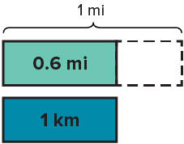
Kilometers and miles are both measures of distance. We can compare kilometers and miles.
1 kilometer is about 0.6 mile.
Compare your reasoning with the
explanation. Explain any revision you make.
How can you represent this relationship as a ratio of kilometers to miles?
Reveal:
1 : 0.6
21 / 41
Notes:
TEACH IN PRACTICE | Embedded facilitation | Lesson 3.7, slide 19 | REVEAL
Focus on the existing task: Kilometers and miles are both measures of distance. We can compare kilometers and miles. 1 kilometer is about 0.6 mile. How can you represent this relationship as a ratio of kilometers to miles?
LAUNCH (T2/3/5): If an existing answer cover is present, gather an attempt before revealing. If the explanation is already visible, ask students to reconstruct and justify it. Compare reasoning and explain a revision; preserve the reveal sequence.
LOOK FOR (T4): Where this task addresses it, students can compare matching units. Ask which feature of their work supports the claim.
RESPOND: If this task shows the lesson misconception—treating a rounded conversion factor as exact—write the given conversion with its units and retain its stated precision. Have the student revise and explain the change. Use this support only where the concept occurs in the current task; otherwise respond to the displayed question.
RECHECK: If a gap is shared, revisit the existing representation together. If it is limited, give targeted support while others compare valid methods on the same task. Check the revision before moving on.
PARTICIPATION (T5/6/7): Think time before volunteers; accept a written, drawn or rehearsed entry. Students ask for evidence respectfully. Recognize a specific contribution or revision and check that both partners participate.
Source: BCPS Updated Instructional Framework Rubric (June 2020), TEACH 1–7.

Slide 22
How can you complete the table of equivalent ratios to compare miles to 10 kilometers? to 100 kilometers?
PICK YOUR STRATEGY · Choose your path — picture, table, number line, or equation — and be ready to say why you chose it.
Kilometers | 1 | 10 | 100
Miles | 0.6
Reveal:
We can multiply the unit ratio by 10 and 100 to determine how many miles are in 10 and 100 kilometers.
22 / 41
Notes:
TEACH IN PRACTICE | Embedded facilitation | Lesson 3.7, slide 20 | REVEAL
Focus on the existing task: Kilometers 1 10 100 Miles 0.6 How can you complete the table of equivalent ratios to compare miles to 10 kilometers?
LAUNCH (T2/3/5): If an existing answer cover is present, gather an attempt before revealing. If the explanation is already visible, ask students to reconstruct and justify it. Compare reasoning and explain a revision; preserve the reveal sequence.
LOOK FOR (T4): Where this task addresses it, students can compare matching units. Ask which feature of their work supports the claim.
RESPOND: If this task shows the lesson misconception—treating a rounded conversion factor as exact—write the given conversion with its units and retain its stated precision. Have the student revise and explain the change. Use this support only where the concept occurs in the current task; otherwise respond to the displayed question.
RECHECK: If a gap is shared, revisit the existing representation together. If it is limited, give targeted support while others compare valid methods on the same task. Check the revision before moving on.
PARTICIPATION (T5/6/7): Think time before volunteers; accept a written, drawn or rehearsed entry. Students ask for evidence respectfully. Recognize a specific contribution or revision and check that both partners participate.
Source: BCPS Updated Instructional Framework Rubric (June 2020), TEACH 1–7.

Slide 23
WARM-UP · THINK • TRY • CHECK
Turn and talk: compare strategies, then defend one.
Session 2 Warm-Up
Lesson 3-7 · Converting Between Systems | Session 2 Warm-Up · about 4 minutes
Try each on your own. Mark an unsure answer; explain and revise when we check.
QUESTION 1
QUESTION 2
1 kilometer ≈ 0.6 mile
10 kilometers ≈ ______ miles
1 pound ≈ 0.45 kilogram
20 pounds ≈ ______ kilograms
QUESTION 3
QUESTION 4
Why do we use ≈ instead of = with a rounded conversion factor?
Which is greater: 1 kilogram or 1 pound? ______
TALK IT OVER: “I got ______ because ______.” • Compare with a partner before we check as a class.
23 / 41
Notes:
TEACH IN PRACTICE | Embedded facilitation | Lesson 3.7, slide 21 | WARMUP
Focus on the existing task: QUESTION 4 Which is greater: 1 kilogram or 1 pound?
GATHER EVIDENCE (T4/6): Keep the original items. Students try independently, mark an uncertain item, and explain one method before checking. Use the existing key when present.
RESPOND: Distinguish a calculation slip from a reasoning gap. Give one next step on the same item; have students revise in a second color. Use the responses to choose flexible support for today’s lesson.
PARTICIPATION (T5/6/7): Think time before volunteers; accept a written, drawn or rehearsed entry. Students ask for evidence respectfully. Recognize a specific contribution or revision and check that both partners participate.
Source: BCPS Updated Instructional Framework Rubric (June 2020), TEACH 1–7. Earlier notes and answer keys are retained below.
EARLIER NOTES / EXISTING ANSWER KEY
Warm-up routine: students start silently on entry; keep it to about 4 minutes.
Circulate and note who is stuck — use what you see to choose who you check on first today.
Go over answers quickly; ask one student to explain a step, not just say the answer.
UIFR: TEACH 4 · TEACH 6.

Slide 24
REVIEW NOTES · RECALL • CONNECT • APPLY
Partner check: explain one idea without looking.
Review Notes — Session 2
Review the key ideas before Session 2.
COPY THESE 3 LINES
LOOK BACK AT THE EXAMPLE
01
A conversion factor links two measurement units.
Kilometers | Miles (about)
1 | 0.6
10 | 6
100 | 60
02
Scale both quantities by the same number.
03
Use ≈ when the conversion factor is rounded.
100 km/h ≈ 60 mi/h, so it is slower than 100 mi/h.
EXPLAIN THE CONNECTION
“I used ≈ because ___. Both quantities were multiplied by ___.”
24 / 41
Notes:
TEACH IN PRACTICE | Embedded facilitation | Lesson 3.7, slide 22 | NOTES
Focus on the existing task: Review Notes — Session 2 Review the key ideas before Session 2. COPY THESE 3 LINES 01 A conversion factor links two measurement units.…
ROUTINE (T1/2/4): Read or copy the original notes, cover one line, and explain it using the displayed example. Reopen and correct. Copying alone is not evidence of understanding.
LOOK FOR: A link between a symbol, quantity or feature and the explanation. If missing, point back to that feature and have the student try again; fade the prompt once they can explain.
PARTICIPATION (T5/6/7): Think time before volunteers; accept a written, drawn or rehearsed entry. Students ask for evidence respectfully. Recognize a specific contribution or revision and check that both partners participate.
Source: BCPS Updated Instructional Framework Rubric (June 2020), TEACH 1–7. Earlier notes and answer keys are retained below.
EARLIER NOTES / EXISTING ANSWER KEY
Copy routine: read one line at a time; students copy, then explain that line to a partner.
Keep it brisk — the understanding work happens in the examples, not the copying.
UIFR: TEACH 1 · TEACH 6.

Slide 25
LEARNING TARGET · CONVERT • COMPARE • EXPLAIN
Tell a partner the new goal and how you will show it.
Learning Target — Session 2
Lesson 3-7 · Converting Between Systems | Maryland Standard 6.AT.3
Today I will convert to matching units and explain what the result means.
CONTENT OBJECTIVE
LANGUAGE OBJECTIVE
I can use ratio reasoning to convert pounds to kilograms.
I can explain why a rounded conversion factor gives an approximate answer.
SUCCESS CHECK
WHY THIS MATTERS
✓ Scale the pounds and kilograms together.
✓ Label the converted amount.
✓ Explain how the result answers the question.
Converting units helps us understand measurements used in different places.
MATH COMMUNITY: Different strategies are welcome • Ask before telling • Revising your thinking is part of learning
25 / 41
Notes:
TEACH IN PRACTICE | Embedded facilitation | Lesson 3.7, slide 23 | GOAL
Focus on the existing task: Learning Target — Session 2 | Maryland Standard 6.AT.3 LEARNING TARGET · CONVERT • COMPARE…
CONNECT (T1/4): Ask students to restate the displayed goal or key idea and connect it to earlier work. Relevant lesson evidence: use the stated cross-system factor; compare matching units; identify approximate results. Use only the criterion that matches the current session.
SHOW PROGRESS: Students point to their own existing work, explain what improved after feedback, and name a next step. Pair confidence ratings with actual evidence.
PARTICIPATION (T5/6/7): Think time before volunteers; accept a written, drawn or rehearsed entry. Students ask for evidence respectfully. Recognize a specific contribution or revision and check that both partners participate.
Source: BCPS Updated Instructional Framework Rubric (June 2020), TEACH 1–7. Earlier notes and answer keys are retained below.
EARLIER NOTES / EXISTING ANSWER KEY
Name today’s content and language goals. Briefly read the success criteria; do not teach procedures here. The original context and model follow. Return to these criteria after the worked example.
UIFR FULL | Lesson-specific facilitation
TEACH 1 | Session 2 purpose and evidence (UIFR PDF p. 8).
Have students restate the displayed session goal in their own words and connect it to the existing context or a familiar experience they choose to share. Use the current session goal to select from these lesson-wide evidence criteria; do not frontload a later-session procedure.
Look for: use the stated cross-system factor; compare matching units; identify approximate results. Ask: “Which part of your work would show this?” Revisit that evidence after the task; a confidence rating alone is not evidence of understanding.

Slide 26
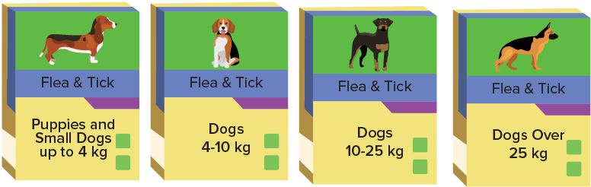
Be Curious
What do you notice?
What do you wonder?
Think first. Share a notice and a question;
build on a classmate’s idea.
Mindset
What strategies are you using to help you be more successful in math class?
26 / 41
Notes:
TEACH IN PRACTICE | Embedded facilitation | Lesson 3.7, slide 24 | CURIOUS
Focus on the existing task: Be Curious What do you notice?
LAUNCH (T2/3/5): Allow quiet observation first. Separate a notice from an inference, invite students’ own questions, and follow the existing launch before teaching a procedure.
LOOK FOR (T4): Where this task addresses it, students can use the stated cross-system factor. Ask which feature of their work supports the claim.
RESPOND: If this task shows the lesson misconception—treating a rounded conversion factor as exact—write the given conversion with its units and retain its stated precision. Have the student revise and explain the change. Use this support only where the concept occurs in the current task; otherwise respond to the displayed question.
RECHECK: If a gap is shared, revisit the existing representation together. If it is limited, give targeted support while others compare valid methods on the same task. Check the revision before moving on.
PARTICIPATION (T5/6/7): Think time before volunteers; accept a written, drawn or rehearsed entry. Students ask for evidence respectfully. Recognize a specific contribution or revision and check that both partners participate.
Source: BCPS Updated Instructional Framework Rubric (June 2020), TEACH 1–7.

Slide 27
STUDENT MOVE · THINK → PARTNER TALK → EXPLAIN
Compare strategies; defend one with evidence.
Veterinary Medicine
Terrance is helping at a veterinarian’s office. A customer needs flea treatment for her dog that weighs 31 pounds. The flea treatment comes in four packages shown.
PLAN YOUR COMPARISON
“The dog is measured in ___. The packages use ___. First I will ___.”
What package should Terrance give the customer?
27 / 41
Notes:
TEACH IN PRACTICE | Embedded facilitation | Lesson 3.7, slide 25 | TASK
Focus on the existing task: Veterinary Medicine Terrance is helping at a veterinarian’s office. A customer needs flea treatment for her dog that weighs 31 pounds. The…
LAUNCH (T2/3/5): Use the displayed question. Give private thinking time; then A explains while B asks for evidence. Switch roles. Each student records their own reasoning.
LOOK FOR (T4): Where this task addresses it, students can compare matching units. Ask which feature of their work supports the claim.
RESPOND: If this task shows the lesson misconception—treating a rounded conversion factor as exact—write the given conversion with its units and retain its stated precision. Have the student revise and explain the change. Use this support only where the concept occurs in the current task; otherwise respond to the displayed question.
RECHECK: If a gap is shared, revisit the existing representation together. If it is limited, give targeted support while others compare valid methods on the same task. Check the revision before moving on.
PARTICIPATION (T5/6/7): Think time before volunteers; accept a written, drawn or rehearsed entry. Students ask for evidence respectfully. Recognize a specific contribution or revision and check that both partners participate.
Source: BCPS Updated Instructional Framework Rubric (June 2020), TEACH 1–7. Earlier notes and answer keys are retained below.
EARLIER NOTES / EXISTING ANSWER KEY
Student move: Compare strategies; defend one with evidence.
Routine: STUDENT MOVE · THINK → PARTNER TALK → EXPLAIN
UIFR FULL | Lesson-specific facilitation
TEACH 2-3 | Session 2 task launch (UIFR PDF pp. 9-10).
Use the problem exactly as displayed. Give individual thinking time before discussion or advancing to the explanation. If the answer is already visible, ask students to reconstruct and justify it. Invite a choice of suitable representations and have students explain why their choice helps.
At the point where this concept appears, ask: “Where does the approximation enter your comparison, and how should that affect your explanation?” Wait for evidence, invite another pathway, and have a student ask a follow-up question. Do not replace students’ reasoning with a sequence of leading steps.

Slide 28
STUDENT MOVE · SCALE • LABEL • EXPLAIN
Pounds → Kilograms
The dog’s weight is 31 pounds. The packages use kilograms.
Pounds | Kilograms (about)
1 | 0.45
Pounds are customary units. Kilograms are metric units.
Use the approximate conversion factor: 1 pound ≈ 0.45 kilogram.
Explain how the information shown supports
your reasoning.
TALK TOOL
“I need kilograms because ___. I will multiply both quantities by ___.”
28 / 41
Notes:
TEACH IN PRACTICE | Embedded facilitation | Lesson 3.7, slide 26 | WORKED
Focus on the existing task: Pounds → Kilograms The dog’s weight is 31 pounds. The packages use kilograms. Pounds are customary units. Kilograms are metric units.…
LAUNCH (T2/3/5): Ask students to explain the displayed idea or example and point to evidence. When a calculation step is shown, ask why it is valid. Have a partner restate the explanation; copying is not the check.
LOOK FOR (T4): Where this task addresses it, students can use the stated cross-system factor. Ask which feature of their work supports the claim.
RESPOND: If this task shows the lesson misconception—treating a rounded conversion factor as exact—write the given conversion with its units and retain its stated precision. Have the student revise and explain the change. Use this support only where the concept occurs in the current task; otherwise respond to the displayed question.
RECHECK: If a gap is shared, revisit the existing representation together. If it is limited, give targeted support while others compare valid methods on the same task. Check the revision before moving on.
PARTICIPATION (T5/6/7): Think time before volunteers; accept a written, drawn or rehearsed entry. Students ask for evidence respectfully. Recognize a specific contribution or revision and check that both partners participate.
Source: BCPS Updated Instructional Framework Rubric (June 2020), TEACH 1–7. Earlier notes and answer keys are retained below.
EARLIER NOTES / EXISTING ANSWER KEY
Teach this step before assigning independent practice. Read the highlighted term and connect it to the example. Model the calculation, then ask students to explain why the same factor applies to both quantities. Give thinking time and invite a partner explanation. Source content: supplied McGraw Hill Unit 3 lesson presentation.

Slide 29
STUDENT MOVE · SCALE • LABEL • EXPLAIN
Match the Weight to the Range
Multiply: 31 × 0.45 = 13.95.
Pounds | Kilograms (about)
1 | 0.45
30 | 13.5
31 | 13.95
31 pounds is about 14 kilograms.
That weight falls in the package range from 10 to 25 kilograms.
Explain how the information shown supports
your reasoning.
TALK TOOL
“About 14 kg is between ___ and ___, so it matches that package range.”
29 / 41
Notes:
TEACH IN PRACTICE | Embedded facilitation | Lesson 3.7, slide 27 | WORKED
Focus on the existing task: Match the Weight to the Range Multiply: 31 × 0.45 = 13.95. 31 pounds is about 14 kilograms. That weight falls in the package range from 10…
LAUNCH (T2/3/5): Ask students to explain the displayed idea or example and point to evidence. When a calculation step is shown, ask why it is valid. Have a partner restate the explanation; copying is not the check.
LOOK FOR (T4): Where this task addresses it, students can use the stated cross-system factor. Ask which feature of their work supports the claim.
RESPOND: If this task shows the lesson misconception—treating a rounded conversion factor as exact—write the given conversion with its units and retain its stated precision. Have the student revise and explain the change. Use this support only where the concept occurs in the current task; otherwise respond to the displayed question.
RECHECK: If a gap is shared, revisit the existing representation together. If it is limited, give targeted support while others compare valid methods on the same task. Check the revision before moving on.
PARTICIPATION (T5/6/7): Think time before volunteers; accept a written, drawn or rehearsed entry. Students ask for evidence respectfully. Recognize a specific contribution or revision and check that both partners participate.
Source: BCPS Updated Instructional Framework Rubric (June 2020), TEACH 1–7. Earlier notes and answer keys are retained below.
EARLIER NOTES / EXISTING ANSWER KEY
Teach this step before assigning independent practice. Read the highlighted term and connect it to the example. Model the calculation, then ask students to explain why the same factor applies to both quantities. Give thinking time and invite a partner explanation. Source content: supplied McGraw Hill Unit 3 lesson presentation.

Slide 30
STUDENT NOTES · COPY LESS • UNDERSTAND MORE
Today’s Math Notes — Session 2
Keep the idea from Veterinary Medicine.
SAY THE GOAL · Say today’s goal in your own words, then name one place this shows up outside math class.
COPY THESE 3 LINES
LOOK BACK AT THE EXAMPLE
01
Convert to the unit used in the comparison.
Pounds | Kilograms (about)
1 | 0.45
30 | 13.5
31 | 13.95
02
Keep the units attached to each amount.
03
Check whether the approximate answer makes sense.
31 pounds is about 14 kilograms.
EXPLAIN THE CONNECTION
“I used ≈ because ___. Both quantities were multiplied by ___.”
30 / 41
Notes:
TEACH IN PRACTICE | Embedded facilitation | Lesson 3.7, slide 28 | NOTES
Focus on the existing task: Today’s Math Notes — Session 2 Keep the idea from Veterinary Medicine. COPY THESE 3 LINES 01 Convert to the unit used in the comparison.…
ROUTINE (T1/2/4): Read or copy the original notes, cover one line, and explain it using the displayed example. Reopen and correct. Copying alone is not evidence of understanding.
LOOK FOR: A link between a symbol, quantity or feature and the explanation. If missing, point back to that feature and have the student try again; fade the prompt once they can explain.
PARTICIPATION (T5/6/7): Think time before volunteers; accept a written, drawn or rehearsed entry. Students ask for evidence respectfully. Recognize a specific contribution or revision and check that both partners participate.
Source: BCPS Updated Instructional Framework Rubric (June 2020), TEACH 1–7. Earlier notes and answer keys are retained below.
EARLIER NOTES / EXISTING ANSWER KEY
Use this slide only after the original worked example. Students copy the three lines on the left; the table is a reference and does not need copying. Read one line at a time. Ask one student to connect a note to the example.

Slide 31
STUDENT MOVE · THINK → PARTNER TALK → EXPLAIN
Compare pathways with a partner; name one revision.
Let’s Explore More
What would you expect the ratio of kilograms to pounds to be?
REVERSE THE RATIO
“If 1 lb ≈ 0.45 kg, then kilograms : pounds is about ___ : ___.”
Knowing that kilograms are a greater unit than pounds, how can you explain why grams are a smaller unit than ounces?
REASON ABOUT UNIT SIZE
Use 1 kg = 1,000 g and 1 lb = 16 oz. Explain why the subdivisions change the comparison.
31 / 41
Notes:
TEACH IN PRACTICE | Embedded facilitation | Lesson 3.7, slide 29 | PRACTICE
Focus on the existing task: Let’s Explore More What would you expect the ratio of kilograms to pounds to be?
LAUNCH (T2/3/5): Use the displayed question. Give private thinking time; then A explains while B asks for evidence. Switch roles. Each student records their own reasoning.
LOOK FOR (T4): Where this task addresses it, students can compare matching units. Ask which feature of their work supports the claim.
RESPOND: If this task shows the lesson misconception—treating a rounded conversion factor as exact—write the given conversion with its units and retain its stated precision. Have the student revise and explain the change. Use this support only where the concept occurs in the current task; otherwise respond to the displayed question.
RECHECK: If a gap is shared, revisit the existing representation together. If it is limited, give targeted support while others compare valid methods on the same task. Check the revision before moving on.
PARTICIPATION (T5/6/7): Think time before volunteers; accept a written, drawn or rehearsed entry. Students ask for evidence respectfully. Recognize a specific contribution or revision and check that both partners participate.
Source: BCPS Updated Instructional Framework Rubric (June 2020), TEACH 1–7. Earlier notes and answer keys are retained below.
EARLIER NOTES / EXISTING ANSWER KEY
Student move: Compare pathways with a partner; name one revision.
Routine: STUDENT MOVE · THINK → PARTNER TALK → EXPLAIN
UIFR FULL | Lesson-specific facilitation
TEACH 4-5 | Session 2 discussion and checkpoint (UIFR PDF pp. 11-12).
Collect a brief response from every student to the existing prompt before hearing volunteers. Partners take turns explaining and asking for evidence: “I understand ___; what supports ___?” Offer rehearsal or an annotated model for students who need language support. Each student records their own reasoning.
Look specifically for: treating a rounded conversion factor as exact. If it appears, write the given conversion with its units and retain its stated precision; then ask the student to revise the same response and explain the change. If evidence is secure, have students compare a second valid pathway or state why their approach works. Choose the next step from the responses, not a preset pace.

Slide 32
LESSON 3.7 / CHECK YOUR WORK
Pause. Check. Improve.
CHECK
A mistake to watch for: treating a rounded conversion factor as exact.
TRY
Write the given conversion with its units and retain its stated precision.
REVISE
Use that check on the task you just completed. Correct or strengthen one part, and explain why.
SELF-CHECK · Mark it: ✓ got it · ~ almost · ? stuck. Then fix one thing before we move on.
Listen to understand. Ask for evidence. Make room for every voice.
Notes:
TEACH IN PRACTICE | Embedded facilitation | Lesson 3.7, slide 30 | PRIOR_INSERT
Focus on the existing task: LESSON 3.7 / CHECK YOUR WORK Pause. Check. Improve. Listen to understand. Ask for evidence. Make room for every voice. CHECK A mistake…
CONNECT (T1/4): Ask students to restate the displayed goal or key idea and connect it to earlier work. Relevant lesson evidence: use the stated cross-system factor; compare matching units; identify approximate results. Use only the criterion that matches the current session.
SHOW PROGRESS: Students point to their own existing work, explain what improved after feedback, and name a next step. Pair confidence ratings with actual evidence.
PARTICIPATION (T5/6/7): Think time before volunteers; accept a written, drawn or rehearsed entry. Students ask for evidence respectfully. Recognize a specific contribution or revision and check that both partners participate.
Source: BCPS Updated Instructional Framework Rubric (June 2020), TEACH 1–7.

Slide 33
Kilograms are metric units and pounds are customary units.
How can you compare 31 pounds to the units on the packages?
Reveal:
I can convert 31 pounds to kilograms to compare it to the packages.
33 / 41
Notes:
TEACH IN PRACTICE | Embedded facilitation | Lesson 3.7, slide 31 | REVEAL
Focus on the existing task: Kilograms are metric units and pounds are customary units. How can you compare 31 pounds to the units on the packages?
LAUNCH (T2/3/5): If an existing answer cover is present, gather an attempt before revealing. If the explanation is already visible, ask students to reconstruct and justify it. Compare reasoning and explain a revision; preserve the reveal sequence.
LOOK FOR (T4): Where this task addresses it, students can compare matching units. Ask which feature of their work supports the claim.
RESPOND: If this task shows the lesson misconception—treating a rounded conversion factor as exact—write the given conversion with its units and retain its stated precision. Have the student revise and explain the change. Use this support only where the concept occurs in the current task; otherwise respond to the displayed question.
RECHECK: If a gap is shared, revisit the existing representation together. If it is limited, give targeted support while others compare valid methods on the same task. Check the revision before moving on.
PARTICIPATION (T5/6/7): Think time before volunteers; accept a written, drawn or rehearsed entry. Students ask for evidence respectfully. Recognize a specific contribution or revision and check that both partners participate.
Source: BCPS Updated Instructional Framework Rubric (June 2020), TEACH 1–7.

Slide 34
STUDENT MOVES
Lesson 3-7
Your move
ANOTHER PATHWAY · Did anyone get there a different way? Put both pathways side by side and compare.
34 / 41

Slide 35
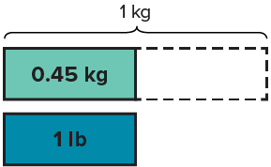
One pound is approximately 0.45 kilograms.
Compare your reasoning with the explanation. Explain any
revision you make.
How can you represent this relationship as a ratio of pounds to kilograms?
Reveal:
The ratio of pounds to kilograms is about 1 : 0.45.
35 / 41
Notes:
TEACH IN PRACTICE | Embedded facilitation | Lesson 3.7, slide 32 | REVEAL
Focus on the existing task: One pound is approximately 0.45 kilograms. How can you represent this relationship as a ratio of pounds to kilograms?
LAUNCH (T2/3/5): If an existing answer cover is present, gather an attempt before revealing. If the explanation is already visible, ask students to reconstruct and justify it. Compare reasoning and explain a revision; preserve the reveal sequence.
LOOK FOR (T4): Where this task addresses it, students can use the stated cross-system factor. Ask which feature of their work supports the claim.
RESPOND: If this task shows the lesson misconception—treating a rounded conversion factor as exact—write the given conversion with its units and retain its stated precision. Have the student revise and explain the change. Use this support only where the concept occurs in the current task; otherwise respond to the displayed question.
RECHECK: If a gap is shared, revisit the existing representation together. If it is limited, give targeted support while others compare valid methods on the same task. Check the revision before moving on.
PARTICIPATION (T5/6/7): Think time before volunteers; accept a written, drawn or rehearsed entry. Students ask for evidence respectfully. Recognize a specific contribution or revision and check that both partners participate.
Source: BCPS Updated Instructional Framework Rubric (June 2020), TEACH 1–7.

Slide 36

Collaborate and Connect
We can create a table of equivalent ratios.
Pounds | 1
Kilograms | 0.45
RESTATE FIRST · Restate your partner’s idea in your own words before you give yours.
How can you complete the table to determine about how much 31 pounds is in kilograms?
Reveal:
I can use multiples of tens to complete the table.
36 / 41
Notes:
TEACH IN PRACTICE | Embedded facilitation | Lesson 3.7, slide 33 | COLLABORATE
Focus on the existing task: How can you complete the table to determine about how much 31 pounds is in kilograms?
LAUNCH (T2/3/5): Use the displayed question. Give private thinking time; then A explains while B asks for evidence. Switch roles. Each student records their own reasoning.
LOOK FOR (T4): Where this task addresses it, students can use the stated cross-system factor. Ask which feature of their work supports the claim.
RESPOND: If this task shows the lesson misconception—treating a rounded conversion factor as exact—write the given conversion with its units and retain its stated precision. Have the student revise and explain the change. Use this support only where the concept occurs in the current task; otherwise respond to the displayed question.
RECHECK: If a gap is shared, revisit the existing representation together. If it is limited, give targeted support while others compare valid methods on the same task. Check the revision before moving on.
PARTICIPATION (T5/6/7): Think time before volunteers; accept a written, drawn or rehearsed entry. Students ask for evidence respectfully. Recognize a specific contribution or revision and check that both partners participate.
Source: BCPS Updated Instructional Framework Rubric (June 2020), TEACH 1–7.

Slide 37
STUDENT MOVE · THINK → PARTNER TALK → EXPLAIN
Summarize: Convert + Compare
1. Start with the given conversion factor.
2. Scale both quantities by the same factor.
3. Compare amounts in matching units.
4. Use ≈ when the conversion factor is rounded.
The table shows common conversion factors for units of length, capacity, and mass or weight.
Length | 1 in. = 2.54 cm 1 ft ≈ 0.305 m 1 yd ≈ 0.914 m 1 mi ≈ 1.609 km
Volume and Capacity | 1 fl oz ≈ 29.574 mL 1 pt ≈ 0.473 L 1 qt ≈ 0.946 L 1 gal ≈ 3.785 L
Weight and Mass | 1 oz ≈ 28.35 g 1 lb ≈ 0.454 kg
CREDIT A CLASSMATE · Name one classmate whose idea helped you today, and say what they said.
37 / 41
Notes:
TEACH IN PRACTICE | Embedded facilitation | Lesson 3.7, slide 34 | SUMMARIZE
Focus on the existing task: 1. Start with the given conversion factor. 2. Scale both quantities by the same factor. 3. Compare amounts in matching units. 4. Use ≈…
CONNECT (T1/4): Ask students to restate the displayed goal or key idea and connect it to earlier work. Relevant lesson evidence: use the stated cross-system factor; compare matching units; identify approximate results. Use only the criterion that matches the current session.
SHOW PROGRESS: Students point to their own existing work, explain what improved after feedback, and name a next step. Pair confidence ratings with actual evidence.
PARTICIPATION (T5/6/7): Think time before volunteers; accept a written, drawn or rehearsed entry. Students ask for evidence respectfully. Recognize a specific contribution or revision and check that both partners participate.
Source: BCPS Updated Instructional Framework Rubric (June 2020), TEACH 1–7. Earlier notes and answer keys are retained below.
EARLIER NOTES / EXISTING ANSWER KEY
Routine: STUDENT MOVE · THINK → PARTNER TALK → EXPLAIN

Slide 38

STUDENT MOVE · THINK → PARTNER TALK → EXPLAIN
Apply: Bridge Engineering
For this math model, assume the bridge can support 35,924,000 pounds of cars. An average midsize car has a mass of about 1,524 kilograms.
About how many cars does the model allow? Use 1 lb ≈ 0.454 kg.
TRY IT BEFORE YOU’RE SURE · Start even if you are not sure. A revised answer counts as much as a first-try answer.
BEFORE YOU FINISH
Convert to matching units. Divide the total capacity by the amount per car. Explain your rounding.
38 / 41
Notes:
TEACH IN PRACTICE | Embedded facilitation | Lesson 3.7, slide 35 | APPLY
Focus on the existing task: Apply: Bridge Engineering For this math model, assume the bridge can support 35,924,000 pounds of cars. An average midsize car has a mass of about 1,524 kilograms. About how many cars does the model allow?
LAUNCH (T2/3/5): Use the exact application task independently first. Ask students to justify their choice of method. Collect evidence before a partner discussion or correction.
LOOK FOR (T4): Where this task addresses it, students can compare matching units. Ask which feature of their work supports the claim.
RESPOND: If this task shows the lesson misconception—treating a rounded conversion factor as exact—write the given conversion with its units and retain its stated precision. Have the student revise and explain the change. Use this support only where the concept occurs in the current task; otherwise respond to the displayed question.
RECHECK: If a gap is shared, revisit the existing representation together. If it is limited, give targeted support while others compare valid methods on the same task. Check the revision before moving on.
PARTICIPATION (T5/6/7): Think time before volunteers; accept a written, drawn or rehearsed entry. Students ask for evidence respectfully. Recognize a specific contribution or revision and check that both partners participate.
Source: BCPS Updated Instructional Framework Rubric (June 2020), TEACH 1–7. Earlier notes and answer keys are retained below.
EARLIER NOTES / EXISTING ANSWER KEY
Routine: STUDENT MOVE · THINK → PARTNER TALK → EXPLAIN

Slide 39
STUDENT MOVE · SELF-ASSESS • NAME YOUR NEXT STEP
Partner debrief: name your evidence and one next step.
Exit Ticket + Self-Check
Use the rounded conversion factor 1 pound ≈ 0.45 kilogram.
SELF-CHECK
About how many kilograms is a 20-pound package?
1. I can convert to matching units.
□ Alone □ With a hint □ Not yet
2. I can explain my result.
□ Alone □ With a hint □ Not yet
My next step:
____________________
Show a ratio table or equation. Label the units and use the ≈ sign.
Explain: “My answer is approximate because ___.”
CONVERT → CHECK
Work independently and show why. Use feedback to revise
in a second color.
39 / 41
Notes:
TEACH IN PRACTICE | Embedded facilitation | Lesson 3.7, slide 36 | ASSESSMENT
Focus on the existing task: Exit Ticket + Self-Check STUDENT MOVE · SELF-ASSESS • NAME YOUR NEXT STEP Use the rounded conversion factor 1 pound ≈ 0.45 kilogram. About how many kilograms is a 20-pound package?
LAUNCH (T2/3/5): Gather an independent response before feedback. Students choose a suitable representation and justify it. Keep the first attempt separate from the revision.
LOOK FOR (T4): Where this task addresses it, students can compare matching units. Ask which feature of their work supports the claim.
RESPOND: If this task shows the lesson misconception—treating a rounded conversion factor as exact—write the given conversion with its units and retain its stated precision. Have the student revise and explain the change. Use this support only where the concept occurs in the current task; otherwise respond to the displayed question.
RECHECK: If a gap is shared, revisit the existing representation together. If it is limited, give targeted support while others compare valid methods on the same task. Check the revision before moving on.
PARTICIPATION (T5/6/7): Think time before volunteers; accept a written, drawn or rehearsed entry. Students ask for evidence respectfully. Recognize a specific contribution or revision and check that both partners participate.
Source: BCPS Updated Instructional Framework Rubric (June 2020), TEACH 1–7. Earlier notes and answer keys are retained below.
EARLIER NOTES / EXISTING ANSWER KEY
Answer: 20 lb ≈ 9 kg; the factor 0.45 is rounded. Give quiet thinking time before sharing. If a student is stuck, point back to the relevant worked model without doing the task for them. Give specific feedback, then allow a correction.
UIFR FULL | Lesson-specific facilitation
TEACH 4 | Independent evidence and revision (UIFR PDF p. 11).
Use the existing application/exit problem as the independent check. If this is a learning-target slide, have students point to and explain their work on the preceding task. Separate initial independent evidence from the revision after feedback.
Check the relevant criteria: use the stated cross-system factor; compare matching units; identify approximate results. Respond with one specific next step tied to the work. Students revise and annotate what changed, then identify a criterion they can now demonstrate and one they still need to practice.

Slide 40
Learning Targets
I can use ratio reasoning to convert units of different measurement systems.
I can attend to precision to convert units of different measurement systems.
CONNECT IT · What earlier lesson does this build on? Tell a partner in one sentence.
40 / 41
Notes:
TEACH IN PRACTICE | Embedded facilitation | Lesson 3.7, slide 37 | REFLECTION
Focus on the existing task: Learning Targets I can use ratio reasoning to convert units of different measurement systems. I can attend to precision to convert units…
CONNECT (T1/4): Ask students to restate the displayed goal or key idea and connect it to earlier work. Relevant lesson evidence: use the stated cross-system factor; compare matching units; identify approximate results. Use only the criterion that matches the current session.
SHOW PROGRESS: Students point to their own existing work, explain what improved after feedback, and name a next step. Pair confidence ratings with actual evidence.
PARTICIPATION (T5/6/7): Think time before volunteers; accept a written, drawn or rehearsed entry. Students ask for evidence respectfully. Recognize a specific contribution or revision and check that both partners participate.
Source: BCPS Updated Instructional Framework Rubric (June 2020), TEACH 1–7. Earlier notes and answer keys are retained below.
EARLIER NOTES / EXISTING ANSWER KEY
UIFR FULL | Lesson-specific facilitation
REFLECT & ADJUST 1-2 | After the lesson (UIFR PDF pp. 15-16).
Sort the existing work by demonstrated reasoning, partial understanding, and the specific misconception: treating a rounded conversion factor as exact. Compare the initial response with the revision. Record which teaching move plausibly helped, which did not, and whose participation or access needs a different approach; do not record sensitive student details in this shared deck.
Plan the next lesson from that evidence: if the misconception persists, write the given conversion with its units and retain its stated precision using the current example before returning to the next grade-level task; if understanding is secure, use an existing extension or ask for a general explanation. Check the targeted idea again at the next warm-up.
Ask students what supported their thinking and what would help next time. Identify one change to try and one successful practice to retain. Seek colleague feedback on anonymized work when useful; these prompts support reflection and do not establish an evaluation rating. Source: Baltimore City Public Schools, Updated Instructional Framework Rubric, June 2020 (UIFR_Full.pdf).

Slide 41
UIFR TEACH — Teacher Reference
Teacher reference • hidden from the student slideshow
TEACH 1 · Session goals, purpose, and content-linked success criteria.
TEACH 2 · Original models precede checks and independent application.
TEACH 3 · Original inquiry questions prompt reasoning and justification.
TEACH 4 · Checks, feedback, and time to revise follow instruction.
TEACH 5 · Think time and purposeful partner explanations.
TEACH 6 · Consistent model → notes → practice sequence.
TEACH 7 · Brief notes, scaffolds, and respectful sharing of strategies.
SHOW YOUR THINKING · Show what you know — write it, draw it, or build it. A picture counts as an explanation.
41 / 41
Notes:
TEACH IN PRACTICE | Embedded facilitation | Lesson 3.7, slide 38 | REFERENCE
Focus on the existing task: UIFR TEACH — Teacher Reference Teacher reference • hidden from the student slideshow TEACH 1 · Session goals, purpose, and content-linked…
TRANSITION (T6/7): Students confirm materials, roles, how to request help, and the next response routine. Ask a student to restate it. Keep teacher-only slides hidden.
PARTICIPATION (T5/6/7): Think time before volunteers; accept a written, drawn or rehearsed entry. Students ask for evidence respectfully. Recognize a specific contribution or revision and check that both partners participate.
Source: BCPS Updated Instructional Framework Rubric (June 2020), TEACH 1–7. Earlier notes and answer keys are retained below.
EARLIER NOTES / EXISTING ANSWER KEY
Source: Baltimore City Public Schools, Updated Instructional Framework Rubric, June 2020. Teacher enactment determines the quality of instruction; this is a support map.

